Slide 1
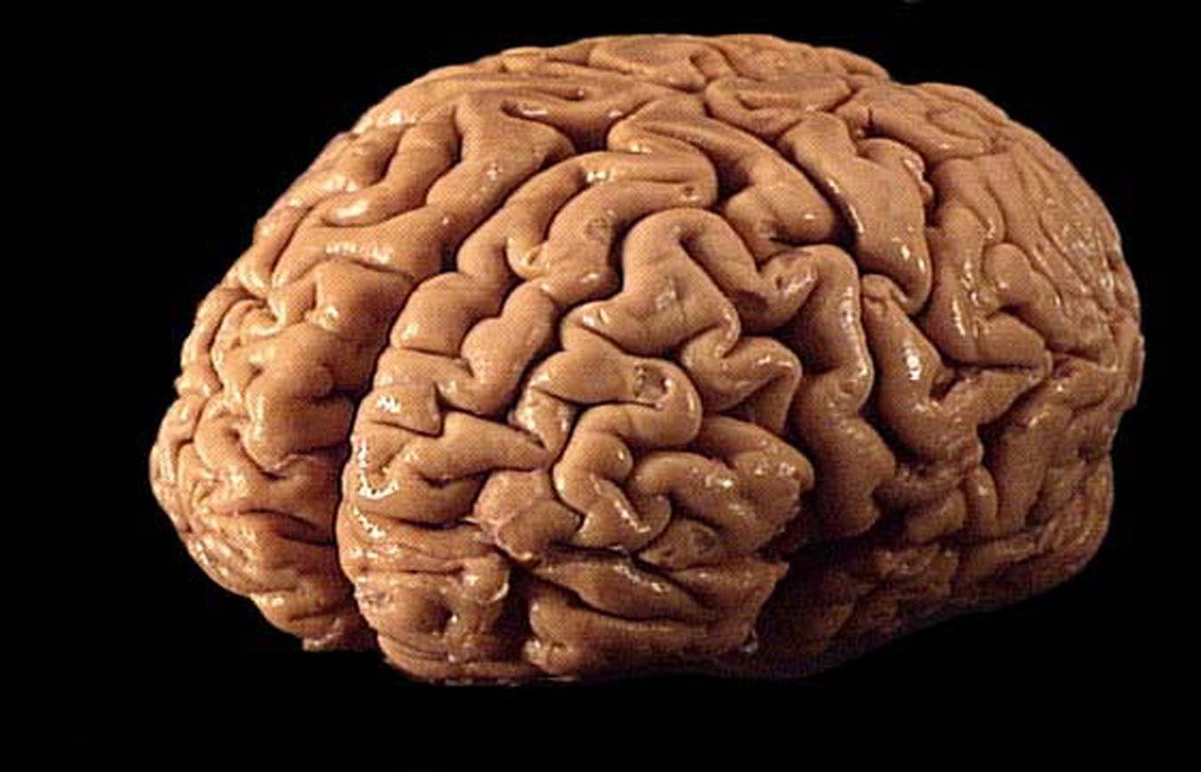
computing with assemblies Christos H. Papadimitriou Columbia U

Slide 2
How does one think computationally about the Brain?

Slide 3
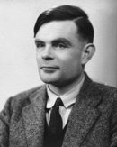
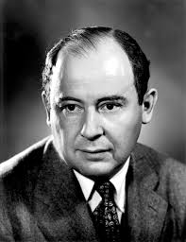
Good Question!
a computational theory
of the Brain is both possible and essential
[the way the brain works]
may be characterized by less
logical and arithmetical depth
than we are normally used to

Slide 4
What are some examples of productive computational models and paradigms in the study of the Brain?

Slide 5
The McCulloch-Pitts neuron and the feed-forward neural network
The recurrent neural network and in particular Hopfield memory and Boltzmann machine
Neural coding in the sensory cortex, and in particular sparse dictionary coding
Valiant’s neuroidal model and theory of memory
Reinforcement learning
Spiking neurons

Slide 6
This talk:
computing with assemblies

Slide 7
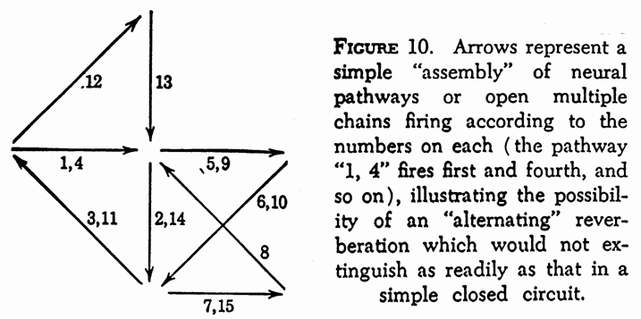
The assembly hypothesis
D. O. Hebb 1949 “Network of neurons activated repeatedly during a mental process”

Slide 8
The assembly hypothesis
K. Harris 2005 Nat. Rev NS
“An explanation for irregular yet structured spike trains”

Slide 9
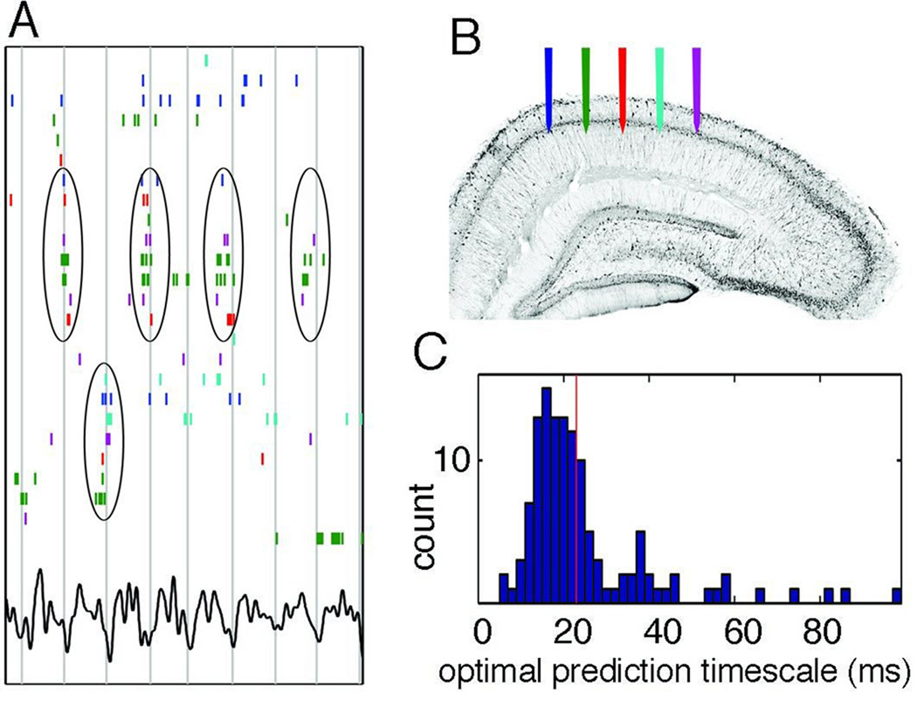
The assembly hypothesis
G. Buzsáki, Neuron 2010
“hypothesis … that cell assemblies
underlie numerous operations
in the Brain, from encoding
memories to reasoning.”
scope

Slide 10
The assembly hypothesis (computational version)
There is an intermediate level of Brain computation that can be best understood in terms of the synchronized firing of persistent, large, and heavily interconnected populations of neurons, and may be implicated in long-term memory and certain higher cognitive functions

Slide 11
Outline
Assembly operations: project and associate
More assembly operations
The Assembly Programming Language
Assemblies for language

Slide 12
Santosh Vempala
Georgia Tech
Wolfgang Maass
TU Graz
Mike Collins
Columbia U
Robert Legenstein
TU Graz

Slide 13
The assembly hypothesis
There is an intermediate level of Brain computation that can be best understood in terms of the synchronized firing of persistent, large, and heavily interconnected populations of neurons, and may be implicated in long-term memory and certain higher cognitive functions
Cf: Valiant’s theory of memory items ca. 1995

Slide 14
Projection
There is evidence that memory representations are projected between Brain areas (e.g. from and to the hippocampus)
Abstraction: project(y, B, x)
An assembly y in some Brain area A(y) can under the right circumstances project/create a copy x in a downstream area B = A(y)
“Downstream:” ample synaptic connectivity from A(y) to B.

Slide 15
cf the assignment operation x := y
In assignment, x and y go on to enjoy independent lives
In project they are linked forever: If y = P(y) (that is, x was created by project(y, B, x)) then subsequent activation of x will activate y
(well, not quite because assemblies fade away, but that’s another story…)

Slide 16
Implementation?
As befits a programming language, all operations should be translatable down to the level of neuron and synapses
So, how is projection implemented?

Slide 17
A computational challenge
In a sparse random network, how can you select a densely connected subnetwork?
Intractable!

Slide 18
Projection: [al. et Axel, 2011] on mouse olfaction
2

Slide 19
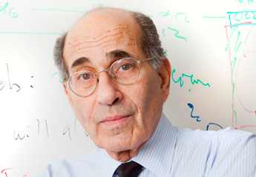
From the Discussion section of [al. et Axel]
An odorant may [cause] a small subset of … neurons [in the PC to fire].
This small fraction of ... cells would then generate sufficient recurrent excitation to recruit a larger population of neurons.
Inhibition triggered by this activity will prevent further firing
In the extreme, some cells could receive enough recurrent input to fire … without receiving [initial] input…

Slide 20
Implementation of projection: results
Simulations [Legenstein et al. 2016, Pokorny et al. 2018]
Simplified graph-theoretic model [Maass et al. 2017]

Slide 21
project(y, B, x)
B
x
y

Slide 22
Simplified Model
Two large sets of excitatory neurons: A(y) and B
Synapses A(y) → B and B → B form random G_{n,p} directed graphs (probability that i → j = p independently)*
Discrete time
The neurons in y fire for a small number of steps T
At each time t, the set A_{t} of K neurons in B that have the largest synaptic input (from A(y) or B) will fire*
Hebbian Plasticity: If at time t cell i fires, and at time t + 1 cell j fires, the weight of synapse (i, j) increases by β

Slide 23
Mathematical Model: Results
Theorem: The precise narrative of [al. et Axel 2011] obtains with high probability
NB: Cute approximation algorithm for the densest subgraph problem…

Slide 24
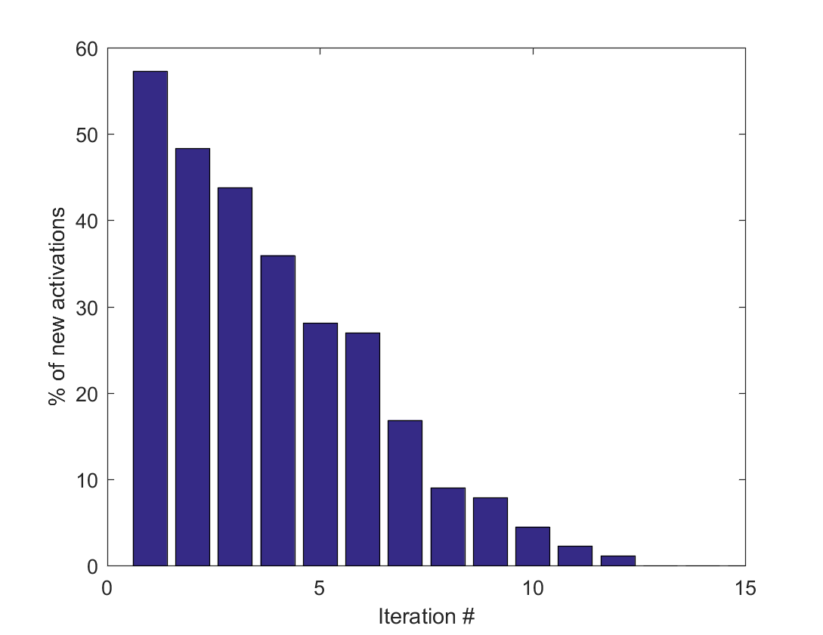
Set of active cells in area B converges exponentially fast to a stable new assembly

Slide 25
Linearized model
probability of activation
synaptic input from y
x_{j}(t+1) = s_{j} + Σ_{i→j} x_{i}(t) w_{ij}(t)
w_{ij}(t+1) = w_{ij}(t) + β x_{i}(t) x_{j}(t + 1)
synaptic weights
plasticity

Slide 26
Linearized model: Closed form
Theorem: The linearized dynamics converges geometrically and with high probability to
x_{j} = s_{j} + Σ_{i→j} x_{i}²/Σ_{i→j} x_{i}
“To be successful, you either
have to be born rich,
or have many successful supporters,
or a little of both”

Slide 27
chicken and egg...
Q: Btw, how are assemblies created?
A: One-shot learning: Projection from a “proto-assembly” putatively from a high sensory area such as IT or the olfactory bulb, to the hippocampus or the piriform cortex

Slide 28
Second operation: association
associate(x, y): two assemblies in the same area increase their intersection to reflect increased affinity
Implementation: Simultaneous firing of P(x) and P(y)
Theorem: If P(x) and P(y) are activated repeatedly, then with high probability a small number of x cells will belong to both x and y and vice-versa
NB: Conjunction too…

Slide 29
Association

Slide 30
NB: The operational semantics of association
Association is not idempotent: more applications increase the intersection…
If x and y are associated, the activation of x will result, with some probability, to the activation of y

Slide 31
A graph theory interlude: Association Graphs
Associated: x intersects y in at least 2𝛂K cells
Otherwise, x, y intersect in less than 𝛂K cells
Experiments: 𝛂 seems to be around 5%
Q: Which graphs are feasible?
A, through block designs: All graphs with degree 2/𝛂, all trees with degree 1/𝛂²
But…. surgical precision required (very un-brainlike…)

Slide 32
Association Graphs: Take two, the soft model
Assume all sets involved must be constructed from the universe [n] by these operations:
X := Y∪/∩ / − Z
X := sample Y with prob q
Theorem (with Costis Daskalakis): All graphs with degree ~ log (1/𝛂) can be realized whp, and log (1/𝛂) is the best possible

Slide 33
Expressive power: binary relations
area A
area B
time
assembly z
assembly w

Slide 34
More operations?
Projection and Association are both supported by experimental evidence
Speculate about other operations: criteria
Useful (if real, they help explain phenomena)
Plausible (can be compiled down to neurons and synapses)

Slide 35
Reciprocal projection and merge

Slide 36
assembly operations recap
project(y, B, x)
associate(x, y)
activate(x)
reciprocal_project(y, B, x)
read(x) information about x, like parent[s], area, associated assemblies, etc.
area-read(B) which assembly is active in area B?
merge(y, z, B, x) y and z project to the same assembly

Slide 37
assembly operations recap
project(y, B, y)
associate(x, y)
activate(x)
reciprocal_project(y, B, x)
merge(y, z, B, x)
read[x] information about x, like parents, associated assemblies, etc.
area-read(B) which assembly is active in area B?
reciprocal_project(Y, b, X)
merge(y, z, B, x) y and z project to the same assembly
what is the computational
power of this machine?

Slide 38
Which brings us to: Language
An environment created by us a few thousand generations ago
A “last-minute adaptation”
Hypothesis: it evolved so as to exploit the Brain’s strengths
Invaluable lens for studying the Brain
A deluge of recent experiments!

Slide 39
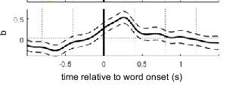
[Nelson…Dehaene, PNAS 2017]

Slide 40
[Frankland & Greene PNAS 2015]
“The ball hit the truck”
vs
“The truck hit the ball’’
Different areas of the STG responded to “truck” in the two sentences [Recall relations…]
The first area also responded to
“The truck was hit by the ball”

Slide 41
The language hemisphere
Wernicke’s area
Broca’s area

Slide 42
The [Ding et al. 2016] experiment
fret
ship
hill
give
true
melt
fans
blue
guess
hits
then
cats
4 hertz

Slide 43
The [Ding et al. 2016] experiment, stage II
bad
cats
eat
fish
new
plan
gave
joy
little
boy
kicks
ball
1 2 4 hertz

Slide 44
One interpretation
bad
cats
eat
fish
new
plan
gave
joy
little
boy
kicks
ball
1 2 4 hertz

Slide 45
Syntax trees in the Brain?
BUT: can each tree-building step
be accomplished by about a dozen spikes?
(12 ~ 50 Hz/4 Hz)

Slide 46
Zaccarella & Friedericci “Merge in the human Brain” Front. Psych. 2015
The completion of phrases, and especially of sentences, lights up parts of Broca’s area

Slide 47
[ZF 2010]: Neural pathways for syntax?
Wernicke’s area
Broca’s area

Slide 48
Finally, more speculation: a candidate architecture for syntax
S
VP
boy
kick
ball
boy
kick
ball

Slide 49
Sooooooo…
How does one think computationally about the Brain?
Assemblies and their operations may be one productive path
A fascinating repertoire of operations
Opens many interesting technical questions
Ultimately, language

Slide 50
Thanks!

