Slide 1


Dynamic Neural Network Structures Through Stochastic Rewiring
Berkeley
April 17, 2018
Robert Legenstein
robert.legenstein@igi.tugraz.at
David Kappel, Guillaume Bellec, Wolfgang Maass
Institute for Theoretical Computer Science
Graz University of Technology, Austria

Slide 2
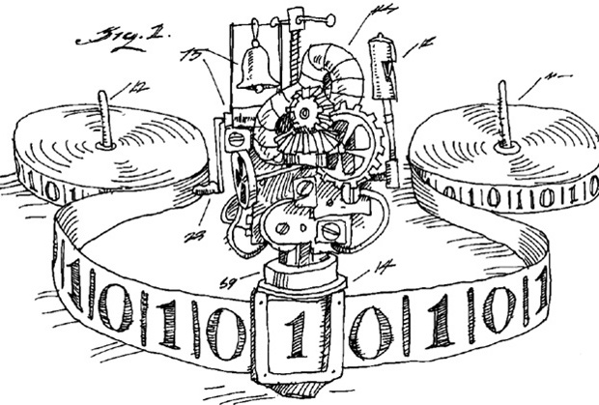
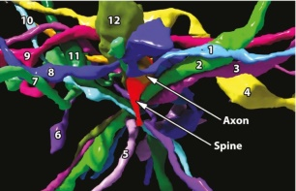
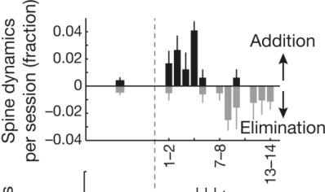
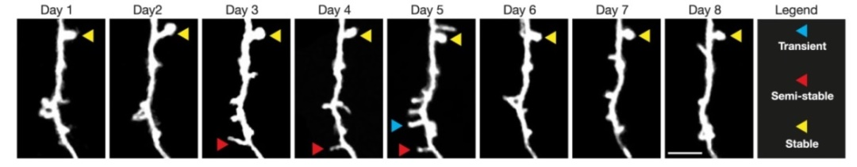
Observation 1: The brain is rewiring its architecture in a task-dependent manner
The Turing machine, a static architecture.
Lichtman Lab
Network rewiring: Dendritic spines are dynamic.
Trachtenberg et al. 2002
Peters et al., 2014

Slide 3
Implications
The connectome does not exist in the strict sense.
Any connectivity matrix can only be a temporal snapshot
[Rumpel and Triesch, e-Neuroforum 2016].
We are used to construct circuits for particular computations.
Instead, we should let the circuit construct itself.
It can be argued that synaptic rewiring is necessary for dynamic network adaptation.
Lichtman Lab

Slide 4
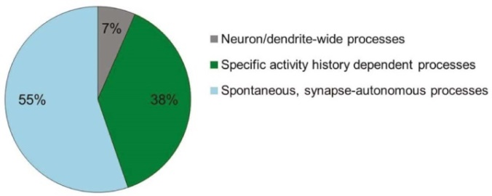
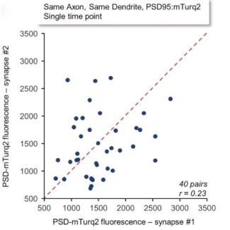
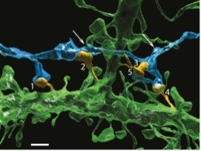

Observation 2: Synaptic dynamics are seemingly stochastic
$$∆θ=f(θ,pre,post,global factors)$$
Dvorkin & Ziv, PLoS Biol 2016
Estimated correlation of weights of synapses between same axon and same dendrite:
r = 0.23

Slide 5

Implications
Usually, we investigate synaptic plasticity rules of the form
$∆θ=f(θ,pre,post,global factors)$
What changes when we consider stochastic dynamics of the form
$∆θ=f\left(θ,pre,post,global factors\right)+noise$ ?
Dvorkin & Ziv, PLoS Biol. 2016

Slide 6

Stochastic synaptic dynamics were modeled as Ornstein Uhlenbeck processes
[Yasumatsu et al., J Neurosci. 2008, Loewenstein et al., J Neurosci 2011]:
$$dθ_{i}=\frac{b}{σ^{2}}\left(μ−θ_{i}\right)dt+\sqrt{2b}∙d𝒲_{i}$$
Synaptic efficacies: $w_{i}=exp⁡(θ_{i}−θ_{0}$)
$d𝒲_{i}$ stochastic changes of a Wiener process (Brownian motion)
Loewenstein et al. 2011

Slide 7
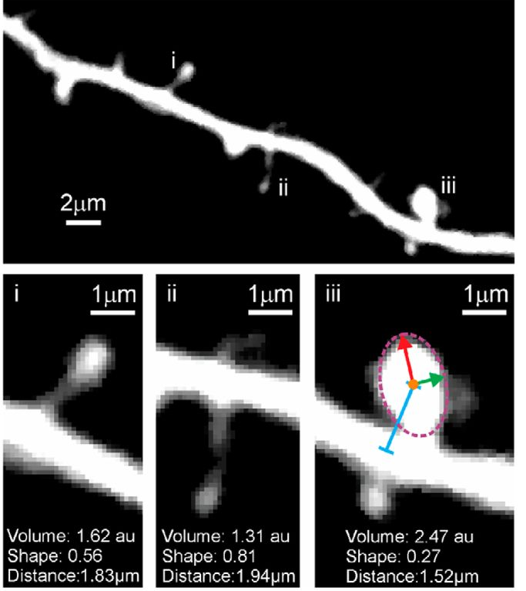

Rewiring
[Yasumatsu et al., J Neurosci. 2008, Loewenstein et al., J Neurosci 2011]:
$$dθ_{i}=\frac{b}{σ^{2}}\left(μ−θ_{i}\right)dt+\sqrt{2b}∙d𝒲_{i}$$
Synaptic efficacies: $w_{i}=exp⁡(θ_{i}−θ_{0}$)
$d𝒲_{i}$ stochastic changes of a Wiener process (Brownian motion)
Rewiring:
$θ_{i}$ encodes
A disconnected synapse for $θ_{i}≤0$
A functional synapse for $θ_{i}>0$
$w_{i}=\left\{\begin{aligned}0 if θ_{i}≤0 \\ \exp\left(θ_{i}−θ_{0}\right) if{ θ}_{i}>0\end{aligned}\right.$
Kappel et al., eNeuro, 2018.
Kappel et al., PLoS Comp Biol, 2015.

Slide 8
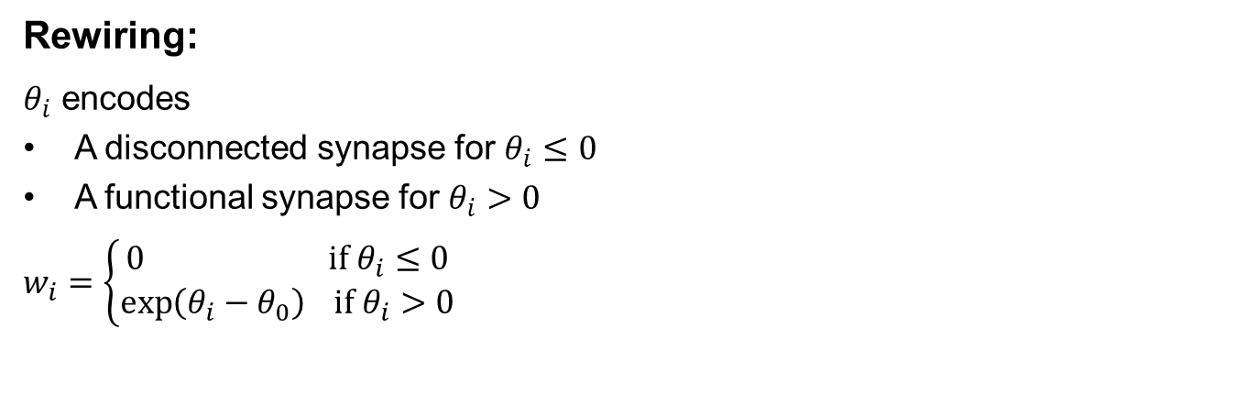

A general framework for stochastic plasticity and rewiring
Synaptic dynamics are formulated as stochastic differential equations (SDEs) for parameters $θ_{i}$.
General SDE:
$$dθ_{i}=\left(b\frac{∂}{∂θ_{i}}\log{p^{∗}(θ)}\right)dt+\sqrt{2Tb}∙d𝒲_{i}$$
Rewiring:
$θ_{i}$ encodes
A disconnected synapse for $θ_{i}≤0$
A functional synapse for $θ_{i}>0$
$w_{i}=\left\{\begin{aligned}0 if θ_{i}≤0 \\ \exp\left(θ_{i}−θ_{0}\right) if{ θ}_{i}>0\end{aligned}\right.$
Kappel et al., eNeuro, 2018.
Kappel et al., PLoS Comp Biol, 2015.

Slide 9
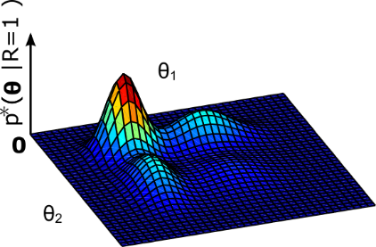
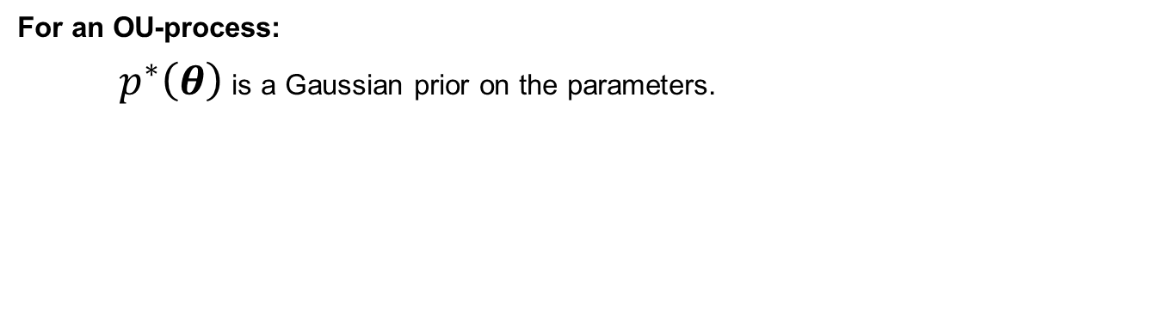


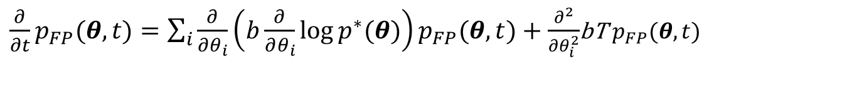

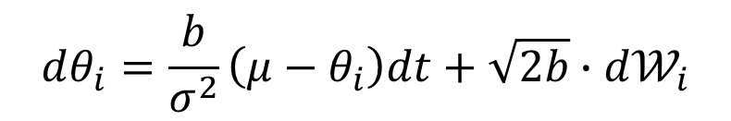
Analysis: The network samples parameters from a well-defined distribution
$$dθ_{i}=\left(b\frac{∂}{∂θ_{i}}\log{p^{∗}(θ)}\right)dt+\sqrt{2Tb}∙d𝒲_{i}$$
Fokker-Planck equation:
$\frac{∂}{∂t}p_{FP}(θ,t)=\sum_{i}{\frac{∂}{∂θ_{i}}}\left(b\frac{∂}{∂θ_{i}}\log{p^{∗}(θ)}\right)p_{FP}(θ,t)+\frac{∂^{2}}{∂θ_{i}^{2}}$bT${ p}_{FP}(θ,t)$
A central theoretical result:
The unique stationary distribution of these parameter dynamics is given by (for T=1)
$$p^{∗}(θ)$$
$$p^{∗}(θ)$$
For an OU-process:
$p^{∗}\left(θ\right)$ is a Gaussian prior on the parameters.
$$dθ_{i}=\frac{b}{σ^{2}}\left(μ−θ_{i}\right)dt+\sqrt{2b}∙d𝒲_{i}$$

Slide 10
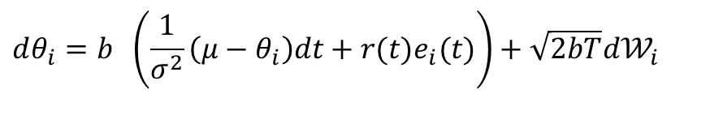
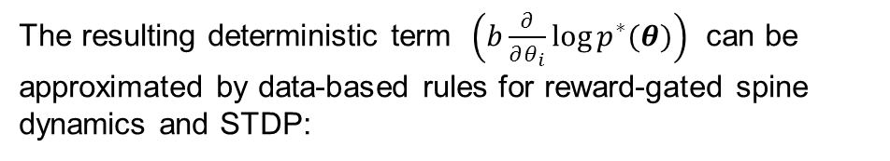
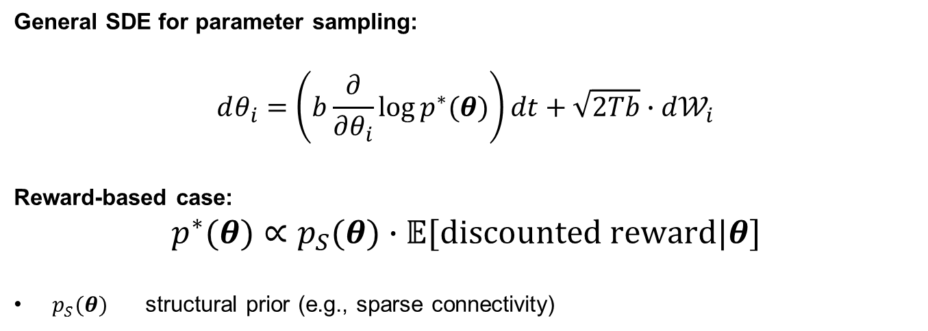
Example 1: Reward-based parameter sampling
General SDE for parameter sampling:
$$dθ_{i}=\left(b\frac{∂}{∂θ_{i}}\log{p^{∗}(θ)}\right)dt+\sqrt{2Tb}∙d𝒲_{i}$$
Reward-based case:
$$p^{∗}(θ)∝p_{S}(θ)∙𝔼[discounted reward|θ]$$
$p_{S}(θ)$ structural prior (e.g., sparse connectivity)
The resulting deterministic term $\left(b\frac{∂}{∂θ_{i}}\log{p^{∗}(θ)}\right)$ can be approximated by data-based rules for reward-gated spine dynamics and STDP:
Log-normal
prior
reward
eligibility trace
noise
$$dθ_{i}=b \left(\frac{1}{σ^{2}}\left(μ−θ_{i}\right)dt+r(t)e_{i}(t)\right)+\sqrt{2bT}d𝒲_{i}$$
Yagishita et al., Science 2014

Slide 11
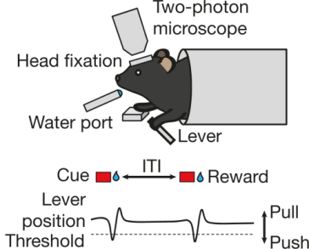
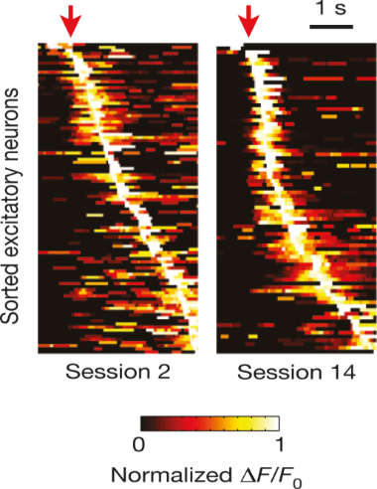
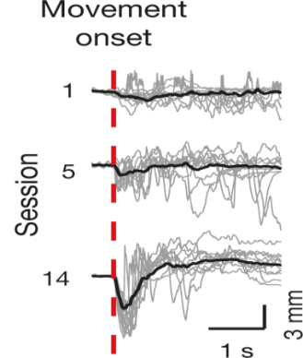
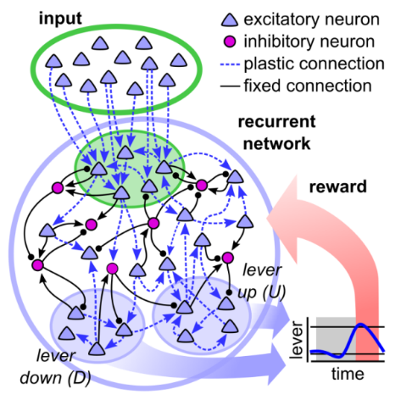
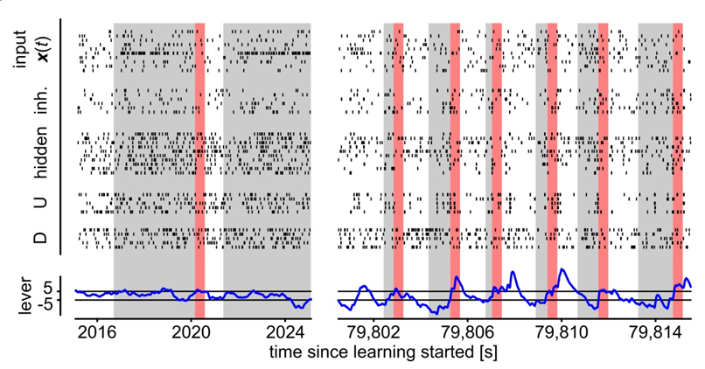
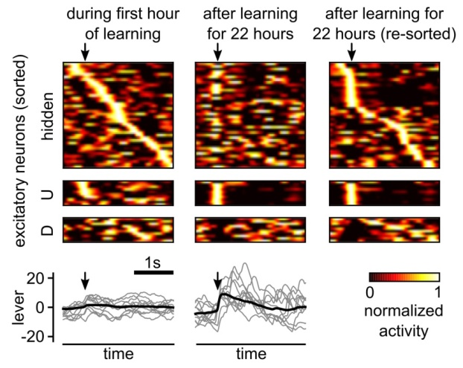
Reward-based self-configuration of recurrent neural networks in the motor cortex
Emergence of reproducible spatiotemporal activity during motor learning.
AJ Peters, SX Chen & T Komiyama, Nature(510) 2014
Recurrent spiking network model with stochastic reward-modulated synaptic dynamics
Kappel et al., eNeuro 2018.

Slide 12
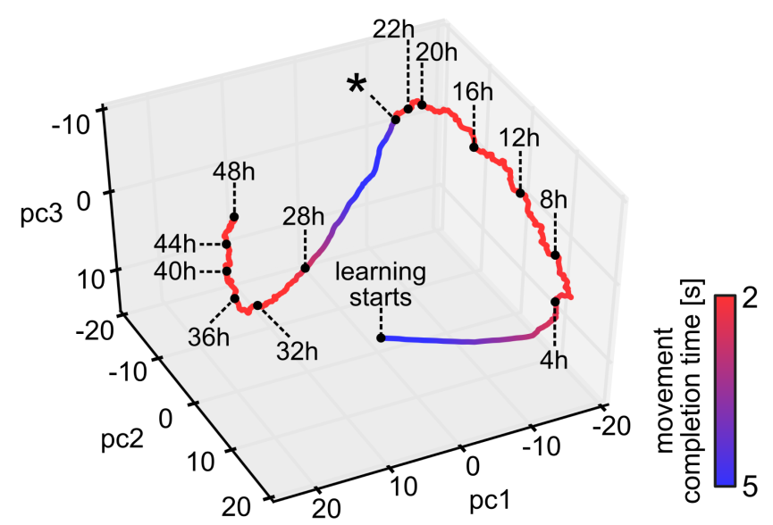
Resulting dynamics of the parameter vector 𝜃
The parameter vector keeps moving even after good performance has been reached.
Compare to: Ziv et al., Nat Neurosci. 2013
Functional benefit of ongoing parameter
dynamics:
Immediate and automatic compensation for
a drastic network perturbation: Switch of
function of the populations U and D after 24h
Kappel et al., eNeuro 2018.

Slide 13
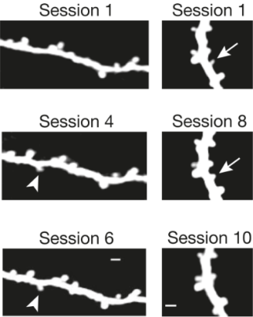
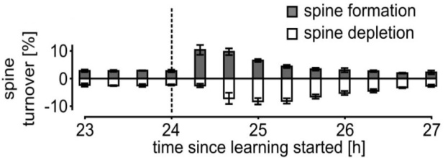
Quantifying stochasticity and rewiring
Rewiring dynamics:
Peters et al., 2014
Synaptic stochasticity:
Dvorkin & Ziv, PLoS Biol. 2016
Kappel et al., eNeuro 2018.

Slide 14

Example 2: Synaptic rewiring for supervised learning in deep networks
We demonstrate effectivity of the framework on more demanding tasks:
General SDE for parameter sampling:
$$dθ_{i}=\left(b\frac{∂}{∂θ_{i}}\log{p^{∗}(θ)}\right)dt+\sqrt{2Tb}∙d𝒲_{i}$$
Supervised case:
$$p^{∗}(θ)∝p_{S}(θ)∙p(t|X,θ)$$
$p(t|X,θ)$ Likelihood of target outputs for given network inputs and parameters.
$p_{S}(θ)$ structural prior:${ L}_{0}$-norm constraint
output
output
The resulting rewiring algorithm DEEP R
Guarantees an upper connectivity bound
throughout learning.
is optimized for memory consumption and
computational efficacy
(e.g. on neuromorphic devices).
input
training
input

Slide 15
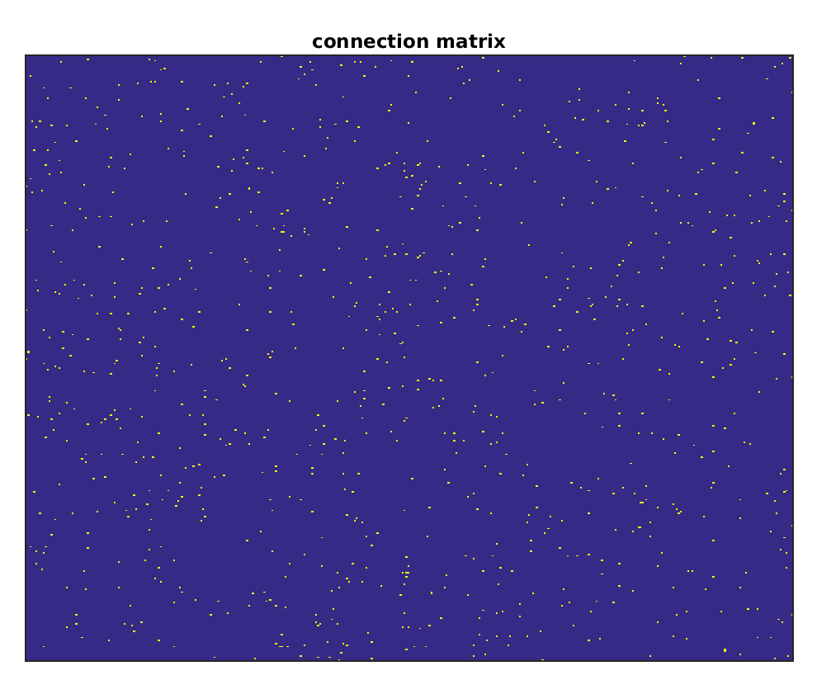
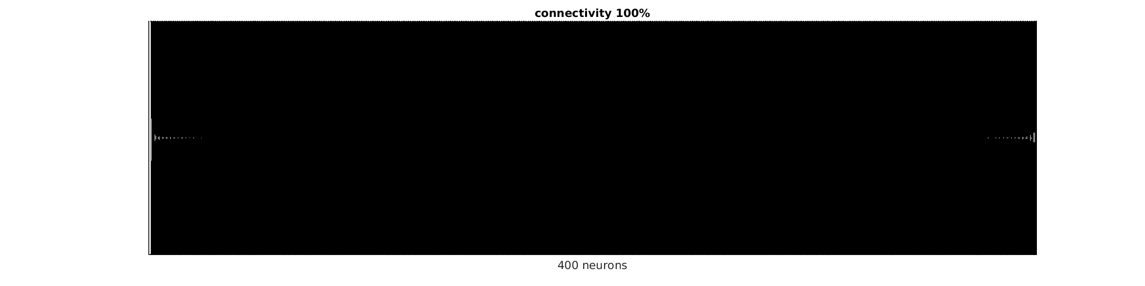
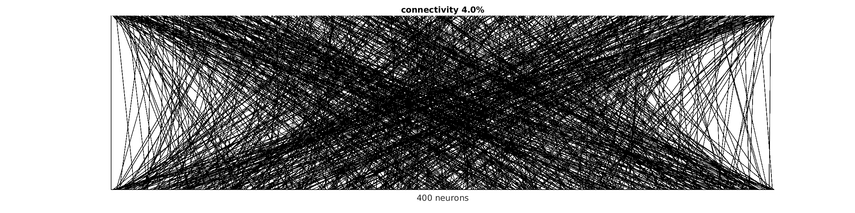
Deep Learning in sparsely connected ANNs can be performed in this way with just a small loss in performance
convolutional network
LSTM with 200 cells
G Bellec et al. Deep Rewiring: Training very sparse deep networks. ICML 2018

Slide 16
Conclusions
Neuroscience
Machine Learning
Our results indicate that spiking neural networks can autonomously find good network architectures under severe connectivity constraints.
Take advantage of the self-construction capabilities of neural networks.
We offer:
A theoretical framework for understanding stochastic network plasticity and rewiring in the brain.

Slide 17
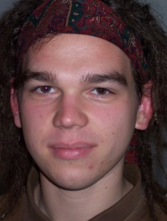
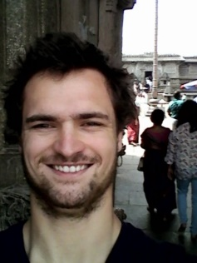
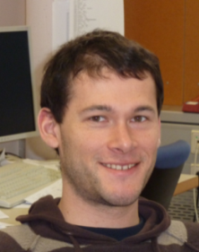
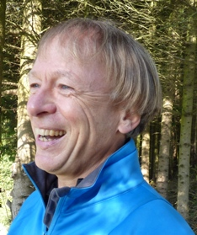
Thank you!
David Guillaume Stefan Wolfgang
Kappel Bellec Habenschuss Maass
D Kappel, R Legenstein, S Habenschuss, M Hsieh, and W Maass. A dynamic connectome supports the emergence of stable computational function of neural circuits through reward-based learning. eNeuor, 2018.
D Kappel, S Habenschuss, R Legenstein, W Maass. Network Plasticity as Bayesian Inference, PLoS Comp Biol, 2015.
G Bellec, D Kappel, W Maass, and R Legenstein. Deep Rewiring: Training very sparse deep networks. ICLR 2018

