Slide 1
An Axiomatic Theory of Non-Bayesian Social Learning
Ali Jadbabaie
JR East Professor of Engineering
Massachusetts Institute of Technology
With: Pooya Molavi (MIT Economics) Alireza Tahbaz-Salehi (Kellogg School, Northwestern)
Amin Rahimian (MIT IDSS)
Research Supported by Supported by: Vannevar Bush Fellowship, ARO MURI W911NF-12-1-0509, AFOSR MURI FA9550-10-1-0567, ONR MURI N00014-08-1-0747, ONR MURI N00014-08-1-0696, ARO MURI W911NF-05-1-0381, ONR YIP N00014-04-1-0467, AFOSR FA9550-13-1-0097

Slide 2
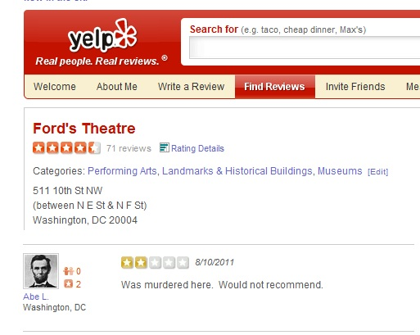
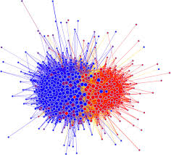
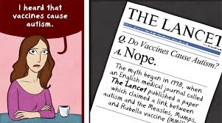
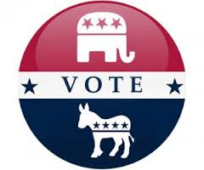
Social Learning and Opinion Pooling
Opinions of individuals often inﬂuenced by private observations and opinion of friends, neighbors, …
How to combine private observations and peer opinions?
Jadbabaie et al. 2012, 2013, Rahimian et al 2015, Khan & Jadbabaie 2016

Slide 3
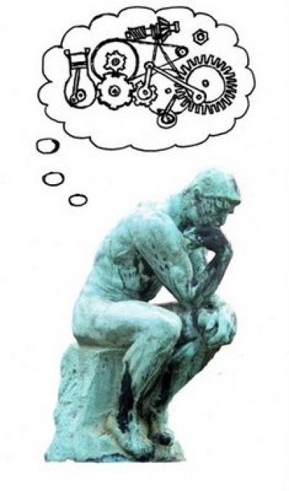
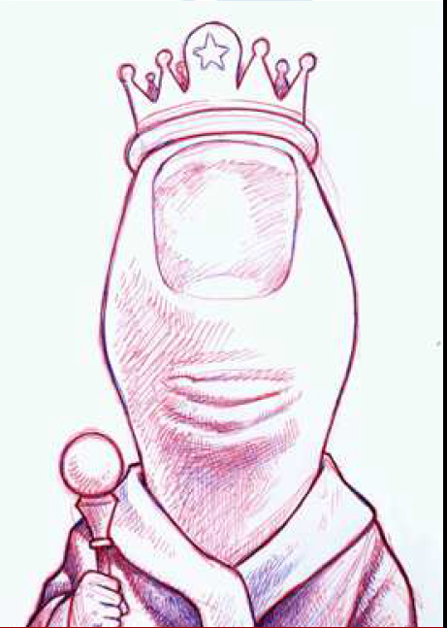
Rational vs. Rule of Thumb Learning Rules
How to combine private observations and peer opinions?
Bayesian Savage ‘54, Aumann ’76, Borkar & Varaiya 82, Gale & Kariv ‘03, Rosenberg et al. ‘09, Acemoglu et al. 2011, Mossel & Tamuz ’15,’16, Jadbabaie et al. 2017
Non Bayesian: DeGroot’74, De Marzo et al. 2003, Golub & Jackson 2010, Jadbabaie et al. 2012-14, Molavi et al. 2017

Slide 4
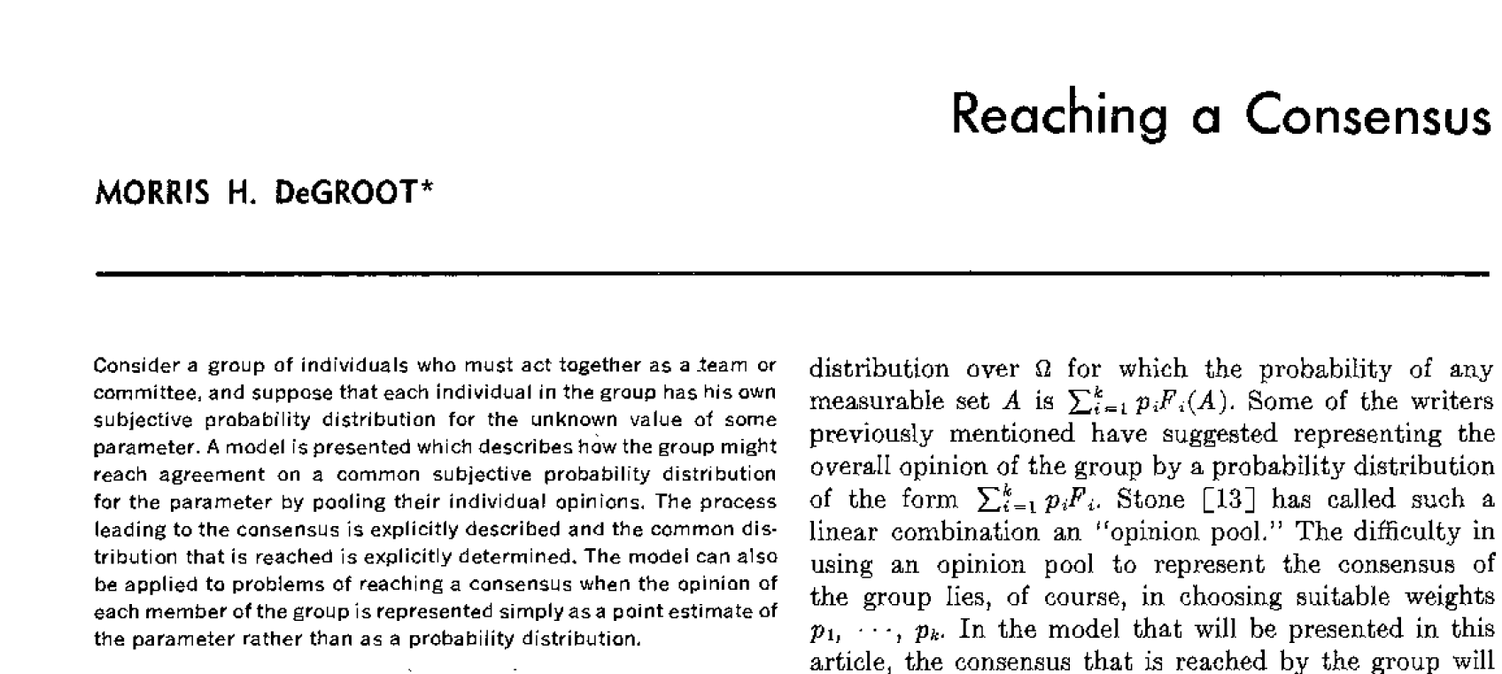
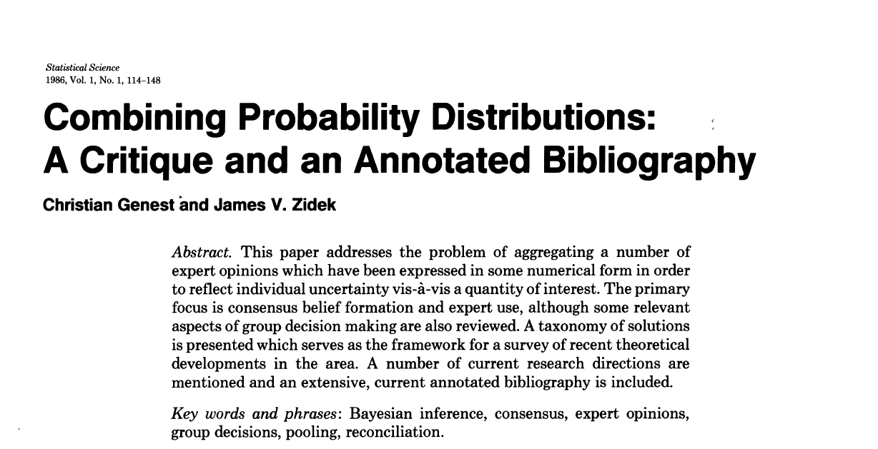
Combining Probabilistic Opinions
Stone’61, DeFinetti ‘70,DeGroot74, Aumann ’76
Bacharach ’70,’78, Wagner ‘81, French ‘81, Lehrer 83, List ’10-’15,…

Slide 5
Bayesian Approach: Rational Learning
A probabilistic model
A prior belief µ_{it}(θ)
A stream of observations ω_{it} ∈ S_{i}
Update belief using Bayes rule
How to generalize this to a network setting?
Likelihood
observation
prior
probability of observation

Slide 6
Bayesian Learning in Networks
Agents need to infer the signal that neighbors observed that lead to their reported beliefs.
Neighbors’ beliefs are influenced by their private observations and their neighbors’ beliefs
A Bayesian agent needs to disentangle the influence of neighbors’ beliefs and private signals
A complicated inferential task
Behavioral experiments have shown that the amount of computation required is beyond cognitive capacity of humans, but what is the computational complexity?

Slide 7
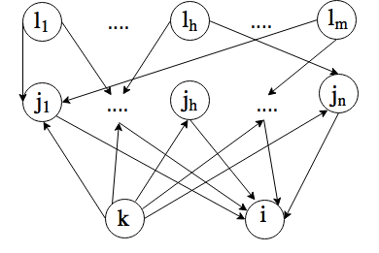
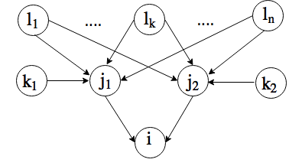
Reductions
SUBSET-SUM
EXACT-COVER
Jadbabaie, Rahimian, Mossel, 2017

Slide 8
Rule of Thumb: Averaging Opinions
Beliefs updated by taking weighted average of neighbors’ probabilistic initial beliefs
Interactions captured by a non-negative, stochastic matrix T
In a “strongly connected” society, finial consensus belief is a weighted average of initial beliefs
is the top left eigenvector of T, called eigenvector centrality

Slide 9
Is Consensus Value the Right Value?
Opinions are weighed by node’s importance in the network, not “information content”
Update suffers from redundancy neglect (Eyster & Rabin 2014):
If two nodes have same info from same source, their information is weighed twice!
When nodes are not overtly influential, and as network grows, averaging ‘works’ (Golub & Jackson 2010)
How do we allow for arrival of new observations?
How should we inject more rationality into the model?
Idea: combine Bayesian update with DeGroot
Jadbabaie.Molavi,,Sandroni, Tahbaz-Salehi,
Games and Economic Behavior, 2012

Slide 10
Non-Bayesian Social Learning
Bayesian updating in networks: too much of a cognitive burden
Alternative: Act Bayesian only with respect to private observations

Slide 11
A general family of Learning Rules
History of beliefs of agents and their neighbors
BU: Bayesian update (Bayes Rule, after observing )
Social learning rule
What assumptions should f satisfy?
Molavi, Tahbaz-Salehi, Jadbabaie, Econometrica, forthcoming, 2018

Slide 12
An Axiomatic Foundation: LN+IIA
Label neutrality:
Independence of Irrelevant alternatives:

Slide 13
Monotonicity and Imperfect Recall

Slide 14
A Representation Result

Slide 15
Learning Rule

Slide 16
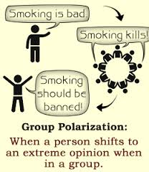
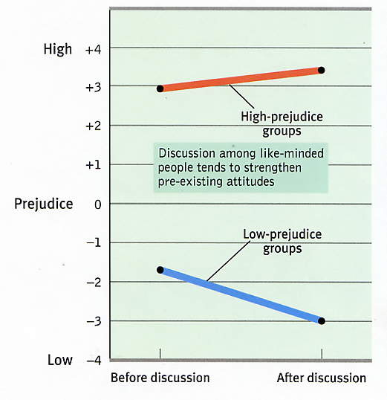
Group Polarization and Learning
Group Polarization: Tendency to make decisions that are more extreme than initial inclinations. Stoner’61, Lamm’75, Isenberg’86
Prevailing explanation: Social Comparison Theory vs. Information Influence theory
A =[a_{ij}] Network matrix
Strictly group polarizing → ρ(A) > 1,depolarizing → ρ(A) <1
Group non-polarizing: ρ(A) = 1, ρ(A) = Spectral radius of A
Theorem (Molavi, Tahbaz-Salehi, Jadbabaie 2018) : In a strongly connected
network, if rule satisfies axioms, all agents learn the underlying state almost
surely, i.e., µ_{it}(·) → 1_{θ}(·) if and only if belief are non-polarizing

Slide 17
Changing Weights, and Unanimous Learning Rules
Suppose social learning rule is unanimous, i.e.,
Unanimity is a sufficient condition for group non-polarization
the log-linear case, same as A being stochastic A1=1
Result can be generalized to rules that are unanimous in the limit

Slide 18
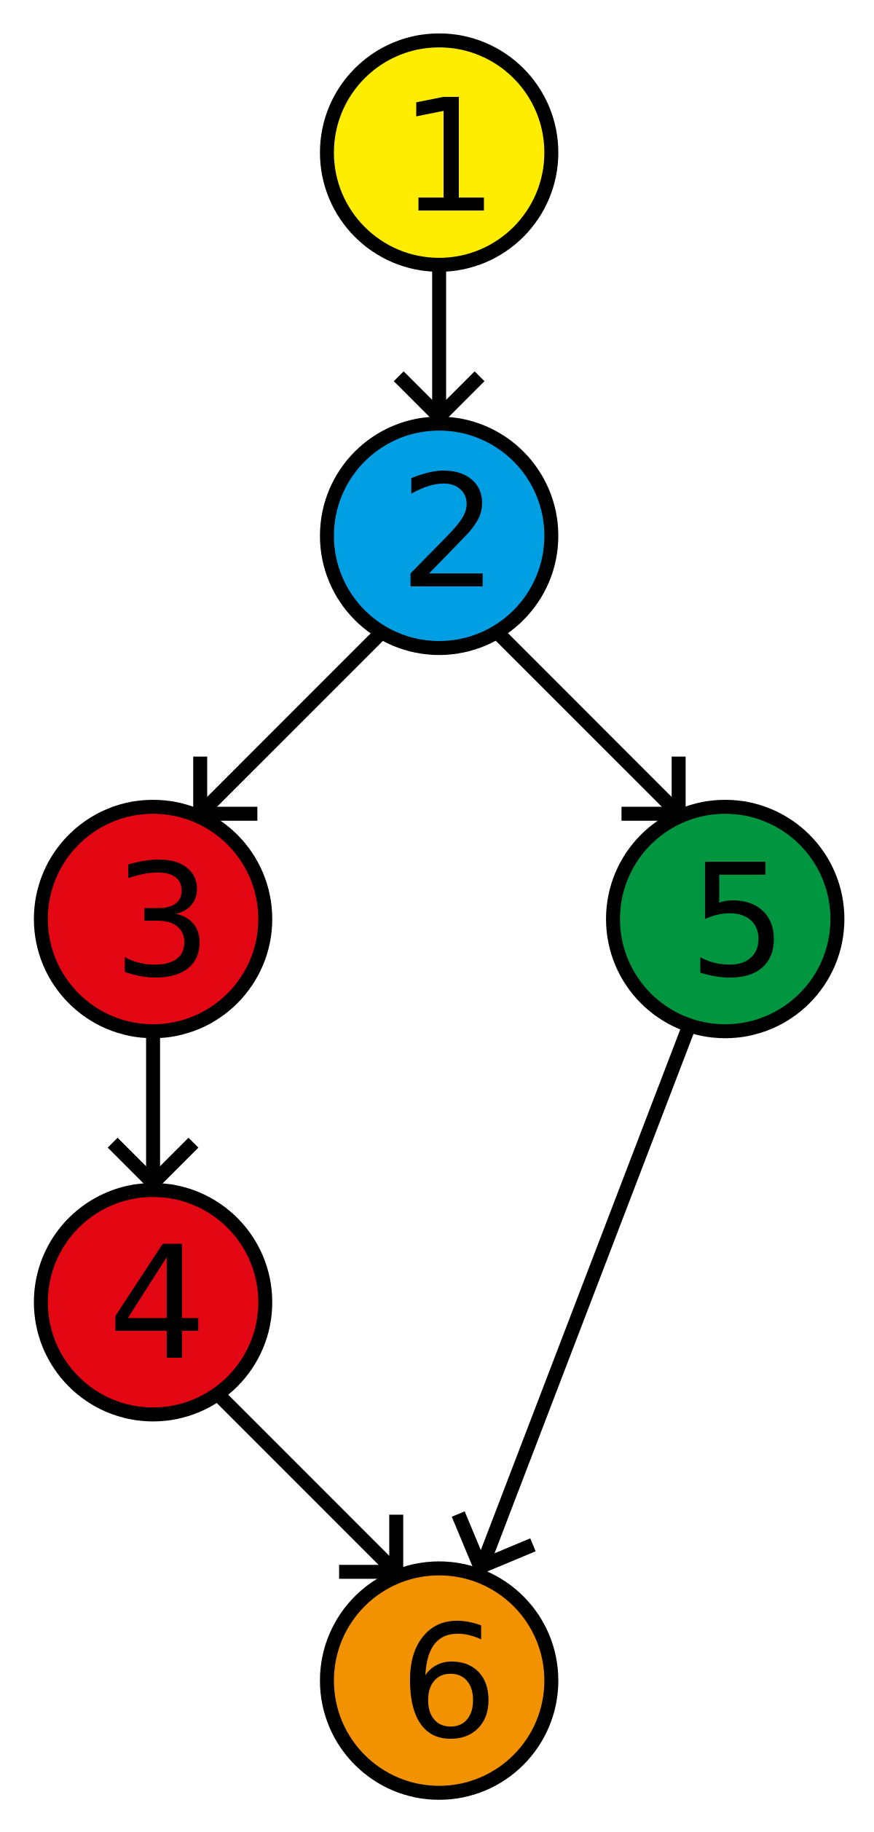
Bayesian Social Learning and Axioms
8
If no multiple independent paths* →log-linear rule
Möbius coefficients (same as in inclusion/exclusion) correct the “information incest” or the double counting
Coefficients can be recursively described
In general networks, far more complicated
Problem is np-hard (reduction from SUBSET SUM and EXACT COVER) (Rahimian, J, Mossel, 2017)
77
7
7
Möbius Coefficients
(Rota 1960)

Slide 19
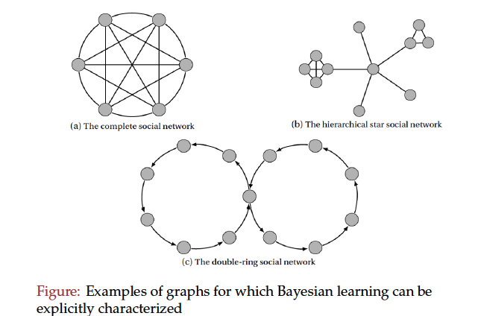
Networks where Bayesian Learning satisfies axioms

Slide 20
Beyond Functional Forms
Weak separability: Social learning rule is weakly separable if there exists a smooth, homogeneous of degree 1 function such that
Reminder: g is homogeneous of degree ½, if g(½ x) = ½^{k} g(x)

Slide 21
Learning with general Nonlinear Rules
Theorem: Suppose social learning rule satisfies label neutrality, monotonicity, and weak separability, then all beliefs will asymptotically concentrate on the true state if the logarithmic curvature of the learning rule is in [-1, 1].
for log-linear rule, log-curvature is zero.

Slide 22
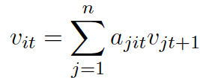
Rate and Network Structure
When there is no polarization, learning is exponentially fast
Rate depends on
relative influence (Kolmogorov centrality of agents)
Informativeness of observations, measured by relative entropy
Fast learning: highly central nodes have good information
Fragmented and polarized societies do not learn
Even when learning occurs, it could be slow if influential agents are not informed, or informed agents are not influential

Slide 23
Conclusions
A general family of non-Bayesian models
Major deviation: imperfect recall
Learning is robust to the form of the learning rule and changing of weights, so long as it is positive homogeneous of degree one with bounded log-curvature.
Popular non-Bayesian models can be derived from axioms
Group polarization is an obstruction to learning. Unanimity is a sufficient condition for non-polarization
Rate of learning is exponential
Bayesian learning is NP hard
Open questions: Tight sufficient conditions on network structure under which Bayesian update is tractable
What if agents observe actions not beliefs?
Experiments on Mechanical Turk?

