Slide 1
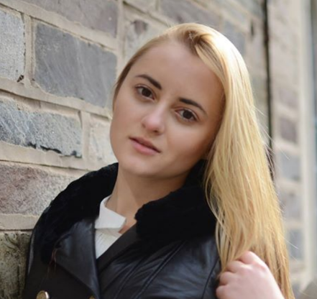
Nonnegative polynomials and applications to learning
Georgina Hall
Princeton, ORFE
Joint work with
Amir Ali Ahmadi Mihaela Curmei
Princeton, ORFE Ex-Princeton, ORFE

Slide 2
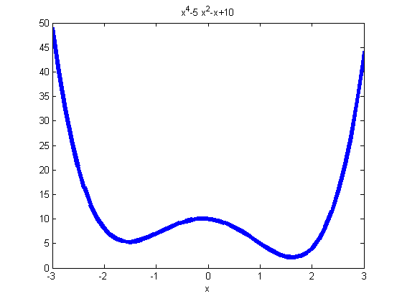
Nonnegative polynomials
A polynomial $p\left(x\right)≔p\left(x_{1},…,x_{n}\right)$ is nonnegative if $p\left(x\right)≥0,∀x∈ℝ^{n}.$
$$p\left(x\right)=x^{4}−5x^{2}−x+10$$
Is this polynomial nonnegative?

Slide 3
Optimizing over nonnegative polynomials
Interested in more than checking nonnegativity of a given polynomial
Problems of the type:
Linear objective and affine constraints in the coefficients of $p$ (e.g., sum of coefs =1$)$
$$\min_{p}{C(p})$$
$$s.t. A\left(p\right)=b$$
$$p\left(x\right)≥0, ∀x$$
Decision variables are the coefficients of the polynomial $p$
Nonnegativity condition
Why would we be interested in problems of this type?

Slide 4
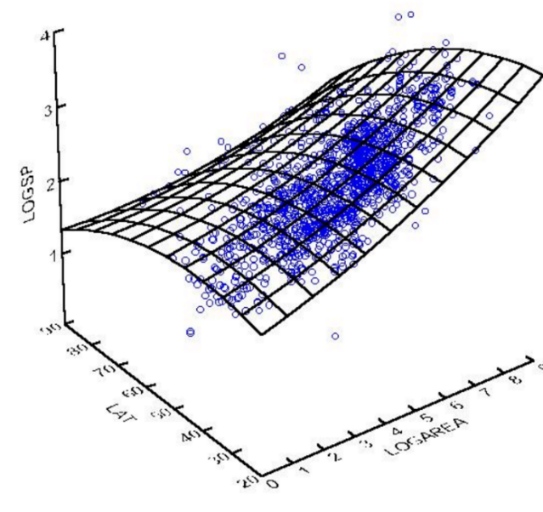
1. Shape-constrained regression
Impose e.g., monotonicity or convexity on the regressor
Example: price of a car with respect to age
How does this relate to optimizing over nonnegative polynomials?
Monotonicity of a polynomial regressor over a range
Nonnegativity
of partial derivatives
over that range
Convexity of a polynomial regressor
$H\left(x\right)≽0,∀x,$ i.e., $y^{T}H\left(x\right)y≥0, ∀ x,y$

Slide 5
2. Difference of Convex (DC) programming
Problems of the form
$$\min{f_{0}(x)}$$
$$s.t. f_{i}\left(x\right)≤0$$
where $f_{i}\left(x\right)≔g_{i}\left(x\right)−h_{i}\left(x\right)$, $g_{i},h_{i}$convex
convex $⇔$ $y^{T}H\left(x\right)y≥0, ∀x,y$
ML Applications: Sparse PCA, Kernel selection, feature selection in SVM
Hiriart-Urruty, 1985
Tuy, 1995
Notes:
Studied for quadratics, polynomials nice to study question computationally

Slide 6
Outline of the rest of the talk
Very brief introduction to sum of squares
Revisit shape-constrained regression
Revisit difference of convex programming

Slide 7
Sum of squares polynomials
Is this polynomial nonnegative?
NP-hard to decide for degree $≥4.$
What if $p$ can be written as a sum of squares (sos)?
Sufficient condition for nonnegativity
Can optimize over the set of sos polynomials using SDP.

Slide 8
Revisiting Monotone Regression
[Ahmadi, Curmei, GH, 2017]

Slide 9
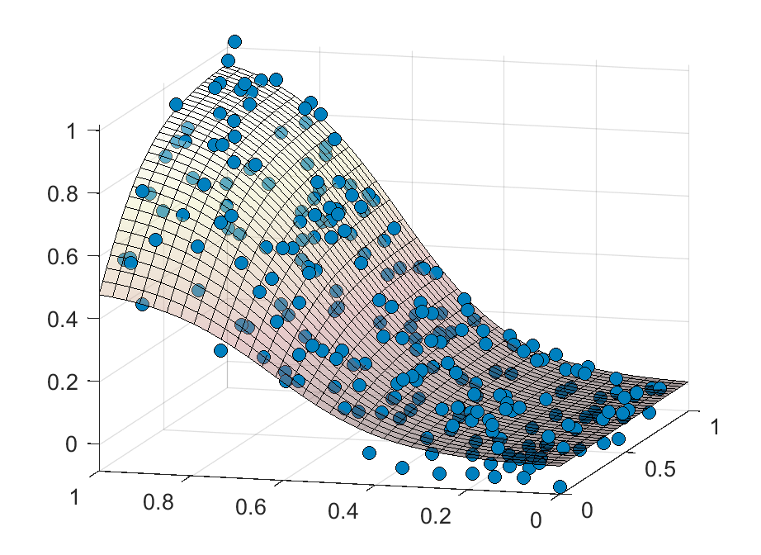
Monotone regression: problem definition
N data points: $\left(x_{i},y_{i}\right)$ with $x_{i}∈ℝ^{n}, y_{i}∈ℝ$
noisy measurements of a monotone function $y_{i}=f\left(x_{i}\right)+ε_{i}$
Feature domain: box $B⊆ℝ^{n}$
Monotonicity profile:
$ρ_{j}=\left\{\begin{aligned}1 \\ −1 \\ 0\end{aligned}\right.$
for $j=1,…,n.$
if $f$ is monotonically increasing w.r.t. $x_{j}$
if $f$ is monotonically decreasing w.r.t. $x_{j}$
if no monotonicity requirements on $f$ w.r.t. $x_{j}$
Can this be done computationally?
How good is this approximation?
Goal: Fit a polynomial to the data that has monotonicity profile $ρ$ over B.

Slide 10
NP-hardness and SOS relaxation
Theorem: Given a cubic polynomial $p,$a box $B,$ and a monotonicity profile $ρ$, it is NP-hard to test whether $p$ has profile $ρ$ over $B.$
SOS relaxation:
$p$ has odd degree
$\frac{∂p(x)}{∂x_{j}}=σ_{0}\left(x\right)+\sum_{i}{σ_{i}}\left(x\right)\left(b_{i}^{+}−x_{i}\right)\left(x_{i}−b_{i}^{−}\right)$
where $σ_{i},i=0,…,n$ are sos polynomials
$$\frac{∂p(x)}{∂x_{j}}≥0, ∀x∈B,$$
where $B=\left[b_{1}^{−},b_{1}^{+}\right]×…×\left[b_{n}^{−},b_{n}^{+}\right]$
$p$ has even degree
$\frac{∂p(x)}{∂x_{j}}=σ_{0}\left(x\right)+\sum_{i}{σ_{i}}\left(x\right)\left(b_{i}^{+}−x_{i}\right)+\sum_{i}{τ_{i}(x)}\left(x_{i}−b_{i}^{−}\right)$
where $σ_{i},τ_{i}$ are sos polynomials

Slide 11
Approximation theorem
Theorem: For any $ε>0,$ and any $C^{1}$ function $f$ with monotonicity profile $ρ,$ there exists a polynomial $p$ with the same profile $ρ$, such that
$\max_{x∈B}\left|f\left(x\right)−p\left(x\right)\right|<ε$.
Moreover, one can certify its monotonicity profile using SOS.
Proof uses results from approximation theory and Putinar’s Positivstellensatz

Slide 12
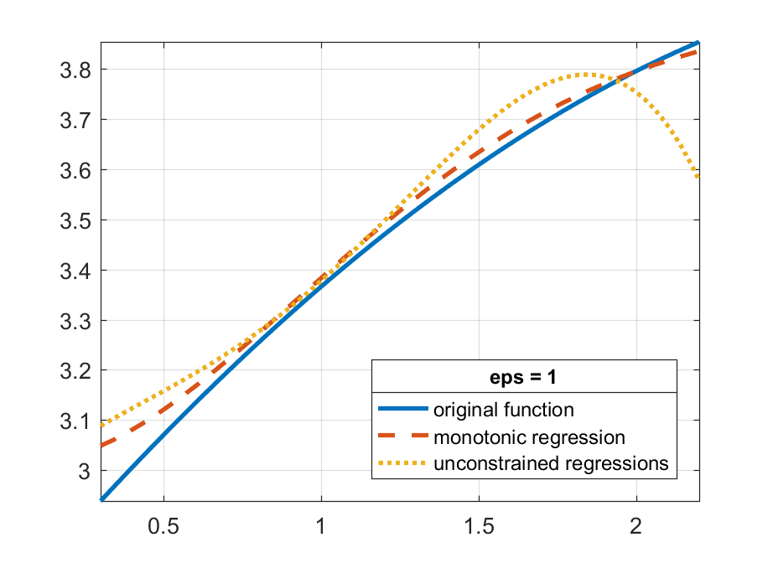
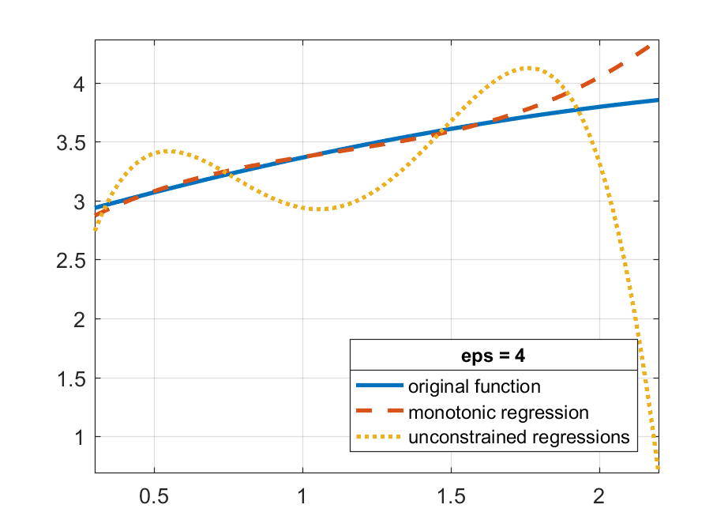
Numerical experiments (1/2)
Low noise environment
High noise environment

Slide 13
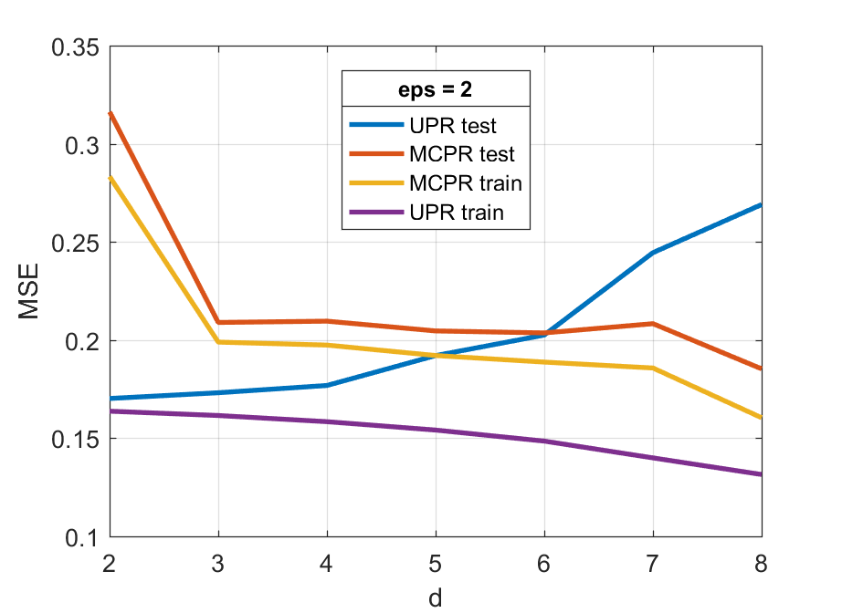
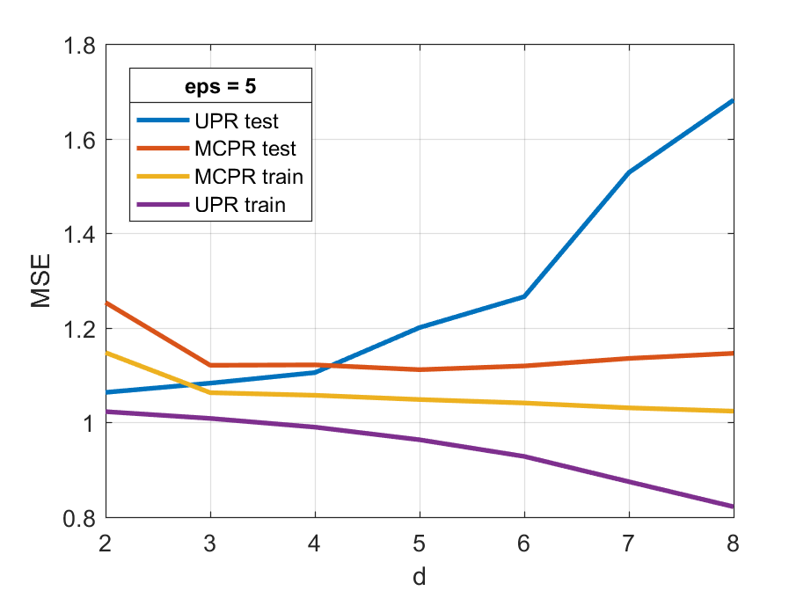
Numerical experiments (2/2)
Low noise environment
High noise environment
Notes:
n=4, d=7

Slide 14
Revisiting difference of convex programming
[Ahmadi, GH*, 2016]
* Winner of the 2016 INFORMS Computing Society Best Student Paper Award

Slide 15
Difference of Convex (dc) decomposition
Interested in problems of the form:
$$\min{f_{0}(x)}$$
$$s.t. f_{i}\left(x\right)≤0$$
where $f_{i}\left(x\right)≔g_{i}\left(x\right)−h_{i}\left(x\right)$, $g_{i},h_{i}$convex.
Leads to difference of convex (dc) decomposition problem:
Given a polynomial $f$, find $g$ and $h$ such that
$$f=g−h,$$
where $g,h$ convex polynomials.
Does such a decomposition always exist? Can it be efficiently computed? Is it unique?

Slide 16
Existence of dc decomposition (1/3)
Recall:
Theorem: Any polynomial can be written as the difference of two
sos-convex polynomials.
Corollary: Any polynomial can be written as the difference of two convex polynomials.
SOS-convexity
$f(x)$ convex
$$y^{T}H_{f}\left(x\right)y≥0,$$
$$∀x,y∈ℝ^{n}$$
$$⇐$$
$y^{T}H_{f}\left(x\right)y$ sos
SDP
$$⇔$$

Slide 17
Existence of dc decomposition (2/3)
Lemma: Let$K$ be a full dimensional cone in a vector space $E.$ Then any
$v∈E$can be written as $v=k_{1}−k_{2}, k_{1},k_{2}∈K$.
Proof sketch:
$$=:k′$$
E
K
$∃ α<1$ such that $\left(1−α\right)v+αk∈K$
$$⇔v=\frac{1}{1−α}k^{′}−\frac{α}{1−α}k$$
$$k$$
$$k′$$
$$v$$
$$k_{1}∈K$$
$$k_{2}∈K$$
Notes:
To change

Slide 18
Existence of dc decomposition (3/3)
Here, $E=${polynomials of degree $2d$ in $n$ variables}$,$
$K=\{$sos-convex polynomials of degree $2d$ in $n$ variables$\}.$
Remains to show that $K$ is full dimensional:
Also shows that a decomposition can be obtained efficiently:
In fact, we show that a decomposition can be found via LP and SOCP (not covered here).
${\left(∑x_{i}^{2}\right)}^{d}$ can be shown to be in the interior of $K.$
solving
$$f=g−h,$$
$g,h$ sos-convex
is an SDP.

Slide 19
Uniqueness of dc decomposition
Dc decomposition: given a polynomial $f$, find convex polynomials $g$ and $h$such that $f=g−h.$
Questions:
Does such a decomposition always exist?
Can I obtain such a decomposition efficiently?
Is this decomposition unique?
✓
Yes
✓
Through sos-convexity
Alternative decompositions
Initial decomposition
$$f\left(x\right)=\left(g\left(x\right)+p\left(x\right)\right)−\left(h\left(x\right)+p\left(x\right)\right)$$
$p(x)$ convex
x$f\left(x\right)=g\left(x\right)−h(x)$
“Best decomposition?”

Slide 20
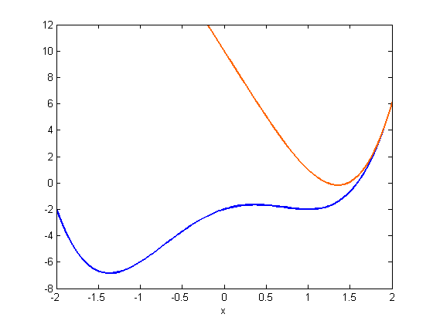
Convex-Concave Procedure (CCP)
$$\min{f_{0}(x)}$$
$$s.t. f_{i}\left(x\right)≤0, i=1,…,m$$
Heuristic for minimizing DC programming problems.
Idea:
Input
Convexify by linearizing $h$
Solve convex subproblem
$$k≔0$$
x$x_{0},$ initial point
$$f_{i}=g_{i}−h_{i}, i=0,…,m$$
x$f_{i}^{k}\left(x\right)=g_{i}\left(x\right)−(h_{i}\left(x_{k}\right)+∇h_{i}{\left(x_{k}\right)}^{T}\left(x−x_{k}\right))$
Take $x_{k+1}$ to be the solution of
$$\min{f_{0}^{k}\left(x\right)}$$
$$s.t. f_{i}^{k}\left(x\right)≤0, i=1,…,m$$
convex
convex
affine
$$f_{i}^{k}\left(x\right)$$
$$k≔k+1$$
$$f_{i}(x)$$

Slide 21
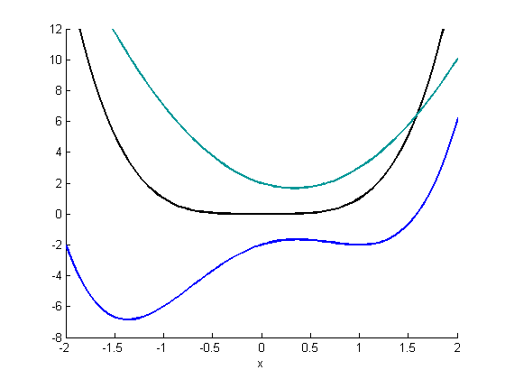
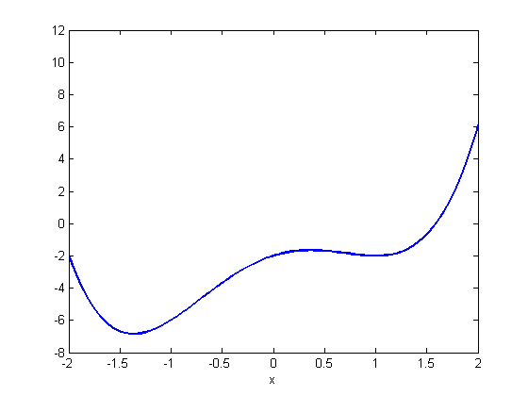
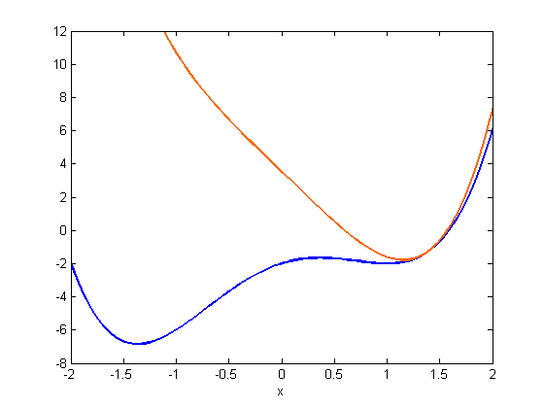
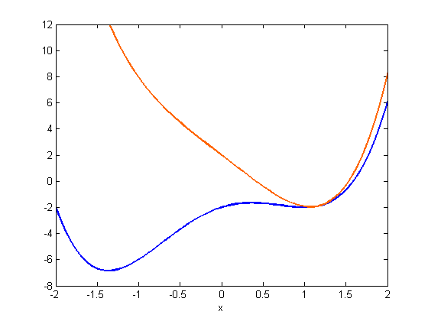
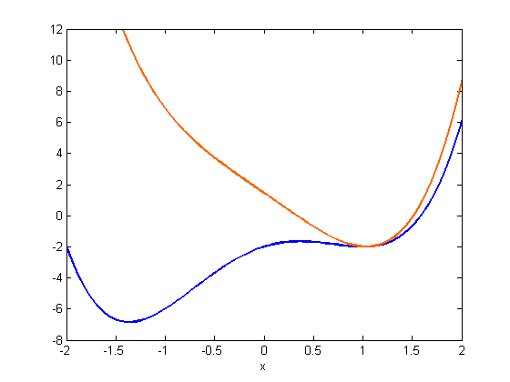
Convex-Concave Procedure (CCP)
Toy example: $\min_{x}{f\left(x\right)}$, where $f\left(x\right)≔g\left(x\right)−h(x)$
Convexify $f\left(x\right)$ to obtain$f^{0}(x)$
Initial point: $x_{0}=2$
Minimize $f^{0}(x)$ and obtain $x_{1}$
Reiterate
$${ x}_{3}$$
$${ x}_{1}$$
$${ x}_{∞}$$
$${ x}_{2}$$
$${ x}_{4}$$
$${ x}_{0}$$
$${ x}_{0}$$

Slide 22
Picking the “best” decomposition for CCP
Algorithm
Algorithm
Algorithm
Linearize $h\left(x\right)$ around a point $x_{k}$ to obtain convexified version of $f(x)$
Linearize $h\left(x\right)$ around a point $x_{k}$ to obtain convexified version of $f(x)$
Linearize $h\left(x\right)$ around a point $x_{k}$ to obtain convexified version of $f(x)$
Idea
Pick $h\left(x\right)$ such that it is as close as possible to affine around $x_{k}$
Mathematical translation
Minimize curvature of $h$

Slide 23
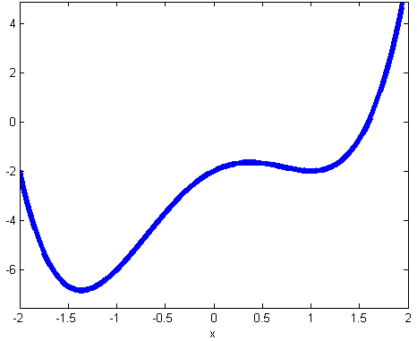
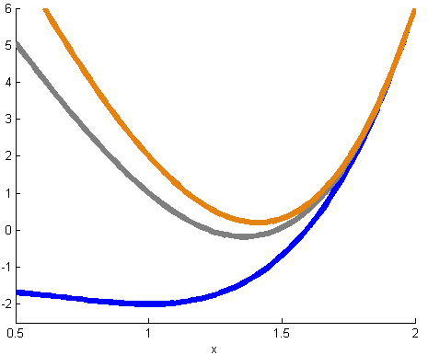
Undominated decompositions (1/2)
Definition: $\left(g ,h≔g−f\right)$is an undominated decomposition of $f$ if no other decomposition of $f$can be obtained by subtracting a (nonaffine) convex function from $h.$
$$g\left(x\right)=x^{4}+x^{2},$$
$$h\left(x\right)=4x^{2}+2x−2$$
Convexify around $x_{0}=2$to get $f^{0}\left(x\right)$
$$f\left(x\right)=x^{4}−3x^{2}+2x−2$$
DOMINATED BY
$$g^{′\left(x\right)}=x^{4},$$
$h^{′}\left(x\right)=3x^{2}+2x−2$
Convexify around $x_{0}=2$to get$f^{0′}\left(x\right)$
If $g′$ dominates $g$then the next iterate in CCP obtained using $g^{′}$always beats the one obtained using $g.$
Notes:
Cannot substract something convex from g and get something convex again.

Slide 24
Undominated decompositions (2/2)
Theorem: Given a polynomial$f$, consider
min${\frac{1}{A_{n}} \int_{S^{n−1}}{Tr H_{h} dσ}}$, (where $A_{n}=\frac{2π^{n/2}}{Γ(n/2)}$)
s.t. $f=g−h,$ $g$convex, $h$convex
Any optimal solution is an undominated dcd of $f$ (and an optimal solution always exists).
Theorem: If $f$ has degree 4, it is NP-hard to solve $(⋆)$.
Idea: Replace $f=g−h, g, h$ convex by $f=g−h, g,h$ sos-convex.
$$(⋆)$$
$$g,h$$

Slide 25
Comparing different decompositions (1/2)
Solving the problem: $\min_{B=\left\{x\right| \left|\left|x\right|\right|≤R\}}{f_{0}}$, where $f_{0}$ has $n=8$ and $d=4.$
Decompose $f_{0},$ run CCP for 4 minutes and compare objective value.
Feasibility | Undominated
$$\min_{g,h}{\frac{1}{A_{n}} \int_{S_{n−1}}{Tr}} H_{g} dσ$$
$$s.t. f_{0}=g−h$$
$g,h$ sos-convex
$$\min_{g,h}{0}$$
s.t. $f_{0}=g−h$
$g,h$ sos-convex

Slide 26
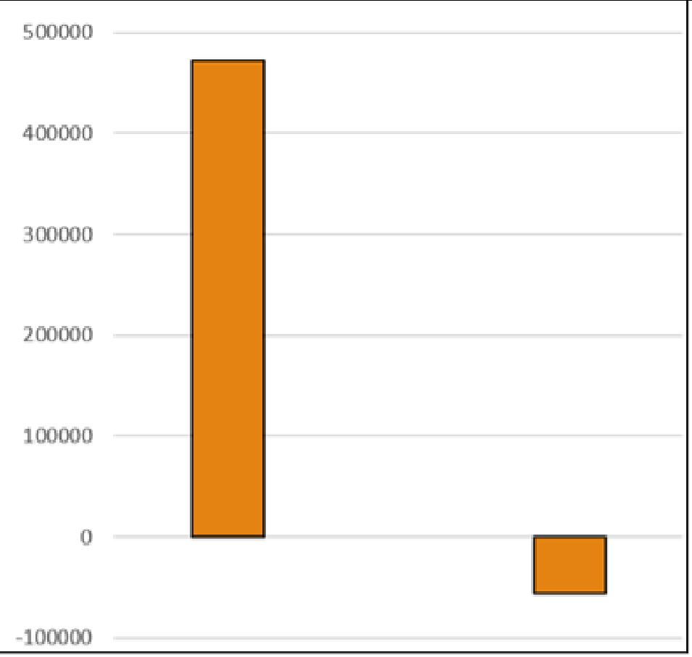
Comparing different decompositions (2/2)
Average over 30 instances
Solver: Mosek
Computer: 8Gb RAM, 2.40GHz processor
Feasibility
Undominated
Conclusion: Performance of CCP strongly affected by initial decomposition.

Slide 27
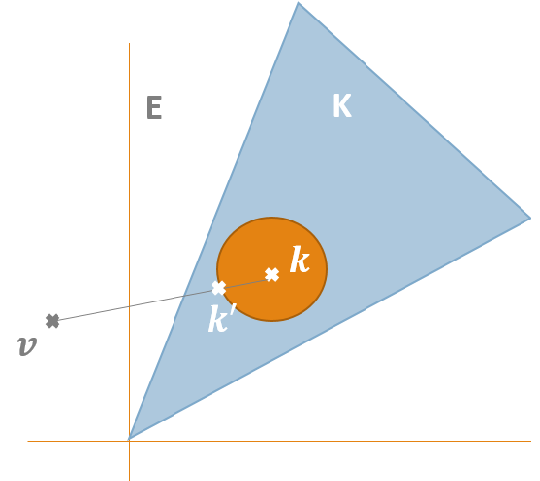
Main messages
Optimization over nonnegative polynomials has many applications. Powerful SDP/SOS-based relaxations available.
Two particular applications here: monotone regression and difference of convex programming.
Future directions:
Recent algorithmic developments to improve scalability of SDP.
Using DC programming for sparse regression $\min_{x}{||Ax−b}\left|{\left.​\right|}_{2}^{2}+λ\right|\left|x\right|{\left.​\right|}_{0}$

Slide 28
Thank you for listening
Questions?
Want to learn more? http://scholar.princeton.edu/ghall/

Slide 29
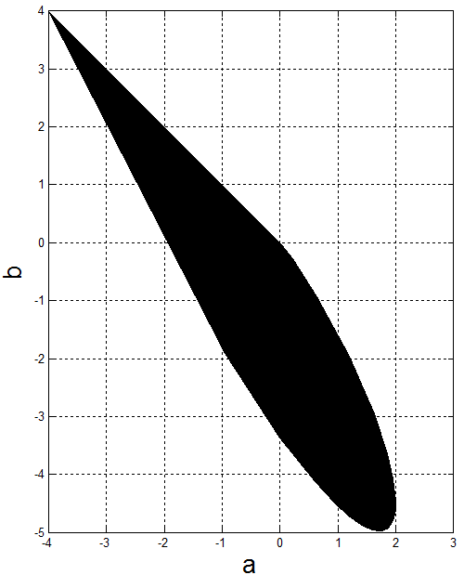
Imposing monotonicity
Example: For what values of $a$ and $b$ is the following polynomial monotone?
$$p\left(x\right)=x^{4}+ax^{3}+bx^{2}−\left(a+b\right)x$$
Theorem: A polynomial $p(x)$ of degree $2d$ is monotone on [0,1] if and only if
$$p^{′}\left(x\right)=xs_{1}\left(x\right)+\left(1−x\right)s_{2}\left(x\right),$$
where $s_{1}(x)$ and $s_{2}(x)$ are some sos polynomials of degree $2d−2.$
Search for sos polynomials using SDP!

Slide 30
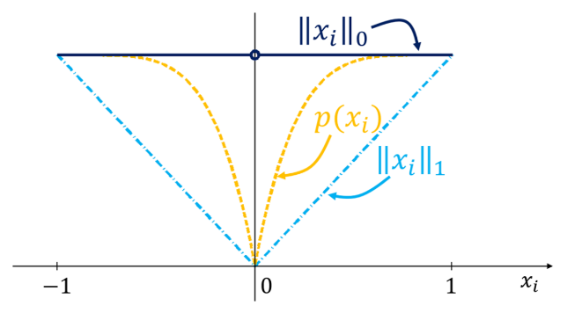
1. Polynomial optimization
$$\min_{x}{p(x)}$$
$$s.t. f_{i}\left(x\right)≤0$$
$$g_{j}\left(x\right)=0$$
$$\max_{γ}{γ}$$
$$s.t. p\left(x\right)−γ≥0,$$
$$∀x∈\{f_{i}\left(x\right)≤0, g_{j}\left(x\right)=0\}$$
$$γ^{∗}$$
ML applications:
Low-rank matrix completion
Training deep nets with polynomial activation functions
Nonnegative matrix factorization
Dictionary learning
Sparse recovery with nonconvex regularizers

