Slide 1

SOS and the
dreaded bit complexity
Ryan O’Donnell
Carnegie Mellon

Slide 2
I apologize for being here.

Slide 3
“The SoS hierarchy… can be solved in time n^{O(d)} for degree parameter d.”
[BHKKMP16]
“The SOS algorithm… with… parameter ℓ takes n^{O(ℓ)} time to run.”
[Bar14]
“If a [degree-d SOS] proof exists it can be found in time n^{O(d)}.”
[OZ12]
“The r round [SOS] relaxation can be solved in n^{O(r)} time on instances of size n.”
[MPW15]
“By semidefinite programming finding such a [degree ℓ dual solution] can be done in n^{O(ℓ)} time.”
[Bar14]
“There is an algorithm running in time n^{O(k)} to optimize [in the degree-k SOS proof system].”
[Ats13]
“If there is a degree-ℓ SOS proof… it can be found in mn^{O(ℓ)} time.”
[BS14]
“If there is a degree-d SoS proof with bit complexity n^{O(d)}, then one can be found in time n^{O(d)}.”
[RRS16]
“… this refutation can also be found efficiently by solving a semidefinite program of size n^{O(d)}.”
[KOTZ13]
“By using semidefinite programming, [SoS algorithm of degree q] run[s] in time n^{O(q)}.”
[BGGLT16]
“n-variable degree-d SOS proofs can be found in n^{O(d)} time whenever they exist.”
[AOW15]
“[If there is an SOS] proof of infeasibility of degree d, then it can be found in time O(m·n^{O(d)}).”
[DMN12]
“Hence the r-round SoS relaxation can be solved up to accuracy ϵ in time (mn·log(1/ϵ))^{O(r)}.”
[BBHKSZ12]
“We can find in (n polylog(M/ϵ))^{O(k)} time [an ϵ-accurate, degree-k SOS dual solution].”
[BKS14]
“For any fixed t, [the SOS relaxation of order t] can be computed in polynomial time (to any precision).”
[Lau10]
“We can compute the SOS(6) [relaxation] within arbitrary accuracy in polynomial time.”
[BM15]
“For each fixed t, [the degree-t SOS relaxation] may be computed… in poly. time to any fixed accuracy.”
[deKL10]
“One [can] optimize over [t-round SOS polytope] in time n^{O(t)}·m^{O(1)} up to numerical errors.”
[Rot13]

Slide 4
“The SoS hierarchy… can be solved in time n^{O(d)} for degree parameter d.”
[BHKKMP16]
“The SOS algorithm… with… parameter ℓ takes n^{O(ℓ)} time to run.”
[Bar14]
“If a [degree-d SOS] proof exists it can be found in time n^{O(d)}.”
[OZ12]
“The r round [SOS] relaxation can be solved in n^{O(r)} time on instances of size n.”
[MPW15]
“By semidefinite programming finding such a [degree ℓ dual solution] can be done in n^{O(ℓ)} time.”
[Bar14]
“There is an algorithm running in time n^{O(k)} to optimize [in the degree-k SOS proof system].”
[Ats13]
“If there is a degree-ℓ SOS proof… it can be found in mn^{O(ℓ)} time.”
[BS14]
“If there is a degree-d SoS proof with bit complexity n^{O(d)}, then one can be found in time n^{O(d)}.”
[RRS16]
“… this refutation can also be found efficiently by solving a semidefinite program of size n^{O(d)}.”
[KOTZ13]
“By using semidefinite programming, [SoS algorithm of degree q] run[s] in time n^{O(q)}.”
[BGGLT16]
“n-variable degree-d SOS proofs can be found in n^{O(d)} time whenever they exist.”
[AOW15]
“[If there is an SOS] proof of infeasibility of degree d, then it can be found in time O(m·n^{O(d)}).”
[DMN12]
“Hence the r-round SoS relaxation can be solved up to accuracy ϵ in time (mn·log(1/ϵ))^{O(r)}.”
[BBHKSZ12]
“We can find in (n polylog(M/ϵ))^{O(k)} time [an ϵ-accurate, degree-k SOS dual solution].”
[BKS14]
“For any fixed t, [the SOS relaxation of order t] can be computed in polynomial time (to any precision).”
[Lau10]
“We can compute the SOS(6) [relaxation] within arbitrary accuracy in polynomial time.”
[BM15]
“For each fixed t, [the degree-t SOS relaxation] may be computed… in poly. time to any fixed accuracy.”
[deKL10]
“One [can] optimize over [t-round SOS polytope] in time n^{O(t)}·m^{O(1)} up to numerical errors.”
[Rot13]

Slide 5
“The SoS hierarchy… can be solved in time n^{O(d)} for degree parameter d.”
[BHKKMP16]
“The SOS algorithm… with… parameter ℓ takes n^{O(ℓ)} time to run.”
[Bar14]
“If a [degree-d SOS] proof exists it can be found in time n^{O(d)}.”
[OZ12]
“The r round [SOS] relaxation can be solved in n^{O(r)} time on instances of size n.”
[MPW15]
“By semidefinite programming finding such a [degree ℓ dual solution] can be done in n^{O(ℓ)} time.”
[Bar14]
“There is an algorithm running in time n^{O(k)} to optimize [in the degree-k SOS proof system].”
[Ats13]
“If there is a degree-ℓ SOS proof… it can be found in mn^{O(ℓ)} time.”
[BS14]
“If there is a degree-d SoS proof with bit complexity n^{O(d)}, then one can be found in time n^{O(d)}.”
[RRS16]
“… this refutation can also be found efficiently by solving a semidefinite program of size n^{O(d)}.”
[KOTZ13]
“By using semidefinite programming, [SoS algorithm of degree q] run[s] in time n^{O(q)}.”
[BGGLT16]
“n-variable degree-d SOS proofs can be found in n^{O(d)} time whenever they exist.”
[AOW15]
“[If there is an SOS] proof of infeasibility of degree d, then it can be found in time O(m·n^{O(d)}).”
[DMN12]
“Hence the r-round SoS relaxation can be solved up to accuracy ϵ in time (mn·log(1/ϵ))^{O(r)}.”
[BBHKSZ12]
“We can find in (n polylog(M/ϵ))^{O(k)} time [an ϵ-accurate, degree-k SOS dual solution].”
[BKS14]
“For any fixed t, [the SOS relaxation of order t] can be computed in polynomial time (to any precision).”
[Lau10]
“We can compute the SOS(6) [relaxation] within arbitrary accuracy in polynomial time.”
[BM15]
“For each fixed t, [the degree-t SOS relaxation] may be computed… in poly. time to any fixed accuracy.”
[deKL10]
“One [can] optimize over [t-round SOS polytope] in time n^{O(t)}·m^{O(1)} up to numerical errors.”
[Rot13]

Slide 6
“The SoS hierarchy… can be solved in time n^{O(d)} for degree parameter d.”
[BHKKMP16]
“The SOS algorithm… with… parameter ℓ takes n^{O(ℓ)} time to run.”
[Bar14]
“If a [degree-d SOS] proof exists it can be found in time n^{O(d)}.”
[OZ12]
“The r round [SOS] relaxation can be solved in n^{O(r)} time on instances of size n.”
[MPW15]
“By semidefinite programming finding such a [degree ℓ dual solution] can be done in n^{O(ℓ)} time.”
[Bar14]
“There is an algorithm running in time n^{O(k)} to optimize [in the degree-k SOS proof system].”
[Ats13]
“If there is a degree-ℓ SOS proof… it can be found in mn^{O(ℓ)} time.”
[BS14]
“If there is a degree-d SoS proof with bit complexity n^{O(d)}, then one can be found in time n^{O(d)}.”
[RRS16]
“… this refutation can also be found efficiently by solving a semidefinite program of size n^{O(d)}.”
[KOTZ13]
“By using semidefinite programming, [SoS algorithm of degree q] run[s] in time n^{O(q)}.”
[BGGLT16]
“n-variable degree-d SOS proofs can be found in n^{O(d)} time whenever they exist.”
[AOW15]
“[If there is an SOS] proof of infeasibility of degree d, then it can be found in time O(m·n^{O(d)}).”
[DMN12]
“Hence the r-round SoS relaxation can be solved up to accuracy ϵ in time (mn·log(1/ϵ))^{O(r)}.”
[BBHKSZ12]
“We can find in (n polylog(M/ϵ))^{O(k)} time [an ϵ-accurate, degree-k SOS dual solution].”
[BKS14]
“For any fixed t, [the SOS relaxation of order t] can be computed in polynomial time (to any precision).”
[Lau10]
“We can compute the SOS(6) [relaxation] within arbitrary accuracy in polynomial time.”
[BM15]
“For each fixed t, [the degree-t SOS relaxation] may be computed… in poly. time to any fixed accuracy.”
[deKL10]
“One [can] optimize over [t-round SOS polytope] in time n^{O(t)}·m^{O(1)} up to numerical errors.”
[Rot13]

Slide 7
“The SoS hierarchy… can be solved in time n^{O(d)} for degree parameter d.”
[BHKKMP16]
“The SOS algorithm… with… parameter ℓ takes n^{O(ℓ)} time to run.”
[Bar14]
“If a [degree-d SOS] proof exists it can be found in time n^{O(d)}.”
[OZ12]
“The r round [SOS] relaxation can be solved in n^{O(r)} time on instances of size n.”
[MPW15]
“By semidefinite programming finding such a [degree ℓ dual solution] can be done in n^{O(ℓ)} time.”
[Bar14]
“There is an algorithm running in time n^{O(k)} to optimize [in the degree-k SOS proof system].”
[Ats13]
“If there is a degree-ℓ SOS proof… it can be found in mn^{O(ℓ)} time.”
[BS14]
“If there is a degree-d SoS proof with bit complexity n^{O(d)}, then one can be found in time n^{O(d)}.”
[RRS16]
“… this refutation can also be found efficiently by solving a semidefinite program of size n^{O(d)}.”
[KOTZ13]
“By using semidefinite programming, [SoS algorithm of degree q] run[s] in time n^{O(q)}.”
[BGGLT16]
“n-variable degree-d SOS proofs can be found in n^{O(d)} time whenever they exist.”
[AOW15]
“[If there is an SOS] proof of infeasibility of degree d, then it can be found in time O(m·n^{O(d)}).”
[DMN12]
“Hence the r-round SoS relaxation can be solved up to accuracy ϵ in time (mn·log(1/ϵ))^{O(r)}.”
[BBHKSZ12]
“We can find in (n polylog(M/ϵ))^{O(k)} time [an ϵ-accurate, degree-k SOS dual solution].”
[BKS14]
“For any fixed t, [the SOS relaxation of order t] can be computed in polynomial time (to any precision).”
[Lau10]
“We can compute the SOS(6) [relaxation] within arbitrary accuracy in polynomial time.”
[BM15]
“For each fixed t, [the degree-t SOS relaxation] may be computed… in poly. time to any fixed accuracy.”
[deKL10]
“One [can] optimize over [t-round SOS polytope] in time n^{O(t)}·m^{O(1)} up to numerical errors.”
[Rot13]

Slide 8
You would be forgiven for thinking that…
“Degree-d SOS solutions can be approximately
computed in n^{O(d)} time by SDP.”
*
This statement is false.
*More accurately: It is not known to be true.
And I would bet on it being false.

Slide 9
You would be forgiven for thinking that…
“Degree-d SOS solutions can be approximately
computed in n^{O(d)} time by SDP.”
*
This statement is still false.
(Still false even when we have
Boolean constraints for all i.)
= 1

Slide 10
Let’s back up the truck.

Slide 11
Linear programming feasibility problem
Input: A ∈ ℚ^{m×n}, b ∈ ℚ^{m}
Decide: Is K = {x ∈ ℝ^{n} : Ax ≤ b} nonempty?
Is this problem in P?

Slide 12
Linear programming feasibility problem
Input: A ∈ ℚ^{m×n}, b ∈ ℚ^{m}
Decide: Is K = {x ∈ ℝ^{n} : Ax ≤ b} nonempty?
Is this problem solvable in polynomial time in size of the input?
Size of the input:
L = 〈A〉+〈b〉, where 〈X〉 = # bits needed to write X

Slide 13
Linear programming feasibility problem
Input: A ∈ ℚ^{m×n}, b ∈ ℚ^{m}
[ L = 〈A〉+〈b〉 ]
Decide: Is K = {x ∈ ℝ^{n} : Ax ≤ b} nonempty?
Is this problem in NP?

Slide 14
Linear programming feasibility problem
Input: A ∈ ℚ^{m×n}, b ∈ ℚ^{m}
[ L = 〈A〉+〈b〉 ]
Decide: Is K = {x ∈ ℝ^{n} : Ax ≤ b} nonempty?
Is this problem in NP?
Not immediately obvious.
If K is nonempty, does it contain a rational point x?
If K is nonempty, does it contain a point x with ||x|| ≤ exp(L)?
Yes, and yes, by elementary linear algebra.

Slide 15
Linear programming feasibility problem
Input: A ∈ ℚ^{m×n}, b ∈ ℚ^{m}
[ L = 〈A〉+〈b〉 ]
Decide: Is K = {x ∈ ℝ^{n} : Ax ≤ b} nonempty?
Is this problem in NP?
Yes.
If K is nonempty, it contains x ∈ ℚ^{n} with 〈x〉 ≤ poly(L).

Slide 16
Linear programming feasibility problem
Input: A ∈ ℚ^{m×n}, b ∈ ℚ^{m}
[ L = 〈A〉+〈b〉 ]
Decide: Is K = {x ∈ ℝ^{n} : Ax ≤ b} nonempty?
Is this problem in NP?
Yes.
Is this problem in coNP?
Yes.
There’s a dual LP, K* = { y : y ≥ 0, A^{T}y = 0, b^{T}y ≤ −1},
such that K* is feasible iff K is infeasible.

Slide 17
Linear programming feasibility problem
Input: A ∈ ℚ^{m×n}, b ∈ ℚ^{m}
[ L = 〈A〉+〈b〉 ]
Decide: Is K = {x ∈ ℝ^{n} : Ax ≤ b} nonempty?
Is this problem in NP?
Yes.
Is this problem in coNP?
Yes.
Is this problem in P?
Yes.
Ellipsoid Algorithm.
[Khachiyan’79, Gács–Lovász’79]

Slide 18
Ellipsoid Algorithm
Input: Radii R > r > 0.
Convex set K ⊆ ℝ^{n} given by a “separation oracle”.
Oracle(x₀) either returns “x₀ ∈ K”
or else a halfspace “a^{T}x ≤ c” containing K but not x₀.
Assumption: Either K = ∅,
or K ⊆ Ball_{R}(0) and K contains a ball of radius r.
Output: Either a point in K, or else “K = ∅”.

Slide 19
K
r

Slide 20
R

Slide 25
Keeps going till center in K,
or ellipsoid too small to contain radius-r ball.
Time: poly(〈R〉, 〈r〉, n, L),
L = max bit-size of oracle’s answers

Slide 26
Ellipsoid Algorithm
Input: Radii R > r > 0, separation oracle for K.
Assumption: Either K = ∅,
or K ⊆ Ball_{R}(0) and K contains a ball of radius r.
Time: poly(〈R〉, 〈r〉, n, L)
LPs: R = exp(L) suffices.
If K is not full-dimensional (common!), no r works.
But little tricks get around that, can use r = exp(−L).

Slide 27
Ellipsoid Algorithm solves LP feasibility in poly(L) time.
Bonus: Can find vertices, optimize linear functions,
detect unboundedness, etc., all in poly(L) time.
Double Bonus: # of inequalities m can be anything,
so long as you have a poly-time separation oracle.

Slide 28

Everything you think you know about poly-time LP solvability…

Slide 29
Although…
Double Bonus: # of inequalities m can be anything,
so long as you have a poly-time separation oracle.
This part requires the theory of
“simultaneous Diophantine approximation”
and the Lenstra−Lenstra−Lovász
lattice basis reduction algorithm…

Slide 30
Semidefinite programming feasibility problem
Input: A ∈ ℚ^{m×n2}, b ∈ ℚ^{m}
[ L = 〈A〉+〈b〉 ]
Decide: Is K = {X ∈ ℝ^{n2} : AX ≤ b, X is PSD} nonempty?
X is PSD ⇔
for all y ∈ ℝ^{n}
(Infinitely) many linear inequalities on X.
There is a poly-time separation oracle:
Deciding if a given X is PSD is in P.

Slide 31

So semidefinite program feasibility is in P?

Slide 32
Ellipsoid Algorithm
Input: Radii R > r > 0.
Convex set K ⊆ ℝ^{n} given by a “separation oracle”.
Oracle(x₀) either returns “x₀ ∈ K”
or else a halfspace “a^{T}x ≤ c” containing K but not x₀.
Assumption: Either K = ∅,
or K ⊆ Ball_{R}(0) and K contains a ball of radius r.
Output: Either a point in K, or else “K = ∅”.

Slide 33
Semidefinite programming feasibility problem
Input: A ∈ ℚ^{m×n2}, b ∈ ℚ^{m}
[ L = 〈A〉+〈b〉 ]
Decide: Is K = {x ∈ ℝ^{n2} : AX ≤ b, X is PSD} nonempty?
The r problem:
There are feasible rational SDPs where
the only feasible points are irrational.
The R problem:
There are feasible SDPs where the only
feasible points X have 〈X〉 = exp(L).
[J. Ramana, Khachiyan]

Slide 34
Semidefinite programming feasibility problem
Input: A ∈ ℚ^{m×n2}, b ∈ ℚ^{m}
[ L = 〈A〉+〈b〉 ]
Decide: Is K = {x ∈ ℝ^{n2} : AX ≤ b, X is PSD} nonempty?
Is this problem in NP?
Unknown. (Believed not.)
Is this problem in coNP?
If and only if it’s in NP.
[M. Ramana’97]: An exact SDP duality theorem,
no “Slater condition” stuff.

Slide 35
Semidefinite programming feasibility problem
Input: A ∈ ℚ^{m×n2}, b ∈ ℚ^{m}
[ L = 〈A〉+〈b〉 ]
Decide: Is K = {x ∈ ℝ^{n2} : AX ≤ b, X is PSD} nonempty?
Is this problem in NP?
Unknown. (Believed not.)
Is this problem in coNP?
If and only if it’s in NP.
Is this problem decidable?
Yes, by existential theory of reals.
[Grigoriev–Vorobjov’88]:
In EXP.
[Canny’88]: In PSPACE.

Slide 36
Sum of Squares testing
Input: P(x₁, …, x_{n}) ∈ ℚ[x₁, …, x_{n}]
Decide: Is P = for some S_{i} ∈ ℝ[x₁, …, x_{n}]?
This is a special case of SDP feasibility testing.
E.g. P(x,y,z) = x⁴+xy³+y⁴−3x²yz−4xy²z+2x²z²+xz³+yz³+z⁴ is SOS?
iff
M
is feasible

Slide 37
Sum of Squares testing
Input: P(x₁, …, x_{n}) ∈ ℚ[x₁, …, x_{n}]
Decide: Is P = for some S_{i} ∈ ℝ[x₁, …, x_{n}]?
This is a special case of SDP feasibility testing.
E.g. P(x,y,z) = x⁴+xy³+y⁴−3x²yz−4xy²z+2x²z²+xz³+yz³+z⁴ is SOS?
Not known to be any easier.
Best upper bound known is PSPACE.

Slide 38
Sum of Squares testing
Input: P(x₁, …, x_{n}) ∈ ℚ[x₁, …, x_{n}]
Decide: Is P = for some S_{i} ∈ ℝ[x₁, …, x_{n}]?
This is a special case of SDP feasibility testing.
E.g. P(x,y,z) = x⁴+xy³+y⁴−3x²yz−4xy²z+2x²z²+xz³+yz³+z⁴ is SOS?
The r problem:
The SDP is never full-dimensional.
This P is SOS, not a sum of rational squares.
Tough to be in NP?
[Scheiderer’13]

Slide 39
Sum of Squares testing
Input: P(x₁, …, x_{n}) ∈ ℚ[x₁, …, x_{n}]
Decide: Is P = for some S_{i} ∈ ℝ[x₁, …, x_{n}]?
This is a special case of SDP feasibility testing.
E.g. P(x,y,z) = x⁴+xy³+y⁴−3x²yz−4xy²z+2x²z²+xz³+yz³+z⁴ is SOS?
The r problem:
The SDP is never full-dimensional.
This P is SOS, not a sum of rational squares.
The R problem:
I don’t know if it’s an issue. (Do you?)

Slide 40
Approximate Sum of Squares testing?
Perhaps you were just trying to certify P(x) ≥ 0 on ℝ^{n}.
Maybe you don’t mind just certifying P(x) ≥ −ϵ.
Makes more sense if there are constraints on x.
Let’s recall the SOS Method in optimization.

Slide 41
P₁(x₁, …, x_{n}) = 0
···
P_{m}(x₁, …, x_{n}) = 0
Q ₁(x₁, …, x_{n}) ≥ 0
···
Q_{m′}(x₁, …, x_{n}) ≥ 0
Max S(x₁, …, x_{n})
s.t.
equalities
inequalities
S, P₁ …, P_{m}, Q₁, …, Q_{m′}
are all polys of low degree (e.g., deg ≤ 3)
Encodes lots of natural NP-hard problems:
Max-Cut, Max-3SAT, Min-Bisection, Max-Clique, …

Slide 42
P₁(x₁, …, x_{n}) = 0
···
P_{m}(x₁, …, x_{n}) = 0
Q ₁(x₁, …, x_{n}) ≥ 0
···
Q_{m′}(x₁, …, x_{n}) ≥ 0
Max S(x₁, …, x_{n})
s.t.
equalities
inequalities
SOS(d) Method:
(Try to) certify S ≤ β on feasible region by writing
β−S = A + ∑ B_{i} Q_{i} + ∑ C_{i} P_{i}
where A, B_{i}’s are SOS, and deg(A), deg(B_{i}Q_{i}), deg(C_{i}P_{i}) ≤ d.
Existence of these is an SDP feasibility problem of size n^{O(d)}.

Slide 43
P₁(x₁, …, x_{n}) = 0
···
P_{m}(x₁, …, x_{n}) = 0
Q ₁(x₁, …, x_{n}) ≥ 0
···
Q_{m′}(x₁, …, x_{n}) ≥ 0
Max S(x₁, …, x_{n})
s.t.
equalities
inequalities
Typically:
Inequalities include
“Compact” (“Archimedean”) case.

Slide 44
P₁(x₁, …, x_{n}) = 0
···
P_{m}(x₁, …, x_{n}) = 0
Q ₁(x₁, …, x_{n}) ≥ 0
···
Q_{m′}(x₁, …, x_{n}) ≥ 0
Max S(x₁, …, x_{n})
s.t.
equalities
inequalities
Typically:
Inequalities include
Good news!
“The r problem” is no longer really a problem!
Fuzz the feasible region to contain a tiny ball.
A fuzzy certificate of S ≤ β can be fixed to a
genuine certificate of S ≤ β + exp(−n^{d}).

Slide 45
P₁(x₁, …, x_{n}) = 0
···
P_{m}(x₁, …, x_{n}) = 0
Q ₁(x₁, …, x_{n}) ≥ 0
···
Q_{m′}(x₁, …, x_{n}) ≥ 0
Max S(x₁, …, x_{n})
s.t.
equalities
inequalities
Typically:
Inequalities include
Good news!
“The r problem” is no longer really a problem!
“The R problem” is still a problem!
Bad news!
[O’17]:
A degree-2 instance where any approximately
good certificate requires exp(exp(n))-size coeffs.

Slide 46
P₁(x₁, …, x_{n}) = 0
···
P_{m}(x₁, …, x_{n}) = 0
Q ₁(x₁, …, x_{n}) ≥ 0
···
Q_{m′}(x₁, …, x_{n}) ≥ 0
Max S(x₁, …, x_{n})
s.t.
equalities
inequalities
Typically:
Inequalities include
Good news!
“The r problem” is no longer really a problem!
“The R problem” is still a problem!
Bad news!
[Raghavendra
–Weitz’17]:
Even when all Boolean equalities
are included!
=

Slide 47
P₁(x₁, …, x_{n}) = 0
···
P_{m}(x₁, …, x_{n}) = 0
Q ₁(x₁, …, x_{n}) ≥ 0
···
Q_{m′}(x₁, …, x_{n}) ≥ 0
Max S(x₁, …, x_{n})
s.t.
equalities
inequalities
Good news!
When the Boolean equalities
are the only constraints, everything is OK!
=
E.g.:
Goemans–Williamson Max-Cut algorithm is OK.
This was carefully proved by Delorme & Poljak
in 1990. (4 years prior to Goemans–Williamson!)

Slide 48
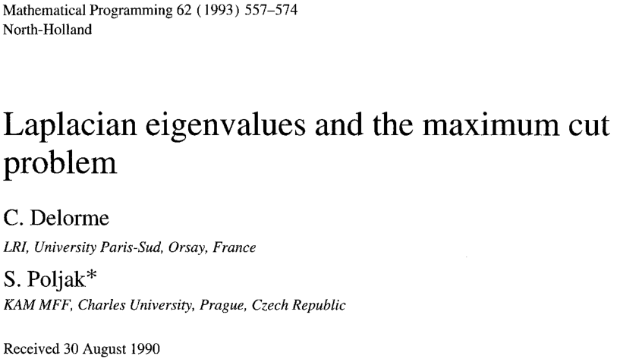
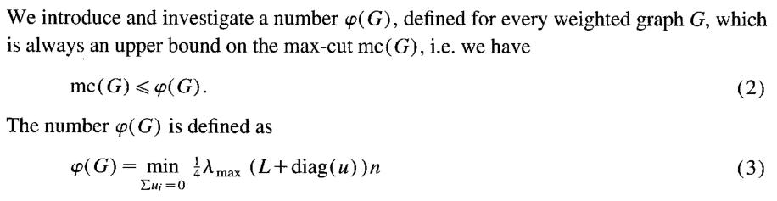
The SOS(2) certificate

Slide 49
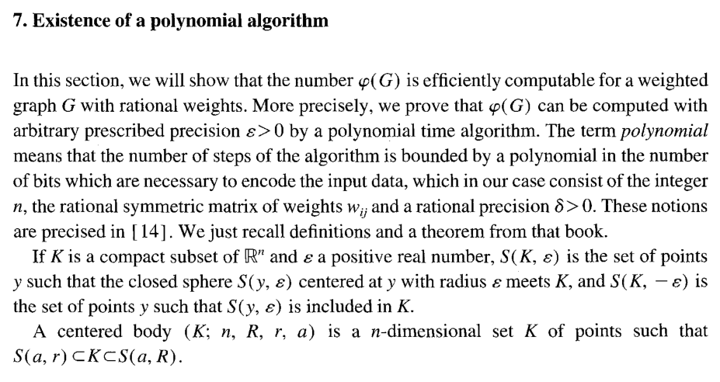
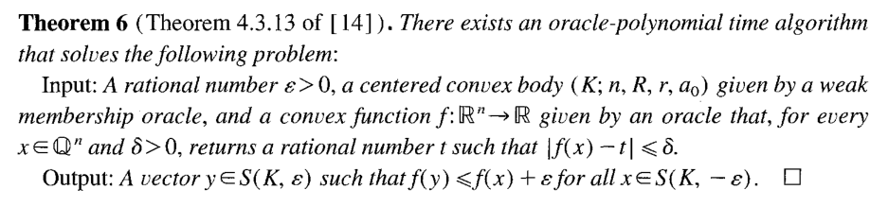

Slide 50
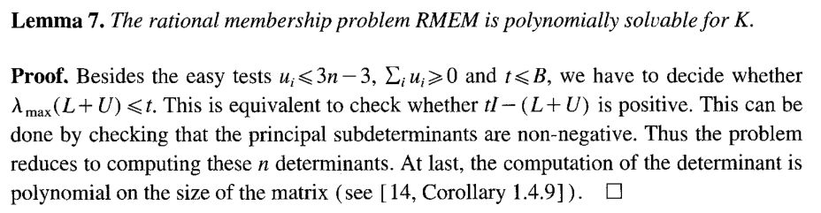

Slide 51
Erroneous explanation for why
testing PSD-ness is in P.

Slide 52
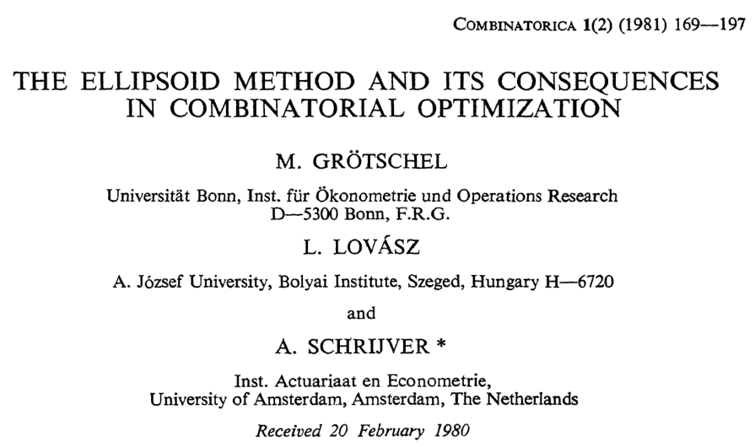
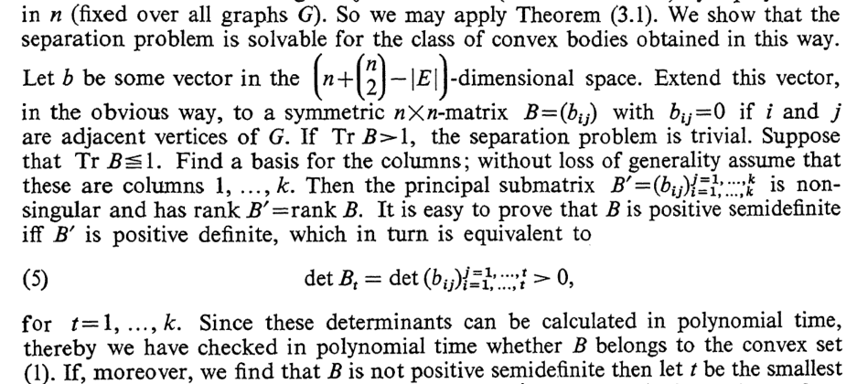

Slide 53
P₁(x₁, …, x_{n}) = 0
···
P_{m}(x₁, …, x_{n}) = 0
Q ₁(x₁, …, x_{n}) ≥ 0
···
Q_{m′}(x₁, …, x_{n}) ≥ 0
Max S(x₁, …, x_{n})
s.t.
equalities
inequalities
Good news!
When the Boolean equalities
are the only constraints, everything is OK!
=
More OK cases!
Boolean+Clique
Boolean+Matching constraints
Boolean Bisection/Approx-Bisection constraints
Unit vector constraints:
[Raghavendra
–Weitz’17]:

Slide 54
P₁(x₁, …, x_{n}) = 0
···
P_{m}(x₁, …, x_{n}) = 0
Q ₁(x₁, …, x_{n}) ≥ 0
···
Q_{m′}(x₁, …, x_{n}) ≥ 0
Max S(x₁, …, x_{n})
s.t.
equalities
inequalities
Good news!
When the Boolean equalities
are the only constraints, everything is OK!
=
More OK cases!
Roughly:
When all the equalities that are implied
by the given equalities & inequalities
are implied for “easy” reasons.
[Raghavendra
–Weitz’17]:

Slide 55
P₁(x₁, …, x_{n}) = 0
···
P_{m}(x₁, …, x_{n}) = 0
Q ₁(x₁, …, x_{n}) ≥ 0
···
Q_{m′}(x₁, …, x_{n}) ≥ 0
Max S(x₁, …, x_{n})
s.t.
equalities
inequalities
Good news!
When the Boolean equalities
are the only constraints, everything is OK!
=
Bad news!
A seemingly not OK case, for Boolean CSPs:
Instead of trying to maximize the Objective,
you try imposing equality constraints like
“Objective = β”.

Slide 56
“The SoS hierarchy… can be solved in time n^{O(d)} for degree parameter d.”
[BHKKMP16]
“The SOS algorithm… with… parameter ℓ takes n^{O(ℓ)} time to run.”
[Bar14]
“If a [degree-d SOS] proof exists it can be found in time n^{O(d)}.”
[OZ12]
“The r round [SOS] relaxation can be solved in n^{O(r)} time on instances of size n.”
[MPW15]
“By semidefinite programming finding such a [degree ℓ dual solution] can be done in n^{O(ℓ)} time.”
[Bar14]
“There is an algorithm running in time n^{O(k)} to optimize [in the degree-k SOS proof system].”
[Ats13]
“If there is a degree-ℓ SOS proof… it can be found in mn^{O(ℓ)} time.”
[BS14]
If your motivation is to use SOS to show that
certain approximation ratios are achievable
in P, in the Turing Machine model,
then please take some care.
“If there is a degree-d SoS proof with bit complexity n^{O(d)}, then one can be found in time n^{O(d)}.”
[RRS16]
“… this refutation can also be found efficiently by solving a semidefinite program of size n^{O(d)}.”
[KOTZ13]
“By using semidefinite programming, [SoS algorithm of degree q] run[s] in time n^{O(q)}.”
[BGGLT16]
“n-variable degree-d SOS proofs can be found in n^{O(d)} time whenever they exist.”
[AOW15]
“[If there is an SOS] proof of infeasibility of degree d, then it can be found in time O(m·n^{O(d)}).”
[DMN12]
“Hence the r-round SoS relaxation can be solved up to accuracy ϵ in time (mn·log(1/ϵ))^{O(r)}.”
[BBHKSZ12]
“We can find in (n polylog(M/ϵ))^{O(k)} time [an ϵ-accurate, degree-k SOS dual solution].”
[BKS14]
“For any fixed t, [the SOS relaxation of order t] can be computed in polynomial time (to any precision).”
[Lau10]
“We can compute the SOS(6) [relaxation] within arbitrary accuracy in polynomial time.”
[BM15]
“For each fixed t, [the degree-t SOS relaxation] may be computed… in poly. time to any fixed accuracy.”
[deKL10]
“One [can] optimize over [t-round SOS polytope] in time n^{O(t)}·m^{O(1)} up to numerical errors.”
[Rot13]

Slide 57
Thanks!

