Slide 1
On Approximating the Covering Radius and Finding Dense Lattice Subspaces
Daniel Dadush
Centrum Wiskunde & Informatica (CWI)

Slide 2
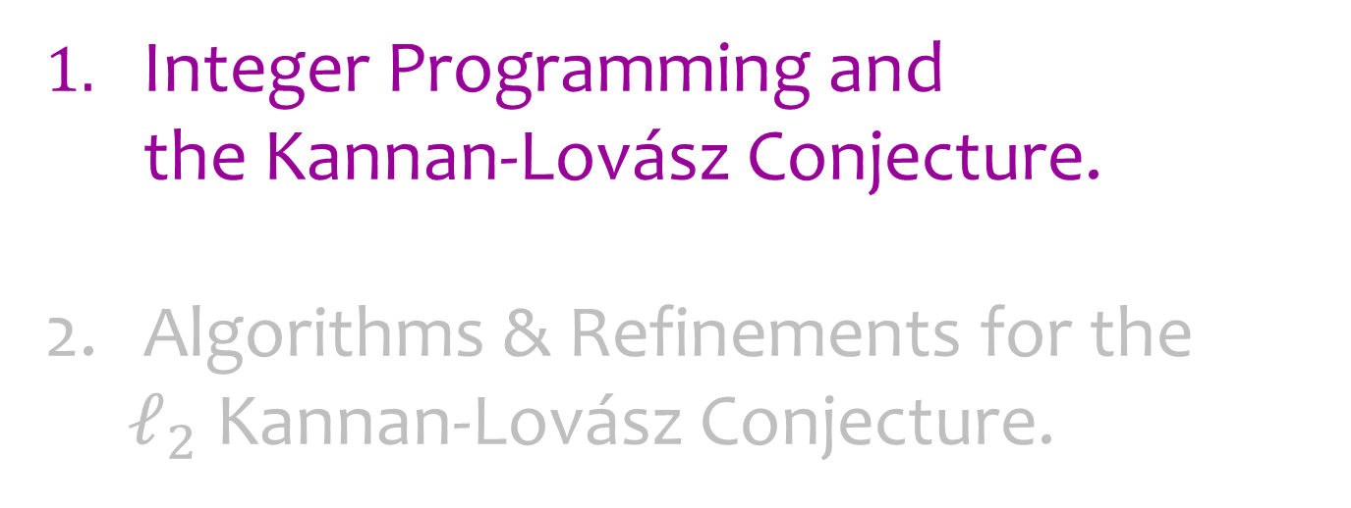
Outline
Integer Programming and
the Kannan-Lovász Conjecture.
Algorithms & Refinements for the
$ℓ_{2}$ Kannan-Lovász Conjecture.

Slide 3

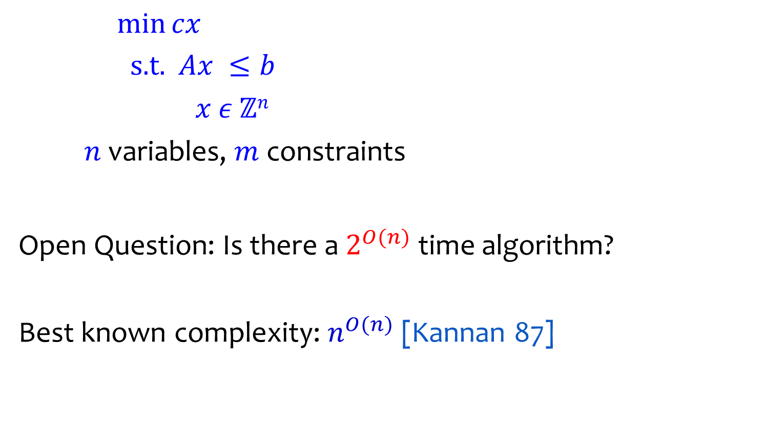

Integer Programming (IP)
$\min{cx}$
$\text{s}\text{.}\text{t}\text{. }Ax ≤b$
$x ε ℤn$
$n$ variables, $m$ constraints
Open Question: Is there a $2^{O(n)}$ time algorithm?
Best known complexity: $n^{O(n)}$ [Kannan 87]
$$c$$
$$K$$

Slide 4




Main Dichotomy
$μ\left(K,ℤ^{n}\right)≔$ smallest scaling $s$ such that
every shift $sK+t$ contains an integer point.
$$K$$
$$ℤ^{2}$$
Either covering radius $μ\left(K,ℤ^{n}\right)≤1$.

Slide 5

Main Dichotomy
$μ\left(K,ℤ^{n}\right)≔$ smallest scaling $s$ such that
every shift $sK+t$ contains an integer point.
$$K$$
$$ℤ^{2}$$
Either covering radius $μ\left(K,ℤ^{n}\right)≤1$.

Slide 6

Main Dichotomy
$μ\left(K,ℤ^{n}\right)≔$ smallest scaling $s$ such that
every shift $sK+t$ contains an integer point.
$$K$$
$$ℤ^{2}$$
Either covering radius $μ\left(K,ℤ^{n}\right)≤1$.

Slide 7


Main Dichotomy
$μ\left(K,ℤ^{n}\right)≔$ smallest scaling $s$ such that
every shift $sK+t$ contains an integer point.
$$μ\left(K,ℤ^{2}\right)=\frac{2}{3}$$
$$\frac{2}{3}K$$
$$ℤ^{2}$$
Either covering radius $μ\left(K,ℤ^{n}\right)≤1$.

Slide 8
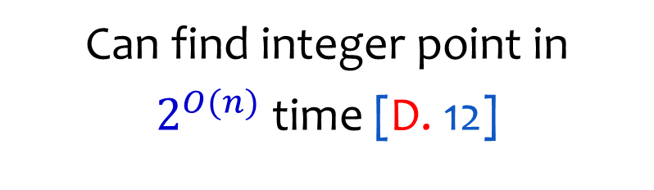
Main Dichotomy
Can find integer point in
$2^{O(n)}$ time [D. 12]
$$K$$
$$ℤ^{2}$$
Either covering radius $μ\left(K,ℤ^{n}\right)≤1$.

Slide 9
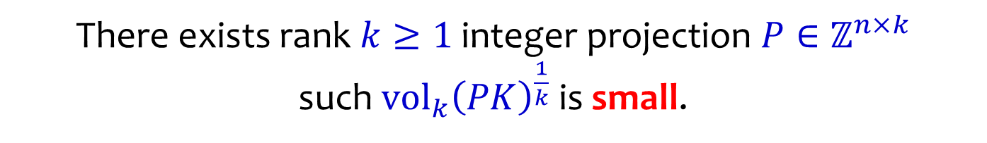

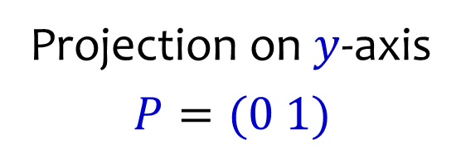

Main Dichotomy
Or $K$ is “flat”:
Projection on $y$-axis
$$P=(0 1)$$
$$K$$
$$ℤ^{2}$$
There exists rank $k≥1$ integer projection $P∈ℤ^{n×k}$
such ${vol}_{k}{\left(PK\right)}^{\frac{1}{k}}$ is small.

Slide 10
Main Dichotomy
Or $K$ is “flat”:
Projection on $y$-axis
$$P=(0 1)$$
$$K$$
$$ℤ^{2}$$
There exists rank $k≥1$ integer projection $P∈ℤ^{n×k}$
such ${vol}_{k}{\left(PK\right)}^{\frac{1}{k}}$ is small.

Slide 11
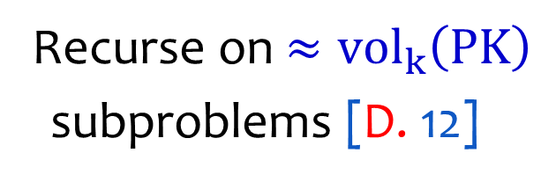
Main Dichotomy
Or $K$ is “flat”:
Recurse on $≈{vol}_{k}\left(PK\right)$
subproblems [D. 12]
$$K$$
$$ℤ^{2}$$
There exists rank $k≥1$ integer projection $P∈ℤ^{n×k}$
such ${vol}_{k}{\left(PK\right)}^{\frac{1}{k}}$ is small.

Slide 12
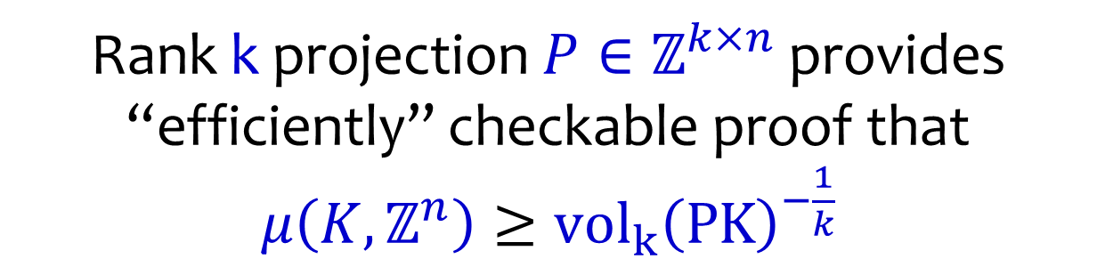
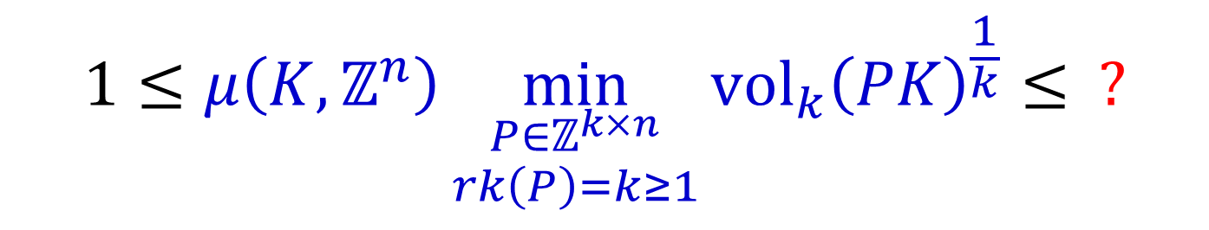
Duality Relation
$$1≤μ\left(K,ℤ^{n}\right)\min_{\begin{aligned}P∈ℤ^{k×n} \\ rk\left(P\right)=k≥1\end{aligned}}{{vol}_{k}{\left(PK\right)}^{\frac{1}{k}}}≤ ?$$
“Easy” side
“Hard” side
Rank k projection $P∈ℤ^{k×n}$ provides
“efficiently” checkable proof that
$μ\left(K,ℤ^{n}\right)≥{vol}_{k}{\left(PK\right)}^{−\frac{1}{k}}$

Slide 13


Khinchine Flatness Theorem
$$K$$
$$1≤ μ\left(K,ℤ^{n}\right)\min_{\begin{aligned}P∈ℤ^{1×n} \\ rk\left(P\right)=1\end{aligned}}{{vol}_{1}(PK)}≤\tilde{O}(n^{4/3})$$
[Khinchine `48, Babai `86, Hastad `86, Lenstra-Lagarias-Schnorr `87, Kannan-Lovasz `88, Banaszczyk `93-96, Banaszczyk-Litvak-Pajor-Szarek `99, Rudelson `00]

Slide 14
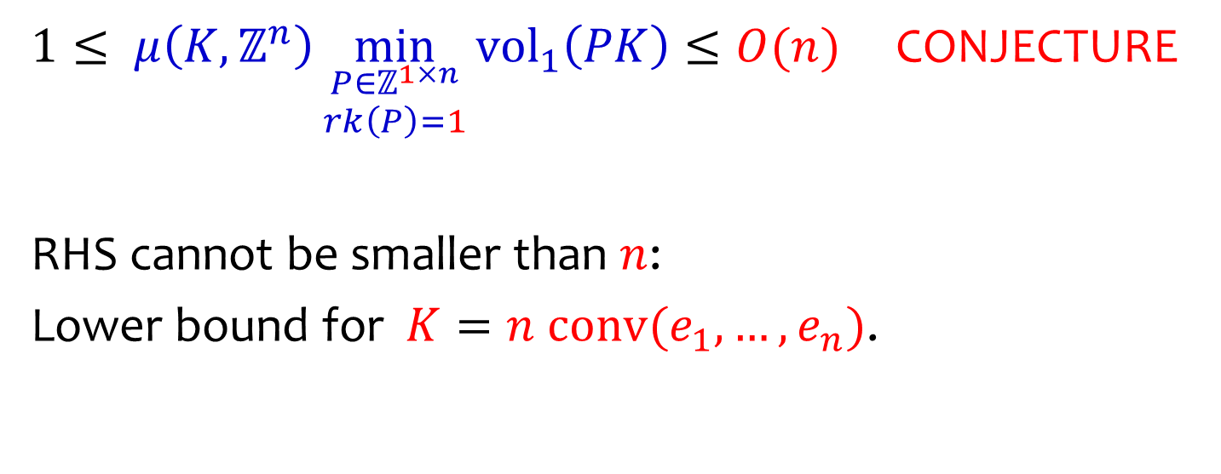
Khinchine Flatness Theorem
$$K$$
$1≤ μ\left(K,ℤ^{n}\right)\min_{\begin{aligned}P∈ℤ^{1×n} \\ rk\left(P\right)=1\end{aligned}}{{vol}_{1}\left(PK\right)}≤O(n)$ CONJECTURE
RHS cannot be smaller than $n$:
Lower bound for $K=n conv(e_{1},…,e_{n})$.

Slide 15
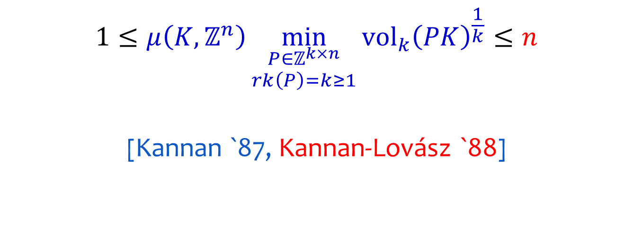
Kannan-Lovász Flatness Theorem
$$K$$
$$1≤μ\left(K,ℤ^{n}\right)\min_{\begin{aligned}P∈ℤ^{k×n} \\ rk\left(P\right)=k≥1\end{aligned}}{{vol}_{k}{\left(PK\right)}^{\frac{1}{k}}}≤n$$
[Kannan `87, Kannan-Lovász `88]

Slide 16
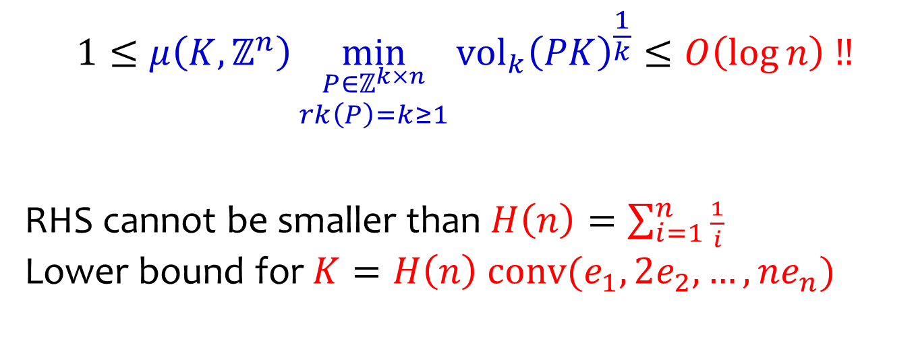
Kannan-Lovász Conjecture
$$K$$
$$1≤μ\left(K,ℤ^{n}\right)\min_{\begin{aligned}P∈ℤ^{k×n} \\ rk\left(P\right)=k≥1\end{aligned}}{{vol}_{k}{\left(PK\right)}^{\frac{1}{k}}}≤O\left(\log{n}\right) ‼$$
RHS cannot be smaller than $H\left(n\right)=\sum_{i=1}^{n}{\frac{1}{i}}$
Lower bound for $K=H\left(n\right) conv(e_{1},2e_{2},…,ne_{n})$

Slide 17
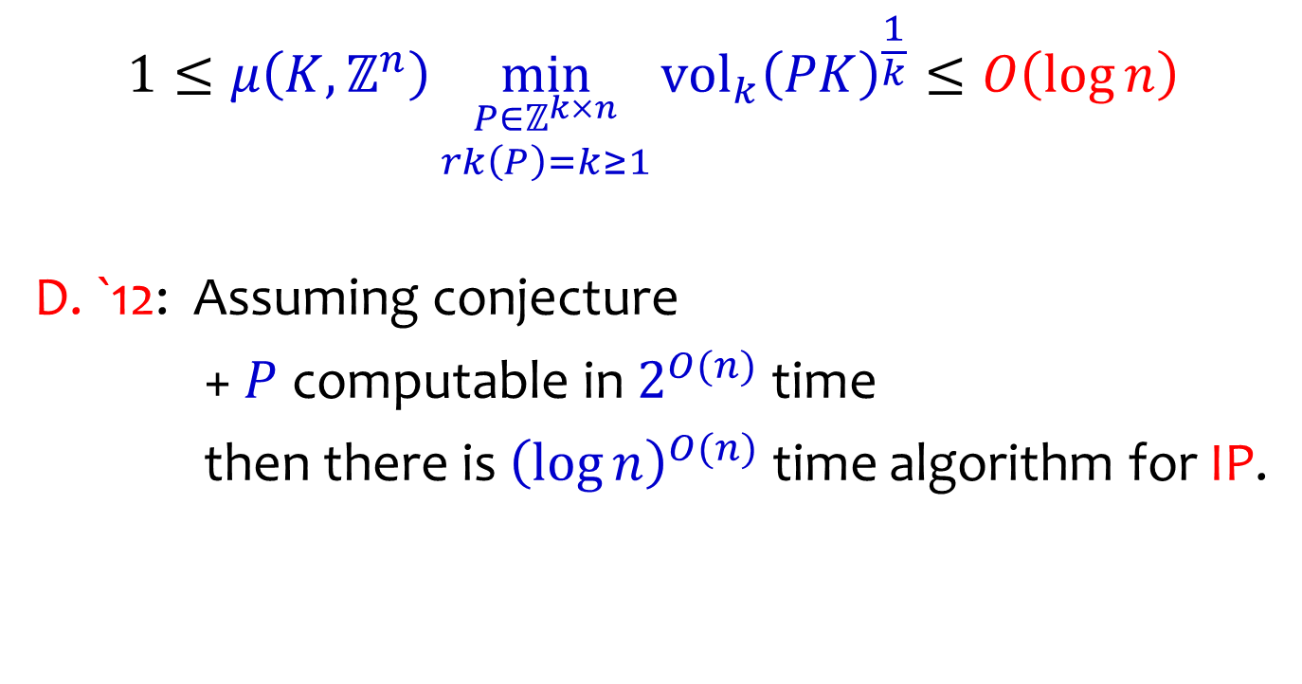
Faster Algorithm for IP?
$$1≤μ\left(K,ℤ^{n}\right)\min_{\begin{aligned}P∈ℤ^{k×n} \\ rk\left(P\right)=k≥1\end{aligned}}{{vol}_{k}{\left(PK\right)}^{\frac{1}{k}}}≤O\left(\log{n}\right)$$
D. `12: Assuming conjecture
+ $P$ computable in $2^{O(n)}$ time
then there is ${\left(\log{n}\right)}^{O(n)}$ time algorithm for IP.

Slide 18

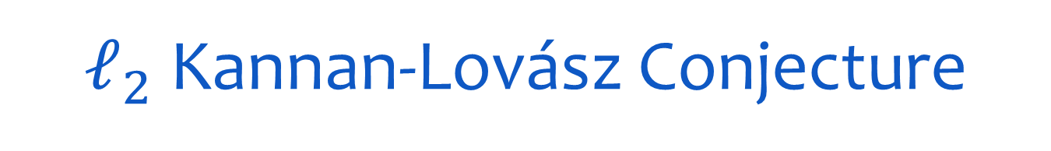


$ℓ_{2}$ Kannan-Lovász Conjecture
Does the conjecture hold for ellipsoids?
$$E$$
$$0$$
$$ℤ^{n}$$

Slide 19
$ℓ_{2}$ Kannan-Lovász Conjecture
Answer: YES* [Regev-S.Davidowitz 17]
$$E$$
$$0$$
$$ℤ^{n}$$
* up to polylogarithmic factors

Slide 20

$ℓ_{2}$ Kannan-Lovász Conjecture
Can we compute the projection $P?$
$$E$$
$$0$$
$$ℤ^{n}$$
THIS TALK: YES, in $2^{O(n)}$ time.

Slide 21
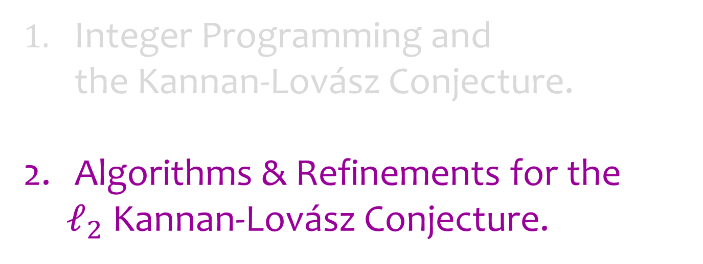
Outline
Integer Programming and
the Kannan-Lovász Conjecture.
Algorithms & Refinements for the
$ℓ_{2}$ Kannan-Lovász Conjecture.

Slide 22

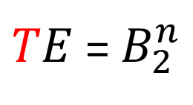

$ℓ_{2}$ Kannan-Lovász Conjecture
Easier to think of Euclidean ball vs general lattice.
$TE$ = $B_{2}^{n}$
$$0$$
$$ℒ=Tℤ^{n}$$

Slide 23

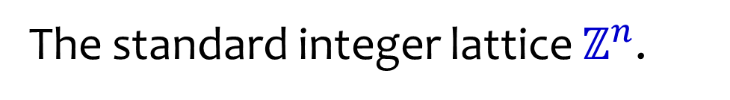


Lattices
The standard integer lattice $ℤ^{n}$.
$$e_{2}$$
$$ℤ^{n}$$
$$e_{1}$$

Slide 24



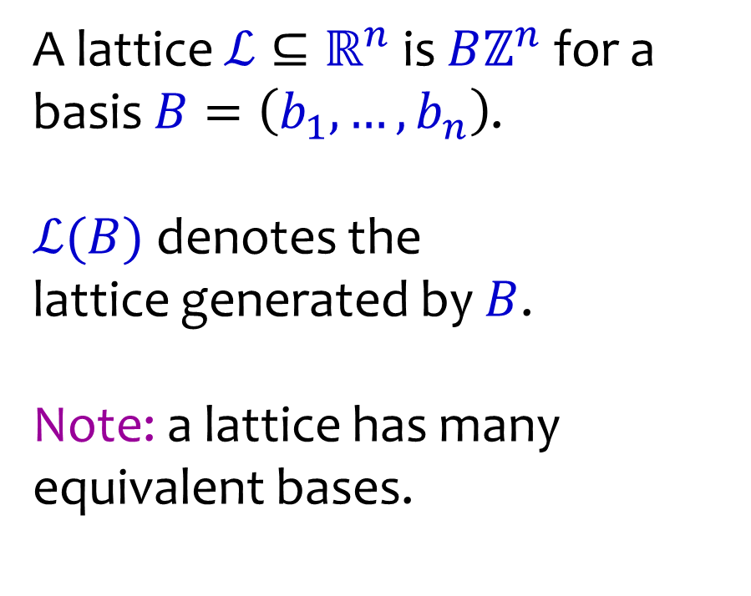



Lattices
A lattice $ℒ⊆ℝ^{n}$ is $Bℤ^{n}$ for a basis $B=\left(b_{1},…,b_{n}\right)$.
$ℒ(B)$ denotes the
lattice generated by $B$.
Note: a lattice has many equivalent bases.
$$b_{2}$$
$$b_{1}$$
$$b_{1}$$
$$b_{2}$$
$$b_{2}$$
$$ℒ$$

Slide 25
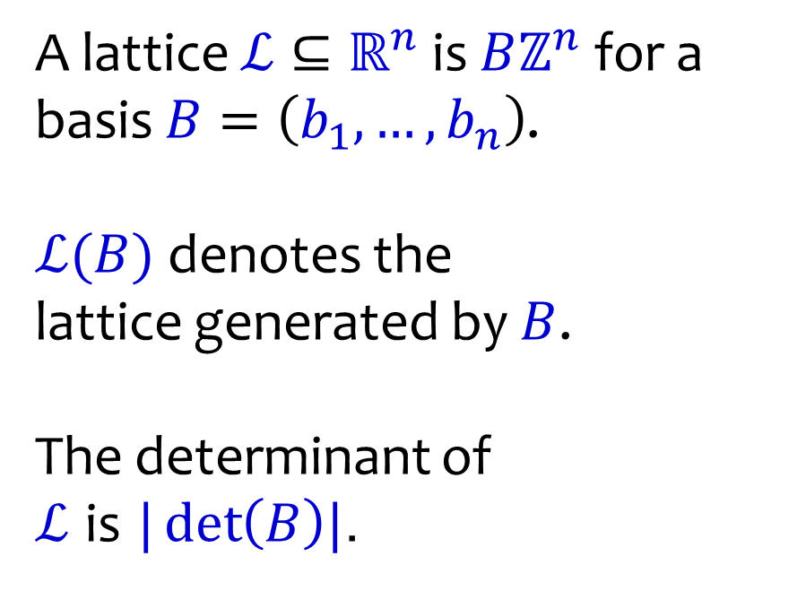
Lattices
A lattice $ℒ⊆ℝ^{n}$ is $Bℤ^{n}$ for a basis $B=\left(b_{1},…,b_{n}\right)$.
$ℒ(B)$ denotes the
lattice generated by $B$.
The determinant of
$ℒ$ is $|\det\left(B\right)|$.
$$b_{1}$$
$$b_{2}$$
$$ℒ$$

Slide 26
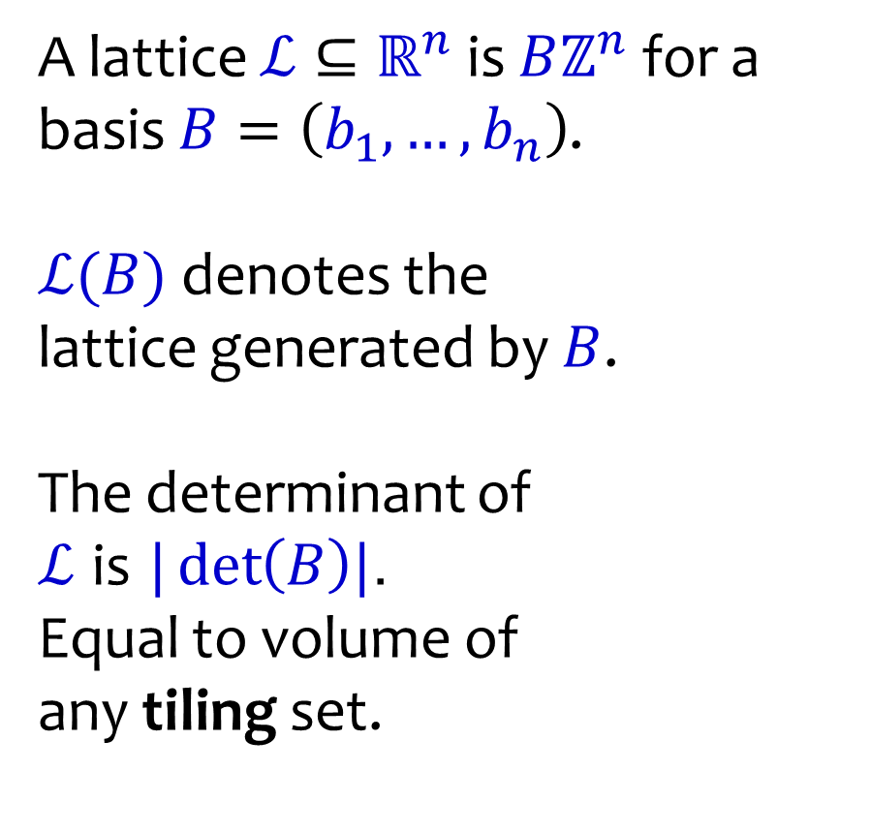
Lattices
A lattice $ℒ⊆ℝ^{n}$ is $Bℤ^{n}$ for a basis $B=\left(b_{1},…,b_{n}\right)$.
$ℒ(B)$ denotes the
lattice generated by $B$.
The determinant of
$ℒ$ is $|\det\left(B\right)|$.
Equal to volume of
any tiling set.
$$b_{1}$$
$$b_{2}$$
$$ℒ$$

Slide 27



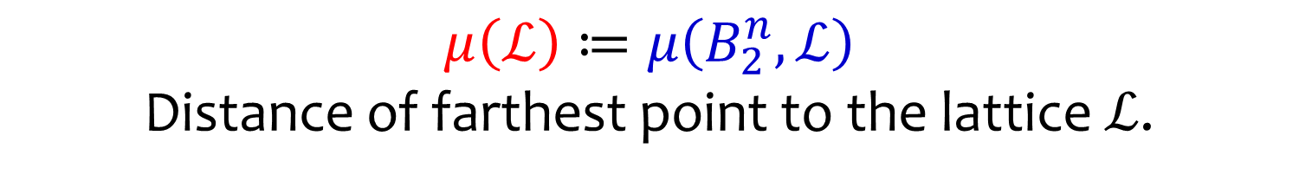

$ℓ_{2}$ Covering Radius
$$μ\left(ℒ\right)≔μ\left(B_{2}^{n},ℒ\right)$$
Distance of farthest point to the lattice $ℒ$.
$$μ$$
$$𝒱$$
$$ℒ$$
Voronoi cell $𝒱≔$ all points closer to $0$

Slide 28
Volumetric Lower Bounds
$${vol}_{n}\left(B_{2}^{n}μ\left(ℒ\right)\right)≥{vol}_{n}\left(𝒱\right)=\det{(ℒ)}$$
$$μ$$
$$𝒱$$
$$ℒ$$
Voronoi cell $𝒱≔$ all points closer to $0$

Slide 29
Volumetric Lower Bounds
$$μ(ℒ) ≥{vol}_{n}{\left(B_{2}^{n}\right)}^{−\frac{1}{n}}\det{{\left(ℒ\right)}^{\frac{1}{n}}}$$
$$μ$$
$$𝒱$$
$$ℒ$$
Voronoi cell $𝒱≔$ all points closer to $0$

Slide 30
Volumetric Lower Bounds
$$μ(ℒ) ≿\sqrt{n}\det{{\left(ℒ\right)}^{\frac{1}{n}}}$$
$$μ$$
$$𝒱$$
$$ℒ$$
Voronoi cell $𝒱≔$ all points closer to $0$

Slide 31



Volumetric Lower Bounds
$$μ\left(ℒ\right)≥μ\left(ℒ_{↓W}\right)$$
$$μ_{↓W}$$
$$μ$$
$$W$$
$$ℒ$$
$ℒ_{↓W}$ projection onto $W$

Slide 32

Volumetric Lower Bounds
$$μ\left(ℒ\right)≥μ\left(ℒ_{↓W}\right)≳\sqrt{k}\det{{\left(ℒ_{↓W}\right)}^{\frac{1}{k}}}$$
$$μ_{↓W}$$
$$μ$$
$$W$$
$$ℒ$$
$ℒ_{↓W}$ projection onto $W$
$$\dim{(W)}=k≥1$$

Slide 33

Volumetric Lower Bounds
$$μ\left(ℒ\right)≳\max_{\dim\left(W\right)=k≥1}{\sqrt{k}\det{{\left(ℒ_{↓W}\right)}^{\frac{1}{k}}}}$$
$$μ_{↓W}$$
$$μ$$
$$W$$
$$ℒ$$
$ℒ_{↓W}$ projection onto $W$
$$\dim{(W)}=k≥1$$

Slide 34
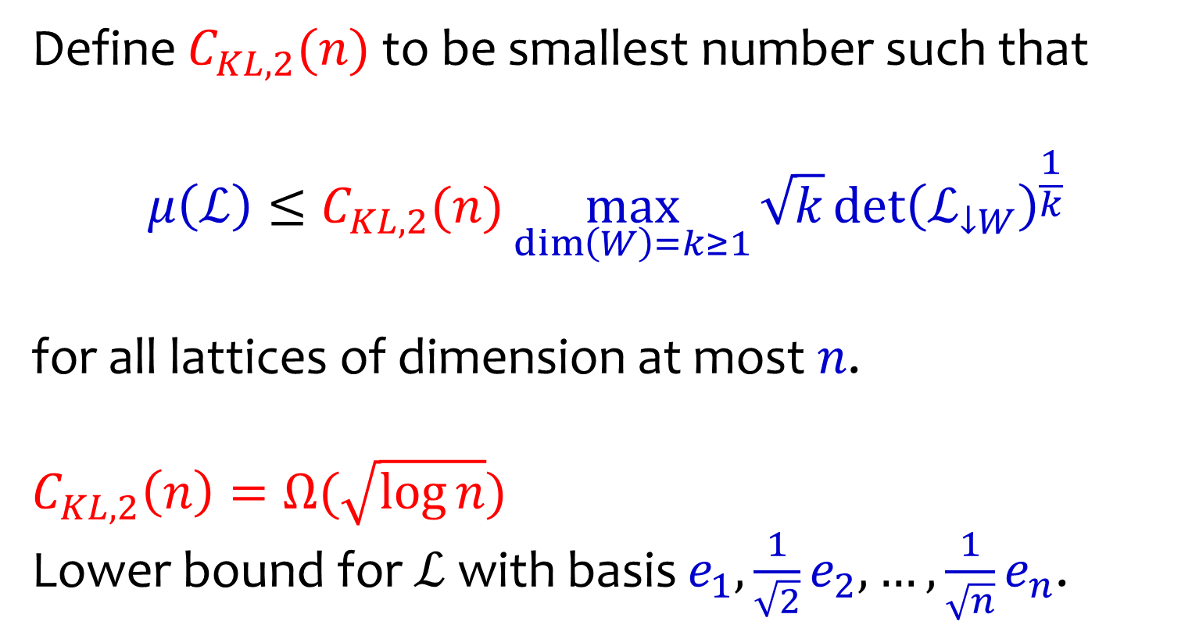
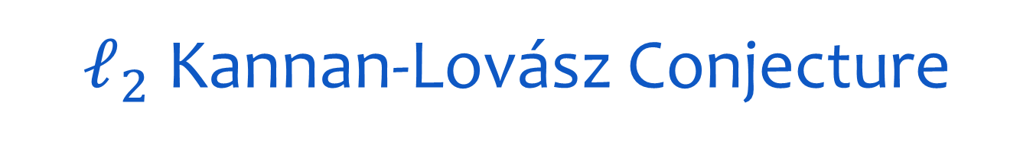
$ℓ_{2}$ Kannan-Lovász Conjecture
Define $C_{KL,2}(n)$ to be smallest number such that
$$μ\left(ℒ\right)≤C_{KL,2}(n)\max_{\dim\left(W\right)=k≥1}{\sqrt{k}\det{{\left(ℒ_{↓W}\right)}^{\frac{1}{k}}}}$$
for all lattices of dimension at most $n$.
$$C_{KL,2}\left(n\right)=Ω(\sqrt{\log{n}})$$
Lower bound for $ℒ$ with basis $e_{1},\frac{1}{\sqrt{2}}e_{2},…,\frac{1}{\sqrt{n}}e_{n}$.

Slide 35
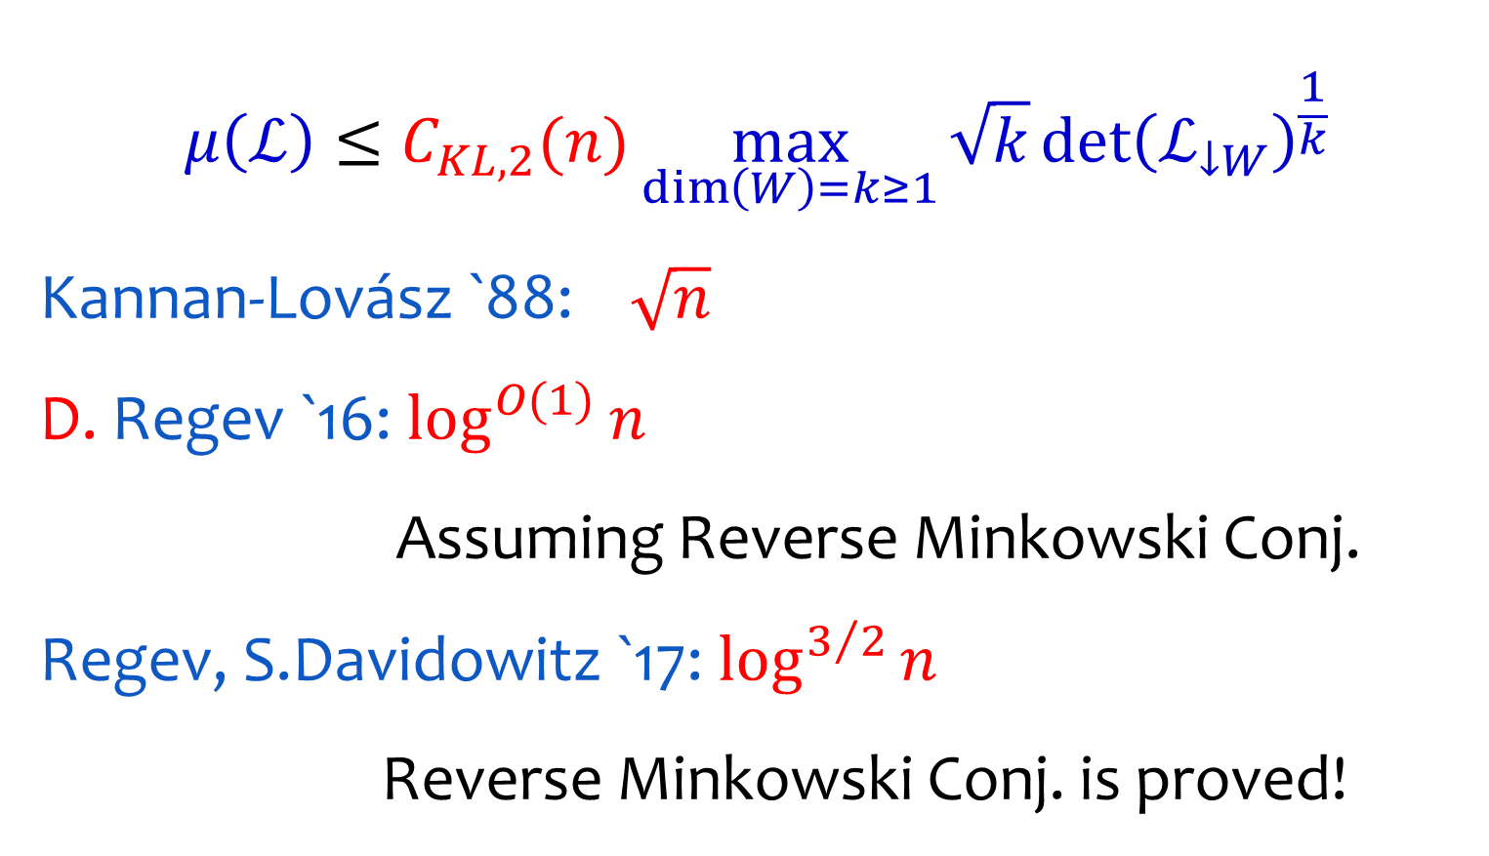
Known Bounds
$$μ\left(ℒ\right)≤C_{KL,2}(n)\max_{\dim\left(W\right)=k≥1}{\sqrt{k}\det{{\left(ℒ_{↓W}\right)}^{\frac{1}{k}}}}$$
Kannan-Lovász `88: $\sqrt{n}$
D. Regev `16: $\log^{O(1)}{n}$
Assuming Reverse Minkowski Conj.
Regev, S.Davidowitz `17: $\log^{3/2}{n}$
Reverse Minkowski Conj. is proved!

Slide 36
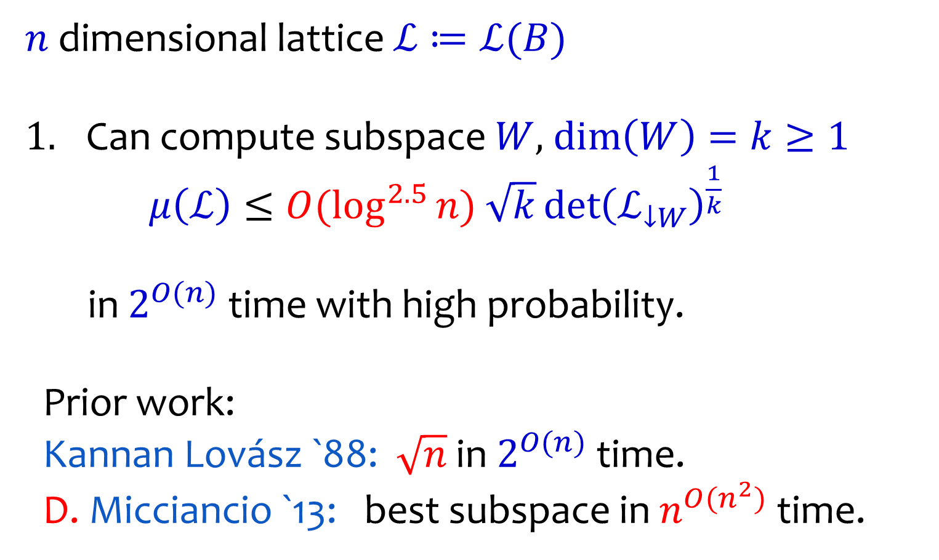
Our Results
$n$ dimensional lattice $ℒ≔ℒ(B)$
Can compute subspace $W$, $\dim\left(W\right)=k≥1$
$μ\left(ℒ\right)≤O(\log^{2.5}{n}$) $\sqrt{k}\det{{\left(ℒ_{↓W}\right)}^{\frac{1}{k}}}$
in $2^{O(n)}$ time with high probability.
Prior work:
Kannan Lovász `88: $\sqrt{n}$ in $2^{O(n)}$ time.
D. Micciancio `13: best subspace in $n^{O(n^{2})}$ time.

Slide 37

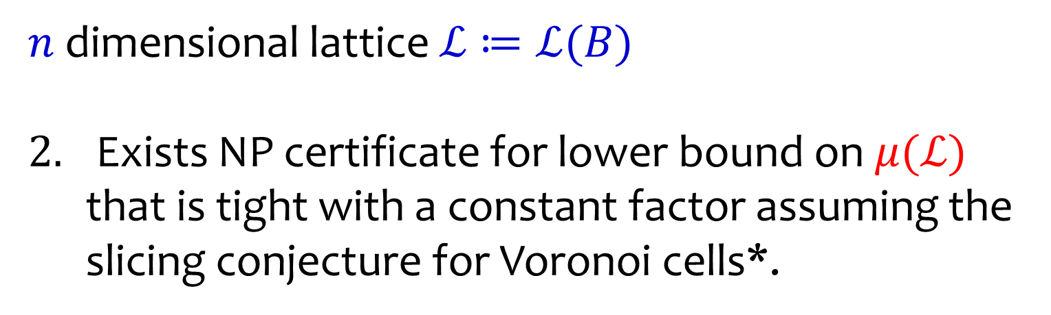

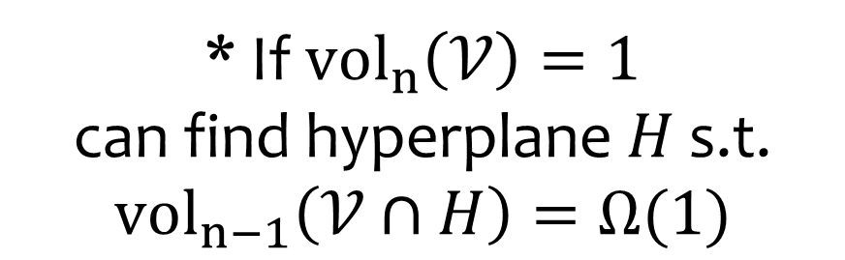
Our Results
$n$ dimensional lattice $ℒ≔ℒ(B)$
Exists NP certificate for lower bound on $μ(ℒ)$ that is tight with a constant factor assuming the slicing conjecture for Voronoi cells*.
$$𝒱$$
* If $vol_{n}\left(𝒱\right)=1$
can find hyperplane $H$ s.t. ${vol}_{n−1}\left(𝒱∩H\right)=Ω(1)$
$$H$$

Slide 38
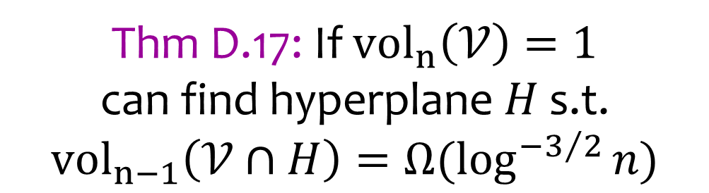
Our Results
$n$ dimensional lattice $ℒ≔ℒ(B)$
Exists NP certificate for lower bound on $μ(ℒ)$ that is tight with a constant factor assuming the slicing conjecture for Voronoi cells*.
$$𝒱$$
Thm D.17: If $vol_{n}\left(𝒱\right)=1$
can find hyperplane $H$ s.t. ${vol}_{n−1}\left(𝒱∩H\right)=Ω(\log^{−3/2}{n})$
$$H$$

Slide 39
Rest of Talk
The Canonical Filtration &
Stronger NP Certificates
Finding Dense Lattice Subspaces and
the Reverse Minkowski Conjecture

Slide 40
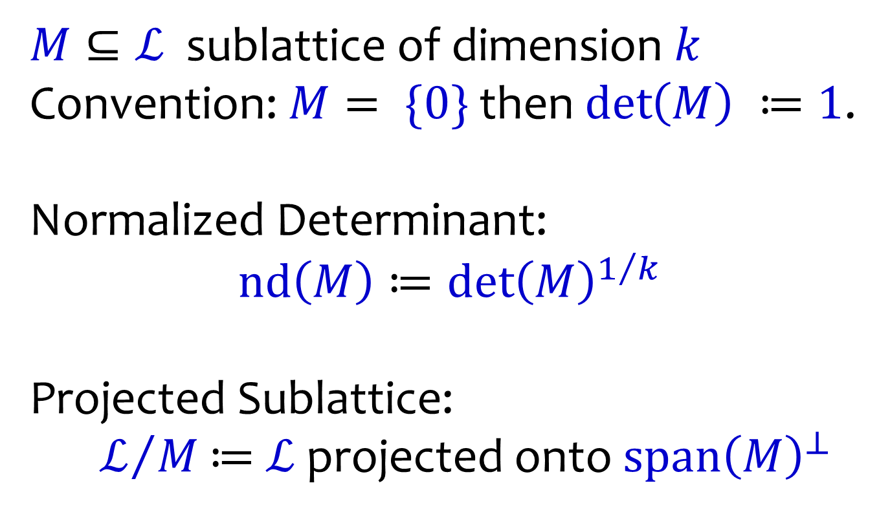
Notation
$M⊆ℒ$ sublattice of dimension $k$
Convention: $M= \{0\}$ then $\det\left(M\right) ≔1$.
Normalized Determinant:
$$nd\left(M\right)≔\det{{\left(M\right)}^{1/k}}$$
Projected Sublattice:
$ℒ/M$ $≔$ $ℒ$ projected onto $span{\left(M\right)}^{⊥}$

Slide 41


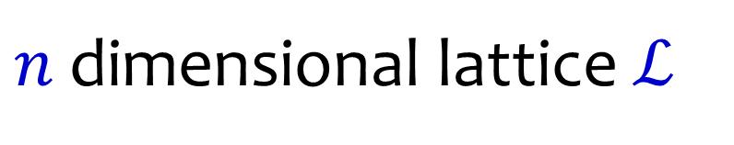
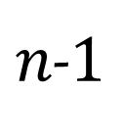





Canonical Polytope [Stuhler 76]
$n$ dimensional lattice $ℒ$
$𝒫(ℒ)$
Log det
$$(n,\log{\det{ℒ}})$$
$$(0,0)$$
dim.
$$0$$
$$1$$
$$2$$
$n$-$1$
$$n$$
$$\{\left(k,\log{\det\left(M\right)}\right):sublattice M⊆ℒ,\dim\left(M\right)=k\}$$

Slide 42
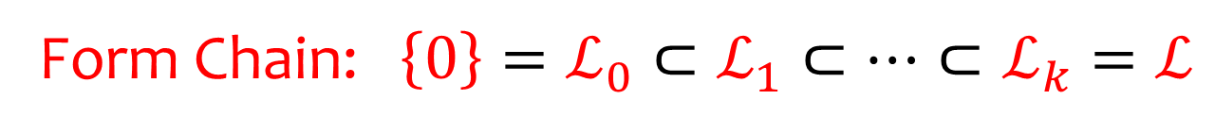
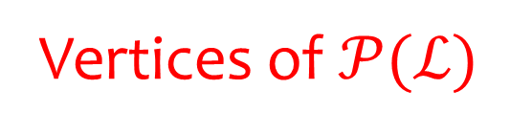




Canonical Filtration [Stuhler 76]
$n$ dimensional lattice $ℒ$
Vertices of $𝒫(ℒ)$
$$ℒ$$
Log det
$$ℒ_{2}$$
$$(n,\log{\det{ℒ}})$$
$$(0,0)$$
$$ℒ_{1}$$
$$\{0\}$$
dim.
$$0$$
$$1$$
$$2$$
$n$-$1$
$$n$$
Form Chain: $\left\{0\right\}=ℒ_{0}⊂ℒ_{1}⊂⋯⊂ℒ_{k}=ℒ$

Slide 43
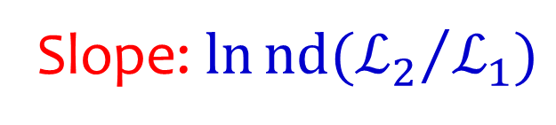
Canonical Filtration [Stuhler 76]
$n$ dimensional lattice $ℒ$
Slope: $\ln{nd({ℒ_{2}}/{ℒ_{1}})}$
$$ℒ$$
Log det
$$ℒ_{2}$$
$$(n,\log{\det{ℒ}})$$
$$(0,0)$$
$$ℒ_{1}$$
$$\{0\}$$
dim.
$$0$$
$$1$$
$$2$$
$n$-$1$
$$n$$
Form Chain: $\left\{0\right\}=ℒ_{0}⊂ℒ_{1}⊂⋯⊂ℒ_{k}=ℒ$

Slide 44
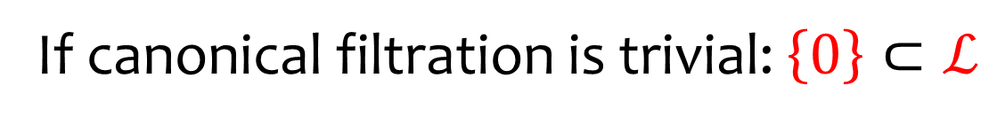
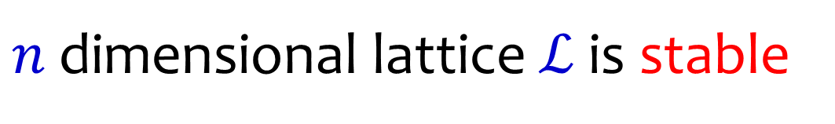
Stable Lattice [Stuhler 76]
$n$ dimensional lattice $ℒ$ is stable
I.e. no dense sublattices
$$ℒ$$
Log det
$$(n,\log{\det{ℒ}})$$
$$(0,0)$$
$$\{0\}$$
dim.
$$0$$
$$1$$
$$2$$
$n$-$1$
$$n$$
If canonical filtration is trivial: $\left\{0\right\}⊂ℒ$

Slide 45
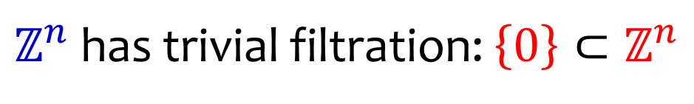
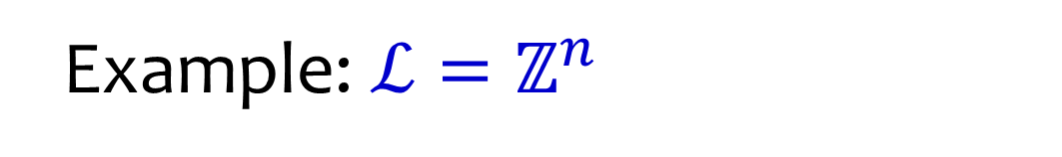

Stable Lattice [Stuhler 76]
Example: $ℒ=ℤ^{n}$
Log det
$𝒫(ℒ)$
$$(0,0)$$
$$\{0\}$$
dim.
$$0$$
$$1$$
$$2$$
$n$-$1$
$$n$$
$ℤ^{n}$ has trivial filtration: $\left\{0\right\}⊂ℤ^{n}$

Slide 46



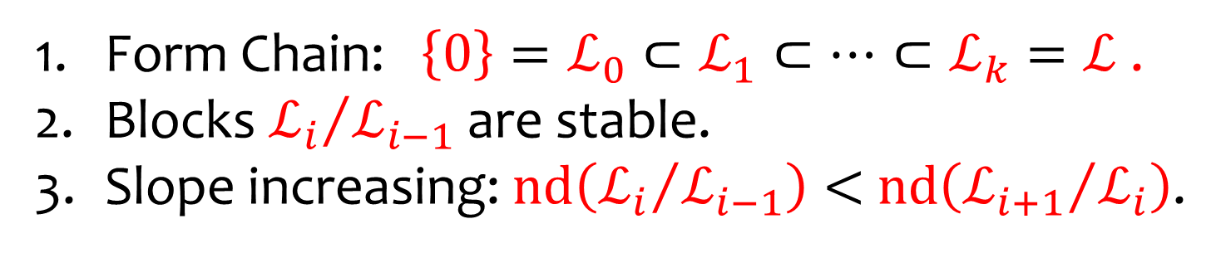
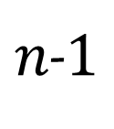





Canonical Filtration [Stuhler 76]
$$ℒ$$
$$ℒ_{2}$$
$$ℒ_{1}$$
$$\{0\}$$
$$0$$
$$1$$
$$2$$
$n$-$1$
$$n$$
Form Chain: $\left\{0\right\}=ℒ_{0}⊂ℒ_{1}⊂⋯⊂ℒ_{k}=ℒ$ .
Blocks ${ℒ_{i}}/{ℒ_{i−1}}$ are stable.
Slope increasing: $nd\left({ℒ_{i}}/{ℒ_{i−1}}\right)<$ $nd\left({ℒ_{i+1}}/{ℒ_{i}}\right)$.

Slide 47
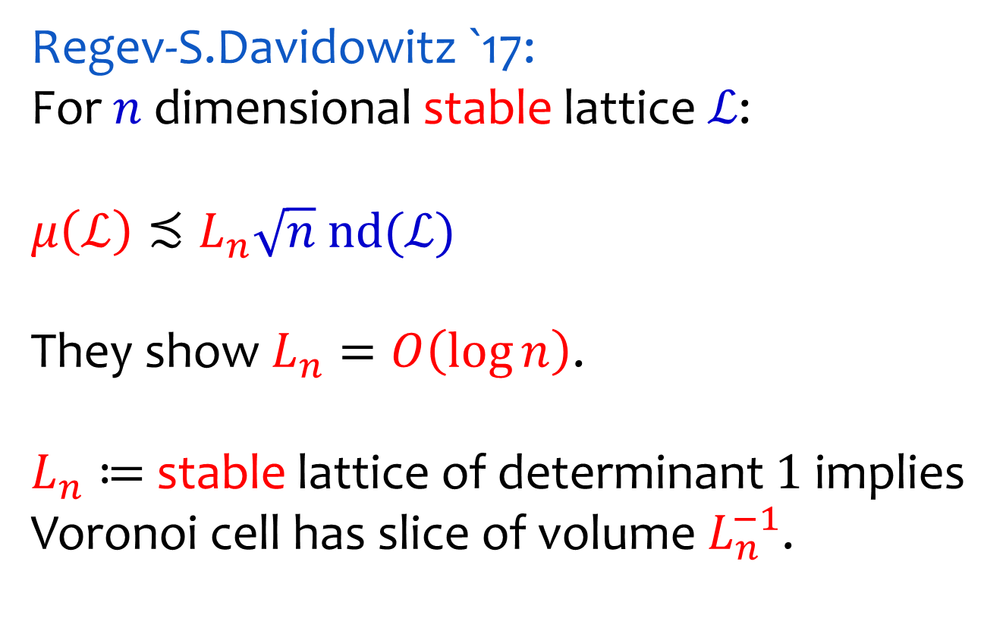
KL for Stable Lattices
Regev-S.Davidowitz `17:
For $n$ dimensional stable lattice $ℒ$:
$$μ\left(ℒ\right)≾L_{n}\sqrt{n} nd(ℒ)$$
They show $L_{n}=O\left(\log{n}\right)$.
$L_{n}≔$ stable lattice of determinant $1$ implies Voronoi cell has slice of volume $L_{n}^{−1}$.

Slide 48
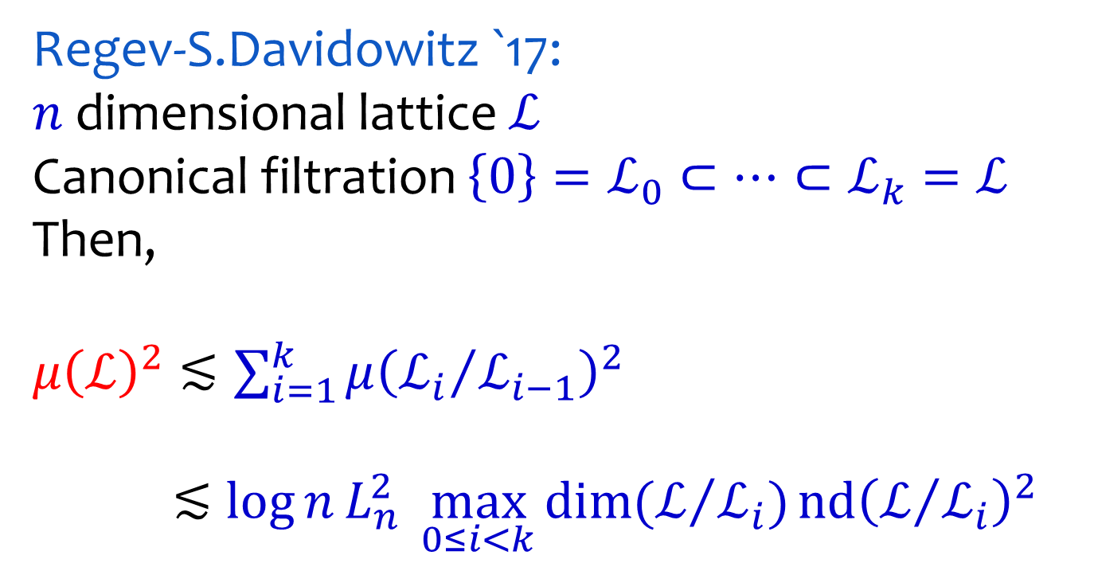
KL for all Lattices
Regev-S.Davidowitz `17:
$n$ dimensional lattice $ℒ$
Canonical filtration $\left\{0\right\}=ℒ_{0}⊂⋯⊂ℒ_{k}=ℒ$
Then,
$μ{\left(ℒ\right)}^{2}≲\sum_{i=1}^{k}{μ{\left({ℒ_{i}}/{ℒ_{i−1}}\right)}^{2}}$
$≲\log{n}L_{n}^{2}\max_{0≤i<k}{\dim{(ℒ/{ℒ_{i}})}}\operatorname{nd}{{\left(ℒ/{ℒ_{i}}\right)}^{2}}$
Kannan Lovász

Slide 49
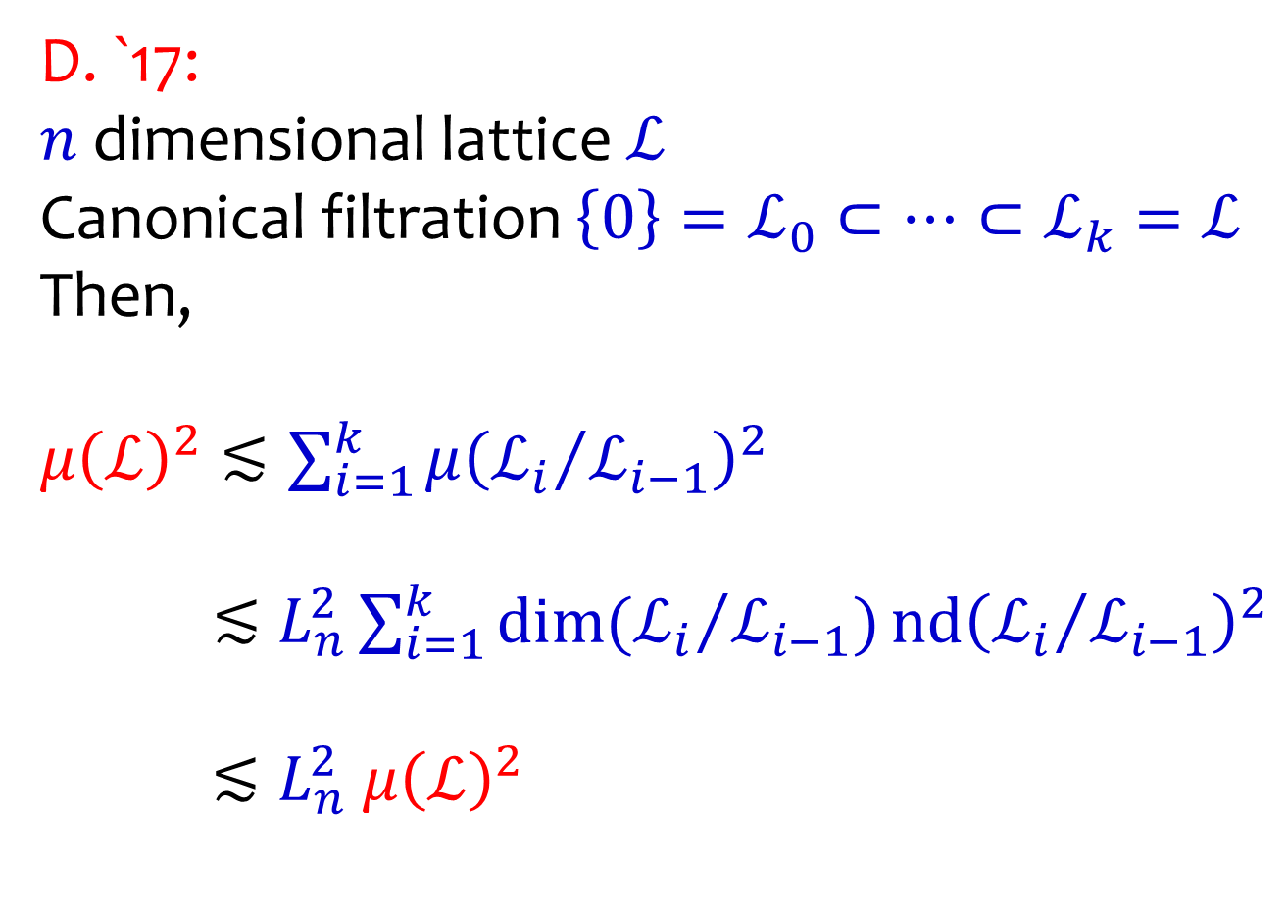
Better Certificates for Chains
D. `17:
$n$ dimensional lattice $ℒ$
Canonical filtration $\left\{0\right\}=ℒ_{0}⊂⋯⊂ℒ_{k}=ℒ$
Then,
$μ{\left(ℒ\right)}^{2}≲\sum_{i=1}^{k}{μ{\left({ℒ_{i}}/{ℒ_{i−1}}\right)}^{2}}$
$≲L_{n}^{2}\sum_{i=1}^{k}{{\dim{({ℒ_{i}}/{ℒ_{i−1}})}\operatorname{nd}\left({ℒ_{i}}/{ℒ_{i−1}}\right)}^{2}}$
$≲L_{n}^{2} μ{\left(ℒ\right)}^{2}$
NEW

Slide 50
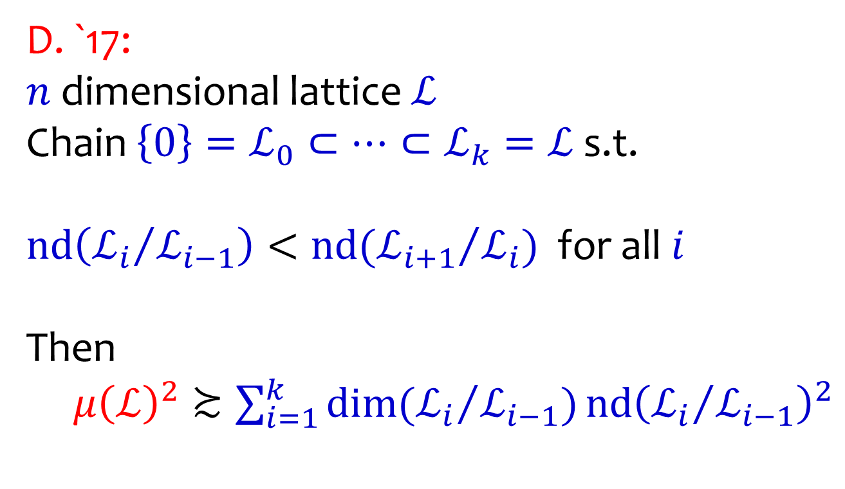
Better Certificates for Chains
D. `17:
$n$ dimensional lattice $ℒ$
Chain $\left\{0\right\}=ℒ_{0}⊂⋯⊂ℒ_{k}=ℒ$ s.t.
$nd\left({ℒ_{i}}/{ℒ_{i−1}}\right)<nd({ℒ_{i+1}}/{ℒ_{i}})$ for all $i$
Then
$μ{\left(ℒ\right)}^{2}≿\sum_{i=1}^{k}{{\dim{({ℒ_{i}}/{ℒ_{i−1}})}\operatorname{nd}\left({ℒ_{i}}/{ℒ_{i−1}}\right)}^{2}}$

Slide 51
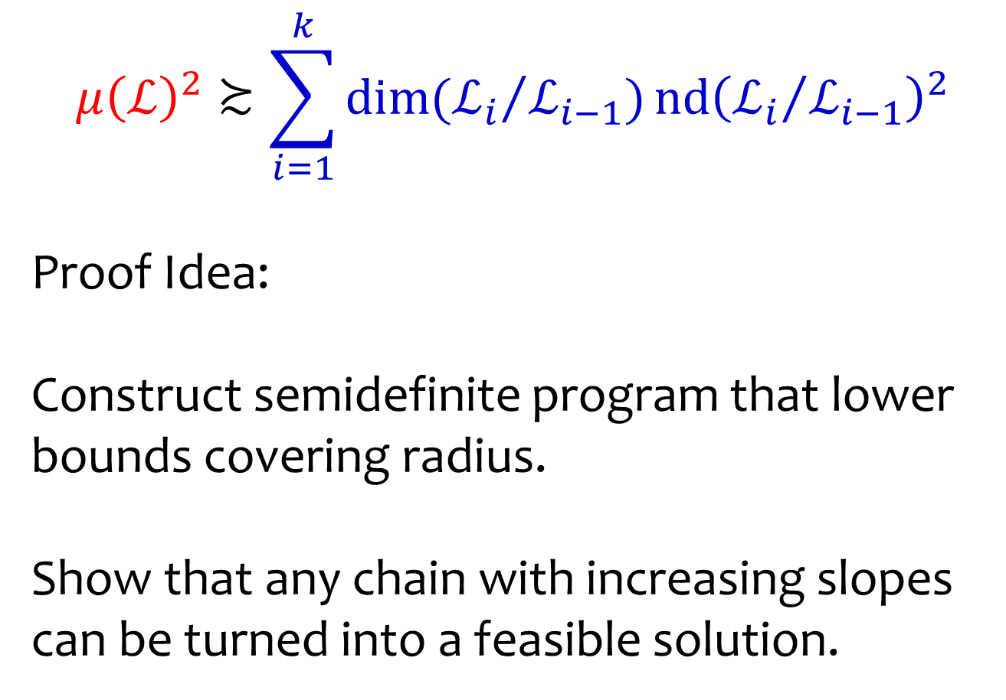
Better Certificates for Chains
$$μ{\left(ℒ\right)}^{2}≿\sum_{i=1}^{k}{{\dim{({ℒ_{i}}/{ℒ_{i−1}})}\operatorname{nd}\left({ℒ_{i}}/{ℒ_{i−1}}\right)}^{2}}$$
Proof Idea:
Construct semidefinite program that lower bounds covering radius.
Show that any chain with increasing slopes can be turned into a feasible solution.

Slide 52
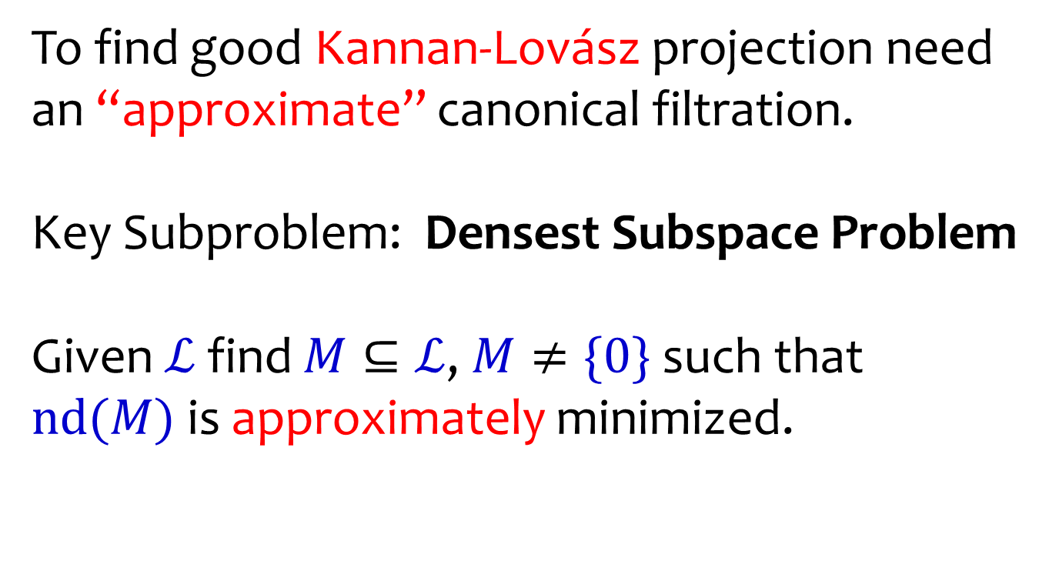
Finding Dense Subspaces
To find good Kannan-Lovász projection need an “approximate” canonical filtration.
Key Subproblem: Densest Subspace Problem
Given $ℒ$ find $M⊆ℒ$, $M≠\{0\}$ such that
$nd(M)$ is approximately minimized.

Slide 53
Densest Subspace Problem
$n$ dimensional lattice $ℒ$
Want sublattice with approx.
minimum slope.
$$ℒ$$
Log det
$$ℒ_{2}$$
$$(n,\log{\det{ℒ}})$$
$$(0,0)$$
$$ℒ_{1}$$
$$\{0\}$$
dim.
$$0$$
$$1$$
$$2$$
$n$-$1$
$$n$$

Slide 54
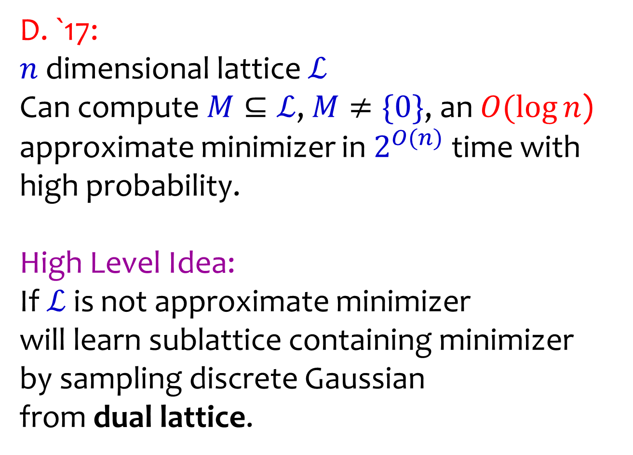
Densest Subspace Problem
D. `17:
$n$ dimensional lattice $ℒ$
Can compute $M⊆ℒ$, $M≠\{0\}$, an $O(\log{n}$)
approximate minimizer in $2^{O(n)}$ time with high probability.
High Level Idea:
If $ℒ$ is not approximate minimizer
will learn sublattice containing minimizer
by sampling discrete Gaussian
from dual lattice.

Slide 55

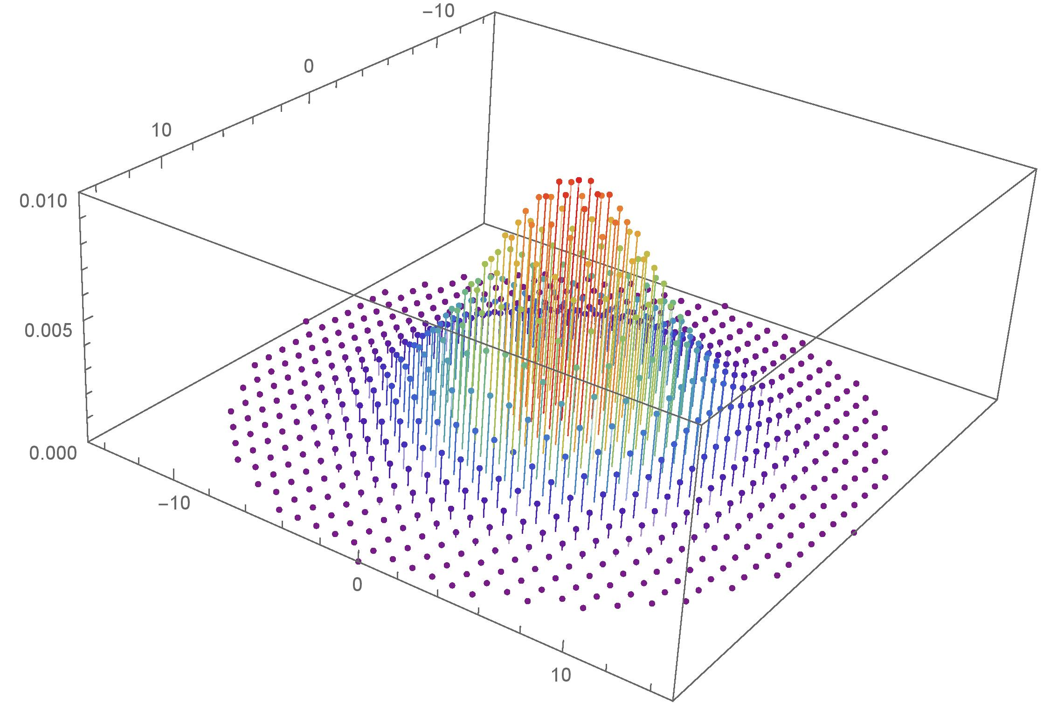
Discrete Gaussian Distribution
Notes:
6:30-8:30
Aharonov and Regev use the periodic Gaussian function. You can see how oracle access to this can be helpful.

Slide 56
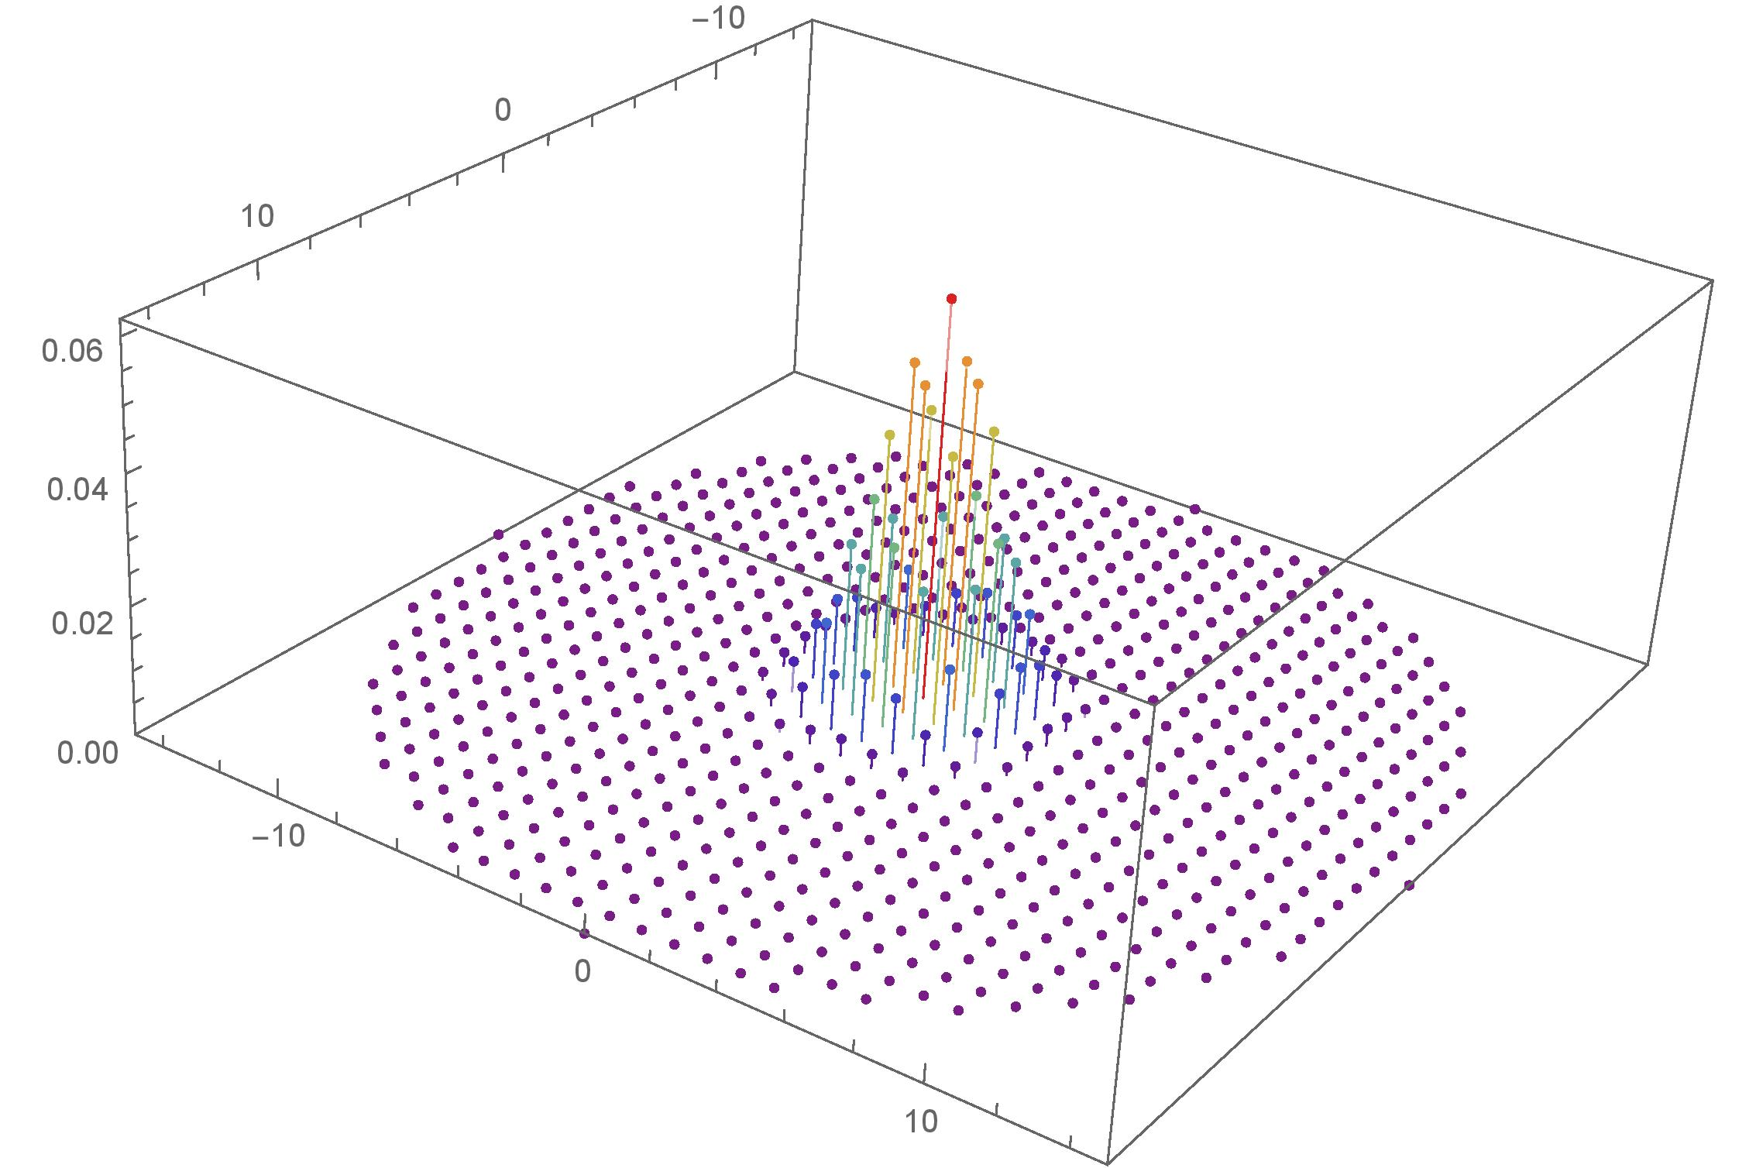
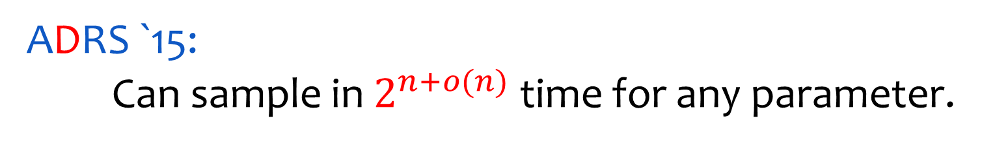
Discrete Gaussian Distribution
ADRS `15:
Can sample in $2^{n+o(n)}$ time for any parameter.
Notes:
6:30-8:30
Aharonov and Regev use the periodic Gaussian function. You can see how oracle access to this can be helpful.

Slide 57








Dual Lattice
A lattice $ℒ⊆ℝ^{n}$ is $Bℤ^{n}$ for a basis $B=\left(b_{1},…,b_{n}\right)$.
The dual lattice is
$ℒ^{∗}=\{y∈span\left(ℒ\right):$
$y^{T}x∈ℤ ∀x∈ℒ\}$
$ℒ^{∗}$ is generated by $B^{−T}$.
Remark: ${\left(ℤ^{n}\right)}^{∗}=ℤ^{n}$
$$\frac{1}{{\left\|y\right\|}_{2}}$$
$$y∈ℒ^{∗}$$
$$ℒ$$
$$y^{T}x=0$$
$$y^{T}x=1$$
$$y^{T}x=2$$
$$y^{T}x=3$$
$$y^{T}x=4$$

Slide 58

Dual Lattice
A lattice $ℒ⊆ℝ^{n}$ is $Bℤ^{n}$ for a basis $B=\left(b_{1},…,b_{n}\right)$.
The dual lattice is
$ℒ^{∗}=\{y∈span\left(ℒ\right):$
$y^{T}x∈ℤ ∀x∈ℒ\}$
$ℒ^{∗}$ is generated by $B^{−T}$.
$\det\left(ℒ^{∗}\right)=1/det⁡(ℒ)$
$$\frac{1}{{\left\|y\right\|}_{2}}$$
$$y∈ℒ^{∗}$$
$$ℒ$$
$$y^{T}x=0$$
$$y^{T}x=1$$
$$y^{T}x=2$$
$$y^{T}x=3$$
$$y^{T}x=4$$

Slide 59






$ℒ =\{\left(a_{1}x_{1},…,a_{n}x_{n}\right):x∈ℤ^{n}\}$
$$\frac{3}{4}e_{2}$$
$${2e}_{1}$$
$$ℒ$$
$ℒ^{∗}=\{\left(a_{1}^{−1}x_{1},…,a_{n}^{−1}x_{n}\right):x∈ℤ^{n}\}$
$$\frac{4}{3}e_{2}$$
$${\frac{1}{2}e}_{1}$$
$$ℒ^{∗}$$

Slide 60

High Level Algorithm
$M′⊆ℒ$ be densest subspace
$t≔nd\left(M^{′}\right)$ (can guess it)
If $nd\left(ℒ\right)≾t\log{n}$, return $ℒ$
o/w sample $y∼D_{ℒ^{∗},1/(t\log{n})}$
Repeat on $ℒ∩y^{⊥}$
Key Point: $y⊥M′$ and non-zero w.h.p.
Analysis needs Reverse Minkowski Theorem
Notes:
6:30-8:30
Aharonov and Regev use the periodic Gaussian function. You can see how oracle access to this can be helpful.

Slide 61


Reverse Minkowski Conjecture
$ℒ$ lattice dimension $n$
If $det\left(ℒ\right)≤1$ then $ℒ$
has $2^{Ω(n)}$ points at distance $\sqrt{n}$
1889
Notes:
6:30-8:30
Aharonov and Regev use the periodic Gaussian function. You can see how oracle access to this can be helpful.

Slide 62


Reverse Minkowski Conjecture
$ℒ$ lattice dimension $n$
$M⊆ℒ$, $\det\left(M\right)≤1$, $\dim{(M)}=k$
has $2^{Ω(k)}$ points at distance $\sqrt{k}$
1889
Conjecture: If all non-trivial sublattices of $ℒ$
have determinant at least $1$ can we upper bound
number of points as above?
Notes:
6:30-8:30
Aharonov and Regev use the periodic Gaussian function. You can see how oracle access to this can be helpful.

Slide 63

Reverse Minkowski Theorem
Regev-S.Davidowitz `17:
$ℒ$ lattice dimension $n$.
If all non-trivial sublattices of $ℒ$
have determinant at least $1$ then:
$ℒ$ has at most $2^{O(\log^{2}{n}{k})}$ points at distance $\sqrt{k}$.
Almost tight: $ℤ^{n}$ has $n^{Ω(k)}$ points at distance $\sqrt{k}$
for $k≪n$.
Notes:
6:30-8:30
Aharonov and Regev use the periodic Gaussian function. You can see how oracle access to this can be helpful.

Slide 64

Conclusions
Algorithmic version of $ℓ_{2}$ Kannan-Lovász conjecture via discrete Gaussian sampling.
NP certificates for covering radius that are tight within $O(1)$ assuming slicing conjecture.
Open Problem
Prove KL conjecture for general convex bodies.

