Slide 1
Machine Learning for Healthcare Data
Katherine A. Heller
Duke University

Slide 2
Outline
Electronic Health Records
  Gaussian Process-based Models for:
    Chronic Kidney Disease
    Sepsis
National Surgery Quality Improvement Program
  The Basics of Predicting Surgical Complications
  Clustering Procedural Codes
  Transfer Learning Models
Mobile apps
  Graph-coupled HMMs for Predicting the Spread of Influenza
  MS Mosaic

Slide 3
Chronic Kidney Disease

Slide 4
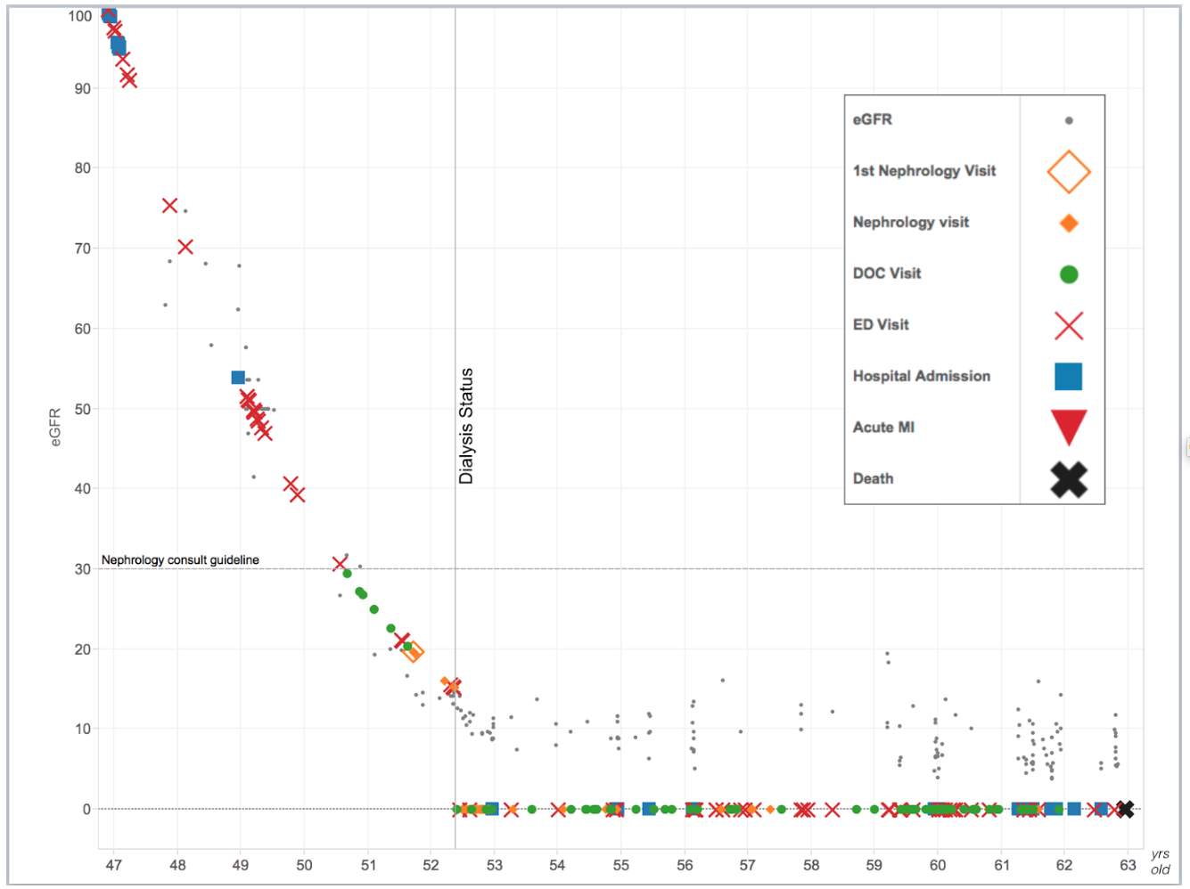
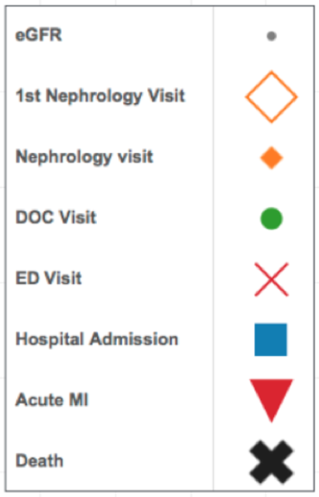
eGFR
Kidney Function
(eGFR)
1st Nephrology Visit
Nephrology Visit
PCP Visit
ED Visit
Hospital Admission
Acute MI
Age
Death
Notes:
I’l start by telling you a story about Bob.
Not his real name of course.
But Bob is a real person.
Bob’s percent kidney function is on the y axis 0-100.
Bob’s age is on the x-axis starting at age 47
The legend over shows the different types of events and medical care Bob receives

Slide 5
Age 47
Untreated diabetes & high blood pressure.
Normal kidney function, but with evidence of kidney damage.
No regular medical care.
eGFR
1st Nephrology Visit
Nephrology Visit
PCP Visit
ED Visit
Hospital Admission
Acute MI
Death
Notes:
Bob first meets Duke health system about 15 years ago at age 47.
Bob shows up at the ED about a half-dozen times, gets a battery of tests.
We collect enough data on Bob to know that he has
Uncontrolled diabetes and HTN
He has normal kidney function but evidence of kidney damage

Slide 6
eGFR
1st Nephrology Visit
Nephrology Visit
PCP Visit
ED Visit
Age 49
Kidney function now 50%
Hospital Admission
Acute MI
Death
Notes:
After a couple of years and visits the ER his kidney function has fallen by half.

Slide 7
eGFR
1st Nephrology Visit
Nephrology Visit
PCP Visit
ED Visit
Hospital Admission
Acute MI
Death
Age 51
Referred to
kidney specialist
Notes:
He finally sees a kidney specialist after 5 consistent years of decline

Slide 8
eGFR
1st Nephrology Visit
Nephrology Visit
PCP Visit
ED Visit
Dialysis Begins
Hospital Admission
Acute MI
Death
Three months later presents to ER with kidney failure symptoms and
“crash starts” dialysis
Notes:
Three months after that visit
Bob starts hemodialysis

Slide 9
eGFR
1st Nephrology Visit
Nephrology Visit
PCP Visit
ED Visit
Dialysis Begins
Hospital Admission
Acute MI
Death
Notes:
He spent 10 years on dialysis and died last year at the age of 63.

Slide 10
eGFR
Missed Opportunities:
To prevent or delay
kidney failure
To prepare for kidney failure
1st Nephrology Visit
Nephrology Visit
PCP Visit
ED Visit
Hospital Admission
Acute MI
Death
Notes:
Bob missed out.
He didn’t get treatment that could have slowed his progression and prolonged his life.
He didn’t get any warning that his life would be turned upside-down.
Nothing to smooth his transition.
But this isn’t just about Bob.
This was a missed opportunity for every taxpayer now footing the bill for all this expensive medical care.

Slide 11

42%
starting dialysis have
no prior nephrology care
Notes:
So we end up in a situation where 42% of incident dialysis patients have no prior nephrology care.
Some of those patients had no prior medical care at all.

Slide 12
  <10% with moderate CKD <50% with severe CKD
  even aware of illness!
Notes:
Where the majority of people with CKD don’t even know they have the disease.
Of course, seeing a kidney specialist is not a guarantee of a smooth transition to dialysis.
Even specialists struggle to predict how fast patients will progress.

Slide 13

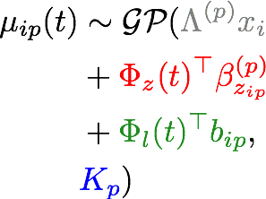
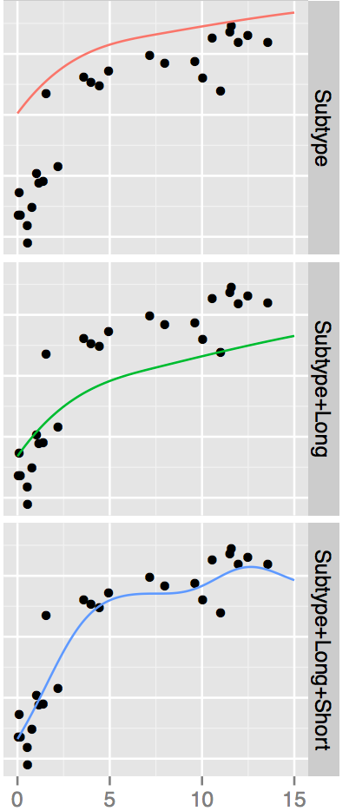
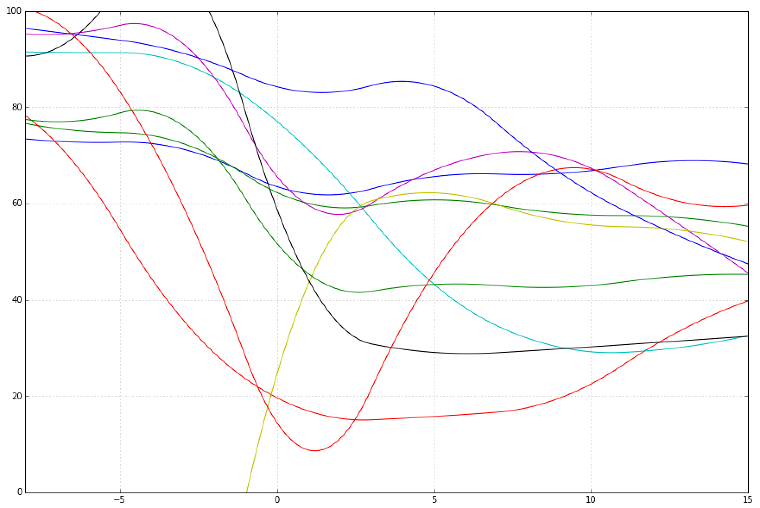
Model for a single trajectory
Population effect
Latent subpopulation curve
Individual long-term deviations
Individual transient deviations (GP)
Curves
per
subtype
Schulam and Saria, NIPS 2015
Notes:
So we’re going to assume that given latent variable for person i, the conditional likelihood factorizes over the variables. So we first need to specify the model for a single trajectory. So we’re going to use a GP model, with a highly structured mean function. The first grey term is a population term that uses baseline covariates. The second red term is a clustering term, assuming that the trajectory for this person’s lab follows a common curve like those shown at bottom left. The green term allows for an individual to adjust this mean function, and the blue term is the explicit GP short-term variations. The figures at right show the effect of these terms to the predicted mean function

Slide 14
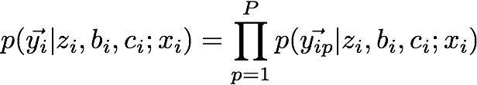
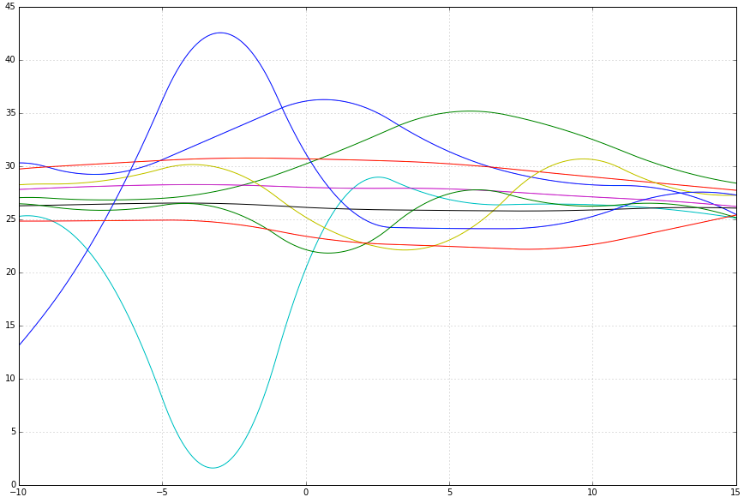


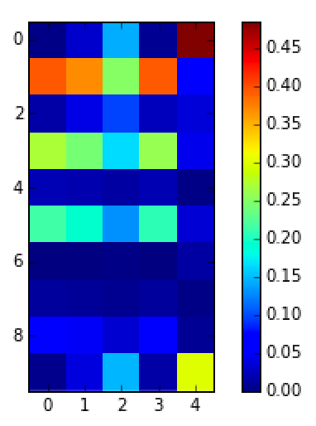
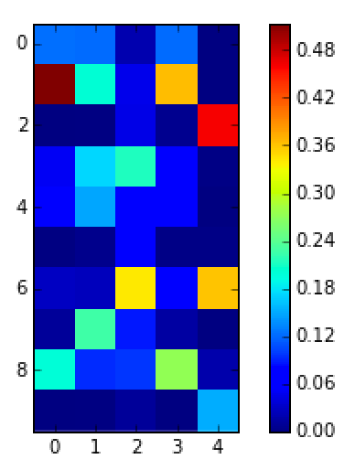
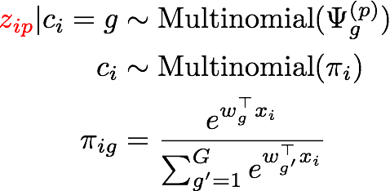



Inducing Dependence
Conditional likelihood factorizes across P labs:
Dependence between mean functions for the P labs in 2 ways:
…
Long-term deviations are correlated
via multivariate normal:
Subtypes/clusters per lab are correlated
via mixture of multinomials:
…
Notes:
So now, we’re going to specify priors that will allow us to learn correlations and induce dependence between the different labs. So we’ll assume that those long-term individual deviations b are correlated via MVN, and the cluster assignments z are correlated via a mixture of multinomials. The c_i is a global cluster assignment that tells which multinomial distribution to draw the corresponding z from

Slide 15
Experimental Setup
6 variables of interest: eGFR, 5 other labs relevant to CKD
Cohort of 44,000 patients at Duke with at least moderate stage CKD (Stage 3+) and 5+ measurements for eGFR
For each test patient: use data before t to predict future labs
Evaluation for each lab:
  average MAE across test patients, in future time windows
  Baseline: [Schulam & Saria, 2015] trained independently
Notes:
To evaluate our approach we use a dataset 6 variables - kidney function + 5 labs relevant to CKD, for a cohort of 44k CKD patients at Duke. After training the model using stochastic variational inference, for each test patient we use all their labs up until a cutoff time to predict held-out labs in the future. We evaluate by taking the mean absolute error for each test patient in future time bins and averaging over test patients. As a baseline we use the model for a single trajectory from 2 slides ago, trained independently to each variable.

Slide 16
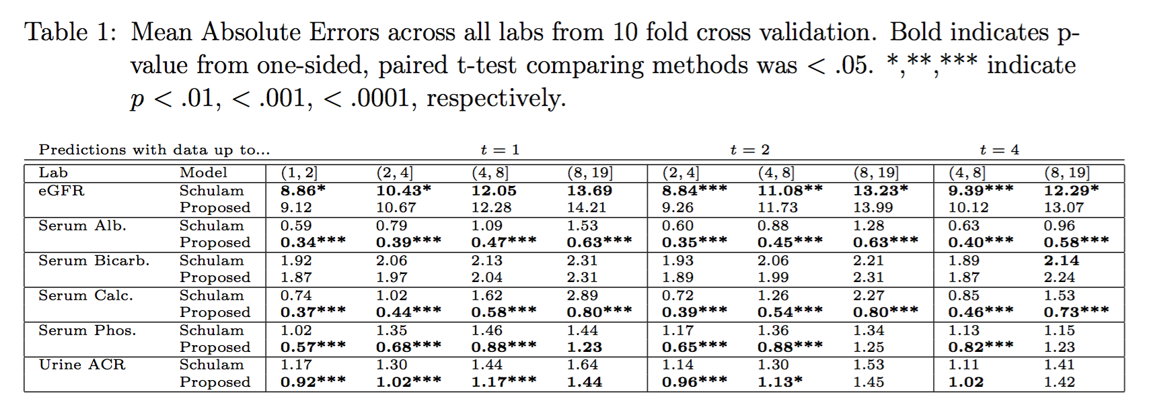
Quantitative Results
Notes:
This table shows the results. Each row shows error for each lab, for our method and the baseline; bold or lower is better. Columns show errors in future time windows. The t=1, for instance, indicates the results for using data up until t=1 for test patients to then make predictions for future labs between t=1 to 2, 2 to 4, 4 to 8, etc. Overall, our method performs better for those labs that tend to have higher degrees of missingness, because our method leverages correlations between labs while the comparator can only use baseline covariates.

Slide 17
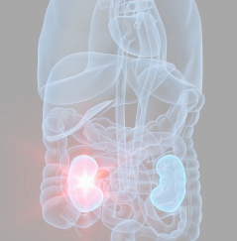
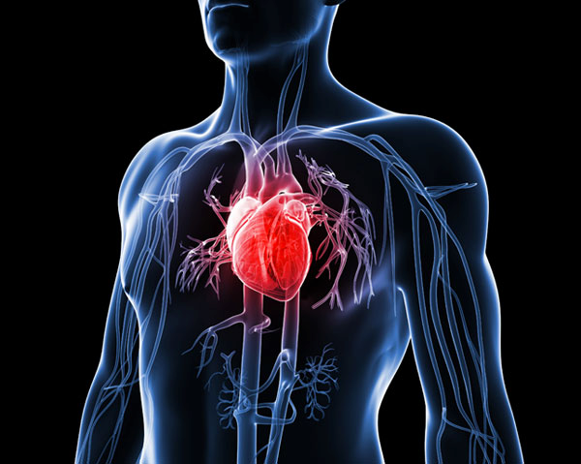
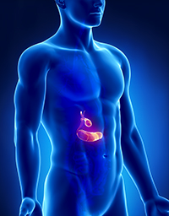
Chronic Kidney Disease (CKD)
Heart disease
Diabetes

Slide 18
Proposed Joint Model
Goal: Jointly model risk of future loss of kidney function and cardiac events.
Hierarchical latent variable model captures dependencies between disease trajectory and event risk
Conditional independence in joint likelihood:
where y are eGFR values at times t, u are event times, and x are covariates

Slide 19
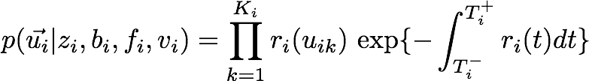
Point Process Submodel
Poisson process model with conditional likelihood on events:
Rate function -- hazard funtion in Cox proportional hazards model:
piecewise constant
baseline rate
coefficient
vector
baseline
covariates
association between
event risk and
expected mean/slope
of eGFR
random effect
(frailty term):

Slide 20
Data
23,450 patients with moderate stage CKD and 10+ eGFR readings
  CKD definition: 2 eGFR readings < 60mL/min, separated by 90+ days
Preprocessing: mean in monthly bins
  eGFR only valid estimate of kidney function at steady state
  22.9 readings on average (std. dev. 13.6, median 19.0)
  Alignment: set t=0 to be first eGFR reading < 60mL/min
Adverse events: AMI, CVA identified using ICD9 codes. Max 1 event / month
  13.4% had 1+ CVA code (mean w/ 1+: 4.1, std dev: 7.1, median: 2.0)
  17.4% had 1+ AMI code (mean w/ 1+: 6.4, std dev: 13.3, median: 3.0)
Baseline covariates: baseline age, race, gender; hypertension, diabetes

Slide 21
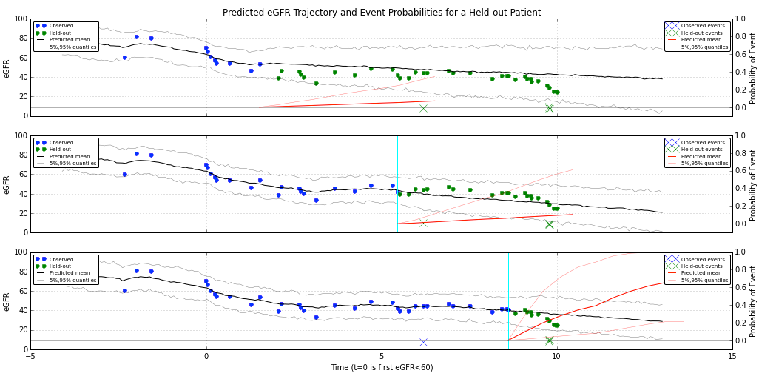
Joint Model Results

Slide 22
Sepsis

Slide 23
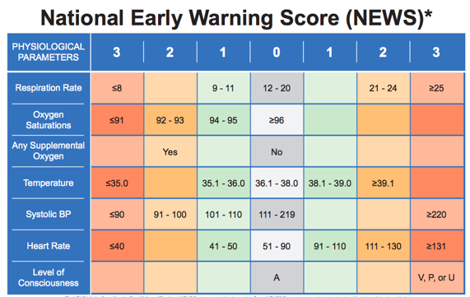
Previous Methods
Early Warning Scores in widespread use
  Duke uses NEWS
  Overly simplistic
(Henry, Hager, Pronovost, Saria; Science Translational Medicine 2015) use
Cox regression to predict time to septic shock, using 54 potential features

Slide 24


Gaussian Processes for Irregularly Sampled Time Series
Classify time series with sparse and irregular sampling, observed on common time interval [0,T]
Observation times t, Observation values v, Reference times x
Represent a time series by its marginal posterior at x:
Use a GP regression with zero-mean, parameters (kernel, noise)
z is random, so use expected loss w.r.t GP posterior:
Learn GP parameters and classifier parameters end-to-end
  Reparameterization trick to get gradients of the expectation
  Approximate intractable expectations with a few Monte Carlo samples
  Conjugate gradient to compute GP means and covariances
  Lanczos method to efficiently draw samples from a (large) normal from the GP (can backprop through this)
(Cheng-Xian Li, Marlin NIPS 2016)

Slide 25
Sepsis with a Multitask GP RNN
Similar setup, but now multivariate (M=31) time series, with highly variable lengths (many < 12 hours, some > 10 days)
Goal: use clinical time series, baseline covariates, times of medications to predict sepsis
New mean which depends on medications p
GP kernel now defines covariances amongst m:
RNN (LSTM with several layers) classifier

Slide 26
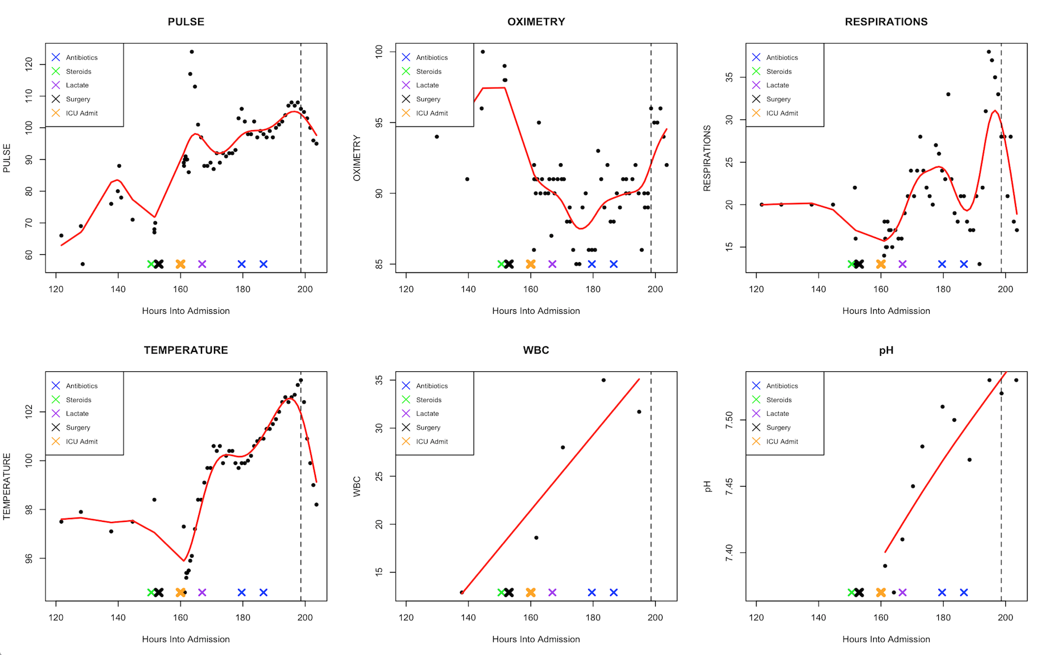

Slide 28
Data
52,000 inpatient encounters for training (all data from 18 months). 14,000 for testing (6 months of future data)
31 longitudinal variables (6 vitals, 25 labs)
36 baseline covariates (29 comorbidity indicators; 6 demographic / admission info)
8 medication classes
Mean length of stay 121 hours (sd: 108)

Slide 29
Results

Slide 30
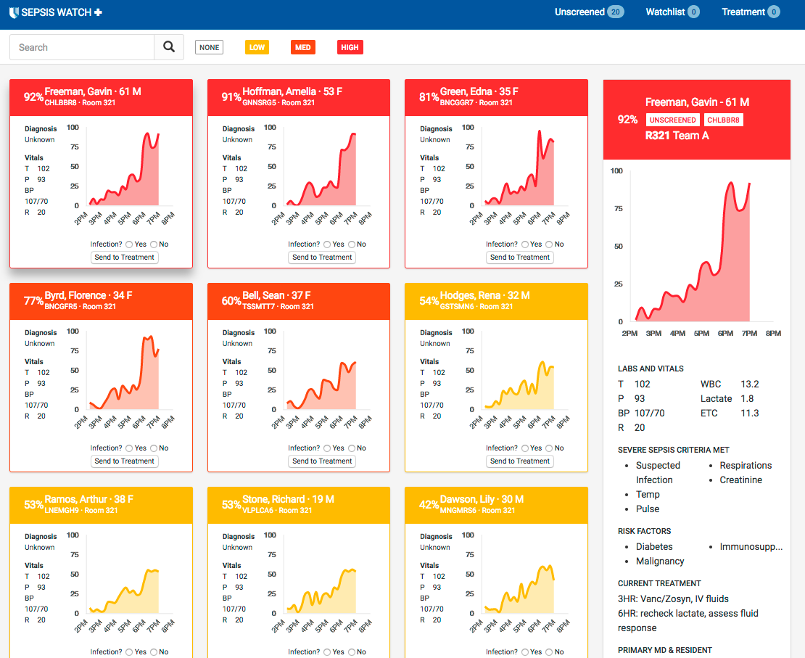

Slide 31
Surgery

Slide 32


Slide 33
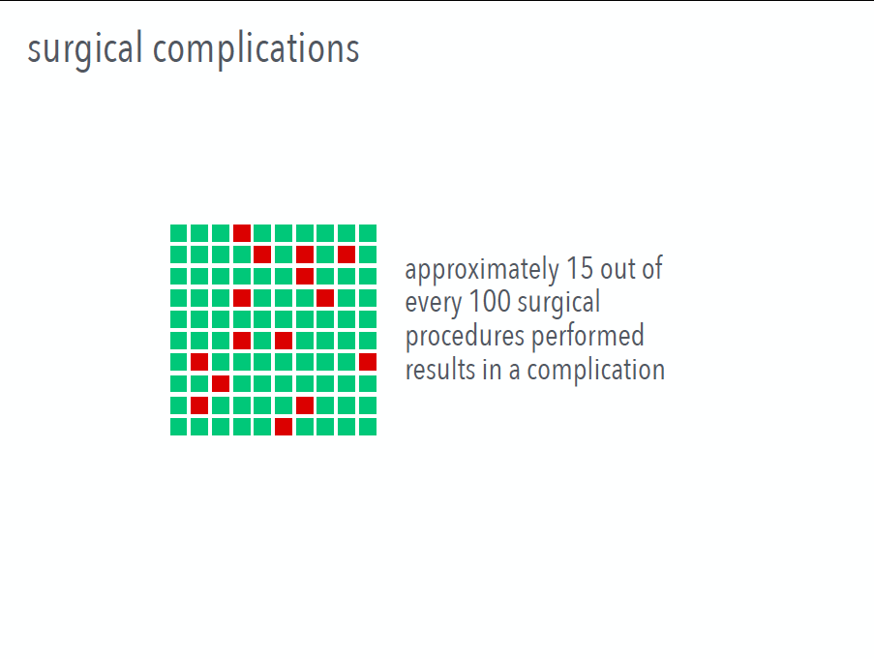

Slide 34
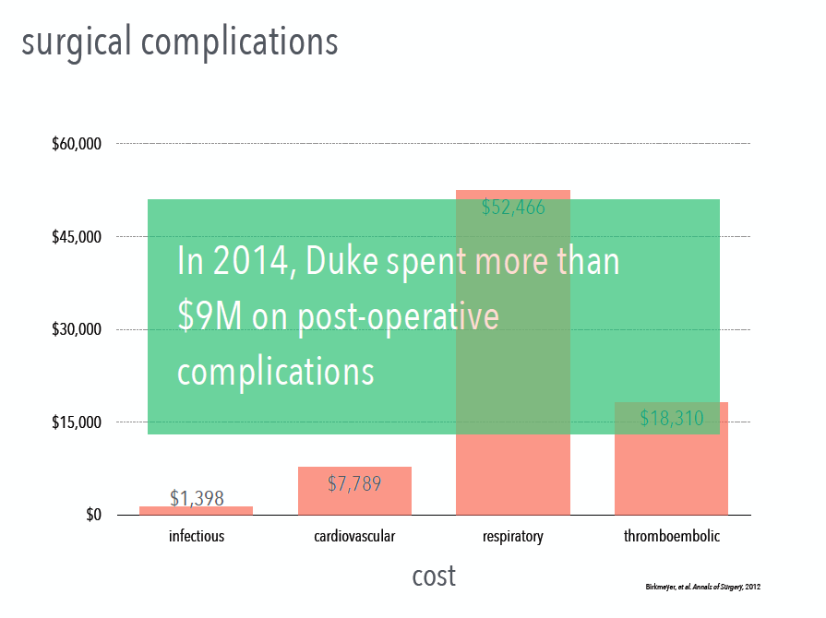

Slide 35


Slide 36
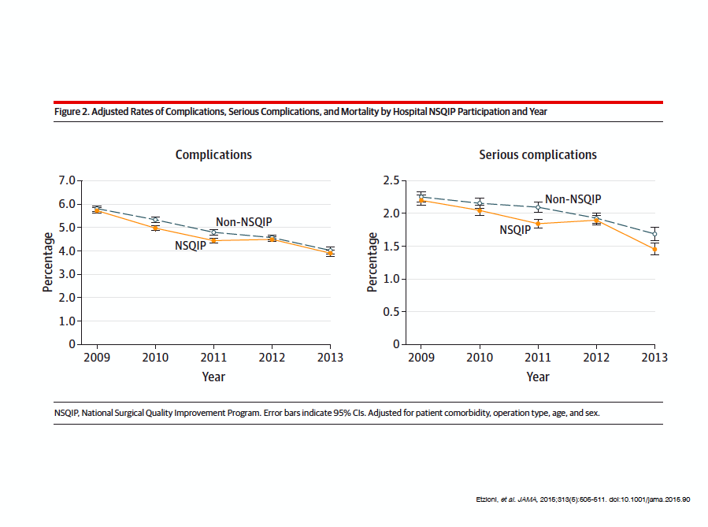

Slide 37
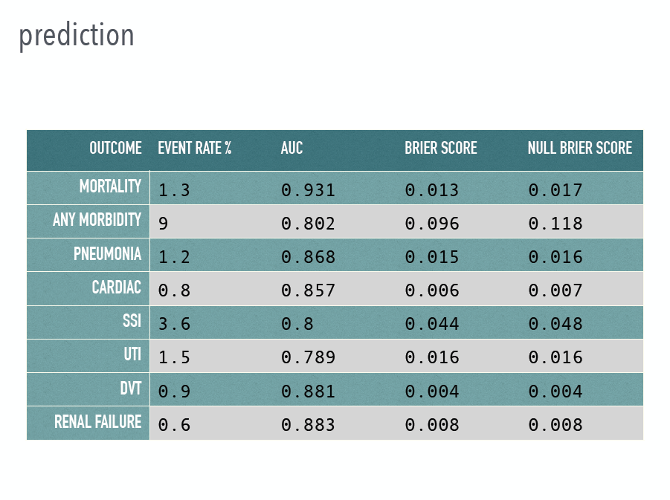

Slide 38
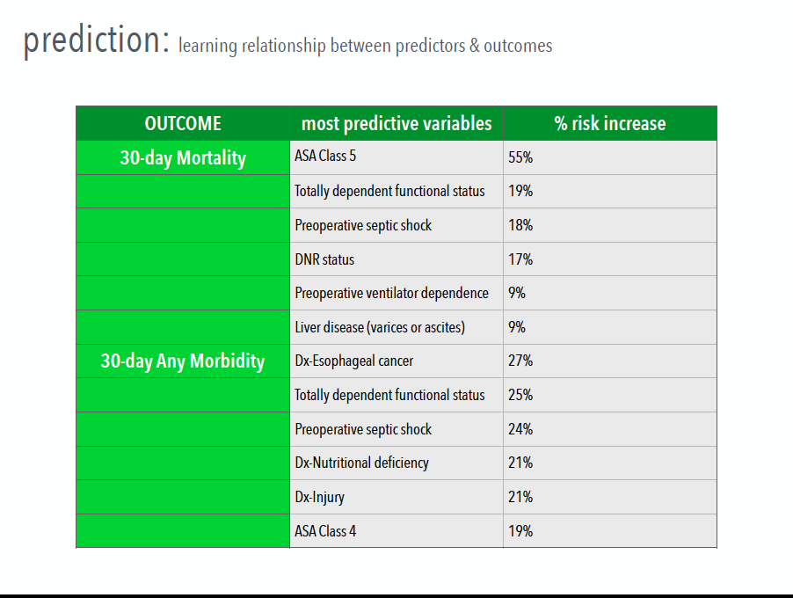

Slide 39


Slide 40
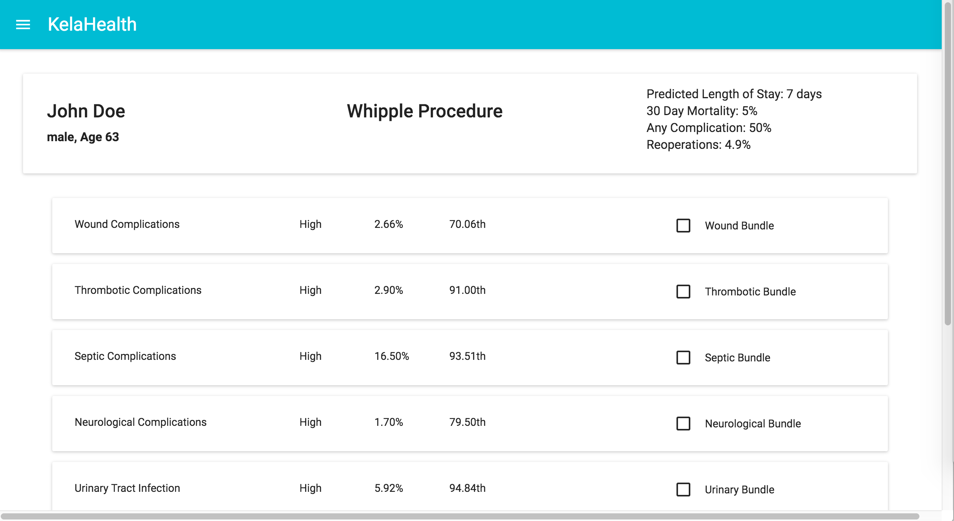

Slide 41
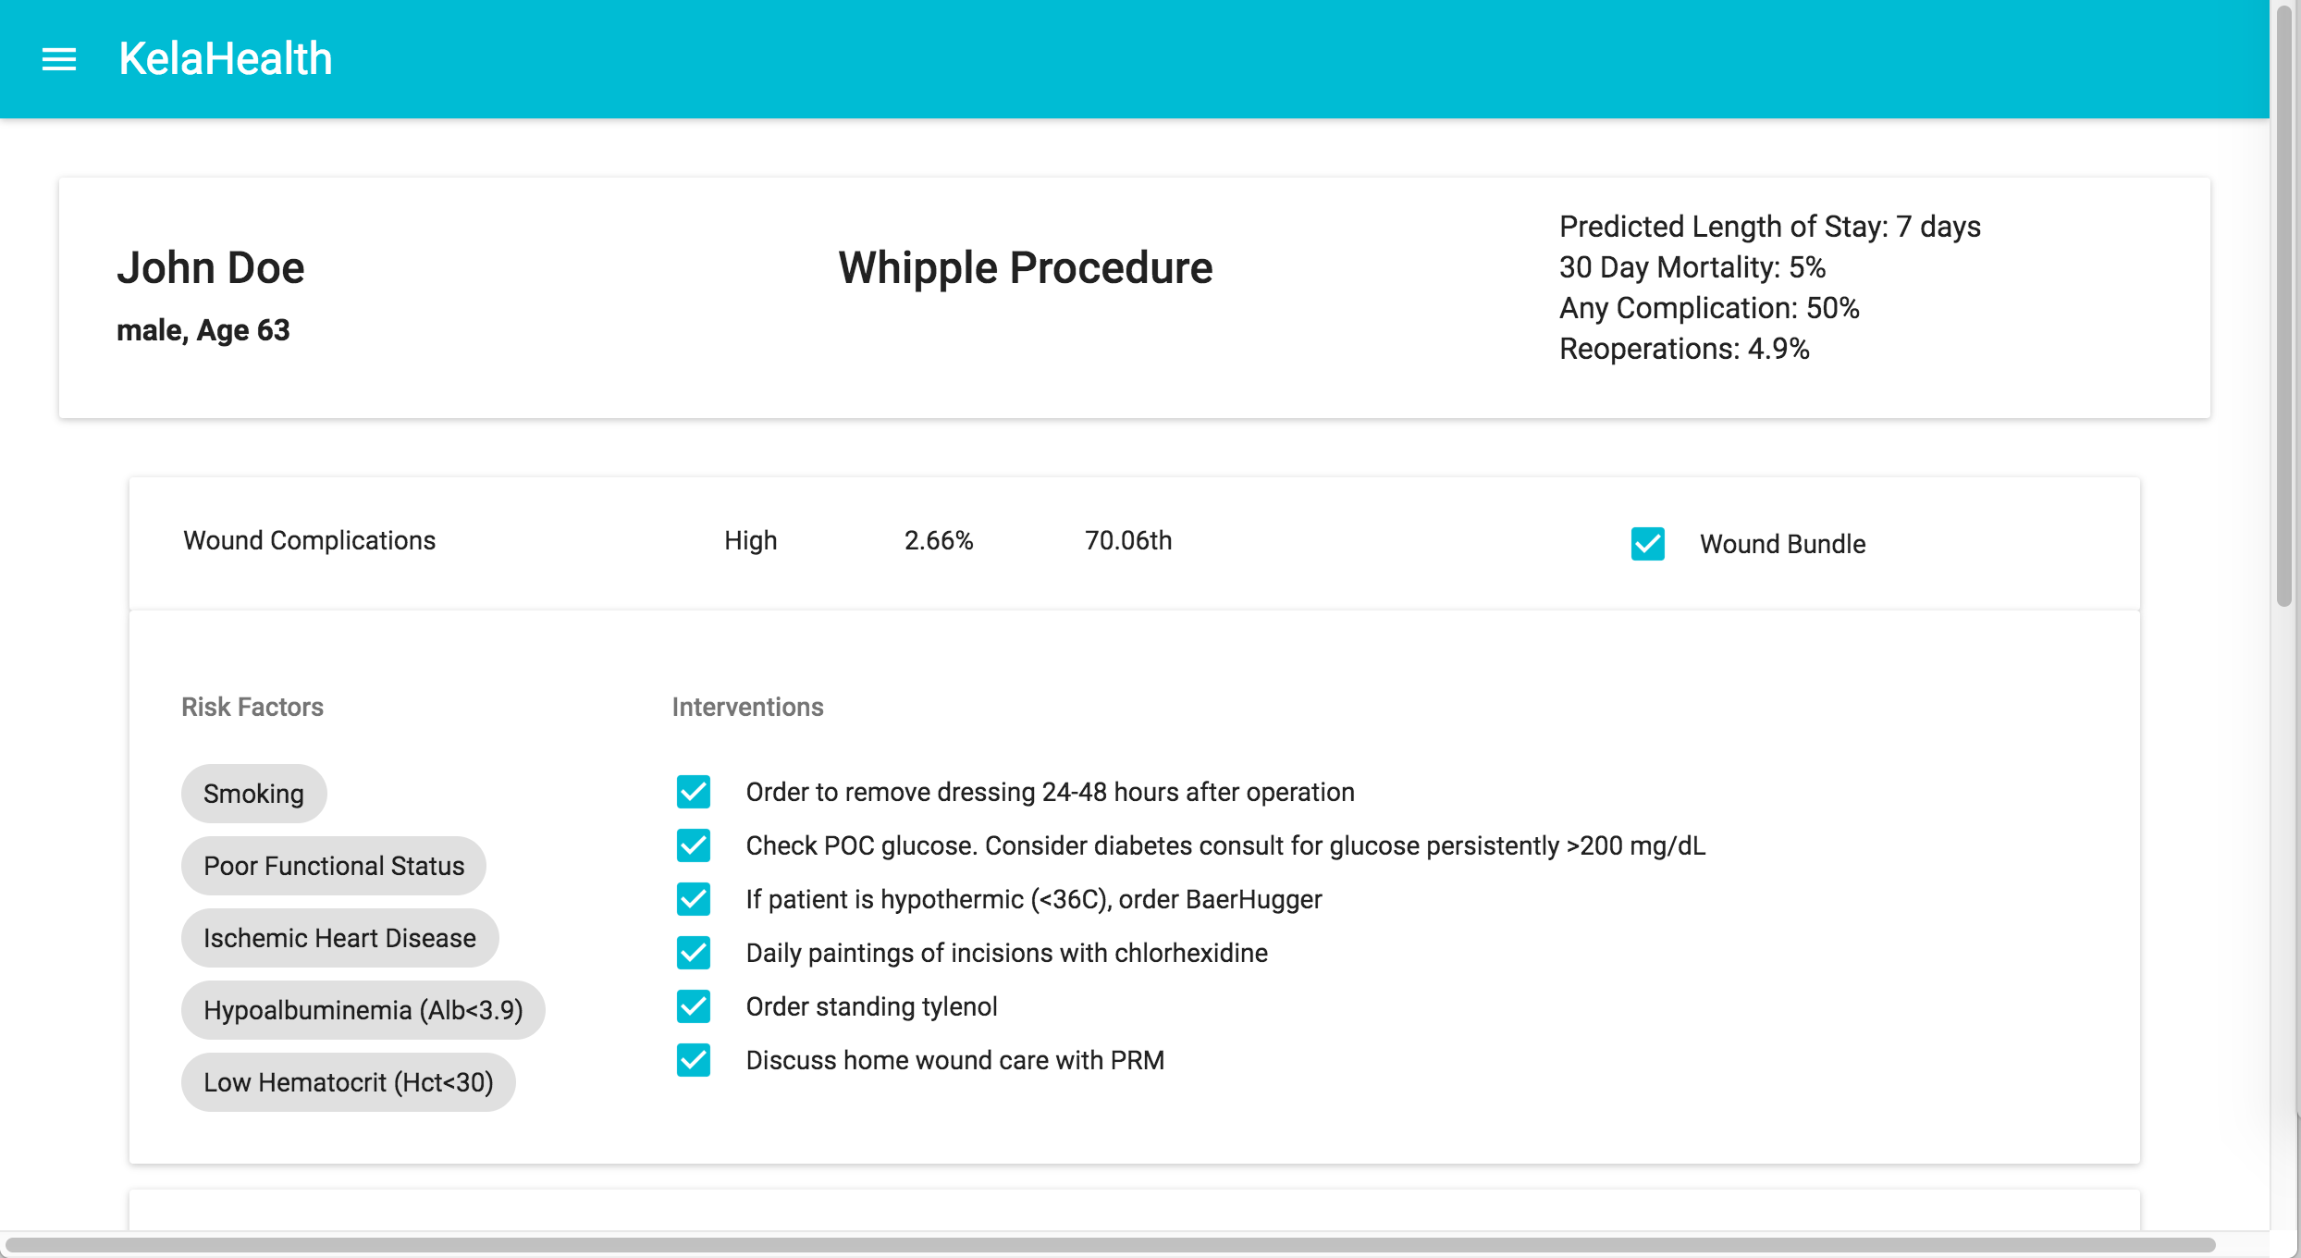

Slide 42
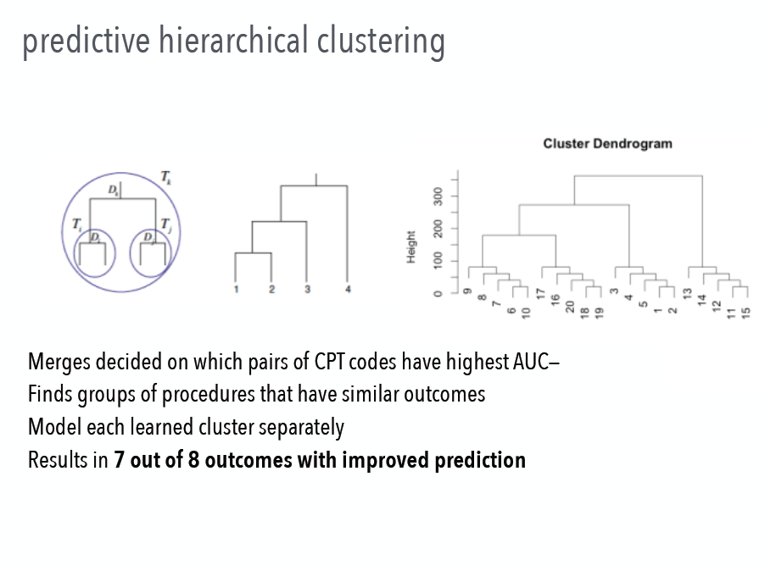

Slide 43
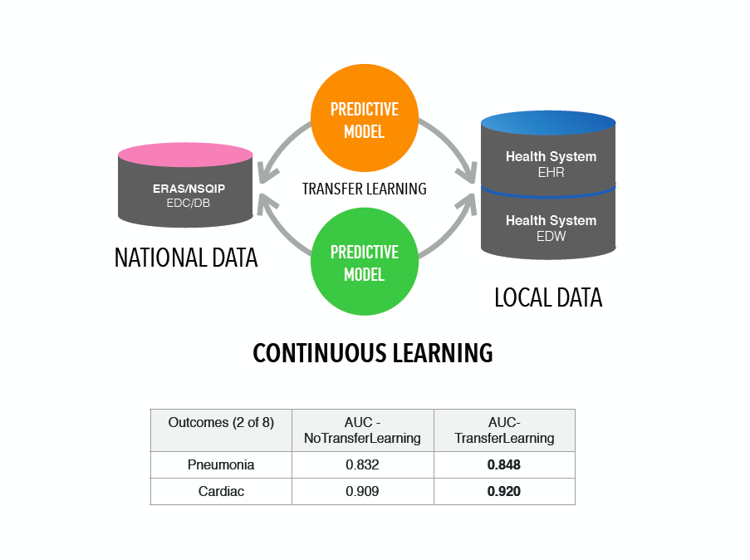
Hierarchical Infinite Factor Model
Speeding up:
Stochastic
Gradient
Nose-Hoover
Thermostats
Sampling

Slide 44
Pre-operative Framework
Preoperative Assessment: Phone/PAT/POET/POSH
Surgery Scheduled
Preoperative Care
Standard Care
Data pulls every 24 hours
LOW
Phone Screen
Machine Learning RISK PREDICTION
(MODEL 1)
Machine Learning
RISK PREDICTION
(MODEL 2)
EPIC
Clarity
INTERMEDIATE
PAT*
HIGH
POET**
Optimization
Interventions
* PAT: Pre-operative Anesthesia Testing
** POET: Peri-Operative Enhancement Team
*** POSH: Perioperative Optimization of Senior Health
POSH***

Slide 45
Infectious Disease

Slide 46
Infection in a Social Network
Goal: To model dynamical interactions between agents in a social network and apply to inferring the spread of infection.
Many traditional epidemics models work on a population level, treating each person the same way.
Contemporary data collection techniques allow us to model the spread of infection on an individual level.
Being able to make infection predictions on an individual level is enormously beneficial because it allows people to receive more personalized and relevant health advice.

Slide 47
Social Evolution Experiment
Data collected in the social evolution experiment allows us for the first time to closely track proximities and contagion in an entire community over a substantial period of time.
Tracked “common cold” symptoms in an MIT residence hall from January to April 2009.
Monitored over 80% of residents through their cell phones from October 2008 to May 2009, taking daily surveys and tracking their location, proximities and phone calls.
Monthly surveys on social, health, and political issues taken. Locations taken by having cell phones scan nearby wifi access points and bluetooth devices.

Slide 48
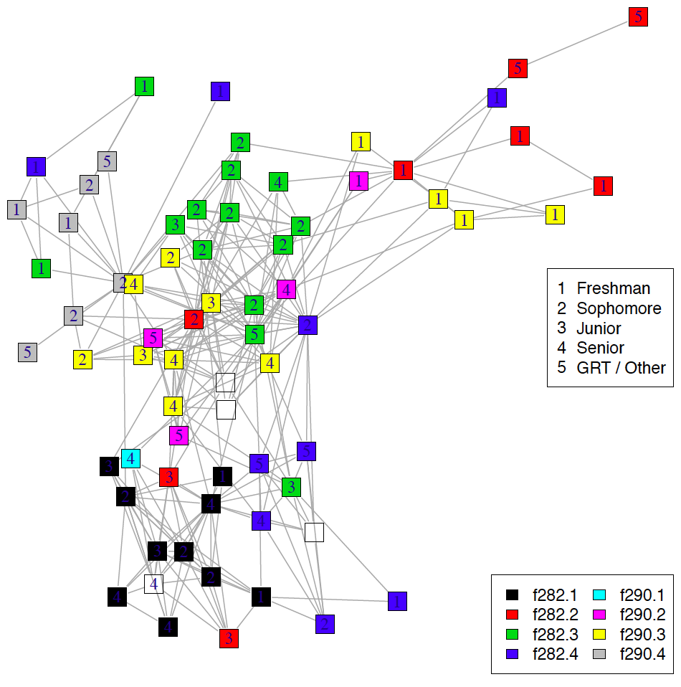
Student Hall Network

Slide 49
Health Surveys
In the Social Evolution experiment students were paid $1 a day to answer surveys about contracting infection.
The surveys asked about symptoms:
  Runny nose, nasal congestion, sneezing
  Nausea, vomiting, diarrhea
  Stress
  Sadness and depression
  Fever
64 of the 85 residents answered the surveys
Symptoms dependent on the social network. A student with a symptom had a 3-10x higher odds of having a friend with the same symptom.

Slide 50


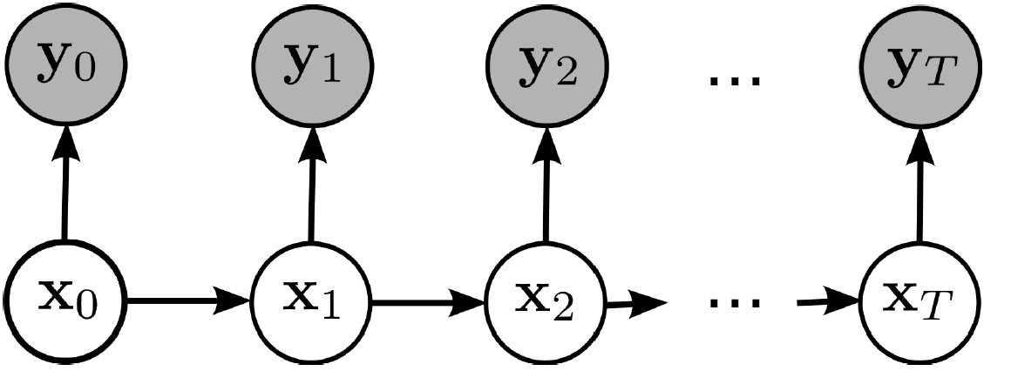
Hidden Markov Models
We aim to leverage the social evolution data to predict the spread of infection to individuals in our social network using a model related to HMMs.

Slide 51
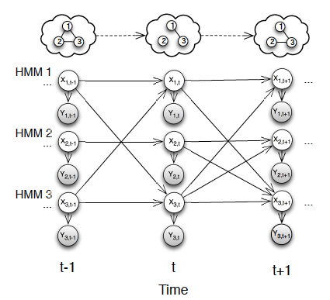
Graph-coupled HMMs
Associate each person in the dynamic interaction network with an HMM chain. Let interaction network structure determine the HMM couplings:

Slide 52
GCHMM Inference
Inference in the coupled HMM is very hard.
  Typically ML estimation is done on few chains with few states or another approximation is made.
In the worst case GCHMM inference is as difficult as CHMM inference.
  When the graph is fully connected.
Fortunately, since we’re dealing with social networks we can leverage a couple of properties:
  Social networks are usually sparse
  For many applications the influence of interactions can be modeled in a fairly simple way via a small number of parameters.

Slide 53


GCHMMs for Modeling Infection
In the case of the social evolution data the influence of other HMMs can be summarized by counts of interactions in the infectious state.
The GCHMM can provide an individual level version of the susceptible-infectious-susceptible (SIS) epidemiology model:
GCHMM for infection:

Slide 54
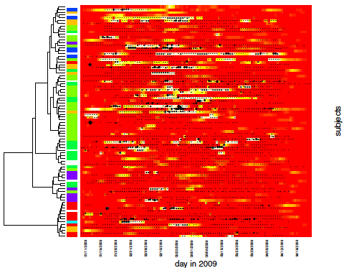
Experimental Results
Dong et al, UAI 2012

Slide 55
Aiello Group Data
eX-FLU study at University of Michigan
  590 students from 6 dorms
  Chain referral scheme
A 103 student subset participated in iEpi
  Smartphone based study where location is tracked and surveys taken
Unlike MIT study confirmation of interaction was recorded on phones and flu testing was done on students who reported being ill.
Also an isolation intervention was tested.

Slide 56
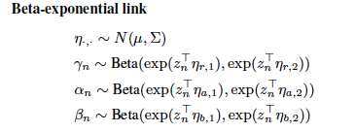

Hierarchical GCHMMs
Add a hierarchical level to where beta distributed infection parameters are learned:
Inference Gibbs-EM algorithm but follow up papers e.g. stochastic VB

Slide 57
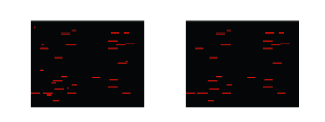
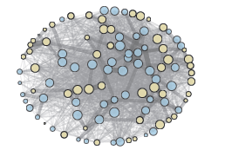

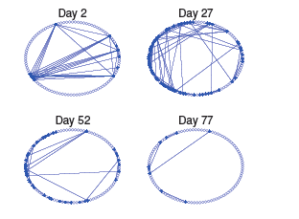
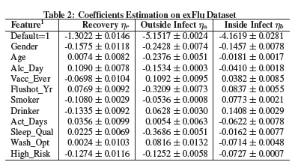
Results
Fan et al, KDD 2016

Slide 58
Multiple Sclerosis

Slide 59

Initial Focus
Chaotic symptoms
Twenty-two non-pathognomonic symptoms
Onset, duration, and severity do not clarify etiology
How can we monitor this continuously to start making sense of it?
Notes:
Our initial focus will be one of the most distressing issues to MSers: seemingly chaotic symptoms. Twenty-two non-specific non-pathognomonic symptoms are seen with MS, ranging from generalized fatigue and cognitive changes to focal sensory changes and walking instability.
Each symptom or collection of symptoms can be affected by active relapse or recrudescence from a silent relapse, medication/toxic effects, temperature change, stress, sleep deprivation, or biorhythm.
So we had to ask…
How can we monitor this continuously to find the patterns in these fragmented symptoms?

Slide 60

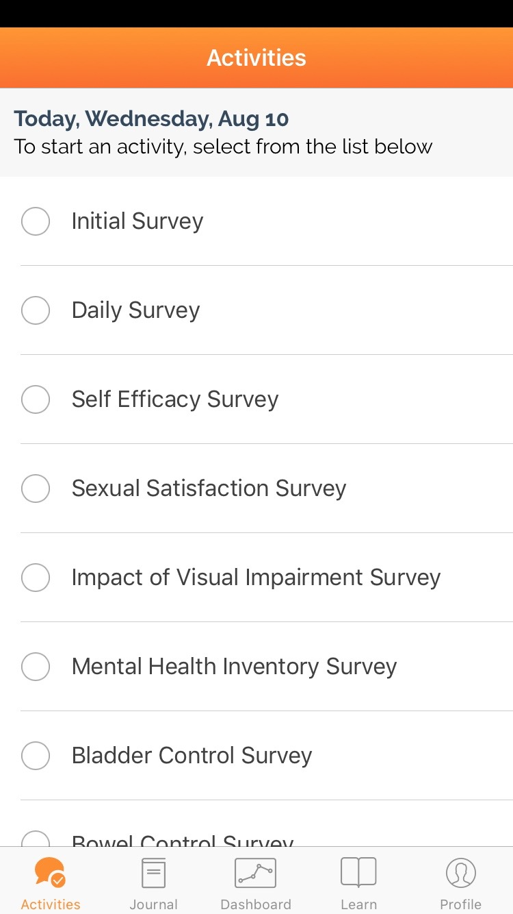

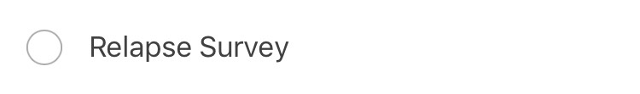
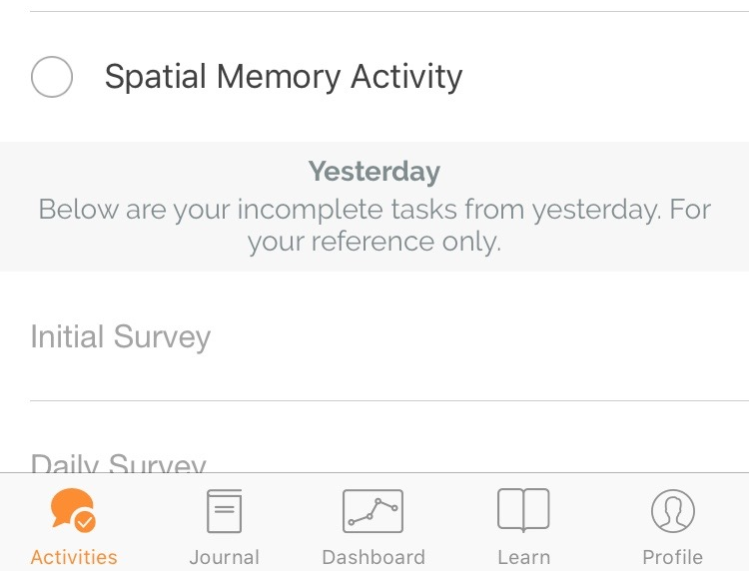
MS Mosaic App
  Embedded Consent
  Disease History Survey
  Daily Symptom & Medication Survey (customized)
  Exportable Relapse Survey
  Five Activities
Notes:
So we developed an app. The app walks them through the consent process and then obtains some preliminary information on disease history
— Year and age at diagnosis, MS type, the diagnostic studies used to make, state of birth, # of relapses, family history, co-morbidities.
The daily symptom and medication survey then prompts the user to report
— Monitor all 22 common symptoms in multiple sclerosis
— Monitor all current medications (pre-populated with 80 medications commonly used in MS and ability to add ones not pre-populated)
— Relapse data
— Five prompted tasks useful for MS monitoring (evaluate spatial memory; auditory processing, cognitive flexibility, and mental calculation; walking stability; rapid alternating movements and fatiguability; coordination)

Slide 61
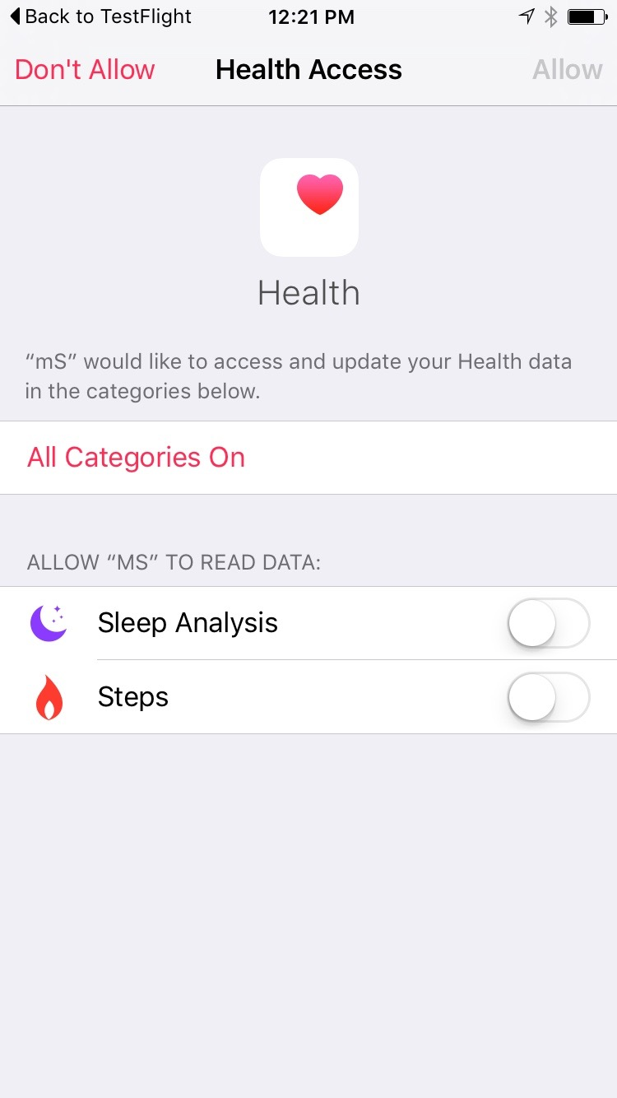








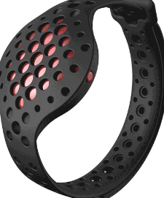


MS Mosaic App
  Passively collects HealthKit data
  82 Different Data Types (>10 thought to affect MS)
  Tagged with date, time, and provenance
Notes:
Data types that are of interest in multiple sclerosis (at least 13): BMI, Weight, Height, electrodermal activity, UV index, steps, workouts, dietary energy, biotin, vitamin D, body temperature, heart rate, sleep analysis

Slide 62

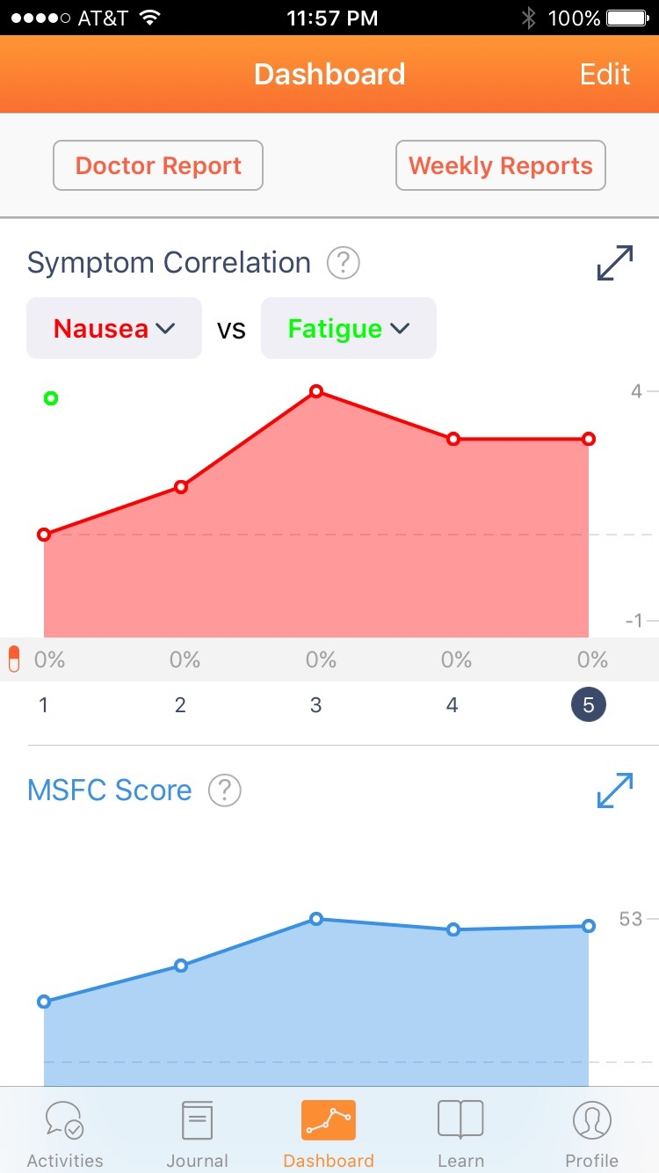
  Single notification
  Each day’s survey will take no more than 1 minute to complete
  Weekly tasks no more than 5 minutes
Notes:
Features immediately useful to participants

Slide 63

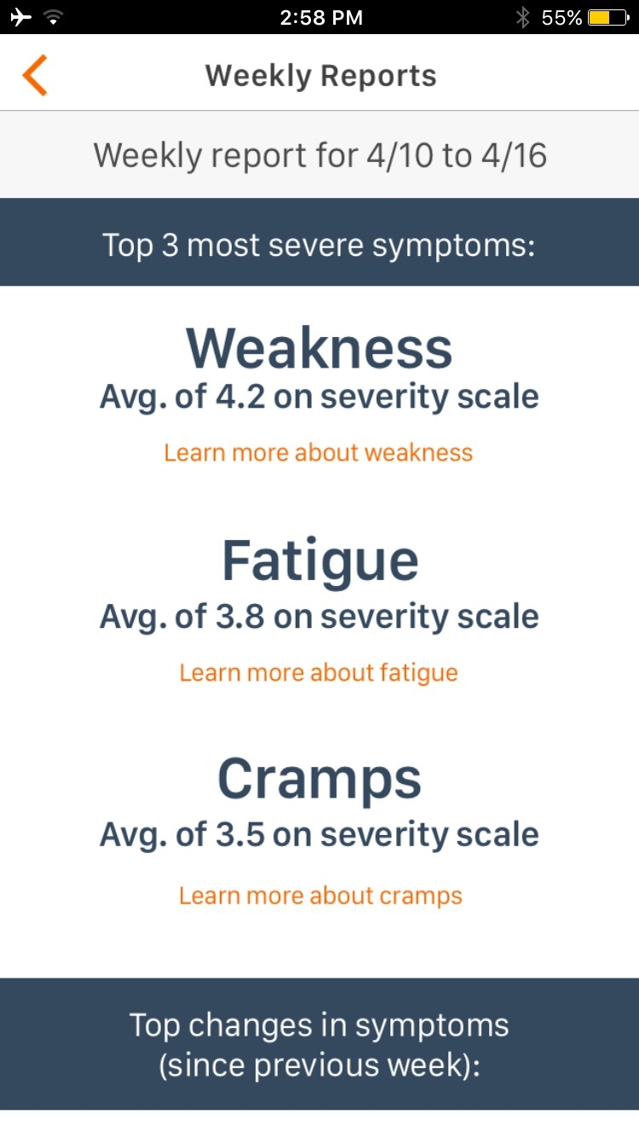
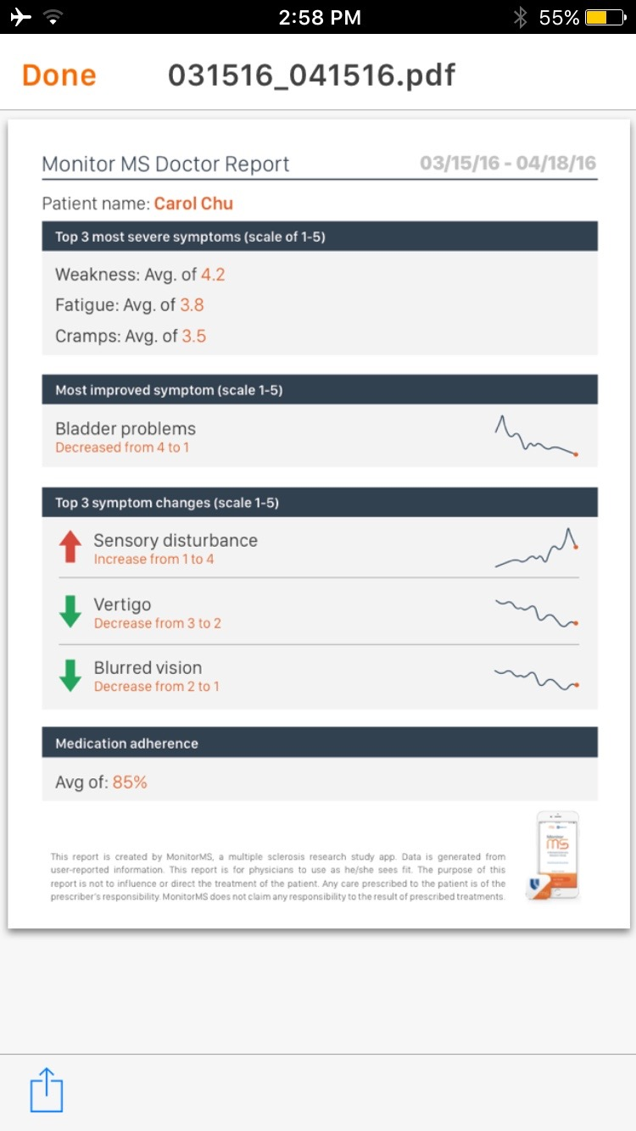
Notes:
Feedback through journal review (ability to supplement each day’s entry with free text), weekly check-in on their symptoms, and a provider report
Provider Reports
Summarize events between clinic visits
Facilitates communication during clinical encounters
Exportable PDF for EMR

Slide 64

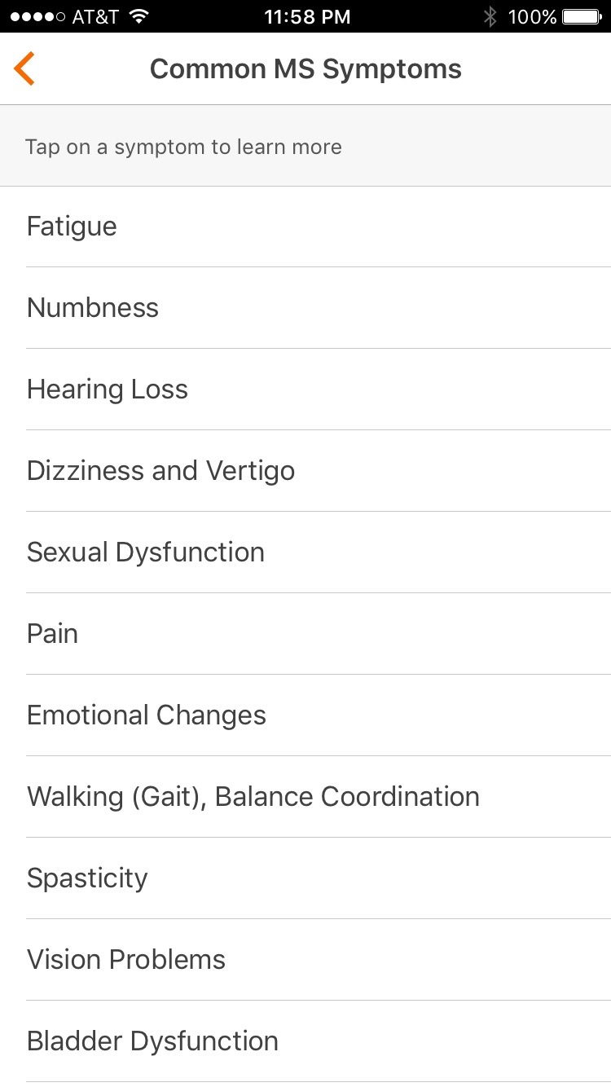
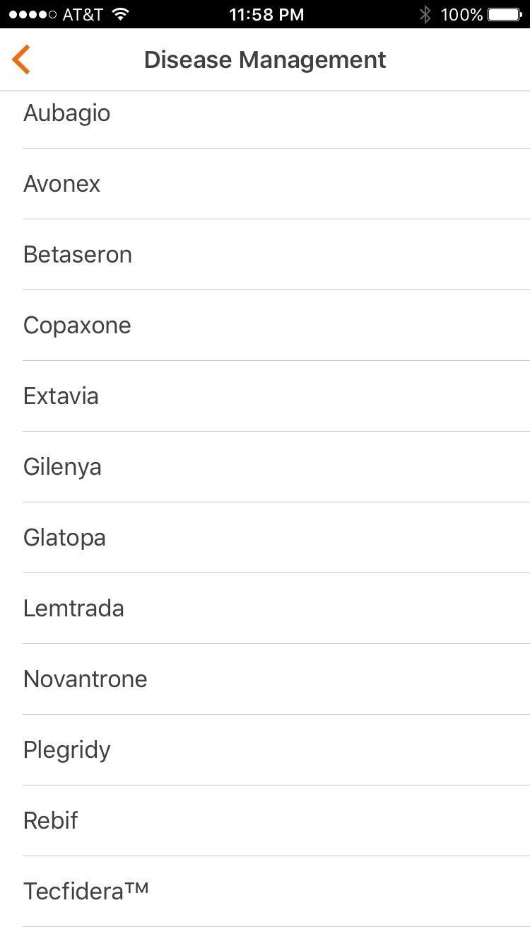
Notes:
Lastly, we have the app’s learn section, where users have direct access to more than 16,000 pages of curated content

Slide 65
Initial Analyses
Develop a sparse logistic regression model for predicting the likelihood of each symptom experience
Incorporate a hierarchical layer based on Gaussian processes for modeling time series data (e.g. sleep)
Discover hidden subpopulations within symptoms (using clustering methodology, such as Dirichlet Process mixture models)
Evaluate the efficacy of symptom interventions using longitudinal models and clinical trials
Notes:
— Develop a sparse logistic regression model for predicting whether patients are likely to experience a particular symptom in the future.
— Incorporate a hierarchical layer, based on Gaussian Processes for modeling time series data, such as data from sleep or activity trackers.
— Use clustering methodology, such as Dirichlet Process mixture models, to discover hidden subpopulations of MS patients. For example, a patient might experience fatigue because they’re not getting enough sleep, they’re depressed, or the underlying cause is their MS.
— Evaluate the efficacy of symptom interventions and disease modifying drugs using longitudinal models and clinical trials.

Slide 66
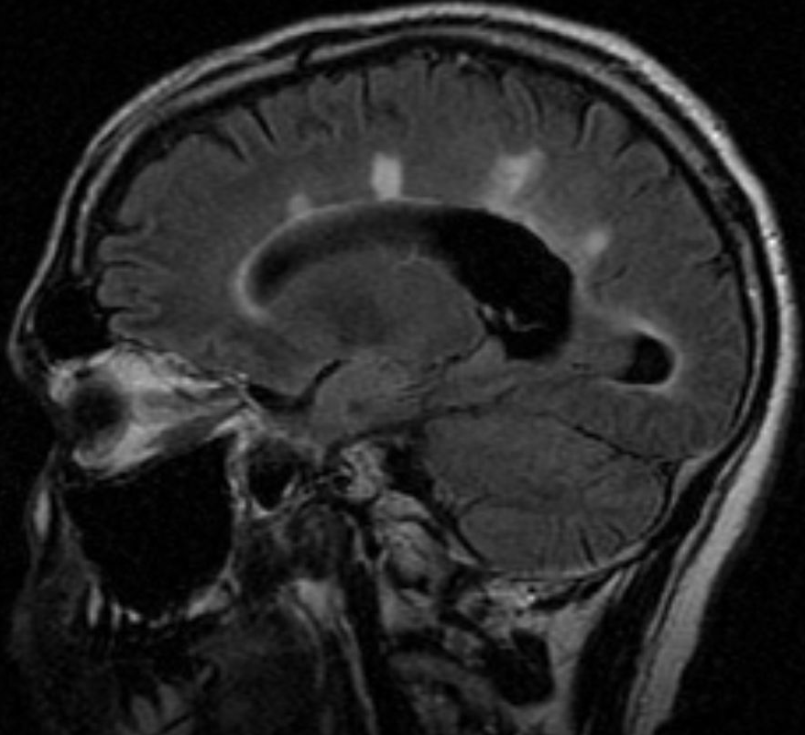
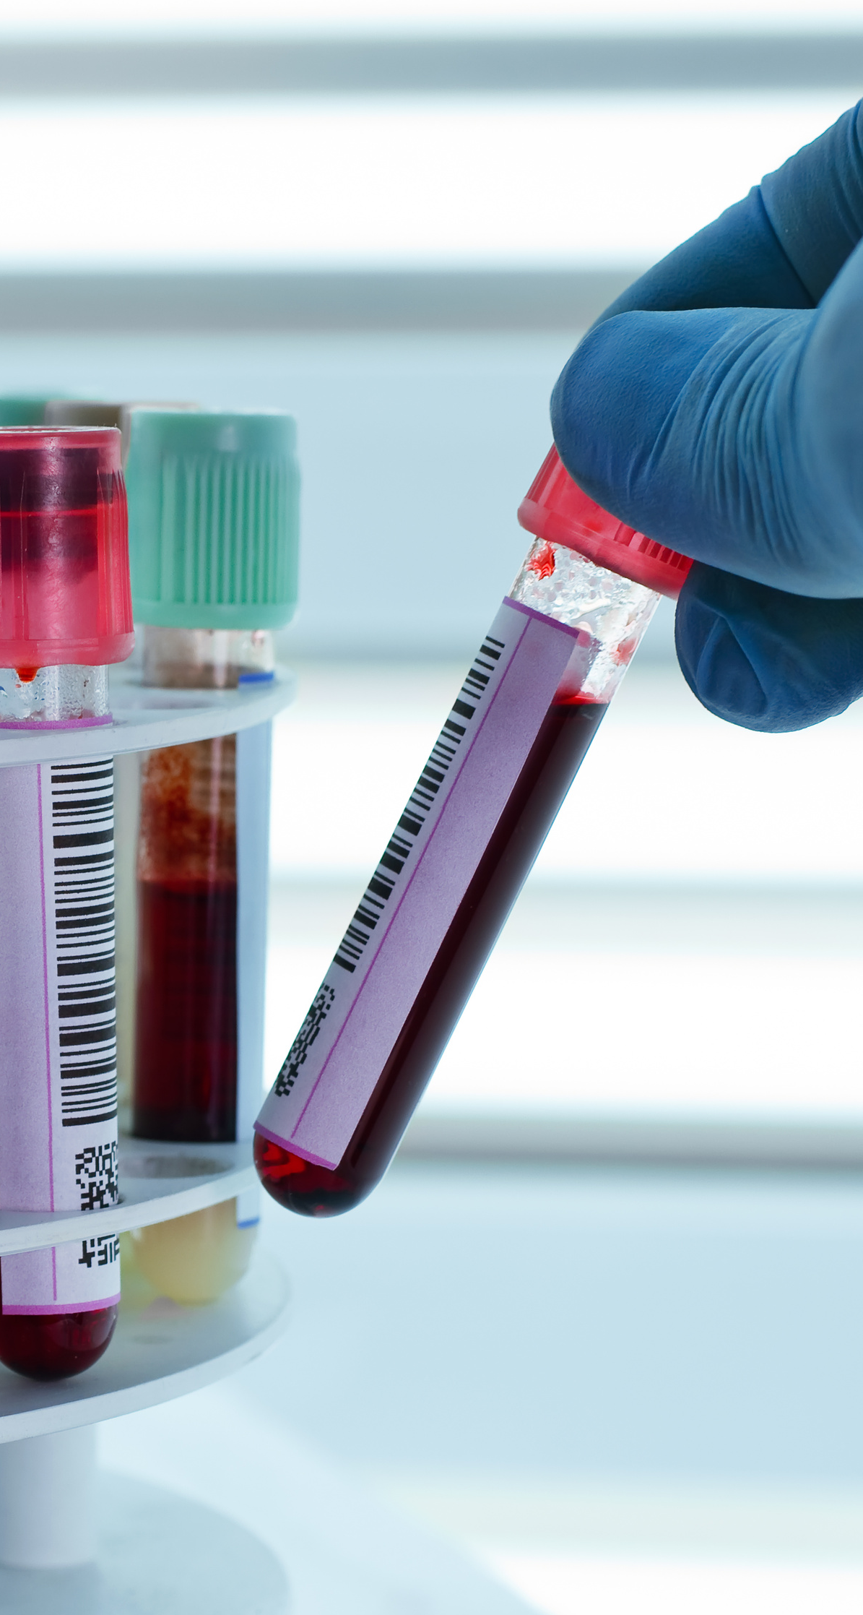
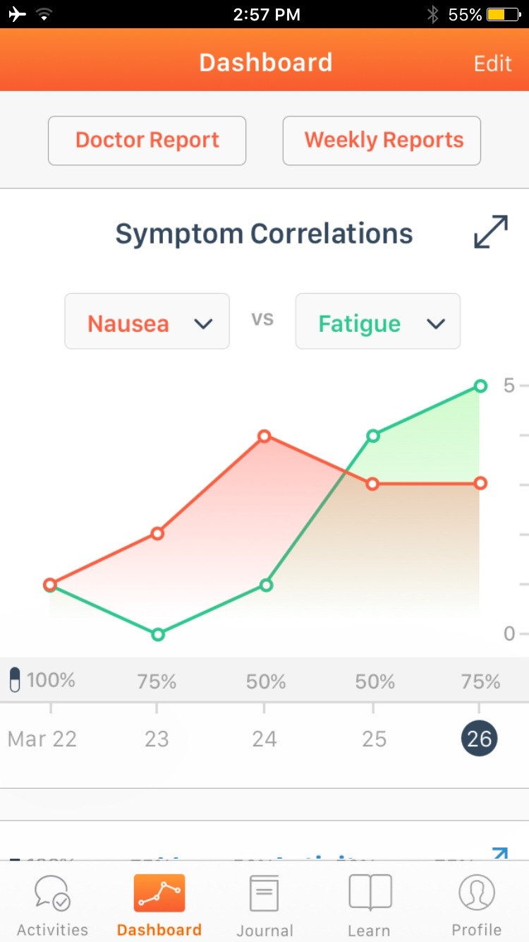

Planned Dataset Evolution
MRI Sub-study
(Duke Pilot)
Symptom sub-study
v1.0 - 4.0
Road-mapped
“Omics” Sub-study
(Duke Pilot)

Slide 67



Thanks!
Sepsis
CKD
Surgery
Influenza
Joe Futoma
Sanjay Hariharan
Cara O’Brien
Blake Cameron
Mark Sendak
Armando Bedhoya
Liz Lorenzi
Erich Huang
Jeff Sun
Sandhya Lagoo
Mitch Heflin
Madhav Swaminathan
Ouwen Huang
Kai Fan
Allison Aiello
Sandy Pentland
Wen Dong
Multiple Sclerosis: Lee Hartsell

