Slide 1
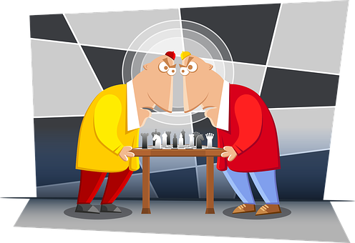
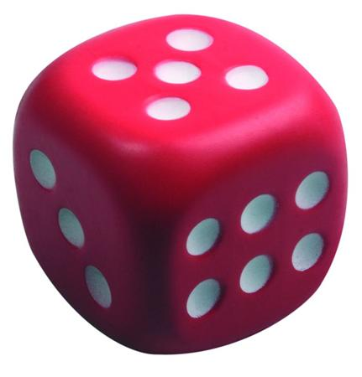
Positional Games and Randomness
Michael Krivelevich
Tel Aviv University

Slide 2
Main goal
To discuss:
positional games, Maker-Breaker games
(multiple and fruitful) connections between positional games and randomness
manifestations and uses of randomness in positional games
Disclaimer:
- not a systematic introduction to positional games;
- choice of topics/results to present is rather subjective

Slide 3
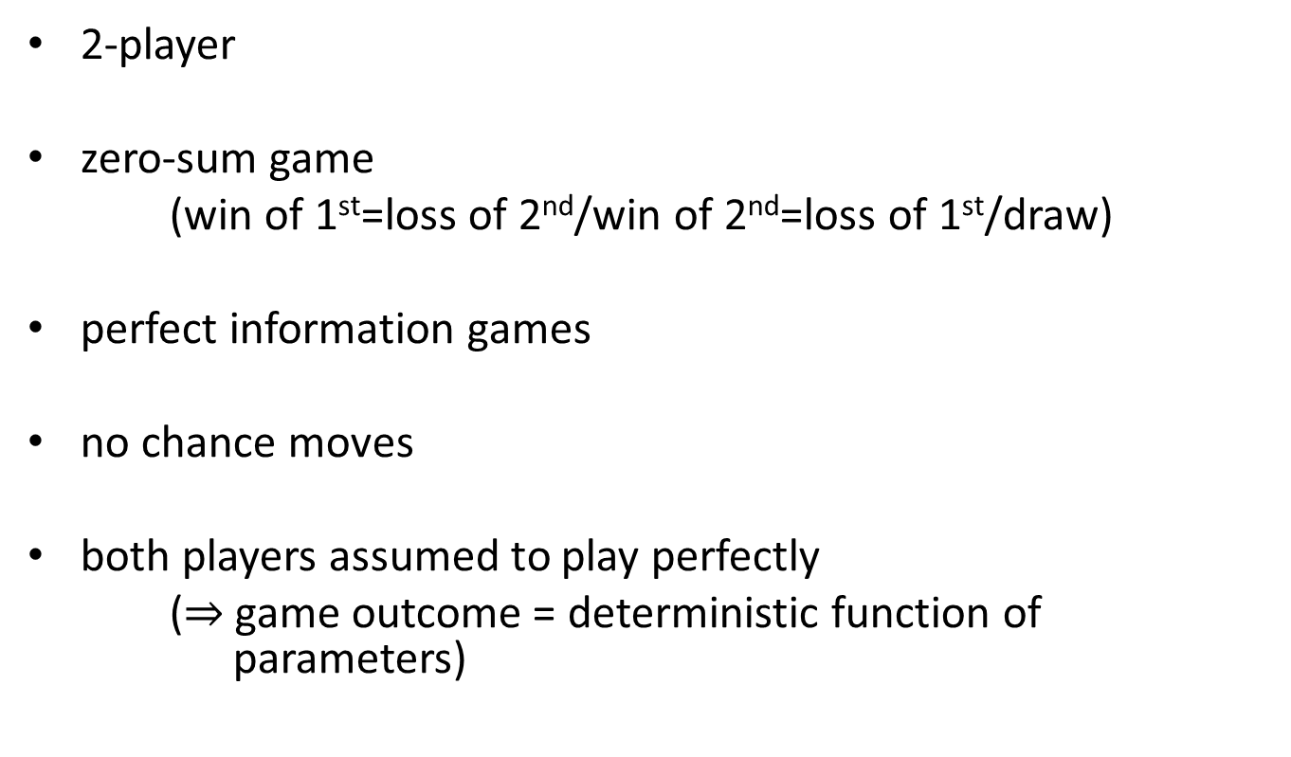
Positional games – setting
2-player
zero-sum game
(win of 1st=loss of 2nd/win of 2nd=loss of 1st/draw)
perfect information games
no chance moves
both players assumed to play perfectly
($⇒$ game outcome = deterministic function of parameters)

Slide 4
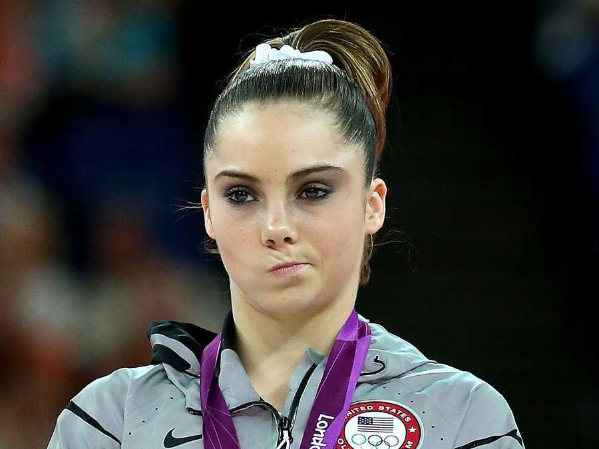
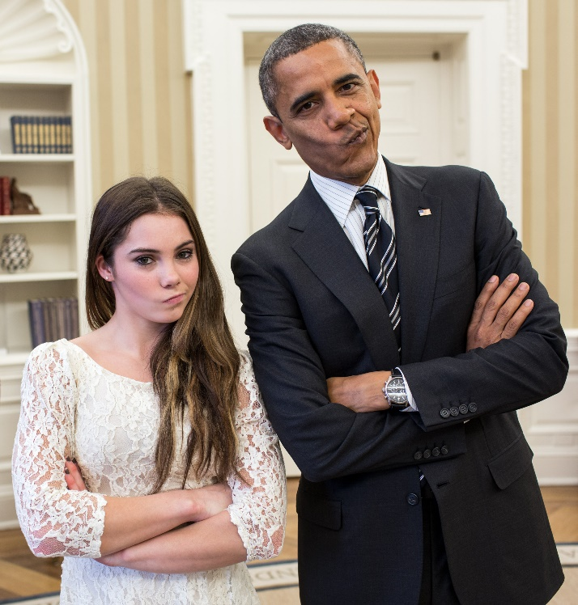
So what’s the connection?
How exactly is randomness related to it?
Quite unclear…
… This will be a fairly short talk…

Slide 5
Omnipresent randomness in positional games
One of the most surprising/important discoveries of the field
probabilistic (looking) winning criteria;
guessing the threshold bias for biased games;
winning games using random play;
playing on random boards;
introducing randomness into game rules;
…

Slide 6
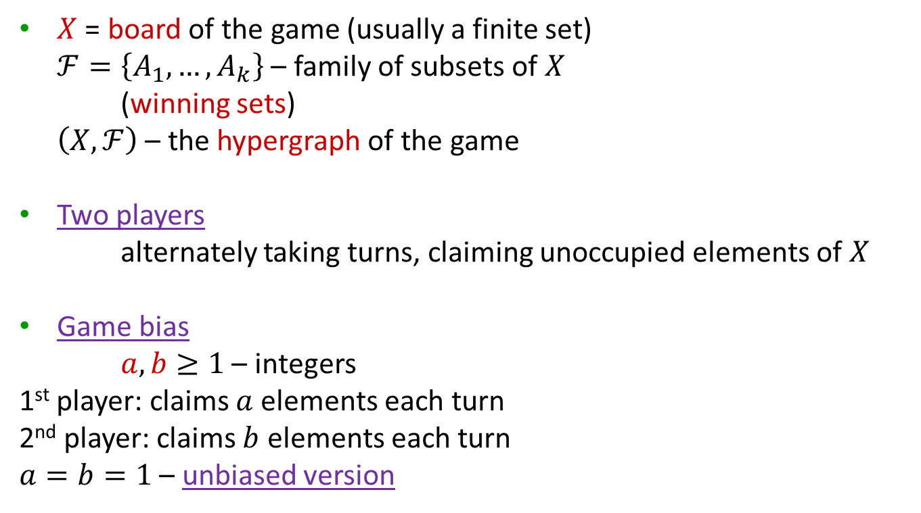
Basic setting
$X$ = board of the game (usually a finite set)
$ℱ=\left\{A_{1},…,A_{k}\right\}$ – family of subsets of $X$
(winning sets)
$\left(X,ℱ\right)$ – the hypergraph of the game
Two players
alternately taking turns, claiming unoccupied elements of $X$
Game bias
$a,b≥1$ – integers
1st player: claims $a$ elements each turn
2nd player: claims $b$ elements each turn
$a=b=1$ – unbiased version

Slide 7
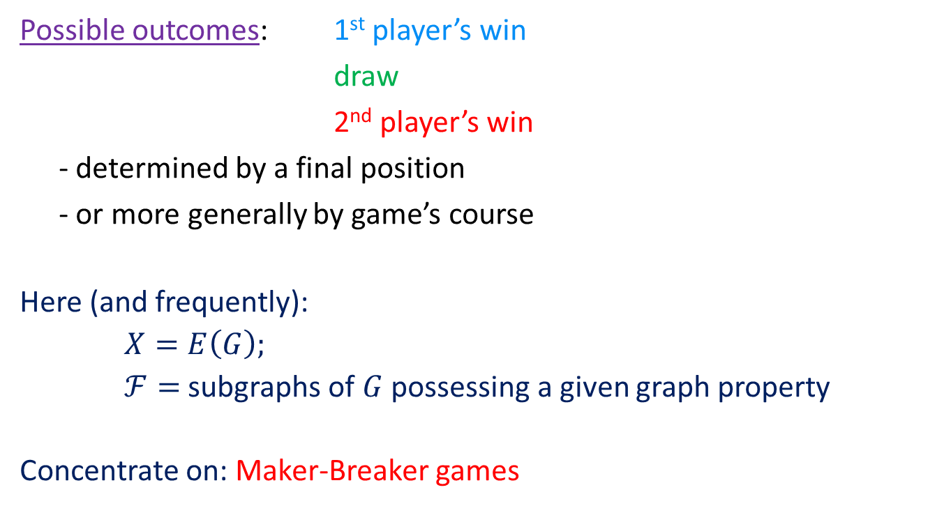
Basic setting (cont.)
Possible outcomes: 1st player’s win
draw
2nd player’s win
- determined by a final position
- or more generally by game’s course
Here (and frequently):
$X=E\left(G\right);$
$ℱ=$ subgraphs of $G$ possessing a given graph property
Concentrate on: Maker-Breaker games

Slide 8
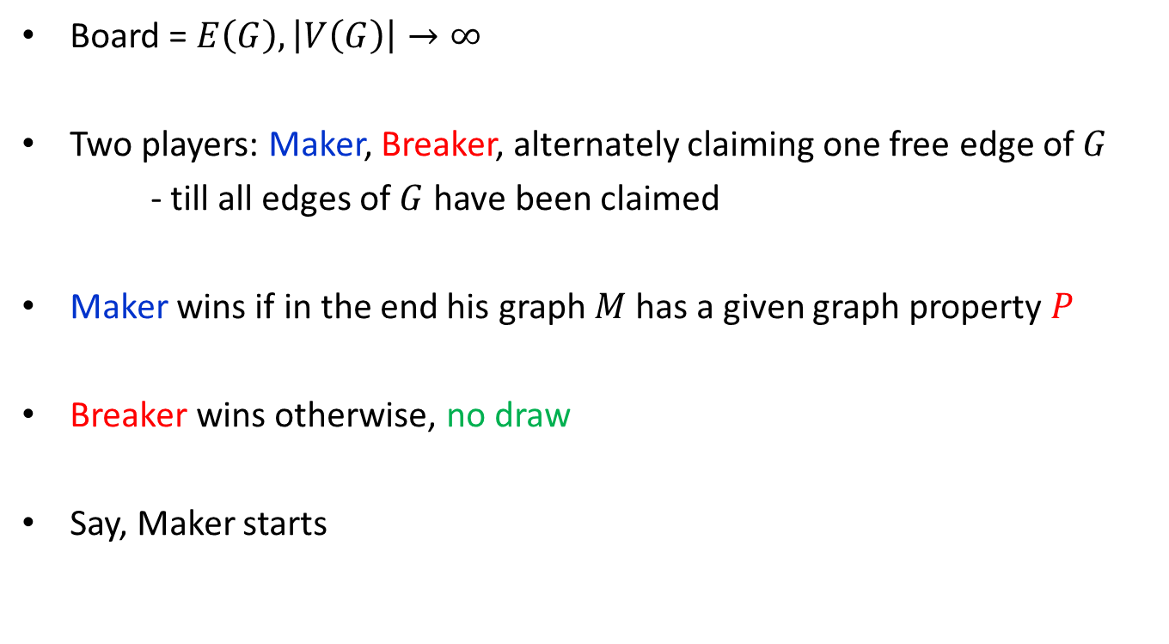
Unbiased Maker-Breaker games
Board = $E\left(G\right), \left|V\left(G\right)\right|→∞$
Two players: Maker, Breaker, alternately claiming one free edge of $G$
- till all edges of $G$ have been claimed
Maker wins if in the end his graph $M$ has a given graph property $P$
Breaker wins otherwise, no draw
Say, Maker starts
unbiased

Slide 9
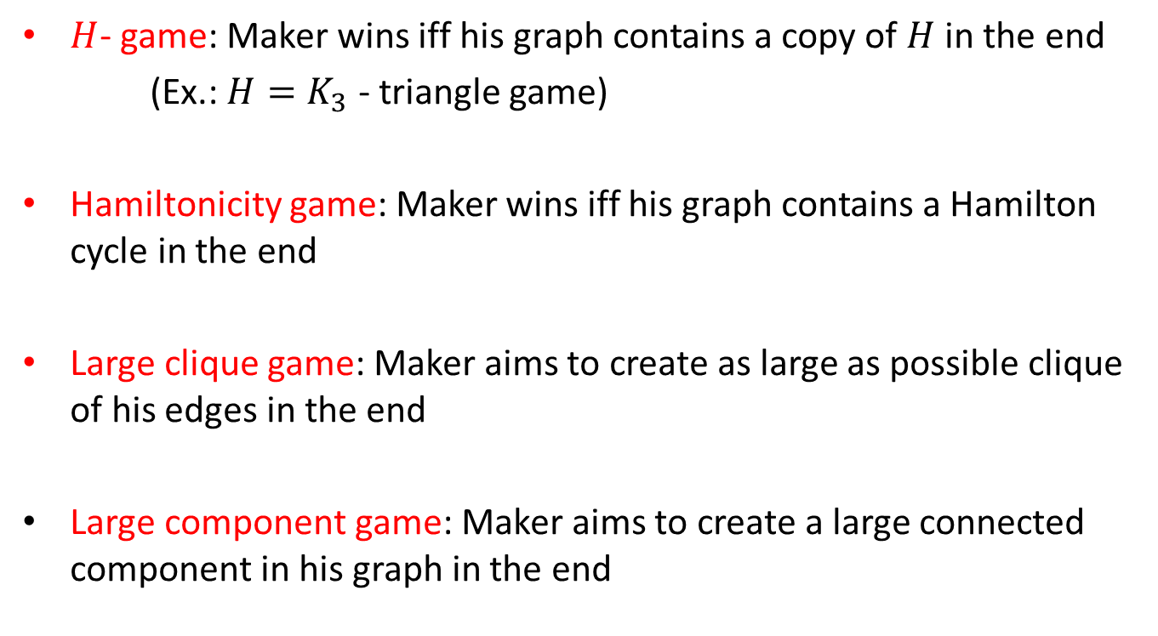
Maker-Breaker games – examples
$H$- game: Maker wins iff his graph contains a copy of $H$ in the end
(Ex.: $H=K_{3}$ - triangle game)
Hamiltonicity game: Maker wins iff his graph contains a Hamilton cycle in the end
Large clique game: Maker aims to create as large as possible clique of his edges in the end
Large component game: Maker aims to create a large connected component in his graph in the end

Slide 10
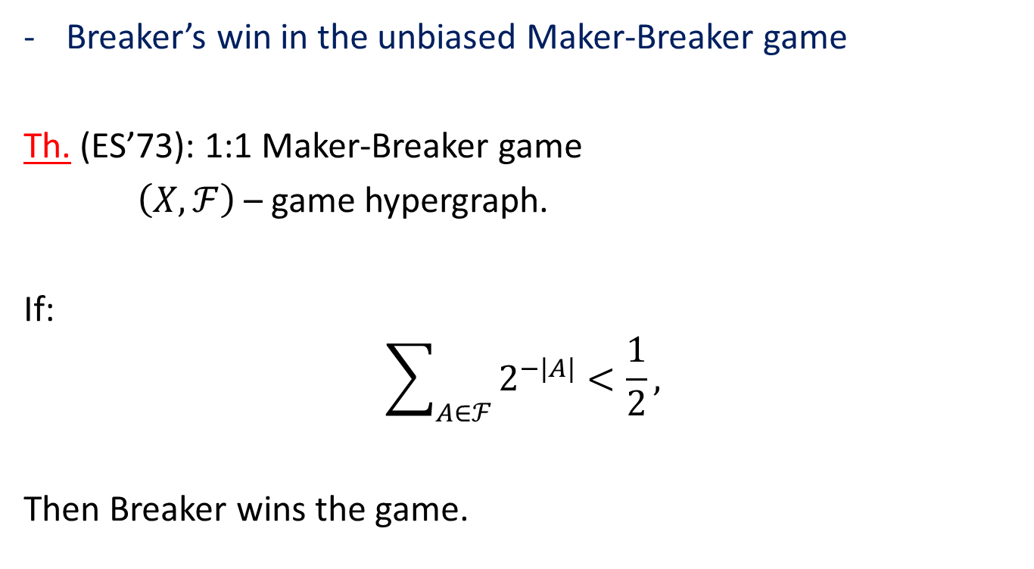
Erdős-Selfridge criterion
Breaker’s win in the unbiased Maker-Breaker game
Th. (ES’73): 1:1 Maker-Breaker game
$\left(X,ℱ\right)$ – game hypergraph.
If:
$$\sum_{A∈ℱ}{2^{−|A|}<\frac{1}{2}},$$
Then Breaker wins the game.

Slide 11
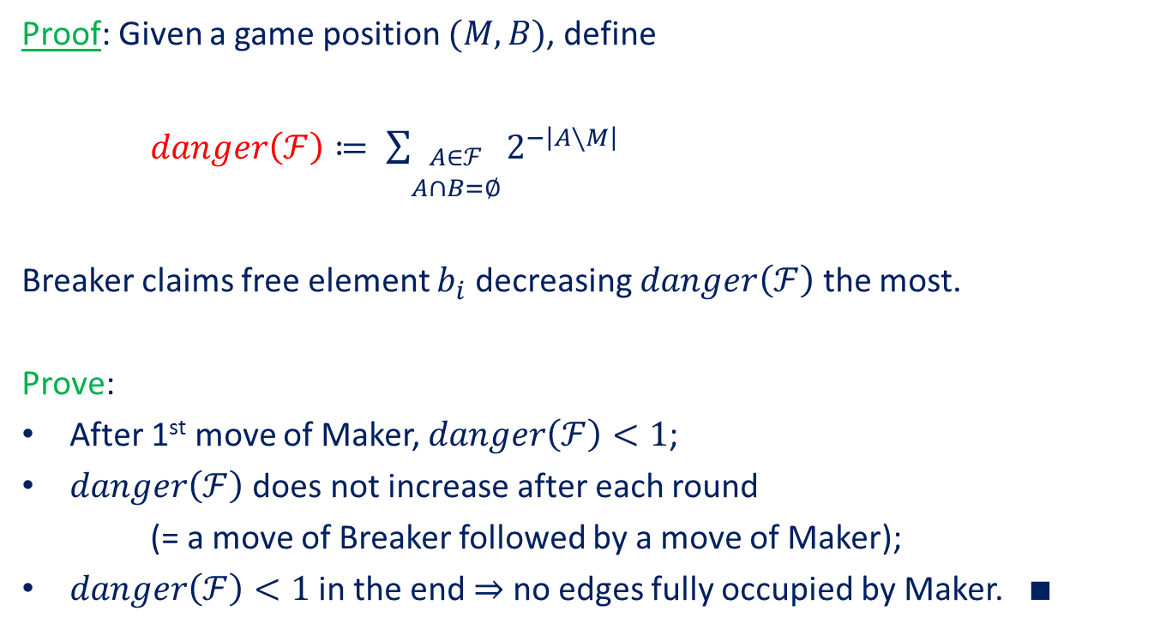
Erdős-Selfridge criterion – proof sketch
Proof: Given a game position $(M,B)$, define
$danger\left(ℱ\right)≔ \sum_{\begin{matrix}A∈ℱ \\ A∩B=∅\end{matrix}}{2^{−\left|A∖M\right|}}$
Breaker claims free element $b_{i}$ decreasing $danger\left(ℱ\right)$ the most.
Prove:
After 1st move of Maker, $danger\left(ℱ\right)<1$;
$danger\left(ℱ\right)$ does not increase after each round
(= a move of Breaker followed by a move of Maker);
$danger\left(ℱ\right)<1$ in the end $⇒$ no edges fully occupied by Maker. $∎$

Slide 12

This looks familiar…
Proof = derandomization argument
(a.k.a. method of conditional expectations)
Have witnessed: probabilistic (looking) criterion for win
of a player

Slide 13
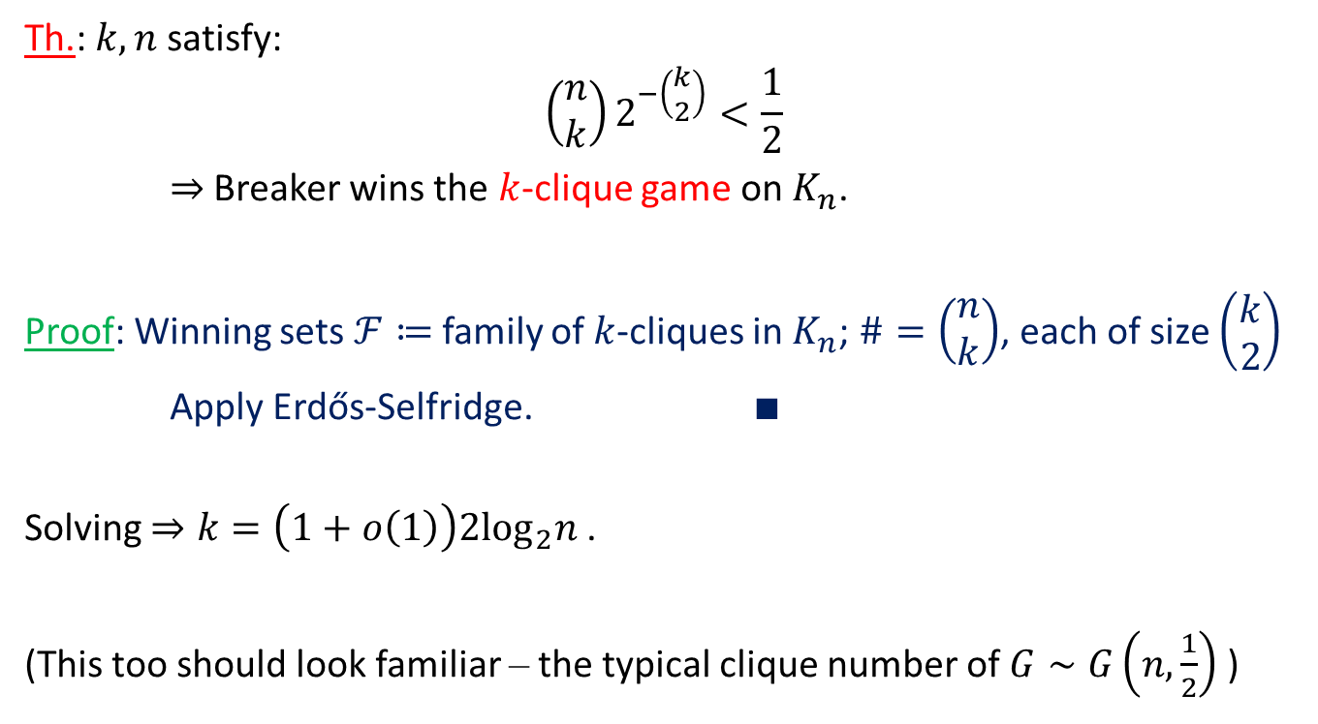
Erdős-Selfridge Criterion – application
Th.: $k,n$ satisfy:
$$\left(\begin{matrix}n \\ k\end{matrix}\right)2^{−\left(\begin{matrix}k \\ 2\end{matrix}\right)}<\frac{1}{2}$$
$⇒$ Breaker wins the $k$-clique game on $K_{n}$.
Proof: Winning sets $ℱ≔$ family of $k$-cliques in $K_{n}$; $\#=\left(\begin{matrix}n \\ k\end{matrix}\right)$, each of size $\left(\begin{matrix}k \\ 2\end{matrix}\right)$
Apply Erdős-Selfridge. $∎$
Solving $⇒k=\left(1+o\left(1\right)\right)2\log_{2}n$ .
(This too should look familiar – the typical clique number of $G∼G\left(n,\frac{1}{2}\right)$ )

Slide 14

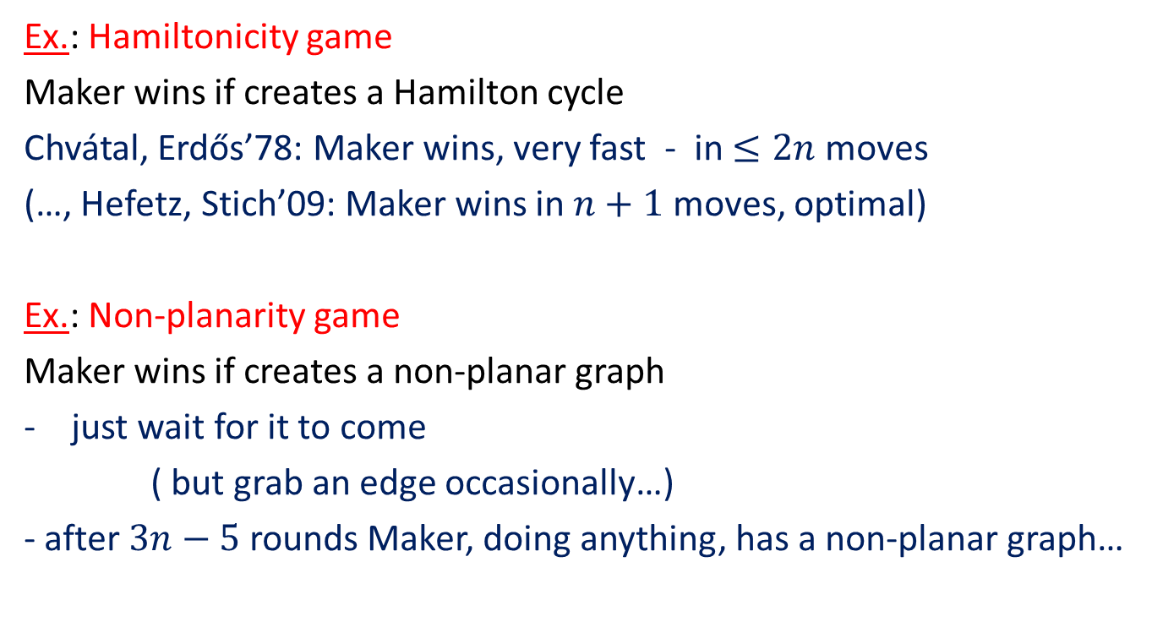
Maker-Breaker unbiased games are frequently boring…
Ex.: Hamiltonicity game
Maker wins if creates a Hamilton cycle
Chvátal, Erdős’78: Maker wins, very fast - in $≤2n$moves
(…, Hefetz, Stich’09: Maker wins in $n+1$ moves, optimal)
Ex.: Non-planarity game
Maker wins if creates a non-planar graph
just wait for it to come
( but grab an edge occasionally…)
- after $3n−5$ rounds Maker, doing anything, has a non-planar graph…

Slide 15
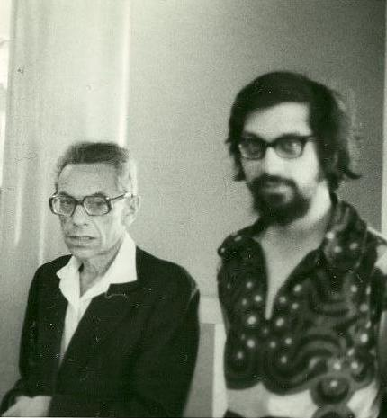
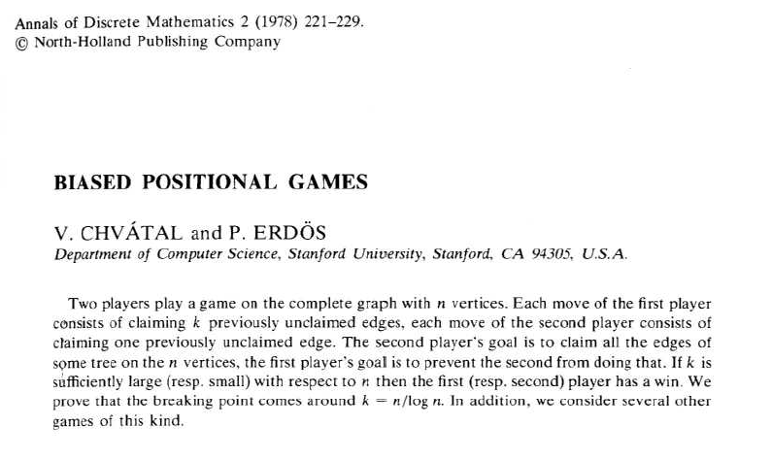

Biased Maker-Breaker games
Now: Breaker takes $b≥1$ elements in each move

Slide 16
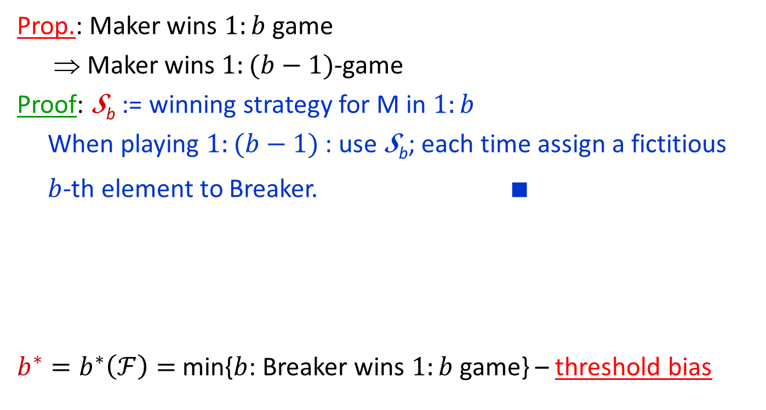


Bias monotonicity, threshold bias
Prop.: Maker wins $1:b$ game
⇒ Maker wins $1:(b−1)$-game
Proof: S_{b} := winning strategy for M in $1:b$
When playing $1:(b−1)$: use S_{b}; each time assign a fictitious
$b$-th element to Breaker. ■
$b^{∗}=b^{∗}\left(ℱ\right)=$ min{$b$: Breaker wins $1:b$ game} – threshold bias
Critical point: game changes hands
M
M
M
M
M
B
B
B
winner
1
2
3
$$b^{∗}$$
bias $b$

Slide 17
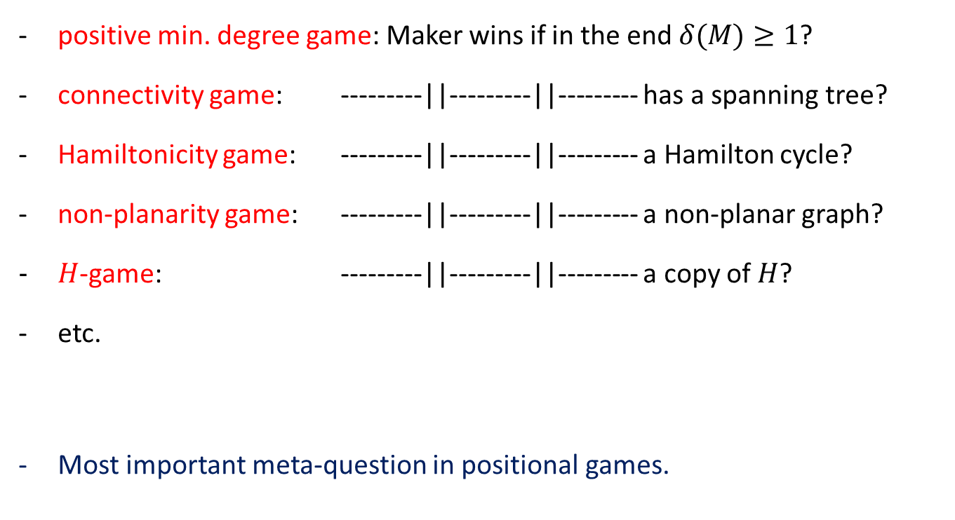
So what is the threshold bias for…?
positive min. degree game: Maker wins if in the end $δ(M)≥1$?
connectivity game: ---------||---------||--------- has a spanning tree?
Hamiltonicity game: ---------||---------||--------- a Hamilton cycle?
non-planarity game: ---------||---------||--------- a non-planar graph?
$H$-game: ---------||---------||--------- a copy of $H$?
etc.
Most important meta-question in positional games.

Slide 18
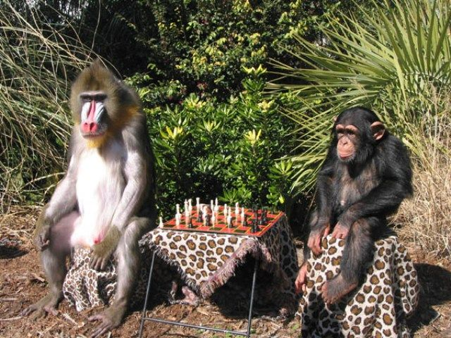
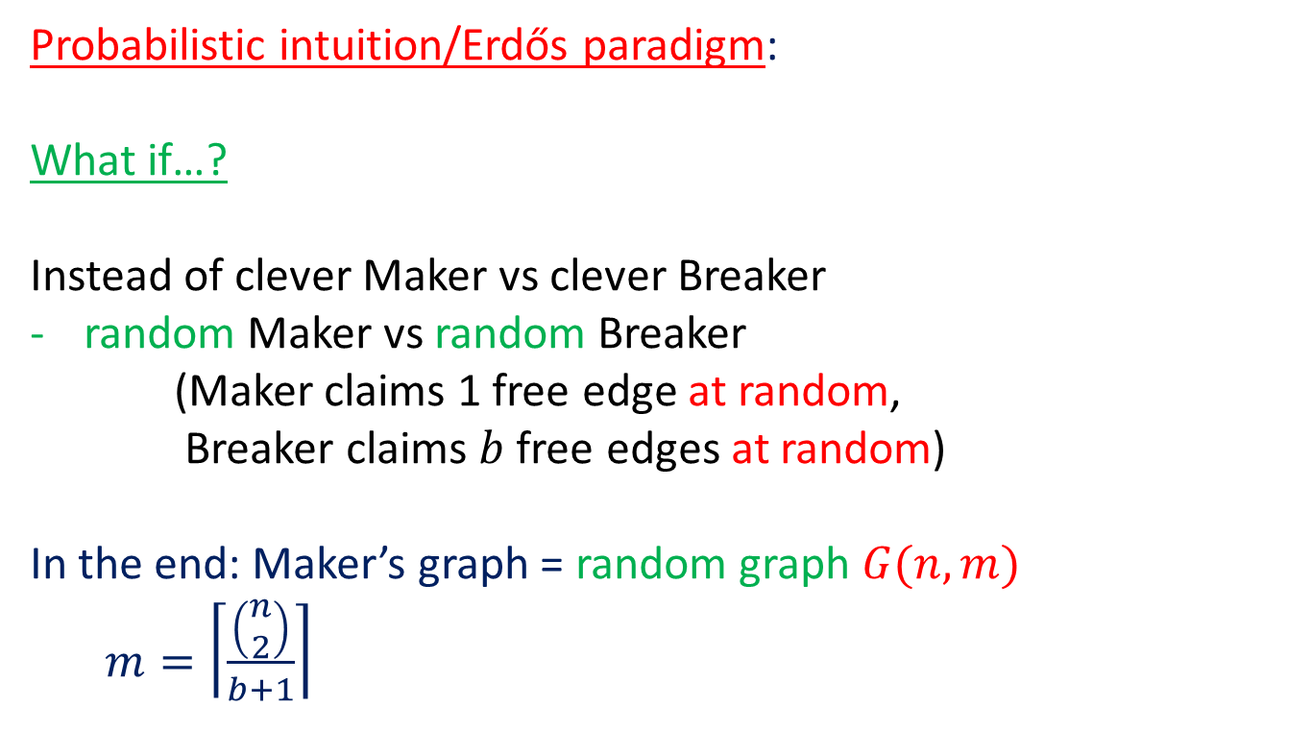
Clever=Dumb?
Probabilistic intuition/Erdős paradigm:
What if…?
Instead of clever Maker vs clever Breaker
random Maker vs random Breaker
(Maker claims 1 free edge at random,
Breaker claims $b$ free edges at random)
In the end: Maker’s graph = random graph $G(n,m)$
$m=\left\lceil \frac{\left(\begin{matrix}n \\ 2\end{matrix}\right)}{b+1}\right\rceil$

Slide 19
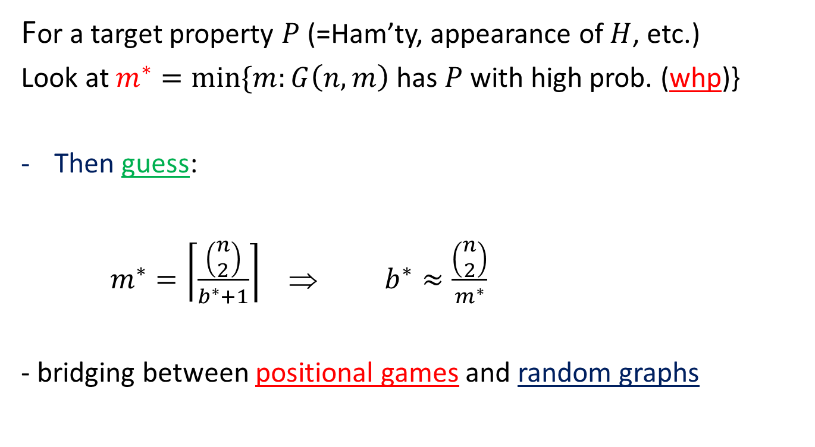
Probabilistic intuition/Erdős paradigm
For a target property $P$ (=Ham’ty, appearance of $H$, etc.)
Look at $m^{∗}=min⁡\{m:G\left(n,m\right)$ has $P$ with high prob. (whp)}
Then guess:
$m^{∗}=\left\lceil \frac{\left(\begin{matrix}n \\ 2\end{matrix}\right)}{b^{∗}+1}\right\rceil$ ⇒ $b^{∗}≈\frac{\left(\begin{matrix}n \\ 2\end{matrix}\right)}{m^{∗}}$
- bridging between positional games and random graphs

Slide 20
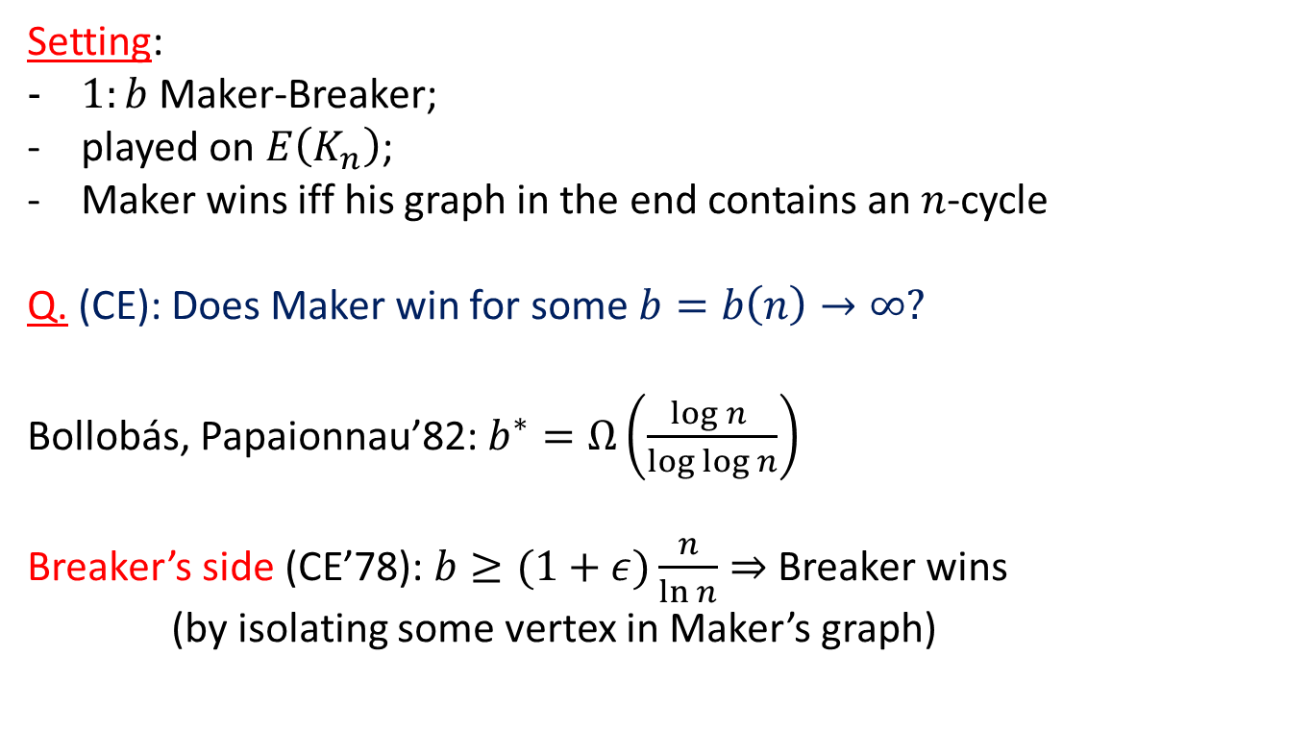
Biased Hamiltonicity game
Setting:
$1:b$ Maker-Breaker;
played on $E\left(K_{n}\right)$;
Maker wins iff his graph in the end contains an $n$-cycle
Q. (CE): Does Maker win for some $b=b\left(n\right)→∞?$
Bollobás, Papaionnau’82: $b^{∗}=Ω\left(\frac{\log{n }}{\log{\log{n}}}\right)$
Breaker’s side (CE’78): $b≥(1+ε)\frac{n}{\ln{n}}⇒$ Breaker wins
(by isolating some vertex in Maker’s graph)

Slide 21
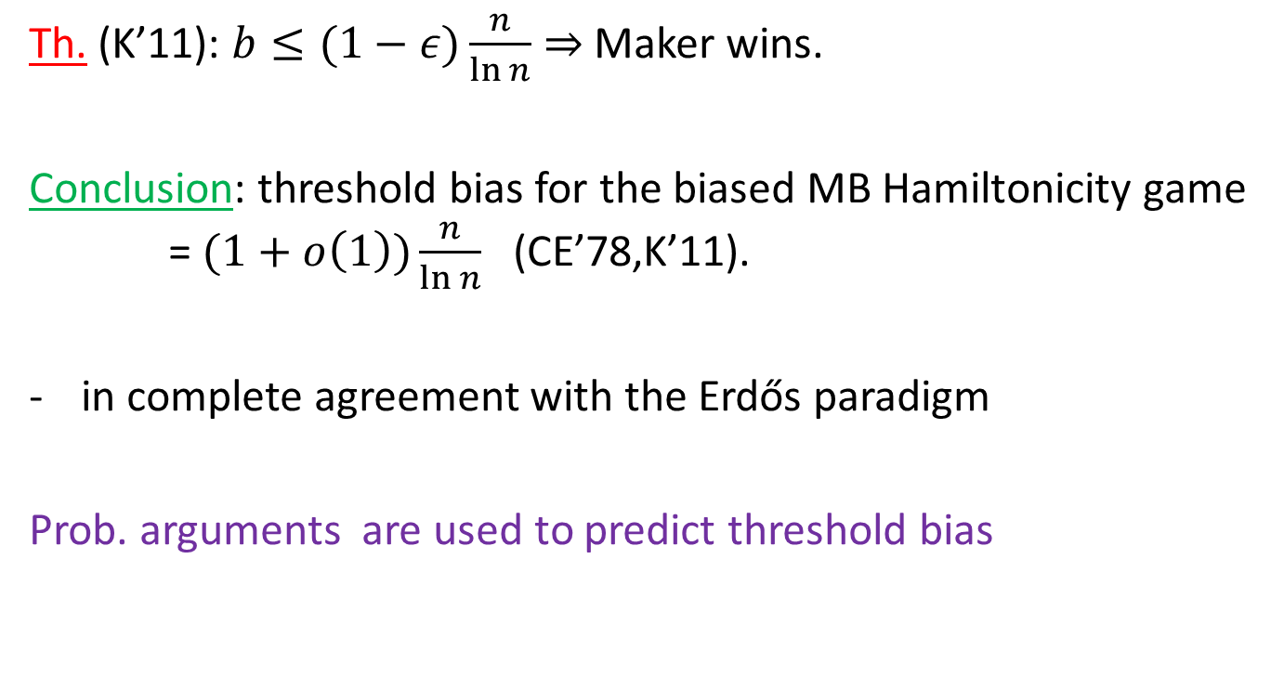
Biased Hamiltonicity game – resolution
Th. (K’11): $b≤(1−ε)\frac{n}{\ln{n}}⇒$ Maker wins.
Conclusion: threshold bias for the biased MB Hamiltonicity game = $(1+o\left(1\right))\frac{n}{\ln{n}}$ (CE’78,K’11).
in complete agreement with the Erdős paradigm
Prob. arguments are used to predict threshold bias

Slide 22
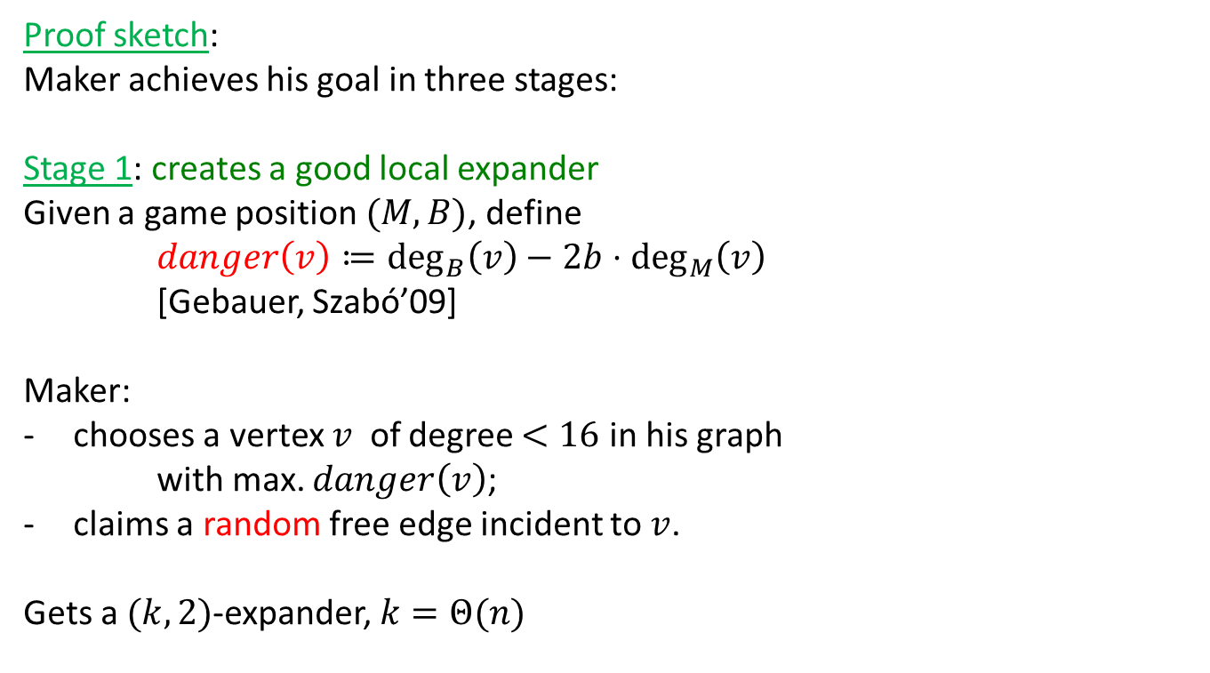
Biased Hamiltonicity game – Maker’s side
Proof sketch:
Maker achieves his goal in three stages:
Stage 1: creates a good local expander
Given a game position $(M,B)$, define
$danger\left(v\right)≔\deg_{B}\left(v\right)−2b⋅\deg_{M}\left(v\right)$
[Gebauer, Szabó’09]
Maker:
chooses a vertex $v$ of degree $<16$ in his graph
with max. $danger\left(v\right)$;
claims a random free edge incident to $v$.
Gets a $(k,2)$-expander, $k=Θ(n)$

Slide 23
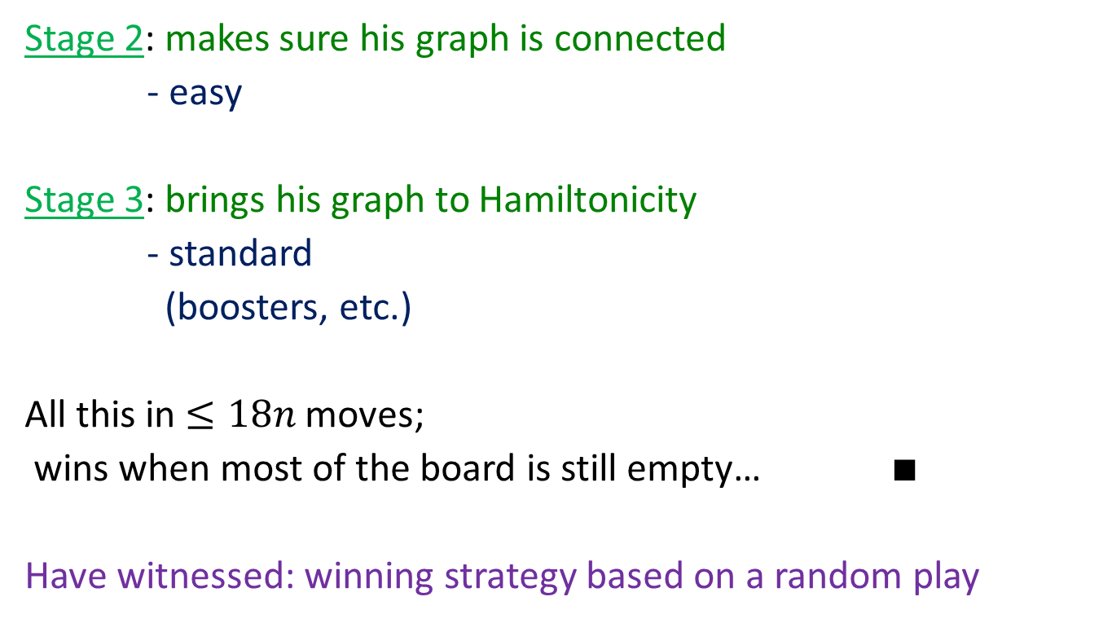
Biased Hamiltonicity game – Maker’s side (cont.)
Stage 2: makes sure his graph is connected
- easy
Stage 3: brings his graph to Hamiltonicity
- standard
(boosters, etc.)
All this in $≤18n$moves;
wins when most of the board is still empty… $∎$
Have witnessed: winning strategy based on a random play

Slide 24
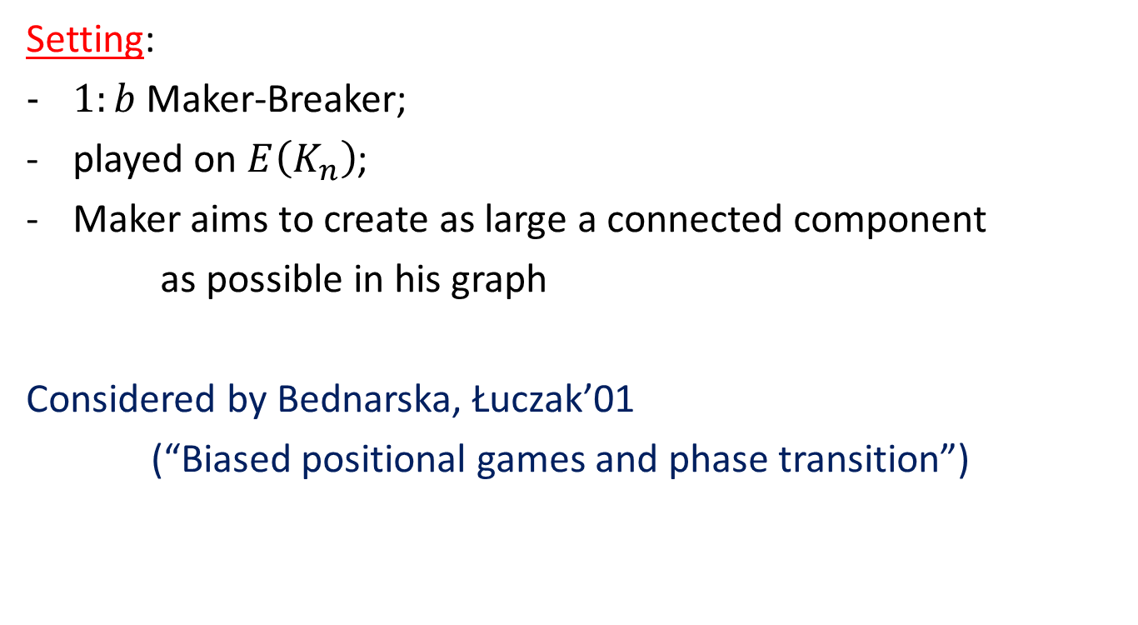
Large component game
Setting:
$1:b$ Maker-Breaker;
played on $E\left(K_{n}\right)$;
Maker aims to create as large a connected component
as possible in his graph
Considered by Bednarska, Łuczak’01
(“Biased positional games and phase transition”)

Slide 25
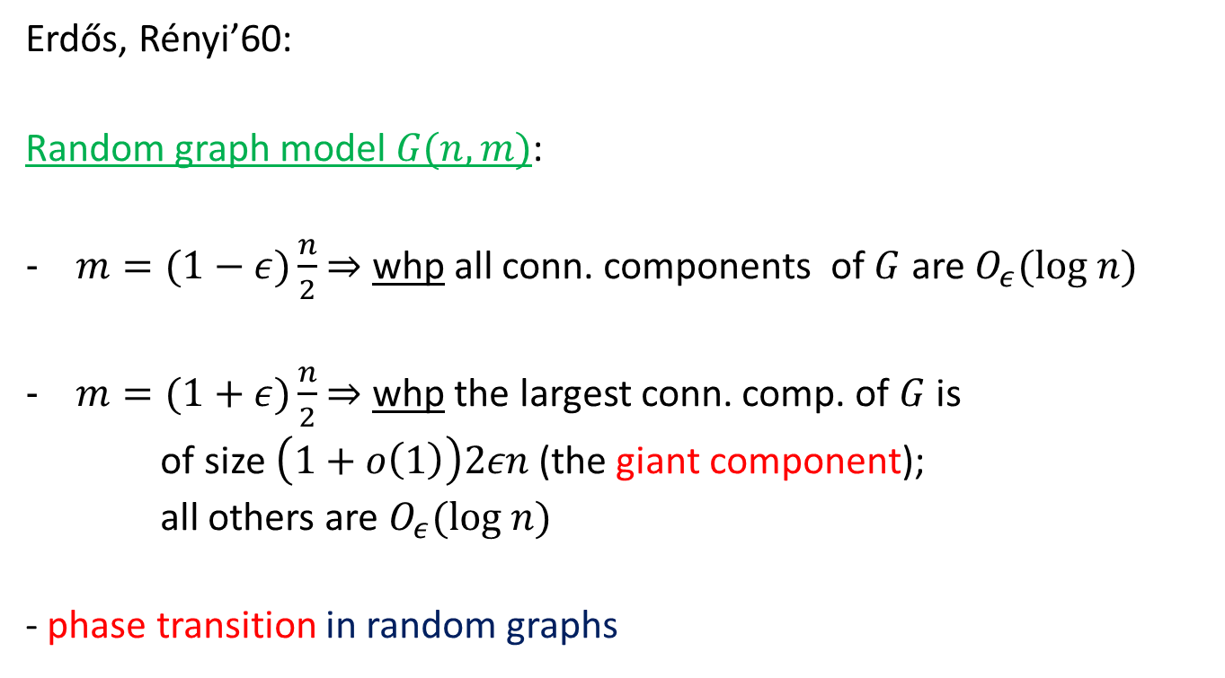

Recall what happens in $G\left(n,m\right)…$
Erdős, Rényi’60:
Random graph model $G(n,m)$:
$m=(1−ε)\frac{n}{2}$ $⇒$ whp all conn. components of $G$ are $O_{ε}(log n)$
$m=(1+ε)\frac{n}{2}$ $⇒$ whp the largest conn. comp. of $G$ is
of size $\left(1+o\left(1\right)\right)2εn$ (the giant component);
all others are $O_{ε}(log n)$
- phase transition in random graphs

Slide 26
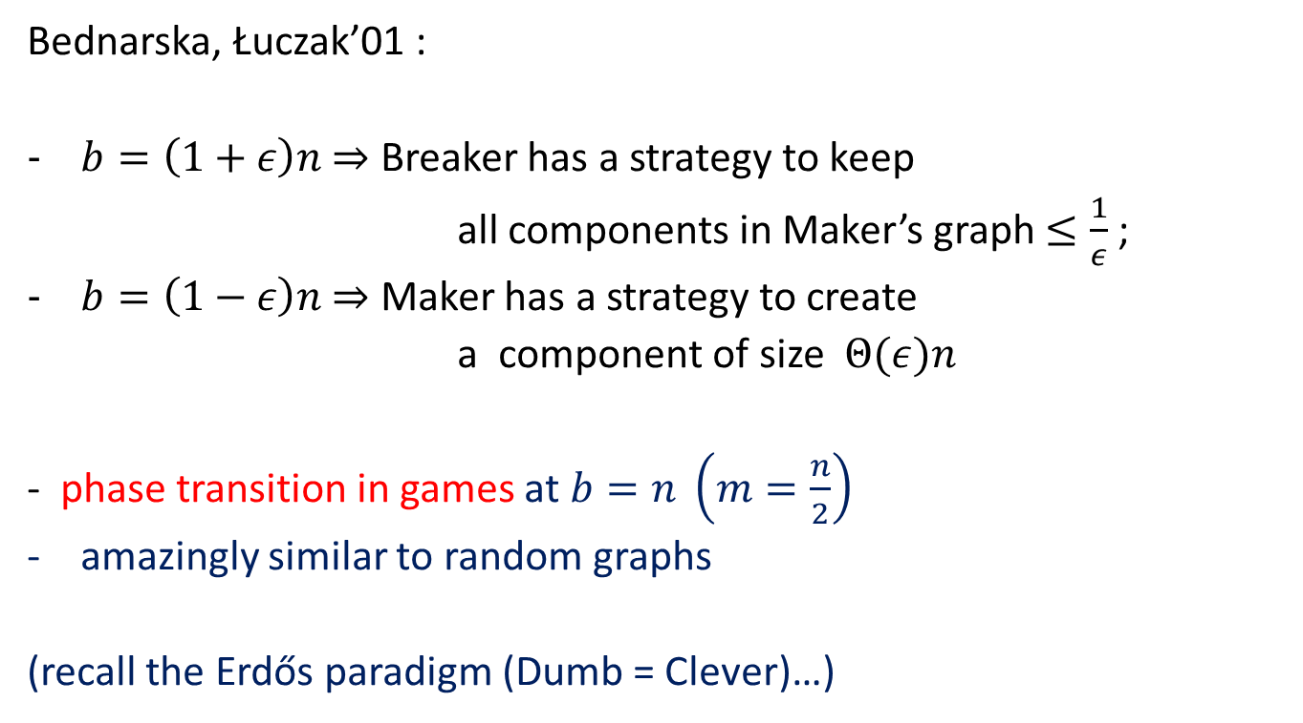
And now – this is what happens in games
Bednarska, Łuczak’01 :
$b=\left(1+ε\right)n$ $⇒$ Breaker has a strategy to keep
all components in Maker’s graph $≤\frac{1}{ε}$ ;
$b=\left(1−ε\right)n$ $⇒$ Maker has a strategy to create
a component of size $Θ(ε)n$
- phase transition in games at $b=n \left(m=\frac{n}{2}\right)$
amazingly similar to random graphs
(recall the Erdős paradigm (Dumb = Clever)…)

Slide 27
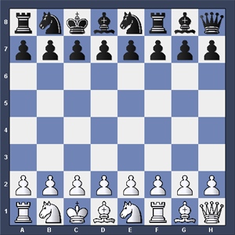
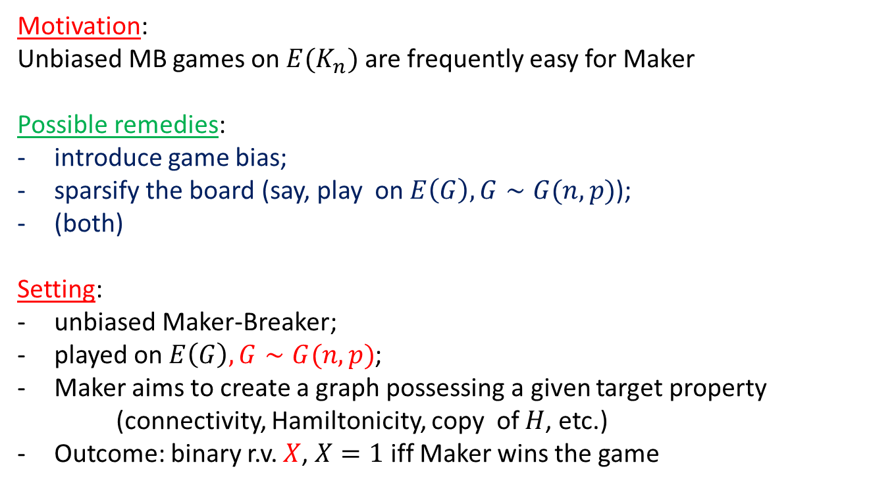
Games on random boards
Motivation:
Unbiased MB games on $E(K_{n})$ are frequently easy for Maker
Possible remedies:
introduce game bias;
sparsify the board (say, play on $E\left(G\right), G∼G(n,p)$);
(both)
Setting:
unbiased Maker-Breaker;
played on $E\left(G\right), G∼G(n,p)$;
Maker aims to create a graph possessing a given target property
(connectivity, Hamiltonicity, copy of $H$, etc.)
Outcome: binary r.v. $X$, $X=1$iff Maker wins the game

Slide 28
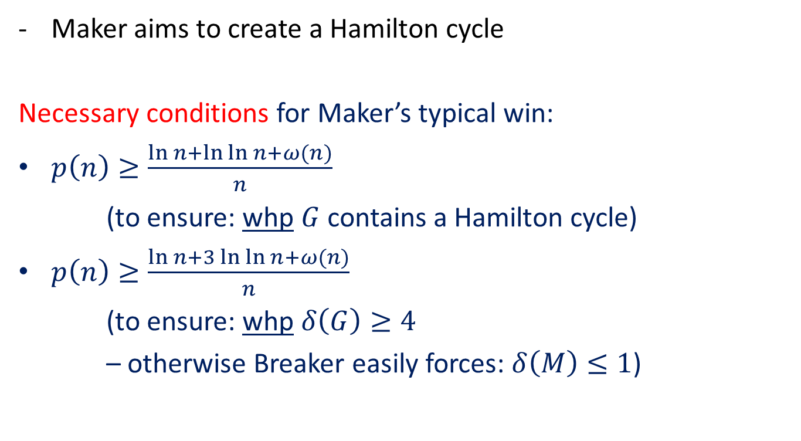
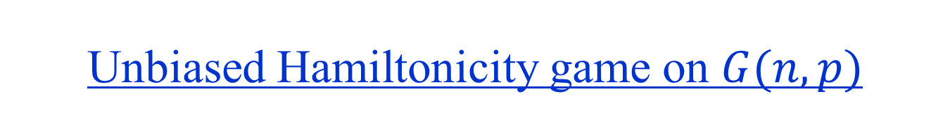
Unbiased Hamiltonicity game on $G(n,p)$
Maker aims to create a Hamilton cycle
Necessary conditions for Maker’s typical win:
$p\left(n\right)≥\frac{\ln{n+\ln{\ln{n+ω(n)}}}}{n}$
(to ensure: whp $G$ contains a Hamilton cycle)
$p\left(n\right)≥\frac{\ln{n+3\ln{\ln{n+ω(n)}}}}{n}$
(to ensure: whp $δ\left(G\right)≥4$
– otherwise Breaker easily forces: $δ\left(M\right)≤1$)

Slide 29
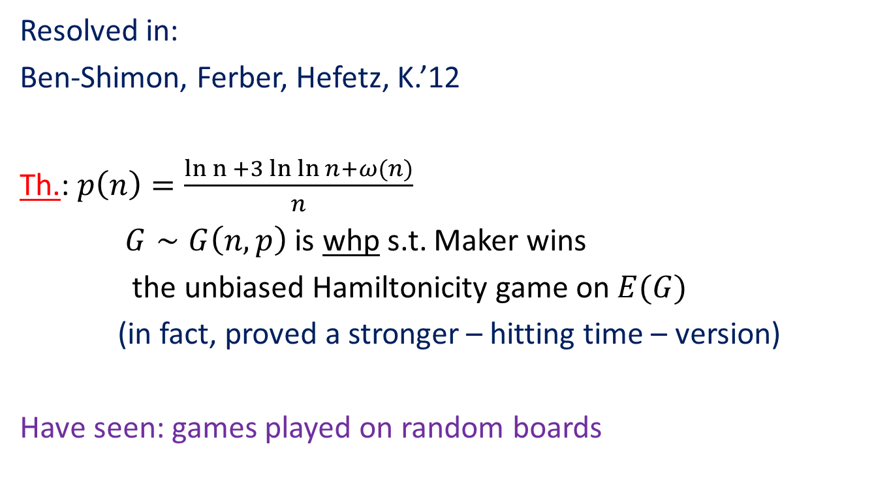
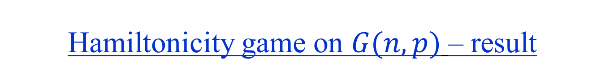
Hamiltonicity game on $G(n,p)$ – result
Resolved in:
Ben-Shimon, Ferber, Hefetz, K.’12
Th.: $p\left(n\right)=\frac{ln n{+3\ln{\ln{n+ω(n)}}}}{n}$
$G∼G\left(n,p\right)$ is whp s.t. Maker wins
the unbiased Hamiltonicity game on $E(G)$
(in fact, proved a stronger – hitting time – version)
Have seen: games played on random boards

Slide 30
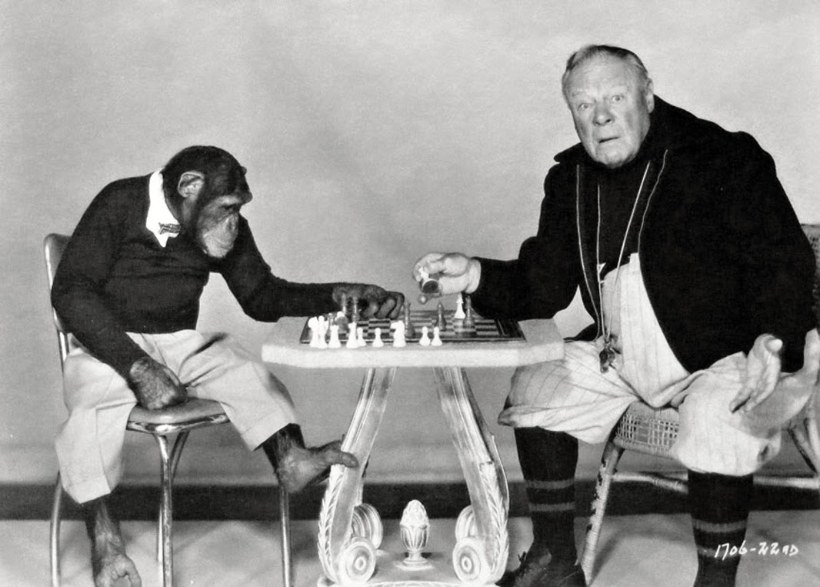
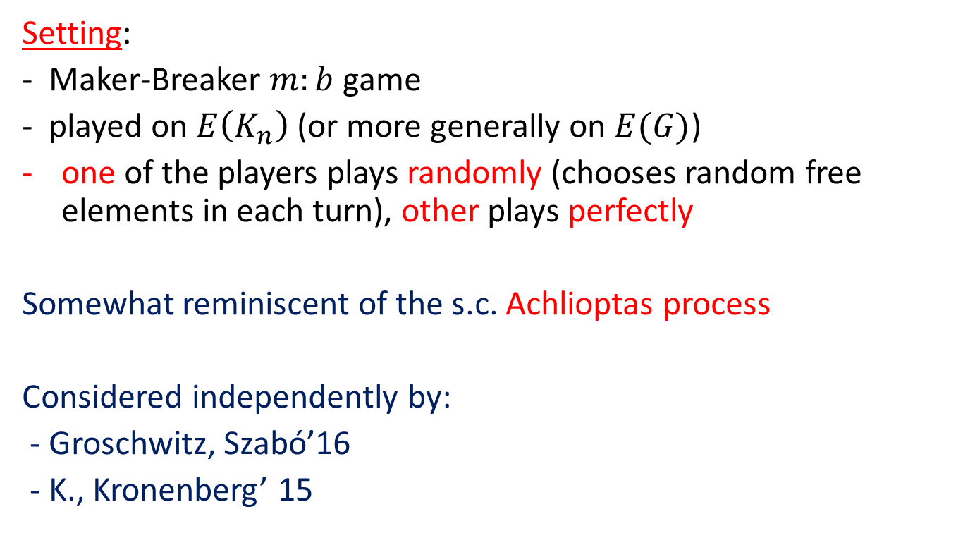
Half-random games
Setting:
- Maker-Breaker $m:b$game
- played on $E\left(K_{n}\right)$ (or more generally on $E(G)$)
one of the players plays randomly (chooses random free elements in each turn), other plays perfectly
Somewhat reminiscent of the s.c. Achlioptas process
Considered independently by:
- Groschwitz, Szabó’16
- K., Kronenberg’ 15

Slide 31
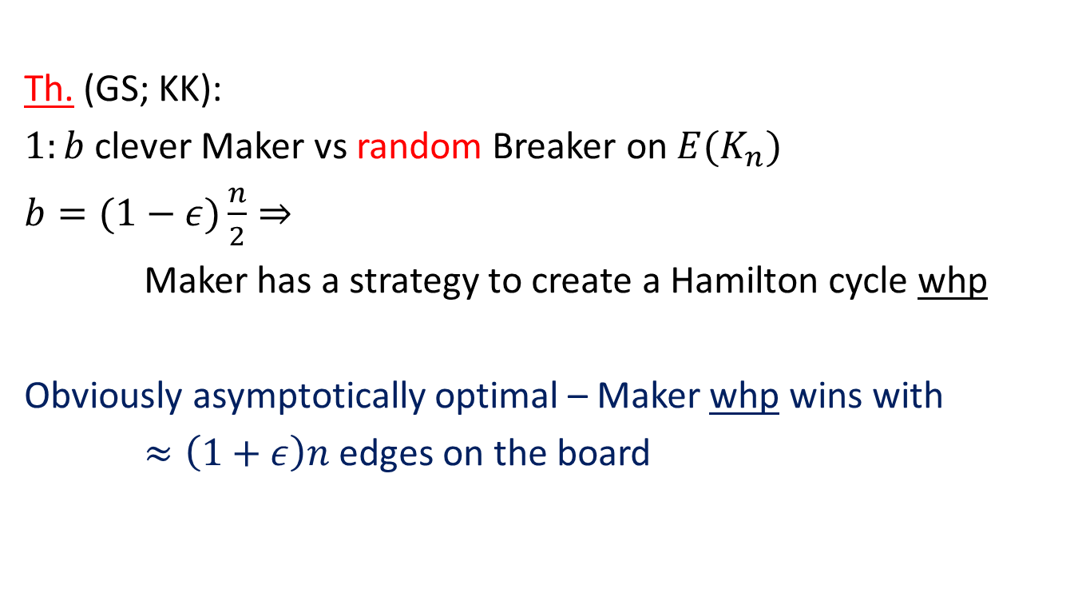
Hamiltonicity game with random Breaker
Th. (GS; KK):
$1:b$ clever Maker vs random Breaker on $E(K_{n})$
$b=(1−ε)\frac{n}{2}⇒$
Maker has a strategy to create a Hamilton cycle whp
Obviously asymptotically optimal – Maker whp wins with
$≈\left(1+ε\right)n$ edges on the board

Slide 32
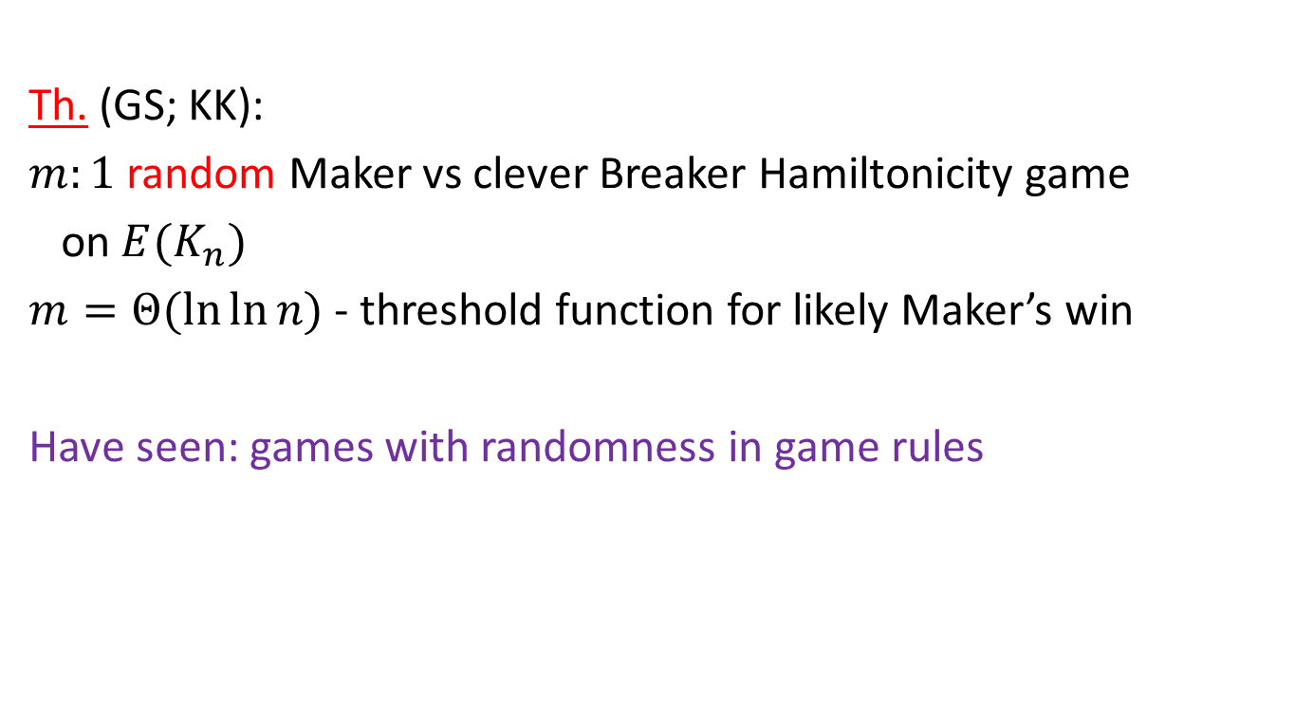
Hamiltonicity game with random Maker
Th. (GS; KK):
$m:1$ random Maker vs clever Breaker Hamiltonicity game
on $E(K_{n})$
$m=Θ(\ln{\ln{n)}}$ - threshold function for likely Maker’s win
Have seen: games with randomness in game rules

Slide 33
THE END

