Slide 1
Symbolic Memories in the Brain Christos Papadimitriou UC Berkeley

Slide 2
…work with…
Santosh Vempala
Wolfgang Maass

Slide 3
Brain and Computation:
The Great
Disconnects
Babies vs computers
Clever algorithms vs what happens in cortex
Deep nets vs the Brain
Understanding Brain anatomy and function vs understanding the emergence of the Mind

Slide 4
How does the Mind emerge from the Brain?

Slide 5
How does the Mind emerge from the Brain?

Slide 6
How does one think computationally about the Brain?

Slide 7
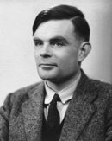
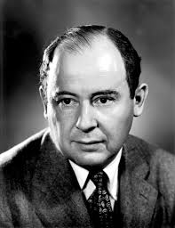
Good Question!
John von Neumann 1950:
[the way the brain works]
may be characterized by less
logical and arithmetical depth
than we are normally used to

Slide 8
Les Valiant on the Brain (1994)
A computational
theory of the Brain is
possible and essential
The neuroidal model
and vicinal algorithms

Slide 9
David Marr (1945 – 1980)
The three-step program:
specs
algorithm
hardware

Slide 10
PCA?
SGD?
hashing?
decision trees?
So, can we use Marr’s framework
to identify the algorithm run by the Brain??
kernel trick?
LP?
SDP?
EM?
SVM?
J-Lindenstrauss? FFT?
AdaBoost?

Slide 11
Our approach
Come up with computational theories consistent as much as possible with what we know from Neuroscience
Start by admitting defeat: Expect large-scale algorithmic heterogeneity
Start at the boundary between “symbolic/subsymbolic” brain function
One candidate: Assemblies of excitatory neurons in medial temporal lobe (MTL)

Slide 12
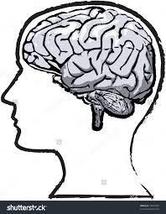
The experiment by [Ison et al. 2016]

Slide 13
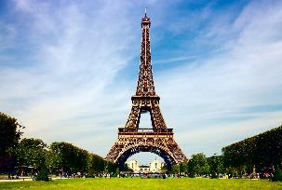
The experiment by [Ison et al. 2016]

Slide 14
The experiment by [Ison et al. 2016]

Slide 15
The experiment by [Ison et al. 2016]

Slide 16
The experiment by [Ison et al. 2016]

Slide 17
The experiment by [Ison et al. 2016]

Slide 18
The experiment by [Ison et al. 2016]

Slide 19
The experiment by [Ison et al. 2016]

Slide 20
The experiment by [Ison et al. 2016]

Slide 21
The Challenge:
These are the specs (Marr)
What is the hardware?
What is the algorithm?

Slide 22
Speculating on the Hardware
A little analysis first
They recorded from ~10² out of ~10⁷ MTL neurons in every subject
Showed ~10² pictures of familiar persons/places, with repetitions
~ each of ~10 neurons responded consistently to one image
Hmmmm...

Slide 23
Speculating on Hardware (cont.)
Each memory is represented by an assembly of many (perhaps ~ 10⁴ - 10⁵ ) neurons;
cf [Hebb 1949], [Buzsaki 2003, 2010]
Highly connected, therefore stable
It is somehow formed by sensory stimuli
Every time we think of this memory, ~ all these neurons fire
Two memories can be associated by “seeping” into each other

Slide 24
Algorithm?
How are assemblies formed?
How are they recalled?
How does association happen?

Slide 25
The theory challenge
In a sparse graph, how can you select a dense induced subgraph?

Slide 26
“sensory
cortex”
MTL, ~10⁷ neurons
~10⁴ neurons
stimulus
~10⁴ neurons
[selection by inhibition]

Slide 27
NB: these are scattered
neurons!
~10⁴ neurons

Slide 28
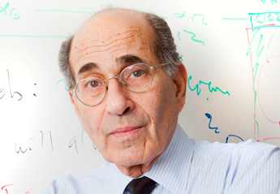
A metaphor: olfaction in the mouse [al. et Axel 2011]
3
1
2

Slide 29
From the Discussion section of [al. et Axel]
…an odorant may evoke suprathreshold input in a small subset of … neurons. This small fraction of ... cells would then generate sufficient recurrent excitation to recruit a larger population of neurons... The strong feedback inhibition resulting from activation of this larger population of neurons would then suppress further spiking… In the extreme, some cells could receive enough recurrent input to fire … without receiving [initial] input…

Slide 30
“sensory
cortex”
MTL, ~10⁷ neurons
~10⁴ neurons
~10⁴ neurons
synapses
random graph,
p ~ 10⁻²

Slide 31
Plasticity
Hebb 1949: “Fire together, wire together”
STDP: near synchronous firing of two cells connected by a synapse increases synaptic weight (by a small factor, up to a limit)

Slide 32
But how does one verify such a theory?
It is reproduced in simulations by artificial neural networks with realistic (scaled down) parameters [Pokorny et al 2017]
Math?

Slide 33
Linearized model
activation
stimulus
x_{j}(t+1) = s_{j} + Σ_{i→j} x_{i}(t) w_{ij}(t)
w_{ij}(t+1) = w_{ij}(t) [1 + β x_{i}(t) x_{j}(t + 1)]
synaptic weights
plasticity

Slide 34
Linearized model: Result
Theorem: The linearized dynamics converges geometrically to
x_{j} = s_{j} + α Σ_{i→j} x_{i}²

Slide 35
Nonlinear model: a quantitative narrative
x_{j} = s_{j} + α Σ_{i→j} x_{i}²
The high s_{j} cells fire
Next, high connectivity cells fire
Next, among the high s_{j} cells, the ones with high connectivity fire again
“The rich get stably rich” through plasticity
A part of the assembly may keep oscillating (periods of 2 and 3 are common)

Slide 36
Mysteries remain...
How can a set of random neurons have exceptionally strong connectivity?
And how are associations (Obama + Eiffel) formed?

Slide 38
High connectivity? Associations?
Random graph theory does not seem to suffice
[Song et al 2005]: reciprocity
and triangle completion
G_{n,p}++
p ~ 10⁻¹
G_{n,p}
p ~ 10⁻²

Slide 39
birthday
paradox!
also,
inside
assemblies

Slide 40
Recall the theory challenge
In a sparse graph, how can you select a dense induced subgraph?
Answer: Through
Recruiting highly connected nodes (recall equation)
Plasticity
Triangle completion and birthday paradox

Slide 41
Remember Marr?
The three-step program:
specs
algorithm
hardware

Slide 42
Another operation: Bind
e. g., “give” isa “verb”
Not between assemblies, but...
...between an assembly and a brain area
A “pointer assembly,” a surrogate for “give,” is formed in the “verb” area
Also supported by simulations [Legenstein et al. 2017] and same math

Slide 43
Bind:
“assembly pointer”
MTL
“give”
“verb area”

Slide 44
cf [Valiant 1994]
Items: internal connectivity immaterial
Operations Join, Link ≠ Association
Formed by recruiting completely new cells
Through orchestrated precise setting of the parameters (strengths, thresholds)
Also, Predictive Join [P. Vempala COLT 2015]
Can do a bunch of feats, but is subject to same criticism viz plausibility

Slide 45
Incidentally, a Theory Problem: Association Graphs
Are these
legitimate strengths
of associations
between ~equal
assemblies?
Connection to the
cut norm
(also with Anari & Saberi)
0.2
0.5
0.6
0.3
0.4

Slide 46
Btw, the Mystery of Invariants
How can very different stimuli elicit the same memory?
E.g. different projections, rotations, and zooms of a familiar face, the person’s voice, gait, and NAME
Association gone awry?

Slide 47
“Eifel”

Slide 48
Finally: The Brain in context
The environment is paramount
Language: An environment created by us a few thousand generations ago
A “last-minute adaptation”
Hypothesis: it evolved so as to exploit the Brain’s strengths
Language is optimized so babies can learn it

Slide 49
Language!
Knowledge of language = grammar
Some grammatical knowledge may predate experience (is innate)
Grammatical minimalism: S → VP NP
Assemblies, Association and Bind (and Pjoin) seem ideally suited for implementing grammar and language in the Brain.

Slide 50
Is S → NP VP Innate?

Slide 51
Sooooooo…
How does one think computationally about the Brain?
Assemblies may be one path
Experimental Neuroscience and Cognitive Science provide specs, hardware
The algorithm [rather often] vanishes
Ultimately, language

Slide 52
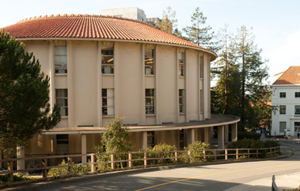
Next spring, in an oddly familiar building…
Program in Computation and the Brain!
Be there…

Slide 53
Thank You!

