Slide 1
Provable Learning of Noisy-OR Networks
Rong Ge
Duke University
Joint work with Sanjeev Arora, Tengyu Ma, Andrej Risteski
“Provable Learning of Noisy-OR Networks” STOC 2017 arxiv:1612.08795
“New practical algorithms for learning Noisy-OR networks via symmetric NMF”

Slide 2
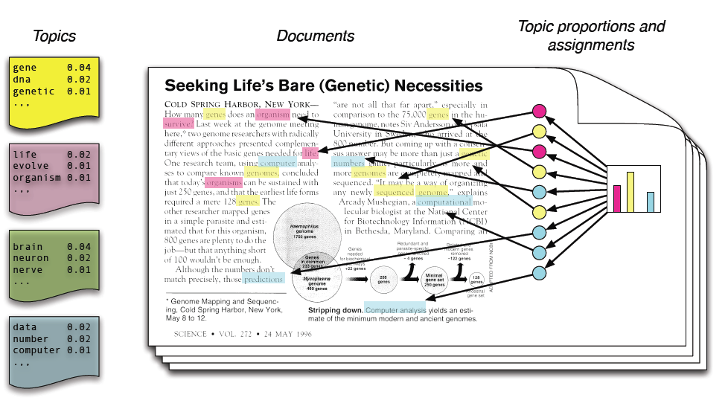
Can be learned by Tensor Decomposition.
Latent Variable Models
Linear
Nonlinear
Harder to Learn
Noisy-OR Networks (Defined next slide)
[Shwe et al.91][Jordan et al.’99] Simpler versions of RBMs

Slide 3
Disease-Symptom Networks
Disease d
Weight W
Symptom s
Observe
m Diseases d_{i}, independent w.p. ρ
Edge weight: Pr[s_{i}=0|d_{j}=1] = exp(-W_{ij})
QMR-DT: 570 diseases, 4k symptoms, 45k edges.

Slide 4
Noisy-OR
50%
50%
1-exp(-W_{ij})
75%

Slide 5
Our Results
Theorem [AGMR’17a] (informal): A poly-time algorithm recovers $W$ with $O\left(ρ\sqrt{m}\right)$ relative error in $ℓ_{2}$-norm in each column (disease).
Example: $ρ=5/m$, the relative error is $O\left(1/\sqrt{m}\right)$
Fewer requirements on structure of network
Structure similar to previous works , faster algorithm. [Halpern-Sontag’13][Jernite-Halpern-Sontag’13]
Can recover 300 diseases on synthetic data.
Theorem [AGMR’17b] (informal): If the network has nice combinatorial structure (true for QMR-DT), an algorithm to recover $W$ with accuracy ε using poly(n,m,1/ε) samples and running time.

Slide 6
Topic Models vs. Noisy-OR
topic = dist. over words
Multiple topics: words from mixture distribution
Goal: Given documents, find topics
Many algorithms with guarantees
disease = set of symptoms
Multiple diseases: symptoms from union of symptoms
Goal: Given patients, find diseases
Few algorithms with guarantees
Why are topic models easier to learn?

Slide 7
Linear vs. Nonlinear models
Document with 2 topics
Generate: 30% words from topic 1 70% words from topic 2
Final doc = all of the words
$E\left[doc\right]=0.3topic1+0.7topic2$
Patient with 2 diseases
Generate: symptoms from disease 1 symptoms from disease 2
Final symptoms = union of two sets
$E\left[patient\right]=nonlinear expr.$
Our Idea: Need a way to linearize the model!

Slide 8
Idea: PMI and Linearization
Pointwise Mutual Information matrix (PMI) matrix:
$PMI(x,y)>0⇒x,y$ are positive correlated, and vice versa.
Symptoms i,j share disease $⇒$ PMI_{i,j} > 0.
Higher order terms
Claim 1:
$$PMI=ρ\sum_{k=1}^{m}{F_{k}F_{k}^{⊤}}+ρ^{2}\left[…\right]≈ρ\sum_{k=1}^{m}{F_{k}F_{k}^{⊤}}$$
$$Fk=1−exp⁡(−W_{k})$$
Idea: Use Taylor Expansion. Log linearizes the product

Slide 9
PMI Tensor
Similar expression for PMI tensor:
$n×n×n$ tensor, measures 3-wise correlation.
Analogous to inclusion-exclusion formula.
Claim 2:
Similar higher order terms (systematic error) as PMI matrix.

Slide 10
Plan: Tensor Decompositions with PMI
[AFHKL12, AGHKT14]: tensor decomposition for topic models
Word-Word Correlation
Tensor Decomposition
Topic Matrix
3-Word Correlation

Slide 11
Plan: Tensor Decompositions with PMI
Hope
PMI
Tensor Decomposition
Weight Matrix W
PMI Tensor
Challenge: Only have access to tensor + systematic error.

Slide 12
Systematic Error in PMI Matrix
Claim 1++: $PMI∈ℝ^{n×n}$ is approximately rank-$m$,
$$PMI≈ρFF^{⊤}+ρ^{2}GG^{⊤}+negligible terms$$
where $F=1−exp{(−W}), G=1−\exp{(−2W)}$
Question: recovering the span of $F$ from $PMI$?
Attempt: using standard matrix perturbation theorem (Davis-Kahan, Wedin … ).
recovery error $≲ρ⋅\frac{\max{x^{⊤}}GG^{⊤}x}{σ_{m}{{\left(F\right)}^{2}{\left\|x\right\|}^{2}}}≲ρm$
vacuous since $ρm≥1$
Difficulty: Matrices F and G are not well-conditioned (QMR-DT: condition number > 40, $\sqrt{m}<80$)

Slide 13
Relative Matrix Perturbation
$F,G very similar: F=1−exp{(−W}), G=1−\exp{(−2W)}$
Intuition: More tolerant on large singular directions.
Traditional theorems (Davis-Kahan, Wedin) does not differentiate these cases.
Need a new relative matrix perturbation theorem.
Large Perturbation
Small Perturbation

Slide 14
Relative Matrix Perturbation
On QMR-DT, $τ≤$ 6.
Provably small constant for random sparse graphs.
Suffices to get good approximation for span of F.
Needs to generalize to asymmetric matrices/tensors (done in paper)
Main Lemma:
recovery error $≲ρ\max{\frac{x^{⊤}GG^{⊤}x}{x^{⊤}(FF^{⊤}+σ_{m}{\left(F\right)}^{2}I)x}=:ρτ}$

Slide 15
Quick Summary
PMI can approximately linearize a log-linear model.
Better matrix/tensor perturbation results can handle systematic error.
Challenge: PMI-tensor requires many samples.
Next: Use structure of the disease/symptom graph to get a faster algorithm!
“New practical algorithms for learning Noisy-OR networks via symmetric NMF”

Slide 16
Anchor words and anchor symptoms
F
Anchor: only one nonzero entry
Symptom
Not Anchor: >1 nonzero entries
disease
Rows = Words = Symptoms
Columns = Topics = Diseases
Anchor symptom: symptom that appear in only one disease.
[Arora G Moitra 12, AGH+12] Efficient algorithm to learn topic models with anchor words!
Difficulty: for QMR-DT, not all diseases have anchor words.

Slide 17
Layered Structure
Only a subset of diseases have anchor symptoms
Idea: Learn these diseases first, and then remove them.

Slide 18
Layered Structure
Now all remaining diseases have anchor symptoms.
Can repeat the procedure T times.
T = 7 suffices for QMR-DT.

Slide 19
Layered Structure
Sequential 2-anchor condition: If all diseases have not been recovered, there is a disease with at least 2 anchor symptoms.
[Halpern-Sontag’13]: requires known graph structure.
[Jernite-Halpern-Sontag’13]: graph needs to be quartet-learnable.
Sample complexity depend exponentially on T.

Slide 20
From Noisy OR to symmetric NMF
Recall PMI matrix
Equivalently
$$PMI≈ρFF^{⊤}$$
Needs to be careful with high order terms.
Focus on exact NMF: $PMI=ρFF^{⊤}$
Symmetric Nonnegative Matrix Factorization!

Slide 21
Symmetric NMF with Sequential 2-anchor
High level algorithm
REPEAT
Find all anchor symptoms.
Learn diseases with at least two anchors.
Remove these diseases from the graph.
UNTIL all diseases are learned.

Slide 22
Finding Anchor Symptoms
F
F^{T}
=
Observation: If two anchors correspond to the same disease, rows in PMI matrix are duplicates.
Observation2: Try to subtract this component, no entry should become negative.
Symmetric + Nonnegative

Slide 23
Learning the diseases and peeling off
i
j
p
i
F
F^{T}
=
j
Symmetric ➔ only need to learn a scaling.
$F_{p}=λPMI_{j}, {PMI}_{i,j}=ρF_{p}(i)F_{p}(j)$
Can learn the scaling from ${PMI}_{i,j}$!
Remove disease p: subtract $F_{p}F_{p}⊤$ from PMI matrix.

Slide 24
Synthetic Experiments
Fails because noise is too large for 3rd layer.
Runs within 45 min (vanilla Matlab implementation)
With 100m samples, the algorithm can find the correct support for the 1st layer, columns have relative error ≈ 0.01.
Can identify 70% of diseases for the 2nd layer.

Slide 25
Open Problems
More practical algorithms for learning Noisy OR networks (esp. improve sample complexity).
Better generative model for QMR-DT. (why does it have layered structure?)
Learning more nonlinear models (RBM, deep belief networks, etc.)
Thank You!

Slide 26
Additional Difficulties
Do not have access to diagonal entries
Solution: Partition symptoms into 3 parts, use asymmetric tensor decomposition.
Traditional tensor decomposition algorithms are not robust enough
Solution: Use a Sum-of-Squares approach []

