Slide 1














A Deployable Decision Service
Alekh Agarwal, Microsoft Research NYC

Slide 2
Contextual Bandit Learning
Observe the state of the world (aka context)
Choose an action
Obtain feedback on the chosen action
Repeat
Goal: Optimize feedback (e.g. maximize reward) for chosen actions
Assumption: Agent’s actions do not influence future contexts

Slide 3
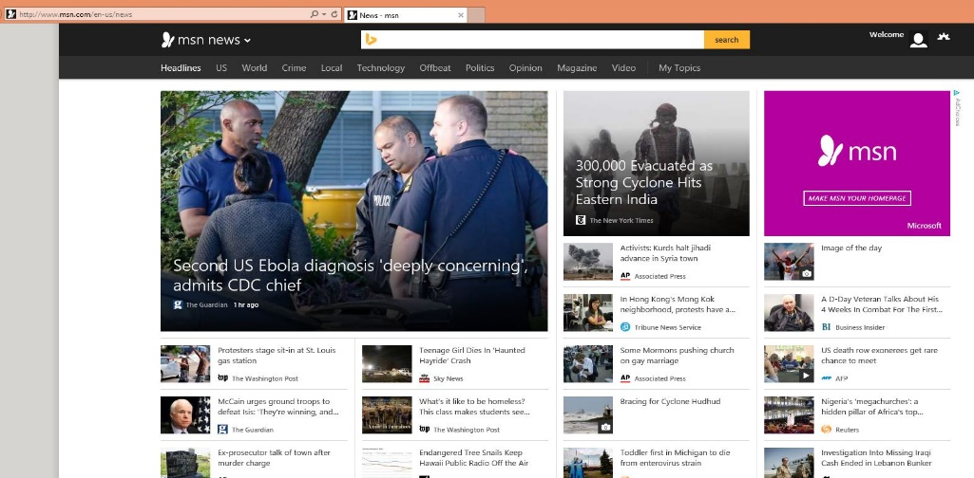
Example: News Recommendation
Loop:
  1. User arrives at MSN with browsing history, user account, previous visits,…
  2. Microsoft chooses news stories, ads, …
  3. User responds to content (clicks/navigation,…)
Goal: Choose content to yield desired user behavior
CB Assumption: Recommendations to one user do not effect other users

Slide 4
Pervasive applications
Content Recommendation: Apps, Movies, Books, …
Personalization of search results
Churn prevention
Adaptive UI personalization
…
How to build a general purpose system to power all of them?

Slide 5
Key Properties
Feedback only on actions taken
Need to try every plausibly good action…
… for every context
Randomized choice of actions makes correct learning possible

Slide 6


Randomization
Recommendation Policy

Slide 7
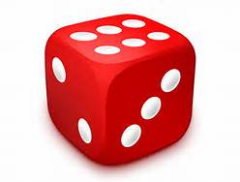
Randomization
Decision Service
Recommendation Policy

Slide 8

Randomization
Decision Service
Recommendation Policy
Need to record the probability of chosen action

Slide 9
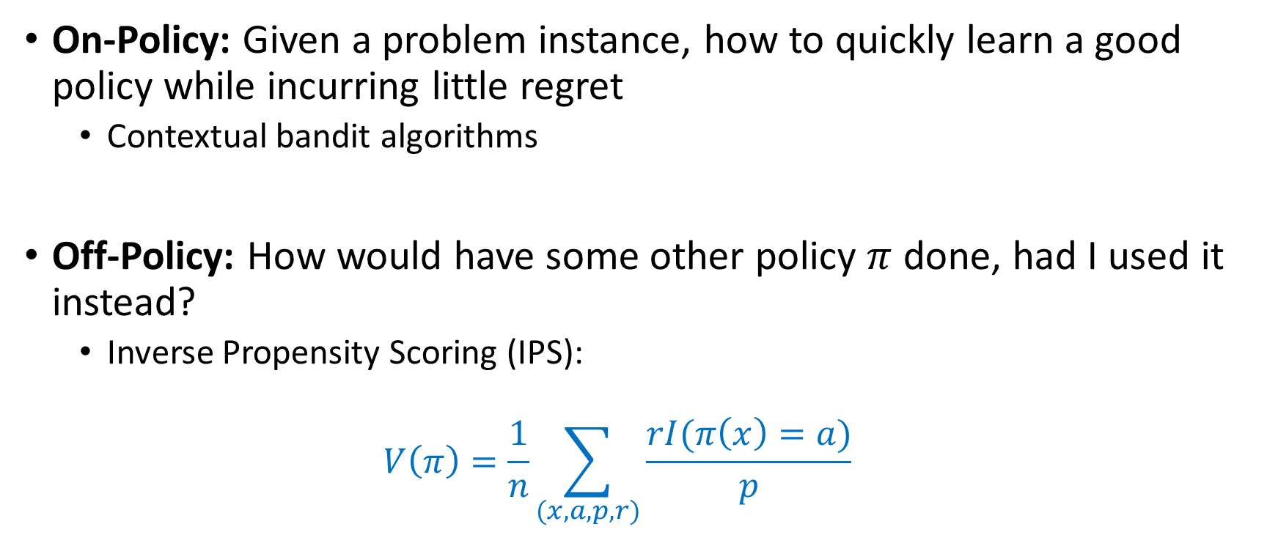
Questions of interest
On-Policy: Given a problem instance, how to quickly learn a good policy while incurring little regret
  Contextual bandit algorithms
Off-Policy: How would have some other policy $π$ done, had I used it instead?
  Inverse Propensity Scoring (IPS):
  $$V\left(π\right)=\frac{1}{n}\sum_{(x,a,p,r)}{\frac{rI(π\left(x\right)=a)}{p}}$$

Slide 10
Why it goes wrong
Separate teams for each part of the process
Faulty logging
  Logging final action, not random choice
  Logging just choice, not probabilities
  Features not logged and change in time
Runtime behavior incompatible with the ML
  Business logic overriding randomization
  Using the probability as feature for downstream ML
Explore
Log
Deploy
Learn
Subtle errors that are difficult to find in complex systems!

Slide 11
Multiworld Testing Decision Service
any part of
Explore
Log
Deploy
Learn
Goal: Make this easy, fast, automated
General-purpose system
Without an ML person in the loop for some classes of applications
∧

Slide 12
Decision Service Gains on MSN

Slide 13
The service
Best model
context
Client Library
Online
Offline
App
decision
or
Learning
Learning
reward
Web API
Contexts
Decisions
Rewards
Join Server

Slide 14
The service
Explore
Best model
context
Client Library
Online
Offline
App
decision
or
Learning
Learning
reward
Web API
Contexts
Decisions
Rewards
Join Server

Slide 15
The service
Best model
context
Client Library
Online
Offline
App
decision
or
Learning
Learning
reward
Web API
Log
Contexts
Decisions
Rewards
Join Server

Slide 16
The service
Best model
Learn
context
Client Library
Online
Offline
App
decision
or
Learning
Learning
reward
Web API
Contexts
Decisions
Rewards
Join Server

Slide 17
The service
Deploy
Best model
context
Client Library
Online
Offline
App
decision
or
Learning
Learning
reward
Web API
Contexts
Decisions
Rewards
Join Server

Slide 18
The service
Best model
context
Client Library
Hyper-
Parameters
Online
Offline
App
decision
or
Learning
Features
Learning
reward
Web API
Contexts
Decisions
Training Data
Rewards
Join Server
Data

Slide 19
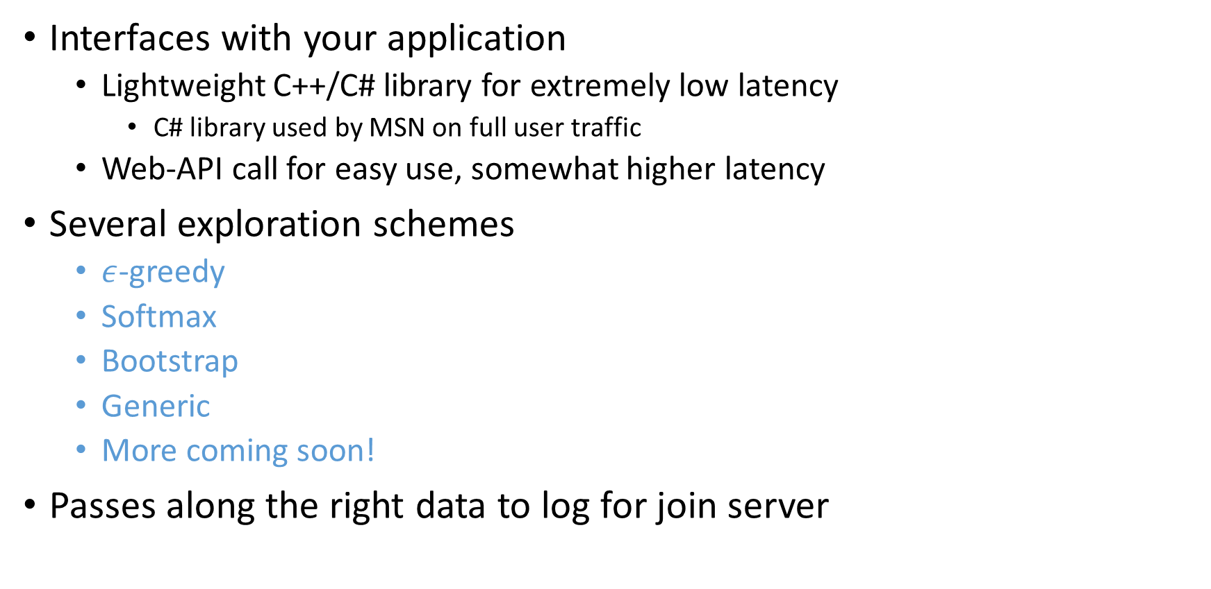
Client Library
Interfaces with your application
  Lightweight C++/C# library for extremely low latency
    C# library used by MSN on full user traffic
  Web-API call for easy use, somewhat higher latency
Several exploration schemes
  $ε$-greedy
  Softmax
  Bootstrap
  Generic
  More coming soon!
Passes along the right data to log for join server

Slide 20
public static void Run()
{
var recorder = new StringRecorder<Context>(); // Create an (optional) recorder.
var mwtt = new MwtExplorer<Context>("mwt", recorder);
var policy = new StringPolicy(); // Creates a policy that interacts with Context type
uint numActions = 10;
float epsilon = 0.2f;
// Creates an Epsilon-Greedy explorer using the specified settings
var explorer = new EpsilonGreedyExplorer<Context>(policy, epsilon, numActions);
// Creates a context of built-in Context type
var context = new Context(new Feature[] { new Feature() { Id = 1, Value = 0.5f }});
// Pass an instance of the Epsilon-Greedy exploration algorithm into MwtExplorer for exploration
// using a sample string to uniquely identify this event
string uniqueKey = "eventid";
uint action = mwtt.ChooseAction(explorer, uniqueKey, context);
Console.WriteLine(recorder.GetRecording());
}

Slide 21
Join Server
Joins together all data with the same key that arrives within the specified time window
  Context, action and probability
  Observed reward
  (Optionally) other data to log
Implemented using Azure Stream Analytics

Slide 22
Semantics
Azure Storage
duration
duration
9
:
00
10
:
00
11
:
00
Events Key₁
Events Key₂

Slide 23
Learning
Existing contextual bandit algorithms for learning and evaluation
Evaluation: Given a policy, estimate its performance if deployed
Provides estimate of the performance of a policy upon deployment without deploying it!

Slide 24
Learning
Existing contextual bandit algorithms for learning and evaluation
Evaluation: Given a policy, estimate its performance if deployed
Optimization: Find a good policy from some set of policies given exploration data
  Reduced to importance-weighted multiclass classification
  Algorithms available in Vowpal Wabbit
  Online as well as batch updates possible
Policy Optimization beyond the reach of A/B testing

Slide 25

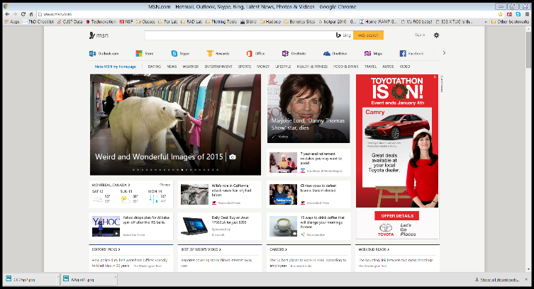


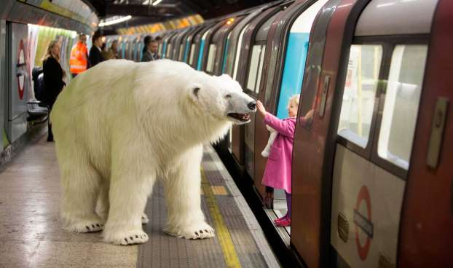
MSN Deployment for Personalized News
    ɛ-greedy exploration
Clicks to join server in Azure
Ranked List
User demographics feature vector
User history feature vector
50 editorially chosen articles with feature vectors
User Clicks Story
…
Front End Server Client Brower

Slide 26
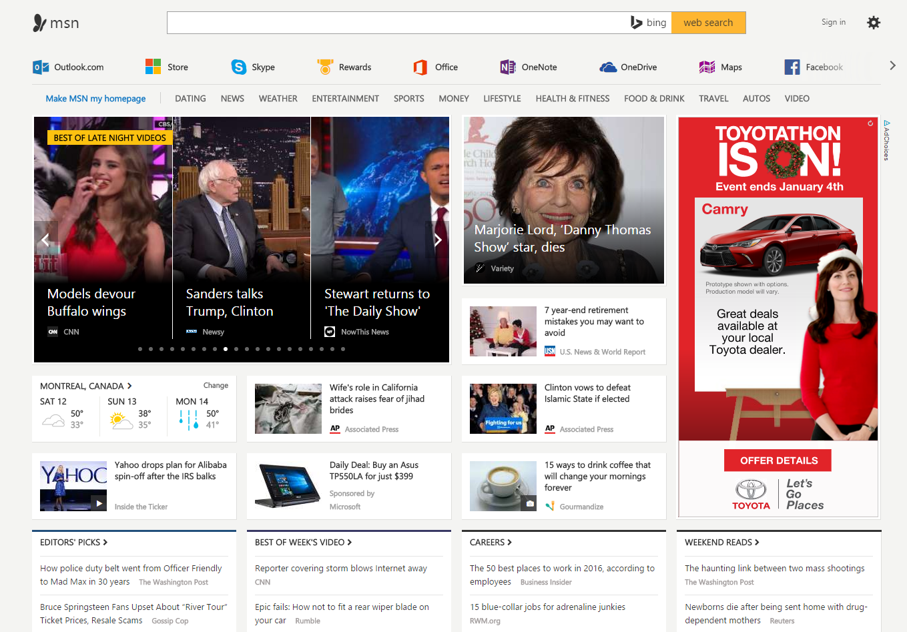

Slide 27
MSN Stats and Results
10s of millions of users
1000s of requests per second
5% overhead on front end machines
10s of servers for joining and training
5 minute model update frequency
> 25% increase in clicks
(without much tuning)
…

Slide 28
Deployable Decision Service
http://aka.ms/mwt
http://arxiv.org/abs/1606.03966
http://hunch.net/~vw

