Slide 1

On the effect of randomness on planted 3-coloring models
Uriel Feige
Weizmann Institute
Joint work with Roee David

Slide 2

3-coloring

Slide 3
3-coloring

Slide 4
NP-hard problems
3-coloring is NP-hard:
for every polynomial time 3-coloring algorithm, there are (worst case) 3-colorable graphs on which it fails.
We consider a framework that attempts to draw the line between easy and hard instances.
Similar frameworks apply to other NP-hard problems.

Slide 5
Hosted coloring framework
Involves two choices:
A host graph H.
A planted (not necessarily legal) coloring P.
The input graph G is obtained by removing from H those edges monochromatic under P.

Slide 6
Choice of host graph H

Slide 7
Planted 3-coloring P

Slide 8
Illegal - monochromatic edges

Slide 9
Remove monochromatic edges

Slide 10
Remove colors →G

Slide 11
The algorithmic challenge
The input is the graph G.
(The algorithm never sees H or P.)
The goal is to legally 3-color G in polynomial time.
G may have several legal 3-colorings. There is no requirement to recover the planted 3-coloring P.

Slide 12
Different models within the framework
Depending on how the host graph H and/or the planted coloring P are selected, the 3-coloring algorithmic challenge might be easy or hard.
Example: if both H and P are selected arbitrarily by an adversary, 3-coloring is NP-hard.

Slide 13
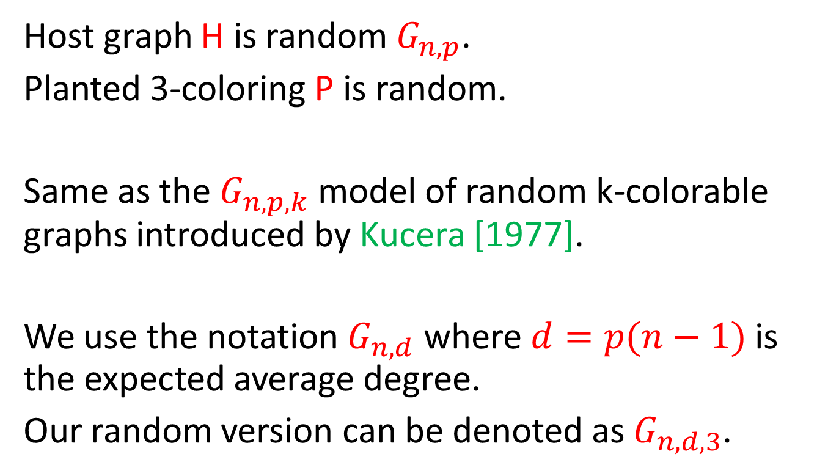
The random planted 3-coloring model
Host graph H is random $G_{n,p}$.
Planted 3-coloring P is random.
Same as the $G_{n,p,k}$ model of random k-colorable graphs introduced by Kucera [1977].
We use the notation $G_{n,d}$ where $d=p(n−1)$ is the expected average degree.
Our random version can be denoted as $G_{n,d,3}$.

Slide 14
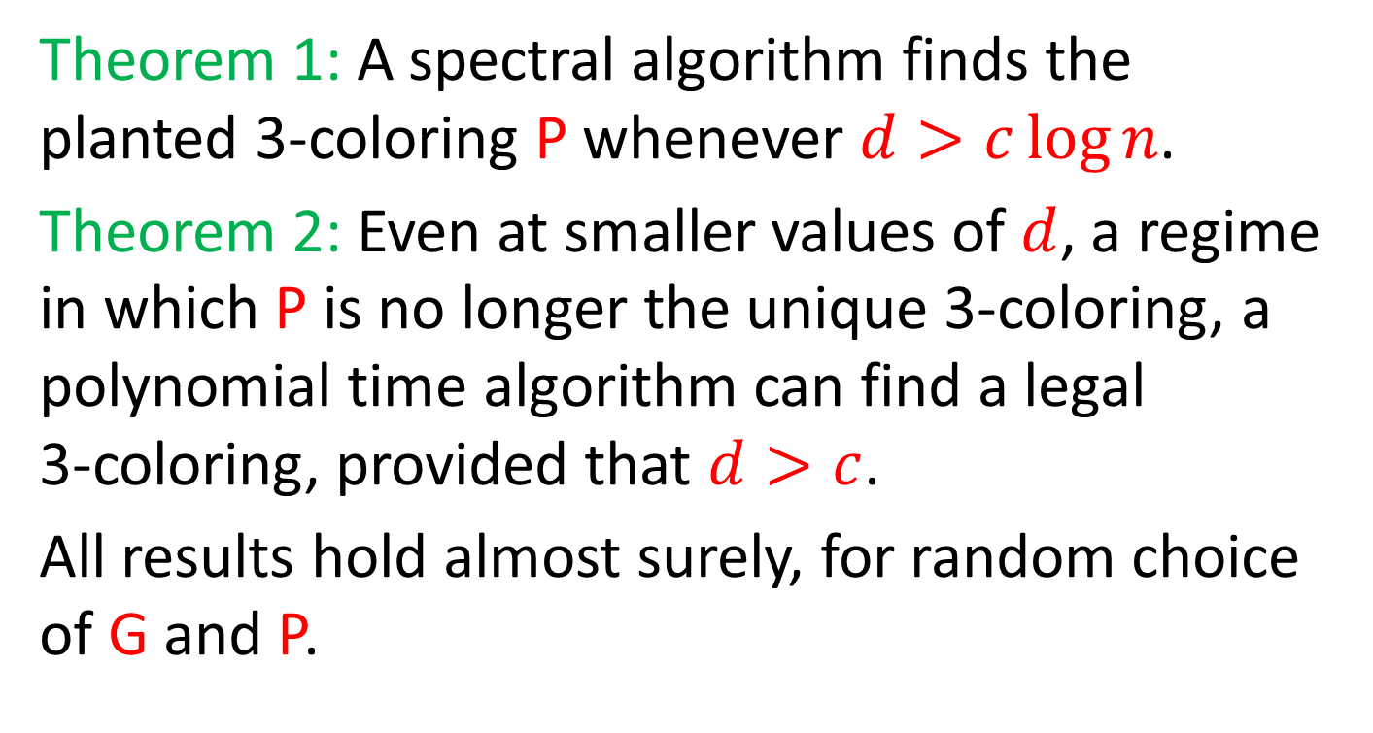
Alon and Kahale [1997]
Theorem 1: A spectral algorithm finds the planted 3-coloring P whenever $d>c\log{n}$.
Theorem 2: Even at smaller values of $d$, a regime in which P is no longer the unique 3-coloring, a polynomial time algorithm can find a legal
3-coloring, provided that $d>c$.
All results hold almost surely, for random choice of G and P.

Slide 15
Our questions
Which aspects of randomness are needed for the Alon-Kahale result?
Which aspects of randomness are needed for the host graph H? Does expansion suffice?
Does the planted coloring P need to be random? Can we instead allow an adversary to choose it after seeing H?

Slide 16
Outline of talk
Review the algorithm of Alon and Kahale, and sketch its analysis.
Consider what changes when the host graph is an expander chosen by an adversary.
Consider what changes when the planted coloring is adversarial.
Open questions.

Slide 17
Notions of coloring
P – the planted coloring.
B-approximate coloring: not necessarily legal, and at most B vertices colored differently than in P.
Safe B-partial coloring: all but at most B vertices colored as in P, and the remaining vertices are not colored (free).
Legal coloring – not necessarily P.

Slide 18
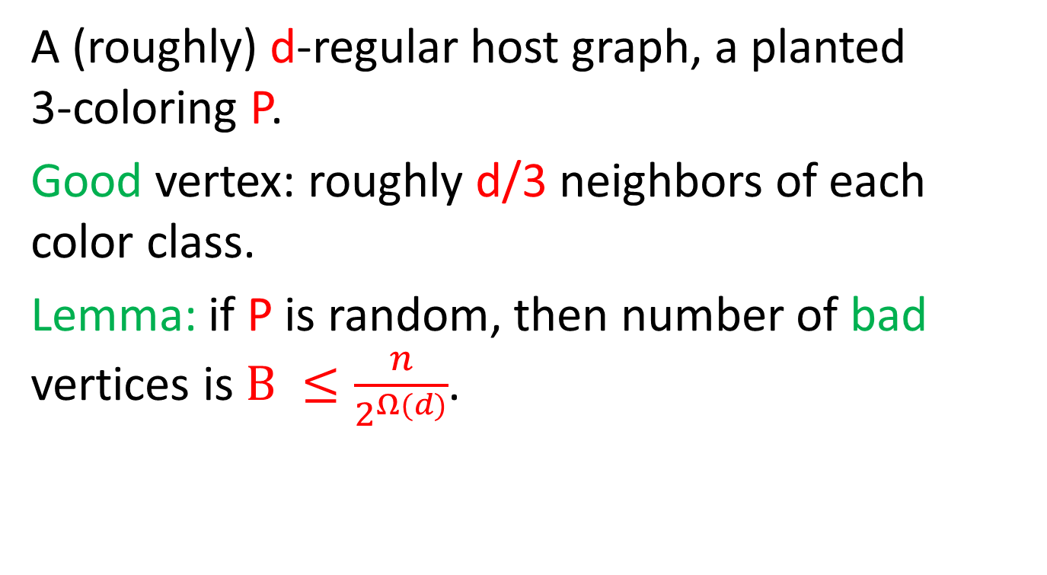
Good and bad vertices
A (roughly) d-regular host graph, a planted
3-coloring P.
Good vertex: roughly d/3 neighbors of each color class.
Lemma: if P is random, then number of bad vertices is $B ≤\frac{n}{2^{Ω(d)}}$.

Slide 19
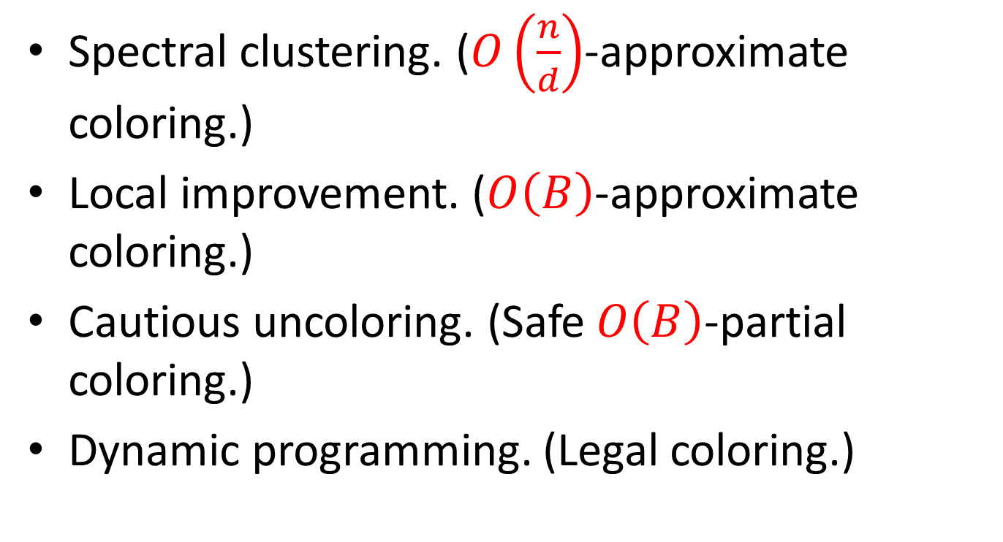
Steps of Alon-Kahale algorithm
Spectral clustering. ($O\left(\frac{n}{d}\right)$-approximate coloring.)
Local improvement. ($O\left(B\right)$-approximate coloring.)
Cautious uncoloring. (Safe $O\left(B\right)$-partial coloring.)
Dynamic programming. (Legal coloring.)

Slide 20
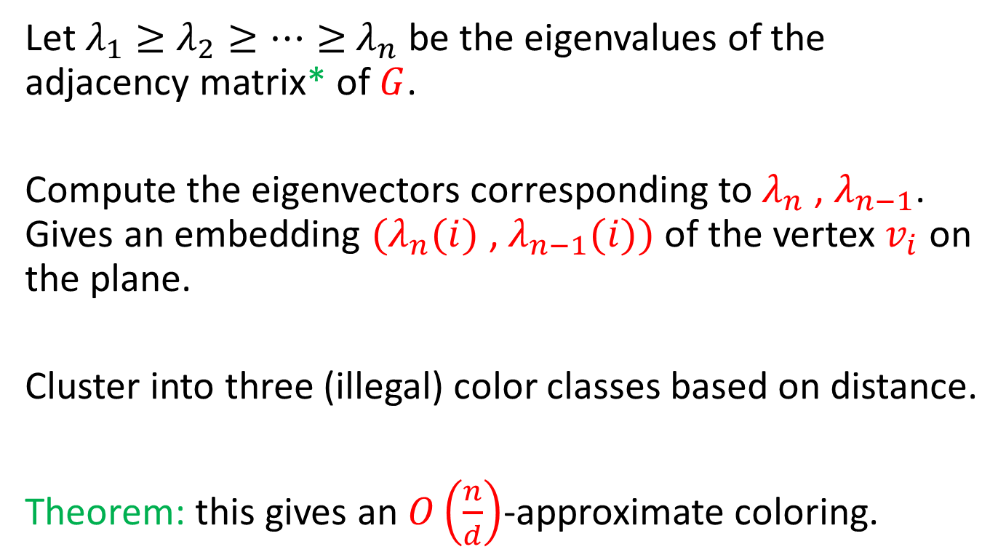
Spectral clustering
Let $λ_{1}≥$ $λ_{2}≥⋯≥$ $λ_{n}$ be the eigenvalues of the adjacency matrix* of $G$.
Compute the eigenvectors corresponding to $λ_{n}$ , $λ_{n−1}$. Gives an embedding ${(λ}_{n}(i)$ , $λ_{n−1}(i))$ of the vertex $v_{i}$ on the plane.
Cluster into three (illegal) color classes based on distance.
Theorem: this gives an $O\left(\frac{n}{d}\right)$-approximate coloring.

Slide 21
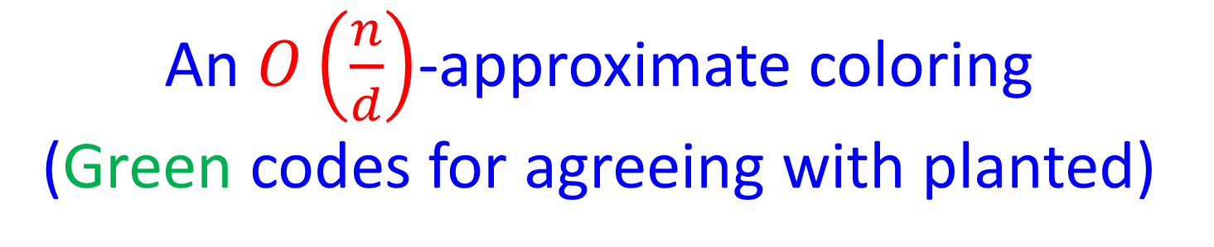
An $O\left(\frac{n}{d}\right)$-approximate coloring
(Green codes for agreeing with planted)

Slide 22
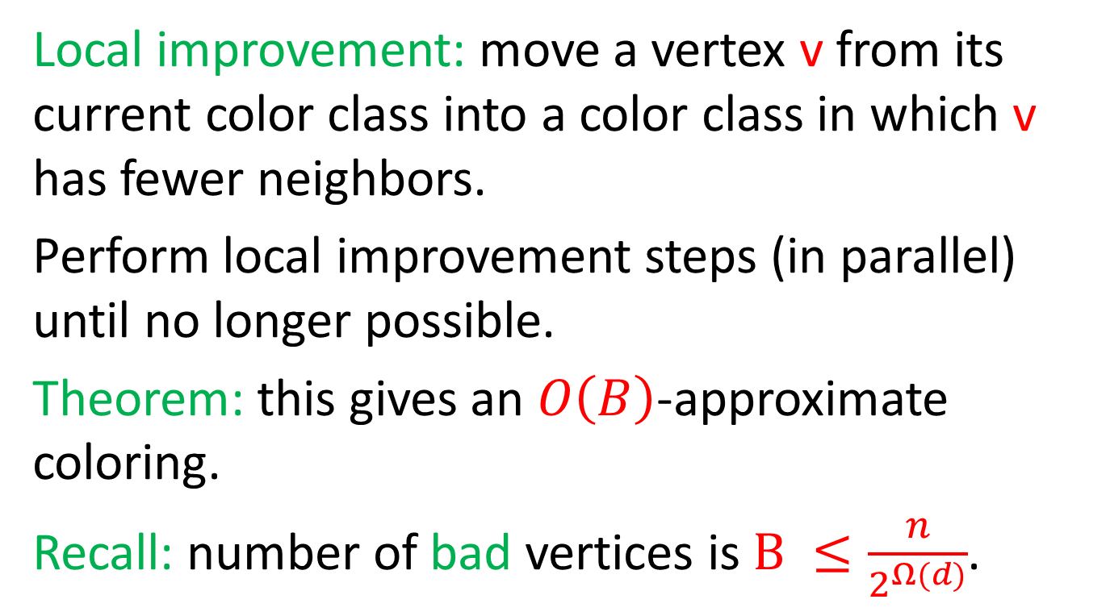
Local improvement
Local improvement: move a vertex v from its current color class into a color class in which v has fewer neighbors.
Perform local improvement steps (in parallel) until no longer possible.
Theorem: this gives an $O\left(B\right)$-approximate coloring.
Recall: number of bad vertices is $B ≤\frac{n}{2^{Ω(d)}}$.

Slide 23
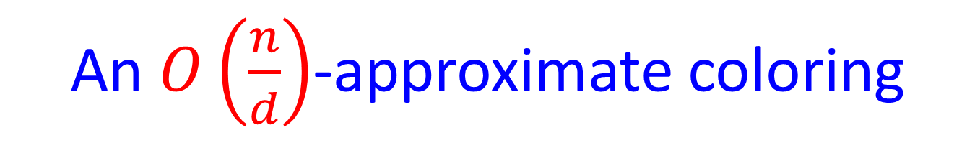
An $O\left(\frac{n}{d}\right)$-approximate coloring

Slide 24
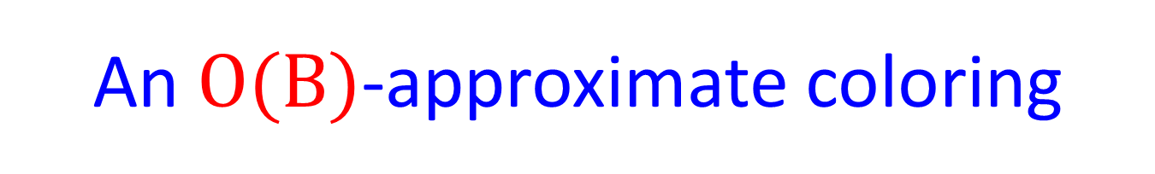
An $O(B)$-approximate coloring

Slide 25
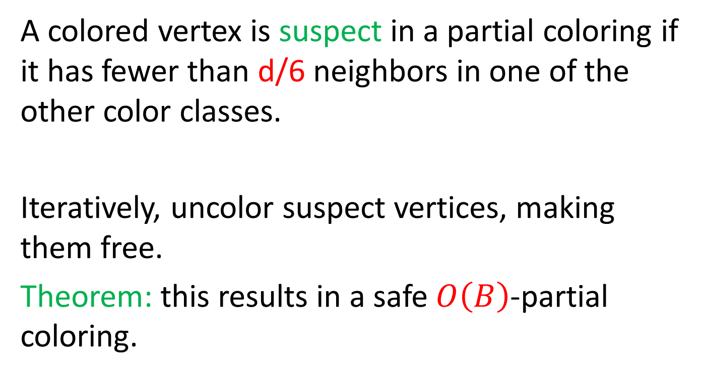
Cautious uncoloring
A colored vertex is suspect in a partial coloring if it has fewer than d/6 neighbors in one of the other color classes.
Iteratively, uncolor suspect vertices, making them free.
Theorem: this results in a safe $O\left(B\right)$-partial coloring.

Slide 26
An $O(B)$-approximate coloring

Slide 27
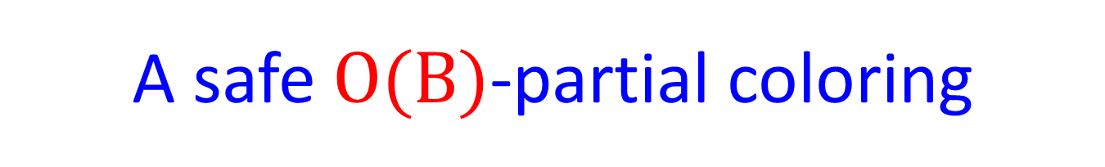
A safe $O(B)$-partial coloring

Slide 28
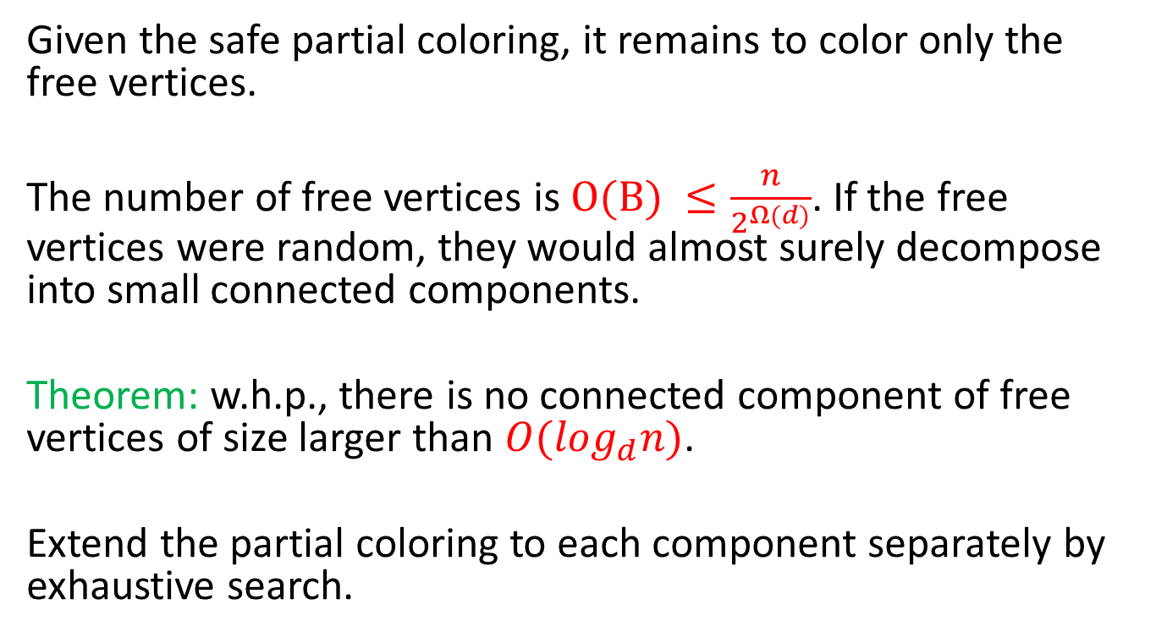
Dynamic programming
Given the safe partial coloring, it remains to color only the free vertices.
The number of free vertices is $O(B) ≤\frac{n}{2^{Ω(d)}}$. If the free vertices were random, they would almost surely decompose into small connected components.
Theorem: w.h.p., there is no connected component of free vertices of size larger than $O(\log_{d}n)$.
Extend the partial coloring to each component separately by exhaustive search.
Notes:
Because partial coloring is safe, we knows that free vertices are 3-coloring.
(Size alone does not imply that treewidth is bounded? Takes cycles and connect by paths.
Cannot remove nodes of degree 2 – list coloring.)

Slide 29
A safe $O(B)$-partial coloring

Slide 30
A legal coloring

Slide 31
Summary of Alon-Kahale algorithm
Spectral clustering. ($O\left(\frac{n}{d}\right)$-approximate coloring.)
Local improvement. ($O\left(B\right)$-approximate coloring.)
Cautious uncoloring. (Safe $O\left(B\right)$-partial coloring.)
Dynamic programming. (Legal coloring.)

Slide 32
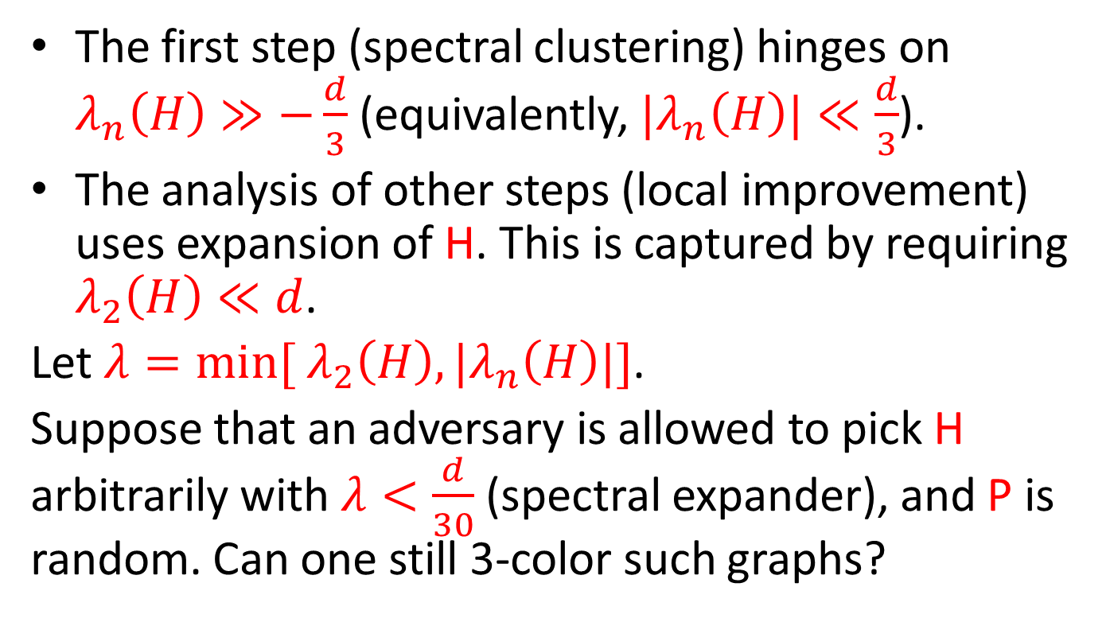
Does the host graph need to be random?
The first step (spectral clustering) hinges on $λ_{n}\left(H\right)≫−\frac{d}{3}$ (equivalently, ${|λ}_{n}\left(H\right)|≪\frac{d}{3}$).
The analysis of other steps (local improvement) uses expansion of H. This is captured by requiring $λ_{2}\left(H\right)≪d$.
Let $λ=min⁡[$ $λ_{2}\left(H\right),|λ_{n}\left(H\right)|]$.
Suppose that an adversary is allowed to pick H arbitrarily with $λ<\frac{d}{30}$ (spectral expander), and P is random. Can one still 3-color such graphs?

Slide 33
Algorithm for 3-coloring with spectral expander host graph
Spectral clustering. ($O\left(\frac{n}{d}\right)$-approximate coloring.)
Local improvement. ($O\left(B\right)$-approximate coloring.)
Cautious uncoloring. (Safe $O\left(B\right)$-partial coloring.)
Dynamic programming. (Legal coloring.)

Slide 34
Our algorithm for spectral expander host graph follows the same steps as the algorithm of Alon and Kahale.
Some of the details of how the steps are implemented differ.
Differences in the analysis – it has to work with only relatively mild expansion, and no randomness assumptions on the host graph H.

Slide 35
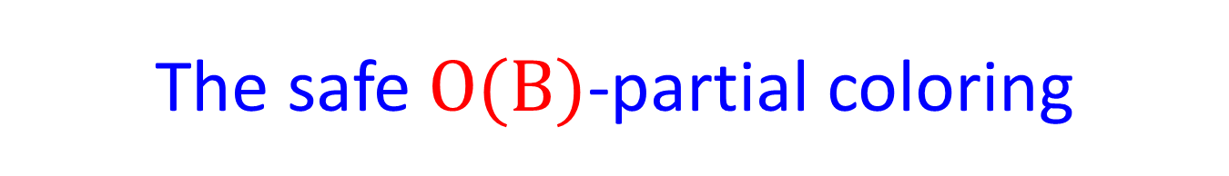
The safe $O(B)$-partial coloring

Slide 36
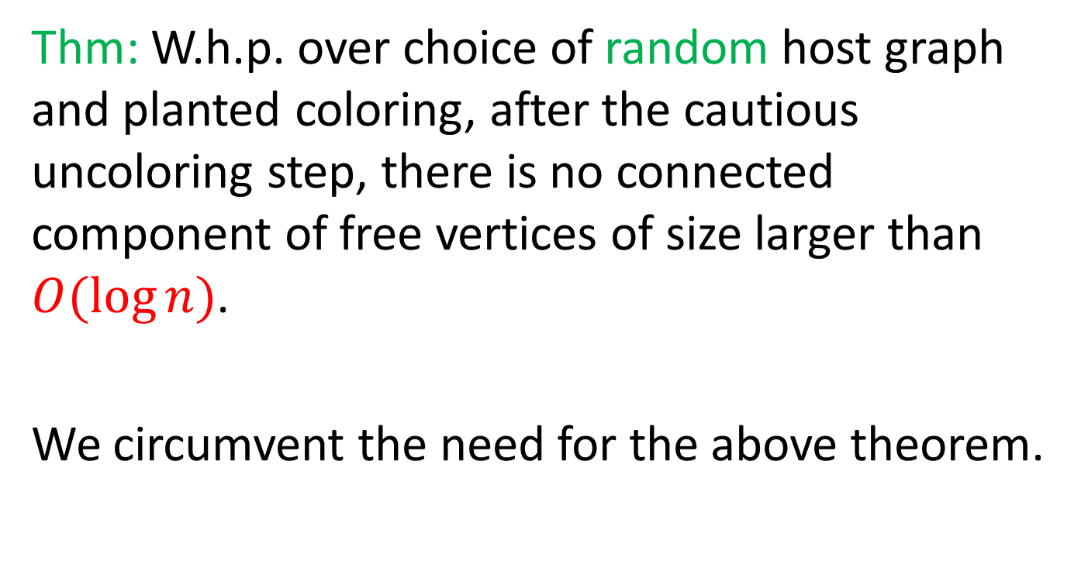
Perhaps the most complicated proof in [Alon and Kahale 1997]
Thm: W.h.p. over choice of random host graph and planted coloring, after the cautious uncoloring step, there is no connected component of free vertices of size larger than $O(\log{n})$.
We circumvent the need for the above theorem.

Slide 37
Even if connected components of free vertices have arbitrary sizes, we complete the partial coloring to a legal one

Slide 38
Safe recoloring
Iteratively, if a free vertex v has (non-free) neighbors of two different colors, color v by the remaining color, and make v non-free.

Slide 39
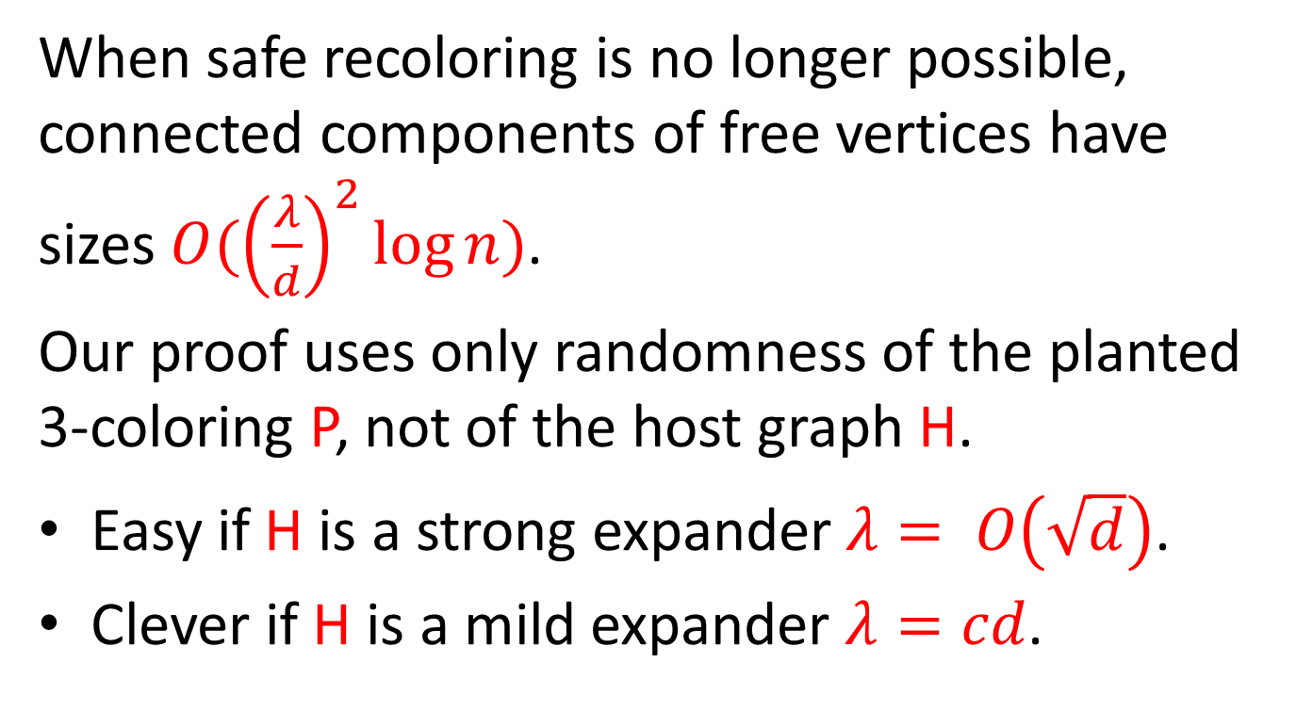
New theorem
When safe recoloring is no longer possible, connected components of free vertices have sizes $O({\left(\frac{λ}{d}\right)}^{2}\log{n})$.
Our proof uses only randomness of the planted
3-coloring P, not of the host graph H.
Easy if H is a strong expander $λ= O\left(\sqrt{d}\right)$.
Clever if H is a mild expander $λ=cd$.

Slide 40
Does the planted coloring P need to be random?
First a host graph H is selected.
Then, after seeing H, an adversary selects a balanced 3-coloring P, and removes all monochromatic edges.

Slide 41
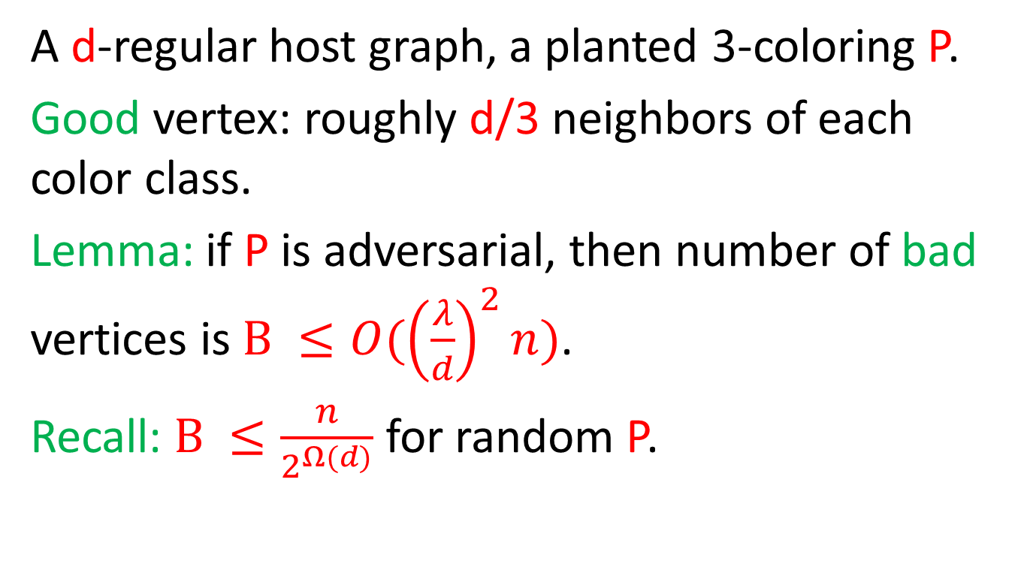
Good and bad vertices
A d-regular host graph, a planted 3-coloring P.
Good vertex: roughly d/3 neighbors of each color class.
Lemma: if P is adversarial, then number of bad vertices is $B ≤O({\left(\frac{λ}{d}\right)}^{2}n)$.
Recall: $B ≤\frac{n}{2^{Ω(d)}}$ for random P.

Slide 42
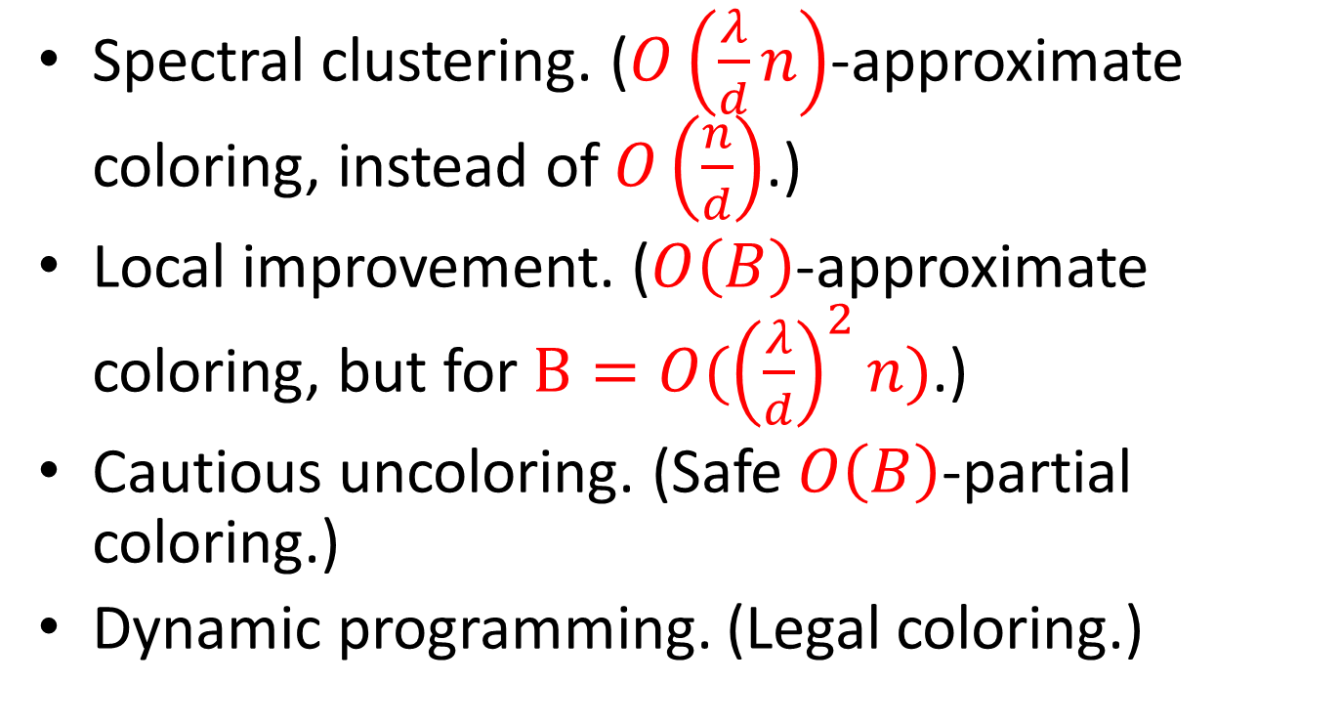
Algorithm for 3-coloring: adversarial expander H and adversarial P
Spectral clustering. ($O\left(\frac{λ}{d}n\right)$-approximate coloring, instead of $O\left(\frac{n}{d}\right)$.)
Local improvement. ($O\left(B\right)$-approximate coloring, but for $B=O({\left(\frac{λ}{d}\right)}^{2}n)$.)
Cautious uncoloring. (Safe $O\left(B\right)$-partial coloring.)
Dynamic programming. (Legal coloring.)

Slide 43
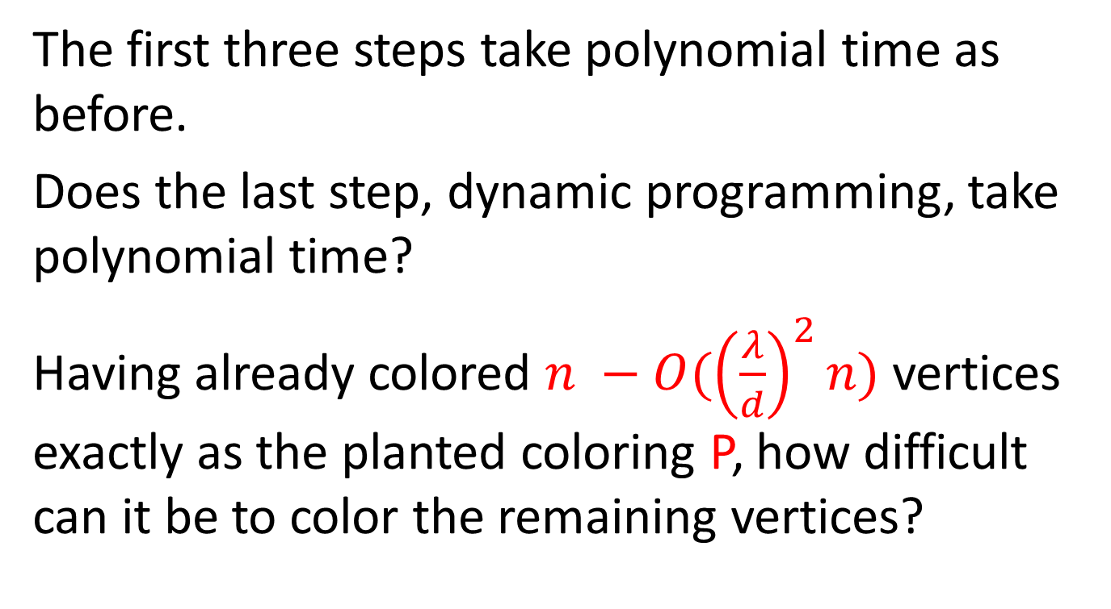
Running time
The first three steps take polynomial time as before.
Does the last step, dynamic programming, take polynomial time?
Having already colored $n −O({\left(\frac{λ}{d}\right)}^{2}n)$ vertices exactly as the planted coloring P, how difficult can it be to color the remaining vertices?

Slide 44
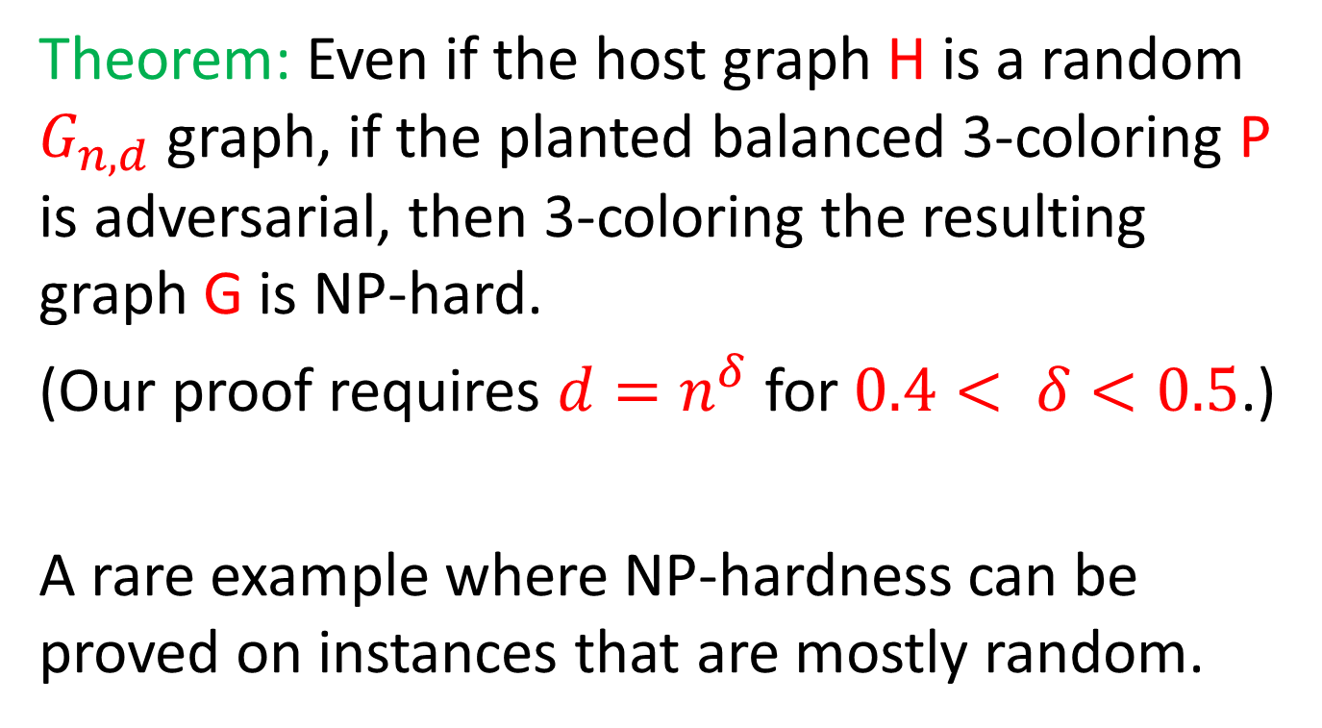
Main hardness result
Theorem: Even if the host graph H is a random $G_{n,d}$ graph, if the planted balanced 3-coloring P is adversarial, then 3-coloring the resulting graph G is NP-hard.
(Our proof requires $d=n^{δ}$ for $0.4< δ<0.5$.)
A rare example where NP-hardness can be proved on instances that are mostly random.

Slide 45
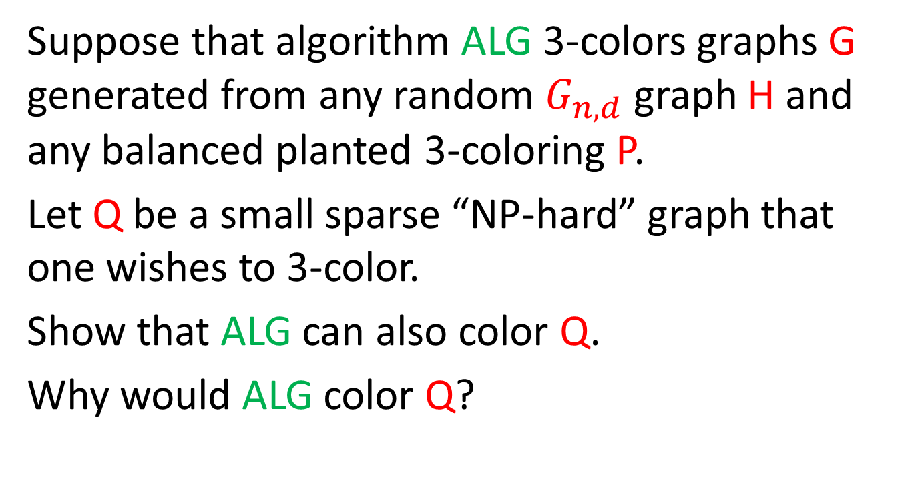
Proof sketch
Suppose that algorithm ALG 3-colors graphs G generated from any random $G_{n,d}$ graph H and any balanced planted 3-coloring P.
Let Q be a small sparse “NP-hard” graph that one wishes to 3-color.
Show that ALG can also color Q.
Why would ALG color Q?

Slide 46

Input to ALG
Z’ (3-colorable) Q (NP-hard graph) $G_{n^{′},d,3}$

Slide 47
Is H a random graph?
Z (random) Q (NP-hard)

Slide 48
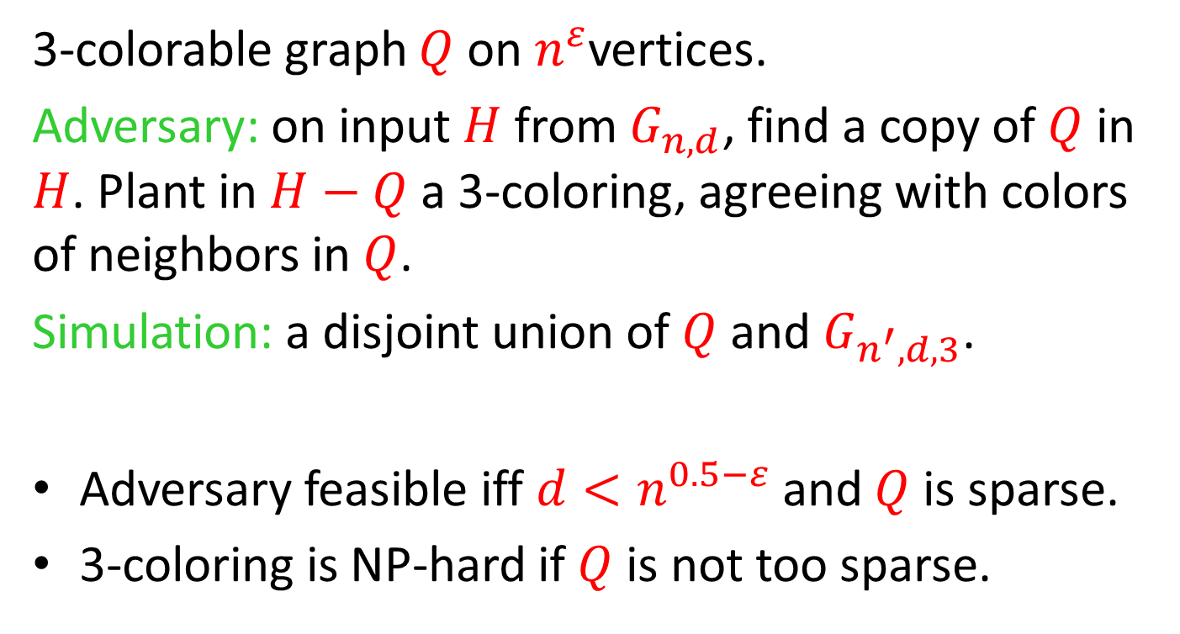
3-colorable graph $Q$ on $n^{ε}$vertices.
Adversary: on input $H$ from $G_{n,d}$, find a copy of $Q$ in $H$. Plant in $H−Q$ a 3-coloring, agreeing with colors of neighbors in $Q$.
Simulation: a disjoint union of $Q$ and $G_{n^{′},d,3}$.
Adversary feasible iff $d<n^{0.5−ε}$ and $Q$ is sparse.
3-coloring is NP-hard if $Q$ is not too sparse.

Slide 49
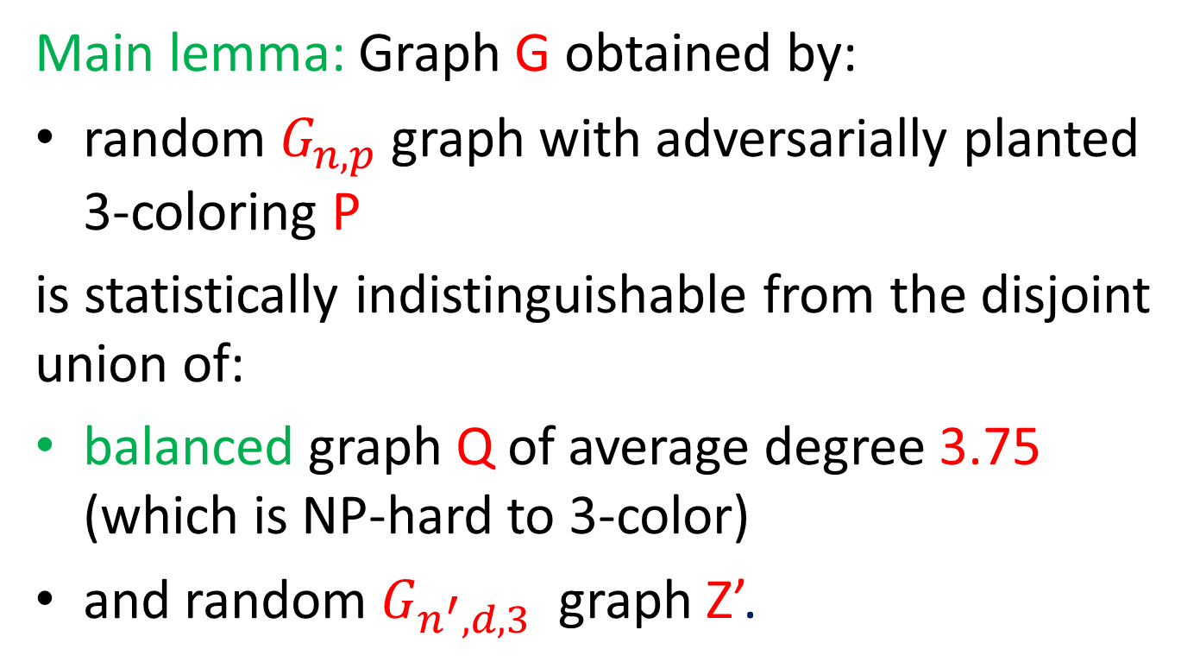
NP-hardness proof
Main lemma: Graph G obtained by:
random $G_{n,p}$ graph with adversarially planted
3-coloring P
is statistically indistinguishable from the disjoint union of:
balanced graph Q of average degree 3.75 (which is NP-hard to 3-color)
and random $G_{n^{′},d,3}$ graph Z’.

Slide 50
Summary
 | Random P | Adversarial balanced P
Random H | Alon and Kahale 1997 | ?
Adversarial expander H | ? | ?

Slide 51
Spectral Techniques
Approx coloring | Random P | Adversarial balanced P
Random H
Adversarial expander H

Slide 52
Plus combinatorial techniques
Safe partial coloring | Random P | Adversarial balanced P
Random H
Adversarial expander H

Slide 53
NP-hardness kicks in
Legal coloring | Random P | Adversarial balanced P
Random H
Adversarial expander H
?
?

Slide 54
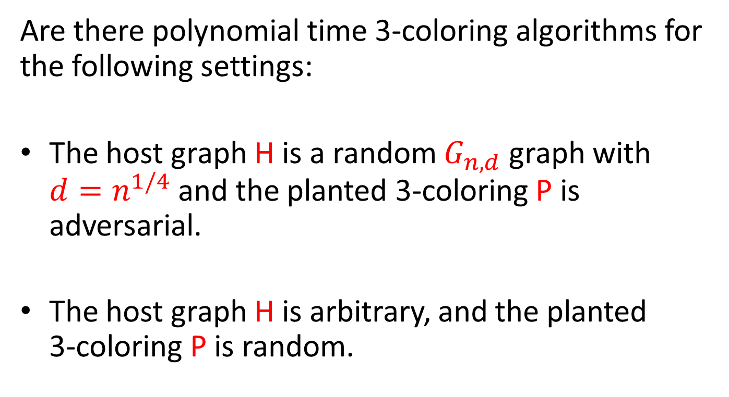
Open questions
Are there polynomial time 3-coloring algorithms for the following settings:
The host graph H is a random $G_{n,d}$ graph with $d=n^{1/4}$ and the planted 3-coloring P is adversarial.
The host graph H is arbitrary, and the planted
3-coloring P is random.

Slide 55
Thank you

