Slide 1
k-center Clustering under Perturbation Resilience
Colin White
Joint work with Nina Balcan and Nika Haghtalab.

Slide 2





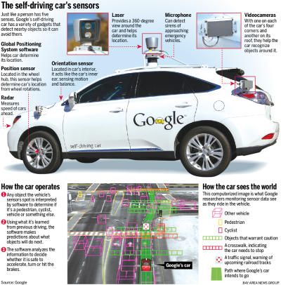


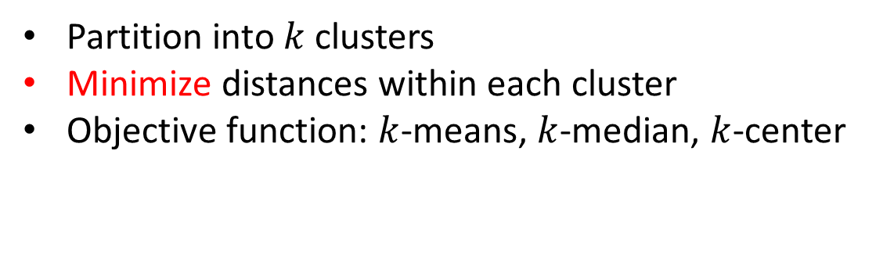
Clustering is everywhere
Given a set of elements, with distances
4
1
3
2
9
2
8
3
Partition into $k$ clusters
Minimize distances within each cluster
Objective function: $k$-means, $k$-median, $k$-center
2

Slide 3


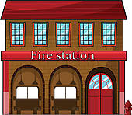
k-center Clustering
Choose fire stations, to minimize
the maximum travel time to any site.
For a set S of n points and distance metric d:
Choose k centers from S, assign each point to closest center.
Goal: minimize the maximum radius.

Slide 4

Asymmetric $k$-center (A$k$C)
Relax the condition that d is symmetric
10 min
30 min
Still have directed triangle-ineq.
Minimize distance from
Centers to points (order matters now)

Slide 5
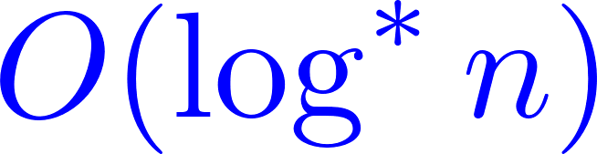
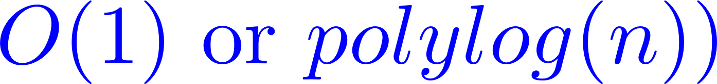
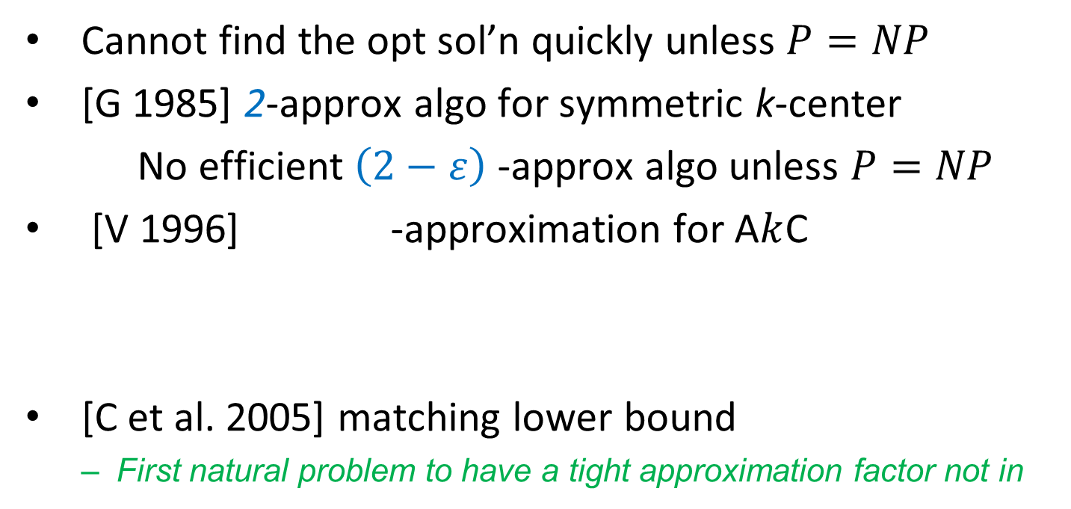
Known approximation results
Cannot find the opt sol’n quickly unless $P=NP$
[G 1985] 2-approx algo for symmetric k-center
No efficient $\left(2−ε\right)$ -approx algo unless $P=NP$
[V 1996] -approximation for A$k$C
[C et al. 2005] matching lower bound
  First natural problem to have a tight approximation factor not in

Slide 6
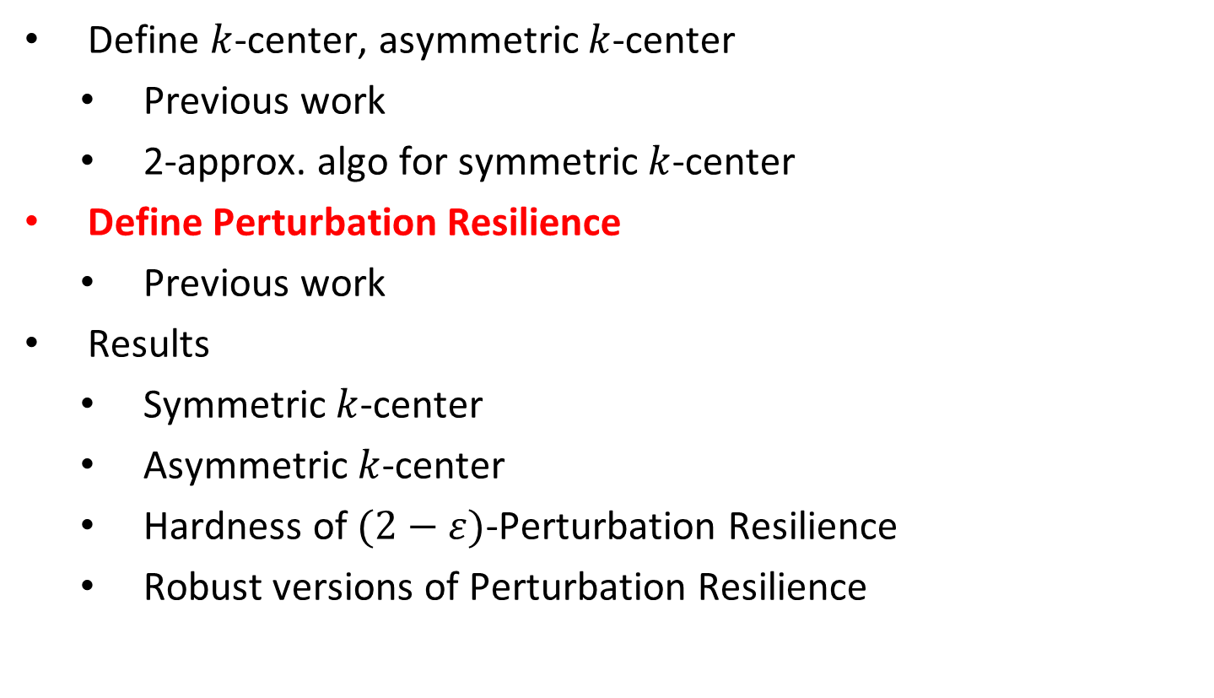
Outline
Define $k$-center, asymmetric $k$-center
  Previous work
  2-approx. algo for symmetric $k$-center
Define Perturbation Resilience
  Previous work
Results
  Symmetric $k$-center
  Asymmetric $k$-center
  Hardness of $(2−ε)$-Perturbation Resilience
  Robust versions of Perturbation Resilience

Slide 7
Beyond the worst-case
O(log*n) is not desirable in practice
The NP-hard instances are often contrived and particular
Theory does not always match up with practice
Perturbation Resilience
Small changes do not affect the opt clustering
More meaningful solution

Slide 8
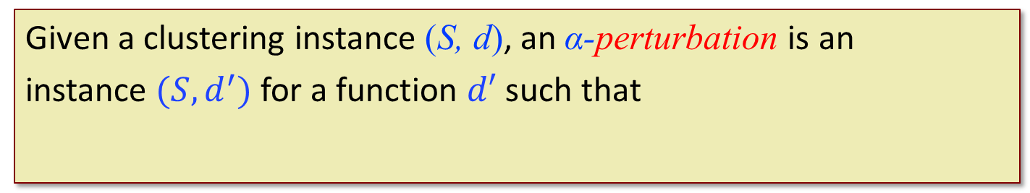

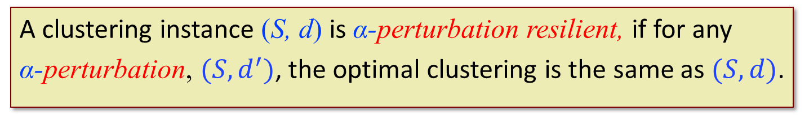

Perturbation Resilience
Given a clustering instance (S, d), an α-perturbation is an
instance $(S,d^{′})$ for a function $d′$ such that
$$∀$$
Bilu & Linial ’12:
A clustering instance (S, d) is α-perturbation resilient, if for any
α-perturbation, $(S,d^{′})$, the optimal clustering is the same as $(S,d)$.
$$×$$
It’s ok for centers to change, but not the partition.

Slide 9
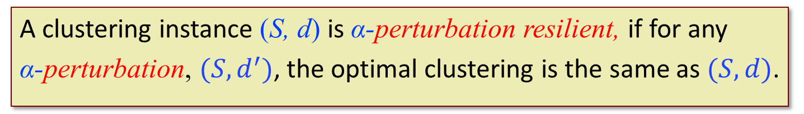
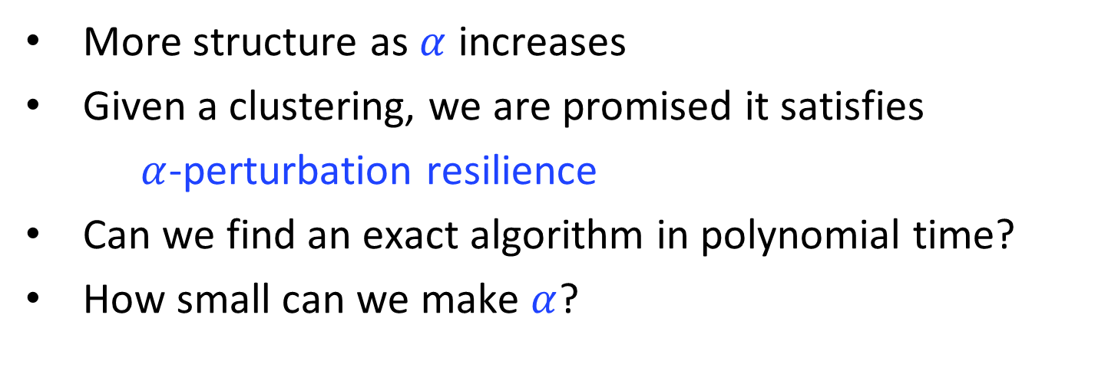
Perturbation Resilience
Bilu & Linial ’12:
A clustering instance (S, d) is α-perturbation resilient, if for any
α-perturbation, $(S,d^{′})$, the optimal clustering is the same as $(S,d)$.
More structure as $α$ increases
Given a clustering, we are promised it satisfies
$α$-perturbation resilience
Can we find an exact algorithm in polynomial time?
How small can we make $α$?

Slide 10
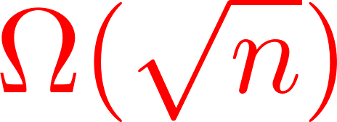
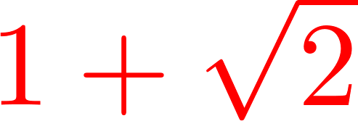
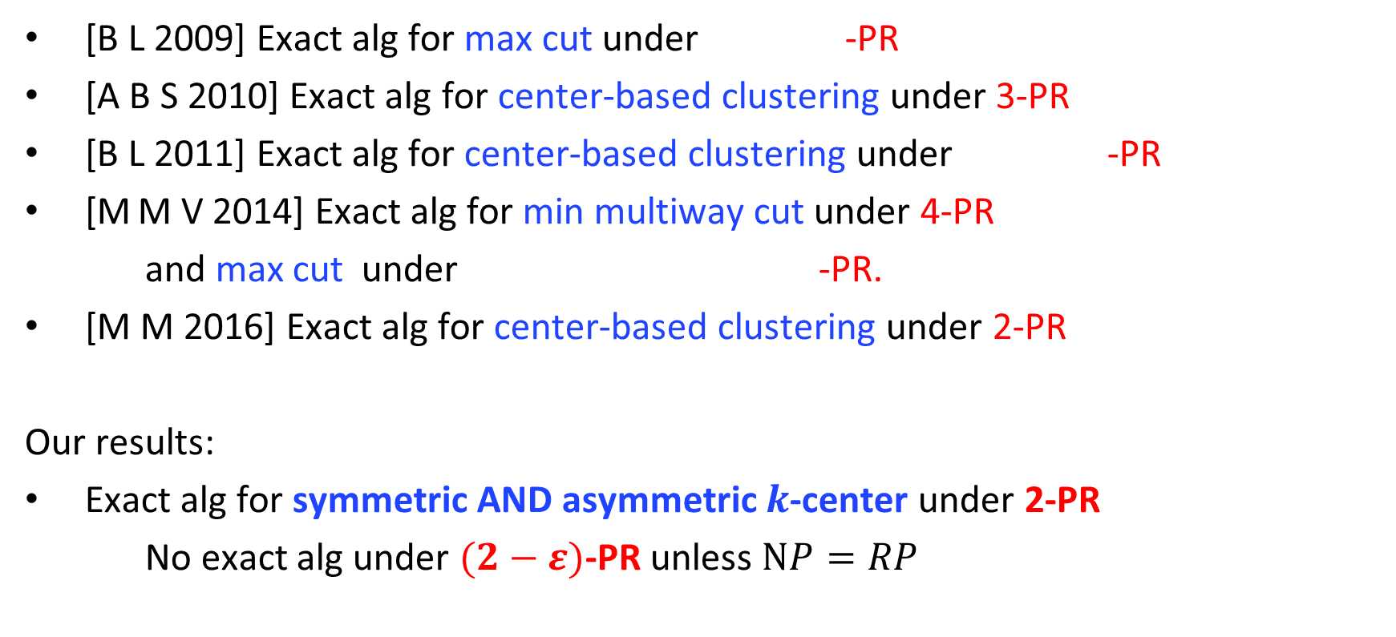
Prior Work
[B L 2009] Exact alg for max cut under -PR
[A B S 2010] Exact alg for center-based clustering under 3-PR
[B L 2011] Exact alg for center-based clustering under -PR
[M M V 2014] Exact alg for min multiway cut under 4-PR
and max cut under -PR.
[M M 2016] Exact alg for center-based clustering under 2-PR
Our results:
Exact alg for symmetric AND asymmetric $k$-center under 2-PR
No exact alg under $(2−ε)$-PR unless $NP=RP$

Slide 11
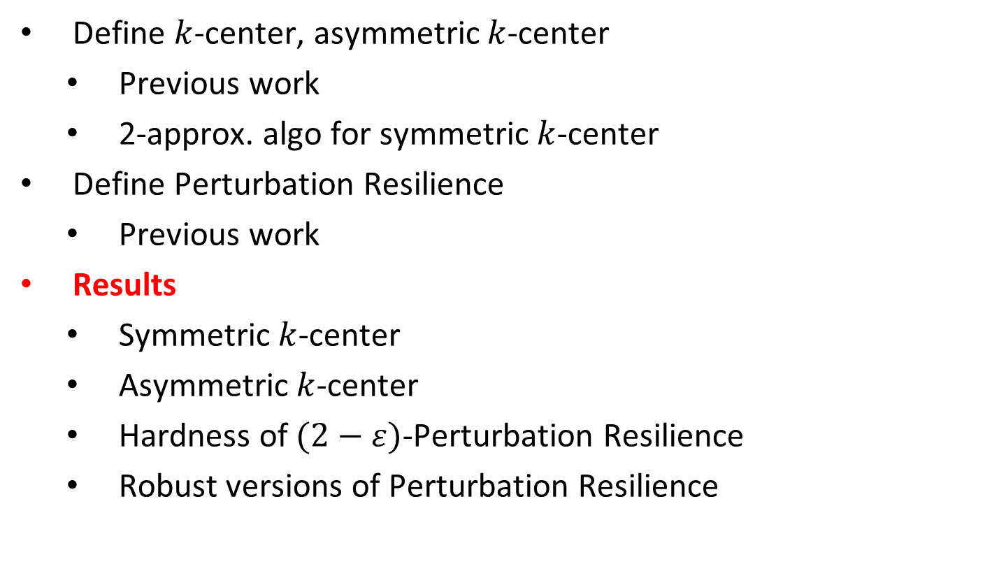
Outline
Define $k$-center, asymmetric $k$-center
  Previous work
  2-approx. algo for symmetric $k$-center
Define Perturbation Resilience
  Previous work
Results
  Symmetric $k$-center
  Asymmetric $k$-center
  Hardness of $(2−ε)$-Perturbation Resilience
  Robust versions of Perturbation Resilience

Slide 12
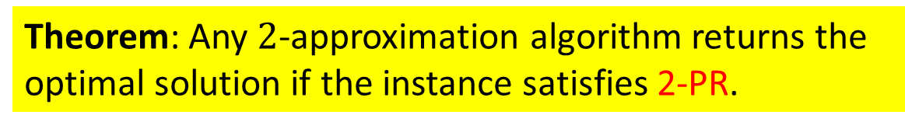


Symmetric $k$-center under 2-PR
Theorem: Any $2$-approximation algorithm returns the optimal solution if the instance satisfies 2-PR.
Proof:
Given a 2-PR instance, with opt. $r^{∗}$
Given a 2-approx solution, $C$
Make a 2-perturbation $d^{′}:$
  Multiply all dists by 2
  Decrease dists in $C$ down to ${2r}^{∗}$
Then $C$ is optimal in $d′$:
  $C$ is cost $≤{2r}^{∗}$
  Everything else has cost $≥{2r}^{∗}$
2-PR implies $C$ is optimal originally

Slide 13
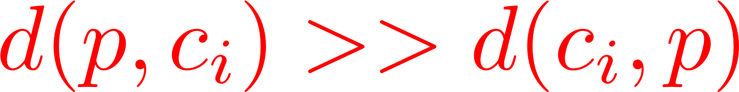
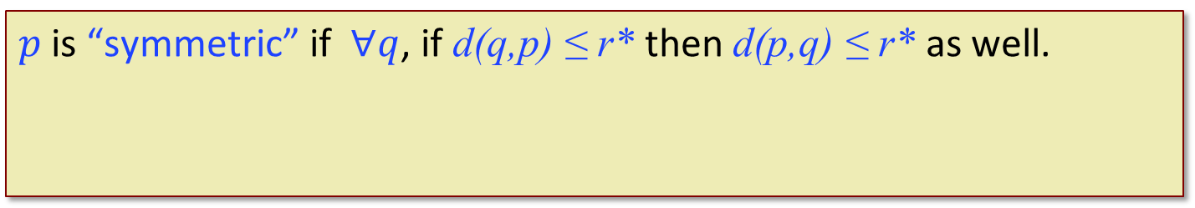

Asymmetric k-center under 2-PR
Theorem: Polynomial algorithm for A$k$C under 2-PR.
Idea: “bad” points for which
are hard to deal with
Can we find a subset of points that
behave “symmetrically” ?
$$100r^{∗}$$
Throw out the bad points
$p$ is “symmetric” if $∀q$, if d(q,p) ≤ r* then d(p,q) ≤ r* as well.
Notes:
But how do we know A is nonempty

Slide 14
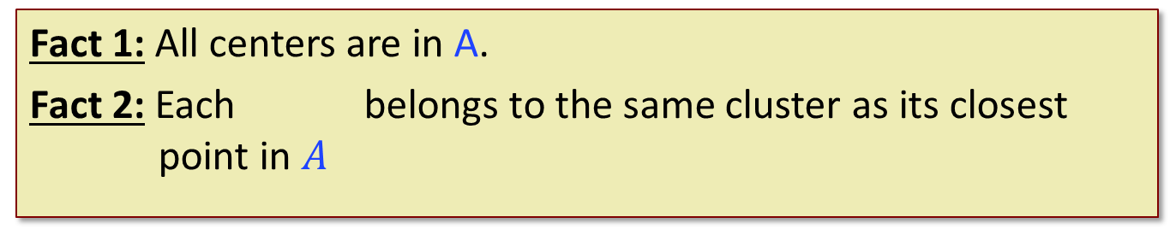
Facts about Set A
Fact 1: All centers are in A.
Fact 2: Each belongs to the same cluster as its closest point in $A$
To find the best clustering over the whole instance, it suffices to find the best clustering over A.
Notes:
With these facts, it suffices to cluster A only

Slide 15


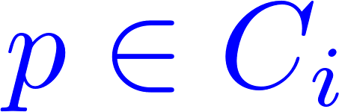
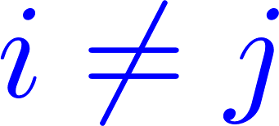
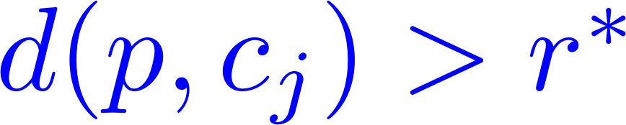
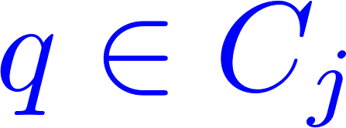
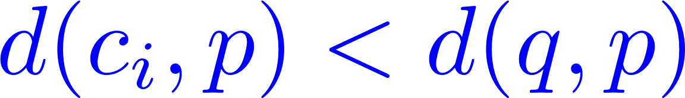

Two Useful Properties
Notation: optimal clusters: centers:
Useful Properties
Property 1: For all and ,
Property 2: For all and , ,
Property 1
Property 2
15

Slide 16

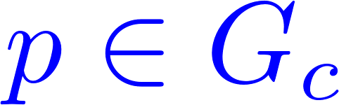



Key Observation
Notation : ball of radius $r^{∗}$ around a point $c$
Margin: Each is closer to $c$ than points outside $G_{c}$
and it satisfies margin!
Non-center $G_{c}$ : no margin unless
Property 1: For all and ,
Property 2: For all and , ,
16

Slide 17

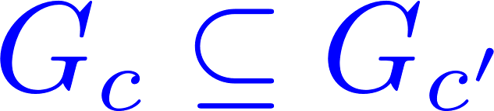
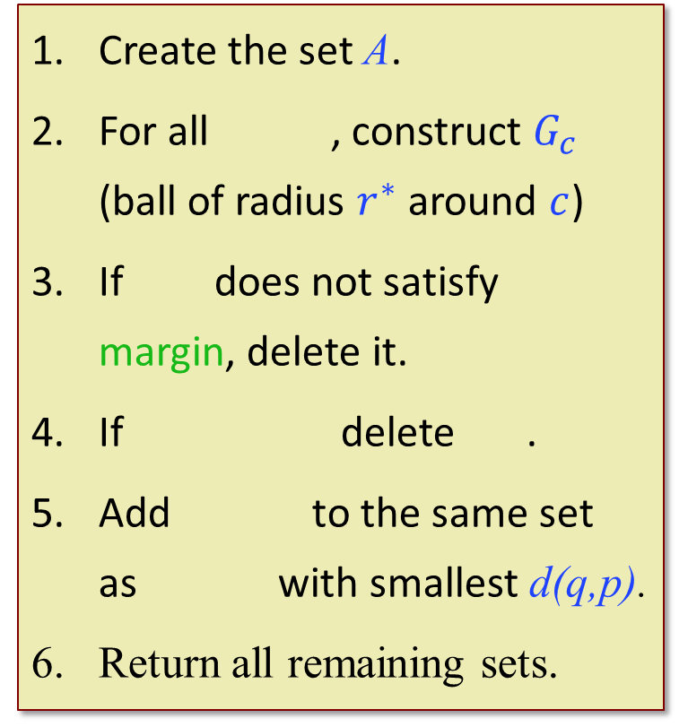
Algorithm
Algorithm:
Create the set A.
For all , construct $G_{c}$ (ball of radius $r^{∗}$ around $c$)
If does not satisfy margin, delete it.
If delete .
Add to the same set as with smallest d(q,p).
Return all remaining sets.

Slide 18
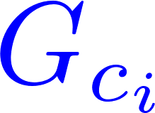



Proof Idea
Create the set A.
For all , construct $G_{c}$ (ball of radius $r^{∗}$ around $c$)
If does not satisfy margin, delete it.
If delete .
Add to the same set as with smallest d(q,p).
Return all remaining sets.
After step 4, we have clustered the set A:
are not deleted in step 3.
Non-center are deleted in step 3 unless
All other non-center
are deleted in step 4.
All points outside of A are added to the correct clusters
Key Observation: and they satisfy margin
Non-center $G_{c}$ : no margin unless

Slide 19
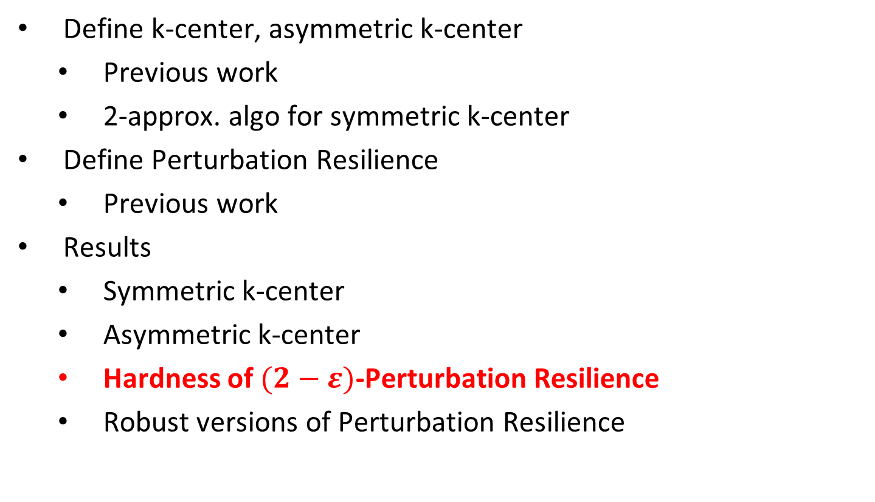
Outline
Define k-center, asymmetric k-center
  Previous work
  2-approx. algo for symmetric k-center
Define Perturbation Resilience
  Previous work
Results
  Symmetric k-center
  Asymmetric k-center
  Hardness of $(2−ε)$-Perturbation Resilience
  Robust versions of Perturbation Resilience

Slide 20




Lower Bounds
Hardness:
No polynomial time algorithm for symmetric k-center under
(2-ε) - perturbation resilience, unless NP=RP.
Parsimonious reduction from dominating set
$$α=1$$
$$α=1.99$$
No structure
No structure
$$α=3$$
Clusters are very far apart
$$α=2$$
Efficient Algorithm!

Slide 21
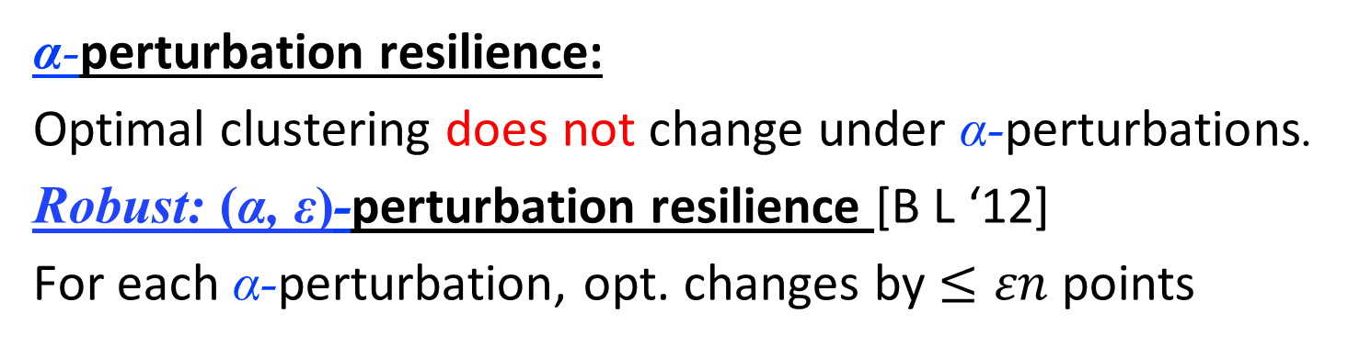
Robust Stability Conditions
α-perturbation resilience:
Optimal clustering does not change under α-perturbations.
Robust: (α, ε)-perturbation resilience [B L ‘12]
For each α-perturbation, opt. changes by $≤εn$ points

Slide 22
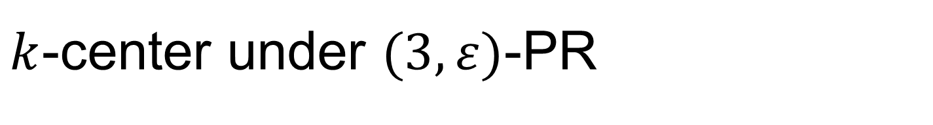
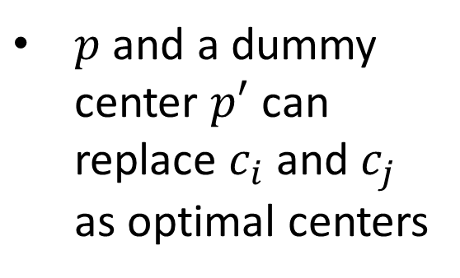



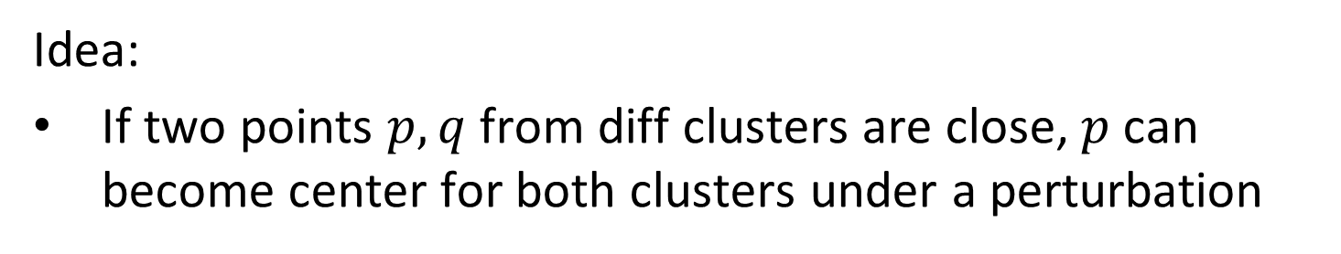
$k$-center under $(3,ε)$-PR
We need $Ω(εn)$ lower bound on opt cluster sizes
Single Linkage returns opt under $(3,ε)$-PR
Idea:
If two points $p,q$ from diff clusters are close, $p$ can become center for both clusters under a perturbation
$p$ and a dummy center $p′$ can replace $c_{i}$ and $c_{j}$ as optimal centers
$$p$$
$$≤3r^{∗}$$

Slide 23
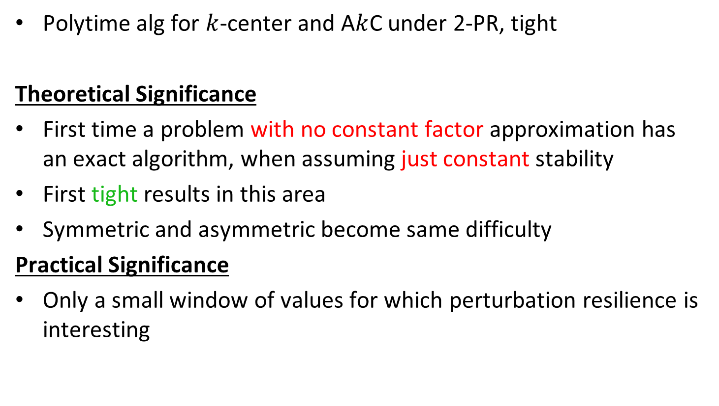
Conclusion
Polytime alg for $k$-center and A$k$C under 2-PR, tight
Theoretical Significance
First time a problem with no constant factor approximation has an exact algorithm, when assuming just constant stability
First tight results in this area
Symmetric and asymmetric become same difficulty
Practical Significance
Only a small window of values for which perturbation resilience is interesting

Slide 24

Open Questions
Can we go below $α=2$ for k-median and k-means?
Can we apply the symmetrizing technique to other problems?
Thanks!

