Slide 1
Welcome to the Simons Workshop on
Learning, Algorithm Design and Beyond Worst-Case Analysis
November 14-18, 2016
Organizers: Nir Ailon, Nina Balcan, Avrim Blum, Ravi Kumar, Kevin Leyton-Brown, and Tim Roughgarden

Slide 2
This workshop on
Learning, Algorithm Design and Beyond Worst-Case Analysis
is part of the
Semester Program on Algorithms and Uncertainty (Fall 2016)
at the
Simons Institute for the Theory of Computing

Slide 3
Some notes:
No food/drinks in auditorium (sorry)
Wireless: CalVisitor or eduroam
Time for short impromptu talks (email/talk to me)
Reception after the talks today
Optional social events each evenings:
  Mon: microbrew pub
  Tue: game night
  Wed: trip to SF
  Thu: microbrew pub
  Fri: Vik’s Chaat House

Slide 4
A Brief Tour of Algorithm Analysis Beyond the Worst Case
Avrim Blum
Carnegie Mellon University

Slide 5
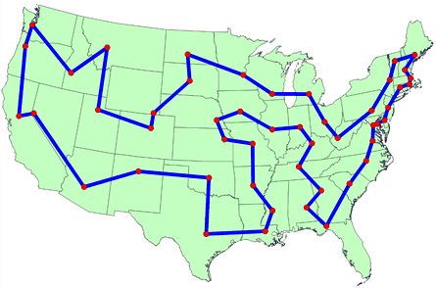
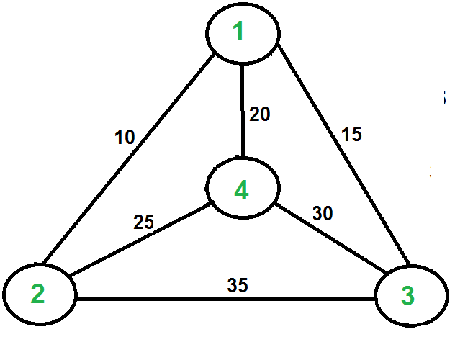
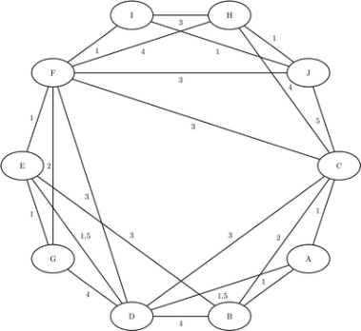
What’s the issue?
A problem (like network flow, TSP, graph coloring, SAT, clustering,…) consists of a family of instances
Traditional goal in TCS: algorithm that performs well on all instances in the family, i.e., Worst-Case Analysis
Great if we can do it

Slide 6
Worst-Case Analysis
Don’t need to worry about instance structure, can use for reductions (e.g., network flow, LP), etc.
We feel we have “cracked” the problem if we have an alg that does well on all instances in the family.
Great if we can do it

Slide 7
Worst-Case Analysis
Don’t need to worry about instance structure, can use for reductions (e.g., network flow, LP), etc.
We feel we have “cracked” the problem if we have an alg that does well on all instances in the family.
But what if we can’t?

Slide 8
Average-Case Analysis
Look at random instances
  Less pessimistic
  Can often give some insight into the problem
Worst case
Average case
[Beardwood et al 1959]: tight analysis of length of optimal TSP tour for random points in unit square
[Karp 1977]: asymptotically optimal heuristic for avg case
Notes:
Beardwood, Halton, and Hammersley (1959)

Slide 9
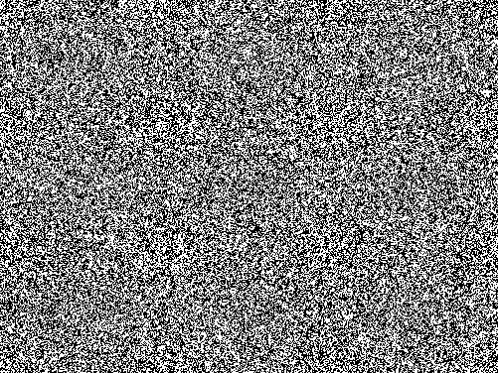
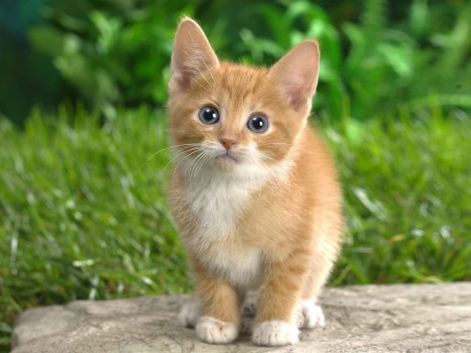
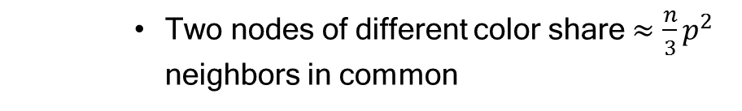
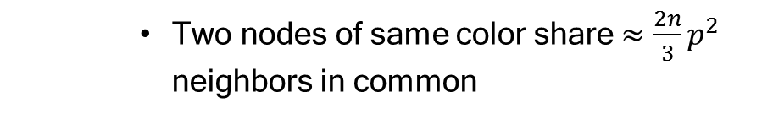
Average-Case Analysis
Look at random instances
  On the other hand, random $≠$ typical
(e.g., images)
vs
  Also random instances often very specific
  E.g., random 3-colorable graph
    Two nodes of same color share $≈\frac{2n}{3}p^{2}$ neighbors in common
    Two nodes of different color share $≈\frac{n}{3}p^{2}$ neighbors in common

Slide 10
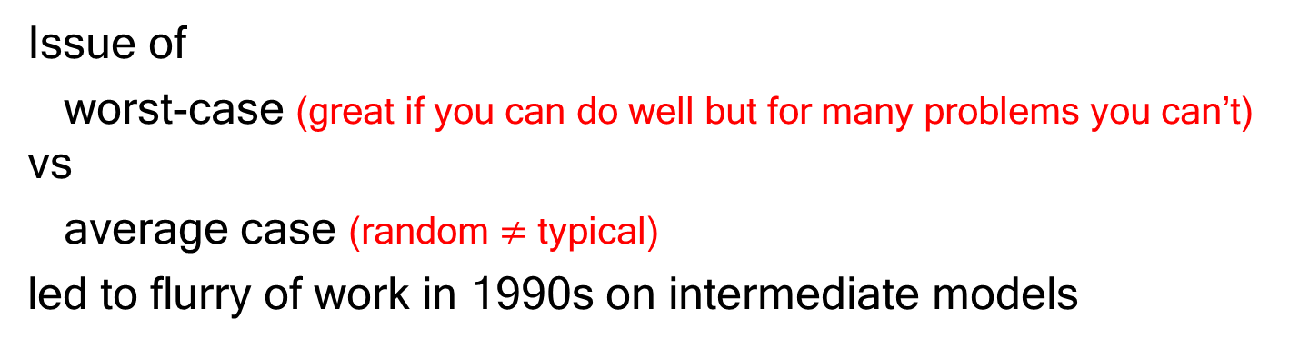
1990s: Intermediate models
Issue of
worst-case (great if you can do well but for many problems you can’t) vs
average case (random $≠$ typical)
led to flurry of work in 1990s on intermediate models
Average Case
Worst Case
Focus: NP-hard problems that are hard to approximate well in worst-case, online problems with high competitive ratios
Notes:
I’ll talk about a few of these models

Slide 11
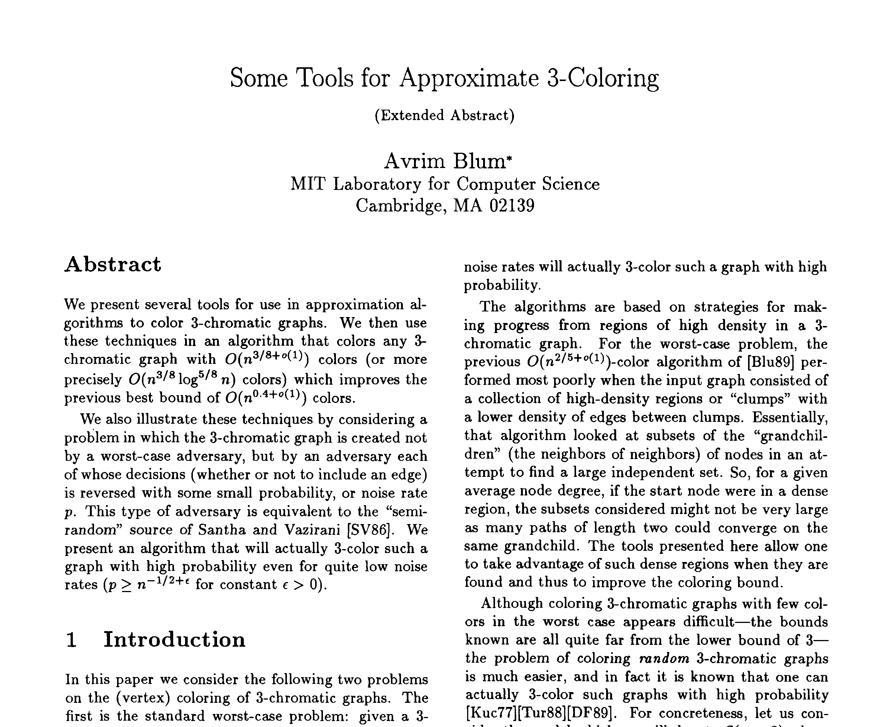
Semi-random input model
[FOCS 1990]
Notes:
One fun thing about giving this talk is the chance to look back at some old papers. I’ll start with one of mine.

Slide 12
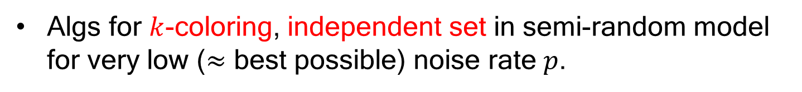
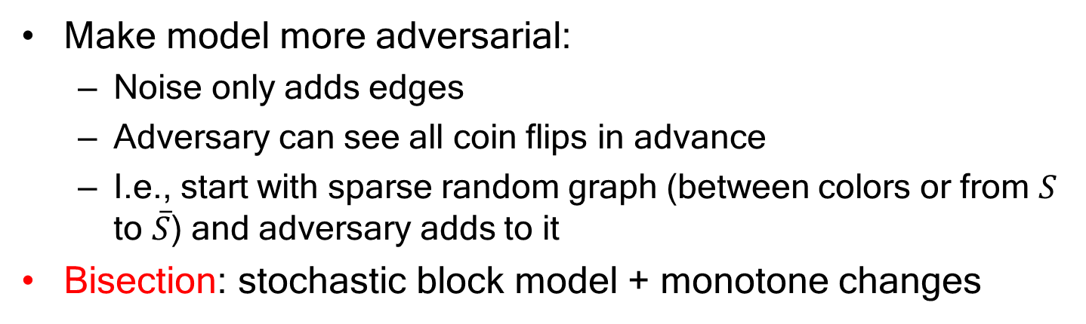
Semi-random input model
[Feige-Kilian ‘98]
Algs for $k$-coloring, independent set in semi-random model for very low ($≈$ best possible) noise rate $p$.
Make model more adversarial:
  Noise only adds edges
  Adversary can see all coin flips in advance
  I.e., start with sparse random graph (between colors or from $S$ to $\overline{S}$) and adversary adds to it
Bisection: stochastic block model + monotone changes
See Aravindan’s talk for recent results in graph partitioning
See Uri’s talk for model where randomness replaced with expansion

Slide 13
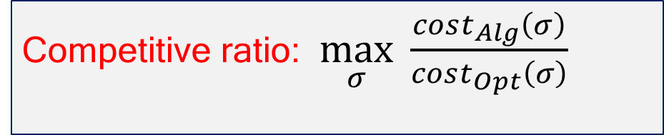
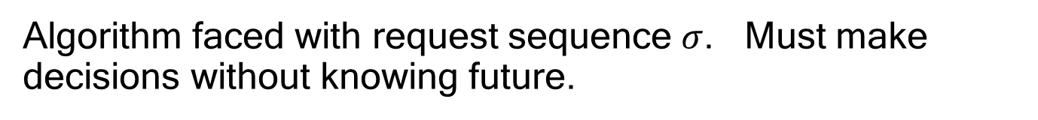
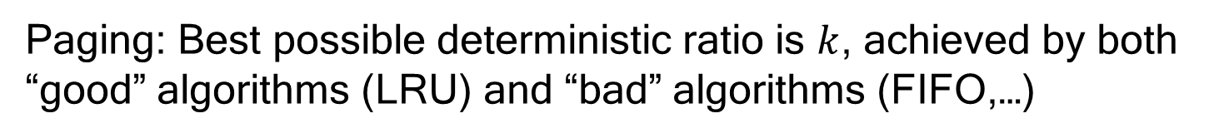
On-line algorithms
Algorithm faced with request sequence $σ$. Must make decisions without knowing future.
Competitive ratio: $\max_{σ} \frac{cost_{Alg}\left(σ\right)}{cost_{Opt}\left(σ\right)}$
Paging: Best possible deterministic ratio is $k$, achieved by both “good” algorithms (LRU) and “bad” algorithms (FIFO,…)
Explain what makes LRU good? Bypass this lower bound?

Slide 14
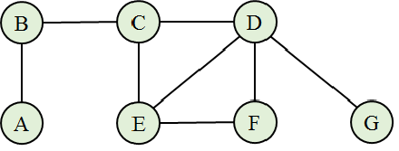
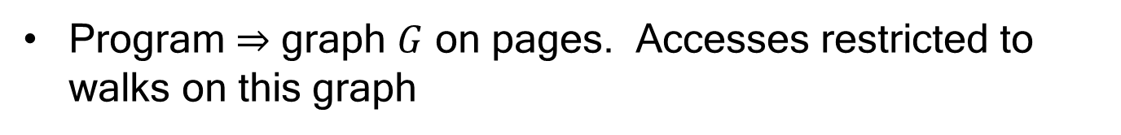
On-line algorithms
Access-graph model [Borodin-Irani-Raghavan-Schieber ‘91]
Program $⇒$ graph $G$ on pages. Accesses restricted to walks on this graph
Analyze competitive ratio of LRU as a function of the graph
LRU never much worse than FIFO and can be much better, and design interesting near-optimal algorithm
Notes:
Has to do with articulation nodes in node-induced subgraphs.

Slide 15
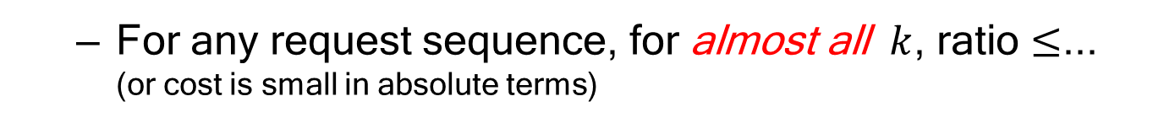
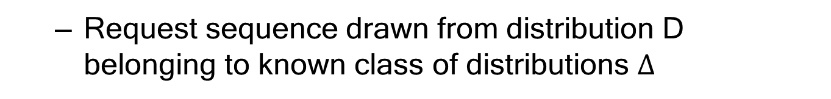
On-line algorithms
Access-graph model [Borodin-Irani-Raghavan-Schieber ‘91]
Loose-competitiveness model [Young ‘91]
  For any request sequence, for almost all $k$, ratio $≤$... (or cost is small in absolute terms)
Markov-paging model [Karlin-Phillips-Raghavan ‘92]
Diffuse-adversary model [Koutsoupias-Papadimitriou ‘94]
  Request sequence drawn from distribution D belonging to known class of distributions $Δ$

Slide 16

1990s Learning theory
Combining expert advice [Littlestone-Warmuth] [Cesa-Bianchi et al]……
  Given a collection of actions (which way to drive to work today), which one should you take?
Robots R Us
32 min
  In hindsight, should have followed path A on day 1, path B on day 2, path A on day 3, …
  Just try to compete with best single action (path).
    Motivationally, if world was iid, best strategy would be a single action
    (Model is worst-case, but competing wrt best strategy in class that includes optimal for iid setting)

Slide 17
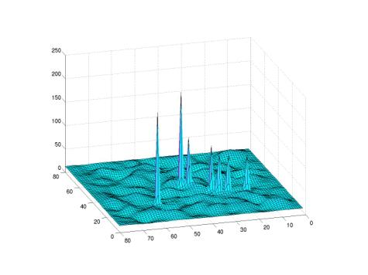
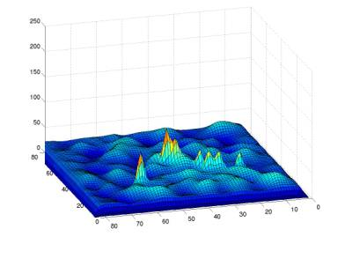
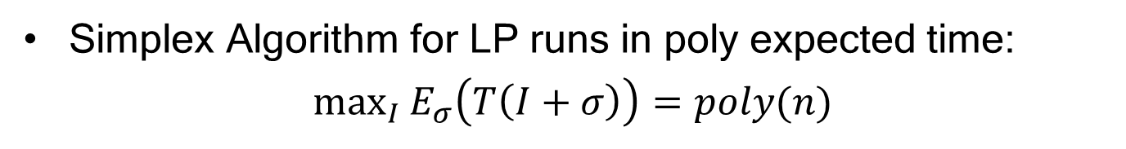
2000s: Understand observed success
Smoothed analysis model [Spielman-Teng ‘01]
Every entry perturbed with small Gaussian noise
Simplex Algorithm for LP runs in poly expected time:
$\max_{I}{E_{σ}\left(T\left(I+σ\right)\right)=poly(n)}$
More adversarial than semi-random model
Notes:
In a formal sense, can’t hope to get poly smoothed complexity if problem is hard to approximate, in fact need to have an FPTAS (also pseudo-polynomial time).

Slide 18
2000s: Understand observed success
Smoothed analysis model [Spielman-Teng ‘01]
2-OPT TSP heuristic [Englert-Röglin-Vöcking ’07]
Lloyd’s $k$-means algorithm [Arthur-Manthey-Röglin ’09]
(analysis is for time to reach a local optimum)
Notes:
Assumption seems too weak to talk about algorithms finding a solution close to the global optimum. For that you need something stronger, which takes me to the next topic.

Slide 19
Late 2000s+: models of “nice” inputs
Replace randomness with deterministic conditions.
Goals:
Understand “reasonable” inputs
What properties of an instance make it easy/hard to find a global optimum or desired solution?
Can we use implicit assumptions in formulations?
Explain success of common heuristics

Slide 20
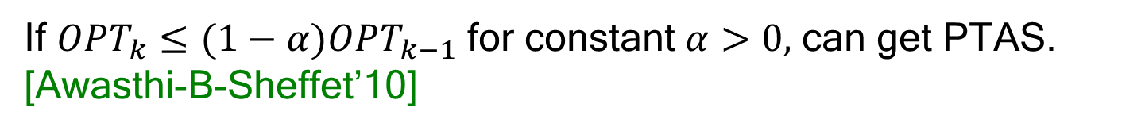
Late 2000s+: models of “nice” inputs
$k$-means clustering [Ostrovsky-Rabani-Schulman-Swamy ‘06]
Cost of optimal $k$-means clustering decreases with $k$.
Often choose $k$ based on “knee” in the curve.
x
x
x
x
x
x
x
If $OPT_{k}≤ε^{2}OPT_{k−1}$ then natural heuristic finds $\left(1+ε\right)OPT_{k}.$
If $OPT_{k}≤(1−α)OPT_{k−1}$ for constant $α>0,$ can get PTAS. [Awasthi-B-Sheffet’10]
Notes:
An important work along these lines is paper of Ostrovsky, Rabani, Schulman, and Swamy on k-means clustering

Slide 21
Late 2000s+: models of “nice” inputs
Approximation Stability [Balcan-B-Gupta ‘09]
Perturbation Resilience [Bilu-Linial ‘10]
Idea: identify assumptions that
(a) are natural based on how input was collected, or
(b) we will want to assume anyway because of how the output is being used.
Observation: In many problems, true goal is to match a reference/ground-truth/desired solution. Objective just a proxy.
Notes:
Then in 2009, 2010, came two models motivated by machine learning considerations based on how the inputs are typically collected and how the outputs of the algorithms are typically used.

Slide 22
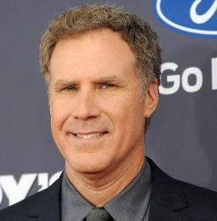

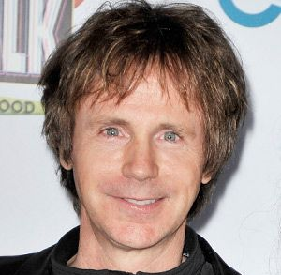

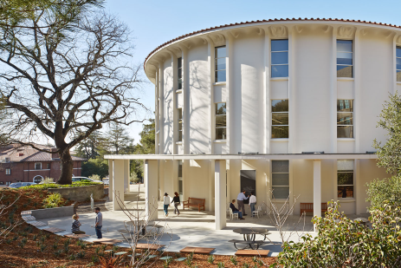

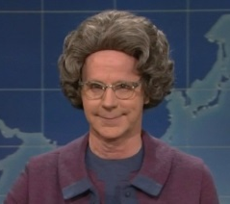
Late 2000s+: models of “nice” inputs
  Given a set of news articles, cluster them how a user would.
  Given a set of images, cluster by who is in them.
  Given a picture, correctly segment into objects.
Observation: In many problems, true goal is to match a reference/ground-truth/desired solution. Objective just a proxy.

Slide 23
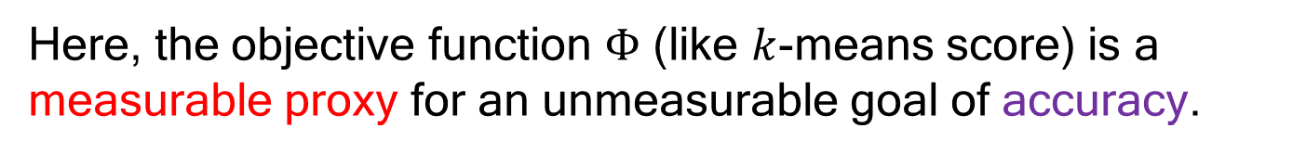

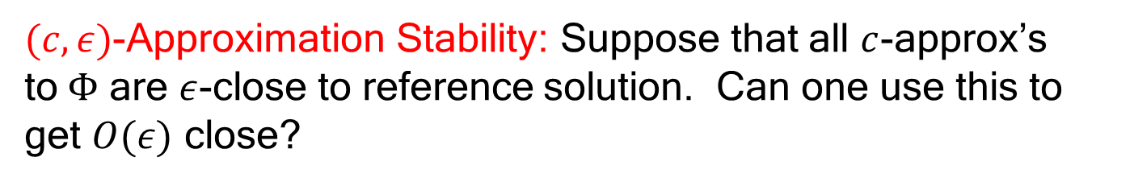
Late 2000s+: models of “nice” inputs
Here, the objective function $Φ$ (like $k$-means score) is a measurable proxy for an unmeasurable goal of accuracy.
Obviously yes if one has a c-approx alg, but what if you don’t?
[Balcan-B-Gupta ‘09]
$(c,ε)$-Approximation Stability: Suppose that all $c$-approx’s to$Φ$ are $ε$-close to reference solution. Can one use this to get $O(ε)$ close?
$c⋅$OPT
OPT
Desired solution

Slide 24
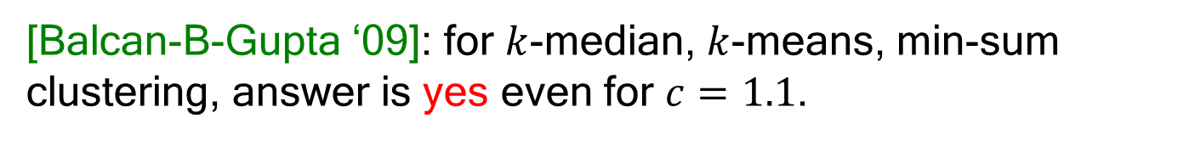
Approximation-Stability
Obviously yes if have a c-apx alg. But what if we don’t?
[Balcan-B-Gupta ‘09]: for $k$-median, $k$-means, min-sum clustering, answer is yes even for $c=1.1$.
$(c,ε)$-Approximation Stability: Suppose that all $c$-approx’s to$Φ$ are $ε$-close to reference solution. Can one use this to get $O(ε)$ close?
$c⋅$OPT
OPT
Desired solution

Slide 25

Approximation-Stability
[Balcan-B-Gupta ‘09]: for $k$-median, $k$-means, min-sum clustering, answer is yes even for $c=1.1$.
[Voevodski-Balcan-Roglin-Teng-Xia ‘10]: superfast algos (small number of distance queries) with this guarantee. Apply to biological sequence clustering.
[Awasthi-Balcan-B-Sheffet-Vempala ‘10]: Nash equilibria
$c⋅$OPT
OPT
Desired solution

Slide 26
Perturbation-Resilience [Bilu-Linial ‘10]
Choice of edge weights, locations often somewhat heuristic
  If small changes to the input affected the optimal solution a lot, then if OPT is good (close to the desired solution) it’s just by luck…
Notes:
Also with the same motivation that often the true goal is one of accuracy, but looking at things in terms of how inputs are constructed, Bilu and Linial defined the model of perturbation-resilience. Idea here is that…

Slide 27
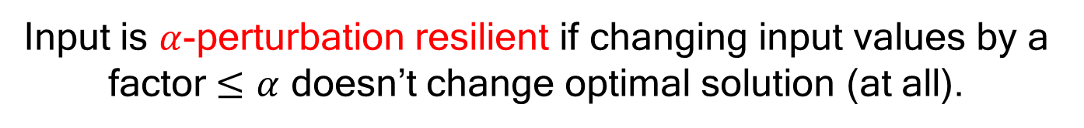
Perturbation-Resilience [Bilu-Linial ‘10]
Choice of edge weights, locations often somewhat heuristic
Input is $α$-perturbation resilient if changing input values by a factor $≤α$ doesn’t change optimal solution (at all).
Notes:
If you did smoothed analysis (took inputs and perturbed them), opt solution wouldn’t change

Slide 28
Perturbation-Resilience [Bilu-Linial ‘10]
Generally harder than approximation-stability for the same level of parameter.
While an optimal solution in a perturbed instance is also an approx-optimal solution in the original, the other direction need not be true.
Many/most results need stability above approx bound
In some cases (Nash equilibria) the two notions coincide [Balcan-Braverman ‘10]
Notes:
Could have approx optimal solution in original that’s not optimal for any perturbed instance

Slide 29
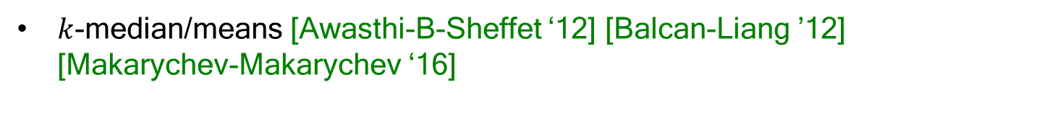
Perturbation-Resilience [Bilu-Linial ‘10]
Lots of results on:
Max-cut [Bilu-Linial ‘10] [Bilu-Daniely-Linial-Saks ‘13] [Makarychev-Makarychev-Vijayaraghavan ‘14]
Nash equilibria [Balcan-Braverman ‘10]
TSP [Mihalak-Schongens-Sramek-Widmayer ‘11]
$k$-median/means [Awasthi-B-Sheffet ‘12] [Balcan-Liang ’12] [Makarychev-Makarychev ‘16]
$k$-center (incl asymmetric) [Balcan-Haghtalab-White ‘16]
Talk today
Minimum multiway cut [Makarychev-Makarychev-Vijayaraghavan ‘14]
Related: [Kushagra-Samadi-BenDavid ‘16] [Ashtiani-Kushagra-BenDavid ‘16]

Slide 30
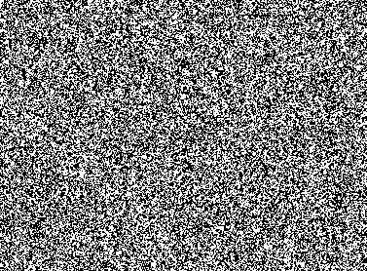

Average-case for Unknown Distribution
Concern with usual average-case analysis: random $≠$ typical
vs
How about average-case over the distribution of typical instances for your given application?
  Input is a collection of random samples of instances from your application
  Then try to use them to learn the best algorithm (from some given family) for your application’s distribution

Slide 31
Average-case for Typical Examples
Sorting and problems in computational geometry [Ailon-Chazelle-Clarkson-Liu-Mulzer-Seshadhri ‘11]
  Assume product distribution on items within input, compete with information-theoretic optimum
Revenue-maximizing auctions [Elkind ‘07] [Cole-Roughgarden ‘14] [Morgenstern-Roughgarden ‘15] [Devanur-Huang-Psamos ‘16],…
General algorithmic problems [Gupta-Roughgarden ‘16] [Balcan-Nagarajan-Vitercik-White ‘16]
  No prior assumption on distribution of instances
  Compete with best algorithm from a given natural family A
Will see talks on these this week

Slide 32
Coming Up
Theoretical talks on algorithms and models
Empirical talks on approaches in practice/experiments
Application talks on properties of real-world inputs in various domains
Enjoy!

