Slide 1
Procrastination
… with Variable Present Bias
Nicole Immorlica, Microsoft
Joint work with N. Gravin, B. Lucier,
and M. Pountourakis

Slide 2
intertemporal tradeoffs.
Incur short-term costs for long-term payoff.
Examples.
Speaker: prep talk or go to the movies?
Student: study or party?
Marathoner: training run or sleep?
Skier: buy skies or rent?
In general.
An agent makes a sequence of costly decisions, where costs and options depend on previous choices.

Slide 3

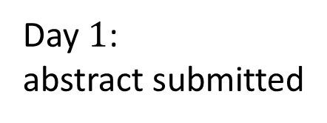





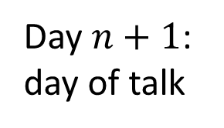

talk prep example.
Task graph.
progress
$$0$$
$$0$$
done
$$2$$
$$2$$
$$2$$
$$1$$
$$1$$
undone
days
Day $1$:
abstract submitted
Day $n+1$:
day of talk

Slide 4
talk prep example.
Minimum cost path.
progress
$$0$$
$$0$$
done
$$2$$
$$2$$
$$2$$
$$1$$
$$1$$
undone
days
Day $1$:
abstract submitted
Day $n+1$:
day of talk

Slide 5
talk prep example.
Anecdotal path.
progress
$$0$$
$$0$$
done
$$2$$
$$2$$
$$2$$
$$1$$
$$1$$
undone
days
Day $1$:
abstract submitted
Day $n+1$:
day of talk

Slide 6






talk prep example.
Actual path.
progress
$$0$$
done
$$2$$
$$2$$
$$2$$
$$1$$
$$1$$
undone
days
Day $1$:
abstract submitted
Day $n+1$:
day of talk

Slide 7
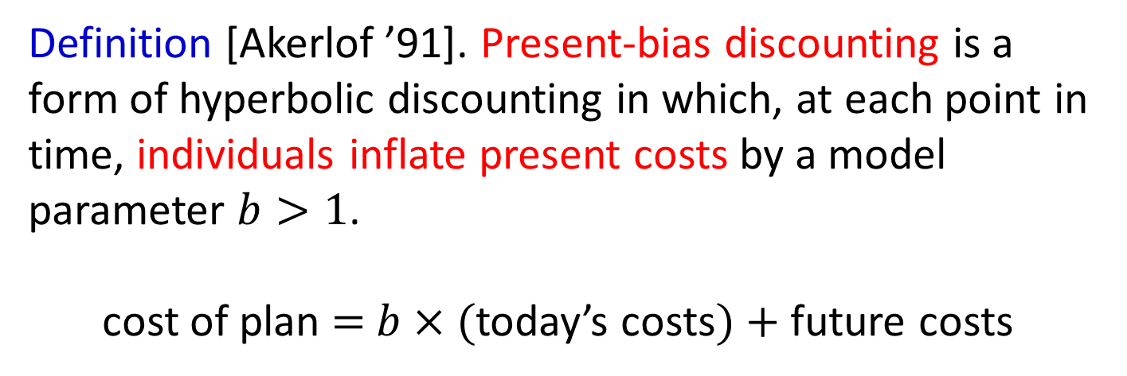
present bias.
Definition [Akerlof ’91]. Present-bias discounting is a form of hyperbolic discounting in which, at each point in time, individuals inflate present costs by a model parameter $b>1$.
cost of plan $=$ $b×($today’s costs$)+$future costs

Slide 8





talk prep example.
Plan of action for present-bias $b>2$.
progress
$$0$$
$$0$$
$$0$$
done
$$2$$
$$2$$
$$2$$
$$2$$
$$1$$
$$1$$
$$1$$
undone
days

Slide 9
talk prep example.
Plan of action for present-bias $b>2$.
progress
$$0$$
$$0$$
$$0$$
done
$$2$$
$$2$$
$$2$$
$$2$$
$$1$$
$$1$$
$$1$$
undone
days

Slide 10
talk prep example.
Plan of action for present-bias $b>2$.
progress
$$0$$
$$0$$
$$0$$
done
$$2$$
$$2$$
$$2$$
$$2$$
$$1$$
$$1$$
$$1$$
undone
days
Linearly-higher cost than optimal plan!

Slide 11
talk prep example.
Plan of action for present-bias $b<2$.
progress
$$0$$
$$0$$
$$0$$
done
$$2$$
$$2$$
$$2$$
$$2$$
$$1$$
$$1$$
$$1$$
undone
days
Model only makes extreme predictions.

Slide 12
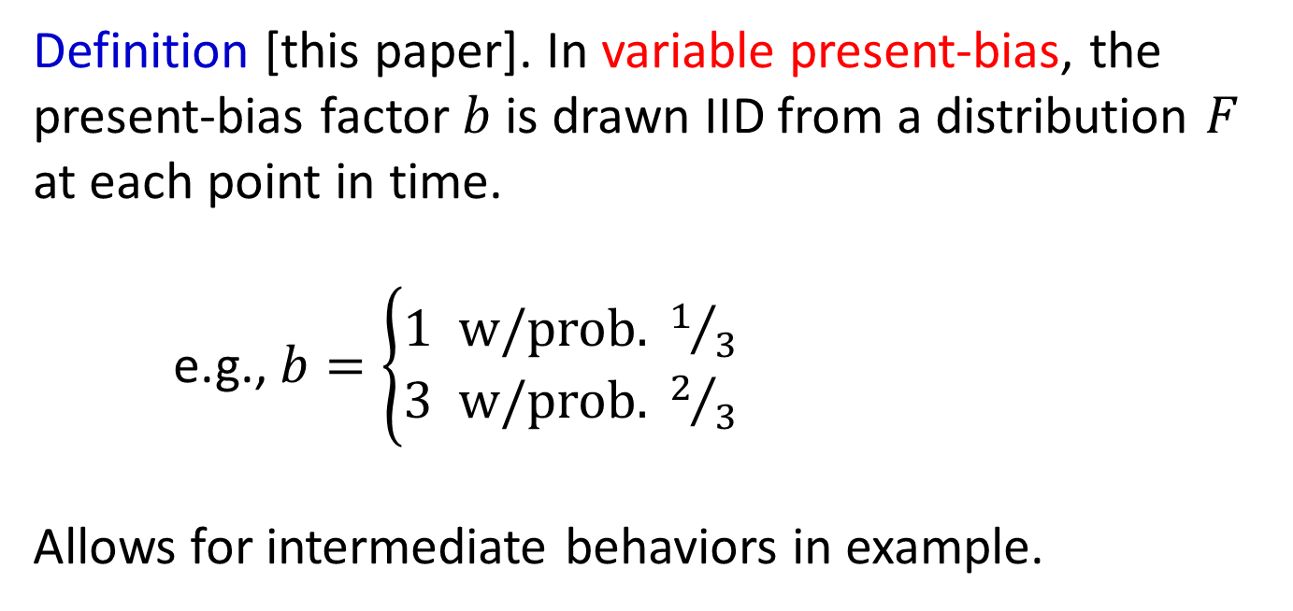
variable present-bias.
Definition [this paper]. In variable present-bias, the present-bias factor $b$ is drawn IID from a distribution $F$ at each point in time.
e.g., $b=\left\{\begin{aligned}1 \text{w}\text{/}\text{prob}\text{. }1/3 \\ 3 \text{w}\text{/}\text{prob}\text{. }2/3\end{aligned}\right.$
Allows for intermediate behaviors in example.
(no procrastination)

Slide 13
question.
What is impact of variable present-bias and task graph structure on cost of procrastination?
Definition [Kleinberg-Oren ‘14]. Procrastination ratio is the ratio between the expected weight of the traversed path and the weight of the initial shortest path.

Slide 14
results (informal).
Main lemma. For any distribution, worst task graph has just two progress levels, with cost to move up.
What bounds procrastination ratio?
If task graph has [some property], then the procrastination ratio is at most linear.
If task graph has [a more stringent property], and the agent has a low tendency to procrastinate, then the procrastination ratio is at most constant.

Slide 15
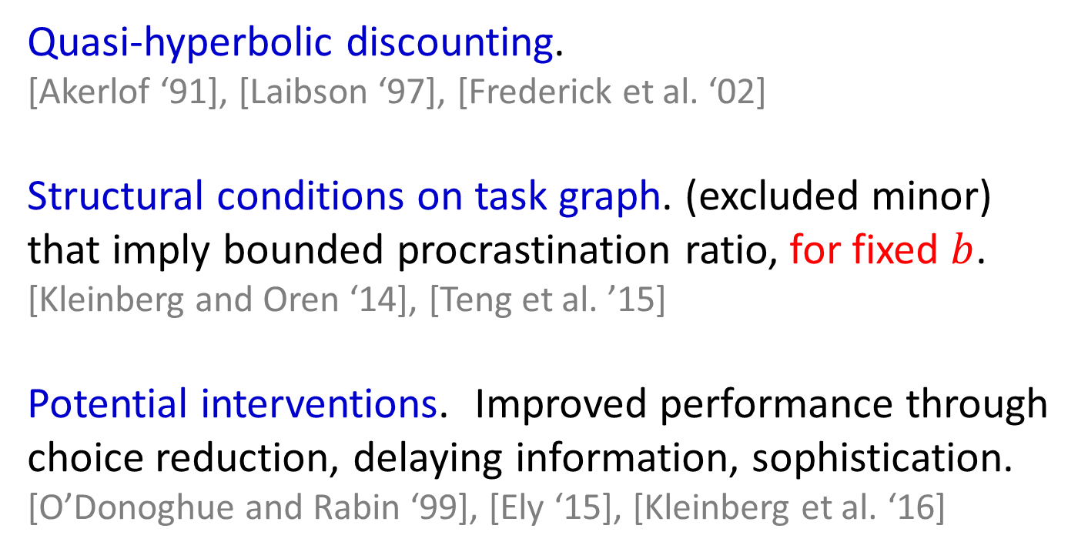
related work.
Quasi-hyperbolic discounting.
[Akerlof ‘91], [Laibson ‘97], [Frederick et al. ‘02]
Structural conditions on task graph. (excluded minor) that imply bounded procrastination ratio, for fixed $b$.
[Kleinberg and Oren ‘14], [Teng et al. ’15]
Potential interventions. Improved performance through choice reduction, delaying information, sophistication.
[O’Donoghue and Rabin ‘99], [Ely ‘15], [Kleinberg et al. ‘16]

Slide 16
outline.
Model and statement of results.
Main lemma and connection to optimal pricing.

Slide 17


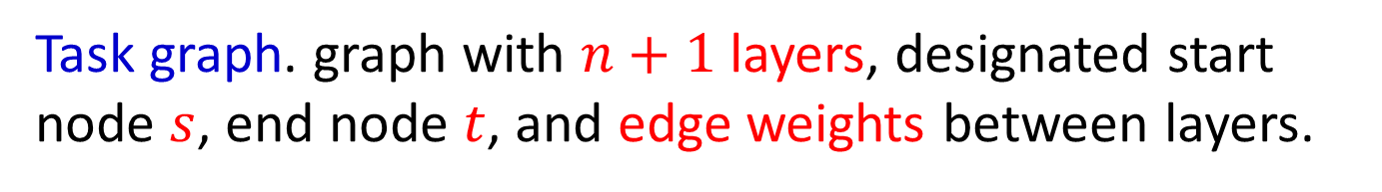








model.
Task graph. graph with $n+1$ layers, designated start node $s$, end node $t$, and edge weights between layers.
progress
$$v$$
$$w_{uv}$$
$$t$$
$$u$$
$$s$$
days
$$1$$
$$2$$
$$3$$
$$n$$
$$n+1$$

Slide 18
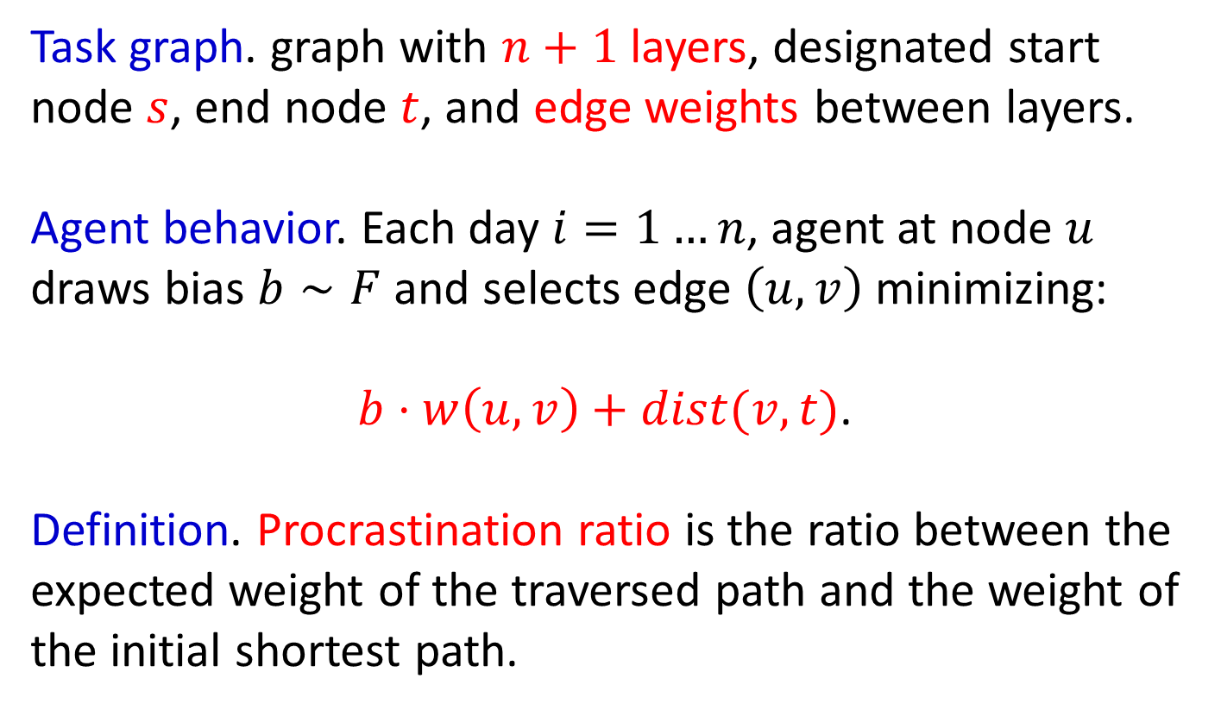
model.
Task graph. graph with $n+1$ layers, designated start node $s$, end node $t$, and edge weights between layers.
Agent behavior. Each day $i=1…n$, agent at node $u$ draws bias $b∼F$ and selects edge $\left(u,v\right)$ minimizing:
$b⋅w\left(u,v\right)+dist(v,t)$.
Definition. Procrastination ratio is the ratio between the expected weight of the traversed path and the weight of the initial shortest path.

Slide 19







extremal task graphs.
Main lemma. For any distribution, worst task graph is
progress
$$0$$
$$0$$
done
$$1$$
$$p$$
$$p^{n}$$
$$0$$
$$0$$
undone
days
where $p≥1$ depends on the distribution $F$.

Slide 20

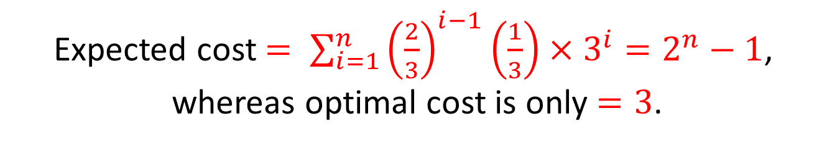


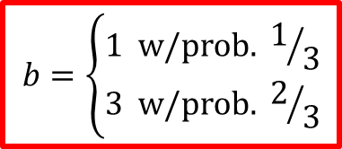






student example.
Exponential ratio even with constant prob. of rationality.
progress
$$0$$
$$0$$
$$0$$
done
$$3$$
$$3^{2}$$
$$3^{3}$$
$$3^{n}$$
$$b=\left\{\begin{aligned}1 \text{w}\text{/}\text{prob}\text{. }1/3 \\ 3 \text{w}\text{/}\text{prob}\text{. }2/3\end{aligned}\right.$$
$$0$$
$$0$$
$$0$$
undone
days
Expected cost $= \sum_{i=1}^{n}{{\left(\frac{2}{3}\right)}^{i−1}\left(\frac{1}{3}\right)×3^{i}}=2^{n}−1$,
whereas optimal cost is only $=3$.

Slide 21


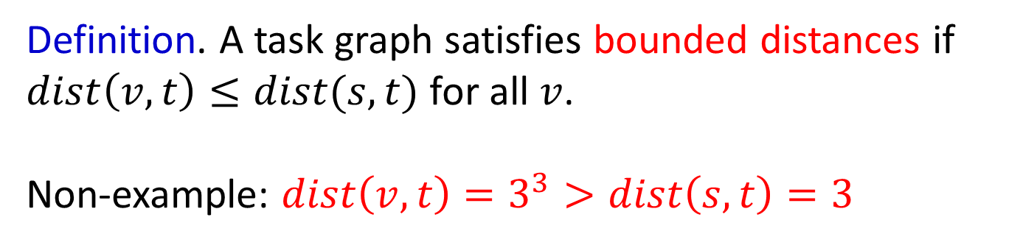








bounded distance.
Definition. A task graph satisfies bounded distances if
$dist\left(v,t\right)≤dist(s,t)$ for all $v$.
Non-example: $dist\left(v,t\right)=3^{3}>dist\left(s,t\right)=3$
$$0$$
$$0$$
$$0$$
$$3$$
$$3^{2}$$
$$3^{3}$$
$$3^{n}$$
$$0$$
$$0$$
$$0$$
$$v$$

Slide 22
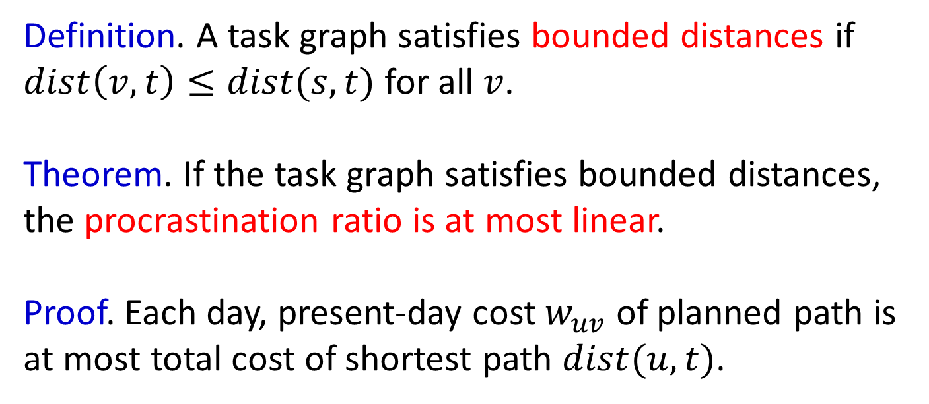
bounded distance.
Definition. A task graph satisfies bounded distances if
$dist\left(v,t\right)≤dist(s,t)$ for all $v$.
Theorem. If the task graph satisfies bounded distances, the procrastination ratio is at most linear.
Proof. Each day, present-day cost $w_{uv}$ of planned path is at most total cost of shortest path $dist(u,t)$.

Slide 23



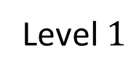

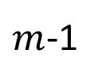

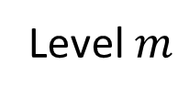





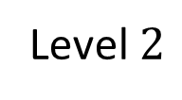



training for a marathon.
$$0$$
$$0$$
Level $m$
$m$-1
$$1$$
$$1$$
Level $2$
$$0$$
$$0$$
$$m$$
$$1$$
$$1$$
$$1$$
Level $1$
$$ϵ$$
$$ε$$
$$ε$$
days
Minimum cost training plan $=m$.

Slide 24


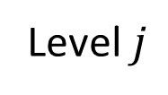
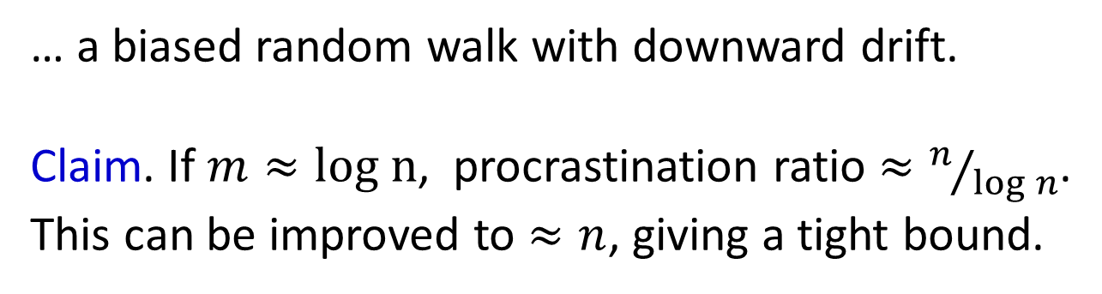
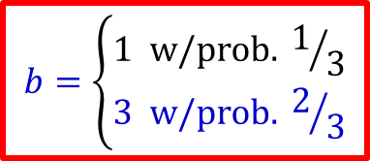



training for a marathon.
Perceived cost of options.
$$1$$
$$+ \left(m−\left(j+1\right)\right)$$
$$b=\left\{\begin{aligned}1 \text{w}\text{/}\text{prob}\text{. }1/3 \\ 3 \text{w}\text{/}\text{prob}\text{. }2/3\end{aligned}\right.$$
Level $j$
$$≥$$
$$0$$
$$+ \left(m−\left(j−1\right)\right)$$
… a biased random walk with downward drift.
Claim. If $m≈log n$, procrastination ratio $≈n/{\log{n}}$.
This can be improved to $≈n$, giving a tight bound.

Slide 25
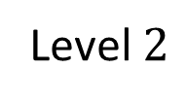
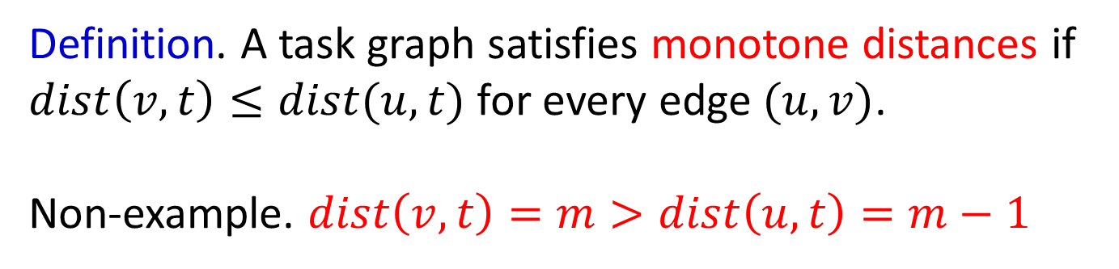




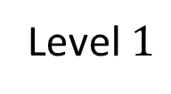

monotone distance.
Definition. A task graph satisfies monotone distances if
$dist\left(v,t\right)≤dist(u,t)$ for every edge $(u,v)$.
Non-example. $dist\left(v,t\right)=m>dist\left(u,t\right)=m−1$
$$1$$
Level $2$
$$u$$
$$1$$
$$1$$
Level $1$
$$v$$

Slide 26
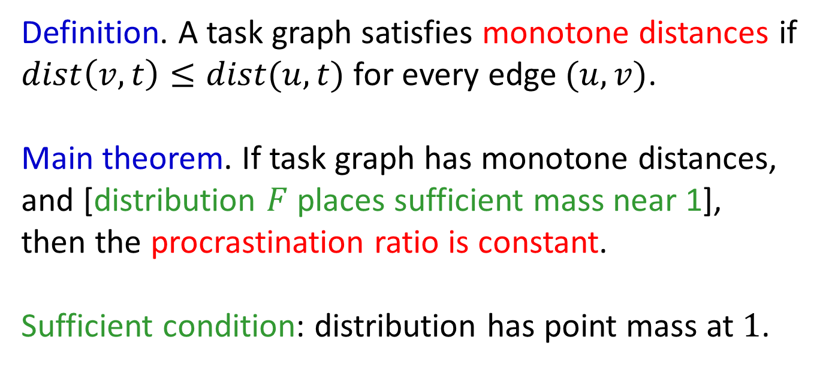
monotone distance.
Definition. A task graph satisfies monotone distances if
$dist\left(v,t\right)≤dist(u,t)$ for every edge $(u,v)$.
Main theorem. If task graph has monotone distances, and [distribution $F$ places sufficient mass near 1],
then the procrastination ratio is constant.
Sufficient condition: distribution has point mass at $1$.

Slide 27









renting skies.
Minimum cost plan of action $=1$.
$$0$$
$$0$$
$$0$$
own
$$1$$
$$1$$
$$1$$
$$1$$
$$\frac{2}{3}$$
$$\frac{2}{3}$$
$$\frac{2}{3}$$
rent
days
Plan of action for present bias $b=3$.

Slide 28

renting skies.
Minimum cost plan of action $=1$.
$$0$$
$$0$$
$$0$$
own
$$1$$
$$1$$
$$1$$
$$b=\left\{\begin{aligned}1 \text{w}\text{/}\text{prob}\text{. }1/3 \\ 3 \text{w}\text{/}\text{prob}\text{. }2/3\end{aligned}\right.$$
$$1$$
$$\frac{2}{3}$$
$$\frac{2}{3}$$
$$\frac{2}{3}$$
rent
days
E[cost] $=\sum_{i=1}^{n}{{\left(\frac{2}{3}\right)}^{i−1}\left(\frac{1}{3}\right)\left(\left(i−1\right)\left(\frac{2}{3}\right)+1\right) }=$ constant.

Slide 29
outline.
Model and statement of results.
Main lemma and connection to optimal pricing.

Slide 30



extremal task graphs.
Main lemma. For any distribution, worst task graph is
progress
$$0$$
$$0$$
done
$$1$$
$$p$$
$$p^{n}$$
$$0$$
$$0$$
undone
days
where $p≥1$ depends on the distribution $F$.

Slide 31
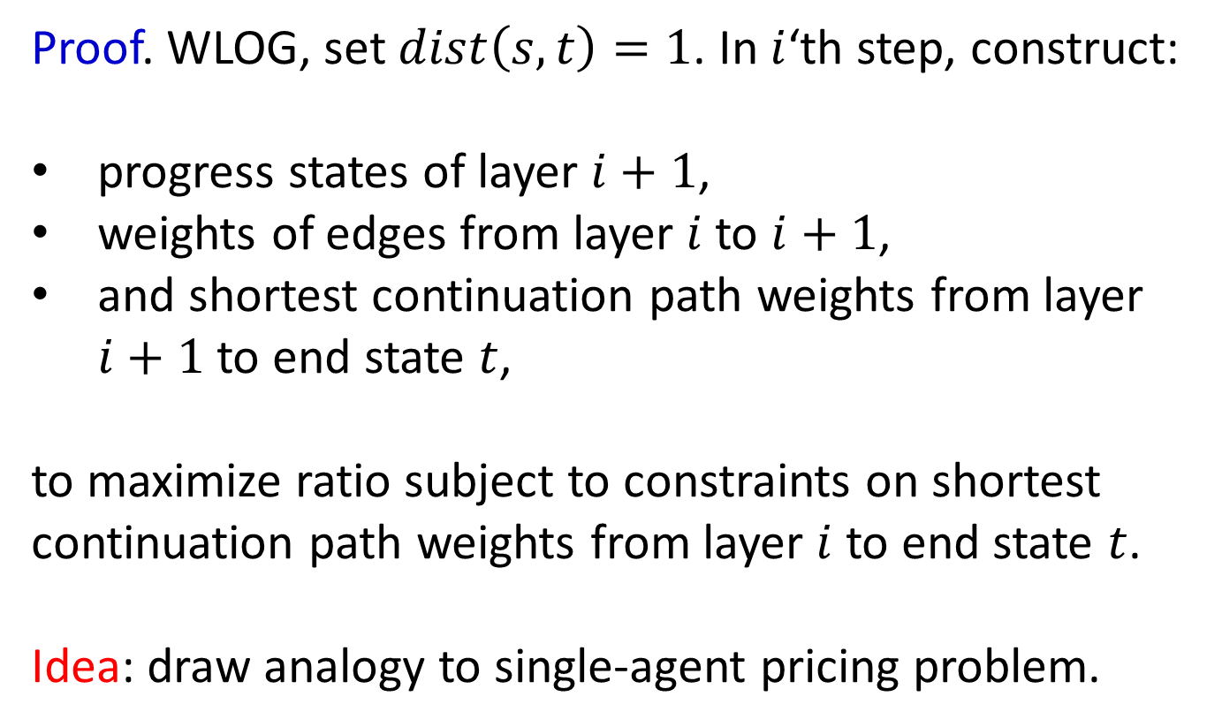
extremal task graphs.
Proof. WLOG, set $dist\left(s,t\right)=1$. In $i$‘th step, construct:
progress states of layer $i+1$,
weights of edges from layer $i$ to $i+1$,
and shortest continuation path weights from layer $i+1$ to end state $t$,
to maximize ratio subject to constraints on shortest continuation path weights from layer $i$ to end state $t$.
Idea: draw analogy to single-agent pricing problem.

Slide 32
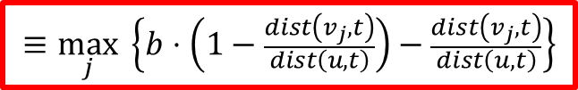






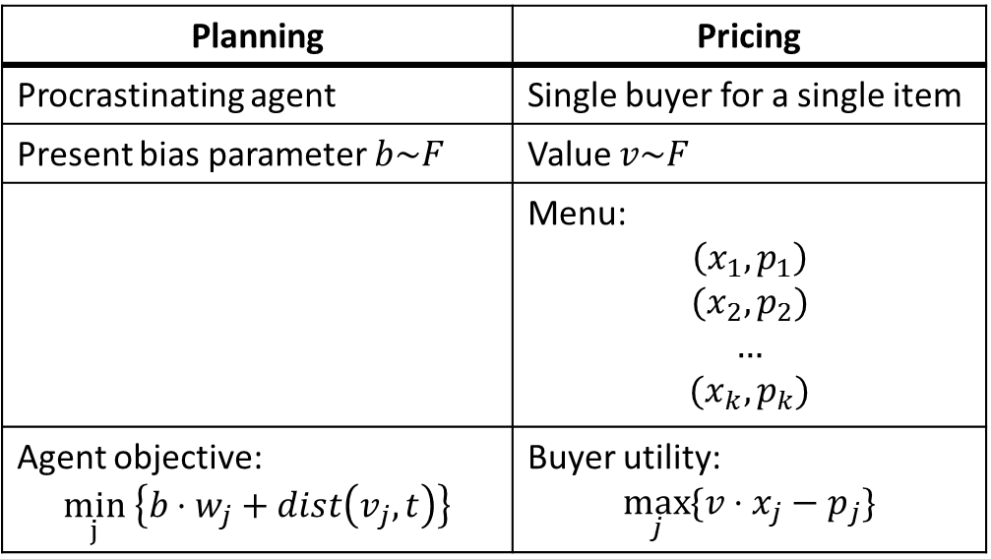

extremal task graphs.
Procrastinating agent, bias parameter $b∼F$:
Planning | Pricing
Procrastinating agent | Single buyer for a single item
Present bias parameter $b\sim F$ | Value $v\sim F$
 | Menu: $$\left(x_{1},p_{1}\right)$$ $$(x_{2},p_{2})$$ $$…$$ $$(x_{k},p_{k})$$
Agent objective: $$\min_{j} \left\{b⋅w_{j}+dist\left(v_{j},t\right)\right\}$$ | Buyer utility: $$\max_{j}{\{v⋅x_{j}−p_{j}\}}$$
Choose parameters to max incurred cost,
i.e., linear function of weight and distance.
$$w_{1}$$
$$dist\left(v_{1},t\right)$$
$$u$$
$$dist\left(v_{2},t\right)$$
$$w_{2}$$
…
$$w_{k}$$
$$dist\left(v_{k},t\right)$$
$$≡\max_{j}{ \left\{b⋅\left(1−\frac{dist\left(v_{j},t\right)}{dist\left(u,t\right)}\right)−\frac{dist\left(v_{j},t\right)}{dist\left(u,t\right)}\right\}}$$

Slide 33







extremal task graphs.
Theorem [Myerson’81]. For objectives linear in allocation and revenue, and any menu with individual rationality, there is an optimal IR menu with just two items:
where $p≥1$ if value is supported on $[1,∞)$.
item
allocation
price
$$v_{1}$$
$$0$$
$$0$$
$${ v}_{2}$$
$$1$$
$$p$$

Slide 34





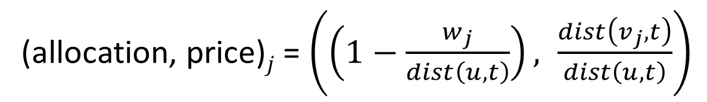
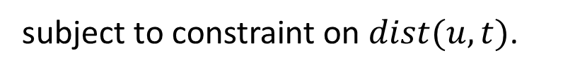





extremal task graphs.
Worst-case task graph, layer$i+1$:
Menu item:
$$w_{2}=dist(u,t)$$
$$v_{k}$$
$$dist\left(v_{2},t\right)=0$$
$$(0,0)$$
$$v_{2}$$
$$u$$
$$w_{1}=0$$
$${ v}_{1}$$
$dist\left(v_{1},t\right)=p⋅dist(u,t)$
$$(1,p)$$
subject to constraint on $dist(u,t)$.
(allocation, price)$j$= $\left(\left(1−\frac{w_{j}}{dist\left(u,t\right)}\right), \frac{dist\left(v_{j},t\right)}{dist\left(u,t\right)}\right)$

Slide 35
extremal task graphs.
Main lemma. For any distribution, worst task graph is
progress
$$0$$
$$0$$
done
$$1$$
$$p$$
$$p^{n}$$
$$0$$
$$0$$
undone
days
where $p≥1$ depends on the distribution $F$.

Slide 36
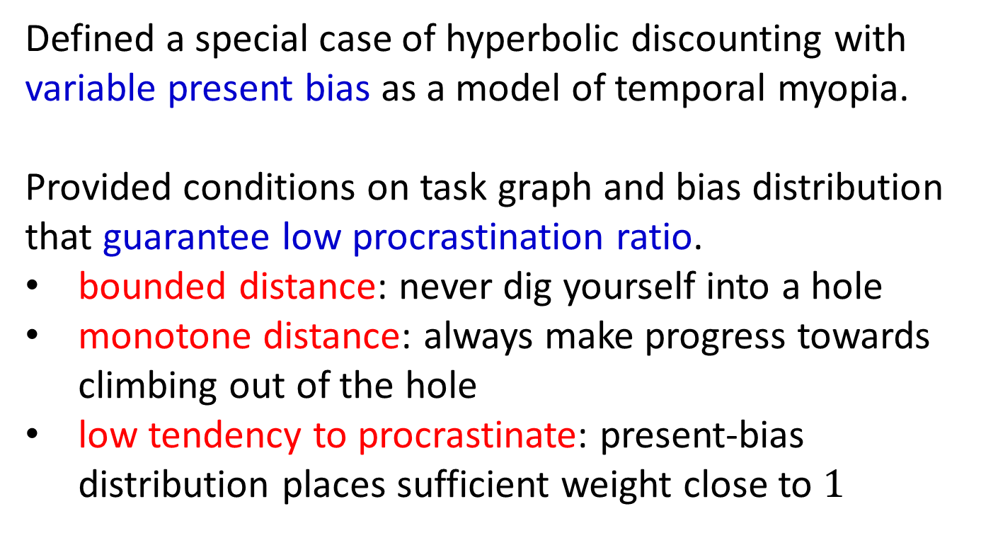
summary.
Defined a special case of hyperbolic discounting with variable present bias as a model of temporal myopia.
Provided conditions on task graph and bias distribution
that guarantee low procrastination ratio.
bounded distance: never dig yourself into a hole
monotone distance: always make progress towards climbing out of the hole
low tendency to procrastinate: present-bias distribution places sufficient weight close to $1$

