Slide 1

Understanding the
Empirical Hardness of
NP-Complete Problems
Kevin Leyton-Brown
Computer Science Department
University of British Columbia
Notes:
Problems are intractable when they “can be solved, but not fast enough for the solution to be usable” [Hopcroft, Motwani & Ullman, 2007]. NP-complete problems are commonly said to be intractable; however, the reality is more complex. All known algorithms for solving NP-complete prob­lems require exponential time in the worst case; however, these algorithms nevertheless solve many problems of practical impor­tance astoundingly quickly, and are hence relied upon in a broad range of applications. The propositional satisfiability problem (SAT) serves as a good example. The FCC's multi-billion dollar spectrum auctions operate by solving hundreds of thousands of SAT-encoded graph coloring problems, typically each involving tens of thousands of variables and millions of constraints. These instances can often be solved in seconds, even though the same solvers can be stymied by hand-crafted instances involving only hundreds of variables. Clearly, we could benefit from a more nuanced understanding of algorithm behaviour than is offered by asymptotic, worst-case analy­sis.
This tutorial is focused on the question most relevant to an end user: “How hard is it to solve a given family of problem instances, using the best available methods?” Formal, complexity-theoretic analysis of this question seems hopeless: the best available algorithms are highly complex (and, in some cases, only available in compiled form), and instance distributions representative of practical applications are heterogeneous and richly structured. For this reason, we turn to statistical, rather than combinatorial, analysis. The main claim of this tutorial is that rigorous statistical methods can characterize algorithm runtime with high levels of confidence. More specifically, this article surveys over a decade of research showing how to build empirical hardness models (EHMs) that, given a new problem instance, estimate the runtime of an algorithm in low-order polynomial time. We have shown that it is possible to build quite accurate models for different NP-complete problems (we have studied SAT, combinatorial auction winner determination, mixed integer program­ming, and the traveling salesman problem), distributions of problem instances (we have considered dozens), solvers (again, dozens). We have robustly found that even very succinct EHMs can achieve high accuracies, meaning that they describe simple relationships between instance characteristics and algorithm runtime. This makes our approach important even for theoretically inclined computer scientists who prefer proofs to experimental findings: EHMs can uncover new, simple relationships between instance characteristics and runtime, and thereby catalyze new theoretical work.
The tutorial will emphasize ways that EHMs contribute to our understanding of NP-complete problems; however, they are also useful in a variety of practical applications. Most straightforwardly, they can aid the distribution of problem instances across a cluster, or predict how long a run will take to complete. More interestingly, they can (1) be leveraged to automatically make benchmark distributions more challenging; (2) be used to combine a set of high-variance algorithms into an “algorithm portfolio” that outperforms its constituents; and (3) aid in the configuration (or “tuning”) of highly parameterized algorithms for good performance on given instance distributions. If time permits, I'll briefly discuss each of these applications. In particular, I'll explain how we leveraged ideas (2) and (3) to build the SAT solver portfolios that clear the FCC auctions.

Slide 2



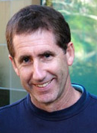

This Talk Suveys 15 Years of Work with/by Many Collaborators, notably:
Holger Hoos Frank Hutter Eugene Nudelman Yoav Shoham Lin Xu
UBC UBC Stanford/Google Stanford UBC
[L-B, Nudelman, Shoham: CP 2002; JACM 2009]
[Nudelman, L-B, Hoos, Devkar, Shoham: CP 2004]
[Xu, Hoos, L-B: CP 2007; AAAI 2012]
[Hutter, Xu, Hoos, L-B: CACM 2014; AIJ 2015]

Slide 3
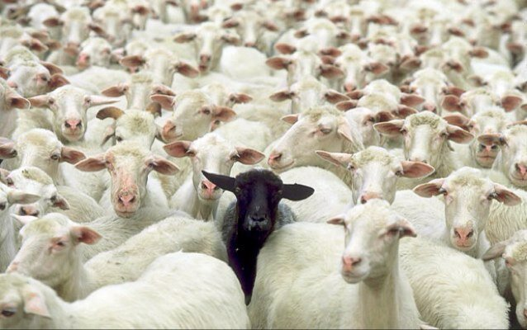
This Talk is a Bit Different from the Others
Motivation EHMs on Uniform-Random 3-SAT Beyond Uniform-Random 3-SAT Applications of EHMs

Slide 4

…But, It Fits Right In
Motivation EHMs on Uniform-Random 3-SAT Beyond Uniform-Random 3-SAT Applications of EHMs

Slide 5
Intractability
Motivation EHMs on Uniform-Random 3-SAT Beyond Uniform-Random 3-SAT Applications of EHMs
NP-complete problems are commonly said to be intractable, but the reality is more complex
The best available methods tend to
  offer no interesting theoretical guarantees
  work astoundingly well in practice
  exhibit exponentially varying performance
  (e.g., milliseconds to days) even on fixed-size problems
Problems are intractable when they “can be solved, but not fast enough for the solution to be usable”
[Hopcroft, Motwani & Ullman, 2007]

Slide 6
Motivating Question
Motivation EHMs on Uniform-Random 3-SAT Beyond Uniform-Random 3-SAT Applications of EHMs
NP-complete problems are commonly said to be intractable, but the reality is more complex
The best available methods tend to
  offer no interesting theoretical guarantees
  work astoundingly well in practice
  exhibit exponentially varying performance
  (e.g., milliseconds to days) even on fixed-size problems
“How hard is it to solve a given problem in practice,
using the best available methods?”

Slide 7
Our Key Finding
Motivation EHMs on Uniform-Random 3-SAT Beyond Uniform-Random 3-SAT Applications of EHMs
Even in settings where formal analysis seems hopeless:
  – algorithms are complex black boxes
  – instance distributions are heterogeneous or richly structured
  …it is possible to apply rigorous statistical methods to answer such questions with high levels of confidence.
I suspect that many here prefer complexity-theoretic analysis to statistical methods that aim “only” to work in practice
Why I think you should still care:
  the success of statistical methods points to patterns in algorithm performance that aren’t yet captured theoretically

Slide 8
Phase Transitions for SAT
Motivation EHMs on Uniform-Random 3-SAT Beyond Uniform-Random 3-SAT Applications of EHMs
Uniform-random 3-SAT: phase transition in probability of solvability at clauses / variables ≈ 4.26
Corresponding easy–hard–less hard transitions discovered in the behavior of DPLL-type solvers [Cheeseman et al, 1991; Selman et al., 1996]
  Spawned a new enthusiasm for using empirical methods
  to study algorithm performance
2
1
0.75
1
0.50
0
0.25
-1
Pr(SAT)
4 * Pr(SAT) - 2
log(Kcnfs runtime)
-2
0
3.3
3.5
3.7
3.9
4.1
4.3
4.5
4.7
4.9
5.1
5.3
c
/
v

Slide 9
Kcnfs Data
Motivation EHMs on Uniform-Random 3-SAT Beyond Uniform-Random 3-SAT Applications of EHMs

Slide 10
Kcnfs Data
Motivation EHMs on Uniform-Random 3-SAT Beyond Uniform-Random 3-SAT Applications of EHMs

Slide 11
Kcnfs Data
Motivation EHMs on Uniform-Random 3-SAT Beyond Uniform-Random 3-SAT Applications of EHMs

Slide 12
Where We Stand
Motivation EHMs on Uniform-Random 3-SAT Beyond Uniform-Random 3-SAT Applications of EHMs
Probability of solvability correlates strongly
with instance hardness
in practice
However, lots of residual variance
Is it possible to make more accurate predictions?
Idea: use machine learning methods to look for patterns
There’s much more going on here

Slide 13
Empirical Hardness Models:
A Case Study on Characterizing SAT Solver
Performance On Uniform Random 3-SAT:
Beyond the Clauses-to-Variables Ratio
Motivation EHMs on Uniform-Random 3-SAT Beyond Uniform-Random 3-SAT Applications of EHMs
[L-B, Nudelman, Shoham: CP 2002; JACM 2009]
[Nudelman, L-B, Hoos, Devkar, Shoham: CP 2004]
[Xu, Hoos, L-B: CP 2007; AAAI 2012]
[Hutter, Xu, Hoos, L-B: CACM 2014]

Slide 14
Empirical Hardness Models
Motivation EHMs on Uniform-Random 3-SAT Beyond Uniform-Random 3-SAT Applications of EHMs
Predict how long an algorithm will take to run, given:
  A set of instances D
  For each instance i ∈ D, a vector x_{i} of feature values
  For each instance i ∈ D, a runtime observation y_{i}
We want a mapping f(x) → y that
accurately predicts y_{i} given x_{i}
  This is a regression problem
    We’ve tried about a dozen different methods over the years
    This choice (sometimes) matters, but features are more important
  First, let’s consider a straightforward, tractable, and often
  very effective approach: basis function ridge regression

Slide 15
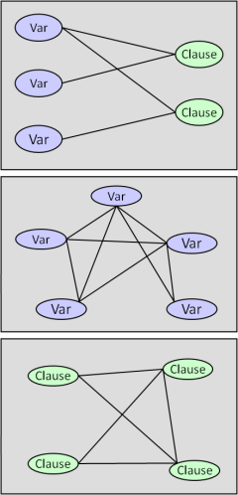
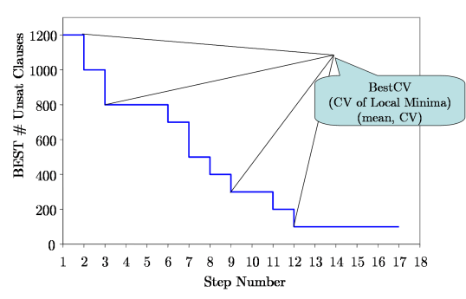
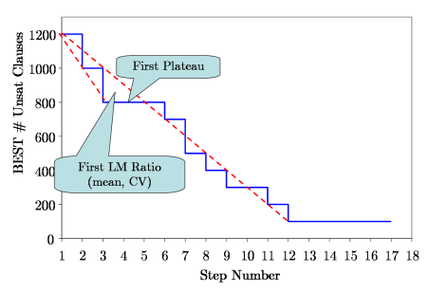
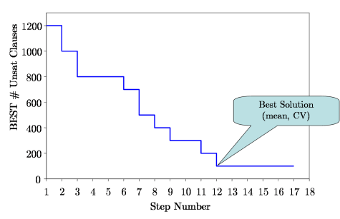
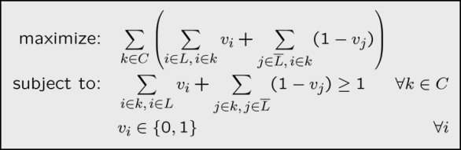
SAT Instance Features
Motivation EHMs on Uniform-Random 3-SAT Beyond Uniform-Random 3-SAT Applications of EHMs
Problem Size (clauses, variables, clauses/variables, …)
Syntactic properties (e.g., positive/negative clause ratio)
Statistics of various constraint graphs
  factor graph
  clause–clause graph
  variable–variable graph
Knuth’s search space size estimate
Cumulative number of unit propagations at different depths (SATz heuristic)
Local search probing
Linear programming relaxation

Slide 16
Variable Ratio Prediction (Kcnfs)

Slide 17
Variable Ratio - UNSAT
Motivation EHMs on Uniform-Random 3-SAT Beyond Uniform-Random 3-SAT Applications of EHMs
Note: each point corresponds to a “test” instance not used to train the model.
1000
100
10
Predicted Runtime [CPU sec]
1
0.1
0.01
0.01
0.1
1
10
100
1000
Actual Runtime [CPU sec]

Slide 18
Variable Ratio - SAT
Motivation EHMs on Uniform-Random 3-SAT Beyond Uniform-Random 3-SAT Applications of EHMs
Note: each point corresponds to a “test” instance not used to train the model.
1000
100
10
Predicted Runtime [CPU sec]
1
0.1
0.01
0.01
0.1
1
10
100
1000
Actual Runtime [CPU sec]

Slide 19
Feature Importance – Variable Ratio
Motivation EHMs on Uniform-Random 3-SAT Beyond Uniform-Random 3-SAT Applications of EHMs
We can analyze a model’s features to identify problem parameters that most affect empirical hardness
  problem: very high-dimensional models
  solution: subset selection
  caveat: other subsets could potentially achieve similar performance
Questions:
  Do our models discover the importance of c/v?
  If so, in what form do the models depend on this quantity?
  What other features are important?
Variable | Cost of Omission
|c/v - 4.26| | 100
|c/v - 4.26|² | 69
(v/c)² · SapsBestCVMean | 53
|c/v - 4.26| · SapsBestCVMean | 33

Slide 20
Feature Importance – Variable Ratio
Motivation EHMs on Uniform-Random 3-SAT Beyond Uniform-Random 3-SAT Applications of EHMs
We can analyze a model’s features to identify problem parameters that most affect empirical hardness
  problem: very high-dimensional models
  solution: subset selection
  caveat: other subsets could potentially achieve similar performance
Variable | Cost of Omission
|c/v - 4.26| | 100
|c/v - 4.26|² | 69
(v/c)² · SapsBestCVMean | 53
|c/v - 4.26| · SapsBestCVMean | 33

Slide 21
Feature Importance – Variable Ratio
Motivation EHMs on Uniform-Random 3-SAT Beyond Uniform-Random 3-SAT Applications of EHMs
We can analyze a model’s features to identify problem parameters that most affect empirical hardness
  problem: very high-dimensional models
  solution: subset selection
  caveat: other subsets could potentially achieve similar performance
Variable | Cost of Omission
|c/v - 4.26| | 100
|c/v - 4.26|² | 69
(v/c)² · SapsBestCVMean | 53
|c/v - 4.26| · SapsBestCVMean | 33

Slide 22
Fixed Ratio Data
Motivation EHMs on Uniform-Random 3-SAT Beyond Uniform-Random 3-SAT Applications of EHMs

Slide 23
Fixed Ratio Prediction (Kcnfs)

Slide 24
Feature Importance – Fixed Ratio
Motivation EHMs on Uniform-Random 3-SAT Beyond Uniform-Random 3-SAT Applications of EHMs
Variable | Cost of Omission
SapsBestSolMean² | 100
SapsBestSolMean · MeanDPLLDepth | 74
GsatBestSolCV · MeanDPLLDepth | 21
VCGClauseMean · GsatFirstLMRatioMean | 9

Slide 25
Feature Importance – Fixed Ratio
Motivation EHMs on Uniform-Random 3-SAT Beyond Uniform-Random 3-SAT Applications of EHMs
Variable | Cost of Omission
SapsBestSolMean² | 100
SapsBestSolMean · MeanDPLLDepth | 74
GsatBestSolCV · MeanDPLLDepth | 21
VCGClauseMean · GsatFirstLMRatioMean | 9

Slide 26
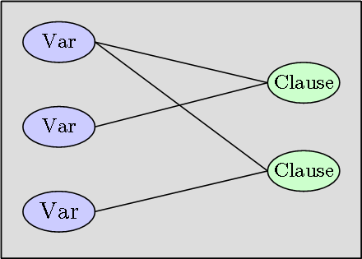
Feature Importance – Fixed Ratio
Motivation EHMs on Uniform-Random 3-SAT Beyond Uniform-Random 3-SAT Applications of EHMs
Variable | Cost of Omission
SapsBestSolMean² | 100
SapsBestSolMean · MeanDPLLDepth | 74
GsatBestSolCV · MeanDPLLDepth | 21
VCGClauseMean · GsatFirstLMRatioMean | 9

Slide 27
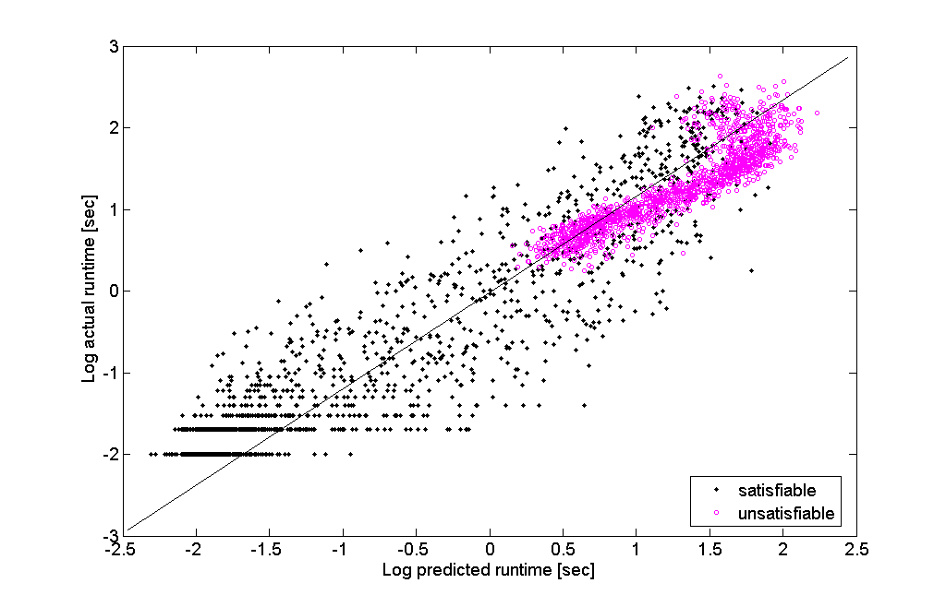
Empirical Performance of EHMs
Motivation EHMs on Uniform-Random 3-SAT Beyond Uniform-Random 3-SAT Applications of EHMs
Predicted vs. Actual Log Runtime, SATZ on Uniform Random 3SAT, variable ratio

Slide 28
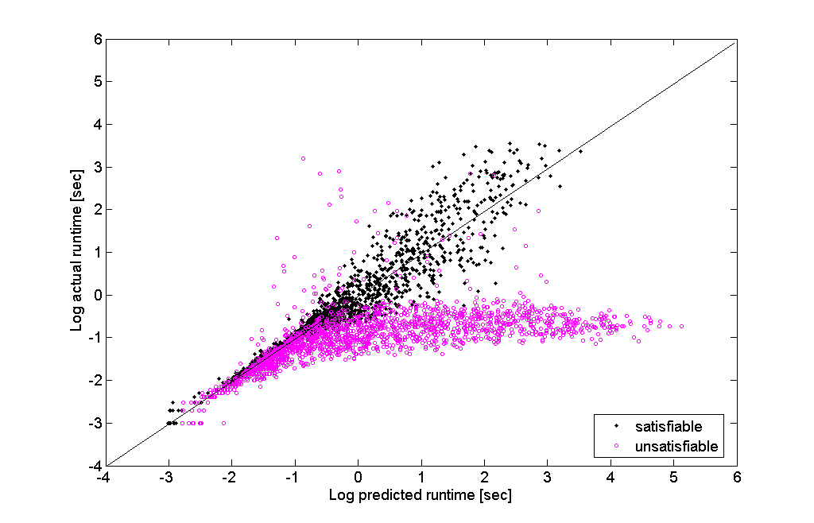
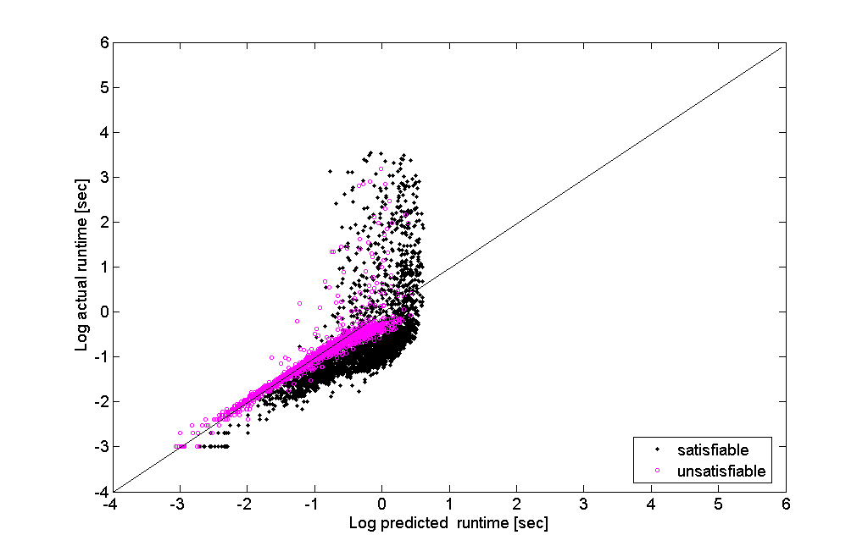
Hierarchical Hardness Models
Motivation EHMs on Uniform-Random 3-SAT Beyond Uniform-Random 3-SAT Applications of EHMs
Conditioning on satisfiability of the instance: clauses/variables unimportant; single-feature models become sufficient
  Satisfiable: local search probing
  Unsatisfiable: search space size
Hierarchical hardness model [Xu, Hoos, Leyton-Brown, 2007]:
  Predict satisfiability status
  Use this prediction as a feature to combine the
  predictions of SAT-only and UNSAT-only models
Not necessarily easy: SAT-only and UNSAT-only models can make large errors when given wrong data
SAT-only
UNSAT-only

Slide 29
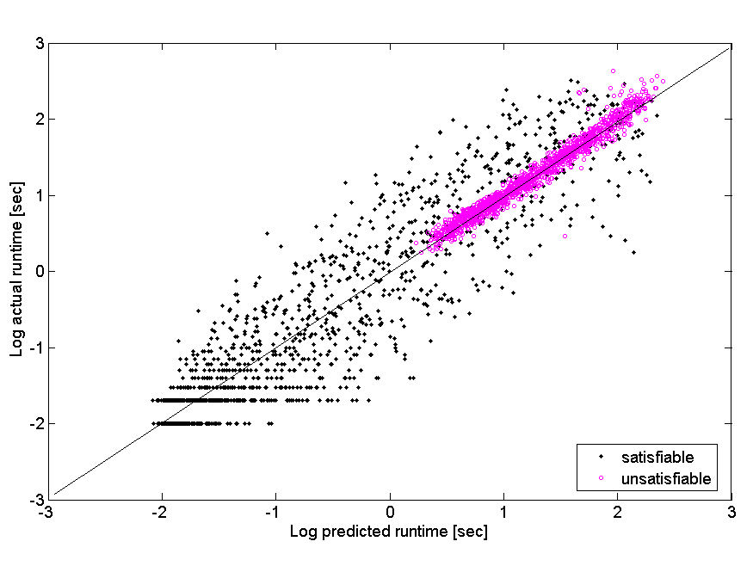
Empirical Performance of HHMs
Motivation EHMs on Uniform-Random 3-SAT Beyond Uniform-Random 3-SAT Applications of EHMs
Predicted vs. Actual Log Runtime, SATZ on Uniform Random 3SAT, variable ratio

Slide 30
Predicting Satisfiability Status (fixed-ratio 3-SAT)
Motivation EHMs on Uniform-Random 3-SAT Beyond Uniform-Random 3-SAT Applications of EHMs

Slide 31
Can We Really Predict Satisfiability Status?
Motivation EHMs on Uniform-Random 3-SAT Beyond Uniform-Random 3-SAT Applications of EHMs
Consider phase-transition instances varying from
100 variables (solvable in milliseconds) to 600 variables (solvable in a day).
  Does prediction accuracy fall to random guessing on larger problems?
  If not, can we identify an easily comprehensible model that would offer theoretical insight?
Restrict models in three ways:
  train only on 100-variable instances
  consider only decision trees with at most two decision nodes
  omit all probing features
    disproportionately effective on small instances
    based on complex, heuristic algorithms

Slide 32
A Simple Model Beats Random Guessing
Motivation EHMs on Uniform-Random 3-SAT Beyond Uniform-Random 3-SAT Applications of EHMs
Predictive accuracies for instances falling into the three regions were between 60% and 70% [A]; a bit more than 50% [B]; and between 70% and 80% [C].
This model was trained only on 100-variable problems.
No evidence that accuracy falls with size (pairwise Mann-Whitney U tests)

Slide 33
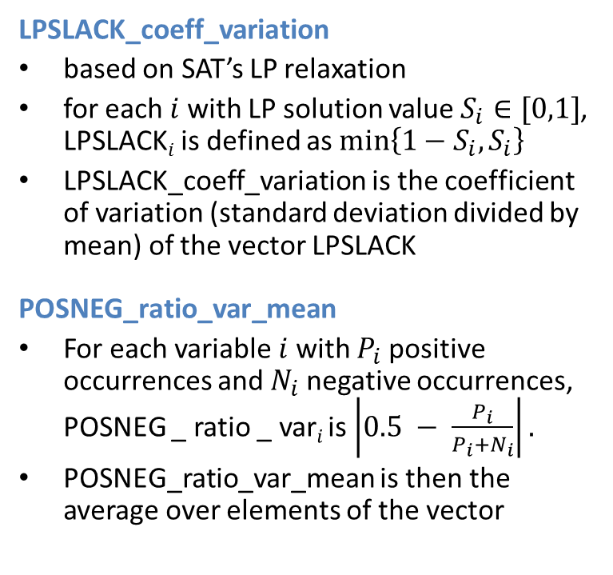
A Simple Model Beats Random Guessing
Motivation EHMs on Uniform-Random 3-SAT Beyond Uniform-Random 3-SAT Applications of EHMs
LPSLACK_coeff_variation
based on SAT’s LP relaxation
for each $i$ with LP solution value $S_{i}∈[0,1]$, LPSLACK$i$ is defined as $min\left\{1−S_{i}, S_{i}\right\}$
LPSLACK_coeff_variation is the coefficient of variation (standard deviation divided by mean) of the vector LPSLACK
POSNEG_ratio_var_mean
For each variable $i$ with $P_{i}$ positive occurrences and $N_{i}$ negative occurrences, POSNEG _ ratio _ var$i$is$\left|0.5 − \frac{P_{i}}{P_{i}+N_{i}}\right|.$
POSNEG_ratio_var_mean is then the average over elements of the vector
Both features normalized to have mean 0, standard deviation 1 on the training set.
To evaluate on a test set instance of a new size:
randomly sampled many instances of that size
estimated new normalization factors
used these factors to compute the features for the test instance

Slide 34
Beyond Uniform-Random 3-SAT
Motivation EHMs on Uniform-Random 3-SAT Beyond Uniform-Random 3-SAT Applications of EHMs
[L-B, Nudelman, Shoham, CP 2002; JACM 2009]
[Hutter, Xu, Hoos, L-B, INFORMS 2006; CACM 2014; AIJ 2015]

Slide 35
Beyond Uniform-Random 3-SAT
Motivation EHMs on Uniform-Random 3-SAT Beyond Uniform-Random 3-SAT Applications of EHMs
We’ve found that EHMs work consistently, across:
4 problem domains (with new features in each domain)
  Combinatorial Auctions
  Satisfiability (SAT)
  Mixed Integer Programming (MIP)
  Travelling Salesman Problem (TSP)
dozens of solvers, including:
  state of the art solvers in each domain
  black-box, commercial solvers
dozens of instance distributions, including:
  major benchmarks (SAT competitions; MIPLIB; …)
  real-world data (hardware verification, computational sustainability, …)
We’ve also investigated different machine learning techniques. Overall, we recommend random forests of regression trees.

Slide 36
Examples: EHMs for SAT
Motivation EHMs on Uniform-Random 3-SAT Beyond Uniform-Random 3-SAT Applications of EHMs
IBM hardware verification data, SPEAR solver
Linear Regression (RMSE=0.60) Random Forest (RMSE=0.38)
Actual Runtime Actual Runtime
SAT Competition (Random + Handmade + Industrial) data, MINISAT solver
Linear Regression (RMSE=1.01) Random Forest (RMSE=0.47)
Predicted Runtime Predicted Runtime
Predicted Runtime Predicted Runtime
Actual Runtime Actual Runtime

Slide 37
Examples: EHMs for MIP
Motivation EHMs on Uniform-Random 3-SAT Beyond Uniform-Random 3-SAT Applications of EHMs
MIPLIB data, CPLEX 12.1 solver
Linear Regression (RMSE=2.68 × 10⁸) Random Forest (RMSE=0.63)
Actual Runtime Actual Runtime
Red Crested Woodpecker habitat data, CPLEX 12.1 solver
Linear Regression (RMSE=0.25) Random Forest (RMSE=0.02)
Predicted Runtime Predicted Runtime
Predicted Runtime Predicted Runtime
Actual Runtime Actual Runtime

Slide 38
Examples: EHMs for TSP
Motivation EHMs on Uniform-Random 3-SAT Beyond Uniform-Random 3-SAT Applications of EHMs
PORTGEN uniform-random data, Concorde solver
Linear Regression (RMSE=0.41) Random Forest (RMSE=0.44)
Actual Runtime Actual Runtime
PORTCGEN random clustered data, LK-H solver
Linear Regression (RMSE=0.78) Random Forest (RMSE=0.74)
Predicted Runtime Predicted Runtime
Predicted Runtime Predicted Runtime
Actual Runtime Actual Runtime

Slide 39
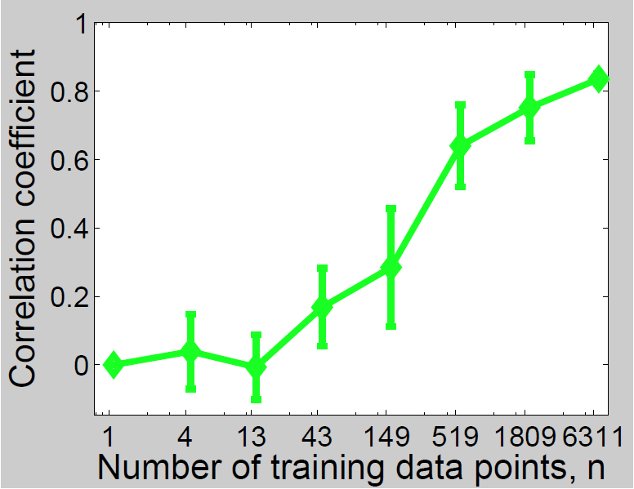
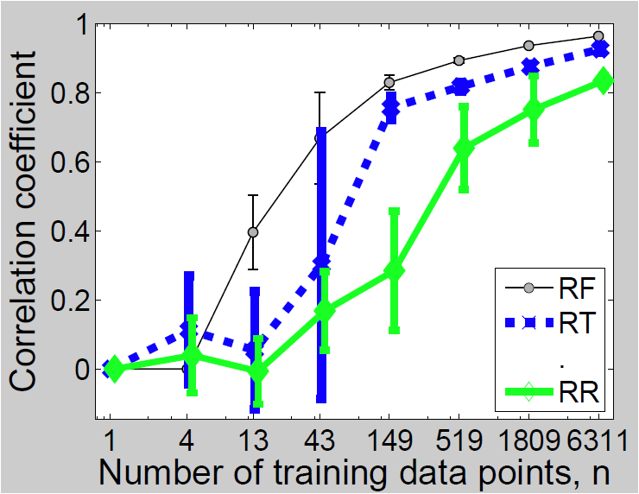
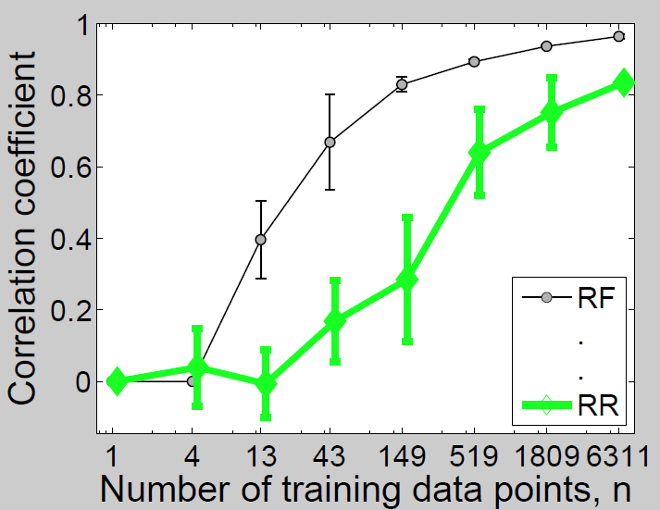
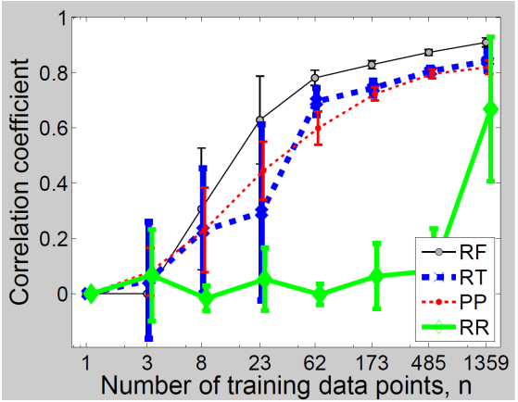
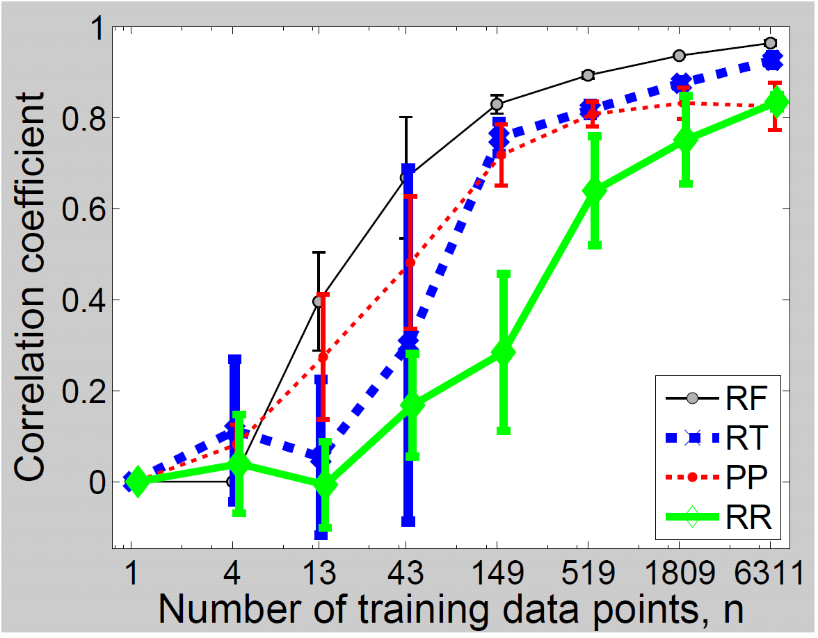
Scaling with Number of Data Points
Motivation EHMs on Uniform-Random 3-SAT Beyond Uniform-Random 3-SAT Applications of EHMs
Correlation coefficient between true & predicted runtime:
higher is better (1 is perfect)
Random forest
Random forest
Ridge
regression
Ridge
regression
MiniSAT on
SAT competition data
CPLEX on heterogeneous
mix of benchmarks

Slide 40
Modeling Algorithm Families
Motivation EHMs on Uniform-Random 3-SAT Beyond Uniform-Random 3-SAT Applications of EHMs
So far we’ve considered single, black box algorithms
What about parameterized algorithm families?
Models can be extended to the sets of algorithms
described by solvers with parameters that are:
  continuous or discrete
  ordinal or categorical
  potentially conditional on the values of other parameters
We call full parameter instantiations
(i.e., runnable algorithms) configurations

Slide 41
Previously Unseen Instances and Configurations
Motivation EHMs on Uniform-Random 3-SAT Beyond Uniform-Random 3-SAT Applications of EHMs
SAT: IBM hardware verification data, SPEAR solver
Linear Regression (RMSE=0.58) Random Forest (RMSE=0.43)
Actual Runtime Actual Runtime
MIP: MIPLIB data, CPLEX 12.1 solver
Linear Regression (RMSE > 1 × 10⁹⁹) Random Forest (RMSE=0.55)
Predicted Runtime Predicted Runtime
Predicted Runtime Predicted Runtime
Actual Runtime Actual Runtime

Slide 42
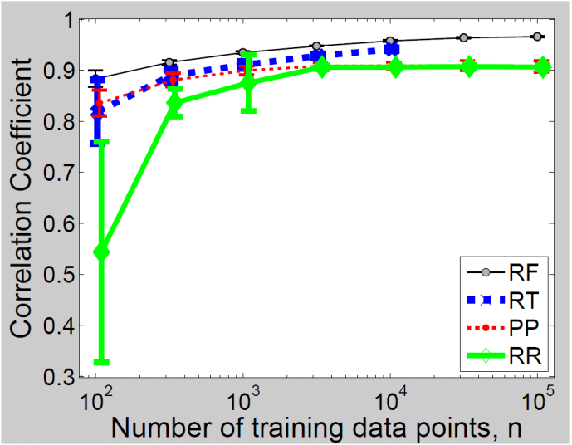
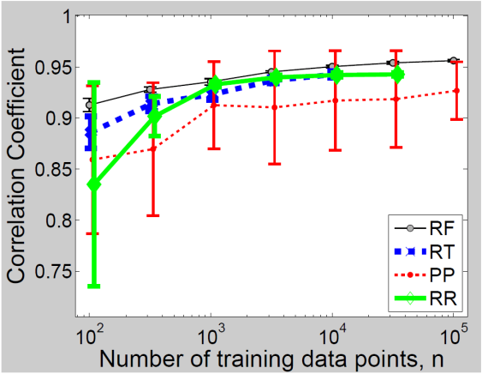
Scaling with Number of Data Points
Motivation EHMs on Uniform-Random 3-SAT Beyond Uniform-Random 3-SAT Applications of EHMs
(Testing on unseen instances and configurations)
Random forest
Random forest
Ridge
regression
Projected
process
SPEAR on
bounded model checking
instances
CPLEX on
wildlife corridor instances

Slide 43
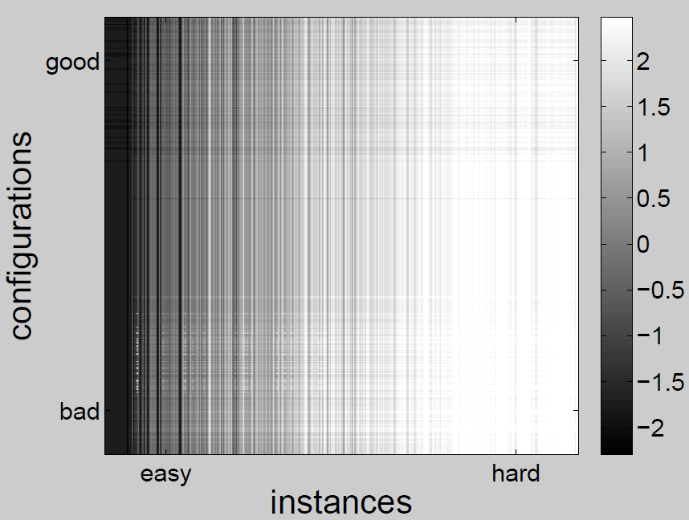
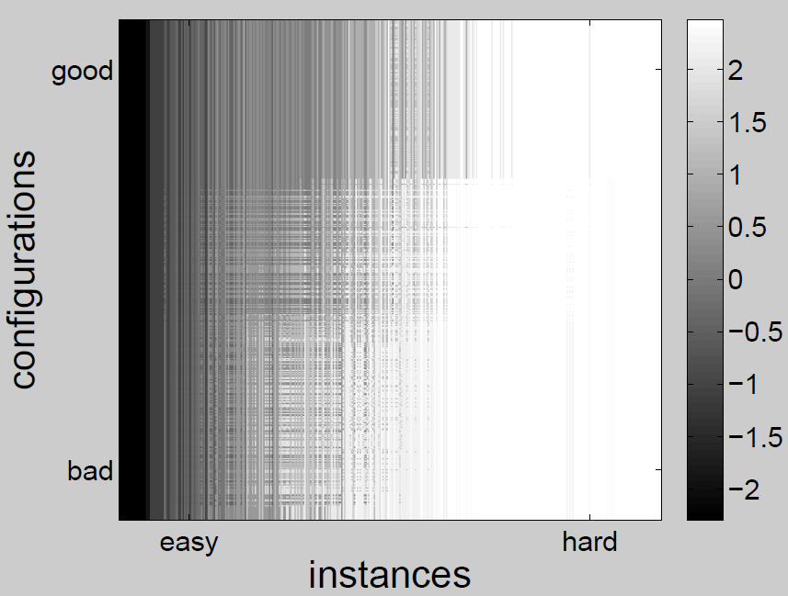
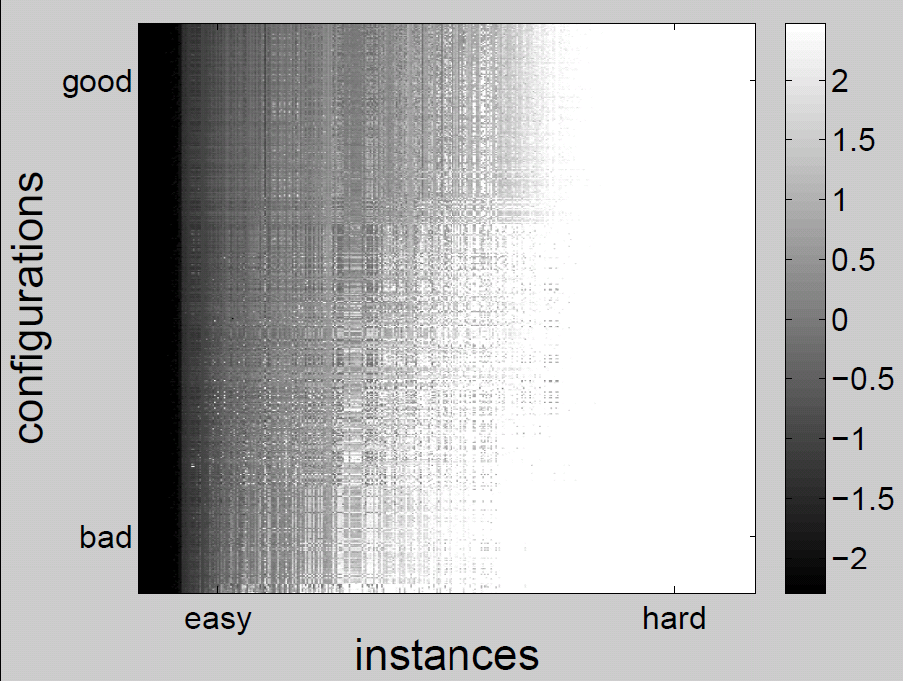

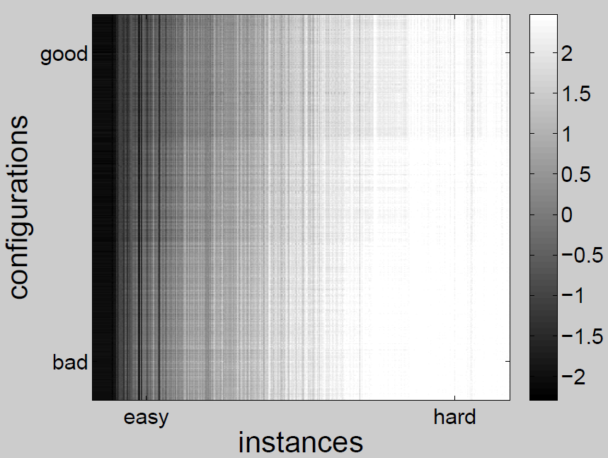
Visualization of Performance in Joint Space
Motivation EHMs on Uniform-Random 3-SAT Beyond Uniform-Random 3-SAT Applications of EHMs
  Scenario: SPEAR on bounded model checking
Data:
  1000 randomly sampled configurations (of over 10¹⁷ in total)
  383 instances ⇒ 383 000 data points
  Training data: 10000 of these data points subsampled at random
Predicted runtime (random forest)
Predicted runtime (regression tree)
Predicted runtime (approximate GP)
True runtime
Predicted runtime (ridge regression)
Darker = faster
Each dot: log₁₀ runtime of one configuration on one instance

Slide 44
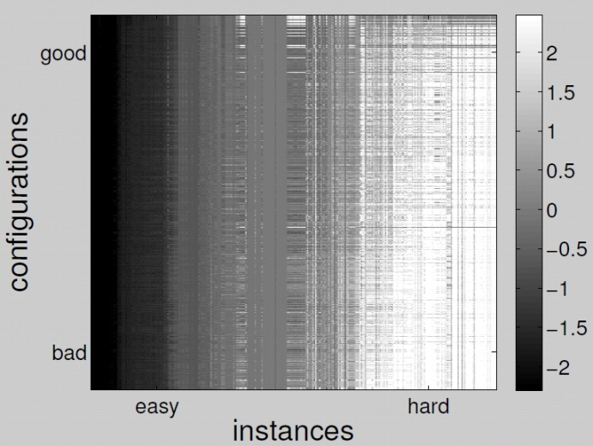
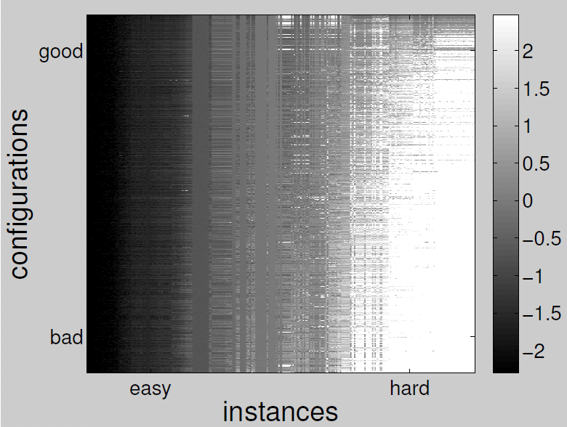
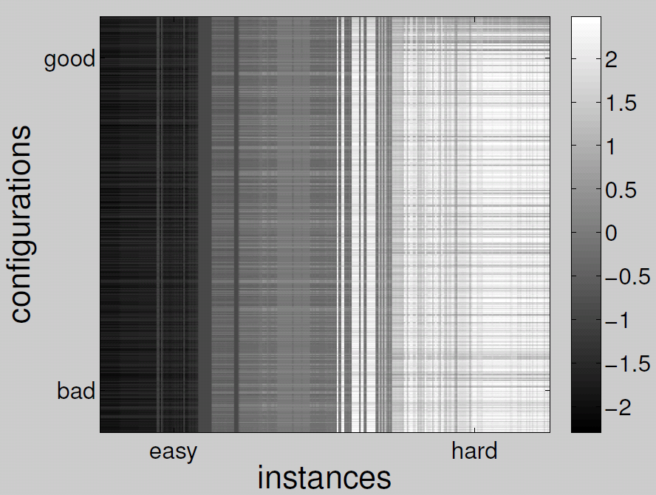
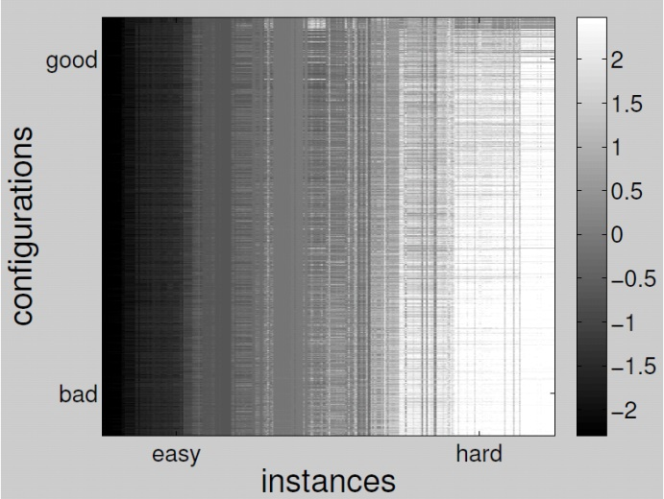
Visualization of Performance in Joint Space
Motivation EHMs on Uniform-Random 3-SAT Beyond Uniform-Random 3-SAT Applications of EHMs
Data:
  1000 randomly sampled configurations (of over 10¹⁷ in total)
  302 instances ⇒ 302 000 data points
  Training data: disjoint instances & configurations (10000 points)
  Scenario: SPEAR on software verification
Using only 1 feature & 1 parameter
Trained on only 100 data points
True runtime
Predicted runtime (random forests)
Darker = faster
Each dot: log₁₀ runtime of one configuration on one instance

Slide 45
APPLICATIONS of
Empirical Hardness Models
Motivation EHMs on Uniform-Random 3-SAT Beyond Uniform-Random 3-SAT Applications of EHMs
[Nudelman, L-B, Andrew, Gomes, McFadden, Selman, Shoham, 2003]
[Nudelman, L-B, Hoos, Devkar, Shoham, CP 2004]
[Xu, Hutter, Hoos, L-B, JAIR 2008]
[L-B, Nudelman, Andrew, McFadden, Shoham, IJCAI 2003; CP 2003]
[L-B, Nudelman, Shoham; JACM 2009]
[Hutter, Hoos, L-B, LION 2011]
[Xu, Hoos, L-B, AAAI 2010; Xu, Hutter, Hoos, L-B, workshop 2011]
[Lindauer, Hoos, L-B, Schaub, AIJ 2016]
[Frechette, Newman, L-B, AAAI 2016]

Slide 46
Recent, enormous increases in compute power
Motivation EHMs on Uniform-Random 3-SAT Beyond Uniform-Random 3-SAT Applications of EHMs
Approaches that might have seemed crazy in 2000 can make a lot of sense in 2016…

Slide 47
Deep Optimization
Motivation EHMs on Uniform-Random 3-SAT Beyond Uniform-Random 3-SAT Applications of EHMs
Machine learning
Classical approach
  Features based on expert insight
  Model family selected by hand
  Manual tuning of hyperparameters
Deep learning
  Very highly parameterized models, using expert knowledge to identify appropriate invariances and model biases (e.g., convolutional structure)
    “deep”: many layers of nodes,
    each depending on the last
  Use lots of data (plus “dropout” regularization) to avoid overfitting
  Computationally intensive search replaces human design
Discrete Optimization
Classical approach
  Expert designs a heuristic algorithm
  Iteratively conducts small experiments to improve the design
Deep optimization
  Very highly parameterized algorithms express a combinatorial space of heuristic design choices that make sense to an expert
    “deep”: many layers of parameters,
    each depending on the last
  Use lots of data to characterize
  the distribution of interest
  Computationally intensive search replaces human design

Slide 48

Algorithm Configuration
Motivation EHMs on Uniform-Random 3-SAT Beyond Uniform-Random 3-SAT Applications of EHMs
Our input: parameters encoding each
design choice considered by the
author of our heuristic algorithm
Our task: the stochastic optimization
problem of finding a parameter
configuration with good performance.
An interesting black-box function
optimization problem
  design dimensions can be continuous; ordinal; categorical
  extra design dimension: which instance do I test?
  objective function to be minimized is the same as the cost of evaluating a given point
  censored sampling: long runs can be terminated
Best current methods for solving this problem are
based on EHMs

Slide 49
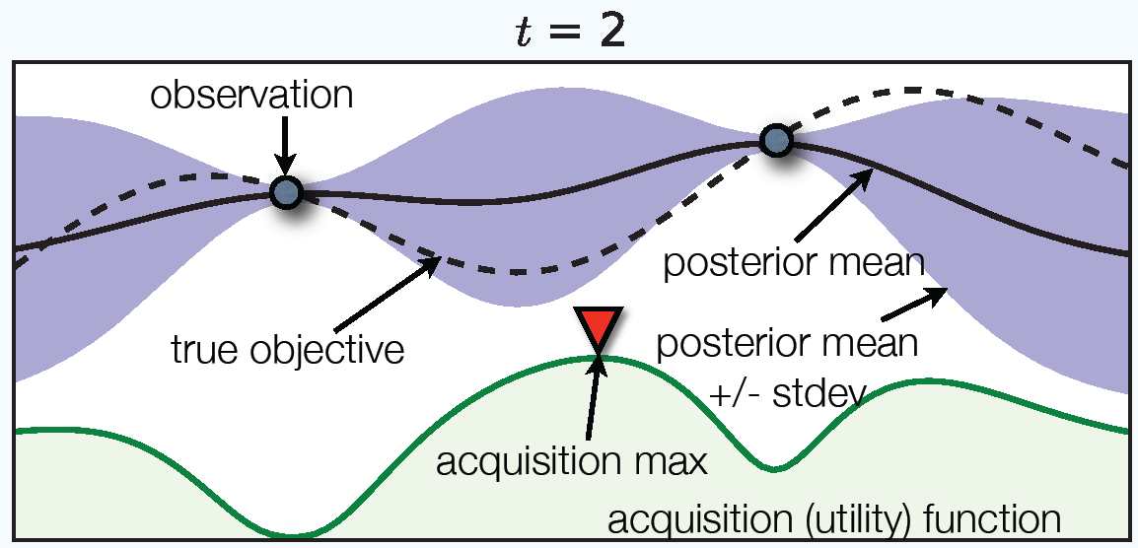
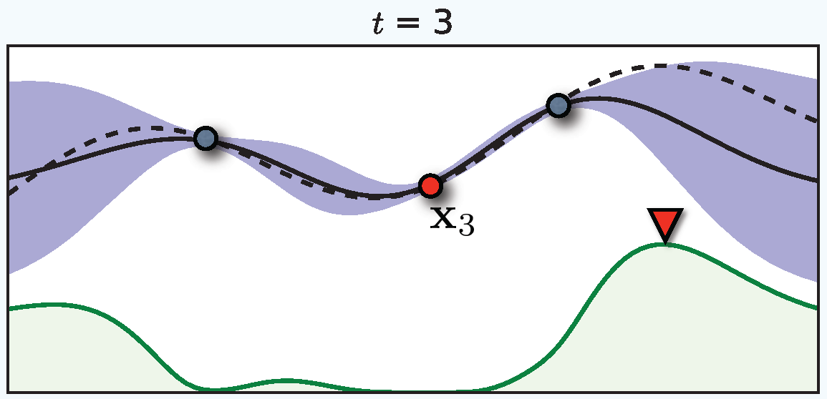
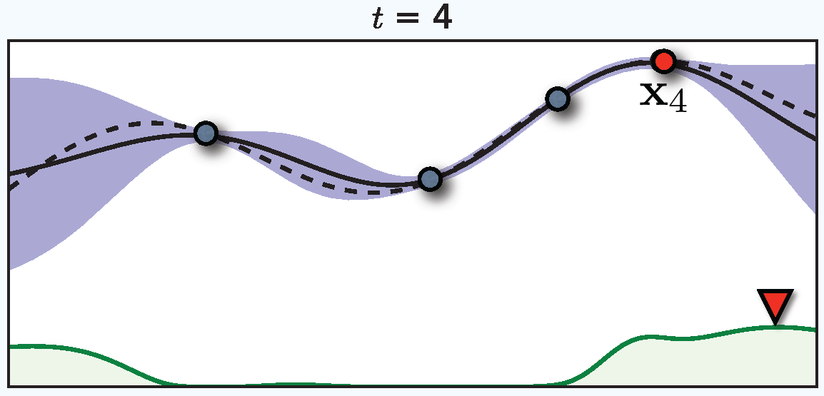
Sequential Model-Based Optimization (SMBO) [Mockus et al., '78]
Motivation EHMs on Uniform-Random 3-SAT Beyond Uniform-Random 3-SAT Applications of EHMs
A popular approach for optimizing expensive black box functions.
  max f(x)
x
f(x)
x∈X
Very efficient in number
of function evaluations
Works when objective is nonconvex, has unknown derivatives, etc
Regret bounds:
  Nearly exponential in the noiseless case
  [Bull '11; de Freitas et al, '12]
  Square-root for noisy case [Srinivas et al, '10]
Slide credit: Frank Hutter

Slide 50
Visualizing Sequential Model-Based Optimization
Motivation EHMs on Uniform-Random 3-SAT Beyond Uniform-Random 3-SAT Applications of EHMs
Acquisition function
Parameter
Slide credit: Frank Hutter

Slide 51
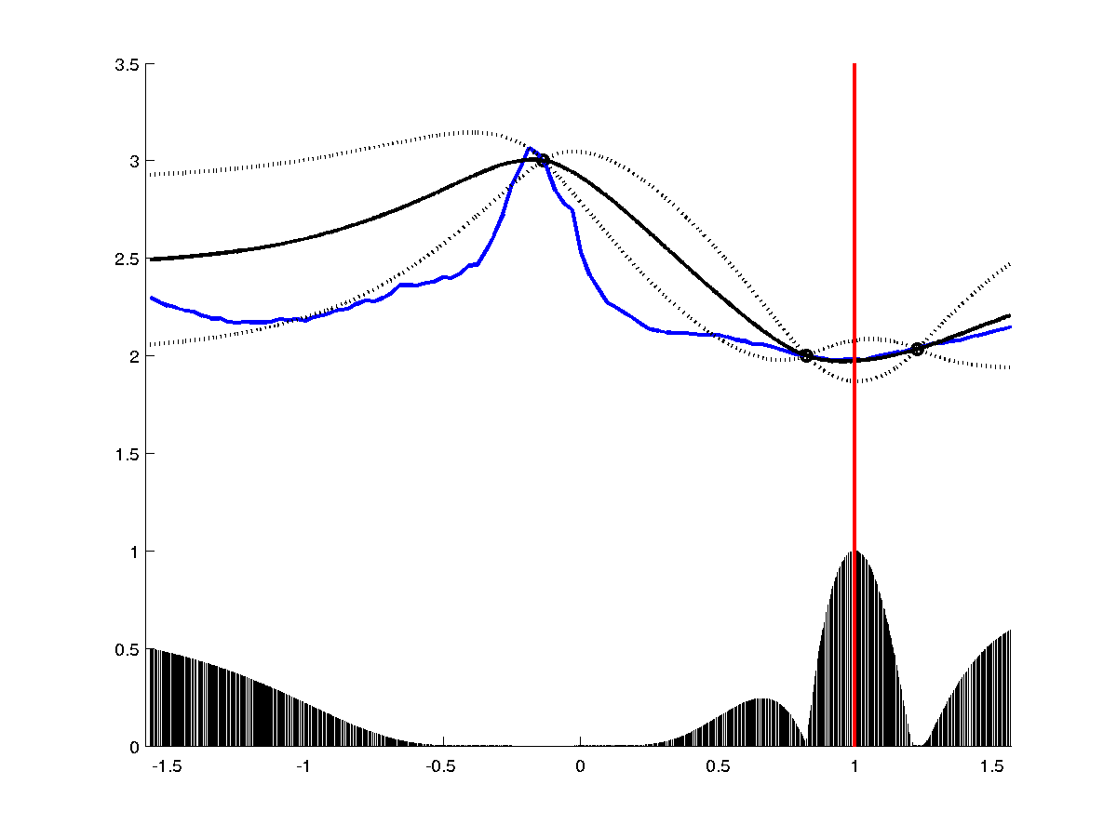
Visualizing Sequential Model-Based Optimization
Motivation EHMs on Uniform-Random 3-SAT Beyond Uniform-Random 3-SAT Applications of EHMs
Acquisition function
Parameter
Slide credit: Frank Hutter

Slide 52
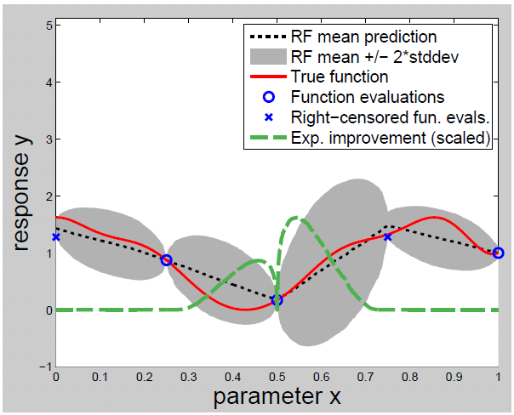
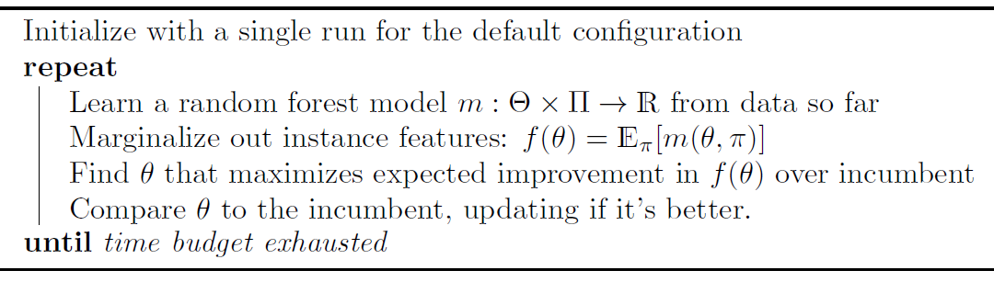
Sequential Model-based Algorithm Configuration (SMAC)
Motivation EHMs on Uniform-Random 3-SAT Beyond Uniform-Random 3-SAT Applications of EHMs

Slide 53







Applications of Algorithm Configuration
Motivation EHMs on Uniform-Random 3-SAT Beyond Uniform-Random 3-SAT Applications of EHMs
Wins in Competitions
SAT: since 2009
IPC: since 2011
ASP: since 2011
Timetabling: 2007
SMT: 2007
Mixed integer
programming
Spectrum
repacking
Scheduling and
Resource Allocation
Game
Optimization
Academic Applications by Others
Protein Folding
Game Theory: Kidney Exchange
Computer GO
Linear algebra subroutines
Evolutionary Algorithms
Machine Learning: Classification
Supply Chain
Planning & Optimization
Exam Timetabling
Notes:
Hundreds academic applications

Slide 54

Is Algorithm Configuration Enough?
Motivation EHMs on Uniform-Random 3-SAT Beyond Uniform-Random 3-SAT Applications of EHMs
There’s not (yet) a “best” SAT solver
  different solvers perform well on different instances
  performance differences between
  them are typically very large
The effectiveness of EHMs suggests
a straightforward solution
  given a new problem instance, predict the runtime of each SAT solvers from
  an algorithm portfolio
  run the one predicted to be fastest
SATzilla: a portfolio-based algorithm selector for SAT (2003-present)

Slide 55
Algorithm Selection
Motivation EHMs on Uniform-Random 3-SAT Beyond Uniform-Random 3-SAT Applications of EHMs
Since proposing it, we’ve improved the approach to:
  allow randomized and incomplete algorithms as component solvers
  include presolvers that run for a short, fixed time
  optimize for complex scoring functions beyond runtime
  automate the construction of the selector given data
    e.g., pre-solver selection; component solver selection
    again, “deep optimization”
We can also improve by moving to a different ML framework
  cost-sensitive classification directly selects best-performing solver
  doesn’t need to predict runtime
Or, just run all algorithms in the portfolio together in parallel

Slide 56
Success of SATzilla
Motivation EHMs on Uniform-Random 3-SAT Beyond Uniform-Random 3-SAT Applications of EHMs
2003 SAT Competition
  placed second and third in several categories
2007 and 2009 SAT Competitions
  winning five medals each time
2012 SAT Challenge
  eligible to enter four categories
  placed first, first, first, second
Then, portfolios banned from competitions ☺
SATzilla’s success demonstrates the effectiveness of automated, statistical methods for combining solvers
  including “uncompetitive” solvers with poor average performance
Our approach is entirely general
  likely to work well for other problems with high runtime variation
  caveat: each domain needs instance features

Slide 57
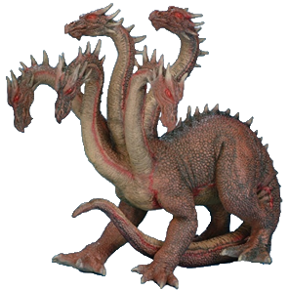
Hydra: Automatic Portfolio Synthesis
Motivation EHMs on Uniform-Random 3-SAT Beyond Uniform-Random 3-SAT Applications of EHMs
So far we’ve assumed that we start out with a
manageable set of relatively uncorrelated solvers
  what if all we start out with is a huge, deep parameter space?
    top level parameter may encode for which of many different solvers to use
  want a “deep optimization” approach that works entirely automatically
Hydra: augment an additional
portfolio P by targeting instances
on which P performs poorly
Give SMAC a dynamic performance metric:
  performance of alg s when s outperforms P;
  performance of P otherwise
  Intuitively: s scored for marginal contribution to P

Slide 58

FCC’s “Incentive Auction”
Motivation EHMs on Uniform-Random 3-SAT Beyond Uniform-Random 3-SAT Applications of EHMs

Slide 59


Thanks to all those who helped make this work possible!
Motivation EHMs on Uniform-Random 3-SAT Beyond Uniform-Random 3-SAT Applications of EHMs
Student leads
on the project:
Neil Newman , Alexandre Fréchette
Further students who made contributions to software:
Nick Arnosti; Emily Chen; Ricky Chen;
Paul Cernek; Guillaume Saulnier Comte; Alim Virani
Others (then) at UBC:
Chris Cameron
Holger Hoos
Frank Hutter
Ashiqur Khudabukhsh
Steve Ramage
James Wright
Lin Xu
Auctionomics:
Ulrich Gall
Jon Levin
Paul Milgrom
Ilya Segal
Karen Wrege
FCC & associates:
Melissa Dunford
Gary Epstein
Karla Hoffman
Sasha Javid
Evan Kwerel
Rory Molinari
Brett Tarnutzer
Venkat Veeramneni
Funding from: Auctionomics; Compute Canada; NSERC Discovery; NSERC E.W.R. Steacie

Slide 60
Building (& Evaluating) a Feasibility Tester
Motivation EHMs on Uniform-Random 3-SAT Beyond Uniform-Random 3-SAT Applications of EHMs
Data generated Nov 2015 – Feb 2016 using
  the FCC’s Nov 2015 interference constraints
  the FCC’s “smoothed ladder” simulator
  varying simulation assumptions:
    how much spectrum is cleared: 126 MHz; 108 MHz; 84 MHz
    which stations opt to participate
    these stations’ valuations
    the timeout given to SATFC in the simulation (1; 5; 10; 60 min)
128 auctions ⇒ 1.4 M instances
  6,128 – 17,764 instances per auction
    all not solvable by directly augmenting the previous solution
    about 20% of the problems encountered in full simulations
  split auctions 102/26 into training/test sets
Our goal: solve problems within a one-minute cutoff

Slide 61
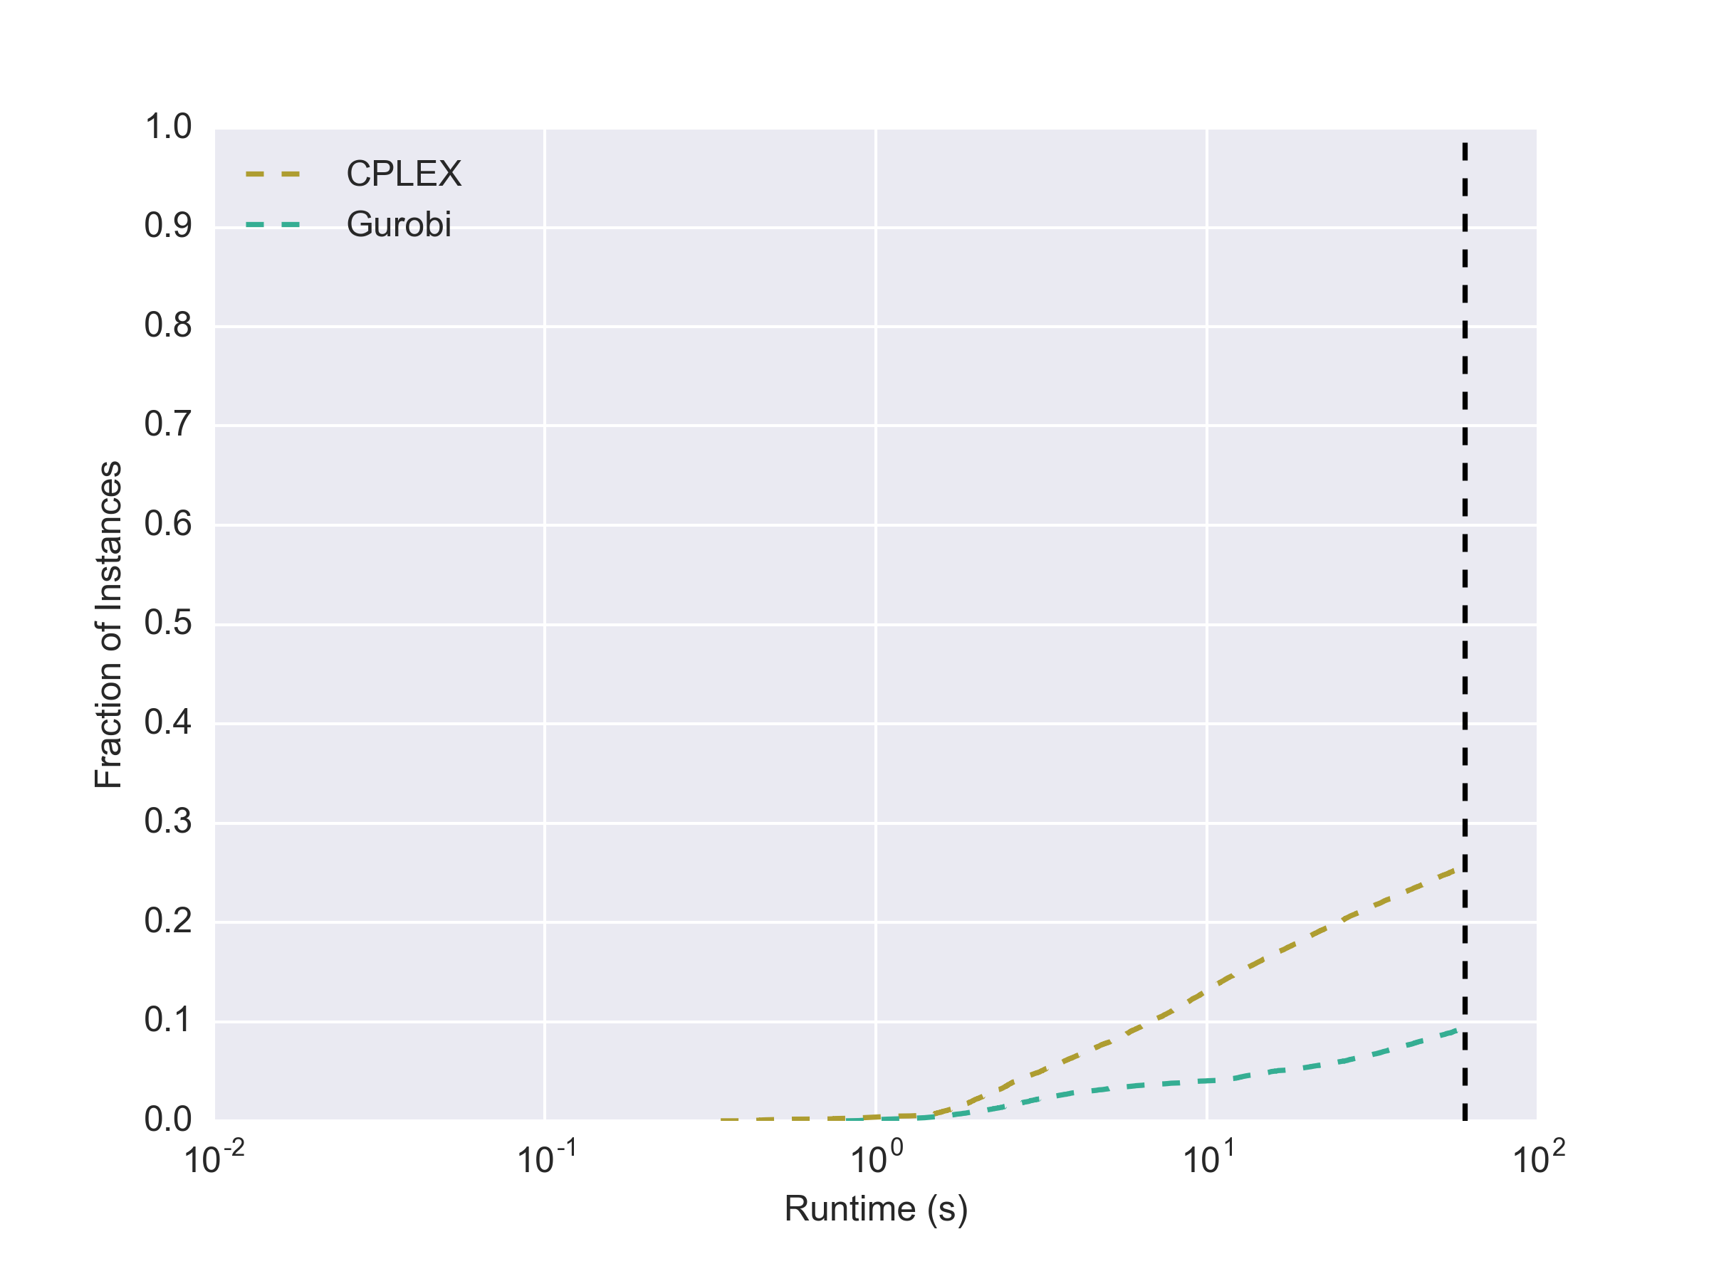
Feasibility Testing via MIP Encoding
Motivation EHMs on Uniform-Random 3-SAT Beyond Uniform-Random 3-SAT Applications of EHMs

Slide 62
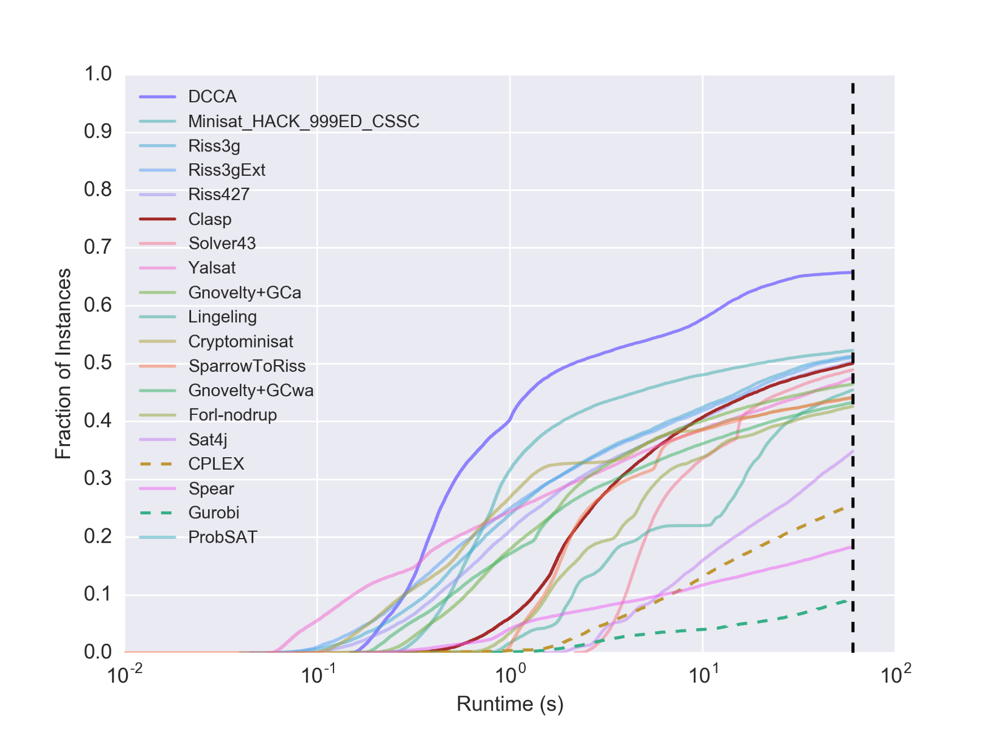
Feasibility Testing via SAT Encoding
Motivation EHMs on Uniform-Random 3-SAT Beyond Uniform-Random 3-SAT Applications of EHMs

Slide 63
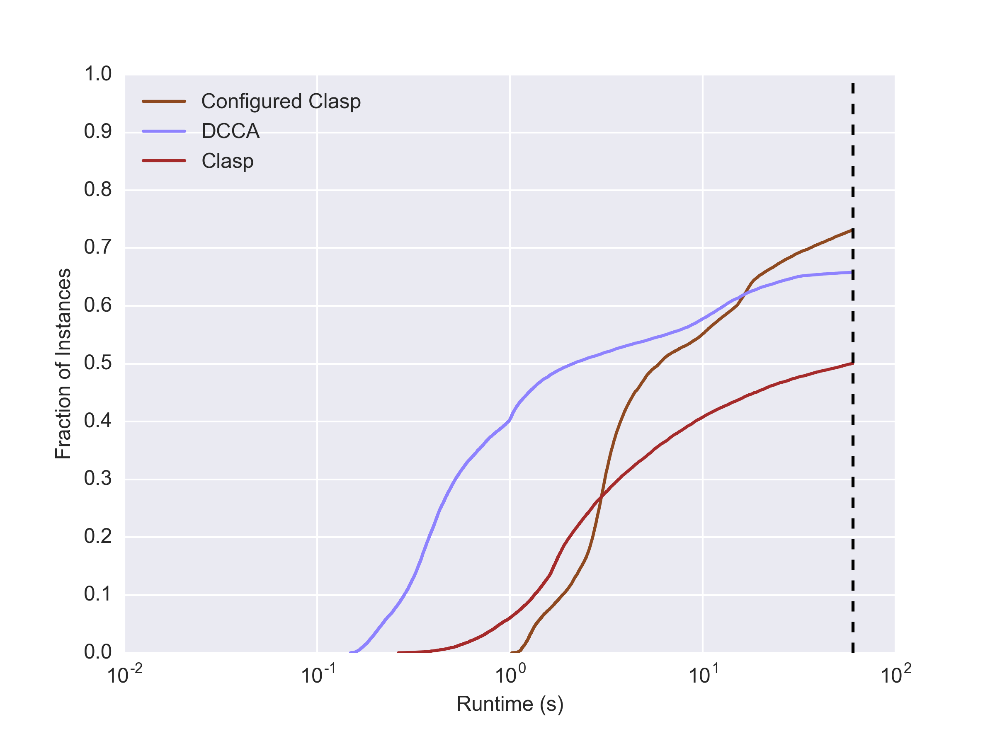
Best Configured Solver
Motivation EHMs on Uniform-Random 3-SAT Beyond Uniform-Random 3-SAT Applications of EHMs

Slide 64
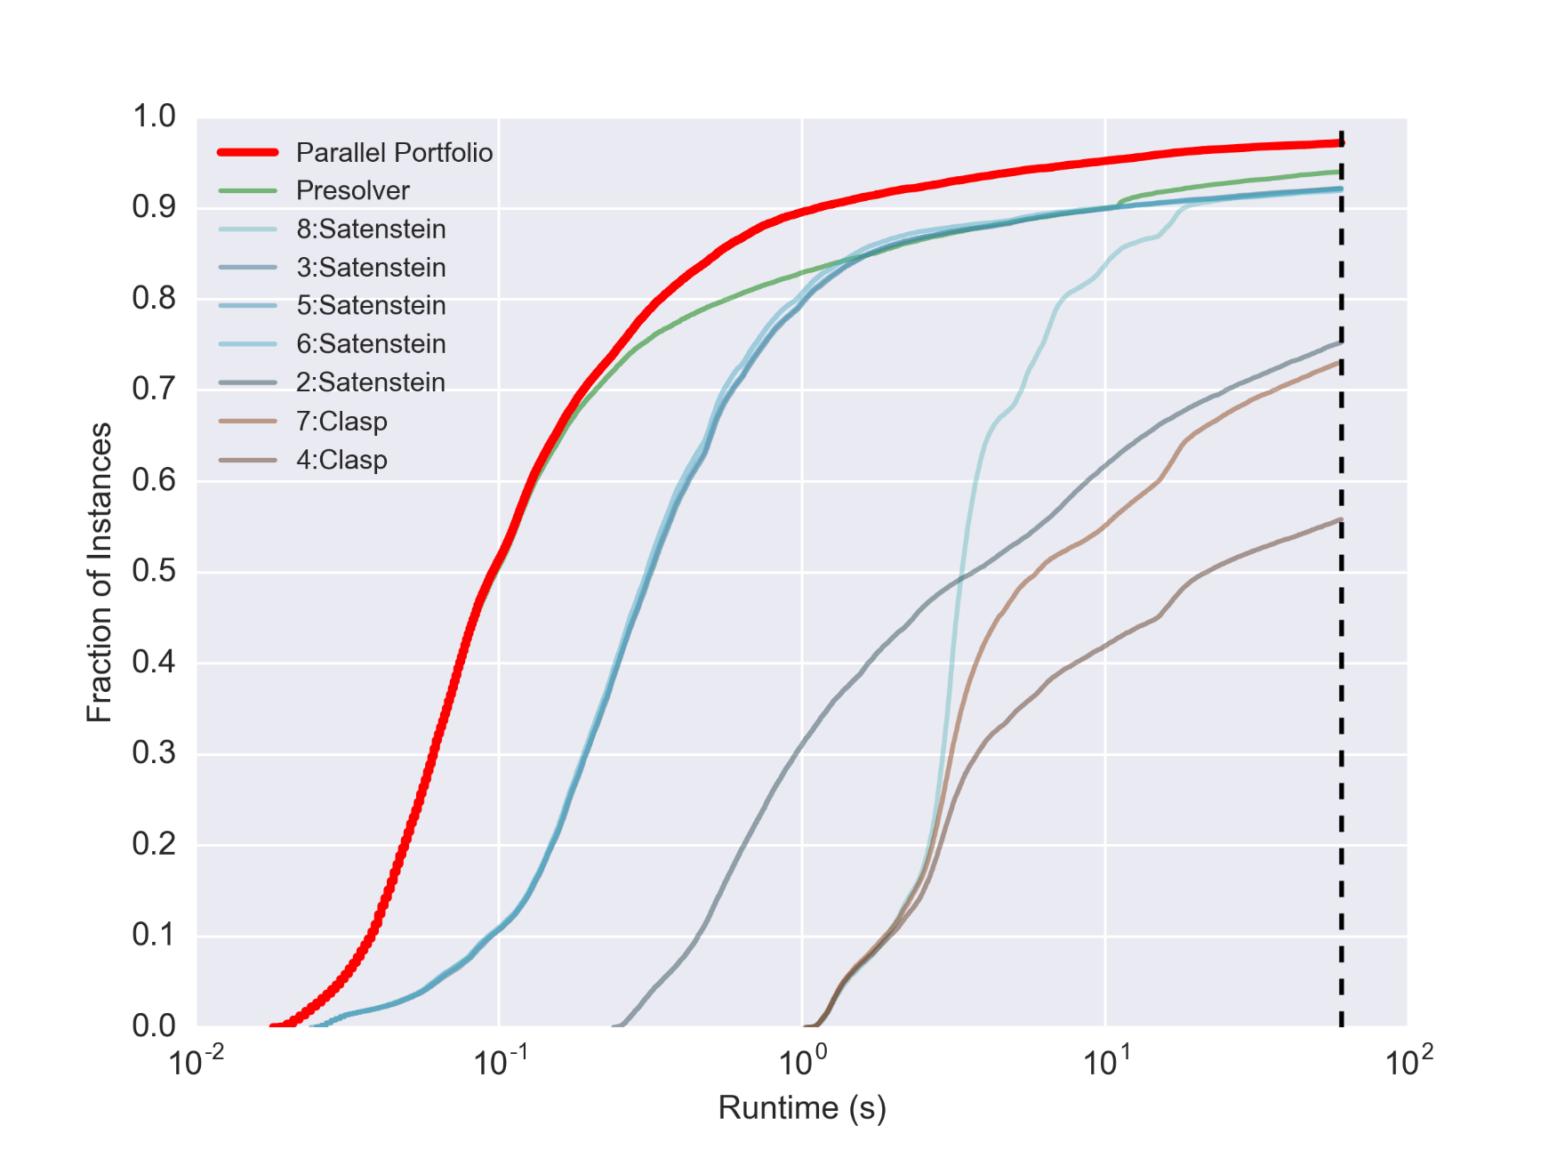
Performance of the Algorithm Portfolio
Motivation EHMs on Uniform-Random 3-SAT Beyond Uniform-Random 3-SAT Applications of EHMs

Slide 65
Conclusions
Motivation EHMs on Uniform-Random 3-SAT Beyond Uniform-Random 3-SAT Applications of EHMs
Empirical Hardness Models
  a statistically rigorous approach to characterizing the difficulty of solving a given family of problems using available methods
  surprisingly effective in practice, across various domains
  analysis of these models can open avenues for theoretical investigations beyond the worst case
EHMs are also useful for practical applications:
  model-based algorithm configuration
  automatic design of algorithm portfolios

