Slide 1
Online Scheduling meets Queueing
(Part 1)
Nikhil Bansal (TU Eindhoven)
Adam Wierman (Caltech)

Slide 2
Scheduling
Server
Objective: Waiting time, fairness, …
Constraints: Preemption, deadlines …
Setting: Multiple machines, networks …
D1
Competitive Analysis Queueing
Relative to best Absolute guarantees
Worst case inputs Stochastic inputs
Robust algorithm Optimized to workloads
Can we use insights from each other?
Design good algorithms that combine insights from both areas
D2
D3
bad
Input Space

Slide 3
Plan for the talk
Basic Terminology
Flavor of results, techniques (queueing)
Case study: Minimizing flow time (response or sojourn time)
How insights from one help another?
Other possible directions
More case studies (part 2) [Adam]

Slide 4
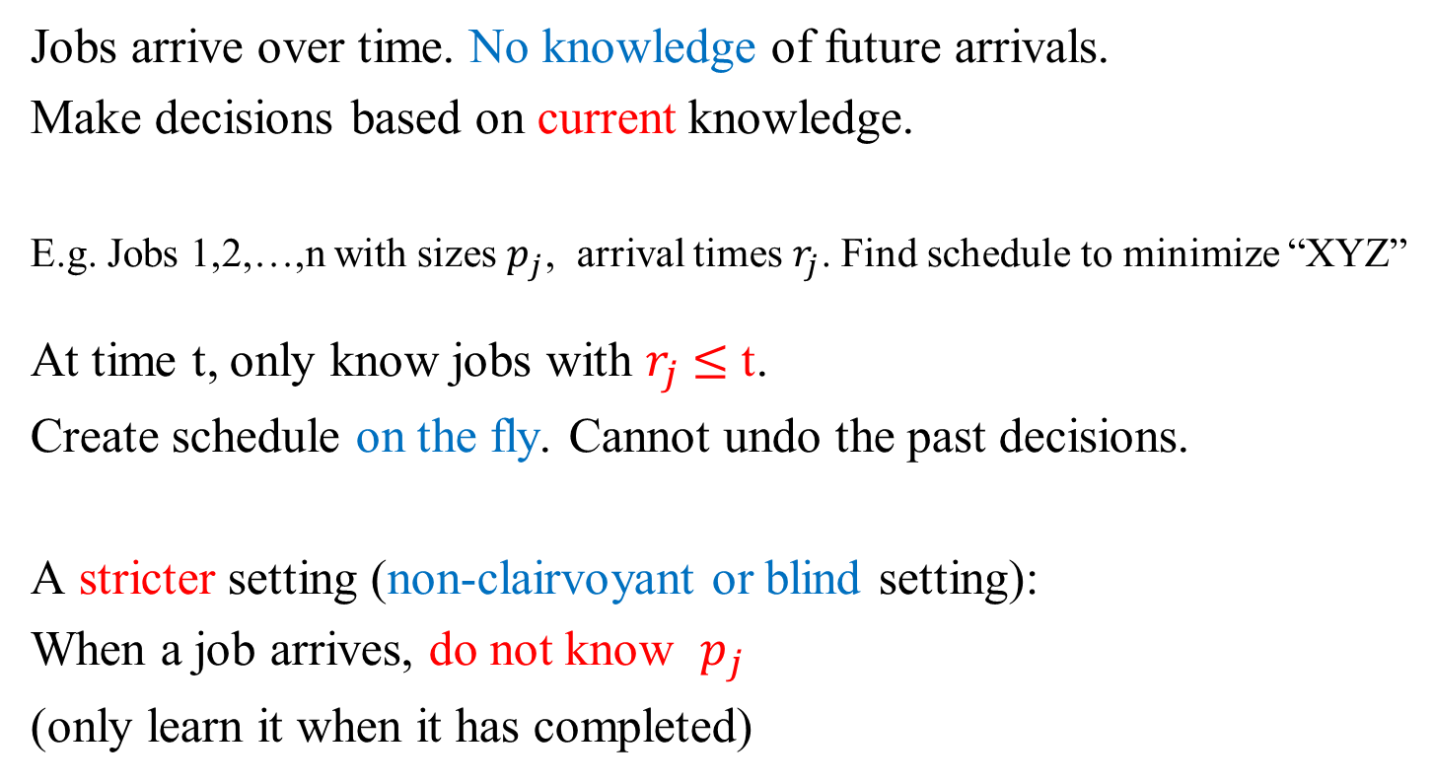
Competitive Analysis
Jobs arrive over time. No knowledge of future arrivals.
Make decisions based on current knowledge.
E.g. Jobs 1,2,…,n with sizes $p_{j}$, arrival times $r_{j}$. Find schedule to minimize “XYZ”
At time t, only know jobs with $r_{j}$ $≤$ t.
Create schedule on the fly. Cannot undo the past decisions.
A stricter setting (non-clairvoyant or blind setting):
When a job arrives, do not know $p_{j}$
(only learn it when it has completed)

Slide 5
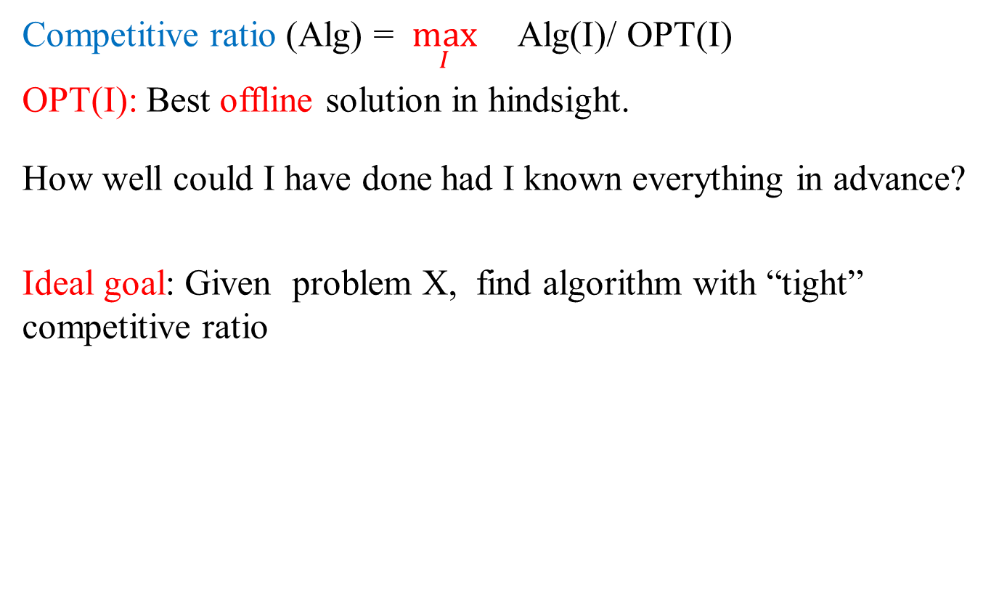
Competitive ratio (Alg) = $\max_{I}{}$Alg(I)/ OPT(I)
OPT(I): Best offline solution in hindsight.
How well could I have done had I known everything in advance?
Ideal goal: Given problem X, find algorithm with “tight” competitive ratio
Lower
bound
Right
Competitive
Ratio
Best
Algorithm
Lower bound: Adversarial input strategy to fool all online algorithms
Upper bound: Design algorithm + show does well on all inputs

Slide 6

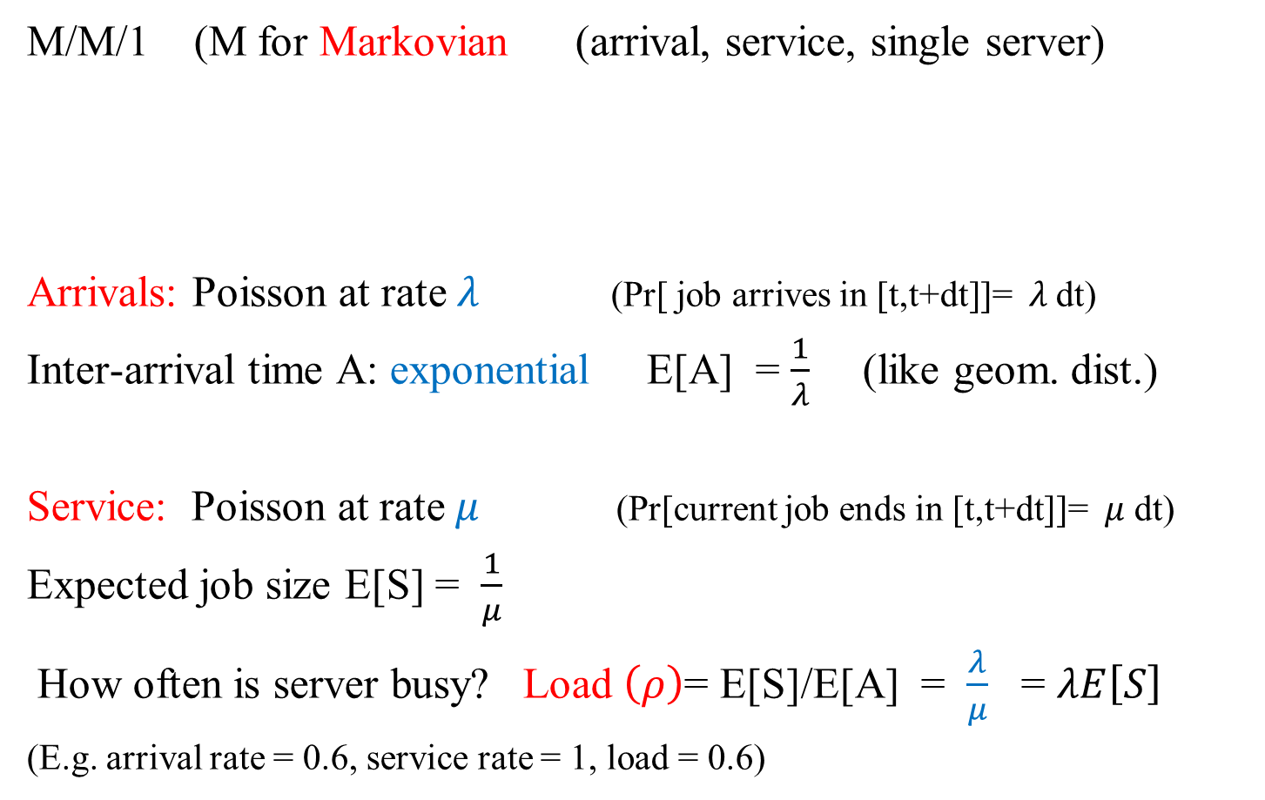

Queueing Model
M/M/1 (M for Markovian (arrival, service, single server)
Arrivals: Poisson at rate $λ$ (Pr[ job arrives in [t,t+dt]]= $λ$dt)
Inter-arrival time A: exponential E[A] = $\frac{1}{λ}$ (like geom. dist.)
Service: Poisson at rate $μ$ (Pr[current job ends in [t,t+dt]]= $μ$ dt)
Expected job size E[S] = $\frac{1}{μ}$
How often is server busy? Load $\left(ρ\right)$= E[S]/E[A] = $\frac{λ}{μ}$ = $λE\left[S\right]$
(E.g. arrival rate = 0.6, service rate = 1, load = 0.6)
$$λ$$
$$μ$$

Slide 7



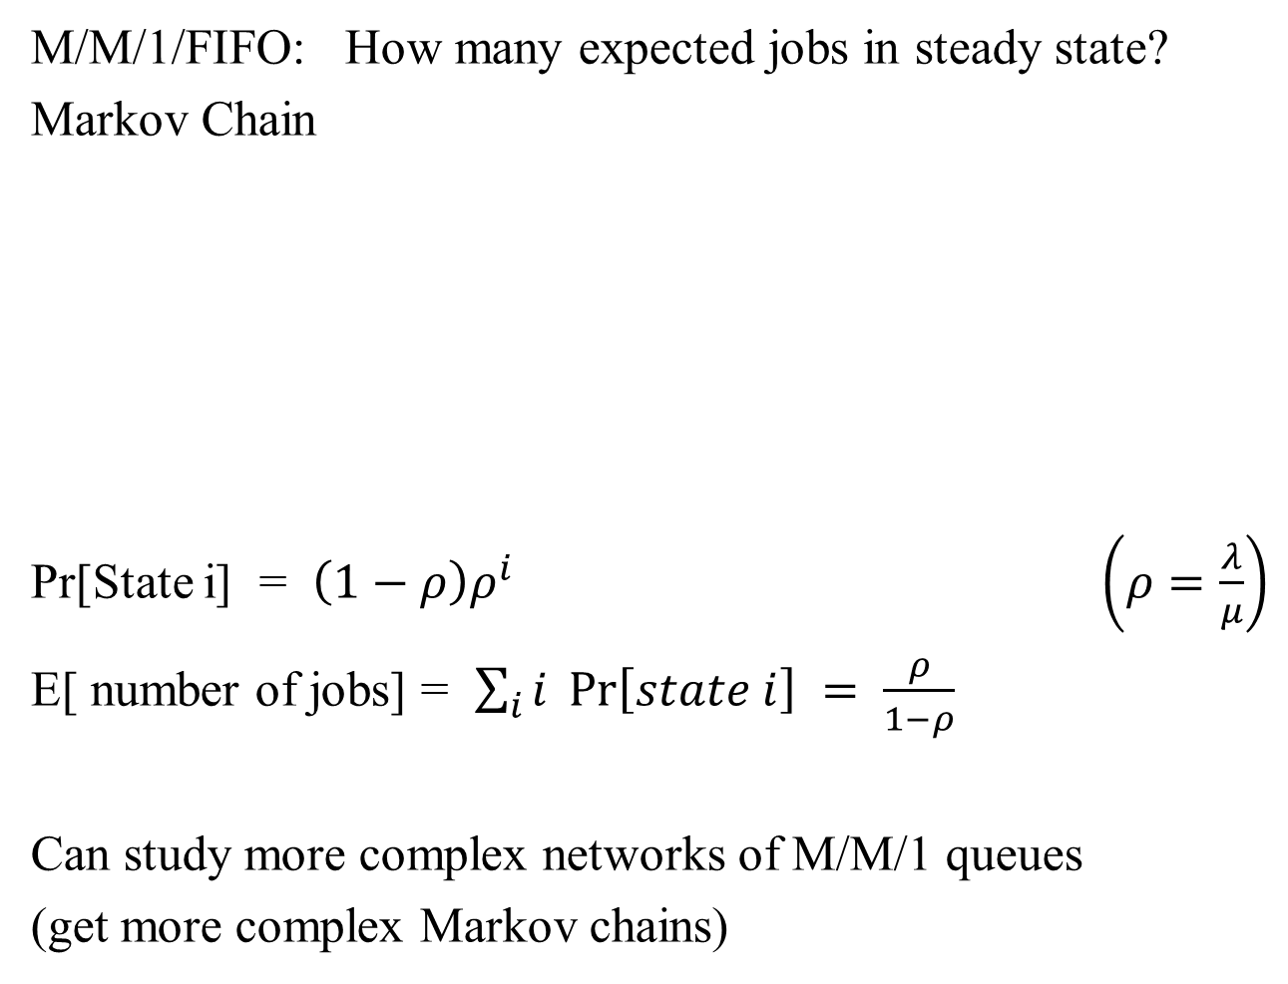





M/M/1/FIFO: How many expected jobs in steady state?
Markov Chain
Pr[State i] = $\left(1−ρ\right)ρ^{i}$ $\left(ρ=\frac{λ}{μ}\right)$
E[ number of jobs] = $\sum_{i}{i} \operatorname{Pr}\left[state i\right] = \frac{ρ}{1−ρ}$
Can study more complex networks of M/M/1 queues
(get more complex Markov chains)
$$λ$$
$$λ$$
$$λ$$
$$λ$$
3
….
0
1
2
4
$$μ$$
$$μ$$
$$μ$$
$$μ$$

Slide 8

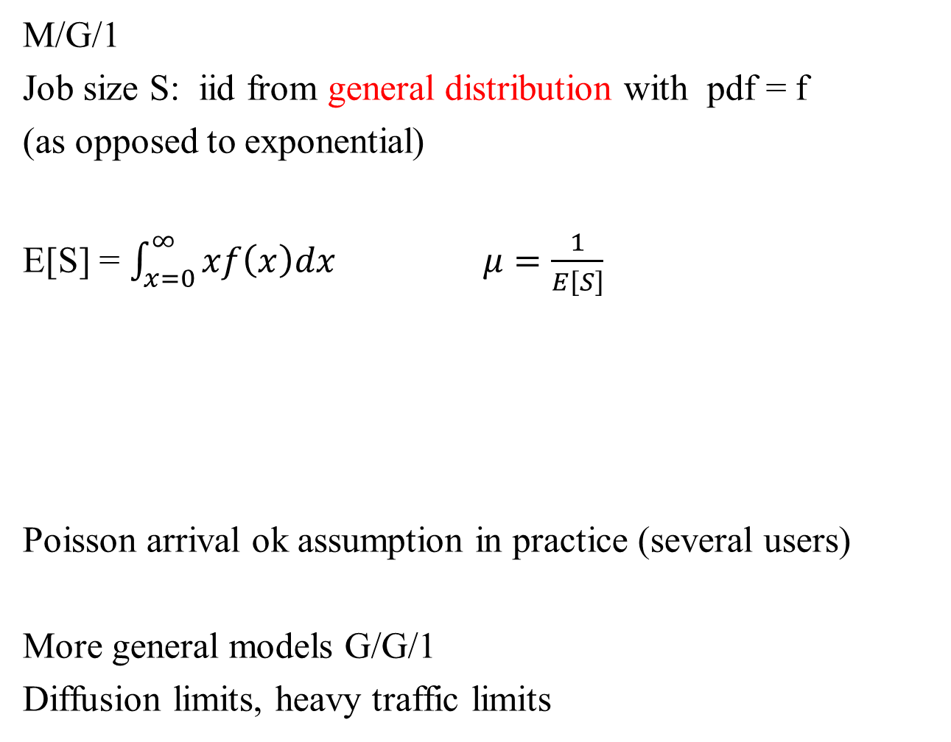

M/G/1
Job size S: iid from general distribution with pdf = f
(as opposed to exponential)
E[S] = $\int_{x=0}^{∞}{xf\left(x\right)dx}$ $μ=\frac{1}{E\left[S\right]}$
Poisson arrival ok assumption in practice (several users)
More general models G/G/1
Diffusion limits, heavy traffic limits
$$λ$$
$$μ$$

Slide 9
Performance Measure
Average flow time

Slide 10

Flow time
Classic single machine setting (with preemptions)
Jobs: size $p_{j}$, release time $r_{j}$
Flow time: $f_{j} = C_{j} − r_{j}$(completion time – release time)
time
Flow time of green job
Objective: Minimize total (average) flow time
What is the right policy (FIFO, Round Robin, LCFS, SJF, SRPT, …)

Slide 11
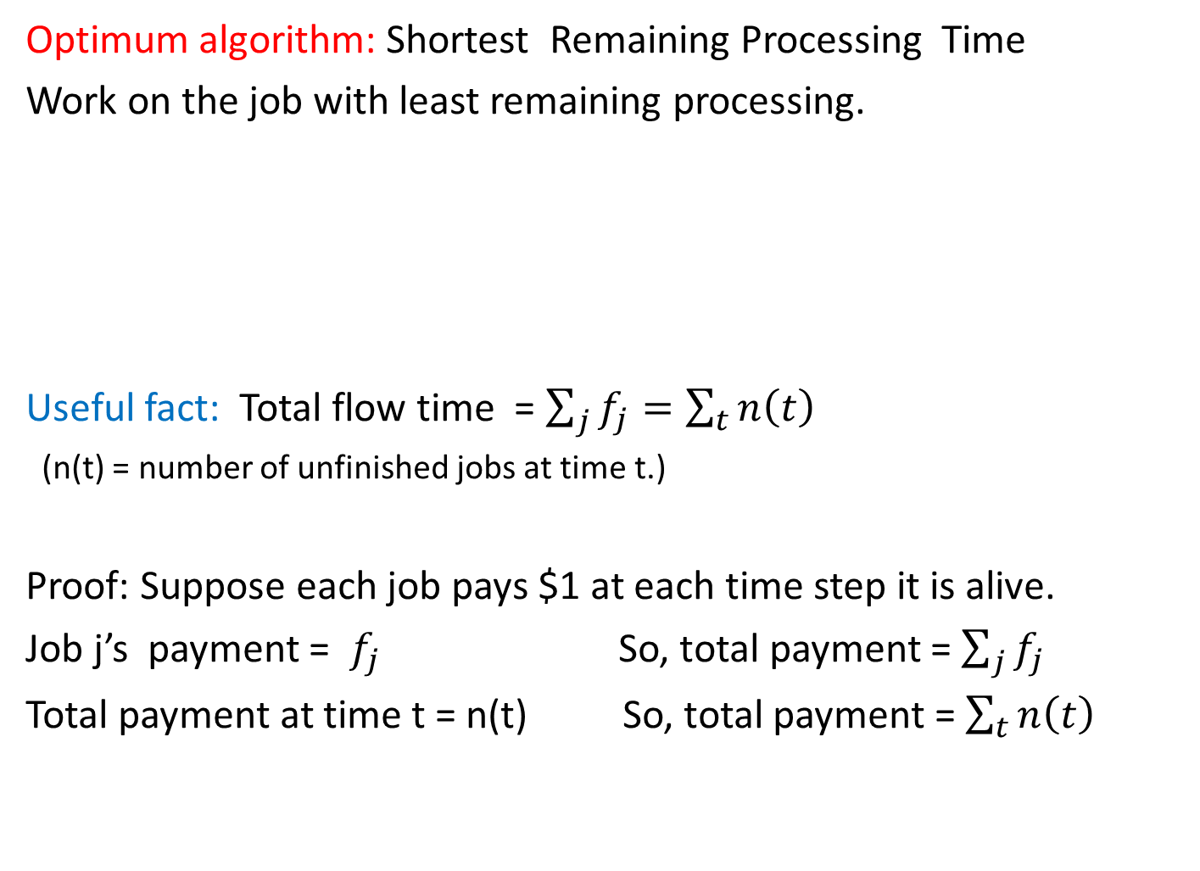
Total Flow time
Optimum algorithm: Shortest Remaining Processing Time
Work on the job with least remaining processing.
Useful fact: Total flow time = $\sum_{j}{f_{j}=\sum_{t}{n\left(t\right)}}$
(n(t) = number of unfinished jobs at time t.)
Proof: Suppose each job pays $1 at each time step it is alive.
Job j’s payment = $f_{j}$ So, total payment = $\sum_{j}{f_{j}}$
Total payment at time t = n(t) So, total payment = $\sum_{t}{n\left(t\right)}$

Slide 12
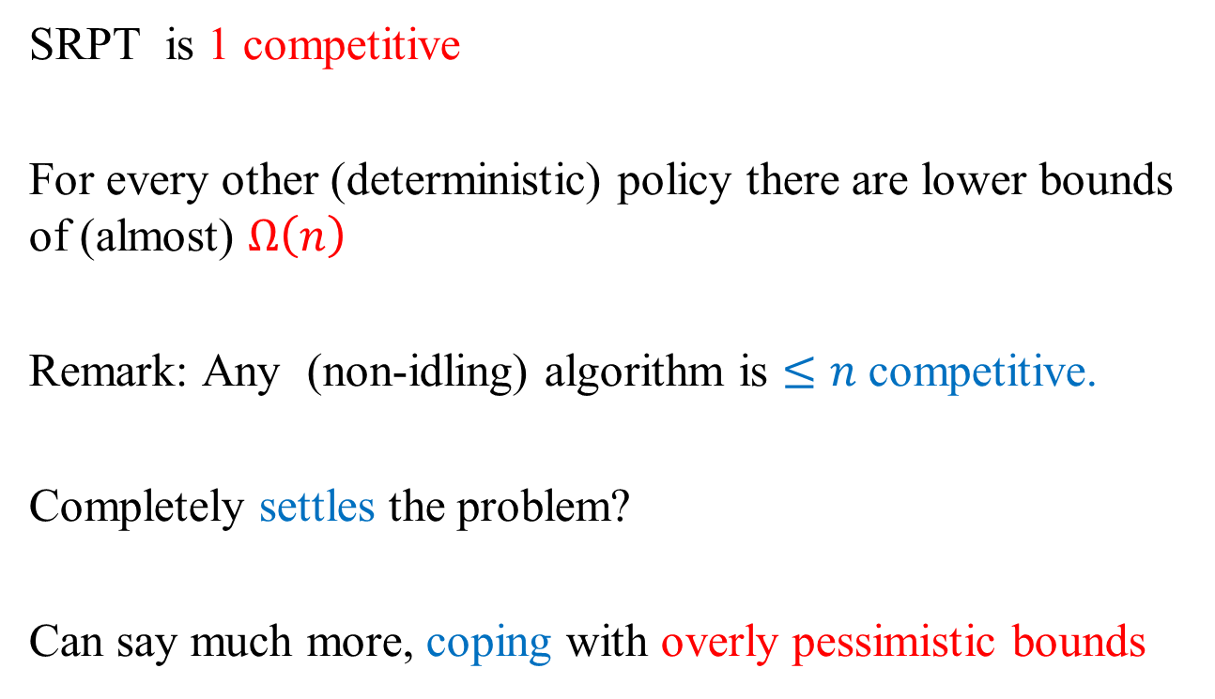
Competitive analysis for the problem
SRPT is 1 competitive
For every other (deterministic) policy there are lower bounds of (almost) $Ω\left(n\right)$
Remark: Any (non-idling) algorithm is $≤n$competitive.
Completely settles the problem?
Can say much more, coping with overly pessimistic bounds

Slide 13

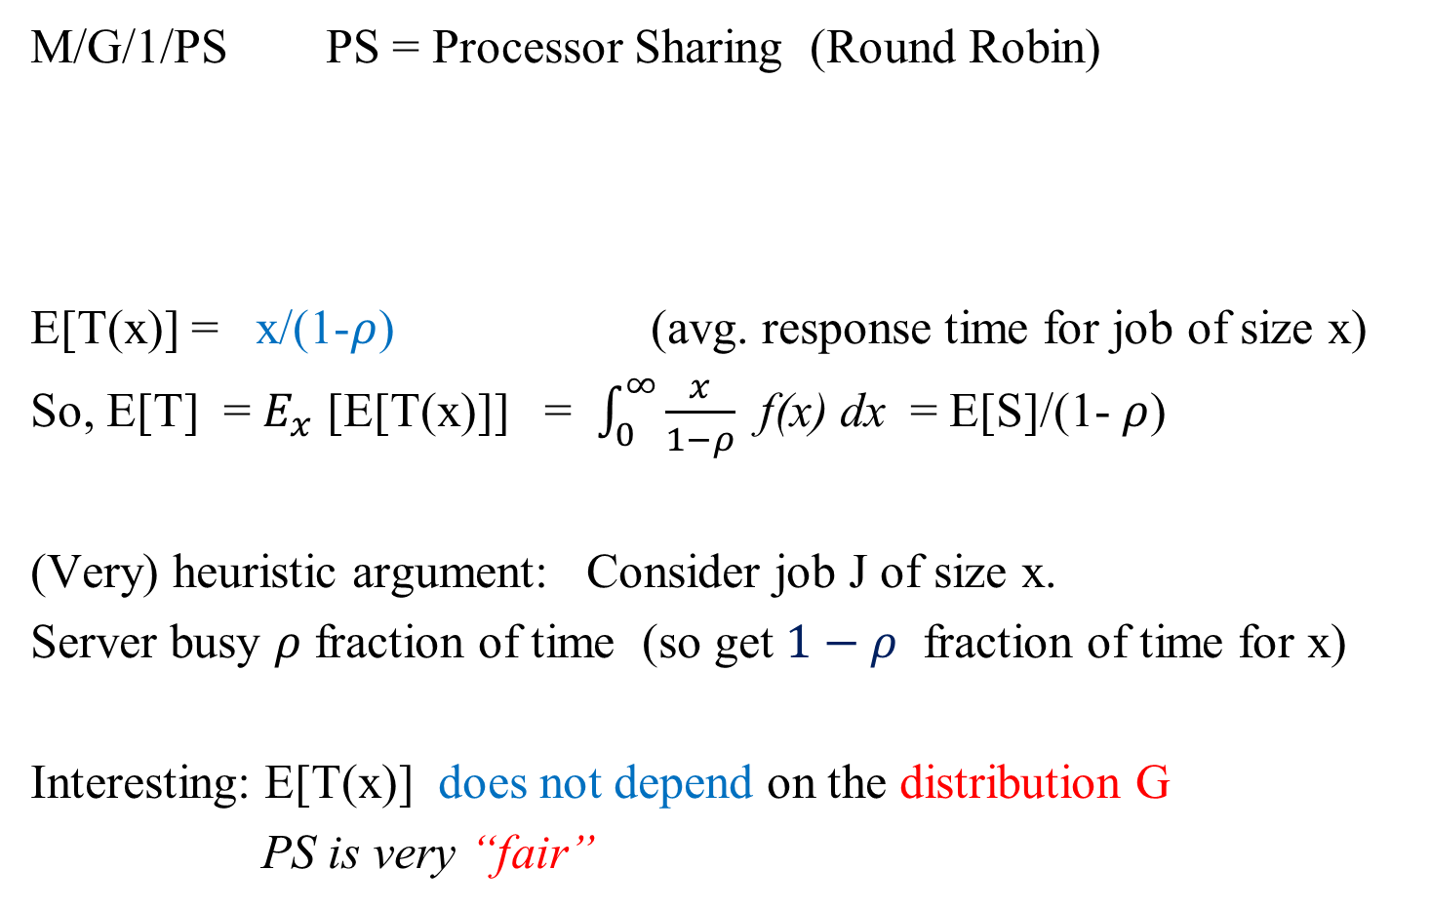

Queueing: Typical results
M/G/1/PS PS = Processor Sharing (Round Robin)
E[T(x)] = x/(1-$ρ$) (avg. response time for job of size x)
So, E[T] = $E_{x}$ [E[T(x)]] = $\int_{0}^{∞}{\frac{x}{1−ρ}}$ f(x) dx = E[S]/(1- $ρ$)
(Very) heuristic argument: Consider job J of size x.
Server busy $ρ$ fraction of time (so get $1−ρ$ fraction of time for x)
Interesting: E[T(x)] does not depend on the distribution G
PS is very “fair”
$$λ$$
$$μ$$

Slide 14
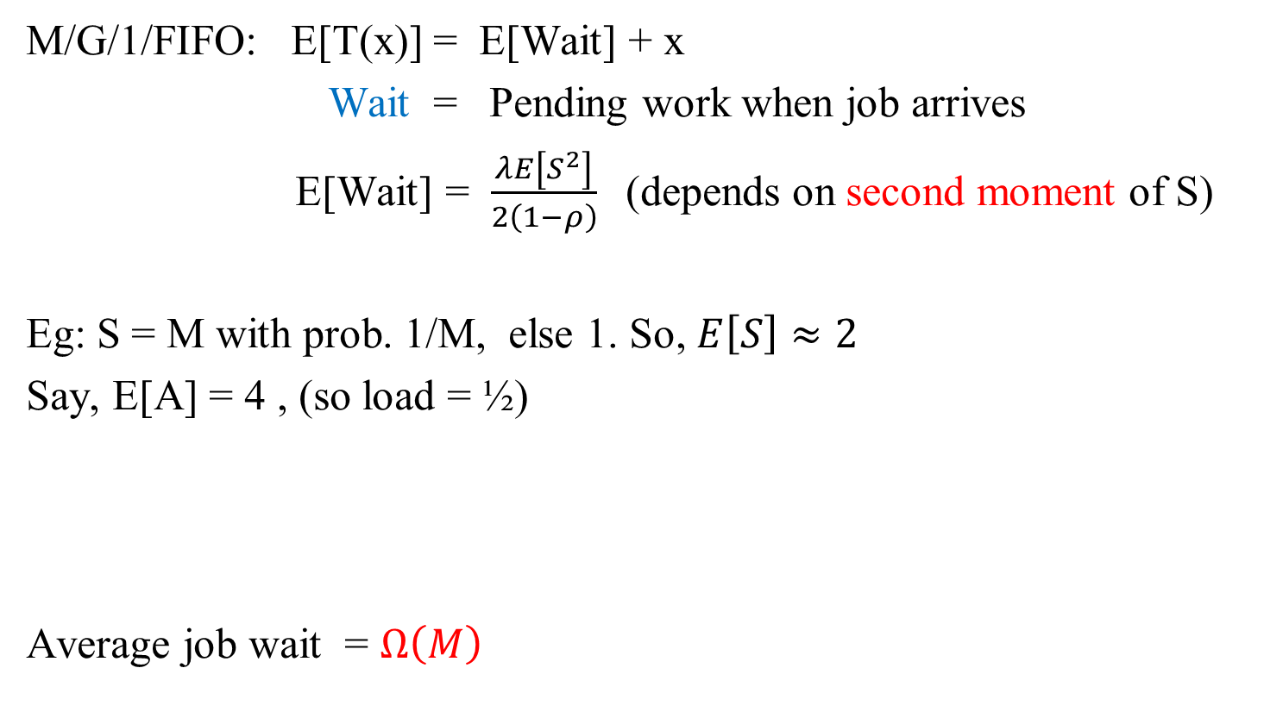
Queueing: Typical results
M/G/1/FIFO: E[T(x)] = E[Wait] + x
Wait = Pending work when job arrives
E[Wait] = $\frac{λE\left[S^{2}\right]}{2\left(1−ρ\right)}$(depends on second moment of S)
Eg: S = M with prob. 1/M, else 1. So, $E\left[S\right]≈2$
Say, E[A] = 4 , (so load = ½)
Average job wait = $Ω\left(M\right)$
…

Slide 15


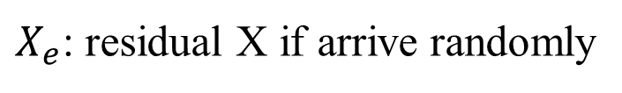


Test your queueing intuition
Bus at a stop (interarrival time = Poisson with mean 10 min.).
If a person lands up randomly, how long is the average wait.
1) 5 minutes (as interarrival time = 10)
10 minutes (memoryless)
Residual Excess Lemma: For a random variable X, with f
Inspection paradox
Length biasing
$$X_{1}$$
$$X_{2}$$
$$X_{3}$$
$$X_{4}$$
$X_{e}$: residual X if arrive randomly

Slide 16


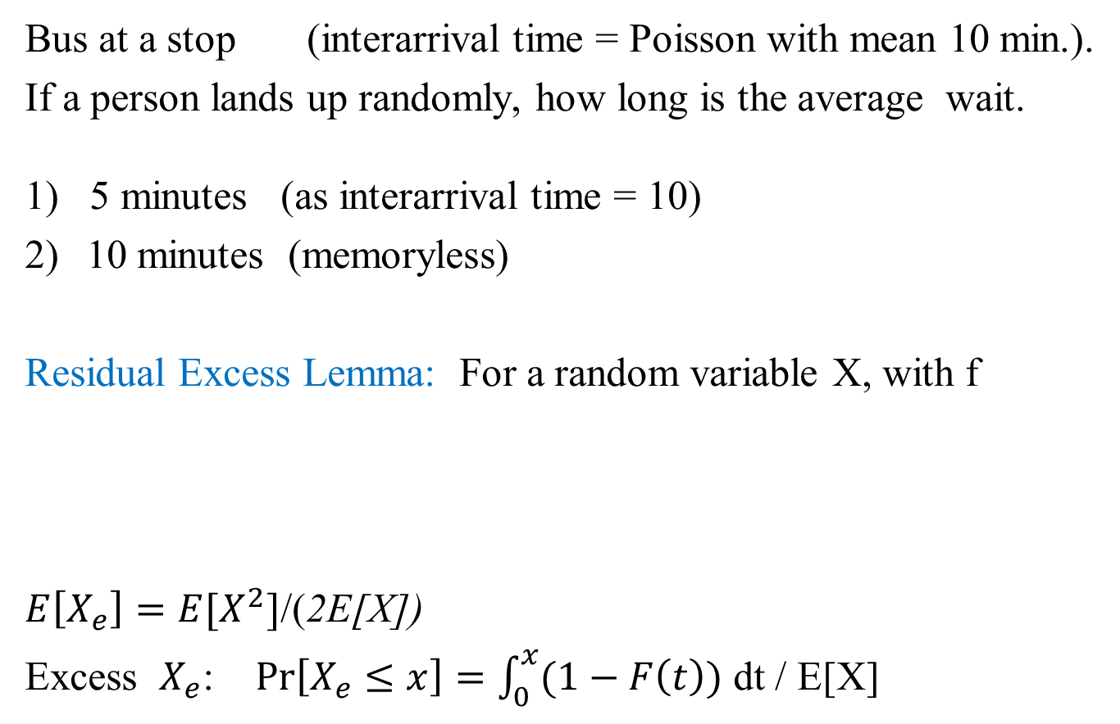


Test your queueing intuition
Bus at a stop (interarrival time = Poisson with mean 10 min.).
If a person lands up randomly, how long is the average wait.
1) 5 minutes (as interarrival time = 10)
10 minutes (memoryless)
Residual Excess Lemma: For a random variable X, with f
$E\left[X_{e}\right]=E[X^{2}]$/(2E[X])
Excess $X_{e}$: $\operatorname{Pr}\left[X_{e}≤x\right]=\int_{0}^{x}{(1−F\left(t\right)})$ dt / E[X]
Inspection paradox
Length biasing
$$X_{1}$$
$$X_{2}$$
$$X_{3}$$
$$X_{4}$$
$$X_{4}$$
$$X_{1}$$
$$X_{2}$$
$$X_{3}$$

Slide 17
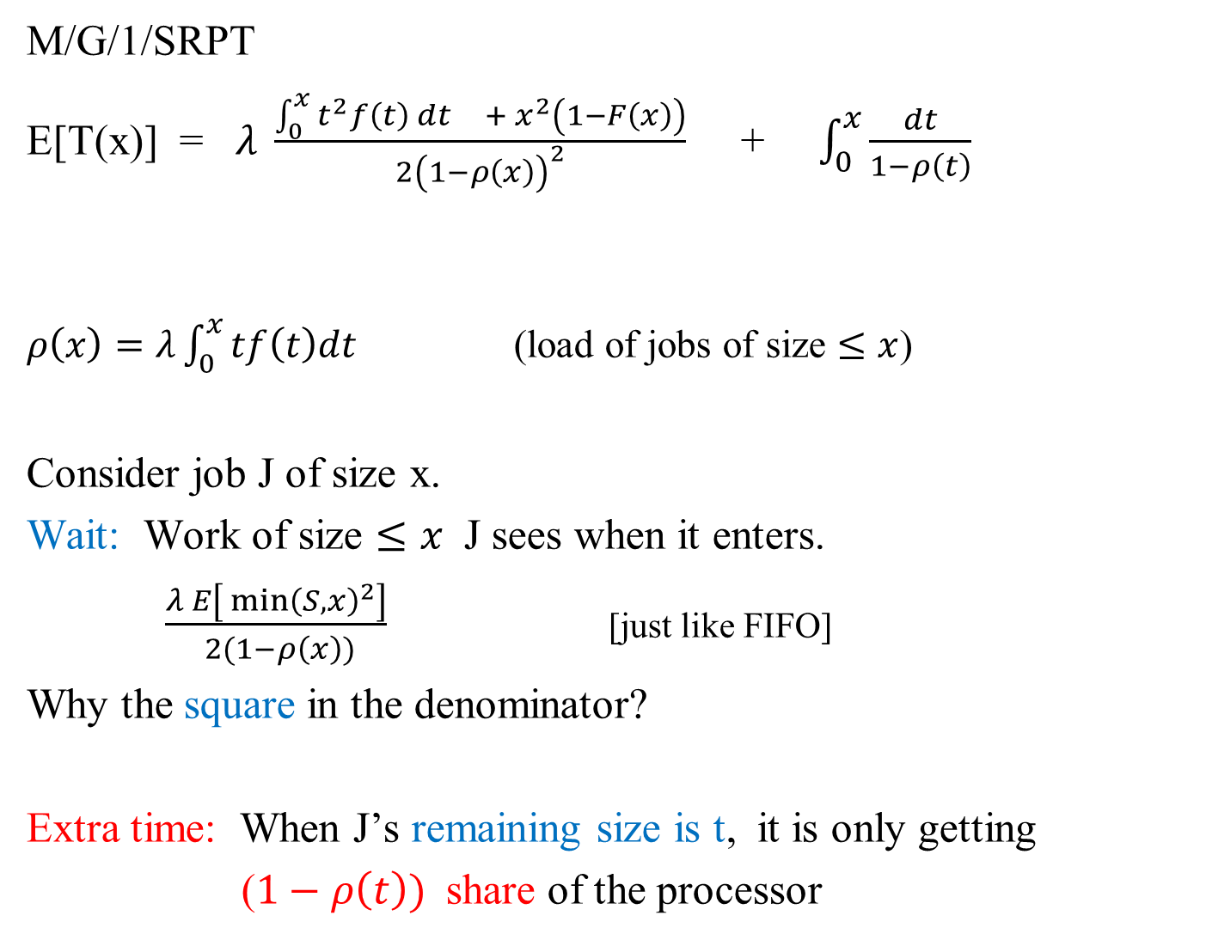
M/G/1/SRPT
E[T(x)] = $λ \frac{{{\int_{0}^{x}{t^{2}f\left(t\right) }dt}^{} + x}^{2}\left(1−F\left(x\right)\right)}{2{\left(1−ρ\left(x\right)\right)}^{2}}$ + $\int_{0}^{x}{\frac{dt}{1−ρ\left(t\right)}}$
$ρ\left(x\right)=λ\int_{0}^{x}{tf\left(t\right)dt }$(load of jobs of size $≤x$)
Consider job J of size x.
Wait: Work of size $≤x$ J sees when it enters.
$\frac{λ E\left[ min{\left(S,x\right)}^{2}\right]}{ 2(1−ρ\left(x\right))}$ [just like FIFO]
Why the square in the denominator?
Extra time: When J’s remaining size is t, it is only getting
($1−ρ\left(t\right))$share of the processor
Wait time till job begins
Extra time till it ends
Pending
J

Slide 18

M/G/1/SRPT
E[T(x)] = $λ \frac{{{\int_{0}^{x}{t^{2}f\left(t\right) }dt}^{} + x}^{2}\left(1−F\left(x\right)\right)}{2{\left(1−ρ\left(x\right)\right)}^{2}}$ + $\int_{0}^{x}{\frac{dt}{1−ρ\left(t\right)}}$
$ρ\left(x\right)=λ\int_{0}^{x}{tf\left(t\right)dt }$(load of jobs of size $≤x$)
E[T] = $E_{x}$[E[T(x)]]
Not easy to work with
Impossible to see optimality

Slide 19
Various connections

Slide 20
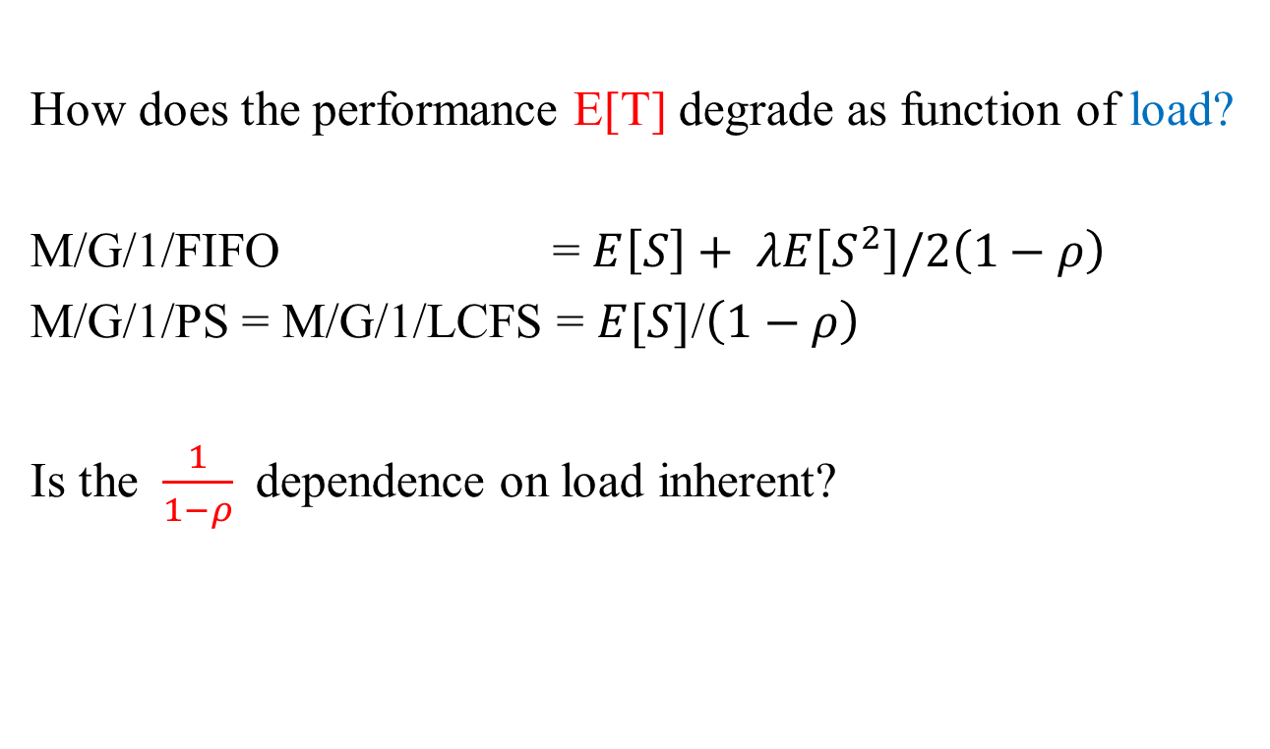
As load approaches 1
How does the performance E[T] degrade as function of load?
M/G/1/FIFO = $E\left[S\right]+ λE\left[S^{2}\right]/2\left(1−ρ\right)$
M/G/1/PS = M/G/1/LCFS = $E[S]$/$\left(1−ρ\right)$
Is the $\frac{1}{1−ρ}$dependence on load inherent?
ρ

Slide 21
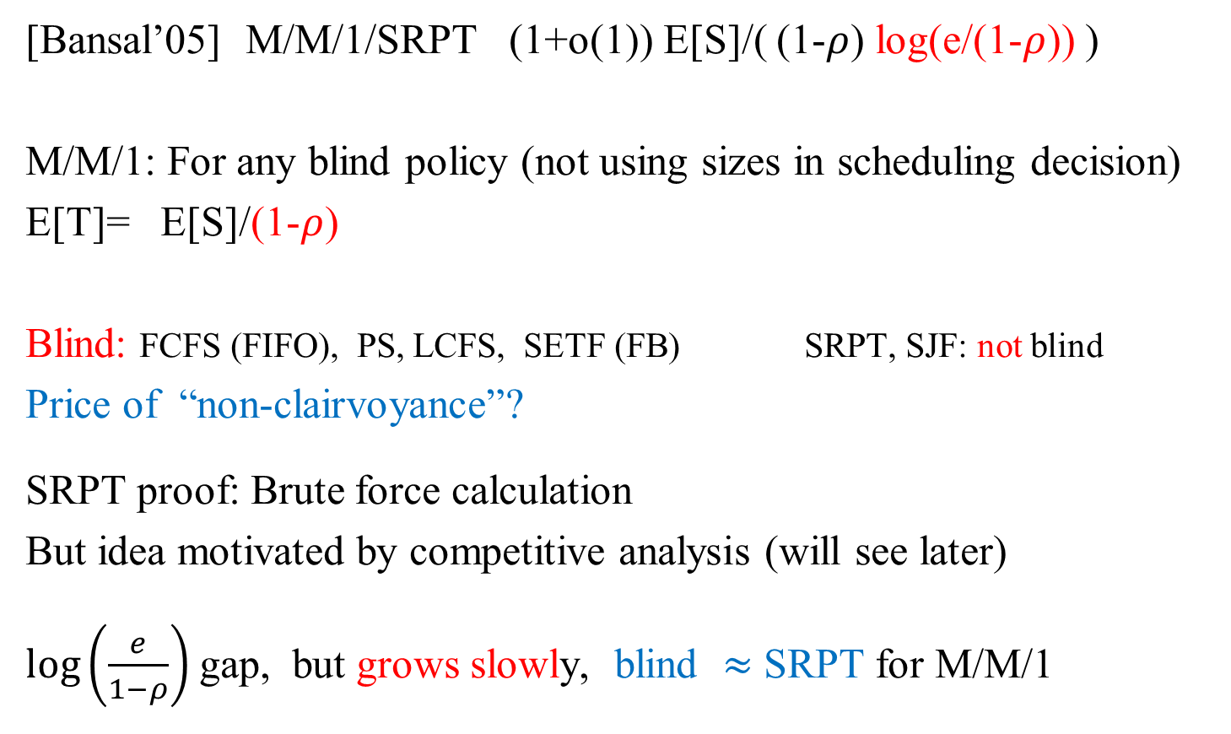
Not necessarily
[Bansal’05] M/M/1/SRPT (1+o(1)) E[S]/( (1-$ρ$) log(e/(1-$ρ$)) )
M/M/1: For any blind policy (not using sizes in scheduling decision)
E[T]= E[S]/(1-$ρ$)
Blind: FCFS (FIFO), PS, LCFS, SETF (FB) SRPT, SJF: not blind
Price of “non-clairvoyance”?
SRPT proof: Brute force calculation
But idea motivated by competitive analysis (will see later)
$\log\left(\frac{e}{1−ρ}\right)$ gap, but grows slowly, blind $≈$ SRPT for M/M/1

Slide 22
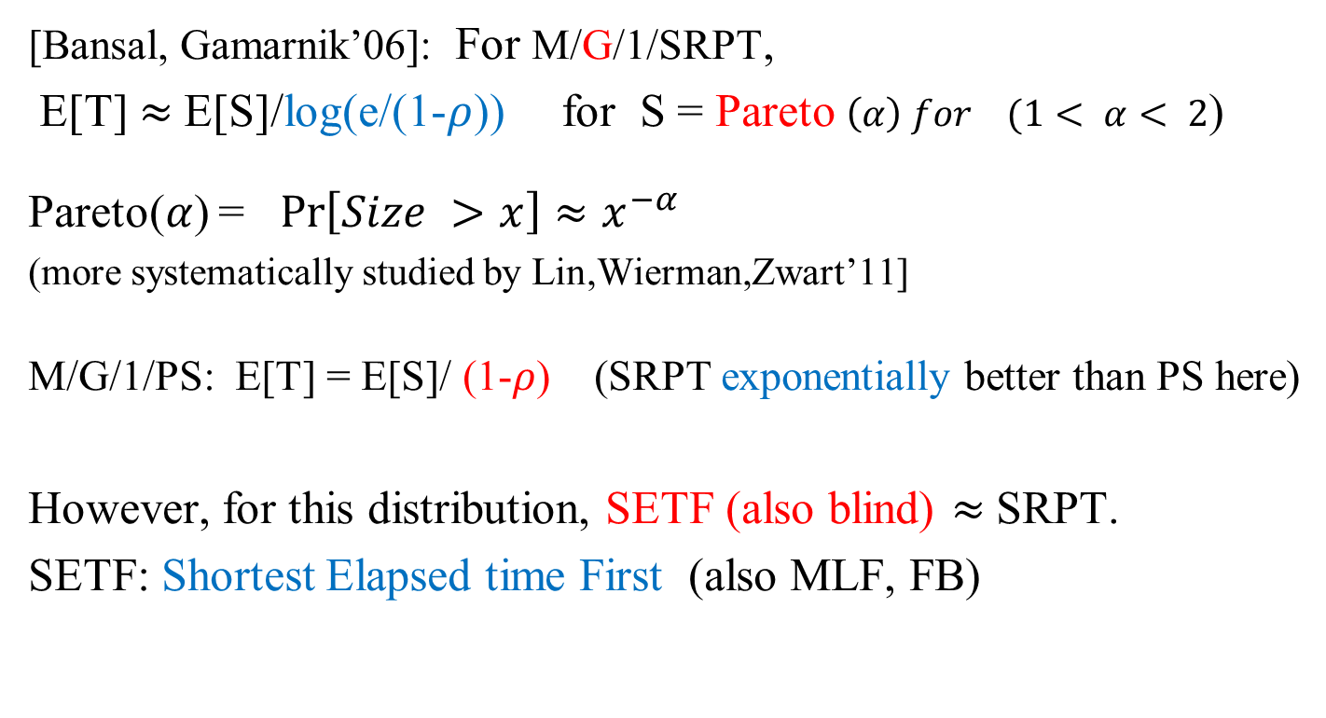
More intriguing example
[Bansal, Gamarnik’06]: For M/G/1/SRPT,
E[T] $≈$E[S]/log(e/(1-$ρ$)) for S = Pareto $\left(α\right) for (1< α< 2$)
Pareto($α$) = $\operatorname{Pr}\left[Size >x\right]≈x^{−α}$
(more systematically studied by Lin,Wierman,Zwart’11]
M/G/1/PS: E[T] = E[S]/ (1-$ρ$) (SRPT exponentially better than PS here)
However, for this distribution, SETF (also blind) $≈$SRPT.
SETF: Shortest Elapsed time First (also MLF, FB)

Slide 23
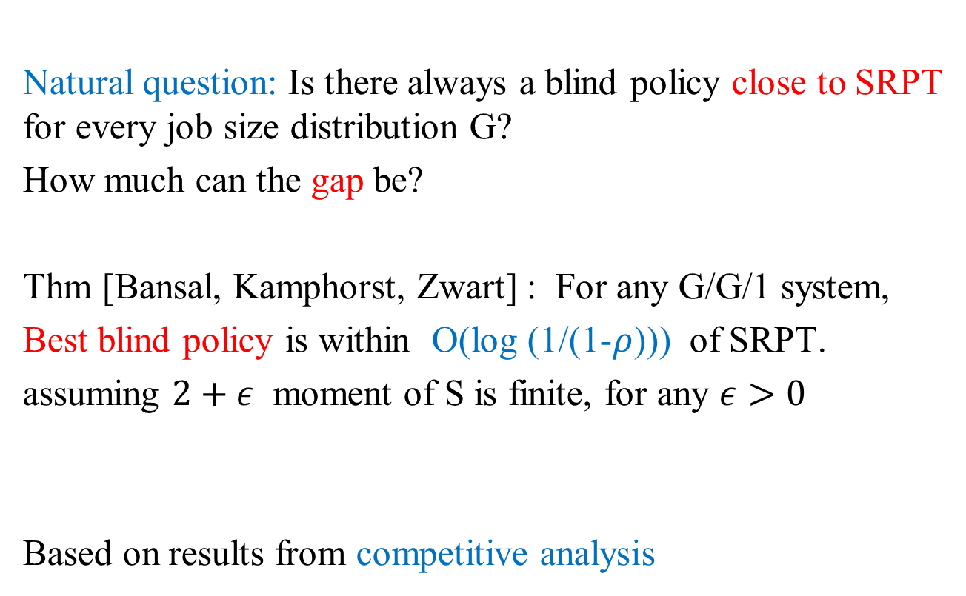
What about general distributions?
Natural question: Is there always a blind policy close to SRPT for every job size distribution G?
How much can the gap be?
Thm [Bansal, Kamphorst, Zwart] : For any G/G/1 system,
Best blind policy is within O(log (1/(1-$ρ$))) of SRPT.
assuming $2+ε$ moment of S is finite, for any $ε>0$
Based on results from competitive analysis

Slide 24

Blind Policies: Competitive Analysis
Thm [Motwani, Phillips, Torng 94]: Any (deterministic) blind policy must be $Ω\left(n^{1/3}\right)$ competitive

Slide 25
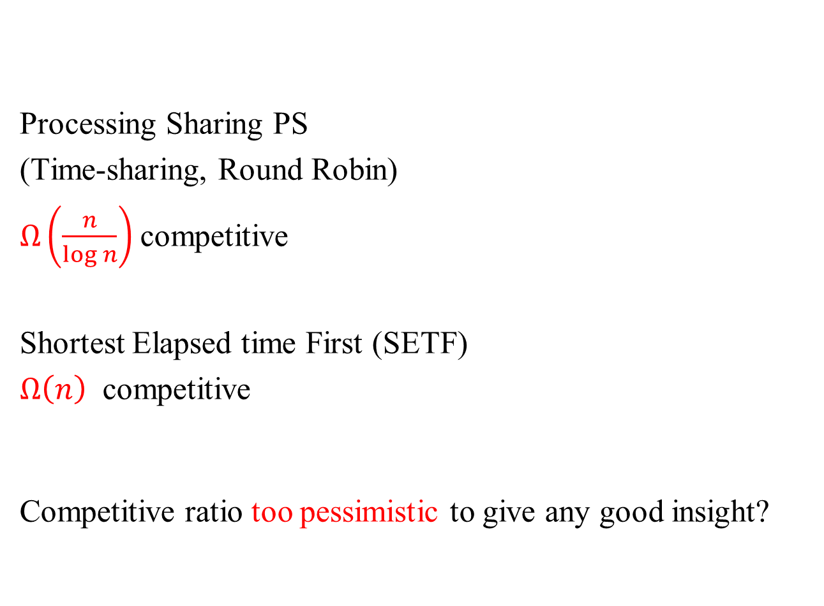
Processing Sharing PS
(Time-sharing, Round Robin)
$Ω\left(\frac{n}{log n}\right)$competitive
Shortest Elapsed time First (SETF)
$Ω\left(n\right)$ competitive
Competitive ratio too pessimistic to give any good insight?
1
1/2
1/3
1/4
1/5

Slide 26
Coping with pessimistic nature of worst case

Slide 27
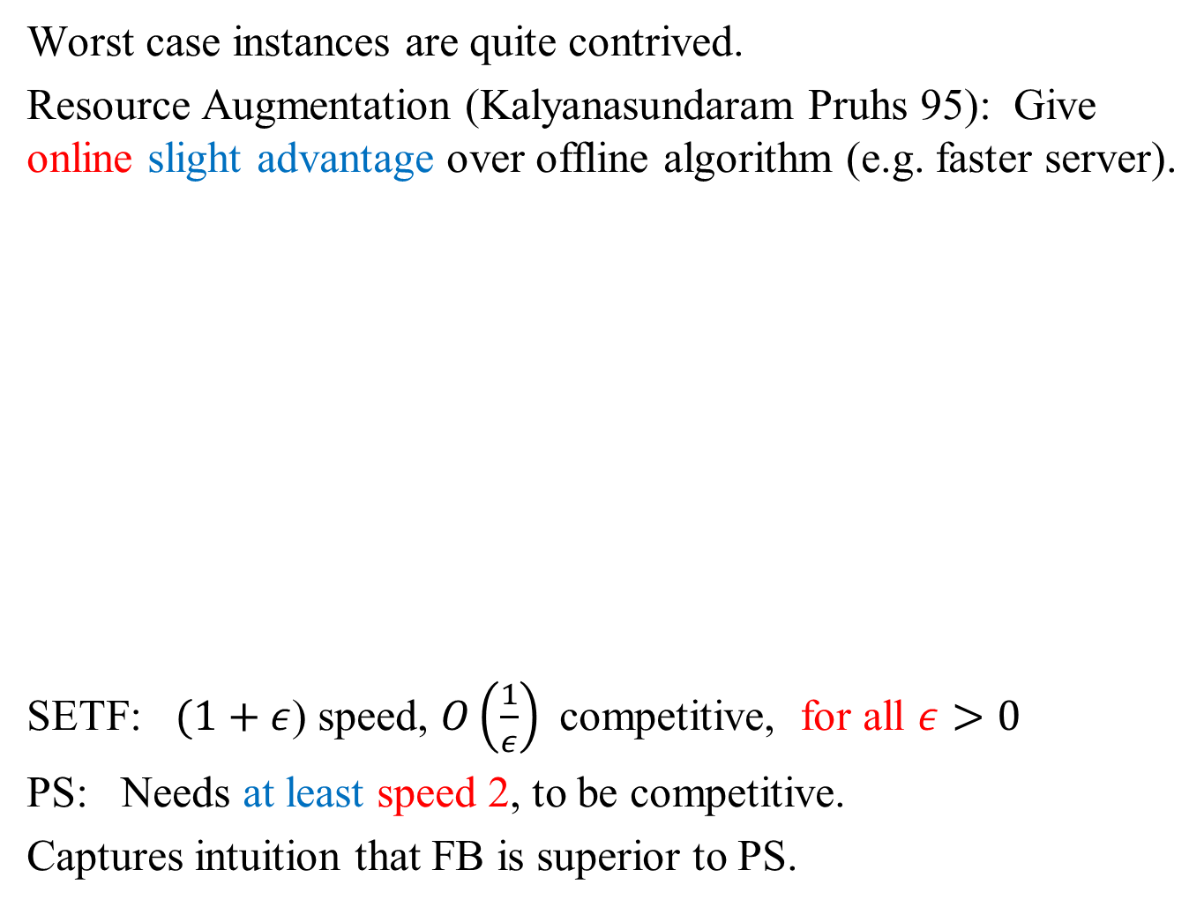
Worst case instances are quite contrived.
Resource Augmentation (Kalyanasundaram Pruhs 95): Give online slight advantage over offline algorithm (e.g. faster server).
SETF: $(1+ε$) speed, $O\left(\frac{1}{ε}\right)$competitive, for all $ε>0$
PS: Needs at least speed 2, to be competitive.
Captures intuition that FB is superior to PS.

Slide 28
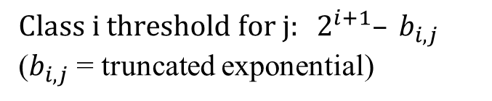
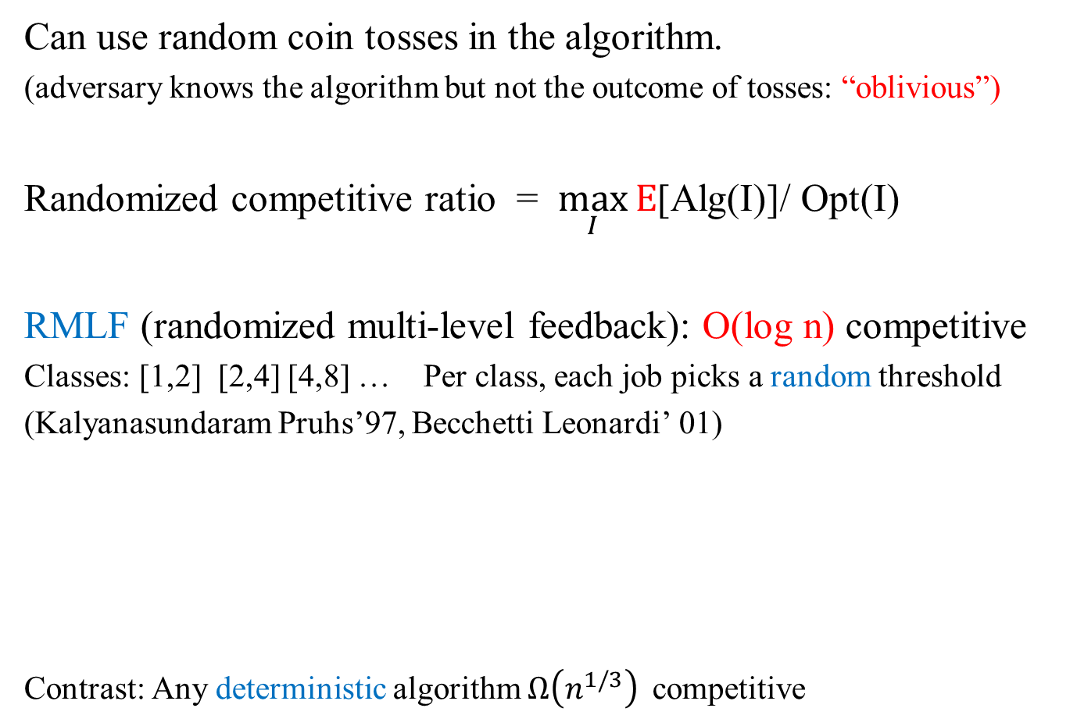
Randomized Algorithms
Can use random coin tosses in the algorithm.
(adversary knows the algorithm but not the outcome of tosses: “oblivious”)
Randomized competitive ratio = $\max_{I}{E}$[Alg(I)]/ Opt(I)
RMLF (randomized multi-level feedback): O(log n) competitive
Classes: [1,2] [2,4] [4,8] … Per class, each job picks a random threshold
(Kalyanasundaram Pruhs’97, Becchetti Leonardi’ 01)
Contrast: Any deterministic algorithm $Ω\left(n^{1/3}\right)$competitive
$Class i threshold for j: 2^{i+1}– b_{i,j}$
($b_{i,j}$ = truncated exponential)

Slide 29
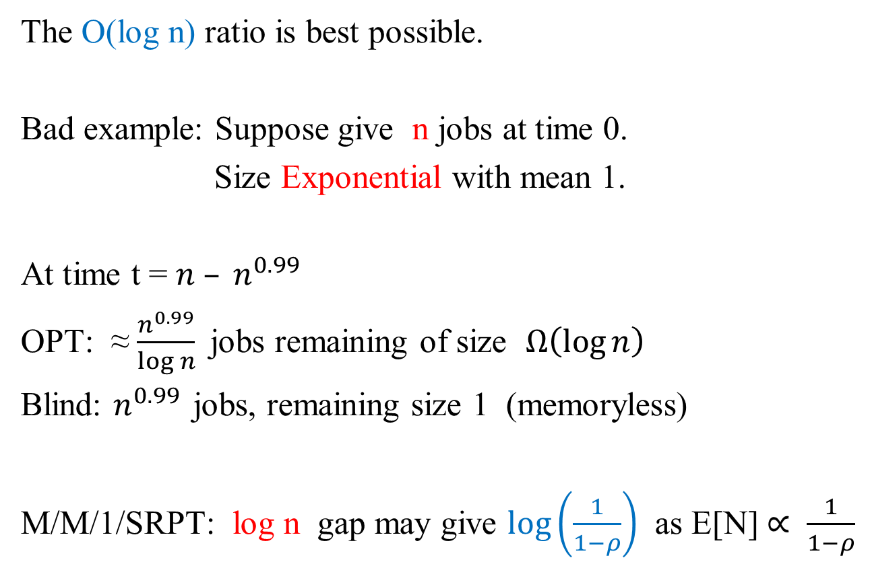
Randomized MLF
The O(log n) ratio is best possible.
Bad example: Suppose give n jobs at time 0.
Size Exponential with mean 1.
At time t = $n – n^{0.99}$
OPT: ≈ $\frac{n^{0.99}}{log n}$jobs remaining of size $Ω\left(\log{n}\right)$
Blind: $n^{0.99 }$jobs, remaining size 1 (memoryless)
M/M/1/SRPT: log n gap may give $\log\left(\frac{1}{1−ρ}\right)$ as E[N] $∝ \frac{1}{1−ρ}$

Slide 30
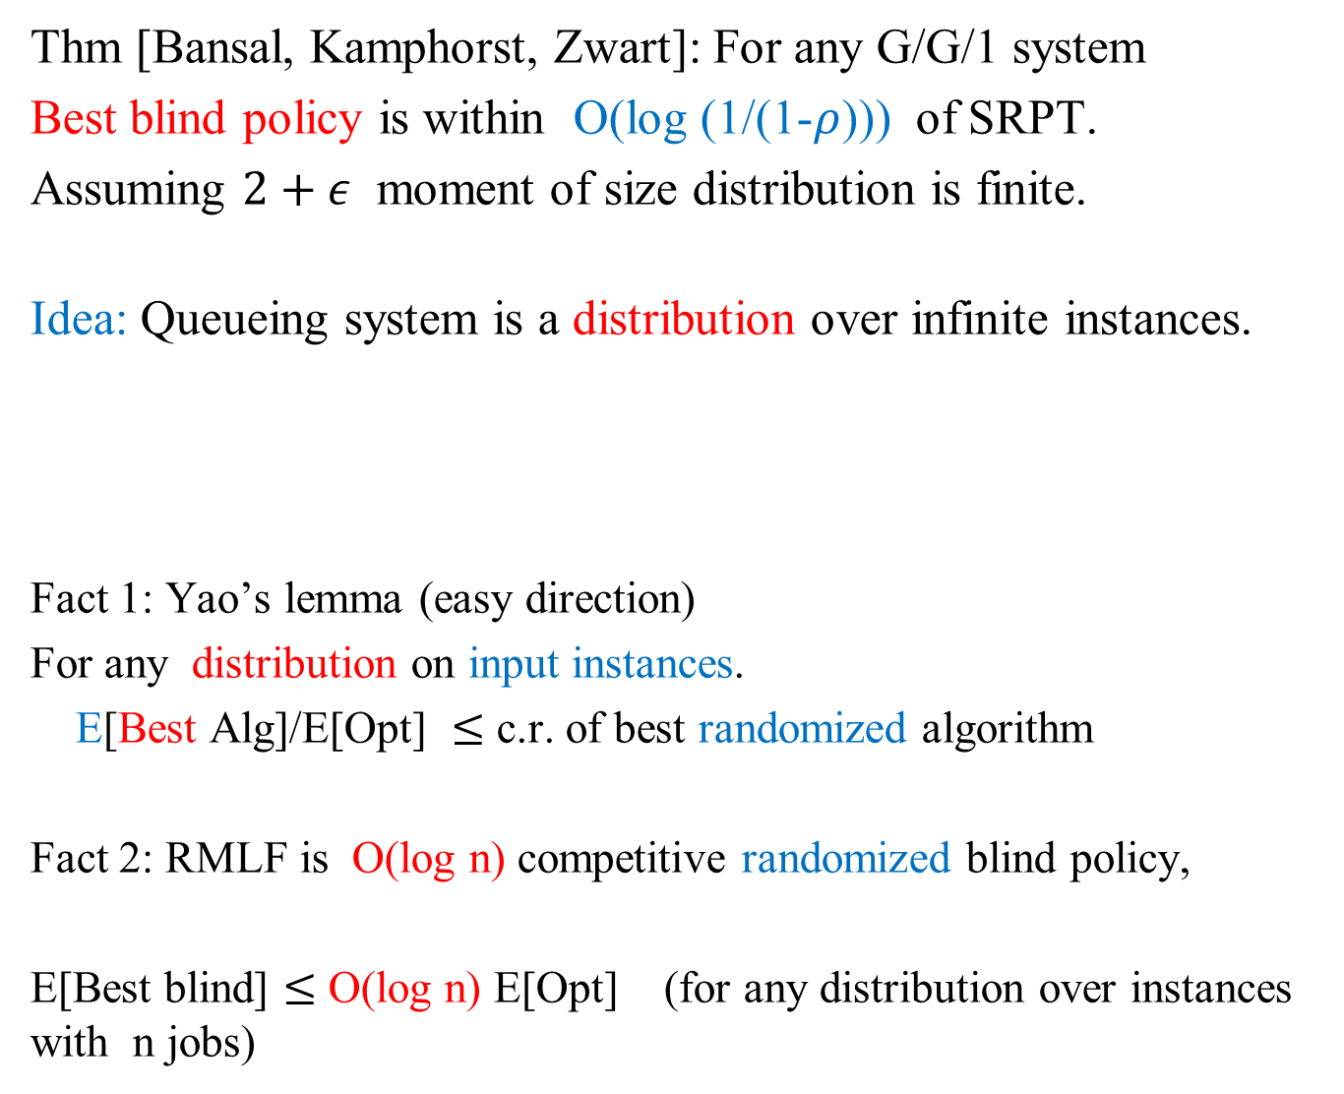
Thm [Bansal, Kamphorst, Zwart]: For any G/G/1 system
Best blind policy is within O(log (1/(1-$ρ$))) of SRPT.
Assuming $2+ε$ moment of size distribution is finite.
Idea: Queueing system is a distribution over infinite instances.
Fact 1: Yao’s lemma (easy direction)
For any distribution on input instances.
E[Best Alg]/E[Opt] $≤$ c.r. of best randomized algorithm
Fact 2: RMLF is O(log n) competitive randomized blind policy,
E[Best blind] $≤$ O(log n) E[Opt] (for any distribution over instances with n jobs)
Workload
time

Slide 31
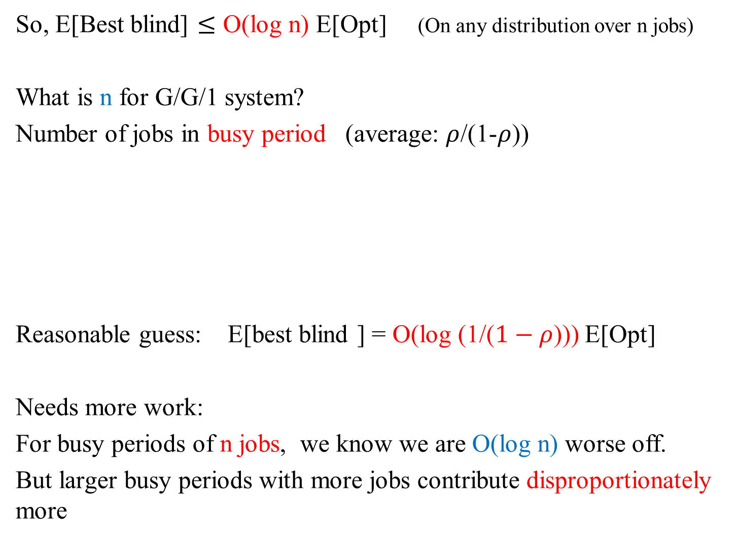
So, E[Best blind] $≤$ O(log n) E[Opt] (On any distribution over n jobs)
What is n for G/G/1 system?
Number of jobs in busy period (average: $ρ$/(1-$ρ$))
Reasonable guess: E[best blind ] = O(log (1/($1−ρ$))) E[Opt]
Needs more work:
For busy periods of n jobs, we know we are O(log n) worse off.
But larger busy periods with more jobs contribute disproportionately more

Slide 32
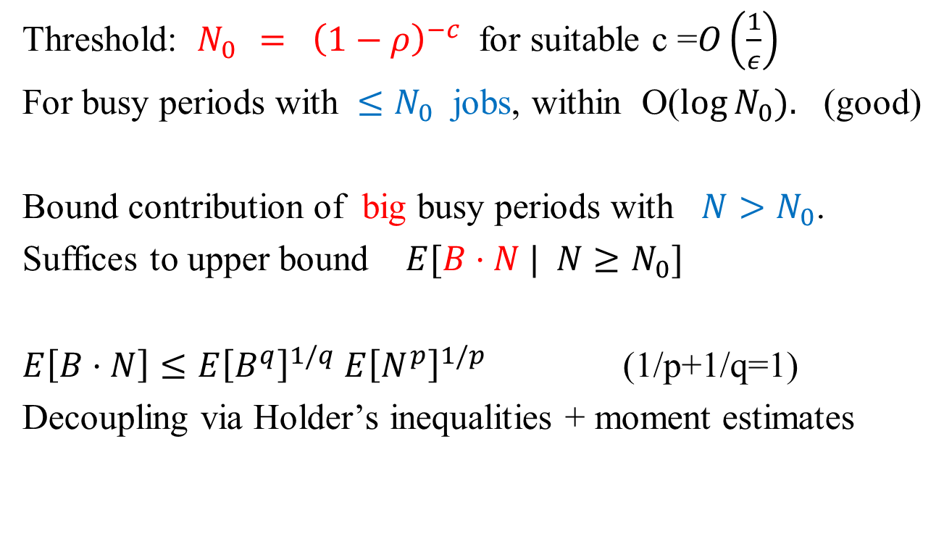
Proof idea
Threshold: $N_{0 }= {\left(1−ρ\right)}^{−c}$ for suitable c =$O\left(\frac{1}{ε}\right)$
For busy periods with $≤N_{0}$ jobs, within O($\log{N_{0}}).$ (good)
Bound contribution of big busy periods with $N>N_{0}$.
Suffices to upper bound $E[B⋅N | N≥N_{0}]$
$E\left[B⋅N\right]≤E{\left[B^{q}\right]}^{1/q}$ $E{\left[N^{p}\right]}^{1/p}$ (1/p+1/q=1)
Decoupling via Holder’s inequalities + moment estimates

Slide 33
Related Worst case Competitive ratio to Average case
Via Yao’s Minimax Theorem.
Immediate open question: How to extend to multiple machines?
RMLF is still polylog competitive
But busy periods not uniquely defined on multiple machines.

Slide 34
Other possible connections

Slide 35
1. Adversarial queueing theory (Kleinberg et al 96)
(notion of load in worst case instances)
2. Smoothed Analysis (Perturb worst case instance by adding random noise)
3. New algorithms combining best of worst case and stochastic optimality (online learning techniques)
4. Online algorithms on networks of servers (very little known)
5. Potential functions vs. Lyapunov functions

Slide 36
Thanks for your attention

