Slide 1
Equitable Rectangular Dissections
Dana Randall
Georgia Institute of Technology
Joint with: Sarah Cannon and Sarah Miracle

Slide 2
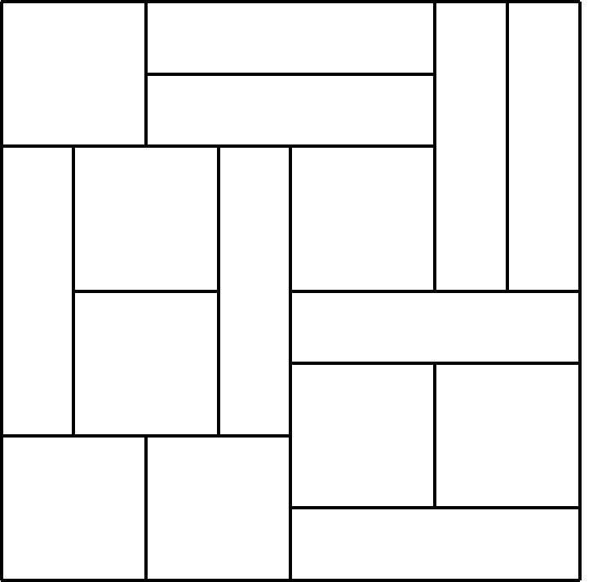
Rectangular Dissections
Equitable Rectangular Dissection: A partition of an n x n lattice region into n²/a rectangles or area a whose corners lie on lattice points.
Rectangular dissections arise in:
  VLSI layout
  Mapping graphs for floor layouts
  Combinatorial applications

Slide 3
Rectangular Dissections
Partition n x n lattice region into rectangles such that:
  There are n²/a rectangles each with area a
  The corners of rectangles lie on lattice points
The Edge-Flip Chain
Repeat:
Pick an random edge e,
Flip edge e with prob. ½, if possible.
Main Questions:
  Does the Edge-Flip Chain connect the
  set of rectangular dissections? (Note: need n=2^{k})
  Is it rapidly mixing?

Slide 4
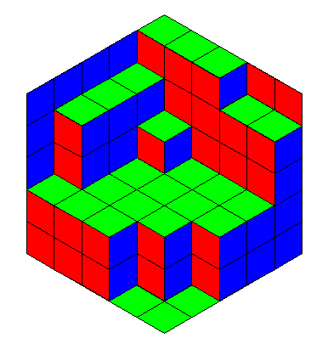
Related Tiling Problems / Flip Chains
Domino Tilings
Lozenge Tilings
Polynomial time
mixing
[Luby, R. Sinclair]
[R., Tetali]
Fortresses: PMs on square-oct lattice
Lattice Triangulations
?
?

Slide 5
Background: Lattice Triangulations
Another Edge-Flip Chain:
Triangulations of general point sets: Open
Triangulations of point sets in convex position: Fast
[McShine, Tetali ‘98], [Molloy, Reed, Steiger ‘98]
Triangulations on subsets of Z²: Open
Weighted Triangulations on subsets of Z²
[Caputo, Martinelli, Sinclair, Stauffer ‘13]

Slide 6
Background: Weighted Triangulations
[Caputo, Martinelli, Sinclair, Stauffer ‘13]
Weight (σ) = λ^{(total length of edges)}
The Edge-Flip chain:
Results [CMSS]:
[Pietro Caputo, Fabio Martinelli, Alistair Sinclair and Alexandre Stauffer. “Random Lattice Triangulations: Structure and Algorithms.” 45th Symposium on Theory of Computing (STOC), 2013.]

Slide 7
Weighted Rectangular Dissections
Given λ > 0,
let weight (σ) = λ^{(total length of edges)}.
The Weighted Edge-Flip Chain
Repeat:
Pick a random edge e.
If e is flippable, let e’ be the new edge it can be flipped to.
Flip edge e with probability min ( 1, λ^{(|e’| -} ^{|e|)} ).
Notes:
More about weighted chain

Slide 8
Weighted Rectangular Dissections
Given λ > 0,
let weight (σ) = λ^{(total length of edges)}.
λ < 1
λ > 1

Slide 9
Weighted Rectangular Dissections
Given λ > 0,
let weight (σ) = λ^{(total length of edges)}.
λ < 1
How fast?
λ > 1
But first:
Does the Edge-Flip Chain connect the state space?
Is there always a move?

Slide 10
Connectivity
Thm: The Edge-Flip Chain connects the set of dissections of the n x n lattice region into n rectangles of area n.
It’s not immediately obvious that a valid move even exists!
Proof sketch: Induction on “h-regions”:
  Simply-connected subset of rectangles from a dissection
  All rectangles have height at most h
  All vertical sections on the boundary have height c.h
  (for some integer c)
For n =16, an 8-region and a 4-region.

Slide 11
Proof Sketch: Connectivity
Thm 1: The Edge-Flip Chain connects the set of dissections of the n x n lattice region into n rectangles of size n.
Proof sketch: Induction on “h-regions”:
  Prove can tile every h-region with all rectangles of height h
  Inside every h-region, find an ^{h}/₂-region or an h-region with smaller area
h/2
I.H.
h
h/2
Inductively show we can reach tiling with all height n rectangles.

Slide 12
Weighted Rectangular Dissections
Given λ > 0,
let weight (σ) = λ^{(total length of edges)}.
λ < 1
How fast?
λ > 1
1. Look at a restricted class of rect. dissections: Dyadic Tilings.
2. Then we’ll consider the general case.

Slide 13
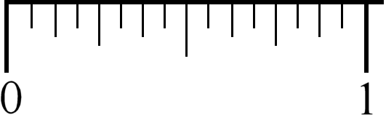
Dyadic Tilings
A dyadic rectangle is a region R with dimensions
R = [a 2^{-s}, (a+1) 2^{-s}] x [b 2^{-t}, (b+1) 2^{-t} ]
,
where a, b, s and t are nonnegative integers.
Dyadic
Not dyadic
A dyadic tiling of the unit square is a set of 2^{k} dyadic rectangles, each with area 2^{-k} (whose union is the full square).
A dyadic
tiling
Not a dyadic
tiling
Thm: The Edge-Flip Chain connects the set of dyadic tilings.
[Janson, R., Spencer ‘02]

Slide 14
Background: Dyadic Tilings
Dyadic rectangles:
R = [a 2^{-s}, (a+1) 2^{-s}] x [b 2^{-t}, (b+1) 2^{-t} ]
Thm: Every dyadic tiling has a horizontal or
vertical “fault line” (or both).
Let A_{k} be the number of tilings with 2^{k} rectangles of area 2^{-k}.
Thm: [CLSW, LSV] A₀=1, A₁=2, and for k ≥ 2,
A_{k} = 2 A_{k-1} – A_{k-2} .
2
4
Thm: The asymptotic behavior of A_{k} is
A_{k} ˜ φ⁻¹ ρ ² ,
where φ = 1+√5 / 2 and ρ ˜ 1.8445…
k

Slide 15
Background: Dyadic Tilings
Recursive sampling: [Janson, R., Spencer ’02]
V
H
V
V
H
not
V
H
V
H
H
H
V
V
H
V
V
H
V
V
V
H
2
Root: V : A_{n-1} / A_{n}
2
2
…
(And similarly for
“infinite” tilings.)
H_{HH} : (A_{n-1} – A_{n-2} ) / A_{n}
2
2
H_{HV} : A_{n-2} (A_{n-1} – A_{n-2} ) / A_{n}
2
2
H_{VH} : A_{n-2} (A_{n-1} – A_{n-2} ) / A_{n}

Slide 16
Stochastic Approaches: Dyadic Tilings
The Edge-Flip Chain:
?
There is a different Markov chain that is rapidly mixing: [JRS’02]

Slide 17
Stochastic Approaches: Dyadic Tilings
The Edge-Flip Chain:
?
There is a different Markov chain that is rapidly mixing: [JRS’02]
Rotate any dyadic rectangle (any scale), and dilate if necessary.
Mixing of the Edge-Flip Chain is open.

Slide 18
Results: Dyadic Tilings
λ = 0.80
λ = 1.00
λ = 1.03
Thm: [Cannon, Miracle, R. ‘15]
?
Rigorous proofs all the way to the critical point λ_{c}= 1 !
Notes:
Change to lambda_c = 1. a million moves starting from the all vertical tiling.

Slide 19
Results: General Rectangular Dissections
λ = 0.80
λ = 1.00
λ = 1.03
Thm: [Cannon, Miracle, R. ‘15]
?
Exponential mixing for very different reasons
Notes:
Worked very hard to prove slow mixing until we simulated it

Slide 20
Proof Sketches
  (Dyadic) When λ < 1, the edge-flip chain is poly.
  (Both) When λ > 1, the edge-flip chain is exp.
  (General) When λ < 1, the edge-flip chain is exp.

Slide 21
Fast Mixing for Dyadic Tilings
Thm: For any constant λ < 1 , the edge-flip chain on the set of dyadic tilings converges in time O(n² log n).
Proof Technique:
Path coupling with an exponential metric [Bubley, Dyer] [Greenberg, Pascoe, R.]
If two configurations differ by flipping edge f to edge e, then
the distance between them is λ^{|f|-|e|}.
The coupled configurations are get closer in expectation in each step.
(Rest is standard.)

Slide 22
Proof Sketches
  (Dyadic) When λ < 1, the edge-flip chain is fast.
  (Both) When λ > 1, the edge-flip chain is slow.
  (General) When λ < 1, the edge-flip chain is slow.

Slide 23
Slow Mixing when λ>1
Thm: For any constant λ > 1 , the edge-flip chain requires
time exp ( Ω(n²) ).
Proof idea: Show that a bottleneck exists.
S
S

Slide 24
The Bottleneck when λ > 1
No 1 x n or n x 1 rectangles
At least one
1 x n rectangle
At least one
n x 1 rectangle

Slide 25
The Bottleneck when λ > 1
No 1 x n or n x 1 rectangles
≥ one 1 x n rectangle
≥ one n x 1 rectangle
(n²+4)/2
≤ (λ )(log n)^{n}
≥ λ^{n(n+1)}
≥ λ^{n(n+1)}

Slide 26
Proof Sketches
  (Dyadic) When λ < 1, the edge-flip chain is fast.
  (Both) When λ > 1, the edge-flip chain is slow.
  (General) When λ < 1, the edge-flip chain is slow.

Slide 27
Slow Mixing λ<1, Gen. Rect. Dis.
Thm: For any constant λ < 1 , the edge-flip chain on
rectangular dissections requires time exp (Ω (n log n)).
Proof idea: It is hard to remove two well-separated bars.
Key Ideas:
In order to remove a “bar” you need two bars next to each other.
If you have 2 separated bars, you must also have lots of other thin rectangles.

Slide 28
The Bottleneck when λ<1
Pair up the bars left to right
The separation is the sum of the “gaps”
Separation = g₁ + g₂ + 4
At least 4 bars and separation = n/2 + 2
Separation ≥ n/2 + 2
Separation < n/2 + 2
The exponentially small cut implies slow mixing.
Notes:
Maybe add one more slide on the cut set

Slide 29
Summary and Open Problems
Dyadic Tilings:
?
General Rectangle Dissections:
?
What happens when λ = 1 (dyadic and general tilings)?
What if we allow 90º or 180º rotations of sub-rectangles?
Decay of correlations? Average edge length? …

Slide 30
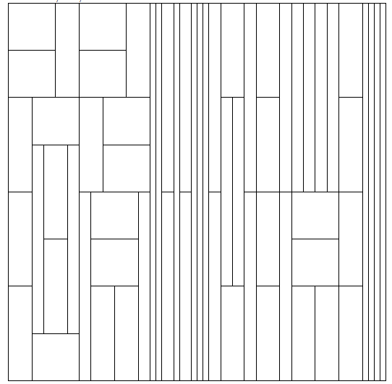
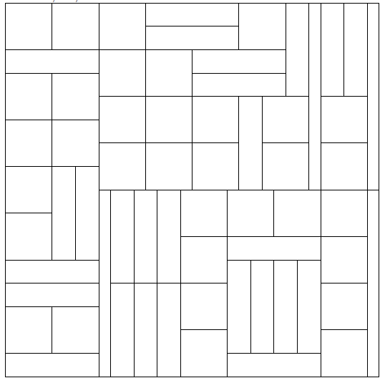
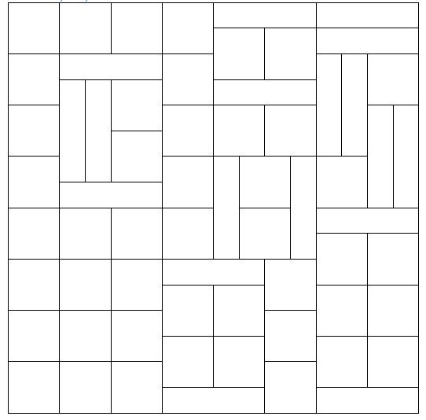
With 180º Rotations
Simulations with 180º rotations:
n = 64, λ = 0.8, starting at all vertical
20,000,000 moves
40,000,000 moves
60,000,000 moves

Slide 31
Summary and Open Problems
Dyadic Tilings:
?
General Rectangle Dissections:
?
What happens when λ = 1 (dyadic and general tilings)?
What if we allow 90º or 180º rotations of sub-rectangles?
Decay of correlations? Average edge length? …

Slide 32
Thank you!
Notes:
Permutations Talk had about 25 slides

