Slide 1
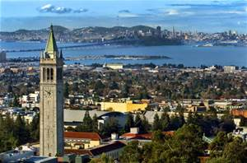
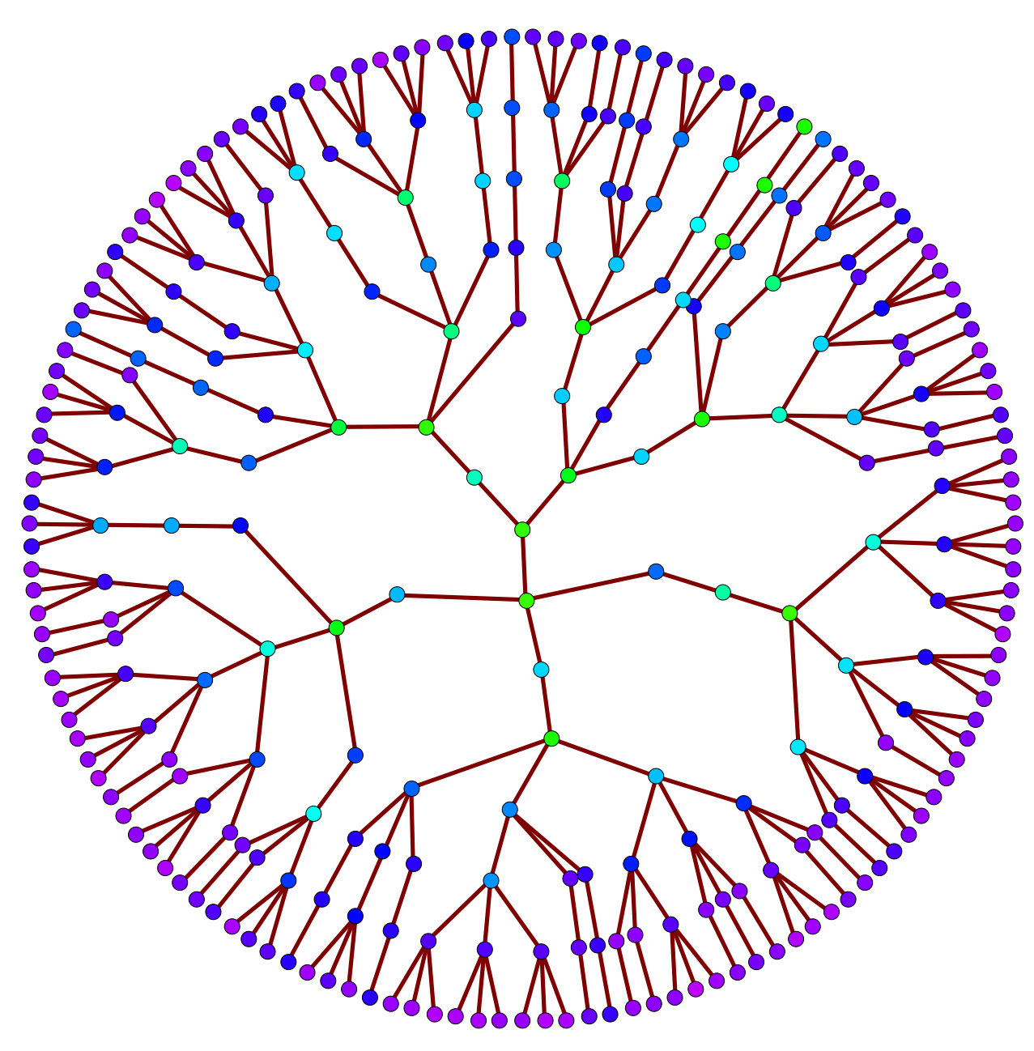
Yuval Peres
Simons Institute
February 2016
Pinpointing Mixing Times:
Random walks on Ramanujan
and Random graphs
Microsoft Research
Joint works with
N. Berestycki, E. Lubetzky, A. Sly

Slide 2
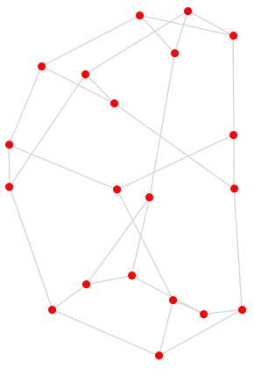
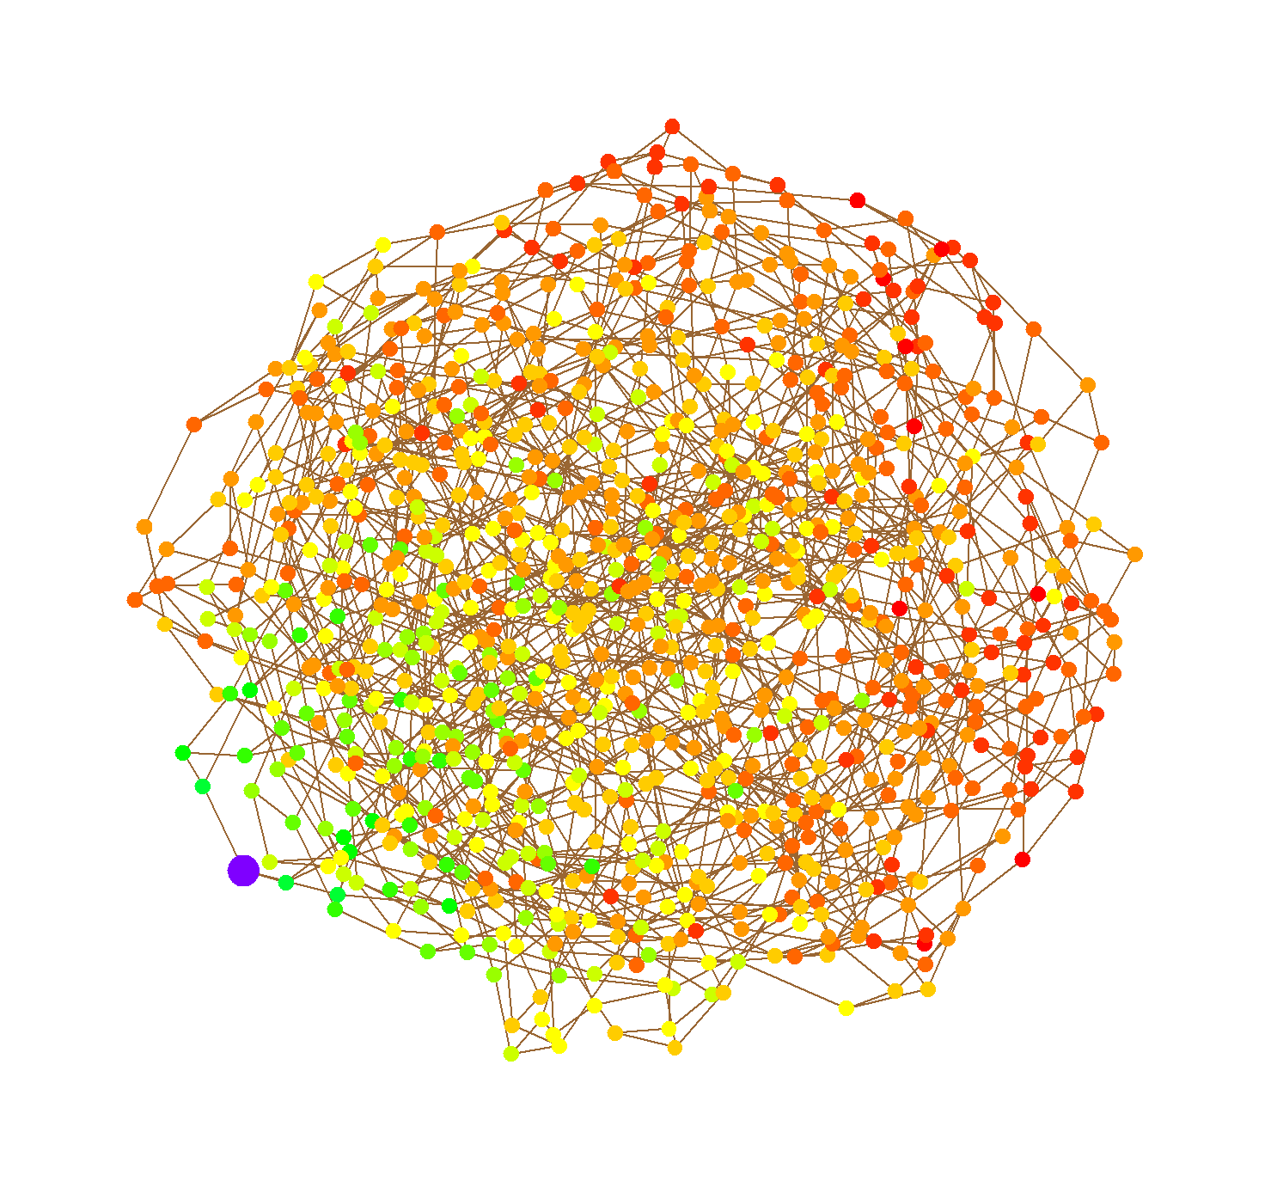
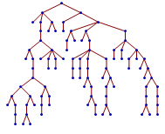
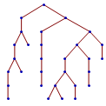
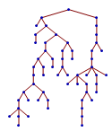
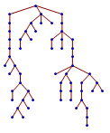


In this talk
Mixing time of random walk and specifically cutoff
as a gauge for delicate properties of the geometry.
Compare its behavior between
and the effect of the initial state on mixing.
$𝒢\left(n,p\right)$
Erdős-Rényi
random graph
$$𝒢\left(n,3\right)$$
random regular graph
(and other degree distributions)
Ramanujan Graphs

Slide 3
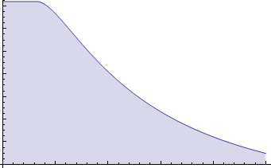
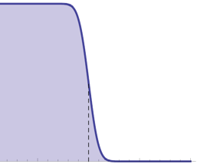

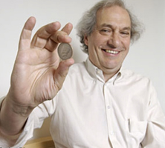


Measuring convergence to equilibrium
Mixing time : (according to a given metric).
Standard choice: $L1$ (total-variation) mixing time to within distance $ε$ is defined as
$t_{mix}\left(ε\right)=inf⁡\left\{t :\max_{x_{0}}{ {\left\|p^{t}(x_{0} , ⋅)−μ\right\|}_{tv}}≤ε\right\}$
( where ${\left\|μ−ν\right\|}_{tv}=\sup_{A⊂Ω }\left[μ\left(A\right)−ν(A)\right]$
Dependence on $ε$ : (cutoff phenomenon [DS81], [A83],[AD86])
We say there is cutoff$⟺{ t}_{mix}\left(ε\right)∼{ t}_{mix}\left(ε^{′}\right)$
$$∀ fixed ε,ε^{′}$$
cutoff
Notes:
[AD’86]: top-in-at-random shuffle analysis
[DS’81]: random transpositions on the symmetric group
[A’83]: RW on hypercube and Riffle-Shuffle

Slide 4
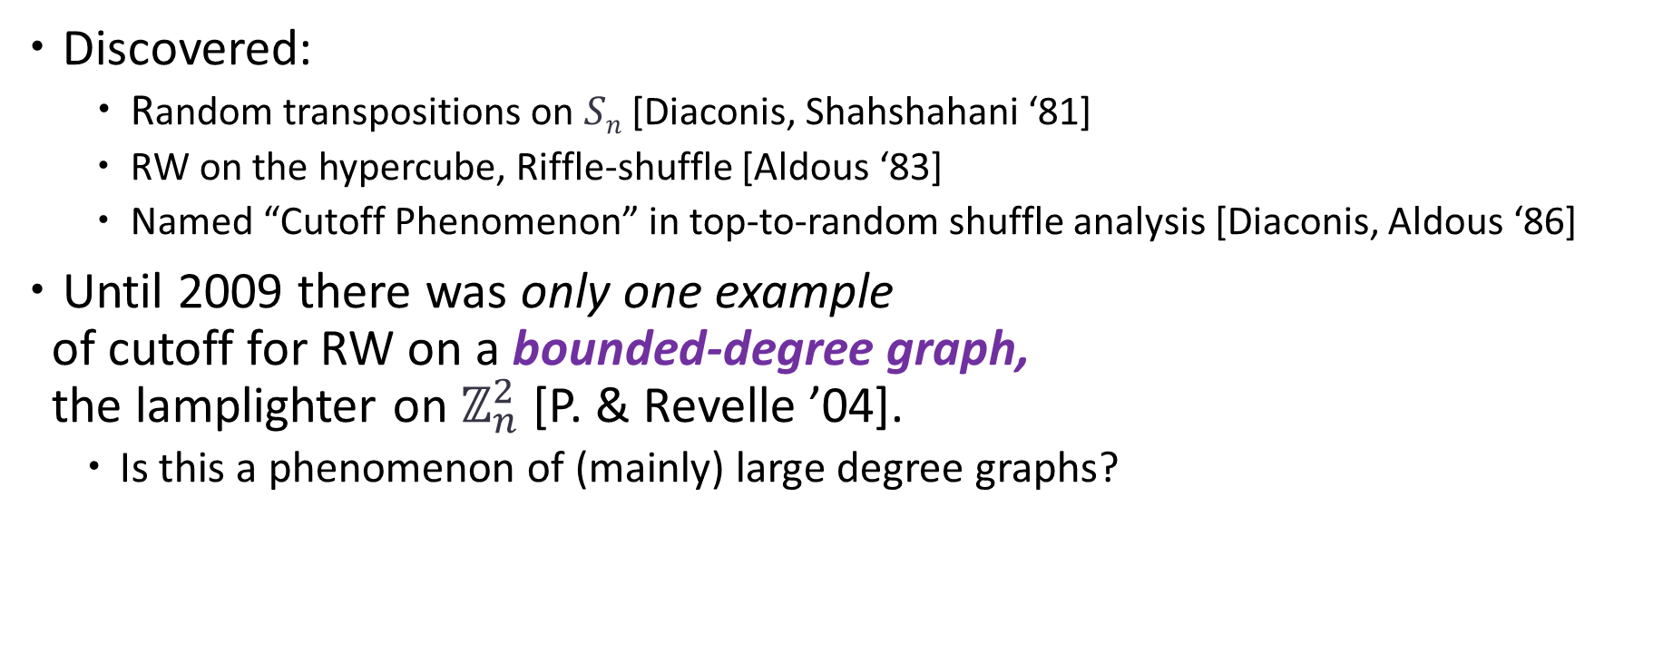
Cutoff History (RWs on graphs/groups)
Discovered:
  Random transpositions on $Sn$ [Diaconis, Shahshahani ‘81]
  RW on the hypercube, Riffle-shuffle [Aldous ‘83]
  Named “Cutoff Phenomenon” in top-to-random shuffle analysis [Diaconis, Aldous ‘86]
Until 2009 there was only one example
of cutoff for RW on a bounded-degree graph,
the lamplighter on $ℤ_{n}^{2}$ [P. & Revelle ’04].
  Is this a phenomenon of (mainly) large degree graphs?
cutoff

Slide 5
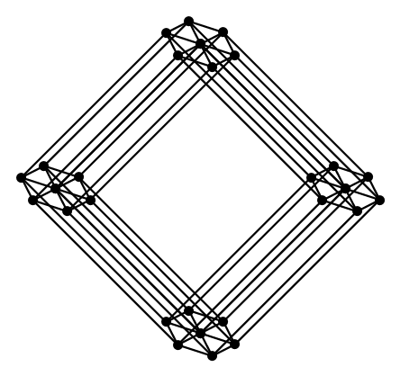
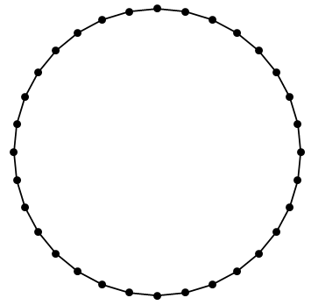
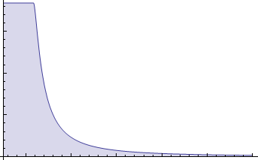
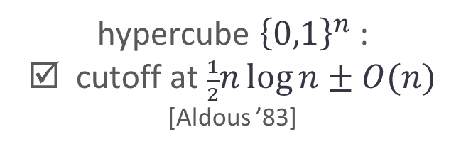

Basic examples: RWs on graphs
Lazy discrete-time simple random walk
hypercube ${\left\{0,1\right\}}^{n}$ :
☑ cutoff at $\frac{1}{2}n\log{n}±O(n)$
[Aldous ’83]
$n$-cycle:
☒ No cutoff.

Slide 6
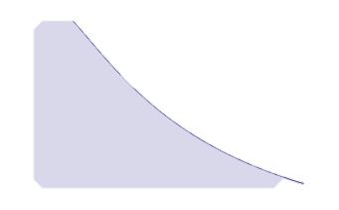
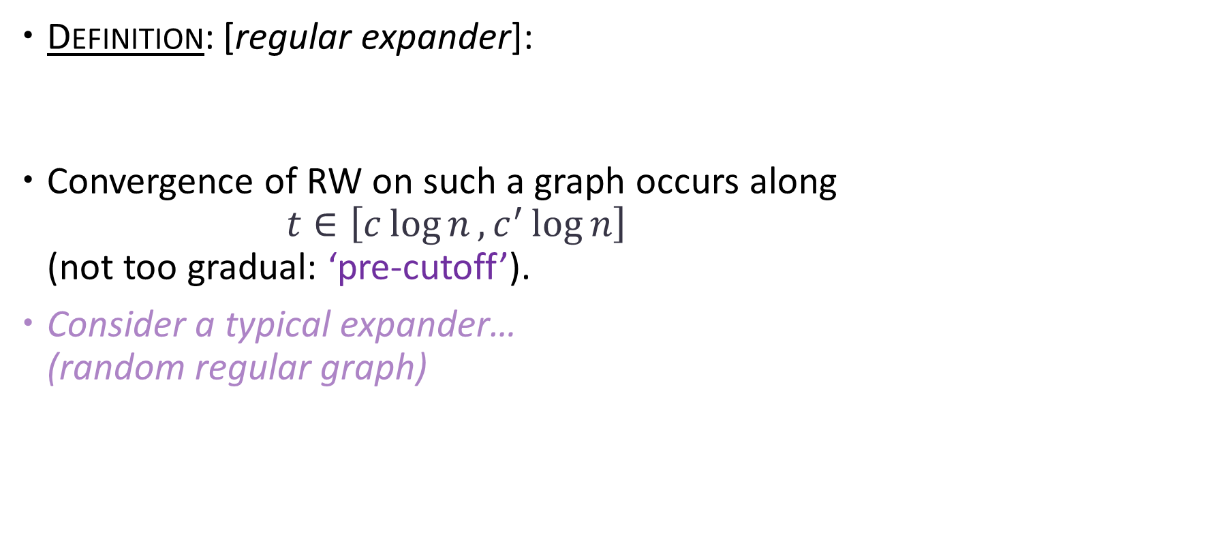
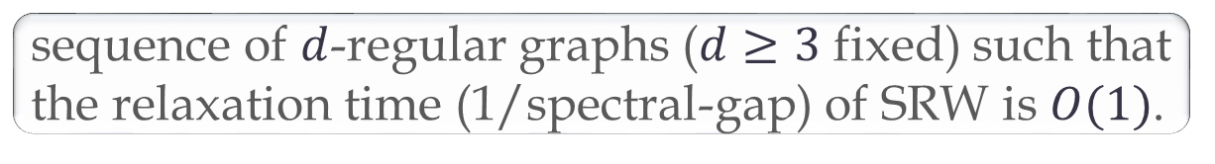
RWs on expanders
Definition: [regular expander]:
Convergence of RW on such a graph occurs along
$t∈\left[c\log{n}, c^{′}\log{n}\right]$
(not too gradual: ‘pre-cutoff’).
Consider a typical expander…
(random regular graph)
sequence of $d$-regular graphs ($d≥3$ fixed) such that the relaxation time (1/spectral-gap) of SRW is $O(1)$.

Slide 7
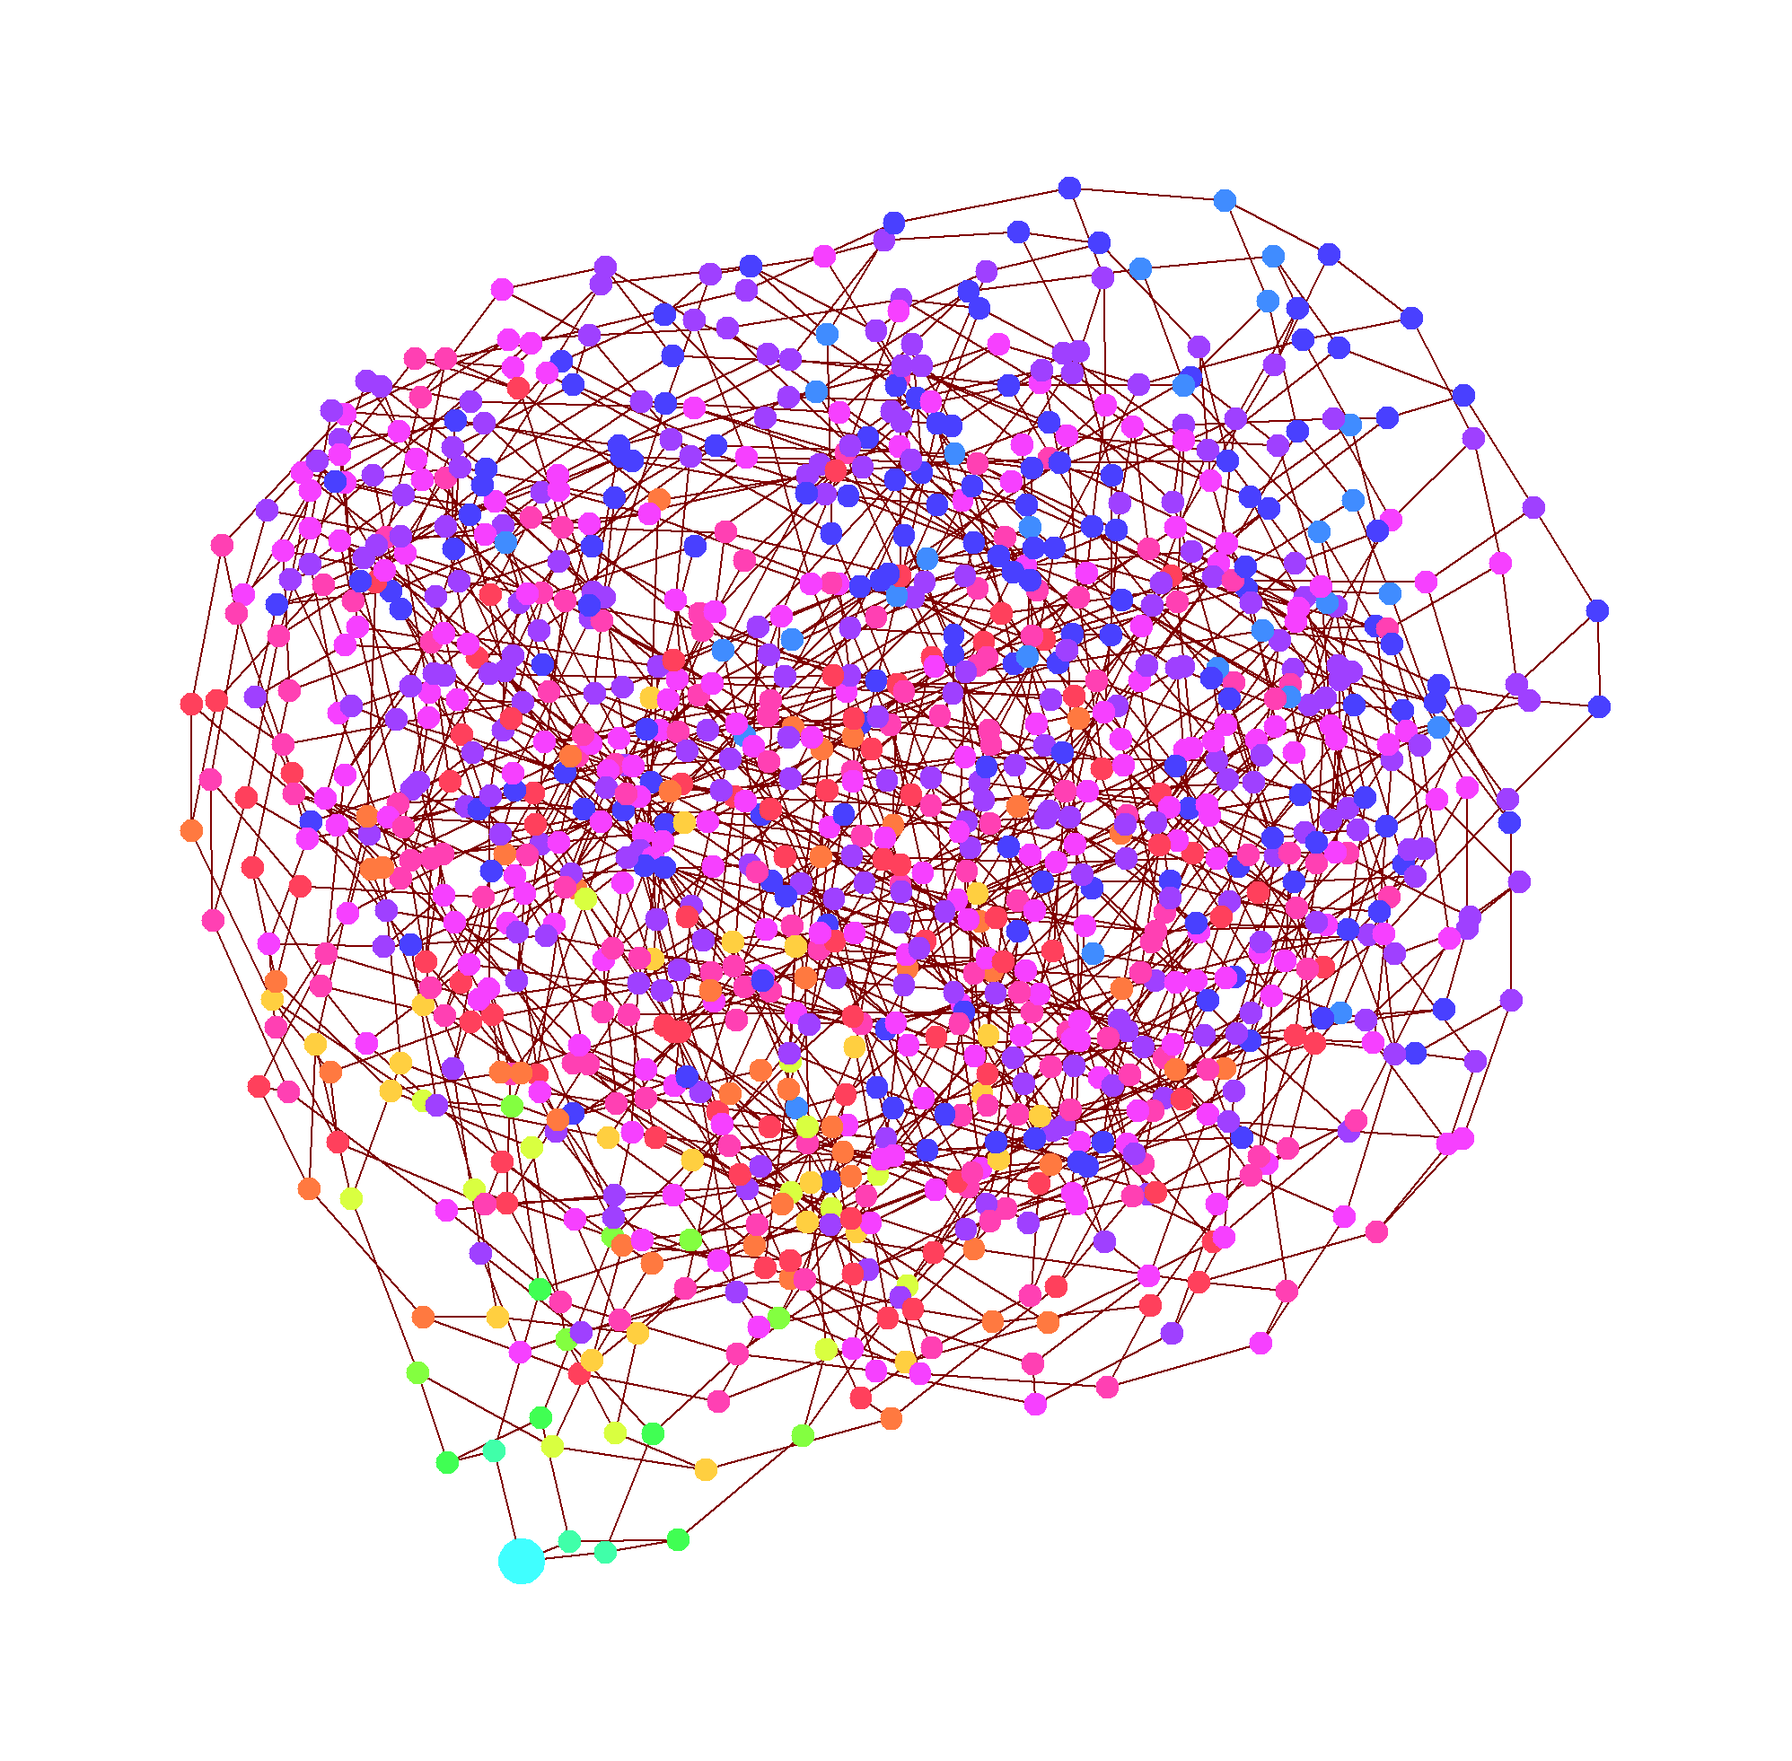
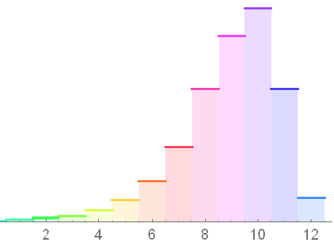
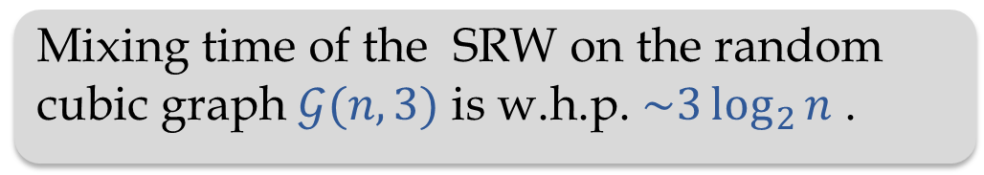


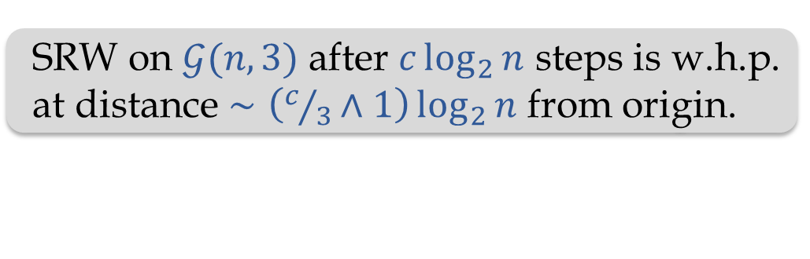
RWs on random regular graphs
$𝒢\left(n,d\right)=$ uniformly chosen $d$-regular $n$-vertex graph.
Its study pioneered by Bollobás in early 80’s.
W.h.p. $G \sim 𝒢(n,d)$ for $d ≥ 3$ is an
expander [Pinsker ’73], [Bollobas ‘84][Broder, Shamir ’87].
Theorem [Berestycki, Durrett ’08]:
Conjecture [Durrett ’07]:
SRW on $𝒢(n,3)$ after $c\log_{2}{n}$ steps is w.h.p.
at distance $∼\left(c/3∧1\right)\log_{2}{n}$ from origin.
$$3\log_{2}{n}$$
?
Mixing time of the SRW on the random cubic graph $𝒢(n,3)$ is w.h.p. $\sim 3\log_{2}{n}$ .

Slide 8
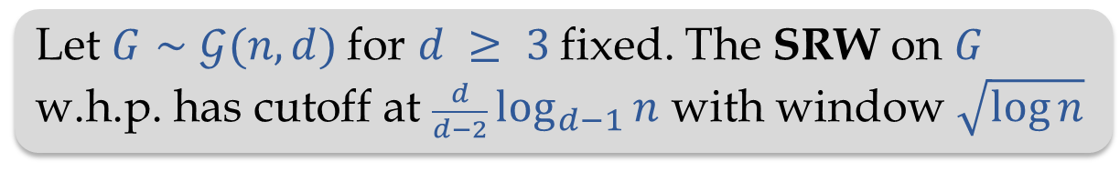
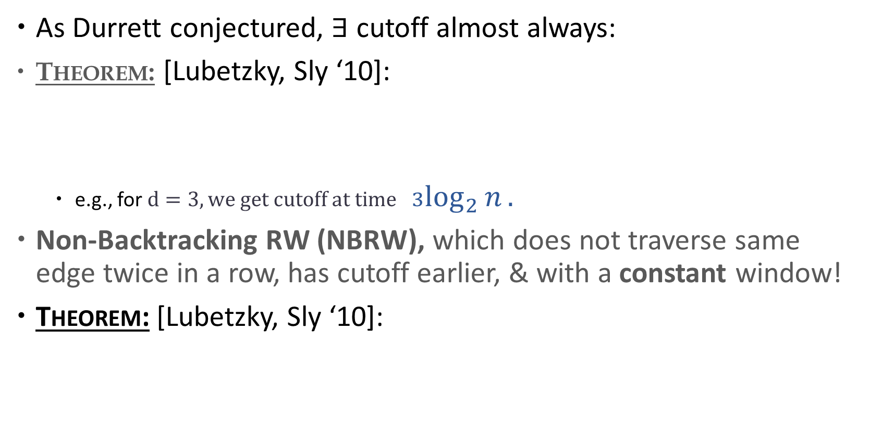

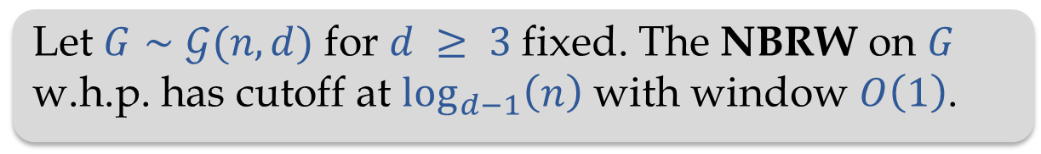
Cutoff for RW on $𝓖(n,d)$
As Durrett conjectured, $∃$ cutoff almost always:
Theorem: [Lubetzky, Sly ‘10]:
  e.g., for $d=3, we get cutoff at time$ $3\log_{2}{n}.$
Non-Backtracking RW (NBRW), which does not traverse same edge twice in a row, has cutoff earlier, & with a constant window!
Theorem: [Lubetzky, Sly ‘10]:
Let $G∼𝒢(n,d)$ for $d ≥ 3$ fixed. The SRW on $G$
w.h.p. has cutoff at $\frac{d}{d−2}\log_{d−1}{n}$ with window $\sqrt{\log{n}}$
Let $G∼𝒢(n,d)$ for $d ≥ 3$ fixed. The NBRW on $G$ w.h.p. has cutoff at $\log_{d−1}\left(n\right)$ with window $O\left(1\right)$.

Slide 9
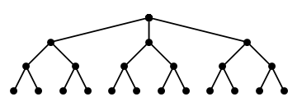
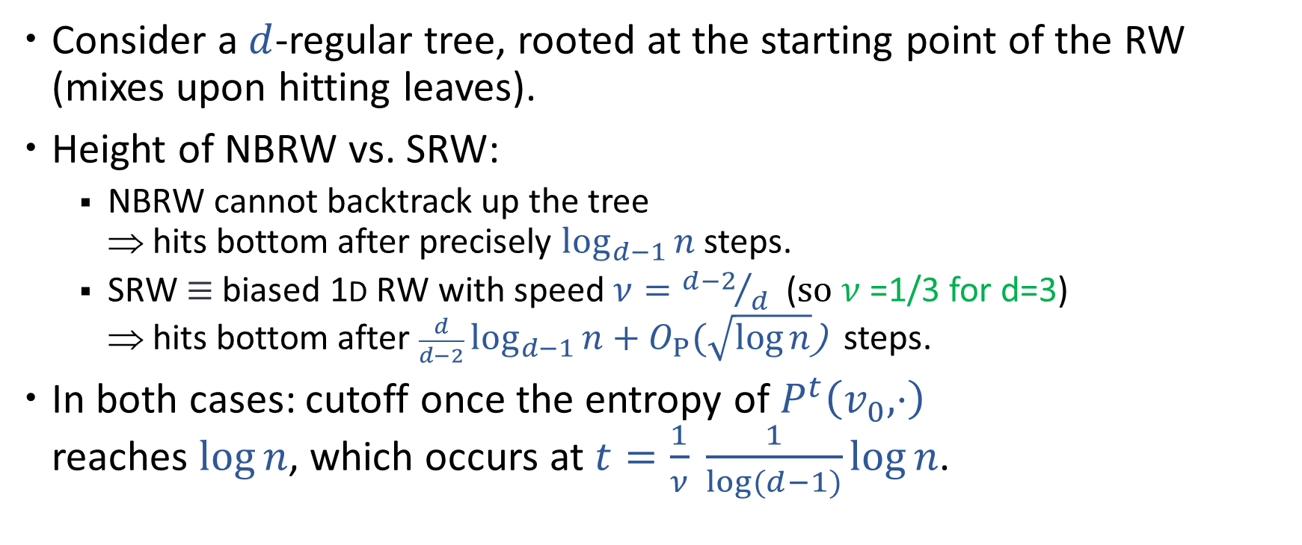


Comparison: cutoff for SRW & NBRW
Consider a $d$-regular tree, rooted at the starting point of the RW (mixes upon hitting leaves).
Height of NBRW vs. SRW:
  NBRW cannot backtrack up the tree
  $$ hits bottom after precisely $\log_{d−1}{n}$ steps.
  SRW $≡$ biased 1D RW with speed $ν={d−2}/d$ ($so ν$=1/3 for d=3)
  $$ hits bottom after $\frac{d}{d−2}\log_{d−1}{n}+O_{P}(\sqrt{\log{n}}$) steps.
In both cases: cutoff once the entropy of $P^{t}\left(v_{0},⋅\right)$
reaches $\log{n}$, which occurs at $t=\frac{1}{ν} \frac{1}{\log{(d−1)}}\log{n}$.
$$\overline{D}/ν$$
$\overline{D}$ (average distance)

Slide 10
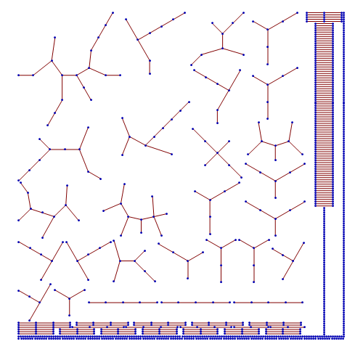
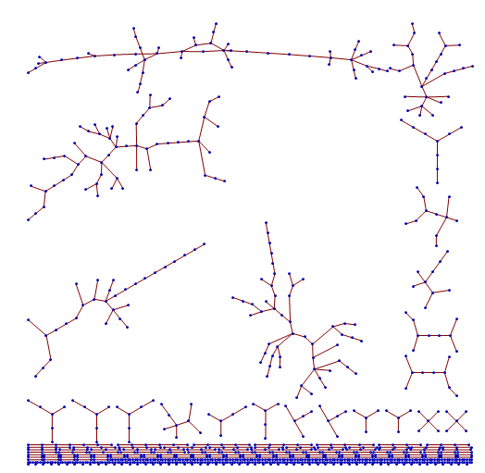
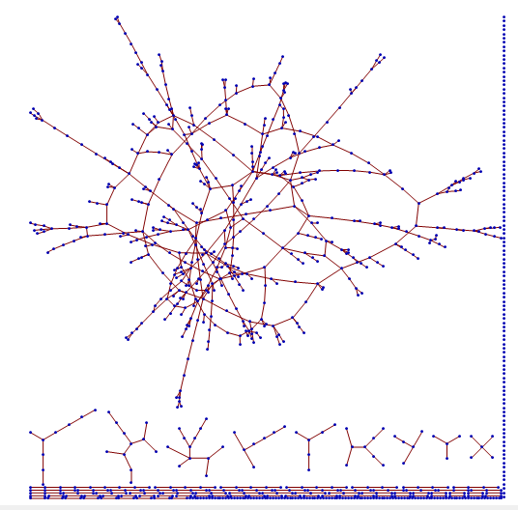


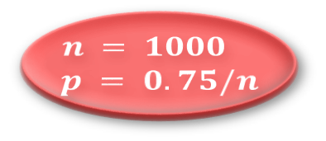
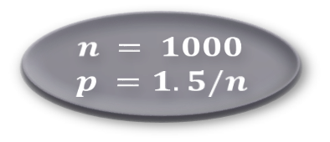
The Erdős-Rényi random graph
$𝒢(n,p)$: indicators of the $\left(\begin{matrix}n \\ 2\end{matrix}\right)$ edges are IID $Bernoulli\left(p\right)$.
$$n = 1000 \\ p = 0.75/n$$
$$n = 1000 \\ p = 1/n$$
$$n = 1000 \\ p =1.5/n$$
“This double “jump” of the size of the largest component… is one of the most striking facts concerning random graphs.” (Erdős and Rényi, 1960)

Slide 11
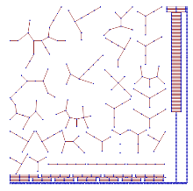
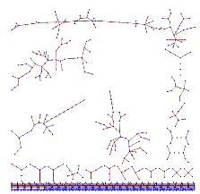
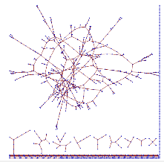
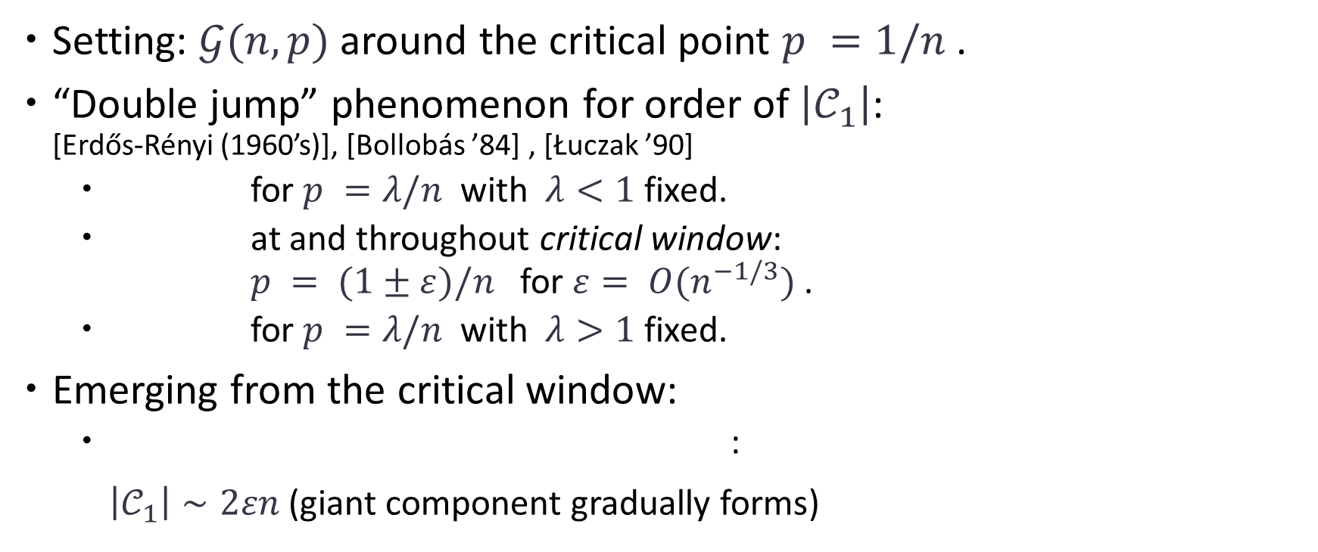




The Erdős-Rényi random graph
Setting: $𝒢(n,p)$ around the critical point $p =1/n$ .
“Double jump” phenomenon for order of $\left|𝒞_{1}\right|$:
[Erdős-Rényi (1960’s)], [Bollobás ’84] , [Łuczak ’90]
  for $p =λ/n$ with $λ<1$ fixed.
  at and throughout critical window:
  $p = (1±ε)/n$ for $ε= O(n^{−1/3})$ .
  for $p =λ/n$ with $λ>1$ fixed.
Emerging from the critical window:
  :
  $\left|𝒞_{1}\right|∼2εn$ (giant component gradually forms)
$$log⁡n$$
$$n^{2/3}$$
$$n$$
$$p = (1+ε)/n \text{for}{ n}^{−1/3}≪ε≪1$$

Slide 12
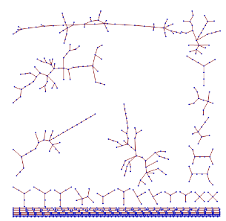
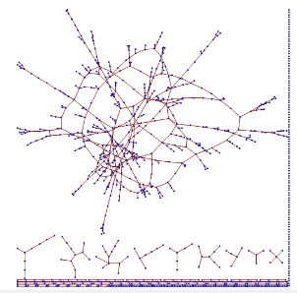
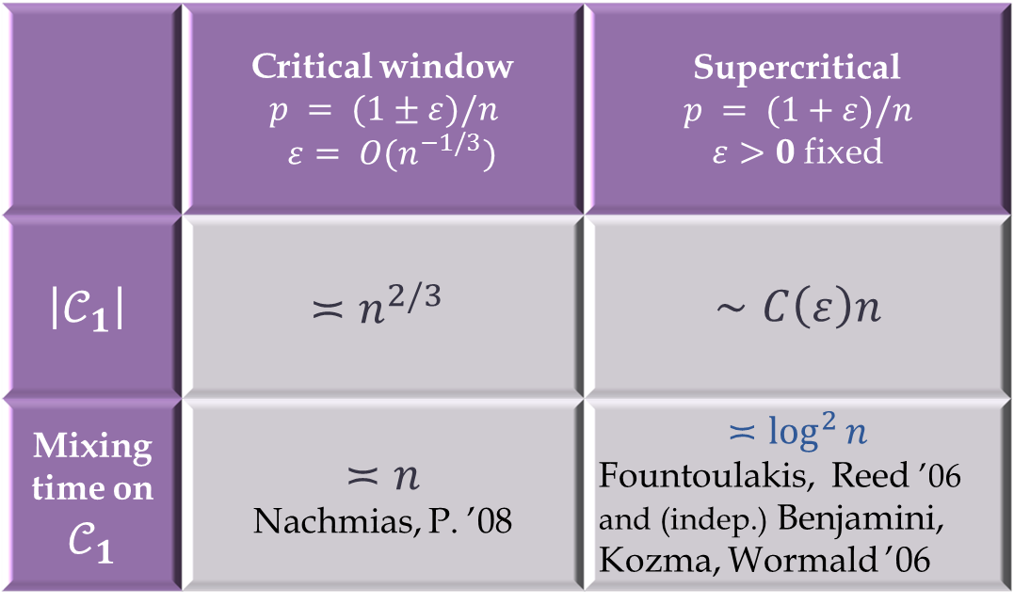
Mixing on the largest component
 | Critical window $p = (1±ε)/n$ $ε= O(n^{−1/3})$ | Supercritical $$p = (1+ε)/n$$ $ε>0$fixed
$$\left|𝒞_{1}\right|$$ | $$≍n^{2/3}$$ | $$∼C\left(ε\right)n$$
Mixing time on $𝒞_{1}$ | $≍n$ Nachmias, P. ’08 | $$≍\log^{2}{n}$$ Fountoulakis, Reed ’06 and (indep.) Benjamini, Kozma, Wormald ’06

Slide 13
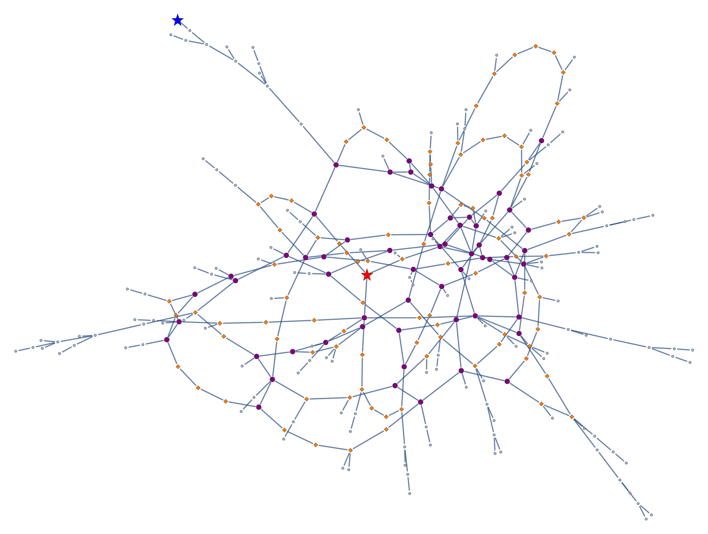

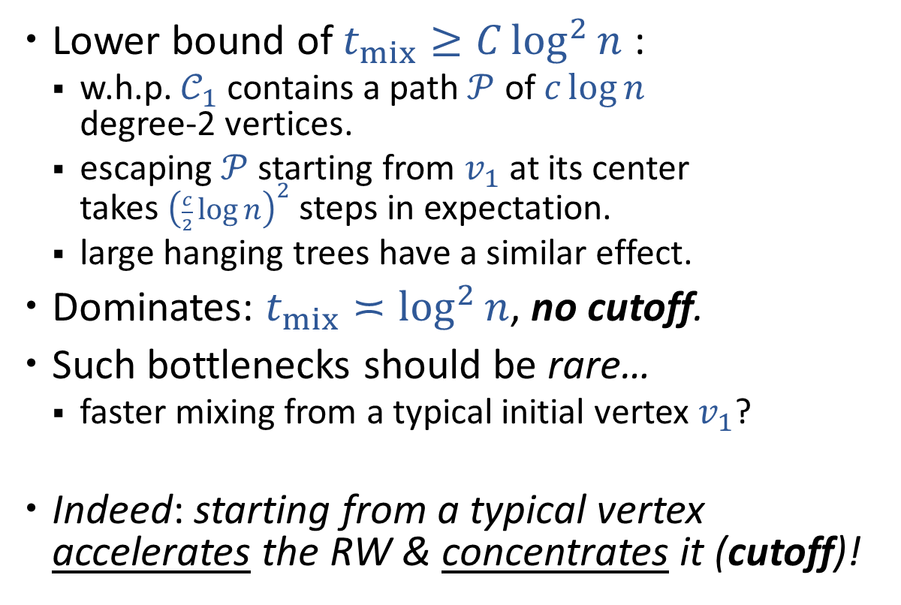
Bottlenecks slow the mixing on $𝒞_{1}$
Lower bound of $t_{mix}≥C\log^{2}{n}$ :
  w.h.p. $𝒞_{1}$ contains a path $𝒫$ of $c\log{n}$
  degree-2 vertices.
  escaping $𝒫$ starting from $v_{1}$ at its center
  takes ${\left(\frac{c}{2}\log{n}\right)}^{2}$ steps in expectation.
  large hanging trees have a similar effect.
Dominates: $t_{mix}≍\log^{2}{n}$, no cutoff.
Such bottlenecks should be rare…
  faster mixing from a typical initial vertex $v_{1}$?
Indeed: starting from a typical vertex
accelerates the RW & concentrates it (cutoff)!

Slide 14


Anatomy of a giant
[Ding, Lubetzky, P. ‘13]: giant of $𝒢(n,p=λ/n)$ is $≈$ (contiguous to):
: $𝒦$ random graph with (nice) given degrees
( $D_{i}∼Po(λ−ε_{λ}∣ ⋅ ≥3)$ IID for$i=1,…,N$)
: edges $↦$ paths of lengths IID $Geom(1−ε_{λ})$
: attach IID $Po(ε_{λ})$-Galton-Watson trees
kernel
$2$-core
giant
. . .
Notes:
w.h.p. exists (many) v with d > 2 induced paths originating from it.

Slide 15
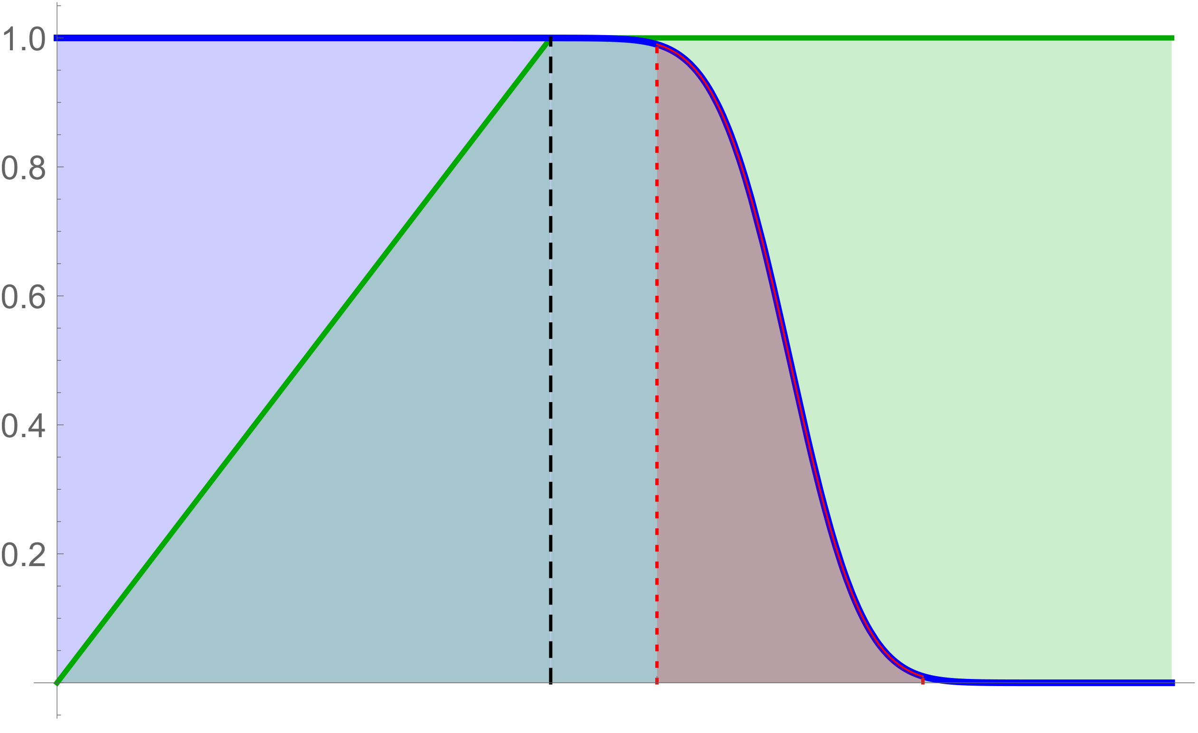
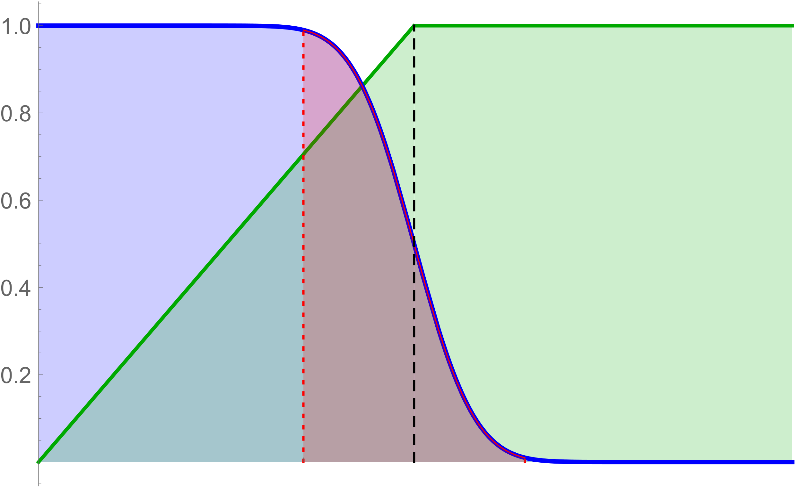







Mixing vs. the distance from the origin
Mixing on irregular graphs is delayed beyond the stabilization of the distance, since the rate at which entropy drops further involves the dimension $d$ :
$$\frac{\overline{D}}{ν}$$
$$t_{mix}\left(ε\right)$$
$$\frac{\overline{D}}{ν}$$
$$t_{mix}\left(ε\right)$$
$$t_{mix}\left(1−ε\right)$$
$$t_{mix}\left(1−ε\right)$$
Irregular graph
Regular graph

Slide 16


New results: RW on the giant
Setup:
  $𝒞_{1}=$ largest component of $𝒢(n, p=λ/n)$ [$λ>1$ fixed].
  $ν=$speed of RW on a Po($λ$)-GW tree.
  $d=$dimension of harmonic measure Po($λ$)-GW tree.
Theorem: [Berestycki, Lubetzky, P., Sly]:
Cutoff from a typical starting point!
RW from a uniform vertex of $𝒞_{1}$ w.h.p. satisfies
$$t_{mix}\left(ε\right)=ν^{−1}d^{−1}\log{n}±{\left(\log{n}\right)}^{1/2+o(1)}$$

Slide 17


Dimension of harmonic measure
$d =\lim_{t→∞}{\frac{1}{t}\log{\frac{1}{θ\left(ξ_{t}\right)}}}$
where $\left(ξ_{t}\right)=$ LERW
and $θ\left(x\right)=$ probability it visits $x$.
a.s.

Slide 18


Dimension of harmonic measure
a.s.
For a.e. GW-tree: $d =\lim_{t→∞}{\frac{1}{t}\log{\frac{1}{θ\left(Y_{t}\right)}}}$
where $\left(Y_{t}\right)=$ LERW and $θ\left(x\right)=$ probability it visits $x$.
Can be written as an integral w.r.t. to the measure on effective conductance in the PGW-tree.
Earlier work [Lyons, Pemantle, P. ‘94]
showed that $d<\log{𝔼Z}$ for a.e. GW-tree.
Density of the $C_{eff}$ distribution for $Z∼\left\{\begin{matrix}1 1/3 \\ 2 1/3 \\ 3 1/3\end{matrix}\right.$
  [ $νd=\int_{s=0}^{∞}{\int_{t=0}^{∞}{\frac{\log\left(1+s\right)}{1+s^{−1}+t^{−1}}dμ\left(t\right)μ(s)}}$ with $μ$ = dist. of $C_{eff}\left(ρ,∞\right)$. ]

Slide 19


RW on random graphs with given degrees
  Random graph with given degrees $≥3$ (e.g., half 3 half 4):
  similarly, dimension reduction due to irregularity of degrees…
  Theorem [Berestycki, Lubetzky, P., Sly]:
Let $G$ be a uniformly chosen graph with degree frequencies $(p_{k})$ s.t. $Z$ with $ℙ\left(Z=k\right)∝k p_{k}$ satisfies $𝔼Z=O(1)$, $2≤Z≤e^{{\left(\log{n}\right)}^{1/2−δ}}$ .
Then RW from a uniform vertex of $v_{1}∈G$ w.h.p. satisfies
$$t_{mix}^{(v_{1})}\left(ε\right)=ν^{−1}d^{−1}\log{n}±O\left(\sqrt{\log{n}}\right)$$
and the same statement holds for NBRW (from typical/worst $v_{1}$).

Slide 20


Proof ingredients for $𝒢(n,p)$
The correct cutoff window requires sharp fluctuation estimates on $\log{θ\left(Y_{t}\right)}$ for $θ=$ harmonic measure.
  Build on arguments of [Grimmett, Kesten 1984], [Lyons, Pemantle, P. ‘94] and [Dembo, Gantert, P., Zeitouni ‘02].
Exploit fact (using the structure theorem for $𝒞_{1}$) that bottlenecks are rare/spread-out to help expansion.
Additional difficulties: delays from hanging trees, coupling the walk on the tree to that on the graph, …
Proof extends to random graphs with given degrees.
  NBRW directly analyzed by an adaptation of the random regular graph proof (sharp cutoff window). This part independently proved by Ben-Hamou and Salez (2015).

Slide 21
Open problems
Does NBRW on random graph with given degrees mix faster than SRW?
(Yes if all degrees >2 : Ben Hamou –Lubetzky-P. (2016))
Does lazy SRW have cutoff on every family of transitive d-regular expanders?

