Slide 1
ETH-hardness of
Densest-k-Subgraph with Perfect Completeness
Aviad Rubinstein (UC Berkeley)
Mark Braverman, Young Kun Ko, and Omri Weinstein

Slide 2
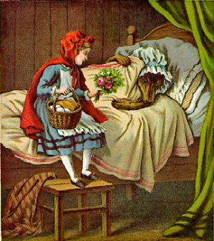
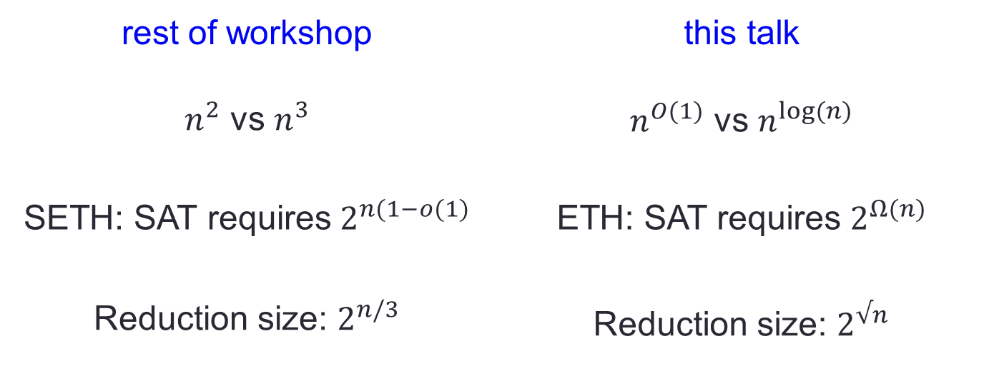
A confession…
this talk isn’t really about low-polynomial time
rest of workshop | this talk
$n^{2}$ vs $n^{3}$ | $n^{O(1)}$ vs $n^{log⁡(n)}$
SETH: SAT requires $2^{n(1−o(1)}$ | ETH: SAT requires $2^{Ω(n)}$
Reduction size: $2^{n/3}$ | Reduction size: $2^{√n}$
(and this isn’t really Grandma)

Slide 3
Densest k-Subgraph with perfect completeness

Slide 4
k-CLIQUE
G
(NP-hard [Karp72])
|S|=k
does G contain a k-clique?

Slide 5
relax “k”?
G
|S|≥k
|S| < k/n^{1-ε}
G
vs
NP-hard [FGLSS96 … Zuckerman07]

Slide 6
relax “clique”?
den(S)=1
G
|S|=k
den(S)<1-δ
G
vs
|S|=k
Quasi-poly algorithms [FS97, Barman15]

Slide 7
relax both?
den(S) = 1
G
|S|≥k
|S| < k/n^{ε/loglogn}
den(S) < 1-δ
G
vs
Our main result: ETH-hard

Slide 8
related works on “sparse vs very sparse”
0<s(n)<c(n)≪1
den(S)≥c(n)
den(S)<s(n)
G
G
vs
[Feige02, AAMMW11] – random k-CNF
[BCVGZ12] – SDP relaxations
[RS10] – Unique Games with expansion

Slide 9
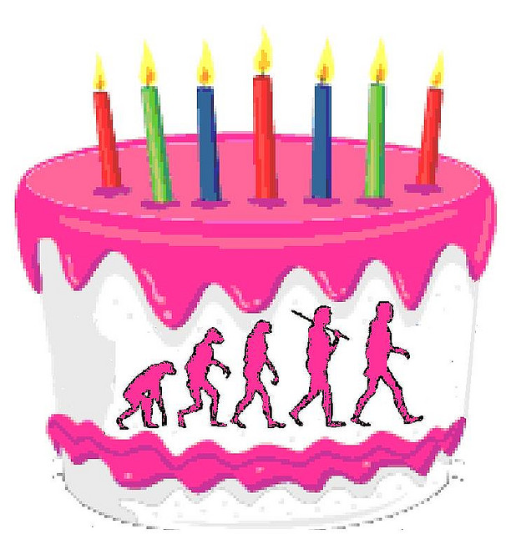
Main technique: Birthday Repetition

Slide 10

Recent applications of B-day Rep
Quasi-poly time hardness for…
[AIM14]: AM with k provers (“something quantum”)
  Dense CSP’s
  Free games
[BKW15]: ε-best ε-Nash
[BPR16]: ε-Nash
[R15] / [BCKS]: Signaling
[this talk]: Densest k-Subgraph
[ you! ]: ???

Slide 11
Recent applications of B-day Rep
Quasi-poly time hardness for…
[AIM14]: AM with k provers (“something quantum”)
  Dense CSP’s
  Free games
[BKW15]: ε-best ε-Nash
[BPR16]: ε-Nash
[R15] / [BCKS]: Signaling
[this talk]: Densest k-Subgraph
[ you! ]: graph isomorphism??

Slide 12
Recent applications of B-day Rep
Quasi-poly time hardness for…
[AIM14]: AM with k provers (“something quantum”)
  Dense CSP’s
  Free games
[BKW15]: ε-best ε-Nash
[BPR16]: ε-Nash
[R15] / [BCKS]: Signaling
[this talk]: Densest k-Subgraph
Tight by [FS97], [LMM03], [Barman15], [MM15], [CCDEHT15], etc.

Slide 13
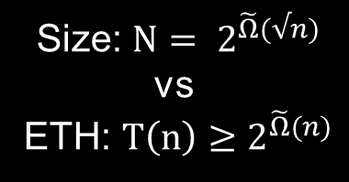
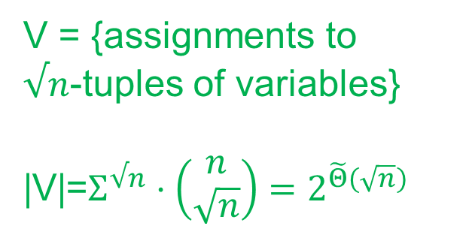

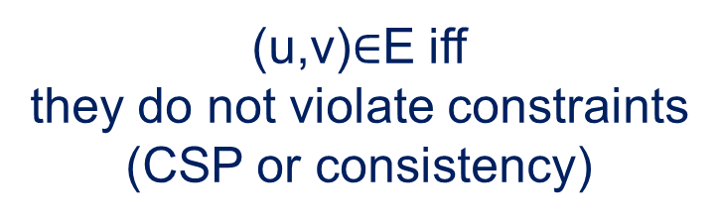
Reduction in 1 slide
Reduction from 2CSP (e.g. 3COL)
variables
x_{i}
constraints

Slide 14


Analysis (soundness) in 1 slide
  If every assignment to 2CSP violates $ε$-fraction of the constrains,
  the corresponding k-subgraph should be missing $Ω(ε)$-fraction of edges.
  QED?
Birthday Paradox:
every pair (u,v) should test a constraint
what about k-subgraphs that don’t correspond to any assignment?

Slide 15
Not so simple…
“Typically” birthday repetition is easy ☺
  Queries to Alice and Bob are independent.
More subtle for Densest k-Subgraph…
  Very simple problem – hard to enforce structure
    we only know that the subgraph is large + dense
  “like proving a parallel repetition theorem,
  when Alice and Bob choose which queries to answer”
  If it were easy, we would get hardness for den(S)=1 vs den(S)=δ

Slide 16
So what can we do?
“Typically” birthday repetition is easy ☺
  Queries to Alice and Bob are independent.
More subtle for Densest k-Subgraph…
  Very simple problem – hard to enforce structure
    we only know that the subgraph is large + dense
  “like proving a parallel repetition theorem,
  when Alice and Bob choose which queries to answer”
  If it were easy, we would get hardness for den(S)=1 vs den(S)=δ

Slide 17
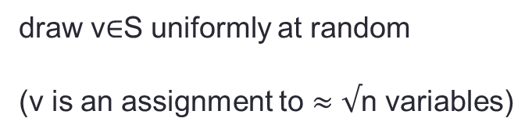
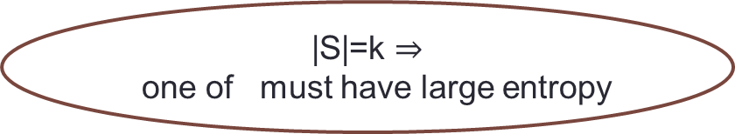
Analysis in 1 slide: “counting entropy”
G
|S|=k
choice of
variables
choice of
assignments
many
CSP violations!
many consistency
violations!
low density,
QED!

Slide 18
Open problems
“Warmup”: same result for Densest k-Bi-Subgraph
Den(S)=1 vs den(S)=δ
Stronger (NP?) hardness for “sparse vs very sparse”
Fixed parameter (k) tractability?

