Slide 1
Optimal Data-Dependent Hashing for
Nearest Neighbor Search
Alex Andoni
(Columbia University)
Joint work with: Ilya Razenshteyn

Slide 2
Nearest Neighbor Search (NNS)
Preprocess: a set $P$ of points
Query: given a query point $q$, report a point $p^{∗}∈P$ with the smallest distance to $q$
$$p^{∗}$$
$$q$$

Slide 3
Motivation
Generic setup:
  Points model objects (e.g. images)
  Distance models (dis)similarity measure
Application areas:
  machine learning: k-NN rule
  speech/image/video/music recognition, vector quantization, bioinformatics, etc…
Distances:
  Hamming, Euclidean,
  edit distance, earthmover distance, etc…
Core primitive for: closest pair, clustering …
000000
011100
010100
000100
010100
011111
000000
001100
000100
000100
110100
111111
$$p^{∗}$$
$$q$$

Slide 4
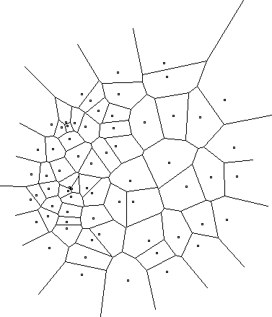
Curse of Dimensionality
All exact algorithms degrade rapidly with the dimension $d$
Algorithm | Query time | Space
Full indexing | $${\left(d⋅\log{n}\right)}^{O\left(1\right)}$$ | $n^{O(d)}$ (Voronoi diagram size)
No indexing – linear scan | $$O(n⋅d)$$ | $$O(n⋅d)$$

Slide 5
Approximate NNS
$c$-approximate
$r$-near neighbor: given a query point $q$, report a point $p^{′}∈P$ s.t. $\left\|p′−q\right\|≤r$
  as long as there is some point within distance $r$
Practice: use for exact NNS
  Filtering: gives a set of candidates (hopefully small)
$$cr$$
$$r$$
$$p^{∗}$$
$$cr$$
$$q$$
$$p^{′}$$

Slide 6
NNS algorithms
Exponential dependence on dimension
    [Arya-Mount’93], [Clarkson’94], [Arya-Mount-Netanyahu-Silverman-We’98], [Kleinberg’97], [Har-Peled’02],[Arya-Fonseca-Mount’11],…
Linear dependence on dimension
    [Kushilevitz-Ostrovsky-Rabani’98], [Indyk-Motwani’98], [Indyk’98, ‘01], [Gionis-Indyk-Motwani’99], [Charikar’02], [Datar-Immorlica-Indyk-Mirrokni’04], [Chakrabarti-Regev’04], [Panigrahy’06], [Ailon-Chazelle’06], [A.-Indyk’06], [A.-Indyk-Nguyen-Razenshteyn’14], [A.-Razenshteyn’15], [Pagh’16],…

Slide 7
Locality-Sensitive Hashing
[Indyk-Motwani’98]
$$q$$
$$p′$$
Random hash function $h$ on $R^{d}$ satisfying:
  for close pair: when $\left\|q−p\right\|≤r$
  $Pr⁡[h(q)=h(p)]$ is “high”
  for far pair: when $\left\|q−p′\right\|>cr$
  $Pr⁡[h(q)=h(p′)]$ is “small”
Use several hash tables:
$$p$$
$$q$$
$$P1=$$
“not-so-small”
$$P2=$$
$$Pr⁡[g(q)=g(p)]$$
$$ρ=\frac{\log{1/P_{1}}}{\log{1/P_{2}}}$$
1
$nρ$, where
$$P1$$
$$P2$$
$$\left\|q−p\right\|$$
$$r$$
$$cr$$

Slide 8
LSH Algorithms
Space | Time | Exponent | $$c=2$$ | Reference
Hamming
space
$$n^{1+ρ}$$ | $$n^{ρ}$$ | $$ρ=1/c$$ | $$ρ=1/2$$ | [IM’98]
 |  | $$ρ≥1/c$$ |  | [MNP’06, OWZ’11]
Euclidean
space
$$n^{1+ρ}$$ | $$n^{ρ}$$ | $$ρ=1/c$$ | $$ρ=1/2$$ | [IM’98, DIIM’04]
 |  | $$ρ≈1/c^{2}$$ | $$ρ=1/4$$ | [AI’06]
 |  | $$ρ≥1/c^{2}$$ |  | [MNP’06, OWZ’11]
LSH is tight.
Are we really done with basic NNS algorithms?
Notes:
Other ways to use LSH

Slide 9

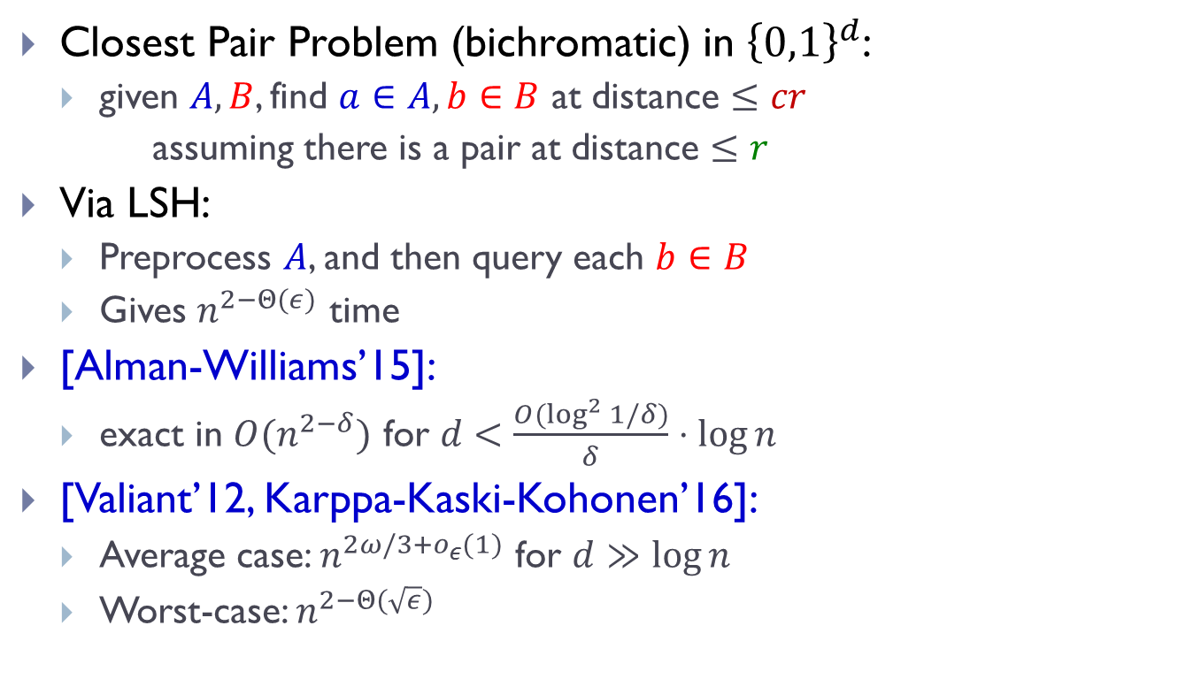
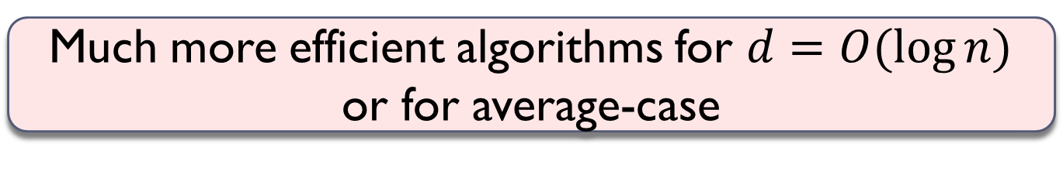

Detour: Closest Pair Problem
Closest Pair Problem (bichromatic) in ${\left\{0,1\right\}}^{d}$:
  given $A,B$, find $a∈A, b∈B$ at distance $≤cr$
  assuming there is a pair at distance $≤r$
Via LSH:
  Preprocess $A$, and then query each $b∈B$
  Gives $n^{2−Θ(ε)}$ time
[Alman-Williams’15]:
  exact in $O(n^{2−δ})$ for $d<\frac{O(\log^{2}{1/δ})}{δ}⋅\log{n}$
[Valiant’12, Karppa-Kaski-Kohonen’16]:
  Average case: $n^{2ω/3+o_{ε}(1)}$ for $d≫\log{n}$
  Worst-case: $n^{2−Θ(\sqrt{ε})}$
  $$c=1+ε$$
Points: random $∈{\left\{0,1\right\}}^{d}$
at distance $cr=d/2$
Close pair: random at
distance $r=\frac{d/2}{c}$
Much more efficient algorithms for $d=O(\log{n})$
or for average-case

Slide 10
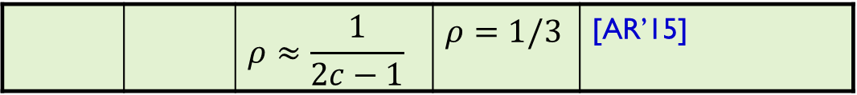
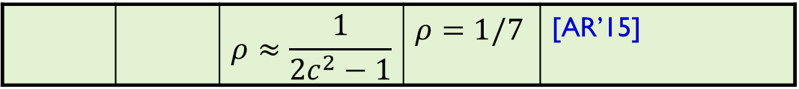
Beyond Locality Sensitive Hashing
Space | Time | Exponent | $$c=2$$ | Reference
Hamming
space
$$n^{1+ρ}$$ | $$n^{ρ}$$ | $$ρ=1/c$$ | $$ρ=1/2$$ | [IM’98]
LSH
 |  | $$ρ≥1/c$$ |  | [MNP’06, OWZ’11]
$$n^{1+ρ}$$ | $$n^{ρ}$$ | complicated | $$ρ=1/2−ε$$ | [AINR’14]
 |  | $$ρ≈\frac{1}{2c−1}$$ | $$ρ=1/3$$ | [AR’15]
Euclidean
space
$$n^{1+ρ}$$ | $$n^{ρ}$$ | $$ρ≈1/c^{2}$$ | $$ρ=1/4$$ | [AI’06]
LSH
 |  | $$ρ≥1/c^{2}$$ |  | [MNP’06, OWZ’11]
$$n^{1+ρ}$$ | $$n^{ρ}$$ | complicated | $$ρ=1/4−ε$$ | [AINR’14]
 |  | $$ρ≈\frac{1}{2c^{2}−1}$$ | $$ρ=1/7$$ | [AR’15]

Slide 11
New approach?
A random hash function, chosen after seeing the given dataset
Efficiently computable
Data-dependent hashing
Notes:
Example: Voronoi diagram
but expensive to compute the hash function

Slide 12

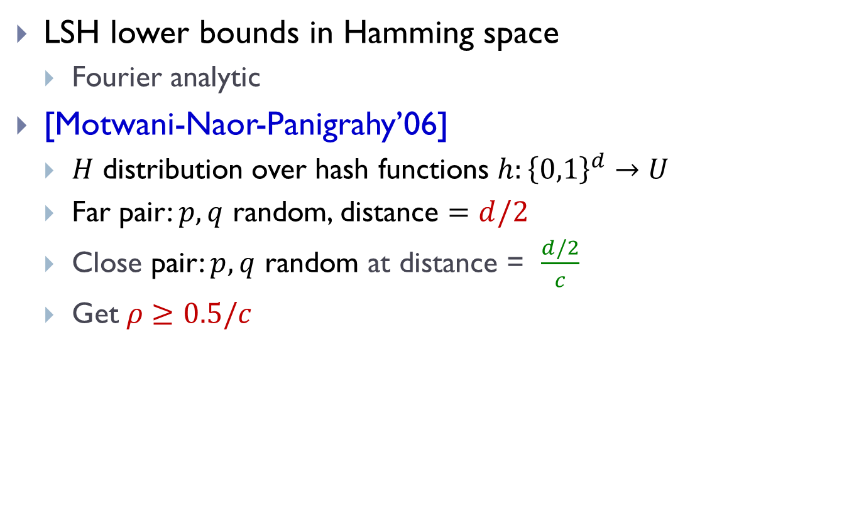



A look at LSH lower bounds
LSH lower bounds in Hamming space
  Fourier analytic
[Motwani-Naor-Panigrahy’06]
  $H$ distribution over hash functions $h:{\left\{0,1\right\}}^{d}→U$
  Far pair: $p,q$ random, distance $=d/2$
  Close pair: $p,q$ random at distance = $\frac{d/2}{c}$
  Get $ρ≥0.5/c$
[O’Donnell-Wu-Zhou’11]
$$δd$$
$$\frac{δd}{c}$$
$$ρ≥1/c$$
Points random $∈{\left\{0,1\right\}}^{d}$
at distance $cr=d/2$
Close pair: distance $d/2c$
at distance $r=d/2c$

Slide 13

Why not NNS lower bound?
Suppose we try to apply [OWZ’11] to NNS
  Pick random $q$
  All the “far point” are concentrated in a small ball of radius $εd$
  Easy to see at preprocessing: actual near neighbor close to the center of the minimum enclosing ball

Slide 14
Construction of hash function
Two components:
  Average-case: nicer structure
  Reduction to such structure
Like a (very weak) “regularity lemma” for a set of points
has better LSH
data-dependent

Slide 15



Average-case: nicer structure
[A.-Indyk-Nguyen-Razenshteyn’14]
Think: random dataset on a sphere
  vectors perpendicular to each other
  s.t. two random points at distance $≈cr$
Lemma: $ρ=\frac{1}{2c^{2}−1}$
  via Cap Carving
$$cr$$
$$cr/\sqrt{2}$$

Slide 16



Reduction to nice structure
Idea:
  iteratively decrease the radius of minimum enclosing ball
Algorithm:
  find dense clusters
    with smaller radius
    large fraction of points
  recurse on dense clusters
  apply cap carving on the rest
    recurse on each “cap”
    eg, dense clusters might reappear
Why ok?
Why ok?
no dense clusters
like “random dataset” with radius=$100cr$
even better!
radius = $100cr$
radius = $99cr$
*picture not to scale & dimension

Slide 17
Hash function
Described by a tree (like a hash table)
radius = $100cr$
*picture not to scale&dimension

Slide 18


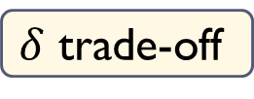
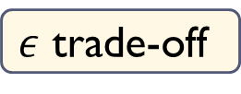
Dense clusters
$$\left(\sqrt{2}−ε\right)R$$
Current dataset: radius $R$
A dense cluster:
  Contains $n^{1−δ}$ points
  Smaller radius: $\left(1−Ω\left(ε^{2}\right)\right)R$
After we remove all clusters:
  For any point on the surface, there are at most $n^{1−δ}$ points within distance $\left(\sqrt{2}−ε\right)R$
  The other points are essentially orthogonal !
When applying Cap Carving with parameters $(P_{1},P_{2})$:
  Empirical number of far pts colliding with query: $nP_{2}+n^{1−δ}$
  As long as $nP_{2}≫n^{1−δ}$, the “impurity” doesn’t matter!
$ε$ trade-off
$δ$ trade-off
?

Slide 19
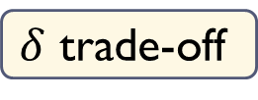
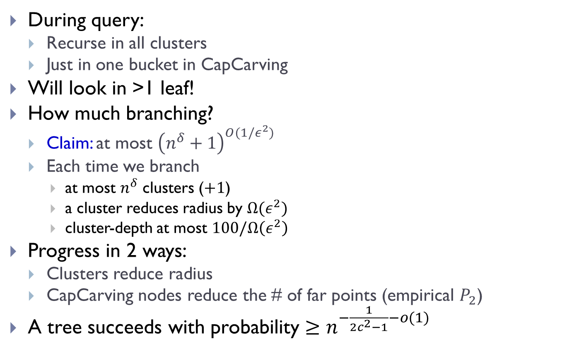
Tree recap
During query:
  Recurse in all clusters
  Just in one bucket in CapCarving
Will look in >1 leaf!
How much branching?
  Claim: at most ${\left(n^{δ}+1\right)}^{O(1/ε^{2})}$
  Each time we branch
    at most $n^{δ}$ clusters ($+1$)
    a cluster reduces radius by $Ω(ε^{2})$
    cluster-depth at most $100/Ω\left(ε^{2}\right)$
Progress in 2 ways:
  Clusters reduce radius
  CapCarving nodes reduce the # of far points (empirical $P_{2}$)
A tree succeeds with probability $≥n^{−\frac{1}{2c^{2}−1}−o(1)}$
$δ$ trade-off

Slide 20


Fast preprocessing
$$\left(\sqrt{2}−ε\right)R$$
How to find the dense clusters fast?
Step 1: reduce to $O(n^{2})$ time.
  Enough to consider centers that
  are data points
Step 2: reduce to near-linear time.
  Down-sample!
  Ok because we want clusters of size $n^{1−δ}$
  After downsampling by a factor of $\sqrt{n}$, a cluster is still somewhat heavy.

Slide 21
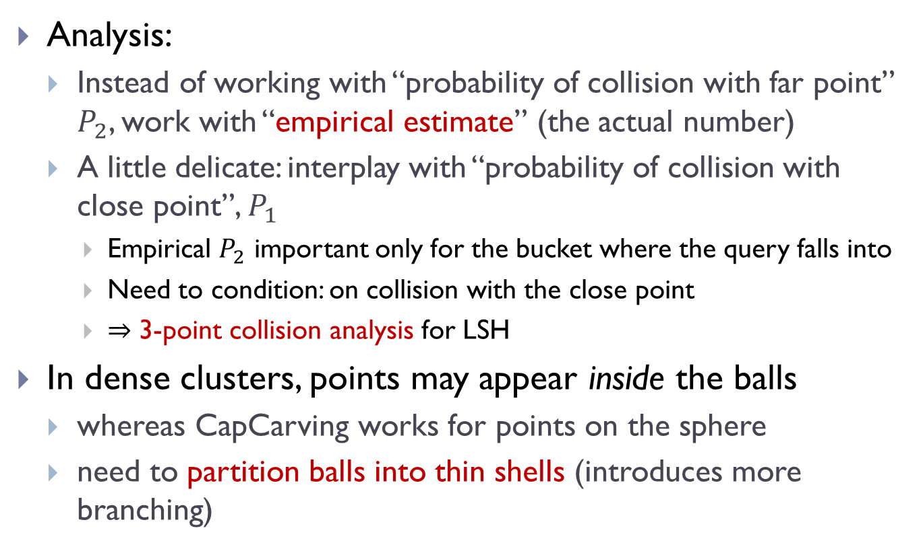
Even more details
Analysis:
  Instead of working with “probability of collision with far point” $P_{2}$, work with “empirical estimate” (the actual number)
  A little delicate: interplay with “probability of collision with close point”, $P_{1}$
    Empirical $P_{2}$ important only for the bucket where the query falls into
    Need to condition: on collision with the close point
    $⇒$ 3-point collision analysis for LSH
In dense clusters, points may appear inside the balls
  whereas CapCarving works for points on the sphere
  need to partition balls into thin shells (introduces more branching)

Slide 22
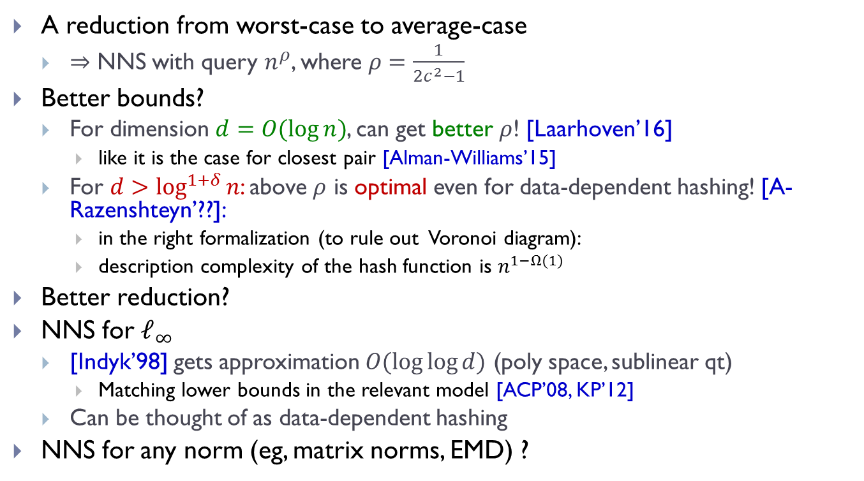
Data-dependent hashing: beyond LSH
A reduction from worst-case to average-case
  $⇒$ NNS with query $n^{ρ}$, where $ρ=\frac{1}{2c^{2}−1}$
Better bounds?
  For dimension $d=O(\log{n})$, can get better $ρ$! [Laarhoven’16]
    like it is the case for closest pair [Alman-Williams’15]
  For $d>\log^{1+δ}{n}$: above $ρ$ is optimal even for data-dependent hashing! [A-Razenshteyn’??]:
    in the right formalization (to rule out Voronoi diagram):
    description complexity of the hash function is $n^{1−Ω(1)}$
Better reduction?
NNS for $ℓ_{∞}$
  [Indyk’98] gets approximation $O(\log{\log{d}})$ (poly space, sublinear qt)
    Matching lower bounds in the relevant model [ACP’08, KP’12]
  Can be thought of as data-dependent hashing
NNS for any norm (eg, matrix norms, EMD) ?
Lower bounds: an opportunity to discover new algorithmic techniques

