Slide 1
Input Sparsity and Hardness for Linear Algebra Problems
David Woodruff
IBM Almaden
Work with Ken Clarkson. Discussions with Amir Abboud, Yuqing Ai, Arturs Backurs, Richard Peng

Slide 2
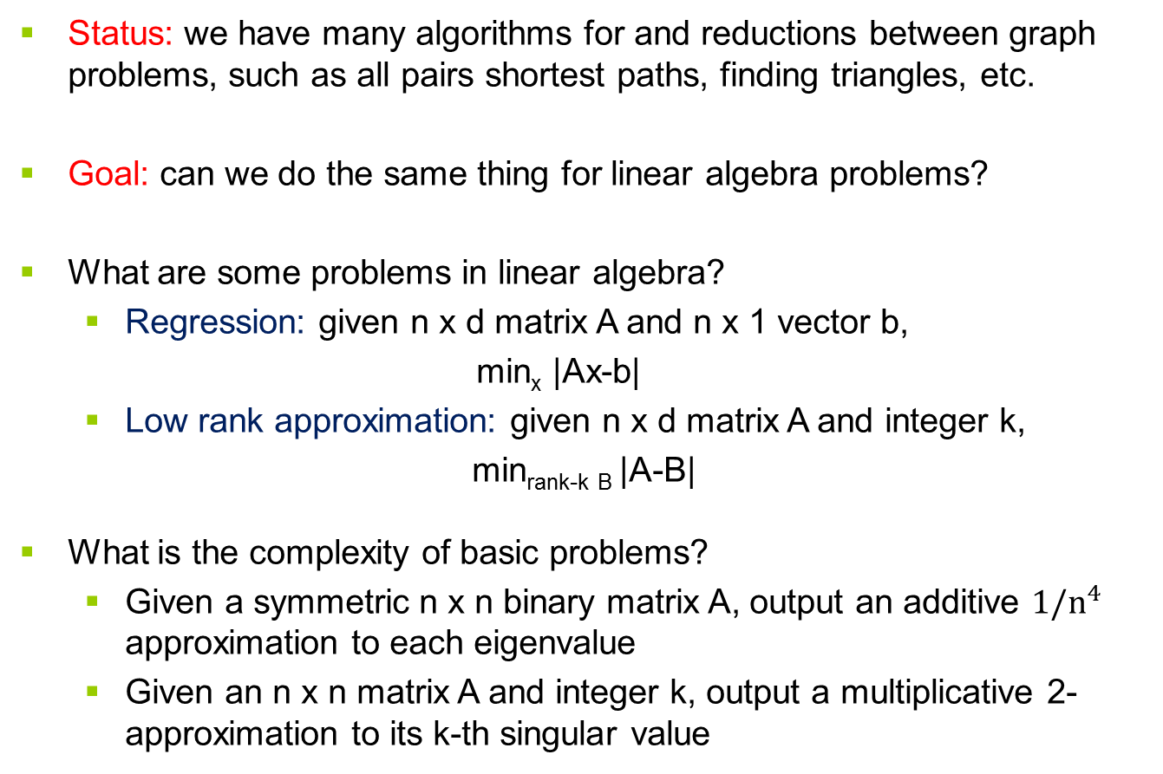
Low Polynomial Time Linear Algebra Problems
Status: we have many algorithms for and reductions between graph problems, such as all pairs shortest paths, finding triangles, etc.
Goal: can we do the same thing for linear algebra problems?
What are some problems in linear algebra?
  Regression: given n x d matrix A and n x 1 vector b,
  min_{x} |Ax-b|
  Low rank approximation: given n x d matrix A and integer k,
min_{rank-k B} |A-B|
What is the complexity of basic problems?
  Given a symmetric n x n binary matrix A, output an additive $1/n^{4}$ approximation to each eigenvalue
  Given an n x n matrix A and integer k, output a multiplicative 2-approximation to its k-th singular value

Slide 3
Talk Outline
Solving linear algebra problems by reductions, “sketch and solve”
  Low Rank Approximation
  Robust Low Rank Approximation
Spectral Low Rank Approximation
  Basic questions on eigenvalues
  What is known?

Slide 4
Low rank approximation
A is an n x d matrix
  Think of n points in R^{d}
E.g., A is a customer-product matrix
  A_{i,j} = how many times customer i purchased item j
A is typically well-approximated by low rank matrix
  E.g., high rank because of noise
Goal: find a low rank matrix approximating A
  Easy to store, data more interpretable

Slide 5
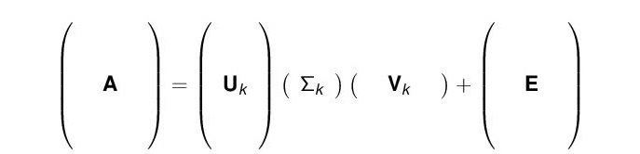
What is a good low rank approximation?
A_{k} = argmin_{rank k matrices B} |A-B|_{F}
(|C|_{F} = (Σ_{i,j} C_{i,j}²)^{1/2} )
Computing A_{k} exactly is expensive
Singular Value Decomposition (SVD)
Any matrix A = U ¢ Σ ¢ V
  U has orthonormal columns
  Σ is diagonal with non-increasing positive entries down the diagonal
  V has orthonormal rows
Rank-k approximation: A_{k} = U_{k} ¢ Σ_{k} ¢ V_{k}
The rows of V_{k} are the top k principal components

Slide 6

Low rank approximation
Goal: output a rank k matrix B, so that
|A-B|_{F} · (1+ε) |A-A_{k}|_{F}
Can do this in nnz(A) + (n+d)$⋅$poly(k/ε) time [S,CW]

Slide 7
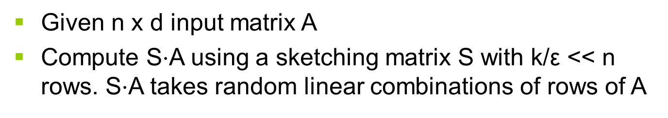
Sketch and solve paradigm [S]
Given n x d input matrix A
Compute S$⋅$A using a sketching matrix S with k/ε << n rows. S$⋅$A takes random linear combinations of rows of A
A
SA
Project rows of A onto SA, then find best rank-k approximation to points inside of SA.

Slide 8
What is the matrix S?
S can be a k/ε x n matrix of i.i.d. normal random variables
[S] S can be a k/ε x n Fast Johnson Lindenstrauss Matrix
[CW] S can be a poly(k/ε) x n CountSketch matrix
[
[
S ¢ A can be computed in nnz(A) time
0 0 1 0 0 1 0 0
1 0 0 0 0 0 0 0
0 0 0 -1 1 0 -1 0
0-1 0 0 0 0 0 1

Slide 9
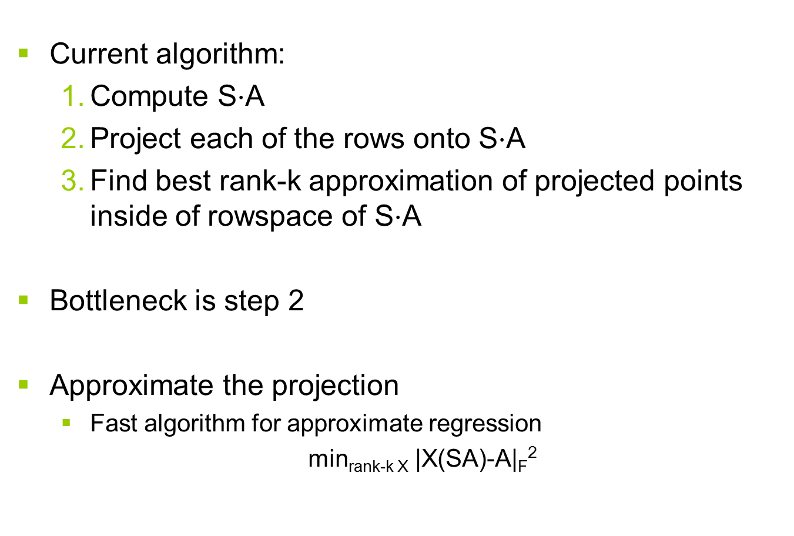
Caveat: projecting the points onto SA is slow
Current algorithm:
  Compute S$⋅$A
  Project each of the rows onto S$⋅$A
  Find best rank-k approximation of projected points inside of rowspace of S$⋅$A
Bottleneck is step 2
Approximate the projection
  Fast algorithm for approximate regression
  min_{rank-k X} |X(SA)-A|_{F}²

Slide 10
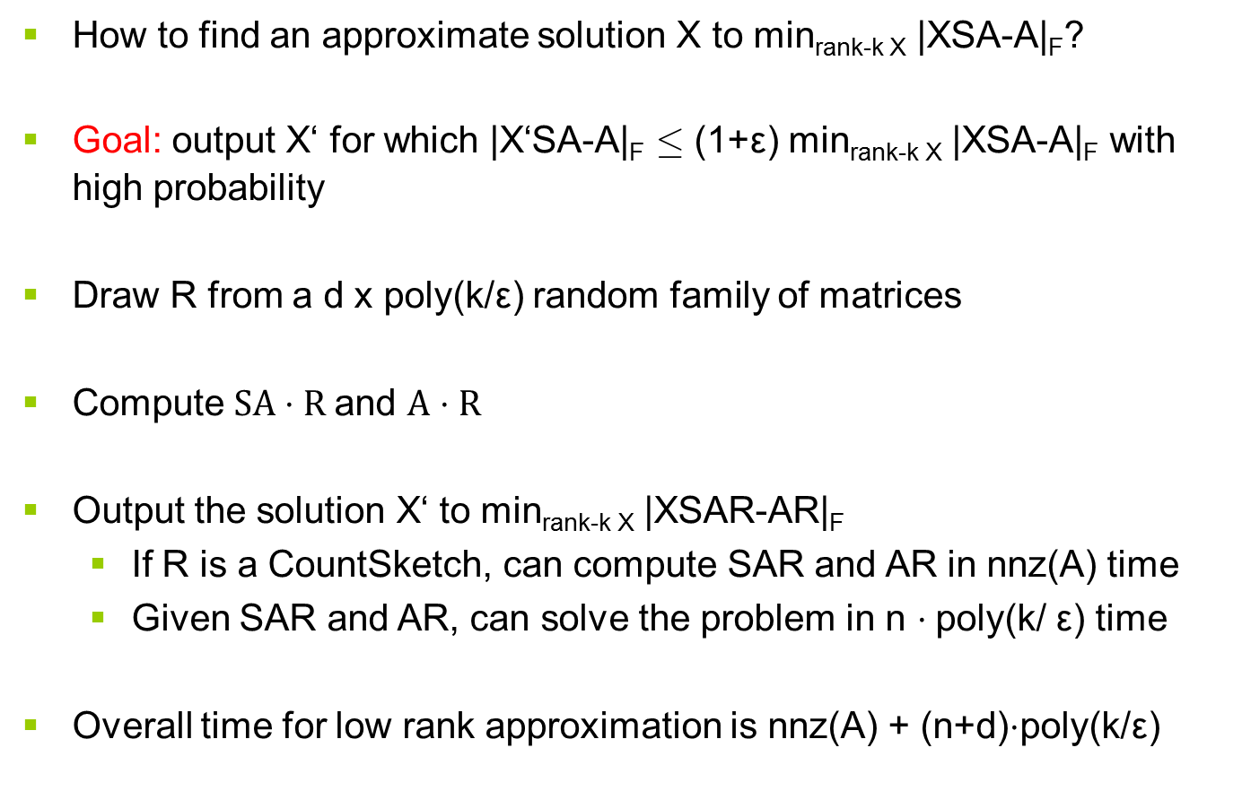
Sketch and solve for regression
How to find an approximate solution X to min_{rank-k X} |XSA-A|_{F}?
Goal: output X‘ for which |X‘SA-A|_{F} · (1+ε) min_{rank-k X} |XSA-A|_{F} with high probability
Draw R from a d x poly(k/ε) random family of matrices
Compute $SA⋅R$and $A⋅R$
Output the solution X‘ to min_{rank-k X} |XSAR-AR|_{F}
  If R is a CountSketch, can compute SAR and AR in nnz(A) time
  Given SAR and AR, can solve the problem in n $⋅$poly(k/ ε) time
  Overall time for low rank approximation is nnz(A) + (n+d)$⋅$poly(k/ε)

Slide 11
Talk Outline
Solving linear algebra problems by reductions, “sketch and solve”
  Low Rank Approximation
  Robust Low Rank Approximation
Spectral Low Rank Approximation
  Basic questions on eigenvalues
  What is known?

Slide 12
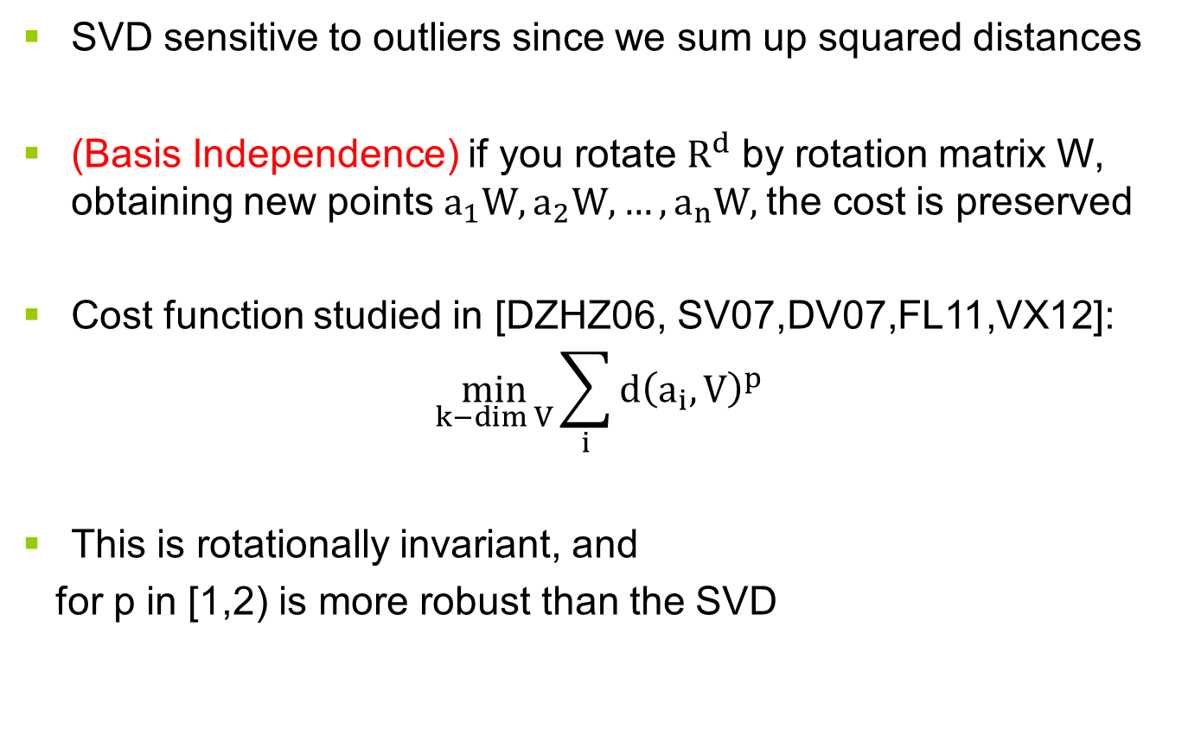
Robust Forms of Low Rank Approximation
SVD sensitive to outliers since we sum up squared distances
(Basis Independence) if you rotate $R^{d}$ by rotation matrix W, obtaining new points $a_{1}W, a_{2}W, …, a_{n}W,$the cost is preserved
Cost function studied in [DZHZ06, SV07,DV07,FL11,VX12]:
$$\min_{k−\dim{V}}\sum_{i}{d{\left(a_{i},V\right)}^{p}}$$
This is rotationally invariant, and
for p in [1,2) is more robust than the SVD

Slide 13
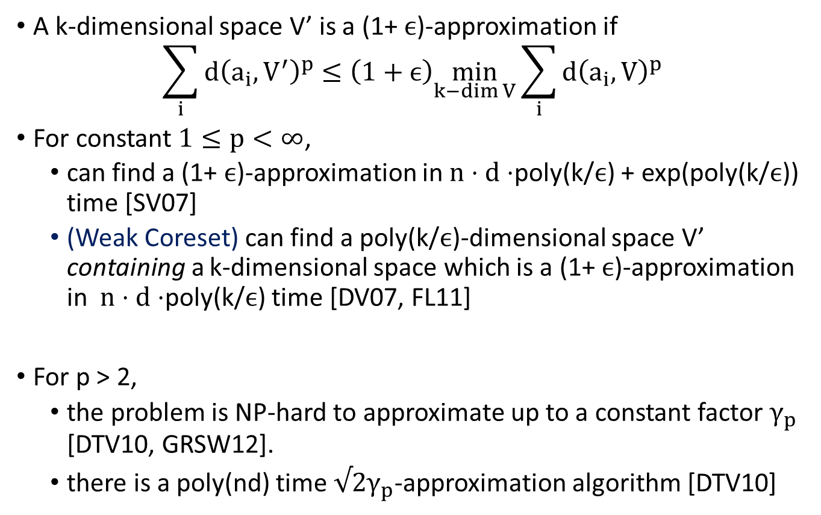
Prior Work on this Cost Function
A k-dimensional space V’ is a (1+ $ϵ$)-approximation if
$$\sum_{i}{d{\left(a_{i}, V^{′}\right)}^{p}≤\left(1+ϵ\right)\min_{k−\dim{V}}\sum_{i}{d{\left(a_{i}, V\right)}^{p}}}$$
For constant $1≤p<∞$,
  can find a (1+ $ϵ$)-approximation in $n⋅d⋅$poly(k/$ϵ$) + exp(poly(k/$ϵ$)) time [SV07]
  (Weak Coreset) can find a poly(k/$ϵ$)-dimensional space V’ containing a k-dimensional space which is a (1+ $ϵ$)-approximation in $n⋅d⋅$poly(k/$ϵ$) time [DV07, FL11]
For p > 2,
  the problem is NP-hard to approximate up to a constant factor $γ_{p}$ [DTV10, GRSW12].
  there is a poly(nd) time $√2γ_{p}$-approximation algorithm [DTV10]

Slide 14
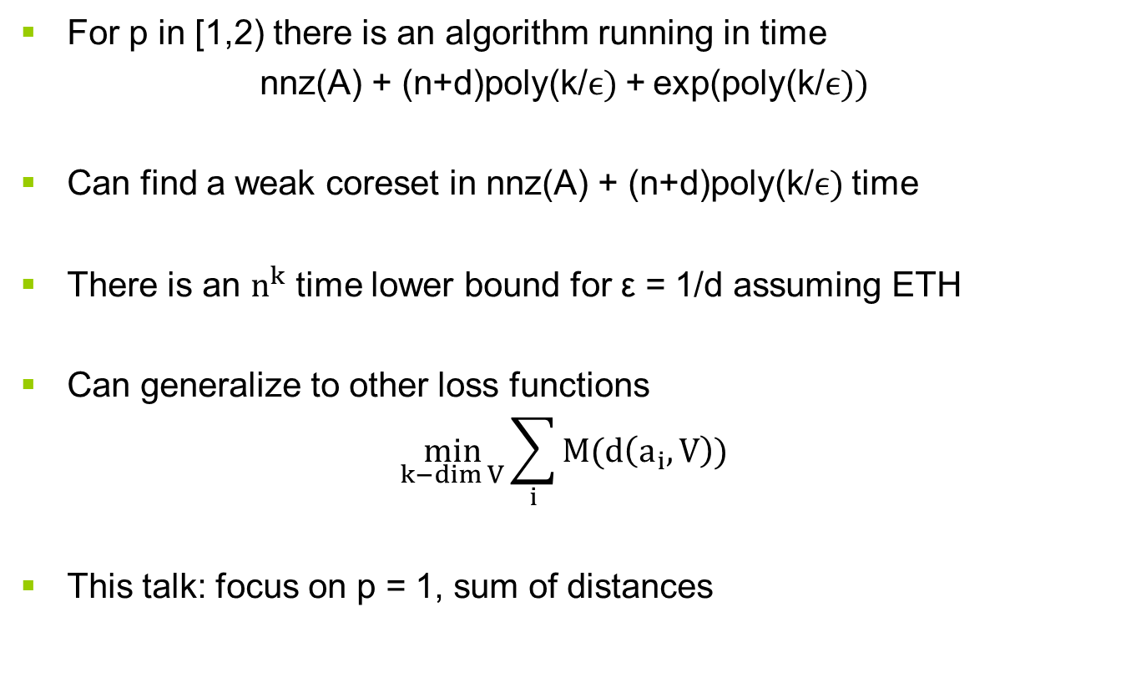
Our Results for Robust Low Rank Approximation
For p in [1,2) there is an algorithm running in time
nnz(A) + (n+d)poly(k/$ϵ)$+ exp(poly(k/$ϵ))$
Can find a weak coreset in nnz(A) + (n+d)poly(k/$ϵ)$ time
There is an $n^{k}$ time lower bound for ε = 1/d assuming ETH
Can generalize to other loss functions
$$\min_{k−\dim{V}}{\sum_{i}{M(d\left(a_{i}, V\right))}}$$
This talk: focus on p = 1, sum of distances

Slide 15
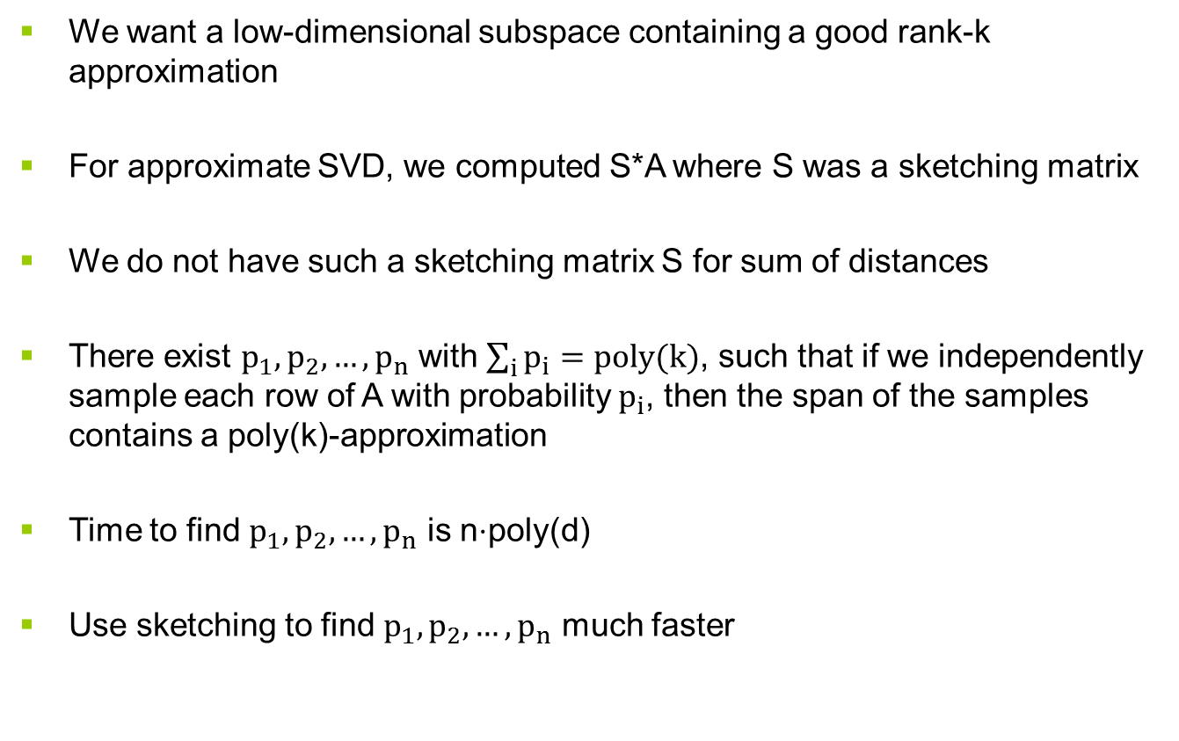
Intuition for the Robust Case
We want a low-dimensional subspace containing a good rank-k approximation
For approximate SVD, we computed S*A where S was a sketching matrix
We do not have such a sketching matrix S for sum of distances
There exist $p_{1}, p_{2},…, p_{n}$ with $\sum_{i}{p_{i}=poly(k)}$, such that if we independently sample each row of A with probability $p_{i}$, then the span of the samples contains a poly(k)-approximation
Time to find $p_{1}, p_{2},…, p_{n}$ is n$⋅$poly(d)
Use sketching to find $p_{1}, p_{2},…, p_{n}$ much faster

Slide 16

Our Algorithm
Approximate each of these residuals for speed
Skip this step if you just want a weak coreset
(Sketch) Compute AR for a d x poly(k/$ϵ)$ CountSketch matrix R
(Create Probabilities) Create sampling probabilities $p_{1},p_{2},…, p_{n}$ for the rows of A by computing “$l_{1}$-leverage scores” of AR
(Sample) Include the i-th row of A in a sample set S independently with probability $p_{i}$
(Adaptively Sample) Sample a set T of poly(k/$ϵ)$ rows of A proportional to their “residual” ${\left|A_{i}−A_{i}P_{S}\right|}_{2}$
(Brute Force) Find the best k-dimensional subspace in span(S $∪$ T)

Slide 17
Talk Outline
Solving linear algebra problems by reductions, “sketch and solve”
  Low Rank Approximation
  Robust Low Rank Approximation
Spectral Low Rank Approximation
  Basic questions on eigenvalues
  What is known?

Slide 18
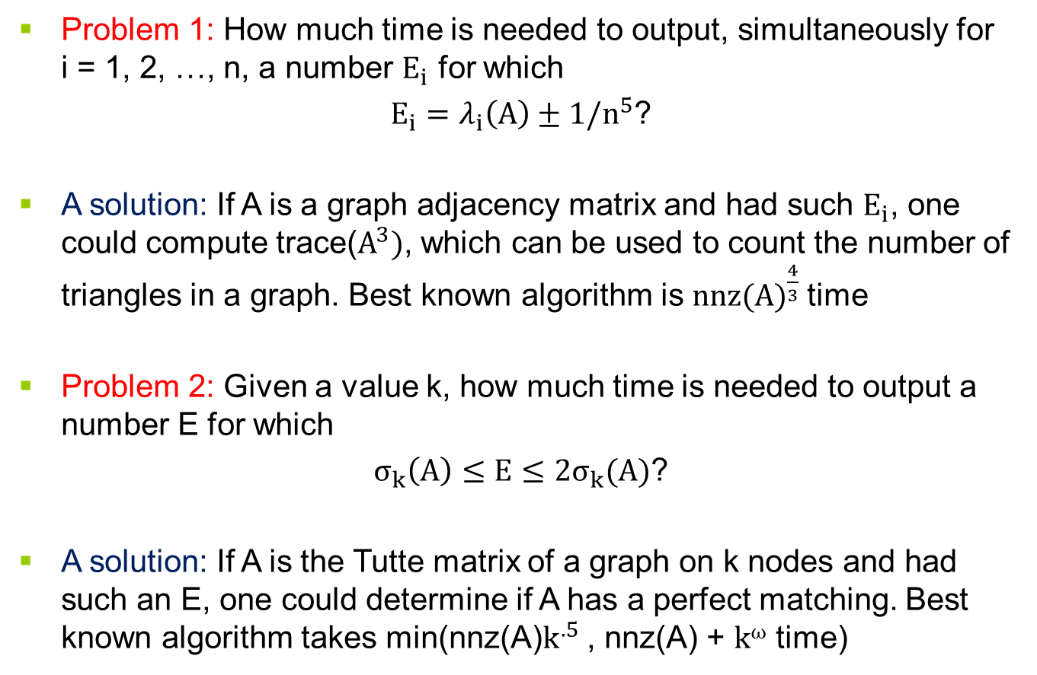
Connecting linear algebra to graph problems
Problem 1: How much time is needed to output, simultaneously for i = 1, 2, …, n, a number $E_{i}$ for which
$E_{i}=λ_{i}\left(A\right)±1/n^{5}$?
A solution: If A is a graph adjacency matrix and had such $E_{i}$, one could compute trace($A^{3})$, which can be used to count the number of triangles in a graph. Best known algorithm is ${nnz(A)}^{\frac{4}{3}}$time
Problem 2: Given a value k, how much time is needed to output a number E for which
$σ_{k}\left(A\right)≤E≤2σ_{k}(A)$?
A solution: If A is the Tutte matrix of a graph on k nodes and had such an E, one could determine if A has a perfect matching. Best known algorithm takes min(nnz(A)$k^{.5}$ , nnz(A) + $kω$ time)

Slide 19
Talk Outline
Solving linear algebra problems by reductions, “sketch and solve”
  Low Rank Approximation
  Robust Low Rank Approximation
Spectral Low Rank Approximation
  Basic questions on eigenvalues
  What is known?

Slide 20
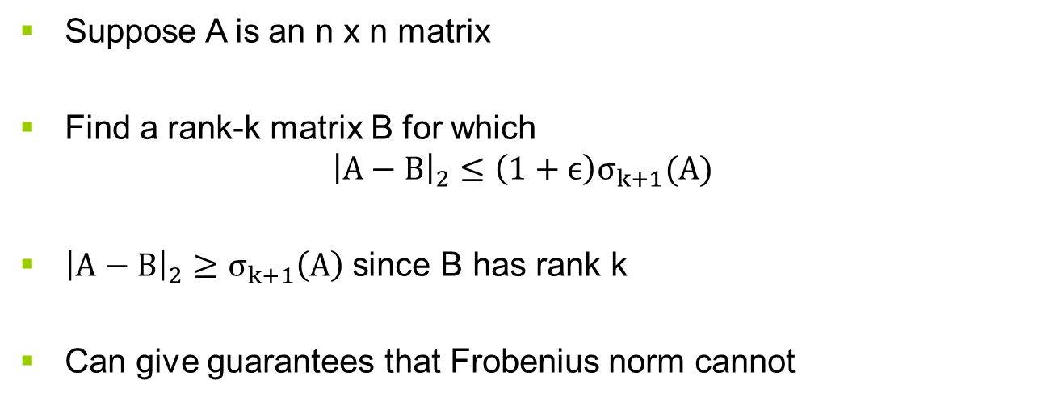
Spectral Low Rank Approximation
Suppose A is an n x n matrix
Find a rank-k matrix B for which
$${\left|A−B\right|}_{2}≤\left(1+ϵ\right)σ_{k+1}(A)$$
${\left|A−B\right|}_{2}≥σ_{k+1}\left(A\right)$ since B has rank k
Can give guarantees that Frobenius norm cannot
[ ]
2
1
1
1
1

Slide 21
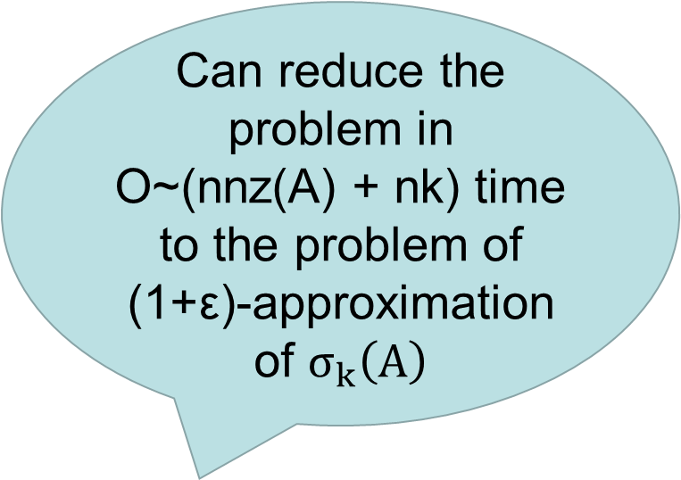

Known Results
Subspace Power Iteration
  Let $q=O((\log{ n)/ε)}$
  Output $B={GA}^{q}$, where G is a k x n matrix of i.i.d. normal random variables
Guarantee: rows of B span a (1+ε)-approximate spectral low rank approximation
Time is k nnz(A) log n / $ε$
  If $k<n^{.30298}$, algorithm is $O(\frac{n^{2}\log{n}}{ε})$ time via fast rectangular matrix multiplication [C, L, AB]
  In general can improve to k nnz(A) log n / $ε^{.5}$ [MM]
Can we achieve nnz(A) + n poly(k/ε) time for this problem?
Can reduce the problem in O~(nnz(A) + nk) time to the problem of (1+ε)-approximation of $σ_{k}\left(A\right)$

Slide 22
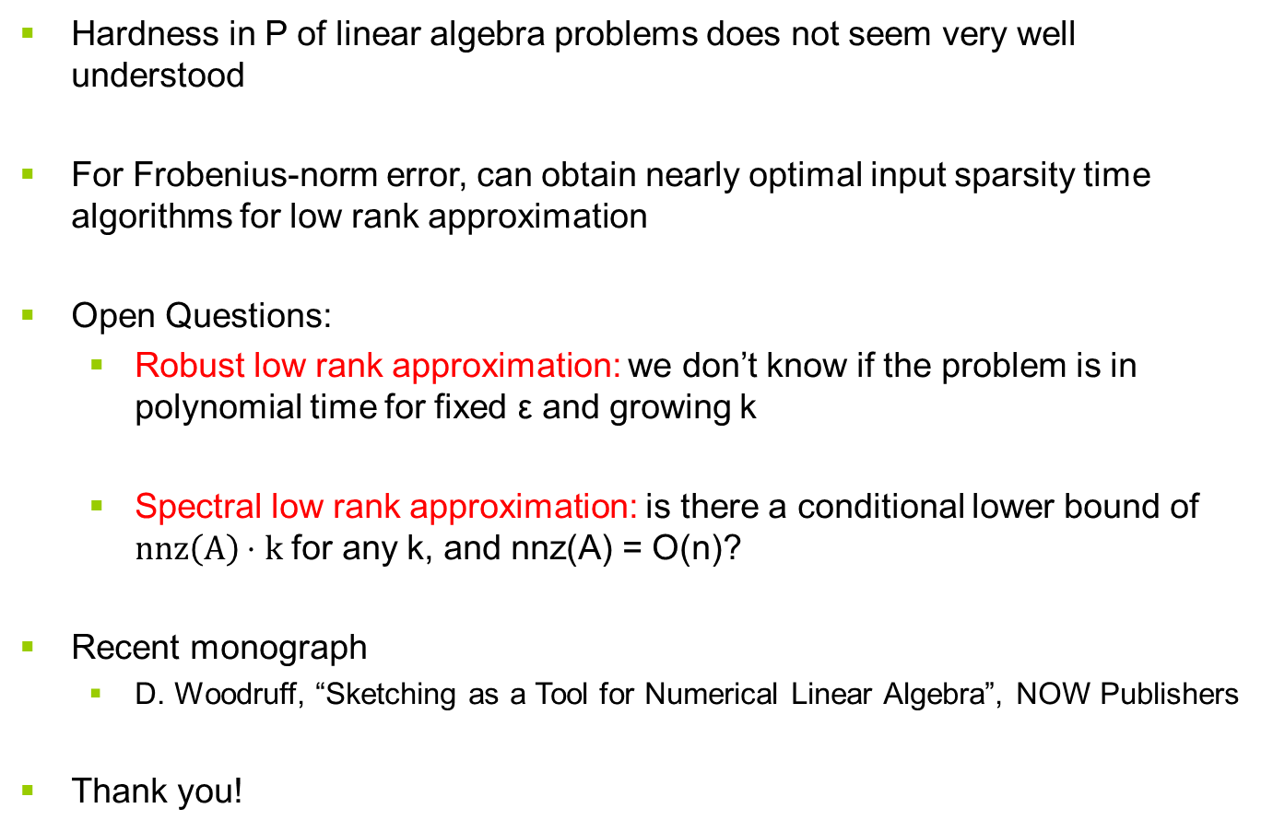
Conclusion
Hardness in P of linear algebra problems does not seem very well understood
For Frobenius-norm error, can obtain nearly optimal input sparsity time algorithms for low rank approximation
Open Questions:
  Robust low rank approximation: we don’t know if the problem is in polynomial time for fixed ε and growing k
  Spectral low rank approximation: is there a conditional lower bound of $nnz\left(A\right)⋅k$ for any k, and nnz(A) = O(n)?
Recent monograph
  D. Woodruff, “Sketching as a Tool for Numerical Linear Algebra”, NOW Publishers
Thank you!

