Slide 1
Algorithmic Game Theory & Machine Learning Christos Papadimitriou

Slide 2
AGT’s three recent brushes with ML
Classification when the data are strategic (with Hardt, Megiddo, Wootters, ITCS 2016)
Statistical learning when the data sources are strategic (with Cai, Daskalakis, COLT 2015)
A theorem in Topology as solution concept (with Georgios Piliouras, ITCS 2016)

Slide 3
1. Classification when the data are strategic
Fact: The number of books in the household is an excellent predictor of success in college – actually, a bit better than grades
So, an admissions classifier should use this!

Slide 4
Problem:
classifier
grades
books

Slide 5
The data are strategic!
Applicants will buy enough books to get in
(Or will invest unreasonable money and effort to improve their SATs, or …)
(Assume they know your classifier)
As long as their utility of admission covers this expense

Slide 6
So, you may have to…
grades
books

Slide 7
But of course…
This way you will misclassify a different set…
(and inconvenience many...)
Suppose applicants have the same utility ±1, and same cost c(x,y) ≥ 0 of moving from x to y
You want to maximize the (expected)
score = #correctly classified - # misclassified

Slide 8
Stackelberg!
Given: Data, cost function, ideal classifier h…
…come up with modified classifier h*…
…such that, when the data respond by moving to the closest admitted point…
(if cost of moving < 2, recall utility = ±1)
…the best score is achieved
Call this theoretical full-information maximum optscore

Slide 9
Our goal in classification
Given data space X,
distribution D on X,
target classification h: X → ±1 ,
sample m points from D labeled by h
based in these, construct in poly time (poly in m, 1/ε, log 1/δ) a classifier f: X → ±1
such that with probability 1 – δ the expected score of any new sample is within ε of optscore

Slide 10
Hard problem even with nonstrategic data
Distribution and concept class must have low “classification complexity”
e.g., VC dimension, Rademacher complexity
and then the problem must be polynomial-time learnable

Slide 11
Surprise: strategic data is “easier” to classify!
Theorem: If the cost function is separable, then we can classify strategic points within ε of the theoretical optscore as long as the distribution and concept class have low classification complexity
Note: No computational complexity constraint!

Slide 12
Separable cost functions
c(x,y) = f(y) – g(x)₊
Example: <β , y – x >₊
In fact, same theorem if c is the minimum of a finite number of k separable functions
“Bounded separability dimension”
Complexity ≈ m^{k+1}
NB: For simple metrics (unbounded k) even the full information problem is NP-complete

Slide 13
How come?
Suppose c(x,y) = < β , y – x >₊
Your optimal, but
computationally complex,
Stackelberg classifier
The vector β
There is a linear
(and thus comp’ly easy)
Stackelberg classifier
that does as well!

Slide 14
AGT’s three recent brushes with ML
Classification when the data are strategic (with Hardt, Megiddo, Wootters, ITCS 2016)
Statistical learning when the data sources are strategic (with Cai, Daskalakis, COLT 2015)
A theorem in Topology as solution concept (with Georgios Piliouras, ITCS 2016)

Slide 15
2. Strategic Data Sources
Context: Statistical estimation
There is a ground truth function F(x)
You estimate it from data points (x_{i},y_{i})
You get the data points from workers
Each worker i has a convex function σ_{i}
With effort e ≥ 0 from x she finds y = F(x) in expectation with variance [σ_{i} (e)]²

Slide 16
Meet the agents
You (the Statistician) have a way, from data {x_{i},y_{i}}, to find an approximation G of F
(Think linear regression, much more general)
Your loss is L = E_{x~D} [(F(x) – G(x))²]
Assumption: L depends only on {x_{i}}, D, {σ_{i}}
(Not on F; estimation is unbiased)
Plus payments to workers, Σ_{i} p_{i}
Each worker i wants to minimize e_{i} – p_{i}

Slide 17
Social Optimum
OPT = min _{W’, x, e} [ L({x_{i}}, D, {e_{i}}) + Σ_{i} e_{i} ]
Notice that OPT is your (the Statistician’s) wildest dream of a total loss
It means that you have persuaded the workers to exert optimum (for you) effort with no surplus (can’t do better because of IR)

Slide 18
Surprise: It can be achieved!
Theorem: There is a mechanism which achieves “your wildest dream” loss OPT in dominating strategiesas dominant strategy equilibrium
Trick: Promise payments
p_{i} = A_{i} – B_{i} (y_{i} – G_{-i} (x_{-i}))²
zero
surplus
optimum
effort

Slide 19
Caveat
This means that the incentive problem can be solved, essentially by a powerful contract
What is less clear is how to solve the computational problem – how to compute OPT
Btw, if the x_{i}’s are given, even ridge regression can be managed the same way

Slide 20
AGT’s three recent brushes with ML
Classification when the data are strategic (with Hardt, Megiddo, Wootters, ITCS 2016)
Statistical learning when the data sources are strategic (with Cai, Daskalakis, COLT 2015)
A theorem in Topology and solution concepts (with Georgios Piliouras, ITCS 2016)

Slide 21
3. Solution Concepts from the Topology of Learning in Games
Fact: Learning dynamics usually fail to find the Nash equilibrium
Is this bad news for learning dynamics?
Or for Nash equilibrium?
In particular, can we view learning dynamics as a novel solution concept?
“learning dynamics” ≈ “replicator dynamics”

Slide 22
Basic idea
The asymptotic behavior of the dynamics
Generalizes the Nash equilibrium
Coarse correlated equilibria are “achieved” this way
(But suppose we are more interested in behavior, not in performance)
What other behaviors are there besides equilibria? Limit cycles perhaps?

Slide 23
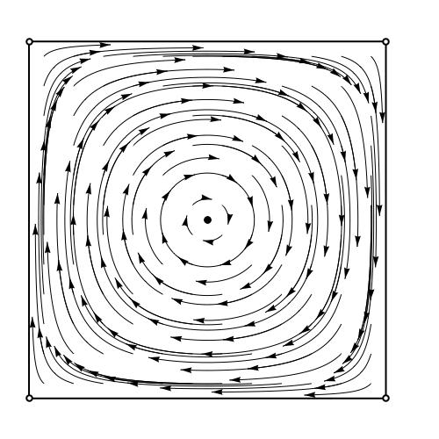
Basic idea seems to work: matching pennies

Slide 24
Basic idea seems to work (cont.): coordination

Slide 25
Basic Idea does not work! The dynamics (of even two-player games) can be chaotic…

Slide 26
Conley to the Rescue
Chain Recurrent Set:
“Almost” limit cycle
Can be turned to a cycle by finitely many, arbitrarily small jumps
Fundamental Theorem of Dynamical Systems [Conley 1984]: Any dynamical system ends up in some chain recurrent set, drawn there by a Lyapunov function

Slide 27
One CRS

Slide 28
Five CRS’s

Slide 29
The CRS structure of a game
The CRSs of a game form a DAG
The matching pennies DAG:
The coordination game DAG:
(0.5, 2) (0.5, 2)
Probabilities and scores of sink nodes determine expected performance of dynamics
Work in progress: characterization of CRS’s for 2-player games

Slide 30
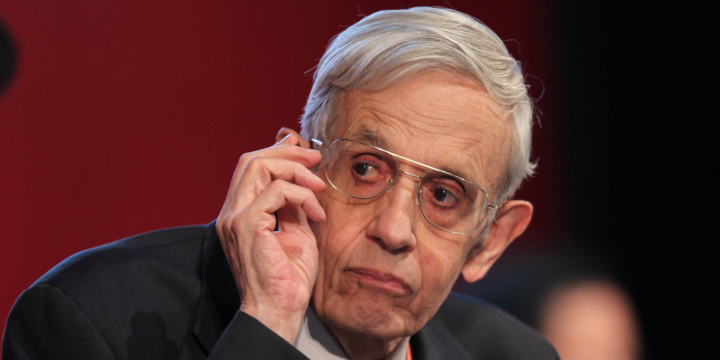
Bottom line
John Nash based his
solution concept on the
most sophisticated theorem
in topology of his era
Shouldn’t we do the same?

Slide 31
Thank You!

