Slide 1
online Advertisements and online algorithms
Nikhil R. Devanur
Microsoft Research

Slide 2
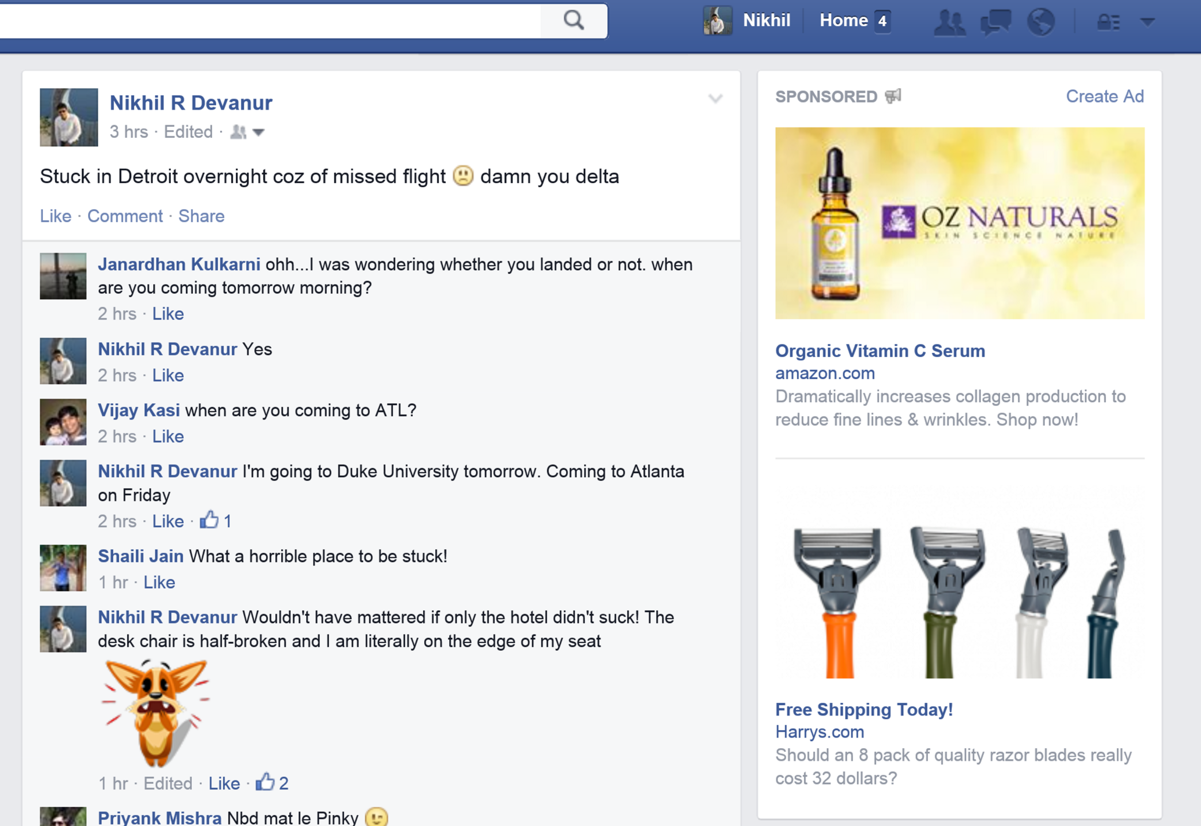
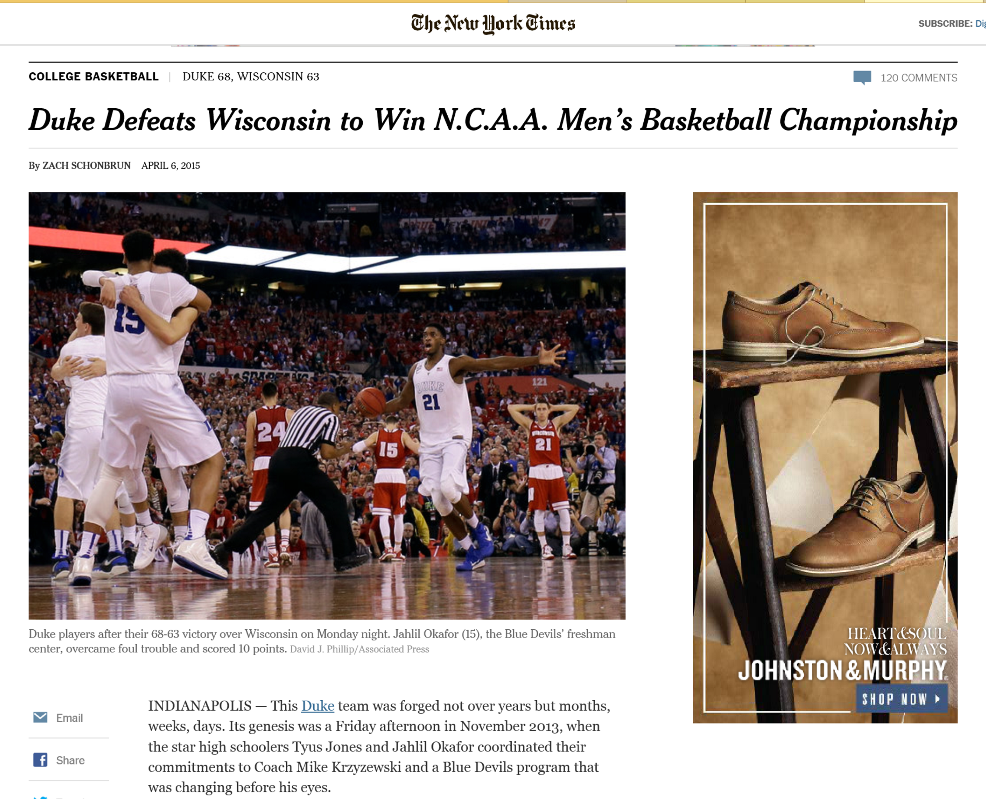
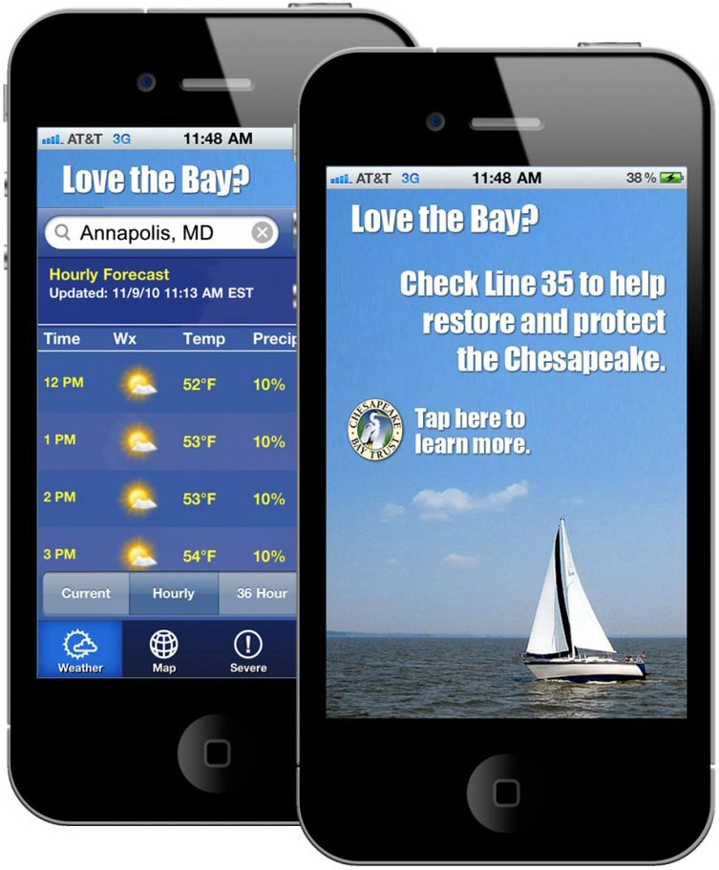
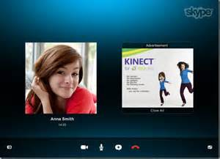
Online advertising

Slide 3
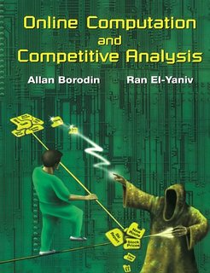
Online algorithms
List accessing, Caching, k-server, load balancing, call admission, circuit routing, ….
Decision making under uncertainty
Modern developments
1998

Slide 4
1. Adwords. mehta, saberi, vazirani, vazirani, 2005. aka online budgeted allocation
Big Simplification!!!
No game theory
Purely optimization
$$1$$
$$2$$
$$i$$
$$T$$
Queries $(T)$
. . .
. . .
$$b_{ia}$$
Advertisers $(n)$
. . .
. . .
$$1$$
$$2$$
$$a$$
$$n$$
Spend $≤B_{a}$
Objective: Maximize $\sum_{a}{\min\left\{\sum_{i:i→a}{b_{ia}}, B_{a}\right\} }$
Greedy Algorithm: ½ of optimum

Slide 5
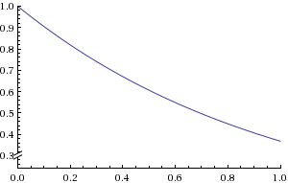
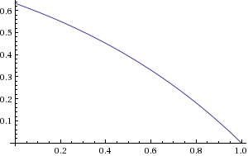
1. Adwords. mehta, saberi, vazirani, vazirani, 2005. aka online budgeted allocation
Balance Algorithm
Allocation rule: $i→\arg{\max_{a}{ \left\{b_{ia}\left(1−α_{a}\right)\right\}}}$
$$α_{a}=e^{−}$$
$$e^{−x}$$
Unspent fraction of budget of $a$
Worst-case performance guarantee
Competitive Ratio = $1−\frac{1}{e}$ (tight)
Bid to budget ratio is small
$$1−e^{−(1−x)}$$

Slide 6
2. Primal-Dual. Buchbinder, Jain, Naor, 2005.
LP relaxation:
$$\max{\sum_{i,a}{b_{ia}}x_{ia}}$$
$∀ a$ $\sum_{i}{b_{ia}x_{ia}}$ $≤$ $B_{a}$
$∀ i$ $\sum_{a}{x_{ia} }$ $≤$ $1$
$$∀ i,a x_{ia} ≥ 0$$
Dual LP :
$$\min{\sum_{a}{B_{a}α_{a} }+\sum_{i}{β_{i}}}$$
$∀ i,a$ $α_{a}b_{ia}+β_{i} ≥b_{ia}$
$$∀ i,a α_{a},β_{i} ≥ 0$$
Fix $i, ∀ a, β_{i}≥b_{ia}\left(1−α_{a}\right)⇔β_{i}≥\max_{a}\left\{b_{ia}(1−α_{a})\right\}$
Complementary slackness condition: $x_{ia}>0⇒β_{i}=b_{ia}(1−α_{a})$
Same allocation rule: $i→\arg{\max_{a}{ \left\{b_{ia}\left(1−α_{a}\right)\right\}}}$

Slide 7
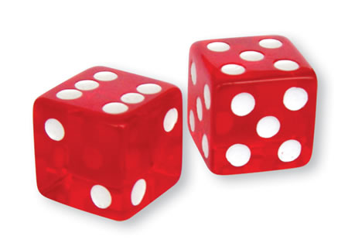
3. Stochastic Model. D, hayes, 2009.
Input comes from some distribution, unknown to the algorithm.
Worst case over all distributions in some class.
IID
Random order
Training:
learn duals
Use dual based alloc.
$$εT$$
$$\left(1−ε\right)T$$
Competitive Ratio $→1$ as bid/budget $→0$
CR = $1−ε$ if bid/budget $≤c\frac{ε^{3}}{\begin{aligned}n\log{n } \\ \end{aligned}}$

Slide 8
3. Stochastic Model. D, hayes, 2009.
Agrawal, Wang, Ye, 2010
Repeat as #samples doubles
CR = $1−ε$ if bid/budget $≤c\frac{ε^{2}}{\begin{aligned}n\log{n } \\ \end{aligned}}$
Agrawal, Wang, Ye & Feldman, Henzinger, Korula, Mirrokni, Stein, 2010
Generalized to a wide class of “Packing” problems.
$$εT$$

Slide 9
Display Ads optimization aka online weighted matching
$$1$$
$$2$$
$$i$$
$$T$$
Impressions $(T)$
. . .
. . .
$$v_{ia}$$
Advertisers $(n)$
. . .
. . .
$$1$$
$$2$$
$$a$$
$$n$$
Capacity $≤C_{a}$
Objective: Maximize $\sum_{a,i:i→a }{v_{ia}}$
Very close to the actual problem: “guaranteed delivery”
Dual based allocation: $i→\arg{\max\left\{v_{ia}−α_{a}\right\}}$: put in practice

Slide 11
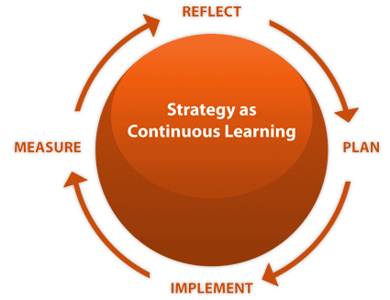
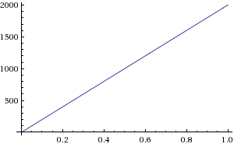
4. Continuous learning. D, Jain, Sivan, Wilkens, 2011.
Not reactive enough
Solving big LPs is not fast
Distribution not stationary
Continuously update duals
Converge faster
Adapt to changes
For $t=1..T,$
$α_{a}\left(t+1\right)=α_{a}\left(t\right)\exp\left(λ\left(\frac{{spend}_{a}\left(t\right)}{B_{a}}−\frac{1}{T}\right)\right)$
Optimal convergence rate: $1−ε$ CR when bid/budget $≤\frac{ε^{2}}{\log{n }}$

Slide 12
4. Continuous learning. D, Jain, Sivan, Wilkens, 2011.
Adversarial Stochastic Input (ASI)
Each time step a different distribution$𝒟_{t}$
$𝒟_{t}$ unknown to the algorithm
Either $OP{T(D}_{t})$ is always high,
or know $C_{at}$= exp. rate of consumption: learnt from historic data
Special case: I.I.D with unknown distributions: $𝒟_{t}=𝒟$
Used at Microsoft
Simple too!

Slide 13
5. No-Regret Learning. Agrawal, D, 2015.
Conjectured connection to experts problem aka no-regret learning in MSVV, 2007.
$∀ t,$ pick $1$ out of $n$ experts, then see rewards of all experts
No-regret: reward of algo $≥$ reward of best expert - $\sqrt{T\log{n}}$
Normalization
$α_{a}$s
probabilities
Online BA
Experts
rewards $=\left\{\begin{matrix}b_{ia}−\frac{B_{a}}{T}⇐a won \\ −\frac{B_{a}}{T}⇐o.w.\end{matrix}\right.$

Slide 14
5. No-Regret Learning. Agrawal, D, 2015.
More Desiderata
Non-linear penalties for ``under-delivery"
Advertisers require a mixture of different impression types
Multiple types of value objective -- revenue, relevance, clicks, conversions, etc.
Can be modeled as
concave objective function/convex constraints

Slide 15
Generalizations
Combinatorial constraints: multiple ads on page
Kapralov, Post, Vondrak, 2013
D, Huang, Korula, Mirrokni, Yan, 2013
Korula, Mirrokni, Zadimoghaddam, 2015
Mixing worst case + stochastic
Mahdian, Nazerzadeh, Saberi, 2007
Mirrokni, OviesGharan, ZadiMoghaddam, 2012
Efsindiari, Korula, Mirrokni, 2015
Multiple objectives: Revenue, relevance, etc.
Korula, Mirrokni, Zadimoghaddam, 2013

Slide 16
Game theory

Slide 17
Fluid mean field equilibria Balseiro, Besbes, Weintraub, 2013.
Display Ad Exchanges: Each impression is sold via a 2nd price auction
Maximum competing bid: $D_{a}≡\max\left\{a^{′}≠a :β_{a′}\left(v_{a′}\right)\right\}$
Bid functions
$β_{a}:v⟼$ bid
Bid landscape ${∀a, D}_{a}$
Best-response: max utility, s.t. budget in exp.
Optimal stategy: $β_{a}\left(v\right)=\left(1−α_{a}\right)v$
Bid lowering in search ad auctions: Karande, Mehta, Srikant 2013

Slide 18
Throttling in search ads. Chakrabarty, Charles, chickering, D, wang, 2013.
Selectively participate in GSP auctions
Don’t change bids
Given $θ_{a} ∀a,$ find ad slate satisfying ROI conditions
Equilibrium Exists + Heuristics to converge to
All competing bids
Thresholds
$θ_{a}:$ participate iff ROI $= v_{a}/p_{a}≥θ_{a}$
Bid landscape ${∀a, D}_{a}$
Best-response: max utility, s.t. budget.

Slide 19
Online mechanism design
Design auction for repeated allocation
Advertisers present at start, submit all bids
Supply uncertain
Allocations online, payment online/at the end
Single item, multiple copies, unknown number of copies
Babaioff, Blumrosen, Roth, 2009 – maximize welfare, prompt payments, $O(\log{n) }$vs. $Ω(\log{\log{n}) }$approx
D, Hartline, 2009 – revenue, payments at the end, $O(1)$ approx
Goel, Paes Leme, Mirrokni, 2013 – Budget constraints, Pareto optimal

Slide 20
Online mechanism design
2 items
2 bidders,
Item 1 arrives first
Item 2 may or may not arrive
Payment at the end.
Maximize welfare
Worst Case Approximation by Truthful Auctions?
$∞^{∗}$
Always allocate both items $⇒$ No truthful mechanism
D, Syrgkanis, Sivan 2015
* Deterministic Mechanisms

Slide 21
summary
Non game theoretic, online allocation problem
Highest discounted value
$≡$Dual based allocation
Continuous learning $≡$ dual updating algorithms, designed for suitable stochastic models, work well in practice
Game theory + online allocation
Fix auction format + Equilibrium of this game
Bid lowering vs. throttling
Impossible to be truthful even in very simple settings
Truthful + asymptotically optimal in a suitable stochastic setting?

Slide 22
Thank you!

