Slide 1
Dense Subset Sum May be the Hardest
Joint work with Per Austrin, Petteri Kaski and Mikko Koivisto.
Jesper Nederlof
Technical University Eindhoven

Slide 2
Background
Contribution
Further Remarks

Slide 3











Complexity of NPC problems
Knapsack
Hamiltonicity
CNF-Sat
Steiner Tree
Circuit Sat
Subset Sum

Slide 4



Complexity of NPC problems
SETH
(Strong ETH)
?
?
ETH
(Exponential Time Hypothesis)
Equivalent!
N, van Leeuwen,
van der Zwaan
(MFCS’12)
P ≠ NP
Knapsack
Hamiltonicity
CNF-Sat
Steiner Tree
Circuit Sat
Subset Sum

Slide 5
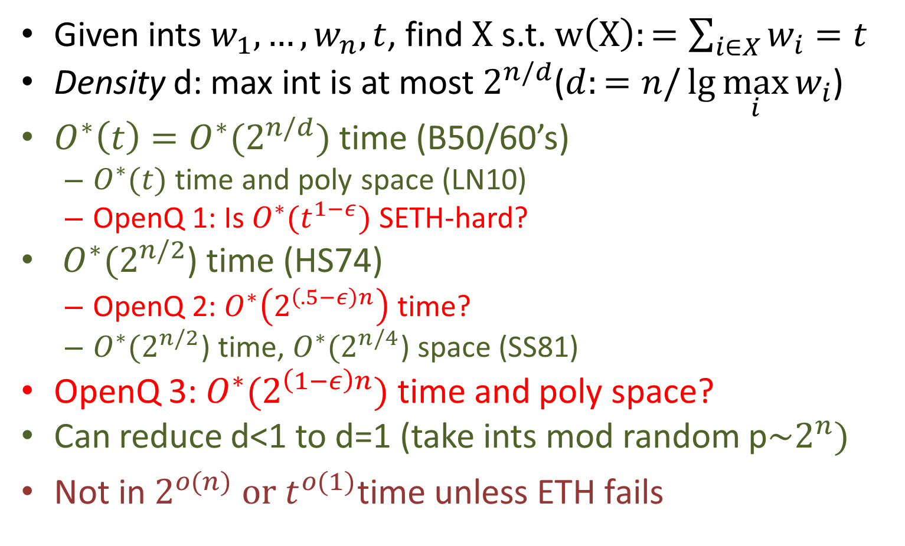
*allowing Monte Carlo algorithms
Worst Case Subset Sum*
Given ints $w_{1},…,w_{n}, t$, find $X$ s.t. $w\left(X\right):=\sum_{i∈X}{w_{i}}=t$
Density d: max int is at most $2^{n/d}$($d:=n/\lg{{\max_{i}{w}}_{i}}$)
$O^{∗}\left(t\right)=O^{∗}(2^{n/d})$ time (B50/60’s)
  $O^{∗}(t)$ time and poly space (LN10)
  OpenQ 1: Is $O^{∗}(t^{1−ε})$ SETH-hard?
$O^{∗}{(2}^{n/2}$) time (HS74)
  OpenQ 2: $O^{∗}\left(2^{\left(.5−ε\right)n}\right)$ time?
  $O^{∗}{(2}^{n/2}$) time, ${O^{∗}(2}^{n/4}$) space (SS81)
OpenQ 3: $O^{∗}(2^{\left(1−ε\right)n})$ time and poly space?
Can reduce d<1 to d=1 (take ints mod random p$\sim 2^{n})$
$\text{Not} \text{in} 2^{o(n)} \text{or}{ t}^{o(1)}\text{time} \text{unless} \text{ETH} \text{fails}$
Possible under NSETH?

Slide 6
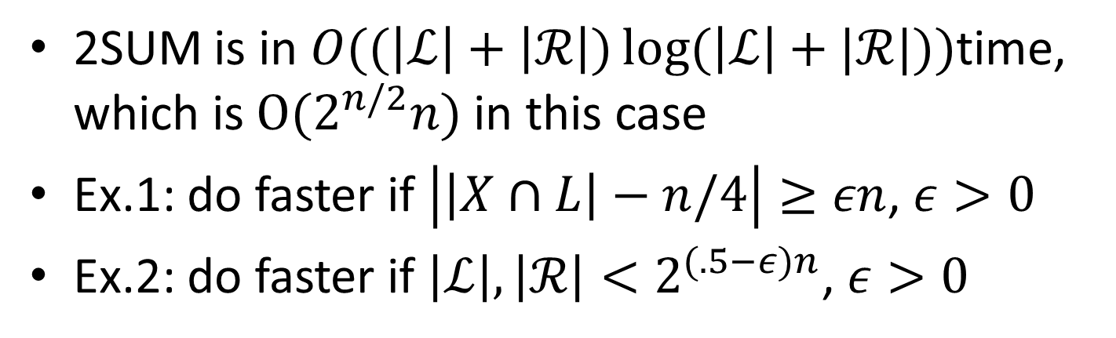
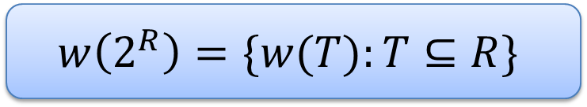
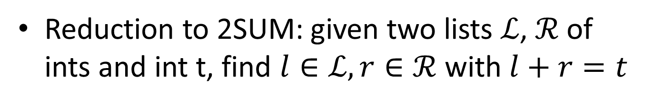
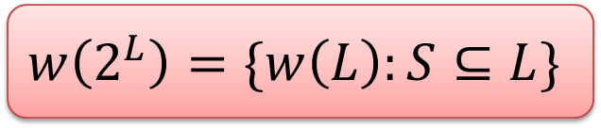



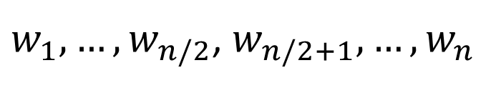

Horowitz-Sahni
Reduction to 2SUM: given two lists $ℒ$, $ℛ$ of ints and int t, find $l∈ℒ,r∈ℛ$ with $l+r=t$
$$L$$
$$R$$
$w_{1},…,w_{n/2}$, $w_{n/2+1},…,w_{n}$
$$ℒ$$
Expand all subsets
and store sum
$$ℛ$$
$$w\left(2^{L}\right)=\{w\left(L\right):S⊆L\}$$
$$w\left(2^{R}\right)=\{w(T):T⊆R\}$$
2SUM is in $O((\left|ℒ\right|+\left|ℛ\right|)\log{(\left|ℒ\right|+|ℛ|)})$time, which is $O(2^{n/2}n)$ in this case
Ex.1: do faster if $\left|\left|X∩L\right|−n/4\right|≥εn$, $ε>0$
Ex.2: do faster if $\left|ℒ\right|,\left|ℛ\right|<2^{(.5−ε)n}\text{, }ε>0$

Slide 7

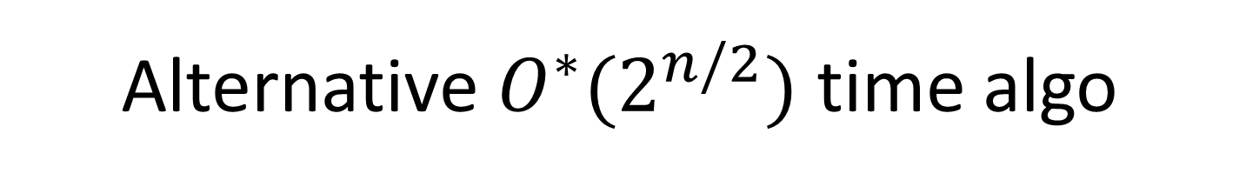
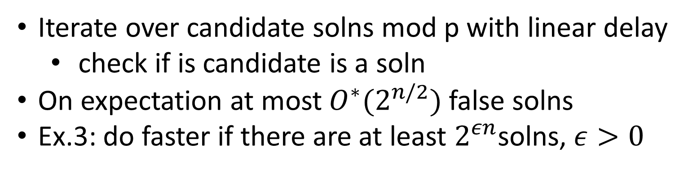
Alternative $O^{∗}(2^{n/2})$ time algo
Pick a prime p of order ${\sim 2}^{n/2}$
Build DP table counting sets summing to t mod p
 | 0 | 1 | 2 | 3 | .. | .. | n
0
1
..
t
…
p-1
Iterate over candidate solns mod p with linear delay
  check if is candidate is a soln
On expectation at most $O^{∗}(2^{n/2})$ false solns
Ex.3: do faster if there are at least $2^{εn}$solns, $ε>0$

Slide 8
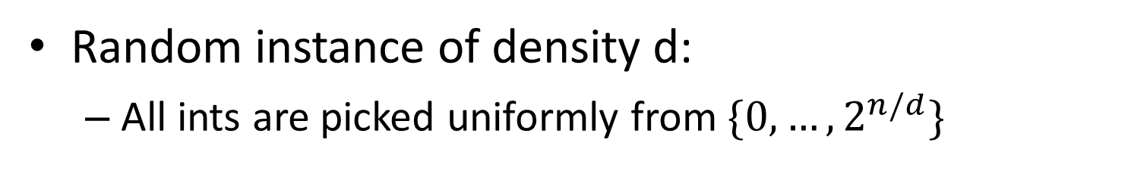
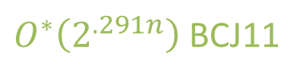
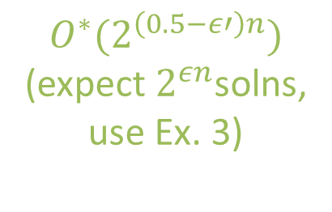

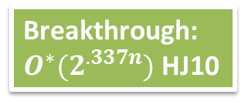
Average Case Subset Sum
Random instance of density d:
  All ints are picked uniformly from $\{{0,…,2}^{n/d}\}$
<.96
1
$$n/\log^{2}{n}$$
Can reduce
Can reduce (IN96)
Fast in practice
reduce to SVP (CJLOSS92)
poly time
(FP06)
Breakthrough:
$O^{∗}(2^{.337n})$ HJ10
$${O^{∗}(2}^{\left(0.5−ε′\right)n})$$
(expect $2^{εn}$solns,
use Ex. 3)
$O^{∗}\left(2^{.291n}\right)$ BCJ11

Slide 9
Why want to improve HS?
Fundamental problems (subset sum, knapsack)
Subset Sum motivated by cryptography
Knapsack motivated by operations research
HS (`meet in the middle’) works at several other places
HJ give interesting new algorithmic insight, want to see what is gives for the worst case

Slide 10
Background
Contribution
Further Remarks

Slide 11
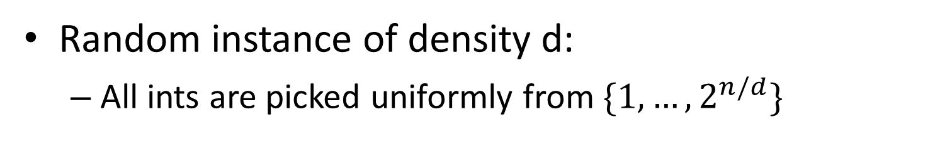

Average Case Subset Sum
Random instance of density d:
  All ints are picked uniformly from $\{{1,…,2}^{n/d}\}$
<.96
1
1.003
$$n/\log^{2}{n}$$
Can reduce
Can reduce (IN96)
Fast in practice
reduce to SVP (CJLOSS92)
poly time
(FP06)
Breakthrough:
$O^{∗}(2^{.337n})$ HJ10
$${O^{∗}(2}^{\left(0.5−ε′\right)n})$$
(expect $2^{εn}$solns,
use ex. 3)
$O^{∗}\left(2^{.291n}\right)$ BCJ11

Slide 12

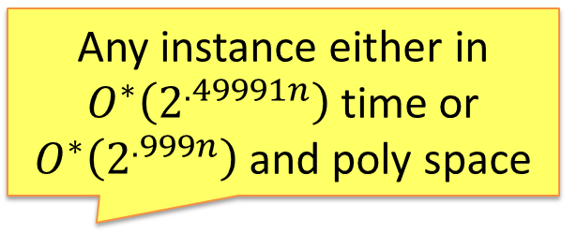
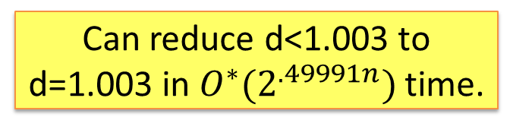
*allowing Monte Carlo algorithms
Worst Case Subset Sum*
Given ints $w_{1},…,w_{n}, t$, find $X$ s.t. $w\left(X\right):=\sum_{i∈X}{w_{i}}=t$
Density d: max int is at most $2^{n/d}$($d:=n/\lg{{\max_{i}{w}}_{i}}$)
$O^{∗}\left(t\right)=O^{∗}(2^{n/d})$ time (B50/60’s)
  $O^{∗}(t)$ time and poly space (LN10)
  OpenQ 1: $O^{∗}(t^{1−ε})$ under SETH?
$O^{∗}{(2}^{n/2}$) time (HS74)
  OpenQ 2: $O^{∗}\left(2^{\left(.5−ε\right)n}\right)$ time?
  $O^{∗}{(2}^{n/2}$) time, ${O^{∗}(2}^{n/4}$) space (SS81)
OpenQ 3: $O^{∗}(2^{\left(1−ε\right)n})$ time and poly space?
Can reduce d<1 to d=1 (take ints mod random p$\sim 2^{n})$
$\text{Not} \text{in} 2^{o(n)} \text{or}{ t}^{o(1)}\text{time} \text{unless} \text{the} \text{ETH} \text{fails}$
Can reduce d<1.003 to d=1.003 in $O^{∗}(2^{.49991n})$ time.
Any instance either in $O^{∗}\left(2^{.49991n}\right)$ time or $O^{∗}\left(2^{.999n}\right)$ and poly space

Slide 13
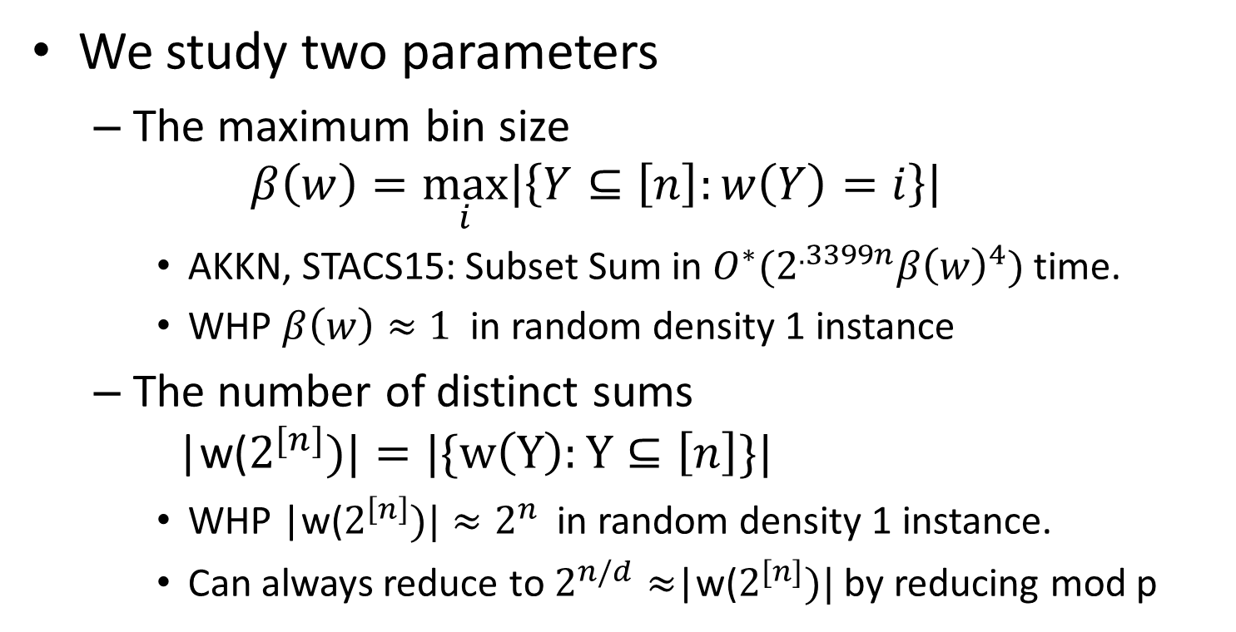
Our Approach
We study two parameters
  The maximum bin size
  $β\left(w\right)=\max_{i}\left|\left\{Y⊆\left[n\right]:w\left(Y\right)=i\right\}\right|$
    AKKN, STACS15: Subset Sum in $O^{∗}(2^{.3399n}β{\left(w\right)}^{4})$ time.
    WHP $β\left(w\right)≈1$ in random density 1 instance
  The number of distinct sums
  |w($2^{[n]})|=|\{w\left(Y\right):Y⊆\left[n\right]\}|$
    WHP $\text{|}\text{w}\text{(}2^{\left[n\right]})|≈2^{n}$ in random density 1 instance.
    Can always reduce to $2^{n/d}≈$|w($2^{[n]})|$ by reducing mod p

Slide 14
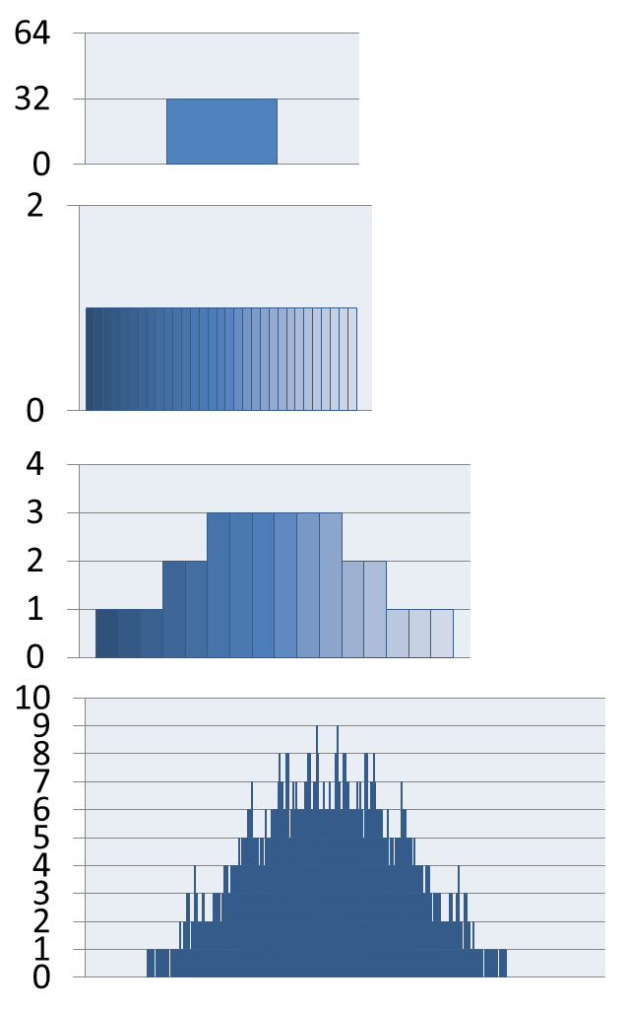
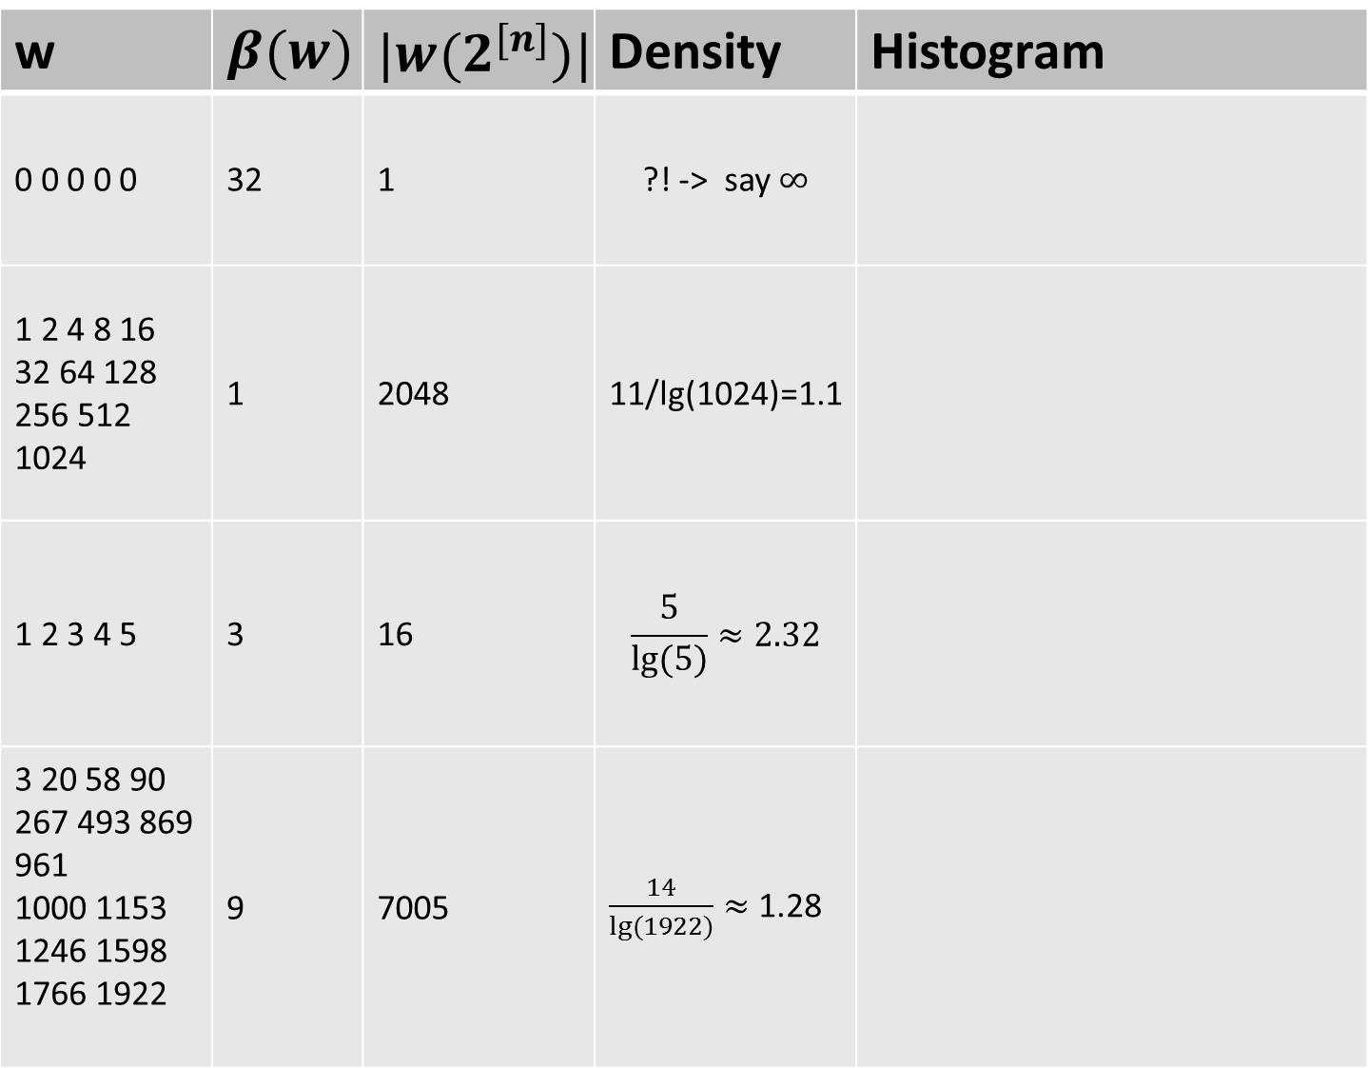
w | $$β(w)$$ | ${|w(2}^{[n]})|$ | Density | Histogram
0 0 0 0 0 | 32 | 1 | ?! -> say $∞$
1 2 4 8 16 32 64 128 256 512 1024 | 1 | 2048 | 11/lg(1024)=1.1
1 2 3 4 5 | 3 | 16 | $$\frac{5}{lg⁡(5)}≈2.32$$
3 20 58 90 267 493 869 961 1000 1153 1246 1598 1766 1922 | 9 | 7005 | $\frac{14}{lg⁡(1922)}≈$ 1.28

Slide 15

novel connection to `Uniquely Decodable Code Pairs’
mix of HS and HJ, combined with WIN-WIN approach
Our Approach
Instances satisfying at least one of the following can be solved truly faster than HS.
  There exists $ε>0$ such that $β\left(w\right)<2^{\left(.5−ε\right)n},$
  $β\left(w\right)>2^{.661n},$
  $\left|w\left(2^{\left[n\right]}\right)\right|≥2^{.997n}$.
If $\left|w\left(2^{\left[n\right]}\right)\right|≥2^{.997n}$, then $β\left(w\right)<2^{.4996n}$.
Can reduce d<1.003 to d=1.003 in $O^{∗}(2^{.49991n})$ time
Any instance either in $O^{∗}(2^{.49991n})$ time or
$O^{∗}{(2}^{.999n})$ time and poly space
directly from 1a & 2
1c & reducing mod p.
3&LN10

Slide 16
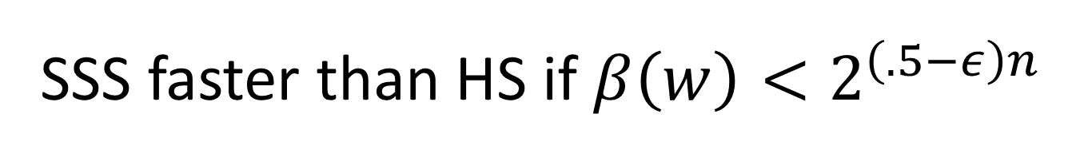

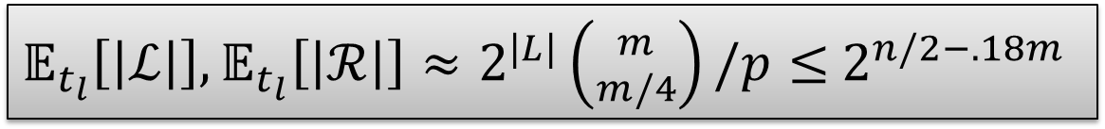
SSS faster than HS if $β\left(w\right)<2^{\left(.5−ε\right)n}$
Let $L\dot{∪}M\dot{∪}R=\left[n\right], \left|L\right|=\left|R\right|;\left|M\right|=m$. Assume
  |$M∩X|∈(.5±ε_{2})|M|$,
  |$w(2^{M∩X})$|$≥2^{\left(1−ε_{3}\right)|M∩X|}$.
Pick prime $p≈2^{m/2}$ and ${t_{L}∈ℤ}_{p}$ u.a.r.; Construct
  $ℒ≔ \{S∈2^{L∪M}:\left|M∩S\right|=|M|/4∧w\left(S\right)≡_{p}t_{l}\}$
  $ℛ≔ \{T∈2^{R∪M}:\left|M∩T\right|=|M|/4∧w\left(T\right)≡_{p}t−t_{l}\}$
Construct $ℒ_{i}:=\{S∈ℒ:w\left(S\right)=i\}$, and similarly $ℛ_{i}$
Return YES iff exists disjoint $\left(S,T\right)∈ℒ_{i}×ℛ_{t−i}$
use ex. 1 (easy).
use ex. 2 (non-trivial)
$𝔼_{t_{l}}\left[\left|ℒ\right|\right],𝔼_{t_{l}}\left[\left|ℛ\right|\right]≈2^{|L|}\left({m \atop m/4}\right)/p≤$ $2^{n/2−.18m}$

Slide 17
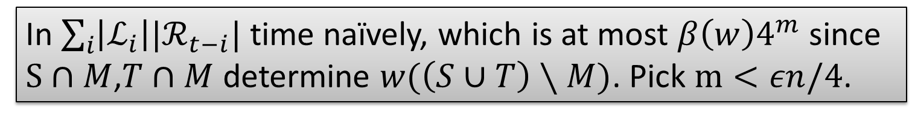
SSS faster than HS if $β\left(w\right)<2^{\left(.5−ε\right)n}$
Let $L\dot{∪}M\dot{∪}R=\left[n\right], \left|L\right|=\left|R\right|;\left|M\right|=m$. Assume
  |$M∩X|∈(.5±ε_{2})|M|$,
  |$w(2^{M∩X})$|$≥2^{\left(1−ε_{3}\right)|M∩X|}$.
Pick prime $p≈2^{m/2}$ and ${t_{L}∈ℤ}_{p}$ u.a.r.; Construct
  $ℒ≔ \{S∈2^{L∪M}:\left|M∩S\right|=|M|/4∧w\left(S\right)≡_{p}t_{l}\}$
  $ℛ≔ \{T∈2^{R∪M}:\left|M∩T\right|=|M|/4∧w\left(T\right)≡_{p}t−t_{l}\}$
Construct $ℒ_{i}:=\{S∈ℒ:w\left(S\right)=i\}$, and similarly $ℛ_{i}$
Return YES iff exists disjoint $\left(S,T\right)∈ℒ_{i}×ℛ_{t−i}$
In $\sum_{i}{\left|ℒ_{i}\right||ℛ_{t−i}|}$ time naïvely, which is at most $β\left(w\right)4^{m}$since $S∩M$,$T∩M$ determine $w(\left(S∪T\right)∖M)$. Pick $m<εn/4$.

Slide 18
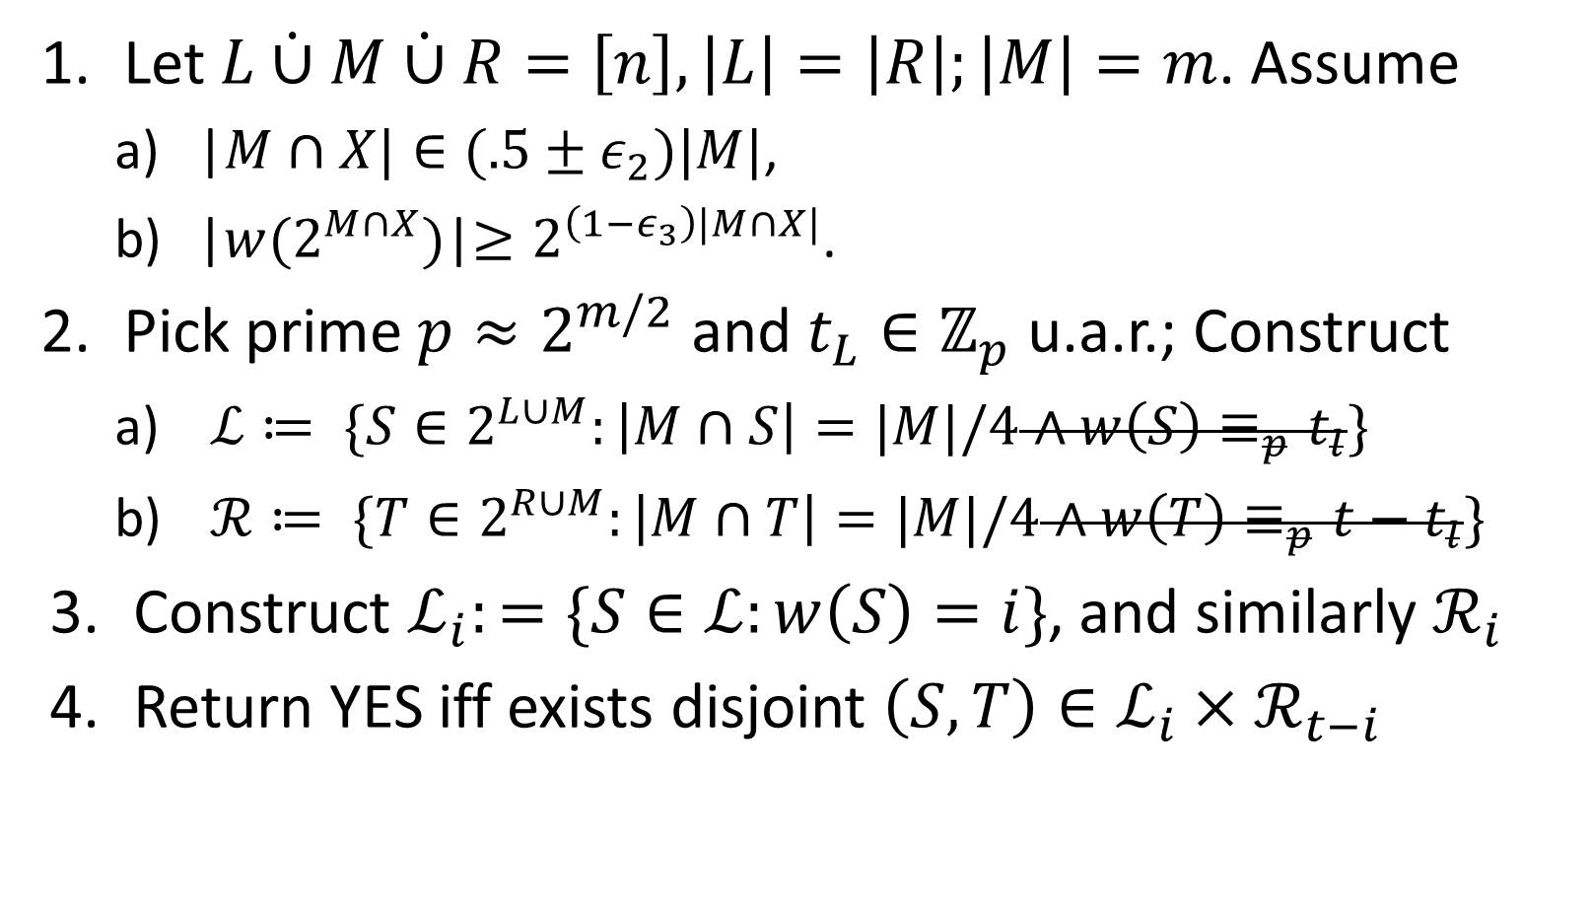
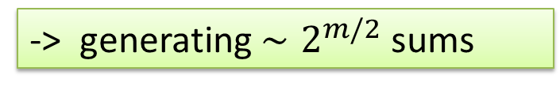
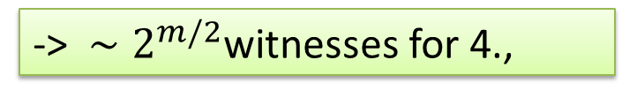
SSS faster than HS if $β\left(w\right)<2^{\left(.5−ε\right)n}$
Let $L\dot{∪}M\dot{∪}R=\left[n\right], \left|L\right|=\left|R\right|;\left|M\right|=m$. Assume
  |$M∩X|∈(.5±ε_{2})|M|$,
  |$w(2^{M∩X})$|$≥2^{\left(1−ε_{3}\right)|M∩X|}$.
Pick prime $p≈2^{m/2}$ and ${t_{L}∈ℤ}_{p}$ u.a.r.; Construct
  $ℒ≔ \{S∈2^{L∪M}:\left|M∩S\right|=|M|/4∧w\left(S\right)≡_{p}t_{l}\}$
  $ℛ≔ \{T∈2^{R∪M}:\left|M∩T\right|=|M|/4∧w\left(T\right)≡_{p}t−t_{l}\}$
Construct $ℒ_{i}:=\{S∈ℒ:w\left(S\right)=i\}$, and similarly $ℛ_{i}$
Return YES iff exists disjoint $\left(S,T\right)∈ℒ_{i}×ℛ_{t−i}$
-> $∼2^{m/2}$witnesses for 4.,
-> generating $∼2^{m/2}$ sums

Slide 19
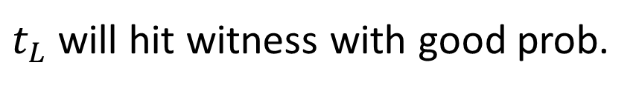
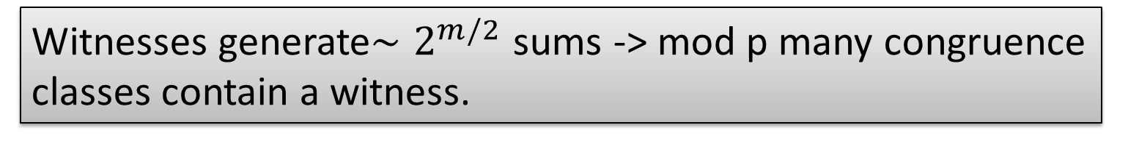
SSS faster than HS if $β\left(w\right)<2^{\left(.5−ε\right)n}$
Let $L\dot{∪}M\dot{∪}R=\left[n\right], \left|L\right|=\left|R\right|;\left|M\right|=m$. Assume
  |$M∩X|∈(.5±ε_{2})|M|$,
  |$w(2^{M∩X})$|$≥2^{\left(1−ε_{3}\right)|M∩X|}$.
Pick prime $p≈2^{m/2}$ and ${t_{L}∈ℤ}_{p}$ u.a.r.; Construct
  $ℒ≔ \{S∈2^{L∪M}:\left|M∩S\right|=|M|/4∧w\left(S\right)≡_{p}t_{l}\}$
  $ℛ≔ \{T∈2^{R∪M}:\left|M∩T\right|=|M|/4∧w\left(T\right)≡_{p}t−t_{l}\}$
Construct $ℒ_{i}:=\{S∈ℒ:w\left(S\right)=i\}$, and similarly $ℛ_{i}$
Return YES iff exists disjoint $\left(S,T\right)∈ℒ_{i}×ℛ_{t−i}$
-> $∼2^{m/2}$witnesses for 4.,
-> generating $∼2^{m/2}$ sums
Witnesses generate${∼2}^{m/2}$ sums -> mod p many congruence classes contain a witness.
$t_{L}$ will hit witness with good prob.

Slide 20
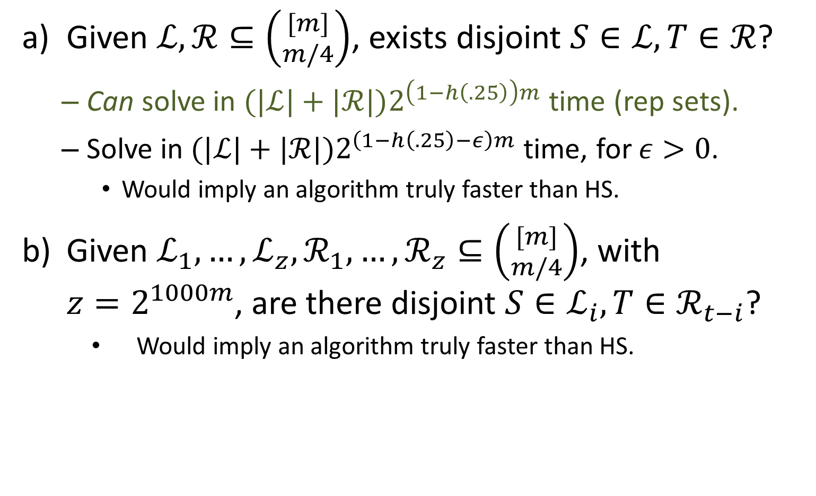
Open Question 4: Orthogonal Vectors
Given $ℒ,ℛ⊆\left({[m] \atop m/4}\right)$, exists disjoint $S∈ℒ,T∈ℛ$?
  Can solve in ${(|ℒ|+|ℛ|)2}^{\left(1−h\left(.25\right)\right)m}$ time (rep sets).
  Solve in ${(|ℒ|+|ℛ|)2}^{\left(1−h\left(.25\right)−ε\right)m}$ time, for $ε>0$.
    Would imply an algorithm truly faster than HS.
Given $ℒ_{1},…,ℒ_{z},ℛ_{1},…,ℛ_{z}⊆\left({[m] \atop m/4}\right)$, with $z=2^{1000m}$, are there disjoint $S∈ℒ_{i},T∈ℛ_{t−i}$?
    Would imply an algorithm truly faster than HS.

Slide 21
novel connection to `Uniquely Decodable Code Pairs’
mix of HS and HJ, combined with WIN-WIN approach
Our Approach
Instances satisfying at least one of the following can be solved truly faster than HS.
  There exists $ε>0$ such that $β\left(w\right)<2^{\left(.5−ε\right)n},$
  $β\left(w\right)>2^{.661n},$
  $\left|w\left(2^{\left[n\right]}\right)\right|≥2^{.997n}$.
If $\left|w\left(2^{\left[n\right]}\right)\right|≥2^{.997n}$, then $β\left(w\right)<2^{.4996n}$.
Can reduce d<1.003 to d=1.003 in $O^{∗}(2^{.49991n})$ time
Any instance either in $O^{∗}(2^{.49991n})$ time or
$O^{∗}{(2}^{.999n})$ time and poly space
directly from 1a & 2
1c & hashing.
3&LN10

Slide 22
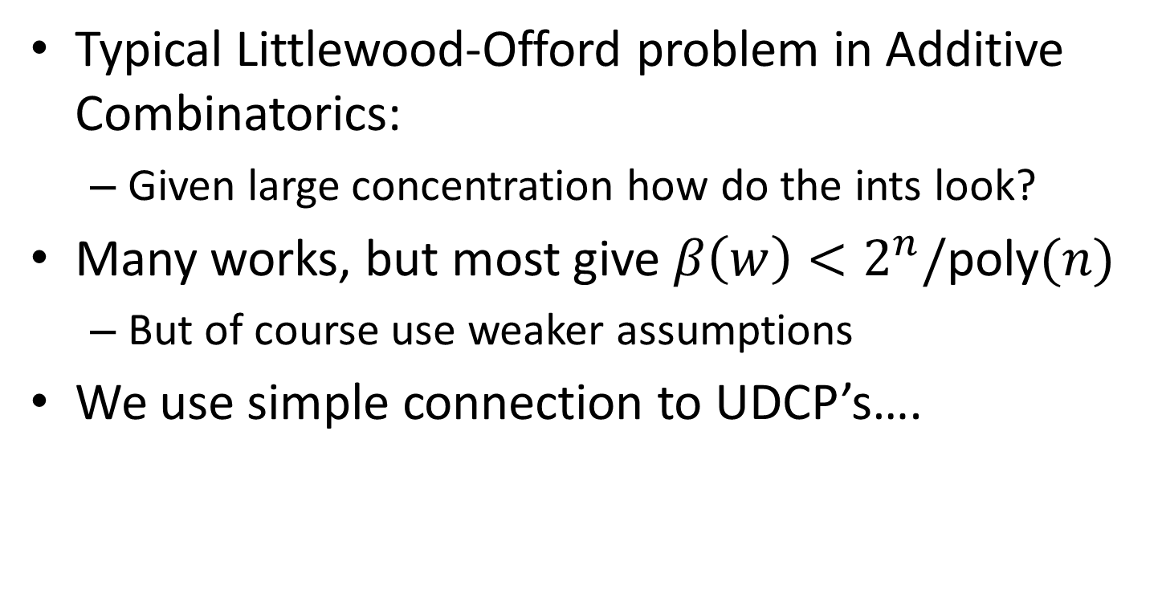
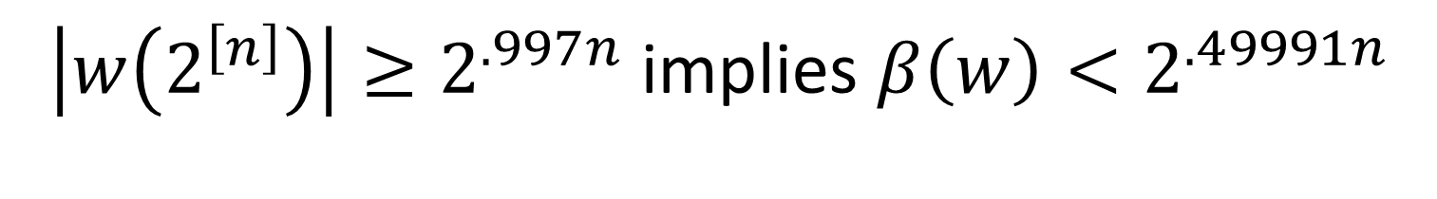
$\left|w\left(2^{\left[n\right]}\right)\right|≥2^{.997n}$ implies $β\left(w\right)<2^{.49991n}$
Typical Littlewood-Offord problem in Additive Combinatorics:
  Given large concentration how do the ints look?
Many works, but most give $β\left(w\right)<2^{n}/$poly$(n)$
  But of course use weaker assumptions
We use simple connection to UDCP’s….

Slide 23



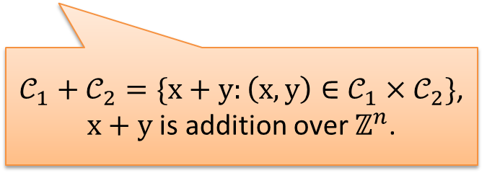



Uniquely Decodable Code Pairs (UDCP)
Pair $𝒞_{1},𝒞_{2}⊆\{0,1\}^{n}$ s.t. $\left|𝒞_{1}+𝒞_{2}\right|=\left|𝒞_{1}\right||𝒞_{2}|$.
$𝒞_{1}+𝒞_{2}=\{x+y:\left(x,y\right)∈𝒞_{1}×𝒞_{2}\}$,
$x+y$ is addition over $ℤ^{n}$.
$$𝒞_{1}$$
1011100
1101101
0000000
1010011
0101010
1111101
1100111
1011100
1101101
0000000
1010011
0101010
1111101
1100111
1 0 1 0 0 1 1
1
0
??
2
1
$$𝒞_{2}$$
0011001
1010101
0011011
0110110
0011001
1010101
0011011
0110110
0
0 1 1 0 1 1 0
1
0

Slide 24
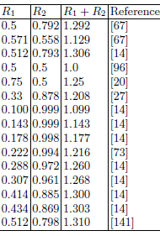
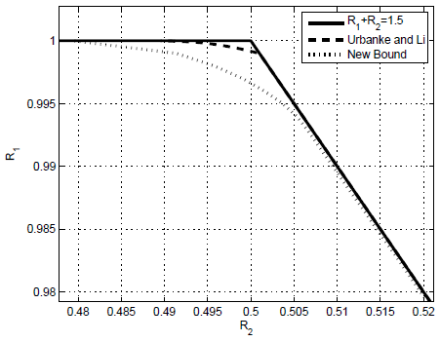

Uniquely Decodable Code Pairs (UDCP)
Pair $𝒞_{1},𝒞_{2}⊆\{0,1\}^{n}$ s.t. $\left|𝒞_{1}+𝒞_{2}\right|=\left|𝒞_{1}\right||𝒞_{2}|$.
$𝒞_{1}=\{10,01\},𝒞_{2}=\{00,01,11\}$ is UDCP:
$𝒞_{1}+𝒞_{2}=\{10,11,21,01,02,12\}$
UL’98, OS’14:
${|𝒞}_{1}|≥2^{.997n}$ implies ${|𝒞}_{2}|≤2^{.4996n}$
Table from
‘Coordinated Multiuser
communications’,
Schleger & Grant, 2006
Graph
From OS’14

Slide 25
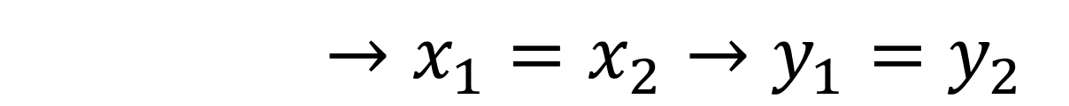

$\left|w\left(2^{\left[n\right]}\right)\right|≥2^{.997n}$ implies $β\left(w\right)<2^{.49991n}$
Let $𝒞_{1}⊆\{0,1\}^{n}$ be s.t. for all $x_{1},x_{2}∈𝒞_{1}:$ $w⋅x_{1}=w⋅x_{2}$ implies $x_{1}=x_{2}$
Let $𝒞_{2}⊆\{0,1\}^{n}$ be s.t. for all $y_{1},y_{2}∈𝒞_{2}:$ $w⋅y_{1}=w⋅y_{2}$
Can take $\left|𝒞_{1}\right|=|w(2^{\left[n\right]})|$, $\left|𝒞_{2}\right|=β\left(w\right)$
${(𝒞}_{1},𝒞_{2})$ is UDCP: suppose $x_{1},x_{2}∈𝒞_{1},y_{1},y_{2}∈𝒞_{2}$
$x_{1}+y_{1}=x_{2}+y_{2}$
$${w⋅(x}_{1}+{w⋅y}_{1})={w⋅(x}_{2}+w⋅y_{2})$$
$${w⋅(x}_{1}+{w⋅y}_{1})={w⋅(x}_{2}+w⋅y_{2})$$
$${w⋅(x}_{1}+{w⋅y}_{1})={w⋅(x}_{2}+w⋅y_{2})$$
$${w⋅(x}_{1}+{w⋅y}_{1})={w⋅(x}_{2}+w⋅y_{2})$$
$${w⋅(x}_{1}+→x_{1}=x_{2}→y_{1}=y_{2}$$

Slide 26
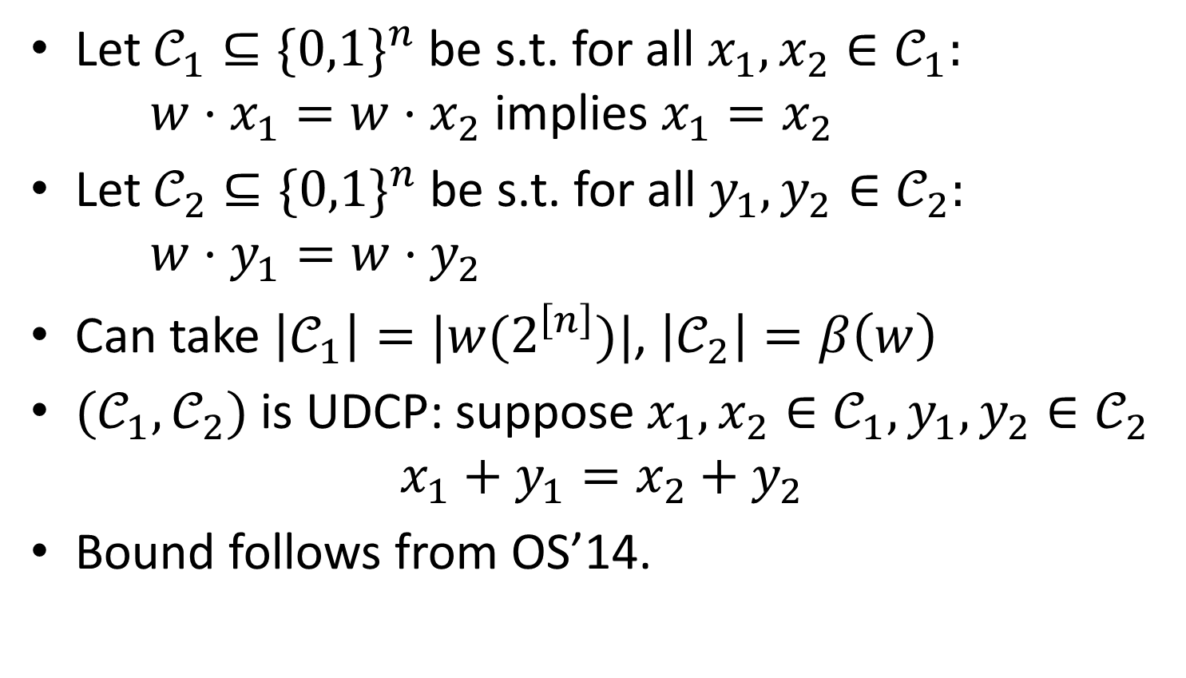
$\left|w\left(2^{\left[n\right]}\right)\right|≥2^{.997n}$ implies $β\left(w\right)<2^{.49991n}$
Let $𝒞_{1}⊆\{0,1\}^{n}$ be s.t. for all $x_{1},x_{2}∈𝒞_{1}:$ $w⋅x_{1}=w⋅x_{2}$ implies $x_{1}=x_{2}$
Let $𝒞_{2}⊆\{0,1\}^{n}$ be s.t. for all $y_{1},y_{2}∈𝒞_{2}:$ $w⋅y_{1}=w⋅y_{2}$
Can take $\left|𝒞_{1}\right|=|w(2^{\left[n\right]})|$, $\left|𝒞_{2}\right|=β\left(w\right)$
${(𝒞}_{1},𝒞_{2})$ is UDCP: suppose $x_{1},x_{2}∈𝒞_{1},y_{1},y_{2}∈𝒞_{2}$
$x_{1}+y_{1}=x_{2}+y_{2}$
Bound follows from OS’14.

Slide 27
Background
Contribution
Further Remarks

Slide 28
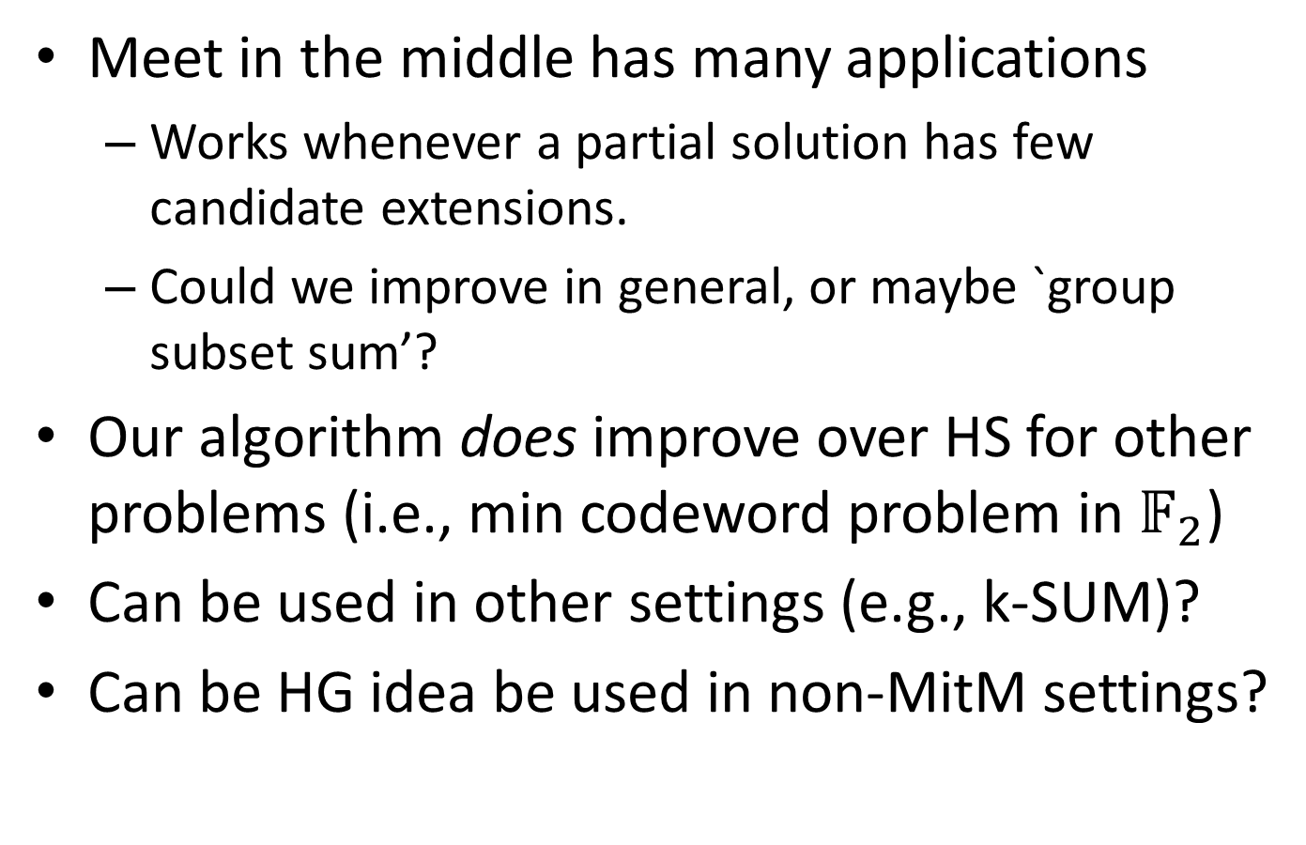
Future Directions
Meet in the middle has many applications
  Works whenever a partial solution has few candidate extensions.
  Could we improve in general, or maybe `group subset sum’?
Our algorithm does improve over HS for other problems (i.e., min codeword problem in $𝔽_{2}$)
Can be used in other settings (e.g., k-SUM)?
Can be HG idea be used in non-MitM settings?

Slide 29
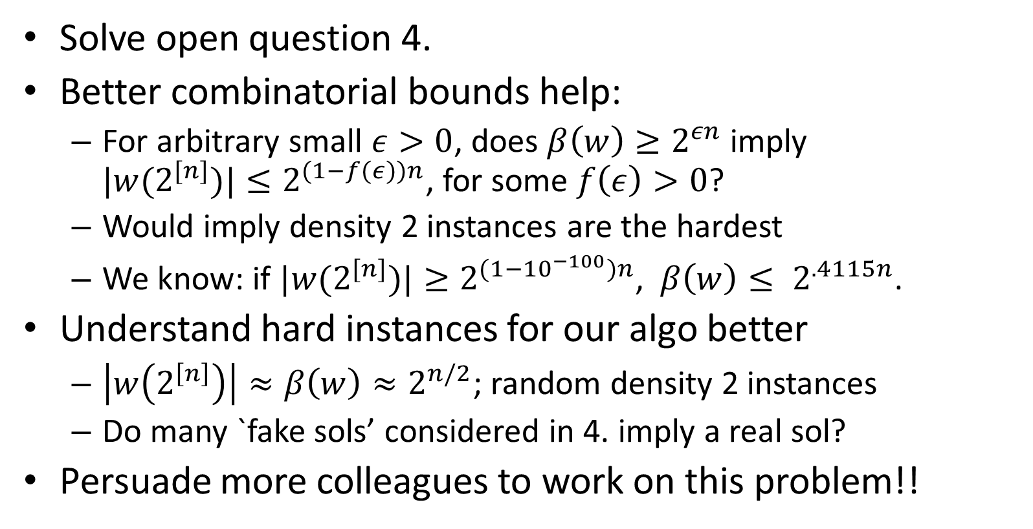
How to get to improved HS?
Solve open question 4.
Better combinatorial bounds help:
  For arbitrary small $ε>0$, does $β\left(w\right)≥2^{εn}$ imply
  ${|w(2}^{[n]})|≤2^{(1−f(ε))n}$, for some $f\left(ε\right)>0$?
  Would imply density 2 instances are the hardest
  We know: if ${|w(2}^{[n]})|≥2^{(1−{10}^{−100})n}$, $β\left(w\right)≤ 2^{.4115n}$.
Understand hard instances for our algo better
  $\left|w\left(2^{\left[n\right]}\right)\right|≈β\left(w\right)≈2^{n/2}$; random density 2 instances
  Do many `fake sols’ considered in 4. imply a real sol?
Persuade more colleagues to work on this problem!!
Thanks for listening

