Slide 1

Fine Grained Hardness in Cryptography
Omer Reingold
SRA

Slide 2
Fine Grained? Really?!?
Our understanding of Computational Hardness is quite coarse. Are we ready for this discussion?
Proof of work – moderately hard puzzles (with concrete bounds)
Gradually increasing hardness? The case of block ciphers (Rackoff’s thesis).

Slide 3

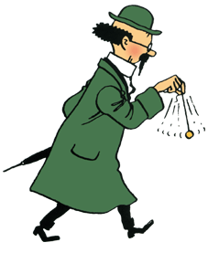
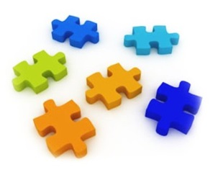

Very Hard Puzzles
N = P Q
1^{k}
P,Q
Generating a puzzle and verifying a solution in time k
Solving the puzzle is infeasible
  Cannot be done in any poly(k) time
  May hope for it to be much harder
aka One-Way Functions, beautiful theory

Slide 4

Spam Fighting [Dwork-Naor 93]
Send you an email?
1^{k}
Sure but this first:
Solving the puzzle is feasible but moderately hard
  Need pretty good bounds
  Shouldn’t be possible to amortize
Various natural candidates
  May be non-interactive

Slide 5
Beyond Spam Protection?
Other applications (Denial of Service, Timed Commitments, Digital Currancy, …)
Can the solved puzzles be combined to address a problem we really want to solve? (analogy: reCAPTCHA digitizing books)
Is there a rich theory to uncover?

Slide 6
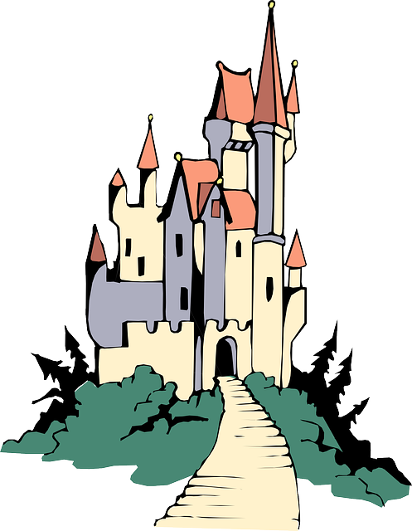


Hardness Reduction
R’< R
R-secure
R’-secure
Consider factoring for instance:
  Born very hard and only weakened by crypto

Slide 7
Gradually Increasing Hardness?
plaintext
Block ciphers:
For any fixed key, P(key,*) is a permutation
For a random key, P(key,*) indistinguishable from uniform permutation
Usually constructed as a composition of very weak (completely insecure) permutations
P
key
ciphertext

Slide 8
Rackoff’s Thesis [1995 or earlier]
For any “sufficiently expressive” family F of permutations, composing polynomial number of random elements of F gives a secure block cipher
Initial result: Simple Permutations Mix Well [Gowers 1996, Hoory-Magen-Myers-Rackoff 2004,…]
What about pseudorandom permutations? Reduce one family F to another? Understanding how hardness evolve in other context?
[HMMR04] For simple permutations, obtaining 4-wise independence -> pseudorandomness?

