Slide 1
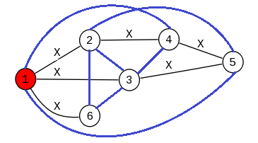
Graph-Induced Multilinear Maps from Lattices
Craig Gentry (IBM)
Sergey Gorbunov (MIT)
Shai Halevi (IBM)
https://eprint.iacr.org/2014/645

Slide 2



Multilinear Maps (MMAPs)
A very powerful crypto tool
Enables computation on “hidden data”
  Similar to homomorphic encryption (HE)
But HE is too “all or nothing”
  No key: result is meaningless
  Has key: can read result and intermediate values

Slide 3

MMAPs Special Ingredient
Leak “some information” about result
  Can tell if results equals zero
  Can’t decrypt result or intermediate values
This partial leakage can do great things
  Multipartite non-interactive key-exchange, Witness-encryption, Attribute-based encryption, Functional encryption, Cryptographic code obfuscation, …
But implementing “limited leakage” is hard

Slide 4
Previous MMAP Constructions
Based on HE Schemes
  NTRU [GGH13] or integer-HE [CLT13]
  Adding a “defective secret key” for zero-test
Subject to “algebraic attacks”
  Attacker that gets many zero-encodings, can setup, solve a system of equations
  Attacks rely partially on computing GCDs
    Over the integers or number-field ideals
  [CLT15] augments [CLT13] to resist attacks

Slide 5
Two “Modes” of Using MMAPS
Private Encoding vs. Public Encoding
Encoding requires trapdoor
  Modeled as “Multilinear Jigsaw Puzzles” [GGHRSW13]
Sufficient for many/most obfuscation schemes
Largely untouched by known attacks
Encoding/re-randomization is available to anyone
  Via public encoding of zero
Needed for key-agreement, some hardness assumptions
[GGH13,CLT13] are broken when used in this mode
  [CLT15] maybe not

Slide 6
This Talk: Less Algebraic MMAPs
Use only standard lattices (with trapdoors), no ideal lattices or hard-to-factor integers
  Less structure to exploit (no GCDs)
  Based loosely on the [GSW13] cryptosystem
Basic setting only gives “private encoding”
  But we can still do key-agreement
  “Graph-Induced”, somewhat harder to use
Some variants:
  Better functionality, safe for public encoding (?)

Slide 7
This Talk: Less Algebraic MMAPs
Use only standard lattices (with trapdoors), no ideal lattices or hard-to-factor integers
  Less structure to exploit (no GCDs)
  Based loosely on the [GSW13] cryptosystem
Basic setting only gives “private encoding”
  But we can still do key-agreement
  “Graph-Induced”, somewhat harder to use
Some variants:
  Better functionality, safe for public encoding (?)
Sales pitch: use this construction for all your MMAP needs

Slide 8



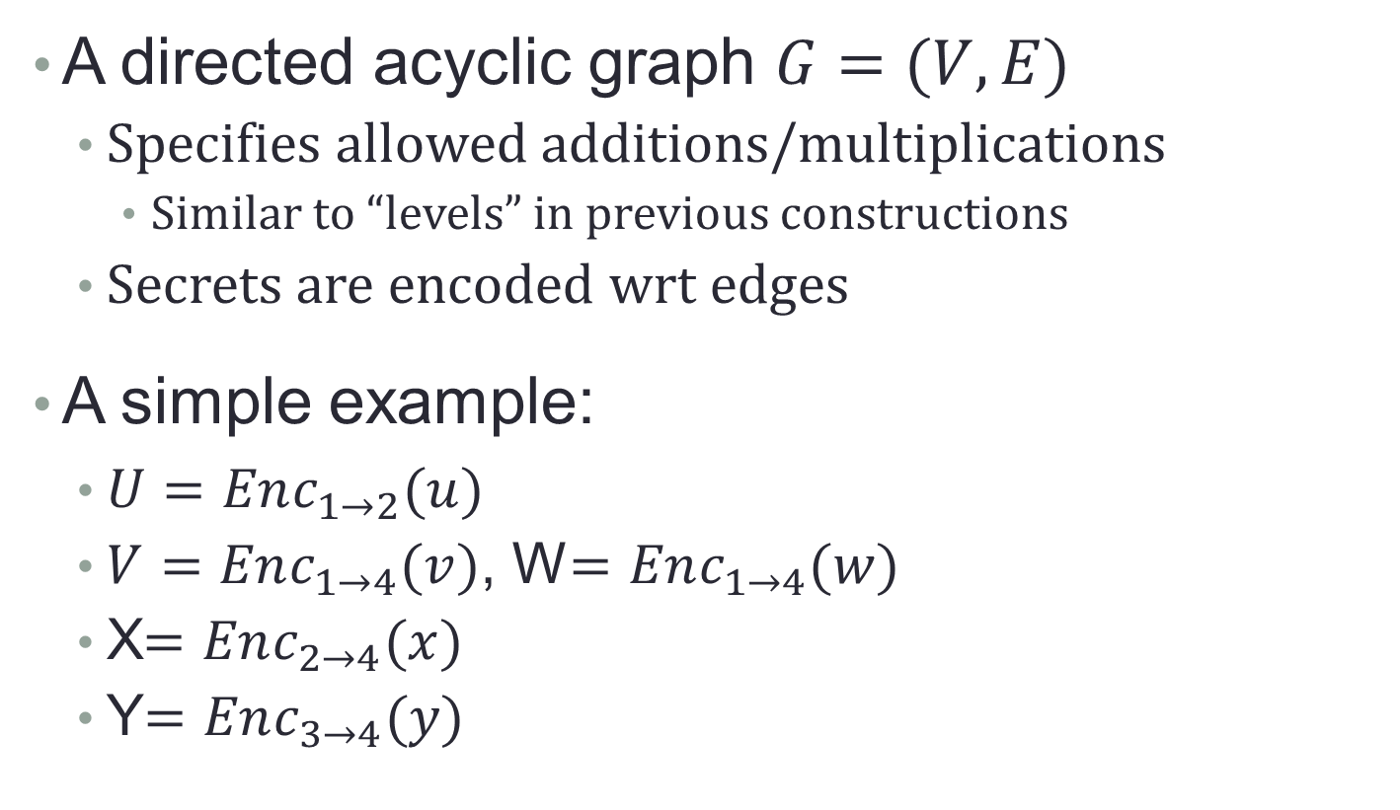





Graph-Induced MMAPs
A directed acyclic graph $G=(V,E)$
  Specifies allowed additions/multiplications
    Similar to “levels” in previous constructions
  Secrets are encoded wrt edges
A simple example:
  $U=Enc_{1→2}(u)$
  $V=Enc_{1→4}(v)$, W$=Enc_{1→4}(w)$
  X$=Enc_{2→4}(x)$
  Y$=Enc_{3→4}(y)$
$$U$$
$$2$$
$$1$$
$$X$$
$$V,W$$
$$4$$
$$Y$$
$$3$$

Slide 9
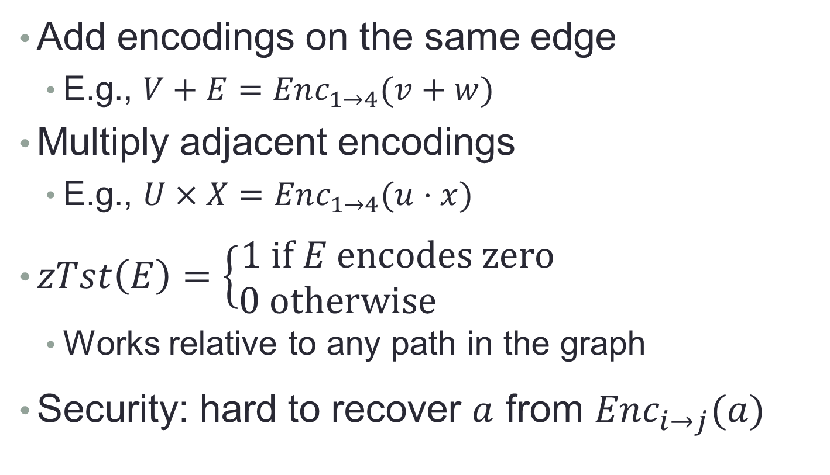
Graph-Induced MMAPs
Add encodings on the same edge
  E.g., $V+E=Enc_{1→4}(v+w)$
Multiply adjacent encodings
  E.g., $U×X=Enc_{1→4}(u⋅x)$
$zTst\left(E\right)=\left\{\begin{matrix}1 if E encodes zero \\ 0 otherwise \end{matrix}\right.$
  Works relative to any path in the graph
Security: hard to recover $a$ from $Enc_{i→j}(a)$
$$U$$
$$2$$
$$1$$
$$X$$
$$V,W$$
$$4$$
$$Y$$
$$3$$

Slide 10





Application: Non-interactive Multipartite KA
Broadcast_{B}
Broadcast_{A}
Alice
Bob
Public
parameters
SSK
Broadcast_{C}
SSK
Eve
Charlie
??
SSK

Slide 11




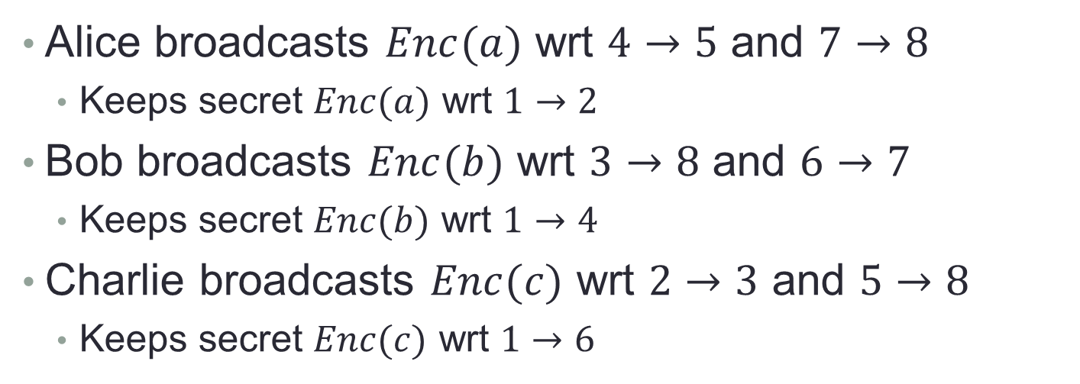








Non-interactive Multipartite KA From Graph-Based MMAPs
$$c$$
3
2
$$a$$
$$b$$
$$c$$
$$a$$
$$b$$
Shared key is $abc$
8
5
4
1
$$a$$
$$c$$
7
$$b$$
6
Alice broadcasts $Enc(a)$ wrt $4→5$ and $7→8$
  Keeps secret $Enc(a)$ wrt $1→2$
Bob broadcasts $Enc(b)$ wrt $3→8$ and $6→7$
  Keeps secret $Enc(b)$ wrt $1→4$
Charlie broadcasts $Enc(c)$ wrt $2→3$ and $5→8$
  Keeps secret $Enc(c)$ wrt $1→6$

Slide 12




Application to Obfuscation
Encode branching-program matrices on a single chain …
$$A_{1}^{0}, A_{1}^{1}$$
$$A_{2}^{0}, A_{2}^{1}$$
$$A_{n}^{0}, A_{n}^{1}$$
1
2
3
…
$$n+1$$

Slide 13
Tools
LWE and Trapdoors

Slide 14

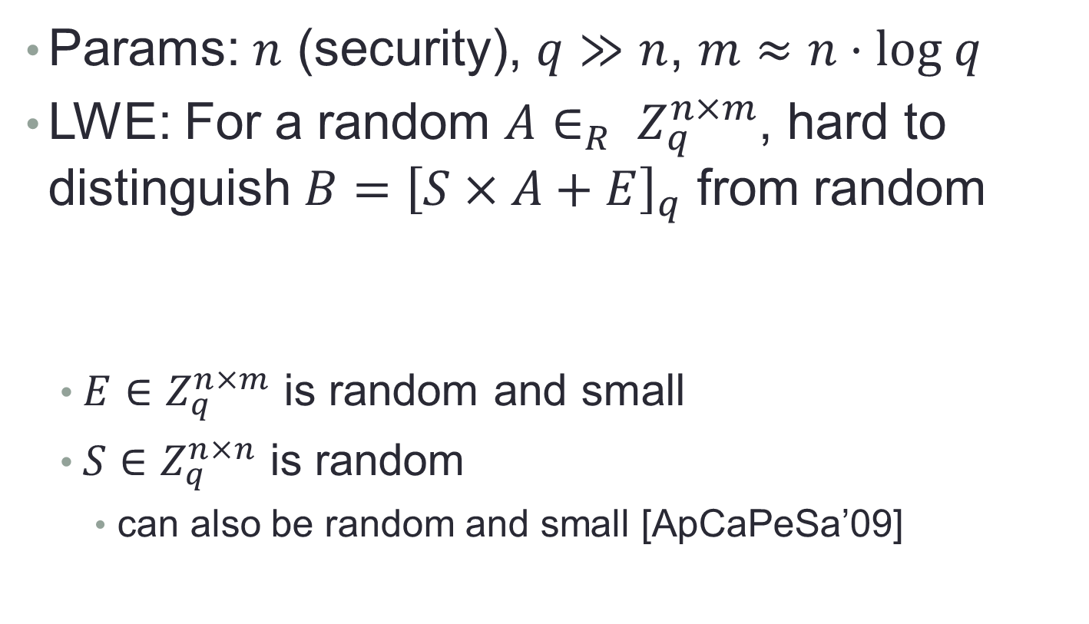

LWE [Reg’05]
Params: $n$ (security), $q≫n$, $m≈n⋅log q$
LWE: For a random $A∈_{R} Z_{q}^{n×m}$, hard to distinguish $B={\left[S×A+E\right]}_{q}$ from random
  $E∈Z_{q}^{n×m}$ is random and small
  $S∈Z_{q}^{n×n}$ is random
    can also be random and small [ApCaPeSa’09]
?
=
B
S
$$×$$
A
$$+$$
E

Slide 15
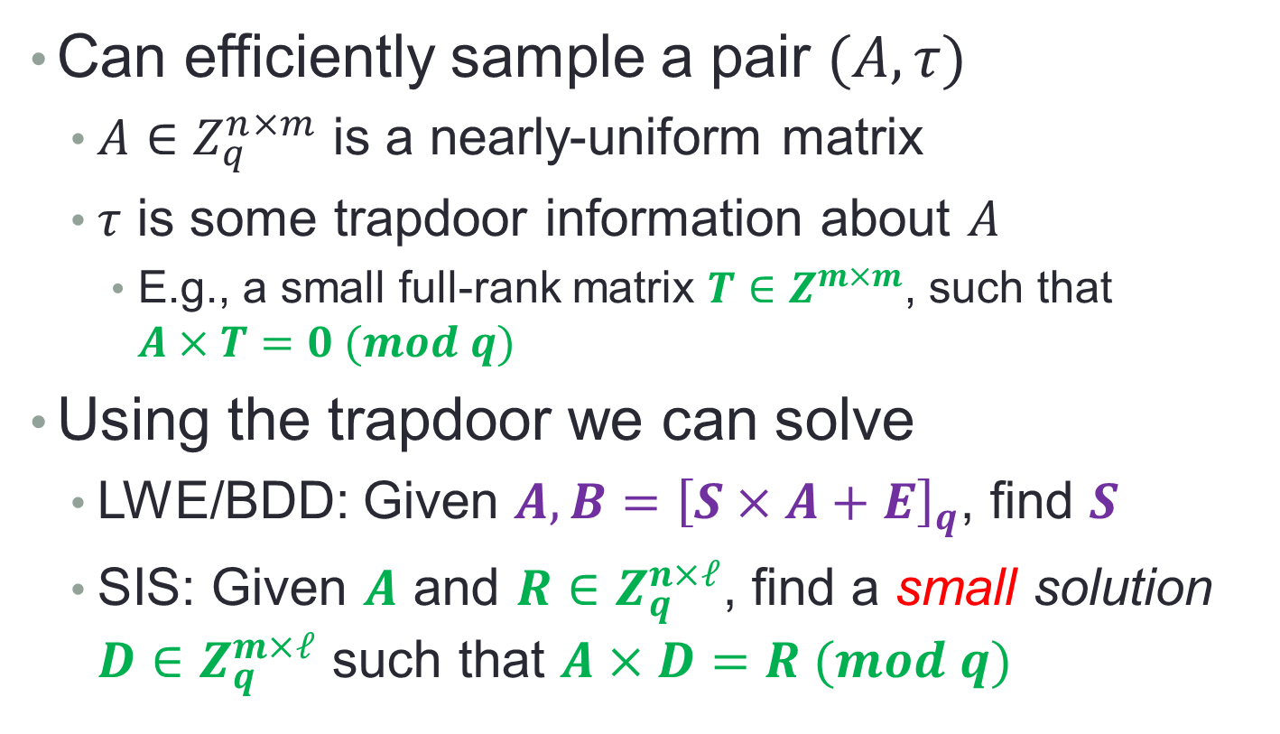
Lattice Trapdoors [Aj’99,…]
Can efficiently sample a pair $(A,τ)$
  $A∈Z_{q}^{n×m}$ is a nearly-uniform matrix
  $τ$ is some trapdoor information about $A$
    E.g., a small full-rank matrix $T∈Z^{m×m}$, such that $A×T=0 (mod q)$
Using the trapdoor we can solve
  LWE/BDD: Given $A,B={\left[S×A+E\right]}_{q}$, find $S$
  SIS: Given $A$ and $R∈Z_{q}^{n×ℓ}$, find a small solution $D∈Z_{q}^{m×ℓ}$ such that $A×D=R (mod q)$

Slide 16

Construction

Slide 17

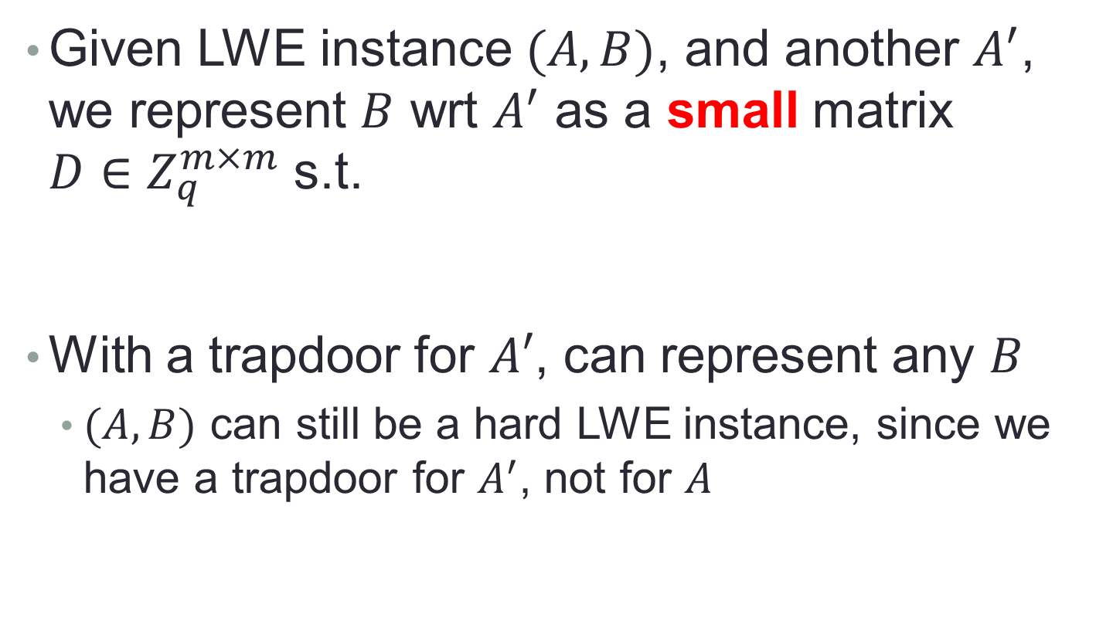



Representing LWE Instances
Given LWE instance $(A,B)$, and another $A^{′}$, we represent $B$ wrt $A^{′}$ as a small matrix $D∈Z_{q}^{m×m}$ s.t.
With a trapdoor for $A′$, can represent any $B$
  $(A,B)$ can still be a hard LWE instance, since we have a trapdoor for $A^{′}$, not for $A$
$$A’$$
$$×$$
$$D$$
=
$$B$$

Slide 18

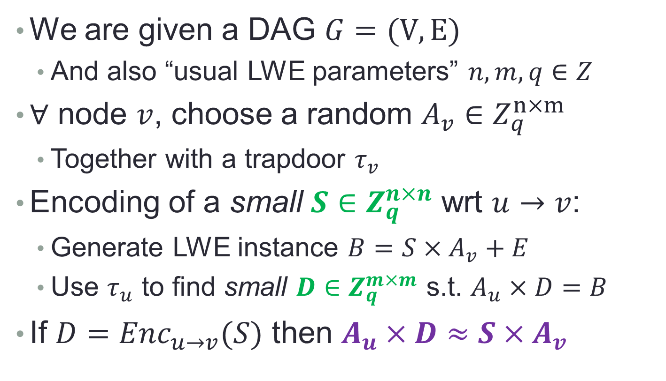



Our Graph-based Construction
$$A_{2}$$
$$A_{1}$$
We are given a DAG $G=(V,E)$
  And also “usual LWE parameters” $n,m,q∈Z$
$∀$ node $v$, choose a random $A_{v}∈Z_{q}^{n×m}$
  Together with a trapdoor $τ_{v}$
Encoding of a small $S∈Z_{q}^{n×n}$ wrt $u→v$:
  Generate LWE instance $B=S×A_{v}+E$
  Use $τ_{u}$ to find small $D∈Z_{q}^{m×m}$ s.t. $A_{u}×D=B$
If $D=Enc_{u→v}(S)$ then $A_{u}×D≈S×A_{v}$
$$A_{4}$$
$$A_{3}$$

Slide 19


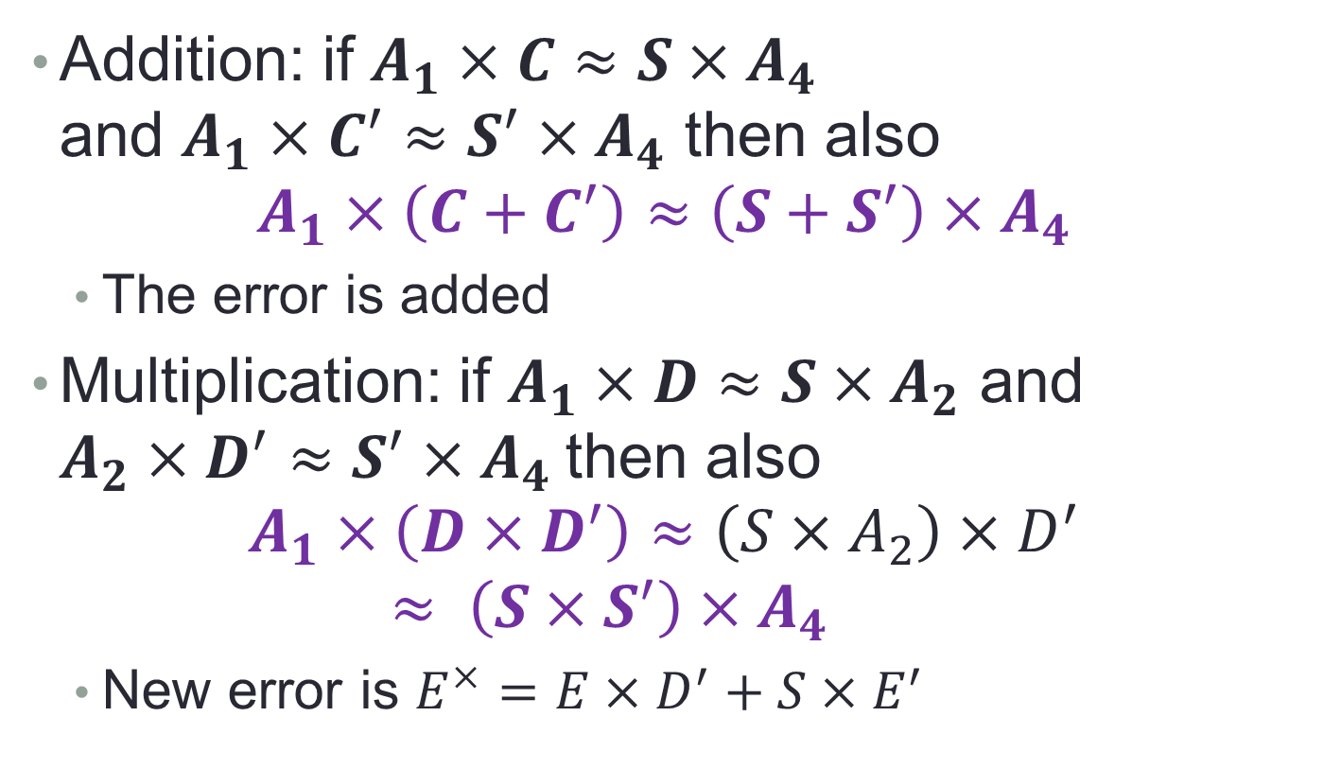

Our Graph-based Construction
$$D$$
$$A_{2}$$
$$A_{1}$$
$$D^{′}$$
Addition: if $A_{1}×C≈S×A_{4}$
and $A_{1}×C^{′}≈{S^{′}×A}_{4}$ then also
$A_{1}×\left(C+C^{′}\right)≈\left(S+S^{′}\right)×A_{4}$
  The error is added
Multiplication: if $A_{1}×D≈S×A_{2}$ and $A_{2}×D^{′}≈S^{′}×A_{4}$then also
$A_{1}×\left(D×D^{′}\right)≈\left(S×A_{2}\right)×D^{′}≈ \left(S×S^{′}\right)×A_{4}$
  New error is $E^{×}=E×D^{′}+S×E^{′}$
$$C, C^{′}$$
$$A_{4}$$
$$A_{3}$$

Slide 20


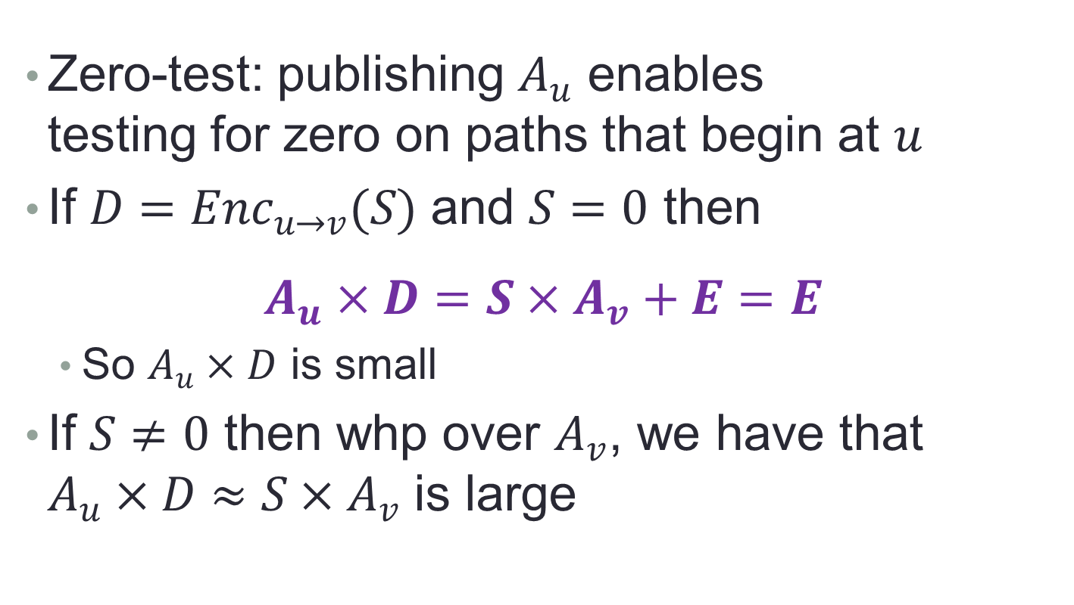

Our Graph-based Construction
$$A_{u}$$
Zero-test: publishing $A_{u}$ enables
testing for zero on paths that begin at $u$
If $D=Enc_{u→v}(S)$ and $S=0$ then
$$A_{u}×D=S×A_{v}+E=E$$
  So $A_{u}×D$ is small
If $S≠0$ then whp over $A_{v}$, we have that $A_{u}×D≈S×A_{v}$ is large
$$D$$
$$A_{v}$$

Slide 21
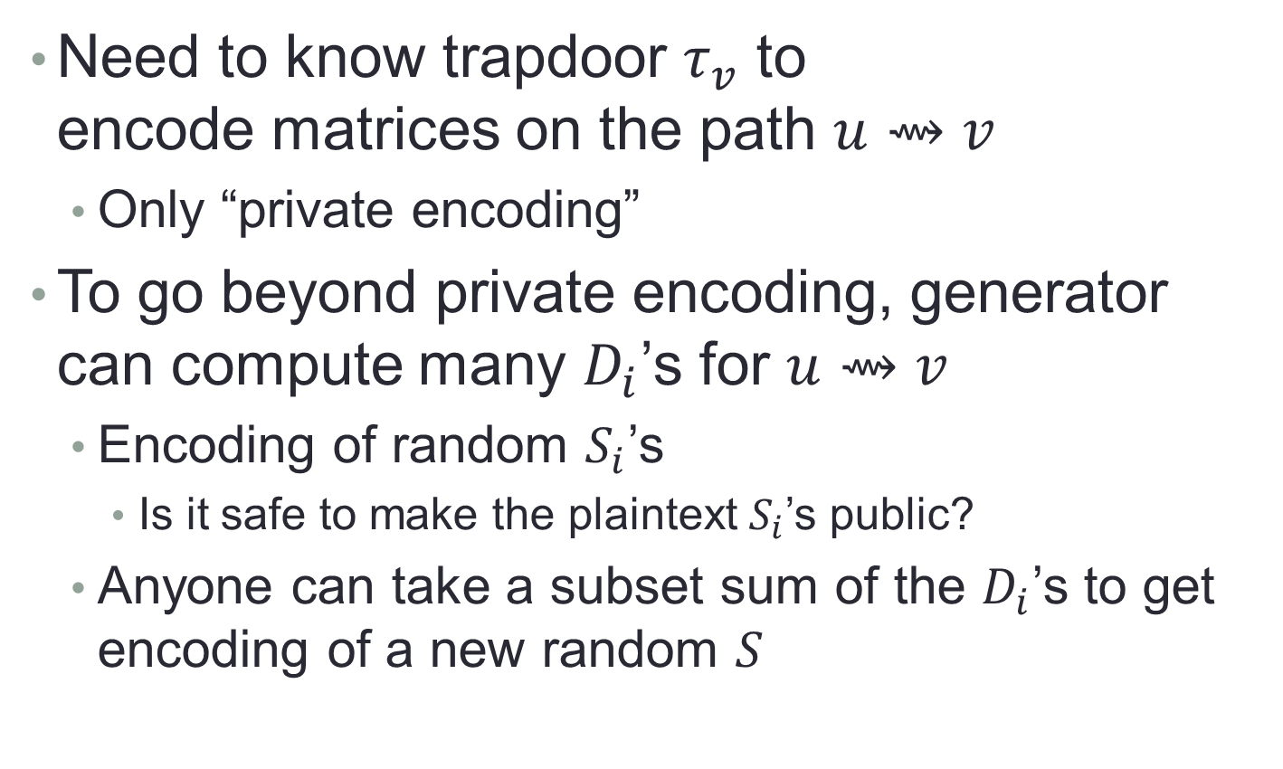
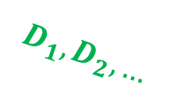
Who Can Encode?
$$A_{u}$$
Need to know trapdoor $τ_{v}$ to
encode matrices on the path $u⇝v$
  Only “private encoding”
To go beyond private encoding, generator can compute many $D_{i}$’s for $u⇝v$
  Encoding of random $S_{i}$’s
    Is it safe to make the plaintext $S_{i}$’s public?
  Anyone can take a subset sum of the $D_{i}$’s to get encoding of a new random $S$
$$D_{1}, D_{2}, …$$
$$A_{v}$$

Slide 22
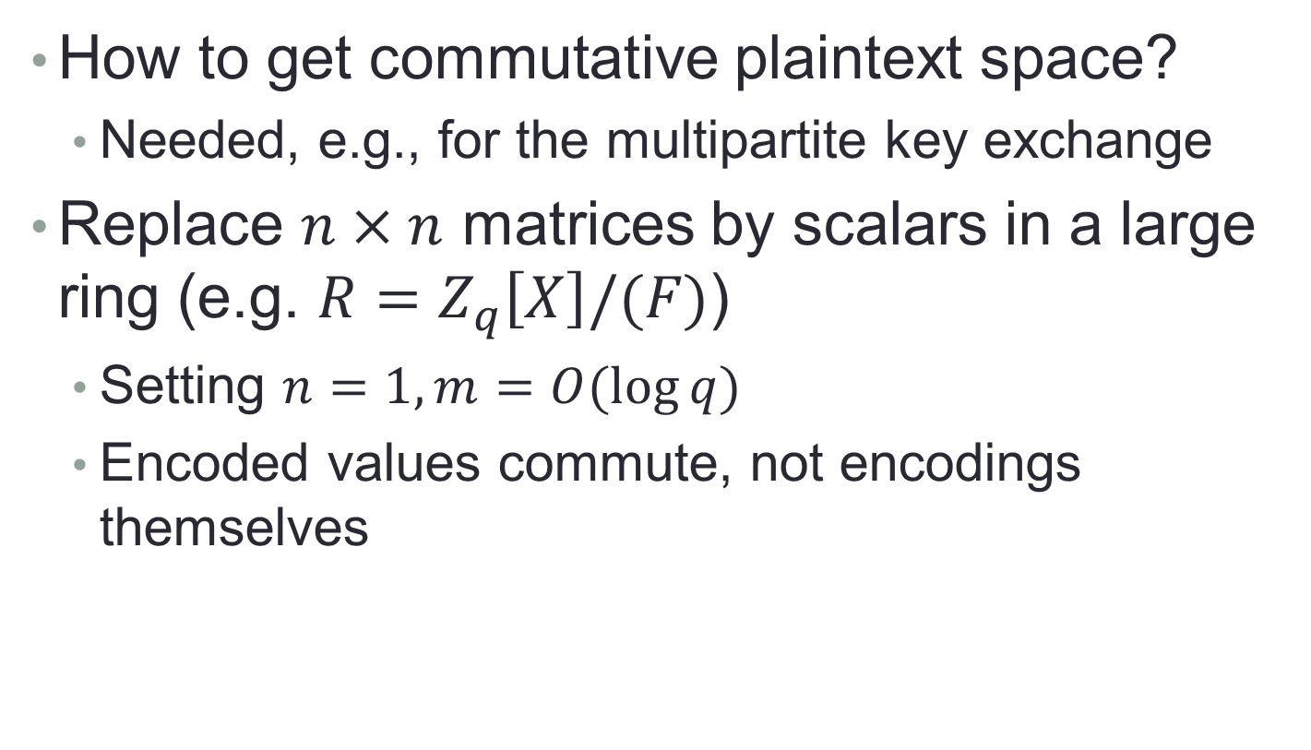
A Commutative Variant
How to get commutative plaintext space?
  Needed, e.g., for the multipartite key exchange
Replace $n×n$ matrices by scalars in a large ring (e.g. $R=Z_{q}\left[X\right]/(F)$)
  Setting $n=1, m=O(\log{q})$
  Encoded values commute, not encodings themselves

Slide 23
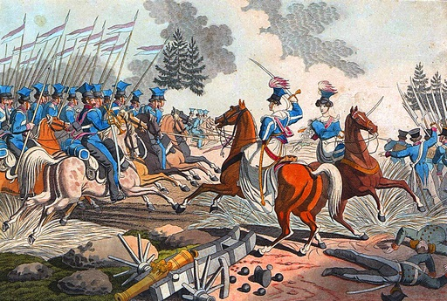
Attacks

Slide 24



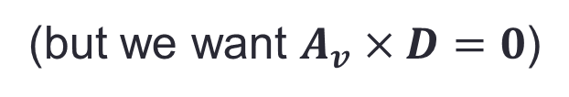












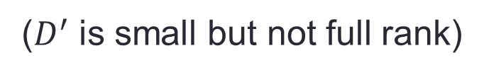

“Zeroizing” Attacks
$$Enc(0)$$
u
v
w
If $D=Enc_{v→w}(0)$ then $A_{v}×D≈0$
  $D$ is “almost a trapdoor” for $A_{v}$
$$A_{v}$$
$$×$$
$$D$$
$$=$$
$$E$$
(but we want $A_{v}×D=0$)
$$A_{v}$$
$$I$$
$$×$$
$$−D$$
$$=$$
$$0$$
$$A_{v}^{′}$$
($D^{′}$ is small but not full rank)
$$E$$
$$D′$$

Slide 25




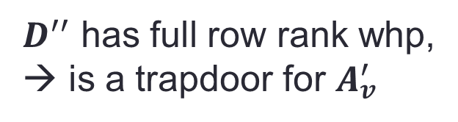








“Zeroizing” Attacks
$$Enc(0)$$
u
v
w
Suppose we had two such zero-encodings,
$A_{v}×D_{1}=E_{1}$ and $A_{v}×D_{2}=E_{2}$
$$A_{v}$$
$$I$$
$$×$$
$$−D_{1}$$
$$−D_{2}$$
$$=$$
$$0$$
$$A_{v}^{′}$$
$D^{′′}$ has full row rank whp,
→ is a trapdoor for $A_{v}^{′}$
$$E_{1}$$
$$E_{2}$$
$$D^{′′}$$

Slide 26









“Zeroizing” Attacks
$$Enc(S)$$
$$Enc(0)$$
u
v
w
$D_{i}=Enc_{v→w}(0)$ yield trapdoor for $A_{v}^{′}$
Now suppose that we have $C=Enc_{u→v}(S)$
  Denote $B≜A_{u}×C=S×A_{v}+E$
$$B$$
$$=$$
$$S$$
$$×$$
$$A_{v}$$
$$+$$
$$E$$

Slide 27



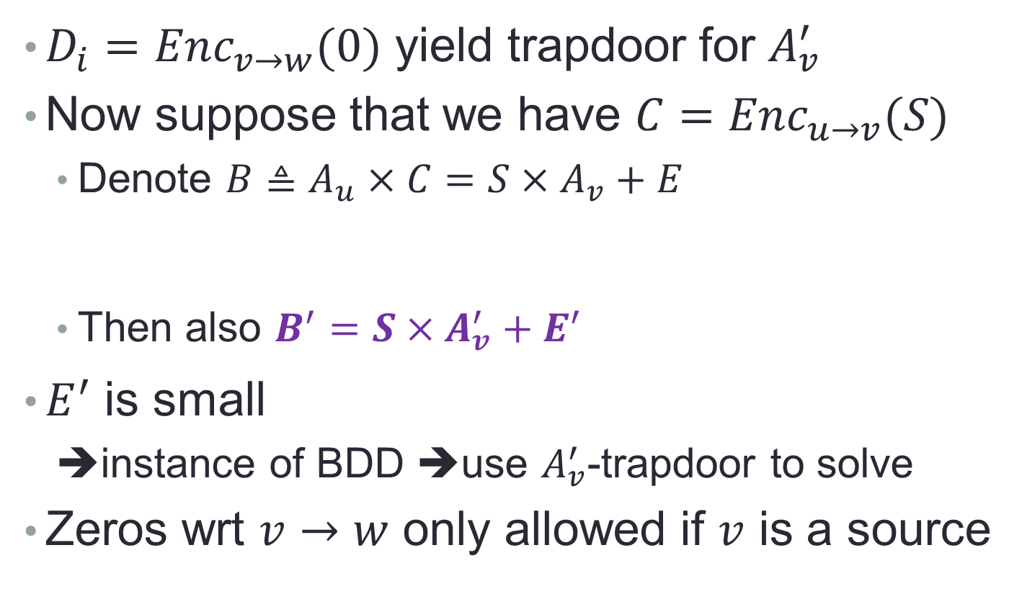



“Zeroizing” Attacks
$$Enc(S)$$
$$Enc(0)$$
u
v
w
$D_{i}=Enc_{v→w}(0)$ yield trapdoor for $A_{v}^{′}$
Now suppose that we have $C=Enc_{u→v}(S)$
  Denote $B≜A_{u}×C=S×A_{v}+E$
  Then also $B^{′}={S×A}_{v}^{′}+E^{′}$
$E^{′}$ is small
  ➔instance of BDD ➔use $A_{v}^{′}$-trapdoor to solve
Zeros wrt $v→w$ only allowed if $v$ is a source
$$B$$
$$0$$
$$=$$
$$S$$
$$×$$
$$A_{v}$$
$$I$$
$$+$$
$$E$$
$$−S$$
$$B^{′}$$
$$A_{v}^{′}$$
$$E^{′}$$

Slide 28



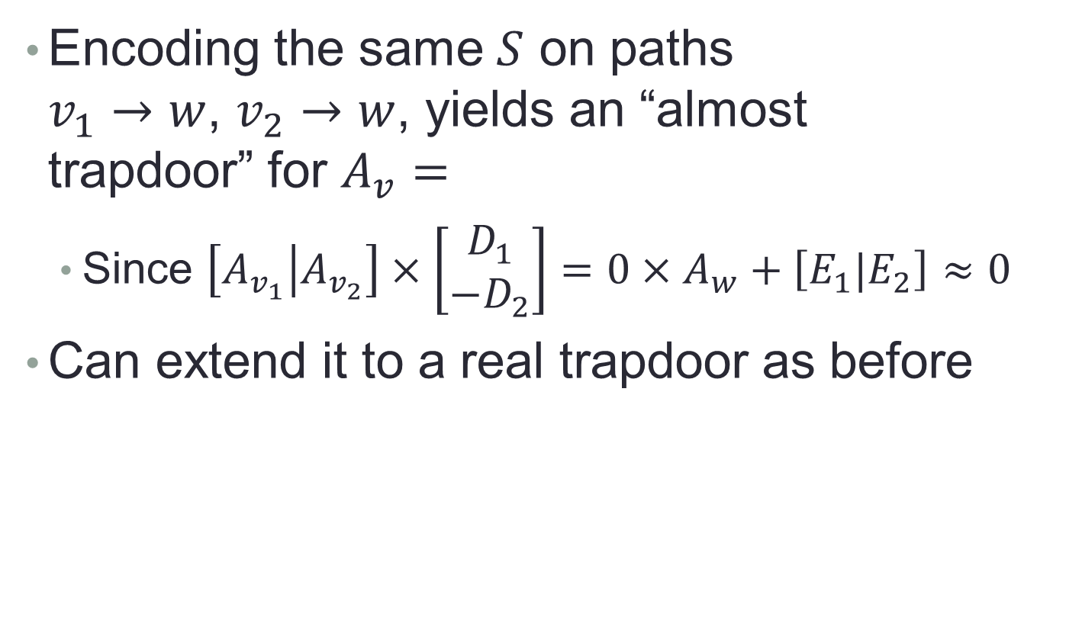






Extensions of the Attack
$$u_{1}$$
$$v_{1}$$
$$D_{1}$$
$$w$$
Encoding the same $S$ on paths
$v_{1}→w$, $v_{2}→w$, yields an “almost
trapdoor” for $A_{v}=$
  Since $\left[A_{v_{1}} | A_{v_{2}}\right]×\left[\begin{matrix}D_{1} \\ −D_{2}\end{matrix}\right]=0×A_{w}+\left[E_{1}|E_{2}\right]≈0$
Can extend it to a real trapdoor as before
$$u_{2}$$
$$v_{2}$$
$$D_{2}$$
$$A_{v_{1}}$$
$$A_{v_{2}}$$

Slide 29




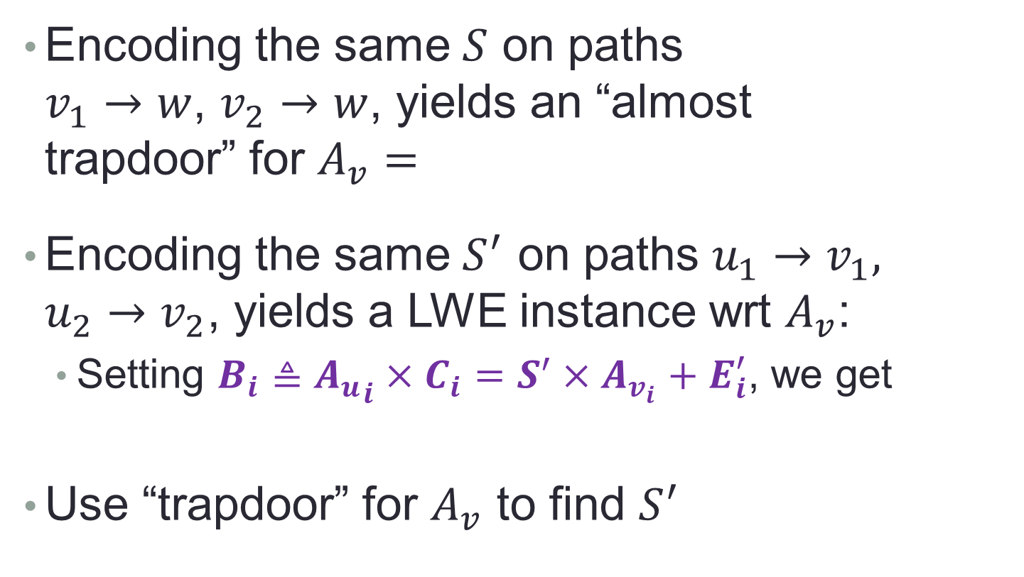








Extensions of the Attack
$$C_{1}$$
$$D_{1}$$
$$u_{1}$$
$$v_{1}$$
$$w$$
Encoding the same $S$ on paths
$v_{1}→w$, $v_{2}→w$, yields an “almost
trapdoor” for $A_{v}=$
Encoding the same $S^{′}$ on paths $u_{1}→v_{1},$
$u_{2}→v_{2}$, yields a LWE instance wrt $A_{v}$:
  Setting $B_{i}≜{A_{u}}_{i}×C_{i}=S^{′}×A_{v_{i}}+E_{i}^{′}$, we get
Use “trapdoor” for $A_{v}$ to find $S^{′}$
$$u_{2}$$
$$C_{2}$$
$$v_{2}$$
$$D_{2}$$
$$A_{v_{1}}$$
$$A_{v_{2}}$$
$$B_{1}$$
$$B_{2}$$
$$=$$
$$S^{′}$$
$$×$$
$$A_{v_{1}}$$
$$A_{v_{2}}$$
$$+$$
$$E_{1}$$
$$E_{2}$$

Slide 30








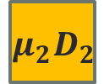

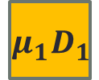

Extensions of the Attack
$$u_{1}$$
$$v_{1}$$
$$D_{1}$$
…
…
$$w$$
We have $A_{v_{i}}×D_{i}=S_{i}×A_{w}+E_{i}$
  We know small scalars $μ_{i}$ s.t. $\sum_{i}{μ_{i}}S_{i}=0$
  ➔Get “almost trapdoor” for the concatenated $A_{v_{i}}$’s
  Since
$$u_{t}$$
$$v_{t}$$
$$D_{t}$$
…
$$×$$
$$=∑i μ_{i}E_{i}≈0$$
$$A_{v_{1}}$$
$$A_{v_{2}}$$
$$A_{v_{t}}$$
$$μ_{1}D_{1}$$
$$μ_{2}D_{2}$$
…
$$μ_{t}D_{t}$$

Slide 31





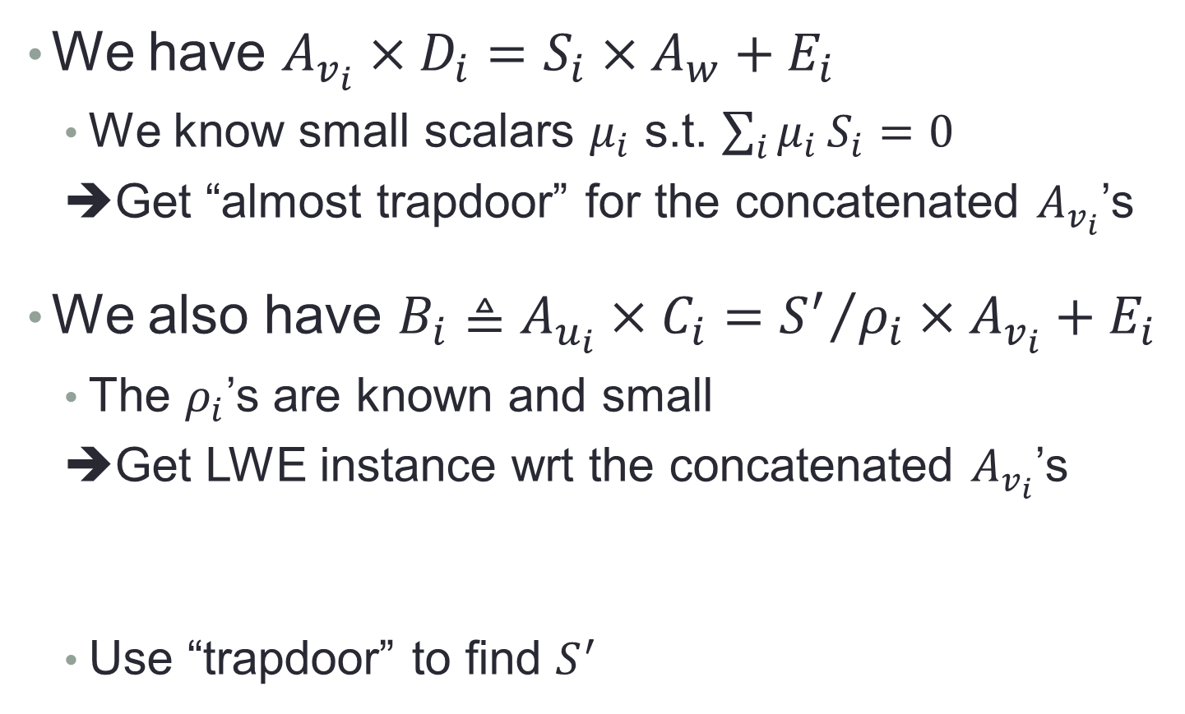









Extensions of the Attack
$$C_{1}$$
$$D_{1}$$
$$u_{1}$$
$$v_{1}$$
…
…
$$w$$
We have $A_{v_{i}}×D_{i}=S_{i}×A_{w}+E_{i}$
  We know small scalars $μ_{i}$ s.t. $\sum_{i}{μ_{i}}S_{i}=0$
  ➔Get “almost trapdoor” for the concatenated $A_{v_{i}}$’s
We also have $B_{i}≜A_{u_{i}}×C_{i}={S^{′}}/{ρ_{i}}×A_{v_{i}}+E_{i}$
  The $ρ_{i}$’s are known and small
  ➔Get LWE instance wrt the concatenated $A_{v_{i}}$’s
  Use “trapdoor” to find $S^{′}$
$$u_{t}$$
$$C_{t}$$
$$v_{t}$$
$$D_{t}$$
…
$$=$$
$$×$$
…
$$ρ_{1}B_{1}$$
$$ρ_{2}B_{2}$$
$$ρ_{t}B_{t}$$
$$S^{′}$$
$$A_{v_{1}}$$
$$A_{v_{2}}$$
$$A_{v_{t}}$$
$$+$$
…
$$ρ_{1}E_{1}$$
$$ρ_{2}E_{2}$$
$$ρ_{t}E_{t}$$

Slide 32
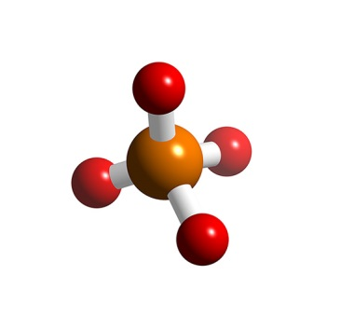
This Suggests a “Generic Model”
The intuition: if you get an approximate trapdoor then you’re dead, else you’re golden
  Approximate trapdoor ↔ encodings on paths with common endpoint, that we know how to annihilate
Should be possible to formalize, use to prove security of various schemes
Any attacks beyond this generic model?

Slide 33
Variants
This presentation is based in part on recent discussions with Ran Canetti

Slide 34



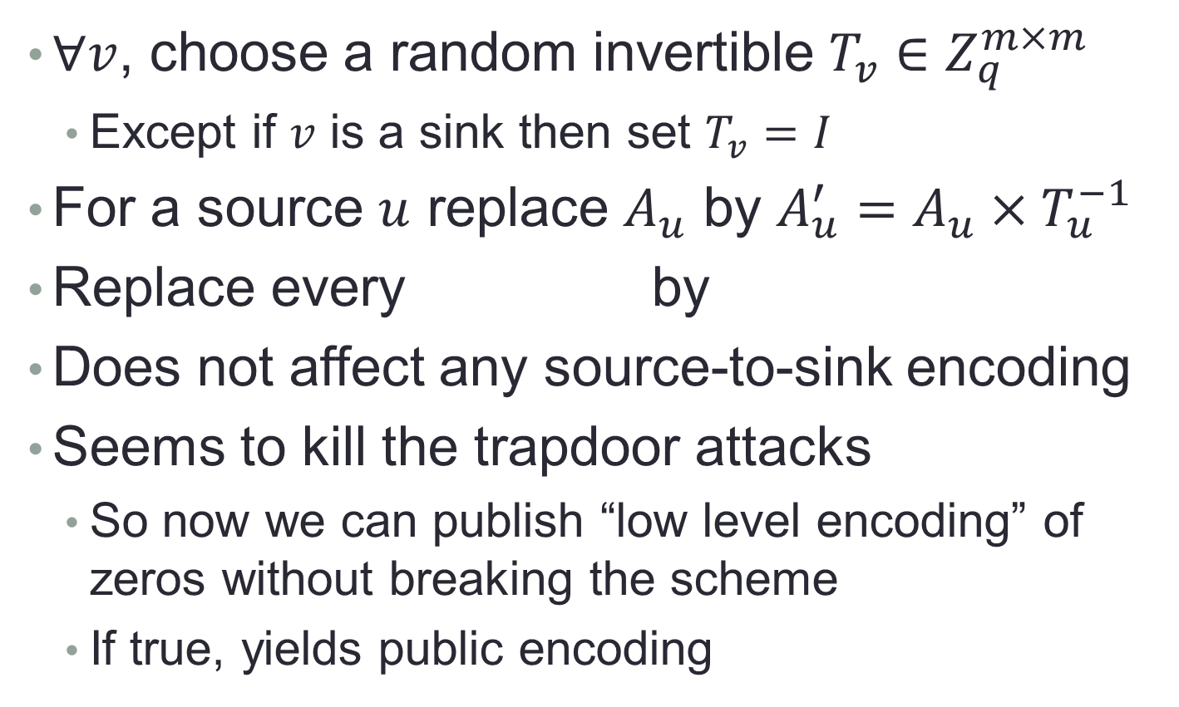



Additional “Safeguards”
$∀v$, choose a random invertible $T_{v}∈Z_{q}^{m×m}$
  Except if $v$ is a sink then set $T_{v}=I$
For a source $u$ replace $A_{u}$ by $A_{u}^{′}=A_{u}×T_{u}^{−1}$
Replace every by
Does not affect any source-to-sink encoding
Seems to kill the trapdoor attacks
  So now we can publish “low level encoding” of zeros without breaking the scheme
  If true, yields public encoding
$$C$$
$$T_{u}×C×T_{v}^{−1}$$
$$u$$
$$v$$
$$u$$
$$v$$

Slide 35

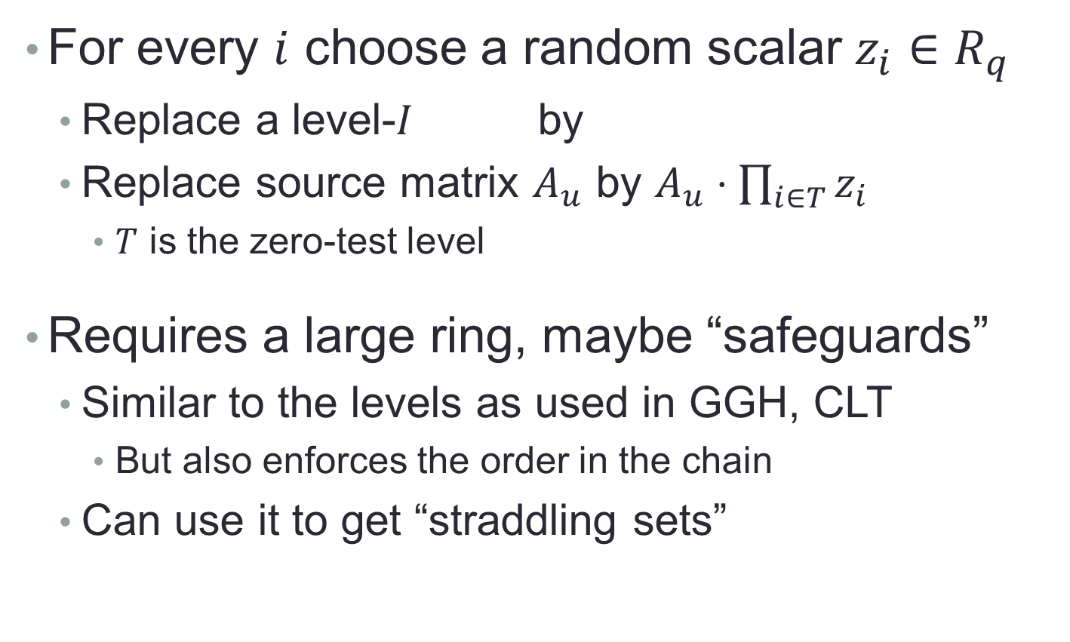

Levels (e.g., for a chain)
For every $i$ choose a random scalar $z_{i}∈R_{q}$
  Replace a level-$I$ by
  Replace source matrix $A_{u}$ by $A_{u}⋅\prod_{i∈T}{z_{i}}$
    $T$ is the zero-test level
Requires a large ring, maybe “safeguards”
  Similar to the levels as used in GGH, CLT
    But also enforces the order in the chain
  Can use it to get “straddling sets”
$$C$$
$$C / ∏i_{∈I}z_{i}$$

Slide 36
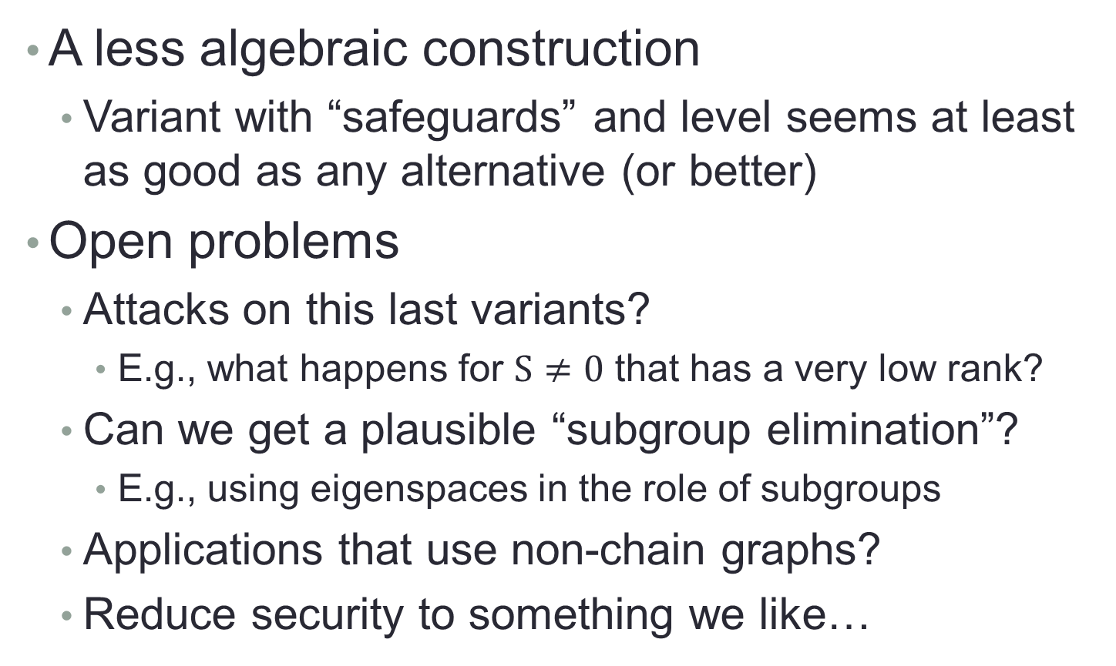
Conclusions and Future Work
A less algebraic construction
  Variant with “safeguards” and level seems at least as good as any alternative (or better)
Open problems
  Attacks on this last variants?
    E.g., what happens for $S≠0$ that has a very low rank?
  Can we get a plausible “subgroup elimination”?
    E.g., using eigenspaces in the role of subgroups
  Applications that use non-chain graphs?
  Reduce security to something we like…

Slide 37

Thank You
Questions?

