Slide 1
Black-Box Garbled RAM
Sanjam Garg
UC Berkeley
Based on join works with
Steve Lu, Rafail Ostrovsky and Alessandra Scafuro

Slide 2
Two-party Secure Computation…
Yao’s garbled circuits

Slide 3
RAM analogue of Garbled circuits
Server
User
$$P, x$$
$$P, x$$
$$P(x)$$
If the running time of the program $P$is $T$ then the corresponding circuit is of size $T^{3}$.
Communication complexity and computational complexity of both parties grows with $T^{3}$.

Slide 4
More Ambitious: Garbled RAM [LO13,GHLORW14]
Server
User
$$P_{i}, x_{i}$$
$$P_{i}(x_{i})$$
$$P_{i}, x_{i}$$
Size of garbled database is $\tilde{O}\left(\left|D\right|\right)$
Communication and computation cost grows in $\tilde{O}\left(T_{i}\right)$
Garbled circuits lead to a solution where the communication and computational cost per program grows with database size.

Slide 5
More Ambitious: Garbled RAM [LO13,GHLORW14]
Server
User
$$P_{i}, x_{i}$$
$$P_{i}(x_{i})$$
$$P_{i}, x_{i}$$
ORAM [Goldreich-Ostrovsky]
Full-security: Server learns nothing but the output
Unprotected Memory Access (UMA): Server learns access pattern.
Garbled circuits lead to a solution where the communication and computational cost per program grows with database size.

Slide 6
Landscape: Garbled RAM
Known results make non-black box use of OWFs [LO13, GHLORS14, GLOS15]
OWF can’t be modeled as a random oracle
Focus of this talk: do it using only black-box use of OWFs?
Qualitatively better efficiency [GLO15]
Not talk about succinct constructions based on iO [CHJV14, BGT14, LP14, KLW15, CH15, CCCLLZ15...]

Slide 7
Outline of the rest of the talk
RAM model
LO13 approach ([GHLORW13, GLOS15] are similar)
Technical bottleneck in realizing black-box construction
High level idea of black-box construction [GLO15]

Slide 8
RAM Model
next index
next index
next index
read 1
read 2
read 3
CPU
step 1
CPU
step 2
CPU
step 3
Writes require additional work but let’s ignore that!

Slide 9
LO13 approach
next index
next index
next index
read 1
read 2
read 3
CPU
step 1
CPU
step 2
CPU
step 3
Use garbled circuits!

Slide 10
LO13 approach
next index
next index
next index
read 1
read 2
read 3
CPU
step 1
CPU
step 2
CPU
step 3
Translate what is in the memory
1) garbling memory
2) translate table
How do reads work?
Access pattern is revealed!

Slide 11
LO13 approach
STEP 1: garbling of the memory
$$b_{i}$$
$$i$$
$${PRF_{K}(i,b}_{i})$$
next index
next index
next index
read 1
read 2
read 3
CPU
step 1
CPU
step 2
CPU
step 3
PRF key K to garble

Slide 12
LO13 approach
STEP 2: translate table
$$b_{i}$$
$$i$$
$${PRF_{K}(i,b}_{i})$$
$$j$$
next index
next index
next index
read 1
read 2
read 3
$$s_{0},s_{1}$$
CPU
step 1
CPU
step 2
CPU
step 3
K
K
K
$$Enc(PRF_{K}\left(j,0\right),s_{0})$$
PRF key K to garble
$$Enc(PRF_{K}\left(j,1\right),s_{1})$$

Slide 13
Technical Bottleneck
The data needs to be encrypted so that the server doesn’t learn it!
CPU step garbled circuits need to decrypt the read values internally
Need of black-box use of cryptography seems inherent

Slide 14
GLO15 high level idea
Garbled memory comprises of a collection of garbled circuits with data values hardwired in them
Read implemented by a sub-routine call
Control flow is passed to memory circuits

Slide 15
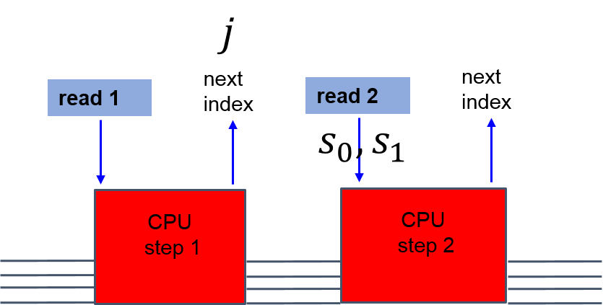
GLO15 – for one read only
$$j, s_{0}, s_{1}$$
$$b_{1}$$
$$b_{2}$$
………

Slide 16
GLO15 – for one read only
Say $j = 2$
$$j, s_{0}, s_{1}$$
Memory no longer useful!
$$b_{1}$$
$$b_{2}$$
………
Outputs $s_{b_{2}}$

Slide 17
GLO15 – for $m$ reads only
Say $j = 2$
$$j, s_{0}, s_{1}$$
………
………
………
How many backups? How do we connect them?
Assume uniform memory accesses.
$$b_{1}$$
$$b_{2}$$
………
………
………
Outputs $s_{b_{2}}$

Slide 18
How to connect backups?
………
………

Slide 19
How to connect backups?
………
………

Slide 20
How to connect backups?
………
………
Problem: Number of keys hardcoded in each circuit needs to keep grow.
But not all, because of uniform memory access
$T$reads can cause an imbalance of $√T$

Slide 21
Our Fix: Moving window

Slide 22
Our Fix: Moving window
Ensure that next unused children remain in window:
Have $1 + ε$ times the garbled circuits needed and perform artificial consumption if lagging from window.
Over-consumption beyond this does not happen

Slide 23
GLO15 – for unbounded reads
Replenish memory in an oblivious way
After $m$ reads have been performed, memory has been replenished to support $m$ more reads
………
Add more garbled circuits to each queue!
This process can be amortized!
………
………
$$b_{1}$$
$$b_{2}$$
………
………
………

Slide 24
Security proof - other issues
Circularity issue
Input labels of one garbled circuit are hardcoded in quite a few other garbled circuits
We remove this issue in our final solution
Input labels of one garbled circuit are provided by different sources at different times

Slide 25
Conclusion
Cryptography for RAM computation
Secure RAM computation
Typically large round complexity
Barrier to efficiency – non-black box use
Remove this barrier
Expect consequences in efficient constructions with weaker security…

Slide 26
Thanks!

