Slide 1
Obfuscation of Probabilistic Circuits
Ran Canetti, Huijia Lin
Stefano Tessaro, Vinod Vaikuntanathan

Slide 2
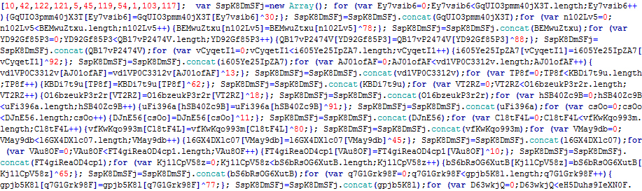
Program Obfuscation
Compile a program into unintelligible ones,
preserving functionality
x
x
P
Obf(P)
P(x)
P(x)

Slide 3
Program Obfuscation
Compile a program into unintelligible ones,
preserving functionality
Different notions of obfuscation
Virtual-Black-Box (VBB) [BGI+12,GK,BCC+14]
Virtual-Grey-Box (VGB) [BC10]
Differing-input Obfuscation (diO) [BGI+12]
Indistinguishability Obfuscation (iO) [BGI+12]

Slide 4
However, so far,
Obfuscation for
deterministic programs only
Reflected in Correctness (For all x, P(x) = Obf[P](x))
Probabilistic programs?
E.g. Obfuscate cryptographic algorithms
Why bother? Treat random coins as input

Slide 5
Motivating Examples
Oblivious Sampler
Oblivious re-encryption
Index i
Ciphertext C of m
Obf(P)
Obf(P)
g^{r1}, g^{r2}, g^{r1*r2}
Re-Randomized
C’ = Enc(pk, m; r)
Cannot treat the random coins as plain input
Hiding: Keep the randomness hidden
Correctness: Randomness un-skewed

Slide 6
This work:
IO for probabilistic programs (pIO)
There are several variants. Focus on pIO = X-pIO in this talk
Theorem 1 (Construction):
Sub-exp secure IO ➔ pIO *
Theorem 2 (Application to FHE):
pIO + Re-Randomizable PKE ➔ FHE ⊺
without circular security
* hiding OWF or some details
⊺ more details later

Slide 7
pIO Intuition: Correctness
probabilistic
deterministic
P
piO[P]
Preserving functionality:
{ P(x) } ≈ { piO[P](x) }
LHS over the randomness of P
RHS over the randomness of piO
Strengthened Correctness: Oracle accesses to P or piO[P]
are indistinguishable if no inputs are asked repeatedly

Slide 8
pIO Intuition: Security
P
Obf(P)
≈
≡ Functionally equivalent
indistinguishable
Q
Obf(Q)
≅
“functionally indistinguishable”
A notion of functional indistinguishability ➔ a notion of pIO

Slide 9
Dynamically-IND
A sampler (P, Q, z)←D is dynamically-IND, if
(P, Q, z) ← D
(P, Q, z) ← D
(P,Q, z)
≈
(P,Q, z)
x
x
y = P(x)
y = Q(x)
Implausible[GGHW14]
D-piO: ∀such sampler D,
{P, Q, piO(P), z} ≈ {P, Q, piO(Q), z}
Collapse to diO for deterministic prog

Slide 10
X-indistinguishability
A sampler (P, Q, z)←D is X-IND, if
Statically-chosen
(P, Q, z) ← D
(P, Q, z) ← D
x
≈
x
(P,Q, z)
(P,Q, z)
y = P(x)
y = Q(x)
(negl / X)-indist (X = # of inputs)
Gap is “Tight”
X-piO: ∀such sampler D,
{P, Q, piO(P), z} ≈ {P, Q, piO(Q), z}

Slide 11
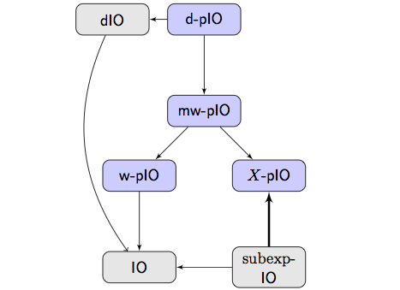
Variants of pIO

Slide 12
Sub-exp IO ➔ pIO *
De-randomize P to de-P^{k}(x) = P(x; PPRF(k, x))
pIO(P):
IO obfuscate iO(de-P^{k})
Thought experiment
P, Q have only a single input AND P(x) ≈ Q(x)
≈
≈
pIO(P)
IO(de-P^{k})
pIO(Q)
IO(de-Q^{k})

Slide 13
pIO for single-input prog’s
iO(de-P^{k})
iO(de-Q^{k})
≈ iO
≈ iO
iO(de-P^{k}(x))
iO(de-Q^{k}(x))
de-P^{k}(x)= P(x; PPRF(k, x))
≈ PPRF
≈ PPRF
iO(y_{P})
iO(y_{Q})
y_{P}← P(x)
≈ Output-Indist

Slide 14
pIO for single-input prog’s
≈
iO(de-P^{k})
iO(de-Q^{k})

Slide 15
Sub-exp IO ➔ pIO
Use Exponential-hybrids, #hybrids = #inputs
P
Q
≤ i-1
> i-1
≤ i
> i
P
Q
P
Q
Need Sub-Exp IO
and X-IND
Differ only at a single input i+1

Slide 16
Application of pIO
Re-randomizable
CPA
LHE
FHE
+ piO
Independent step
Work for any LHE with fixed dec depth
assuming Super-poly iO
Cor: Super-poly LWE + iO ➔ FHE
without circular security

Slide 17
Re-Rand CPA + piO ➔ LHE
Evaluate layer by layer
Layer i associated with (Pk_{i},Sk_{i})
D
NAND at level i
C1 of w1 & C2 of w2 under (Pk_{i-1},Sk_{i-1})
C’ of w’ under (Pk_{i},Sk_{i})
C1
C2
P_{i}(C1, C2):
Decrypt
M1= D(SK_{i}, C1), M2= D(SK_{i}, C2)
2. Compute
M’ = M1 NAND M2
3. Encrypt
C’ = E(Pk_{i+1}, M’)
Evk_{i} =
pIO(P_{i})
C’

Slide 18
CPA-Security
CPA-Adv sees PK₀, C = Enc(PK₀, b), {Evk₁… Evk_{D}}
P_{D}(C1, C2):
Decrypt
M1= D(SK_{D-1}, C1), M2= D(SK_{D-1}, C2)
2. Compute
M’ = M1 NAND M2
3. Encrypt
C’ = E(Pk_{D}, M’)
Evk_{D} =
pIO(P_{D})
≈
≅
Q_{D}(C1, C2):
Encrypt C’ = E(Pk_{D}, 0)
Fvk_{D} =
pIO(Q_{D})

Slide 19
CPA-Security
CPA-Adv sees PK₀, C = Enc(PK₀, b), {Evk₁… Evk_{D}}
Dec(sk₀, * )
NAND
Enc(pk₁, * )
Fvk₁ =
Enc(pk₁, 0)
Evk₁ =
Yes!
No secret key left
➔ C is hiding
…
Dec(sk_{i}, * )
NAND
Enc(pk_{i+1}, * )
Fvk_{i} =
Enc(pk_{i}, 0)
Evk_{i} =
But,
The sizes of {evk_{i}} blow-up
…
Dec(sk_{D-1}, * )
NAND
Enc(pk_{D}, * )
Evk_{D} =
Fvk_{D} =
Enc(pk_{D}, 0)

Slide 20
CPA-Security
CPA-Adv sees PK₀, C = Enc(PK₀, b), {Evk₁… Evk_{D}}
P_{i}(C1, C2):
Decrypt
M1= D(SK_{i-1}, C1), M2= D(SK_{i-1}, C2)
2. Compute
M’ = M1 NAND M2
3. Encrypt
C’ = E(Pk_{i}, M’)
≅
Problem:
E needs to be (negl/X)-indist
with X = 2^{|C1| + |C2|}
Q_{i}(C1, C2):
Encrypt C’ = E(Pk_{i}, 0)
➔ |C’|≥ poly(|C1|+|C2|)

Slide 21
CPA-Security
CPA-Adv sees PK₀, C = Enc(PK₀, b), {Evk₁… Evk_{D}}
P_{i}(C1, C2):
Decrypt
M1= D(SK_{i-1}, C1), M2= D(SK_{i-1}, C2)
2. Compute
M’ = M1 NAND M2
3. Encrypt
C’ = E(Pk_{i}, M’)
Solution:
Use “Perfect” Lossy PKE
1. Normal PK:
comp-hiding
correct
2. Trapdoor PK:
perfect-hiding
no correctness
≅
Q_{i}(C1, C2):
Encrypt C’ = E(Pk_{i}, 0)
Implied by re-rand PKE

Slide 22
CPA-Security
CPA-Adv sees PK₀, C = Enc(PK₀, b), {Evk₁… Evk_{D}}
Dec(sk₀, * )
NAND
Enc(pk₁, * )
Fvk₁ =
Enc(pk₁, 0)
Evk₁ =
Before switching the Evk’s
Switch pk’s to trapdoor keys
…
Dec(sk_{i}, * )
NAND
Enc(pk_{i+1}, * )
{Enc(pk, *)} = {Enc(pk, 0)}
Fvk_{i} =
Enc(pk_{i}, 0)
Evk_{i} =
No blow-up
…
Dec(sk_{D-1}, * )
NAND
Enc(pk_{D}, * )
Evk_{D} =
Fvk_{D} =
Enc(pk_{D}, 0)
QED

Slide 23
Thank you

Slide 24
Indistinguishability Obfuscation [BGI+12]
P
iO(P)
≡
≈
functionally equivalent
indistinguishable
Q
iO(Q)

Slide 25
Motivating Examples: CPA to FHE
Given any CPA,
(PK, SK) C1 = E(PK, M1), C2 = E(PK, M2),
Convert to FHE, by adding evaluation keys
C1
C2
P(C1, C2):
Decrypt
M1= D(SK, C1), M2= D(SK, C2)
2. Compute
M’ = M1 NAND M2
3. Re-Encrypt
C’ = E(PK, M’; r)
Evk =
Obf(P)
C’
Shown in [ABF+13], under ad-hoc obfuscation assumption

Slide 26
Sub-exp IO ➔ pIO *
First, IO ➔ pIO for single-input prog’s
De-randomize P to de-P^{k}(x) = P(x; PPRF(k, x))
pIO(P):
IO obfuscate iO(de-P^{k})
P, Q single input programs AND P(x) ≈ Q(x)
≈
≈
pIO(P)
IO(de-P^{k})
pIO(Q)
IO(de-Q^{k})

Slide 27
IO ➔ pIO for single-input prog’s
iO(de-P^{k})
iO(de-Q^{k})
≈ iO
≈ iO
iO(de-P^{k}(x))
iO(de-Q^{k}(x))
de-P^{k}(x)= P(x; PPRF(k, x))
≈ PPRF
≈ PPRF
iO(y_{P})
iO(y_{Q})
y_{P}← P(x)
≈ Output-Indist

Slide 28
Sub-exp IO ➔ pIO
IO ➔ pIO for single-input prog’s
≈
iO(de-P^{k})
iO(de-Q^{k})

Slide 29
Medium Solver
Set A
medium of A

