Slide 1


How to Use Bitcoin to Enhance Secure Computation
Ranjit Kumaresan (MIT)
Based on joint works with
Iddo Bentov (Technion), Tal Moran (IDC), Guy Zyskind (MIT)

Slide 2


Secure Computation
[Yao86,GMW87,BGW88,CCD88,RB89,…]
x
y
f (x,y)
f (x,y)
Most general problem in cryptography
Moving fast from theory to practice
  Major research effort
    Implementation & “systems’’ issues
Notes:
Mike about “implementation”, Yehuda’s talk about “systems”,

Slide 3

Bitcoin [Nak08]
Decentralized digital currency
  Provides some level of anonymity
Widely adopted
Lots of recent research activity
“Securely” implements a bank
Wide variety of transactions
  Expressive via Bitcoin “scripts” + timelocks
Wide range of applications
  E.g.: Lottery, gambling, auctions,…
  Currently done using a “trusted” party
Notes:
Instead of picking on the wimpy functions we go after the toughest functions on the block.

Slide 4
Issues with Traditional MPC
Fairness [Cle86,ASW97,BN00,Pin03,Lin08,GK08,KL10,…]
  Provably impossible in the presence of dishonest majority
Resource fairness [GM99,GMPY06,BCE⁺07,BCE⁺08,…]
  Honest party wastes resources even when no one gets output
Protocol completion [Cle86]
  Cannot guarantee in multi-stage reactive computation
Cash distribution [JJ93,GM99,BCE⁺07,BCE⁺08,…]
  Cannot handle money in auctions, poker, etc.
Malicious MPC [GMW87,Pin03,MF06,LP07,…]
  Tremendous progress but still huge overhead
Notes:
These problems exist even assuming perfect VBB obfuscation…

Slide 5

Penalty Model
[ASW00,MS01,CLM07,Lin08,KL10,ADMM14a,…]
Deviating party pays monetary penalty to honest party
Bad guys lose money if they deviate
Honest parties never lose money
Fairness
Resource usage
Protocol completion
Cash distribution
Malicious 2PC
Applications
  Fair lottery, poker, auctions, markets
View as “complex” contracts
  With privacy/security
Build from “simple” contracts
  Stateless; involves only 2 parties
Notes:
Instead of picking on the wimpy functions we go after the toughest functions on the block.

Slide 6
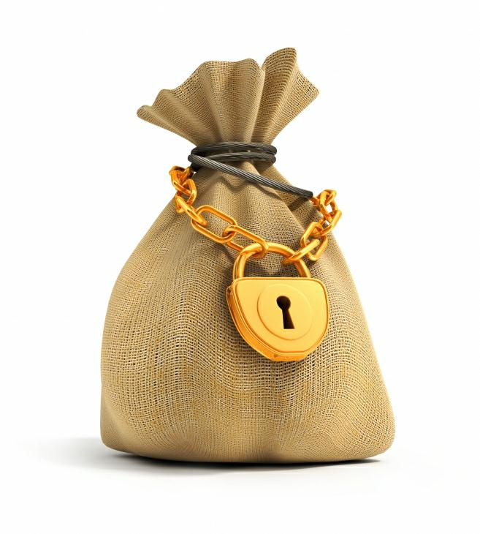


Claim-or-Refund Functionality
Implicit in [Max11,BBSU12,BB14]
F_{CR}
Accepts from “sender” S
  Deposit: coins(x)
  Time bound: τ
  Circuit: ϕ
Designated “receiver” R can claim this deposit
  Produce witness T that satisfies ϕ
  Within time τ
If claimed, then witness revealed to ALL parties
Else coins(x) returned to S
T
ϕ, τ
Efficient realization via Bitcoin
Bitcoin scripts & timelocks
Allows realization in & across different models
Notes:
Escrow like functionality

Slide 7
Efficiency Metrics
Computation/communication/round complexity
  Varies depending on application
Validation complexity
  Complexity of scripts (complexity of ϕ)
  Reduced load on the Bitcoin network
  Faster validation
  Transaction fee proportional to validation complexity
Optimistic complexity
  Typically expect parties to behave honestly
  Optimize for this; not for worst case
Notes:
Instead of picking on the wimpy functions we go after the toughest functions on the block.

Slide 8
Practical Issues
Attacks on Bitcoin (e.g., 51%) break our schemes
Good communication network
  No DoS, etc.
Extended script support
  Currently many opcodes blacklisted
  Altcoins with Turing-complete scripts (Ethereum)
  Support with increased transaction fees
Heavy crypto
  Garbled circuits, SNARKs, NIZKs, …
  Efficiency expected to improve
Notes:
Instead of picking on the wimpy functions we go after the toughest functions on the block.

Slide 9
Talk Outline
Enhancements to secure computation
  Fairness
  Resource fairness
  Protocol completion
  Cash distribution
  Malicious secure computation
Notes:
Instead of picking on the wimpy functions we go after the toughest functions on the block.

Slide 10

Fairness in Secure Computation
Fair exchange/Contract signing:
  Two parties want to sign a contract
  Neither wants to commit first
    The other signer could be malicious…
  Impossible! [Cle86,BN00]
Fairness in the penalty model
  Can abort after learning output but pay penalty to other parties
Fair secure computation with penalties
2-party lottery [BB14]; multiparty lottery [ADMM14a]
2-party secure computation [ADMM14b]
Multiparty secure computation in F_{CR} hybrid model [BK14a]
  Validation complexity: hash verifications
Efficiency improvements via complex contracts [BK14b,KVZ15]
Notes:
Instead of picking on the wimpy functions we go after the toughest functions on the block.

Slide 11
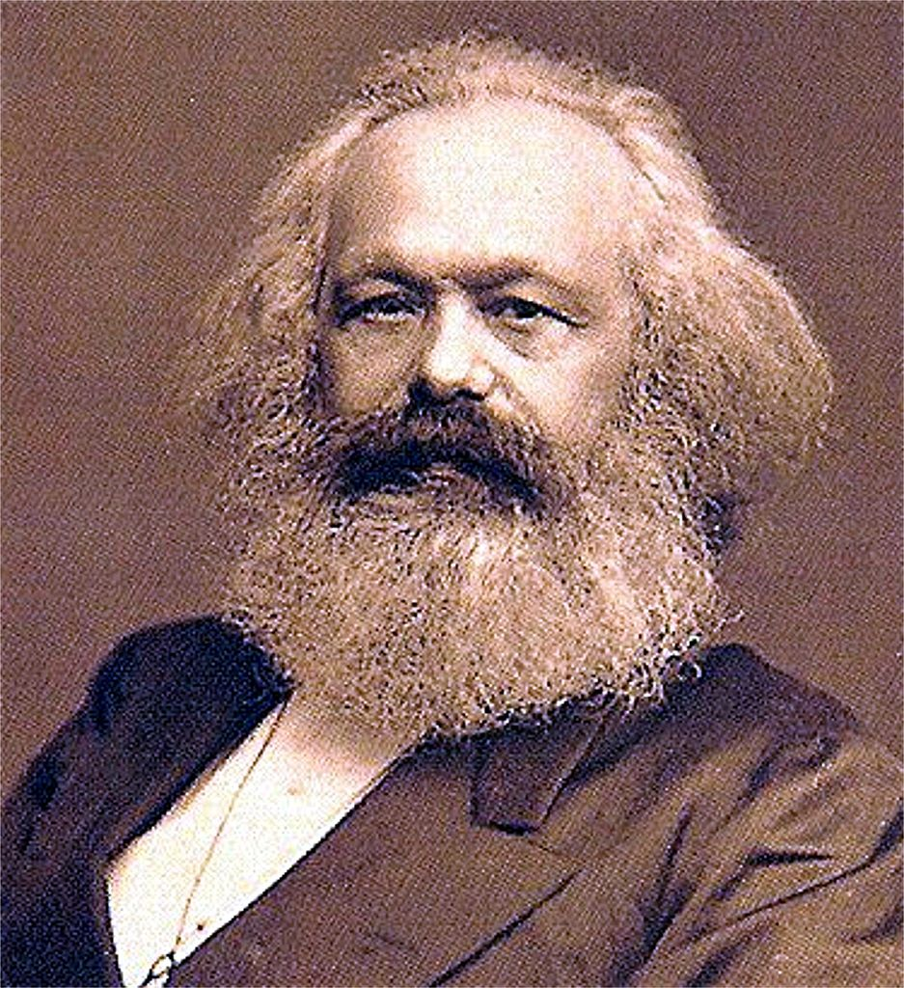
Secure Computation with Penalties
Honest parties submit
  Inputs
  Deposit: coins(d)
Ideal adversary submits
  Inputs of corrupt parties
  Penalty deposit: coins(x)
Functionality F_{f*} does:
  Return coins(d) to each honest party
  Deliver output to S iff x = hq where h = #honest parties
    If S returns abort, send coins(q) to each honest party
    If S returns continue, send output to each honest party and return coins(x) to S
  If x != hq, then send output to all parties
F_{f*}
q = penalty amount
Notes:
Honest parties don’t lose money
Adv aborts after learning output then each honest psarty is compensated

Slide 12
Strategy
Reduce fair secure computation to
fair reconstruction
Run secure computation that:
  Computes output of f, say z
  Secret share z into n additive shares sh₁,…,sh_{n}
  Computes commitments c_{i} = SHA(sh_{i}; w_{i}) for every i
  Delivers output: ({c₁,…,c_{n}}, T_{i} = (sh_{i}, w_{i})) to party P_{i}
denotes
P₂ must reveal witness T = (sh,w) within time τ to claim coins(q) from P₁
Notes:
Escrow like functionality

Slide 13
“Ladder” Protocol [BK14a]
Order of deposits/claims
Roof deposits made simultaneously
Ladder deposits made one after the other
Ladder claims in reverse
Roof claims at the end
Roof
High-level intuition
At the end of ladder claims, all parties except P_{n} have “evened out”
If P_{n} does not make roof claims then honest parties get coins(q) via roof refunds
Else P_{n} “evens out”
Ladder
Notes:
Instead of picking on the wimpy functions we go after the toughest functions on the block.

Slide 14


Resource Fairness
Verifiable Computation
Incentive for the server?
  Pay per computation model
  Client pays server for output
Fairness issues?
  Client aborts after learning output, doesn’t pay
  Cannot pay ahead of time, server might just not compute!
Fair scheme for verifiable computation [BK14b]
2PC to compile any VC into a “fair” VC using F_{CR}
  Validation complexity = Client verification (e.g., SNARK)
Notes:
Instead of picking on the wimpy functions we go after the toughest functions on the block.

Slide 15

Resource Fairness
Private Simultaneous Messages
f (x,y)
Multiple clients, one referee
Clients share randomness
Clients send single mesg
Referee learns f(x,y) alone
x,r
r,y
Setting where referee pays for output
  Honest client computes, but dishonest client deviates
    Referee doesn’t get output, so shouldn’t pay
  Need to compensate honest client for wasted computation
    Need to penalize dishonest client
Resource Fair PSM [KZ15]
Constant round solution in F_{CR} hybrid model
Validation comp. O(|x|+|y|); comm. comp. = 4 x semihonest Yao
Notes:
Instead of picking on the wimpy functions we go after the toughest functions on the block.

Slide 16
Secure Protocol Completion with Penalties
[BKM15]
General protocol completion
  Reactive multi-stage computation
  Penalize on aborts; every honest party gets compensated
Does NOT reduce to the non-reactive case
  Fairness with penalties works for a single stage
    Does not guarantee next stage computation will happen
  Aborts between stages need to be penalized as well
Applications:
  Multi-round adaptive fair exchange
    Adaptively decide on commodities to exchange based on commodities exchanged in previous stages
  Mental poker
Notes:
Instead of picking on the wimpy functions we go after the toughest functions on the block.

Slide 17






Cash Distribution
Functionality takes “values” and “coins”
  Coins redistributed depending on output
Secure Cash Distribution with Penalties
Introduced in [ADMM14a]; 2-party non-reactive solved [ADMM14b]
Generalizations [BKM15]
  Multiparty; bounded reactive computations
  Construction in F_{CR} hybrid model
  Validation complexity: Verification of underlying reactive MPC messages

Slide 18
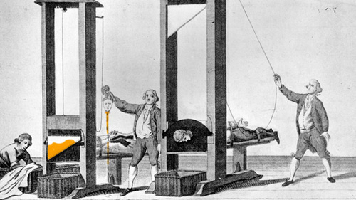
Efficient Secure Computation
[…,LP07,LPS08,LP11,sS11,NNOB12,HEK13,MR13,Lin13,HKKKM14,LR14,…]
Cost of Malicious 2PC
40 x semi-honest
8 x semi-honest (amortized)
Dual Ex [MF06,HEK12]
2 x semi-honest
But leaks 1-bit of honest input!
Leakage only when cheating
Detected when cheater guesses leaked bit incorrectly
Bad for multiple executions
Penalizing deviations in Dual Ex [BK14b]
  Penalize cheating party whenever leakage detected
  Preserve efficiency of Dual-Ex when parties behave honestly
  Validation complexity:
    Optimistic: hash verifications; Worst case: depends on function
Notes:
Instead of picking on the wimpy functions we go after the toughest functions on the block.

Slide 19
Summary
MPC Enhancements
Fairness
Resource usage
Protocol completion
Cash distribution
Malicious 2PC
Applications
  Fair lottery, poker, auctions, markets
View as “complex” contracts
  With privacy/security
Build from “simple” contracts
  Stateless; involves only 2 parties
Future directions
Formalizations?
More applications?
Efficiency improvements?
  Round complexity
Thank You!
Notes:
Smart contracts that Elaine talked about…

