Slide 1




Practical Private
DB Querying
Vladimir Kolesnikov (Bell Labs)
Steven M. Bellovin, Seung Geol Choi, Ben Fisch, Wesley George,
Angelos Keromytis, Fernando Krell, Abishek Kumarasubramanian,
Tal Malkin, Vasilis Pappas and Binh Vo

Slide 2
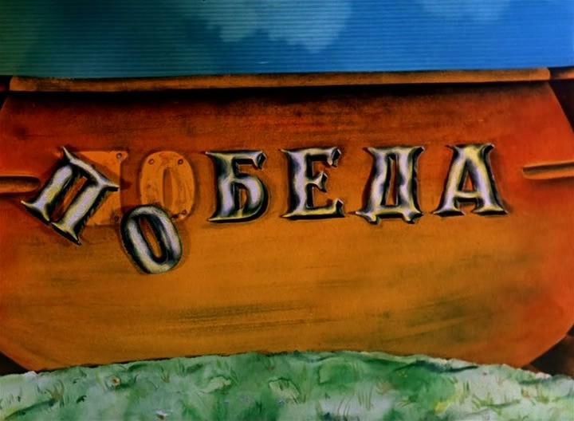
BLIND SEER
Как вы яхту назовете,
Так она и поплывет.
*The boat’s character is determined by her name.
BLoom-filter INDex SEarch of Encrypted Results
BLIND SEER

Slide 3
Outline
  Problem
  High-level Approach
  Selected subtleties
  Motivation for MPC scenarios

Slide 4
Required features
100M records, 10TB DB
Preserve query and data privacy
Robust query support:
select * where NAME=Bob AND AGE >20
Boolean query expressions (including at least three conjunctions)
Range queries and inequalities for integer numeric, date/time, etc
Matching of keywords ―close to a specified value (stemming)
Text fields with many keywords (e.g. 100’s)
Matching of values with wildcards
Matching of values with a specified subsequence
m-of-n conjunctions
Ranking of results
…
Allowed up to 2-10x overhead compared to MySQL

Slide 5
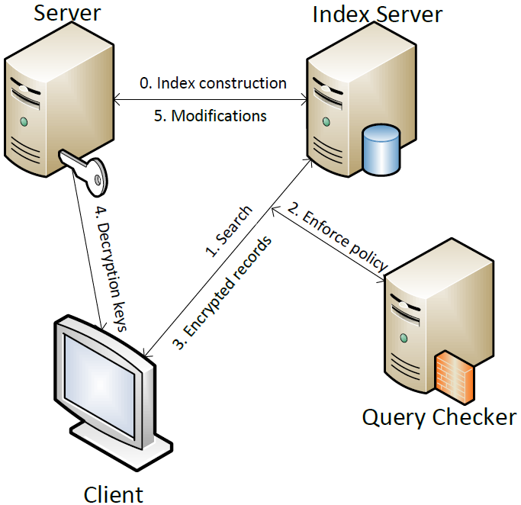
Blind Seer Architecture
Notes:
The Server is thought of as the "data owner." The Server builds and encrypted index to the DB and sends it to the Index Server. The Index Server interacts with the Client to process the Client's private queries on the encrypted index. The Client obtains the encrypted records returned by its query, and obtains the keys to decrypt these records from the Server.
Animation adds query checker
Reminder to say: logically could be run on the server or index server, but for sake of generality we depict it as a separate entity

Slide 6
Secure Computation: how to scale
  If OK to have some security loss (as efficiency tradeoff):
  Identify privacy-critical subroutines and implement them securely
  Insecure implementation of the rest
  Challenge: Understand and formalize security guarantees (hard problem)

Slide 7
Natural Trade Offs
  Deterministic encryption
  Because of scale, comparison of encrypted values used in search must be very fast. Not clear how to approach with probabilistic encryption
  Access patterns
  Seems quite expensive to avoid, so live with it.

Slide 8
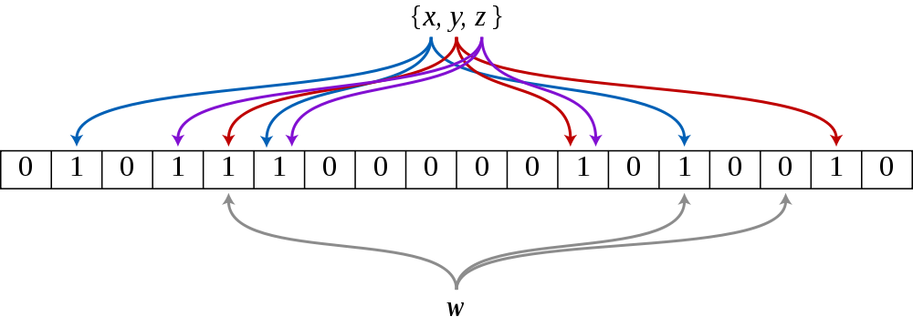
Bloom Filter
  Constant-time querying
  Efficient storage (ca 10 bits per keyword)
  Fixed access pattern (same for both match and non-match)
Encrypted BF:
  Same as BF, but objects are encrypted – need deterministic encryption

Slide 9
Occluded BF
Query: C sends Enc(kw), S computes match
OK for single keyword searches
For formulas, need to hide terms matching
Idea:
Mask BF with a (pseudo-)random pad
Let Client know the pad (via seed)
Then Client and Server run SFE for computing match, where C inputs pad.
GC is very efficient: 10-20 gates per term, plus gates to implement formula.

Slide 10
DB Search
C
S
DB records
Solution: Evaluate via Secure Computation
…
…
…
…
…
…

Slide 11
Security Guarantee
  We leak to S at most the following access patterns:
  - the query pattern of a set of queries (e.g., S can distinguish between simple and complex queries)
  - tree search pattern of each query
  - returned records access pattern

Slide 12
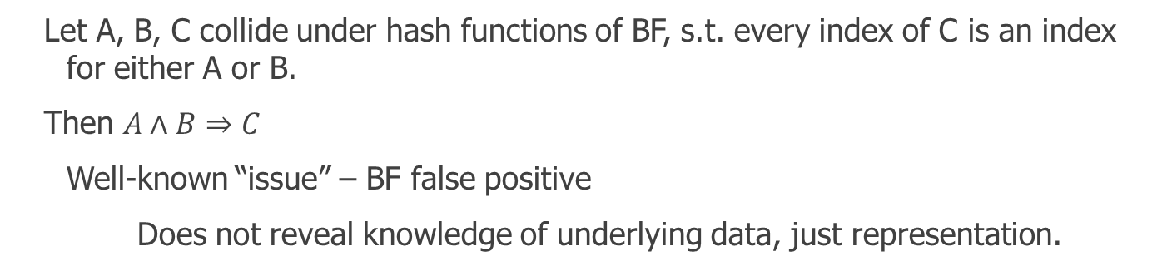
Subtlety 1: inexact data representation by BF
A
B
C
  Let A, B, C collide under hash functions of BF, s.t. every index of C is an index for either A or B.
  Then $A∧B⇒C$
  Well-known “issue” – BF false positive
  Does not reveal knowledge of underlying data, just representation.

Slide 13
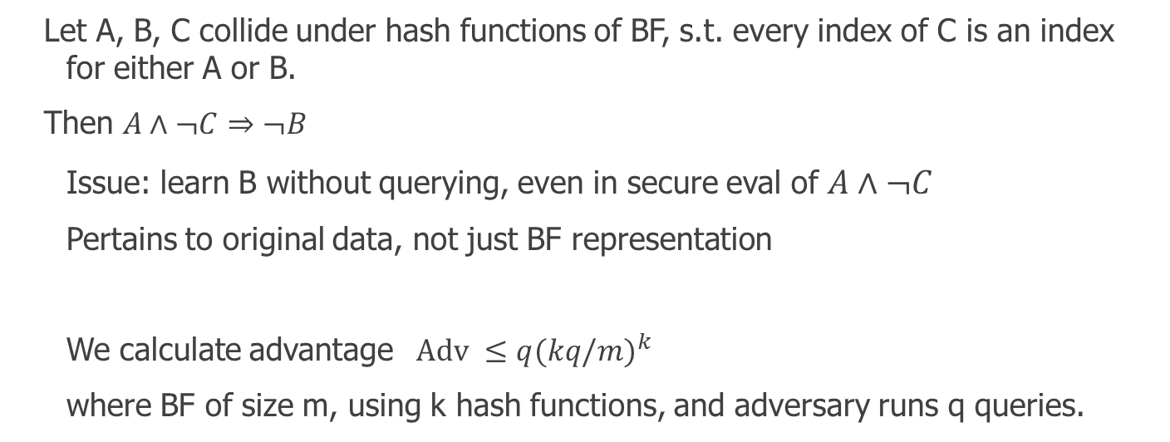
Subtlety 1: inexact data representation by BF
A
B
C
  Let A, B, C collide under hash functions of BF, s.t. every index of C is an index for either A or B.
  Then $A∧¬C⇒¬B$
  Issue: learn B without querying, even in secure eval of $A∧¬C$
  Pertains to original data, not just BF representation
  We calculate advantage $\text{Adv} ≤{q(kq/m)}^{k}$
  where BF of size m, using k hash functions, and adversary runs q queries.

Slide 14
0-1 Result Set Size Indistinguishability
  Goal: hide from S whether there was a 0 or 1 match.
  S is an airline and C is gov’t querying for POI. Expect 0 hits
  S learning of a match can be disruptive.
  Def 1: Consider probability of bad event, prove it’s small
  Def 2: If distinguishable, guarantee that D’s confidence is not very high

Slide 15
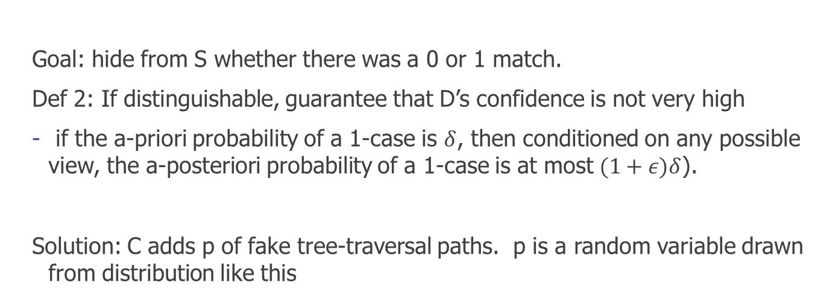
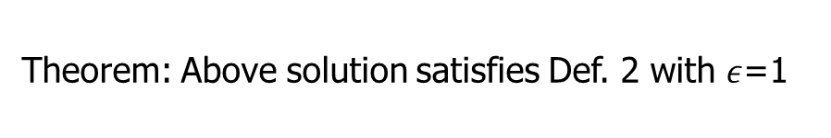
0-1 Result Set Size Indistinguishability
  Goal: hide from S whether there was a 0 or 1 match.
  Def 2: If distinguishable, guarantee that D’s confidence is not very high
  if the a-priori probability of a 1-case is $δ$, then conditioned on any possible view, the a-posteriori probability of a 1-case is at most $(1+ε)δ$).
  Solution: C adds p of fake tree-traversal paths. p is a random variable drawn from distribution like this
N paths
Theorem: Above solution satisfies Def. 2 with $ε$=1

Slide 16
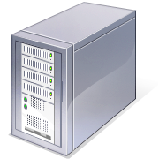


Malicious behavior in OT/Circuit generation
Index
Server
Big potential
for cheating
Client Query
For results
Client Query For Check
Query
Checker
Client

Slide 17
Malicious behavior in OT/Circuit generation
Index
Server
Client does not learn the
output of either the policy
Or the result. Learns only
garbled output
Garbled Universal
Circuit
Information to
Synchronize keys
Query
Checker
Garbled Query Check Circuit
Client

Slide 18
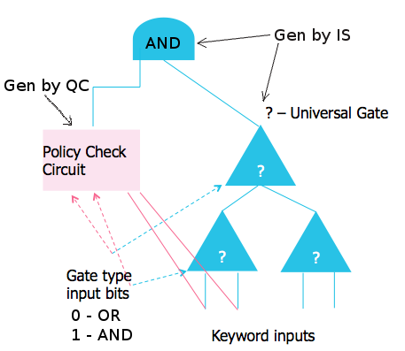
(Malicious.. ) Universal Circuit
IS generates universal circuit which evaluates any circuit on any input.
Circuit has a fixed tree pattern. The gates and inputs are unknown and provided by the client and IS
AND of policy check circuit and universal circuit performed
Inputs to PC and Evalualtion Circuits are cryptographically binded.

Slide 19
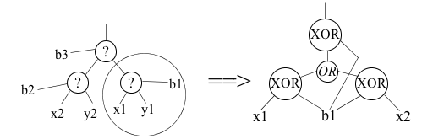
Universal Query Circuit Transformation
“Free” XOR gates!

Slide 20
Practical MPC problems from Blind Seer
  Universal circuit for a small set of circuits (queries meeting policy)
  Here latency not very important. Throughput is important
  Often no opportunity for offline phase (queries arrive at same rate)
  GC batching in the hundreds of thousands
  Small shallow circuits (# of OTs similar to # gates)
  Fast server-aided malicious security (S does not know circuit)

