Slide 1
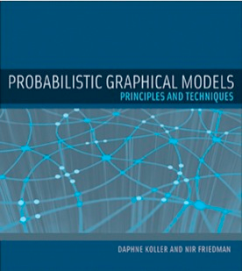
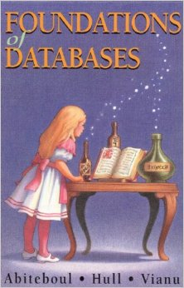
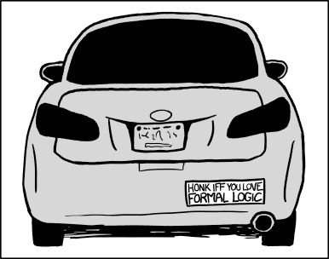
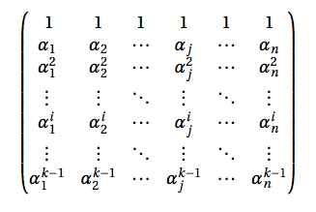
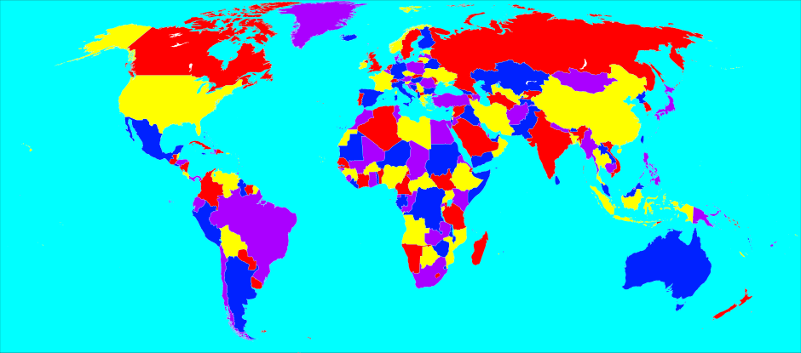
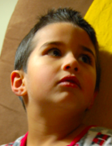
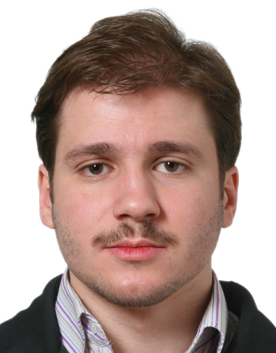
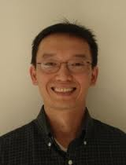
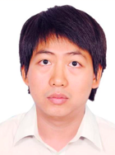
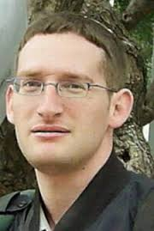
Answering FAQs
in CSPs, PGMs, Databases, Logic and Matrix Operations
Atri Rudra

Slide 2
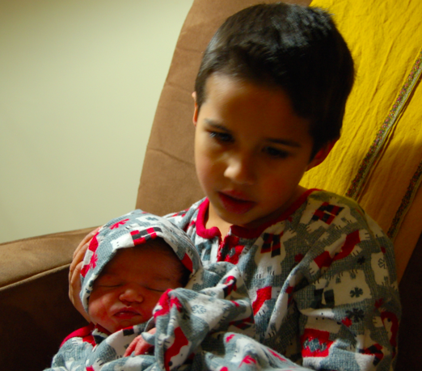
On FAQs
“Baby” FAQs

Slide 3
Baby FAQs
X₀
Variables V = {X₀, X₁, …, X_{n-1}}
R
T
Hypergraph H = (V, E )
X₁
X₂
S
Factors: for every e in E
ψ_{e}: Π _{i in e} Dom(X_{i}) ➔ D
Aji
McEliece
There are f “free” variables
(D, ✜ ,✪ ) is a semi-ring*
Functional Aggregate Query
φ (x₀,…,x_{f-1}) = ✜ _{x ,..,x} ✪_{e in E} ψ_{e}(x_{e})
f
_{n-1}

Slide 4
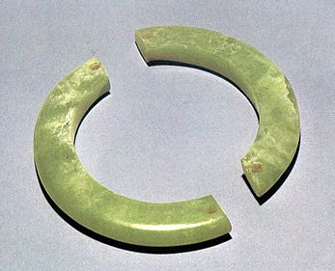
In case you were afraid to ask
What is a semi-ring*?
(D, ✜ ,✪ )
http://treasure.chinesecio.com/en/article/2010-01/19/content_102796.htm
( {0,1}, OR, AND )
(D, 0 , ✜ ) is a commutative monoid
(D, 1 , ✪ ) is a commutative* monoid
( {0,1}, +, × )
✪ distributes over ✜
( C, +, × )
0 ✪ x = 0

Slide 5
Baby FAQs are very expressive
CSPs: ( {0,1}, OR, AND )
Logic
http://en.wikipedia.org/wiki/Four_color_theorem#/media/File:World_map_with_four_colours.svg
PGMs: ( R₊, +, × )
https://xkcd.com/1033/
Matrix Ops
Joins
φ (x₀,…,x_{f-1}) = ✜ _{x ,..,x} ✪_{e in E} ψ_{e}(x_{e})
f
_{n-1}

Slide 6
What do we show?
A single algorithm that solves the general FAQ problem
One algorithm to rule all the semi-rings
Faster algorithms for problems in PGMs and logic
Recovers best known results in other FAQ instances
Analysis is the technically challenging part

Slide 7
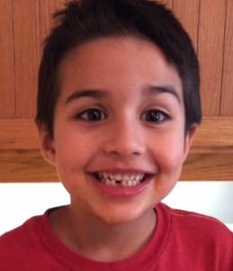
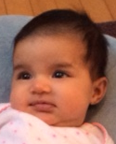
What is “grown up” FAQ?
_{(n-1)}
φ (x₀,…,x_{f-1}) = ✜ _{x} ....... ✜ _{x} ✪_{e in E} ψ_{e}(x_{e})
(f)
f
_{n-1}
Can handle # quantified conjunctive queries
For every i ≥ f
(i)
(i)
✜ = ✪
OR
(D, ✜ ,✪ ) is a semi-ring*
φ (x₀,…,x_{f-1}) = ✜ _{x ,..,x} ✪_{e in E} ψ_{e}(x_{e})
f
_{n-1}

Slide 8
Baby FAQs are very expressive
CSPs: ( {0,1}, OR, AND )
Logic
http://en.wikipedia.org/wiki/Four_color_theorem#/media/File:World_map_with_four_colours.svg
PGMs: ( R₊, +, × )
https://xkcd.com/1033/
Matrix Ops
Joins
φ (x₀,…,x_{f-1}) = ✜ _{x ,..,x} ✪_{e in E} ψ_{e}(x_{e})
f
_{n-1}

Slide 9
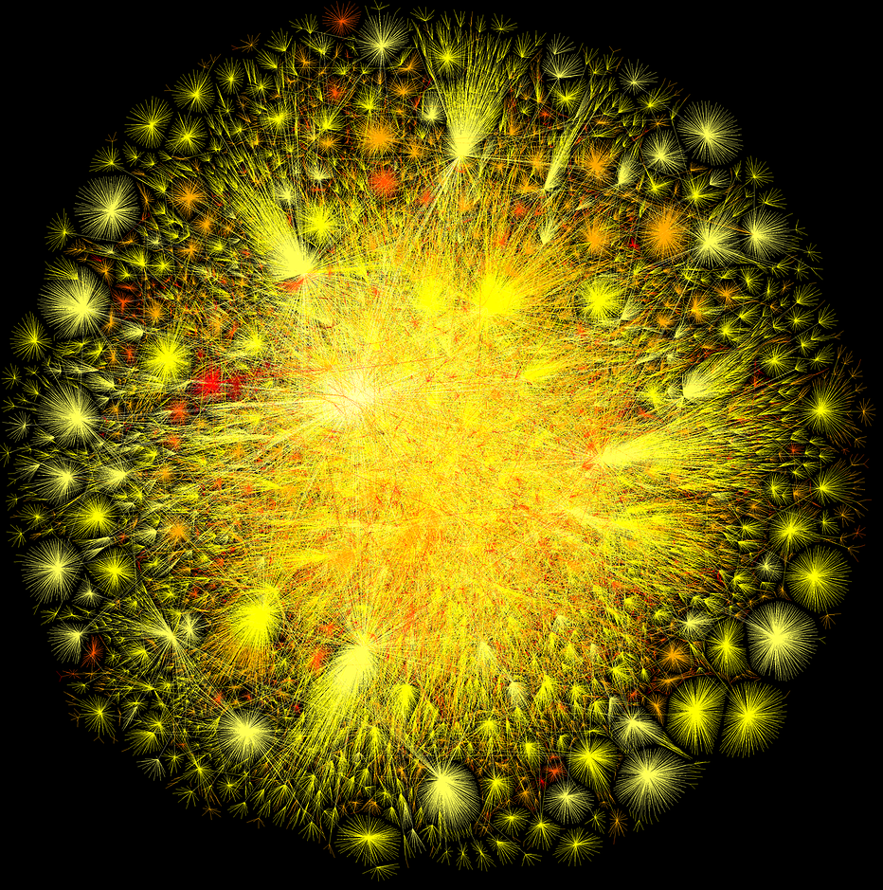
Morally the join problem
Input: A big (hypergraph) G = (V(G), E(G))
G
A small hypergraph H = (V, E )
Output: All copies of H in G
X₀
φ (x₀,x₁,x₂) = ψ_{R}(x₀,x₁)•ψ_{S}(x₁,x₂)•ψ_{T}(x₀,x₂)
R
T
H
ψ_{R}(x,y) = 1 if (x,y) in E(G) and x<y
X₁
X₂
= 0 otherwise
Encoding of the functions is crucial
S
ψ_{S} and ψ_{T} defined similarly

Slide 10
Baby FAQs are very expressive
CSPs: ( {0,1}, OR, AND )
Logic
http://en.wikipedia.org/wiki/Four_color_theorem#/media/File:World_map_with_four_colours.svg
PGMs: ( R₊, +, × )
https://xkcd.com/1033/
Matrix Ops
Joins
φ (x₀,…,x_{f-1}) = ✜ _{x ,..,x} ✪_{e in E} ψ_{e}(x_{e})
f
_{n-1}

Slide 11
Matrix vector multiplication
H
a_{0,0}
a_{0,2}
…..
a_{0,N-1}
b₀
b
X
Y
A
a_{N-1,0}
a_{N-1,1}
a_{N-1,N-1}
b_{N-1}
…..
A
b
φ (x) = Σ ψ_{A}(x,y)•ψ_{b}(y)
Θ(N²) time in worst-case
y

Slide 12
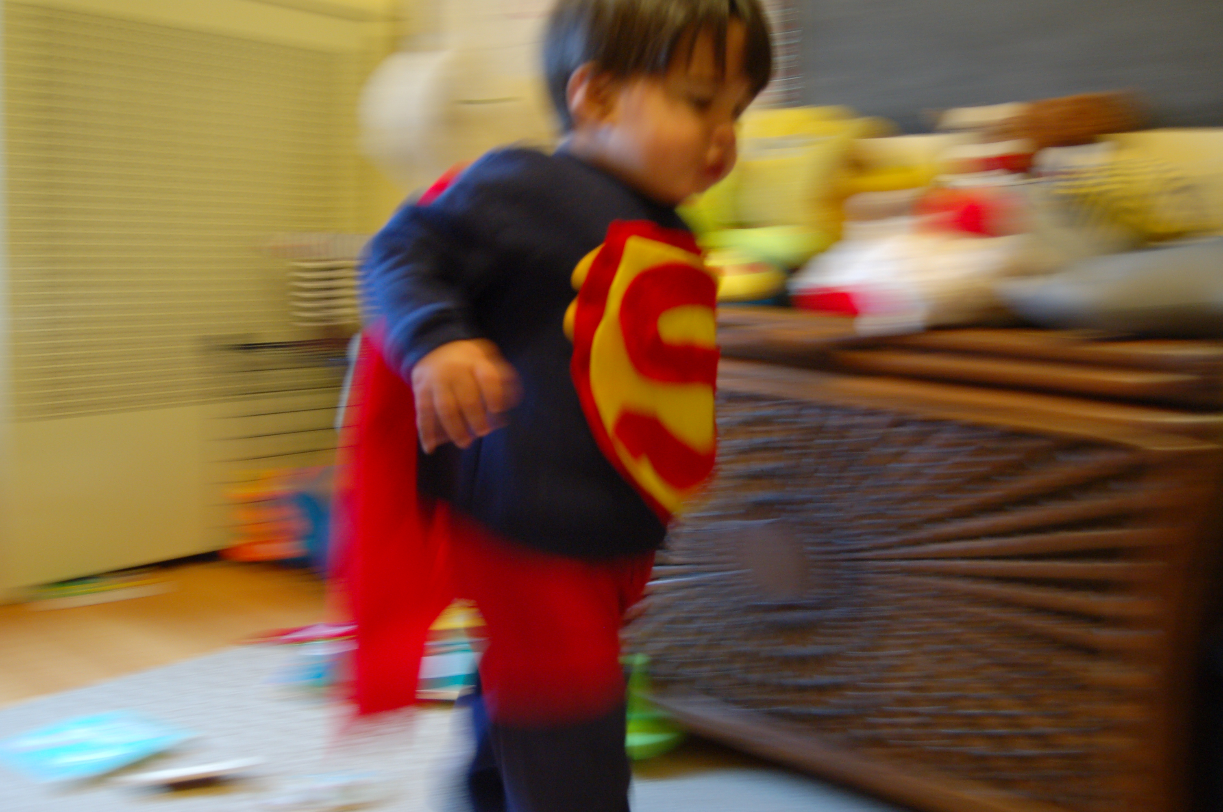
Let’s do it faster

Slide 13
Discrete Fourier Transform
Intuition behind FFT
a_{0,0}
a_{0,2}
…..
a_{0,N-1}
b₁₀
N = p³
x = x₀ + x₁p + x₂p²
O(N^{4/3}) time FFT
y = y₀ + y₁p + y₂p²
x •y =
Σ x_{j} • y_{k} •p^{j+k}
( 0 ≤ j+k ≤ 4 )
a_{N-1,0}
a_{N-1,1}
…..
a_{N-1,N-1}
b_{N-1}
exp(2πi x•y/N) = Π exp (2πi x_{j}•y_{k}p^{j+k}/p³)
A
b
_{0 ≤ j+k ≤ 4}
= Π exp (2πi x_{j}•y_{k}p^{j+k}/p³)
a_{x,y} = exp(2πi x•y/N)
_{0 ≤ j+k ≤ 2}
= 1 for j+k ≥ 3
φ (x) = Σ ψ_{A}(x,y)•ψ_{b}(y)
y

Slide 14
Discrete Fourier Transform
N = p³
a_{x,y} = Π exp (2πi x_{j}•y_{k}p^{j+k}/p³)
a_{0,0}
a_{0,2}
a_{0,N-1}
b₁₀
…..
_{0 ≤ j+k ≤ 2}
X₀
Y₀
a_{N-1,0}
a_{N-1,1}
…..
a_{N-1,N-1}
b_{N-1}
H
X₁
Y₁
A
b
φ (x) = Σ ψ_{A}(x,y)•ψ_{b}(y)
X₂
Y₂
y
ψ_{j,k}(x_{j},y_{k}) = exp (2πi x_{j}•y_{k}p^{j+k}/p³)
φ (x₀,x₁,x₂) = Σ ψ_{b}(y₀,y₁,y₂) • Π ψ_{j,k}(x_{j},y_{k})
y₀,y₁,y₂
0 ≤ j+k ≤ 2

Slide 15
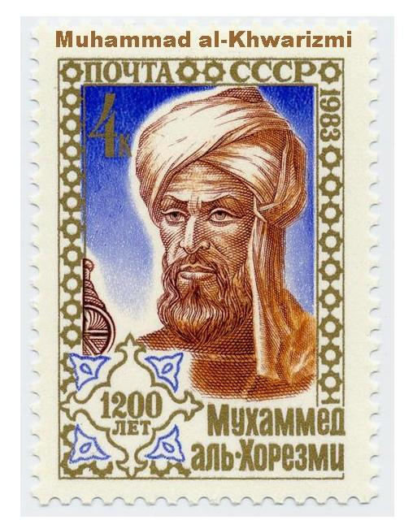
Algorithms for (baby) FAQs
φ (x₀,…,x_{f-1}) = ✜ _{x ,..,x} ✪_{e in E} ψ_{e}(x_{e})
f
_{n-1}
?

Slide 16
How are functions represented?
Assume truth-table representation for now
Assume D = |Dom(X_{i})| for every i

Slide 17
Trivial algorithm for (baby) FAQs
Go through all D^{n} instantiations for (x₀,..,x_{n-1})
O(mnD^{n}) time
φ (x₀,…,x_{f-1}) = ✜ _{x ,..,x} ✪_{e in E} ψ_{e}(x_{e})
f
_{n-1}

Slide 18
Matrix vector multiplication
H
a_{0,0}
a_{0,2}
…..
a_{0,N-1}
b₁₀
b
X
Y
A
a_{N-1,0}
a_{N-1,1}
a_{N-1,N-1}
b_{N-1}
…..
D=N
n=m=2
A
b
φ (x) = Σ ψ_{A}(x,y)•ψ_{b}(y)
Trivial algo runs in O(N²) time
y

Slide 19
Discrete Fourier Transform
N = p³
a_{x,y} = Π exp (2πi x_{j}•y_{k}p^{j+k}/p³)
_{0 ≤ j+k ≤ 2}
X₀
Y₀
H
X₁
Y₁
Trivial algo runs in O(p⁶) time
D=p
n=m=6
X₂
Y₂
φ (x₀,x₁,x₂) = Σ ψ_{b}(y₀,y₁,y₂) • Π ψ_{j,k}(x_{j},y_{k})
y₀,y₁,y₂
0 ≤ j+k ≤ 2

Slide 20
Faster than trivial algorithm

Slide 21
Fast(er) Fourier Transform
N = p³
a_{x,y} = Π exp (2πi x_{j}•y_{k}p^{j+k}/p³)
X₀
Y₀
_{0 ≤ j+k ≤ 2}
X₀
Y₀
Y₁
H
X₁
Y₁
Y₂
X₀,Y₀,Y₁,Y₂
O(p⁴)
X₂
Y₂
Σ Σ ψ_{0,0}•ψ_{1,0}•ψ_{2,0}•ψ_{0,1}•ψ_{1,1}• Σ ψ_{0,2}•ψ_{b}
Σ Σ Σ ψ_{0,0}•ψ_{1,0}•ψ_{2,0}•ψ_{0,1}•ψ_{1,1}•ψ_{0,2}•ψ_{b}
y₀
y₂
y₀
y₁
y₁
y₂
φ (x₀,x₁,x₂) = Σ ψ_{b}(y₀,y₁,y₂) • Π ψ_{j,k}(x_{j},y_{k})
y₀,y₁,y₂
0 ≤ j+k ≤ 2

Slide 22
Fast(er) Fourier Transform
N = p³
a_{x,y} = Π exp (2πi x_{j}•y_{k}p^{j+k}/p³)
X₀
Y₀
_{0 ≤ j+k ≤ 2}
X₀
Y₀
X₁
Y₁
H
X₁
Y₁
X₀,X₁,Y₀,Y₁
O(p⁴)
X₀,Y₀,Y₁,Y₂
O(p⁴)
X₂
Σ Σ ψ_{0,0}•ψ_{1,0}•ψ_{2,0}•ψ_{0,1}•ψ_{1,1}• Σ ψ_{0,2}•ψ_{b}
Σ ψ_{0,0}•ψ_{1,0}•ψ_{2,0}• Σ ψ_{0,1}•ψ_{1,1}• φ’(x₀,y₀,y₁)
Σ Σ ψ_{0,0}•ψ_{1,0}•ψ_{2,0}•ψ_{0,1}•ψ_{1,1}• φ’(x₀,y₀,y₁)
y₀
y₂
y₀
y₁
y₁
y₀
y₁
φ (x₀,x₁,x₂) = Σ ψ_{b}(y₀,y₁,y₂) • Π ψ_{j,k}(x_{j},y_{k})
y₀,y₁,y₂
0 ≤ j+k ≤ 2

Slide 23
Fast(er) Fourier Transform
N = p³
a_{x,y} = Π exp (2πi x_{j}•y_{k}p^{j+k}/p³)
Overall algo runs in O(p⁴) = O(N^{4/3}) time
_{0 ≤ j+k ≤ 2}
X₀
Y₀
X₀,X₁,X₂,Y₀
O(p⁴)
H
X₁
X₀,X₁,Y₀,Y₁
O(p⁴)
X₀,Y₀,Y₁,Y₂
O(p⁴)
Aji
McEliece
X₂
Σ ψ_{0,0}•ψ_{1,0}•ψ_{2,0}• φ’’(x₀,x₁,y₀)
Σ ψ_{0,0}•ψ_{1,0}•ψ_{2,0}• Σ ψ_{0,1}•ψ_{1,1}• φ’(x₀,y₀,y₁)
y₀
y₀
y₁
φ (x₀,x₁,x₂) = Σ ψ_{b}(y₀,y₁,y₂) • Π ψ_{j,k}(x_{j},y_{k})
y₀,y₁,y₂
0 ≤ j+k ≤ 2

Slide 24
Going back to representations
φ (x₀,…,x_{f-1}) = ✜ _{x ,..,x} ✪_{e in E} ψ_{e}(x_{e})
f
_{n-1}
Listing representation:
Only list non-0 values of ψ_{e}(x_{e})
ψ_{e}(x_{e}) =0 determines the product
0
1
1
1
0
0
1
0
0

Slide 25
Let’s go back to joins …
CSPs: ( {0,1}, OR, AND )
Logic
http://en.wikipedia.org/wiki/Four_color_theorem#/media/File:World_map_with_four_colours.svg
PGMs: ( R₊, +, × )
https://xkcd.com/1033/
Matrix Ops
Joins
φ (x₀,…,x_{f-1}) = ✜ _{x ,..,x} ✪_{e in E} ψ_{e}(x_{e})
f
_{n-1}

Slide 26
… and run the previous algo
Runs in Ω(N²) time
X₀
T
X₀,X₁,X₂
X₁
X₂
H
X₀
S
R
T
X₁
X₂
S
|ψ_{R}|=|ψ_{S}|=
|ψ_{T}|=N
φ (x₀,x₁,x₂) = ψ_{R}(x₀,x₁)•ψ_{S}(x₁,x₂)•ψ_{T}(x₀,x₂)

Slide 27
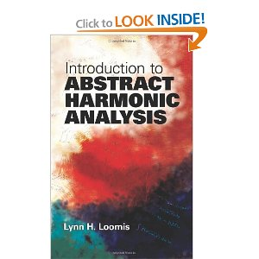
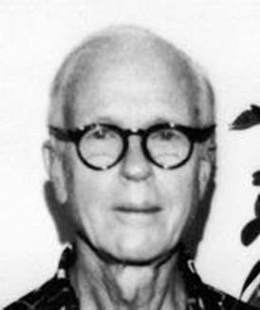
Is Ω(N²) time necessary?
X₂
N^{3/2}
|ψ_{T}| =N
|ψ_{S}|=N
Loomis
Whitney
X₀
H
X₀
|ψ_{R}|= N
R
T
X₁
X₁
X₂
φ (x₀,x₁,x₂) = ψ_{R}(x₀,x₁)•ψ_{S}(x₁,x₂)•ψ_{T}(x₀,x₂)
S

Slide 28
?
Loomis
Whitney

Slide 29
Algorithmic Loomis-Whitney
B
A
X₀
d_{S}(c)
d_{T}(c)
Loomis-Whitney bound: R^{1/2} • S^{1/2} •T^{1/2}
R
X₃
T
Goal: Count number of triangles
c
•
http://agilitrix.com/2011/03/red-pill-blue-pill/
X₁
X₂
ψ_{S}
ψ_{T}
S
ψ_{R}
X₁
X₀
There are R
choices for
edges in ψ_{R}
There are d_{S}(c)•d_{T}(c)
choices for pairs of
neighbors of c
X₃
c
•
ψ_{T}
ψ_{S}

Slide 30
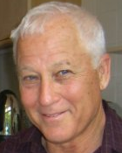
Algorithmic Loomis-Whitney
Loomis-Whitney bound: R^{1/2} • S^{1/2} •T^{1/2}
Run time of algo=
Σ_{c} min( R
,d_{S}(c)•d_{T}(c) )
Goal: Count number of triangles
ψ_{R}
Itai
Rodeh
X₁
X₀
There are R
choices for
edges in Ψ_{R}
There are d_{S}(c)•d_{T}(c)
choices for pairs of
neighbors of c
X₃
c
•
ψ_{T}
ψ_{S}
Make this choice for every c in C

Slide 31
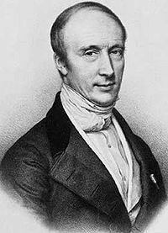
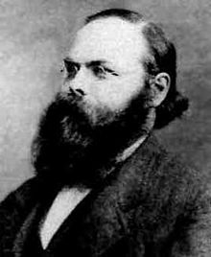
Analyzing the algorithm
Loomis Whitney bound: R^{½} • S^{½} •T^{½}
ψ_{R}
X₁
X₀
Σ_{c} min( R , d_{S}(c) •d_{T}(c) )
X₂
c
•
≤ Σ_{c} (R • d_{S}(c) •d_{T}(c) ) ^{½}
ψ_{T}
ψ_{S}
= R^{½}•Σ_{c} ( d_{S}(c) ^{½} •d_{T}(c) ^{½} )
≤ R^{½}•(Σ_{c} d_{S}(c)) ^{½}•(Σ_{c}d_{T}(c)) ^{½}
min(E,F) ≤ (E•F)^{½}
= R^{½}•S^{½}•T^{½}
Cauchy
Schwartz

Slide 32
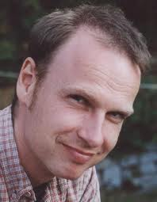
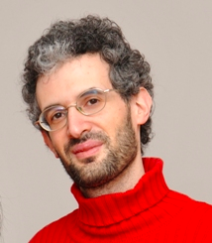
Algorithm for FAQ
_{(n-1)}
φ (x₀,…,x_{f-1}) = ✜ _{x} ....... ✜ _{x} ✪_{e in E} ψ_{e}(x_{e})
(f)
f
_{n-1}
Run the “trivial” algorithm
Obvious generalization of the FFT algorithm
For each sub-problem run the “joins algorithm”
Generalization of the triangle algorithm
Grohe
Marx
The only ingenuity is in computing the “correct” variable ordering

Slide 33
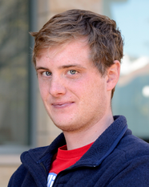
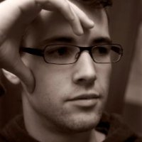
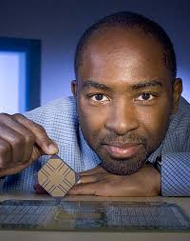
Simplicity leads to performance
>
10x faster

Slide 34
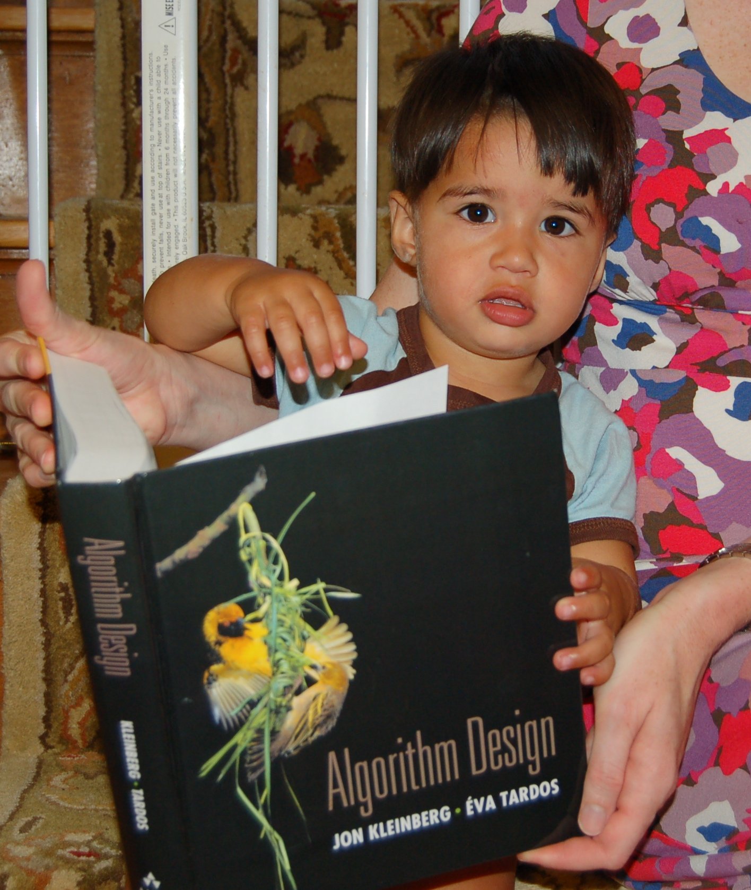
Further Reading

Slide 35
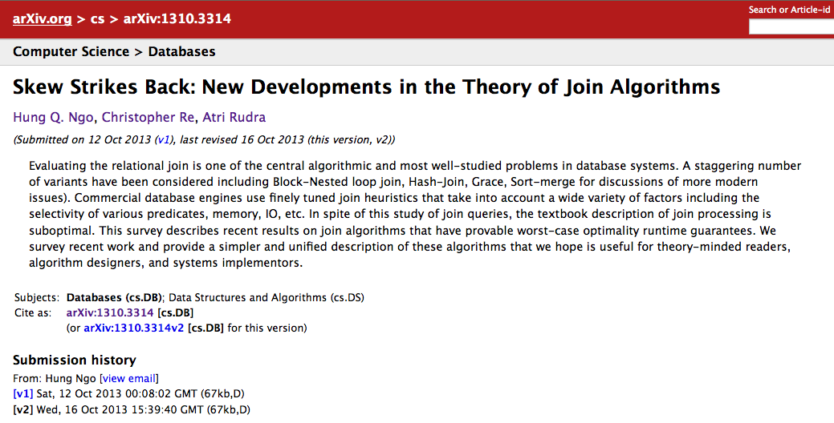
Worst-case optimal join algo
DO NOT READ THE PODS 12 PAPER

Slide 36
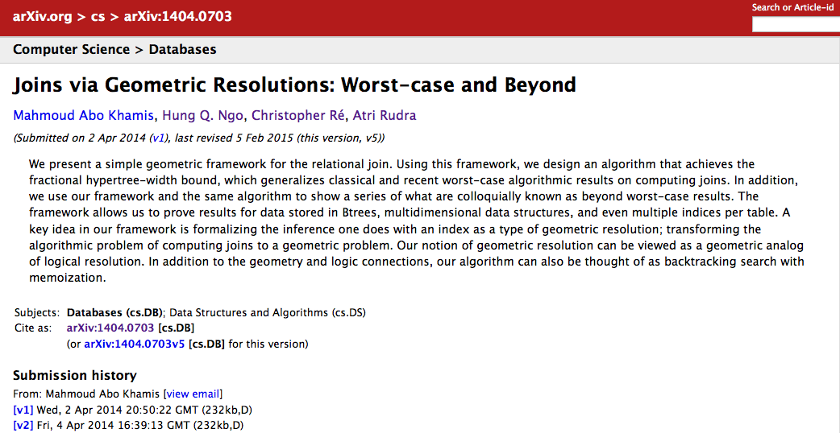
Joins and resolutions
Beyond worst-case analysis for join algorithms

Slide 37
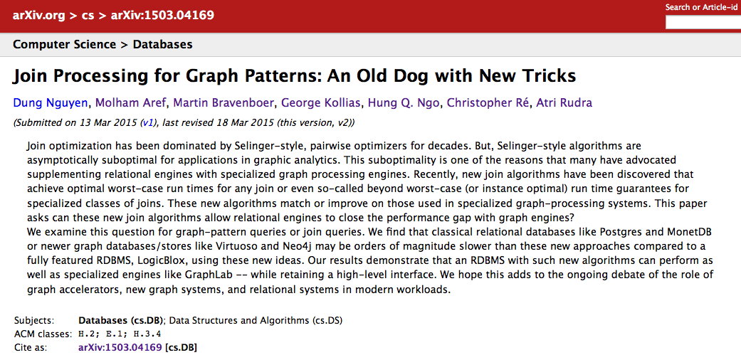
Beyond worst-case analysis algorithms also perform great!

Slide 38
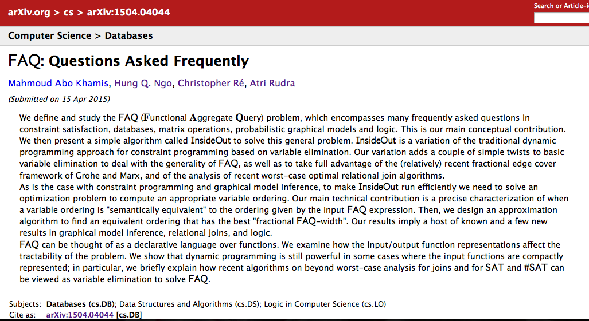
More on FAQs

Slide 39
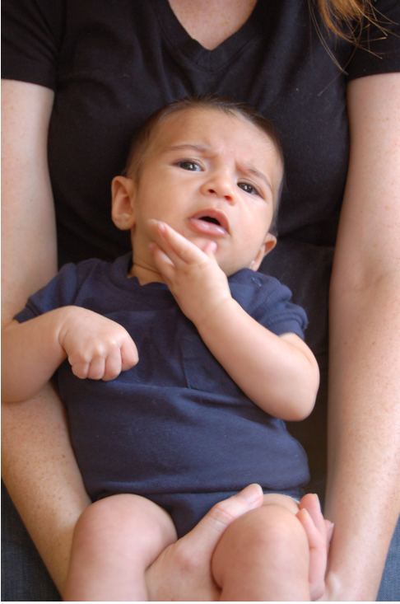
Questions?
Questions?

