Slide 1
Multilinear Maps and Attacks
Sanjam Garg (UC Berkeley)
Based on works of Cheon, Coron, Garg, Gentry, Halevi, Han, Lee, Lepoint, Ryu, Stehle, Tibouchi

Slide 2
Outline
Bilinear Maps: Recall
  Intuitively: Multilinear Maps
  Known results and Applications
Definitions of Multi-linear Maps
  Classical Notion
  Our Notion
GGH – Construction and Attacks
CLT – Construction and Attacks

Slide 3
Cryptographic Bilinear Maps
Bilinear maps are extremely useful in cryptography
  lots of applications [Joux00, BF01]
As the name suggests allow pairing two things together

Slide 4
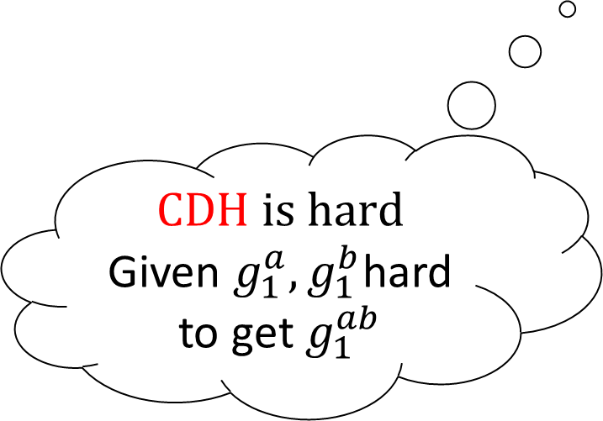


Bilinear Maps – Definitions
Cryptographic bilinear map
  Groups $G_{1}$ and $G_{2}$ of order $p$ with generators $g_{1}, g_{2}=e\left(g_{1},g_{1}\right)$and a bilinear map $e :G_{1}×G_{1}→{ G}_{2}$ such that
  $$∀ a,b ∈ Z_{p}^{}, e\left(g_{1}^{a},g_{1}^{b}\right)=g_{2}^{ab}$$
Instantiation: Weil or Tate pairings over elliptic curves.
DDH is easy
Given $g_{1}^{a}, g_{1}^{b}, T$
$$T { \overset{?}{\overbrace{=}} }^{}g_{1}^{ab}$$
$$e\left(g_{1}^{a}, g_{1}^{b}\right)=e\left(g_{1}, T\right)$$
$$\text{CDH} \text{is} \text{hard}$$
Given $g_{1}^{a}, g_{1}^{b}$hard to get $g_{1}^{ab}$

Slide 5

  Bilinear Maps: ``Hard” Problem
Bilinear Diffie-Hellman: Given
$g_{1}, g_{1}^{a},g_{1}^{b},g_{1}^{c}∈G_{1}$hard to distinguish ${e\left(g_{1},g_{1}^{abc}\right)=g_{2}}^{abc}$from Random
Multilinear Maps [BS03] generalize this concept.

Slide 6
Candidate Constructions of Multilinear Maps
Approximate Multilinear Maps [GGH13, CLT13, GGH14]
Various attacks [GGH13, CHLRS15, CGHLMRST15]
Most obfuscation schemes unaffected
New Multilinear Maps [CLT15]
Very active area of research…

Slide 7



Non-Interactive Key Agreement [DH76]
Application 1
$$PK_{a}$$
$$PK_{b}$$
$$K_{a,b}$$
Alice
Bob
Extended to three parties by [Joux00]
Mmaps would give solution for more than 3-parties. [BS03]

Slide 8

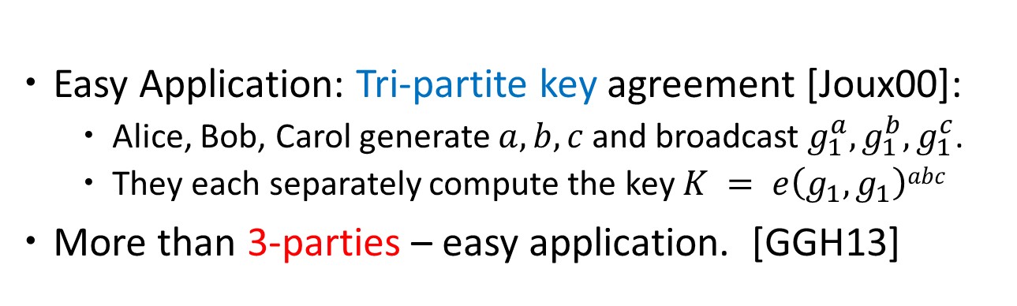




  Non-Interactive Key Agreement [DH76]
Application 1
$$g_{1}^{a}$$
$$g_{1}^{b}$$
$$a$$
$$K = g_{1}^{ab}$$
$$b$$
Easy Application: Tri-partite key agreement [Joux00]:
  Alice, Bob, Carol generate $a,b,c$ and broadcast $g_{1}^{a}, g_{1}^{b}{, g}_{1}^{c}$.
  They each separately compute the key $K = e\left(g_{1},g_{1}\right)abc$
More than 3-parties – easy application. [GGH13]

Slide 9
Software Obfuscation [BGIRSVY01, GR07, GGHRSW13]
Application 2
Obfuscation aims to make computer programs “unintelligible” while preserving their functionality.
O(P)
P
Alice
Bob

Slide 10
Obfuscation + Mmaps Applications
Witness Encryption [GGSW13]
Attribute Based Encryption [GGHSW13]
Functional Encryption [GGHRSW13, GJKS13, GGJS13, ABGSZ13,…]
Round Optimal Multiparty Secure computation [GGHR14]
Deniable Encryption [SW13]
Removing random oracles [HSW13a, FHPS13, HSW13b]
Broadcast Encryption and Traitor-Tracing [GGHRSW13, BZ13, ABGSZ13]
Impossibility results [BCPR13a,BP13,GK13,BCPR13b,KRW13,MO13,…]
Functional Witness Encryption [BCP13]
Mmaps optimizations and extensions [CLT13,GGH13b,…]
Obfuscation optimizations and extensions [BCP13, ABGSZ13, BR13, BGKPS13, PTS13,…]
Pick your favorite primitive in cryptography
  Can it be improved?

Slide 11
Outline
Bilinear Maps: Recall
  Intuitively: Multilinear Maps
  Results and Applications
Definitions of Multi-linear Maps
  Classical Notion
  Our Notion
GGH – Construction and Attacks
CLT – Construction and Attacks

Slide 12
Cryptographic
Multi-linear Maps
Definitions: Classical notion and our Approximate variant

Slide 13
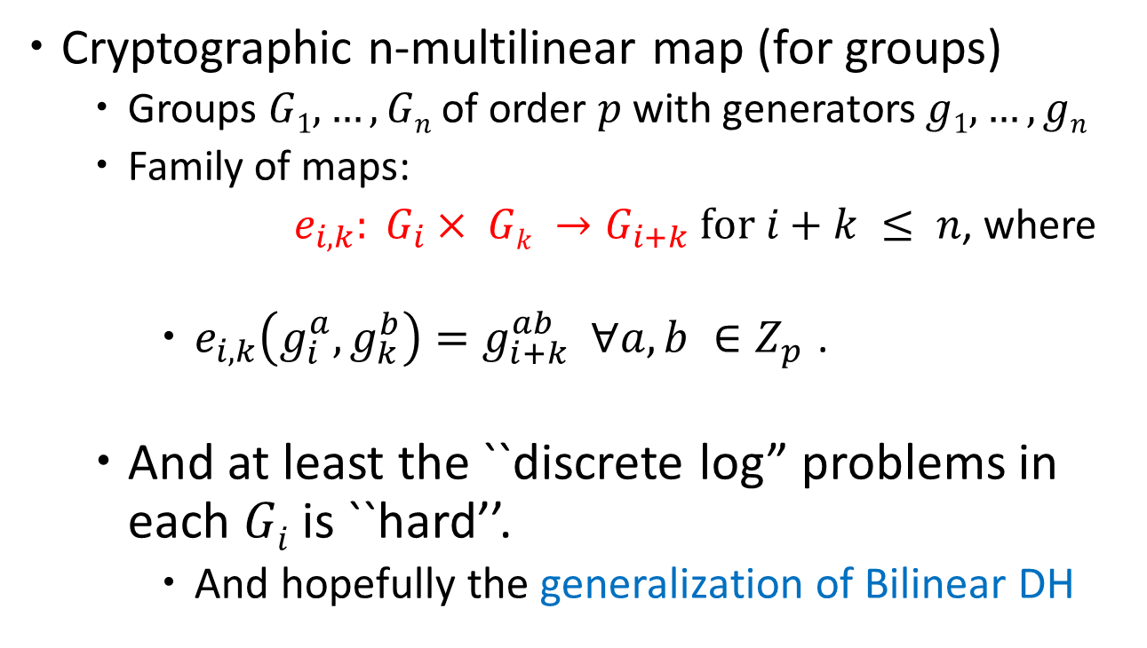
Multilinear Maps: Classical Notion
Cryptographic n-multilinear map (for groups)
  Groups $G1, …, Gn$ of order $p$ with generators $g1, …, gn$
  Family of maps:
  $e_{i,k}: G_{i}× Gk →G_{i+k} \text{for} i+k ≤ n$, where
    $e_{i,k}\left(g_{i}^{a},g_{k}^{b}\right)=g_{i+k}^{ab}$ $∀a,b ∈Z_{p}^{}$.
  And at least the ``discrete log” problems in each $Gi$ is ``hard’’.
    And hopefully the generalization of Bilinear DH

Slide 14
Getting to our Notion
Our visualization of (traditional) Bilinear Maps
Step by step I will make changes to get our notion of Bilinear Maps
At each step provide Extension to Multi-linear Maps

Slide 15





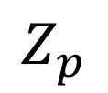
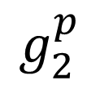

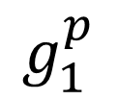






Bilinear Maps: Our visualization
$$Z_{p}$$
$$G_{1}$$
$$G_{2}$$
$$1$$
$$g_{1}^{1}$$
$$g_{2}^{1}$$
$$2$$
$$g_{1}^{2}$$
$$g_{2}^{2}$$
$$⋮$$
$$⋮$$
$$⋮$$
$$p$$
$$g_{1}^{p}$$
$$g_{2}^{p}$$

Slide 16

Bilinear Maps: Our visualization Sampling
$$Z_{p}$$
$$G_{1}$$
$$G_{2}$$
$$1$$
$$g_{1}^{1}$$
$$g_{2}^{1}$$
$$2$$
$$g_{1}^{2}$$
$$g_{2}^{2}$$
$$⋮$$
$$⋮$$
$$⋮$$
$$p$$
$$g_{1}^{p}$$
$$g_{2}^{p}$$
It was easy to sample uniformly from $Z_{p}$.

Slide 17
Bilinear Maps: Our visualization
Equality Checking
$$Z_{p}$$
$$G_{1}$$
$$G_{2}$$
$$1$$
$$g_{1}^{1}$$
$$g_{2}^{1}$$
$$2$$
$$g_{1}^{2}$$
$$g_{2}^{2}$$
$$⋮$$
$$⋮$$
$$⋮$$
$$p$$
$$g_{1}^{p}$$
$$g_{2}^{p}$$
Trivial to check if two terms are the same.

Slide 18

Bilinear Maps: Our visualization
Addition
$$Z_{p}$$
$$G_{1}$$
$$G_{2}$$
$$1$$
$$g_{1}^{1}$$
$$g_{2}^{1}$$
$$2$$
$$g_{1}^{2}$$
$$g_{2}^{2}$$
$$⋮$$
$$⋮$$
$$⋮$$
$$p$$
$$g_{1}^{p}$$
$$g_{2}^{p}$$
$$g_{1}^{3}$$

Slide 19
Bilinear Maps: Our visualization
Multiplication
$$Z_{p}$$
$$G_{1}$$
$$G_{2}$$
$$1$$
$$g_{1}^{1}$$
$$g_{2}^{1}$$
$$2$$
$$g_{1}^{2}$$
$$g_{2}^{2}$$
$$⋮$$
$$⋮$$
$$⋮$$
$$p$$
$$g_{1}^{p}$$
$$g_{2}^{p}$$

Slide 20












Bilinear Maps: Sets
(Our Notion)
$$Z_{p}$$
$$G_{1}$$
$$G_{2}$$
$$1$$
$${ S}_{0}^{1}$$
$$g_{1}^{1}$$
$${ S}_{1}^{1}$$
$$g_{2}^{1}$$
$${ S}_{2}^{1}$$
$$2$$
$${ S}_{0}^{2}$$
$$g_{1}^{2}$$
$${ S}_{1}^{2}$$
$$g_{2}^{2}$$
$${ S}_{2}^{2}$$
$$⋮$$
$$⋮$$
$$⋮$$
$$p$$
$$g_{1}^{p}$$
$$g_{2}^{p}$$
$${ S}_{0}^{p}$$
$${ S}_{1}^{p}$$
$${ S}_{2}^{p}$$
$${ S}_{0}^{}$$
$${ S}_{1}^{}$$
$${ S}_{2}^{}$$
Level-0 encodings

Slide 21

Multilinear Maps: Our Notion
Finite ring $R$ and sets $Si ∀i ∈\left[n\right]:$``level-$i$ encodings”
Each set$Si$ is partitioned into $S_{i}^{a}$for each $a ∈R$: ``level-$i$ encodings of $a$”.

Slide 22

Bilinear Maps: Sampling
(Our Notion)
$$Z_{p}$$
$$G_{1}$$
$$G_{2}$$
$$1$$
$${ S}_{0}^{1}$$
$$g_{1}^{1}$$
$${ S}_{1}^{1}$$
$$g_{2}^{1}$$
$${ S}_{2}^{1}$$
I should be efficient to sample $α←S_{0}$ such that $α∈S_{0}^{a}$ for a u$niform a.$It may not be uniform in $S_{0}$ or $S_{0}^{a}$.
$$2$$
$${ S}_{0}^{2}$$
$$g_{1}^{2}$$
$${ S}_{1}^{2}$$
$$g_{2}^{2}$$
$${ S}_{2}^{2}$$
$$⋮$$
$$⋮$$
$$⋮$$
$$p$$
$$g_{1}^{p}$$
$$g_{2}^{p}$$
$${ S}_{0}^{p}$$
$${ S}_{1}^{p}$$
$${ S}_{2}^{p}$$
$${ S}_{0}^{}$$
$${ S}_{1}^{}$$
$${ S}_{2}^{}$$
It was easy to sample uniformly from $Z_{p}$.

Slide 23

Multilinear Maps: Our Notion
Finite ring $R$ and sets $Si ∀i ∈\left[n\right]:$``level-$i$ encodings”
Each set$Si$ is partitioned into $S_{i}^{a}$for each $a ∈R$: ``level-$i$ encodings of $a$”.
Sampling: Output $α \text{such} \text{that} α∈S_{0}^{a}$ for a u$nifrom a$

Slide 24
Bilinear Maps: Equality Checking
(Our Notion)
Check if two values come from the same set.
$$Z_{p}$$
$$G_{1}$$
$$G_{2}$$
$$1$$
$${ S}_{0}^{1}$$
$$g_{1}^{1}$$
$${ S}_{1}^{1}$$
$$g_{2}^{1}$$
$${ S}_{2}^{1}$$
$$2$$
$${ S}_{0}^{2}$$
$$g_{1}^{2}$$
$${ S}_{1}^{2}$$
$$g_{2}^{2}$$
$${ S}_{2}^{2}$$
$$⋮$$
$$⋮$$
$$⋮$$
$$p$$
$$g_{1}^{p}$$
$$g_{2}^{p}$$
$${ S}_{0}^{p}$$
$${ S}_{1}^{p}$$
$${ S}_{2}^{p}$$
$${ S}_{0}^{}$$
$${ S}_{1}^{}$$
$${ S}_{2}^{}$$
It was trivial to check if two terms are the same.

Slide 25
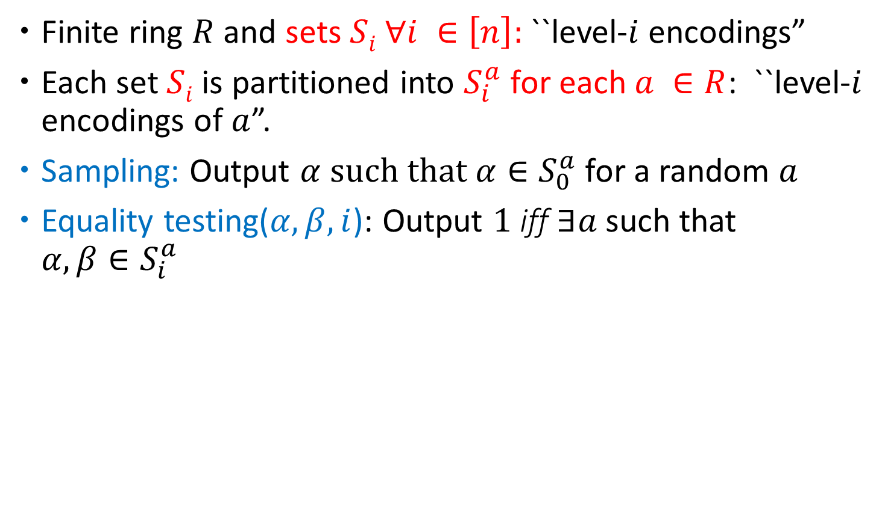
Multilinear Maps: Our Notion
Finite ring $R$ and sets $Si ∀i ∈\left[n\right]:$``level-$i$ encodings”
Each set$Si$ is partitioned into $S_{i}^{a}$for each $a ∈R$: ``level-$i$ encodings of $a$”.
Sampling: Output $α \text{such} \text{that} α∈S_{0}^{a}$ for a random $a$
Equality testing($α,β,i$): Output $1$ iff $∃a$such that $α,β∈S_{i}^{a}$

Slide 26

Bilinear Maps: Addition
(Our Notion)
$$Z_{p}$$
$$G_{1}$$
$$G_{2}$$
$$1$$
$${ S}_{0}^{1}$$
$$g_{1}^{1}$$
$${ S}_{1}^{1}$$
$$g_{2}^{1}$$
$${ S}_{2}^{1}$$
$$2$$
$${ S}_{0}^{2}$$
$$g_{1}^{2}$$
$${ S}_{1}^{2}$$
$$g_{2}^{2}$$
$${ S}_{2}^{2}$$
$$⋮$$
$$⋮$$
$$⋮$$
$$p$$
$$g_{1}^{p}$$
$$g_{2}^{p}$$
$${ S}_{0}^{p}$$
$${ S}_{1}^{p}$$
$${ S}_{2}^{p}$$
$${ S}_{0}^{}$$
$${ S}_{1}^{}$$
$${ S}_{2}^{}$$
$$g_{1}^{3}$$
$${ S}_{1}^{3}$$

Slide 27
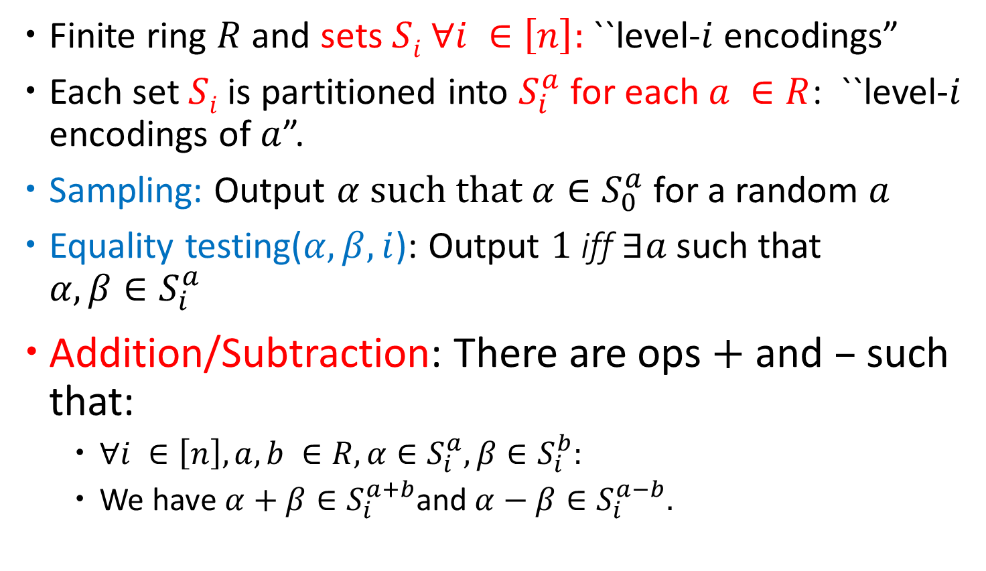
Multilinear Maps: Our Notion
Finite ring $R$ and sets $Si ∀i ∈\left[n\right]:$``level-$i$ encodings”
Each set$Si$ is partitioned into $S_{i}^{a}$for each $a ∈R$: ``level-$i$ encodings of $a$”.
Sampling: Output $α \text{such} \text{that} α∈S_{0}^{a}$ for a random $a$
Equality testing($α,β,i$): Output $1$ iff $∃a$such that $α,β∈S_{i}^{a}$
Addition/Subtraction: There are ops $+$ and $–$ such that:
  $∀i ∈\left[n\right], a, b ∈R, α∈S_{i}^{a}, β∈S_{i}^{b}:$
  We have $α+β∈S_{i}^{a+b}$and $α−β∈S_{i}^{a−b}.$

Slide 28
Bilinear Maps: Multiplication
(Our Notion)
$$Z_{p}$$
$$G_{1}$$
$$G_{2}$$
$$1$$
$${ S}_{0}^{1}$$
$$g_{1}^{1}$$
$${ S}_{1}^{1}$$
$$g_{2}^{1}$$
$${ S}_{2}^{1}$$
$$2$$
$${ S}_{0}^{2}$$
$$g_{1}^{2}$$
$${ S}_{1}^{2}$$
$$g_{2}^{2}$$
$${ S}_{2}^{2}$$
$$⋮$$
$$⋮$$
$$⋮$$
$$p$$
$$g_{1}^{p}$$
$$g_{2}^{p}$$
$${ S}_{0}^{p}$$
$${ S}_{1}^{p}$$
$${ S}_{2}^{p}$$
$${ S}_{0}^{}$$
$${ S}_{1}^{}$$
$${ S}_{2}^{}$$

Slide 29
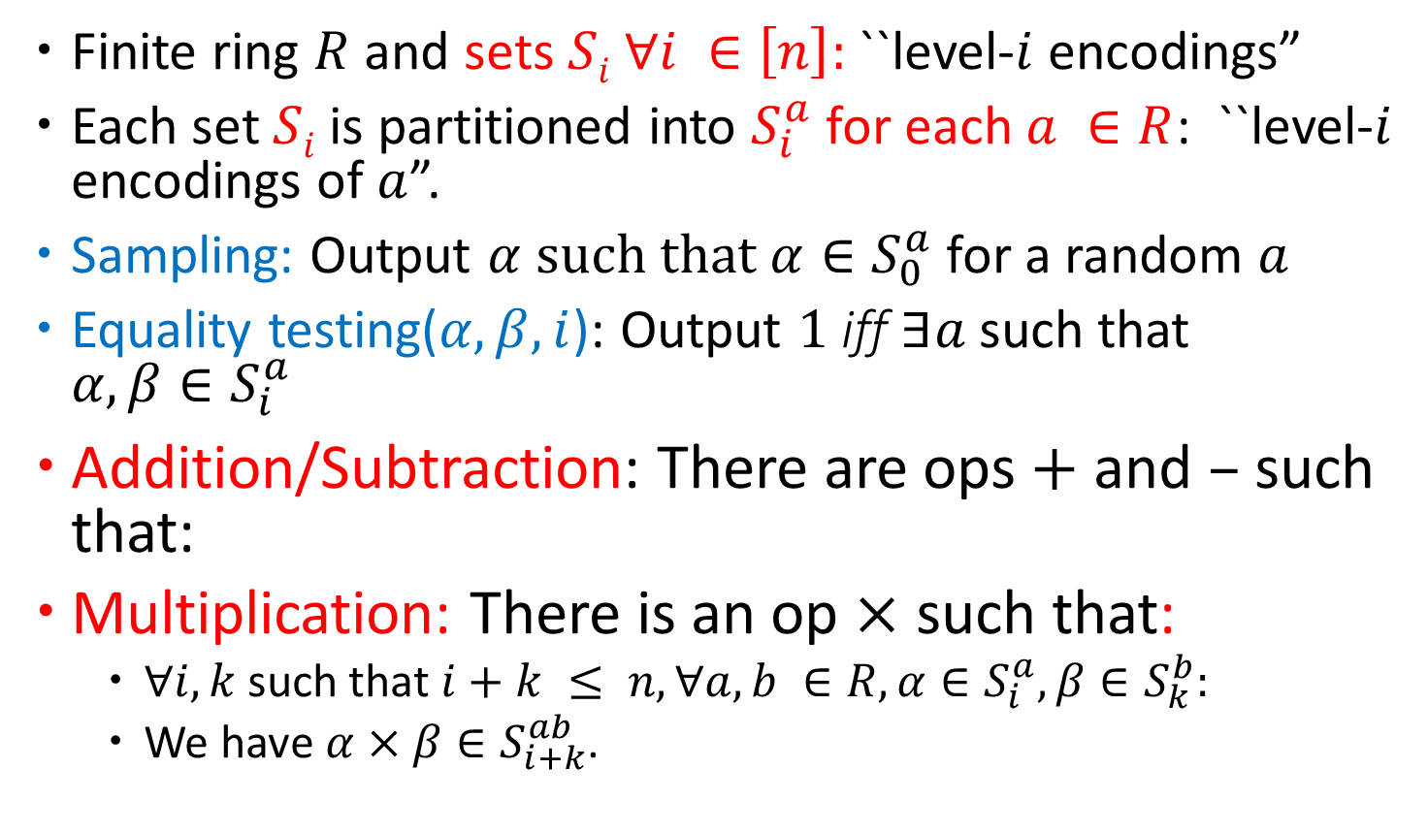
Multilinear Maps: Our Notion
Finite ring $R$ and sets $Si ∀i ∈\left[n\right]:$``level-$i$ encodings”
Each set$Si$ is partitioned into $S_{i}^{a}$for each $a ∈R$: ``level-$i$ encodings of $a$”.
Sampling: Output $α \text{such} \text{that} α∈S_{0}^{a}$ for a random $a$
Equality testing($α,β,i$): Output $1$ iff $∃a$such that $α,β∈S_{i}^{a}$
Addition/Subtraction: There are ops $+$ and $–$ such that:
Multiplication: There is an op $×$ such that:
  $∀i,k$such that $i+k ≤ n, ∀a, b ∈R, α∈S_{i}^{a}, β∈S_{k}^{b}:$
  We have $α×β∈S_{i+k}^{ab}$.

Slide 30
Bilinear Maps: Noisy
(Our Notion)
All operations are required to work as long as ``noise’’ level remains small.
$$Z_{p}$$
$$G_{1}$$
$$G_{2}$$
$$1$$
$${ S}_{0}^{1}$$
$$g_{1}^{1}$$
$${ S}_{1}^{1}$$
$$g_{2}^{1}$$
$${ S}_{2}^{1}$$
$$2$$
$${ S}_{0}^{2}$$
$$g_{1}^{2}$$
$${ S}_{1}^{2}$$
$$g_{2}^{2}$$
$${ S}_{2}^{2}$$
$$⋮$$
$$⋮$$
$$⋮$$
$$p$$
$$g_{1}^{p}$$
$$g_{2}^{p}$$
$${ S}_{0}^{p}$$
$${ S}_{1}^{p}$$
$${ S}_{2}^{p}$$
$${ S}_{0}^{}$$
$${ S}_{1}^{}$$
$${ S}_{2}^{}$$

Slide 31
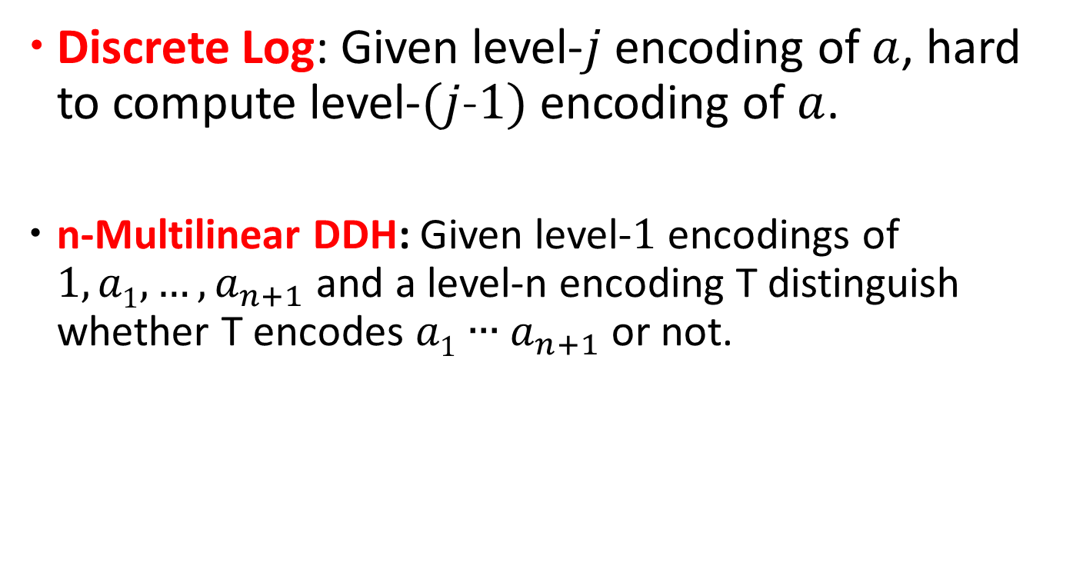
Multilinear Maps: Our Notion
Discrete Log: Given level-$j$ encoding of $a$, hard to compute level-$(j$-$1)$ encoding of $a$.
n-Multilinear DDH: Given level-$1$ encodings of $1, a1, …, a_{n+1}$and a level-n encoding T distinguish whether T encodes $a1∙∙∙a_{n+1}$ or not.

Slide 32
Outline
Bilinear Maps: Recall
  Intuitively: Multilinear Maps
  Results and Applications
Definitions of Multi-linear Maps
  Classical Notion
  Our Notion
GGH – Construction and Attacks
CLT – Construction and Attacks

Slide 33
``Noisy” Multilinear Maps
(Kind of like NTRU-Based FHE, but with Equality Testing)

Slide 34
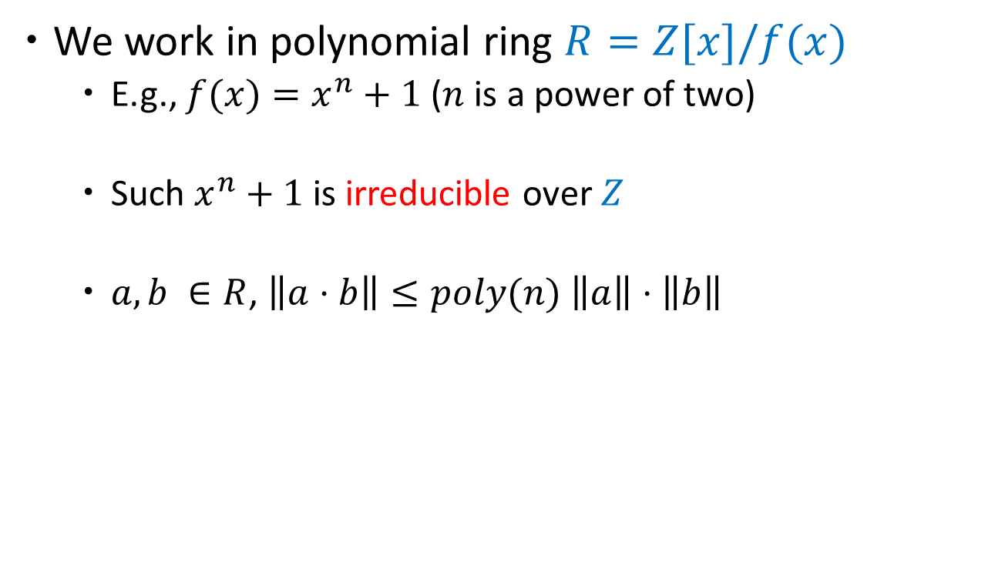
Background
We work in polynomial ring $R=Z[x]/f(x)$
  E.g., $f(x)=x^{n}+1$($n$ is a power of two)
  Such $x^{n}+1$is irreducible over $Z$
  $a,b ∈R$, $\left\|a⋅b\right\|≤poly(n) \left\|a\right\|⋅\left\|b\right\|$

Slide 35

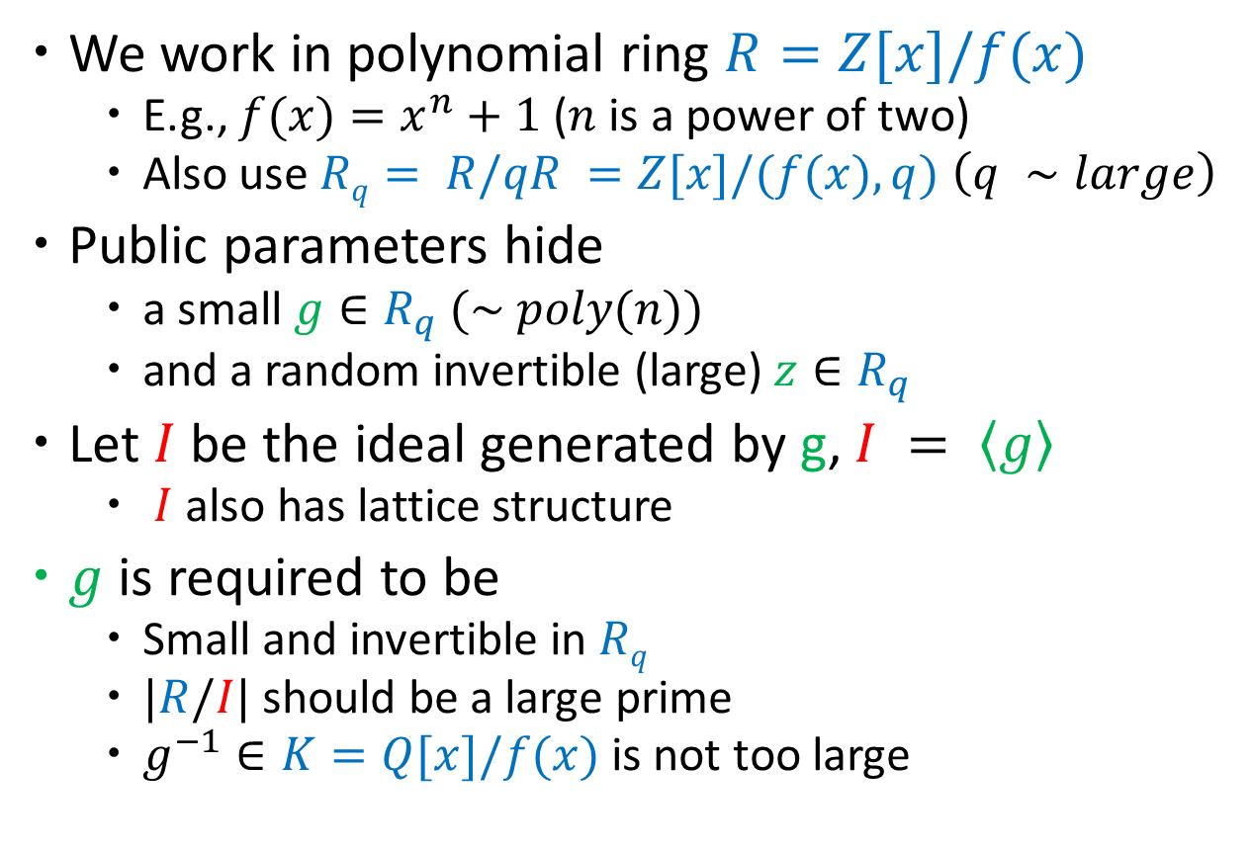
GGH13 Construction
We work in polynomial ring $R=Z[x]/f(x)$
  E.g., $f(x)=x^{n}+1$($n$ is a power of two)
  Also use $Rq= R/qR =Z[x]/(f(x), q)$ $\left(q ∼large\right)$
Public parameters hide
  a small $g∈R_{q}$ $(\sim poly(n))$
  and a random invertible (large) $z∈R_{q}$
Let $I$ be the ideal generated by g, $I = \left\langle g\right\rangle$
  $I$ also has lattice structure
$g$ is required to be
  Small and invertible in $Rq$
  $|R/I|$ should be a large prime
  $g^{−1}∈K=Q[x]/f(x)$ is not too large
  The ``scalars” that we encode are cosets of $I$
  (i.e., elements in the quotient ring $R/I$)

Slide 36







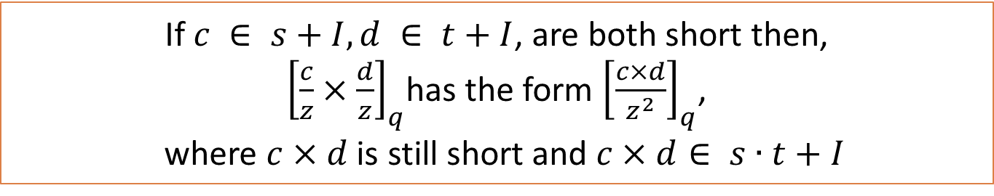


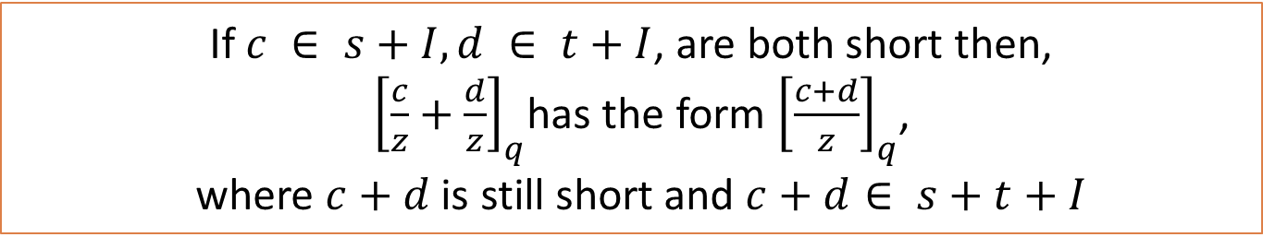



GGH13 Construction
$R=Z[x]/f\left(x\right) \text{and} Rq= R/qR$
  Small $g∈R_{q}$ defines a principal ideal $I=(g)$over $R$
  A random (large) $z∈R_{q}$
$$c$$
$${ S}_{0}^{1}$$
$$1+ I$$
$${ S}_{1}^{1}$$
$${ S}_{2}^{1}$$
$$+ \text{and} ×$$
$$2+ I$$
$${ S}_{0}^{2}$$
$${ S}_{1}^{2}$$
$${\left[\frac{c}{z}\right]}_{q}$$
$${ S}_{2}^{2}$$
$${\left[\frac{c}{z^{2}}\right]}_{q}$$
$$⋮$$
$$⋮$$
$$⋮$$
If $c ∈ s+I, d ∈ t+I$, are both short then,
${\left[\frac{c}{z}+\frac{d}{z}\right]}_{q}$has the form ${\left[\frac{c+d}{z}\right]}_{q}$,
where $c+d$is still short and $c+d∈ s+t+I$
If $c ∈ s+I, d ∈ t+I$, are both short then,
${\left[\frac{c}{z}×\frac{d}{z}\right]}_{q}$has the form ${\left[\frac{c×d}{z^{2}}\right]}_{q}$,
where $c×d$is still short and $c×d∈ s∙t+I$
$${ S}_{0}^{p}$$
$$I$$
$${ S}_{1}^{p}$$
$${ S}_{2}^{p}$$
Multiplication
Addition
$${ S}_{0}^{}$$
$${ S}_{1}^{}$$
$${ S}_{2}^{}$$
$c$ should have small coefficients

Slide 37
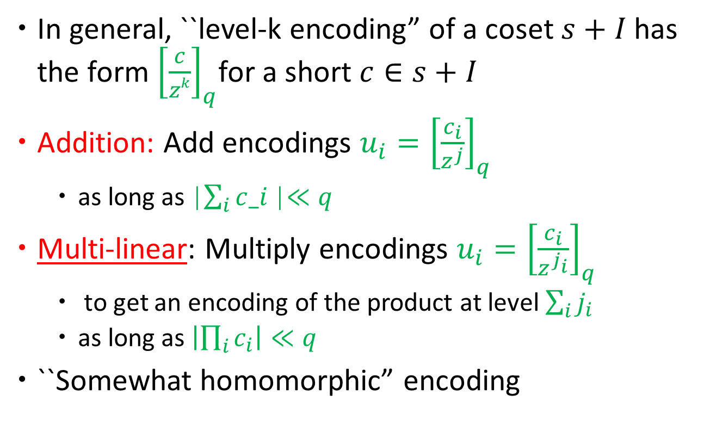
GGH13 Construction (in general)
In general, ``level-k encoding” of a coset $s+I$has the form ${\left[\frac{c}{zk}\right]}_{q}$for a short $c∈s+I$
Addition: Add encodings $u_{i}={\left[\frac{c_{i}}{z^{j}}\right]}_{q}$
  as long as |$\sum_{i}{c_i}$|$≪q$
Multi-linear: Multiply encodings $u_{i}={\left[\frac{c_{i}}{z^{j_{i}}}\right]}_{q}$
  to get an encoding of the product at level $\sum_{i}{j_{i} }$
  as long as $\left|\prod_{i}{c_{i}}\right|≪q$
``Somewhat homomorphic” encoding
Sampling and equality check?

Slide 38












Bilinear Maps: Sampling
(Our Notion)
$$Z_{p}$$
$$G_{1}$$
$$G_{2}$$
$$1$$
$${ S}_{0}^{1}$$
$$g_{1}^{1}$$
$${ S}_{1}^{1}$$
$$g_{2}^{1}$$
$${ S}_{2}^{1}$$
I should be efficient to sample $α←S_{0}$ such that $α∈S_{0}^{a}$ for a u$niform a.$It may not be uniform in $S_{0}$ or $S_{0}^{a}$.
$$2$$
$${ S}_{0}^{2}$$
$$g_{1}^{2}$$
$${ S}_{1}^{2}$$
$$g_{2}^{2}$$
$${ S}_{2}^{2}$$
$$⋮$$
$$⋮$$
$$⋮$$
$$p$$
$$g_{1}^{p}$$
$$g_{2}^{p}$$
$${ S}_{0}^{p}$$
$${ S}_{1}^{p}$$
$${ S}_{2}^{p}$$
$${ S}_{0}^{}$$
$${ S}_{1}^{}$$
$${ S}_{2}^{}$$
It was easy to sample uniformly from $Z_{p}$.

Slide 39

Sampling
  Sampling: Sample small $c←R_{q}$, but larger than $g$ then $c$ encodes a random coset.
    Why should this work?
    $\text{Recall} I = \left(g\right)$ -- vector with tiny coefficients

Slide 40
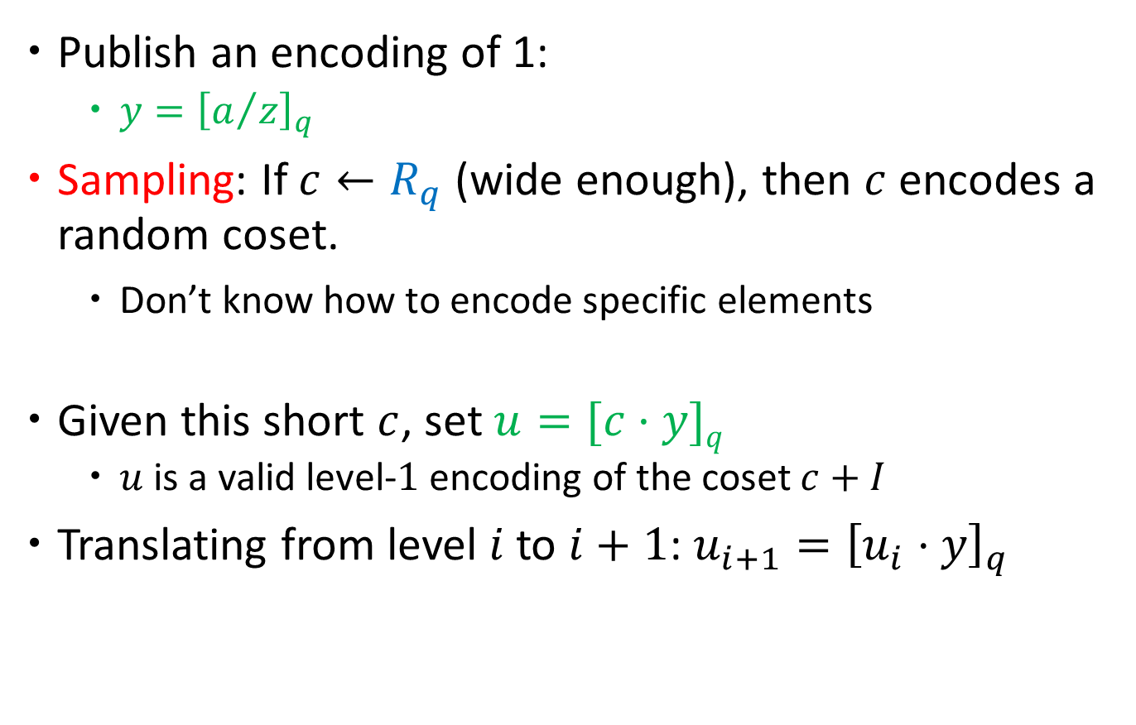
Encoding this random coset
Publish an encoding of 1:
  $y={\left[a/z\right]}_{q}$
  Sampling: If $c←R_{q}$ (wide enough), then $c$ encodes a random coset.
    Don’t know how to encode specific elements
Given this short $c$, set $u=[c·y]q$
  $u$ is a valid level-$1$ encoding of the coset $c+I$
Translating from level $i$ to $i+1$: $u_{i+1}={\left[u_{i}⋅y\right]}_{q}$

Slide 41
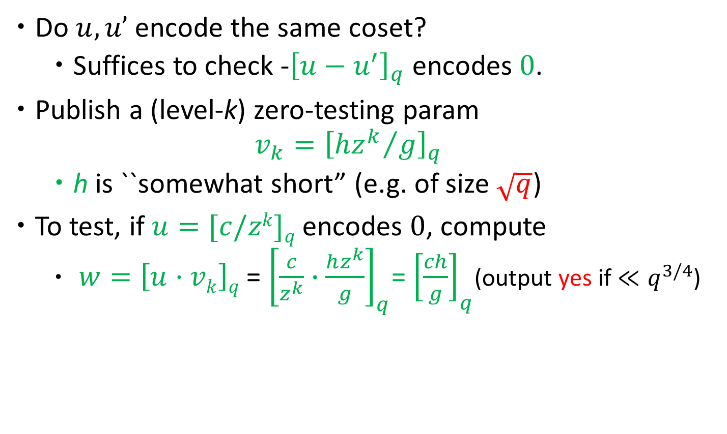
Equality Checking
Do $u,u’$ encode the same coset?
  Suffices to check -${\left[u−u^{′}\right]}_{q}$ encodes $0$.
Publish a (level-k) zero-testing param
  $$v_{k}={\left[{hz^{k}}/g\right]}_{q}$$
  h is ``somewhat short” (e.g. of size $\sqrt{q}$)
To test, if $u=[c/zk]q$ encodes $0$, compute
  $w=\left[u·vk\right]q$ = ${\left[\frac{c}{z^{k}}∙\frac{hz^{k}}{g}\right]}_{q}$= ${\left[\frac{ch}{g}\right]}_{q}$(output yes if $≪q^{3/4}$)

Slide 42
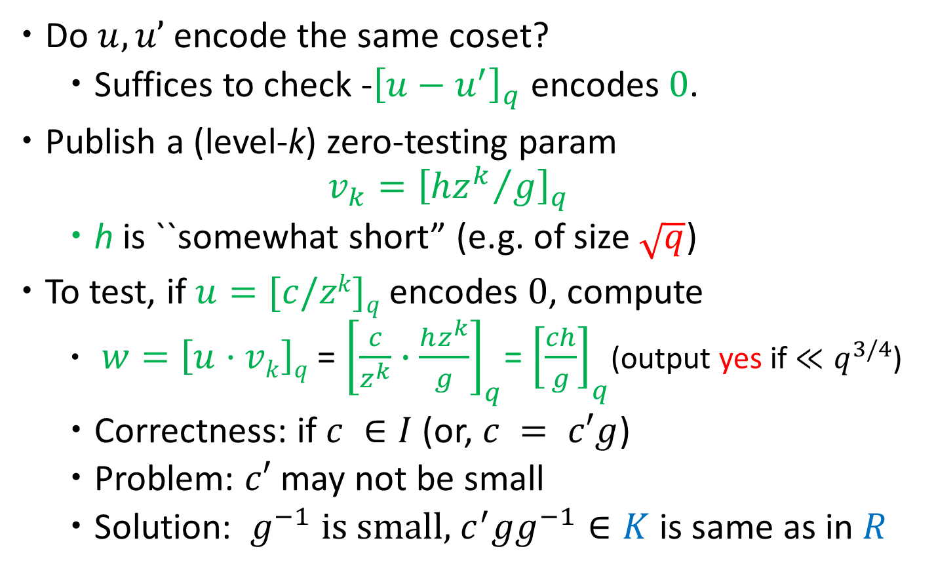
Equality Checking – Correctness I
Do $u,u’$ encode the same coset?
  Suffices to check -${\left[u−u^{′}\right]}_{q}$ encodes $0$.
Publish a (level-k) zero-testing param
  $$v_{k}={\left[{hz^{k}}/g\right]}_{q}$$
  h is ``somewhat short” (e.g. of size $\sqrt{q}$)
To test, if $u=[c/zk]q$ encodes $0$, compute
  $w=\left[u·vk\right]q$ = ${\left[\frac{c}{z^{k}}∙\frac{hz^{k}}{g}\right]}_{q}$= ${\left[\frac{ch}{g}\right]}_{q}$(output yes if $≪q^{3/4}$)
  Correctness: if $c ∈I$(or, $c = c′g$)
  Problem: $c′$ may not be small
  Solution: $g^{−1}$is small, $c^{′}gg^{−1}∈K$ is same as in $R$

Slide 43
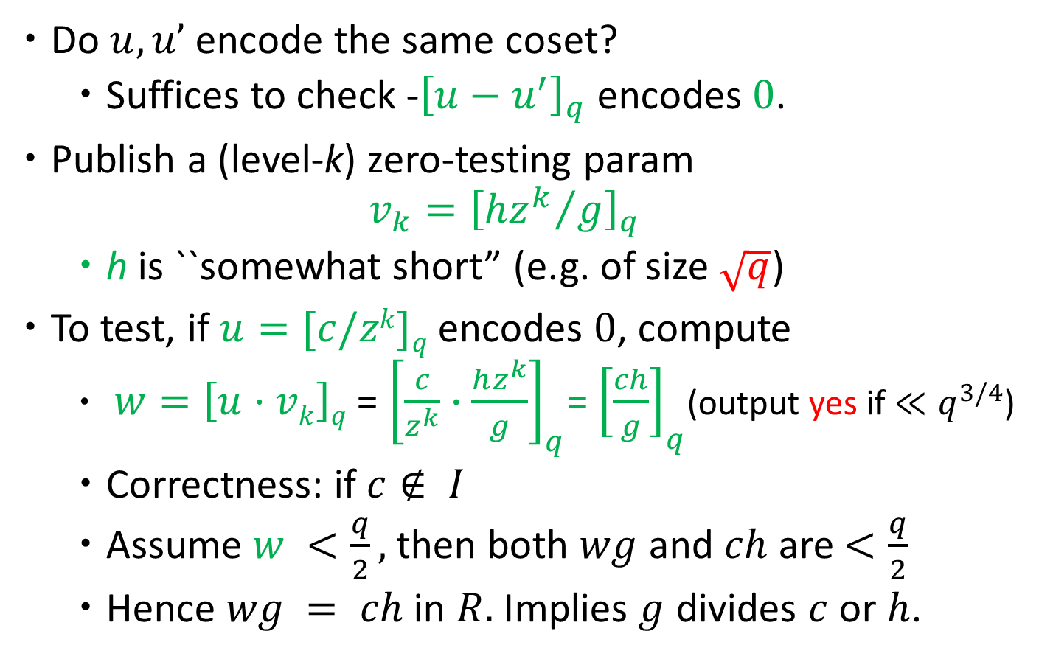
Equality Checking – Correctness II
Do $u,u’$ encode the same coset?
  Suffices to check -${\left[u−u^{′}\right]}_{q}$ encodes $0$.
Publish a (level-k) zero-testing param
  $$v_{k}={\left[{hz^{k}}/g\right]}_{q}$$
  h is ``somewhat short” (e.g. of size $\sqrt{q}$)
To test, if $u=[c/zk]q$ encodes $0$, compute
  $w=\left[u·vk\right]q$ = ${\left[\frac{c}{z^{k}}∙\frac{hz^{k}}{g}\right]}_{q}$= ${\left[\frac{ch}{g}\right]}_{q}$(output yes if $≪q^{3/4}$)
  Correctness: if $c∉ I$
  Assume $w <\frac{q}{2},$then both $wg$ and $ch$ are $<\frac{q}{2}$
  Hence $wg = ch$ in $R.$ Implies $g$ divides $c$ or $h$.

Slide 44

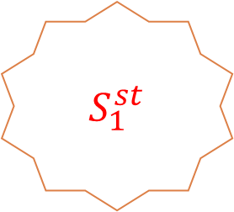









Re-randomizaton
This re-randomization gets us statistically close to the actual distribution [AGHS12,AR13].
$${ S}_{0}^{s}$$
$${ S}_{0}^{t}$$
$${ S}_{0}^{st}$$
$${ S}_{0}^{r}$$
$$c_{s} c_{t} c_{st} c_{r}$$
$$S_{1}^{}$$
$$u_{s} u_{t} u_{st} u_{r}$$
$\text{C}\text{ompute} cst=csct$
And $\text{encode} us=[c_{s}y]q, ut=[c_{t}y]q, ust=[c_{st}y]q$
  But then $ust=\frac{u_{s}u_{t}}{y}$
We need to re-randomize the encoding, to break these simple algebraic relations
$${ S}_{1}^{st}$$
Need to re-randomize this as well.
$$S_{1}^{0}$$
$$x_{0} x_{0}^{′}{ x}_{0}^{′′}⋯⋯⋯$$

Slide 45
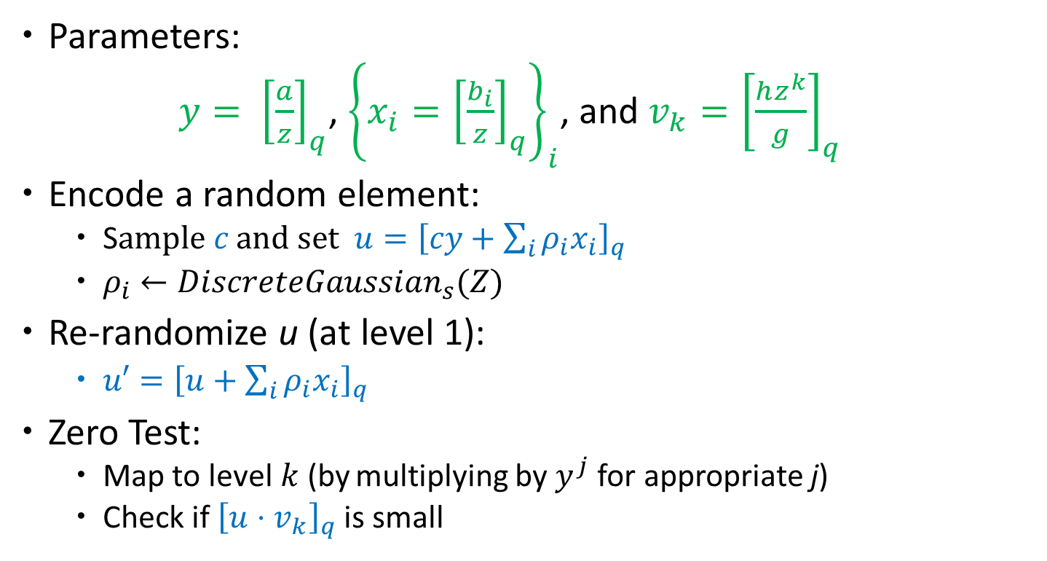
The Complete Encoding Scheme
Parameters:
$y= {\left[\frac{a}{z}\right]}_{q}$, ${\left\{x_{i}={\left[\frac{b_{i}}{z}\right]}_{q}\right\}}_{i}$, and $v_{k}={\left[\frac{hz^{k}}{g}\right]}_{q}$
Encode a random element:
  S$\text{ample} c \text{and} \text{set} u={\left[cy+\sum_{i}{ρ_{i}x_{i}}\right]}_{q}$
  $ρ_{i}←DiscreteGaussian_{s}(Z)$
Re-randomize u (at level 1):
  $u′={\left[u+\sum_{i}{ρ_{i}x_{i}}\right]}_{q}$
Zero Test:
  Map to level$k$(by multiplying by $y_{}^{j}$ for appropriate j)
  Check if ${\left[u⋅v_{k}\right]}_{q}$ is small
Re-randomization not needed for applications like obfuscation.

Slide 46

Variants
Asymmetric variants (many z_{i}’s), XDH analog
${ y}_{i}= {\left[\frac{a_{i}}{z_{i}}\right]}_{q}$, ${\left\{x_{i,j}={\left[\frac{b_{i,j}}{z_{i}}\right]}_{q}\right\}}_{i,j}$, $v_{k}={\left[\frac{h\prod_{i}{z_{i}}}{g}\right]}_{q}$
Partially symmetric and partially asymmetric

Slide 47
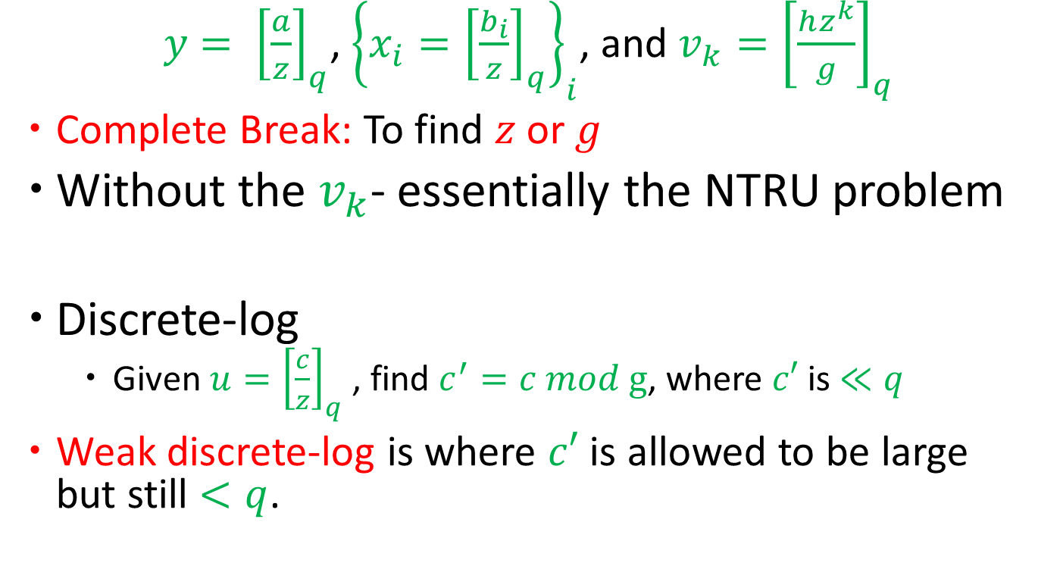
Discrete-log attack
$y= {\left[\frac{a}{z}\right]}_{q}$, ${\left\{x_{i}={\left[\frac{b_{i}}{z}\right]}_{q}\right\}}_{i}$, and $v_{k}={\left[\frac{hz^{k}}{g}\right]}_{q}$
Complete Break: To find $z$ or $g$
Without the $v_{k}$- essentially the NTRU problem
Discrete-log
  Given $u={\left[\frac{c}{z}\right]}_{q}$ , find $c^{′}=c mod g$, where $c′$ is $≪q$
Weak discrete-log is where $c′$ is allowed to be large but still $<q$.

Slide 48
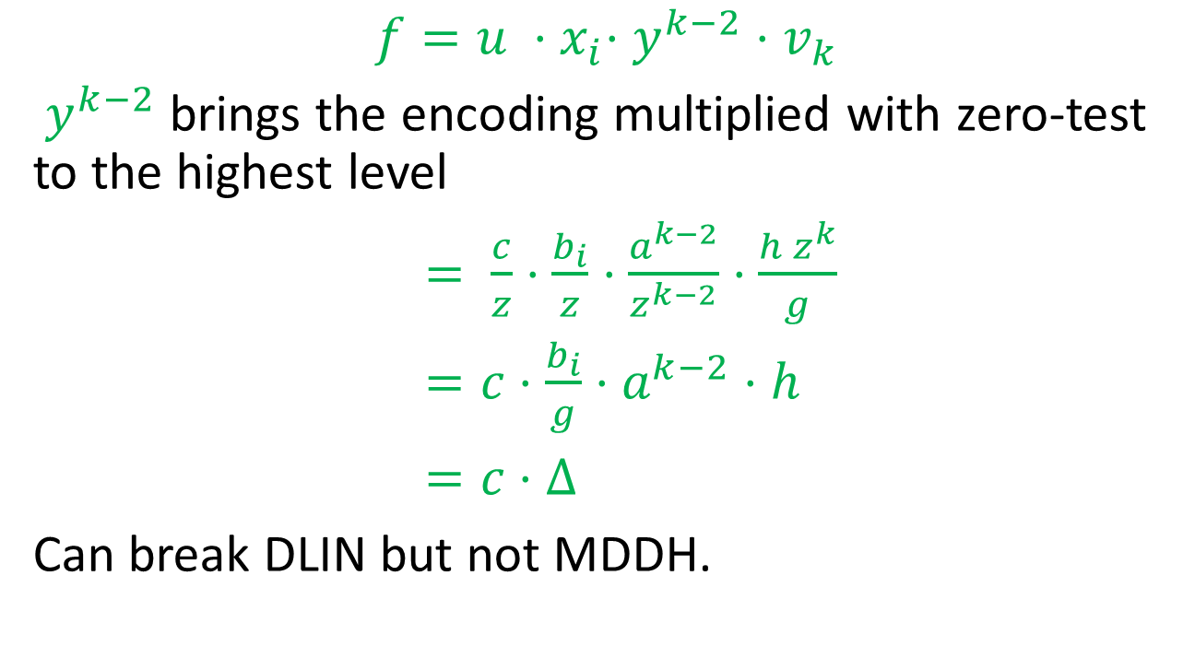
Weak Discrete Log Attack
$$f=u {⋅x}_{i}⋅y^{k−2}{⋅v}_{k}$$
$y^{k−2}$ brings the encoding multiplied with zero-test to the highest level
$= \frac{c}{z}⋅\frac{b_{i}}{z}⋅\frac{a^{k−2}}{z^{k−2}}⋅\frac{h z^{k}}{g}$
$=c⋅\frac{b_{i}}{g}⋅a^{k−2}⋅h$
$=c⋅Δ$
Can break DLIN but not MDDH.
  Extended to some other settings without zeros [CGHLMRST15]
  Extended to total break – given zeros [Hu-Jia15]

Slide 49
Outline
Bilinear Maps: Recall
  Intuitively: Multilinear Maps
  Results and Applications
Definitions of Multi-linear Maps
  Classical Notion
  Our Notion
GGH – Construction and Attacks
CLT – Construction and Attacks

Slide 50
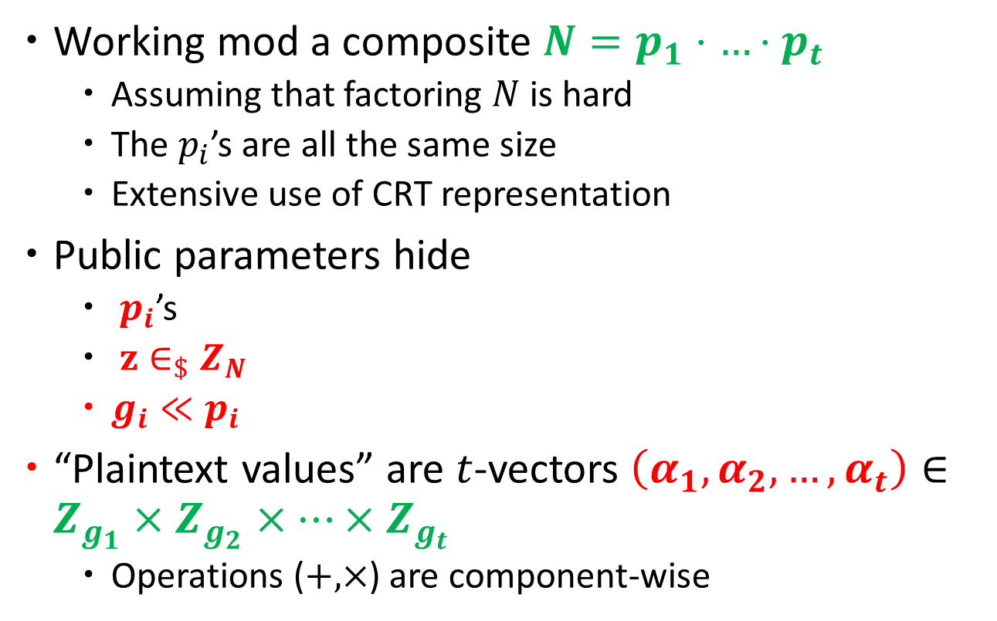
The [CLT'13] Construction
Working mod a composite $N=p_{1}⋅…⋅p_{t}$
  Assuming that factoring $N$ is hard
  The $p_{i}$’s are all the same size
  Extensive use of CRT representation
Public parameters hide
  $p_{i}$’s
  $z∈_{\$}Z_{N}$
  $g_{i}≪p_{i}$
“Plaintext values” are $t$-vectors $\left(α_{1},α_{2},…,α_{t}\right)∈Z_{g_{1}}×Z_{g_{2}}×…×Z_{g_{t}}$
  Operations ($+,×$) are component-wise

Slide 51
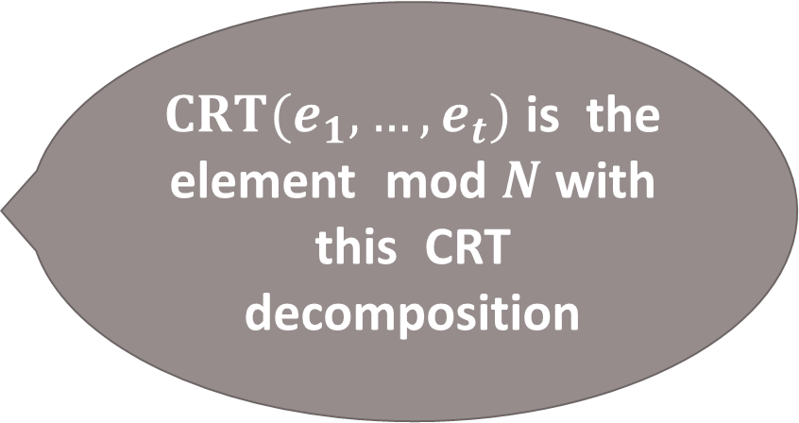

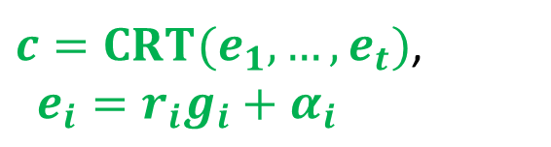

The CLT13 Construction
$N=p_{1}⋅…⋅p_{t}$
$α= \left(α_{1},α_{2},…,α_{t}\right)∈Z_{g_{1}}×Z_{g_{2}}×…×Z_{g_{t}}$
  A random (large) $z∈Z_{N}$
$${ S}_{0}^{1}$$
$CRT(e_{1},…,e_{t})$ is the element mod $N$ with this CRT decomposition
$$+ \text{and} ×$$
$${ S}_{0}^{2}$$
$c=CRT(e_{1},…,e_{t})$,
$e_{i}=r_{i}g_{i}+α_{i}$
$$⋮$$
$${ S}_{0}^{g}$$
$${ S}_{0}^{}$$

Slide 52
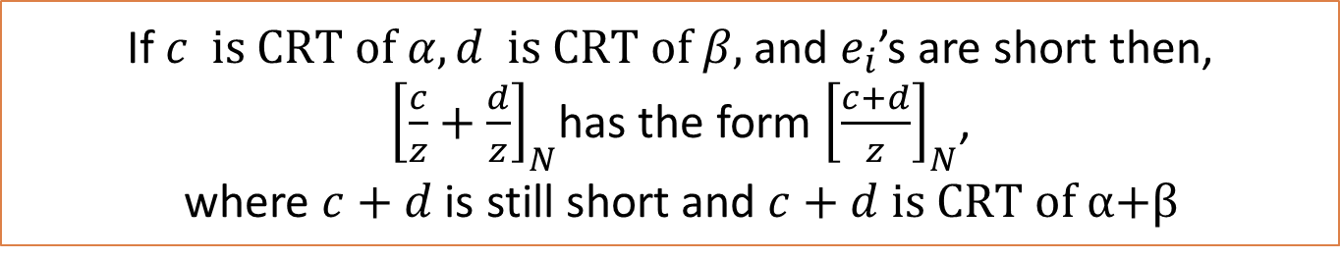


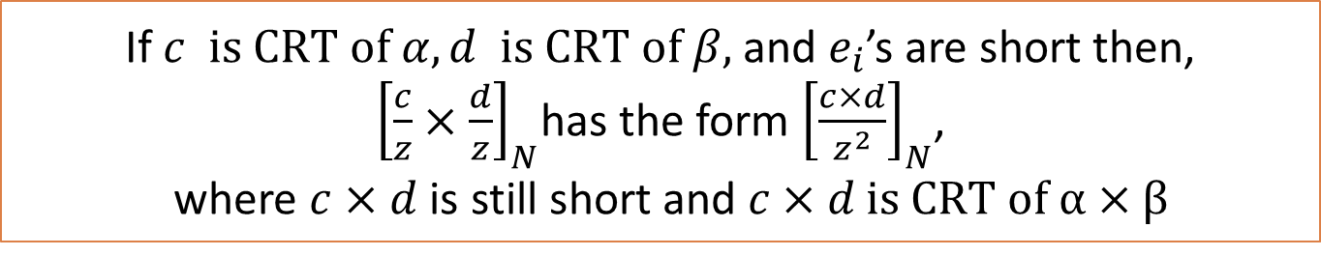



The CLT13 Construction
$N=p_{1}⋅…⋅p_{t}$
$α=\left(α_{1},α_{2},…,α_{t}\right)∈Z_{g_{1}}×Z_{g_{2}}×…×Z_{g_{t}}$
  A random (large) $z∈Z_{N}$
$$c$$
$${ S}_{0}^{1}$$
$${ S}_{1}^{1}$$
$${ S}_{2}^{1}$$
$${ S}_{0}^{2}$$
$${ S}_{1}^{2}$$
$${\left[\frac{c}{z}\right]}_{N}$$
$${ S}_{2}^{2}$$
$${\left[\frac{c}{z^{2}}\right]}_{N}$$
$c=CRT(e_{1},…,e_{t})$,
$e_{i}=r_{i}g_{i}+α_{i}$
$$⋮$$
$$⋮$$
$$⋮$$
$${ S}_{0}^{g}$$
$${ S}_{2}^{g}$$
If $c \text{is} \text{CRT} \text{of} α,d \text{is} \text{CRT} \text{of} β,$and $e_{i}$’s are short then,
${\left[\frac{c}{z}×\frac{d}{z}\right]}_{N}$has the form ${\left[\frac{c×d}{z^{2}}\right]}_{N}$,
where $c×d$is still short and $c×d \text{is} \text{CRT} \text{of} \text{α}×β$
If $c \text{is} \text{CRT} \text{of} α,d \text{is} \text{CRT} \text{of} β,$ and $e_{i}$’s are short then,
${\left[\frac{c}{z}+\frac{d}{z}\right]}_{N}$has the form ${\left[\frac{c+d}{z}\right]}_{N}$,
where $c+d$is still short and $c+d \text{is} \text{CRT} \text{of} \text{α}\text{+}β$
$${ S}_{1}^{g}$$
Multiplication
Addition
$${ S}_{0}^{}$$
$${ S}_{1}^{}$$
$${ S}_{2}^{}$$

Slide 53
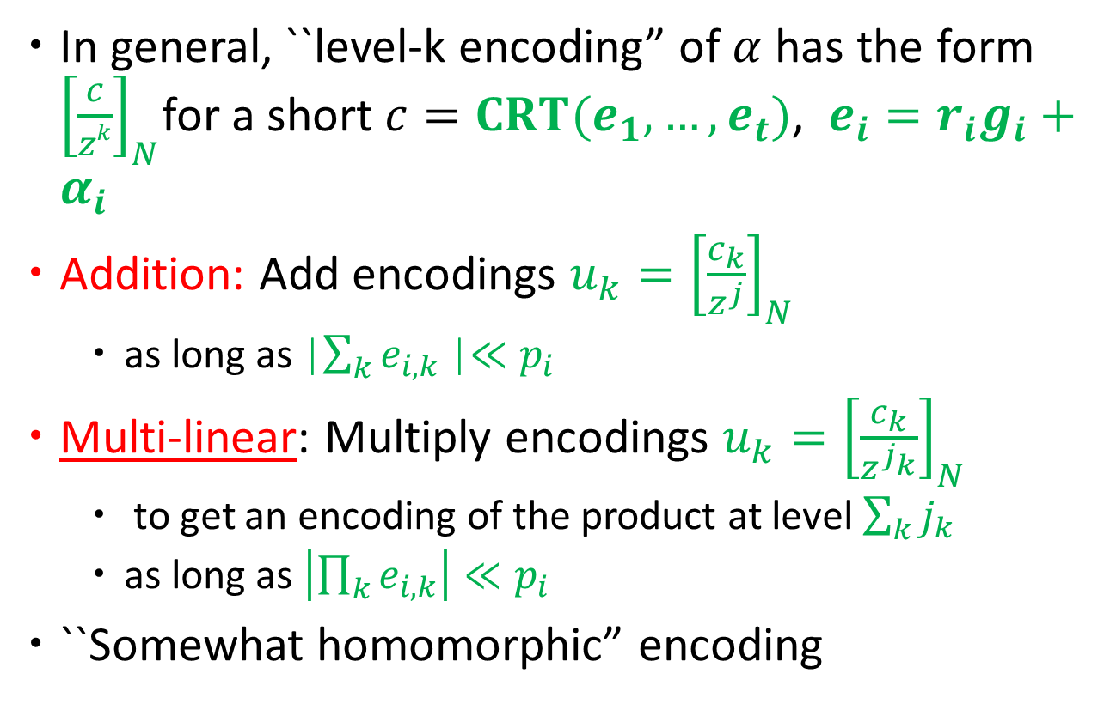
The CLT13 Construction (in general)
In general, ``level-k encoding” of $α$ has the form ${\left[\frac{c}{zk}\right]}_{N}$for a short $c=CRT(e_{1},…,e_{t})$, $e_{i}=r_{i}g_{i}+α_{i}$
Addition: Add encodings $u_{k}={\left[\frac{c_{k}}{z^{j}}\right]}_{N}$
  as long as |$\sum_{k}{e_{i,k}}$|$≪p_{i}$
Multi-linear: Multiply encodings $u_{k}={\left[\frac{c_{k}}{z^{j_{k}}}\right]}_{N}$
  to get an encoding of the product at level $\sum_{k}{j_{k} }$
  as long as $\left|\prod_{k}{e_{i,k}}\right|≪p_{i}$
``Somewhat homomorphic” encoding
Sampling and equality check?

Slide 54
Sampling/Encoding/
Re-randomization
  Sampling at level-0: Similar to re-randomization from GGH
  Public parameters include level-0 encodings of random plaintext elements
  Taking random linear combinations gives a level-0 encoding of a random plaintext element.
  Encoding at higher level: Include encoding of 1
  Re-randomization: Publicly include encoding of 0’s

Slide 55
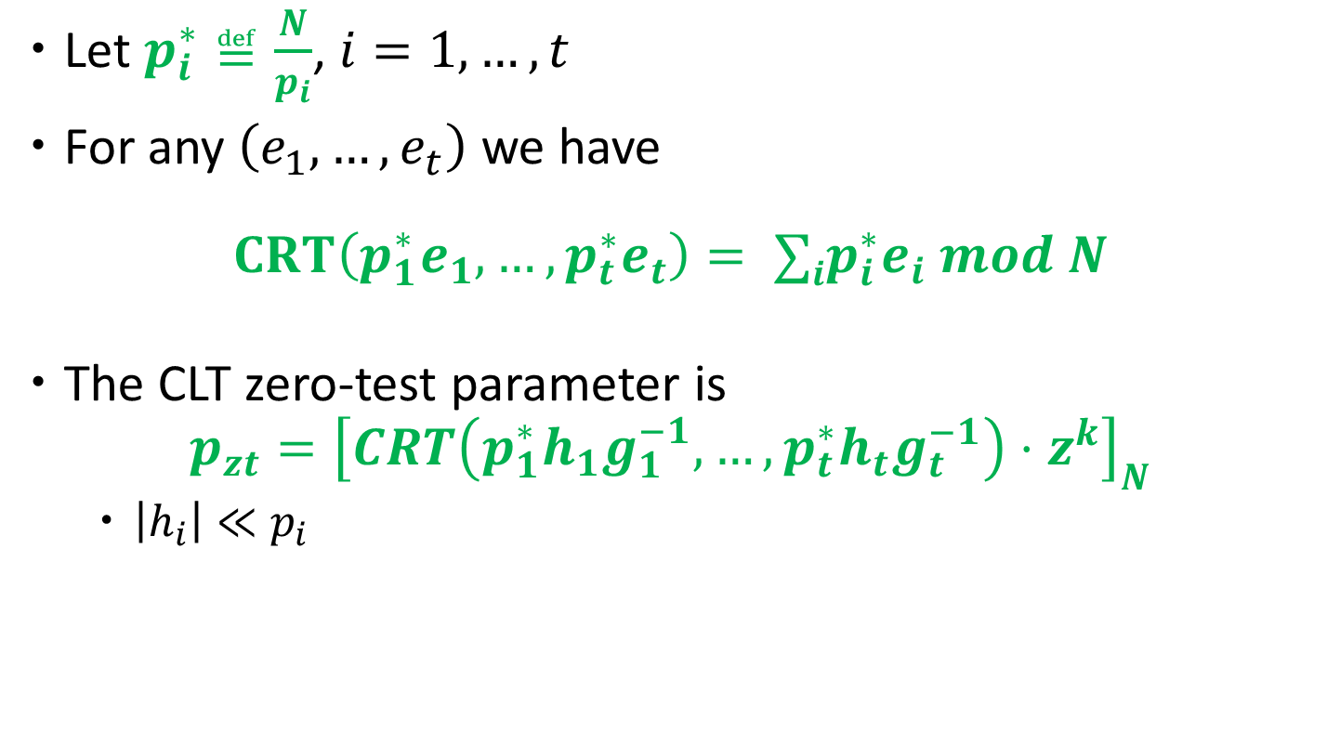
The [CLT'13] Zero-Test
Let $p_{i}^{∗}≝\frac{N}{p_{i}}$, $i=1,…,t$
For any $\left(e_{1},…,e_{t}\right)$ we have
$$CRT\left(p_{1}^{∗}e_{1},…,p_{t}^{∗}e_{t}\right)= ∑ip_{i}^{∗}e_{i} mod N$$
The CLT zero-test parameter is
$p_{zt}={\left[CRT\left({p_{1}^{∗}h}_{1}g_{1}^{−1},…,{p_{t}^{∗}h}_{t}g_{t}^{−1}\right)⋅z^{k}\right]}_{N}$
  $\left|h_{i}\right|≪p_{i}$

Slide 56
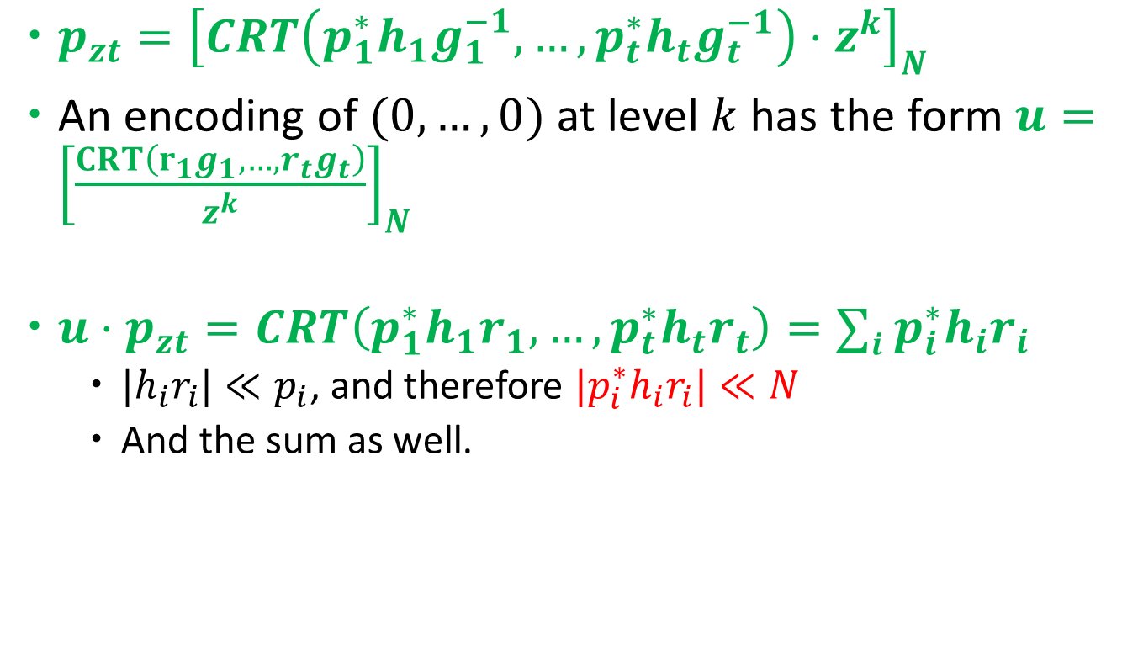
The [CLT'13] Zero-Test
$p_{zt}={\left[CRT\left({p_{1}^{∗}h}_{1}g_{1}^{−1},…,{p_{t}^{∗}h}_{t}g_{t}^{−1}\right)⋅z^{k}\right]}_{N}$
An encoding of $(0,…,0)$at level $k$ has the form $u={\left[\frac{CRT\left(r_{1}g_{1},…,r_{t}g_{t}\right)}{z^{k}}\right]}_{N}$
$u⋅p_{zt}=CRT\left({p_{1}^{∗}h}_{1}r_{1},…,{p_{t}^{∗}h}_{t}r_{t}\right)=∑i {p_{i}^{∗}h}_{i}r_{i}$
  ${|h}_{i}r_{i}|≪p_{i}$, and therefore ${|p_{i}^{∗}h}_{i}r_{i}|≪N$
  And the sum as well.

Slide 57
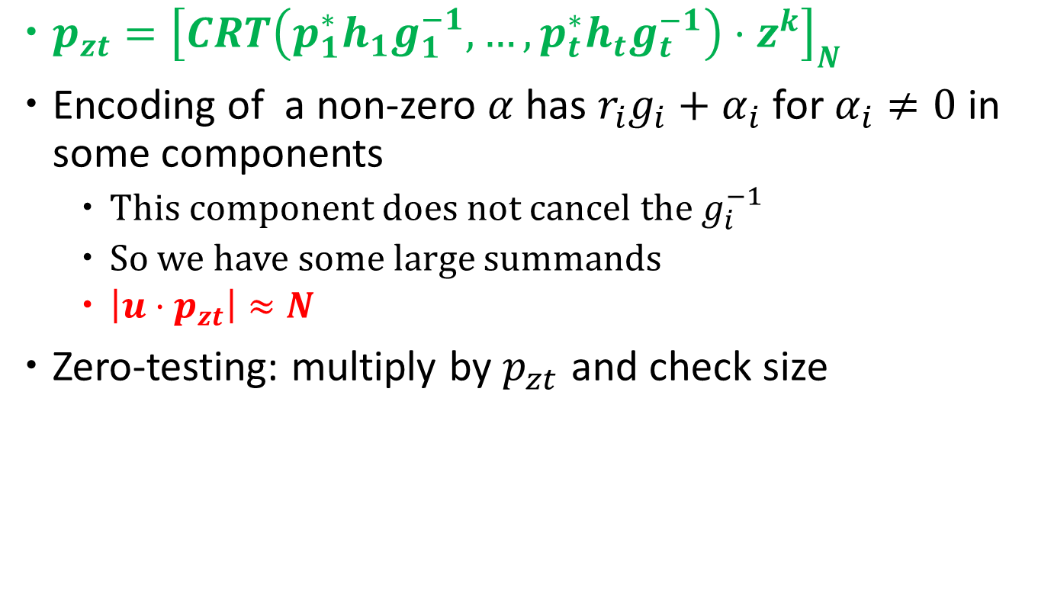
The [CLT'13] Zero-Test
$p_{zt}={\left[CRT\left({p_{1}^{∗}h}_{1}g_{1}^{−1},…,{p_{t}^{∗}h}_{t}g_{t}^{−1}\right)⋅z^{k}\right]}_{N}$
Encoding of a non-zero $α$ has $r_{i}g_{i}+α_{i}$ for $α_{i}≠0$ in some components
  This component does not cancel the $g_{i}^{−1}$
  So we have some large summands
  $\left|u⋅p_{zt}\right|≈N$
Zero-testing: multiply by $p_{zt}$ and check size

Slide 58
Zeroing Attacks on CLT13
Initially GGH13 attacks did not seem to extend to [CLT'13]
[Cheon-Han-Lee-Ryu-Stehle'15] extend these attacks breaking [CLT'13] in case when encodings of zero are provided

Slide 59
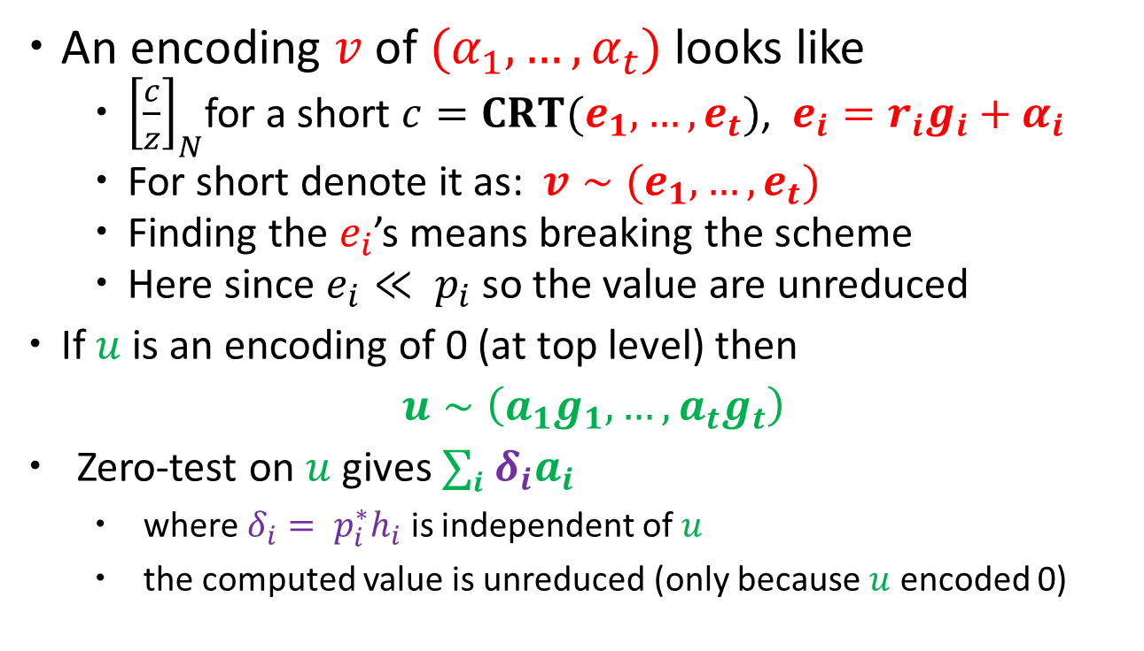
Cheon et al. Attack
An encoding $v$ of $(α_{1},…,α_{t})$ looks like
  ${\left[\frac{c}{z}\right]}_{N}$for a short $c=CRT(e_{1},…,e_{t})$, $e_{i}=r_{i}g_{i}+α_{i}$
  For short denote it as: $v∼(e_{1},…,e_{t})$
  Finding the $e_{i}$’s means breaking the scheme
  Here since $e_{i}≪ p_{i}$ so the value are unreduced
  If $u$ is an encoding of 0 (at top level) then
  $u∼\left(a_{1}g_{1},…,a_{t}g_{t}\right)$
  Zero-test on $u$ gives $∑i {δ_{i}a}_{i}$
    where $δ_{i}= p_{i}^{∗}h_{i}$ is independent of $u$
    the computed value is unreduced (only because $u$ encoded 0)

Slide 60

Cheon et al. Attack
Attack Encodings:
$v∼\left(b_{1}, … , b_{t}\right)$, $v^{′}∼\left(b_{1}^{′}, … , b_{t}^{′}\right)$
Encoding of 0:
  $$u∼\left(a_{1}g_{1},…,a_{t}g_{t}\right)$$
Filler encoding:
$$w∼\left(c_{1}, …c_{t}\right)$$
We get a level-$k$ encoding
  $u⋅v⋅w∼(a_{1}b_{1}c_{1}⋅g_{1},…,a_{t}b_{t}c_{t}⋅g_{t})$
  Similarly $u⋅v′⋅w∼(a_{1}b_{1}^{′}c_{1}⋅g_{1},…,a_{t}b_{t}^{′}c_{t}⋅g_{t})$

Slide 61

Cheon et al. Attack
Z$\text{ero}\text{−}\text{test} \text{on} u⋅v⋅w$
  $$∑i a_{i}b_{i}c_{i}⋅δ_{i}$$
  Or $\left(a_{1},…, a_{t}\right)×\left[\begin{matrix}b_{1}δ_{1} & ⋯ & 0 \\ ⋮ & ⋱ & ⋮ \\ 0 & ⋯ & b_{t}δ_{t}\end{matrix}\right]×\left(\begin{matrix}c_{1} \\ ⋮ \\ c_{t}\end{matrix}\right)$
Similarly z$\text{ero}\text{−}\text{test} \text{on} u⋅v^{′}⋅w$gives
  $$∑i a_{i}b_{i}^{′}c_{i}⋅δ_{i}$$
  Or $\left(a_{1},…, a_{t}\right)×\left[\begin{matrix}b_{1}^{′}δ_{1} & ⋯ & 0 \\ ⋮ & ⋱ & ⋮ \\ 0 & ⋯ & b_{t}^{′}δ_{t}\end{matrix}\right]×\left(\begin{matrix}c_{1} \\ ⋮ \\ c_{t}\end{matrix}\right)$
Unreduced mod N

Slide 62

Cheon et al. Attack
Extending $u⋅v⋅w$to multiple values
$$U⋅V⋅W$$
  $U$ has rows consisting of encodings of 0
  $V$ is the target encoding along the diagonal
  $W$ has columns of filler encodings
Zero-test on $U⋅V⋅W$
$$Y= A×\left[\begin{matrix}b_{1}δ_{1} & ⋯ & 0 \\ ⋮ & ⋱ & ⋮ \\ 0 & ⋯ & b_{t}δ_{t}\end{matrix}\right]×C$$
Similarly, $Y^{′}= A×\left[\begin{matrix}b_{1}^{′}δ_{1} & ⋯ & 0 \\ ⋮ & ⋱ & ⋮ \\ 0 & ⋯ & b_{t}^{′}δ_{t}\end{matrix}\right]×C$

Slide 63

Cheon et al. Attack
G$iven Y, Y^{′}$ we compute
$Z=Y×Y^{′^{−1}}= A×\left[\begin{matrix}\frac{b_{1}}{b_{1}^{′}} & ⋯ & 0 \\ ⋮ & ⋱ & ⋮ \\ 0 & ⋯ & \frac{b_{t}}{b_{t}^{′}}\end{matrix}\right]×A^{−1}$
Eigenvalues of $Z$ are $b_{i}^{}{/b}_{i}^{′}, i=1,…,t$
Enough to violate security of many assumption
Can be used to factor N as well!
Extensions of attack [CGHMMRST15]
Strengthened scheme that resists these attacks
  [CLT'15] make zero-test ``less linear”

Slide 64
Summary of current constructions
Not for obfuscation!
Ideal Lattice based [GGH]
  Weak-discrete Log Attack – given zeros [GGH13]
  Quantum Attack [CDPR] and sub-exponential classical attack
  Extend weak-discrete log attack to some other settings without zeros [CGHLMRST15]
  Extend weak-discrete log attack to total break – given zeros [Hu-Jia15]
Over the integers [CLT]
  Quantum Attack - relies on hardness of factoring
  Total break – given zeros [CHLRS15]
  Extend to some other settings without zeros [CGHLMRST15]
  A new fix [CLT15] also for GGH
Graph Based Mmaps [GGH]
  Open to investigation?

Slide 65
Conclusion and Current Landscape
Multilinear maps - very useful and currently a very active area of investigation
Attacks break many hardness assumptions and several schemes
  But certainly not all (e.g. most obfuscation schemes are unaffected)
Break and repair situation
  Better understand what does not work
  Theoretical understanding on the hardness of what we are assuming is missing

Slide 66
Thank You! Questions?
?
?

