Slide 1
Homomorphic Encryption (Part I):
SWHE
Shai Halevi
* Many slides taken from Craig Gentry
May 18, 2015
Simons Institute, Cryptography Boot Camp

Slide 2
Computing on Encrypted Data
Can we delegate the processing of data, without giving away access to it.

Slide 3

Encrypted Cloud Computing
The special sauce! For security parameter λ, Eval’s running should be Time(f)∙poly(λ)
“I want 1) the cloud to process my data 2) even though it is encrypted.
Run
Eval[ f, Enc_{pk}(x) ]
= Enc_{pk}[f(x)]
Enc_{pk}(x)
function f
Server (Cloud)
This could be encrypted too.
Alice
Delegation: Should cost less for Alice to encrypt x and decrypt f(x) than to compute f(x) herself.
(Input: data x, secret key sk)
Enc_{pk}[f(x)]
f(x)

Slide 4
Homomorphic Encryption (HE)
Procedures: KeyGen, Encrypt, Decrypt, Eval
Semantic Security: same as for basic encryption
Correctness: For any function f in “supported” family F:
c₁ ← Enc_{pk}(m₁) … c_{t} ← Enc_{pk}(m_{t})
c* ← Eval_{pk}(f, c₁, …, c_{t}) Dec_{sk}(c*) = f(m₁, …, m_{t})
Compactness: complexity of decrypting c* does not depend on complexity of f

Slide 5
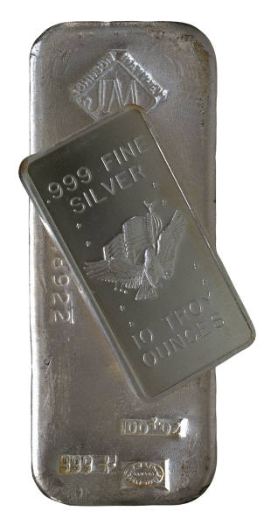


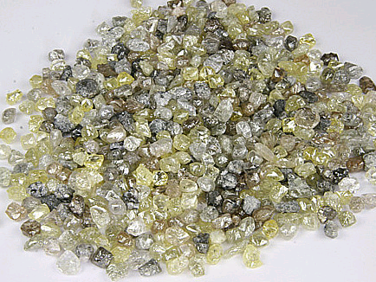
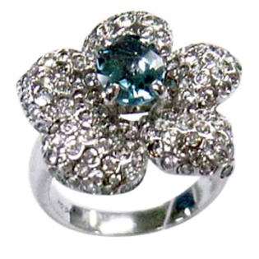
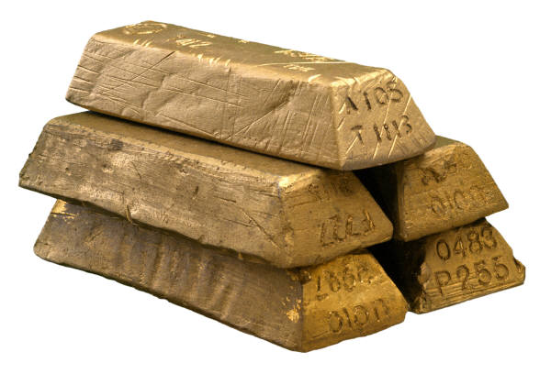

An Analogy: Alice’s Jewelry Store
Alice wants workers to assemble raw materials into jewelry
But Alice is worried about theft:
  She wants workers to process raw materials without having access.
Alice puts raw materials in locked glovebox.
Workers assemble jewelry inside glovebox, using the gloves.
Alice unlocks box to get “results”.

Slide 6
Homomorphic Encryption
“Somewhat” means it works for some functions f
f
Somewhat
Homomorphic
Encryption (SWHE):
Enc[x]
Eval
Enc[f(x)]
Pre-2009 schemes were somewhat homomorphic.

Slide 7
Homomorphic Encryption
“Fully” means it works for all functions f
f
Fully Homomorphic Encryption (FHE) [RAD78, Gen09]:
Enc[x]
Eval
Enc[f(x)]

Slide 8
Homomorphic Encryption Basics
A way to delegate processing of your data, without giving away access to it.
Fully Homomorphic Encryption (FHE):
  Arbitrary processing
  But computationally expensive.
Somewhat Homomorphic Encryption (SWHE):
  Limited processing
  Could be cheaper computationally.

Slide 9
Encrypted String Matching
b denotes an encryption of bit b.
Bit-wise encrypted file
Step 1: Match string against subsequences of file
01100111101100100100010001
E-ADD
111011
111011
100010
E-ZeroString(100010) = 0
(not the zero string! not a match!)
E-ZeroString function itself can be computed from basic bit operations.

Slide 10
Encrypted String Matching
b denotes an encryption of bit b.
Bit-wise encrypted file
Step 2: Aggregate info about the subsequences
01100111101100100100010001
111011
111011
111011
111011
111011
111011
111011
111011
0
0
0
0
0
0
1
0
E-OR(00000010…) = 1
(string is in the encrypted file!)
E-OR can also be computed from basic bit operations.

Slide 11
HE Security: A Paradox?
Cloud stores my encrypted files: pk, Enc_{pk}(f₁),…, Enc_{pk}(f_{n}).
Later, I want f₃, but want to hide “3” from cloud.
I send Enc_{pk} (3) to the cloud.
Cloud runs Eval_{pk} (F, Enc_{pk}(3), Enc_{pk}(f₁),…, Enc_{pk}(f_{n})), where F(n, {files}) is the function that outputs the nth file.
It sends me the (encrypted) file f₃.
Paradox?: Can’t the cloud “see” it is sending the 3rd encrypted file? By comparing the stored value Enc_{pk}(f₃) to the ciphertext it sends?
Resolution of paradox:
Semantic security implies:
Many encryptions of f₃,
Hard to tell when two ciphertexts encrypt the same thing.

Slide 12
Properties/Limitations of HE

Slide 13
Some Properties
Chosen-ciphertext security: HE is malleable by design, standard CCA security cannot be achieved
  Can get CCA1other security notions (e.g. homomorphic sigs)
Multi-hop: Can we apply Eval to evaluated ciphertexts?
  Usually yes, but not inherently so
Function privacy: Does Eval_{pk}(f,…) hide f?
  Even from an adversary that has the secret key?
  This can be arranged
Malicious security: What if pk, c are malformed?
Notes:
Lopez-Alt Tromer Vaikun

Slide 14
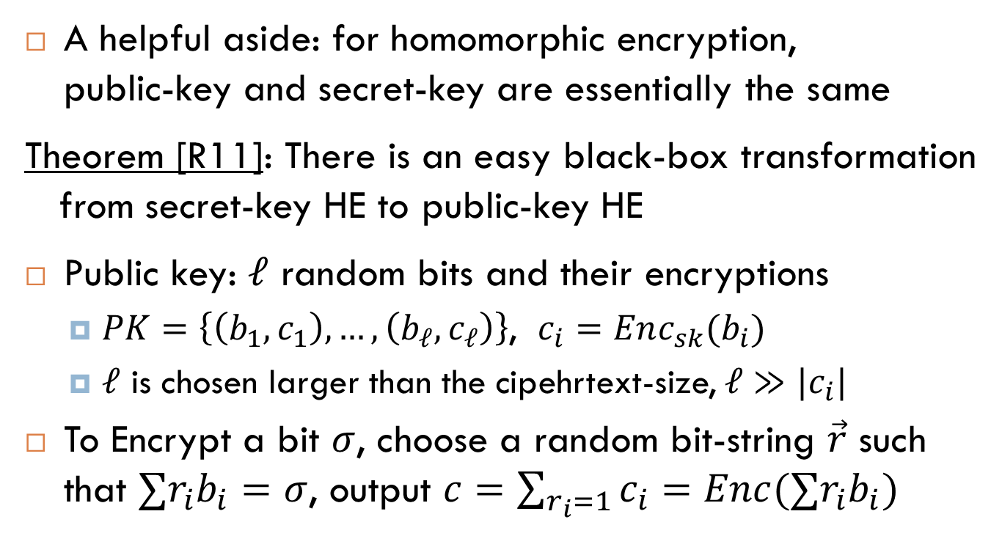
Secret-key vs. Public-key HE
A helpful aside: for homomorphic encryption,
public-key and secret-key are essentially the same
Theorem [R11]: There is an easy black-box transformation
from secret-key HE to public-key HE
Public key: $ℓ$ random bits and their encryptions
  $PK=\left\{\left(b_{1},c_{1}\right),…,\left(b_{ℓ}, c_{ℓ}\right)\right\}$, $c_{i}=Enc_{sk}(b_{i})$
  $ℓ$ is chosen larger than the cipehrtext-size, $ℓ≫|c_{i}|$
To Encrypt a bit $σ$, choose a random bit-string $\vec{r}$ such that $∑r_{i}b_{i}=σ$, output $c=\sum_{r_{i}=1}{c_{i}}=Enc(∑r_{i}b_{i})$

Slide 15
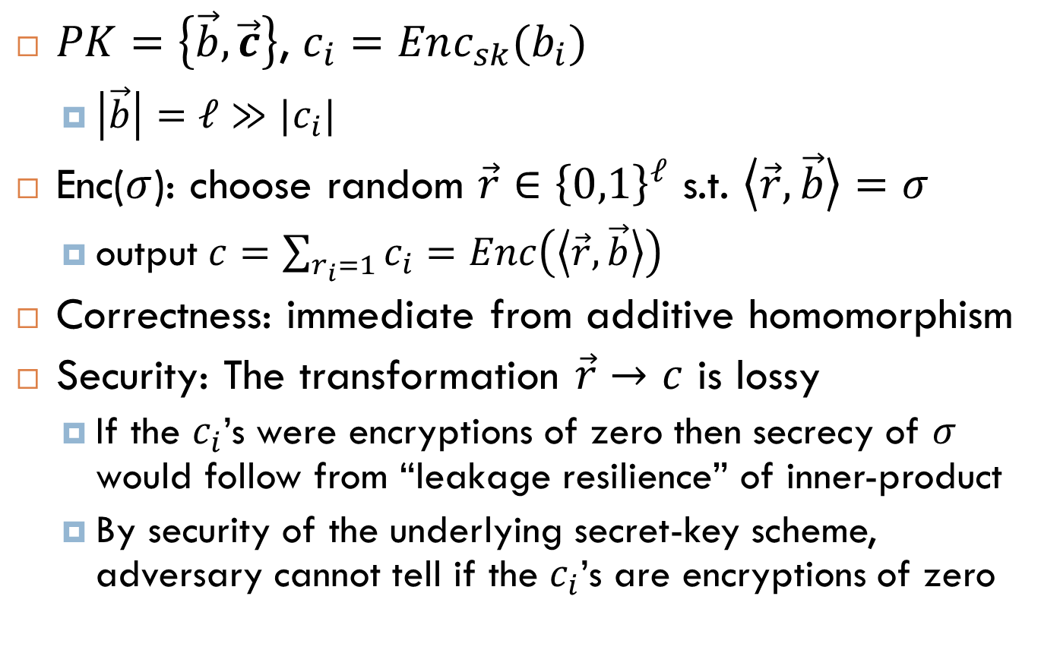
Transforming HE from SK to PK
$PK=\left\{\vec{b},\vec{c}\right\}$, $c_{i}=Enc_{sk}(b_{i})$
  $\left|\vec{b}\right|=ℓ≫|c_{i}|$
Enc($σ$): choose random $\vec{r}∈{\left\{0,1\right\}}^{ℓ}$ s.t. $\left\langle \vec{r},\vec{b}\right\rangle =σ$
  output $c=\sum_{r_{i}=1}{c_{i}}=Enc\left(\left\langle \vec{r},\vec{b}\right\rangle \right)$
Correctness: immediate from additive homomorphism
Security: The transformation $\vec{r}→c$ is lossy
  If the $c_{i}$’s were encryptions of zero then secrecy of $σ$ would follow from “leakage resilience” of inner-product
  By security of the underlying secret-key scheme, adversary cannot tell if the $c_{i}$’s are encryptions of zero

Slide 16
FHE Doesn’t Do Obfuscation
Obfuscation:
  I give the cloud an “encrypted” program Enc(P).
  For any input x, cloud can compute Enc(P)(x) = P(x).
  Cloud learns “nothing” about P, except {x_{i},P(x_{i})}.
Difference between obfuscation and FHE:
  In FHE, cloud computes Enc(P(x)), and it can’t decrypt to get P(x).
Barak et al: “On the (Im)possibility of Obfuscating Programs”
  Certain types of obfuscation are impossible.
Garg et al: “Candidate Indistinguishability Obfuscation and Functional Encryption for All Circuits”
  Certain types of obfuscation seem possible (we have schemes).
Notes:
Barak Goldreich Impag Rudich Sahai Vadhan Yang

Slide 17
FHE Doesn’t Do RAM
Circuits vs. RAMs:
  Circuits are powerful: Circuit-size ≈ TM complexity.
  But random-access machines compute some functions much faster than a TM or circuit (Binary search)
  Can’t do “random access” on encrypted data without leaking some information (not surprising)
What we can do:
  Oblivious RAM: But this is a very interactive protocol between client and server where server can’t tell what client is computing
  Use Obfuscation to do ORAM: Intuitively, obfuscation allows addresses in memory to be revealed “noninteractively”.
Notes:
Gordon Katz Kolesnikov Malkin Raykova Vahlis

Slide 18
FHE Doesn’t Do Multi-Key
Multi-Key FHE
  Different clients encrypt data under different FHE keys
    c_{i}← Enc_{pki}(m_{i})
  Later, cloud “combines” data encrypted under different keys to get c* ← Eval(pk₁,…pk_{t},f,c₁,…c_{t}).
    Can decrypt c* to f(m₁,…,m_{t}) by pooling sk₁,…sk
FHE doesn’t do this “automatically”.
  But there are some schemes that do this
Notes:
Lopez-Alt Tromer Vaikun

Slide 19
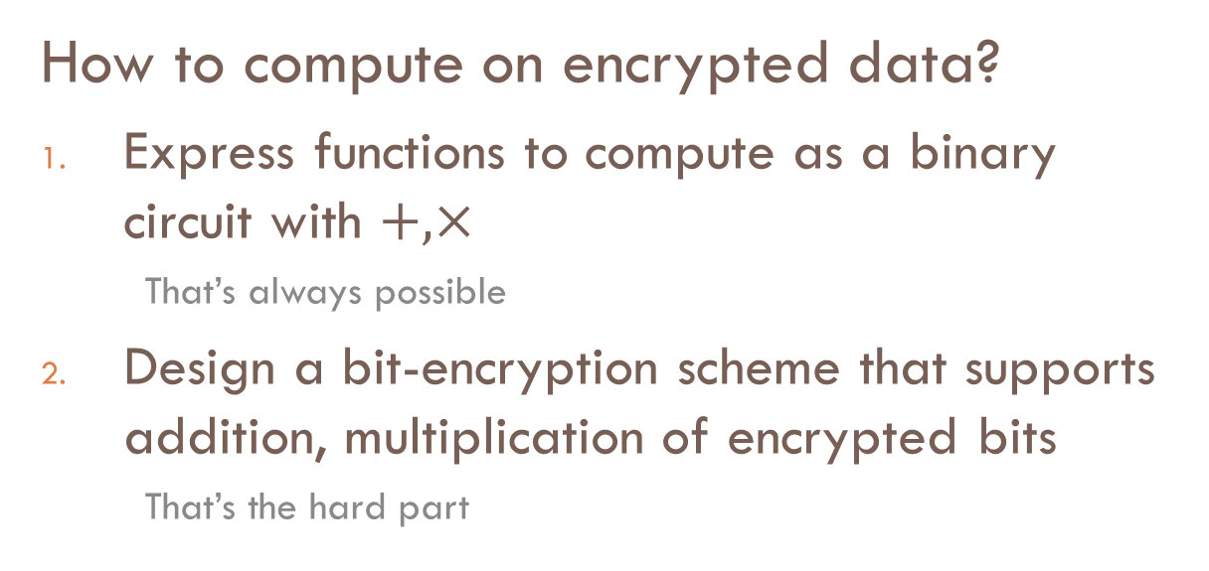
Constructing SWHE
How to compute on encrypted data?
Express functions to compute as a binary circuit with $+, ×$
  That’s always possible
Design a bit-encryption scheme that supports addition, multiplication of encrypted bits
  That’s the hard part

Slide 20
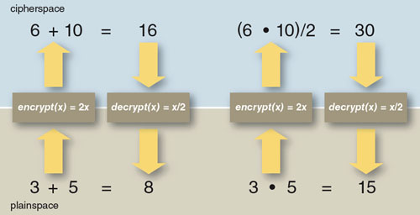
A Toy HE Scheme
(from American Scientist magazine)
Encryption: Double the plaintext. x → 2x
Decryption: Halve the ciphertext. x → x/2

Slide 21


About “Homomorphism”
Name inspired by ring-homomorphism
Ring of plaintexts
Ring of ciphertexts
Enc
$$+, ×$$
Commutative Diagram
$$⊞, ⊠$$
Ring of plaintexts
Ring of ciphertexts
Enc

Slide 22
About “Homomorphism”
Name inspired by ring-homomorphism
Homomorphism should not be taken too literally
  Else zero-encryptions form a linear subspace (ideal)
Is it possible to hide such an ideal?
  Some attempts (e.g. Polly Cracker), but broken
Ring of plaintexts
Ring of ciphertexts
Enc

Slide 23
Noisy Ciphertexts
Each ciphertext has some noise that hides the message.
  Think: “hidden” error correcting codes…
If error is small, Alice can use knowledge of “hidden” code to remove the noise.
If noise is large, decryption is hopeless even for Alice.

Slide 24
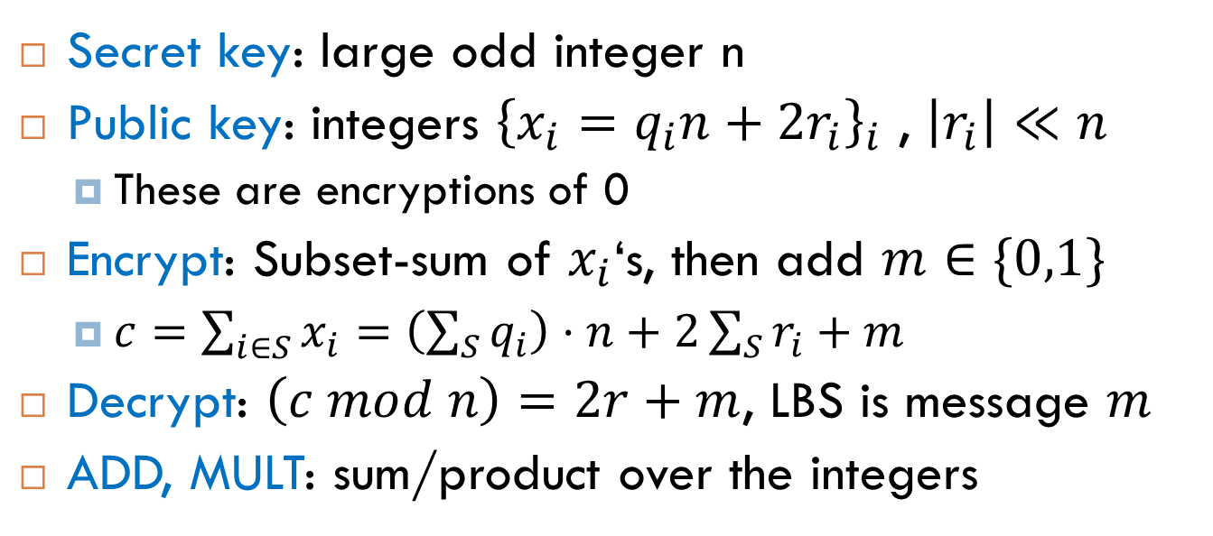
Example: SWHE over the Integers
Main Idea
Encryptions of 0 are something small and even
modulo a secret integer.
Secret key: large odd integer n
Public key: integers ${\left\{x_{i}=q_{i}n+{2r}_{i}\right\}}_{i}$ , $\left|r_{i}\right|≪n$
  These are encryptions of 0
Encrypt: Subset-sum of $x_{i}$‘s, then add $m∈\{0,1\}$
  $c=\sum_{i∈S}{x_{i}}=\left(\sum_{S}{q_{i}}\right)⋅n+2\sum_{S}{r_{i}}+m$
Decrypt: $\left(c mod n\right)=2r+m$, LBS is message $m$
ADD, MULT: sum/product over the integers

Slide 25
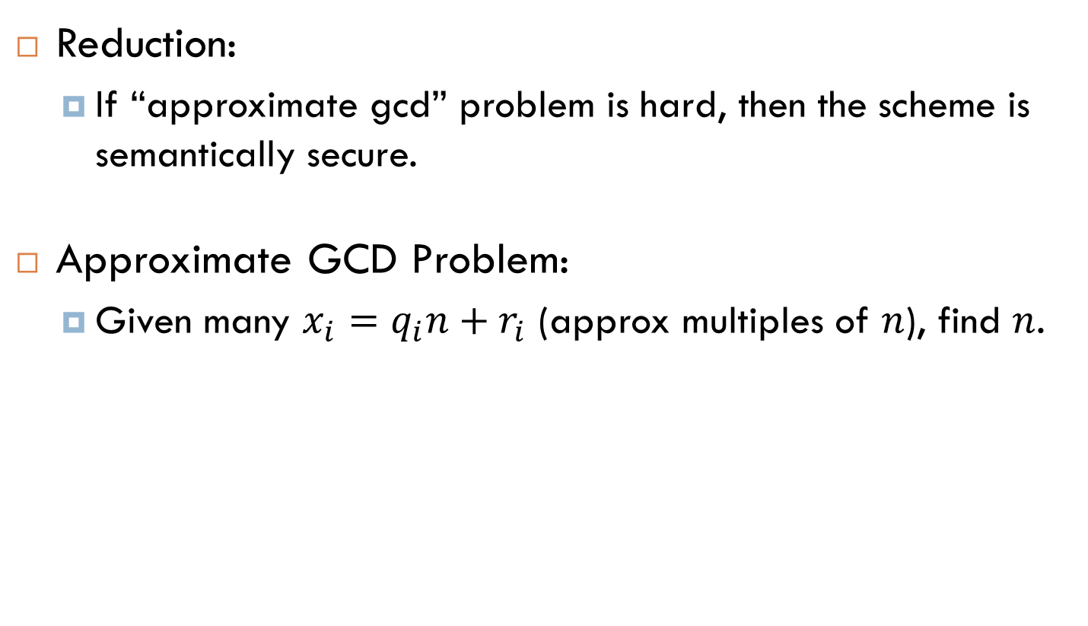
Security of SWHE with Integers
Reduction:
  If “approximate gcd” problem is hard, then the scheme is semantically secure.
Approximate GCD Problem:
  Given many $x_{i}=q_{i}n+r_{i}$ (approx multiples of $n$), find $n$.

Slide 26
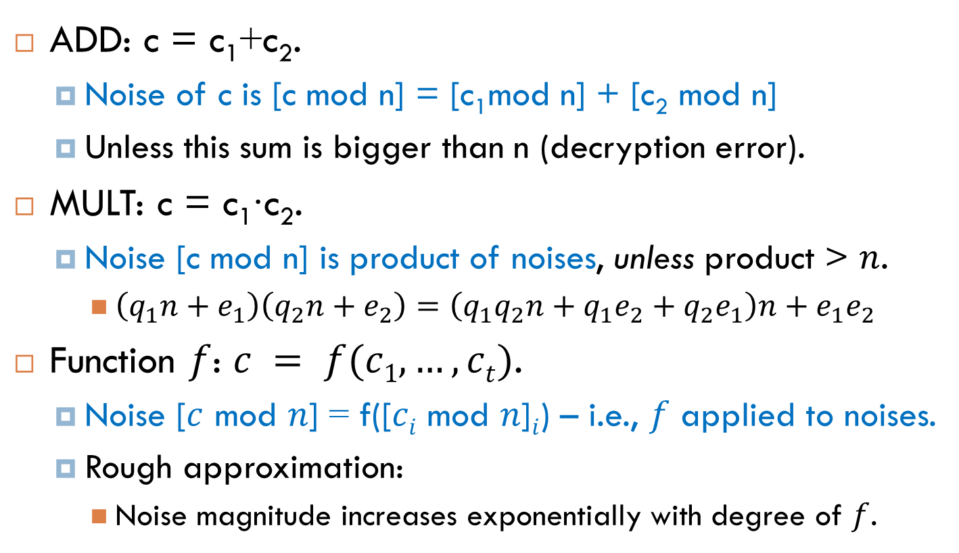
The Noise Problem
ADD: c = c₁+c₂.
  Noise of c is [c mod n] = [c₁mod n] + [c₂ mod n]
  Unless this sum is bigger than n (decryption error).
MULT: c = c₁∙c₂.
  Noise [c mod n] is product of noises, unless product > $n$.
    $\left(q_{1}n+e_{1}\right)\left(q_{2}n+e_{2}\right)=\left(q_{1}q_{2}n+q_{1}e_{2}+q_{2}e_{1}\right)n+e_{1}e_{2}$
Function $f$: $c = f(c1,…,ct)$.
  Noise [$c$ mod $n$] = f([$ci$ mod $n$]$i$) – i.e., $f$ applied to noises.
  Rough approximation:
    Noise magnitude increases exponentially with degree of $f$.

Slide 27
The Noise Problem Hurts Efficiency. Why?
Ciphertexts must be large to let noise “room to grow”.
  Noise grows exponentially with degree.
    Bit-length of noise grows linearly with degree.
  Ciphertext size grows linearly with degree.

Slide 28
Somewhat Homomorphic Encryption Based on LWE
Focusing on the Gentry-Sahai-Waters scheme.
(Brakerski and Vaikuntanathan were the first to construct HE based on LWE.)

Slide 29
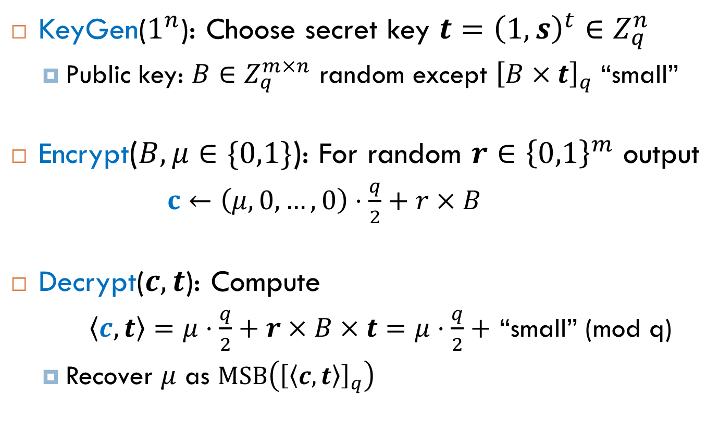
Regev’s Encryption Scheme
KeyGen($1^{n}$): Choose secret key $t={\left(1, s\right)}^{t}∈Z_{q}^{n}$
  Public key: $B∈Z_{q}^{m×n}$ random except ${\left[B×t\right]}_{q}$ “small”
Encrypt($B, μ∈\{0,1\}$): For random $r∈{\left\{0,1\right\}}^{m}$ output
  $c←\left(μ, 0,…, 0\right)⋅\frac{q}{2}+r×B$
Decrypt($c,t$): Compute
  $\left\langle c,t\right\rangle =μ⋅\frac{q}{2}+r×B×t=μ⋅\frac{q}{2}+$ “small” (mod q)
  Recover $μ$ as $MSB\left({\left[\left\langle c,t\right\rangle \right]}_{q}\right)$

Slide 30
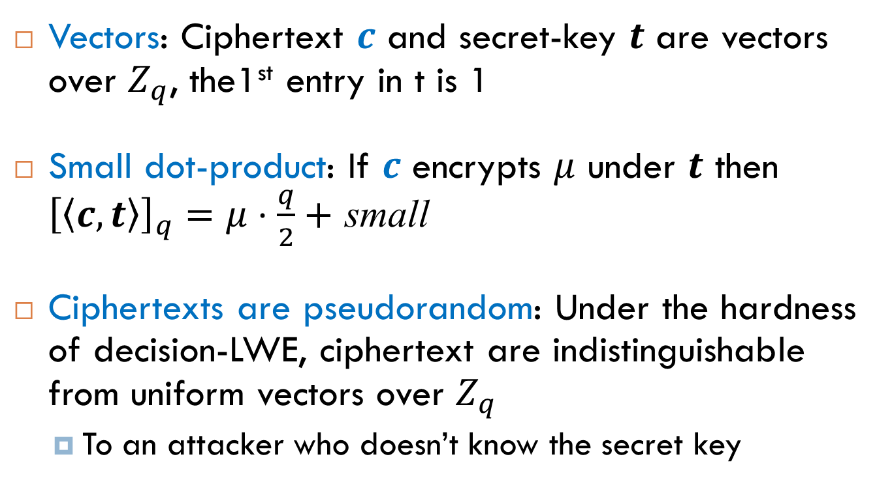
Properties of Regev’s Scheme
Vectors: Ciphertext $c$ and secret-key $t$ are vectors over $Z_{q}$, the1st entry in t is 1
Small dot-product: If $c$ encrypts $μ$ under $t$ then ${\left[\left\langle c,t\right\rangle \right]}_{q}=μ⋅\frac{q}{2}+$ small
Ciphertexts are pseudorandom: Under the hardness of decision-LWE, ciphertext are indistinguishable from uniform vectors over $Z_{q}$
  To an attacker who doesn’t know the secret key

Slide 31
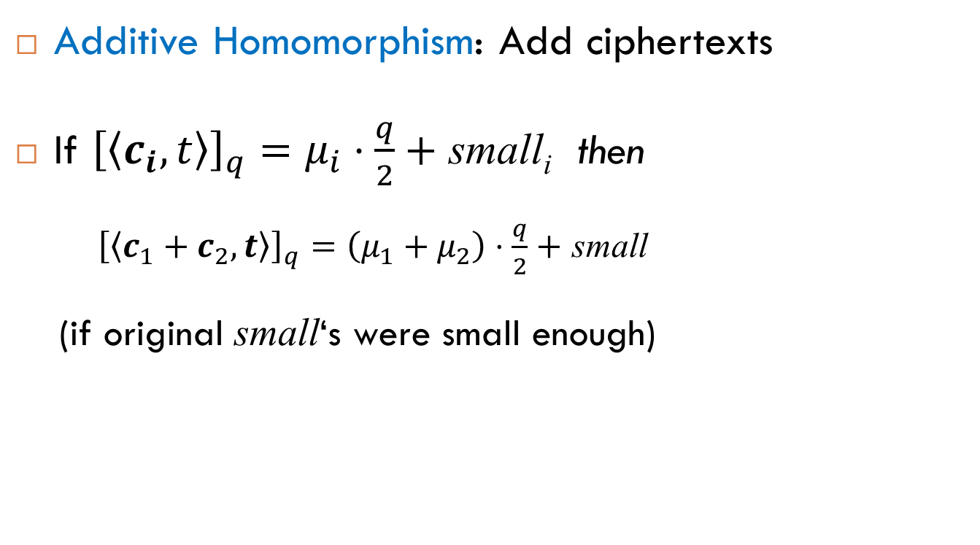
Homomorphic ADD in Regev
Additive Homomorphism: Add ciphertexts
If ${\left[\left\langle c_{i},t\right\rangle \right]}_{q}=μ_{i}⋅\frac{q}{2}+$ small_{i} then
    ${\left[\left\langle c_{1}+c_{2},t\right\rangle \right]}_{q}=\left(μ_{1}+μ_{2}\right)⋅\frac{q}{2}+$ small
  (if original small‘s were small enough)

Slide 32
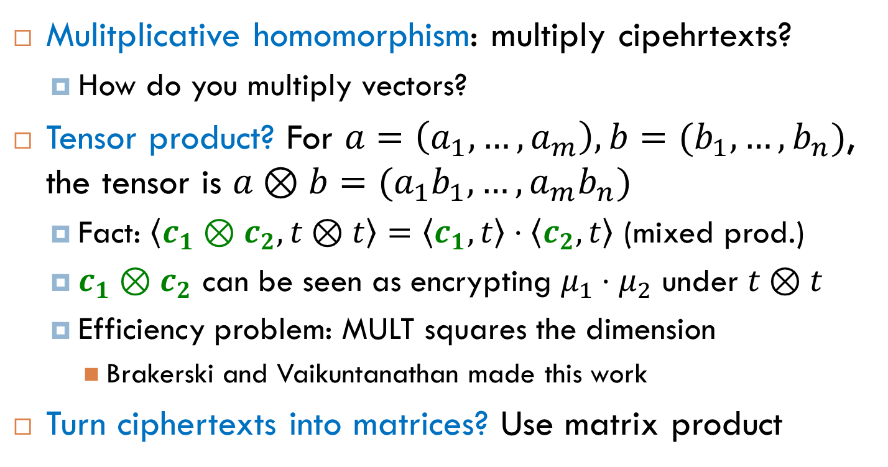
Homomorphic MULT in Regev
Mulitplicative homomorphism: multiply cipehrtexts?
  How do you multiply vectors?
Tensor product? For $a=\left(a_{1},…,a_{m}\right), b=(b_{1},…,b_{n})$, the tensor is $a⊗b=(a_{1}b_{1},…,a_{m}b_{n})$
  Fact: $\left\langle c_{1}⊗c_{2},t⊗t\right\rangle =\left\langle c_{1},t\right\rangle ⋅\left\langle c_{2},t\right\rangle$ (mixed prod.)
  $c_{1}⊗c_{2}$ can be seen as encrypting $μ_{1}⋅μ_{2}$ under $t⊗t$
  Efficiency problem: MULT squares the dimension
    Brakerski and Vaikuntanathan made this work
Turn ciphertexts into matrices? Use matrix product

Slide 33
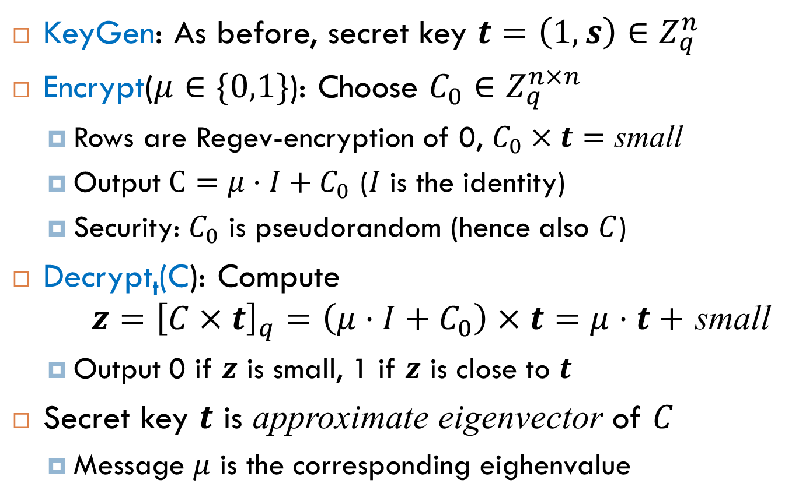
Matrix Version (1st try)
KeyGen: As before, secret key $t=\left(1, s\right)∈Z_{q}^{n}$
Encrypt($μ∈\{0,1\}$): Choose $C_{0}∈Z_{q}^{n×n}$
  Rows are Regev-encryption of 0, $C_{0}×t=$ small
  Output $C=μ⋅I+C_{0}$ ($I$ is the identity)
  Security: $C_{0}$ is pseudorandom (hence also $C$)
Decrypt_{t}(C): Compute
$z={\left[C×t\right]}_{q}=\left(μ⋅I+C_{0}\right)×t=μ⋅t+$ small
  Output 0 if $z$ is small, 1 if $z$ is close to $t$
Secret key $t$ is approximate eigenvector of $C$
  Message $μ$ is the corresponding eighenvalue

Slide 34

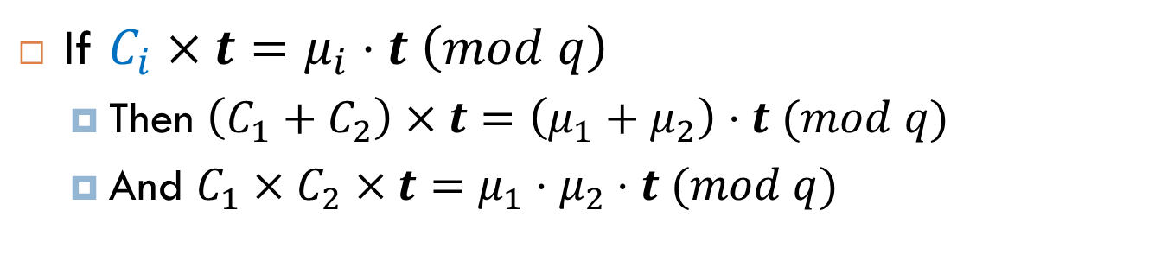
Homomorphism in Error-Free Setting
Ciphertext Matrix
Message Eigenvalue
Secret Key Eigenvector
If $C_{i}×t=μ_{i}⋅t \left(mod q\right)$
  Then $\left(C_{1}+C_{2}\right)×t=\left(μ_{1}+μ_{2}\right)⋅t (mod q)$
  And $C_{1}×C_{2}×t=μ_{1}⋅μ_{2}⋅t (mod q)$

Slide 35
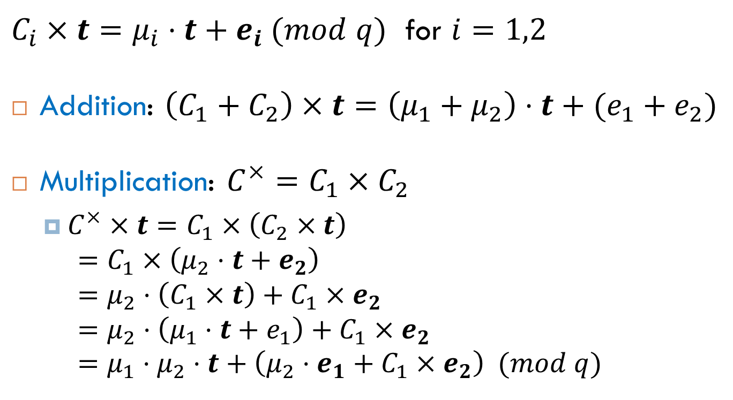
Homomorphism with Error (1st try)
$C_{i}×t=μ_{i}⋅t+e_{i} (mod q)$ for $i=1,2$
Addition: $\left(C_{1}+C_{2}\right)×t=\left(μ_{1}+μ_{2}\right)⋅t+(e_{1}+e_{2})$
Multiplication: $C^{×}=C_{1}×C_{2}$
  $C^{×}×t=C_{1}×\left(C_{2}×t\right)$
  $=C_{1}×\left(μ_{2}⋅t+e_{2}\right)$
  $=μ_{2}⋅\left(C_{1}×t\right)+C_{1}×e_{2}$
  $=μ_{2}⋅\left(μ_{1}⋅t+e_{1}\right)+C_{1}×e_{2}$
  $=μ_{1}⋅μ_{2}⋅t+\left(μ_{2}⋅e_{1}+C_{1}×e_{2}\right) (mod q)$
New Noise

Slide 36
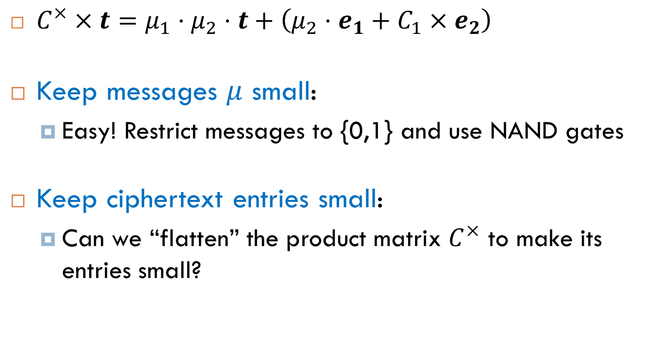
Controlling the Noise
New Noise
  $C^{×}×t=μ_{1}⋅μ_{2}⋅t+\left(μ_{2}⋅e_{1}+C_{1}×e_{2}\right)$
Keep messages $μ$ small:
  Easy! Restrict messages to {0,1} and use NAND gates
Keep ciphertext entries small:
  Can we “flatten” the product matrix $C^{×}$ to make its entries small?

Slide 37
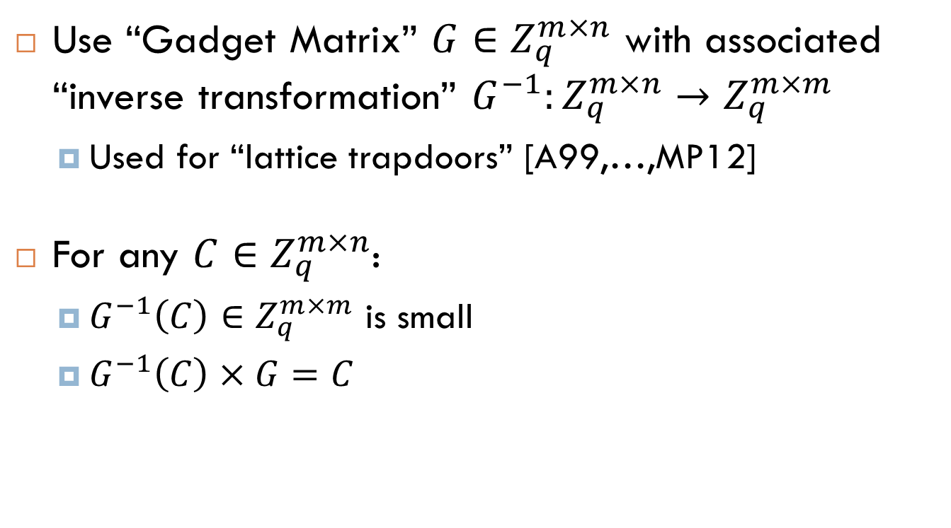
Gadget for Flattening
Use “Gadget Matrix” $G∈Z_{q}^{m×n}$ with associated “inverse transformation” $G^{−1}:Z_{q}^{m×n}→Z_{q}^{m×m}$
  Used for “lattice trapdoors” [A99,…,MP12]
For any $C∈Z_{q}^{m×n}$:
  $G^{−1}\left(C\right)∈Z_{q}^{m×m}$ is small
  $G^{−1}\left(C\right)×G=C$

Slide 38
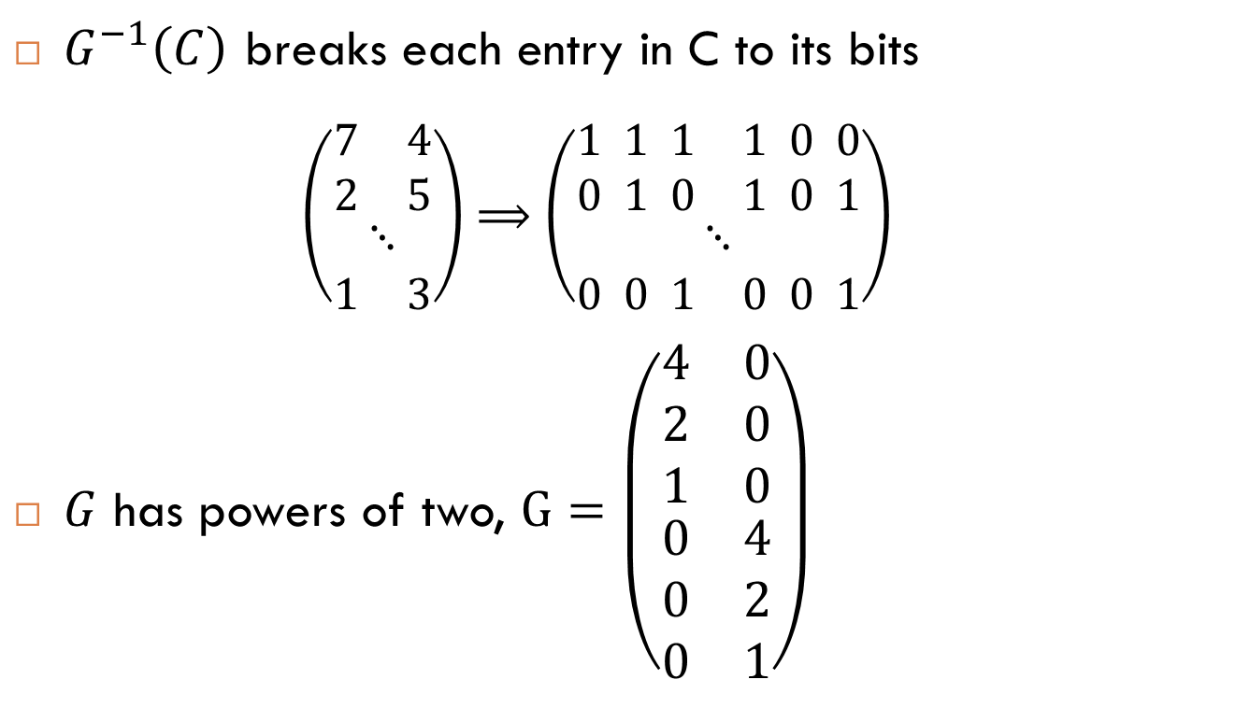
Example of a Gadget Matrix
$G^{−1}\left(C\right)$ breaks each entry in C to its bits
  $$\left(\begin{matrix}\begin{matrix}\begin{matrix}7 & 4\end{matrix} \\ \begin{matrix}2 & 5\end{matrix}\end{matrix} \\ ⋱ \\ \begin{matrix}1 & 3\end{matrix}\end{matrix}\right)⟹\left(\begin{matrix}\begin{matrix}\begin{matrix}1 1 1 & 1 0 0\end{matrix} \\ \begin{matrix}0 1 0 & 1 0 1\end{matrix}\end{matrix} \\ ⋱ \\ \begin{matrix}0 0 1 & 0 0 1\end{matrix}\end{matrix}\right)$$
$G$ has powers of two, $G=\left(\begin{aligned}\begin{matrix}4 & 0 \\ 2 & 0 \\ 1 & 0\end{matrix} \\ \begin{matrix}0 & 4 \\ 0 & 2 \\ 0 & 1\end{matrix}\end{aligned}\right)$

Slide 39
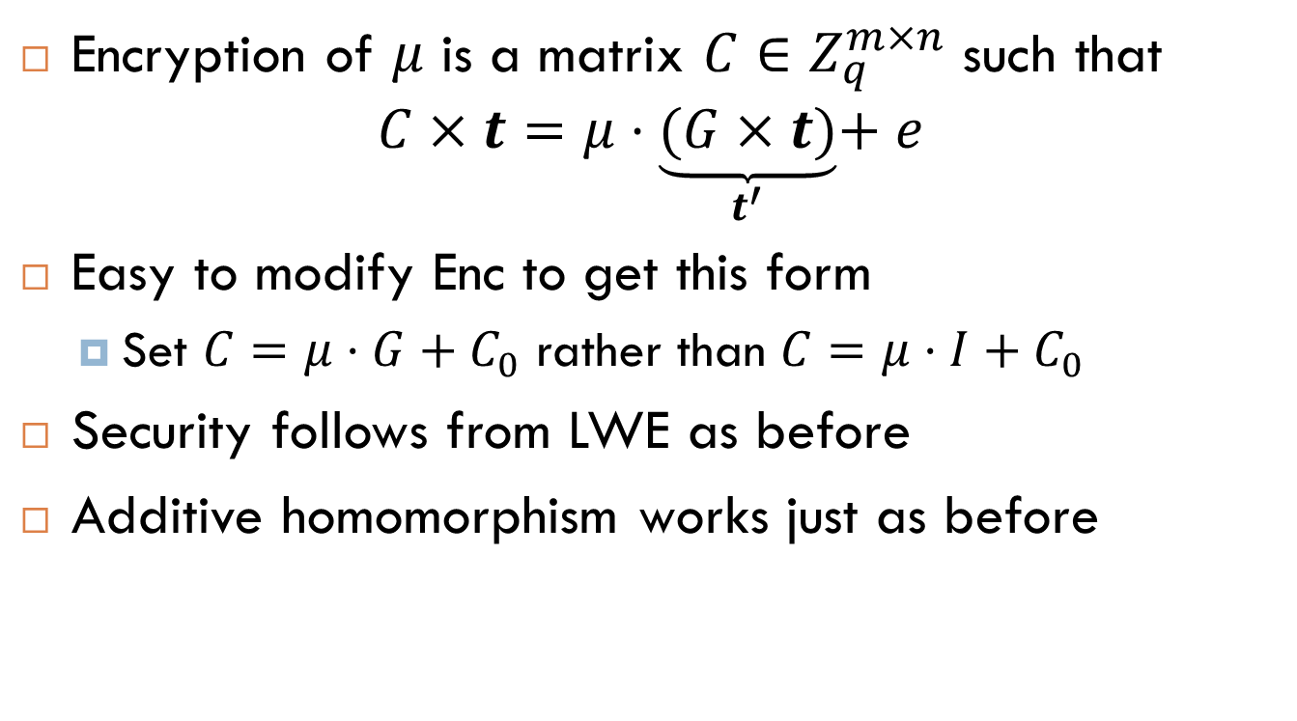
Modified Matrix Encryption
Encryption of $μ$ is a matrix $C∈Z_{q}^{m×n}$ such that
$$C×t=μ⋅\underset{t^{′}}{\underbrace{(G×t)}}+e$$
Easy to modify Enc to get this form
  Set $C=μ⋅G+C_{0}$ rather than $C=μ⋅I+C_{0}$
Security follows from LWE as before
Additive homomorphism works just as before

Slide 40

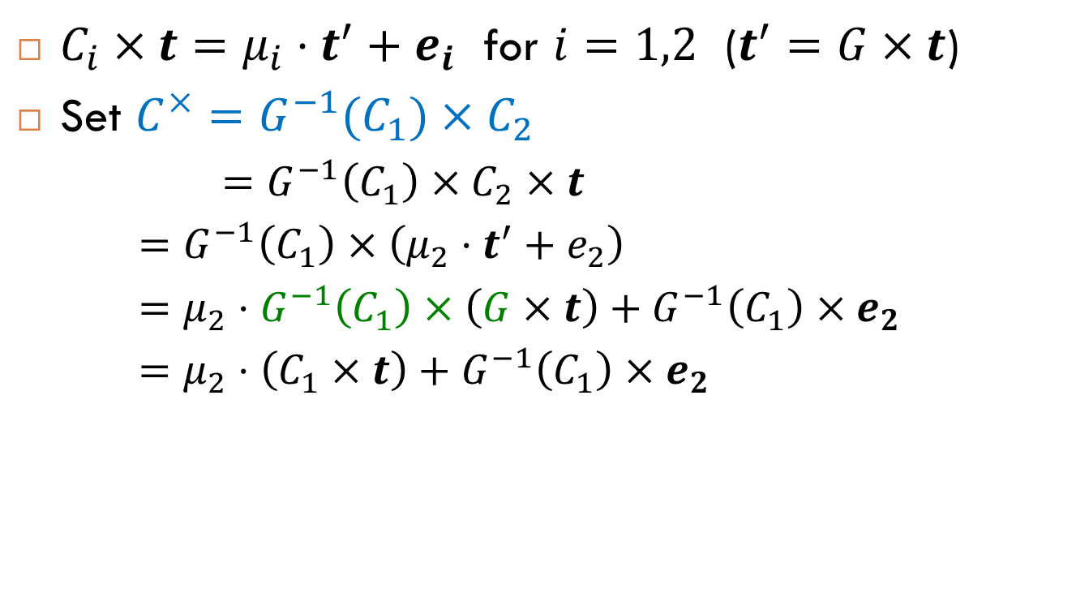
Homomorphic Multiplication
$C_{i}×t=μ_{i}⋅t^{′}+e_{i}$ for $i=1,2$ ($t^{′}=G×t$)
Set $C^{×}=G^{−1}(C_{1})×C_{2}$
  $=G^{−1}\left(C_{1}\right)×C_{2}×t$
  $=G^{−1}\left(C_{1}\right)×\left(μ_{2}⋅t^{′}+e_{2}\right)$
  $=μ_{2}⋅G^{−1}\left(C_{1}\right)×\left(G×t\right)+G^{−1}\left(C_{1}\right)×e_{2}$
  $=μ_{2}⋅\left(C_{1}×t\right)+G^{−1}\left(C_{1}\right)×e_{2}$
$$C^{×}×t$$

Slide 41
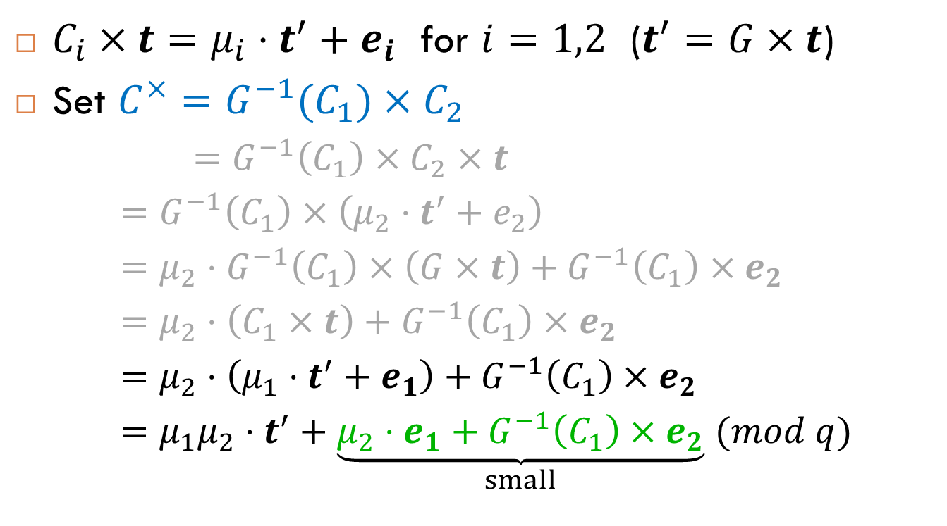
Homomorphic Multiplication
$C_{i}×t=μ_{i}⋅t^{′}+e_{i}$ for $i=1,2$ ($t^{′}=G×t$)
Set $C^{×}=G^{−1}(C_{1})×C_{2}$
  $=G^{−1}\left(C_{1}\right)×C_{2}×t$
  $=G^{−1}\left(C_{1}\right)×\left(μ_{2}⋅t^{′}+e_{2}\right)$
  $=μ_{2}⋅G^{−1}\left(C_{1}\right)×\left(G×t\right)+G^{−1}\left(C_{1}\right)×e_{2}$
  $=μ_{2}⋅\left(C_{1}×t\right)+G^{−1}\left(C_{1}\right)×e_{2}$
  $=μ_{2}⋅\left(μ_{1}⋅t^{′}+e_{1}\right)+G^{−1}\left(C_{1}\right)×e_{2}$
  $=μ_{1}μ_{2}⋅t^{′}+\underset{small}{\underbrace{μ_{2}⋅e_{1}+G^{−1}\left(C_{1}\right)×e_{2}}}$ $(mod q)$
$$C^{×}×t$$
New Noise

Slide 42
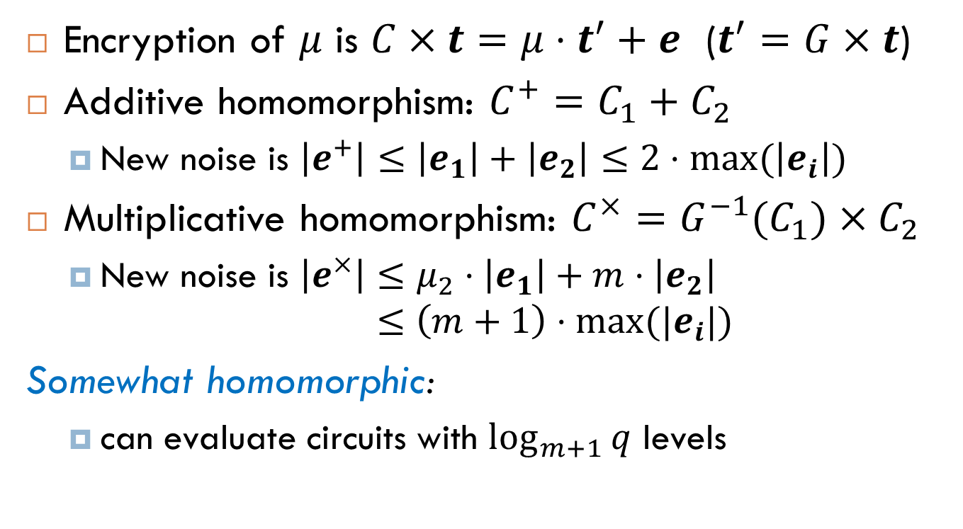
Summary of GSW
Encryption of $μ$ is $C×t=μ⋅t^{′}+e$ ($t^{′}=G×t$)
Additive homomorphism: $C^{+}=C_{1}+C_{2}$
  New noise is $\left|e^{+}\right|≤\left|e_{1}\right|+\left|e_{2}\right|≤2⋅\max{(\left|e_{i}\right|)}$
Multiplicative homomorphism: $C^{×}=G^{−1}(C_{1})×C_{2}$
  New noise is $\left|e^{×}\right|≤μ_{2}⋅\left|e_{1}\right|+m⋅\left|e_{2}\right|$
  $≤\left(m+1\right)⋅\max{(|e_{i}|)}$
Somewhat homomorphic:
  can evaluate circuits with $\log_{m+1}{q}$ levels

Slide 43
Questions?
Time for a break
?
?

Slide 44
Polly Cracker [FK93]:
Ciphertexts in a multivariate polynomial ring
Main Idea
Encryptions of 0 are polynomials that evaluate to 0 at the secret key.
KeyGen: Secret sk = some point (s₁, …,s_{t}) 2 Z_{q}^{t}.
Public key: Polynomials {f_{i}(x₁,…,x_{t})} s.t. f_{i}(s₁,…,s_{t})=0 mod q.
Encrypt: From {f_{i}}, generate random poly g s.t. g(s₁,…,s_{t}) = 0 mod q. Ciphertext is c(x₁,…,x_{t}) = μ + g(x₁,…,x_{t}) mod q.
Decrypt: Evaluate ciphertext at the secret: c(s₁,…,s_{t}) = μ mod q.
ADD and MULT: Output sum or product of ciphertext polys.
Security: Distinguish whether c has common root with the f_{i}’s.

Slide 45
Polly Cracker Attack
Collect lots of encryptions {c_{i}} of 0. They form an ideal.
The coefficient vectors of the c_{i}’s generate a lattice L. Compute Hermite Normal Form (HNF) of L.
  Coefficient vectors must be only polynomially long
  Else, the scheme is inefficient
Linear algebra attack on semantic security:
  To distinguish whether c encrypts 0 or 1, reduce it modulo HNF(L): the result will be 0 only if m = 0.
  Ideal membership problem is easy in this case.
Notes:
Albrecht, Farshim, Faugere, Perret

