Slide 1
The edge removal problem
Michelle Effros
Caltech
Michael Langberg
SUNY Buffalo

Slide 2
Network Information Theory
The field of network communication is a very rich and intriguing field of study.
There has been great progress over the last decades, on several communication scenarios. Several problems remain open.
Studies may share at times analytical techniques, however, to some extent, each new problem engenders its own new theory.
We are in search of a unifying theory, that may explain the commonalities and differences between problems and solutions.
s₁
t₁
s₂
t₂
s₃
t₃
s₄
t₄

Slide 3
Towards a unifying theory
Individual studies focusing on specific problems have been extremely productive.
Different perspective: we propose a “conditional” study of network communication problems.
Focus on connections: compare different comm. problems through the lens of reductions.
We can connect between problems without explicitly knowing either of their solutions.
s₁
t₁
s₁
t₁
s₂
N₁
t₂
s₂
N₂
t₂
s₃
t₃
s₃
t₃
s₄
t₄
s₄
t₄

Slide 4
This talk: reductive studies
Index Coding/Network Coding.
Index Coding/Interference Alignment.
Multiple Unicast vs. Multiple Multicast NC.
Network Equivalence.
Secure Communication vs. MU NC.
Reliable Communication vs. MU NC.
2 Unicast vs. K Unicast NC.
Index Coding/Distributed storage.
…
This talk:
The “edge removal problem”.
Reductions can show that a problem is easy.
Reductions can show that a problem is hard.
Reductions allow propagation of proof techniques.
Study of reduction raise new questions.
Study of reductive arguments identify central problems.
Provides a framework for generating a taxonomy.
Have the potential to unify and steer future studies.
N₁
N₂

Slide 5
Noiseless networks: network coding
S₁
S₂
Directed network N.
Source vertices S.
Terminal vertices T.
Set of requirements:
  Transfer information from S_{i} to T_{j}.
Objective:
  Design information flow that satisfies requirements.
T₃
T₂
T₁

Slide 6
Simplifying assumptions
S₁
S₂
T₃
Let N be a directed acyclic network.
  Assume each edge e in N is of capacity c_{e}.
Sources S_{i} hold independent information.
Throughout the talk we consider the multiple unicast communication requirement.
  k source/terminal pairs (S_{i},T_{i}) that wish to communicate over N.
T₁
T₂
S₁
T₁
N
S₂
T₂
S₃
T₃
S₄
T₄
6

Slide 7
Communication
S₁
T₁
S₂
T₂
Each S_{i} transmits one of 2^{Rin} messages.
S₃
T₃
S₄
T₄
R=(R₁,…R_{k}) feasible: for all ε>0 exist n: (ε,n)-feasible.
Capacity: closure of all feasible R.
Communication at rate R = (R₁,…,R_{k}) is achievable over instance (N,{(s_{i},t_{i})}_{i}) with block length n if: ∃ random variables {S_{i}},{X_{e}}:
Rate: Source S_{i} = R.V. independent and uniform with H(S_{i})=R_{i}n.
Edge capacity: For each edge e of cap. c_{e}: X_{e} = R.V. in [2^{cen}].
Functionality: for each edge e we have f_{e} = function from incoming R.V.’s X_{e1},…,X_{e,in(e)} to X_{e} (i.e., X_{e}=f_{e}(X_{e1},…,X_{e,in(e)})).
Decoding: for each terminal T_{i} we define
a decoding function yielding S_{i}.
  Communication is successful with probability 1-ε over {S_{i}}_{i}:
R=(R₁,…R_{k}) is ”(ε,n)-feasible” if comm. is achievable.
X₁
f_{e}
X₂
X_{e}
X₃
7

Slide 8
[HoEffrosJalali]
Assume rate (R₁,…,R_{k}) is achievable on network N.
Consider network N\e without edge e of capacity δ.
What can be said regarding the achievable rate on the new network?
The edge removal problem
What is the guarantee on loss in rate when experiencing link failure?
S₁
T₁
S₂
e
T₂
N
S₃
T₃
S₄
T₄
S₁
T₁
S₂
e
T₂
N\e
S₃
T₃
S₄
T₄

Slide 9
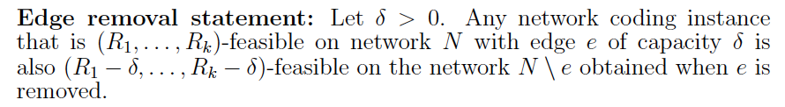
Edge removal
S₁
T₁
S₂
e
T₂
S₃
T₃
S₄
T₄
What is the loss in rate when removing a δ capacity edge?
There exist simple instances in which removing an edge of capacity δ will decrease each rate by an additive δ.
  E.g.: the butterfly with bottleneck consisting of 1/δ edges of capacity δ.
What is the “price of edge removal” in general?
S₁
T₂
S₁
S₁
R=(1,1) is achievable
S₁+S₂
S₂
R=(1-δ,1-δ) is achievable
S₂
S₂
T₁
9

Slide 10
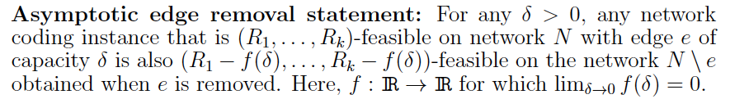
Price of “edge removal”
In several special instances: the removal of a δ capacity edge causes at most an additive δ decrease in rate [HoEffrosJalali].
Multicast: ≤ δ decrease in rate.
Collocated sources: ≤ δ decrease in rate.
Linear codes: ≤ δ decrease in rate.
Is this true for all NC instances?
Is the decrease in rate continuous as a function of δ?
T₁
S_{1,...,}S₄
T₂
N
T₃
T₄
Seemingly simple problem: but currently open.

Slide 11
Edge removal in noisy networks
In the case of noisy networks, the edge removal statement does not hold.
Adversarial noise (jamming):
  Point to point communication.
  Adding a side channel of negligible capacity allows to send a hash of message x between X and Y. Turning list decoding into unique decoding [Guruswami] [Langberg].
  Significant difference in rate when edge removed.
Memoryless noise:
  Multiple access channel:
  Adding edges with negligible capacity allows to significantly increase communication rate [Noorzad Effros Langberg Ho].
X
Y
x
e
y=x+e
X₁
Cooperation facilitator
p(y|x₁x₂)
Y
X₂

Slide 12
What is the price of “edge removal”?
Network coding: not known? Even for relaxed statement.
Challenge, designing code for N given one for N\{e}.
Nevertheless, may study implications if true … or false …even for asymptotic version.
Will show implications on:
  Reliability in network communication.
  Assumed topology of underlying network.
  Assumed demand structure in communication.
  Advantages in cooperation in network communication.

Slide 13
Assume rate (R₁,…,R_{k}) is achievable on network N with some small probability of error ε>0.
What can be said regarding the achievable rate when insisting on zero error?
What is the cost in rate when assuring zero error of communication as opposed to ε error?
1.Reliability: Zero vs ε error
S₁
T₁
S₂
N
T₂
S₃
T₃
S₄
T₄

Slide 14
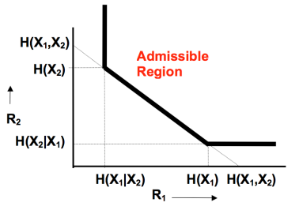
Reliability: Zero vs ε error
Can one obtain higher communication rate when allowing an ε-error, as opposed to zero-error?
In general communication models, when source information is dependent, the answer is YES! [SlepianWolf].
What about the Network Coding scenario in which source information is independent and network is noiseless?
Is there advantage in ε over zero error for general NC?
X₁
[Witsenhausen]
Y
X₂
14

Slide 15

Price of zero error
T₁
S_{1,...,}S₄
T₂
N
T₃
T₄
What’s known:
Multicast: Statement is true [Li Yeung Cai] [Koetter Medard].
Collocated sources: Statement is true [Chan Grant] [Langberg Effros].
Linear codes: Statement is true [Wong Langberg Effros].
Is statement true in general?
Is the loss in rate continuous as a function of ε?

Slide 16
Edge removal ⇔ zero error !
Edge removal is true iff zero~ε error in NC.
Edge removal ⇒ zero error [Chan Grant][Langberg Effros]:
  Assume: Network N is R=(R₁,…R_{k})–feasible with ε error.
  Assume: Asymptotic edge removal holds.
  Prove: Network N is R-δ feasible with zero error.

Slide 17
2. Topology of networks.
Network communication challenging: combines topology with information.
Reduction separates information from topology.
Index Coding has only 1 network node performs encoding.
Recent studies have shown that any network coding instance (NC) can be reduced to a simple instance referred to as index coding (IC). [ElRouayheb Sprintson Georghiades], [Effros ElRouayheb Langberg].
An efficient reduction that allows to solve NC using any scheme to solve IC.
s₁
s₁
s₂
s₃
s₄
s₅
s₆
s₂
NC
IC
t₃
t₁
t₂
t₁
t₂
t₃
t₄
t₅
t₆
Obtain solution to NC
Solve IC

Slide 18
Connecting NC to IC
Reduction in code design: a code for IC corresponds to a code for NC.
s₁
s₁
s₂
s₃
s₄
s₅
s₆
s₂
NC
IC
t₁
t₂
t₁
t₂
t₃
t₄
t₅
t₆
Obtain solution to NC
Solve IC
Theorem: NC is R-feasible iff IC is R’=f(R) -feasible.
Related question: can one determine capacity region of NC with that of IC ?
Surprisingly: currently no!
Reduction breaks down with closure operation.

Slide 19
Connecting NC to IC
s₁
s₁
s₂
s₃
s₄
s₅
s₆
s₂
NC
IC
t₁
t₂
t₁
t₂
t₃
t₄
t₅
t₆
Obtain solution to NC
Solve IC
Theorem: NC is R-feasible iff IC is R’=f(R)-feasible.
Related question: can one determine capacity region of NC with that of IC ?

Slide 20
Edge removal resolves the Q
s₁
s₁
s₂
s₃
s₄
s₅
s₆
s₂
NC
IC
t₁
t₂
t₁
t₂
t₃
t₄
t₅
t₆
[Wong Langberg Effros]
Can determine capacity region of NC with that of IC
20

Slide 21
“Edge removal” implies:
Zero ~ ε error in Network Coding.
Reduction in capacity vs. reduction in code design.
Advantages in cooperation in network communication.
Assumed demand structure in communication.

Slide 22
What can be said regarding the achievable rate
when the source information is independent?
3. Source dependence
What are the rate benefits in shared information/cooperation?
Let N be a directed acyclic multiple unicast network.
Up to now we considered independent sources.
In general, if source information is dependent, it is “easier” to communicate (i.e., cooperation).
Assume rate (R₁,…,R_{k}) is achievable when source information S₁,…,S_{k} is slightly dependent:
S₁
T₁
S₂
T₂
S₃
T₃
S₄
T₄
∑H(S_{i}) - H(S₁,…,S_{k}) ≤ δ

Slide 23
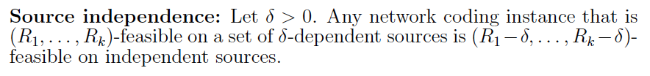
Price of “independence”.
In several cases, there is a limited loss in rate when comparing δ-dependent and independent source information [Langberg Effros].
Multicast: ≤ δ decrease in rate.
Collocated sources: ≤ δ decrease in rate.
Is this true for all NC instances?
Is the decrease in rate continuous as a function of δ?
T₁
S_{1,...,}S₄
T₂
N
T₃
T₄
∑H(S_{i}) - H(S₁,…,S_{k}) ≤ δ

Slide 24
Edge removal ⇔ Source ind.
[Langberg Effros]

Slide 25
“Edge removal” implies:
Zero = ε error in Network Coding.
Reduction in capacity vs. reduction in code design.
Advantages in cooperation in network communication.
Multiple Unicast NC can be reduced to 2 unicast.

Slide 26
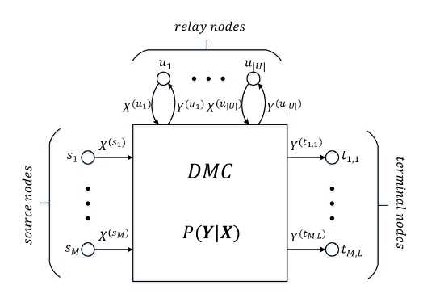
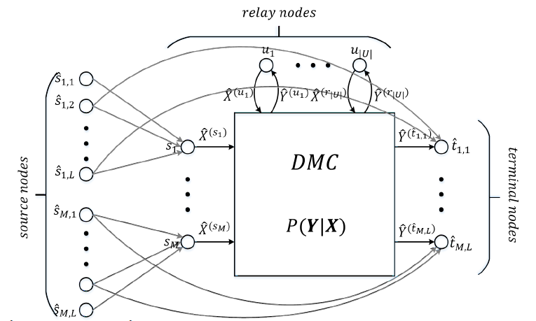
4. Network demands
Recent studies have reduced any network commination instance with multiple multicast demands to a multiple unicast instance.
Network Coding [Dougherty Zeger] zero error setting.
Linear Index Coding [Maleki Cadambe Jafar].
General (noisy) networks [Wong Langberg Effros].

Slide 27
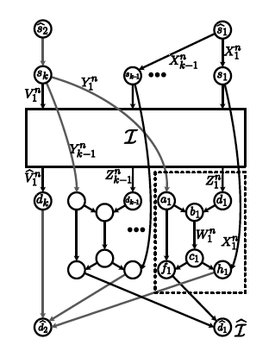
Network demands
For the case of Network Coding one can further reduce to 2 unicast! [Kamath Tse Wang].
Holds only in limited setting of code design (not capacity) and only for zero error.
Can one determine capacity of multiple multicast networks using 2 unicast networks?
Again, reduction breaks down in general setting.
Lets connect to edge removal …

Slide 28
Network demands
The asymptotic edge removal statement is true iff the reduction of [Kamath Tse Wang] holds in capacity.
[Wong Effros Langberg].
NC: multiple multicast capacity can be determined by 2 unicast capacity.

Slide 29
“Edge removal” equivalent:
Zero = ε error in Network Coding.
Reduction in capacity vs. reduction in code design.
Limited dependence in network coding implies limited capacity advantage.
Multiple Unicast NC can be reduced to 2 unicast.
All form of slackness are equivalent.
  Reliability, closure, dependence, edge capacity.

Slide 30
Summary
Thanks!
Discussed the paradigm of reductive arguments in network communication.
Presented the edge removal problem:
  Open.
  Its solution will imply the solution of several other problems that span a number of different aspects of network communication (reliability, topology, demands, source dependence).
Highlights central nature of the edge removal problem.
Are there other implications of solving the edge removal problem (e.g., distortion).
This talk hopefully added onto Michelle’s talk in placing the reductive study of network communication in the spotlight.

