Slide 1
A Faster Algorithm for Linear Programming
and the Maximum Flow Problem I
Yin Tat Lee
(MIT, Simons)
Joint work with Aaron Sidford

Slide 2
the problem

Slide 3
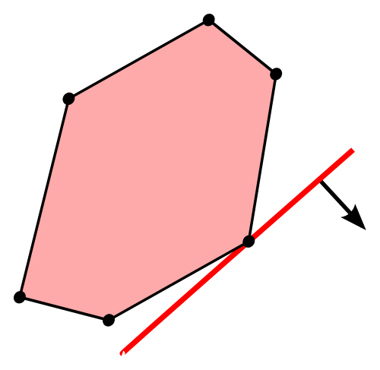
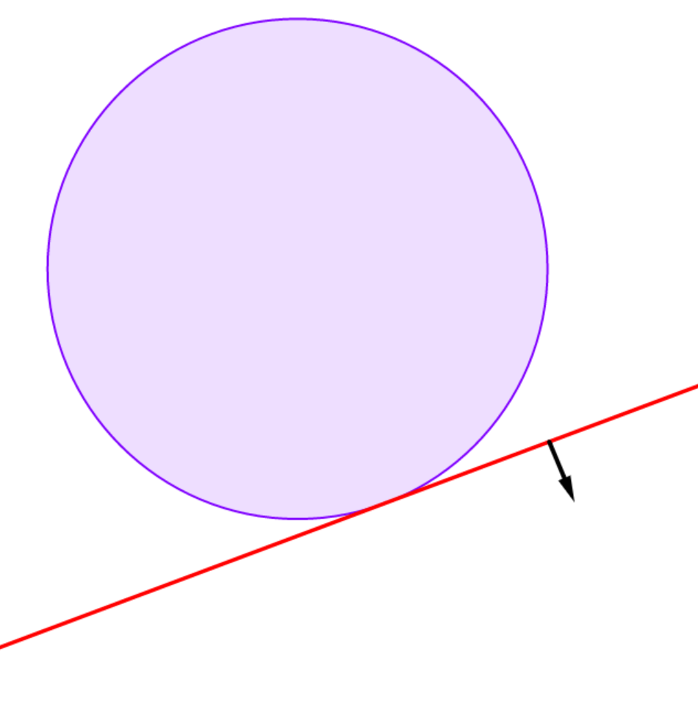
Linear Programming
Consider the linear program (LP)
$$\min_{Ax≥b}{c^{T}x}$$
where $A$ is a $m×n$ matrix.
$m$ is the number of constraints.
$n$ is the number of variables.
$$n=2,m=6$$
$$n=2,m=∞$$

Slide 4
Previous Results
$m$ = # of constraints
$n$ = # of variables
All of them are iterative methods.
Start with some initial point $x$.
While $x$ is not optimal
Improve $x$
Time = $(\#iter)×(cost per iter)$
This talk focus on #iter.
We call it efficient if
Polynomial time
Doesn’t use LP solver

Slide 5
Previous Results (Selected)
$m$ = # of constraints
$n$ = # of variables
($log(ε^{−1}))$ is omitted)
Year | Author | # of iter | Cost per iter | Efficient steps
1947 | Dantzig | $$2^{n}$$ | Pivot | Yes
1979 | Khachiyan | $$n^{2}$$ | Update the Ellipsoid | Yes
1984 | Karmarkar | $$m$$ | Solve linear systems | Yes
1986 | Renegar | $$\sqrt{m}$$ | Solve linear systems | Yes
1989 | Vaidya | $${\left(mn\right)}^{1/4}$$ | Matrix inverse | Yes
1994 | Nesterov, Nemirovskii | $$\sqrt{n}$$ | Compute volume | No
2013 | Lee, Sidford | $$\tilde{O}(\sqrt{n})$$ | Solve Linear Systems | Yes
 |  | $$\tilde{O}(\sqrt{rank})$$ | Solve Linear Systems | Yes
Remark: In 2013, Mądry shows how to obtain $m^{3/7}$ iters for certain LPs!

Slide 6
Outline
$m$ = # of constraints
$n$ = # of variables
($log(ε^{−1}))$ is omitted)
Year | Author | # of iter | Cost per iter | Efficient steps
1947 | Dantzig | $$2^{n}$$ | Pivot | Yes
1979 | Khachiyan | $$n^{2}$$ | Update the Ellipsoid | Yes
1984 | Karmarkar | $$m$$ | Solve linear systems | Yes
1986 | Renegar | $$\sqrt{m}$$ | Solve linear systems | Yes
1989 | Vaidya | $${\left(mn\right)}^{1/4}$$ | Matrix inverse | Yes
1994 | Nesterov, Nemirovskii | $$\sqrt{n}$$ | Compute volume | No
2013 | Lee, Sidford | $$\tilde{O}(\sqrt{n})$$ | Solve Linear Systems | Yes
 |  | $$\tilde{O}(\sqrt{rank})$$ | Solve Linear Systems | Yes
Remark: In 2013, Mądry shows how to obtain $m^{3/7}$ iters for certain LPs!

Slide 7
LP and center

Slide 8
A general framework
We can solve linear program by maintaining center.
Somehow, get a “center” first
Put the cost constraint there and move it.
Say we can move $θ$ portion closer each time
After $\tilde{O}(θ^{−1})$ steps, we are done.

Slide 9
A general framework
We can solve linear program by maintaining center.
Somehow, get a “center” first
Put the cost constraint there and move it.
Why center?
Say we can move $θ$ portion closer each time
After $\tilde{O}(θ^{−1})$ steps, we are done.

Slide 10
What if we don’t try to maintain a center?
It is just like simplex method.
It is good now.
Still good.
…..
Oh, it touches. What to do?

Slide 11
What if we don’t try to maintain a center?
It is just like simplex method.
It is good now.
Still good.
Avoid bad decision by using global information!
…..
Oh, it touches. What to do?

Slide 12
A general framework
Formally, we have (say $OPT=0$):
$t=2^{2014}$. Find the center of $\left\{c^{T}x≤t,Ax≥b\right\}$
While $t$ is large
$t←t(1−θ)$ for some fixed $θ>0$
Update the center of $\left\{c^{T}x≤t,Ax≥b\right\}$
This is called interior point method.
The initial point is easy:
$$\min_{{\left(Ax\right)}_{i}+d≥b_{i},d≥0}2^{2014}d+c^{T}x$$

Slide 13
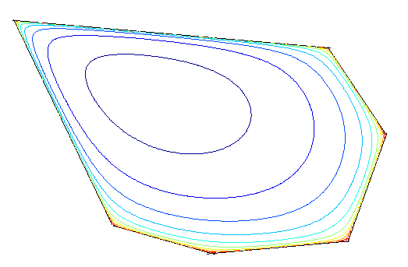
A general way to define a center
Let $p$ be a smooth convex function on $Ω$ such that
$p\left(x\right)→+∞$ as $x→∂Ω$.
For example,
Standard log barrier: $p_{s}\left(x\right)=−\sum{\ln\left({\left(Ax\right)}_{i}−b_{i}\right)}=−\sum{ln⁡(s_{i}) }$
Barrier
Function
Center $=argmin p\left(x\right)$

Slide 14
Quality of a center

Slide 15
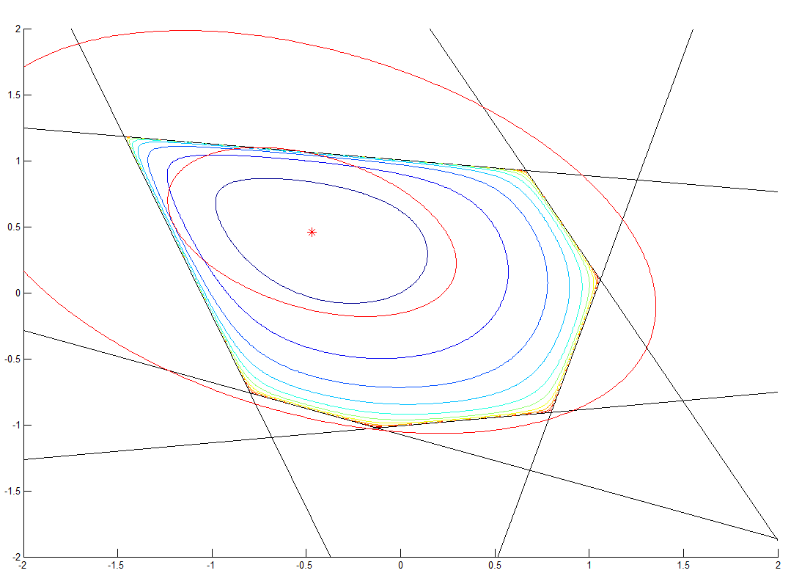
Rounding
Assume center is induced by some barrier function $p$.
Look at the ellipsoid $E$ induced by $p$ at the center $x$.
Call $E$ is $λ$ rounding if $sE⊂Ω⊂λsE$ for some $s$.

Slide 16
Self concordant barrier
$p$ is a $λ$-self concordant barrier function for $Ω$ if
$p$ is smooth.
$p$ gives $λ$ rounding.
$p$ is not smooth enough
Bad rounding.

Slide 17
Rounding Algorithm
For general barrier function $p$:
Repeat
Tighten the cost constraint
Maintain the rounding ellipsoid induced by $p$.
Why $\sqrt{λ}$ iterations?

Slide 18
Why $λ$ iterations?
Think $p\left(x\right)=−∑ln⁡s_{i}$.
Newton Method (Using smoothness)
Given $p\left(y\right)−\min_{x}{p (x)}<0.5$, we can find the center in $\tilde{O}(1)$ steps.

Slide 19
Why $λ$ iterations?
Let $y$ be the old center. Using the smoothness, we have
$$p_{new}\left(y\right)−\min_{x}{p_{new} \left(x\right)}≤\frac{t_{new}−c^{T}y}{t−c^{T}y}≤\frac{1}{2}.$$

Slide 20
Why $λ$ iterations?
So, we need
$$\frac{t_{new}−c^{T}y}{t−c^{T}y}≤\frac{1}{2}.$$
It takes $\tilde{O}\left(λ\right)$ iters.

Slide 21
Why $\sqrt{λ}$ iterations?
We can reduce the gap by $1/\sqrt{λ}$.
Roughly Speaking:
Smoothness + $λ$ rounding gives
$\sqrt{λ}log⁡(ε^{−1})$ iterations LP solvers.

Slide 22
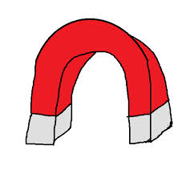
Quality of analytic center is arbitrary bad in $n$!
Recall the standard log barrier function
$$p_{s}\left(x\right)=−\sum_{i=1}^{m}{\ln\left({\left(Ax\right)}_{i}−b_{i}\right)}=−\sum_{i=1}^{m}{\ln\left(s_{i}\right)}.$$
The center $x={argmin}_{y}p\left(y\right)$ is called analytic center.

Slide 23
Is it tight?
In practice, it takes $≤60$ steps.
Mizuno, Todd, Ye showed it is “usually” correct on first step.
In 2014, Mut and Terlaky showed an example really takes $Ω\left(\sqrt{m}\log\left(ε^{−1}\right)\right)$ iterations where $m$ is exponential in $n$.

Slide 24
Universal Barrier Function

Slide 25
Universal Barrier Function
Theorem [NN94]: For any convex set $Ω∈R^{n}$,
$$p\left(x\right)=−log vol({\left(Ω−x\right)}^{o})$$
is a $O(n)$-self concordant barrier function.
“Smaller” set has larger polar. Hence, $p→∞$ as $x→∂Ω$
Note that $∇^{2}p \sim Second Moment of {\left(Ω−x\right)}^{o}$.
Kannan-Lovasz-Simonovits Lemma: For any convex set $Ω$, the second moment matrix
$$M(Ω)=\int_{Ω}{xx^{T}}$$
gives a $O(n)$ rounding of $Ω$.

Slide 26
The cost of Universal Barrier
To get second moment matrix, you need $n^{O\left(1\right)}$ sampling.
To get 1 sampling, you need to do $n^{O(1)}$ iters of Markov chain.
To do 1 iter of Markov chain, you need to implement separation oracle for ${\left(Ω−x\right)}^{o}$.
If $Ω=\{Ax≥b\}$, one need to solve an LP.
Hence, one iteration requires solving $n^{O(1)}$ many LPs.
The problem:
Get an efficient $O(n)$ self concordant barrier function.

Slide 27
Volumetric Barrier Function

Slide 28
Volumetric Barrier Function
In 1989, Vaidya showed
$$p_{v}\left(x\right)=\frac{1}{2}\log{\det{∇^{2}p_{s}(x)}}+\frac{n}{m}p_{s}(x)$$
where $p_{s}\left(x\right)=−\sum_{i}{\ln{s_{i}}}.$ Why it is volumetric?
For example:
It is a ${\left(mn\right)}^{1/2}$ barrier.
Volumetric Barrier
Log Barrier

Slide 29
Why Volumetric is good?
$$p_{v}\left(x\right)=\frac{1}{2}\log{\det{∇^{2}p_{s}(x)}}+\frac{n}{m}p_{s}(x)$$
Around $y$, we have
$$p_{v}\left(x\right)\sim −\sum_{i}{\left(σ_{i}\left(S_{y}^{−1}A\right)+\frac{n}{m}\right)}logs_{i}(x)$$
where
$$σ_{i}\left(B\right)=e_{i}^{T}B{\left(B^{T}B\right)}^{−1}Be_{i}.$$
Example: $B=\left(\begin{matrix}1 & 0 \\ 3 & 0 \\ 0 & 2\end{matrix}\right)$. Then, $B^{T}B=\left(\begin{matrix}1^{2}+3^{2} & 0 \\ 0 & 2^{2}\end{matrix}\right)$. $σ_{1}=\frac{1}{10}$, $σ_{2}=\frac{9}{10}$, $σ_{3}=1$.
In general, $∑σ_{i}=n$, $0≤σ_{i}≤1$, if the $i^{th}$ row is repeated, $σ_{i}$ is decreased by $2$.
For [0,1] interval with 0 repeated $k$ times:
$$S^{−1}A=\left(\begin{matrix}1 \\ 1 \\ ⋮\end{matrix}\right)$$
$$S^{−1}A=\left(\begin{matrix}k^{1/3} \\ 1 \\ ⋮\end{matrix}\right)$$

Slide 30
Our Barrier Function

Slide 31
Repeated Volumetric Barrier Function
$$p^{(1)}\left(x\right)=\frac{1}{2}\log{\det{∇^{2}p_{s}(x)}}+\frac{n}{m}p_{s}(x)$$
How about $p^{(k+1)}\left(x\right)=\frac{1}{2}\log{\det{∇^{2}p^{(k)} (x)}}+\frac{n}{m}p^{(k)}(x)$?
Suppose $p^{(k)}\left(x\right)=−\sum_{i}{ω_{i}^{(k)} logs_{i}}$, around $y$, we have
$$p^{(k+1)}\left(x\right)\sim −\sum_{i}{\left(σ_{i}\left(\sqrt{W^{(k)}}S_{y}^{−1}A\right)+\frac{n}{m}\right)}logs_{i}\left(x\right).$$
So, we have
$$w_{i}^{(k+1)}=σ_{i}\left(\sqrt{W^{(k)}}S_{y}^{−1}A\right)+w_{i}^{(k)}.$$
We call $p^{(∞)}\left(x\right)=−∑w_{i}^{\left(∞\right)}(x)\log{s_{i}}$ where $w_{i}^{\left(∞\right)}$ satisfies
$$w_{i}^{\left(∞\right)}(x)=σ_{i}\left(\sqrt{W^{(∞)}}S_{x}^{−1}A\right).$$
What is that?

Slide 32
What is that weight?
Let $τ_{i}=σ_{i}(W^{\frac{1}{2}}A)/w_{i}$.
$$w_{i}^{\left(∞\right)}(x)=σ_{i}\left(\sqrt{W^{(∞)}}S_{x}^{−1}A\right).$$
If $τ_{i}≤1$ for all $i$,
the ellipsoid is inside.
The $w_{i}^{(∞)}$ represents John ellipsoid of $\{{\left\|S_{x}^{−1}A\right\|}_{∞}≤1\}$
Our Condition (John Ellipsoid):
$τ_{i}=1$ if $w_{i}≠0$.

Slide 33
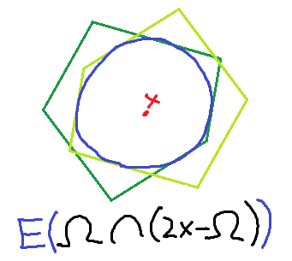
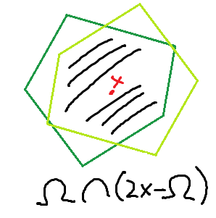
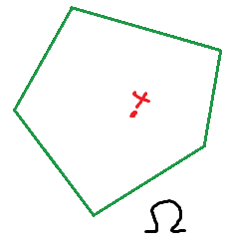
Repeated Volumetric Barrier Function
Recall
$$p^{(∞)}\left(x\right)\sim \ln{\det\left(∇^{2}p^{\left(∞\right)}\left(x\right)\right)}\sim −\ln{\det\left(AS_{x}^{−1}W^{(∞)}S_{x}^{−1}A\right)}$$
We get
$$p^{(∞)}\sim −ln vol JohnEllipsoid\left(Ω∩(2x−Ω)\right).$$
Symmetrize
Find John Ellipsoid

Slide 34
The barrier function is not perfect!
The path is piecewise smooth because it may not touch every constraint.
$p^{(∞)}=\max_{∑w=n,w≥0}{lndet⁡(A^{T}S^{−1}WS^{−1}A)}$

Slide 35
Our Barrier Function
Standard Log Barrier:
$$p_{s}\left(x\right)=−∑lns_{i}$$
Volumetric Barrier:
$$p_{v}\left(x\right)=\frac{1}{2}\log{\det{∇^{2}p_{s}(x)}}+\frac{n}{m}p_{s}(x)$$
John Ellipsoid Barrier:
$$p^{\left(∞\right)}(x)=\max_{∑w=n,w≥0}{lndet⁡(A^{T}S^{−1}WS^{−1}A)}$$
Regularized John Ellipsoid Barrier (1):
$$\max_{w≥0}{lndet⁡(A^{T}S^{−1}W^{1−\log^{−1}{(\frac{m}{n})}}S^{−1}A)}+\frac{n}{m}∑lnw_{i}−∑w_{i}$$
Regularized John Ellipsoid Barrier (2):
$$\max_{w≥0}\ln{\det{A^{T}S^{−1}WS^{−1}A}}−\frac{n}{m}∑w_{i}lnw_{i}−\frac{n}{m}∑lns_{i}$$

Slide 36
$l^{p}$ Lewis Weight
$$\max_{w≥0}{lndet⁡(A^{T}S^{−1}W^{1−\log^{−1}{(\frac{m}{n})}}S^{−1}A)}.$$
We call $w$ is $l^{p}$ Lewis weight for $B$ if
$$w_{i}=σ_{i}(W^{\frac{1}{2}−\frac{1}{p}}B)$$
Thanks to Cohen and Peng, we know
Let $C$ be $\tilde{O}(d^{\max\left(1,\frac{p}{2}\right)})$ rows sample of $B$ accordingly to $w_{i}$,
$${\left\|Cz\right\|}_{p}\sim {\left\|Bz\right\|}_{p} ∀z.$$
$Q=B^{T}W^{1−\frac{2}{p}}B$ is the maximizer of
$$−log\det{Q} subject to 𝔼_{x^{T}Qx≤1}{\left\|Bx\right\|}_{p}^{p}≤1$$
i.e, the maximum ellipsoid such that it “insides” the polytopes.
For $p=∞$, $\{x^{T}Qx≤1\}$ is the John ellipsoid for $\{|Bx|≤1\}$.

Slide 37
Computing $l^{p}$ Lewis Weight
Cohen and Peng showed how to compute it when $p<4$.
The repeated volumetric barrier: $w_{i}^{(1)}=n/m$,
$$w_{i}^{(k+1)}=σ_{i}\left(\sqrt{W^{(k)}}B\right)+w_{i}^{\left(k\right)}.$$
After renormalization, $w_{i}^{(log⁡(m))}$ gives “$l^{∞}$ “Lewis” weight:
$$w_{i}\left(x\right)\sim σ_{i}(W^{\frac{1}{2}}B).$$
Cohen, L., Peng, Sidford shows that in fact a similar algorithm find constant “approximate” $l^{p}$ Lewis weight for $p>2$ in $\tilde{O}(1)$.

Slide 38
Conclusion

Slide 39
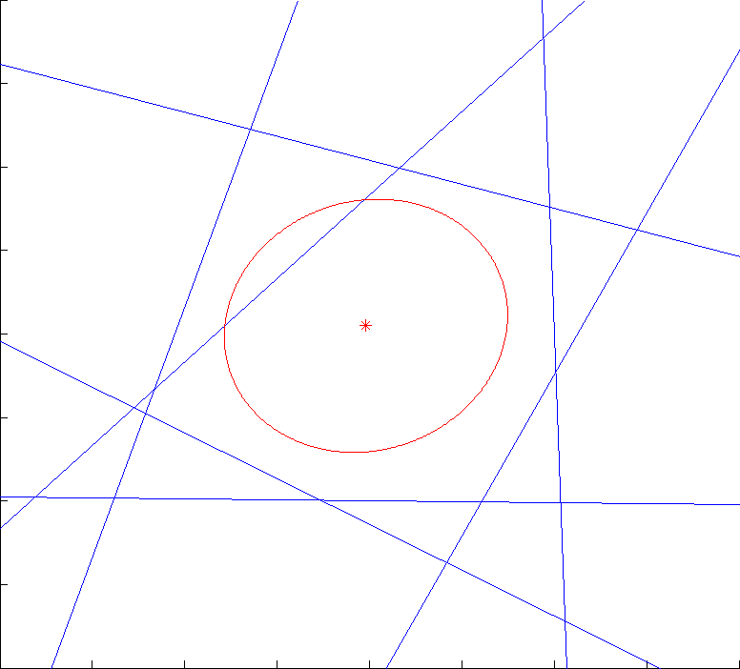
Our Barrier
$m$ = # of constraints
$n$ = # of variables
Given any polytope $\{Ax≥b\}$, let
$$p\left(x\right)=\max_{w≥0}\ln{\det{A^{T}S^{−1}WS^{−1}A}}−\frac{n}{m}∑w_{i}lnw_{i}−\frac{n}{m}∑lns_{i}.$$
Theorem: The barrier function $p$ gives $\tilde{O}(\sqrt{n}\log\left(ε^{−1}\right))$ iterations algorithm for LP of the form
$$\min_{Ax≥b}{c^{T}x}.$$
Algorithm:
While
Move the cost constraint
Maintain the regularized John ellipsoid

Slide 40
However…
$m$ = # of constraints
$n$ = # of variables
My goal is
to design general LP algo fast enough to
beat the best maxflow algorithm!
We obtained
$$\tilde{O}\left(\sqrt{n}\log\left(ε^{−1}\right)\right)$$
$$\min_{Ax≥b}{c^{T}x}$$
$$\text{Compute} {\left(A^{T}D_{k}A\right)}^{−1}$$

