Slide 1
Spectral Approaches to Nearest Neighbor Search
Alex Andoni
Joint work with: Amirali Abdullah
Ravi Kannan
Robi Krauthgamer

Slide 2



Nearest Neighbor Search (NNS)
Preprocess: a set $P$ of points
Query: given a query point $q$, report a point $p^{∗}∈P$ with the smallest distance to $q$
$$p^{∗}$$
$$q$$

Slide 3
Motivation
Generic setup:
  Points model objects (e.g. images)
  Distance models (dis)similarity measure
Application areas:
  machine learning: k-NN rule
  speech/image/video/music recognition, vector quantization, bioinformatics, etc…
Distance can be:
  Hamming, Euclidean, edit distance, Earth-mover distance, etc…
Primitive for other problems
000000
011100
010100
000100
010100
011111
000000
001100
000100
000100
110100
111111
$$p^{∗}$$
$$q$$

Slide 4
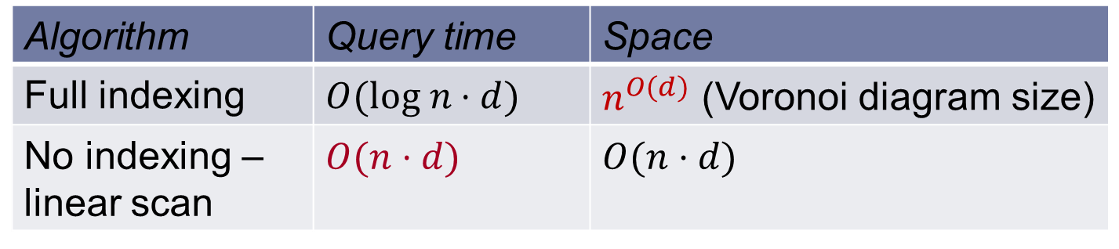

Curse of dimensionality
All exact algorithms degrade rapidly with the dimension $d$
Algorithm | Query time | Space
Full indexing | $$O(log n⋅d)$$ | $n^{O(d)}$ (Voronoi diagram size)
No indexing – linear scan | $$O(n⋅d)$$ | $$O(n⋅d)$$

Slide 5

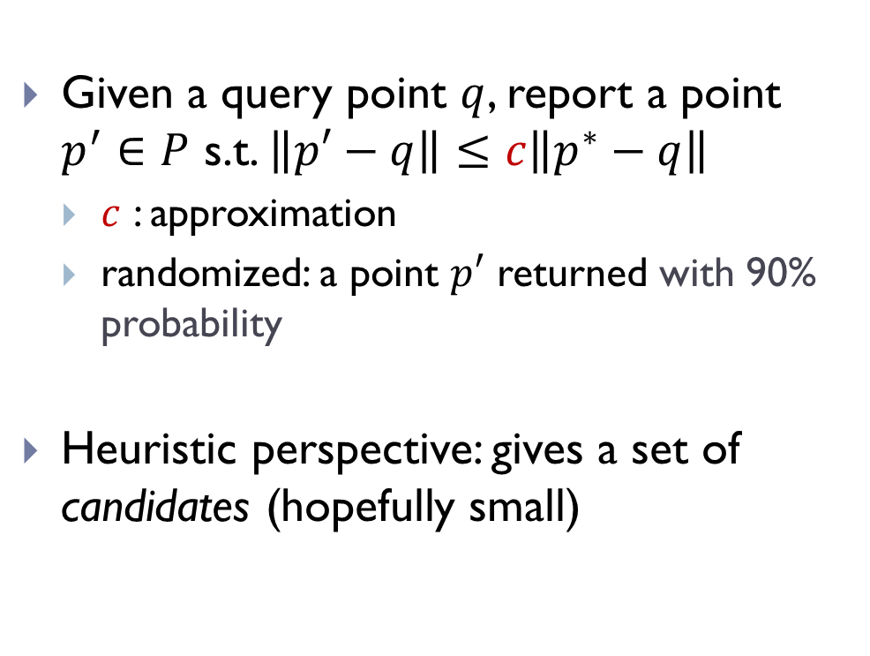


Approximate NNS
Given a query point $q$, report a point $p^{′}∈P$ s.t. $\left\|p′−q\right\|≤c\left\|p^{∗}−q\right\|$
  $c$ : approximation
  randomized: a point $p′$ returned with 90% probability
Heuristic perspective: gives a set of candidates (hopefully small)
$$p^{∗}$$
$$q$$
$$p^{′}$$

Slide 6
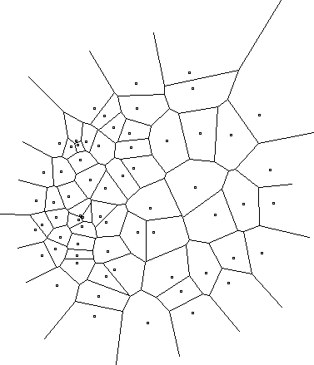
NNS algorithms
It’s all about space partitions !
Low-dimensional
    [Arya-Mount’93], [Clarkson’94], [Arya-Mount-Netanyahu-Silverman-We’98], [Kleinberg’97], [Har-Peled’02],[Arya-Fonseca-Mount’11],…
High-dimensional
    [Indyk-Motwani’98], [Kushilevitz-Ostrovsky-Rabani’98], [Indyk’98, ‘01], [Gionis-Indyk-Motwani’99], [Charikar’02], [Datar-Immorlica-Indyk-Mirrokni’04], [Chakrabarti-Regev’04], [Panigrahy’06], [Ailon-Chazelle’06], [A-Indyk’06], [A-Indyk-Nguyen-Razenshteyn’14], [A-Razenshteyn’14]

Slide 7

Low-dimensional
kd-trees,…
$c=1+ε$
runtime: $\frac{1}{ε^{O(d)}}⋅log n$

Slide 8

High-dimensional
Locality-Sensitive Hashing
Crucial use of random projections
  Johnson-Lindenstrauss Lemma: project to random subspace of dimension $O(\log{n}/ε^{2})$ for $1+ε$ approximation
Runtime: $n^{1/c}$ for $c$ approximation

Slide 9
Practice
Data-aware partitions
  optimize the partition to your dataset
  PCA-tree [S’91, M’01, VKD’09]
  randomized kd-trees [SAH08, ML09]
  spectral/PCA/semantic/WTA hashing [WTF08, CKW09, SH09, YSRL11]

Slide 10
Practice vs Theory
Data-aware projections often outperform (vanilla) random-projection methods
But no guarantees (correctness or performance)
JL generally optimal [Alo’03, JW’13]
  Even for some NNS regimes! [AIP’06]
Why do data-aware projections outperform random projections ?
Algorithmic framework to study phenomenon?

Slide 11
Plan for the rest
Model
Two spectral algorithms
Conclusion

Slide 12


Our model
“low-dimensional signal + large noise”
  inside high dimensional space
Signal: $P∈U$ where $U∈ℜ^{d}$ of dimension $k≪d$
Data: each point is perturbed by a full-dimensional Gaussian noise $N_{d}(0,σ^{2})$
$$U$$

Slide 13
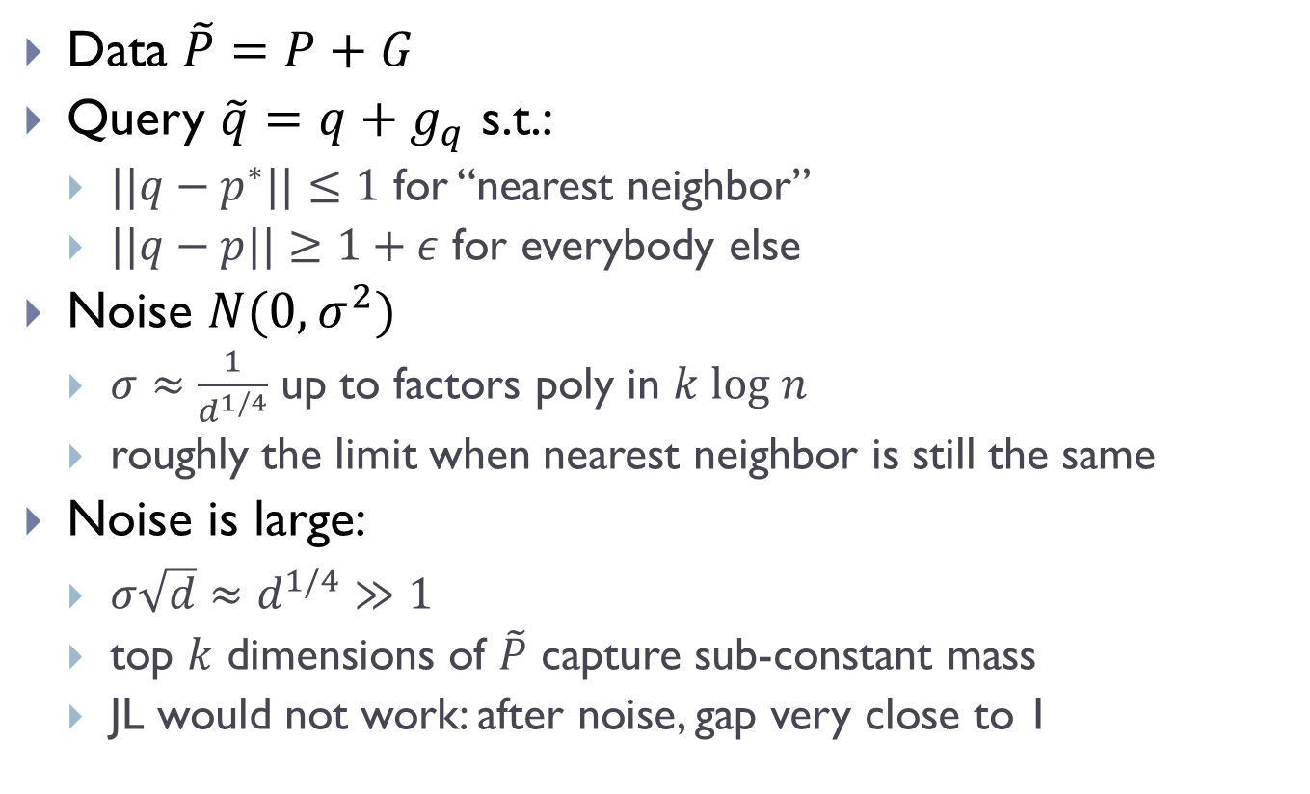
Model properties
Data $\tilde{P}=P+G$
Query $\tilde{q}=q+g_{q}$ s.t.:
  $||q−p^{∗}||≤1$ for “nearest neighbor”
  $||q−p||≥1+ε$ for everybody else
Noise $N(0,σ^{2})$
  $σ≈\frac{1}{d^{1/4}}$ up to factors poly in $k log n$
  roughly the limit when nearest neighbor is still the same
Noise is large:
  $σ\sqrt{d}≈d^{1/4}≫1$
  top $k$ dimensions of $\tilde{P}$ capture sub-constant mass
  JL would not work: after noise, gap very close to 1

Slide 14
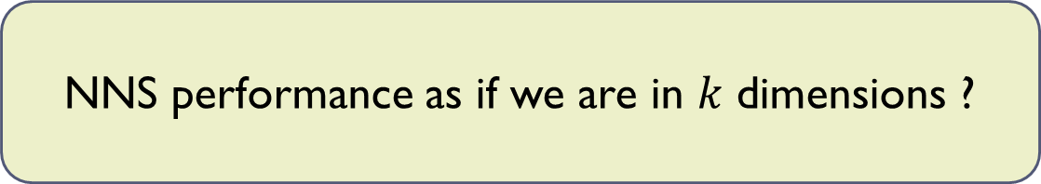

Best we can hope for
  dataset contains a “worst-case” $k$-dimensional instance
Reduction from dimension $d$ to $k$
Spoiler: Yes
NNS performance as if we are in $k$ dimensions ?

Slide 15
Tool: PCA
Principal Component Analysis
  like SVD
  Top PCA direction: direction maximizing variance of the data

Slide 16

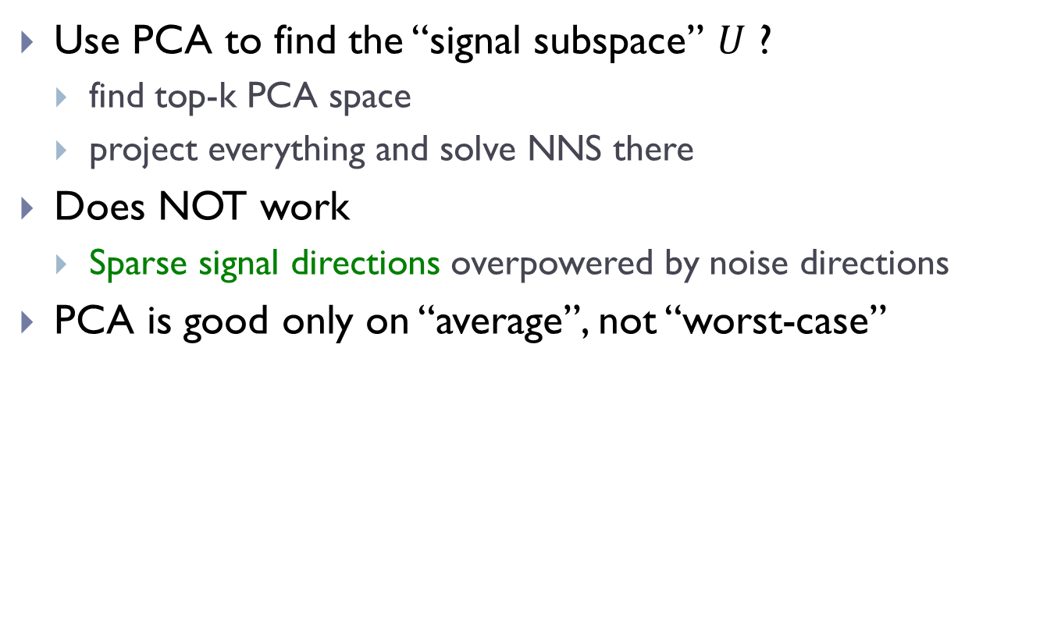
Naïve attempt via PCA
Use PCA to find the “signal subspace” $U$ ?
  find top-k PCA space
  project everything and solve NNS there
Does NOT work
  Sparse signal directions overpowered by noise directions
PCA is good only on “average”, not “worst-case”
$$p^{∗}$$

Slide 17
1st Algorithm: intuition
Extract “well-captured points”
  points with signal mostly inside top PCA space
  should work for large fraction of points
Iterate on the rest
$$p^{∗}$$

Slide 18
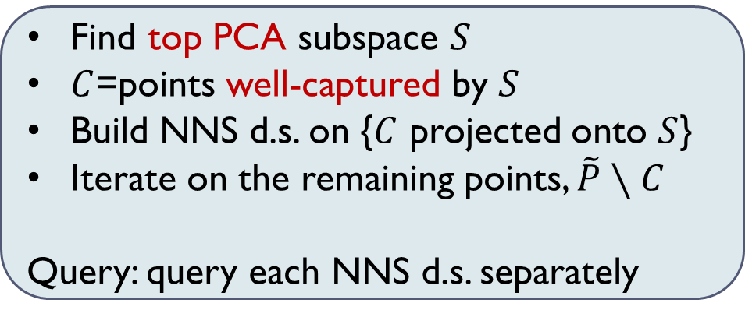

Iterative PCA
To make “PCA work” :
  Nearly no noise in $S$: ensuring $S$ close to $U$
    $S$ determined by heavy-enough spectral directions (dimension may be less than $k$)
  Capture points whose signal fully in $S$
    well-captured: distance to $S$ explained by noise only
Find top PCA subspace $S$
$C$=points well-captured by $S$
Build NNS d.s. on {$C$ projected onto $S$}
Iterate on the remaining points, $\tilde{P}∖C$
Query: query each NNS d.s. separately

Slide 19
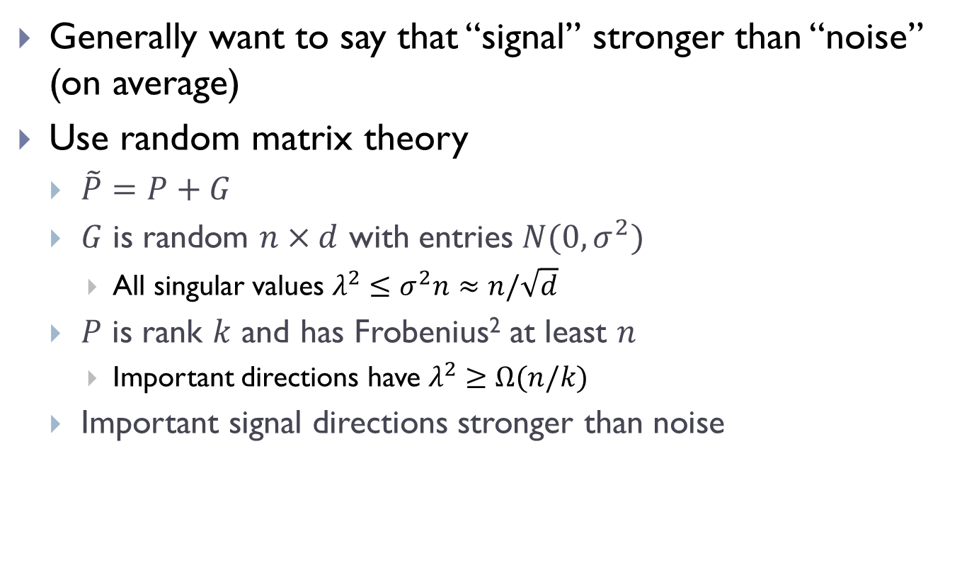
Analysis of PCA
Generally want to say that “signal” stronger than “noise” (on average)
Use random matrix theory
  $\tilde{P}=P+G$
  $G$ is random $n×d$ with entries $N(0,σ^{2})$
    All singular values $λ^{2}≤σ^{2}n≈n/\sqrt{d}$
  $P$ is rank $k$ and has Frobenius² at least $n$
    Important directions have $λ^{2}≥Ω(n/k)$
  Important signal directions stronger than noise

Slide 20

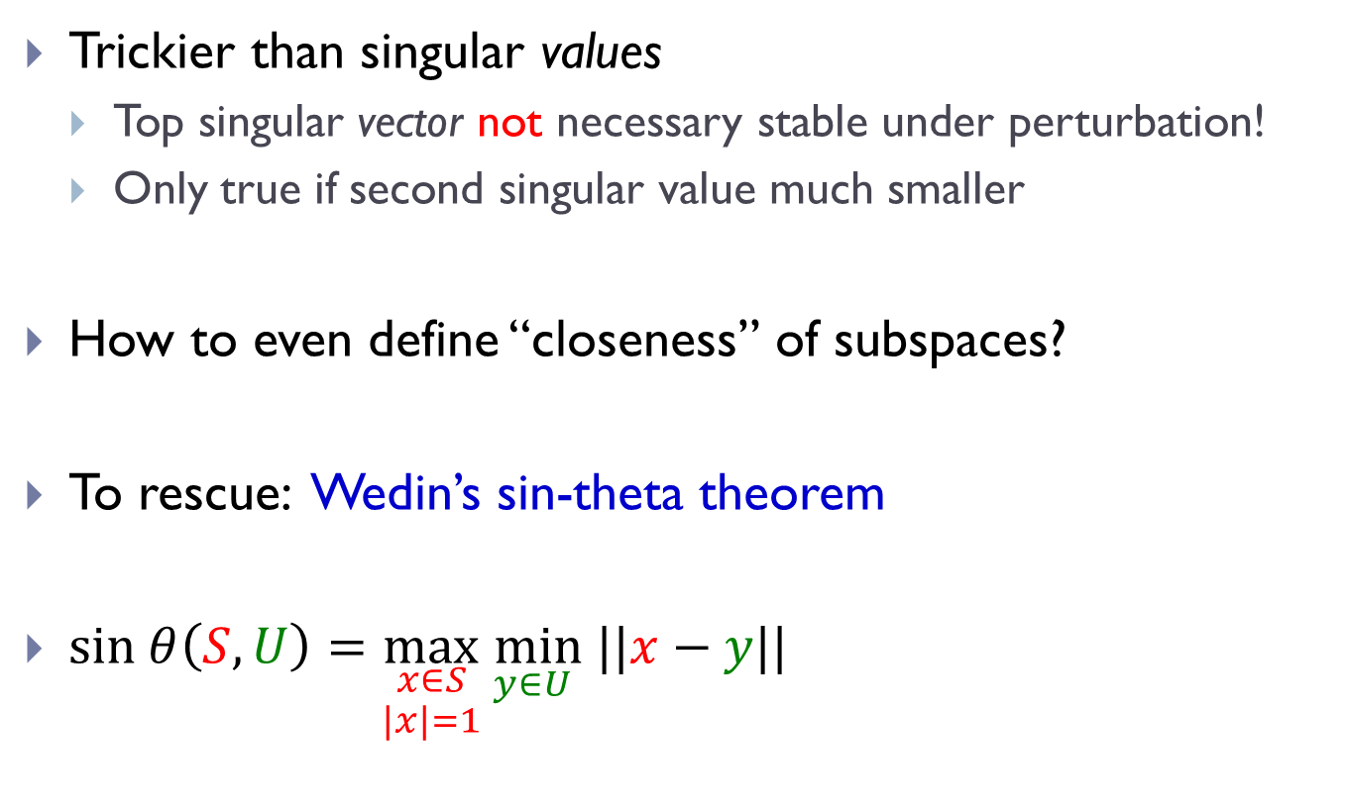
Closeness of subspaces ?
Trickier than singular values
  Top singular vector not necessary stable under perturbation!
  Only true if second singular value much smaller
How to even define “closeness” of subspaces?
To rescue: Wedin’s sin-theta theorem
$sin θ\left(S,U\right)=\max_{\begin{aligned}x∈S \\ |x|=1\end{aligned}}\min_{y∈U} ||x−y||$
$$θ$$

Slide 21

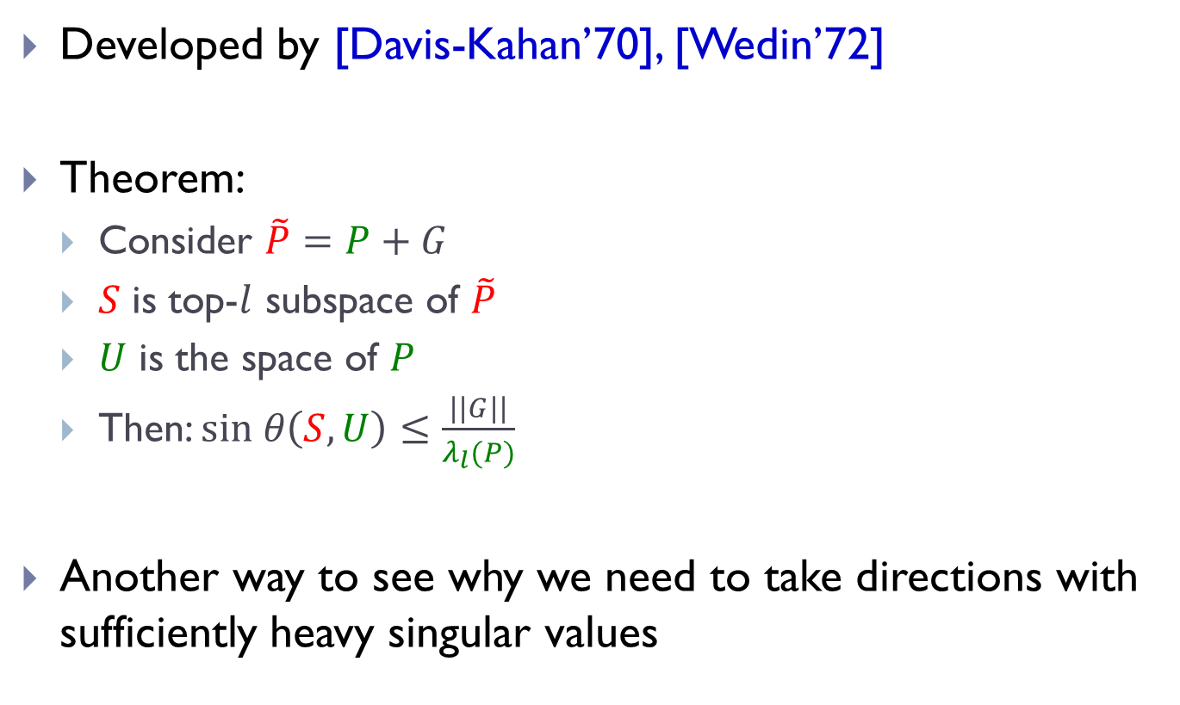
Wedin’s sin-theta theorem
Developed by [Davis-Kahan’70], [Wedin’72]
Theorem:
  Consider $\tilde{P}=P+G$
  $S$ is top-$l$ subspace of $\tilde{P}$
  $U$ is the space of $P$
  Then: $sin θ\left(S,U\right)≤\frac{||G||}{λ_{l}(P)}$
Another way to see why we need to take directions with sufficiently heavy singular values
$$θ$$

Slide 22
Additional issue: Conditioning
After an iteration, the noise is not random anymore!
  Conditioning because of selection of points (non-captured points)
Fix: estimate top PCA subspace from a small sample of the data
Might be purely due to analysis
  But does not sound like a bad idea in practice either

Slide 23
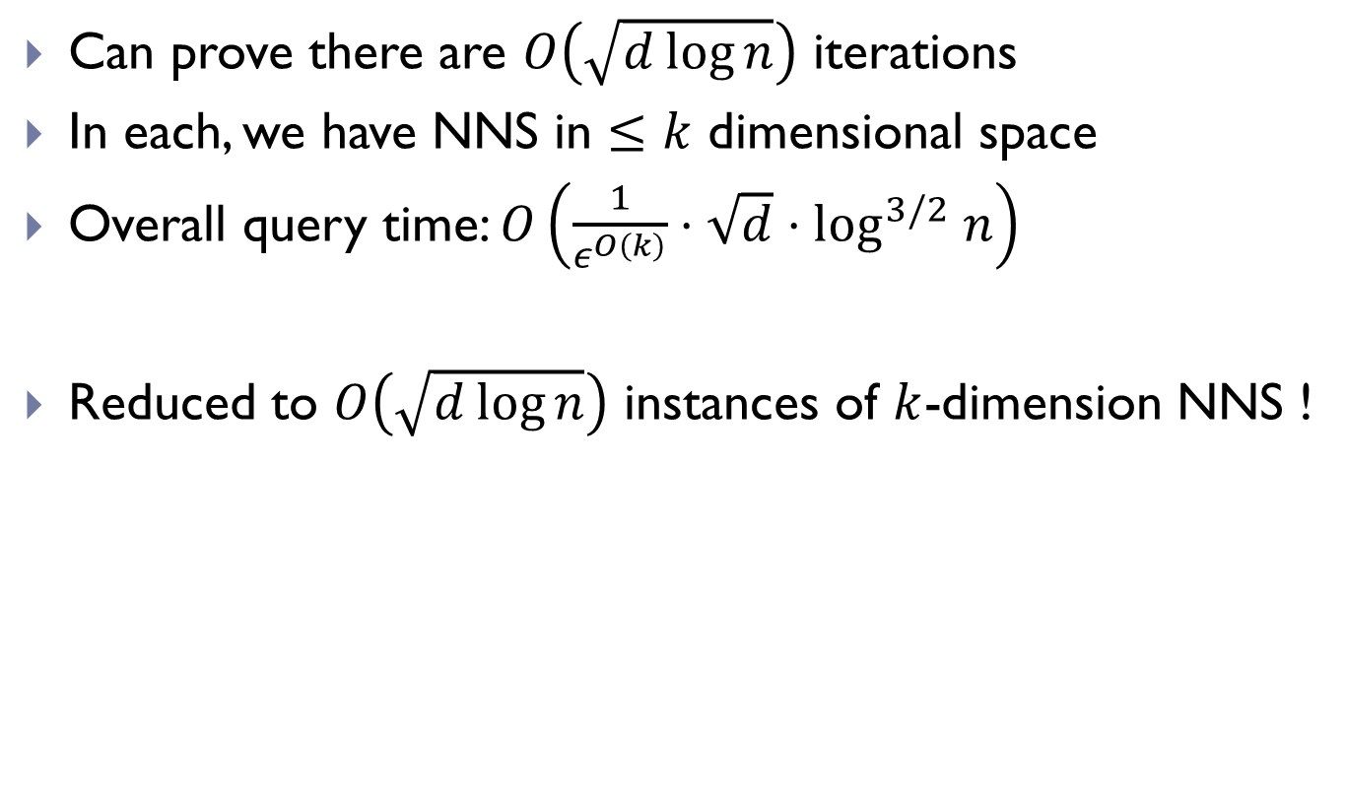
Performance of Iterative PCA
Can prove there are $O\left(\sqrt{d\log{n}}\right)$ iterations
In each, we have NNS in $≤k$ dimensional space
Overall query time: $O\left(\frac{1}{ε^{O\left(k\right)}}⋅\sqrt{d}⋅\log^{3/2} n\right)$
Reduced to $O\left(\sqrt{d\log{n}}\right)$ instances of $k$-dimension NNS !

Slide 24

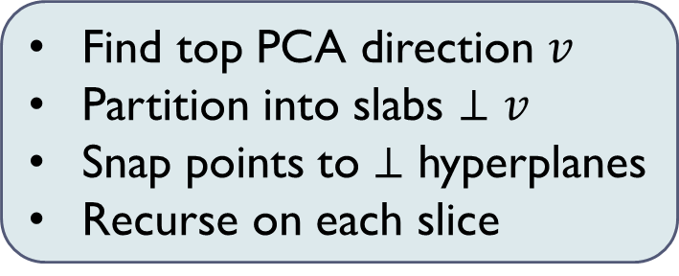
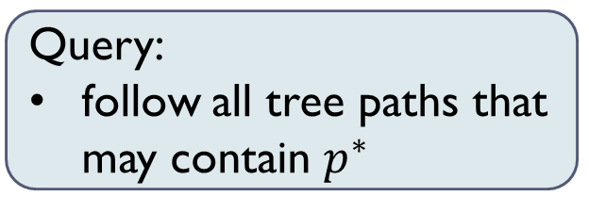
2nd Algorithm: PCA-tree
Closer to algorithms used in practice
Find top PCA direction $v$
Partition into slabs $⊥v$
Snap points to $⊥$ hyperplanes
Recurse on each slice
Query:
follow all tree paths that may contain $p^{∗}$
$$≈ε/k$$

Slide 25
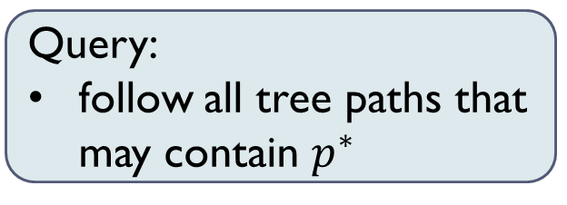
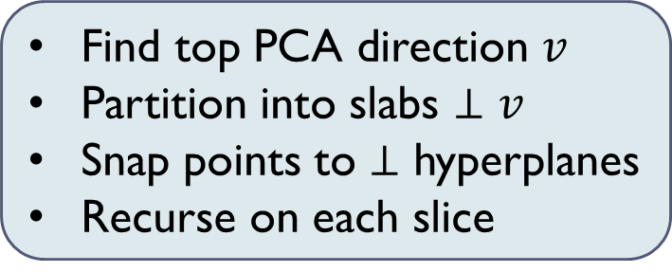
2 algorithmic modifications
Centering:
  Need to use centered PCA (subtract average)
  Otherwise errors from perturbations accumulate
Sparsification:
  Need to sparsify the set of points in each node of the tree
  Otherwise can get a tight cluster:
    not enough variance in signal
    lots of noise
Find top PCA direction $v$
Partition into slabs $⊥v$
Snap points to $⊥$ hyperplanes
Recurse on each slice
Query:
follow all tree paths that may contain $p^{∗}$

Slide 26
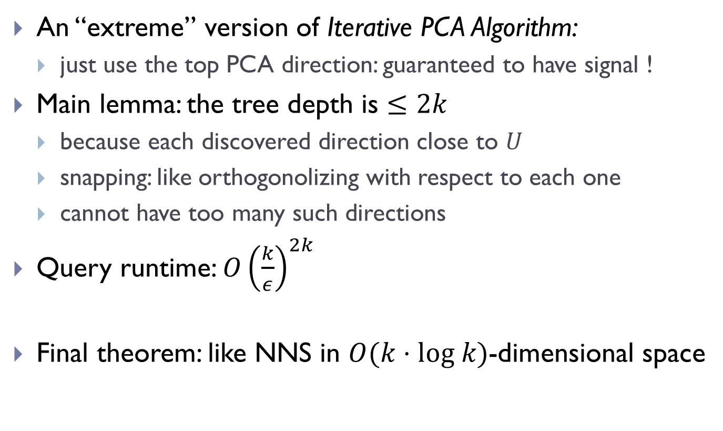
Analysis
An “extreme” version of Iterative PCA Algorithm:
  just use the top PCA direction: guaranteed to have signal !
Main lemma: the tree depth is $≤2k$
  because each discovered direction close to $U$
  snapping: like orthogonolizing with respect to each one
  cannot have too many such directions
Query runtime: ${O\left(\frac{k}{ε}\right)}^{2k}$
Final theorem: like NNS in $O(k⋅log k)$-dimensional space

Slide 27
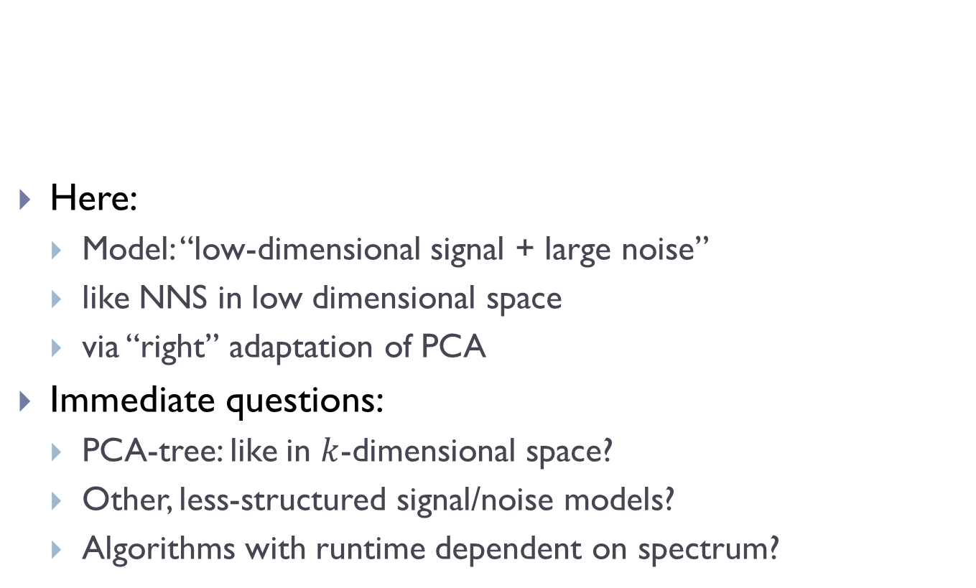
Wrap-up
Here:
  Model: “low-dimensional signal + large noise”
  like NNS in low dimensional space
  via “right” adaptation of PCA
Immediate questions:
  PCA-tree: like in $k$-dimensional space?
  Other, less-structured signal/noise models?
  Algorithms with runtime dependent on spectrum?
Why do data-aware projections outperform random projections ?
Algorithmic framework to study phenomenon?

Slide 28
Post-perspective
Can data-aware projections help in worst-case situation?
Data-aware LSH provably better than classic LSH
  [A-Indyk-Nguyen-Razenshteyn’14], [A-Razenshteyn]
  Overall improve performance almost quadratically
  But not based on (spectral) projections
    random data-dependent hash function
Data-aware projections for LSH ?
Instance-optimal partitions/projections?

