Slide 1
An Efficient Parallel Solver for SDD Linear Systems
Richard Peng
M.I.T.
Joint work with Dan Spielman (Yale)
Notes:
1

Slide 2
Efficient Parallel Solvers for SDD Linear Systems
Richard Peng
M.I.T.
Work in progress with Dehua Cheng (USC),
Yu Cheng (USC), Yintat Lee (MIT), Yan Liu (USC), Dan Spielman (Yale), and Shanghua Teng (USC)
Notes:
2

Slide 3
Outline
L_{G}x = b
Why is it hard?
Key Tool
Parallel Solver
Other Forms

Slide 4
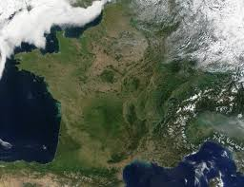
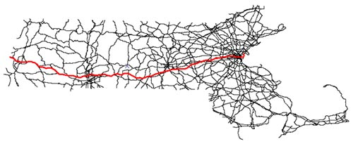
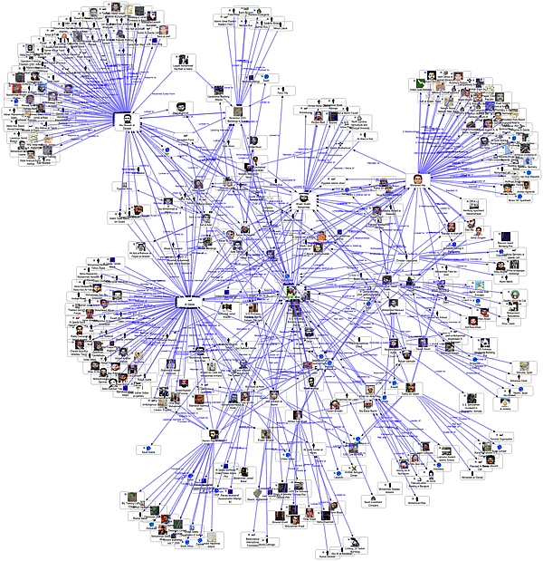
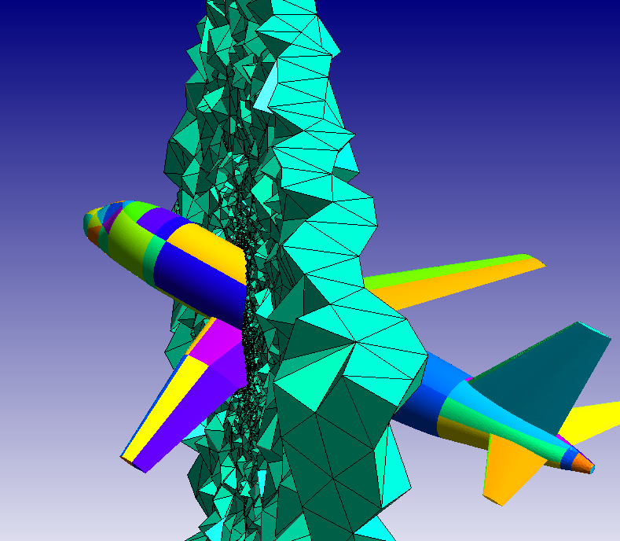
Large Graphs
Images
Roads
Social networks
Meshes
Algorithmic challenges:
  How to store?
How to analyze?
How to optimize?

Slide 5
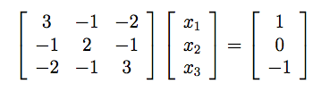
Graph Laplacian
1
1
2
Row/column ⬄ vertex
Off-diagonal ⬄ -weight
Diagonal ⬄ weighted degree
n vertices
m edges
Lx=b
Input: graph Laplacian L, vector b
Output: vector x s.t. Lx ≈ b

Slide 6
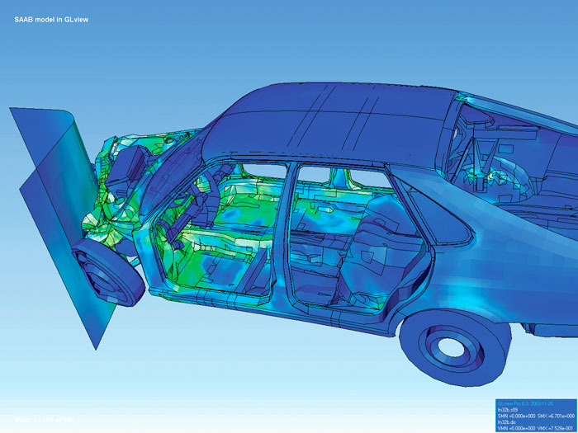
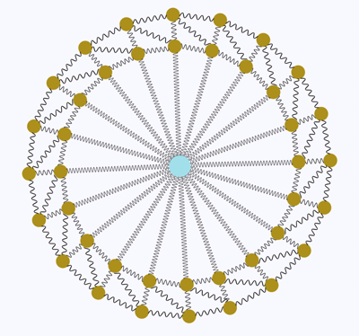
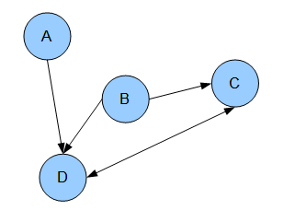

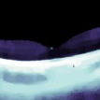
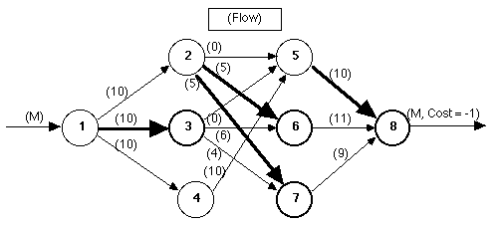
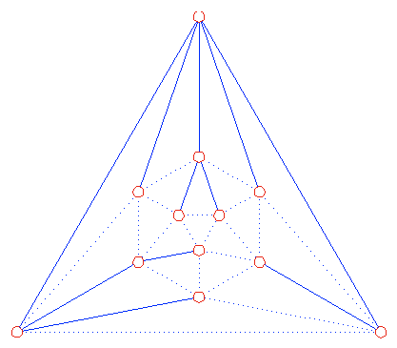
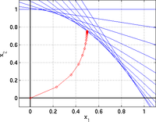
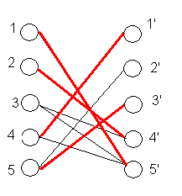
The Laplacian Paradigm
Directly related:
Elliptic systems
Lx=b
Few iterations: Eigenvectors,
Heat kernels
Many iterations / modify algorithm
Graph problems
Image processing

Slide 7
Solvers
1
1
Lx=b
2
Direct Methods: O(n³)→O(n^{2.3727})
Iterative methods: O(nm), O(mκ^{1/2})
Combinatorial Preconditioning
[Vaidya`91]: O(m^{7/4})
[Boman-Hendrickson`01]: O(mn)
[Spielman-Teng `03, `04]: O(m^{1.31})→O(mlog^{c}n)
[KMP`10][KMP`11][KOSZ 13][LS`13][CKMPPRX`14]: O(mlog²n)→→→O(mlog^{1/2}n)
n x n matrix
m non-zeros

Slide 8
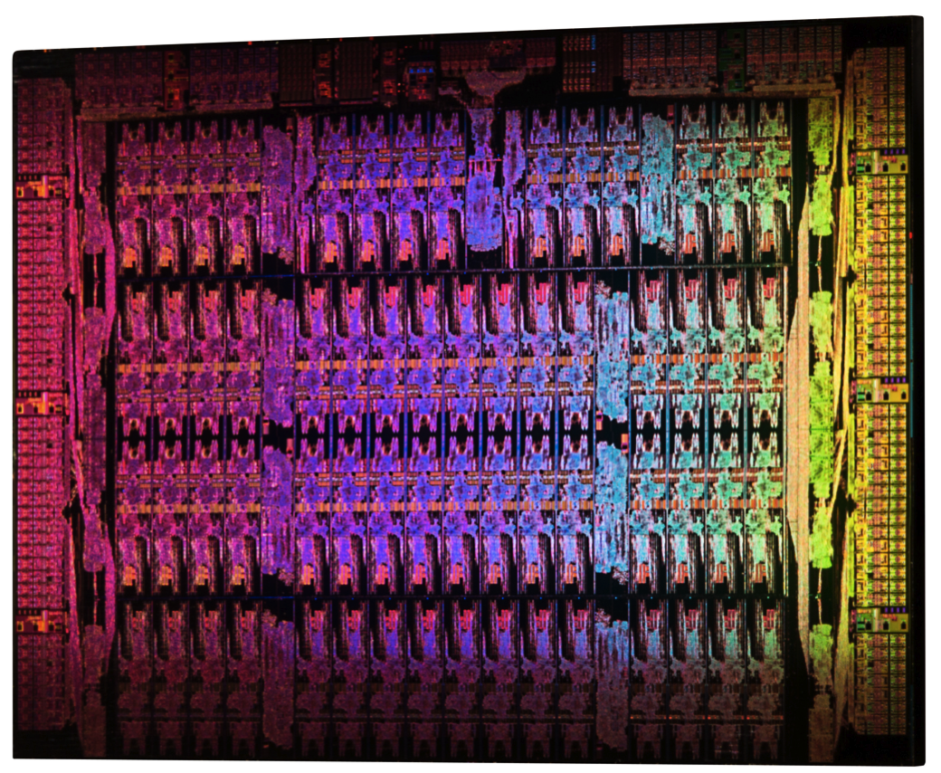
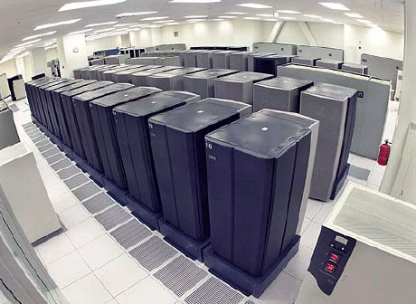
Parallel Speedups
Common architectures: multicore, MapReduce
Speedups by splitting work
Time: max # of dependent steps
Work: # operations
Nearly-linear work parallel Laplacian solvers
[KM `07]: O(n^{1/6+a}) for planar
[BGKMPT `11]: O(m^{1/3+a})
Notes:
8

Slide 9
Our Result
Input: Graph Laplacian L_{G} with condition number κ
Output: Access to operator Z s.t. Z ≈_{ε} L_{G}⁻¹
Cost: O(log^{c1}m log^{c2}κ log(1/ε)) depth
O(m log^{c1}m log^{c2}κ log(1/ε)) work
Note: L_{G} is low rank, omitting pseudoinverses
Logarithmic dependency on error
κ ≤ O(n²w_{max}/w_{min})
Extension: sparse approximation of L_{G}^{p} for any -1 ≤ p ≤ 1 with poly(1/ε) dependency
Notes:
Same guarantees, also parallelizable.

Slide 10
Summary
Would like to solve L_{G}x = b
Goal: polylog depth, nearly-linear work

Slide 11
Outline
L_{G}x = b
Why is it hard?
Key Tool
Parallel Solver
Other Forms

Slide 12
Extreme Instances
Highly connected, need global steps
Long paths / tree, need many steps
Each easy on their own:
Iterative method
Gaussian elimination
Solvers must handle both simultaneously

Slide 13
Previous Fast Algorithms
Combinatorial preconditioning
Spectral sparsification
Tree Routing
Local partitioning
Tree Contraction
Iterative Methods
Low stretch spanning trees
Reduce G to a sparser G’
Terminate at a spanning tree T
Focus of subsequent improvements
‘Driver’
Polynomial in L_{G}L_{T}⁻¹
Need: L_{G}⁻¹L_{T}⁼(L_{G}L_{T}⁻¹)⁻¹
Horner’s method:
degree d → O(dlogn) depth
[Spielman-Teng` 04]: d ≈ n^{1/2}
Fast due to sparser graphs

Slide 14
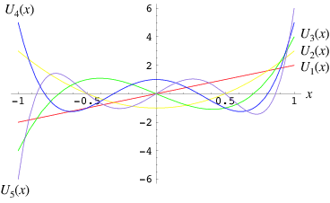
Polynomial Approximations
Division with multiplication:
(1 – a)⁻¹ = 1 + a + a² + a³ + a⁴ + a⁵…
If |a| ≤ ρ, κ = (1-ρ)⁻¹ terms give good approximation to (1 – a)⁻¹
Spectral theorem: this works for marices!
Better: Chebyshev / heavy ball:
d = O(κ^{1/2}) sufficient
Optimal ([OSV `12])
Exists G (,e.g. cycle) where κ(L_{G}L_{T}⁻¹) needs to be Ω(n)
Ω(n^{1/2}) lower bound on depth?
Notes:
14

Slide 15
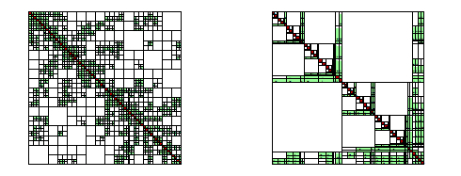
Lower Bound for Lower bound
Multiplying by L_{G}⁻¹ is highly parallel!
[BGKMPT `11]: O(m^{1/3+a}) via. (pseudo) inverse:
Preprocess: O(log²n) depth, O(n^{ω}) work
Solve: O(logn) depth, O(n²) work
Inverse is dense, expensive to use
Only use on O(n^{1/3}) sized instances
Possible improvement: can we make L_{G}⁻¹ sparse?
[George `73][LRT `79]:yes for planar graphs

Slide 16
Summary
Would like to solve L_{G}x = b
Goal: polylog depth, nearly-linear work
`Standard’ numerical methods have high depth
Equivalent: sparse inverse representations
Aside: cut approximation / oblivious routing schemes by [Madry `10][Sherman `13][KLOS `13] are parallel, can be viewed as asynchronous iterative methods

Slide 17
Outline
L_{G}x = b
Why is it hard?
Key Tool
Parallel Solver
Other Forms

Slide 18
Degree d polynomial → depth d?
a¹⁶ = (((a²)²)²)²
Repeated squaring sidesteps assumption in lower bound!
Apply to power method:
(1 – a)⁻¹ = 1 + a + a² + a³ + a⁴ + a⁵ + a⁶ + a⁷ …
=(1 + a) (1 + a²) (1 + a⁴)…
Matrix version: I + (A)^{2i}
Notes:
18

Slide 19
Reduction to (I – A)⁻¹
Adjust/rescale so diagonal = I
Add to diag(L) to make it full rank
A:
Weighted degree < 1
Random walk,|A| < 1
Notes:
19

Slide 20
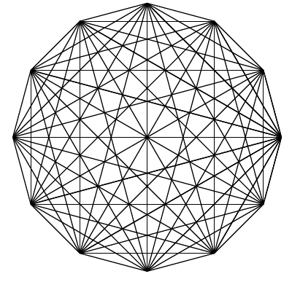
Interpretation
A
(I – A)⁻¹ = (I + A)(I + A²)…(I + A^{2i})…
A: one step transition of random walk
A^{2i}: 2^{i} step transition of random walk
One step of walk on each A_{i} = A^{2i}
Until A^{2i} becomes `expander’
O(logκ) matrix multiplications
O(n^{ω}logκlogn) work
I
Need: size reductions
Notes:
20

Slide 21
Similar To
Multiscale methods
NC algorithm for shortest path
Logspace connectivity: [Reingold `02]
Deterministic squaring: [Rozenman Vadhan `05]
 | Connectivity | Parallel Solver
Iteration | A_{i+1} ≈ A_{i}² | A_{i+1} ≈ A_{i}²
Until | |A_{d}| small | |A_{d}| small
Size Reduction | Low degree | Sparse graph
Method | Derandomized | Randomized
Solution transfer | Connectivity | (I - A_{i})x_{i} = b_{i}
Notes:
21

Slide 22
Summary
Would like to solve L_{G}x = b
Goal: polylog depth, nearly-linear work
`Standard’ numerical methods have high depth
Equivalent: sparse inverse representations
Squaring gets around lower bound

Slide 23
Outline
L_{G}x = b
Why is it hard?
Key Tool
Parallel Solver
Other Forms

Slide 24
What Is AN Algorithm
Input
b
Z
x
Output
b → x: linear operator, Z
Algorithm ⬄ matrix Z ≈_{ε} (I – A)⁻¹
≈_{ε}:, spectral similarity with relative error ε
Symmetric, invertible, composable (additive)
Goal: Z = sum/product of a few matrices
Notes:
24

Slide 25
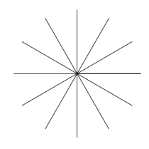
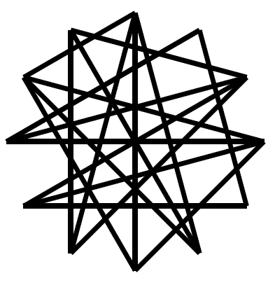
Squaring
[BSS`09]: exists I - A’ ≈_{ε} I – A² with O(nε⁻²) entries
[ST `04][SS`08][OV `11] + some modifications: O(nlog^{c}n ε⁻²) entries, efficient, parallel
[Koutis `14]: faster algorithm based on spanners /low diameter decompositions
Notes:
25

Slide 26
Approximate Inverse Chain
I - A₀
I - A₁ ≈_{ε} I – A²
I – A₂ ≈_{ε} I – A₁²
…
I – A_{i} ≈_{ε} I – A_{i-1}²
I - A_{d} ≈ I
d = O(logκ)
Convergence: |A_{i+1}|<|A_{i}|/2
I – A_{i+1} ≈_{ε} I – A_{i}²: |A_{i+1}|<|A_{i}|/ 1.5
I - A_{d}≈ I

Slide 27
Issue 1
Need to invoke: (1 – a)⁻¹
= (1 + a) (1 + a²) (1 + a⁴)…
I - A₀
Only have 1 – a_{i+1} ≈ 1 – a_{i}²
Solution: apply one at a time
(1 – a_{i})⁻¹ = (1 + a_{i})(1 – a_{i}²)⁻¹
≈ (1 + a_{i})(1 – a_{i+1})⁻¹
z_{i} = (1 + a_{i}) z_{i+1} ≈ (1 + a_{i})(1 – a_{i+1})⁻¹ ≈(1 – a_{i})⁻¹
Induction: z_{i+1} ≈ (1 – a_{i+1})⁻¹
I - A_{d}≈ I
z_{d} = (1 – a_{d})⁻¹ ≈ 1
Notes:
27

Slide 28
Issue 2
In matrix setting, replacements by approximations need to be symmetric:
Z ≈ Z’ → U^{T}ZU ≈ U^{T}Z’U
In Z_{i}, terms around (I - A_{i}²)⁻¹ ≈ Z_{i+1} needs to be symmetric
(I – A_{i}) Z_{i+1} is not symmetric around Z_{i+1}☹
Solution 1 ([PS `14]):
(1 – a)⁻¹=1/2 ( 1 + (1 + a)(1 – a²)⁻¹(1 + a))
Notes:
28

Slide 29
algorithm
(I – A_{i})⁻¹ = ½ [I+(1 + A_{i}) (I – A_{i}²)⁻¹ (1 + A_{i})]
Chain: (I – A_{i+1})⁻¹ ≈_{ε} (I – A_{i}²)⁻¹
Z_{i+1} ≈ _{α+ε} (1 – A_{i}²)⁻¹
Induction: Z_{i+1} ≈_{α} (I – A_{i+1}) ⁻¹
Z_{i} ← ½ [I+(1 + A_{i}) Z_{i+1}(I + A_{i})]
Composition: Z_{i} ≈ _{α+ε} (I – A_{i})⁻¹
Total error = dε= O(logκε)

Slide 30
Pseudocode
x = Solve(I, A₀, … A_{d}, b)
For i from 1 to d,
  set b_{i} = (I + A_{i}) b_{i-1}.
Set x_{d} = b_{d}.
For i from d - 1 downto 0,
set x_{i} = ½[b_{i}+(I +A_{i})x_{i+1}].

Slide 31
Total Cost
Multigrid V-cycle like call structure: each level makes one call to next
Answer from d = O(log(κ))
matrix-vector multiplications
d = O(logκ)
ε = 1 / d
nnz(A_{i}): O(nlog^{c}nlog²κ)
O(log^{c}nlogκ) depth, O(nlog^{c}nlog³κ) work

Slide 32
Summary
Would like to solve L_{G}x = b
Goal: polylog depth, nearly-linear work
`Standard’ numerical methods have high depth
Equivalent: sparse inverse representations
Squaring gets around lower bound
Can keep squares sparse
Operator view of algorithms can drive its design

Slide 33
Outline
L_{G}x = b
Why is it hard?
Key Tool
Parallel Solver
Other Forms

Slide 34
Representation of (I – A)⁻¹
Gaussian graphical models sampling:
Sample from Gaussian with covariance I – A
Need C s.t. C^{T}C ≈ (I – A)⁻¹
Algorithm from [PS `14] gives: (I – A)⁻¹
≈ ½[I + (I + A₀)[I + (I + A₁)(I – A₂)⁻¹(I + A₁)](I + A₀)]
Sum and product of O(logκ) matrices
Need: just a product

Slide 35
Solution 2
(I – A)⁻¹= (I + A)^{1/2}(I – A²)⁻¹(I + A)^{1/2}
≈ (I + A)^{1/2}(I – A₁)⁻¹(I + A)^{1/2}
Repeat on A₁: (I – A)⁻¹ ≈ C^{T}C
where C = (I + A₀)^{1/2}(I + A₁)^{1/2}…(I + A_{d})^{1/2}
How to evaluate (I + A_{i})^{1/2}?
A₁ ≈ A₀^{2:}
Eigenvalues between [0,1]
Eigenvalues of I + A_{i} in [1,2]
Well-conditioned matrix
Mclaurin series expansion
= low degree polynomial
What about (I + A₀)^{1/2}?
Notes:
35

Slide 36
Solution 3 ([CCLPT `14])
(I – A)⁻¹= (I + A/2)^{1/2}(I – A/2 - A²/2)⁻¹(I + A/2)^{1/2}
Modified chain: I – A_{i+1}≈ I – A_{i}/2 - A_{i}²/2
I + A_{i}/2 has eigenvalues in [1/2, 3/2]
Replace with O(loglogκ) degree polynomial / Mclaurin series, T_{1/2}
C = T_{1/2}(I + A₀/2) T_{1/2}(I + A₁/2)…T_{1/2} (I + A_{d}/2)
gives (I – A)⁻¹ ≈ C^{T}C,
Generalization to (I – A)^{p} (-1 < p <1):
T_{-p/2}(I + A₀) T_{-p/2}(I + A₁) …T_{-p/2} (I + A_{d})
Notes:
36

Slide 37
Summary
Would like to solve L_{G}x = b
Goal: polylog depth, nearly-linear work
`Standard’ numerical methods have high depth
Equivalent: sparse inverse representations
Squaring gets around lower bound
Can keep squares sparse
Operator view of algorithms can drive its design
Entire class of algorithms / factorizations
Can approximate wider class of functions

Slide 38
Open Questions
Generalizations:
        (Sparse) squaring as an iterative method?
        Connections to multigrid/multiscale methods?
        Other functions? log(I - A)? Rational functions?
        Other structured systems?
        Different notions of sparsification?
More efficient:
      How fast for O(n) sized sparsifier?
      Better sparsifiers? for I – A²?
      How to represent resistances?
      O(n) time solver? (O(mlog^{c}n) preprocessing)
      Applications / implementations
        How fast can spectral sparsifiers run?
        What does L^{p} give for -1<p<1?
        Trees (from sparsifiers) as a stand-alone tool?

Slide 39
Thank You!
Questions?
Manuscripts on arXiv:
http://arxiv.org/abs/1311.3286
http://arxiv.org/abs/1410.5392

