Slide 1
Truth-Seeking in the Criminal Legal System

Slide 2
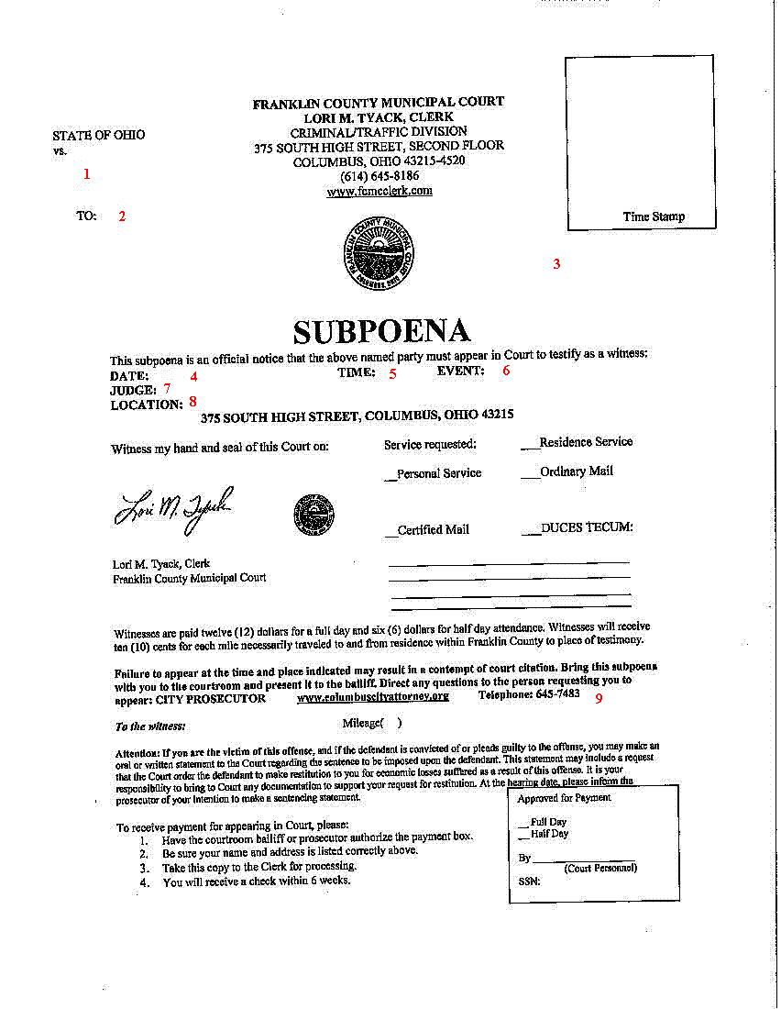
Criminal Subpoenas
Relevance: Any tendency to make a fact of consequence more or less likely than it would be without the evidence.
Admissibility: Has to be admissible at trial.
Specificity: Have to identify it with specificity in advance.

Slide 3
Privileges
“[E]xceptions to the demand for every man’s evidence are not lightly created nor expansively construed, for they are in derogation of the search for truth.”
- United States v. Nixon

Slide 6
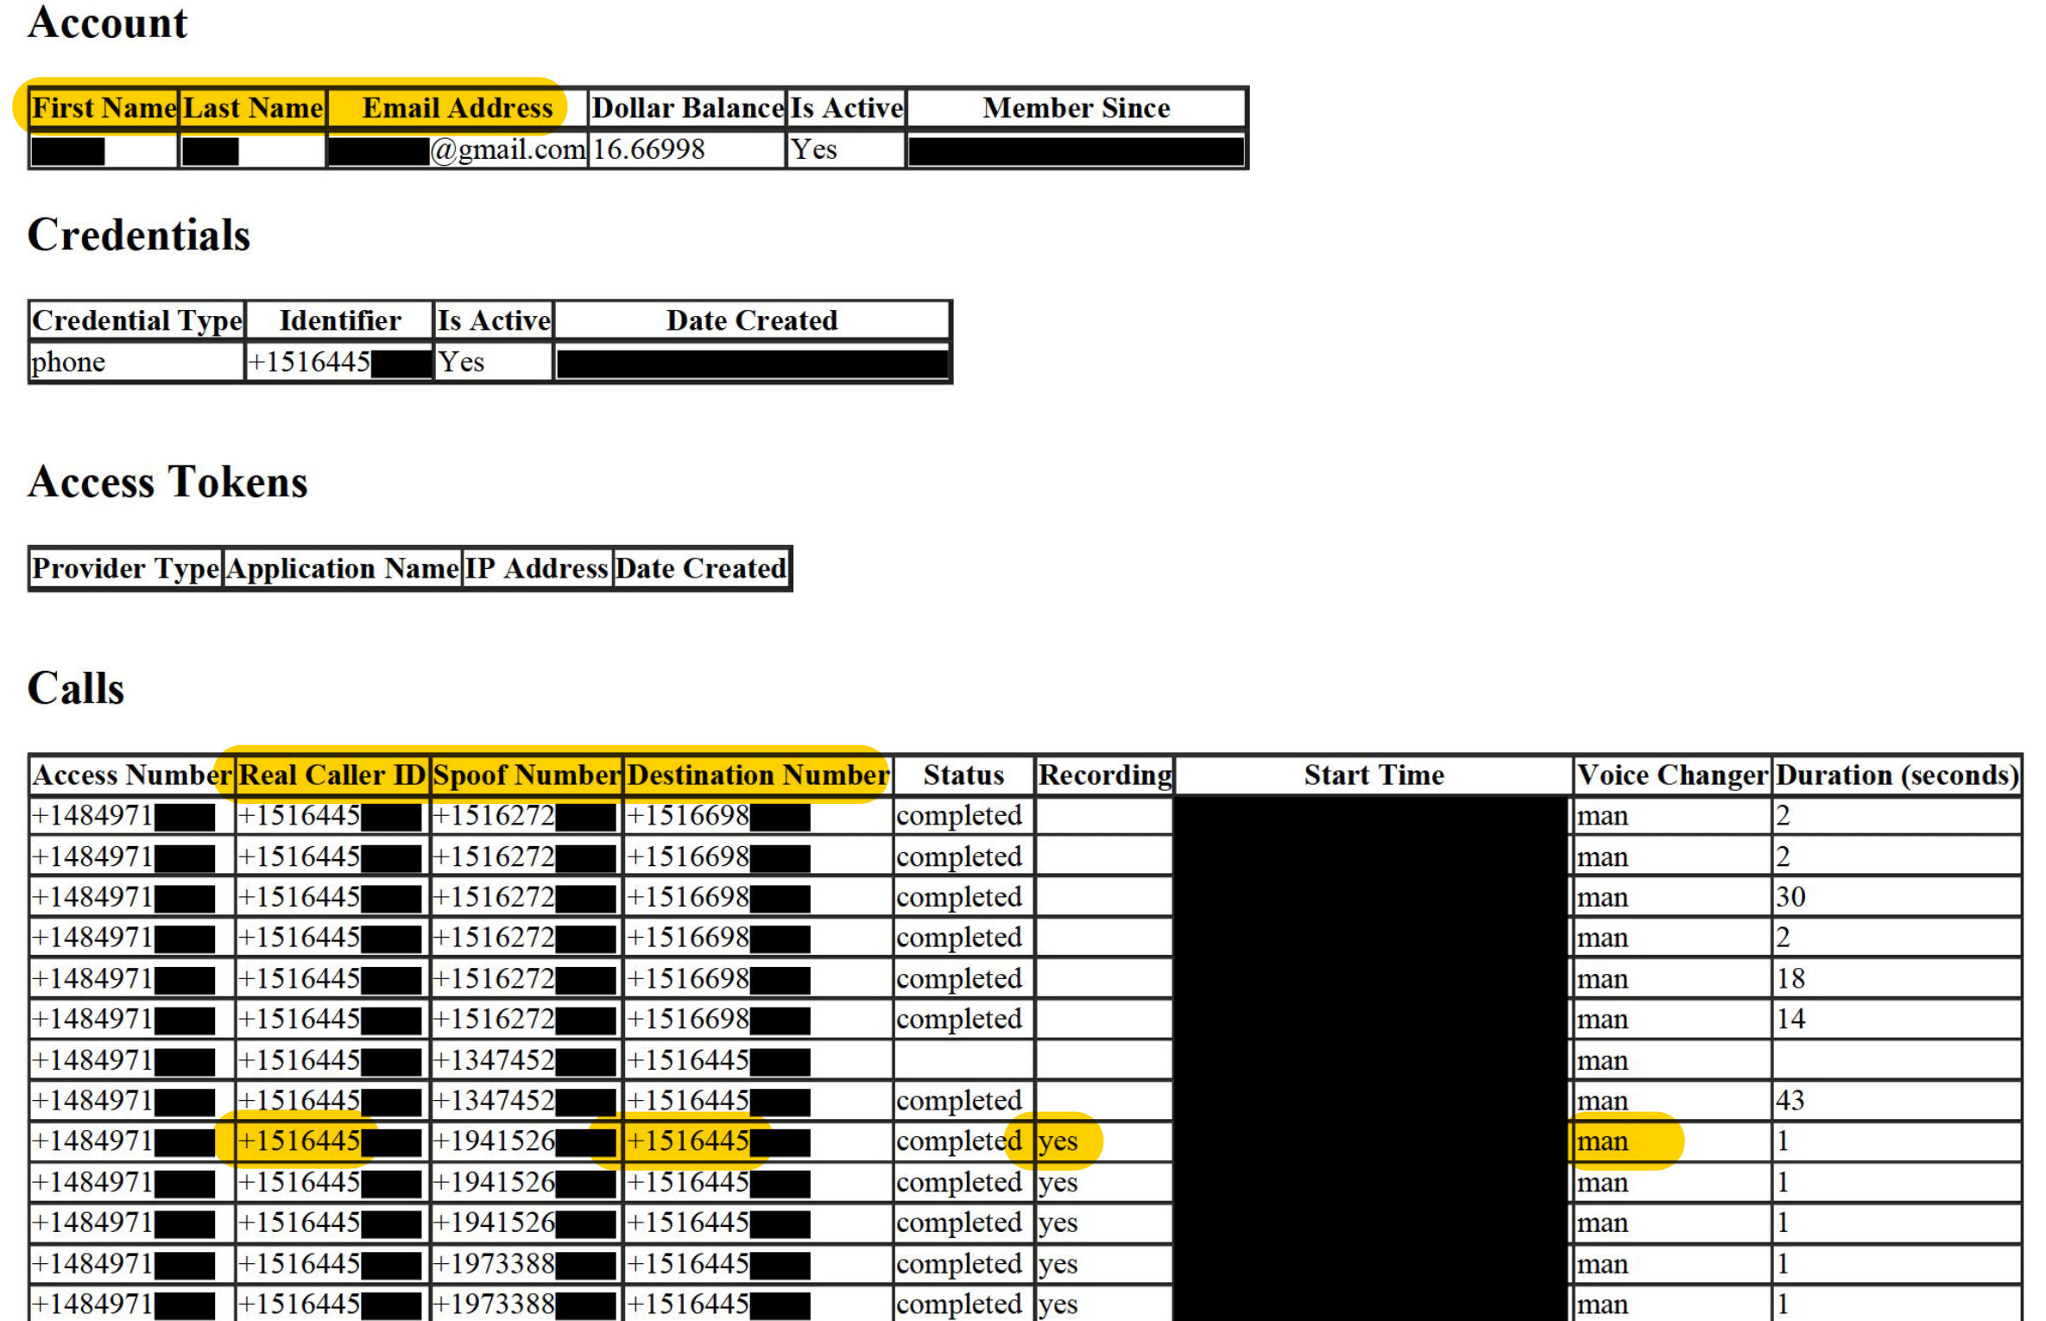

Slide 7
“Privacy Asymmetries”
Permit courts to order disclosures when requested by law enforcement but not when requested by criminal defense counsel.
Selectively suppress evidence of innocence.
Create disparities in who can deploy, assess, and develop new AI/ML technologies.

Slide 8
U.S. Privacy Asymmetries
The Postal Accountability and Enhancement Act
The Video Privacy Protection Act
Section 6103 of the Tax Code
The Family Educational Rights and Privacy Act
Regulations for Substance Abuse Treatment Records
The Wiretap Act
The Computer Fraud and Abuse Act
The Stored Communications Act

Slide 9
Law Enforcement Privilege

Slide 10
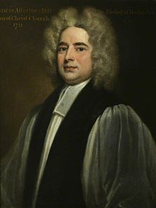
Bishop Atterbury

Slide 11
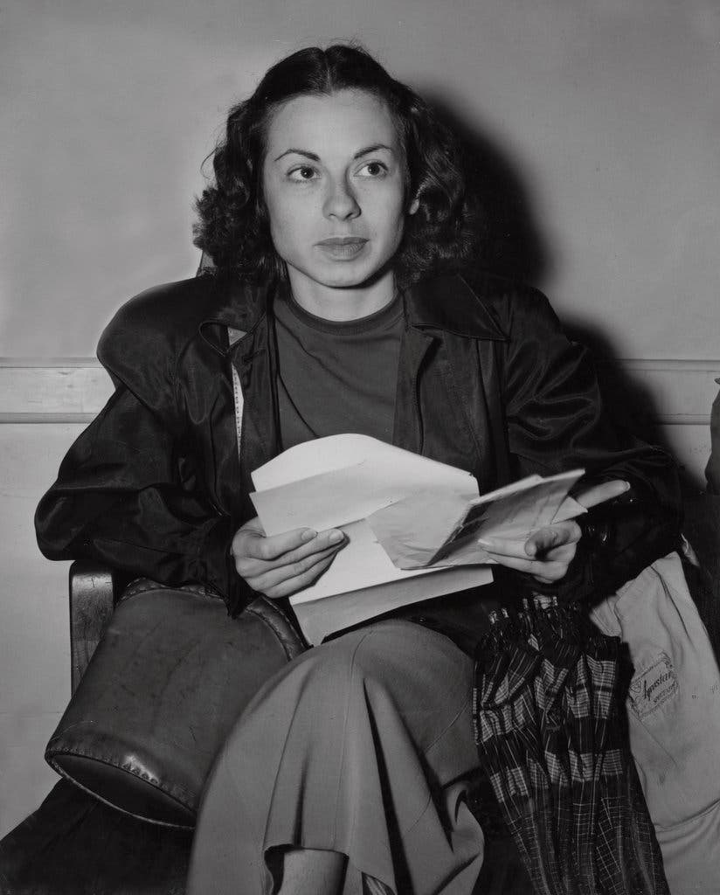
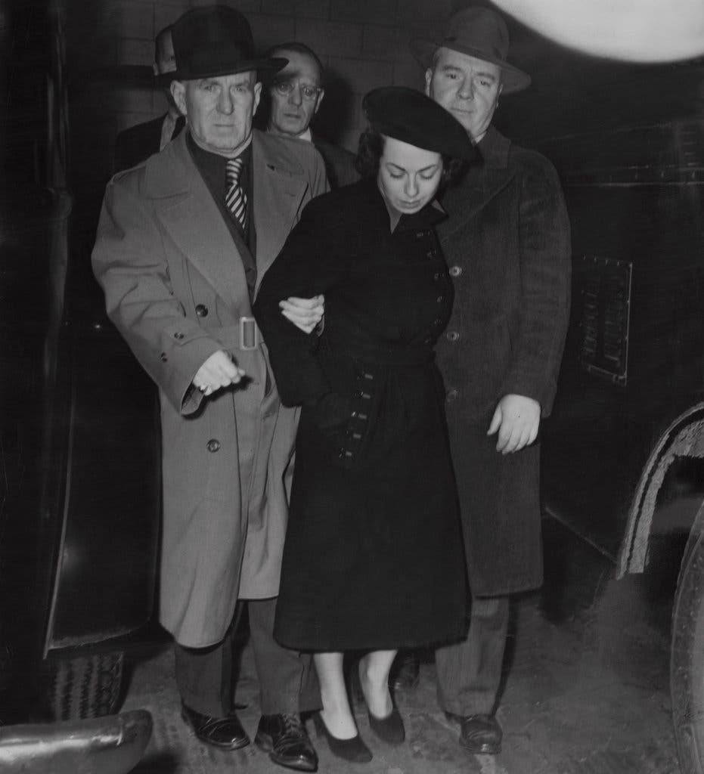
Judith Coplon

