Slide 1
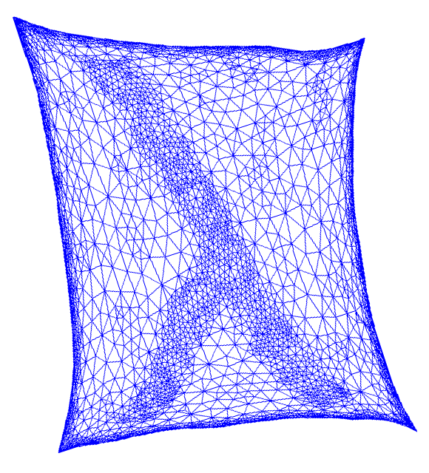
the unreasonable effectiveness of spectral graph theory:
a confluence of algorithms, geometry, and physics
James R. Lee
University of Washington

Slide 2
the agenda
The reasonable effectiveness of spectral graph theory [a primer]
The unreasonable effectiveness of spectral graph theory
Probing the borders of intractability

Slide 3

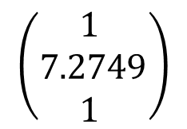
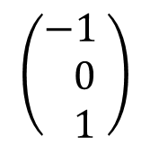
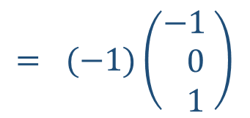
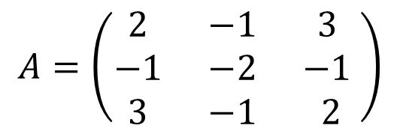

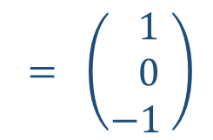

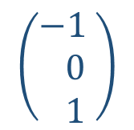

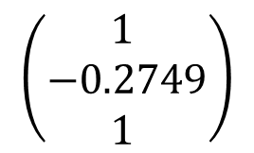
mathematical background
Real symmetric matrices have real eigenvalues and eigenvectors.
$$A_{ij}=A_{ji}$$
$$A=\left(\begin{matrix}2 & −1 & 3 \\ −1 & −2 & −1 \\ 3 & −1 & 2\end{matrix}\right)$$
$$\left(\begin{matrix}−1 \\ 0 \\ 1 \end{matrix}\right)$$
$$= \left(\begin{matrix} 1 \\ 0 \\ −1 \end{matrix}\right)$$
$$= (−1)\left(\begin{matrix}−1 \\ 0 \\ 1 \end{matrix}\right)$$
eigenvalues:
$$−2.2749$$
$$−1$$
$$5.2749$$
$$\left(\begin{matrix}1 \\ 7.2749 \\ 1 \end{matrix}\right)$$
$$\left(\begin{matrix}−1 \\ 0 \\ 1 \end{matrix}\right)$$
$$\left(\begin{matrix}1 \\ −0.2749 \\ 1 \end{matrix}\right)$$
eigenvectors:

Slide 4
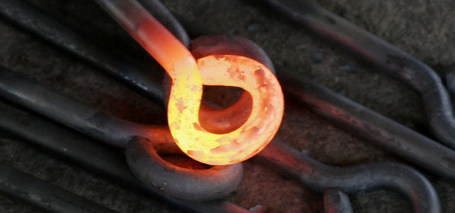
physics background

Slide 5
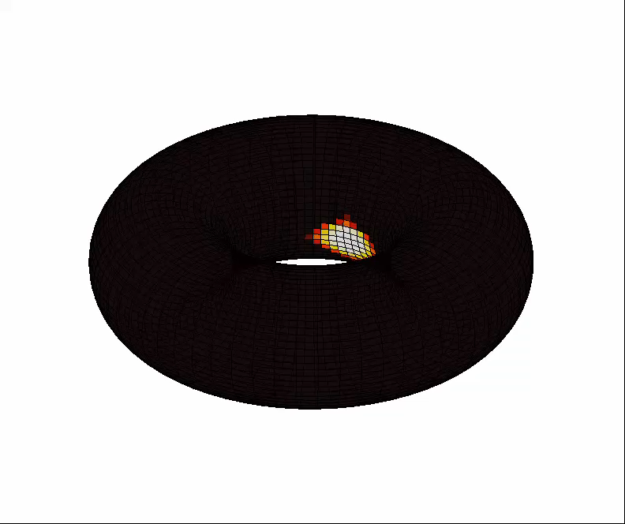
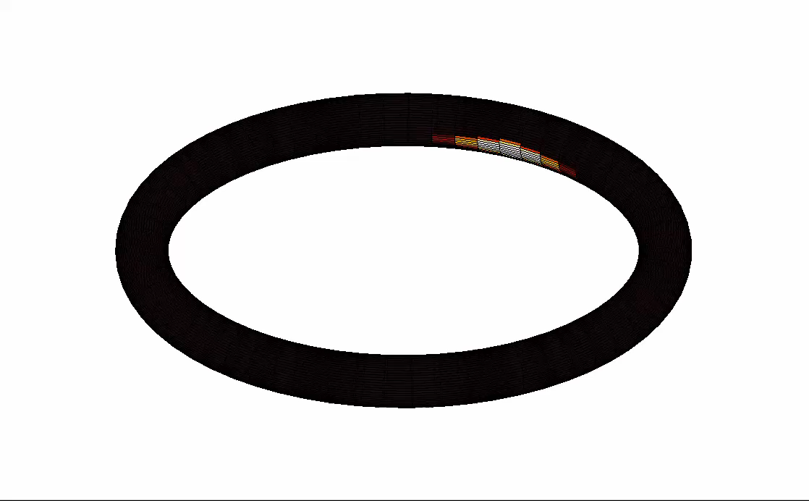
heat flow

Slide 6

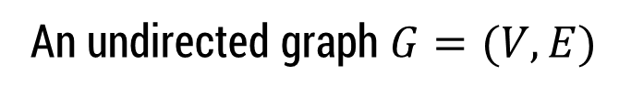
a discretization
An undirected graph $G=(V,E)$
For the rest of the day: All graphs are
$d$-regular for some number $d$.

Slide 7




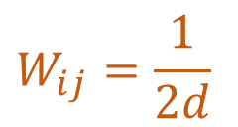
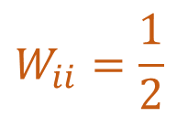
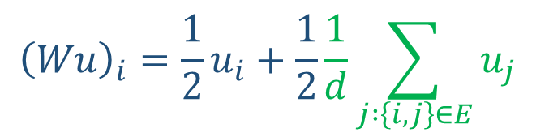
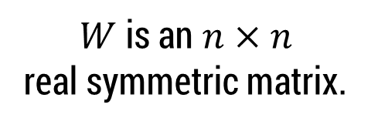

a discretization
An undirected graph $G=(V,E)$
Random walk matrix:
$W$ is an $n×n$
real symmetric matrix.
$$W_{ii}=\frac{1}{2}$$
$$W_{ij}=\frac{1}{2d}$$
$\{i,j$} an edge
$$W_{ij}=0$$
$\{i,j$} not an edge
$$V=\left\{1, 2, …, n\right\}$$
$${\left(Wu\right)}_{i}=\frac{1}{2}u_{i}+\frac{1}{2}\frac{1}{d}\sum_{j :\left\{i,j\right\}∈E}{u_{j}}$$
$$u=\left(u_{1},u_{2},…, u_{n}\right)∈ℝ^{n}$$

Slide 8
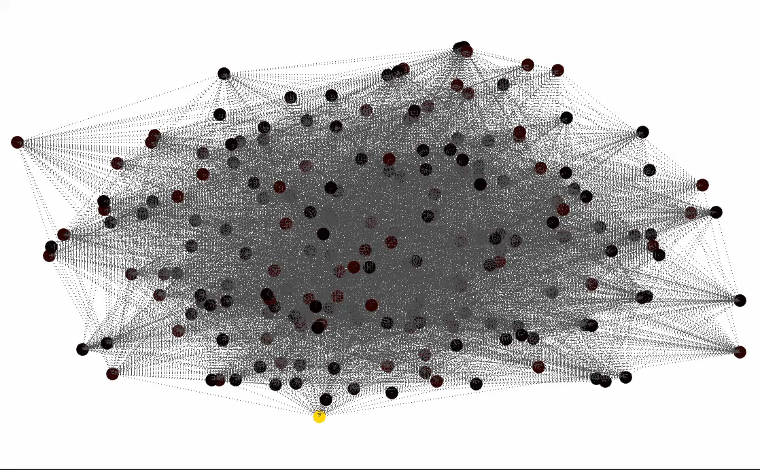
heat dispersion on a graph

Slide 9


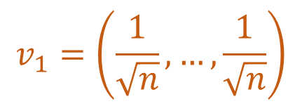
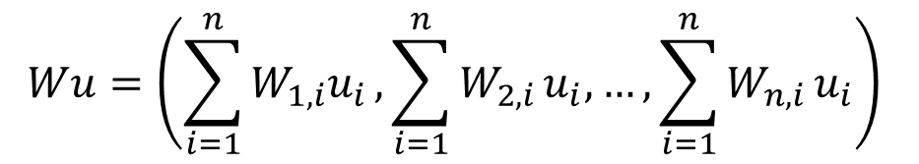








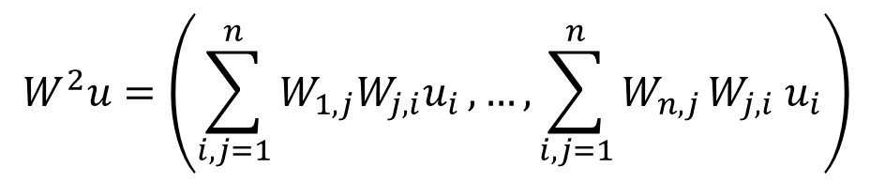

spectral geometry
$$u=\left(u_{1},u_{2},…, u_{n}\right)$$
eigenvalues/
eigenvectors of $W$
$$Wu=\left(\sum_{i=1}^{n}{W_{1,i}u_{i}},\sum_{i=1}^{n}{W_{2,i}}u_{i},…, \sum_{i=1}^{n}{W_{n,i}}u_{i}\right)$$
$$μ_{1}$$
$$v_{1}$$
$$μ_{2}$$
$$v_{2}$$
$$W^{2}u=\left(\sum_{i,j=1}^{n}{W_{1,j}W_{j,i}u_{i}},…, \sum_{i,j=1}^{n}{W_{n,j}}W_{j,i} u_{i}\right)$$
$$⋯$$
$$μ_{n}$$
$$v_{n}$$
$$u=α_{1}v_{1}+α_{2}v_{2}+⋯+α_{n}v_{n}$$
$$μ_{1}=1$$
$$Wu={μ_{1}α}_{1}v_{1}+{μ_{2}α}_{2}v_{2}+⋯+{μ_{n}α}_{n}v_{n}$$
$$W^{2}u={μ_{1}^{2}α}_{1}v_{1}+{μ_{2}^{2}α}_{2}v_{2}+⋯+{μ_{n}^{2}α}_{n}v_{n}$$
$$v_{1}=\left(\frac{1}{\sqrt{n}},…,\frac{1}{\sqrt{n}}\right)$$
$$W^{k}u={μ_{1}^{k}α}_{1}v_{1}+{μ_{2}^{k}α}_{2}v_{2}+⋯+{μ_{n}^{k}α}_{n}v_{n}$$

Slide 10
spectral geometry
$$u=\left(u_{1},u_{2},…, u_{n}\right)$$
eigenvalues/
eigenvectors of $W$
$$Wu=\left(\sum_{i=1}^{n}{W_{1,i}u_{i}},\sum_{i=1}^{n}{W_{2,i}}u_{i},…, \sum_{i=1}^{n}{W_{n,i}}u_{i}\right)$$
$$μ_{1}$$
$$v_{1}$$
$$μ_{2}$$
$$v_{2}$$
$$W^{2}u=\left(\sum_{i,j=1}^{n}{W_{1,j}W_{j,i}u_{i}},…, \sum_{i,j=1}^{n}{W_{n,j}}W_{j,i} u_{i}\right)$$
$$⋯$$
$$μ_{n}$$
$$v_{n}$$
$$u=α_{1}v_{1}+α_{2}v_{2}+⋯+α_{n}v_{n}$$
$$μ_{1}=1$$
$$Wu={μ_{1}α}_{1}v_{1}+{μ_{2}α}_{2}v_{2}+⋯+{μ_{n}α}_{n}v_{n}$$
$$W^{2}u={μ_{1}^{2}α}_{1}v_{1}+{μ_{2}^{2}α}_{2}v_{2}+⋯+{μ_{n}^{2}α}_{n}v_{n}$$
$$v_{1}=\left(\frac{1}{\sqrt{n}},…,\frac{1}{\sqrt{n}}\right)$$
$$W^{k}u={ α}_{1}v_{1}+{μ_{2}^{k}α}_{2}v_{2}+⋯+{μ_{n}^{k}α}_{n}v_{n}$$

Slide 11


spectral geometry
$$u=\left(u_{1},u_{2},…, u_{n}\right)$$
eigenvalues/
eigenvectors of $W$
$$Wu=\left(\sum_{i=1}^{n}{W_{1,i}u_{i}},\sum_{i=1}^{n}{W_{2,i}}u_{i},…, \sum_{i=1}^{n}{W_{n,i}}u_{i}\right)$$
$$μ_{1}$$
$$v_{1}$$
$$μ_{2}$$
$$v_{2}$$
$$W^{2}u=\left(\sum_{i,j=1}^{n}{W_{1,j}W_{j,i}u_{i}},…, \sum_{i,j=1}^{n}{W_{n,j}}W_{j,i} u_{i}\right)$$
$$⋯$$
$$μ_{n}$$
$$v_{n}$$
$$u=α_{1}v_{1}+α_{2}v_{2}+⋯+α_{n}v_{n}$$
$$μ_{1}=1$$
$$Wu={μ_{1}α}_{1}v_{1}+{μ_{2}α}_{2}v_{2}+⋯+{μ_{n}α}_{n}v_{n}$$
$$W^{2}u={μ_{1}^{2}α}_{1}v_{1}+{μ_{2}^{2}α}_{2}v_{2}+⋯+{μ_{n}^{2}α}_{n}v_{n}$$
$$v_{1}=\left(\frac{1}{\sqrt{n}},…,\frac{1}{\sqrt{n}}\right)$$
$$W^{k}u={ α}_{1}v_{1}+{μ_{2}^{k}α}_{2}v_{2}+⋯+{μ_{n}^{k}α}_{n}v_{n}$$

Slide 12
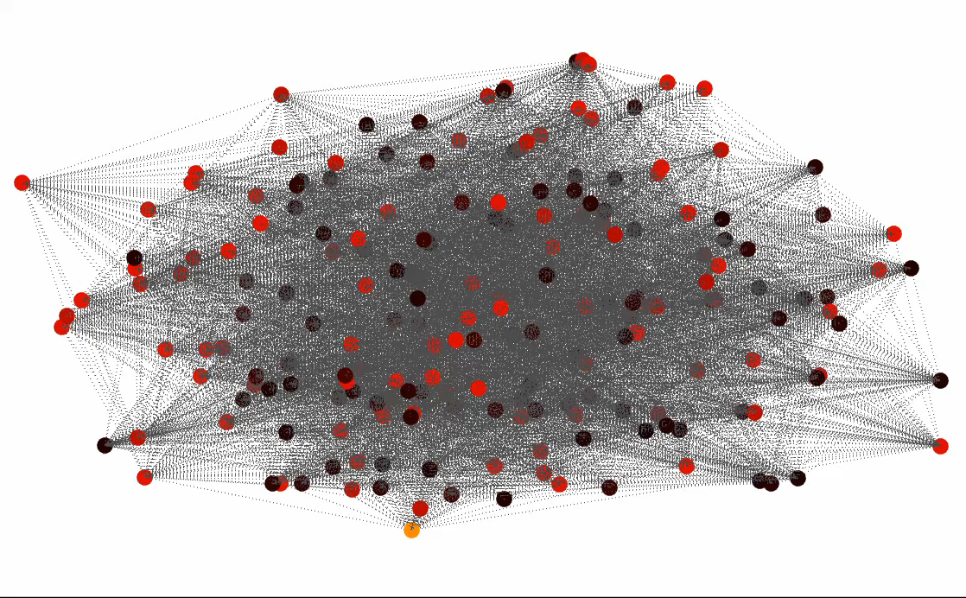

spectral embedding
$$v_{2}$$

Slide 13
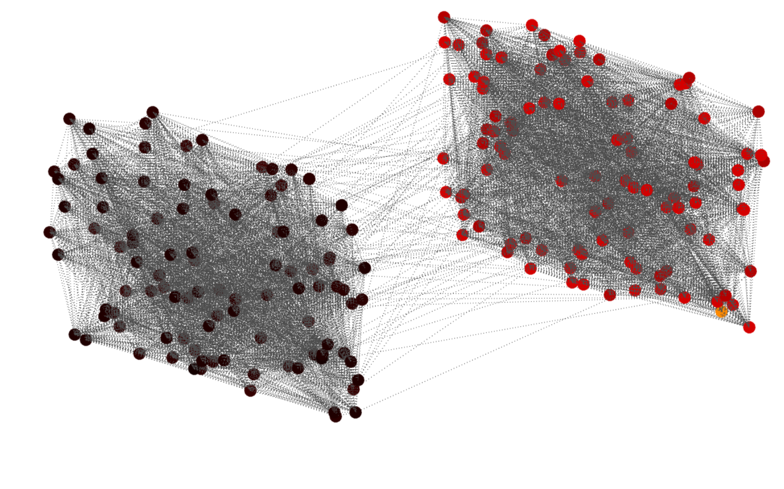

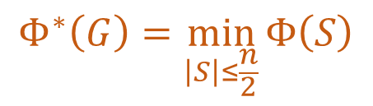
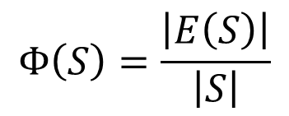

bottlenecks
$$G=(V,E)$$
$$Φ^{∗}\left(G\right)=\min_{\left|S\right|≤\frac{n}{2}}{Φ\left(S\right)}$$
$$S$$
$$Φ\left(S\right)=\frac{\left|E\left(S\right)\right|}{\left|S\right|}$$

Slide 14
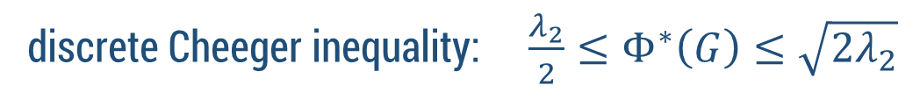
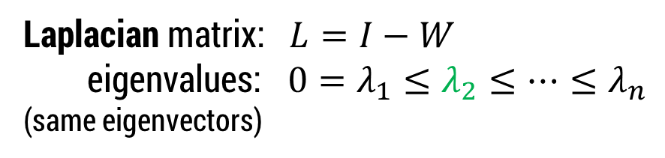
the Cheeger inequality
$$G=(V,E)$$
$$Φ^{∗}\left(G\right)=\min_{\left|S\right|≤\frac{n}{2}}{Φ\left(S\right)}$$
Laplacian matrix: $L=I−W$
eigenvalues: $0=λ_{1}≤λ_{2}≤⋯≤λ_{n}$
(same eigenvectors)
discrete Cheeger inequality: $\frac{λ_{2}}{2}≤Φ^{∗}\left(G\right)≤\sqrt{2λ_{2}}$
“the major obstructions to equilibrium are bottlenecks”

Slide 15
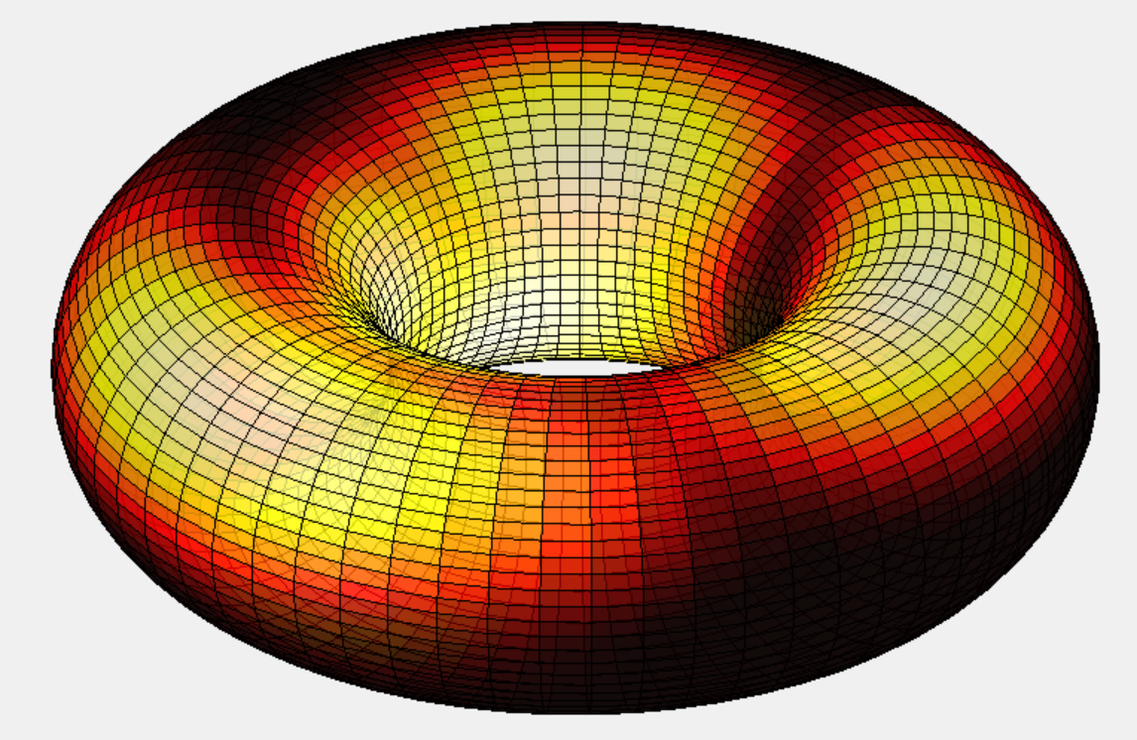
the unreasonable effectiveness
random walk:

Slide 16
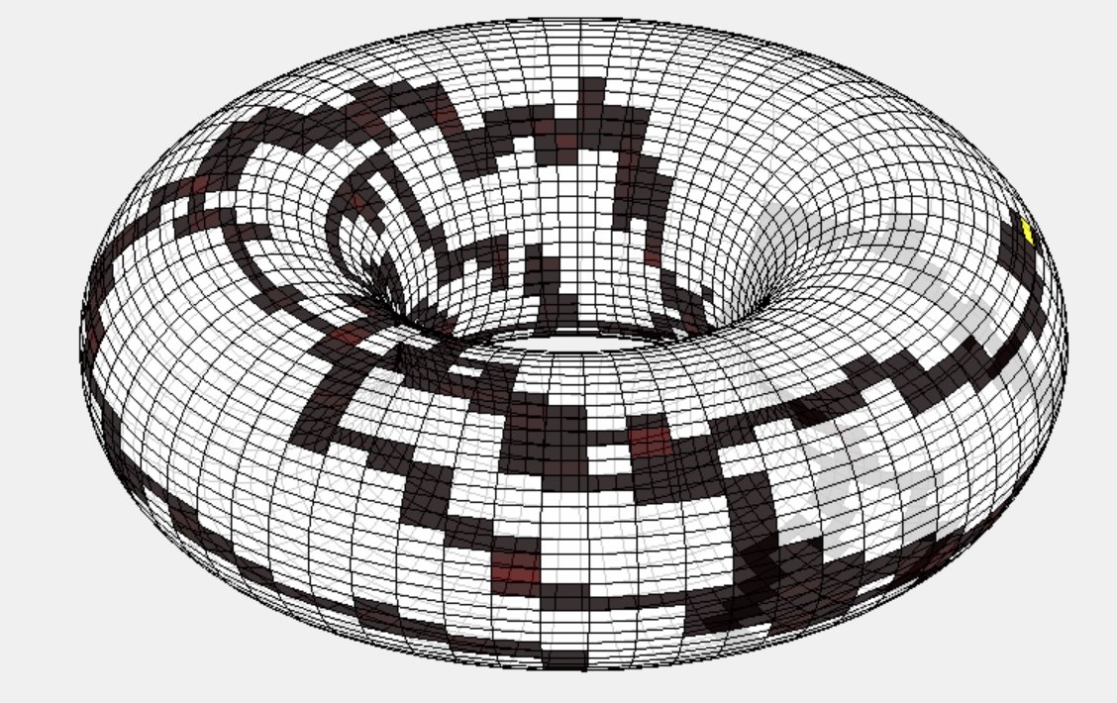

the unreasonable effectiveness
random walk:

Slide 17
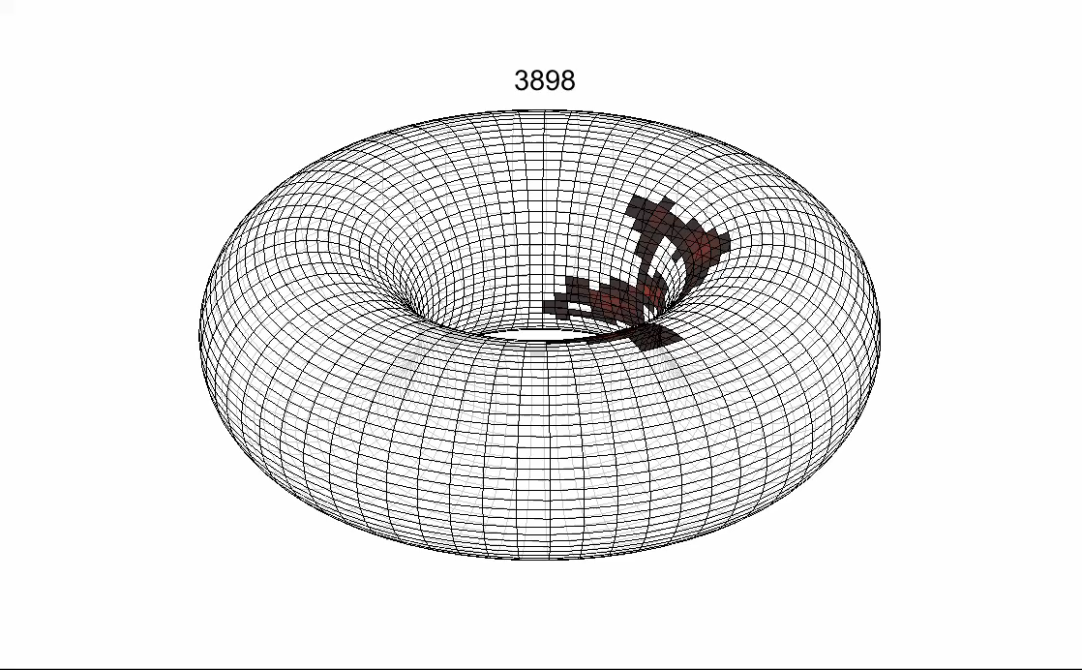
cover time of a graph
  [Aleliunas-Karp-Lipton-Lovász-Rackoff 1979]:
  (Expected) first time at which the random walk has visited every node at least once.

Slide 18
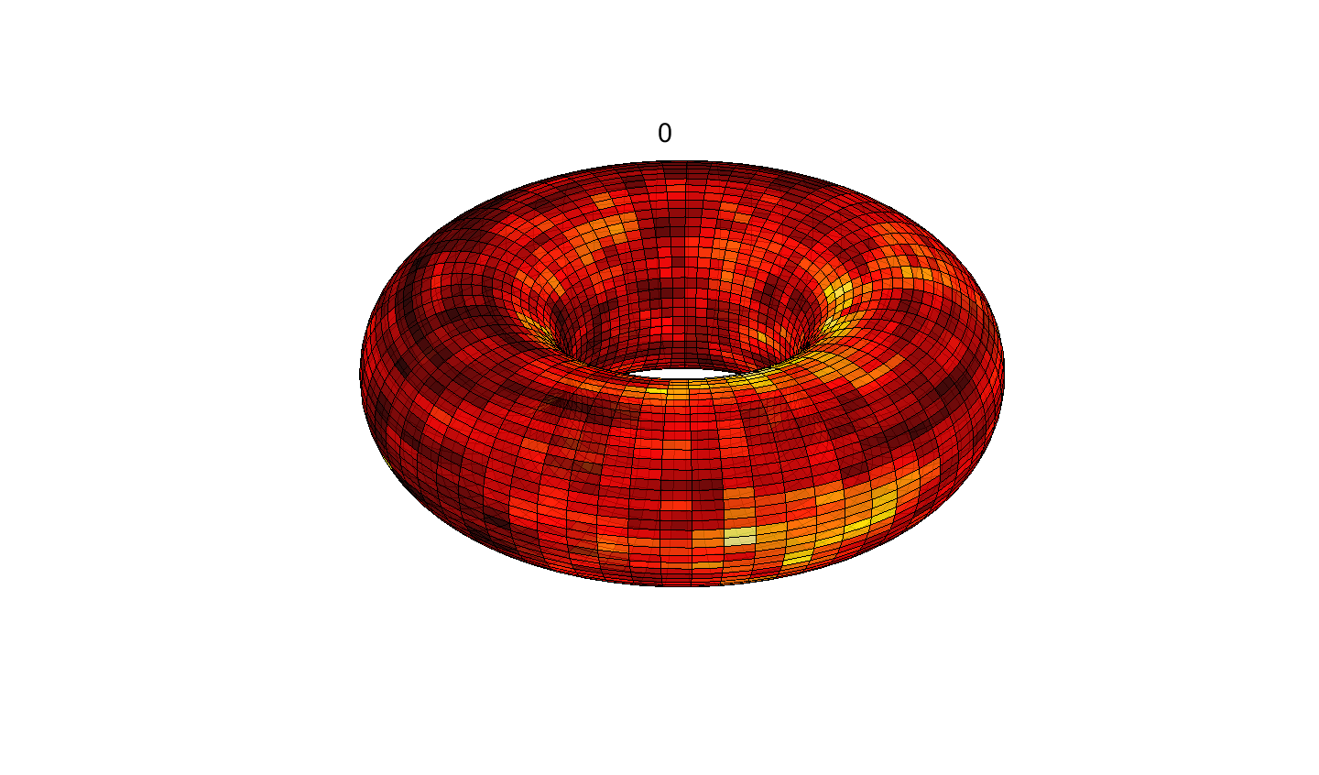
cover time of a graph
  [Aleliunas-Karp-Lipton-Lovász-Rackoff 1979]:
  (Expected) first time at which the random walk has visited every node at least once.

Slide 19
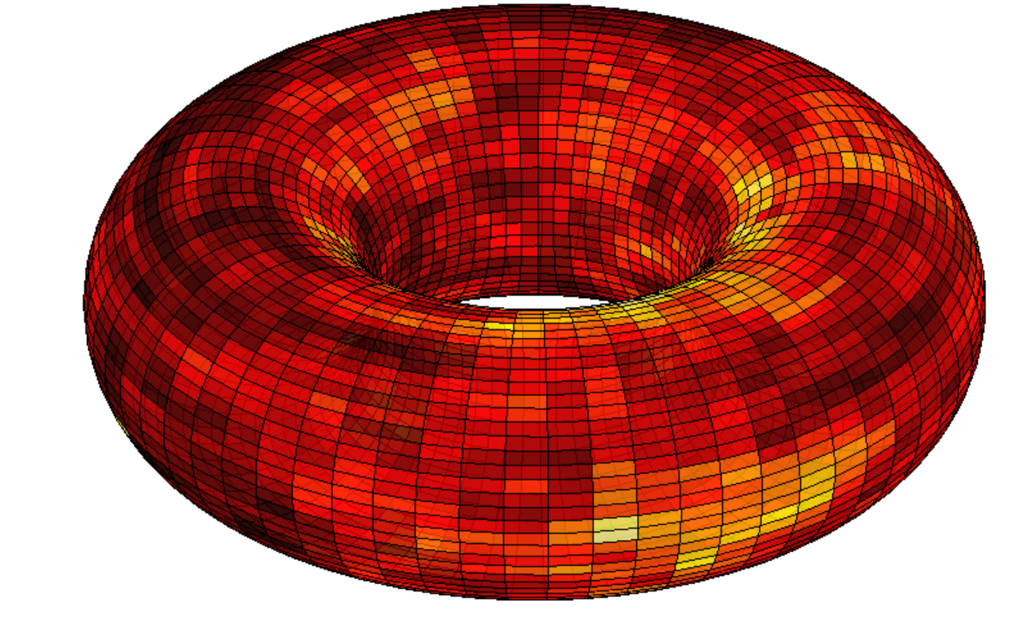
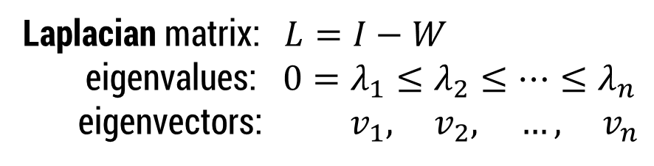

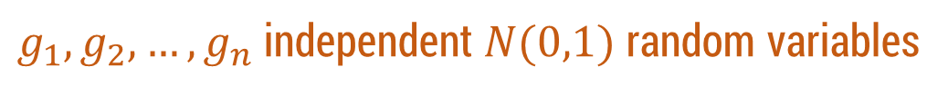
cover time of a graph
Laplacian matrix: $L=I−W$
eigenvalues: $0=λ_{1}≤λ_{2}≤⋯≤λ_{n}$
eigenvectors: $v_{1}, { v}_{2}, …, { v}_{n}$
$g_{1},g_{2},…, g_{n}$ independent $N(0,1)$ random variables
  $$\sum_{i=2}^{n}{\frac{g_{i}}{\sqrt{λ_{i}}}}v_{i}$$

Slide 20

cover time of a graph
Laplacian matrix: $L=I−W$
eigenvalues: $0=λ_{1}≤λ_{2}≤⋯≤λ_{n}$
eigenvectors: $v_{1}, { v}_{2}, …, { v}_{n}$
$g_{1},g_{2},…, g_{n}$ independent $N(0,1)$ random variables
  $${\left\|\sum_{i=2}^{n}{\frac{g_{i}}{\sqrt{λ_{i}}}}v_{i}\right\|}_{∞}^{ }$$

Slide 21

cover time of a graph
Laplacian matrix: $L=I−W$
eigenvalues: $0=λ_{1}≤λ_{2}≤⋯≤λ_{n}$
eigenvectors: $v_{1}, { v}_{2}, …, { v}_{n}$
$g_{1},g_{2},…, g_{n}$ independent $N(0,1)$ random variables
  $${\left\|\sum_{i=2}^{n}{\frac{g_{i}}{\sqrt{λ_{i}}}}v_{i}\right\|}_{∞}^{2}$$

Slide 22

cover time of a graph
Laplacian matrix: $L=I−W$
eigenvalues: $0=λ_{1}≤λ_{2}≤⋯≤λ_{n}$
eigenvectors: $v_{1}, { v}_{2}, …, { v}_{n}$
$g_{1},g_{2},…, g_{n}$ independent $N(0,1)$ random variables
  $$n⋅{\left\|\sum_{i=2}^{n}{\frac{g_{i}}{\sqrt{λ_{i}}}}v_{i}\right\|}_{∞}^{2}$$

Slide 23
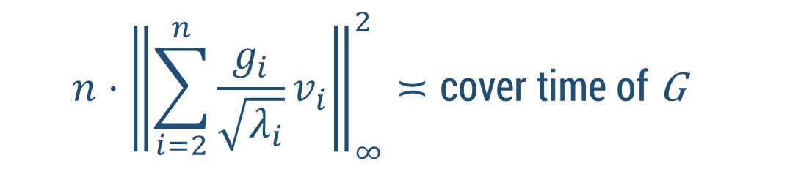
cover time of a graph
Laplacian matrix: $L=I−W$
eigenvalues: $0=λ_{1}≤λ_{2}≤⋯≤λ_{n}$
eigenvectors: $v_{1}, { v}_{2}, …, { v}_{n}$
$g_{1},g_{2},…, g_{n}$ independent $N(0,1)$ random variables
  $$n⋅{\left\|\sum_{i=2}^{n}{\frac{g_{i}}{\sqrt{λ_{i}}}v_{i}}\right\|}_{∞}^{2}≍\text{cover} \text{time} \text{of} \text{G}$$
[Ding-L-Peres 2011]
[Zhai 2014]

Slide 24
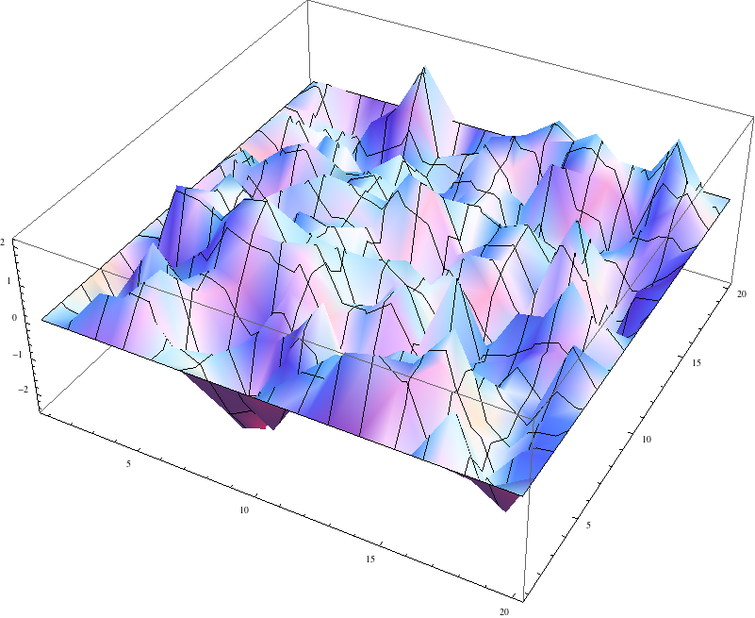


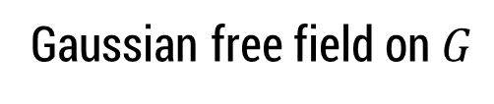

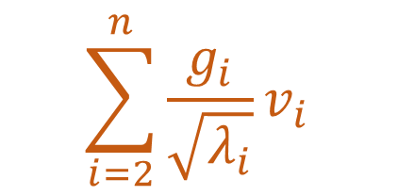

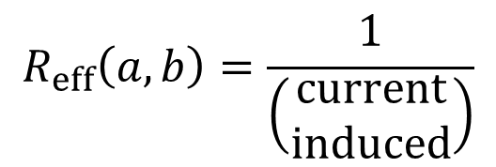
holistic spectral data
  $$\sum_{i=2}^{n}{\frac{g_{i}}{\sqrt{λ_{i}}}}v_{i}$$
Gaussian free field on $G$
$$R_{eff}\left(a,b\right)=\frac{1}{\left(\begin{aligned}current \\ induced\end{aligned}\right)}$$
$$a$$
$$b$$

Slide 25

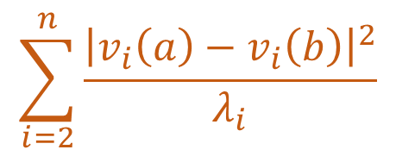
holistic spectral data
  $$\sum_{i=2}^{n}{\frac{g_{i}}{\sqrt{λ_{i}}}}v_{i}$$
Gaussian free field on $G$
$$R_{eff}\left(a,b\right)=$$
$$a$$
$$b$$
$$\sum_{i=2}^{n}{\frac{{\left|v_{i}\left(a\right)−v_{i}\left(b\right)\right|}^{2}}{λ_{i}}}$$

Slide 26

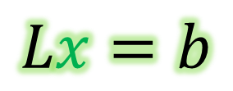
holistic spectral data
Can we compute these spectral objects fast?
$$Lx=b$$
Yes. [Spielman-Teng’04, Koutis-Miller-Peng’10,
Kelner-Orecchia-Sidford-Zhu’13]
Can we do unreasonable things with the solver?
Yes. Break long-standing barriers for
computing max flows, min cuts.
[Christiano-Kelner-Madry-Spielman-Teng’11,
Lee-Srivastava-Rao’13, Sherman’13*,
Kelner-Lee-Orecchia-Sidford’13, Peng’14,
Daitch-Spielman’08, Madry’13]

Slide 27


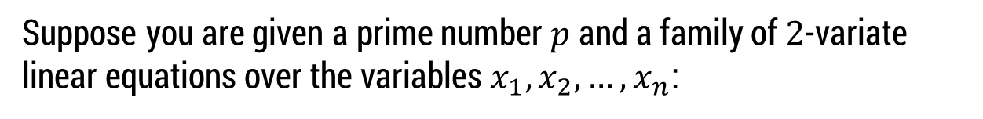



the borders of intractability
Suppose you are given a prime number $p$ and a family of $2$-variate linear equations over the variables $x_{1},x_{2},…, x_{n}$:
$$x_{13}−x_{7}=4 (mod p)$$
$$x_{4}−x_{2}=9 (mod p)$$
$$x_{7}−x_{12}=1 (mod p)$$
$$x_{11}−x_{4}=0 (mod p)$$
$$⋯$$
If 99% of the equations are satisfiable, can you find a sol’n that satisfies 1%?
Unique Games Conjecture [Khot 2002]:
This problem is computationally intractable.

Slide 28
the borders of intractability
Suppose you are given a prime number $p$ and a family of $2$-variate linear equations over the variables $x_{1},x_{2},…, x_{n}$:
$$x_{13}−x_{7}=4 (mod p)$$
$$x_{4}−x_{2}=9 (mod p)$$
$$x_{7}−x_{12}=1 (mod p)$$
$$x_{11}−x_{4}=0 (mod p)$$
$$⋯$$
If 99% of the equations are satisfiable, can you find a sol’n that satisfies 1%?
Unique Games Conjecture [Khot 2002]:
This problem is computationally intractable.

Slide 29
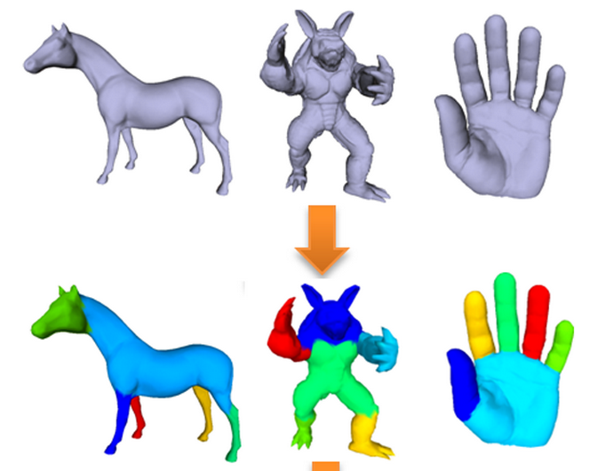



multi-way spectral clustering
$$v_{2}$$
[photo credit: Ma-Wu-Luo-Feng 2011]
$$Φ^{∗}\left(G\right)$$
$$Φ_{k}^{∗}\left(G\right)$$

Slide 30
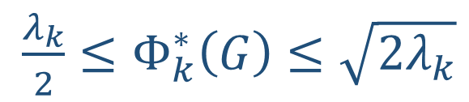
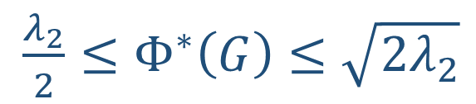
multi-way spectral clustering
$$v_{2}$$
[photo credit: Ma-Wu-Luo-Feng 2011]
$\frac{λ_{2}}{2}≤Φ^{∗}\left(G\right)≤\sqrt{2λ_{2}}$
$\frac{λ_{k}}{2}≤Φ_{k}^{∗}\left(G\right)≤\sqrt{2λ_{k}}$
?
$$Φ^{∗}\left(G\right)$$
$$Φ_{k}^{∗}\left(G\right)$$

Slide 31
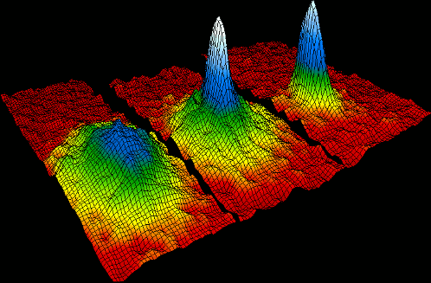
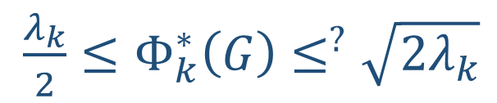
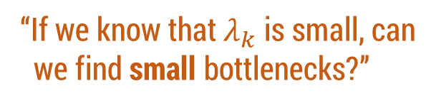
multi-way spectral clustering
$\frac{λ_{k}}{2}≤Φ_{k}^{∗}\left(G\right)≤^{?}\sqrt{2λ_{k}}$
“Hypercontractive semigroups and
the two-dimensional Bose field”
[B. Simon and R. Høegh-Krohn 1972]
(connection made by L. Miclo)
“If we know that $λ_{k}$ is small, can
we find small bottlenecks?”
Finding small bottlenecks =
small set expansion problem

Slide 32
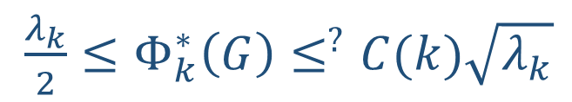
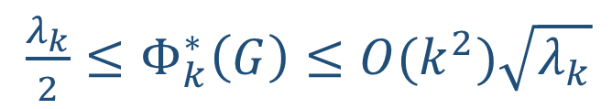
multi-way spectral clustering
$\frac{λ_{k}}{2}≤Φ_{k}^{∗}\left(G\right)≤^{?}C(k)\sqrt{λ_{k}}$
“Hypercontractive semigroups and
the two-dimensional Bose field”
[B. Simon and R. Høegh-Krohn 1972]
(connection made by L. Miclo)
“If we know that $λ_{k}$ is small, can
we find small bottlenecks?”
Theorem [L-Oveis Gharan-Trevisan’12]:
$\frac{λ_{k}}{2}≤Φ_{k}^{∗}\left(G\right)≤O(k^{2})\sqrt{λ_{k}}$
Finding small bottlenecks =
small set expansion problem
See also:
[Louis-Raghavendra-Tetali-Vempala’12]

Slide 33
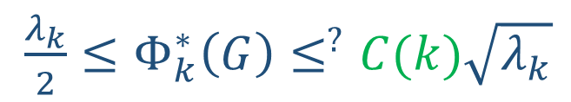
multi-way spectral clustering
$\frac{λ_{k}}{2}≤Φ_{k}^{∗}\left(G\right)≤^{?}C(k)\sqrt{λ_{k}}$
“Hypercontractive semigroups and
the two-dimensional Bose field”
[B. Simon and R. Høegh-Krohn 1972]
(connection made by L. Miclo)
“If we know that $λ_{k}$ is small, can
we find small bottlenecks?”
Theorem [L-Oveis Gharan-Trevisan’12]:
$\frac{λ_{k}}{2}≤Φ_{k}^{∗}\left(G\right)≤O(k^{2})\sqrt{λ_{k}}$
Finding small bottlenecks =
small set expansion problem
See also:
[Louis-Raghavendra-Tetali-Vempala’12]

Slide 34

the borders of intractability
Suppose you are given a prime number $p$ and a family of $2$-variate linear equations over the variables $x_{1},x_{2},…, x_{n}$:
$$x_{13}−x_{7}=4 (mod p)$$
$$Φ_{k}^{∗}\left(G\right)≤^{?}C(k)\sqrt{λ_{k}}$$
$$x_{4}−x_{2}=9 (mod p)$$
$$x_{7}−x_{12}=1 (mod p)$$
$$x_{11}−x_{4}=0 (mod p)$$
$$⋯$$
If 99% of the equations are satisfiable, can you find a sol’n that satisfies 1%?
Unique Games Conjecture [Khot 2002]:
This problem is computationally intractable.

Slide 35


Arora-Barak-Steurer 2009
If $G$ has $n$ vertices and we are given $n^{0.1}$ small eigenvalues
$λ_{1},λ_{2},…, λ_{n^{0.1}}$ then we can find a set $S$ with $\left|S\right|≤n^{0.99}$ and
$$Φ\left(S\right)≤100 \sqrt{λ_{n^{0.1}}}$$
The “short code”
[Barak, Gopalan, Hastad, Meka,
Raghavendra, Steurer 2011]
An improvement to their bound would
“disprove” the unique games conjecture.

Slide 36

what’s next?
In hour three of the talk…
Spectral sparsification
[Spielman-Teng 2008]
Ramanujan graphs of every degree
[Marcus-Spielman-Srivastava 2013]
spectrahedron / SDP
The Kadison-Singer conjecture
[Marcus-Spielman-Srivastava 2013]
“sums of squares” (SoS)
[Shor’87, Lasserre’00, Parillo’00]
The traveling salesman problem (ATSP)
[Anari-Oveis Gharan 2014]
- SoS optimal assuming UGC
[Raghavendra 08]
- SoS optimal spectrahedra (unconditional)
[L-Raghavendra-Steurer 14]
Thanks for listening.

