Slide 1
Interpretability and Other Highlights from Natural Language Processing
Yonatan Belinkov
Decoding Communication in Nonhuman Species
Simons Institute, August 4, 2020
Notes:
Thanks to Shafi, Michael, and David.
Apologies for missing most of yesterday.

Slide 2
Outline
Large scale language models as the predominant approach to NLP
Interpreting and analyzing them
Other NLP topics that might be relevant
Grammar induction
Unsupervised machine translation
Emergent communication in AI agents

Slide 3
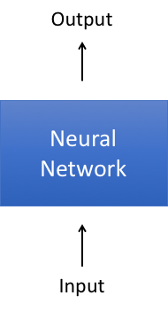
End-to-End Learning
The predominant approach in NLP these days is end-to-end learning
Learn a model f : x → y, which maps input x to output y

Slide 4
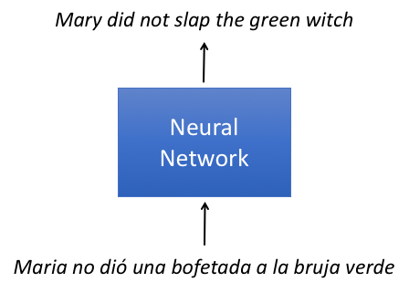
End-to-End Learning
For example, in machine translation we map a source sentence to a target sentence, via a deep neural network:

Slide 5
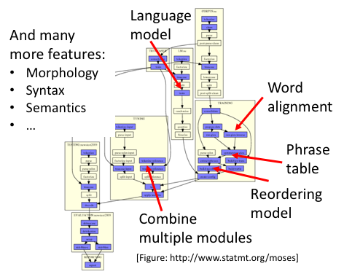
A Historical Perspective
Compare this with a traditional statistical approach to MT, based on multiple modules and features:

Slide 6
End-to-End Learning
The predominant approach in NLP these days is end-to-end learning, where all parts of the model are trained on the same task:

Slide 7
Pre-training Language Models
Common use case: pre-train a very large model on one task
Given raw text, predict a part of it
Then, fine-tune it on another task
Question answering, sentiment analysis, etc.
Many state-of-the-art results
ELMo (Peters et al., 2018)
BERT (Devlin et al., 2019)
Many more…
green
Mary did not slap the ______ witch

Slide 8
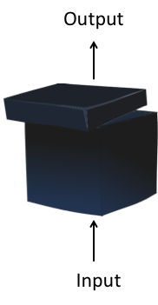
How can we open the black box?
Given f : x → y, we want to ask some questions about f
What is its internal structure?
How does it behave on different data?
Why does it make certain decisions?
When does it succeed/fail?
...

Slide 9
How can we open the black box?
Given f : x → y, we want to ask some questions about f
What is its internal structure?
How does it behave on different data?
Why does it make certain decisions?
When does it succeed/fail?
...

Slide 10
Structural Analyses
Let f : x → y be a model mapping an input x to an output y
f might be a complicated neural network with many layers/components
For example, f^{l}(x) might be the output of the network at the l-th layer
Some questions we might want to ask:
What is the role of different components of f (layers, neurons, etc.)?
What kind of information do different components capture?
More specifically: Does components A know something about property B?
Properties may come from different linguistic areas: morphology, syntax, semantics

Slide 11
Structural Analyses
Let f : x → y be a model mapping an input x to an output y
f might be a complicated neural network with many layers/components
For example, f^{l}(x) might be the output of the network at the l-th layer

Slide 12
Structural Analyses
Let f : x → y be a model mapping an input x to an output y
f might be a complicated neural network with many layers/components
For example, f^{l}(x) might be the output of the network at the l-th layer
Analysis via a probing classifier
Assume a corpus of inputs x with linguistic annotations z
Generate representations of x from some part of the model f, for example representations f^{l}(x) at a certain layer
Train a classifier g : f^{l}(x) → z that maps representations f^{l}(x) to property z
Evaluate the accuracy of g as a proxy to the quality of representations f^{l}(x) w.r.t property z

Slide 13
Structural Analyses
Let f : x → y be a model mapping an input x to an output y
f might be a complicated neural network with many layers/components
For example, f^{l}(x) might be the output of the network at the l-th layer
Analysis via a probing classifier
Assume a corpus of inputs x with linguistic annotations z
Generate representations of x from some part of the model f, for example representations f^{l}(x) at a certain layer
Train a classifier g : f^{l}(x) → z that maps representations f^{l}(x) to property z
Evaluate the accuracy of g as a proxy to the quality of representations f^{l}(x) w.r.t property z
In information theoretic terms:
Set h = f(x) and recall that I(h; z) = H(z) - H(z | h)
Then the probing classifier minimizes H(z | h), or maximizes I(h, z)

Slide 14
Milestones (partial list)
 | f | x | y | g | z
Köhn 2015 | Word embedding | Word | Word | Linear | POS, morphology
Ettinger et al. 2016 | Sentence embedding | Word, sentence | Word, sentence | Linear | Semantic roles, scope
Shi et al. 2016 | RNN MT | Word, sentence | Word, sentence | Linear / tree decoder | Syntactic features, tree
Adi et al. 2017 Conneau et al. 2018 | Sentence embedding | sentence | sentence | Linear, MLP | surface, syntax, semantics
Hupkes et al. 2018 | RNN, treeRNN | five plus free | eight | Linear | Position, cumulative value
Hewitt+Manning 2019 | ELMo, BERT | Sentence | Sentence | Linear | Full tree

Slide 15
Example Results
Numerous papers using this methodology to study:
Linguistic phenomena (z): phonology, morphology, syntax, semantics
Network components (f): word embeddings, sentence embeddings, hidden states, attention weights, etc.
We’ll show example results on machine translation
Much more related work reviewed in our survey (Belinkov and Glass 2019)

Slide 16
Example: Machine Translation
Setup
f : an RNN encoder-decoder MT model
x and y are source and target sentences (lists of words)
g: a non-linear classifier (MLP with one hidden layer)
z: linguistic properties of words in x or y

Slide 17
Example: Machine Translation
Setup
f : an RNN encoder-decoder MT model
x and y are source and target sentences (lists of words)
g: a non-linear classifier (MLP with one hidden layer)
z: linguistic properties of words in x or y
Morphology:
A challenge for machine translation, previously solved with feature-rich approaches.
Do neural networks acquire morphological knowledge?

Slide 18
Example: Machine Translation
Setup
f : an RNN encoder-decoder MT model
x and y are source and target sentences (lists of words)
g: a non-linear classifier (MLP with one hidden layer)
z: linguistic properties of words in x or y
Morphology:
A challenge for machine translation, previously solved with feature-rich approaches.
Do neural networks acquire morphological knowledge?
Experiment
Take f^{l}(x), an RNN hidden state at layer l
Predict z, a morphological tag (verb-past-singular-feminine, noun-plural, etc.)
Compare accuracy at different layers l

Slide 19
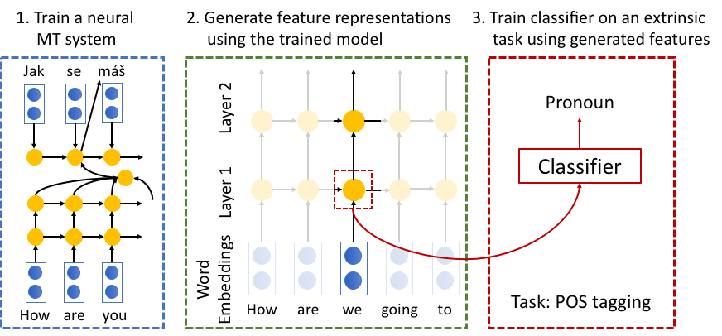
Example: Machine Translation

Slide 20
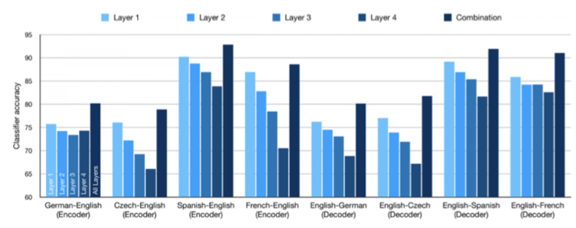
Machine Translation: Morphology
Lower is better
But deeper models translate better → what’s going on in top layers?

Slide 21
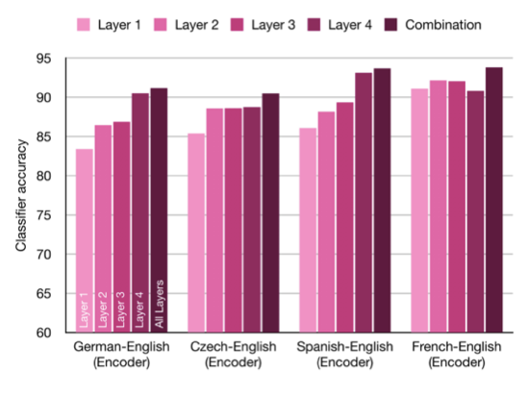
Machine Translation: Syntactic Relations
Higher is better

Slide 22
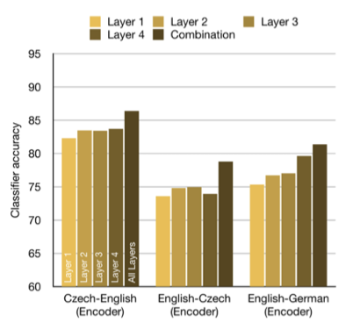
Machine Translation: Semantic Relations
Higher is better

Slide 23
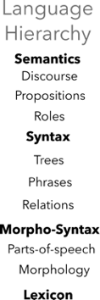
Hierarchies

Slide 24
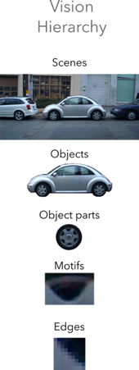
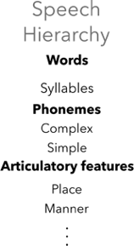
Hierarchies

Slide 25
Probing Classifiers: Limitations
Recall the setup:
Original model f : x → y
Probing classifier g : f(x) → z
g maximizes the mutual information between the representation f(x) and property z

Slide 26
Probing Classifiers: Limitations
Recall the setup:
Original model f : x → y
Probing classifier g : f(x) → z
g maximizes the mutual information between the representation f(x) and property z
Suppose we get an accuracy, what should we compare it to?
Many studies focus on relative performance (say, comparing different layers)
But it may be desirable to compare to external numbers
Baselines: Compare to using static word embeddings (Belinkov et al. 2017) or random features (Zhang and Bowman 2018)
This tells us that a representation is non-trivial
Skylines: Report state of the art on the task
This can tell us how much is missing from the representation

Slide 27
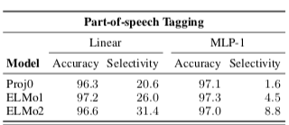
Probing Classifiers: Limitations
Recall the setup:
Original model f : x → y
Probing classifier g : f(x) → z
g maximizes the mutual information between the representation f(x) and property z
Suppose we get an accuracy, what should we compare it to?
Hewitt and Liang (2019) define control tasks: tasks that only g can learn, not f
Specifically, assign a random label to each word type
A “good” probe should be selective: high linguistic task accuracy, low control task accuracy
This leads to different insights
Example
Linear vs. MLP
Accuracy vs. selectivity

Slide 28
Probing Classifiers: Limitations
Recall the setup:
Original model f : x → y
Probing classifier g : f(x) → z
g maximizes the mutual information between the representation f(x) and property z

Slide 29
Probing Classifiers: Limitations
Recall the setup:
Original model f : x → y
Probing classifier g : f(x) → z
g maximizes the mutual information between the representation f(x) and property z
What is g? What’s the relation between the probe g and the model f?
Common wisdom: use a linear classifier to focus on the representation and not the probe
Anecdotal evidence: non-linear classifiers achieve better probing accuracy, but do not change the qualitative patterns (Conneau et al. 2018, Belinkov 2018)

Slide 30
Probing Classifiers: Limitations
Recall the setup:
Original model f : x → y
Probing classifier g : f(x) → z
g maximizes the mutual information between the representation f(x) and property z
What is g? What’s the relation between the probe g and the model f?
Pimentel et al. (2020) argue that we should always choose the most complex probe g, since it will maximize the mutual information I(h; z), where f(x)=h

Slide 31
Probing Classifiers: Limitations
Recall the setup:
Original model f : x → y
Probing classifier g : f(x) → z
g maximizes the mutual information between the representation f(x) and property z
What is g? What’s the relation between the probe g and the model f?
Pimentel et al. (2020) argue that we should always choose the most complex probe g, since it will maximize the mutual information I(h; z), where f(x)=h
They also show that I(x; z) = I(h; z) (under mild assumptions)
Thus the representation f(x):=h contains the same amount of information about z as x
Does this make the probing endeavor obsolete?

Slide 32
Probing Classifiers: Limitations
Recall the setup:
Original model f : x → y
Probing classifier g : f(x) → z
g maximizes the mutual information between the representation f(x) and property z
What is g? What’s the relation between the probe g and the model f?
Pimentel et al. (2020) argue that we should always choose the most complex probe g, since it will maximize the mutual information I(h; z), where f(x)=h
They also show that I(x; z) = I(h; z) (under mild assumptions)
Thus the representation f(x):=h contains the same amount of information about z as x
Does this make the probing endeavor obsolete?
Not necessarily:
We would still like to know how good a representation is in practice
We can still ask relative questions about ease of extraction of information

Slide 33
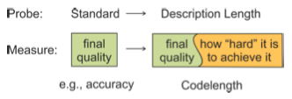
Probing Classifiers: Limitations
Recall the setup:
Original model f : x → y
Probing classifier g : f(x) → z
g maximizes the mutual information between the representation f(x) and property z
What is g? What’s the relation between the probe g and the model f?
Voita and Titov (2020) measure both probe complexity and probe quality
Instead of measuring accuracy, estimate the minimum description length: how many bits are required to transmit z knowing f(x), plus the cost of transmitting g

Slide 34
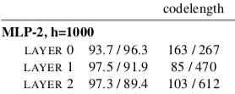
Probing Classifiers: Limitations
Recall the setup:
Original model f : x → y
Probing classifier g : f(x) → z
g maximizes the mutual information between the representation f(x) and property z
What is g? What’s the relation between the probe g and the model f?
Voita and Titov (2020) measure both probe complexity and probe quality
Instead of measuring accuracy, estimate the minimum description length: how many bits are required to transmit z knowing f(x), plus the cost of transmitting g
Example
Layer 0 control: control accuracy is high (96.3) but at the expense of code length (267)

Slide 35
Probing Classifiers: Limitations
Recall the setup:
Original model f : x → y
Probing classifier g : f(x) → z
g maximizes the mutual information between the representation f(x) and property z

Slide 36
Probing Classifiers: Limitations
Recall the setup:
Original model f : x → y
Probing classifier g : f(x) → z
g maximizes the mutual information between the representation f(x) and property z
Correlation vs. causation
The above setup only measures correlation between f(x) and property z
It is not directly linked to the behavior of the model f on the task it was trained on, that is, predicting y
Some work found negative/lack of correlation between probe and task quality (Vanmassenhove et al. 2017, Cífka and Bojar 2018)
An alternative direction: intervene in the model representations to discover causal effects on prediction (Giulianelli et al. 2018, Bau et al. 2019, Vig et al., 2020, Elazar et al., 2020)

Slide 37
Other NLP Highlights
A brief look at some potentially relevant problems in NLP
Disclaimers
Not necessarily representative
I’m not an expert on any of these

Slide 38
Grammar Induction
Given a collection of strings, infer a grammar generating the language
Usually, given a corpus of sentences, infer a grammar generating them (say, a context-free grammar)
'A recipe for disaster': Charlie Baker blames clusters for coronavirus uptick in Massachusetts
Methuen’s police chief is one of the highest paid in the country — and he says he deserves more
Another Patriot has opted out of the 2020 NFL season
Marcus Smart fined $15,000
S → NP VP
NP → Det NP
VP → V NP
VP → V PP
NP → clusters
NP → police
V → blames
V → opted
Det → the
…

Slide 39
Grammar Induction
Given a collection of strings, infer a grammar generating the language
Usually, given a corpus of sentences, infer a grammar generating them (say, a context-free grammar)
In reality, we don’t even know the non-terminal types
'A recipe for disaster': Charlie Baker blames clusters for coronavirus uptick in Massachusetts
Methuen’s police chief is one of the highest paid in the country — and he says he deserves more
Another Patriot has opted out of the 2020 NFL season
Marcus Smart fined $15,000
A → B C
B → D B
C → E B
C → E F
B → clusters
B → police
E → blames
E → opted
D → the
…

Slide 40
Grammar Induction
A very difficult problem
For instance, hard to beat a trivial right-branching baseline
Some key studies
Induce constituency structures (Clark 2001, Klein & Manning 2002, …)
Induce dependency structures (Klein & Manning 2004, Cohen & Smith 2009, Spitkovsky et al. 2010, Cohn et al. 2010, …)
Timeline in Yonatan Bisk’s thesis (table 2.1)
Recent advances with neural networks and latent models (Kim et al., 2019, Shen et al. 2019, Drozdon et al., 2019)

Slide 41
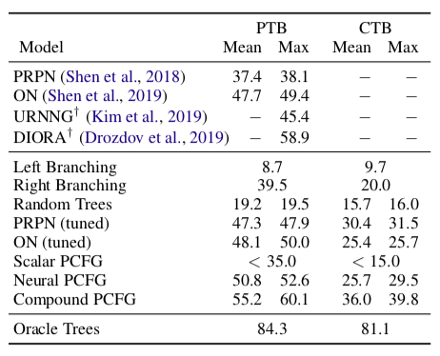
Grammar Induction
A very difficult problem
For instance, hard to beat a trivial right-branching baseline
Impressive recent advances
But results are still far from human performance (results from Kim et al., 2019)

Slide 42
Unsupervised Machine Translation
Usual machine translation setup
Given a parallel corpus of source sentences and target translations
Learn a translation model from source language to target language
A supervised learning setup
What if we don’t have any parallel data?
Given two datasets, one in each language
Learn a translation model between them
An unsupervised learning setup

Slide 43
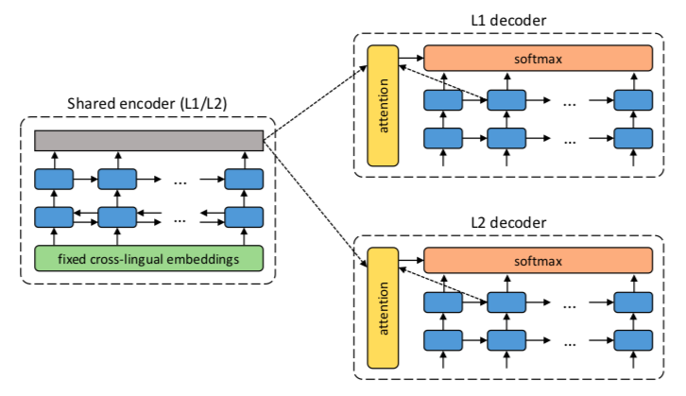
Unsupervised Machine Translation
How does this work?
Neural approach: denoising auto-encoders, adversarial regularization, back translation (Artetxe et al. 2018a, Lample et al. 2018a)
Anchor: bilingual word embeddings

Slide 44
Unsupervised Machine Translation
How does this work?
Non-neural approach: induced phrase-table, usual n-gram language model, back translation (Artetxe et al. 2018b, Lample et al. 2018b)
Anchor: bilingual word embeddings

Slide 45
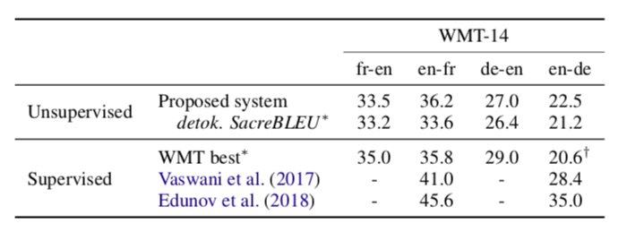
Unsupervised Machine Translation
Amazingly, once can still obtain a reasonable performance
Results from Artetxe et al. (2019)

Slide 46
Emergent Communication in AI Agents
How to build artificial agents that communicate about mutual or competing goals?
What are the properties of the emergent communication protocol?
How can interactive AI improve human machine communication?
Credit: this part heavily draws on Lazaridou & Baroni (2020)

Slide 47
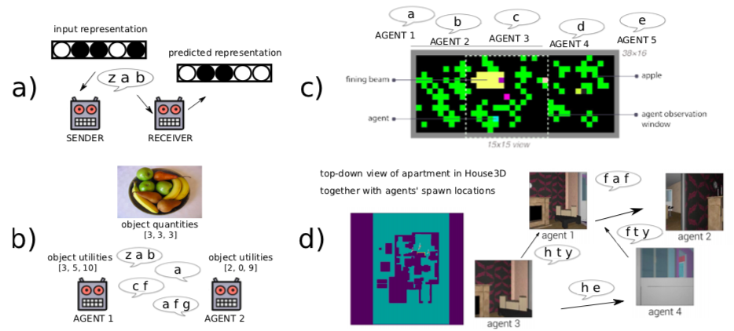
Emergent Communication in AI Agents
(Jaques et al. 2018)
(Batali 1998)
(Cao et al. 2018)
(Das et al. 2018)
[Source: Lazaridou & Baroni 2020]
Notes:
“(a) Emergent communication work in the pre-deep-learning era typically usedsymbolic data as input: Batali (1998) presents a study where recurrent neuralnetwork agents communicate in a referential game using sequences of discretesymbols. Similar work with deep networks often uses realistic pictures as input,see Fig. 3 for an example. (b) More complex scenarios with deep agents: Cao et al.(2018) study self-interested agents engaging in a multi-turn negotiation game.(c) Richer, dynamic environments: Jaques et al. (2019) study five embodied self-interested agents engaging in multi-turn interactions while navigating in a 2Dvisual environment. (d) Scaling up to fully realistic scenarios: in the experimentof Das et al. (2019), embodied cooperative agents solve navigation challengesin a 3D environment. Images from Jaques et al. (2019) and Das et al. (2019)reproduced by permission.
“

Slide 48
Emergent Communication in AI Agents
(Jaques et al. 2018)
(Batali 1998)
(Cao et al. 2018)
(Das et al. 2018)
[Source: Lazaridou & Baroni 2020]
Notes:
“(a) Emergent communication work in the pre-deep-learning era typically usedsymbolic data as input: Batali (1998) presents a study where recurrent neuralnetwork agents communicate in a referential game using sequences of discretesymbols. Similar work with deep networks often uses realistic pictures as input,see Fig. 3 for an example”

Slide 49
Emergent Communication in AI Agents
(Jaques et al. 2018)
(Batali 1998)
(Cao et al. 2018)
(Das et al. 2018)
[Source: Lazaridou & Baroni 2020]
Notes:
“(b) More complex scenarios with deep agents: Cao et al.(2018) study self-interested agents engaging in a multi-turn negotiation game."

Slide 50
Emergent Communication in AI Agents
(Jaques et al. 2018)
(Batali 1998)
(Cao et al. 2018)
(Das et al. 2018)
[Source: Lazaridou & Baroni 2020]
Notes:
“(c) Richer, dynamic environments: Jaques et al. (2019) study five embodied self-interested agents engaging in multi-turn interactions while navigating in a 2Dvisual environment.”

Slide 51
Emergent Communication in AI Agents
(Jaques et al. 2018)
(Batali 1998)
(Cao et al. 2018)
(Das et al. 2018)
[Source: Lazaridou & Baroni 2020]
Notes:
“. (d) Scaling up to fully realistic scenarios: in the experimentof Das et al. (2019), embodied cooperative agents solve navigation challengesin a 3D environment. “

Slide 52
Emergent Communication in AI Agents
(Jaques et al. 2018)
(Batali 1998)
(Cao et al. 2018)
(Das et al. 2018)
[Source: Lazaridou & Baroni 2020]

Slide 53
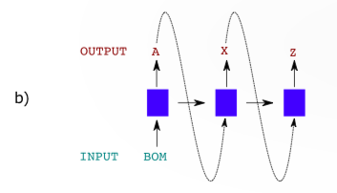
Emergent Communication in AI Agents
Components in deep AI agents
Visual processing
Symbol generation
Symbol understanding

Slide 54
Emergent Communication in AI Agents
Challenges in understanding the emergent language
How to segment messages into units (words, sentences, etc.)?
What are the referents of different units?
Are the messages consistent?
“The enterprise is akin to linguistic fieldwork, except that we are dealing with an alien race, with no guarantees that universals of human communication will apply.” (Lazaridou & Baroni 2020)
In terms of analysis, much work on compositionality
Can agent express novel concepts composed of familiar parts?

