Slide 1
What It Takes to Control Societal Bias in Natural Language Processing
Kai-Wei Chang
UCLA
References: http://kwchang.net

Slide 2
NLP techniques have been used in many applications
Translation
Conversation chatbot
Sentiment analysis for
market survey
Information extraction
& text mining

Slide 3
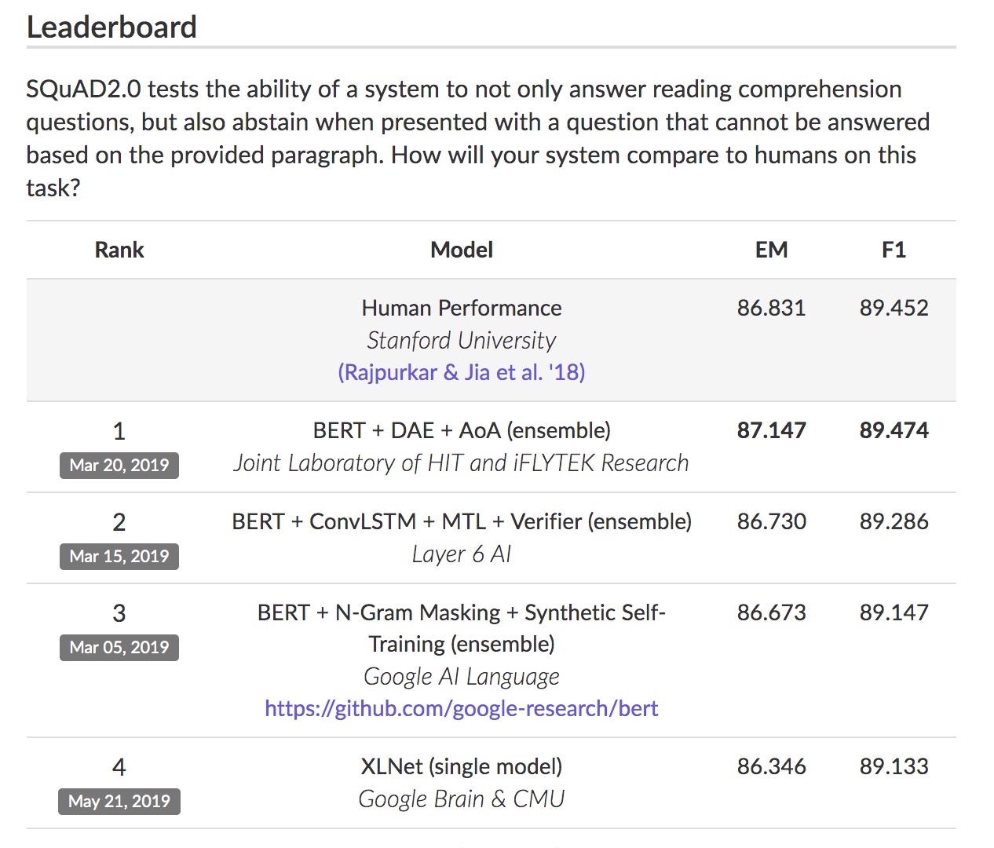

Slide 4


Always working?!
http://viralscape.com/travel-expectations-vs-reality/
Performance on Benchmarks
Performance in reality

Slide 5
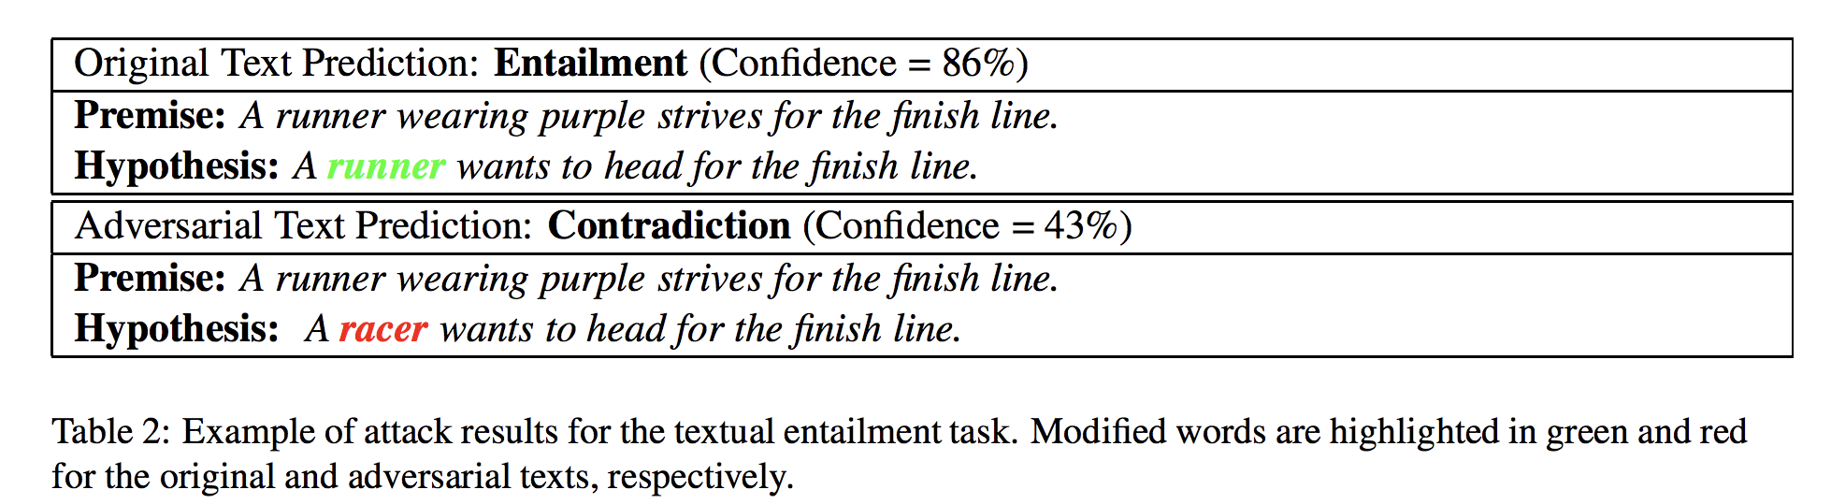
NLP Models are Brittle
Generating Natural Language Adversarial Examples [ASEHSC 18 (EMNLP)]

Slide 6
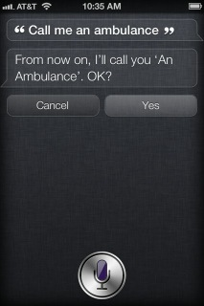
NLP Models is lack of commonsense

Slide 7
NLP Models Exhibit Societal Bias
Data with Societal Bias
Model with Societal Bias
https://xkcd.com/1838/

Slide 8
A carton of ML (NLP) pipeline
Prediction
(Structured) Inference
Auxiliary Corpus/Models
(e.g, word embedding)
Representation
Data

Slide 9

Outline
Gender Bias in NLP
  Representational harm
  Performance gap in downstream applications
Ideas for Mitigating Bias in Text Applications
  Surgery representation space
  Data augmentation with “gender-swapping”
  Calibration with corpus-level constraints
[ACL 2019]

Slide 10
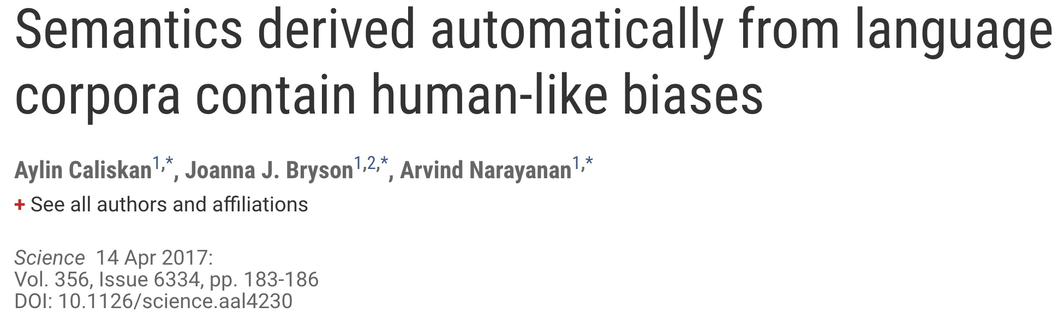

Representational Harm in NLP:
Word Embeddings can be Sexist
Tolga Bolukbasi, Kai-Wei Chang, James Zou, Venkatesh Saligrama, Adam Kalai [NeurIPS16]
$v_{man}−v_{woman}+v_{uncle }{∼v}_{aunt }$
he: ________ | she:_______
brother | sister
beer | cocktail
physician | registered_nurse
professor | associate professor
We use Google w2v embedding trained from the news
Concurrent work: replicated IAT
findings using word embeddings

Slide 11
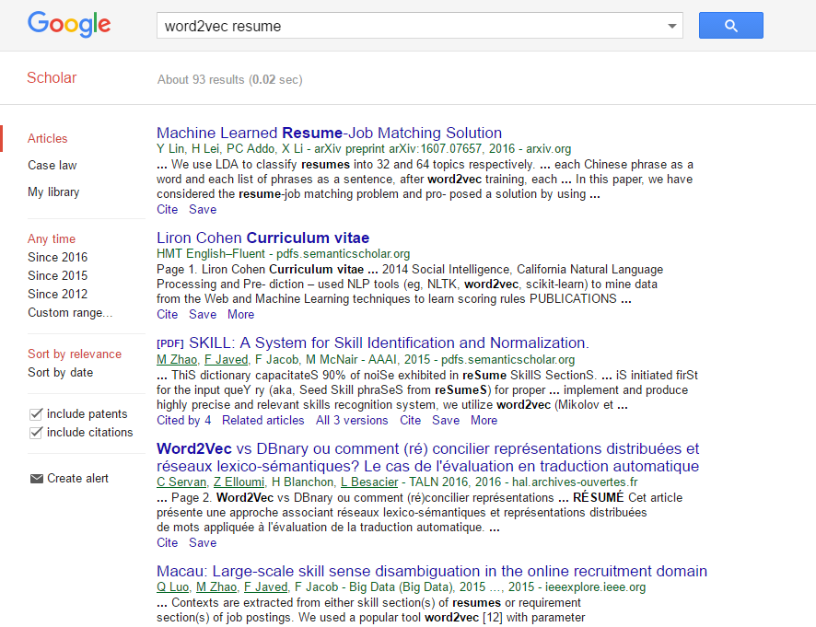
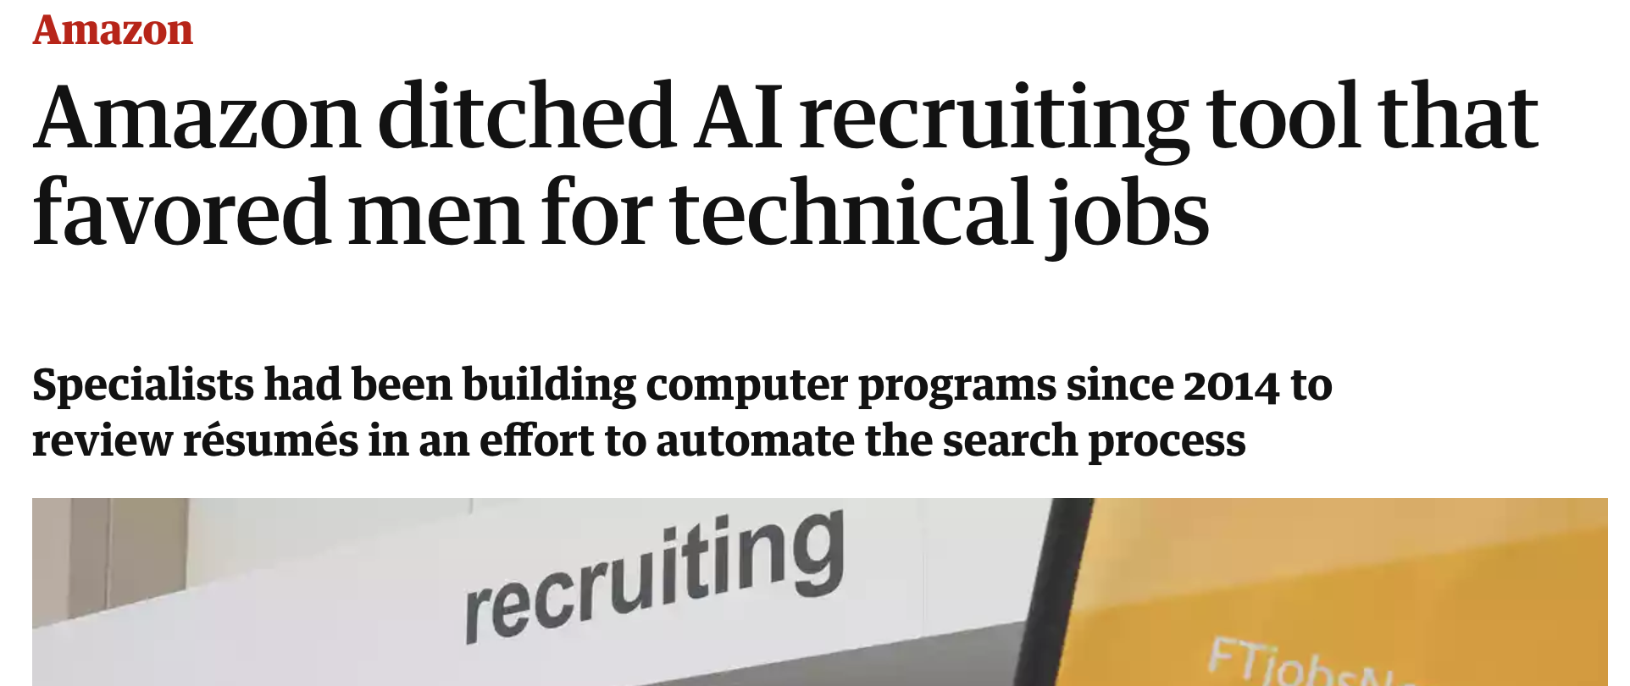
May cause allocative harms in downstream applications

Slide 12
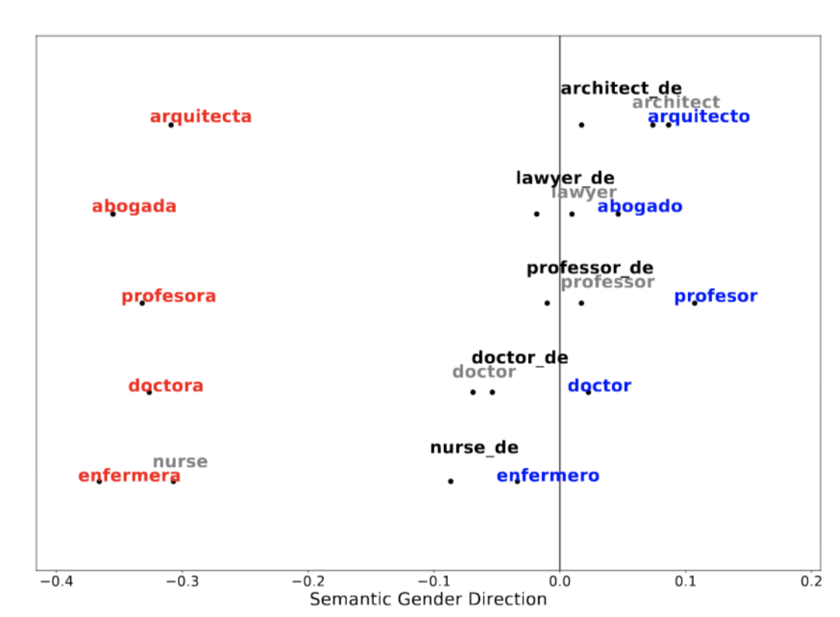



Representational Harm in NLP:
Bias in Multi-lingual Embedding
[ZSZHCCC 19; under submission]
Female doctor in Spanish
male doctor in Spanish

Slide 13

Representational Harm in NLP:
Contextualized Representation
Gender Bias in Contextualized Word Embeddings
[ZWYCOC; NAACL19]
Assign words with different embeddings based on the surrounding contexts
(trained by language model objective)
He learn to play the violin . Do you enjoy the play ?
Embedding
visualization
from context¹
from context²
word2vec
ELMo

Slide 14
Unequal Treatment of Gender
The writer taught himself to play violin .
Classifier
ELMo(occupation)
context gender
ELMo propagates gender information to other words
Male information is 14% more accurately propagated than female
ELMo embeddings are biased

Slide 15
Outline
Gender Bias in NLP
  Representational harm
  Performance gap in downstream applications
Ideas for Mitigating Bias in Text Applications
  Surgery representation space
  Data augmentation with “gender-swapping”
  Calibration with corpus-level constraints
[ACL 2019]

Slide 16
Gender Bias in Coref
Gender Bias in Coreference Resolution:Evaluation and Debiasing Methods
[ZWYOC NAACL 2018]
Stereotypical dataset
Anti-stereotypical dataset

Slide 17
Performance Gap

Slide 18

Bias in Visual-and-Language Models
Men Also Like Shopping: Reducing Gender Bias Amplification using Corpus-level Constraints
[EMNLP 17*] Jieyu Zhao, Tianlu Wang, Mark Yatskar, Vicente Ordonez, Kai-Wei Chang
What’s the agent for this image?
Cooking
Role | Object
agent | woman
food | vegetable
container | bowl
tool | knife
place | kitchen
?
An example from a vSRL (visual Semantic Role Labeling) system
*Best Long Paper Award at EMNLP 17

Slide 19
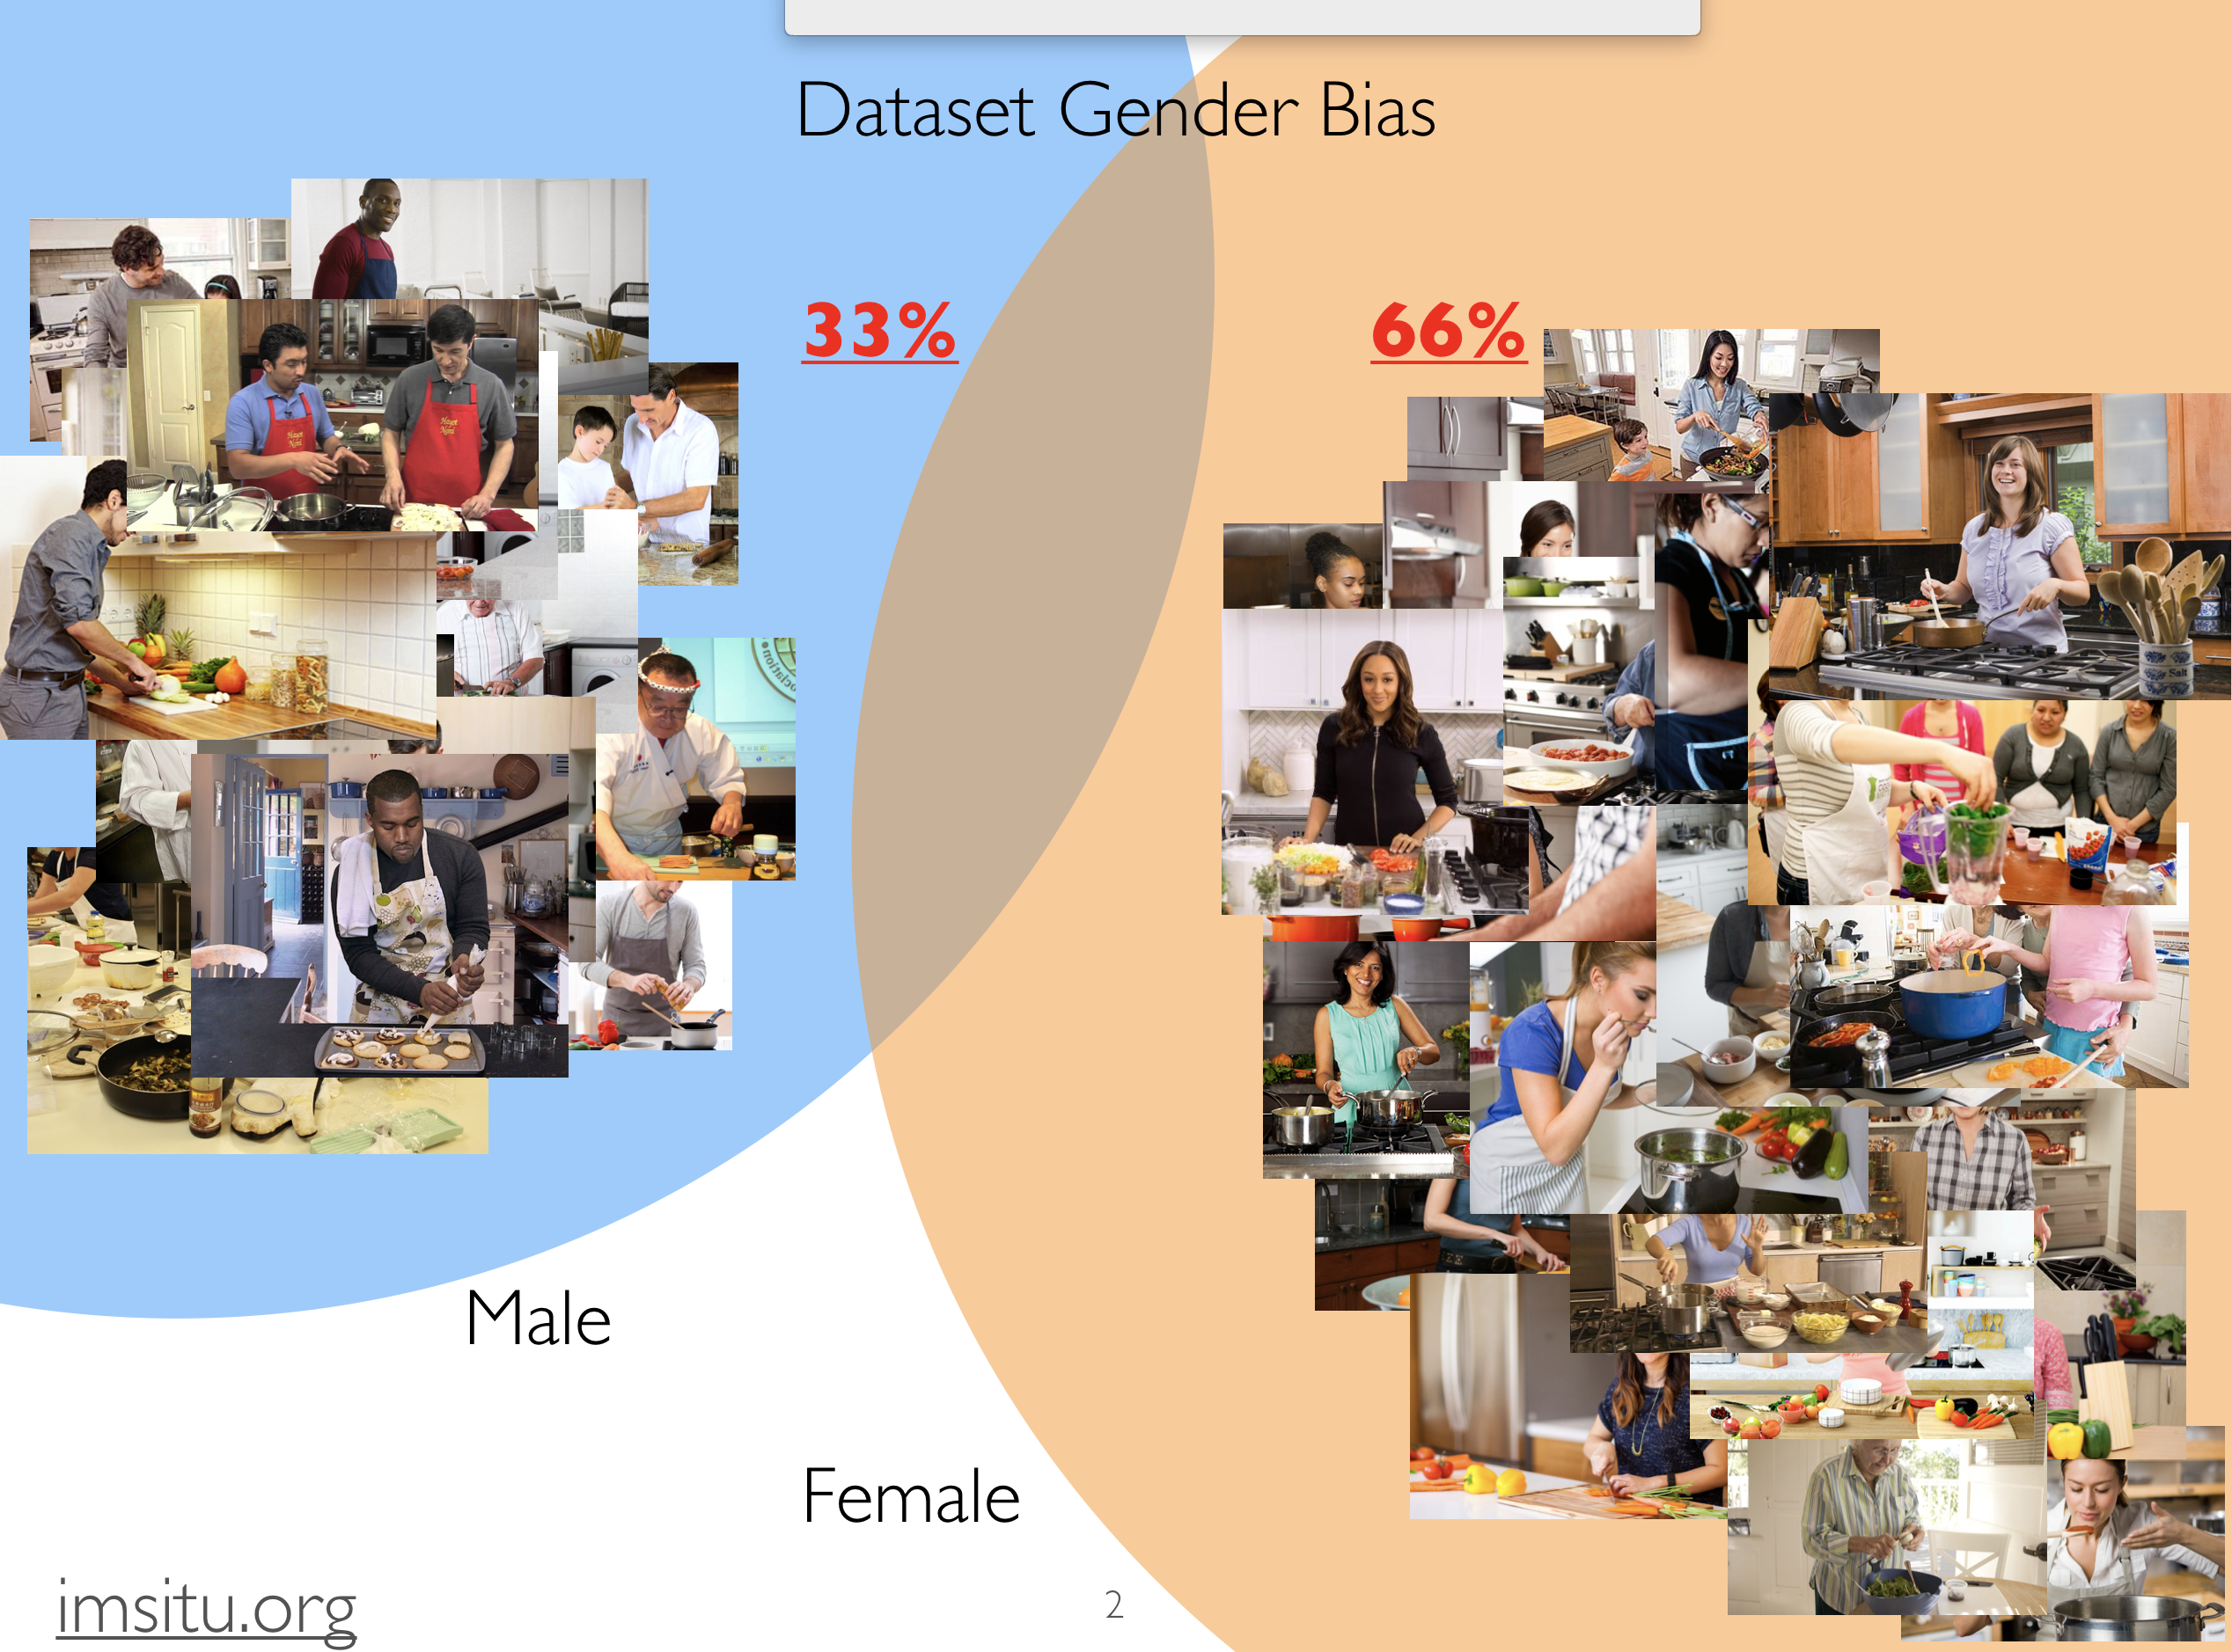

Slide 20
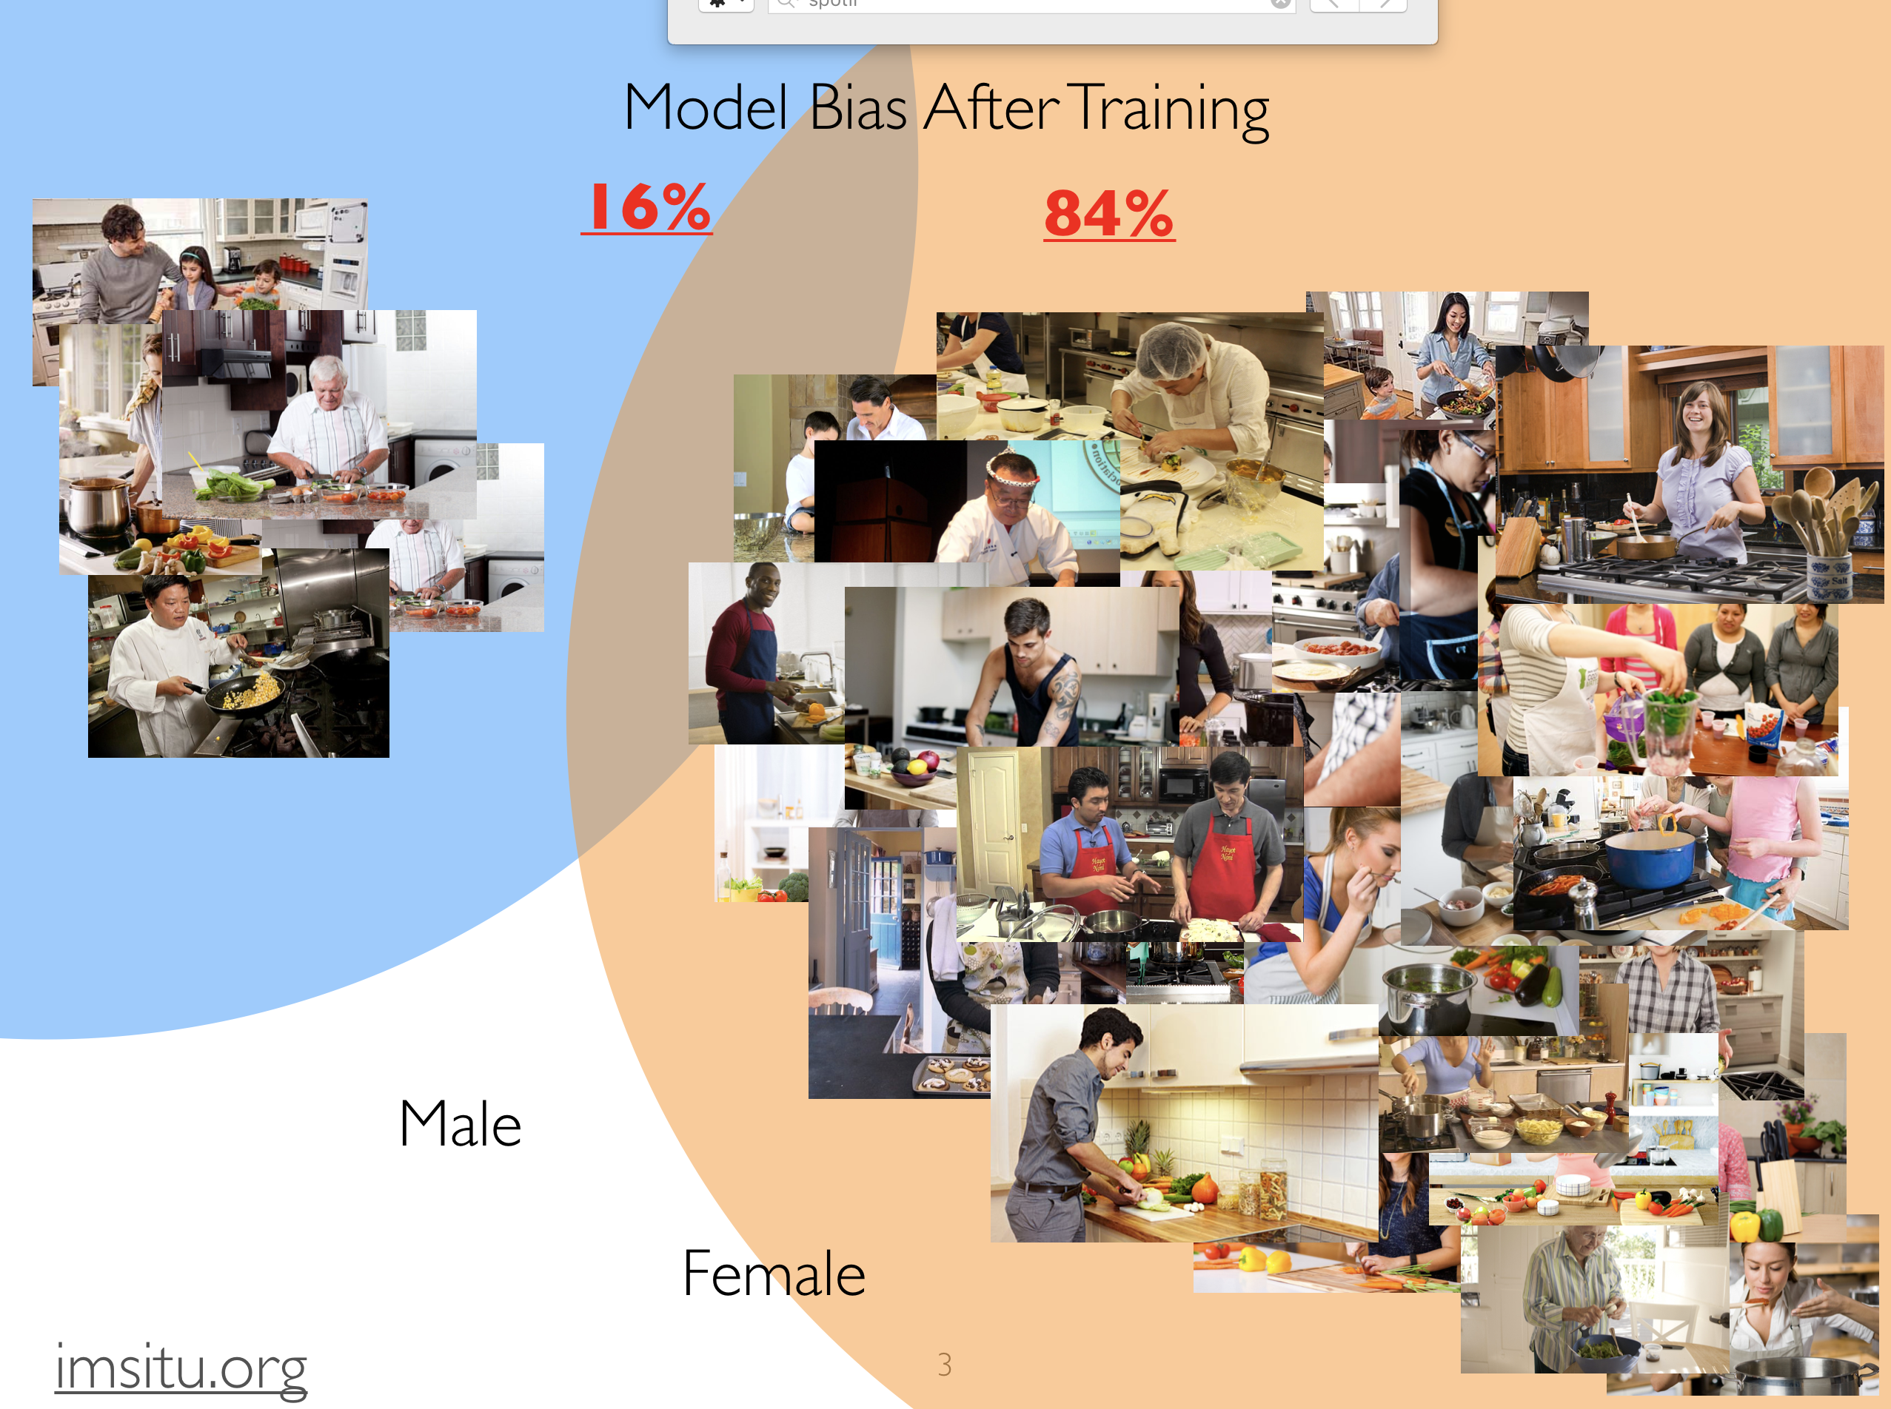

Slide 21
imSitu Visual Semantic Role Labeling (vSRL)
Convolutional
Neural Network
(events)
COOKING
ROLES | NOUNS
AGENT | woman
FOOD | vegetable
CONTAINER | pot
TOOL | spatula
Regression
Conditional Random Field
Yatskar et al. CVPR ’16, Yang et al. NAACL ’16, Gupta and Malik arXiv ’16

Slide 22


Algorithmic Bias in Applications
cooking
dusting
faucet
fork
World
Dataset
Model
Credit: Mark Yatskar

Slide 23
Algorithmic Bias in Applications
woman cooking
cooking
dusting
faucet
fork
World
Dataset
Model
Credit: Mark Yatskar

Slide 24
Algorithmic Bias in Applications
woman cooking
man fixing faucet
cooking
dusting
faucet
fork
World
Dataset
Model
Credit: Mark Yatskar

Slide 25
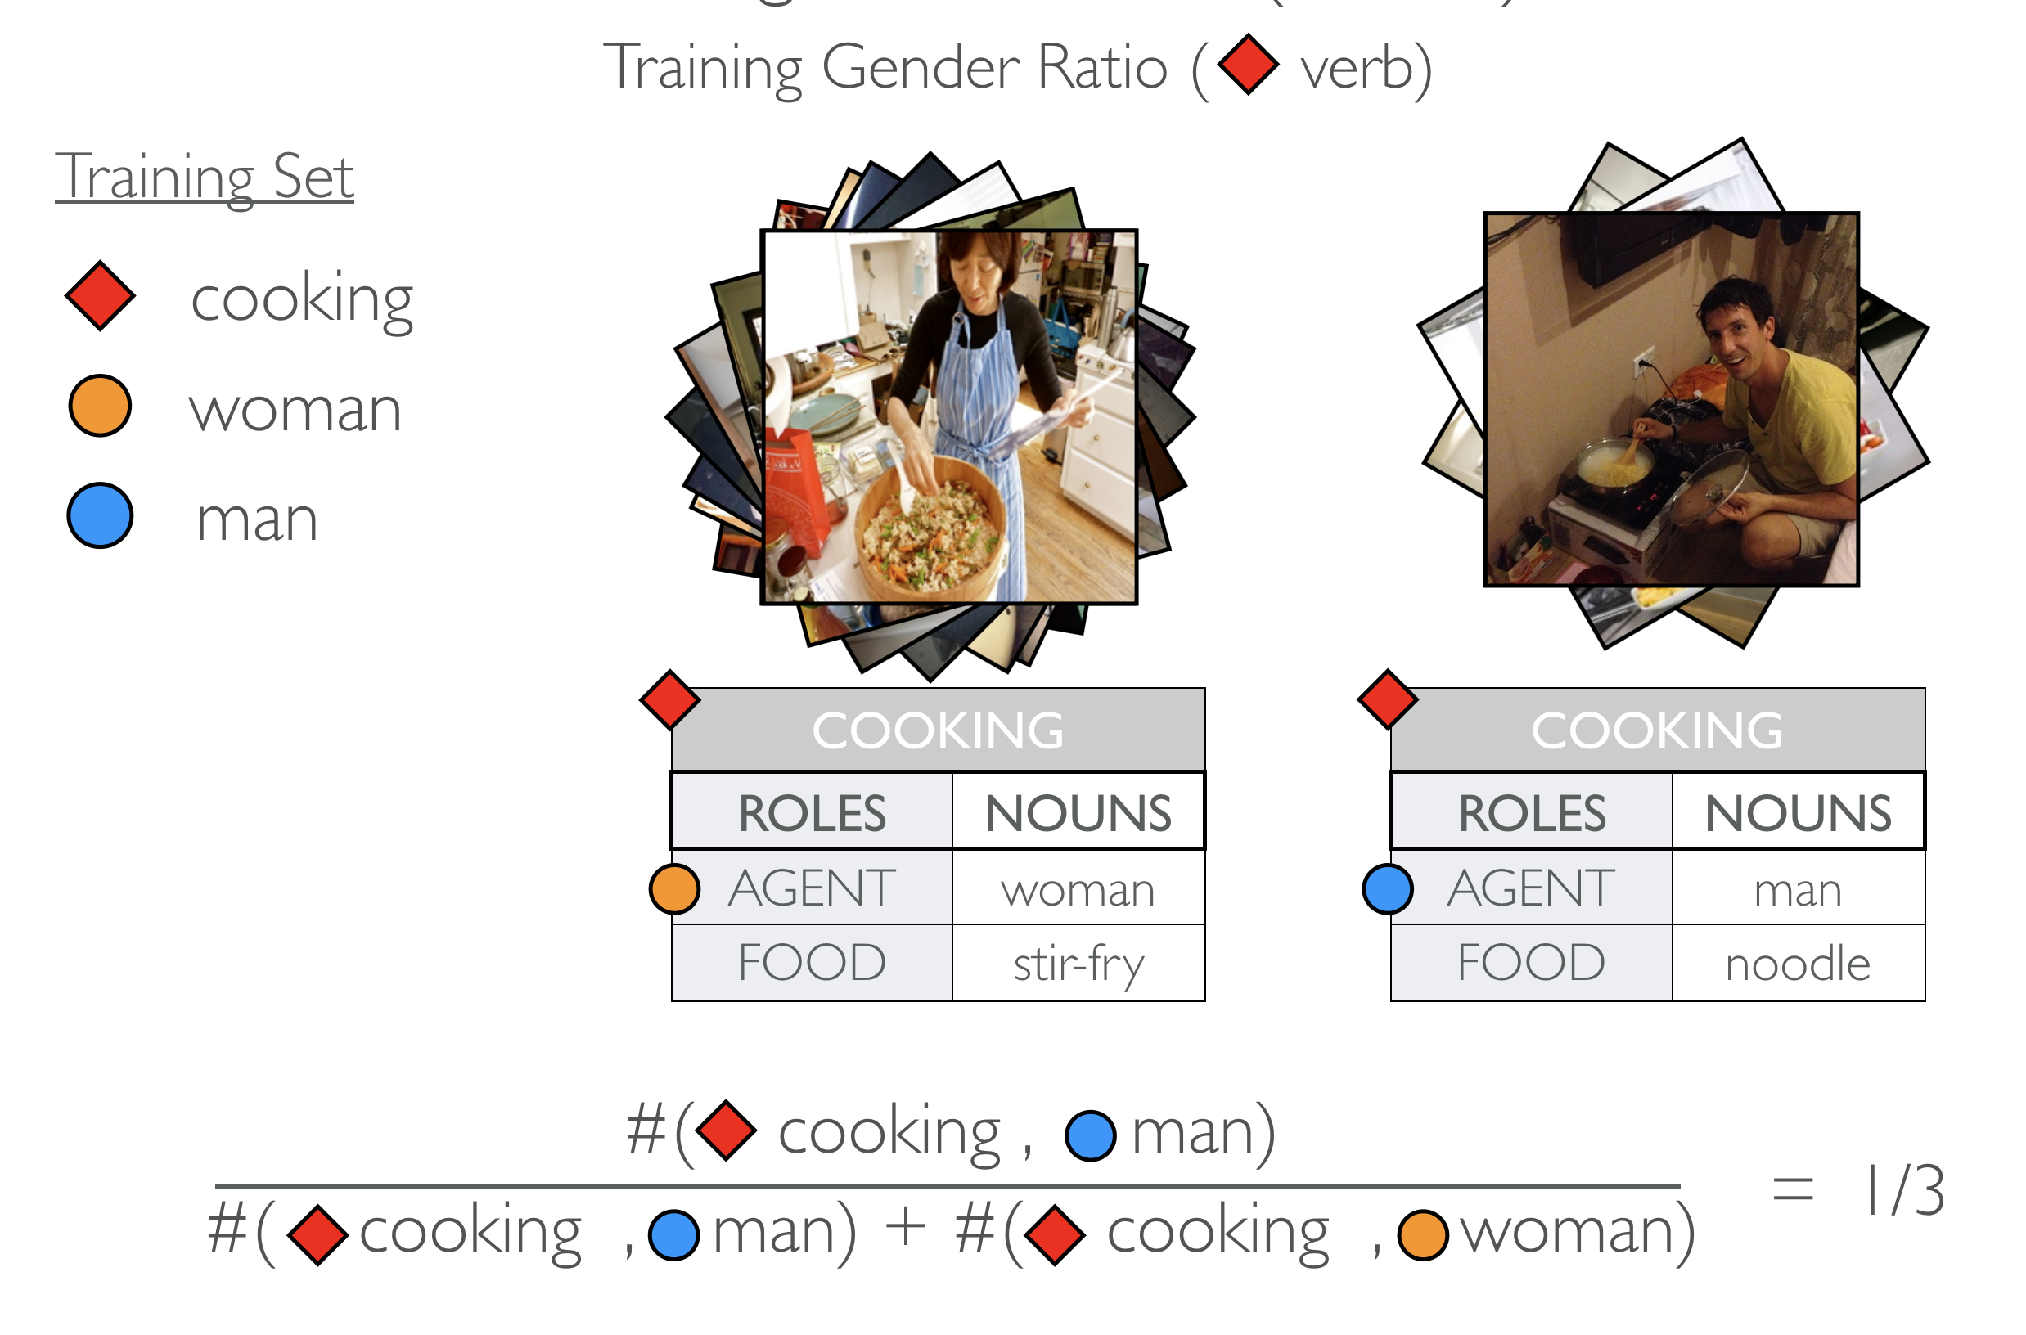
Defining Dataset Bias (events)

Slide 26
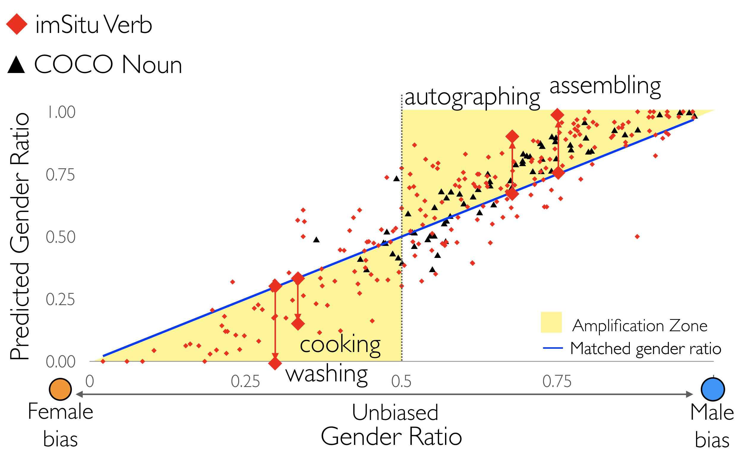
Model Bias Amplification

Slide 27
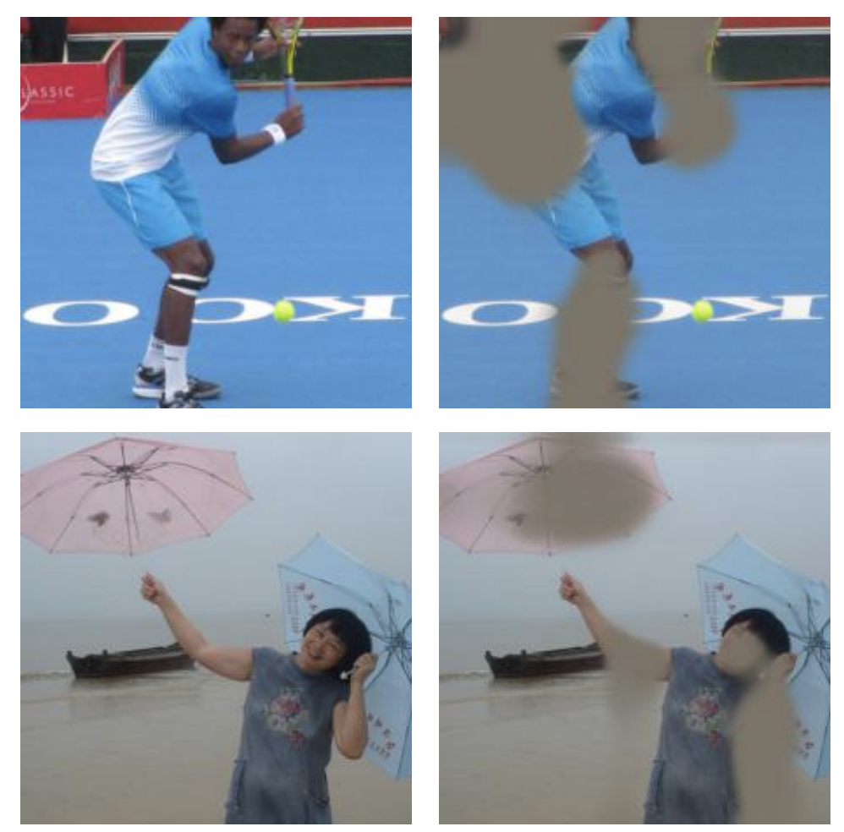
Leakage of Gender
Adversarial Removal of Gender from Deep Image Representations
[WZYCO19; FATE in CV Workshop at CVPR 19]

Slide 28
Outline
Gender Bias in NLP
  Representational harm
  Performance gap in downstream applications
Ideas for Mitigating Bias in Text Applications
  Surgery representation space
  Data augmentation with “gender-swapping”
  Calibration with corpus-level constraints
[ACL 2019]

Slide 29
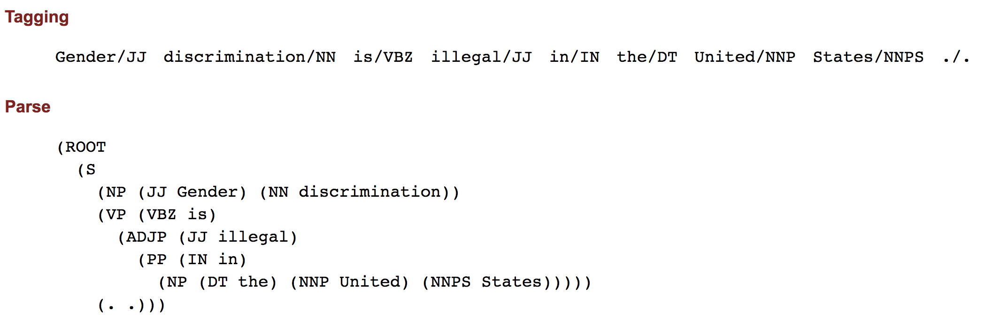
What It Takes to Control Societal Bias in NLP?
It’s hard for machine to even understand the sentence:
“Gender discrimination is illegal in the United States.”
As NLP applications are widespread in our daily life,
we need both immediate remedies and fundamental approaches to control societal bias.

Slide 30
Outline
Gender Bias in NLP
Ideas for Mitigating Bias in Text Applications
  Controlling Gender Bias in Representation Level
  A study of removing bias in Word Embedding
  Reducing Gender Bias in Data Level
  A case study on co-reference resolution
  Reducing Gender Bias in Inference Level
  Guiding predictions by corpus-wise constraints

Slide 31
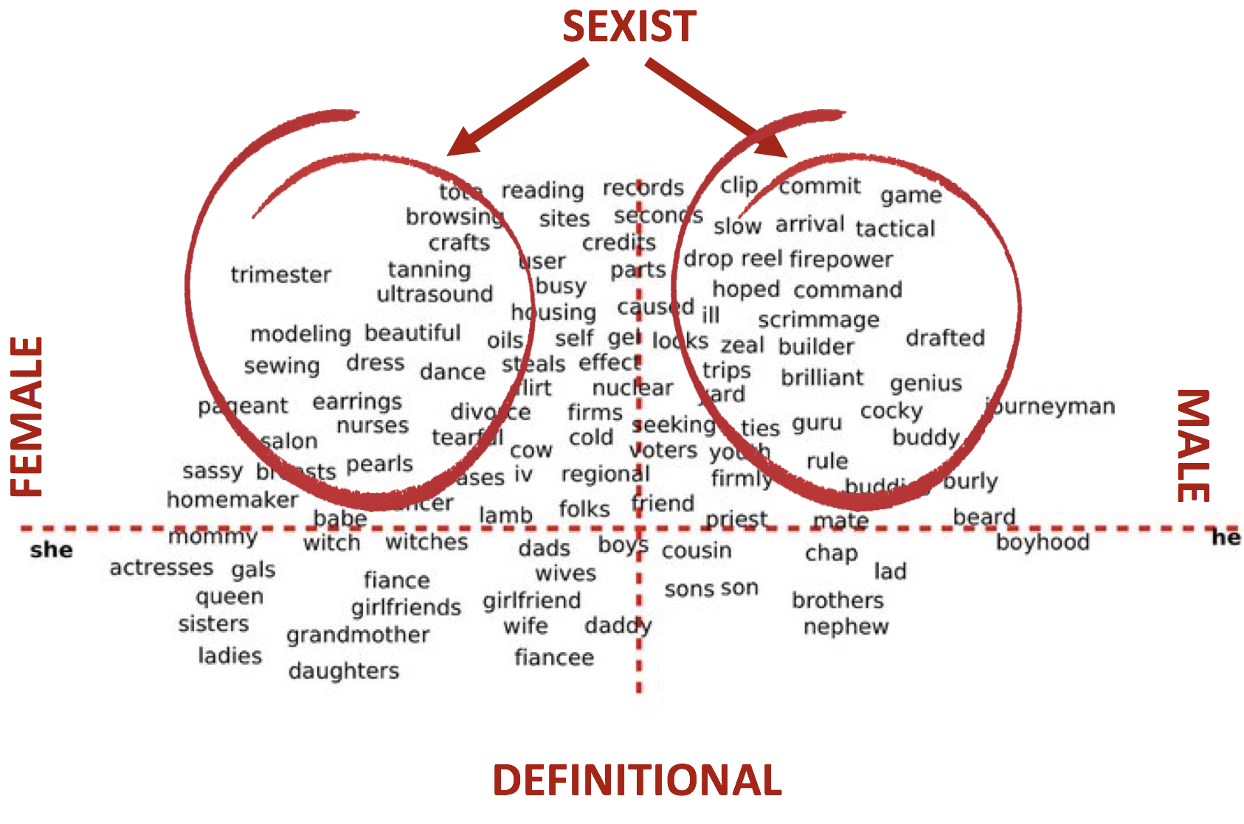
Approach 1: Surgery representation space

Slide 32
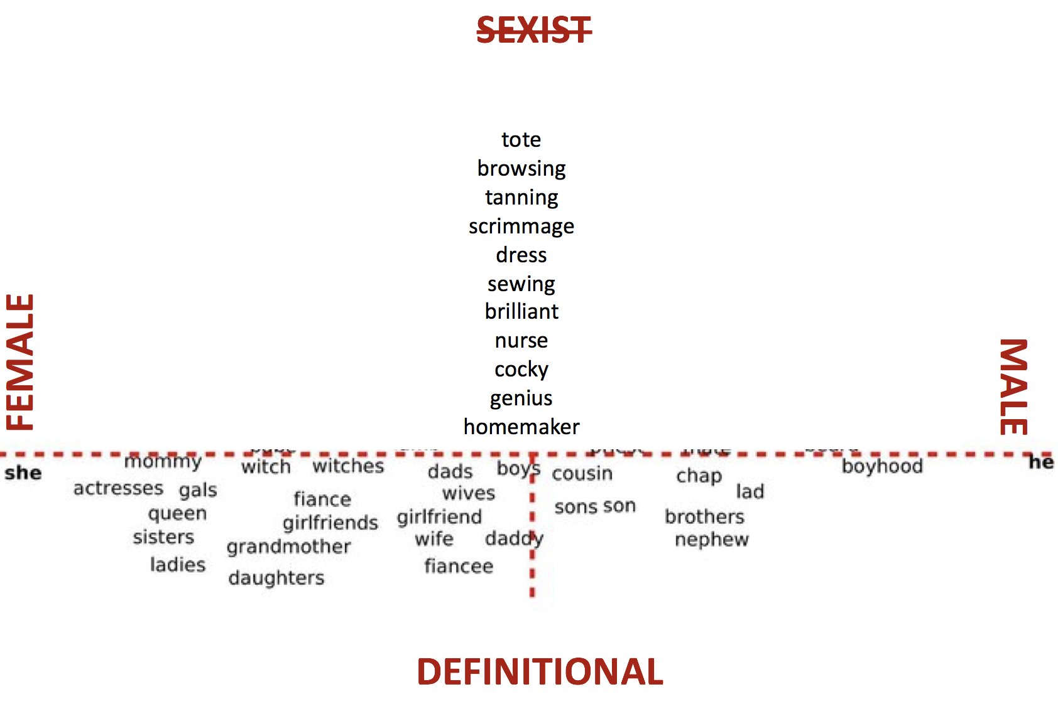
[BCZSK; NeurIPS 16]
This can be done by projecting gender direction out
from gender neutral words using linear operations
Thoughtful criticism: Awareness is better than blindness (Caliskan et. al. 17)

Slide 33
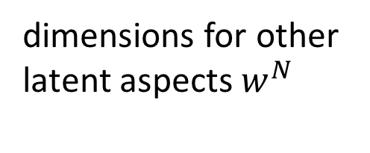
Approach 1’: Make Gender Information Transparent in Word Embedding
Learning Gender-Neutral Word Embeddings [ZZLWC; EMNLP18]
dimensions for other
latent aspects $w^{N}$
1
-1
?
dimensions reserve for
gender information
mother
father
doctor
Caveat: Completely removing bias from embedding is hard if not impossible
[Gonen&Goldberg 19]

Slide 34
Wino-bias data
Stereotypical dataset
Anti-stereotypical dataset
[ZWYOC NAACL 2018]

Slide 35
Gender bias in Coref System

Slide 36
Source of gender bias
Co-reference Prediction
Use gender-neutral embedding
(Structured) Inference
Word Embedding
Representation
Data
80% entities in OntoNotes are male

Slide 37
Gender bias in Coref System

Slide 38
Outline
Gender Bias in NLP
Ideas for Mitigating Bias in Text Applications
  Controlling Gender Bias in Representation Level
  A study of removing bias in Word Embedding
  Reducing Gender Bias in Data Level
  A case study on co-reference resolution
  Reducing Gender Bias in Inference Level
  Guiding predictions by corpus-wise constraints

Slide 39
How to deal with bias in data
Idea: simulate sentence in opposite gender
John went to his house
F2 went to her house
Named Entity are anonymized
Gender words are swapped
Better than down/up sampling

Slide 40
Gender bias in Coref System

Slide 41
Outline
Controlling Gender Bias in Representation Level
A study of removing bias in Word Embedding
Reducing Gender Bias in Data Level
A case study on co-reference resolution
Reducing Gender Bias in Inference Level
Guiding predictions by corpus-wise constraints

Slide 42
Reducing Bias Amplification (RBA)
Dataset
Model
RBA
Corpus level constraints on model output (ILP)
  Doesn’t require model retraining
Reuse model inference through Lagrangian relaxation
    Can be applied to any structured model

Slide 43
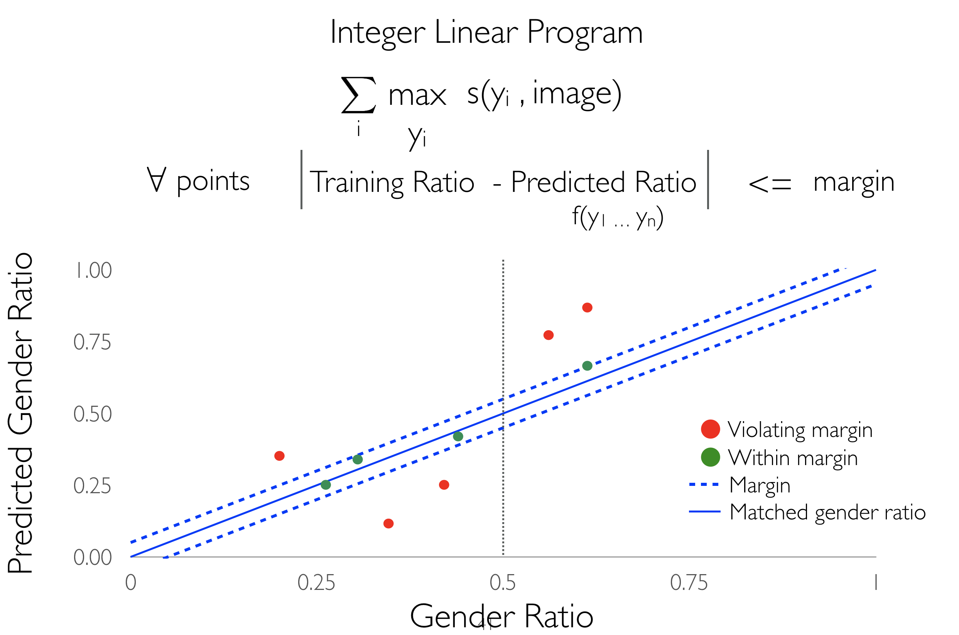
Reducing Bias Amplification (RBA)

Slide 44
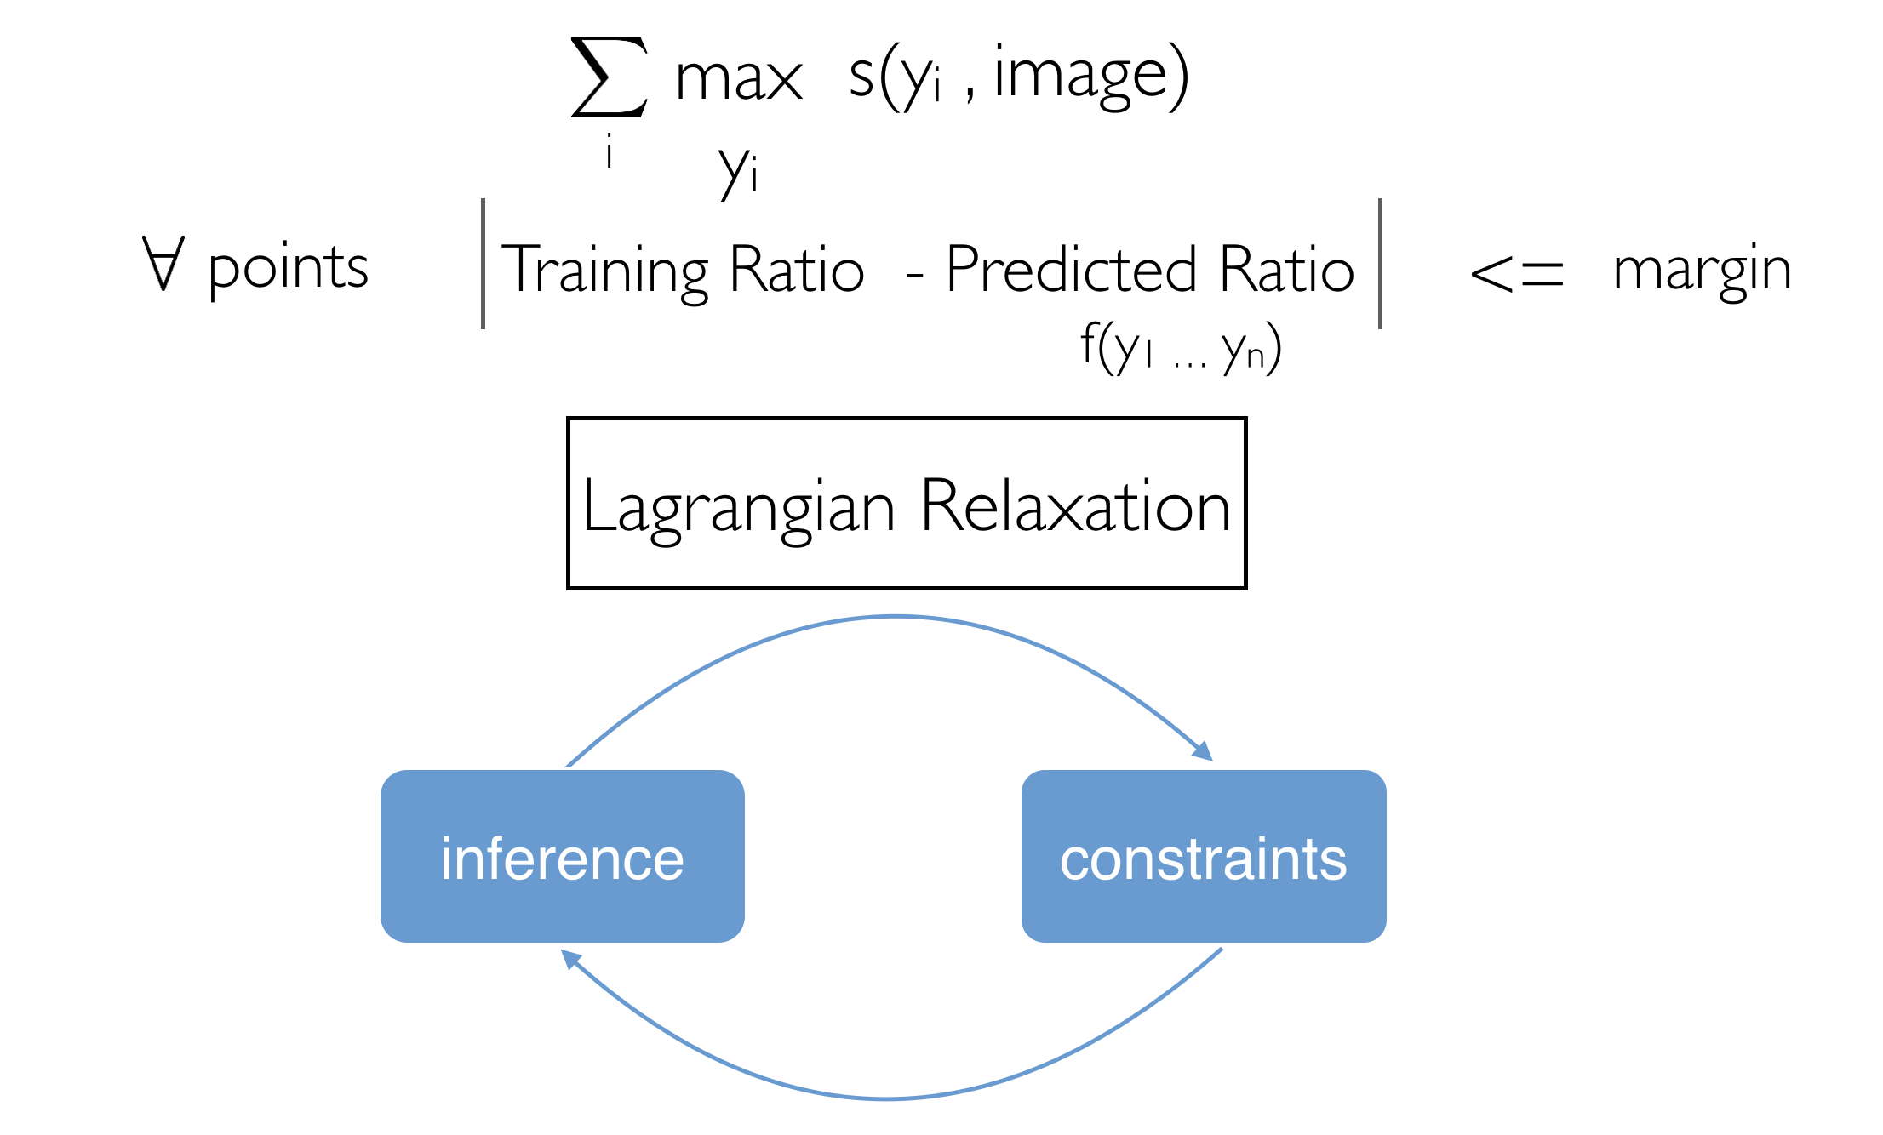
Reducing Bias Amplification (RBA)
Sontag et al., 2011; Rush and Collins, 2012; Chang and Collins, 2011; Peng et al., 2015, Chang et al., 2013; Dalvi, 2015

Slide 45



Reducing Bias Amplification (RBA)
Lagrangian :
$$λ_{j}≥0$$
Sontag et al., 2011; Rush and Collins, 2012; Chang and Collins, 2011; Peng et al., 2015, Chang et al., 2013; Dalvi, 2015

Slide 46
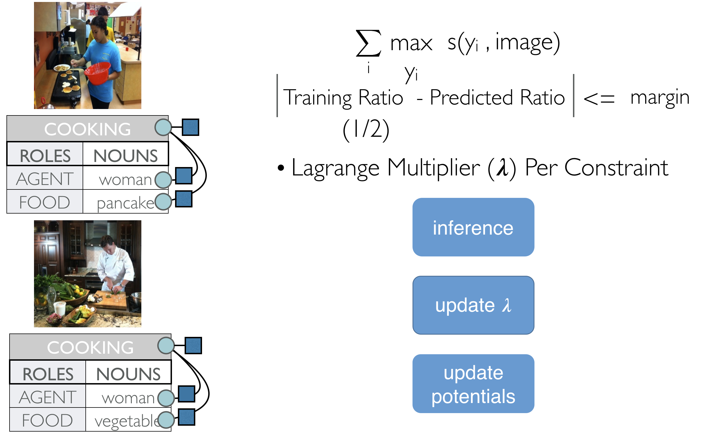
Lagrangian Relaxation
Sontag et al., 2011; Rush and Collins, 2012; Chang and Collins, 2011; Peng et al., 2015, Chang et al., 2013; Dalvi, 2015

Slide 47
Lagrangian Relaxation
Sontag et al., 2011; Rush and Collins, 2012; Chang and Collins, 2011; Peng et al., 2015, Chang et al., 2013; Dalvi, 2015

Slide 48
Lagrangian Relaxation
Sontag et al., 2011; Rush and Collins, 2012; Chang and Collins, 2011; Peng et al., 2015, Chang et al., 2013; Dalvi, 2015

Slide 49

Lagrangian Relaxation
Sontag et al., 2011; Rush and Collins, 2012; Chang and Collins, 2011; Peng et al., 2015, Chang et al., 2013; Dalvi, 2015

Slide 50
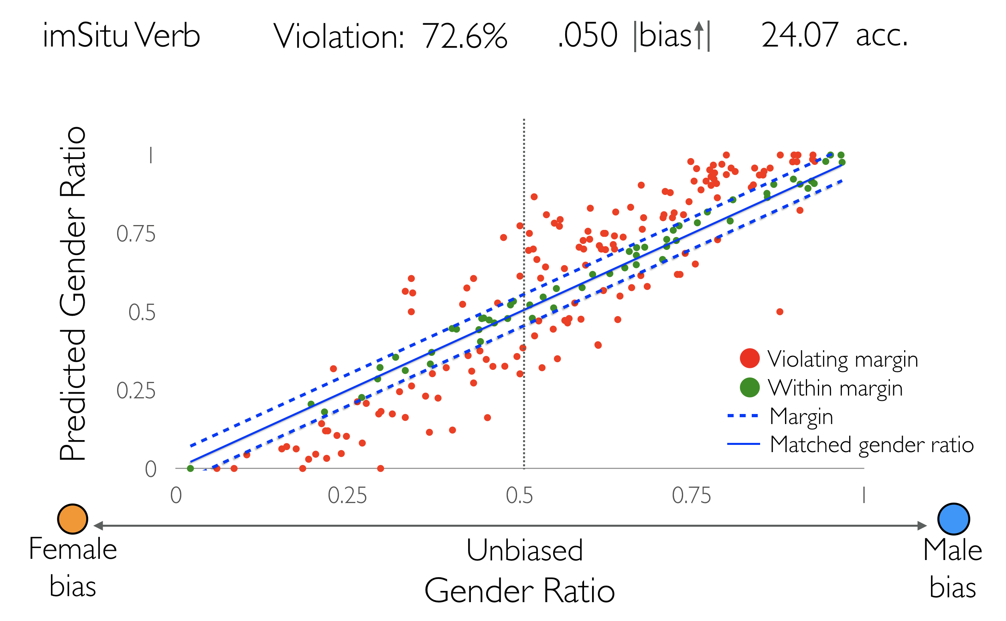
Gender Bias De-amplification in imSitu
Male
bias

Slide 51
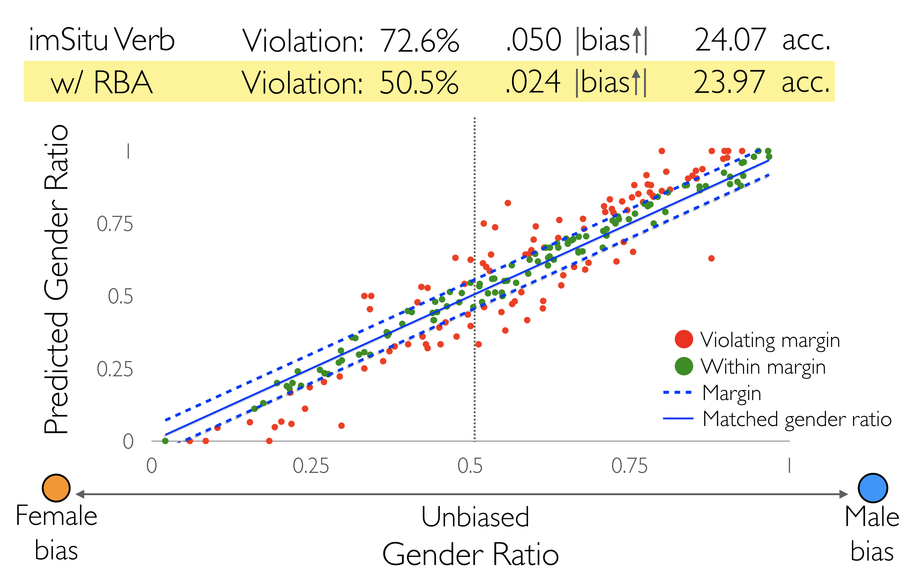
Gender Bias De-amplification in imSitu
Male
bias

Slide 52
Conclusions
Like other AI systems, NLP systems affect by societal bias present in data
The issues cause unfair predictions are not new
  Domain adaptation / Data collection bias
Ultimate goal: robust NLP systems for social good
References: http://kwchang.net

