Slide 1

Oracle Separation of BQP and PH
Avishay Tal (Stanford University)
joint with Ran Raz (Princeton University)
© Kevin Hong for Quanta Magazine

Slide 2
The Landscape of Complexity Classes
PSPACE
PH
NP
BPP
coNP
P
BQP?

Slide 3
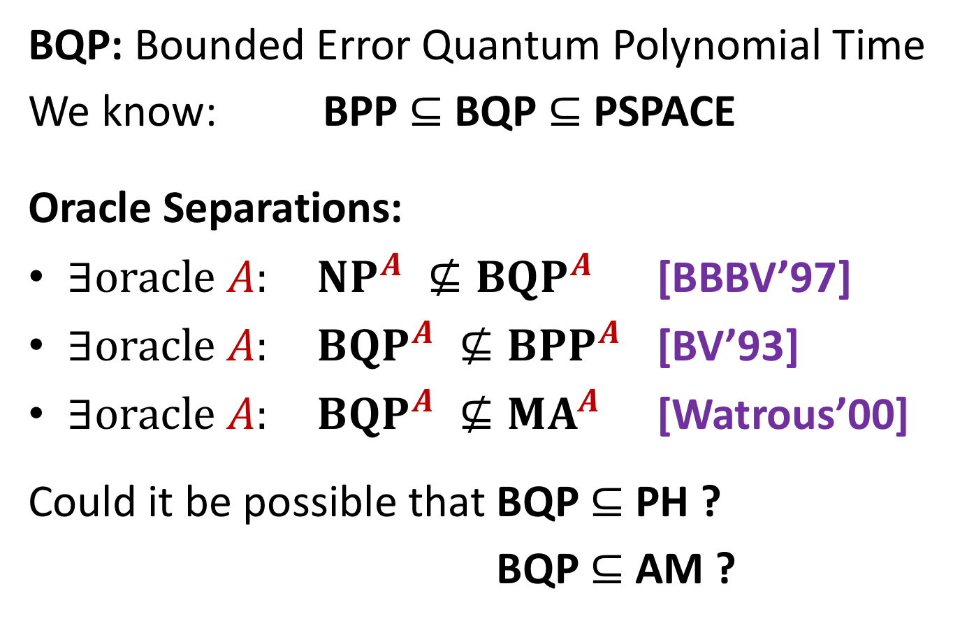
Where does BQP fit in the landscape?
BQP: Bounded Error Quantum Polynomial Time
We know: BPP $⊆$ BQP $⊆$ PSPACE
Oracle Separations:
$∃oracle A: NP^{A} ⊈BQP^{A}$ [BBBV’97]
$∃oracle A: BQP^{A} ⊈BPP^{A}$ [BV’93]
$∃oracle A: BQP^{A} ⊈MA^{A}$ [Watrous’00]
Could it be possible that BQP $⊆$ PH ?
Could it be possible that BQP $⊆$ AM ?

Slide 4
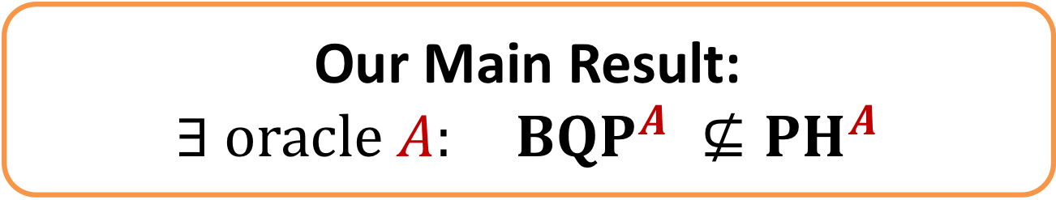

Our Main Result: BQP vs. PH
Recall: a language $L$ in PH iff there exists a constant $k$, and a poly-time computable relation $R$ s.t.
$$x∈L ⟺ {∃y}_{1}∀y_{2}∃y_{3}… Q_{k}y_{k}:R\left(x,y_{1}, …, y_{k}\right)$$
$$\left|y_{1}\right|+\left|y_{2}\right|+ … + \left|y_{k}\right|≤poly\left(\left|x\right|\right)$$
Our Main Result:
$∃ oracle A: BQP^{A} ⊈{PH}^{A}$
Notes:
*In fact: BQP cannot be captured by $k$ alternations,
as long as $\left|y_{1}\right|+ … + \left|y_{k}\right|≤exp⁡(|x|/5k)$

Slide 5
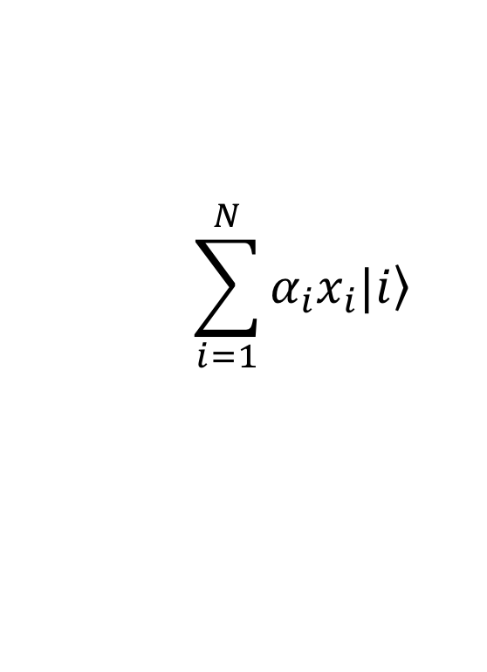

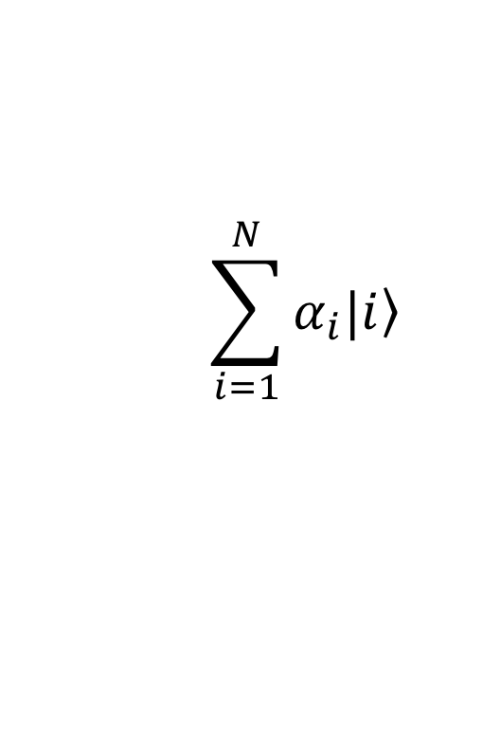

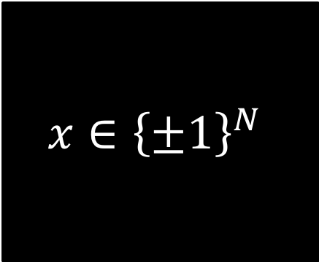
The Black-Box/Query Model
$$\sum_{i=1}^{N}{α_{i}|\left.i\right\rangle }$$
$$\sum_{i=1}^{N}{α_{i}x_{i}|\left.i\right\rangle }$$
$$x∈{\left\{±1\right\}}^{N}$$
$$i$$
$$x_{i}$$
Complexity measure: number of queries to the black box.
Deterministic Query Complexity = Decision Tree Complexity
Quantum Query Complexity = Queries are made in superposition
PH analog = AC⁰ circuits
Known reductions: Black-box separations imply oracle separations

Slide 6

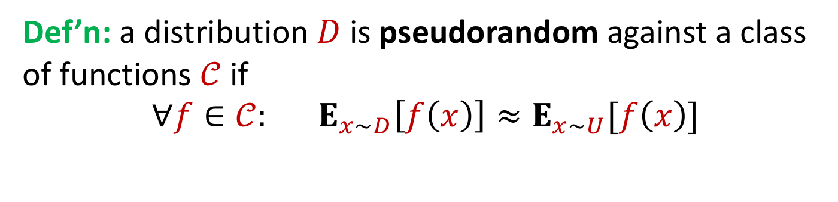
The Pseudorandomness Setting
f
f
Def’n: a distribution $D$ is pseudorandom against a class of functions $𝒞$ if
$$∀f∈𝒞: E_{x\sim D}\left[f\left(x\right)\right]≈E_{x∼U}[f\left(x\right)]$$

Slide 7
The Pseudorandomness Setting
[Aaronson’10, Fefferman-Shaltiel-Umans-Viola’12]
Can you find a distribution which is pseudorandom for AC⁰ but not pseudorandom for poly-log-time quantum algorithms?
f
f
➔ an oracle separation between BQP from PH

Slide 8
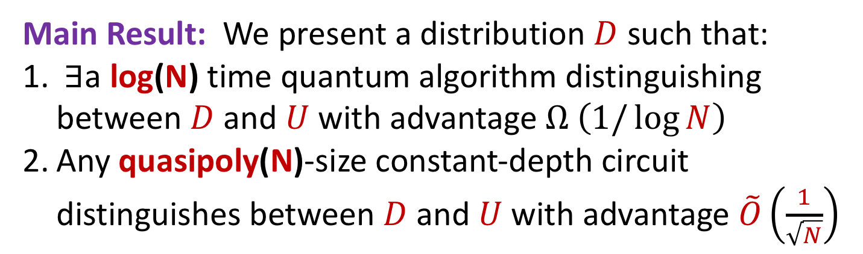
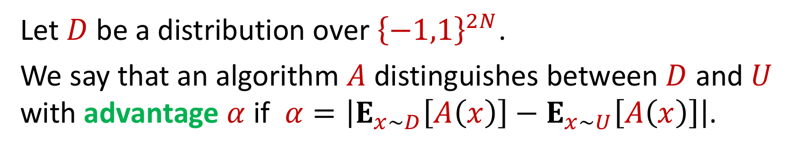
F
F
Let $D$ be a distribution over ${\left\{−1,1\right\}}^{2N}$.
We say that an algorithm $A$ distinguishes between $D$ and $U$ with advantage $α$ if $α=\left|E_{x\sim D}\left[A\left(x\right)\right]−E_{x∼U}\left[A\left(x\right)\right]\right|$.
Main Result: We present a distribution $D$ such that:
$∃$a log(N) time quantum algorithm distinguishing between $D$ and $U$ with advantage $Ω \left(1/\log{N}\right)$
Any quasipoly(N)-size constant-depth circuit distinguishes between $D$ and $U$ with advantage $\tilde{O}\left(\frac{1}{\sqrt{N}}\right)$
Standard techniques ➔ amplify advantage of quantum algorithm to be 0.99 or even 1-1/poly(N).

Slide 9
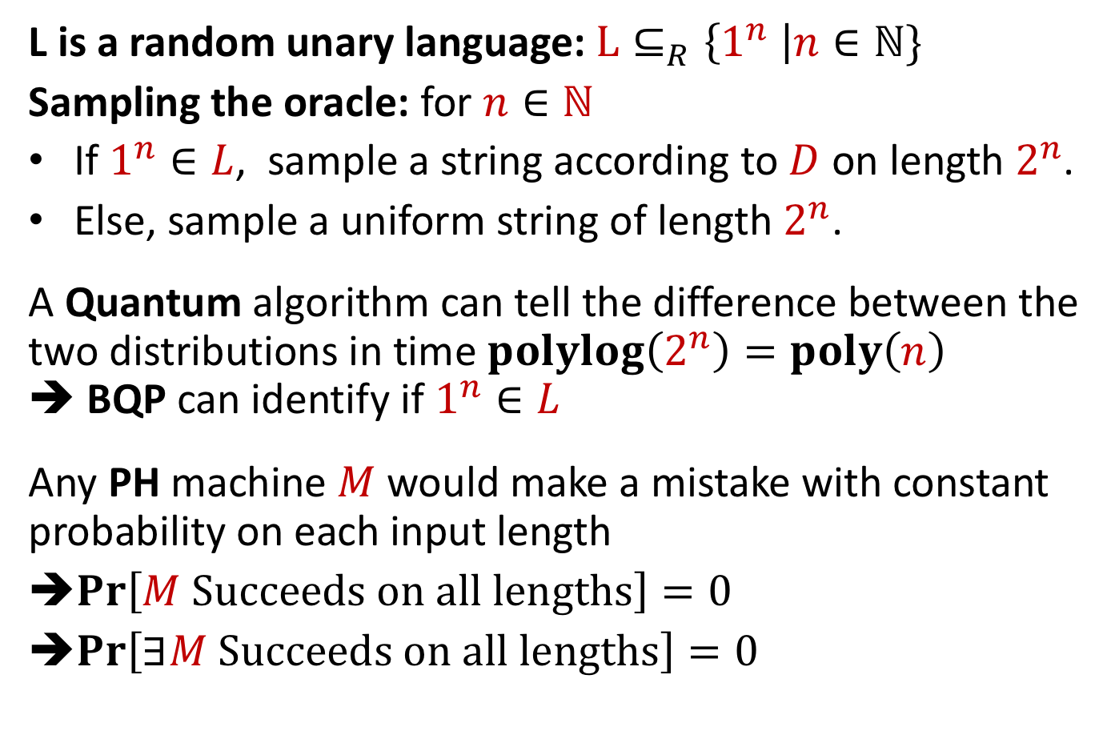
The Oracle & Language
Bennett-Gill’81, Aaronson’10, Fefferman-Shaltiel-Umans-Viola’12
L is a random unary language: $L⊆_{R}\left\{1^{n} \right|n∈ℕ\}$
Sampling the oracle: for $n∈ℕ$
If $1^{n}∈L$, sample a string according to $D$ on length $2^{n}$.
Else, sample a uniform string of length $2^{n}$.
A Quantum algorithm can tell the difference between the two distributions in time $polylog\left(2^{n}\right)=poly\left(n\right)$
➔ BQP can identify if $1^{n}∈L$
Any PH machine $M$ would make a mistake with constant probability on each input length
$\operatorname{Pr}\left[M Succeeds on all lengths\right]=0$
$\operatorname{Pr}\left[∃M Succeeds on all lengths\right]=0$

Slide 10
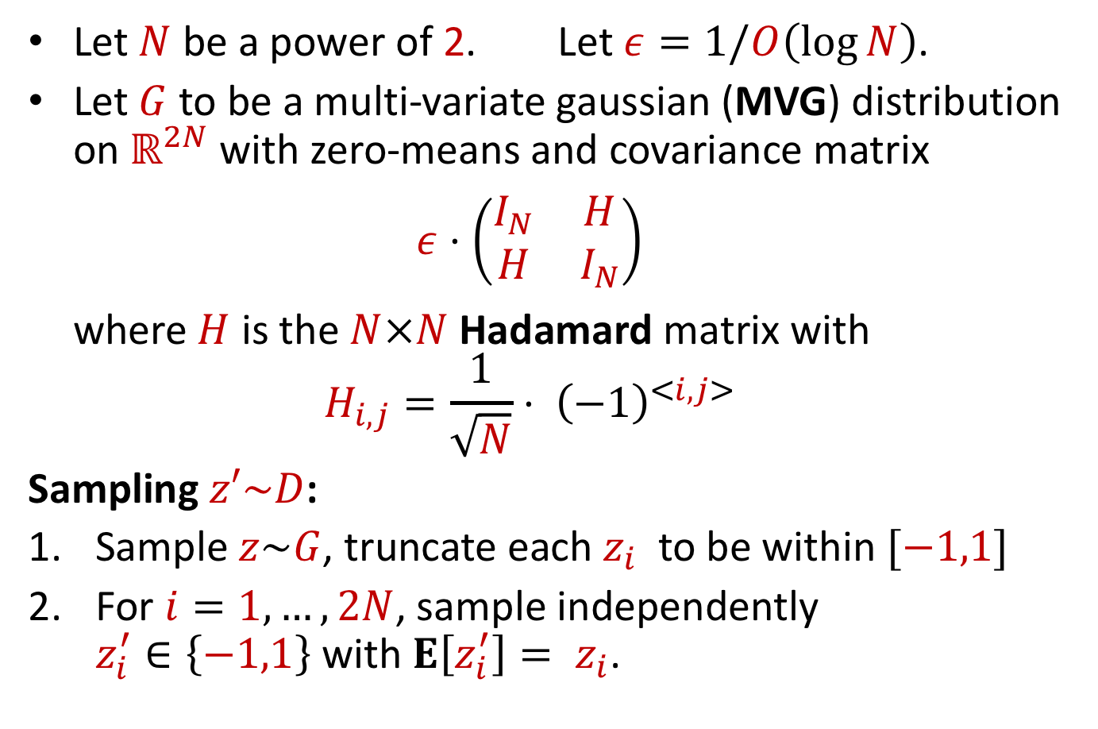
The Separating Distribution D
(Based on Aaronson’s Forrelation distribution)
Let $N$ be a power of 2. Let $ε=1/O\left(\log{N}\right)$.
Let $G$ to be a multi-variate gaussian (MVG) distribution on $ℝ^{2N}$ with zero-means and covariance matrix
$ε⋅\left(\begin{matrix}I_{N} & H \\ H & I_{N}\end{matrix}\right)$
where $H$ is the $N×N$ Hadamard matrix with
$H_{i,j}=\frac{1}{\sqrt{N}}⋅ {\left(−1\right)}^{<i,j>}$
Sampling $z′\sim D$:
Sample $z\sim G$, truncate each $z_{i}$ to be within $[−1,1]$
For $i=1, …, 2N$, sample independently
$z_{i}^{′}∈\left\{−1,1\right\}$ with $E\left[z_{i}^{′}\right]= z_{i}$.
Notes:
Alternative view of G:
Sample x1,…, xN ~ N(0,eps) independently
Take y_1,…, yN to be H*x^t.
Output (x1, …, xN, y1,…, yN)
Based on Aaronson Forrelation distribution.
Aaronson took w = sgn(z).

Slide 11
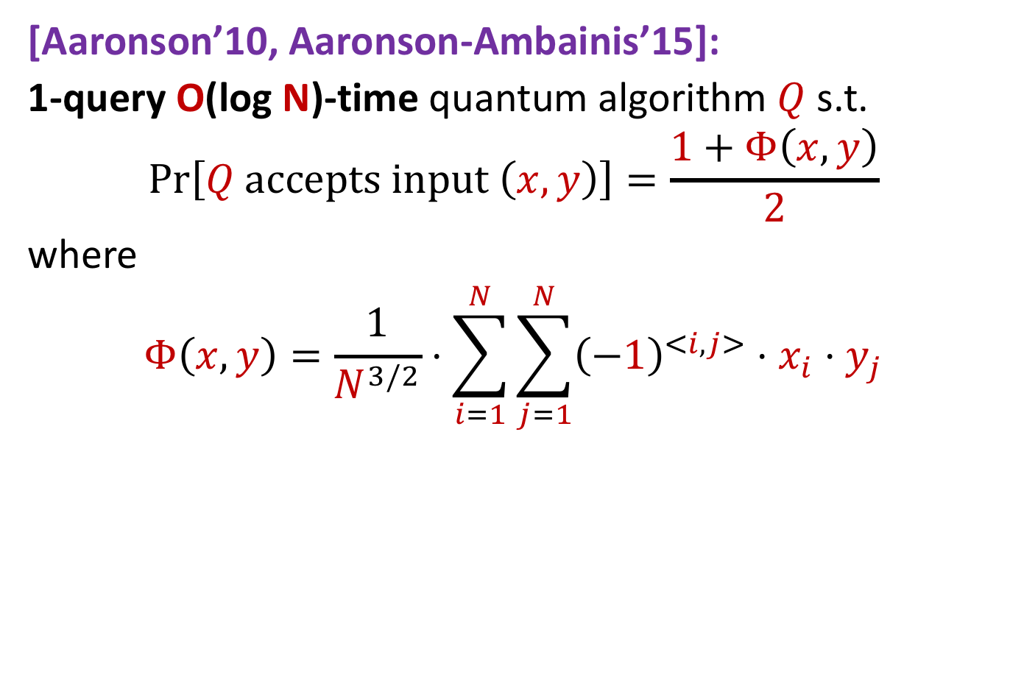
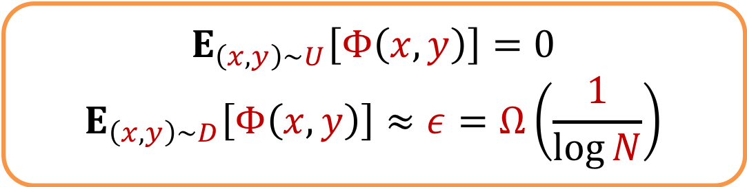
Quantum Algorithm Distinguishing D
[Aaronson’10, Aaronson-Ambainis’15]:
1-query O(log N)-time quantum algorithm $Q$ s.t.
$$\operatorname{Pr}\left[Q accepts input \left(x,y\right)\right]=\frac{1+Φ\left(x,y\right)}{2}$$
where
$$Φ\left(x,y\right)=\frac{1}{N^{3/2}}⋅\sum_{i=1}^{N}{\sum_{j=1}^{N}{{\left(−1\right)}^{<i,j>}⋅x_{i}⋅y_{j}}}$$
$$E_{\left(x,y\right)\sim U}\left[Φ\left(x,y\right)\right]=0$$
$$E_{\left(x,y\right)\sim D}\left[Φ\left(x,y\right)\right]≈ε=Ω\left(\frac{1}{\log{N}}\right)$$
Notes:
Intuition to the difference between Q and PH:
The distribution D has very small pairwise correlations -- at most 1/sqrt{N}.
Q can somehow accumulate all these N^2 tiny pairwise correlations in the input.
On the other hand, we will show that AC0 cannot.

Slide 12
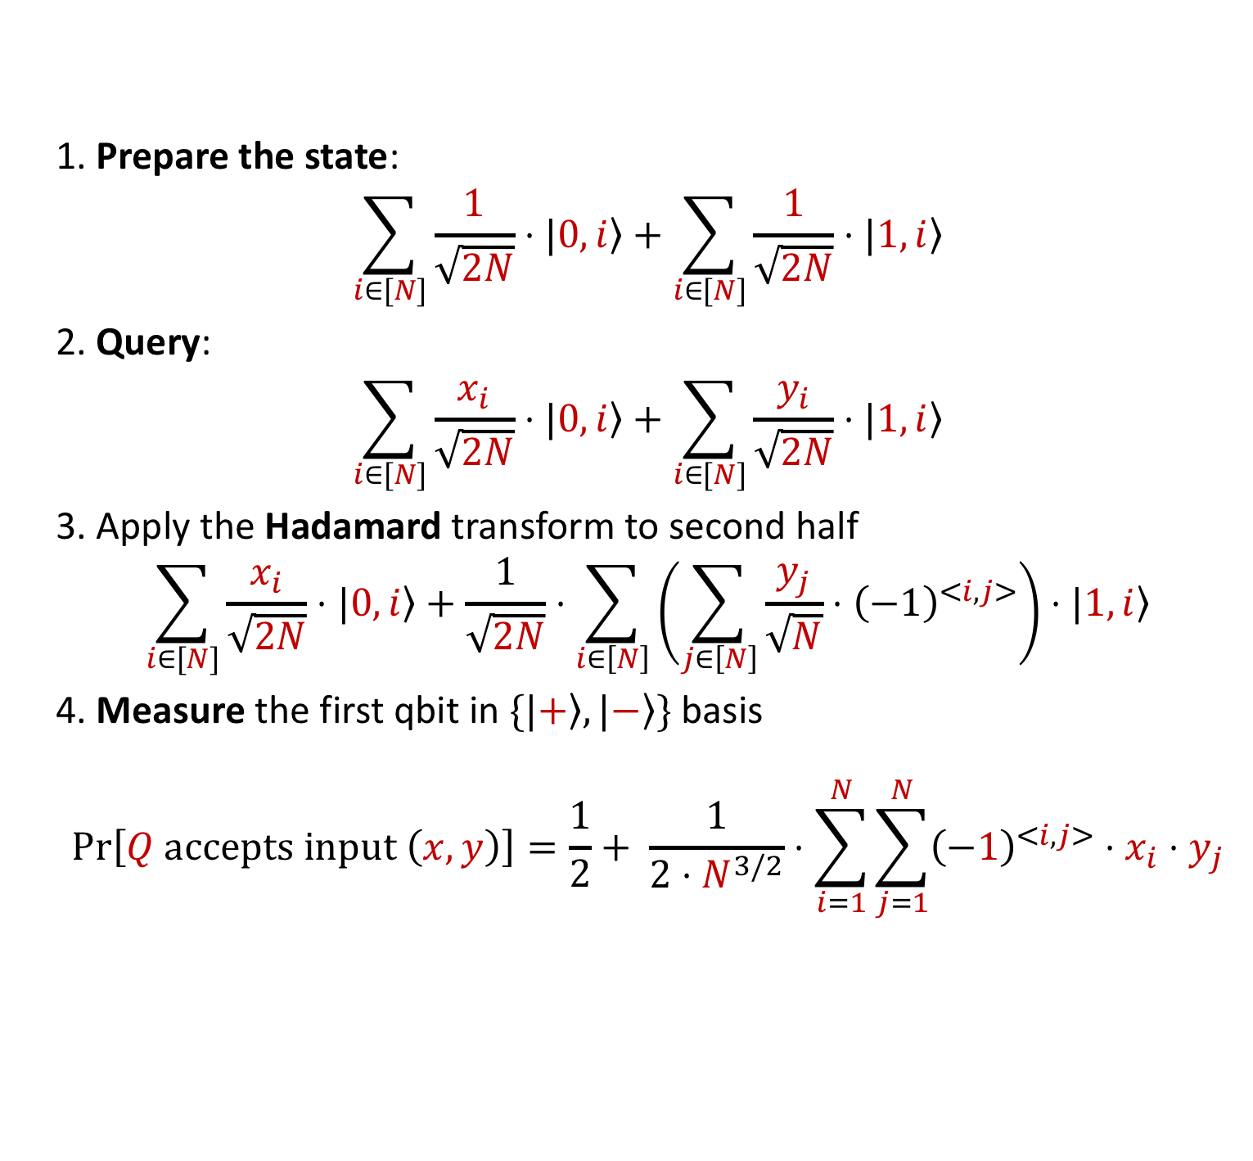
The Quantum Algorithm
1. Prepare the state:
$$\sum_{i∈[N]}{\frac{1}{\sqrt{2N}}}⋅|\left.0,i\right\rangle +\sum_{i∈[N]}{\frac{1}{\sqrt{2N}}}⋅|\left.1,i\right\rangle$$
2. Query:
$$\sum_{i∈[N]}{\frac{x_{i}}{\sqrt{2N}}}⋅|\left.0,i\right\rangle +\sum_{i∈[N]}{\frac{y_{i}}{\sqrt{2N}}}⋅|\left.1,i\right\rangle$$
3. Apply the Hadamard transform to second half
$$\sum_{i∈[N]}{\frac{x_{i}}{\sqrt{2N}}}⋅|\left.0,i\right\rangle +\frac{1}{\sqrt{2N}}⋅\sum_{i∈\left[N\right]}{\left(\sum_{j∈\left[N\right]}{\frac{y_{j}}{\sqrt{N}}⋅{\left(−1\right)}^{<i,j>}}\right)}⋅|\left.1,i\right\rangle$$
4. Measure the first qbit in $\{|\left.+\right\rangle ,|\left.−\right\rangle \}$ basis
$$\operatorname{Pr}\left[Q accepts input \left(x,y\right)\right]=\frac{1}{2}+ \frac{1}{{2⋅N}^{3/2}}⋅\sum_{i=1}^{N}{\sum_{j=1}^{N}{{\left(−1\right)}^{<i,j>}⋅x_{i}⋅y_{j}}}$$

Slide 13
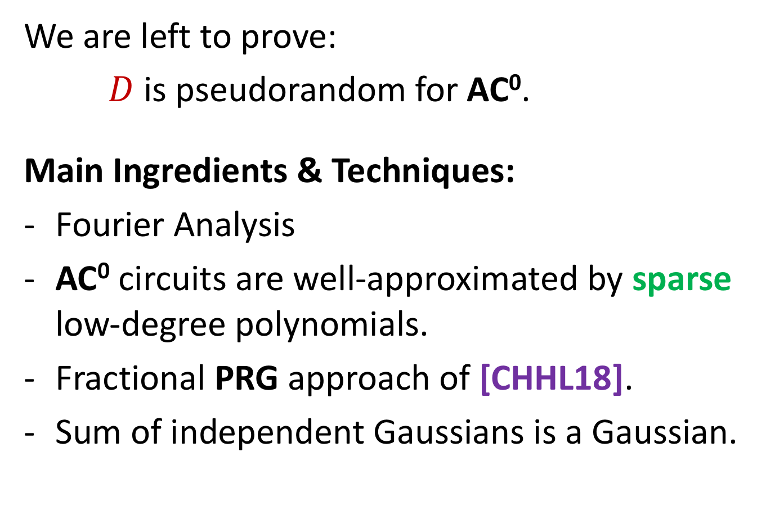
D is Pseudorandom for AC⁰
We are left to prove:
$D$ is pseudorandom for AC⁰.
Main Ingredients & Techniques:
Fourier Analysis
AC⁰ circuits are well-approximated by sparse low-degree polynomials.
Fractional PRG approach of [CHHL18].
Sum of independent Gaussians is a Gaussian.

Slide 14





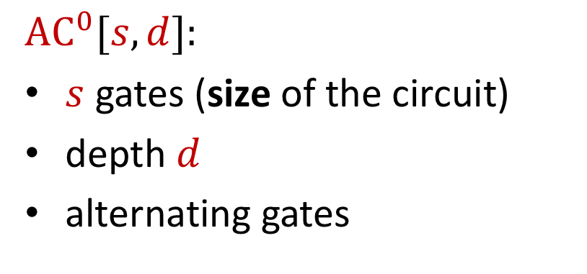

Bounded Depth Circuits
$$AC^{0}[s,d]:$$
$s$ gates (size of the circuit)
depth $d$
alternating gates
We focus on
$$AC^{0}\left[N^{polylog\left(N\right)},O\left(1\right)\right]$$

Slide 15
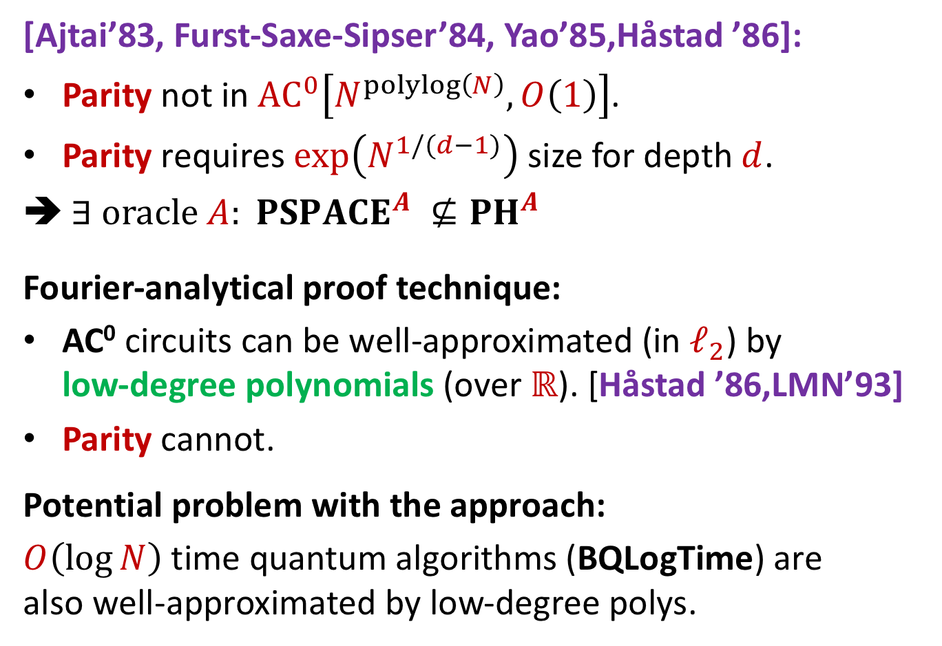
What do we know about AC⁰?
[Ajtai’83, Furst-Saxe-Sipser’84, Yao’85,Håstad ’86]:
Parity not in $AC^{0}\left[N^{polylog\left(N\right)},O\left(1\right)\right]$.
Parity requires $\exp\left(N^{1/(d−1)}\right)$ size for depth $d$.
➔ $∃ oracle A: PSPACE^{A} ⊈{PH}^{A}$
Fourier-analytical proof technique:
AC⁰ circuits can be well-approximated (in $ℓ_{2}$) by
low-degree polynomials (over $ℝ$). [Håstad ’86,LMN’93]
Parity cannot.
Potential problem with the approach:
$O\left(\log{N}\right)$ time quantum algorithms (BQLogTime) are
also well-approximated by low-degree polys.

Slide 16
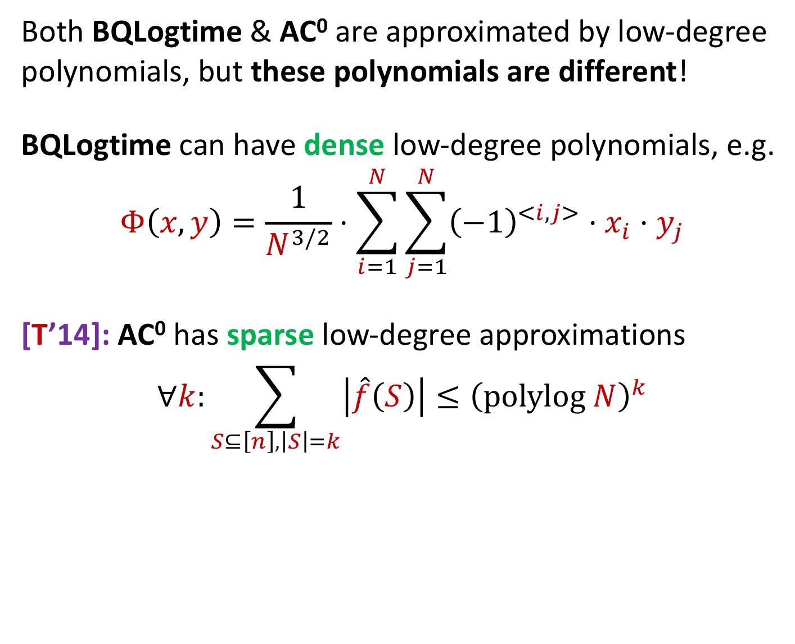
The Difference between BQLogTime and AC⁰
Both BQLogtime & AC⁰ are approximated by low-degree polynomials, but these polynomials are different!
BQLogtime can have dense low-degree polynomials, e.g.
$$Φ\left(x,y\right)=\frac{1}{N^{3/2}}⋅\sum_{i=1}^{N}{\sum_{j=1}^{N}{{\left(−1\right)}^{<i,j>}⋅x_{i}⋅y_{j}}}$$
[T’14]: AC⁰ has sparse low-degree approximations
$$∀k:\sum_{S⊆\left[n\right], \left|S\right|=k}{\left|\hat{f}\left(S\right)\right|}≤{\left(polylog N\right)}^{k}$$

Slide 17
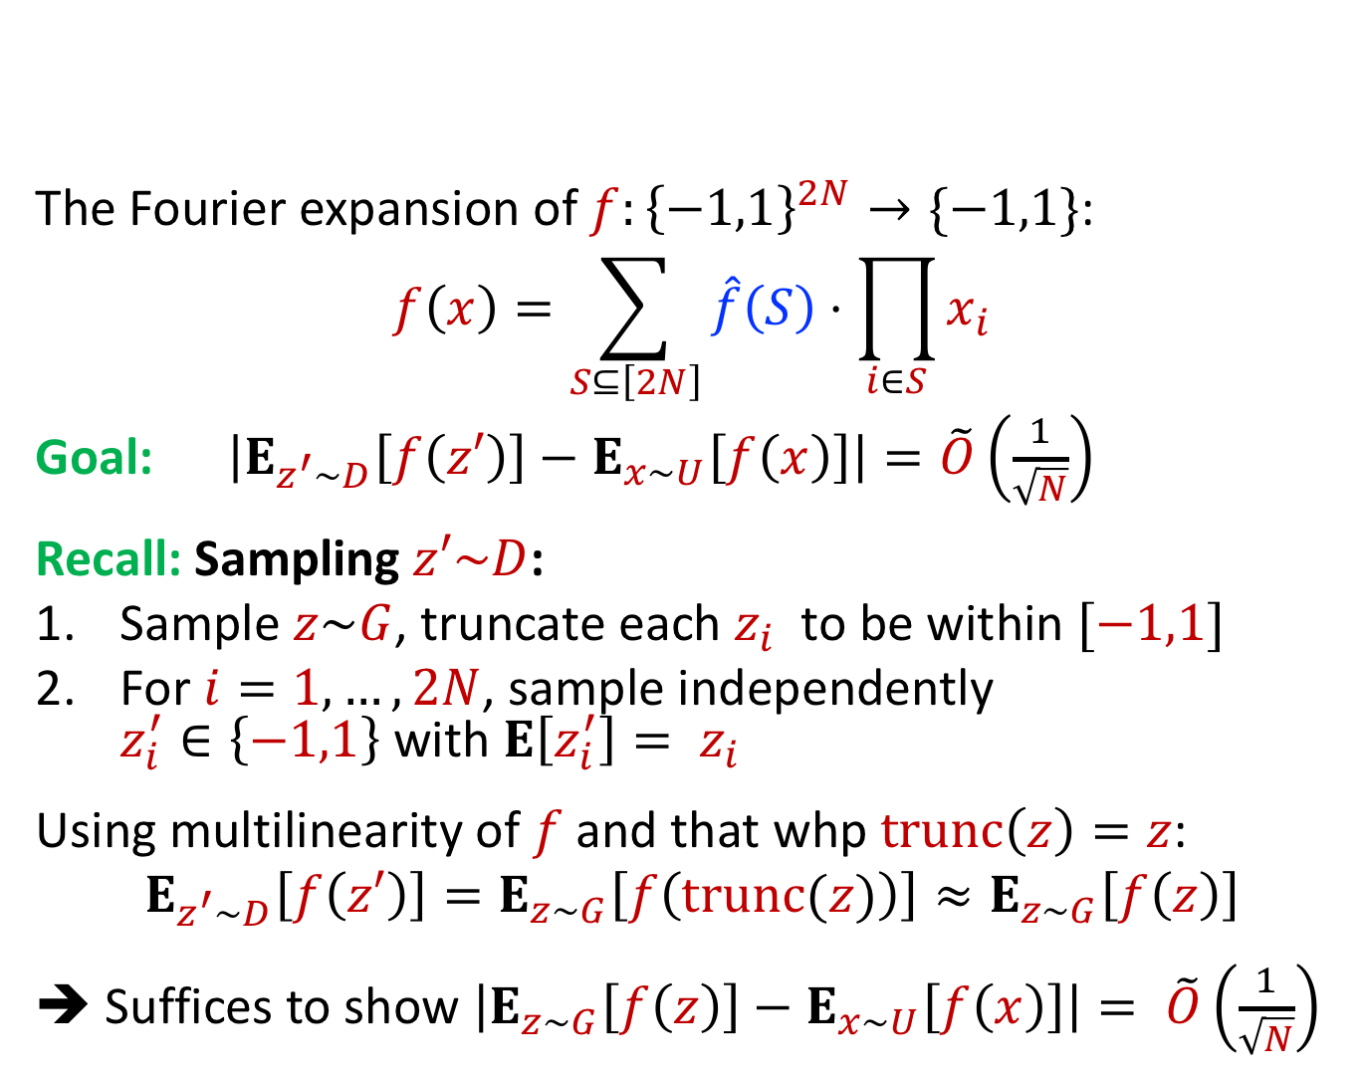
Fourier Analytical Approach – First Attempt
The Fourier expansion of $f:{\left\{−1,1\right\}}^{2N}→\{−1,1\}$:
$$f\left(x\right)=\sum_{S⊆\left[2N\right]}{\hat{f}\left(S\right)⋅\prod_{i∈S}{x_{i}}}$$
Goal: $\left|E_{z^{′}∼D}\left[f\left(z′\right)\right]−E_{x∼U}\left[f\left(x\right)\right]\right|=\tilde{O}\left(\frac{1}{\sqrt{N}}\right)$
Recall: Sampling $z′\sim D$:
Sample $z\sim G$, truncate each $z_{i}$ to be within $[−1,1]$
For $i=1, …, 2N$, sample independently
$z_{i}^{′}∈\left\{−1,1\right\}$ with $E\left[z_{i}^{′}\right]= z_{i}$
Using multilinearity of $f$ and that whp $trunc\left(z\right)=z$:
$$E_{z^{′}∼D}\left[f\left(z′\right)\right]=E_{z∼G}\left[f\left(trunc(z)\right)\right]≈E_{z∼G}\left[f\left(z\right)\right]$$
➔ Suffices to show $\left|E_{z∼G}\left[f\left(z\right)\right]−E_{x∼U}\left[f\left(x\right)\right]\right|= \tilde{O}\left(\frac{1}{\sqrt{N}}\right)$

Slide 18

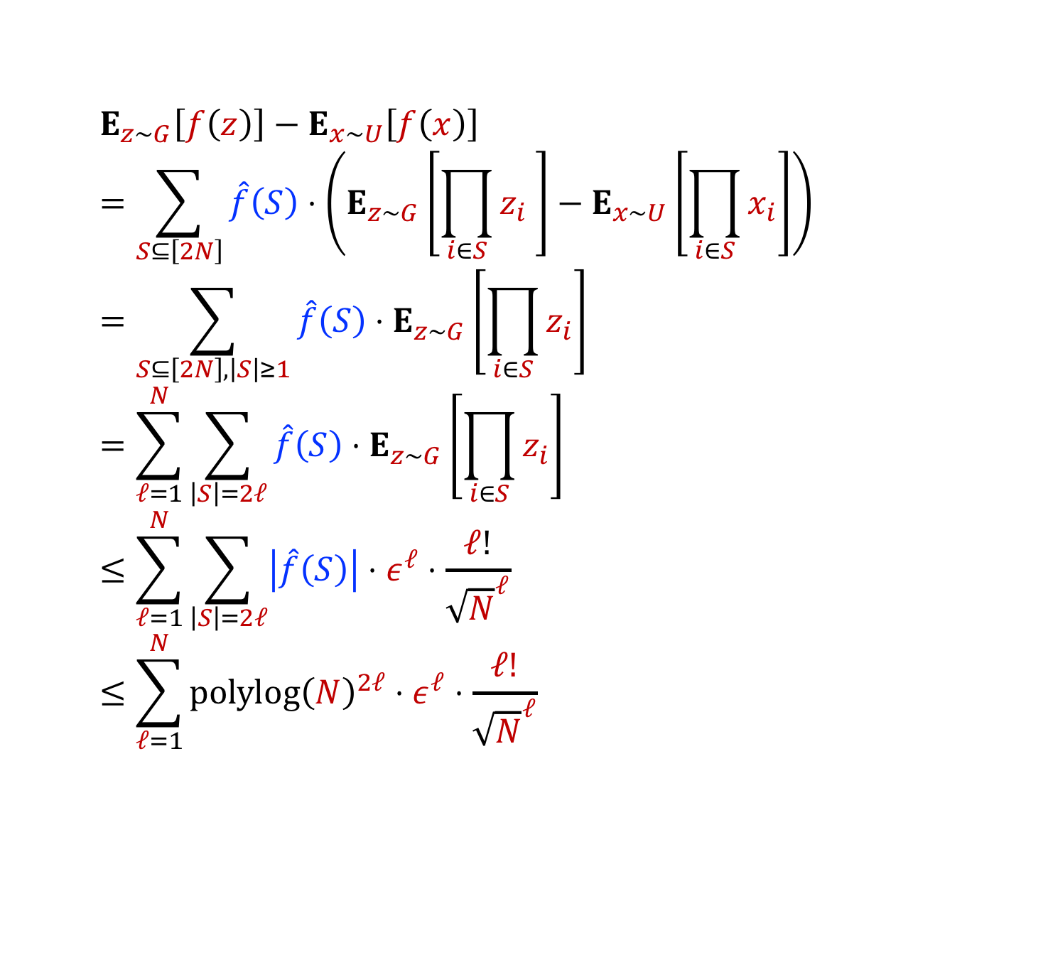
Fourier Analytical Approach – First Attempt
$E_{z∼G}\left[f\left(z\right)\right]−E_{x∼U}\left[f\left(x\right)\right]$
$$=\sum_{S⊆\left[2N\right]}{\hat{f}\left(S\right)⋅\left(E_{z∼G}\left[\prod_{i∈S}{z_{i}} \right]−E_{x∼U}\left[\prod_{i∈S}{x_{i}}\right]\right)}$$
$$=\sum_{S⊆\left[2N\right],\left|S\right|≥1}{\hat{f}\left(S\right)⋅E_{z∼G}\left[\prod_{i∈S}{z_{i}}\right]}$$
$$=\sum_{ℓ=1}^{N}{\sum_{\left|S\right|=2ℓ}{\hat{f}\left(S\right)⋅E_{z∼G}\left[\prod_{i∈S}{z_{i}}\right]}}$$
$$≤\sum_{ℓ=1}^{N}{\sum_{\left|S\right|=2ℓ}{\left|\hat{f}\left(S\right)\right|⋅ε^{ℓ}⋅\frac{ℓ!}{{\sqrt{N}}^{ℓ}}}}$$
$$≤\sum_{ℓ=1}^{N}{polylog{\left(N\right)}^{2ℓ}⋅ε^{ℓ}⋅\frac{ℓ!}{{\sqrt{N}}^{ℓ}}}$$
Contribution of first $\tilde{O}(\sqrt{N})$ terms:
$$ε⋅polylog(N)/\sqrt{N}$$
Contribution of larger terms?
Notes:
One way to solve it is to take eps (think of it as noise) to be smaller than 1/polylog(N) but this would hurt the advantage of the quantum algorithm → this gives a separation between quantum algorithms with more resources then PH which is not too interesting (even parity on polylog bits can give such a separation)
Our main insight (presented in the next slides) is that this is not needed and indeed the high degree terms do not matter too much

Slide 19

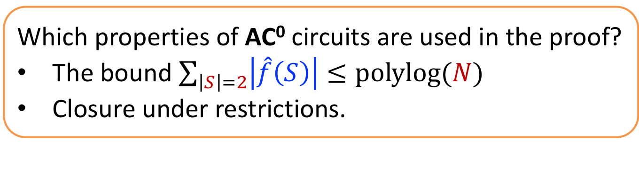
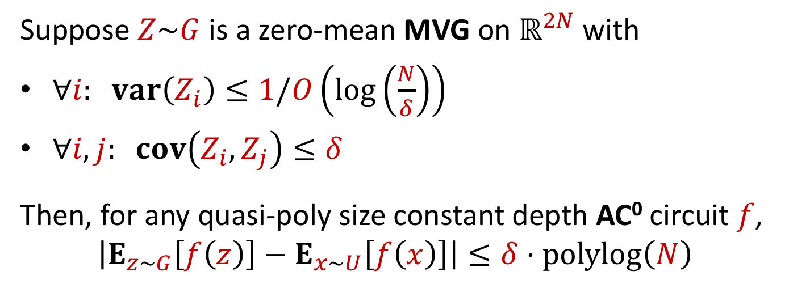
Main Technical Lemma
Suppose $Z\sim G$ is a zero-mean MVG on $ℝ^{2N}$with
$∀i: var\left(Z_{i}\right)≤1/O\left(\log\left(\frac{N}{δ}\right)\right)$
$∀i,j: cov\left(Z_{i},Z_{j}\right)≤δ$
Then, for any quasi-poly size constant depth AC⁰ circuit $f$,
$$\left|E_{z∼G}\left[f\left(z\right)\right]−E_{x∼U}\left[f\left(x\right)\right]\right|≤δ⋅polylog\left(N\right)$$
➔ whp $Z ∈{\left[−1,1\right]}^{2N}$
Which properties of AC⁰ circuits are used in the proof?
The bound $\sum_{\left|S\right|=2}{\left|\hat{f}\left(S\right)\right|≤polylog(N)}$
Closure under restrictions.
$G$ fools any class of functions with these two properties
Notes:
Credit to Boaz Barak and Jarosław Błasiok blog post for improved notation/presentation that we adapt:
https://windowsontheory.org/2018/06/17/on-the-raz-tal-oracle-separation-of-bqp-and-ph/

Slide 20
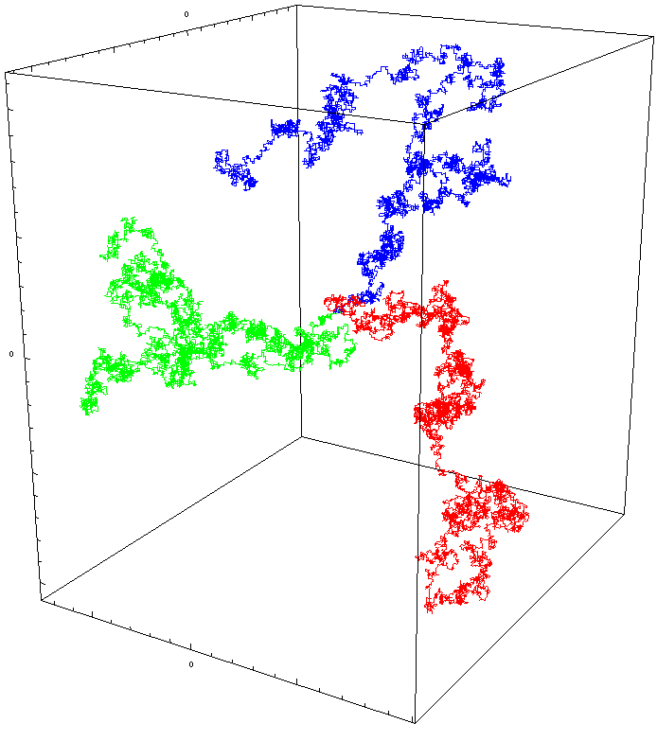
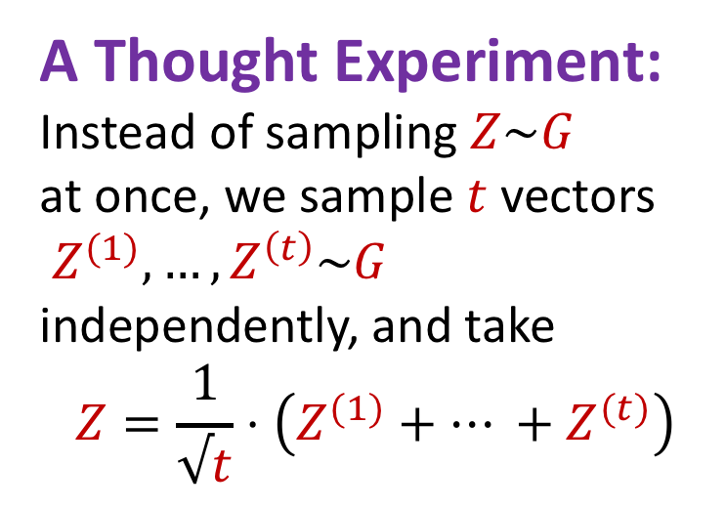

Viewing $Z\sim G$ as a result of a random walk
A Thought Experiment:
Instead of sampling $Z\sim G$
at once, we sample $t$ vectors
$Z^{(1)},…,Z^{\left(t\right)}\sim G$
independently, and take
$$Z=\frac{1}{√t}⋅\left(Z^{(1)}+… +Z^{(t)}\right)$$
Based on the work of
[Chattopadhyay, Hatami, Hosseini, Lovett’18]
Picture from http://en.wikipedia.org/wiki/Random_walk

Slide 21





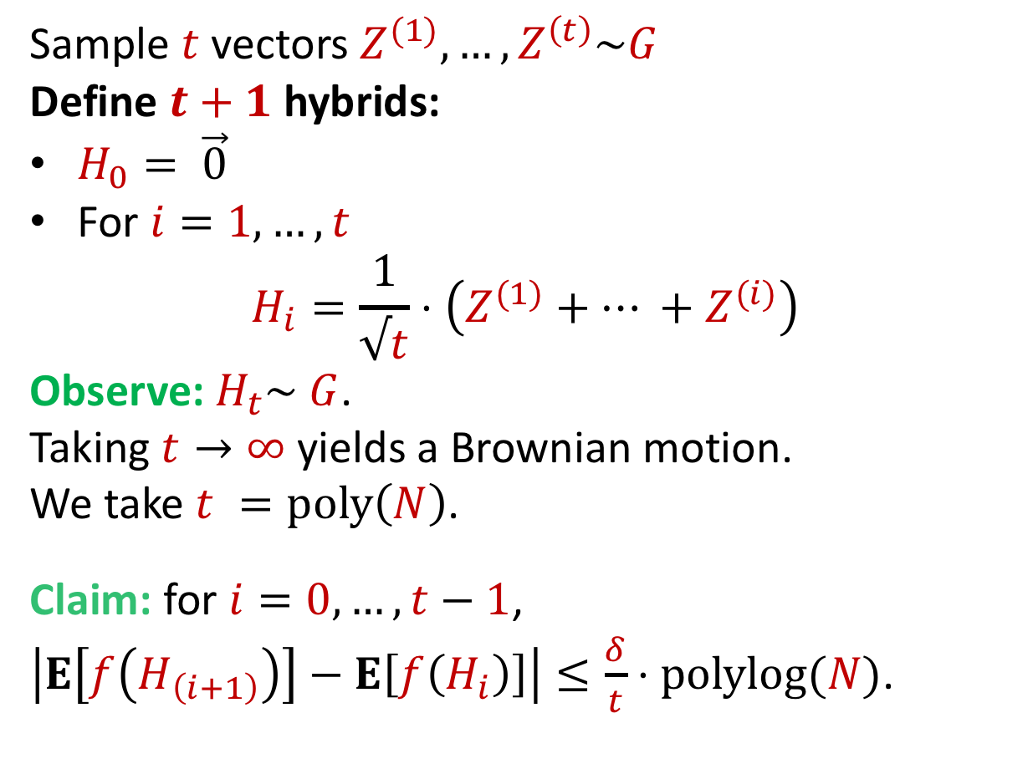

Viewing $Z\sim G$ as a result of a random walk
Sample $t$ vectors $Z^{(1)},…,Z^{\left(t\right)}\sim G$
Define $t+1$ hybrids:
$H_{0}= \vec{0}$
For $i=1,…,t$
$$H_{i}=\frac{1}{√t}⋅\left(Z^{(1)}+… +Z^{(i)}\right)$$
Observe: $H_{t}\sim G$.
Taking $t→∞$yields a Brownian motion.
We take $t =poly\left(N\right)$.
Claim: for $i=0, …, t−1$,
$\left|E\left[f\left(H_{\left(i+1\right)}\right)\right]−E\left[f\left(H_{i}\right)\right]\right|≤\frac{δ}{t}⋅polylog(N)$.
$$H_{t}$$
$$H_{i+1}$$
$$H_{i}$$
$$H_{1}$$
$$H_{0}$$

Slide 22
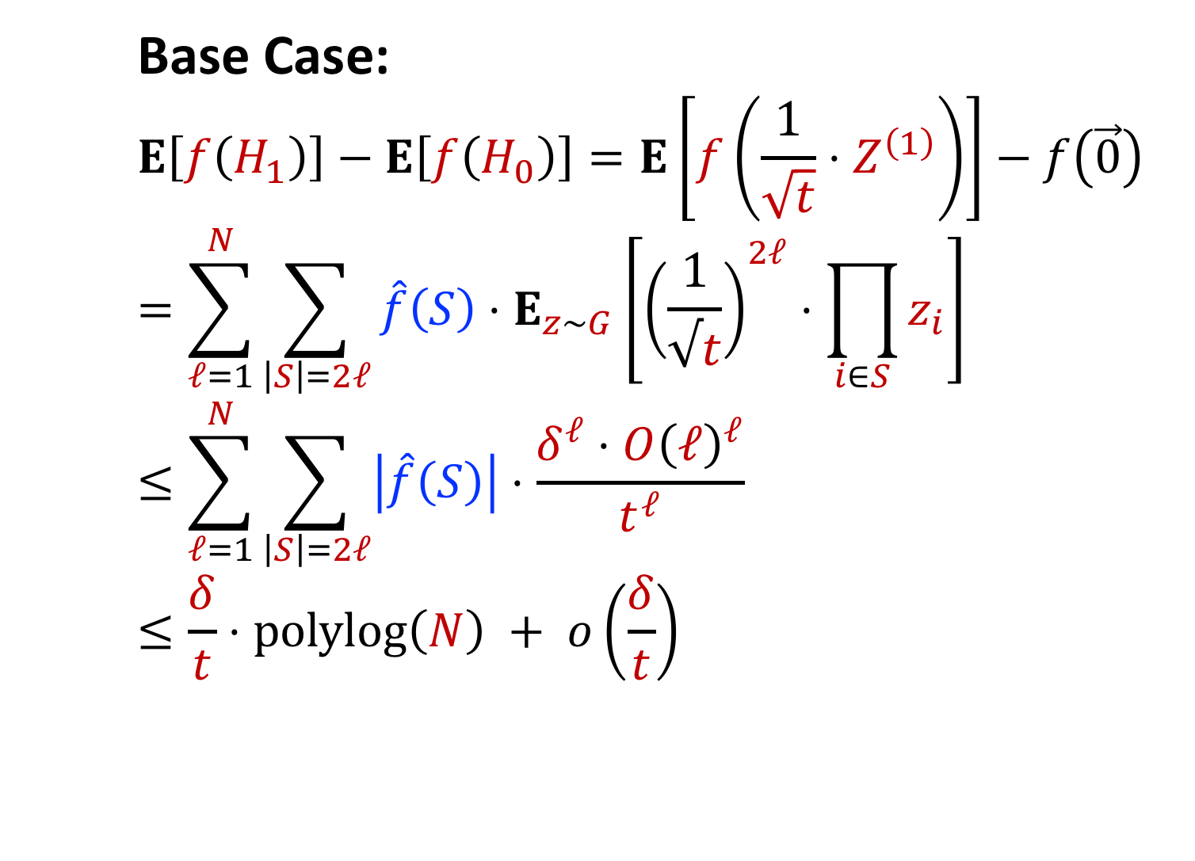
Claim - Base Case
Base Case:
$$E\left[f\left(H_{1}\right)\right]−E\left[f\left(H_{0}\right)\right]=E\left[f\left(\frac{1}{\sqrt{t}}⋅Z^{\left(1\right)}\right)\right]−f\left(\vec{0}\right)$$
$$=\sum_{ℓ=1}^{N}{\sum_{\left|S\right|=2ℓ}{\hat{f}\left(S\right)⋅E_{z∼G}\left[{\left(\frac{1}{√t}\right)}^{2ℓ}⋅\prod_{i∈S}{z_{i}}\right]}}$$
$$≤\sum_{ℓ=1}^{N}{\sum_{\left|S\right|=2ℓ}{\left|\hat{f}\left(S\right)\right|⋅\frac{δ^{ℓ}⋅O{\left(ℓ\right)}^{ℓ}}{t^{ℓ}}}}$$
$$≤\frac{δ}{t}⋅polylog\left(N\right) + o\left(\frac{δ}{t}\right)$$

Slide 23
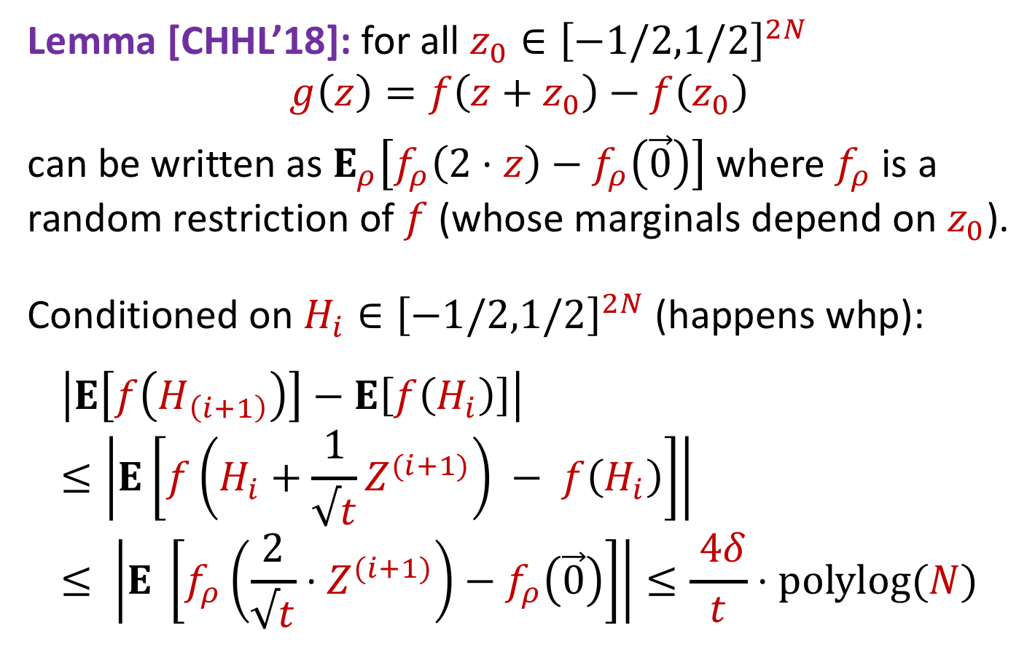
Reducing the General Case to the Base Case
Lemma [CHHL’18]: for all $z_{0}∈{\left[−1/2,1/2\right]}^{2N}$
$$g\left(z\right)=f\left(z+z_{0}\right)−f\left(z_{0}\right)$$
can be written as $E_{ρ}\left[f_{ρ}\left(2⋅z\right)−f_{ρ}\left(\vec{0}\right)\right]$ where $f_{ρ}$is a random restriction of $f$ (whose marginals depend on $z_{0}$).
Conditioned on $H_{i}∈{\left[−1/2,1/2\right]}^{2N}$ (happens whp):
$$\left|E\left[f\left(H_{\left(i+1\right)}\right)\right]−E\left[f\left(H_{i}\right)\right]\right|≤\left|E\left[f\left(H_{i}+\frac{1}{√t}Z^{(i+1)}\right) − f\left(H_{i}\right)\right]\right|≤ \left|E \left[f_{ρ}\left(\frac{2}{√t}⋅Z^{(i+1)}\right)−f_{ρ}\left(\vec{0}\right)\right]\right|≤\frac{ 4δ}{t}⋅polylog(N)$$

Slide 24

Recap: Proof by Picture
[CHHL’18]: i-th step $≈$ first step,
using closure under restrictions.
i-th step
First Step: Simple Fourier Analysis
Only second level matters.
first step

Slide 25
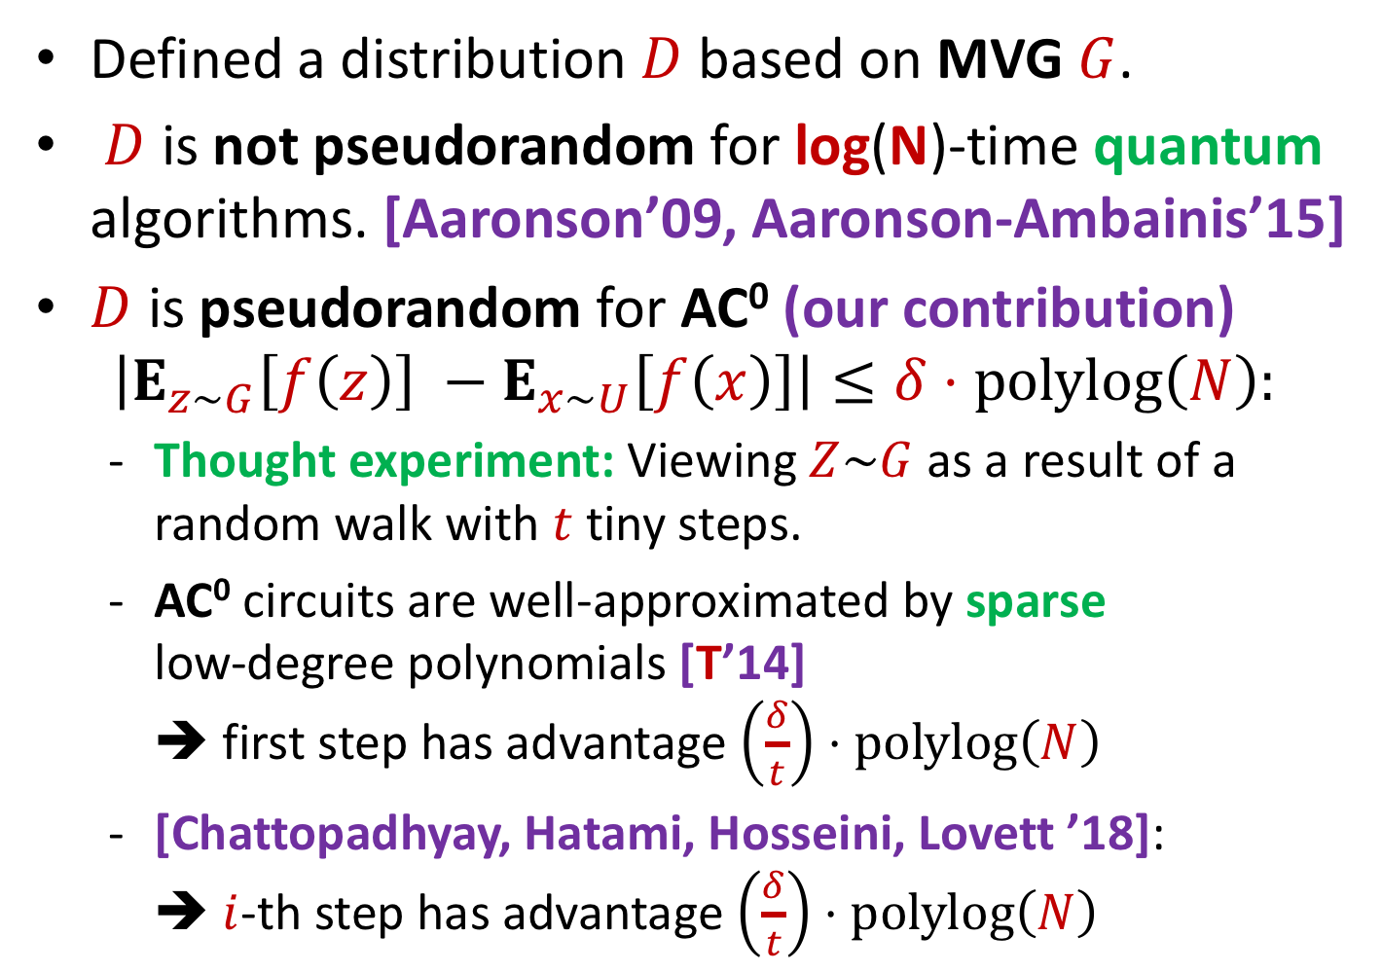
Recap
Defined a distribution $D$ based on MVG $G$.
$D$ is not pseudorandom for log(N)-time quantum algorithms. [Aaronson’09, Aaronson-Ambainis’15]
$D$ is pseudorandom for AC⁰ (our contribution)
$$\left|E_{z∼G}\left[f\left(z\right)\right] −E_{x∼U}\left[f\left(x\right)\right]\right|≤δ⋅polylog\left(N\right):$$
  Thought experiment: Viewing $Z\sim G$ as a result of a random walk with $t$ tiny steps.
  AC⁰ circuits are well-approximated by sparse
  low-degree polynomials [T’14]
  ➔ first step has advantage $\left(\frac{δ}{t}\right)⋅polylog\left(N\right)$
  [Chattopadhyay, Hatami, Hosseini, Lovett ’18]:
  ➔ $i$-th step has advantage $\left(\frac{δ}{t}\right)⋅polylog\left(N\right)$

Slide 26
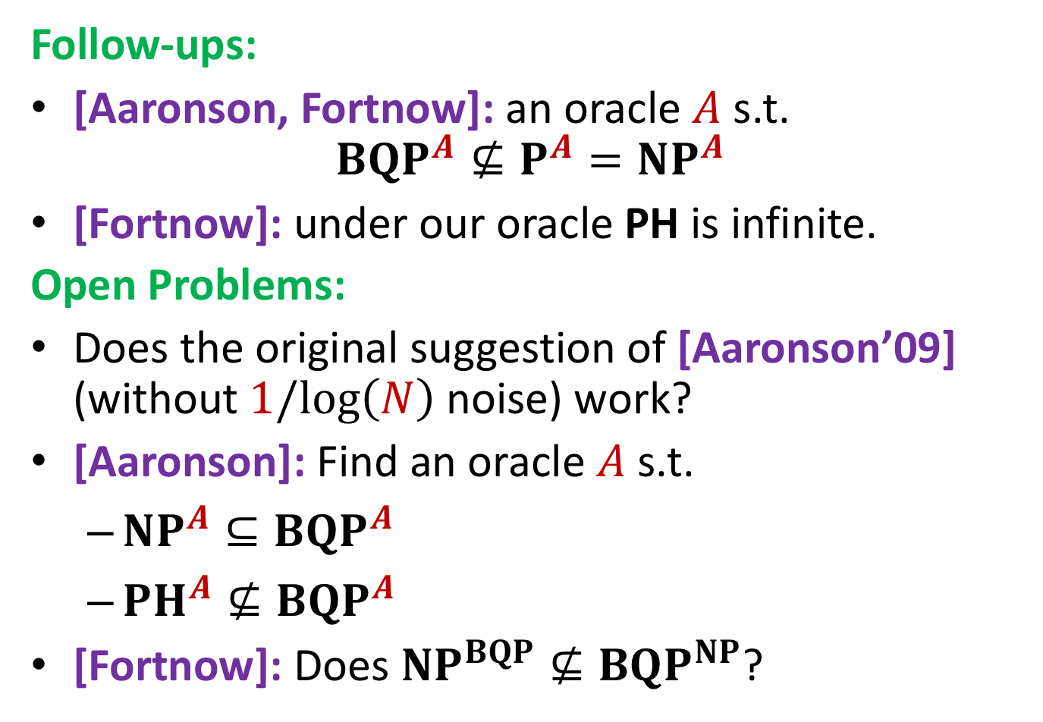
Open Problems & New results
Follow-ups:
[Aaronson, Fortnow]: an oracle $A$ s.t.
$BQP^{A}⊈P^{A}=NP^{A}$
[Fortnow]: under our oracle PH is infinite.
Open Problems:
Does the original suggestion of [Aaronson’09] (without $1/log\left(N\right)$noise) work?
[Aaronson]: Find an oracle $A$ s.t.
  $NP^{A}⊆BQP^{A}$
  ${PH}^{A}⊈BQP^{A}$
[Fortnow]: Does $NP^{BQP}⊈BQP^{NP}$?

Slide 27
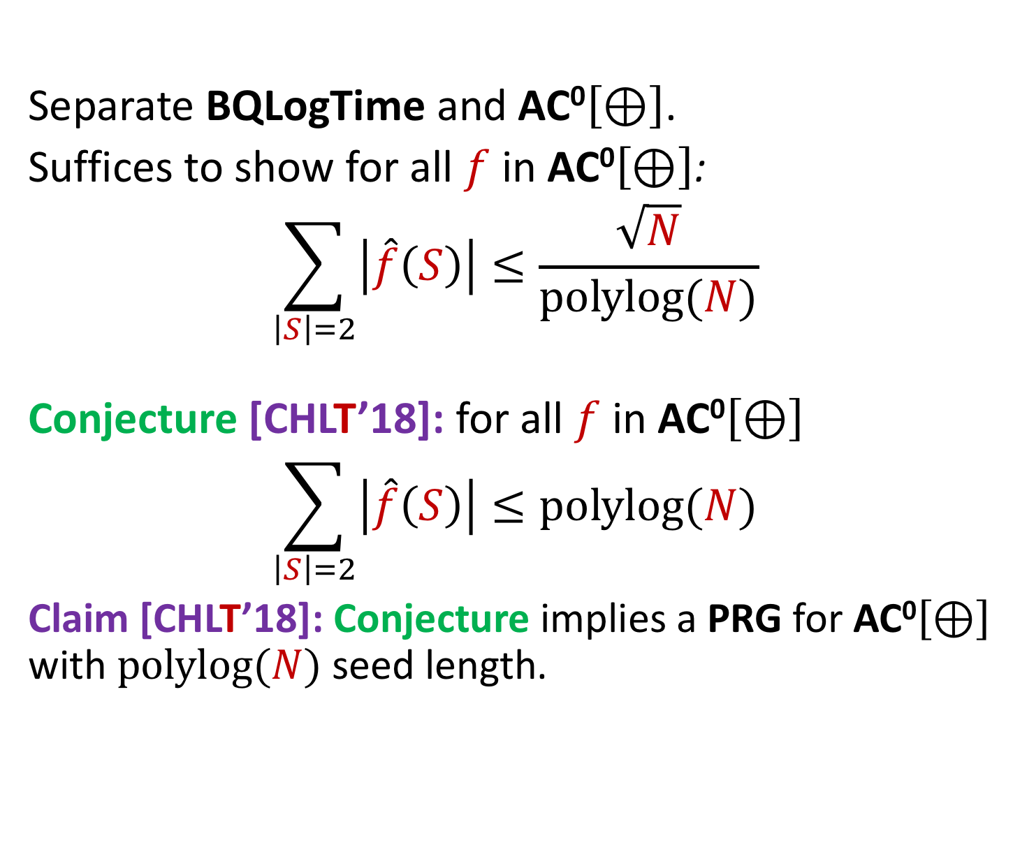
Open Problems 2: Pseudorandomness
Separate BQLogTime and AC⁰$\left[⊕\right]$.
Suffices to show for all $f$ in AC⁰$\left[⊕\right]$:
$$\sum_{\left|S\right|=2}{\left|\hat{f}\left(S\right)\right|}≤\frac{\sqrt{N}}{polylog(N)}$$
Conjecture [CHLT’18]: for all $f$ in AC⁰$\left[⊕\right]$
$$\sum_{\left|S\right|=2}{\left|\hat{f}\left(S\right)\right|}≤polylog(N)$$
Claim [CHLT’18]: Conjecture implies a PRG for AC⁰$\left[⊕\right]$
with $polylog(N)$seed length.

Slide 28
Thank You!
© Kevin Hong for Quanta Magazine

Slide 29
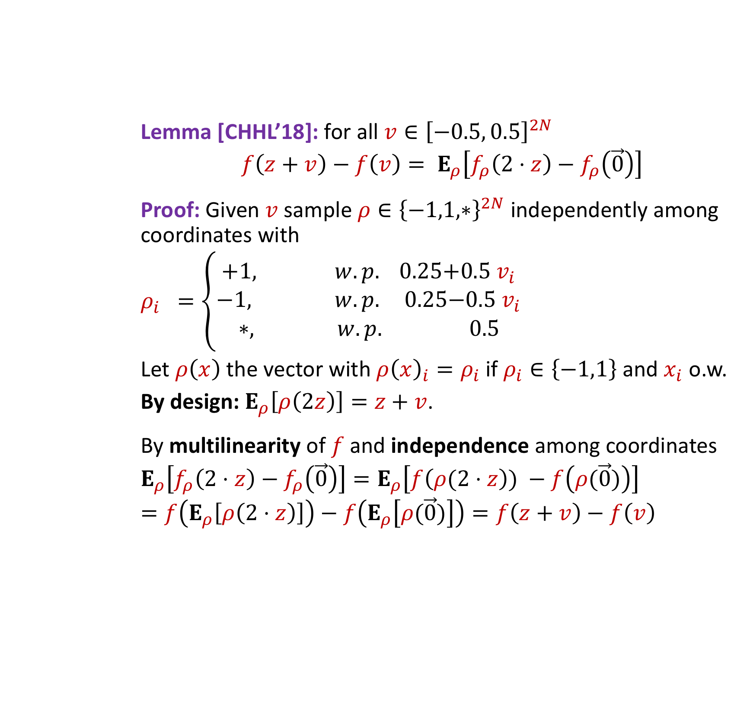
Reducing the General Case to the Base Case
Lemma [CHHL’18]: for all $v∈{\left[−0.5, 0.5\right]}^{2N}$
$$f\left(z+v\right)−f\left(v\right)= E_{ρ}\left[f_{ρ}\left(2⋅z\right)−f_{ρ}\left(\vec{0}\right)\right]$$
Proof: Given $v$ sample $ρ∈{\left\{−1,1,∗\right\}}^{2N}$ independently among coordinates with
$$ρ_{i} =\left\{\begin{aligned}+1, w.p. 0.25\text{+}0.5 v_{i} \\ −1, w.p. 0.25\text{−}0.5 v_{i} \\ ∗, w.p. 0.5\end{aligned}\right.$$
Let $ρ\left(x\right)$the vector with $ρ{\left(x\right)}_{i}=ρ_{i}$if $ρ_{i}∈\left\{−1,1\right\}$ and $x_{i}$ o.w.
By design: $E_{ρ}\left[ρ\left(2z\right)\right]=z+v$.
By multilinearity of $f$ and independence among coordinates
$$E_{ρ}\left[f_{ρ}\left(2⋅z\right)−f_{ρ}\left(\vec{0}\right)\right]=E_{ρ}\left[f\left(ρ(2⋅z\right)) −f\left(ρ(\vec{0})\right)\right]$$
$$=f\left(E_{ρ}\left[ρ\left(2⋅z\right)\right]\right)−f\left(E_{ρ}\left[ρ(\vec{0})\right]\right)=f\left(z+v\right)−f\left(v\right)$$

