Slide 1
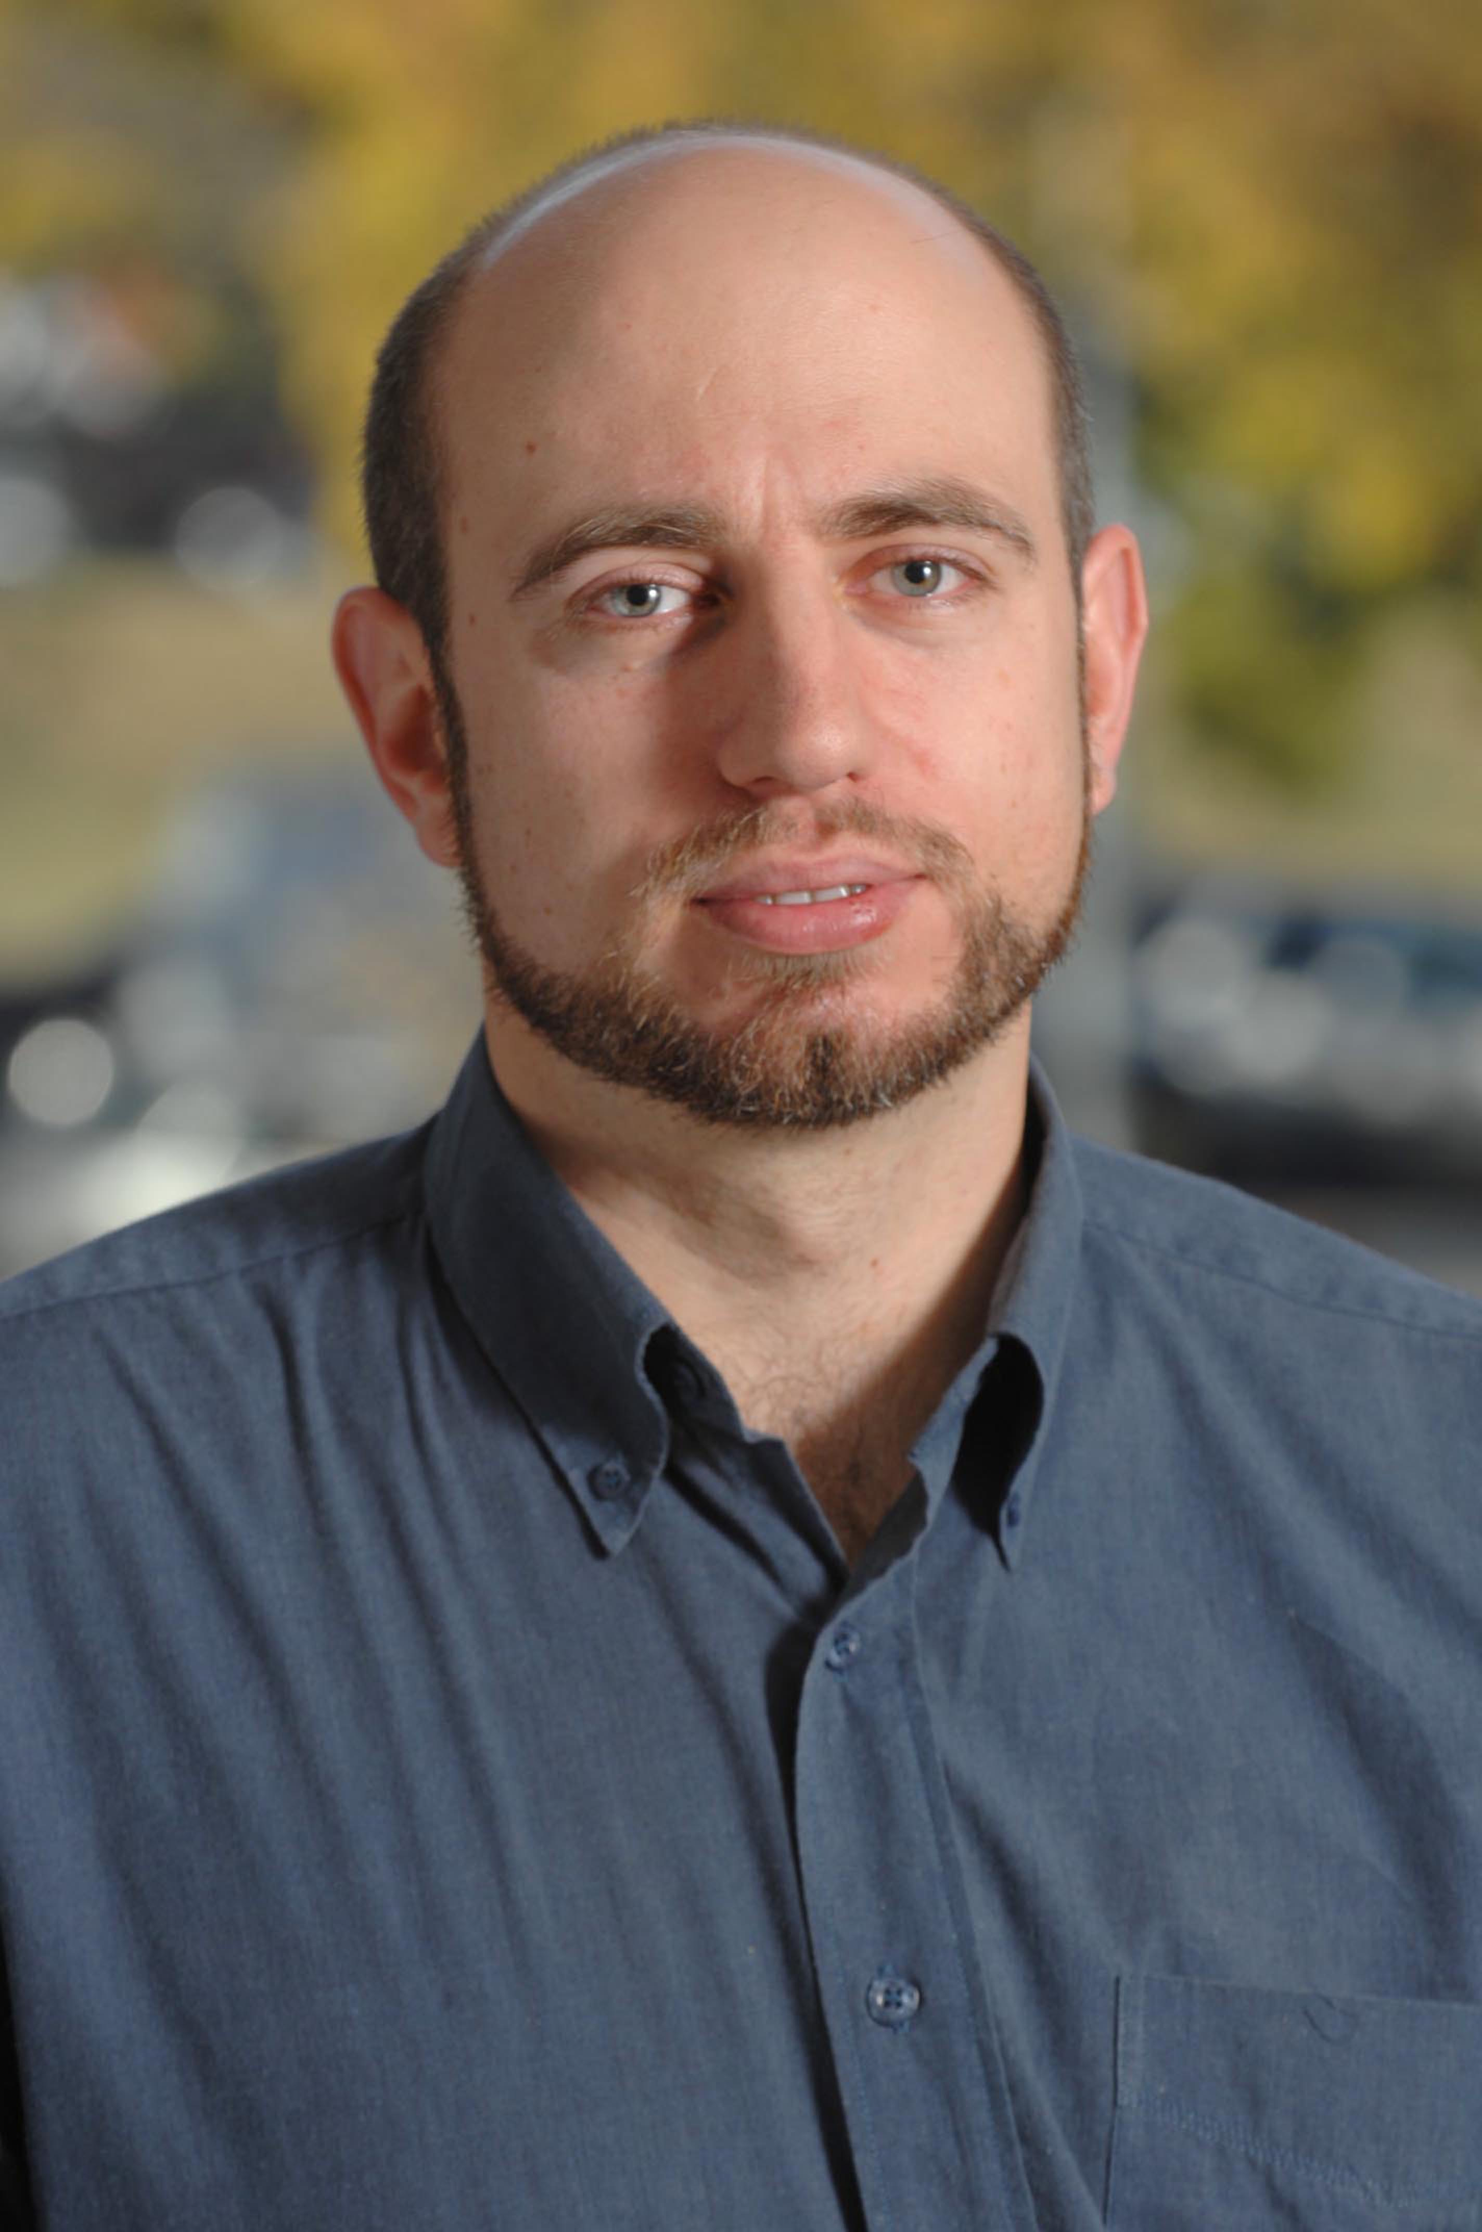
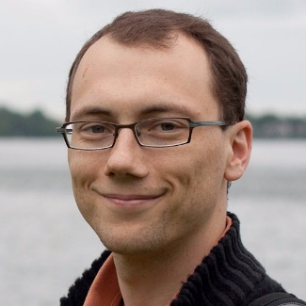
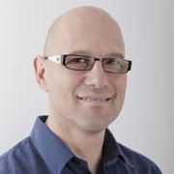
The Everlasting Database: Statistical Validity at a Fair Price
Blake Woodworth
TTIC
Nati Srebro
TTIC
Vitaly Feldman
Google
Saharon Rosset
Tel Aviv University

Slide 2
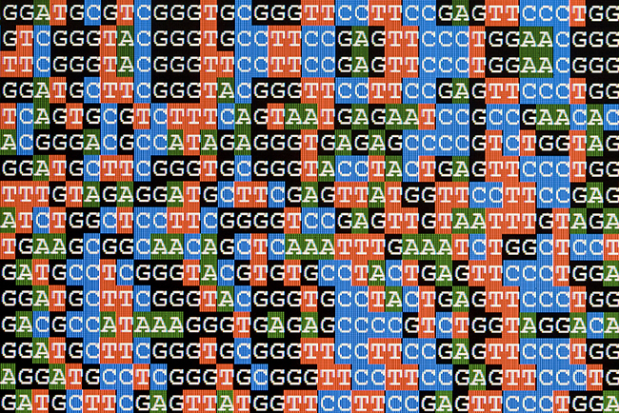
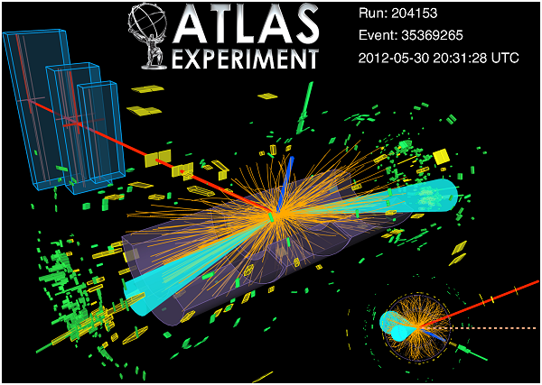
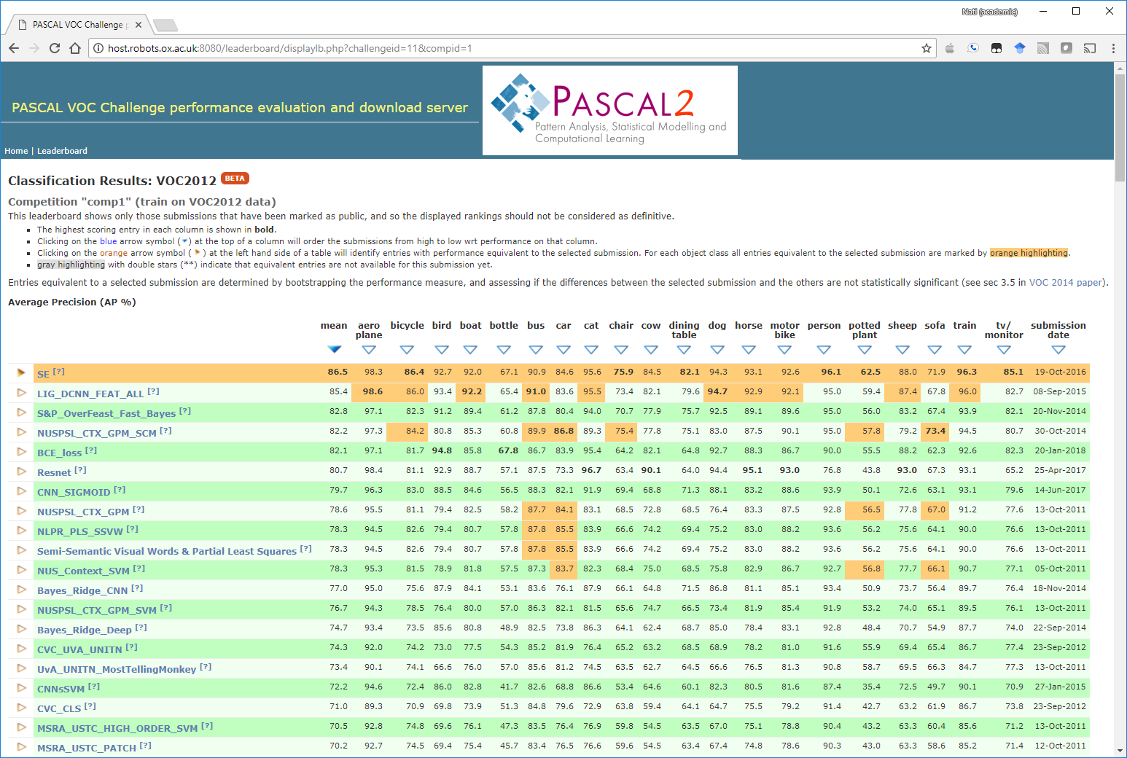
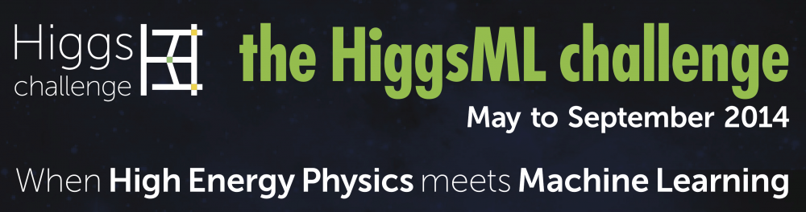
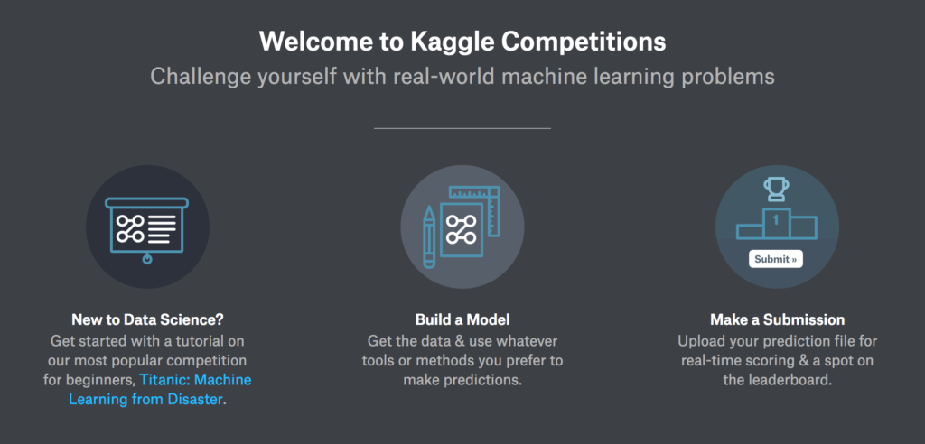
Validation in Machine Learning and Scientific Discovery
Notes:
Large public datasets drive research and discovery in scientific fields such as physics and genomics, and datasets like Imagenet are critically important to machine learning research.
Unfortunately, as previous speakers hopefully convinced you of earlier, there is evidence of false discoveries in science and collective overfitting to public benchmarks in machine learning. These are significant problems for scientific scholarship, and they require remedy.
To that end, we imagine ourselves in the role of a database curator. For instance, the NIH with patient medical data, the maintainers of Imagenet, or the commissioners of a Kaggle competition.
In addition to making data available, we see a potential additional role of providing reliable validation of putative discoveries or machine learning models.
A key purpose of this validation would be to serve as an authoritative stamp-of-approval, giving credence to published results and trying to weed out false discoveries before the enter the mainstream.
Concretely, I want to look at accurately answering statistical queries.
However, there is evidence that the scientific and machine learning communities as a whole have in some sense collectively overfit to these datasets. Given their importance, this raises the possibility that we might be drawing incorrect scientific conclusions.
We want to help mitigate these problems by providing provably reliable validation of putative scientific discoveries or machine learning models. In particular, we imagine ourselves in the role of a dataset curator – for example physicists at CERN who maintain a public repository of particle physics data, or the people who run the Imagenet Large Scale Visual Recognition Competition. In addition to providing public access to data,
Concretely, we look at the problem of answering statistical queries.

Slide 3
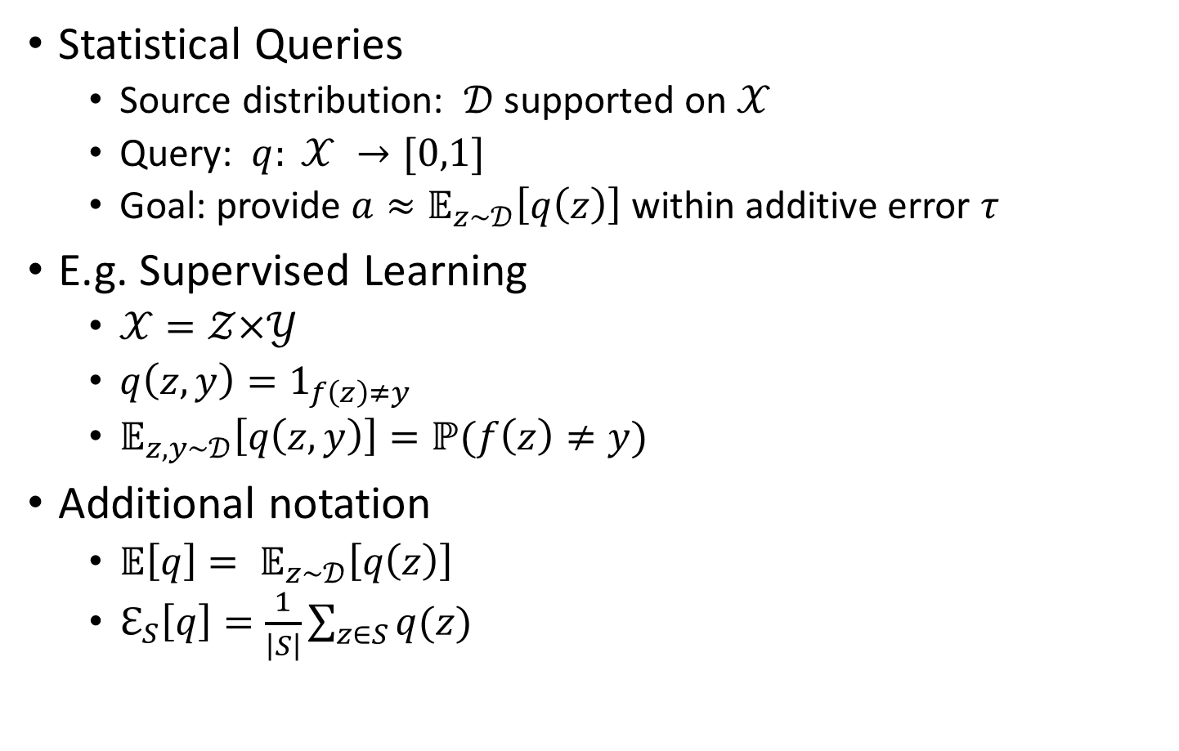
Statistical Queries
Statistical Queries
  Source distribution: $𝒟$ supported on $𝒳$
  Query: $q: 𝒳 →[0,1]$
  Goal: provide $a≈𝔼_{z∼𝒟}\left[q\left(z\right)\right]$ within additive error $τ$
E.g. Supervised Learning
  $𝒳=𝒵×𝒴$
  $q\left(z,y\right)=1_{f\left(z\right)≠y}$
  $𝔼_{z,y∼𝒟}\left[q\left(z,y\right)\right]=ℙ(f\left(z\right)≠y)$
Additional notation
  $𝔼\left[q\right]= 𝔼_{z∼𝒟}\left[q\left(z\right)\right]$
  $ℇ_{S}\left[q\right]=\frac{1}{\left|S\right|}\sum_{z∈S}{q(z)}$
Notes:
Just so that we are all on the same page notation-wise, a statistical query is composed of the following pieces.
There is a source distribution D supported on data universe X.
A statistical query is a predicate on X.
As an “answer” to the statistical query, we want to return a scalar which is within additive error tau of the expected value of the query.
This of course captures things like measuring the test loss in supervised learning and certain hypothesis testing scenarios such as testing for correlations.
Throughout the talk, I will use the following notation for brevity: blackboard E of q is the expected value of q(z) on the population and curly E sub S of q is the sample mean of q(z) on the dataset S.

Slide 4

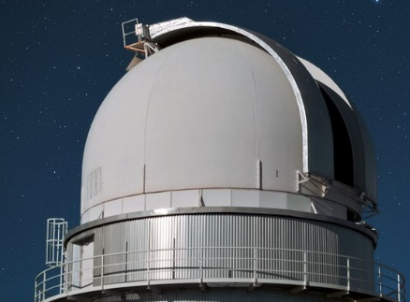
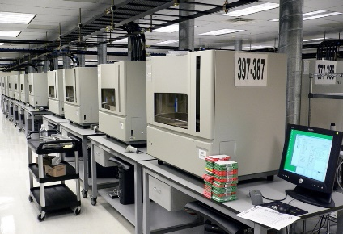
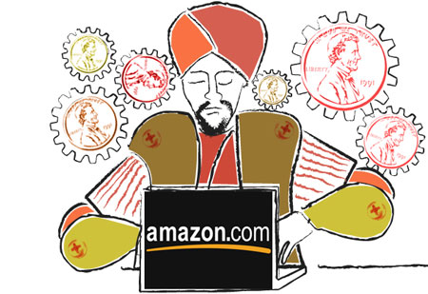






Validation Server
$$𝒟$$
Public/Training Data
Unrestricted Access
$$z∼𝒟$$
$$q:𝒳→[0,1]$$
Validation Server
$$a≈𝔼[q]$$
Notes:
This is the research situation as we see it. Scientists should have access to two types of data. There is public/training data which they have full access to. This is where they should be doing their discovery, training, model selection, hyperparameter tuning, etc. This is where the research happens.
Then, at the end of the day, when it is time to publish the paper, deploy the ML system, or what have you, they come to the validation server. They submit their model or discovery to the validation server in the form of a statistical query.
In our work we study the challenge of providing statistically valid answers to an arbitrarily long sequence of potentially adaptive statistical queries.
I want to distinguish this a little bit from how people have been talking about the problem so far today. They generally came from the perspective of having some dataset of a fixed size and seeing how far they could stretch it, i.e. how accurately they could answer a certain number of queries or how many queries could they answer at a given accuracy.
I want to turn that around a little bit. I am assuming that the accuracy at which I need to answer queries is fixed for me in advance, and the number of queries I will eventually get is unbounded. Thus, my validation server can’t be operating using a pre-collected dataset, because that would impose a limit the number of queries I can eventually answer at the desired accuracy.
As a result, we assume that the validation server has access to additional samples from the source distribution D, which is can purchase at a fixed cost per-sample.
The assumption that we can buy more data is often realistic. In astrophysics, we can pay for more telescope time, in particle physics we can pay for more accelerator runs, and in machine learning we can pay Mechanical Turkers to label more examples.
In order to fund the purchase of the needed data in an equitable way, the server will charge a price for each statistical query that a researcher submits.
So here is the overall picture. The researcher interacts however they like with the public data, and come up with some statistical queries that they’d like answered. They pay the validation server for accurate answers, and the proceeds go towards buying new data in order to maintain validity in perpetuity.
So how much should a query cost?

Slide 5

Goals
Validity: $ℙ\left(∀_{i} \left|𝔼\left[q_{i}\right]−a_{i}\right|<τ\right)≥1−β$
Sustainability: enough revenue is collected in order to fund the purchase of new samples
Cost for non-adaptive: the cost of making non-adaptive queries is as low as possible
Notes:
In order to decide how much to charge, we need to consider the goals of the validation server
The whole reason it exists is to provide provably reliable validation, so the most important goal is validity. We want all answers ever returned by the validation server to be accurate with high probability.
This would not be very useful if the server were not solvent. Thus, it has to set prices for the queries high enough that it can buy enough data to maintain validity forever.
Alone, the first two goals are very easy to accomplish --- simply charge a large price for every query, roughly 1/tau^2 would suffice.
However, this is much more expensive than it needs to be. We want to charge as little as possible.
However, the main purpose of the validation server is validation, not training or discovery, so we want to reward researchers who are doing good science with non-adaptive validation queries. Thus, we prioritize making non-adaptive queries as inexpensive as possible.
For adaptive queries, we will charge as much as we need to in order to maintain validity.

Slide 6

Adaptivity
Non-adaptive queries: can answer $M$ queries with $Θ\left(\frac{\log{M}}{τ^{2}}\right)$ samples (e.g. sample mean)
Adaptive queries: can answer $M$ queries with $Θ\left(\frac{\sqrt{M}}{τ^{2}}\right)$ samples (e.g. Laplace/Gaussian mechanism)
Notes:
Of course, as was explained this morning, there is a sharp difference in the sample complexity of answering adaptive vs non-adaptive queries.
On the one hand, non-adaptive queries are easily answered using a very modest amount of data. In particular, M non-adaptive queries can be answered to accuracy tau using only order log M samples.
On the other hand, adaptive queries are much more difficult to answer. It provably takes at least order sqrt M samples to answer M adaptive queries.
Thus, unavoidably, different queries “use up” the database’s samples at different rates.
So, a reasonable and equitable thing to do is to try to charge a price that depends on the query in question.

Slide 7

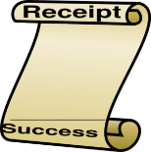



Everlasting Validity
$$𝒟$$
Public/Training Data
Unrestricted Access
$$z∼𝒟$$
$$q_{i}:𝒳→[0,1]$$
Validation Server
$$a_{i}≈𝔼[q_{i}]$$
$$p_{i}$$
Notes:
So, the scenario we envision is as follows.
After a researcher has done their training or discovery and has a statistical query to test,
The user submits their query along with their credit card number,
The validation server examines the query and calculates both an answer and a price, which they charge to the credit card,
And finally the user receives the answer and the receipt.

Slide 8
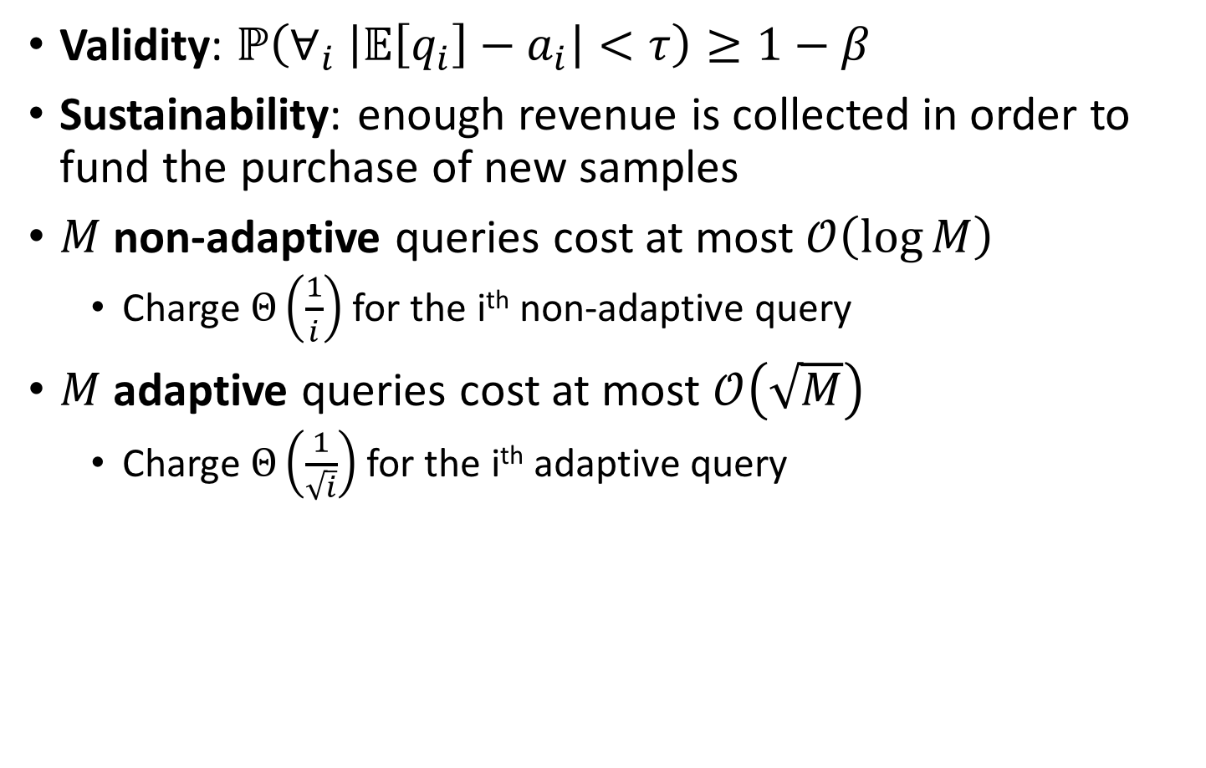
What can we hope for?
Validity: $ℙ\left(∀_{i} \left|𝔼\left[q_{i}\right]−a_{i}\right|<τ\right)≥1−β$
Sustainability: enough revenue is collected in order to fund the purchase of new samples
$M$ non-adaptive queries cost at most $𝒪\left(\log{M}\right)$
  Charge $Θ\left(\frac{1}{i}\right)$ for the i^{th} non-adaptive query
$M$ adaptive queries cost at most $𝒪\left(\sqrt{M}\right)$
  Charge $Θ\left(\frac{1}{\sqrt{i}}\right)$ for the i^{th} adaptive query
Notes:
So, returning to our goals, what are the best price guarantees we can hope for?
For non-adaptive queries, it is certainly impossible to guarantee that M queries will cost any less than order log M, since that is the sample complexity.
Similarly, for adaptive queries, we can’t guarantee that M queries will cost less than order sqrt M.
If we knew which queries were non-adaptive and which were adaptive, we could achieve this by charging 1/i for the ith non-adaptive query and 1/sqrt(i) for the ith adaptive query.
Unfortunately, we have to keep in mind that the database has no way of knowing for sure which queries are adaptive and which aren’t.
So we have no way of implementing this particular pricing scheme.
In fact, we suspect that this particular set of price guarantees might be impossible to achieve.
However, we do have a method for providing a similar set of guarantees based on a slightly more specific notion of adaptivity.
To explain, I want to formalize exactly what is meant by non-adaptive or adaptive queries, being very precise about how queries are generated, and what they may depend on.

Slide 9
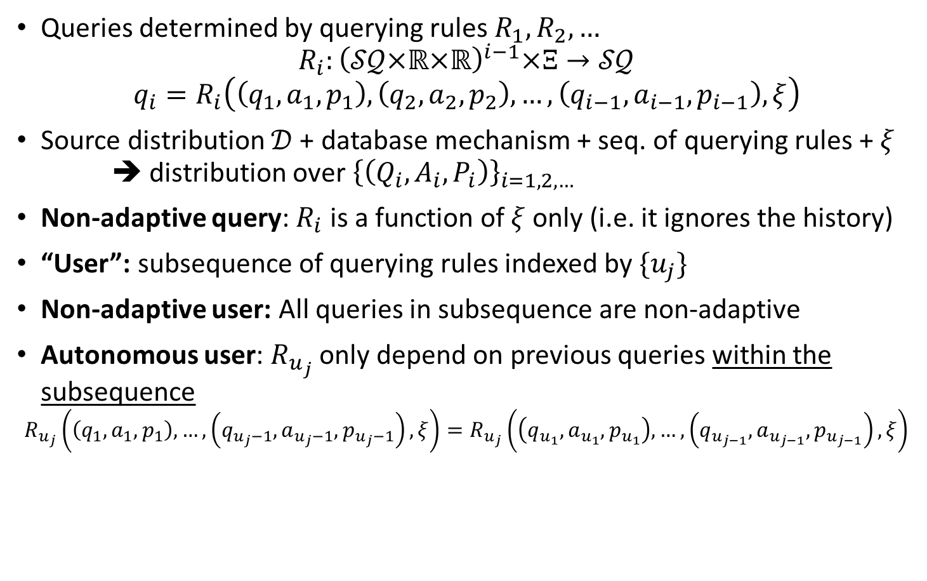
Formal Model of Adaptivity
Shared, independent source of randomness
Queries determined by querying rules $R_{1},R_{2},…$
$$R_{i}:{\left(𝒮𝒬×ℝ×ℝ\right)}^{i−1}×Ξ→𝒮𝒬$$
$$q_{i}=R_{i}\left(\left(q_{1},a_{1},p_{1}\right),\left(q_{2},a_{2},p_{2}\right),…,\left(q_{i−1},a_{i−1},p_{i−1}\right),ξ\right)$$
Source distribution $𝒟$ + database mechanism + seq. of querying rules + $ξ$
➔ distribution over ${\left\{\left(Q_{i},A_{i},P_{i}\right)\right\}}_{i=1,2,…}$
Non-adaptive query: $R_{i}$ is a function of $ξ$only (i.e. it ignores the history)
“User”: subsequence of querying rules indexed by $\{u_{j}\}$
Non-adaptive user: All queries in subsequence are non-adaptive
Autonomous user: $R_{u_{j}}$ only depend on previous queries within the subsequence
$$R_{u_{j}}\left(\left(q_{1},a_{1},p_{1}\right), …,\left(q_{u_{j}−1},a_{u_{j}−1},p_{u_{j}−1}\right),ξ\right)=R_{u_{j}}\left(\left(q_{u_{1}},a_{u_{1}},p_{u_{1}}\right), …,\left(q_{u_{j−1}},a_{u_{j−1}},p_{u_{j−1}}\right),ξ\right)$$
Notes:
We model the sequence of all queries as being generated by a sequence of “querying rules”.
The ith querying rule R_i is a mapping which takes the history of the first i-1 statistical queries, answers, and prices, along with xi, a source of shared randomness, and outputs a new statistical query to submit as q_i.
This sequence of querying rules along with the source distribution and the query answering and pricing mechanism together specify a joint distribution over the sequence of queries, answers, and prices. All probabilities in our theorem statements are in terms of this joint distribution.
We define a non-adaptive query as a query which is generated from a querying rule which ignores the history.
We call a subsequence of the queries a “user.” Although it is important to keep in mind that a “user” is not necessarily a single individual, research group, company, etc.
A non-adaptive user is a subsequence of queries, all of which are non-adaptive. Again, this may be the queries of a single individual, or it may not be. The only defining characteristic is that all of the queries in the subsequence are non-adaptive.
An AUTONOMOUS user on the other hand, is a subsequence of the queries which may contain adaptive queries, but for which the querying rules only depend on previous queries and answers WITHIN THE SUBSEQUENCE. Again, this may or may not correspond to queries made by a single individual. It is simply a subsequence of the queries that are only adaptive to themselves.
With these definitions in hand, I will show you the guarantees of our algorithm:

Slide 10
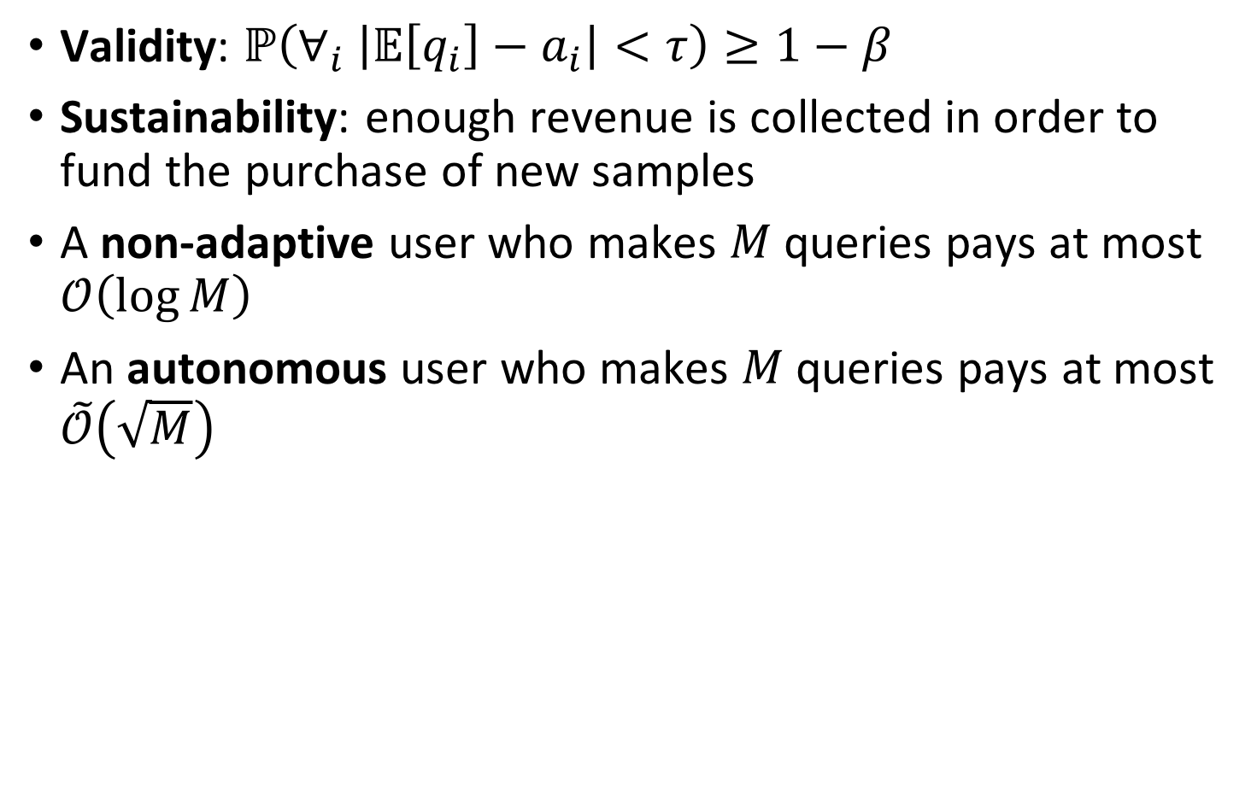
EverlastingValidation
Validity: $ℙ\left(∀_{i} \left|𝔼\left[q_{i}\right]−a_{i}\right|<τ\right)≥1−β$
Sustainability: enough revenue is collected in order to fund the purchase of new samples
A non-adaptive user who makes $M$ queries pays at most $𝒪\left(\log{M}\right)$
An autonomous user who makes $M$ queries pays at most $\tilde{𝒪}\left(\sqrt{M}\right)$
Notes:
First and foremost, we guarantee validity and sustainability.
Along with those, we have two cost guarantees.
We guarantee that a “non-adaptive user” who makes M queries pays at most order log M. Up to constants, this is the best we could hope for.
We also guarantee that an “autonomous” user consisting of M queries pays roughly order sqrt M. This matches up to logarithmic factors the best we could possibly hope to guarantee for ADAPTIVE queries, although the notion of an autonomous user is somewhat more restricted.
I want to emphasize that all mention of users and autonomy are in the analysis. From the database’s perspective, it receives queries, it calculates an answer and a price, and it returns them. It does not need to keep track of different subsequences of the queries it receives, who is making them, or which subsequence of queries is being considered non-adaptive or autonomous for the purposes of price guarantees.
Let me explain now how we achieve these guarantees.

Slide 11
Round-Based Scheme
Buy initial dataset
Repeat:
Answer queries using current dataset
Charge enough to afford new, fresh dataset
Once current one is “used up”, discard it
Buy new dataset
Notes:
Our approach is a simple, general round-based scheme.
We start each round with a set of fresh samples
We use them to answer queries through some mechanism
As we answer queries, we charge enough to buy the next set of samples
Repeat forever.
To explain our particular instantiation of this, I will start with the mechanism by which we answer queries within each round, which we call ValidationRound.

Slide 12
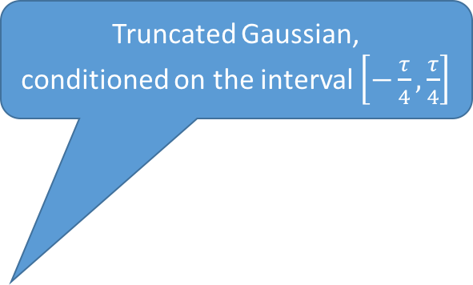

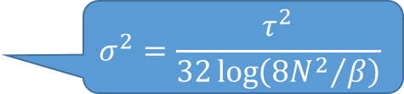
ValidationRound
Using $S,T∼𝒟^{N}$
For each query $i=1,2,3,…$
  If $i≥\frac{β}{4}\exp\left(\frac{Nτ^{2}}{8}\right)$, Halt (type 1)
  Elif $\left|ℰ_{S}\left[q_{i}\right]−ℰ_{T}\left[q_{i}\right]\right|>\frac{τ}{2}$, Halt (type 2)
  Else
  output $a_{i}=ℰ_{S}[q_{i}]+𝒩_{τ/4}(0,σ^{2})$
Truncated Gaussian,
conditioned on the interval $\left[−\frac{τ}{4},\frac{τ}{4}\right]$
$$σ^{2}=\frac{τ^{2}}{32\log\left({8N^{2}}/β\right)}$$
~ Number of non-adaptive queries that can be answered using $N$ samples
“Validity check”
Notes:
Let’s go through this. ValidationRound uses two datasets, S and T of size N each.
For most queries, it simply returns the sample mean of q_i on the dataset S plus some additional random noise, which is distributed according to the truncated gaussian distribution, which is simply gaussian noise conditioned on being in the interval from –tau/4 to tau/4.
There are two ways that the algorithm might halt and refuse to answer more queries: we call them type 1 and type 2 halts.
Red box: A type 1 halt occurs once a certain number of queries are answered.
This is the number of non-adaptive queries that can be answered using N samples. If we answer more than this many queries, even if all of them are non-adaptive, we risk answering inaccurately.
Yellow box: I will refer to the other condition as the “validity check.” This triggers a type 2 halt if the sample means of a query are significantly different on S and on T.
One way of looking at the validity check, is as a means of identifying queries that are “badly adaptive.” In particular, non-adaptive queries, with high probability, will never fail this check, because the sample mean of a non-adaptive query on both S and T will be very close to the population mean. Sometimes, adaptive queries will pass this validity check too, as long as their sample means on S are still relatively close to their population means.
The purpose of the validity check is to guarantee that all of our answers are accurate.
The argument goes like this:
Looking at how the answer is calculated, as long as the empirical mean of q_i on S is close enough to the population mean, then the answer is accurate since the truncated gaussian noise is bounded.
Therefore, as long as the empirical mean of q_i on T is close enough to the population mean, the query will only pass the validity check if the eventual answer will be accurate
I will now argue that the empirical mean of q_i on T will always be close to the population mean with high probability, no matter how adaptive a query might be.

Slide 13
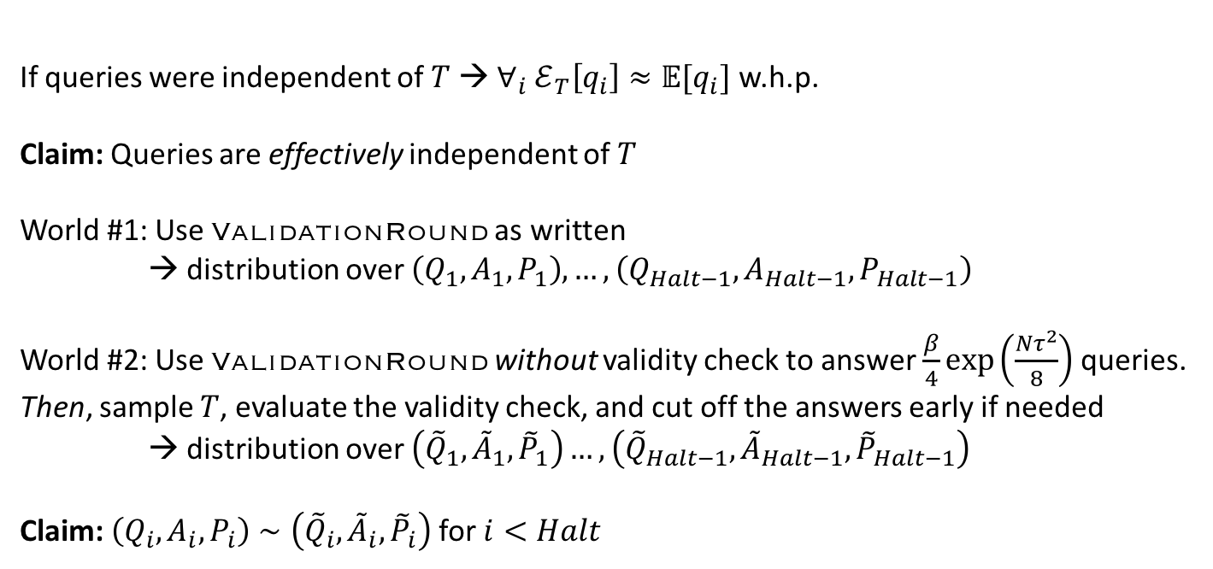
Validity Check
If queries were independent of $T$ → $∀_{i} ℰ_{T}\left[q_{i}\right]≈𝔼[q_{i}]$ w.h.p.
Claim: Queries are effectively independent of $T$
World #1: Use ValidationRound as written
→ distribution over $\left(Q_{1},A_{1},P_{1}\right), …, \left(Q_{Halt−1},A_{Halt−1},P_{Halt−1}\right)$
World #2: Use ValidationRound without validity check to answer $\frac{β}{4}\exp\left(\frac{Nτ^{2}}{8}\right)$ queries. Then, sample $T$, evaluate the validity check, and cut off the answers early if needed
→ distribution over $\left({\tilde{Q}}_{1},{\tilde{A}}_{1},{\tilde{P}}_{1}\right)…,\left({\tilde{Q}}_{Halt−1},{\tilde{A}}_{Halt−1},{\tilde{P}}_{Halt−1}\right)$
Claim: $\left(Q_{i},A_{i},P_{i}\right)∼\left({\tilde{Q}}_{i},{\tilde{A}}_{i},{\tilde{P}}_{i}\right)$ for $i<Halt$
Notes:
If q_i were statistically independent of T, then the sample mean of q_i on T would be close to the population mean for all i by standard concentration inequalities.
Of course, the queries are not quite independent of T. Nevertheless, I claim that they are pretty much independent in the following way:
Consider two scenarios:
First, consider using Validationround as stated. This imposes a certain distribution over queries, answers, and prices up until a halt.
On the other hand, consider using Validation round to answer all of the queries up until a type 1 halt, ignoring the validity check. Then, sample the second dataset T, go through all the queries and evaluate the validity check after the fact, and cut off the sequence early if any of the queries fail the validity check. This also imposes a distribution over queries answers and prices.
In the second case, the queries are all generated before T is even sampled, so their sample means on T will be accurate with high probability.
I claim that the distribution over queries, answers, and prices BEFORE THE HALT is the same in both cases, therefore the sample mean on T will be accurate for ValidationRound as written too.

Slide 14
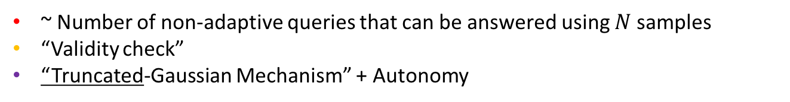
ValidationRound
Using $S,T∼𝒟^{N}$
For each query $i=1,2,3,…$
  If $i≥\frac{β}{4}\exp\left(\frac{Nτ^{2}}{8}\right)$, Halt (type 1)
  Elif $\left|ℰ_{S}\left[q_{i}\right]−ℰ_{T}\left[q_{i}\right]\right|>\frac{τ}{2}$, Halt (type 2)
  Else
  output $a_{i}=ℰ_{S}[q_{i}]+𝒩_{τ/4}(0,σ^{2})$
Truncated Gaussian,
conditioned on the interval $\left[−\frac{τ}{4},\frac{τ}{4}\right]$
$$σ^{2}=\frac{τ^{2}}{32\log\left({8N^{2}}/β\right)}$$
~ Number of non-adaptive queries that can be answered using $N$ samples
“Validity check”
“Truncated-Gaussian Mechanism” + Autonomy
Notes:
Purple box: So, whenever we pass the validity check, the sample mean on S is accurate and so is the answer a_i.
However, this would not be very useful if ValidationRound only answered 1 or a small number of queries before failing the validity check and halting forever.
We would like some assurance that ValidationRound will make good use of our 2N samples and answer many queries before it halts, even when many of the queries are adaptively chosen.
As I have already argued, the sample mean on T is always accurate so, the algorithm does NOT type 2 halt as long as the sample mean on S is accurate too.
I will now explain why the sample mean on S will be accurate for a large number of queries, even adaptive ones.
This should also give some insight into why we need to look at autonomous users, and why we use truncated gaussian noise rather than laplace or regular gaussian noise.

Slide 15
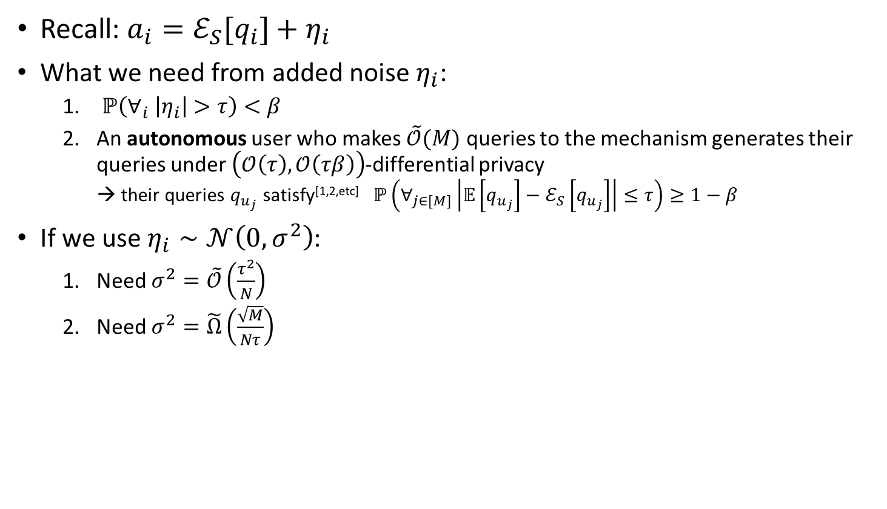

Truncated-Gaussian Mechanism
+ “Autonomy”
Recall: $a_{i}=ℰ_{S}[q_{i}]+η_{i}$
What we need from added noise $η_{i}$:
  $ℙ\left(∀_{i} \left|η_{i}\right|>τ\right)<β$
  An autonomous user who makes $\tilde{𝒪}(M)$ queries to the mechanism generates their queries under $\left(𝒪\left(τ\right),𝒪\left(τβ\right)\right)$-differential privacy
  → their queries $q_{u_{j}}$ satisfy^{[1,2,etc]} $ℙ\left(∀_{j∈[M]}\left|𝔼\left[q_{u_{j}}\right]−ℰ_{S}\left[q_{u_{j}}\right]\right|≤τ\right)≥1−β$
If we use $η_{i}∼𝒩\left(0,σ^{2}\right)$:
  Need $σ^{2}=\tilde{𝒪}\left(\frac{τ^{2}}{N}\right)$
  Need $σ^{2}=\tilde{Ω}\left(\frac{\sqrt{M}}{Nτ}\right)$
Must have $M=𝒪\left(τ^{6}\right)≤1$
[1] Nissim and Stemmer 2015 [2] Dwork et al 2015
Notes:
Assuming we pass the validity check, we answer queries according to their sample mean plus some added noise, call it eta.
Since the query passed the validity check, the sample mean on S is accurate, so we need to make sure that eta is always small, or else we will answer inaccurately. Therefore, eta must have extremely LIGHT tails, since we might answer an exponentially large number of queries.
On the other hand, we want to pass the validity check for a large number of potentially adaptive queries.
For this, we use tools from differential privacy. We argue that answering in this way ensures that the statistical queries are generated under differential privacy with respect to the dataset S. As Aaron and Adam mentioned earlier, this ensures that the empirical mean of the queries on S are accurate, even when the queries are generated adaptively.
Of course, in order to ensure a sufficient level of privacy, we need control over the number of differentially private algorithms are being composed in order to apply the advanced composition theorem. This is why we look at autonomous users. The M queries make by an autonomous user are the composition of at most M differentially private computations. Contrast this with an arbitrary adaptive query, which might be the composition of many more, even exponentially many private computations, which would prevent us from ensuring any useful generalization.
In order to achieve the necessary level of differential privacy, it turns out that we need eta to have sufficiently HEAVY tails.
So for accuracy, we need eta to have light tails, and to get privacy and thus generalization we need eta to have heavy tails, this tension is a source of significant difficulty.
Consider what would happen if we used regular, untruncated gaussian noise:
In order to answer accurately for an exponentially large number of queries, the variance needs to be quite small
On the other hand, ensuring sufficient privacy for generalization requires the variance to be relatively large
Unfortunately, these cannot be satisfied simultaneously for M larger than 1.
Therefore, if we used regular gaussian noise, we can only guarantee an answer for a single query before we might fail a validity check and halt.

Slide 16
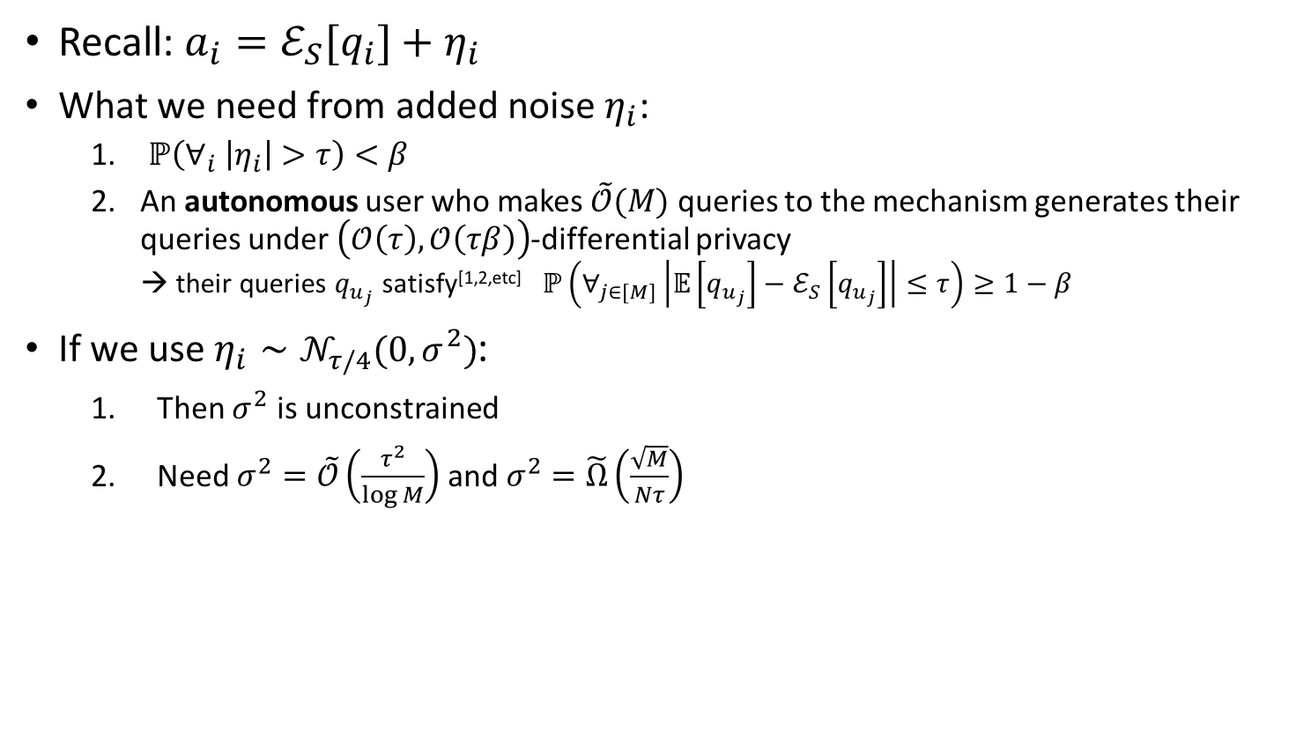

Truncated-Gaussian Mechanism
+ “Autonomy”
Recall: $a_{i}=ℰ_{S}[q_{i}]+η_{i}$
What we need from added noise $η_{i}$:
  $ℙ\left(∀_{i} \left|η_{i}\right|>τ\right)<β$
  An autonomous user who makes $\tilde{𝒪}(M)$ queries to the mechanism generates their queries under $\left(𝒪\left(τ\right),𝒪\left(τβ\right)\right)$-differential privacy
  → their queries $q_{u_{j}}$ satisfy^{[1,2,etc]} $ℙ\left(∀_{j∈[M]}\left|𝔼\left[q_{u_{j}}\right]−ℰ_{S}\left[q_{u_{j}}\right]\right|≤τ\right)≥1−β$
  If we use $η_{i}∼𝒩_{τ/4}(0,σ^{2})$:
    Then $σ^{2}$ is unconstrained
    Need $σ^{2}=\tilde{𝒪}\left(\frac{τ^{2}}{\log{M}}\right)$ and $σ^{2}=\tilde{Ω}\left(\frac{\sqrt{M}}{Nτ}\right)$
Can set $M=\tilde{Ω}\left(N^{2}τ^{4}\right)$
[1] Nissim and Stemmer 2015 [2] Dwork et al 2015
Notes:
On the other hand, here is the situation when we use truncated gaussian noise.
Since eta is bounded, the variance can be as large or small as you want, and we will still answer accurately.
In order to ensure sufficient privacy, we first argue that if the variance is small enough then an autonomous user will not notice the truncation, and thus the truncated gaussian mechanism will behave just like the regular gaussian mechanism. We then argue that if the variance is large enough, then the regular gaussian mechanism provides the required level of privacy and thus generalization.
Optimizing over M, the truncated gaussian noise allows us to ensure that an autonomous user will only trigger a type 2 halt once they have made at least order N^2 queries.

Slide 17

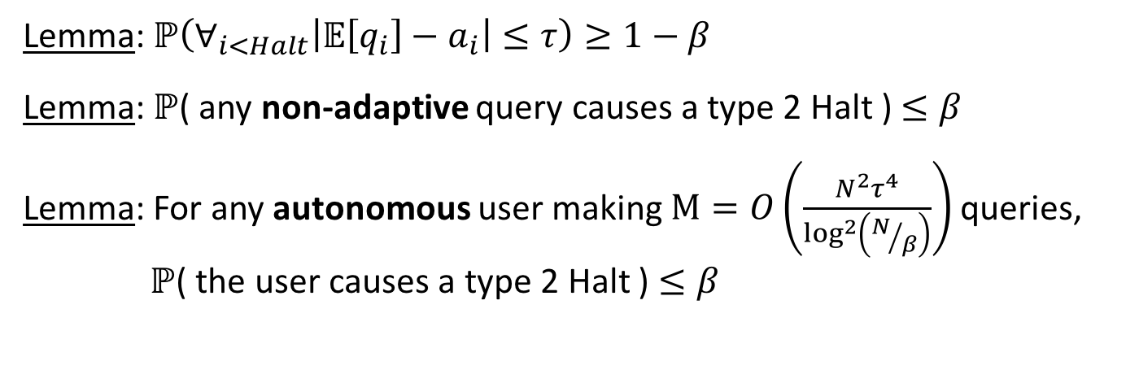
ValidationRound
Using $S,T∼𝒟^{N}$
For each query $i=1,2,3,…$
  If $i≥\frac{β}{4}\exp\left(\frac{Nτ^{2}}{8}\right)$, Halt (type 1)
  Elif $\left|ℰ_{S}\left[q_{i}\right]−ℰ_{T}\left[q_{i}\right]\right|>\frac{τ}{2}$, Halt (type 2)
  Else
  output $a_{i}=ℰ_{S}[q_{i}]+𝒩_{τ/4}(0,σ^{2})$
Lemma: $ℙ\left(∀_{i<Halt}\left|𝔼\left[q_{i}\right]−a_{i}\right|≤τ\right)≥1−β$
Lemma: $ℙ$( any non-adaptive query causes a type 2 Halt ) $≤β$
Lemma: For any autonomous user making $M=O\left(\frac{N^{2}τ^{4}}{\log^{2}\left(N/β\right)}\right)$ queries,
$ℙ$( the user causes a type 2 Halt ) $≤β$
Notes:
To summarize,
ValidationRound ensures that all of the answers it gives before halting are accurate
Non-adaptive queries never case a type 2 halt,
And autonomous users can only cause a type 2 halt once they’ve made at least order N^2 queries.
Returning to the big picture, I have explained how we answer queries within each round – using ValidationRound.

Slide 18
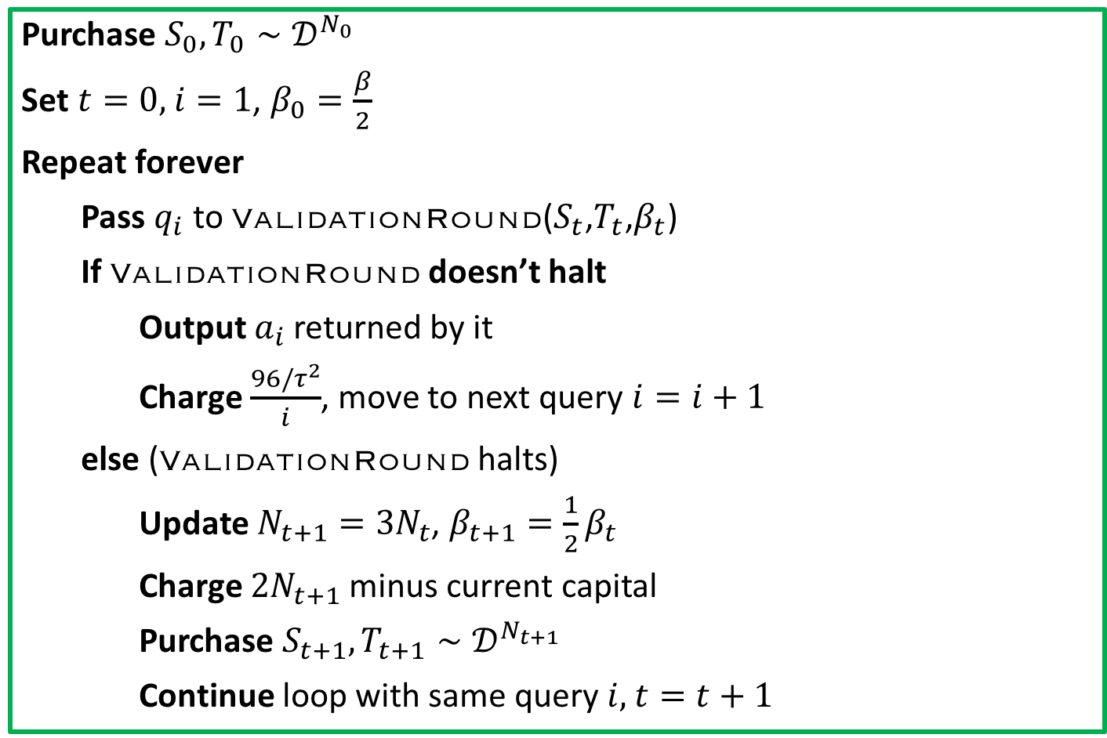

EverlastingValidation
Purchase $S_{0},T_{0}∼𝒟^{N_{0}}$
Set $t=0,$ $i=1$, $β_{0}=\frac{β}{2}$
Repeat forever
Pass $q_{i}$ to ValidationRound($S_{t}$,$T_{t}$,$β_{t}$)
If ValidationRound doesn’t halt
Output $a_{i}$ returned by it
Charge $\frac{96/τ^{2}}{i}$, move to next query $i=i+1$
else (ValidationRound halts)
Update $N_{t+1}=3N_{t}$, $β_{t+1}=\frac{1}{2}β_{t}$
Charge $2N_{t+1}$ minus current capital
Purchase $S_{t+1},T_{t+1}∼𝒟^{N_{t+1}}$
Continue loop with same query $i,$ $t=t+1$
“Low price”
“High price”
Sustainability
$=0$ after a type I halt
Notes:
I will now fill in the rest of the details, in particular, the pricing, which is the most interesting part that remains.
Upon receiving a query, we pass it to ValidationRound which uses our current datasets S and T. If the query does NOT cause ValidationRound to halt,
Then we charge the low price. This is the “harmonic price” that i mentioned earlier and it leads to the logarithmic total cost guarantee for non-adaptive queries.
On the other hand, if the query does cause ValidationRound to halt,
Then we charge the high price, buy new datasets, and continue on our merry way.
The first immediate observation is that this high price automatically ensures sustainability. Whenever we need to buy more data, we charge exactly enough to do so by construction.
We can also show that this “high price” is 0 after a type 1 halt (the kind that happens after an instance of ValidationRound answers an exponentially large number of queries).
Therefore, a query is only charged the high price if it causes a type 2 halt.
In the case of a type 2 halt, however, that this can be an extremely high price!
Note that N_t triples in each round, so after a relatively small number of rounds the high price could be colossal.
Nevertheless, since non-adaptive queries never trigger type 2 halts, a non-adaptive user will never need to pay the high price.
Furthermore, autonomous users can only trigger a type 2 halt after they have made a relatively large number of queries within a round.
So even though a few individual queries might cost an exorbitant amount of money, the average cost to an autonomous user is still controlled.

Slide 19
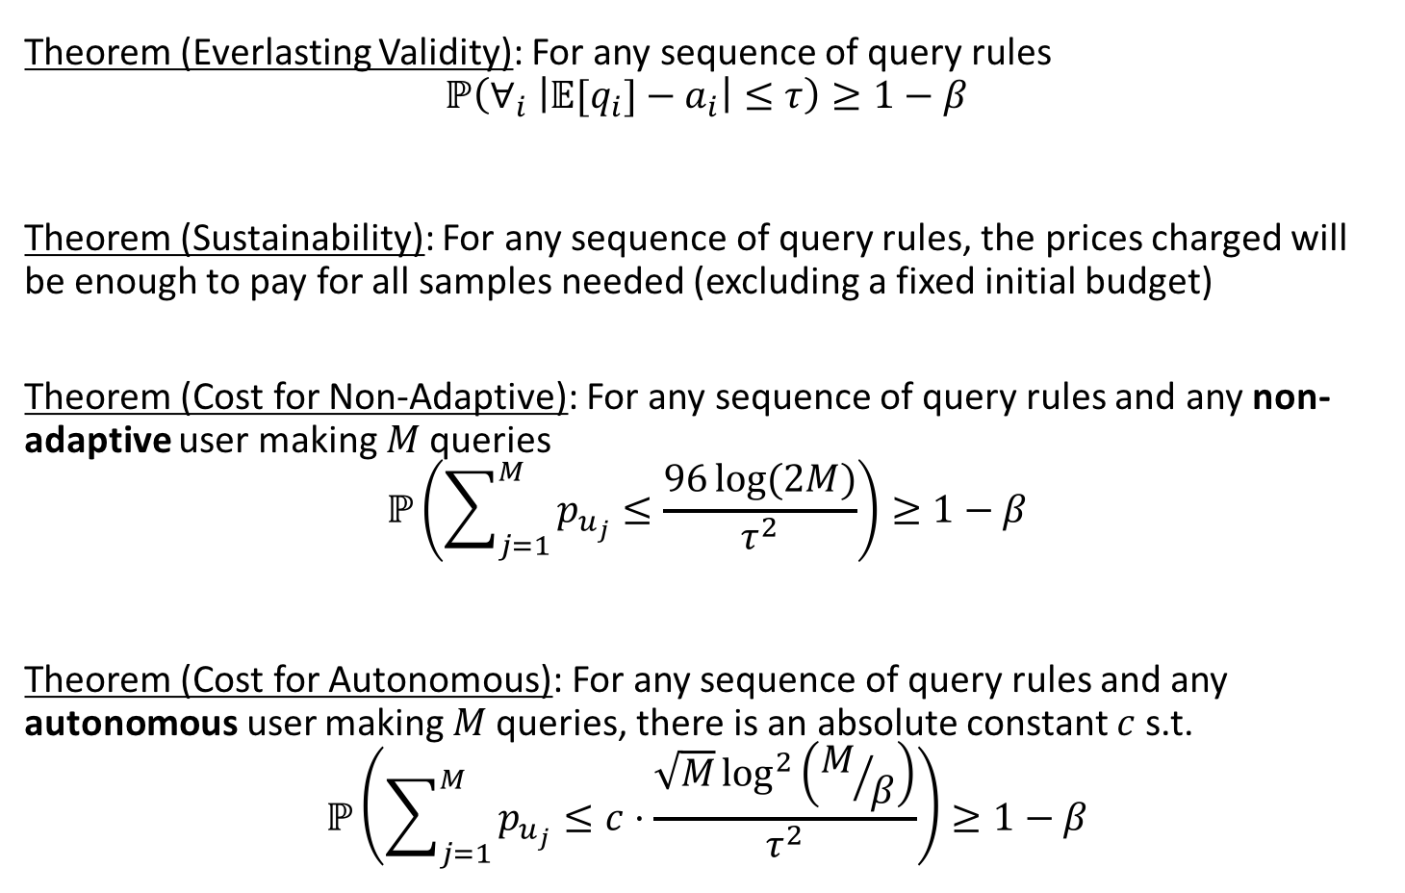
EverlastingValidation
Theorem (Everlasting Validity): For any sequence of query rules
$$ℙ\left(∀_{i} \left|{𝔼[q}_{i}]−a_{i}\right|≤τ\right)≥1−β$$
Theorem (Sustainability): For any sequence of query rules, the prices charged will be enough to pay for all samples needed (excluding a fixed initial budget)
Theorem (Cost for Non-Adaptive): For any sequence of query rules and any non-adaptive user making $M$ queries
$$ℙ\left(\sum_{j=1}^{M}{p_{u_{j}}}≤\frac{96\log{(2M)}}{τ^{2}}\right)≥1−β$$
Theorem (Cost for Autonomous): For any sequence of query rules and any autonomous user making $M$ queries, there is an absolute constant $c$ s.t.
$$ℙ\left(\sum_{j=1}^{M}{p_{u_{j}}}≤c⋅\frac{\sqrt{M}\log^{2}\left(M/β\right)}{τ^{2}}\right)≥1−β$$
Because all of ValidationRound’s answers are accurate w.h.p.
High price assures this by construction
Non-adaptive queries do not cause type II halts, so only the low price is paid
Autonomous user might pay high price in a round, but only after making $\tilde{Ω}\left(N_{t}^{2}\right)$ queries
Notes:
Here are the guarantees of the algorithm again. They have almost trivial proofs because of validiationround’s guarantees
We have everlasting validity because all of validationrounds answers are accurate.
We have sustainability trivially because of how the high price is set.
Since non-adaptive queries never cause a type 2 halt, they always cost the low harmonic price, leading to a logarithmic total cost.
Autonomous users might pay the high price in one or more rounds, however, since they have to make a quadratic number of queries in each of those rounds in order to pay the high price, their average cost is still controlled.

Slide 20
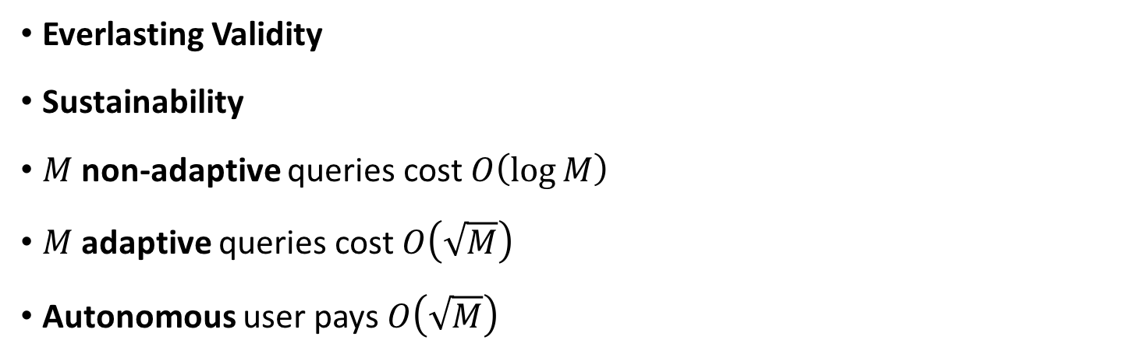
Goals
Everlasting Validity
Sustainability
$M$ non-adaptive queries cost $O\left(\log{M}\right)$
$M$ adaptive queries cost $O\left(\sqrt{M}\right)$
Autonomous user pays $O\left(\sqrt{M}\right)$
Notes:
Looking back at what we hoped to achieve, we get almost everything, except we had to look at autonomous users rather than just at adaptive queries.
Using our current scheme, we cannot provide any meaningful price guarantee for a set of adaptive queries (which could each depend on arbitrarily many past queries and answers).

Slide 21
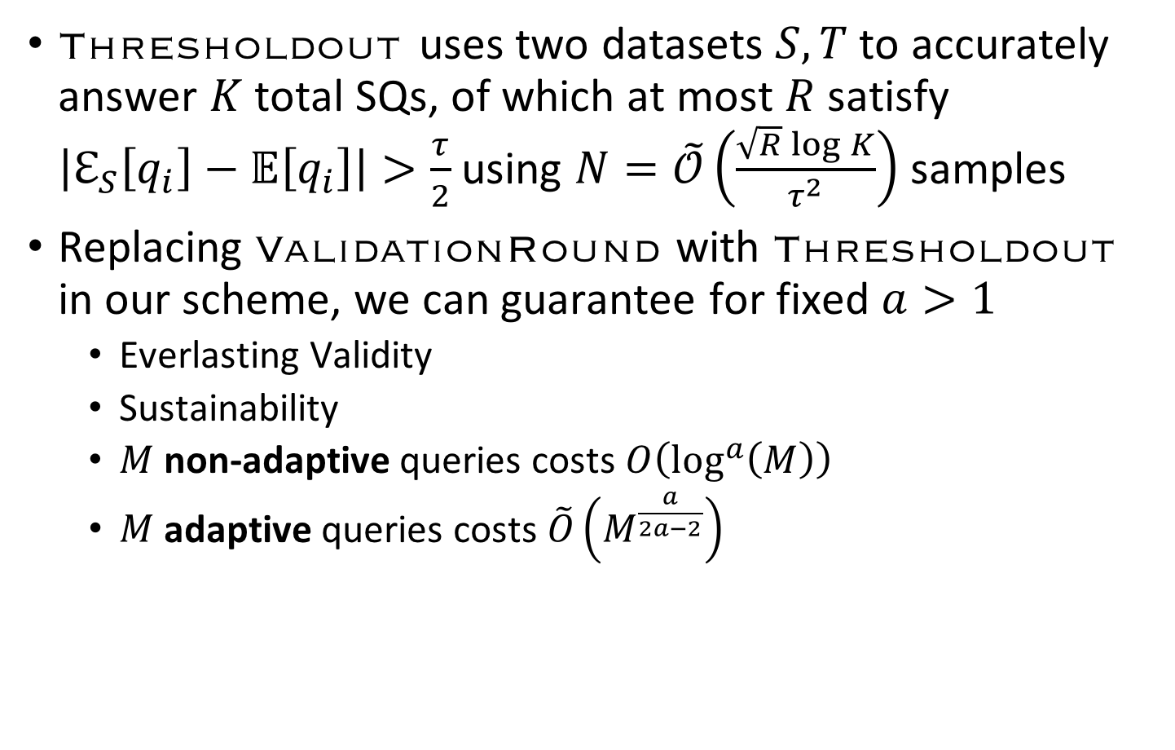
Using Thresholdout^{[1]}
Thresholdout uses two datasets $S,T$ to accurately answer $K$ total SQs, of which at most $R$ satisfy $\left|ℇ_{S}\left[q_{i}\right]−𝔼\left[q_{i}\right]\right|>\frac{τ}{2}$ using $N=\tilde{𝒪}\left(\frac{\sqrt{R}\log{K}}{τ^{2}}\right)$ samples
Replacing ValidationRound with Thresholdout in our scheme, we can guarantee for fixed $a>1$
  Everlasting Validity
  Sustainability
  $M$ non-adaptive queries costs $O\left(\log^{a}\left(M\right)\right)$
  $M$ adaptive queries costs $\tilde{O}\left(M^{\frac{a}{2a−2}}\right)$
[1] DDFHPRR 2015
Notes:
However, if we are willing to charge a slightly higher cost for non-adaptive queries (namely polylog M rather than log M), we can prove price guarantees for arbitrary adaptive queries with an alternative algorithm which uses an different query answering mechanism in the place of validationround.
Thresholdout is similar to validationround, except it is able to keep running for up to R failed validity checks (compared with validationround which has to stop after a single failure)
For any chosen-in-advance a > 1 we can guarantee that: …
As a->1 we recover the logarithmic price for non-adaptive queries (but adaptive query price goes to infinity) and as a->infty we get the sqrt(M) price for adaptive queries, but non-adaptive queries get really costly.

Slide 22
Improvements?
Reduce the maximum cost of a single query
Can we make similar guarantees in terms of adaptive (vs autonomous) queries?
Can we (cheaply) reveal the price of a query before we have to charge it?
Reduce constants
Notes:
In the future, there are several things that might be improved.
It would be nice to ensure that the higher cost to an adaptive/autonomous user is spread out over more queries, rather than charging almost nothing for the vast majority of the queries and an enormous amount for a couple of them.
It would be nice to come up with an algorithm that has similar price guarantees but for non-adaptive and adaptive users rather than non-adaptive and autonomous users. Or it would be useful to prove that this is impossible.
Another interesting question is whether it is possible to reveal the price of a query before it is necessary to charge it. In our current system, telling the user that they have to pay the high price is just as revealing about the data as telling them the answer.
Finally, there are prohibitively large constants in the price guarantees that could be improved with a tighter analysis, which will be necessary before the validation system is practical.

