Slide 1
Time-Space Hardness for Learning Problems
Avishay Tal (Stanford)
Based on joint works with
Sumegha Garg, Gillat Kol & Ran Raz

Slide 2


Learning – The Streaming Model
aka Online Learning
Black Box
$$f$$
(0,1,1,0,1)
(0,0,1,0,1)
(1,1,0,1,0)
1
0
Learner
stream of examples
[Shamir’2014]
[Steinhardt-Valiant-Wager'2015]

Slide 3
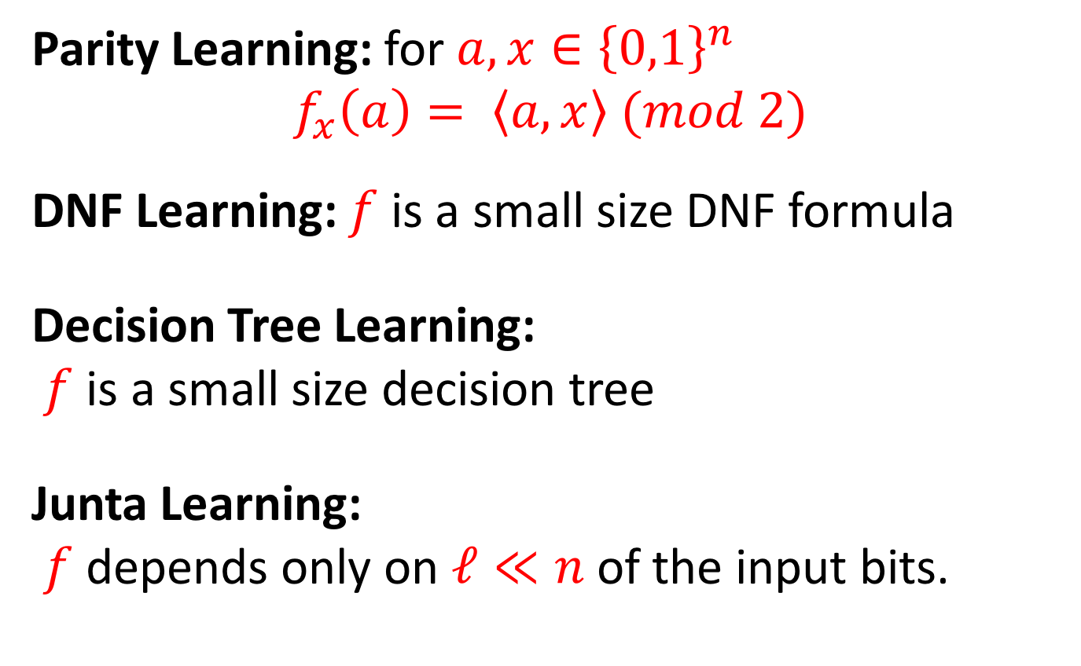
Examples of Learning Problems
Parity Learning: for $a,x∈{\left\{0,1\right\}}^{n}$
$$f_{x}\left(a\right)= \left\langle a,x\right\rangle (mod 2)$$
DNF Learning: $f$ is a small size DNF formula
Decision Tree Learning:
$f$ is a small size decision tree
Junta Learning:
$f$ depends only on $ℓ≪n$of the input bits.

Slide 4

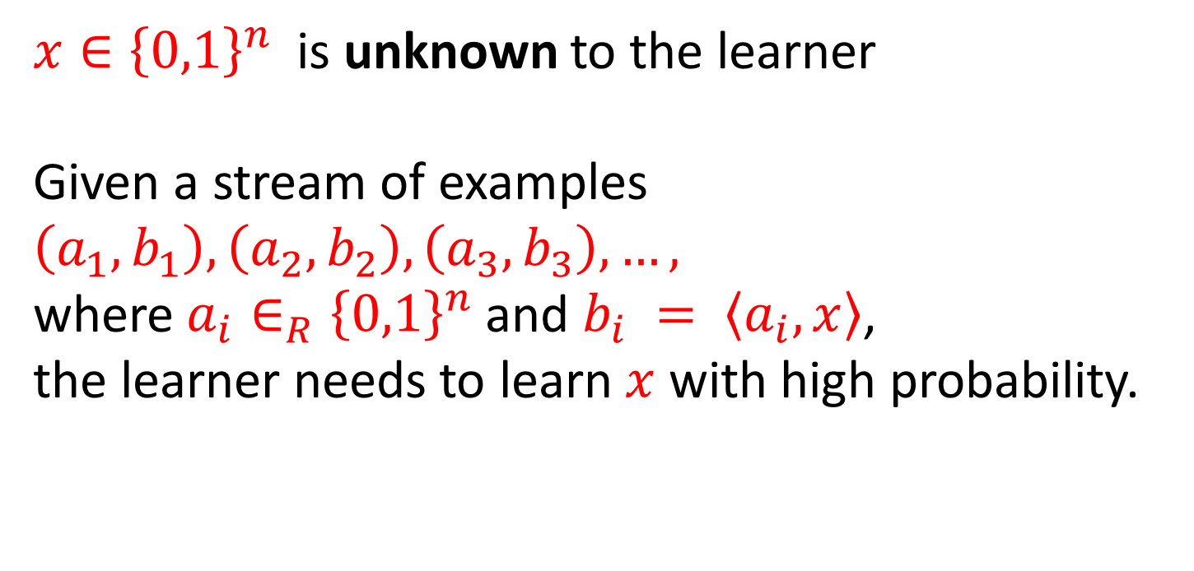
Parity Learning Problem
$f_{x}\left(a\right)=\left\langle a,x\right\rangle (mod 2)$
$x∈{\left\{0,1\right\}}^{n}$ is unknown to the learner
Given a stream of examples $\left(a_{1}, b_{1}\right), \left(a_{2}, b_{2}\right),\left(a_{3}, b_{3}\right),…,$
where $a_{i}∈_{R}{\left\{0,1\right\}}^{n}$ and $b_{i} = \left\langle a_{i}, x\right\rangle$,
the learner needs to learn $x$ with high probability.

Slide 5
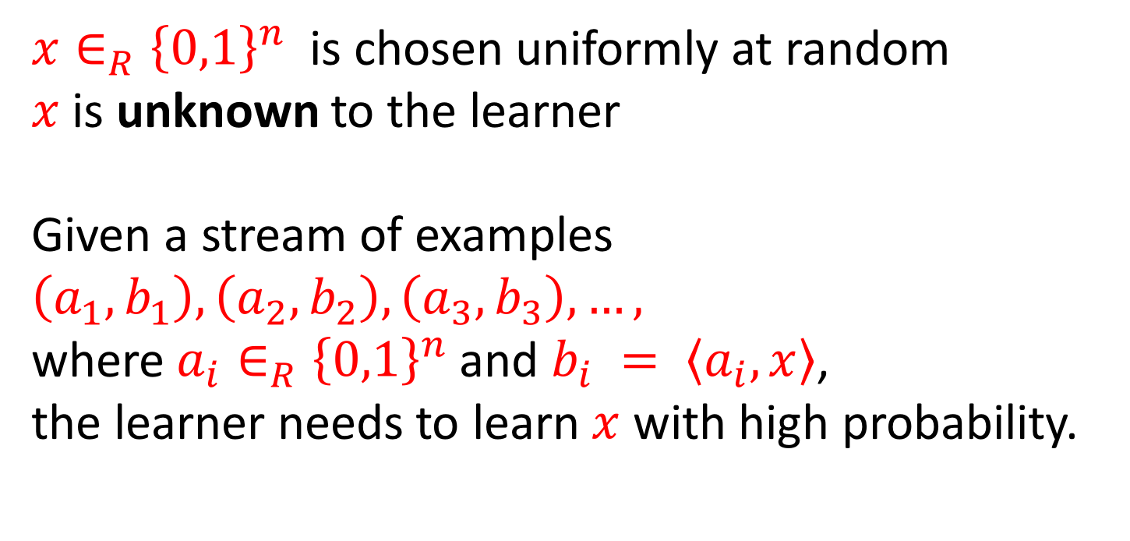
Parity Learning Problem
$f_{x}\left(a\right)=\left\langle a,x\right\rangle (mod 2)$
$x∈_{R}{\left\{0,1\right\}}^{n}$ is chosen uniformly at random
$x$ is unknown to the learner
Given a stream of examples $\left(a_{1}, b_{1}\right), \left(a_{2}, b_{2}\right),\left(a_{3}, b_{3}\right),…,$
where $a_{i}∈_{R}{\left\{0,1\right\}}^{n}$ and $b_{i} = \left\langle a_{i}, x\right\rangle$,
the learner needs to learn $x$ with high probability.

Slide 6

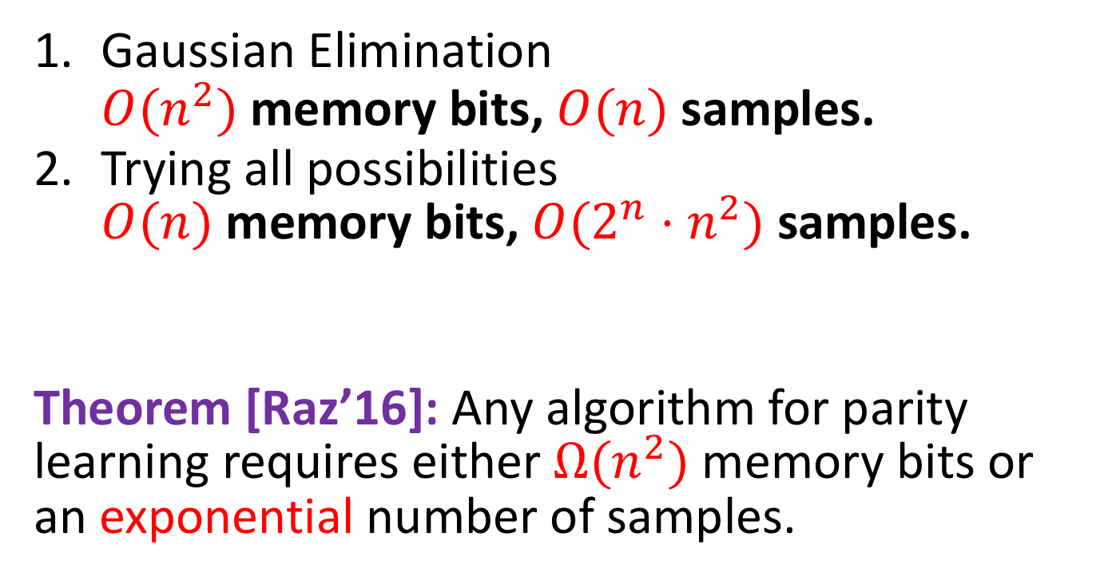
Algorithms for Parity Learning:
$f_{x}\left(a\right)=\sum_{i=1}^{n}{a_{i}x_{i}} (mod 2)$
Gaussian Elimination
$O(n^{2})$ memory bits, $O(n)$ samples.
Trying all possibilities
$O(n)$ memory bits, $O(2^{n}⋅n^{2})$ samples.
Theorem [Raz’16]: Any algorithm for parity learning requires either $Ω(n^{2})$ memory bits or an exponential number of samples.
Raz’s Breakthrough
Notes:
Mention that time is not an issue in this talk. We are concerned with # of Samples, # of memory bits.

Slide 7
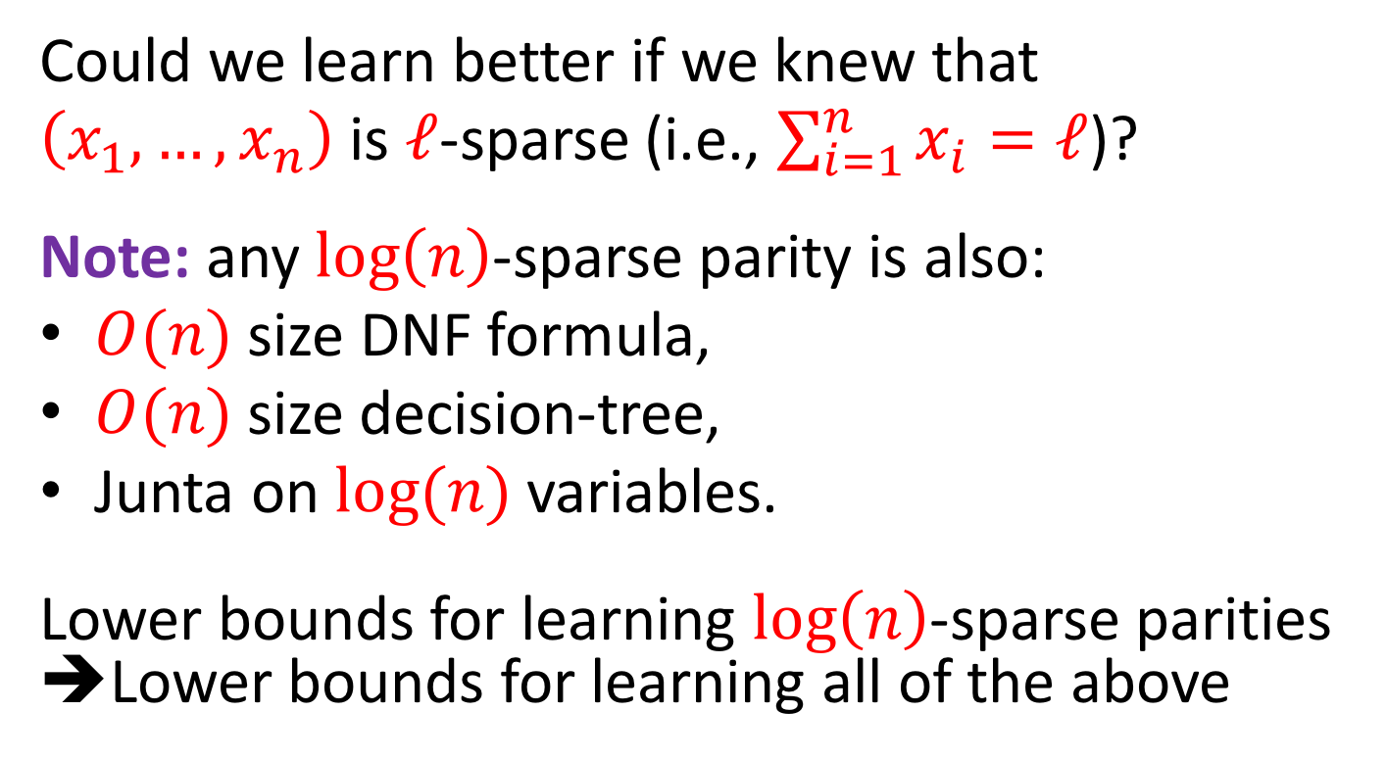

Sparse Parities
$f_{x}\left(a\right)=\sum_{i=1}^{n}{a_{i}x_{i}} (mod 2)$
Could we learn better if we knew that
$\left(x_{1}, …, x_{n}\right)$ is $ℓ$-sparse (i.e., $\sum_{i=1}^{n}{x_{i}}=ℓ$)?
Note: any $log\left(n\right)$-sparse parity is also:
$O(n)$ size DNF formula,
$O(n)$size decision-tree,
Junta on $log(n)$variables.
Lower bounds for learning $log\left(n\right)$-sparse parities
➔Lower bounds for learning all of the above

Slide 8


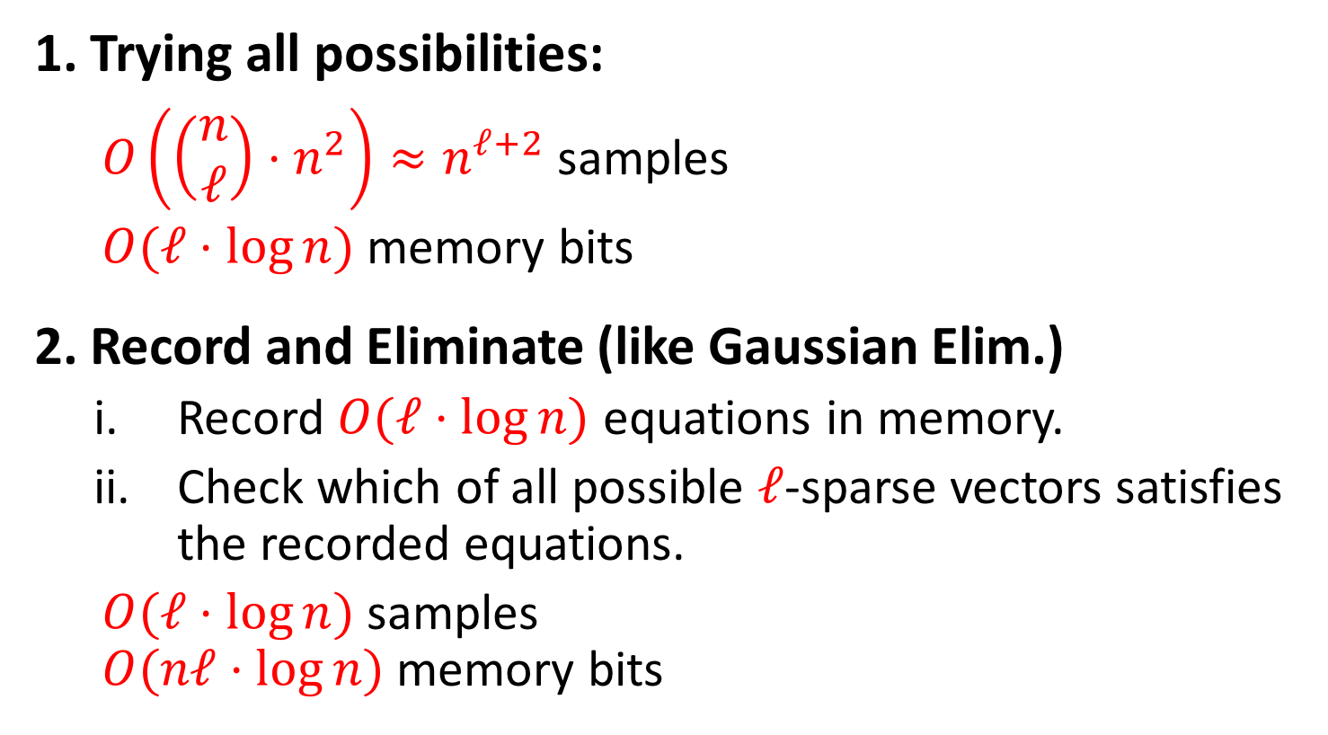
Upper Bounds
$f_{x}\left(a\right)=\sum_{i=1}^{n}{a_{i}x_{i}} (mod 2)$
$\sum_{i=1}^{n}{x_{i}} =ℓ$
1. Trying all possibilities:
  $O\left(\left(\begin{aligned}n \\ ℓ\end{aligned}\right)⋅n^{2}\right)≈n^{ℓ+2}$ samples
  $O(ℓ⋅\log{n})$ memory bits
2. Record and Eliminate (like Gaussian Elim.)
  Record $O(ℓ⋅\log{n})$ equations in memory.
  Check which of all possible $ℓ$-sparse vectors satisfies the recorded equations.
  $O(ℓ⋅\log{n})$ samples
  $O(nℓ⋅\log{n})$memory bits
Notes:
Are these the only examples?
This is what we thought and we even had a proof that we started writing, but then…

Slide 9
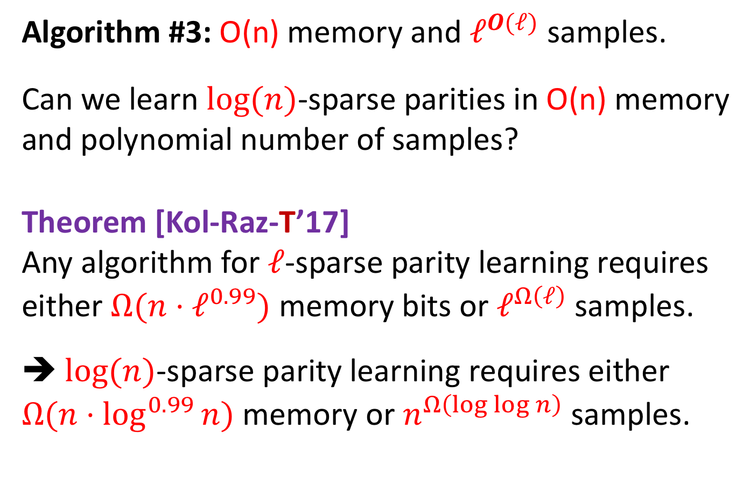
Algorithm #3: O(n) memory and $ℓ^{O(ℓ)}$ samples.
Can we learn $\log{(n)}$-sparse parities in O(n) memory
and polynomial number of samples?
Theorem [Kol-Raz-T’17]
Any algorithm for $ℓ$-sparse parity learning requires either $Ω(n⋅ℓ^{0.99})$ memory bits or $ℓ^{Ω\left(ℓ\right)}$ samples.
➔ $\log{(n)}$-sparse parity learning requires either
$Ω(n⋅\log^{0.99}{n})$ memory or $n^{Ω\left(\log{\log{n}}\right)}$ samples.
No!

Slide 10
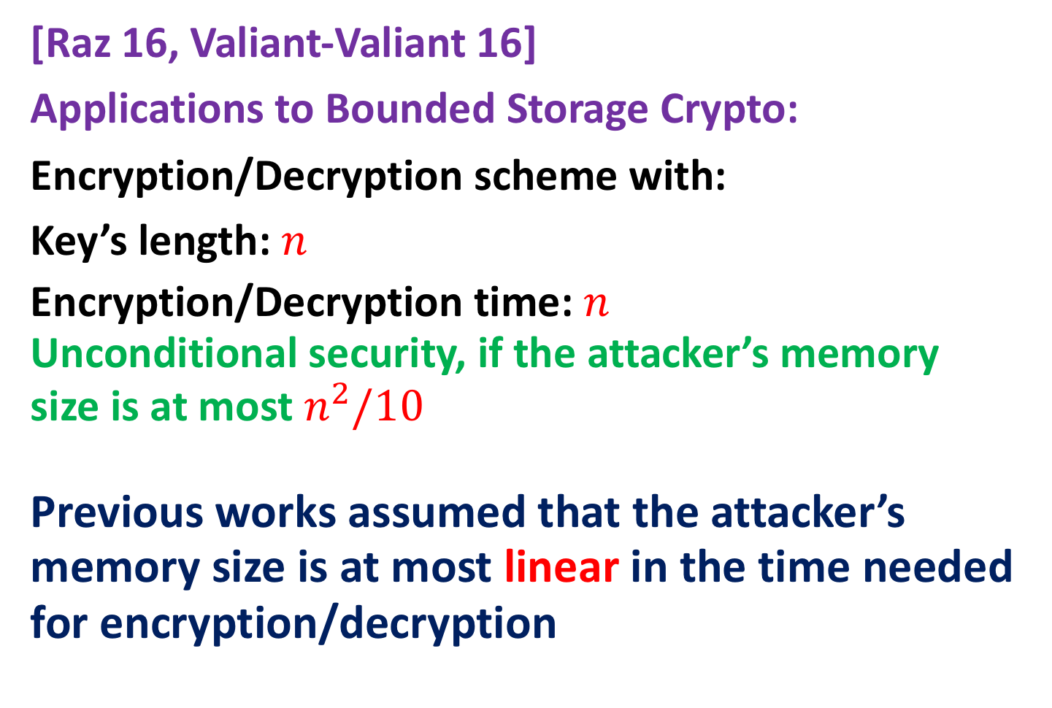
Motivation: Cryptography
[Raz 16, Valiant-Valiant 16]
Applications to Bounded Storage Crypto:
Encryption/Decryption scheme with:
Key’s length: $n$
Encryption/Decryption time: $n$
Unconditional security, if the attacker’s memory size is at most $n^{2}/10$
Previous works assumed that the attacker’s memory size is at most linear in the time needed for encryption/decryption

Slide 11
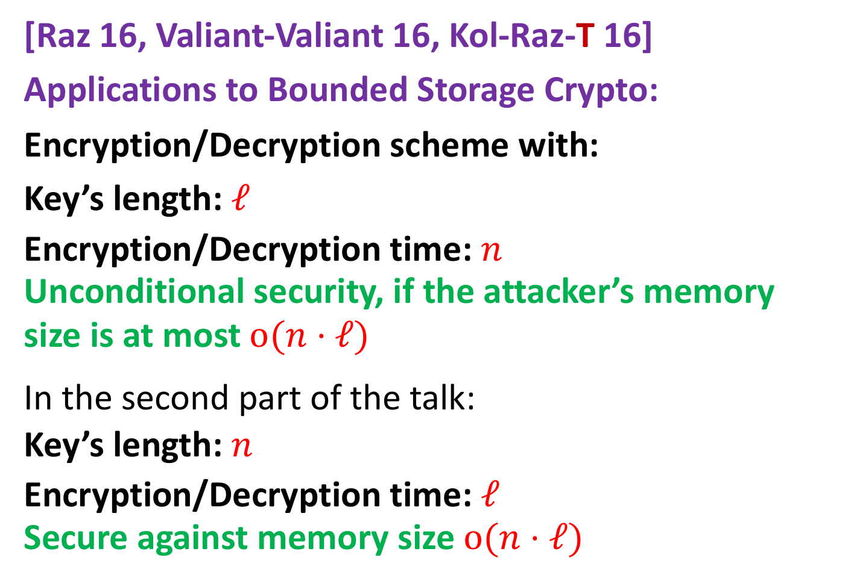
Motivation: Cryptography
[Raz 16, Valiant-Valiant 16, Kol-Raz-T 16]
Applications to Bounded Storage Crypto:
Encryption/Decryption scheme with:
Key’s length: $ℓ$
Encryption/Decryption time: $n$
Unconditional security, if the attacker’s memory size is at most $o(n⋅ℓ)$
In the second part of the talk:
Key’s length: $n$
Encryption/Decryption time: $ℓ$
Secure against memory size $o(n⋅ℓ)$

Slide 12
Motivation: Complexity Theory
Time-Space Lower Bounds have been studied in many models
[Beame-Jayram-Saks 98, Ajtai 99,
Beame-Saks-Sun-Vee’00, Fortnow 97,
Fortnow-Lipton-van Melkebeek-Viglas05, Williams’06,…]
Main difference:
the online model is easier to prove lower bounds against, since the input is read only once.

Slide 13

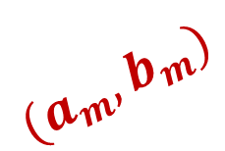

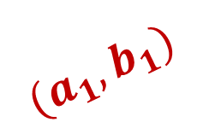
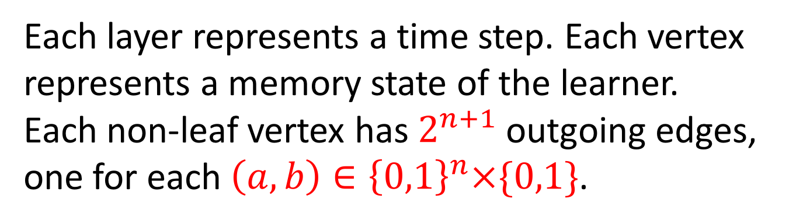
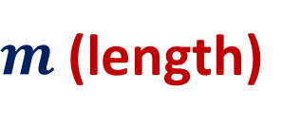
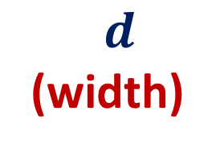
The Branching Program (BP) Model
$$(a_{2},b_{2})$$
$$(a_{1},b_{1})$$
$$(a_{m},b_{m})$$
$$d$$
(width)
$$(a,b)$$
$m$ (length)
Each layer represents a time step. Each vertex represents a memory state of the learner.
Each non-leaf vertex has $2^{n+1}$ outgoing edges,
one for each $\left(a,b\right)∈{\left\{0,1\right\}}^{n}×\{0,1\}$.

Slide 14
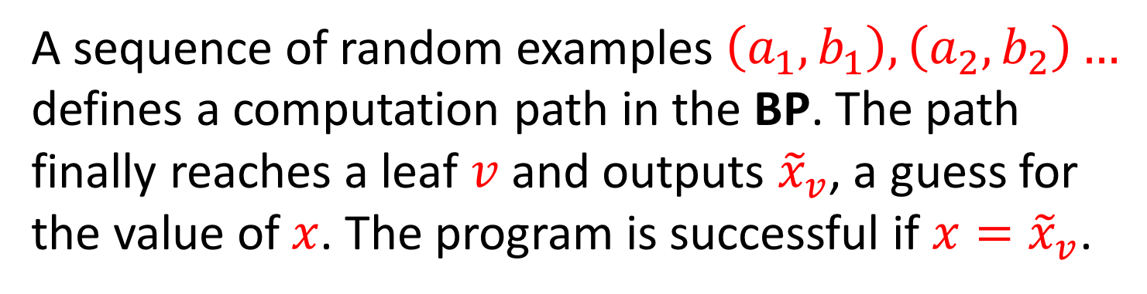
The Branching Program (BP) Model
$$(a_{2},b_{2})$$
$$(a_{1},b_{1})$$
$$(a_{m},b_{m})$$
$$d$$
(width)
$$(a,b)$$
$m$ (length)
A sequence of random examples $\left(a_{1},b_{1}\right),\left(a_{2},b_{2}\right)…$
defines a computation path in the BP. The path finally reaches a leaf $v$ and outputs ${\tilde{x}}_{v}$, a guess for the value of $x$. The program is successful if $x={\tilde{x}}_{v}$.

Slide 15
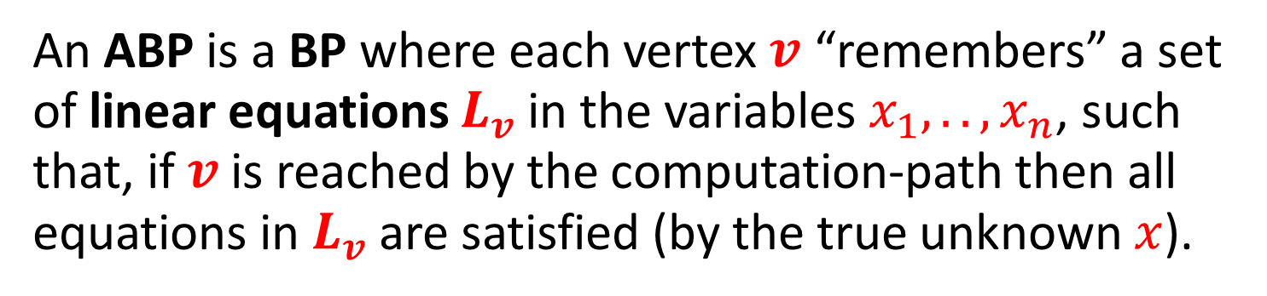
Affine Branching Programs (ABP)
$$(a_{2},b_{2})$$
$$(a_{1},b_{1})$$
$$(a_{m},b_{m})$$
$$d$$
(width)
$$(a,b)$$
$m$ (length)
An ABP is a BP where each vertex $v$ “remembers” a set of linear equations $L_{v}$ in the variables $x_{1},..,x_{n}$, such that, if $v$is reached by the computation-path then all equations in $L_{v}$ are satisfied (by the true unknown $x$).
Notes:
Mention that in the second layer it is not clear what is L_v.
There's always an obvious choice for L_v = emptyset.

Slide 16
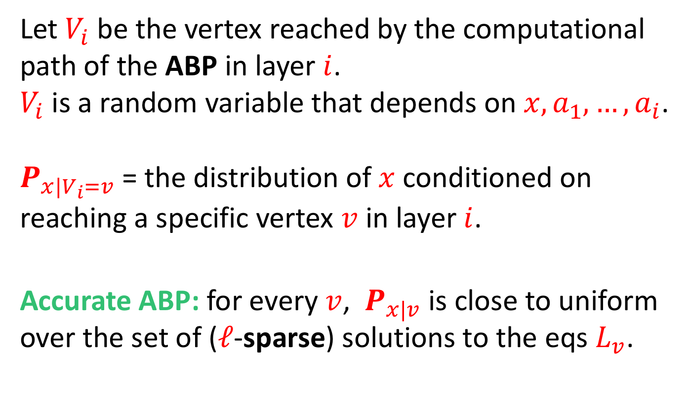
Accurate Affine BPs
Let $V_{i}$ be the vertex reached by the computational path of the ABP in layer $i$.
$V_{i}$ is a random variable that depends on $x,a_{1},…,a_{i}$.
$P_{x|V_{i}=v}$ = the distribution of $x$ conditioned on reaching a specific vertex $v$ in layer $i$.
Accurate ABP: for every $v$, $P_{x|v}$ is close to uniform over the set of ($ℓ$-sparse) solutions to the eqs $L_{v}$.

Slide 17
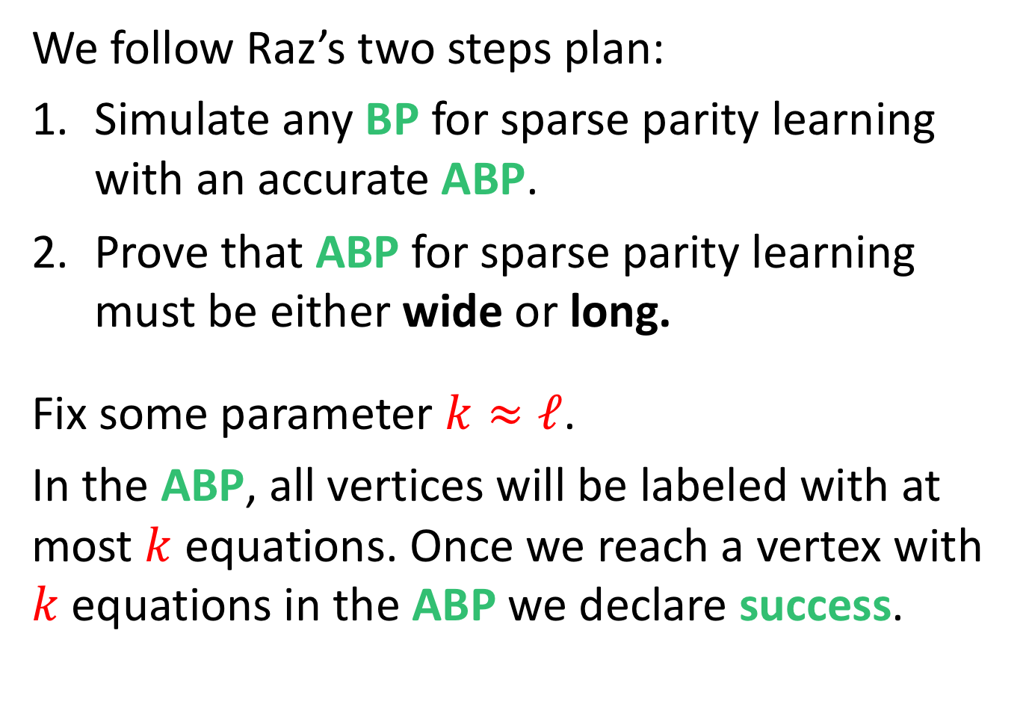
Proof Plan
We follow Raz’s two steps plan:
Simulate any BP for sparse parity learning with an accurate ABP.
Prove that ABP for sparse parity learning must be either wide or long.
Fix some parameter $k≈ℓ$.
In the ABP, all vertices will be labeled with at most $k$ equations. Once we reach a vertex with $k$ equations in the ABP we declare success.
Notes:
This choice of having at most k equations may seem arbitrary.
We will see the role of this choice in later slides.
Recall that we are proving lower bounds and this choice may only make the task of the learner easier, so we are proving even stronger results. That is, we prove that the learner cannot even learn k equation on the unknown string x.
Note also that if we learned much less than log(T) equations on x, then x still have a lot of entropy, so the learner cannot guess it with decent probability.

Slide 18


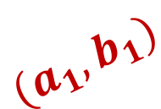




Proof Highlights – Simulation Part
Layer by layer, we convert the BP to an ABP.
For $i=1, …, m$, we convert the $i$-th layer of the program.
Every vertex $v$ in the $i$-th layer is split into many vertices by regrouping the edges entering $v$.
$$(a_{2},b_{2})$$
$$(a_{1},b_{1})$$
$$(a_{m},b_{m})$$
$$d$$
$$(a,b)$$
$$m$$

Slide 19











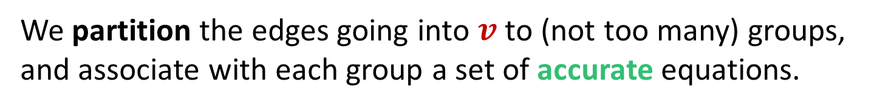


Regrouping
We partition the edges going into $v$ to (not too many) groups, and associate with each group a set of accurate equations.
Layer i-1
Layer i
$$u$$
$$L_{v^{′}}$$
$$L_{u}$$
$$u′$$
$$v′$$
$$L_{u^{′}}$$
$$L_{v^{′′}}$$
$$v′′$$
. . . .
$$v$$
$$L_{v^{′′′}}$$
$$v′′′$$
$$u^{′′}$$
$$L_{u^{′′}}$$

Slide 20


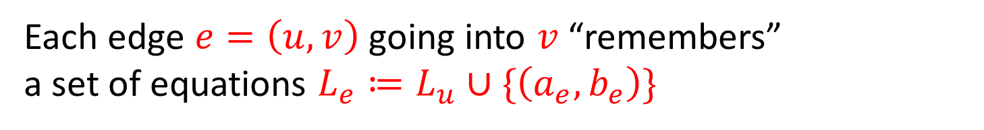
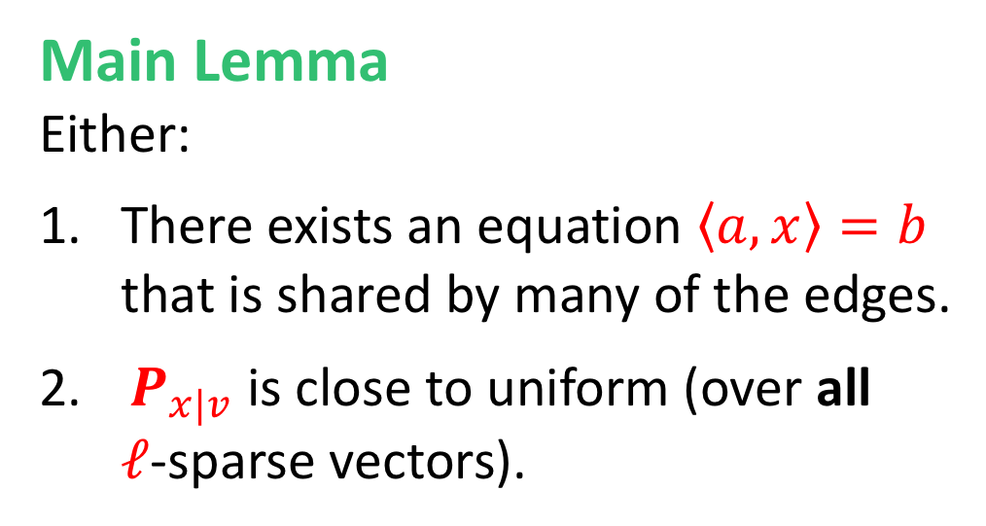








Main Lemma
Each edge $e=\left(u,v\right)$ going into $v$ “remembers”
a set of equations $L_{e}≔L_{u}∪\{\left(a_{e},b_{e}\right)\}$
Main Lemma
Either:
There exists an equation $\left\langle a,x\right\rangle =b$ that is shared by many of the edges.
$P_{x|v}$ is close to uniform (over all
$ℓ$-sparse vectors).
$$u$$
$$L_{u}$$
$$\left(a,b\right)$$
$$v$$
$$u′$$
$$(a^{′},b^{′})$$
$$L_{u′}$$
$$(a′′,b′′)$$
$$u′′$$
$$L_{u′′}$$

Slide 21
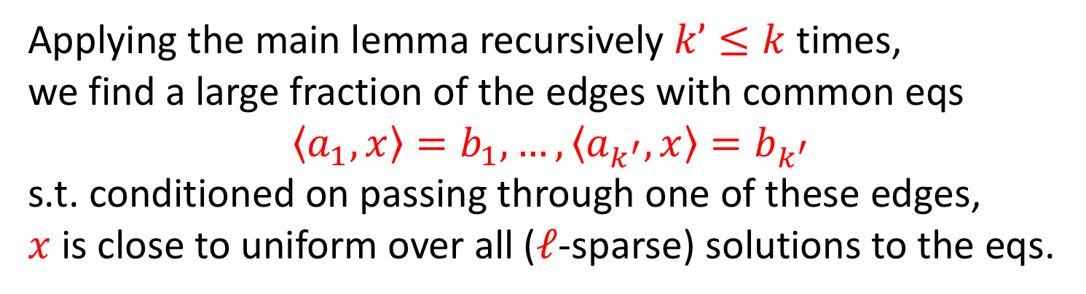
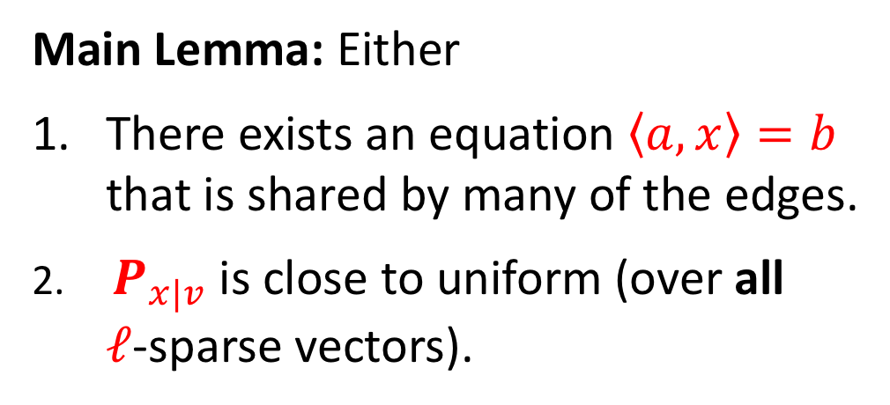
Regrouping from Main Lemma
Main Lemma: Either
There exists an equation $\left\langle a,x\right\rangle =b$ that is shared by many of the edges.
$P_{x|v}$ is close to uniform (over all
$ℓ$-sparse vectors).
$$u$$
$$L_{u}$$
$$\left(a,b\right)$$
$$v$$
$$u′$$
$$(a^{′},b^{′})$$
$$L_{u′}$$
$$(a′′,b′′)$$
$$u′′$$
$$L_{u′′}$$
Applying the main lemma recursively $k’≤k$times,
we find a large fraction of the edges with common eqs
$$\left\langle a_{1},x\right\rangle =b_{1},…,\left\langle a_{k^{′}},x\right\rangle =b_{k^{′}}$$
s.t. conditioned on passing through one of these edges,
$x$ is close to uniform over all ($ℓ$-sparse) solutions to the eqs.

Slide 22
Proof on White Board

Slide 23
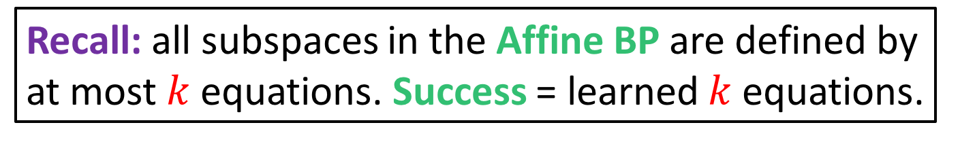


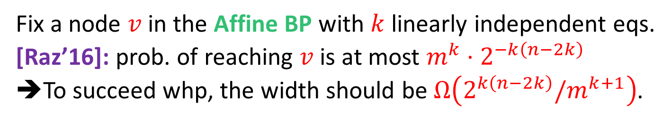
Lower Bounds on the Affine BP
Recall: all subspaces in the Affine BP are defined by at most $k$ equations. Success = learned $k$ equations.
$$(a_{2},b_{2})$$
$$(a_{1},b_{1})$$
$$(a_{m},b_{m})$$
$$(a,b)$$
$$v$$
$$L_{v}$$
Fix a node $v$ in the Affine BP with $k$ linearly independent eqs.
[Raz’16]: prob. of reaching $v$ is at most $m^{k}⋅2^{−k\left(n−2k\right)}$
➔To succeed whp, the width should be $Ω\left(2^{k\left(n−2k\right)}/m^{k+1}\right)$.

Slide 24
Proof on White Board

Slide 25
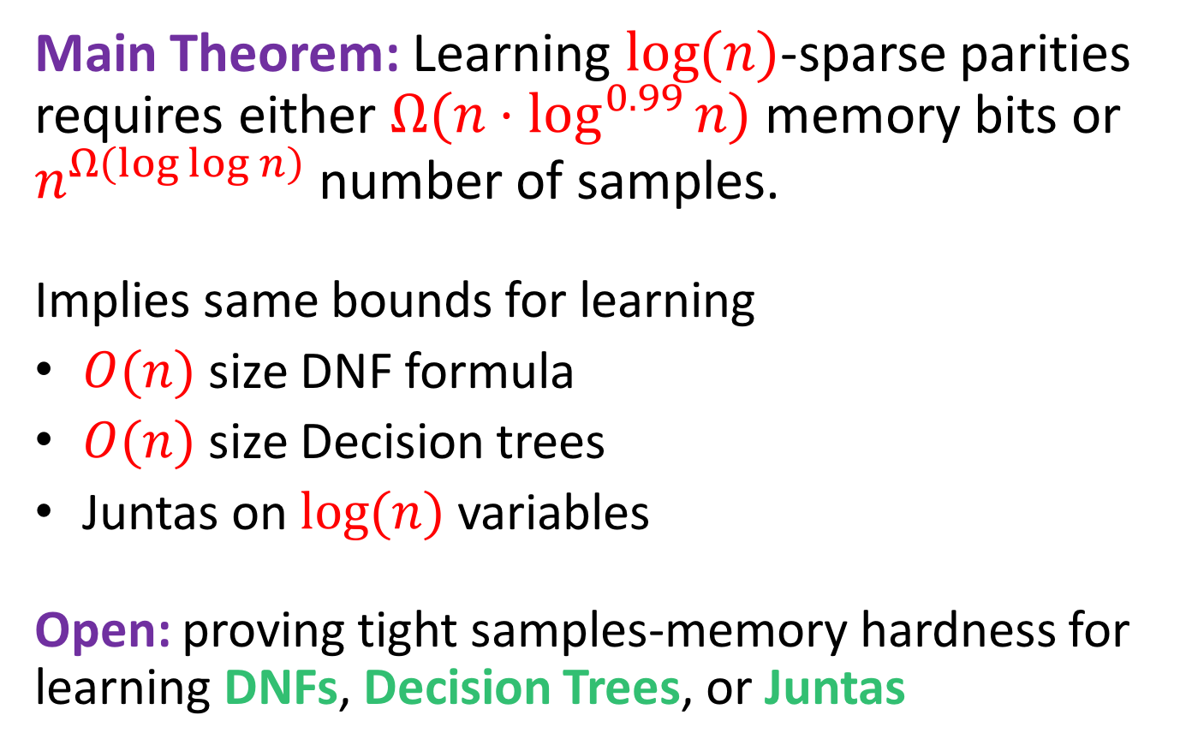
Conclusion – First Part
Main Theorem: Learning $\log{(n)}$-sparse parities requires either $Ω(n⋅\log^{0.99}{n})$ memory bits or
$n^{Ω\left(\log{\log{n}}\right)}$ number of samples.
Implies same bounds for learning
$O(n)$ size DNF formula
$O(n)$size Decision trees
Juntas on $log(n)$variables
Open: proving tight samples-memory hardness for learning DNFs, Decision Trees, or Juntas

Slide 26
Lower Bounds more Generally
Q: Can we generalize the lower bounds to hold for problems not involving parities?
[Raz’17, Moshkovitz-Moshkovitz’17, Moshkovitz-Moshkovitz’18]: Yes
A new and general proof technique
(we shall focus on Raz’s proof technique)
As a special case: a new proof for the memory-samples lower bound for parity learning.
[Garg-Raz-T’18, Beame-Oveis Gharan-Yang’18]:
Further generalizations of the method & more applications

Slide 27
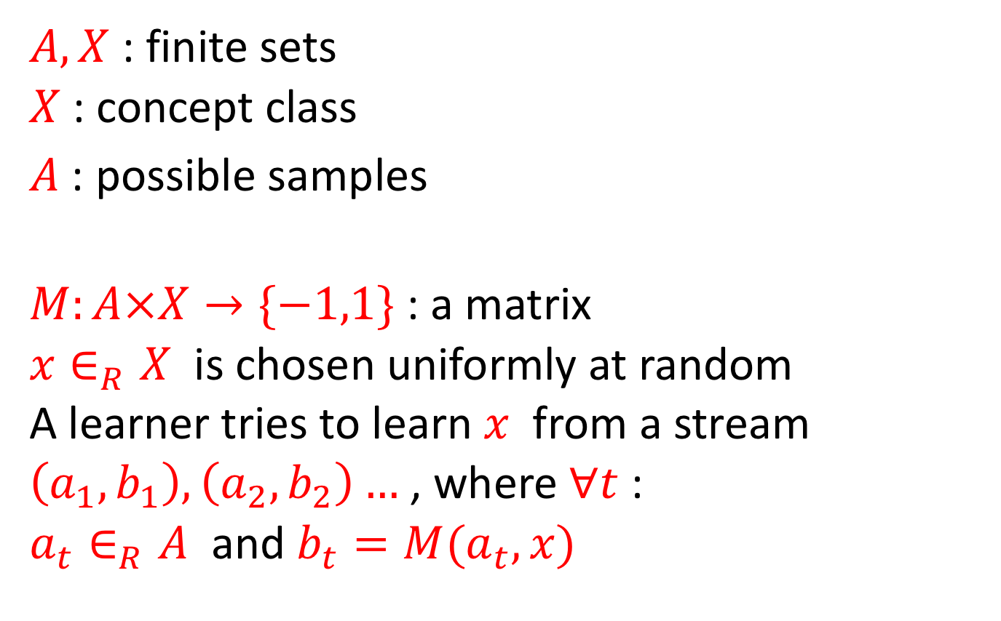
A Learning Problem as a Matrix
$A,X$ : finite sets
$X$ : concept class
$A$ : possible samples
$M:A×X→\{−1,1\}$ : a matrix
$x∈_{R}X$ is chosen uniformly at random
A learner tries to learn $x$ from a stream
$\left(a_{1}, b_{1}\right), \left(a_{2}, b_{2}\right)…$ , where $∀t$ :
$a_{t}∈_{R}A$ and $b_{t}=M(a_{t},x)$

Slide 28



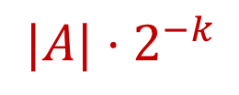

Extractor-Based Lower Bounds for Learning
Thm [Garg-Raz-T’18] Assume that any submatrix of $M$ of fraction ${2^{−k}×2}^{−ℓ}$ has bias of at most $2^{−r}$.
Then, any learning algorithm for the learning problem defined by $M$ requires either:
$Ω\left(k⋅ℓ\right)$ memory bits,
or $2^{Ω\left(r\right)}$ samples.
Independently, [Beame-
Oveis Gharan-Yang’18]
got a similar result
$$X$$
$$|X|{⋅2}^{−ℓ}$$
$$A$$
$$|A|{⋅2}^{−k}$$

Slide 29
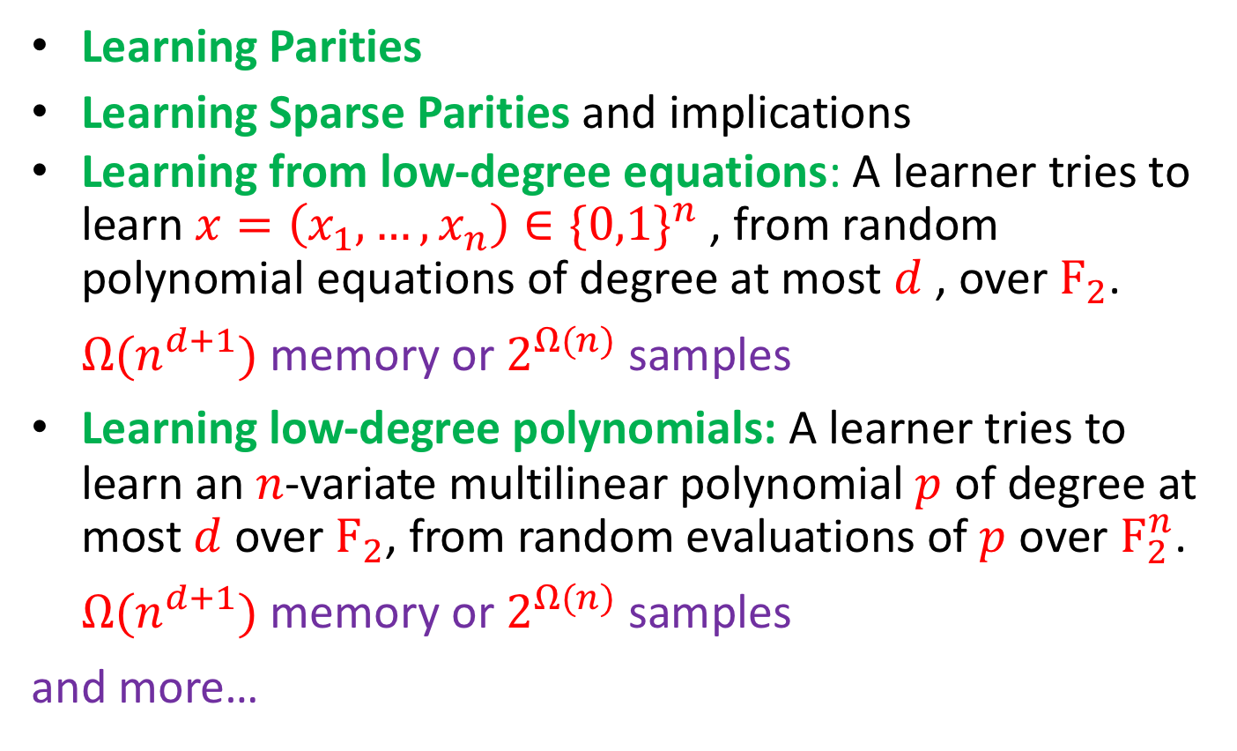
Applications of Extractor-Based Theorem
Learning Parities
Learning Sparse Parities and implications
Learning from low-degree equations: A learner tries to learn $x=\left(x_{1},…,x_{n}\right)∈\{0,1\}^{n}$ , from random polynomial equations of degree at most $d$ , over $F_{2}$.
$Ω(n^{d+1})$ memory or $2^{Ω(n)}$ samples
Learning low-degree polynomials: A learner tries to learn an $n$-variate multilinear polynomial $p$ of degree at most $d$over $F_{2}$, from random evaluations of $p$ over $F_{2}^{n}$.
$Ω(n^{d+1})$ memory or $2^{Ω(n)}$ samples
and more…

Slide 30
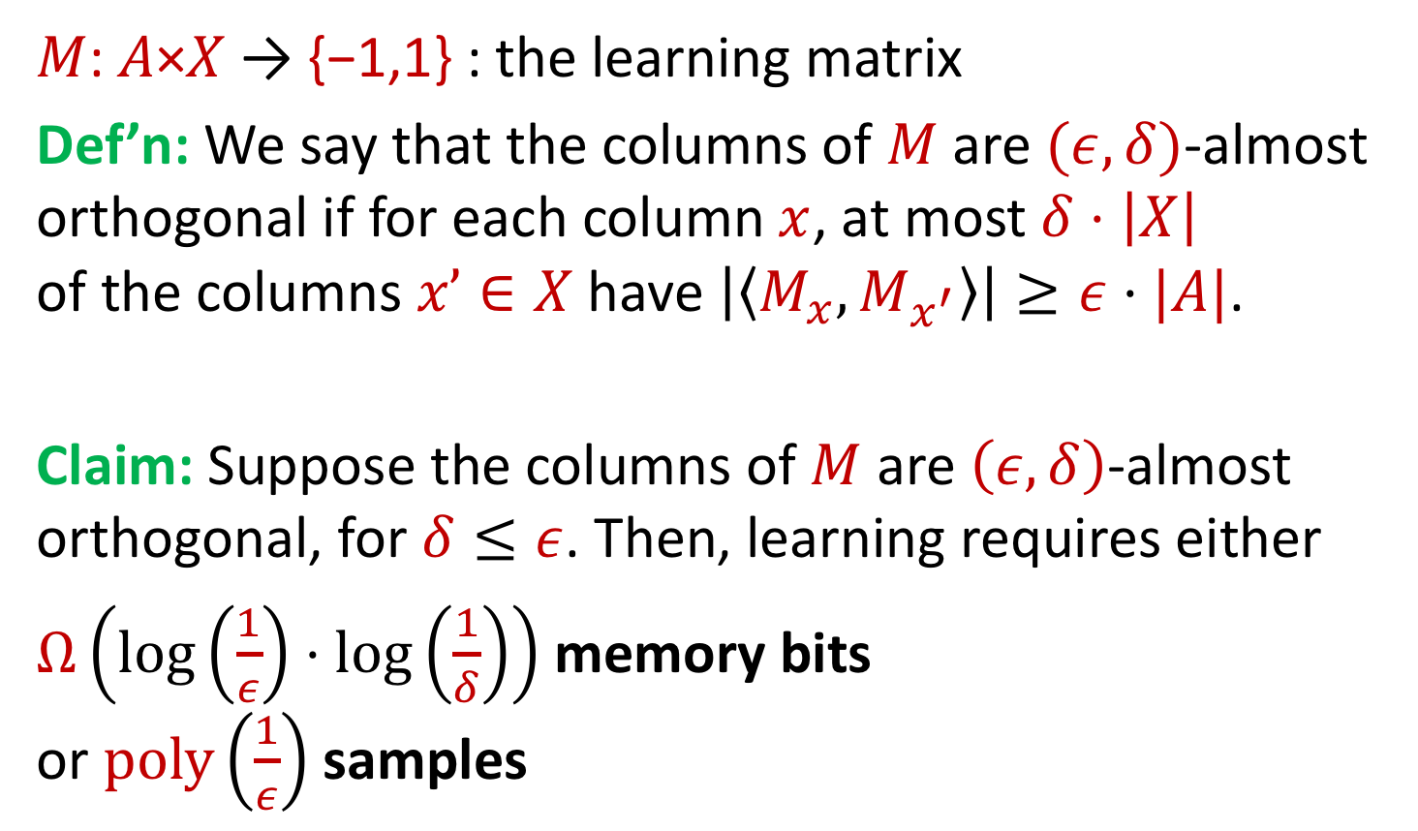
Technique to Prove Extractor Property
𝑀: 𝐴×𝑋 → {−1,1} : the learning matrix
Def’n: We say that the columns of $M$ are $(ε, δ)$-almost orthogonal if for each column $x$, at most $δ⋅\left|X\right|$
of the columns $x’∈X$ have $\left|\left\langle M_{x}, M_{x^{′}}\right\rangle \right|≥ε⋅|A|$.
Claim: Suppose the columns of $M$ are $\left(ε, δ\right)$-almost orthogonal, for $δ≤ε$. Then, learning requires either
$Ω\left(\log\left(\frac{1}{ε}\right)⋅\log\left(\frac{1}{δ}\right)\right)$ memory bits
or $poly\left(\frac{1}{ε}\right)$ samples

Slide 31
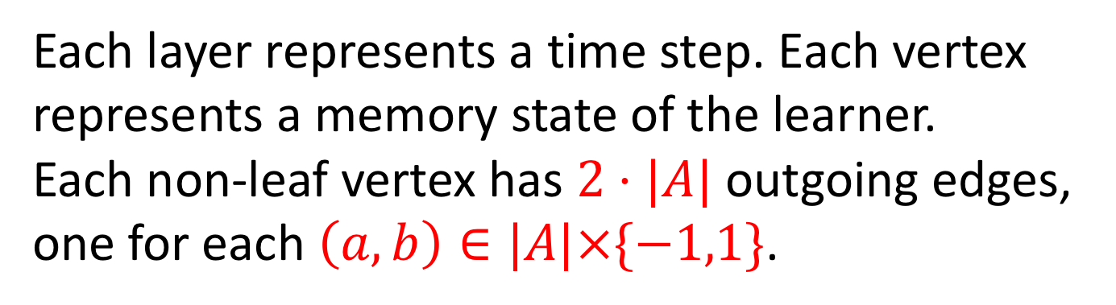
Recall: The Branching Program Model
$$(a_{2},b_{2})$$
$$(a_{1},b_{1})$$
$$(a_{m},b_{m})$$
$$d$$
(width)
$$(a,b)$$
$m$ (length)
Each layer represents a time step. Each vertex represents a memory state of the learner.
Each non-leaf vertex has $2⋅|A|$ outgoing edges,
one for each $\left(a,b\right)∈|A|×\{−1,1\}$.

Slide 32

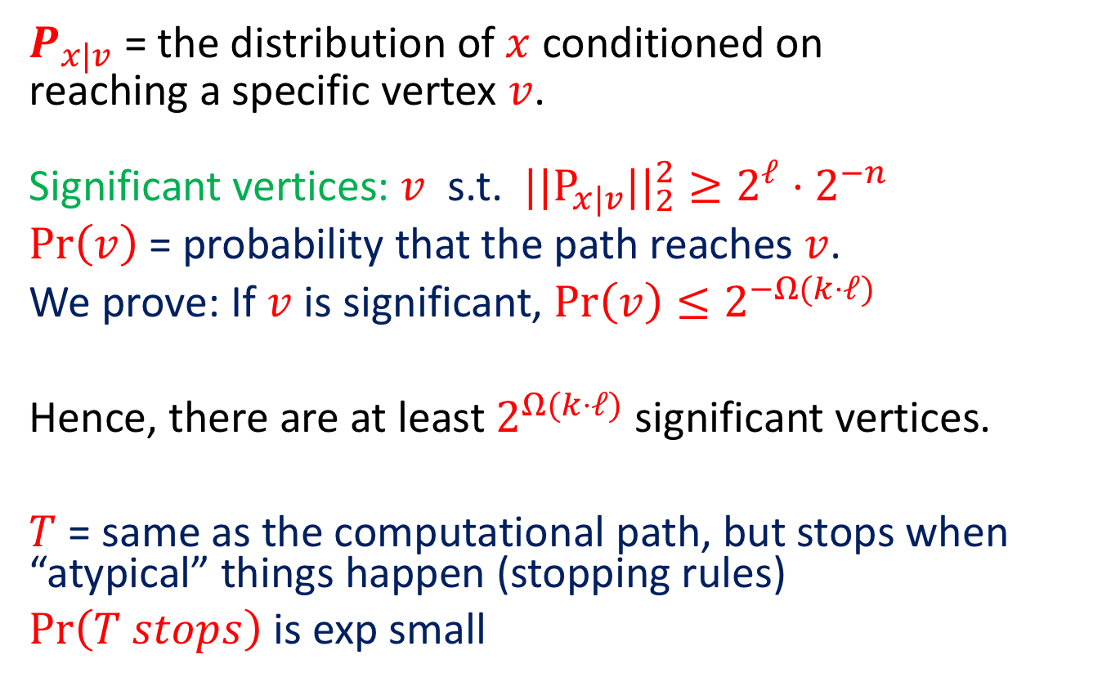
Proof Overview
$P_{x|v}$ = the distribution of $x$ conditioned on
reaching a specific vertex $v$.
Significant vertices: $v$ s.t. ${||P}_{x|v}||_{2}^{2}≥2^{ℓ}⋅2^{−n}$
$Pr\left(v\right)$ = probability that the path reaches $v$.
We prove: If $v$ is significant, $Pr\left(v\right)≤2^{−Ω(k⋅ℓ)}$
Hence, there are at least $2^{Ω(k⋅ℓ)}$ significant vertices.
$T$ = same as the computational path, but stops when “atypical” things happen (stopping rules)
$Pr\left(T stops\right)$ is exp small
$${\left|X\right|=2}^{n}$$

Slide 33
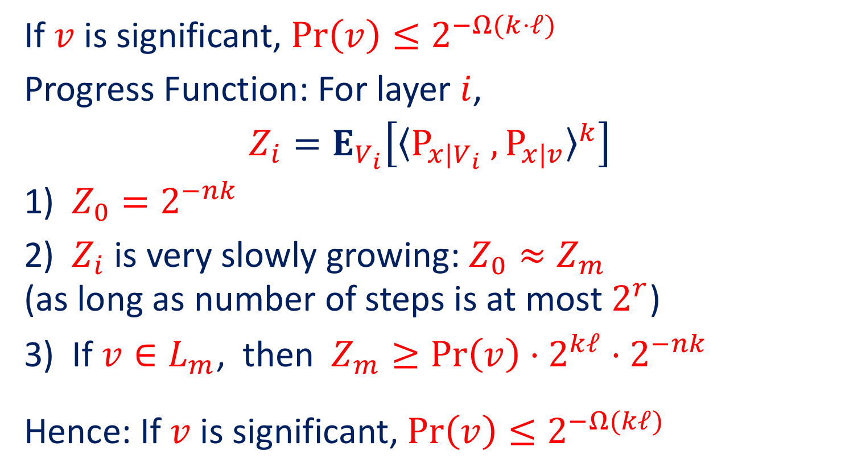
Proof Overview
If $v$ is significant, $Pr\left(v\right)≤2^{−Ω(k⋅ℓ)}$
Progress Function: For layer $i$,
$$Z_{i}=E_{V_{i}}\left[{〈P_{x|V_{i}} , P_{x|v}〉}^{k}\right]$$
1) $Z_{0}=2^{−nk}$
2) $Z_{i}$ is very slowly growing: $Z_{0}≈Z_{m}$
(as long as number of steps is at most $2^{r}$)
If ${v∈L}_{m}$, then $Z_{m}≥Pr\left(v\right)⋅2^{kℓ}⋅2^{−nk}$
Hence: If $v$ is significant, $Pr\left(v\right)≤2^{−Ω(kℓ)}$

Slide 34
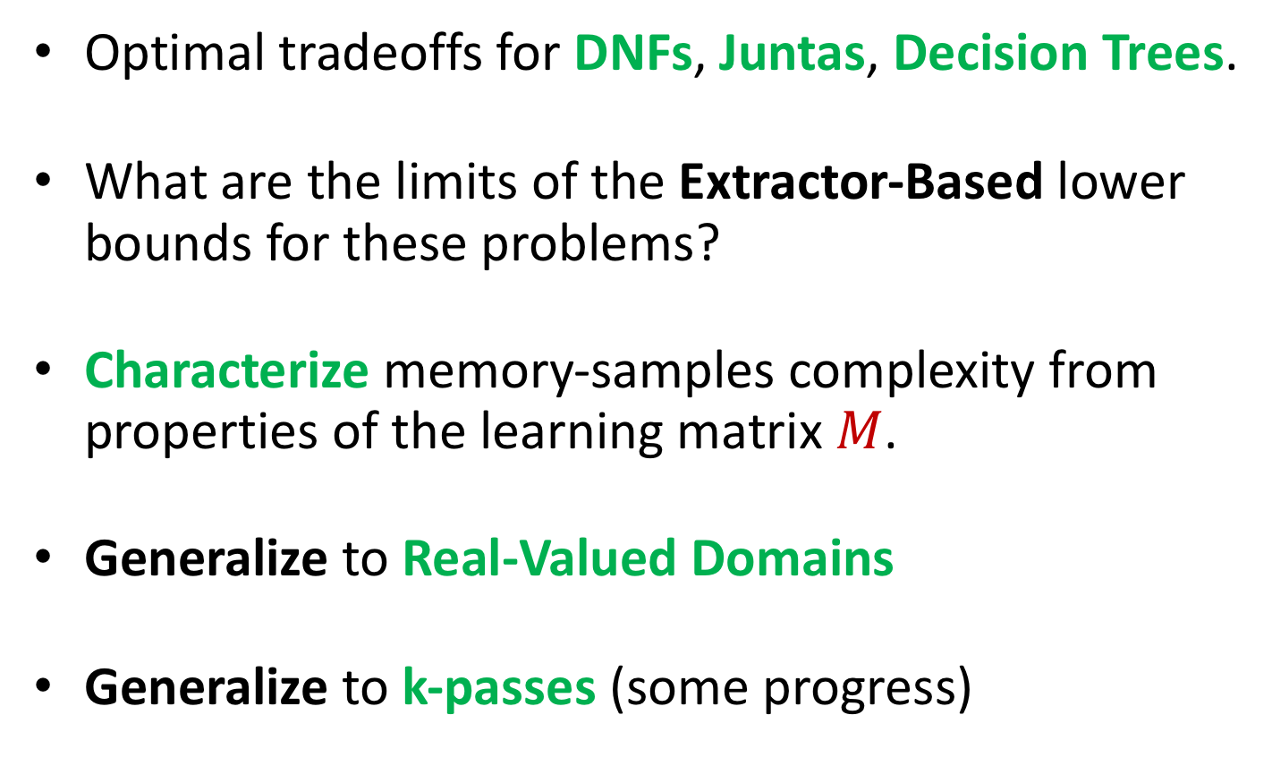
Open Problems
Optimal tradeoffs for DNFs, Juntas, Decision Trees.
What are the limits of the Extractor-Based lower bounds for these problems?
Characterize memory-samples complexity from properties of the learning matrix $M$.
Generalize to Real-Valued Domains
Generalize to k-passes (some progress)

Slide 35
Open Problem: Understanding Neural Nets
Expressiveness and Learnability are empirically different in Neural Nets.
Consider the following experiment:
Generate (input,output) pairs from a depth-2 NN with a fixed structure & randomly chosen weights.
Try to learn weights from (input,output) pairs using stochastic gradient descent.
This usually fails.
Can this be explained by the low-memory of the learner?

Slide 36
Thank You!

