Slide 1
Understanding Queries by Conditional Instances
Sudeepa Roy
Joint work with
Amir Gilad*, Zhengjie Miao*, and Jun Yang
* Joint first authors and thanks for slides!
1

Slide 2
This talk…
An application
of First Order Logic
to Database Education
(query debugging)

Slide 3

The growth of CS and Database classes
New
prerequisite
2022: 390, 2023: 428
  Enrollment increase in CS and database courses everywhere
  How do we provide students/TAs automated personalized help to debug queries

Slide 4
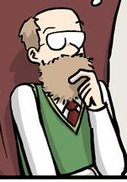
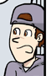
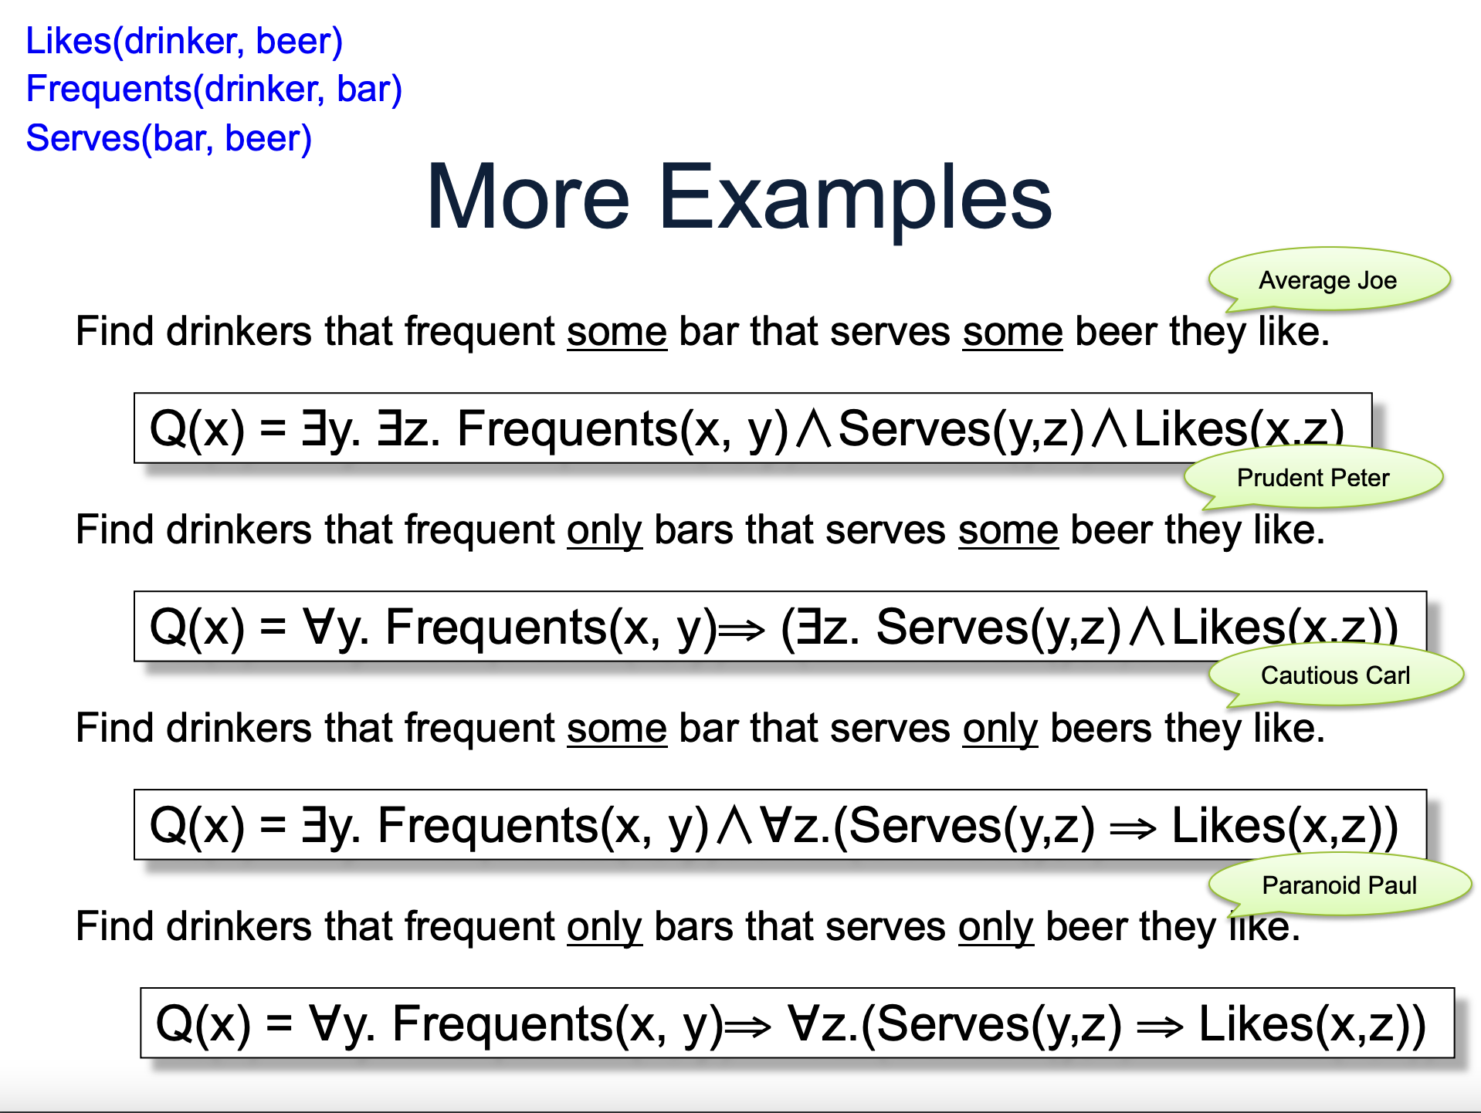
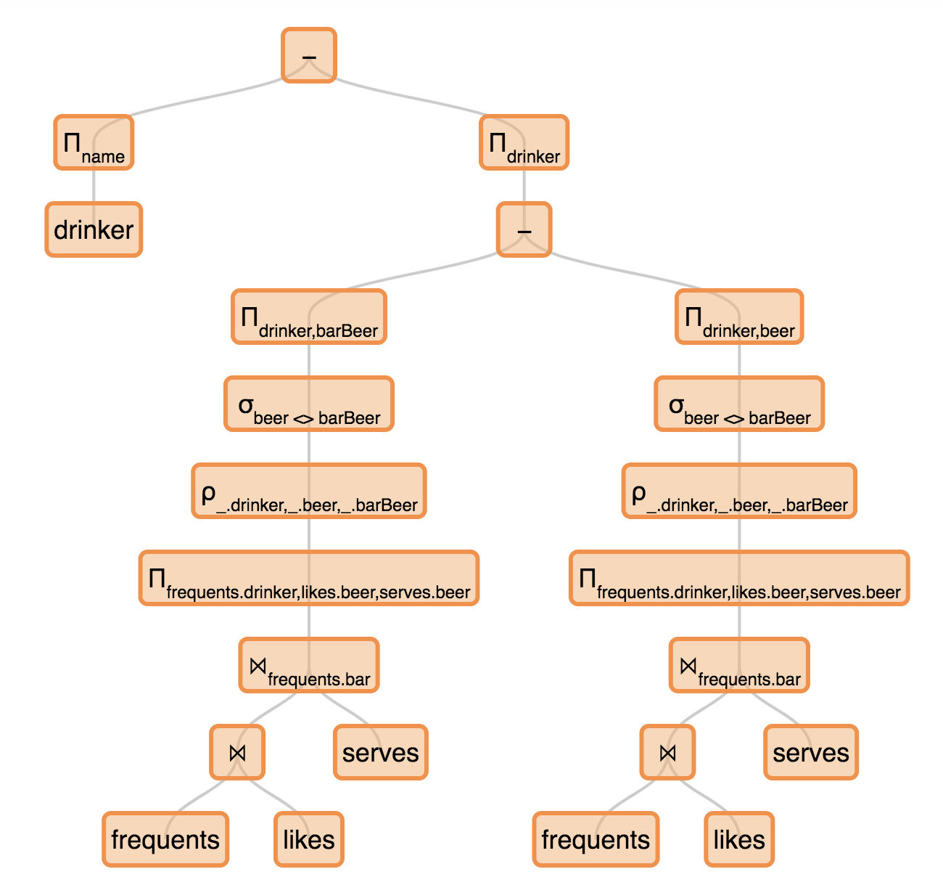
Explaining wrong queries
Frequents(drinker, bar)
Likes(drinker, beer)
Serves(bar, beer, price)
Q1: “For each beer, find the bars serving it at the highest price” (non-monotone)
π_{beer,bar}Serves – π_{beer,bar}(Serves ⨝beer=S1.beer AND price < S1.price Serves S1)
Q2: “For each beer, find the bars serving it not at the lowest price” (monotone)
π_{beer,bar}(Serves ⨝beer=S1.beer AND price > S1.price Serves S1)
The queries (questions & answers) can get quite complicated!
Ack: from lecture slide by Dan Suciu
Broad goal: build tools to help students
debug queries (without revealing the answer)

Slide 5
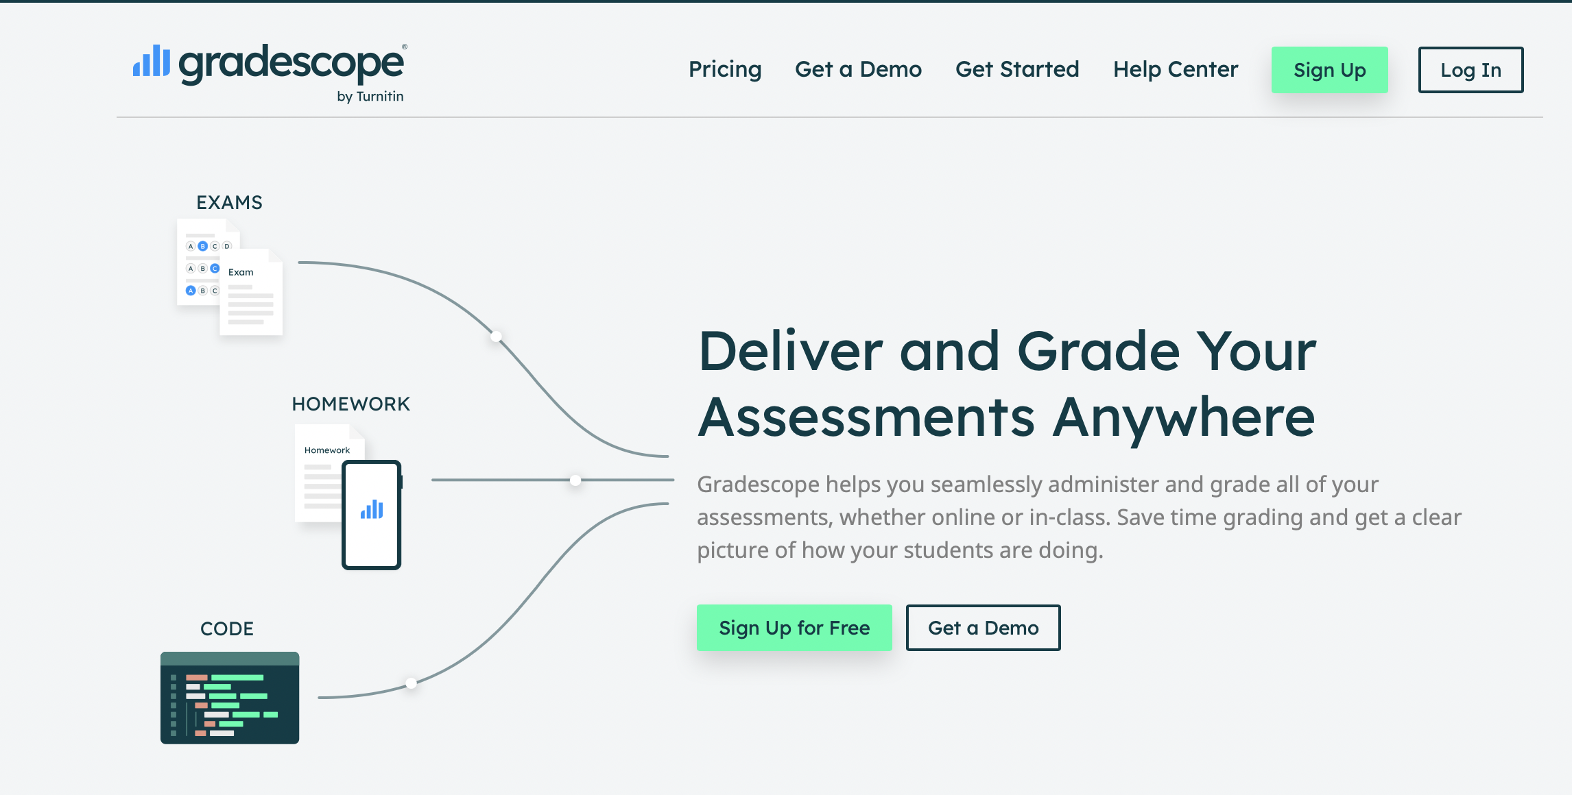
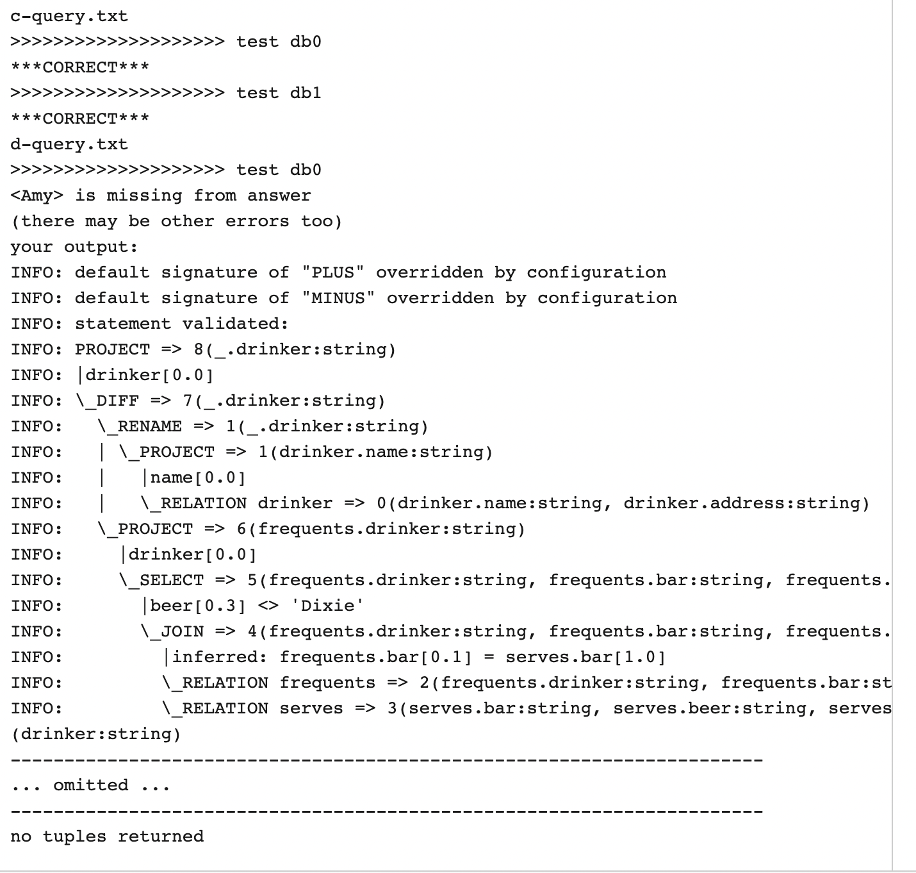
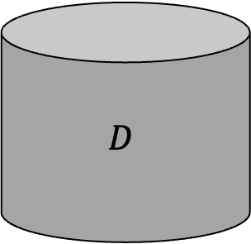
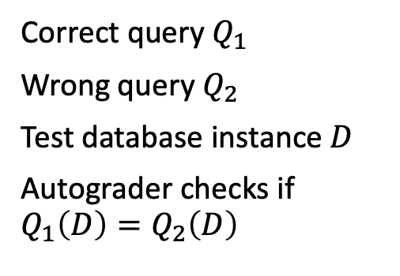


Autograding to the rescue?
$$Q_{1}\left(D\right)$$
$$Q_{2}\left(D\right)$$
Correct query $Q_{1}$
Wrong query $Q_{2}$
Test database instance $D$
Autograder checks if $Q_{1}\left(D\right)=Q_{2}\left(D\right)$
$$D$$
…Not quite ☹
The test instance can be
very big to explain the
error to the student

Slide 6


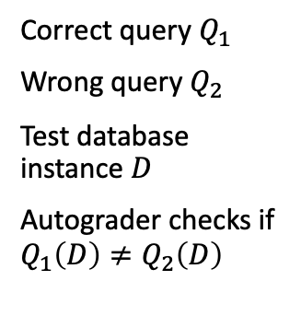
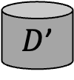

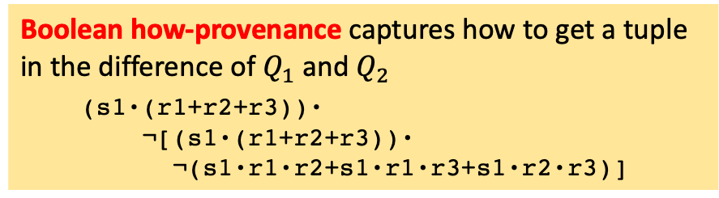
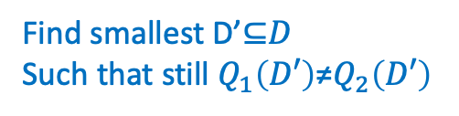

Prior work: explaining wrong queries with small examples
e.g., Distinguish Q1: Return highest vs. Q2: Return non-lowest
$$Q_{1}\left(D\right)$$
$$Q_{2}\left(D\right)$$
Correct query $Q_{1}$
Wrong query $Q_{2}$
Test database instance $D$
Autograder checks if $Q_{1}\left(D\right)≠Q_{2}\left(D\right)$
Poly-time if Q2 monotone
NP-hard in general
$$Q_{1}\left(D′\right)$$
$$Q_{2}\left(D′\right)$$
Boolean how-provenance captures how to get a tuple in the difference of $Q_{1}$ and $Q_{2}$
  (s1·(r1+r2+r3))·
    ¬[(s1·(r1+r2+r3))·
    ¬(s1·r1·r2+s1·r1·r3+s1·r2·r3)]
$$D$$
$D$’
in $Q_{2}$
Find smallest D’⊆𝐷
Such that still $Q_{1}\left(D′\right)\text{≠}Q_{2}\left(D′\right)$
in $Q_{1}$
Set min no. of vars to 1 to satisfy the expression
SMT-solvers
Multiple optimizations
Extension to aggregates and HAVING clause
[Miao-Roy-Yang, SIGMOD’19 paper & demo]

Slide 7
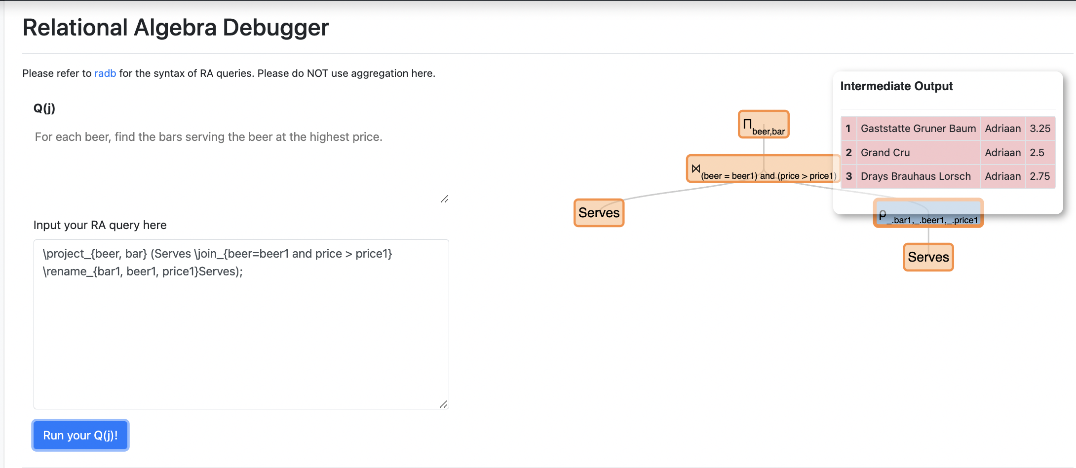
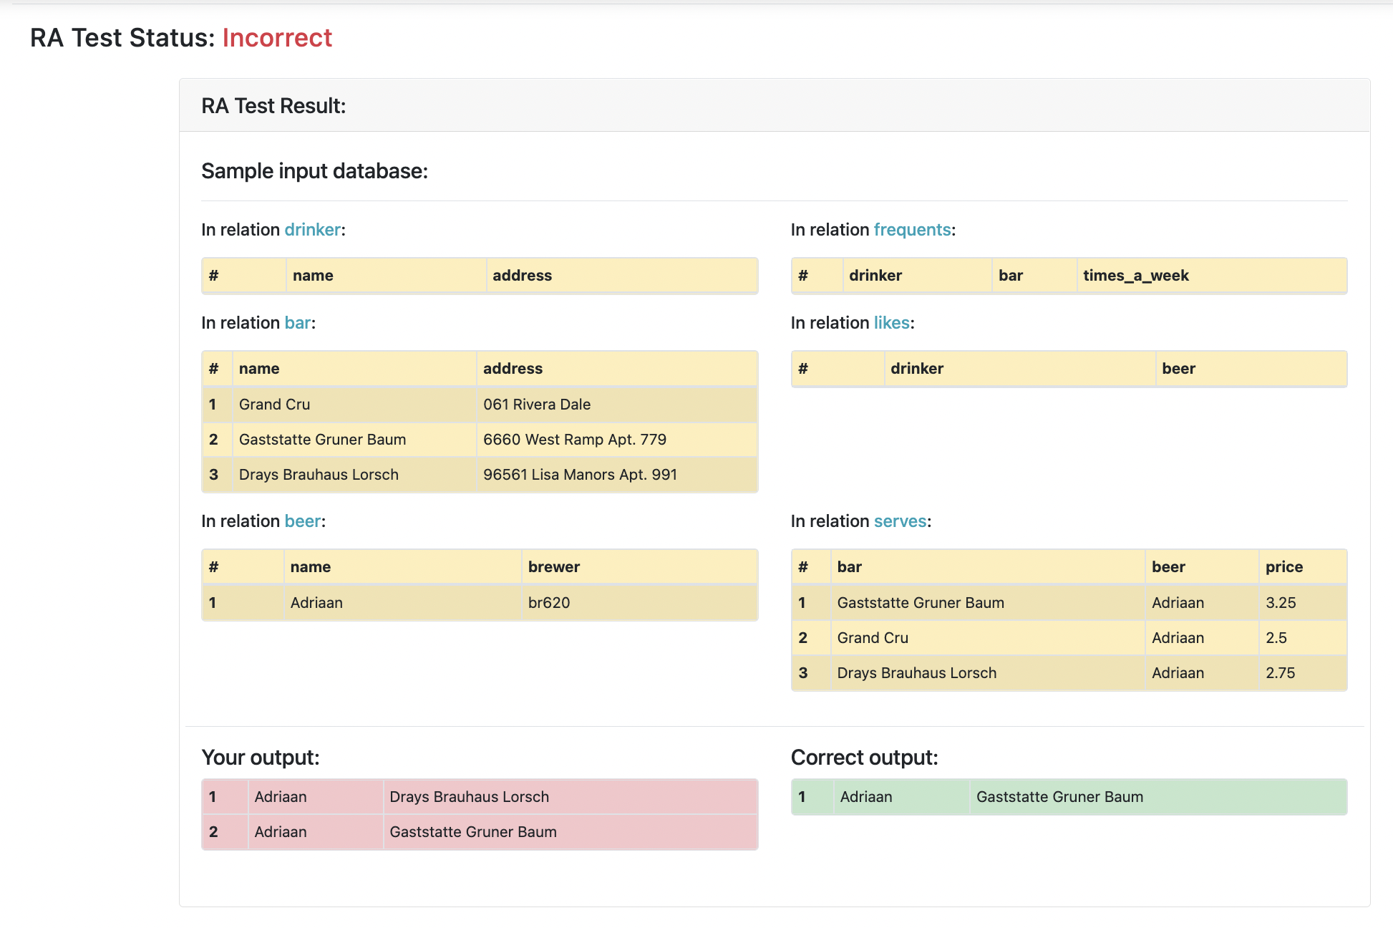
RATest: Explaining Queries Using Small Instances
e.g., Distinguish Q1: Return highest vs. Q2: Return non-lowest
Three distinct values
3.25, 2.5, 2.75
RATest tool has been used by > 1600 students in
database classes at Duke since Fall 2018
for debugging homework questions in RA!
Check out at: https://dukedb-hnrq.github.io/

Slide 8

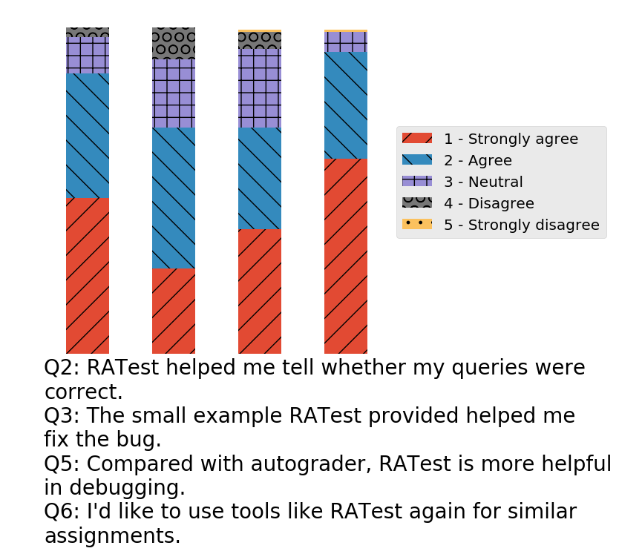
User study and student feedback
“It was incredibly useful debugging edge cases in the larger dataset not provided in our sample dataset with behavior not explicitly described in the problem set.”
Detailed study in undergrad DB class in Fall 2017
Made RATest available for 50% questions, pairing questions with equal difficulty
134 valid responses
69.4% are positive on the usefulness
92.5% would like to use similar tools
Helped more on harder queries
In consultation with IRB
“I wish I had used RATest more. … I love the idea and the implementation of the idea. It is a great project!”
“It was very helpful, and I wish it covered all of the queries!”
“Overall, very helpful and would like to see similar testers for future assignments”
“I liked how it gave us a concise example showing what we did wrong.”
“… it could have been way more helpful if it had more instances in the database..”
“Add like a little more context around the information in the database.“
Can we specify the source of error using an abstraction instead of a concrete/ground instance?
[Gilad-Miao-Roy-Yang, SIGMOD’22, SIGMOD’23 demo]

Slide 9
Toward conditional instance for debugging queries
Question: for each beer liked by drinker whose first name is Eve, find the bars serving the beer at the highest price
Correct query Q₁:
SELECT S1.beer, S1.bar
FROM Likes L, Serves S1
WHERE L.drinker LIKE 'Eve␣%'
AND L.beer = S1.beer AND NOT EXISTS (
SELECT * FROM Serves S2
WHERE S1.beer = S2.beer
AND S1.price < S2.price);
Q2 returns the bar serving the beer at the price in the middle
if there are three bars with different prices
(p1 < p2 < p3)
Ground Instance I₀
Wrong query Q₂:
SELECT S1.beer, S1.bar
FROM Likes L, Serves S1, Serves S2
WHERE L.drinker LIKE 'Eve%'
AND L.beer = S1.beer
AND S1.beer = S2.beer
AND S1.price > S2.price;
beer | bar
American Pale Ale | Tadim
American Pale Ale | Restaurante Raffaele
Result of Q₂
beer | bar
American Pale Ale | Tadim
Result of Q₁
9

Slide 10
Toward conditional instance for debugging queries
Question: for each beer liked by drinker whose first name is Eve, find the bars serving the beer at the highest price
Q2 returns the bar serving the beer at the price in the middle
if there are three bars with different prices
(p1 < p2 < p3)
Concrete Instance I₀
Ground Instance I₀
Q2 also returns wrong results if
the drinker’s first name starts with ‘Eve’
but is not exactly ‘Eve’
How to formalize and obtain such explanations to the error?
Wrong query Q₂:
SELECT S1.beer, S1.bar
FROM Likes L, Serves S1, Serves S2
WHERE L.drinker LIKE 'Eve%'
AND L.beer = S1.beer
AND S1.beer = S2.beer
AND S1.price > S2.price;
beer | bar
American Pale Ale | Tadim
American Pale Ale | Restaurante Raffaele
Result of Q₂
beer | bar
American Pale Ale | Tadim
Result of Q₁
10

Slide 11
Explaining errors by conditional instances
C-tables
Imilienski-Lipski’84
Q2 returns the bar serving the beer at the price in the middle
if there are three bars with different prices
(p1 < p2 < p3)
Conditional Instance (C-Instance) I₁
name | addr
d1 | *
Drinker
drinker | beer
d1 | b1
Likes
Conjunct of atomic conditions captures the same logic as the textual explanation
name | addr
x1 | *
x2 | *
x3 | *
Bar
bar | beer | price
x1 | b1 | p1
x2 | b1 | p2
x3 | b1 | p3
Serves
Wrong query Q₂:
SELECT S1.beer, S1.bar
FROM Likes L, Serves S1, Serves S2
WHERE L.drinker LIKE 'Eve%'
AND L.beer = S1.beer
AND S1.beer = S2.beer
AND S1.price > S2.price;
d1 LIKE ‘Eve%’ AND p1 > p2 AND p2 > p3
Global condition 𝜙
name | brewer
b1 | *
Beer
bar | beer
b1 | x1
Result of Q₁
bar | beer
b1 | x1
b1 | x2
Result of Q₂
11

Slide 12
Explaining errors by (a set of) conditional instances
Q2 also returns wrong results if
the drinker’s first name starts with ‘Eve’
but is not exactly ‘Eve’
Conditional Instance (C-Instance) I₂
name | addr
d1 | *
Drinker relation
drinker | beer
d1 | b1
Likes relation
Return another c-instance
that captures the second mistake
name | addr
x1 | *
x2 | *
Bar relation
bar | beer | price
x1 | b1 | p1
x2 | b1 | p2
Serves relation
d1 LIKE ‘Eve%’ AND p1 > p2 AND NOT(d1 LIKE ‘Eve␣%’)
Global condition 𝜙
name | brewer
b1 | *
Beer relation
Wrong query Q₂:
SELECT S1.beer, S1.bar
FROM Likes L, Serves S1, Serves S2
WHERE L.drinker LIKE 'Eve%'
AND L.beer = S1.beer
AND S1.beer = S2.beer
AND S1.price > S2.price;
bar | beer
(empty)
Result of Q₁
bar | beer
b1 | x2
Result of Q₂
12

Slide 13
Domain Relational Calculus (DRC) as query trees
∃d1, p1
⋀
⋀
∃x2, p2
Wrong query Q₂:
SELECT S1.beer, S1.bar
FROM Likes L, Serves S1, Serves S2
WHERE L.drinker LIKE 'Eve%'
AND L.beer = S1.beer
AND S1.beer = S2.beer
AND S1.price > S2.price;
⋀
Serves(x1, b1, p1)
⋀
d1 LIKE ‘Eve%’
Likes(d1, b1)
Serves(x2, b1, p2)
p1>p2
13

Slide 14























Domain Relational Calculus (DRC) as query trees
Wrong query Q2
{(x1, b1) |∃ x2, p2 (Serves(x1, b1, p1) ∧ Likes (d1, p1) ∧ d1 LIKE ‘EVE%’ ∧ Serves(x2, b1, p2) ∧ (p1 > p2)
∧
    ∀ d2, p3 ($¬$ Likes(d2, b1) ∨ $¬$ (d2 LIKE ‘EVE$␣$%’) ∨ $¬$ Serves(x1, b1, p3) ∨ ∃ x3, p4 (Serves(x3, b1, p4) ∧ (p1 > p2)))}
And NOT Correct query Q1
$$∧$$
$$∃d_{1},p_{1}$$
$$∀d_{2},p_{3}$$
$$∧$$
$$∧$$
$$∃x_{2},p_{2}$$
$$∨$$
$$∧$$
$$Serves(x_{1},b_{1},p_{1})$$
$$∧$$
$$∨$$
$$∃x_{3},p_{4}$$
$$p_{1}>p_{2}$$
$$∨$$
$¬Serves(x_{1},b_{1},p_{3}$)
$$∧$$
$Likes(d_{1},b_{1}$)
$$d_{1}LIKE `EVE␣\%′$$
$Serves(x_{2},b_{1},p_{2}$)
$¬Likes(d_{2},b_{1}$)
$${¬(d}_{2}LIKE `EVE\%′)$$
$Serves(x_{3},b_{1},p_{4}$)
$$p_{3}>p_{4}$$
14

Slide 15
Query characterization by conditional instances
Q2
Q1
−
Applications:
Explain why queries are different
Explore how various parts of the query can be “triggered” by different data
Help building test-suites
Q
“Characterize” different ways that Q is satisfied (return non-empty results)
15

Slide 16
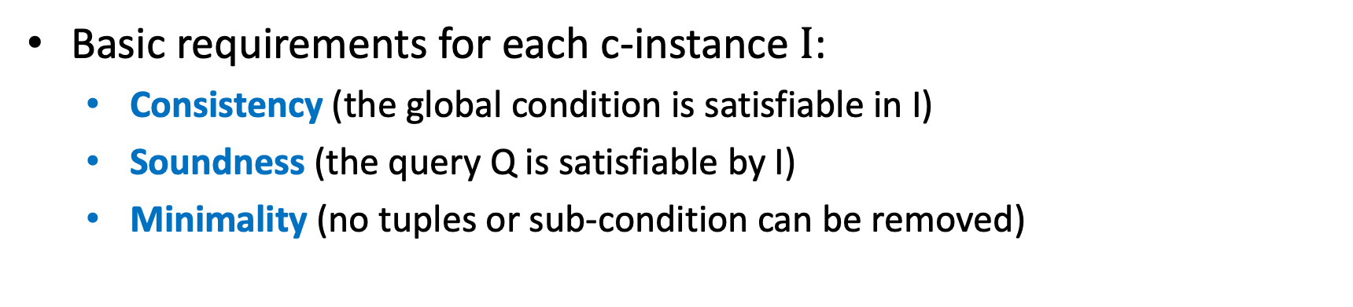
What is a good characterization for Q?
Basic requirements for each c-instance $I$:
  Consistency (the global condition is satisfiable in I)
  Soundness (the query Q is satisfiable by I)
  Minimality (no tuples or sub-condition can be removed)
Additional Ideal properties:
  “Completeness”: maps to all ground instances? But unbounded size
    capture all possible ways Q can be satisfied with multiple c-instances using “coverage”
  No-redundancy: different c-instances capture different ways satisfying Q
Enumerate homomorphisms from query variables to
“labeled nulls” (variables) in the c-instance
16

Slide 17
Soundness: Check if the C-Instance satisfies a Query
Enumerate the homomorphisms from query variables to labeled nulls
C-Ins I₀
name | addr
d1 | *
Drinker relation
drinker | bar | times
(empty)
Frequents relation
x1, b1
x1 → x1, b1 →b1
name | addr
x1 | *
x2 | *
x3 | *
Bar relation
drinker | beer
d1 | b1
Likes relation
∃d1, p1
d1 → d1, p1 →p1
⋀
bar | beer | price
x1 | b1 | p1
x2 | b1 | p2
x3 | b1 | p3
Serves relation
x2 → x2, p2 →p2
⋀
∃x2, p2
name | brewer
b1 | *
Beer relation
⋀
Serves(x1, b1, p1)
⋀
d1 LIKE ‘Eve%’ AND p1 < p2 AND p2 < p3
Likes(d1, b1)
d1 LIKE ‘Eve’
Serves(x2, b1, p2)
p1>p2
p1 > p2 conflicts with the global condition

Slide 18
Soundness: Check if the C-Instance satisfies a Query
Enumerate the homomorphisms from query variables to labeled nulls
C-Ins I₀
name | addr
d1 | *
Drinker relation
drinker | bar | times
(empty)
Frequents relation
x1, b1
x1 → x3, b1 →b1
name | addr
x1 | *
x2 | *
x3 | *
Bar relation
drinker | beer
d1 | b1
Likes relation
∃d1, p1
d1 → d1, p1 →p3
⋀
bar | beer | price
x1 | b1 | p1
x2 | b1 | p2
x3 | b1 | p3
Serves relation
x2 → x2, p2 →p2
⋀
∃x2, p2
name | brewer
b1 | *
Beer relation
⋀
Serves(x1, b1, p1)
⋀
d1 LIKE ‘Eve%’ AND p1 < p2 AND p2 < p3
Likes(d1, b1)
d1 LIKE ‘Eve’
Serves(x2, b1, p2)
p1>p2
Now p3 > p2 matches the global condition and I₀ ⊧ Q₂

Slide 19
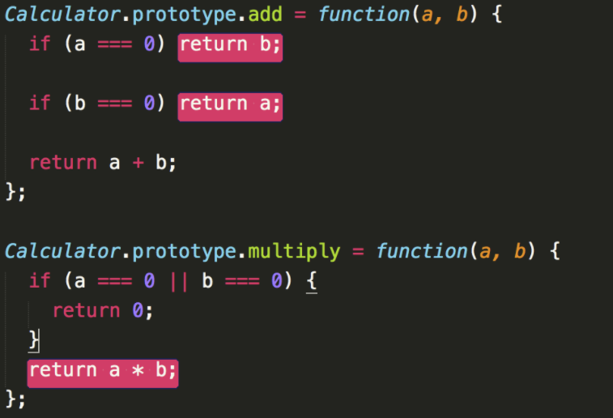
Completeness: Coverage of C-Instances
Motivated by code-coverage
Read X
Read Y
Read X
Read Y
Read X
Read Y
X > 10
X > 10
X > 10
False
True
False
True
False
True
Print “Foo”
Print “Foo”
Print “Foo”
End if
End if
End if
X+Y < 50
X+Y < 50
X+Y < 50
False
True
False
True
False
True
Print “Bar”
Print “Bar”
Print “Bar”
End if
End if
End if

Slide 20















Completeness: Coverage of C-Instances
Coverage of a c-instance I for Q:
Atoms (leaves) of Q that evaluate to True by I
C-Ins I₁
name | addr
d1 | *
Drinker
drinker | beer
d1 | b1
Likes
$\overline{x}1$, $\overline{b}1$
name | addr
x1 | *
x2 | *
x3 | *
Bar
bar | beer | price
x1 | b1 | p1
x2 | b1 | p2
x3 | b1 | p3
Serves
⋀
∃$\overline{d}1$, $\overline{p}1$
∀$\overline{d}2\text{,} \overline{p}3$
name | brewer
b1 | *
Beer
d1 LIKE ‘Eve␣%’ AND p1> p2 AND p2>p3
Global condition 𝜙
⋀
⋀
∃$\overline{x}2$, $\overline{p}2$
⋁
Serves($\overline{x}1$, $\overline{b}1$, $\overline{p}1$)
⋀
⋁
∃$\overline{x}3$, $\overline{p}4$
⋀
Serves($\overline{x}2$, $\overline{b}1$, $\overline{p}2$)
$\overline{p}1$>$\overline{p}2$
⋁
¬Serves($\overline{x}1$, $\overline{b}1$, $\overline{p}3$)
⋀
Likes($\overline{d}1$, $\overline{b}1$)
$\overline{d}1$LIKE ‘Eve%’
¬ ($\overline{d}2$ LIKE ‘Eve␣%’)
¬ Likes($\overline{d}2$, $\overline{b}1$)
Serves($\overline{x}3$, $\overline{b}1$, $\overline{p}4$)
$\overline{p}3$<$\overline{p}4$

Slide 21

Completeness: Coverage of C-Instances
Coverage of a c-instance I for Q:
Atoms (leaves) of Q that evaluate to True by I
C-Ins I₂
name | addr
d1 | *
Drinker
drinker | beer
d1 | b1
Likes
$\overline{x}1$, $\overline{b}1$
name | addr
x1 | *
x2 | *
Bar
bar | beer | price
x1 | b1 | p1
x2 | b1 | p2
Serves
⋀
∃$\overline{d}1$, $\overline{p}1$
name | brewer
b1 | *
Beer
d1 LIKE ‘Eve␣%’ AND p1> p2 AND NOT ( d1 LIKE ‘Eve␣%’)
Global condition 𝜙
∀$\overline{d}2\text{,} \overline{p}3$
⋀
⋀
∃$\overline{x}2$, $\overline{p}2$
⋁
Serves($\overline{x}1$, $\overline{b}1$, $\overline{p}1$)
⋀
⋁
∃$\overline{x}3$, $\overline{p}4$
⋀
Serves($\overline{x}2$, $\overline{b}1$, $\overline{p}2$)
$\overline{p}1$>$\overline{p}2$
⋁
¬Serves($\overline{x}1$, $\overline{b}1$, $\overline{p}3$)
⋀
Likes($\overline{d}1$, $\overline{b}1$)
$\overline{d}1$LIKE ‘Eve%’
¬ ($\overline{d}2$ LIKE ‘Eve␣%’)
¬ Likes($\overline{d}2$, $\overline{b}1$)
Serves($\overline{x}3$, $\overline{b}1$, $\overline{p}4$)
$\overline{p}3$<$\overline{p}4$

Slide 22
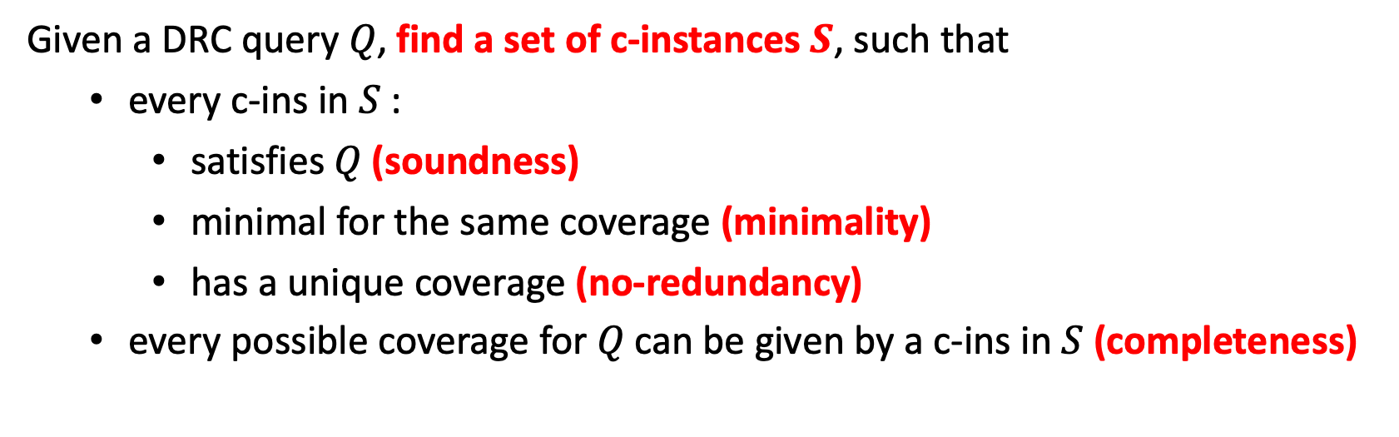
Problem Definition
Given a DRC query 𝑄, find a set of c-instances $S$, such that
  every c-ins in $S$:
    satisfies 𝑄 (soundness)
    minimal for the same coverage (minimality)
    has a unique coverage (no-redundancy)
  every possible coverage for 𝑄 can be given by a c-ins in $S$ (completeness)
Minimal C-Solution
Even the existence of the solution is undecidable for general DRC queries
(from finite model satisfiability for FOL)
Our solution:
Run a chase-inspired procedure with a stopping condition
Enumerate homomorphisms from query variables to c-instance labeled nulls
Post-process for satisfiability and redundancy using solvers

Slide 23













Algorithm Walkthrough
Handling ⋁, ⋀, ∃, ∀
Query: find drinkers who either like Budweiser OR do not like any beer
$$\overline{d}$$
Reduce disjunction into conjunctive trees
⋁
Likes($\overline{d}$, Budweiser)
∀$\overline{b}$
¬ Likes($\overline{d}$, $\overline{b}$)
Conj-Tree 1
Conj-Tree 2
Conj-Tree 3
⋀
⋀
⋀
Likes($\overline{d}$, Budweiser)
∀$\overline{b}$
Likes($\overline{d}$, Budweiser)
∃$\overline{b}$
¬ Likes($\overline{d}$, Budweiser)
∀$\overline{b}$
¬ Likes($\overline{d}$, $\overline{b}$)
Likes($\overline{d}$, $\overline{b}$)
¬ Likes($\overline{d}$, $\overline{b}$)

Slide 24


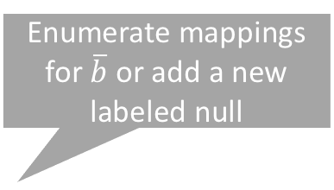
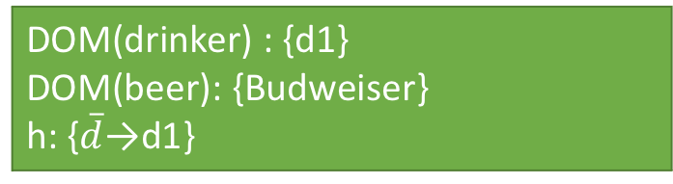


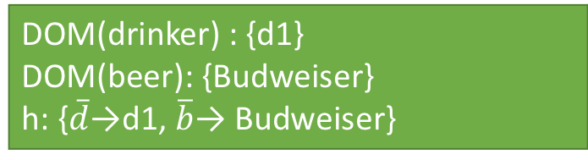
Algorithm Walkthrough
Handling ⋁, ⋀, ∃, ∀
$$\overline{d}$$
DOM(drinker) : {}
DOM(beer): {}
h: {}
DOM(drinker) : {d1}
DOM(beer): {Budweiser}
h: {$\overline{d}\text{→}$d1, $\overline{b}$→ Budweiser}
DOM(drinker) : {d1}
DOM(beer): {Budweiser}
h: {$\overline{d}\text{→}$d1}
Enumerate mappings for $\overline{b}$ or add a new labeled null
Conj-Tree 2
⋀
Likes($\overline{d}$, Budweiser)
∃$\overline{b}$
Likes($\overline{d}$, $\overline{b}$)
∅
+: Likes(d1, Budweiser)
⊤

Slide 25
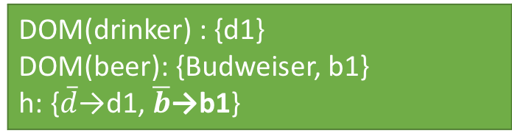
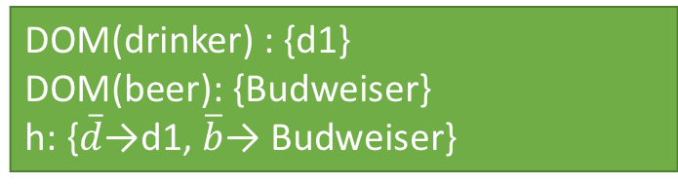
Algorithm Walkthrough
Handling ⋁, ⋀, ∃, ∀
$$\overline{d}$$
DOM(drinker) : {d1}
DOM(beer): {Budweiser}
h: {$\overline{d}\text{→}$d1, $\overline{b}$→ Budweiser}
DOM(drinker) : {d1}
DOM(beer): {Budweiser, b1}
h: {$\overline{d}\text{→}$d1, $\overline{b}$→b1}
Enumerate mappings for $\overline{b}$ or add a new labeled null
Conj-Tree 2
⋀
Likes($\overline{d}$, Budweiser)
∃$\overline{b}$
Likes($\overline{d}$, $\overline{b}$)
∅
+: Likes(d1, Budweiser)
⊤
+: Likes(d1, b1)
⊤

Slide 26
Algorithm Walkthrough
Handling ⋁, ⋀, ∃, ∀
Query: find drinkers who either like Budweiser OR do not like any beer
$$\overline{d}$$
Reduce disjunction into conjunctive trees
⋁
Likes($\overline{d}$, Budweiser)
∀$\overline{b}$
¬ Likes($\overline{d}$, $\overline{b}$)
Conj-Tree 1
Conj-Tree 2
Conj-Tree 3
⋀
⋀
⋀
Likes($\overline{d}$, Budweiser)
∀$\overline{b}$
Likes($\overline{d}$, Budweiser)
∃$\overline{b}$
¬ Likes($\overline{d}$, Budweiser)
∀$\overline{b}$
¬ Likes($\overline{d}$, $\overline{b}$)
Likes($\overline{d}$, $\overline{b}$)
¬ Likes($\overline{d}$, $\overline{b}$)

Slide 27

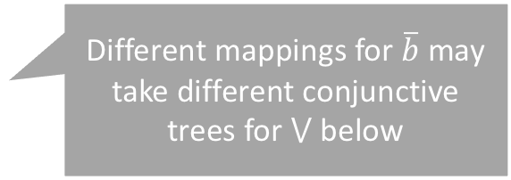



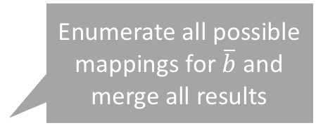
Challenging Case
Handling ⋁, ⋀, ∃, ∀
$$\overline{d}$$
$$\overline{d}$$
Enumerate all possible mappings for $\overline{b}$ and merge all results
Different mappings for $\overline{b}$ may take different conjunctive trees for ⋁ below
Conj-Tree 1
∀$\overline{b}$
⋀
Likes($\overline{d}$, Budweiser)
∀$\overline{b}$
⋁
…
¬ Likes($\overline{d}$, $\overline{b}$)
Optimizations reducing the search space

Slide 28
User Study
64 participants (42 undergrads + 22 grads)
Task: spot errors in two SQL queries Q_{a}, Q_{b} (each has two errors)
Treatment group
  C-instances with example values
Control group
  Concrete-value-only instances from our prior RATest tool
Users are randomly given
  (𝑄_{a}, treatment) + (𝑄_{b}, control)
  Or (𝑄_{a}, control) + (𝑄_{b}, treatment)

Slide 29
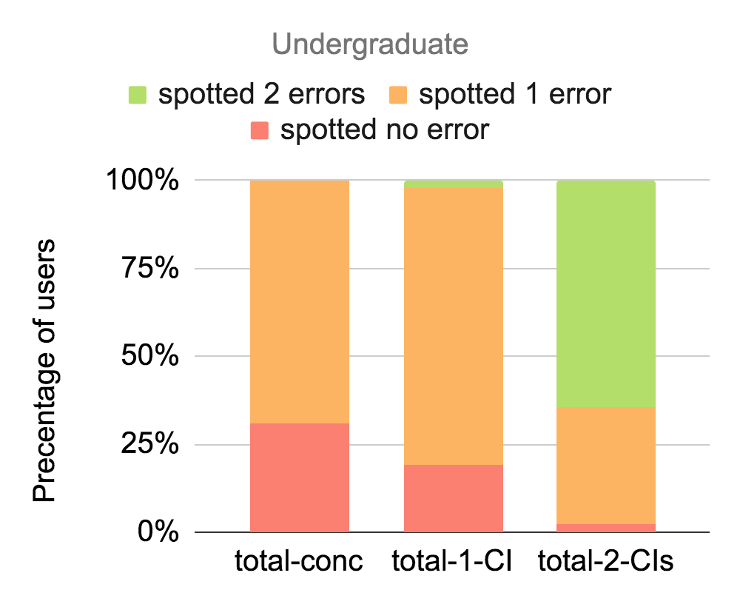
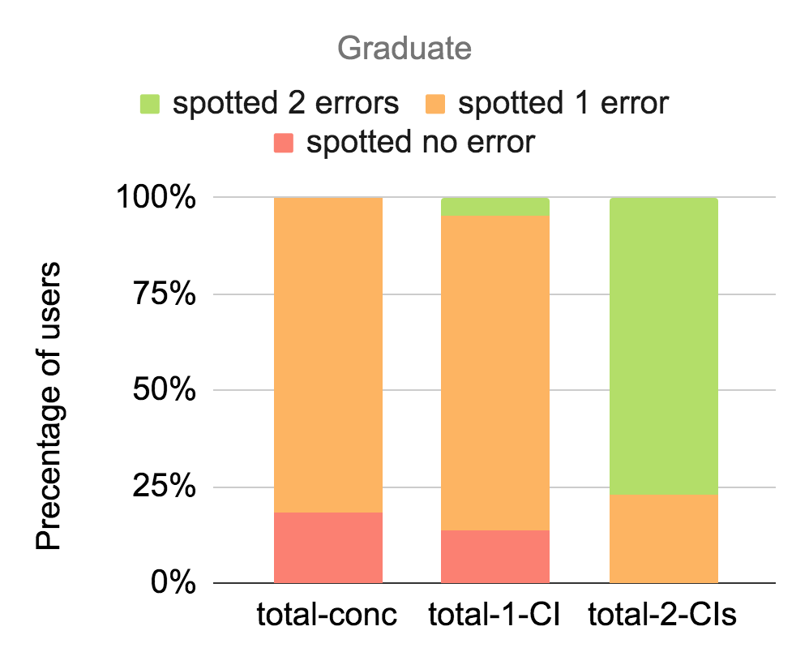
User Study
Ground
instance
One
C-instance
Two
C-instances
Ground
instance
One
C-instance
Two
C-instances
C-Instances better help users spotting errors
Multiple c-instances with different coverage dramatically help spotting multiple errors

Slide 30
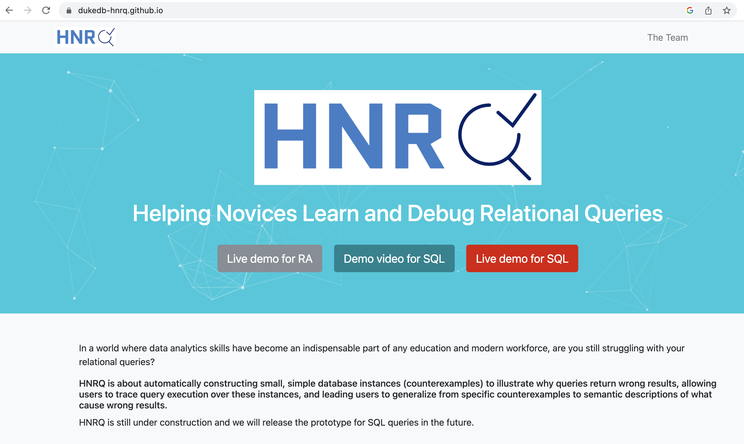

Summary and open problems
DB Education and automated TA is an important and potentially high-impact area of research with DB theory, systems, optimization, UI, user study (IRB!) – several groups are working on this but this needs more work
Query characterization by conditional-instances
Advantages:
  Test-instance-independent
  Capture different ways to satisfy a query
  Can explain the difference between two queries
Undecidable－but efficient heuristics possible
User study: better help users spot errors
Collaboration with experts in CS education
Other work: debugger/tracer for SQL, hints to fix a query
Open:
  Conditional instances for aggregates & HAVING (beyond FOL)
  Other (decidable) forms of explanations
  Explanations in natural language
  Use / get around LLMs!
HNRQ: Helping Novices learn Relational Queries
  https://dukedb-hnrq.github.io/

Slide 31
Thank you!

