Slide 1
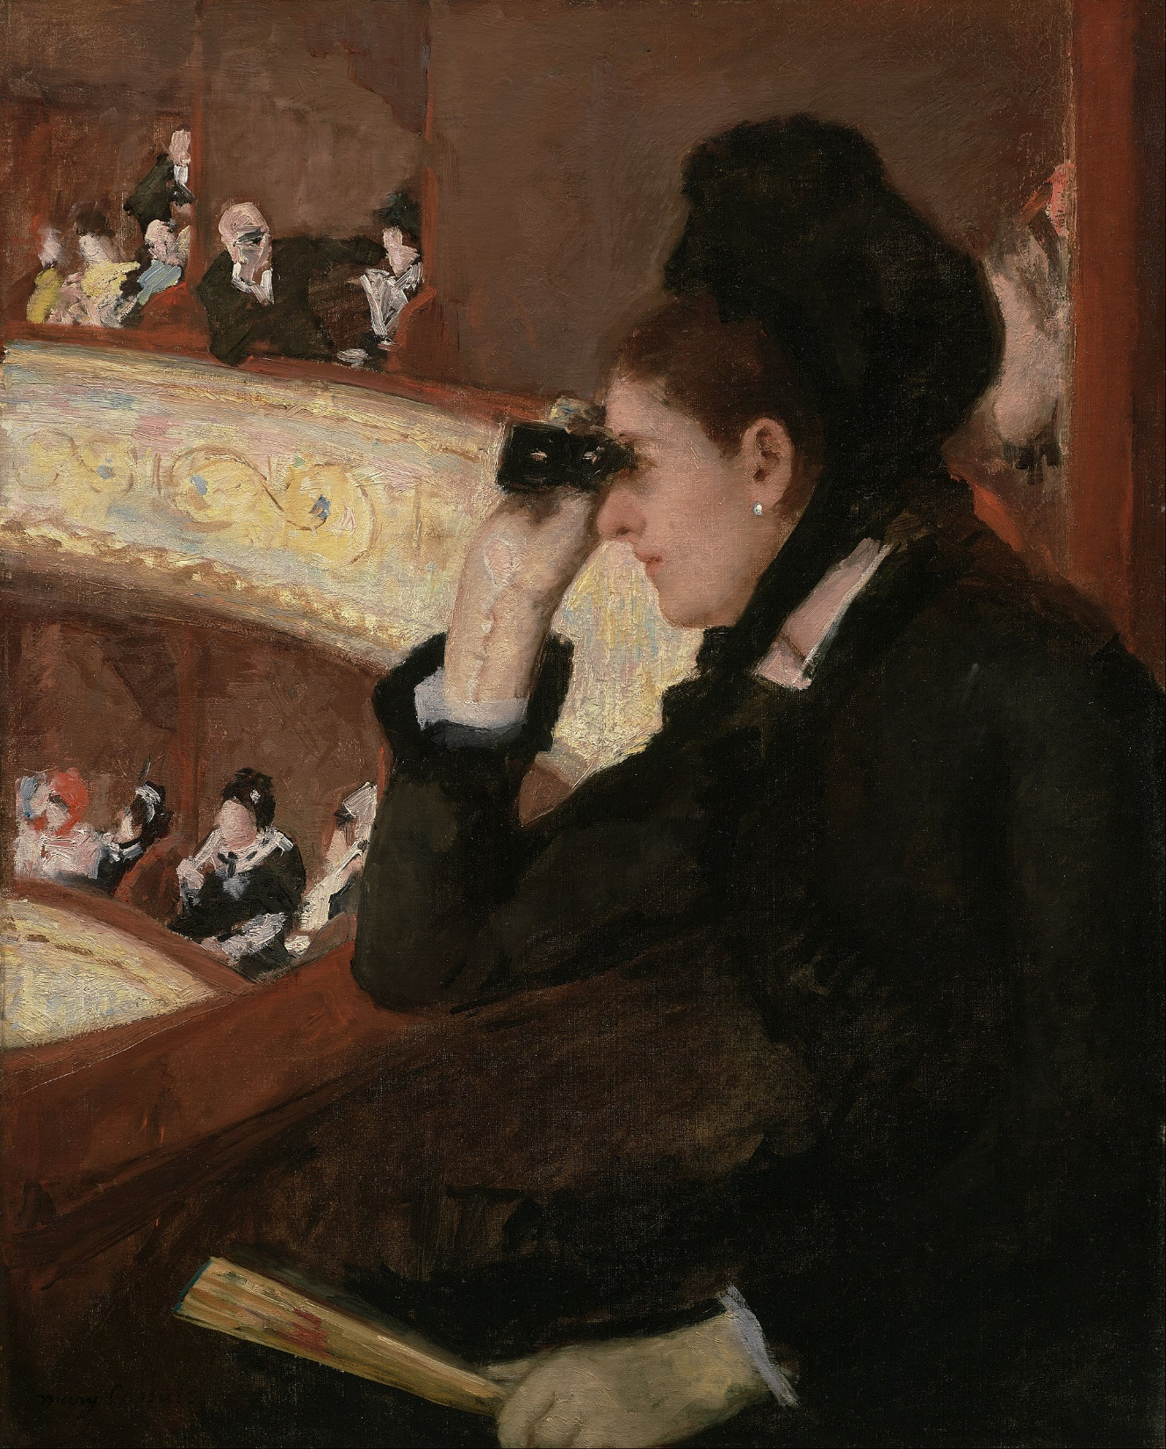
Explicit Orthogonal
& Unitary Designs
or,
``Pseudorandom Rotations”
Ryan O’Donnell
Carnegie Mellon University
with
Pedro Paredes
Rocco Servedio
Princeton
Columbia

Slide 2
Let G be a group of N×N matrices.
# bits of entropy needed to sample from Unif distribution on G
Example groups G:
(Haar)
S_{N} − the permutations of [N]
(N×N permutation matrices)c.
log(N!) = Θ~(N)
SO(N) − the rotations of ℝ^{N}
morally Θ~(N²)
U(N) − the unitaries on ℂ^{N}
morally Θ~(N²)
ℤ₂^{N} − diagonal matrices of ±1’s
N)

Slide 3
Goal:
A distribution Pseudo on G,
efficiently samplable with ≪ N bits of entropy,
such that
“almost k-wise uniform distribution on G”
or
“approximate…
k-design for G”
k^{th}
moments
Pseudo ≈ Unif
N^{k}×N^{k} matrix whose
entries are all products
of k entries of X
ϵ
≈
X ^{⊗k/2} ⊗ X ^{⊗k/2}
for unitaries

Slide 4
Example: G = S_{N}, all N×N permutation matrices. k = 4.
N^{k}×N^{k} matrix whose
entries are all products
of k entries of X
ϵ
≈

Slide 5
Example: G = S_{N}, all N×N permutation matrices. k = 4.
i₁ → j₁
i₂ → j₂
i₃ → j₃
i₄ → j₄
Pr
under
Pseudo
is the matrix of all quantities
ϵ
≈
?

Slide 6
Example: G = S_{N}, all N×N permutation matrices. k = 4.
i₁ → j₁
i₂ → j₂
i₃ → j₃
i₄ → j₄
Pr
under
Pseudo
is the matrix of all quantities
ϵ
≈
?
has entry
when i₁, i₂, … j₄ distinct
For simplicity, we fix ϵ = in this talk.

Slide 7
(ϵ = )-approximate k-designs for G
(N = 2^{n})
Baseline (inefficient) randomized construction needs
≥ log(1/ϵ) bits of entropy.
k log N

Slide 8
(ϵ = )-approximate k-designs for G
(N = 2^{n})
Baseline (inefficient) randomized construction: ≳ k n bits of entropy.
G
reference
entropy
applications
S_{N}
[KNR’05]
[Kas’05]
O(k n)
Cryptography, sparse JL,
codes, hashing, explicit
near-Ramanujan graphs
[BHH’19]
[HHj’20]
[Haf’22]
U(2^{n})
Õ(k^{C} n²)
Randomized benchmarking,
black holes, “hierarchy for replica quantum advantage”
strongly explicit
random size-O(k^{C} n²)
n-qubit circuit works

Slide 9
(ϵ = )-approximate k-designs for G
(N = 2^{n})
Baseline (inefficient) randomized construction: ≳ k n bits of entropy.
G
reference
entropy
applications
S_{N}
[KNR’05]
[Kas’05]
O(k n)
Cryptography, sparse JL,
codes, hashing, explicit
near-Ramanujan graphs
[BHH’19]
[HHj’20]
[Haf’22]
U(2^{n})
O(k n)
Randomized benchmarking,
black holes, “hierarchy for replica quantum advantage”
SO(2^{n})
us
O(k n)
Almost optimal PRGs for spherical caps [KM’18]
(& strongly explicit)

Slide 10
Part 1:
Derandomization techniques

Slide 11
(ϵ = )-approximate k-designs for G
(N = 2^{n})
Baseline (inefficient) randomized construction: ≳ k n bits of entropy.
G
reference
entropy
S_{N}
[KNR’05]
[Kas’05]
O(k n)
[BHH’19]
[HHj’20]
[Haf’22]
U(2^{n})
Õ(k^{C} n²)
strongly explicit
random size-O(k^{C} n²)
n-qubit circuit works

Slide 12
(ϵ = )-approximate k-designs for G
(N = 2^{n})
Baseline (inefficient) randomized construction: ≳ k n bits of entropy.
G
reference
entropy
Derandomized using, e.g., derandomized squaring
of graphs [RTV’05], [RV’05]
S_{N}
[KNR’05]
O(k n)
S_{N}
[Gow’96]
[HMMR’04]
[BH’07]
Õ(k^{C} n²)
Observation:
Not really about graphs
(averages of permutation matrices),
proof extends to avgs. of
bounded operators
strongly explicit
random size-O(k^{C} n²)
classical reversible
n-bit circuit works

Slide 13
Goal: (k=4 case) Low-entropy distribution Pseudo on G such that…
_{ϵ}
≈
Def: ℜ(X) = X ⊗ X ⊗ X ⊗ X.
A representation of G: ℜ(XY) = ℜ(X) ℜ(Y).

Slide 14
Goal: (k=4 case) Low-entropy distribution Pseudo on G such that…
Def: UnifAvg_{ℜ} =
ℜ
Def: ℜ(X) = X ⊗ X ⊗ X ⊗ X.
A representation of G: ℜ(XY) = ℜ(X) ℜ(Y).
Fact:
For fixed X₀ and X ~ Unif we have X₀ X ~ X X₀ ~ Unif.
Cor: ℜ(X₀) · UnifAvg_{ℜ} = UnifAvg_{ℜ} (and also for right-multiplication)
Cor: AnyDistributionAvg_{ℜ} · UnifAvg_{ℜ} = UnifAvg_{ℜ} (and also for right-multiplication)
Cor: (UnifAvg_{ℜ})² = UnifAvg_{ℜ} (it’s a projection matrix)

Slide 15
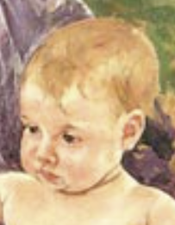
Goal: (k=4 case) O(k n)-bit entropy distribution Pseudo on G such that…
ϵ
PseudoAvg_{ℜk} ≈ UnifAvg_{ℜk} (where ℜ_{k}(X) = X^{⊗k}) (ϵ = )
Plan: Find a Baby pseudorand distribution, samplable with s bits of entropy,
such that
||BabyAvg_{ℜk} − UnifAvg_{ℜk}||_{op} ≤ 1−δ
⇒ || (BabyAvg_{ℜk} − UnifAvg_{ℜk})² ||_{op} ≤ (1−δ)²
(BabyAvg_{ℜk})² − BabyAvg_{ℜk} · UnifAvg_{ℜk} − UnifAvg_{ℜk} · BabyAvg_{ℜk} + (UnifAvg_{ℜk})²
= (BabyAvg_{ℜk})² − UnifAvg_{ℜk}

Slide 16
Goal: (k=4 case) O(k n)-bit entropy distribution Pseudo on G such that…
ϵ
PseudoAvg_{ℜk} ≈ UnifAvg_{ℜk} (where ℜ_{k}(X) = X^{⊗k}) (ϵ = )
Plan: Find a Baby pseudorand distribution, samplable with s bits of entropy,
such that
||BabyAvg_{ℜk} − UnifAvg_{ℜk}||_{op} ≤ 1−δ
⇒ || (BabyAvg_{ℜk})² − UnifAvg_{ℜk} ||_{op} ≤ (1−δ)²
(BabyAvg_{ℜk})² = E [ℜ_{k}(X₁)] · E [ℜ_{k}(X₂)] = E [ℜ_{k}(X₁ X₂)] = E [ℜ_{k}(X)]
X₁~Baby
X₂~Baby
X~Baby²
samplable with 2s bits of entropy

Slide 17
Goal: (k=4 case) O(k n)-bit entropy distribution Pseudo on G such that…
ϵ
PseudoAvg_{ℜk} ≈ UnifAvg_{ℜk} (where ℜ_{k}(X) = X^{⊗k}) (ϵ = )
Plan: Find a Baby pseudorand distribution, samplable with s bits of entropy,
such that
||BabyAvg_{ℜk} − UnifAvg_{ℜk}||_{op} ≤ 1−δ
⇒ || (BabyAvg_{ℜk})² − UnifAvg_{ℜk} ||_{op} ≤ (1−δ)²
Repeated squaring:
1−δ → ϵ with s · log(1/ϵ) / δ bits of entropy
Derandomized squaring:
O( s + log(1/ϵ) + log(1/δ) ) bits of entropy

Slide 18
Goal: (k=4 case) O(k n)-bit entropy distribution Pseudo on G such that…
ϵ
PseudoAvg_{ℜk} ≈ UnifAvg_{ℜk} (where ℜ_{k}(X) = X^{⊗k}) (ϵ = )
Plan: Find a Baby pseudorand distribution, samplable with s bits of entropy,
such that
||BabyAvg_{ℜk} − UnifAvg_{ℜk}||_{op} ≤ 1−δ
Upshot:
We get the desired strongly explicit O(k n)-bit entropy distribution
provided Baby has:
δ ≤
with s ≪ n

Slide 19
Part 2:
The Baby distribution

Slide 20
(ϵ = )-approximate k-designs for G
(N = 2^{n})
Baseline (inefficient) randomized construction: ≳ k n bits of entropy.
G
reference
entropy
applications
S_{N}
[KNR’05]
[Kas’05]
O(k n)
Cryptography, sparse JL,
codes, hashing, explicit
near-Ramanujan graphs
[BHH’19]
[HHj’20]
[Haf’22]
U(2^{n})
O(k n)
Randomized benchmarking,
black holes, “hierarchy for replica quantum advantage”
SO(2^{n})
us
O(k n)
Almost optimal PRGs for spherical caps [KM’18]
(& strongly explicit)

Slide 21
(ϵ = )-approximate k-designs for G
(N = 2^{n})
Baseline (inefficient) randomized construction: ≳ k n bits of entropy.
G
reference
entropy
S_{N}
[KNR’05]
[Kas’05]
O(k n)
Need a cheap Baby distribution on
n-qubit quantum circuits such that
[BHH’19]
[HHj’20]
[Haf’22]
U(2^{n})
O(k n)
||BabyAvg_{ℜk} − UnifAvg_{ℜk}||_{op}
SO(2^{n})
us
O(k n)
≤ 1 −
(& strongly explicit)

Slide 22
Universality Theorem:
There is a finite set S of quantum “gates” (1-, 2-, 3-qubit unitaries)
such that every X in U(2^{n}) can be approximated (arbitrarily well)
by an n-qubit circuit using gates from S.
[Shi’02] version: S =
Toffoli
CNOT
NOT
Hadamard
Phase

Slide 23
Universality Theorem:
There is a finite set S of quantum “gates” (1-, 2-, 3-qubit unitaries)
such that every X in U(2^{n}) can be approximated (arbitrarily well)
by an n-qubit circuit using gates from S.
g₁
g₄
g₆
g₇
X ≈
g₃
n
g₅
g₂
each g_{j} ∈ S
each g_{j} ∈ S

Slide 24
Universality Theorem:
There is a finite set S of quantum “gates” (1-, 2-, 3-qubit unitaries)
such that every X in U(2^{n}) can be approximated (arbitrarily well)
by an n-qubit circuit using gates from S.
g₁
g₄
Need a cheap Baby distribution on
n-qubit quantum circuits such that
g₃
g₂
||BabyAvg_{ℜk} − UnifAvg_{ℜk}||_{op}
each g_{j} ∈ S
≤ 1 −

Slide 25
Baby distribution:
Output a single, randomly placed, random gate from S.
Bits of entropy needed:
3 log n + O(1)
Need a cheap Baby distribution on
n-qubit quantum circuits such that
g
≪ n
||BabyAvg_{ℜk} − UnifAvg_{ℜk}||_{op}
≤ 1 −

Slide 26
Baby distribution:
Output a single, randomly placed, random gate from S.
Theorem:
[BHH’19], [HHj’20], [Haf’22]
Bits of entropy needed:
3 log n + O(1)
||BabyAvg_{ℜk} − UnifAvg_{ℜk}||_{op}
g
≤ 1 −
· Õ( )
≪ n

Slide 27
Baby distribution:
Output a single, randomly placed, random gate from S.
Theorem:
[Gow’96], [HMMR’04], [BH’07]
Bits of entropy needed:
3 log n + O(1)
||BabyAvg_{ℜk} − UnifAvg_{ℜk}||_{op}
g
≤ 1 −
≪ n
in the G = S_{N} setting,
if you delete
Hadamard, Phase from S.

Slide 28
Baby distribution:
Output a single, randomly placed, random gate from S.
Theorem:
[me & Pedro & Rocco]
Bits of entropy needed:
3 log n + O(1)
||BabyAvg_{ℜk} − UnifAvg_{ℜk}||_{op}
g
≤ 1 −
· O( )
≪ n
in the G = SO(2^{n}) setting,
if you delete
Hadamard, Phase from S.

Slide 29
Q: Aren’t SO(2^{n}) and U(2^{n}) very similar groups?
Shouldn’t the proof be very similar to that of [BHH’19], [HHj’20]?
A: Yeah.
  Our proof gives a unified analysis of SO(2^{n}) and U(2^{n}),
  with slightly better parameters,
  and is (I think) a bit simpler/clearer.

Slide 30
Part 3:
Outline of the proof

Slide 31
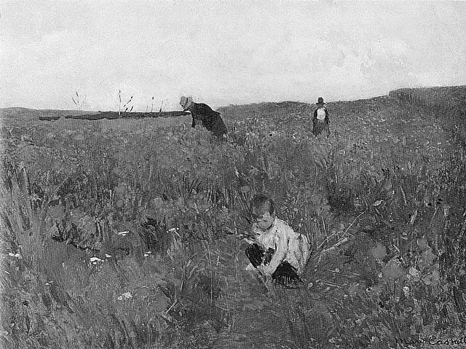

Slide 32
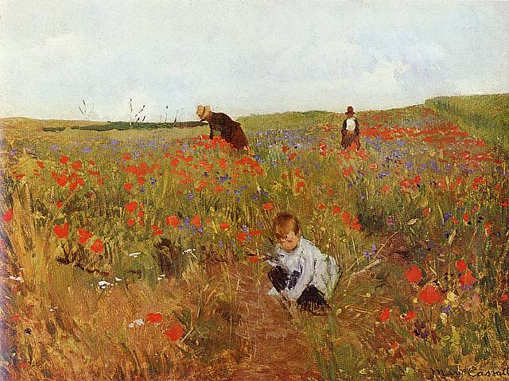

Slide 33
Baby
Unif
U
g
...at least
· O( )
as random as…
(averaged over
random placement)
Real meaning:
(Id − BabyAvg_{ℜk}) ≥ (Id − UnifAvg_{ℜk})
· O( )

Slide 34
Step 0
g
...at least
Ω(1)
U
as random as…
(averaged over
random placement)
(averaged over
random placement)
This follows from a deep “arithmetic combinatorics”-type theorem
of [BG’12] for U(d), [BdS’16] for general compact simple Lie groups.

Slide 35
So now it remains to show:
U
U
...at least
· O( )
as random as…
(averaged over
random placement)

Slide 36
Step n
U
U
...at least
τ_{n}
as random as…
(averaged over randomly skipped wire)s
Bounding τ_{n} is the heart of the proof.
Assume we’ve done it for now.

Slide 37
Step n−1
U
U
...at least
τ_{n−1}
as random as…
(averaged over 2 randomly skipped wires)
(averaged over randomly skipped wire)s

Slide 38
Therefore…
U
U
...at least
τ_{n−1} τ_{n}
as random as…
(averaged over 2
randomly skipped wires)

Slide 39
Therefore…
U
U
...at least
τ₄ τ₅ ··· τ_{n−1} τ_{n}
as random as…
(averaged over
random placement)
Theorem 1: τ_{m} ≥ .04 for all m
Theorem 2: τ_{m} ≥ − ^{(tiny)} provided 2^{m} ≳ k²

Slide 40
Therefore…
U
U
...at least
τ₄ τ₅ ··· τ_{n−1} τ_{n}
as random as…
(averaged over
random placement)
Theorem 1: τ_{m} ≥ .04 for all m
Theorem 2: τ_{m} ≥ − ^{(tiny)} provided 2^{m} ≳ k²
(m ≳ 2 log k)

Slide 41
Therefore…
U
τ₄ τ₅ ··· τ_{n−1} τ_{n}
≳
U
(.04)^{2 log k} ·
···
≥
· O( )
(averaged over
random placement)
Theorem 1: τ_{m} ≥ .04 for all m
Theorem 2: τ_{m} ≥ − ^{(tiny)} provided 2^{m} ≳ k²
(m ≳ 2 log k)

Slide 42


Slide 43
Part 4:
Final comments

Slide 44

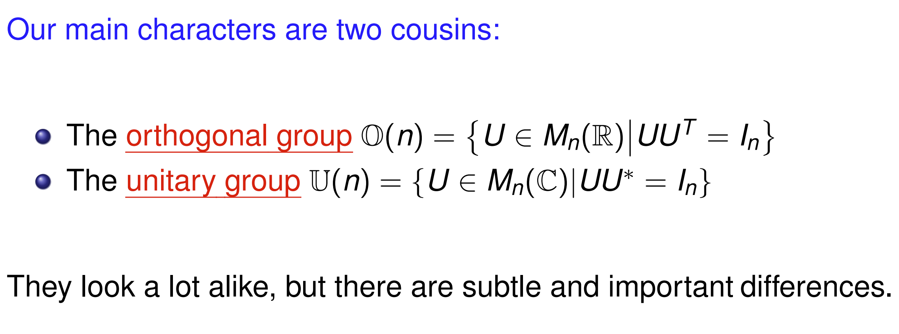
U
U
...at least
τ_{n}
as random as…
Theorem 1: τ_{m} ≥ .04 for all m
Theorem 2: τ_{m} ≥ − ^{(tiny)} provided 2^{m} ≳ k²
We tried to do this in the most general setting of compact Lie groups.

Slide 45
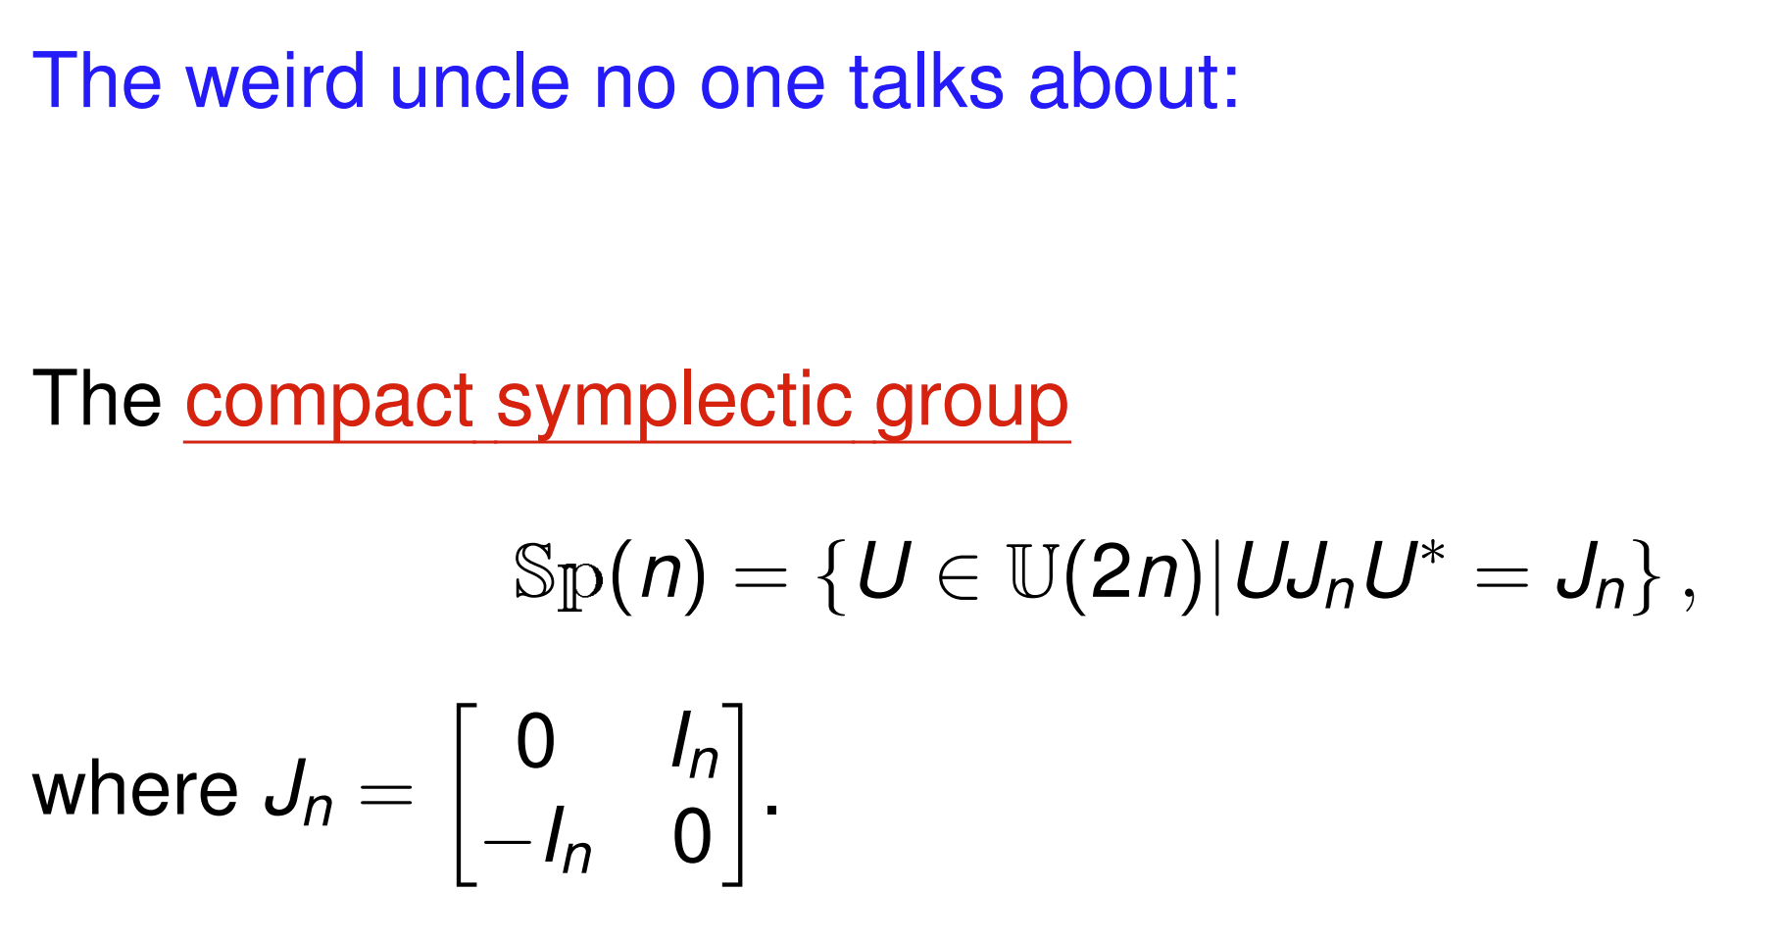
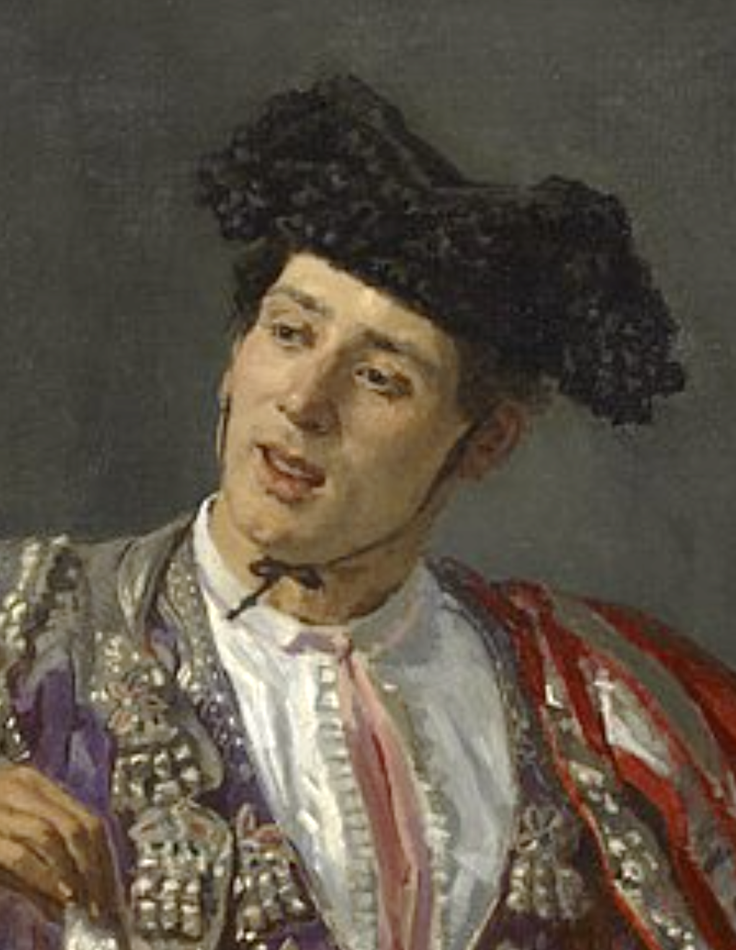
U
U
...at least
τ_{n}
as random as…
Theorem 1: τ_{m} ≥ .04 for all m
Theorem 2: τ_{m} ≥ − ^{(tiny)} provided 2^{m} ≳ k²
We tried to do this in the most general setting of compact Lie groups.

Slide 46
U
U
...at least
τ_{n}
as random as…
Theorem 1: τ_{m} ≥ .04 for all m
Theorem 2: τ_{m} ≥ − ^{(tiny)} provided 2^{m} ≳ k²
You can also try to do the permutations setting of S_{2n} via this plan.
Theorem 2 seems particularly unclear in this setting.

Slide 47
U
U
...at least
τ_{n}
as random as…
Theorem 1: τ_{m} ≥ .04 for all m
Theorem 2: τ_{m} ≥ − ^{(tiny)} provided 2^{m} ≳ k²
You can also try to do the permutations setting of S_{2n} via this plan.
For Baby defined by one randomly placed classical reversible gate,
||BabyAvg_{ℜk} − UnifAvg_{ℜk}||_{op}
≤ 1 −
· O( )
is not known.

Slide 48
U
U
...at least
τ_{n}
as random as…
Theorem 1: τ_{m} ≥ .04 for all m
Theorem 2: τ_{m} ≥ − ^{(tiny)} provided 2^{m} ≳ k²
You can also try to do the permutations setting of S_{2n} via this plan.
For Baby defined by one randomly placed classical reversible gate,
||BabyAvg_{ℜk} − UnifAvg_{ℜk}||_{op}
≤ 1 −
· O( ²)
is known, but only implies random O(n³)-size classical reversible circuits
are almost k-wise uniform permutations.

Slide 49

Thanks!

