Slide 1
The miracle of algebra
And especially of Toni Pitassi’s work in algebraic proof systems

Slide 2
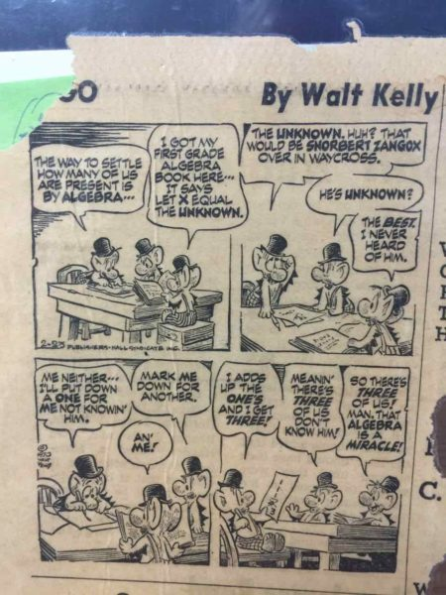

Slide 4
Maybe I should have given the talk a more personal title
I see on the schedule that many people will
be talking about Toni’s Birth Day (TBD)

Slide 5
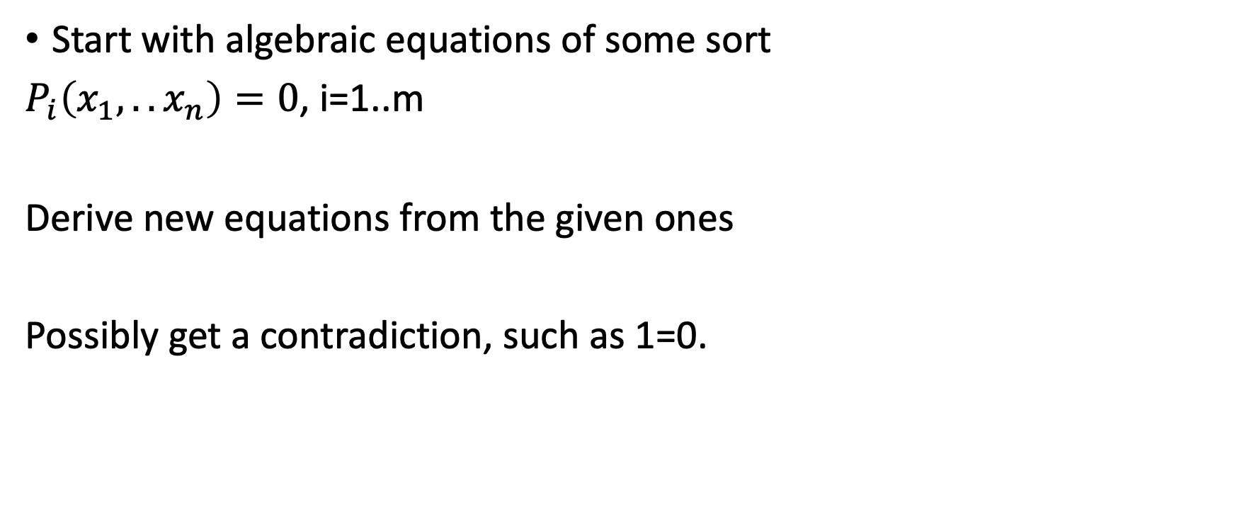
What are algebraic proofs?
Start with algebraic equations of some sort
$P_{i}\left(x_{1},..x_{n}\right)=0$, i=1..m
Derive new equations from the given ones
Possibly get a contradiction, such as 1=0.

Slide 6
We’ve all done them
X+Y+Z= 1
2X+ Z=0
3X+ Y=1
Derive Z=-2X, so –X+Y =1. Y=X+1, so 4X+1=1, X=0, Y=1, Z=0.

Slide 7
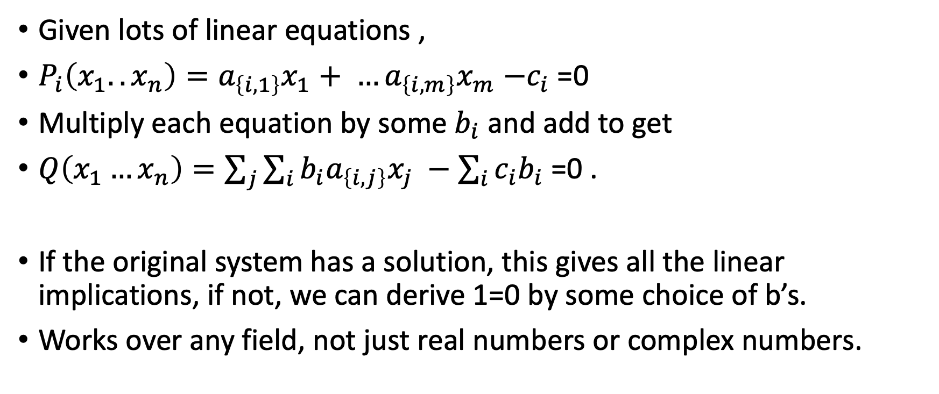
Gaussian proof system
Given lots of linear equations ,
$P_{i}\left(x_{1}..x_{n}\right)=a_{\left\{i,1\right\}}x_{1}+ …a_{\left\{i,m\right\}}x_{m}$ $−c_{i}$ =0
Multiply each equation by some $b_{i}$ and add to get
$Q\left(x_{1}…x_{n}\right)=\sum_{j}{\sum_{i}{b_{i}a_{\left\{i,j\right\}}x_{j} −\sum_{i}{{c_{i}b}_{i}}}}$ =0 .
If the original system has a solution, this gives all the linear implications, if not, we can derive 1=0 by some choice of b’s.
Works over any field, not just real numbers or complex numbers.

Slide 8
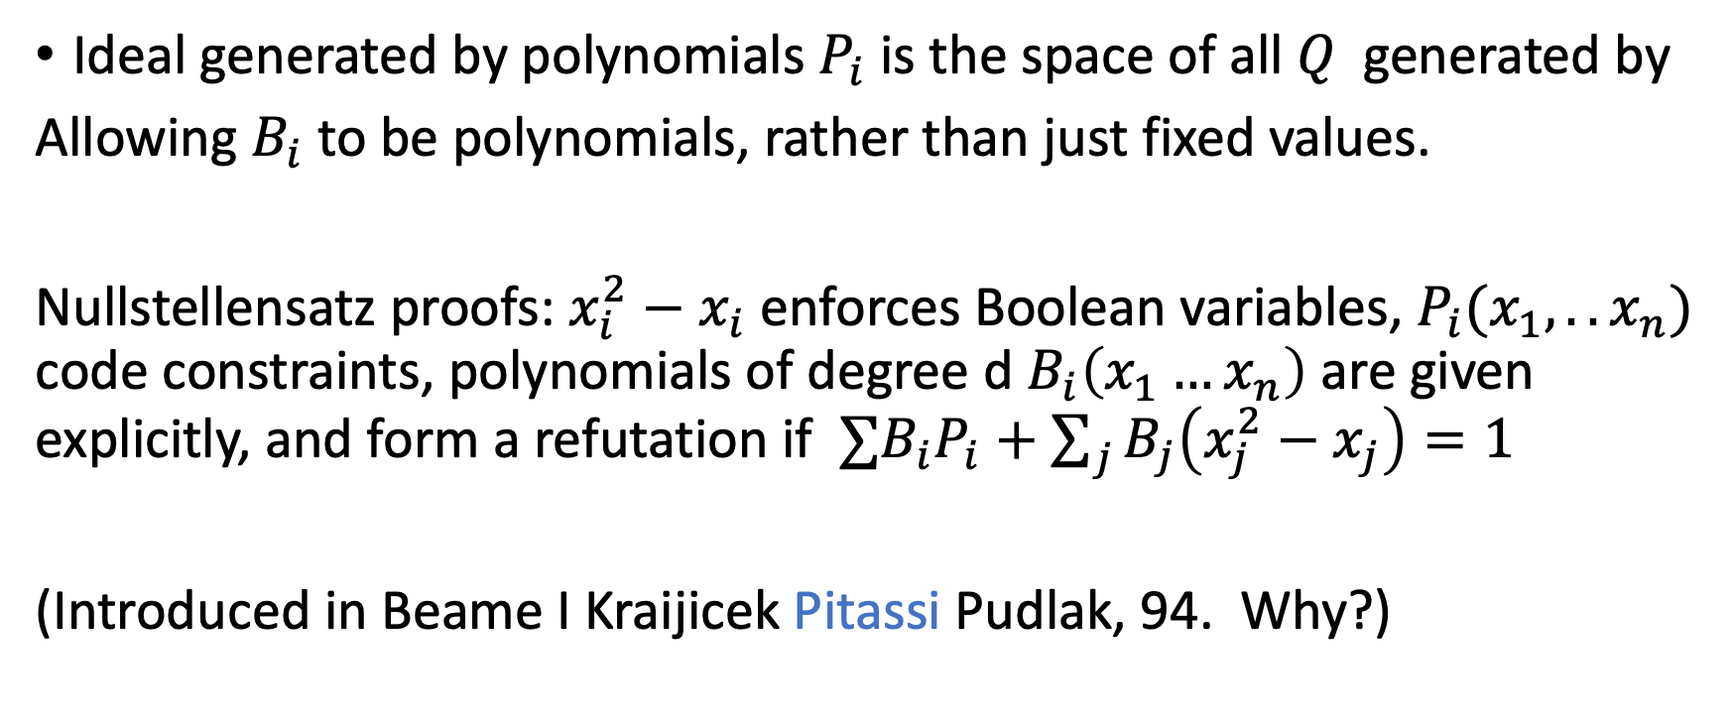
How to generalize:
Ideal generated by polynomials $P_{i}$ is the space of all $Q$ generated by
Allowing $B_{i}$to be polynomials, rather than just fixed values.
Nullstellensatz proofs: $x_{i}^{2}−x_{i}$ enforces Boolean variables, $P_{i}(x_{1},..x_{n})$ code constraints, polynomials of degree d $B_{i}\left(x_{1}…x_{n}\right)$ are given explicitly, and form a refutation if $∑B_{i}P_{i}+\sum_{j}{B_{j}\left(x_{j}^{2}−x_{j}\right)=1}$
(Introduced in Beame I Kraijicek Pitassi Pudlak, 94. Why?)

Slide 9
Circuit complexity vs. proof complexity
Intuition: Proofs in formal systems are limited to reasoning that can be expressed with allowable lines in the systems
Proving limitations on the types of circuits allowed as lines should help prove lower bounds in proof complexity, and hence lower bounds on SAT algorithms using reasoning expressible within the system.

Slide 10
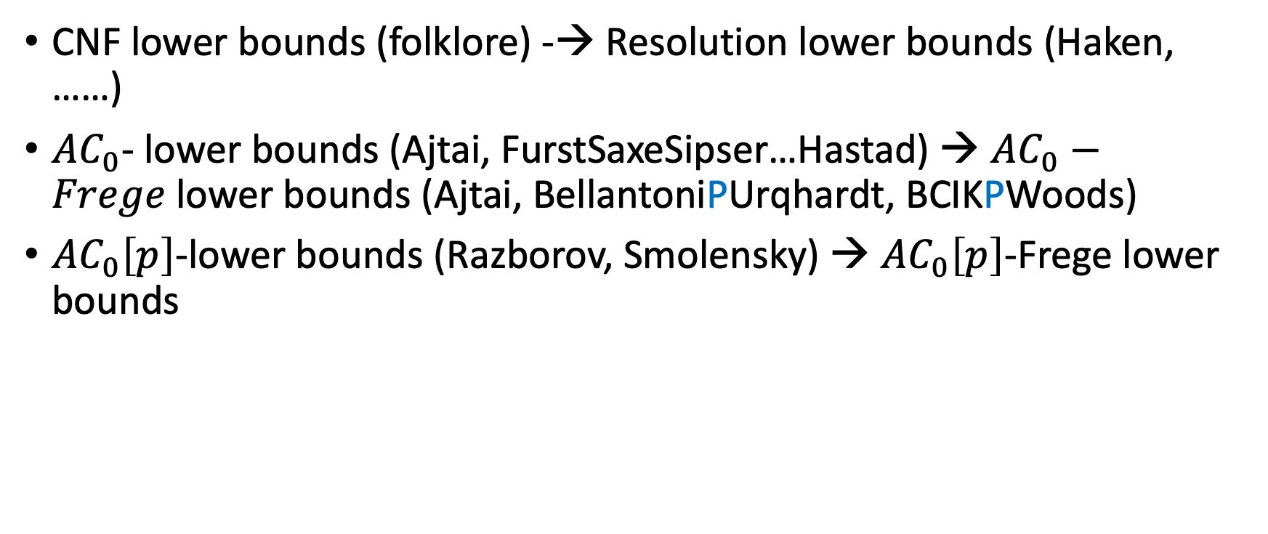
To put this into practice, we need some circuit lower bounds
CNF lower bounds (folklore) -→ Resolution lower bounds (Haken, ……)
$AC_{0}$- lower bounds (Ajtai, FurstSaxeSipser…Hastad) → $AC_{0}−Frege$lower bounds (Ajtai, BellantoniPUrqhardt, BCIKPWoods)
$AC_{0}\left[p\right]$-lower bounds (Razborov, Smolensky) → $AC_{0}\left[p\right]$-Frege lower bounds

Slide 11
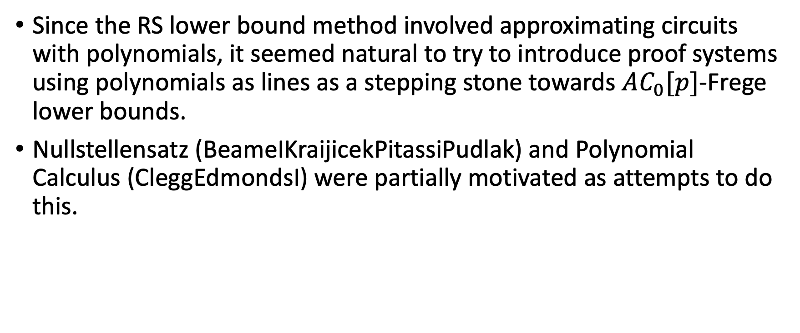
Algebraic proof systems
Since the RS lower bound method involved approximating circuits with polynomials, it seemed natural to try to introduce proof systems using polynomials as lines as a stepping stone towards $AC_{0}[p]$-Frege lower bounds.
Nullstellensatz (BeameIKraijicekPitassiPudlak) and Polynomial Calculus (CleggEdmondsI) were partially motivated as attempts to do this.

Slide 12
What we wanted to do:
In early 90’s, I suggested to Toni the following program:
Step A: Prove Nullstellensatz bounds
Step B: generalize to ``Nullstellensatz’’ with errors
Step C: profit
She was somewhat skeptical, I believe. (I’m not sure she remembers the conversation)
Then I told this plan to Roman Smolensky. He pointed out that it failed at Step B.

Slide 13
No lower bounds for ``approximate Nullstellensatz’’
Take any unsatisfiable system of polynomials.
Small AND of linear combinations of negations is very close to ``1’’
Each linear combination is degree 0 nullstellensatz of orginal, and so
And is small degree and in ideal.
The derivation ``0=1’’ from this is almost always correct….

Slide 14
The revised plan
Step A: Prove Nullstellensatz bounds
Step B: There is no step B
Step C: profit
A remarkably successful approach!

Slide 15
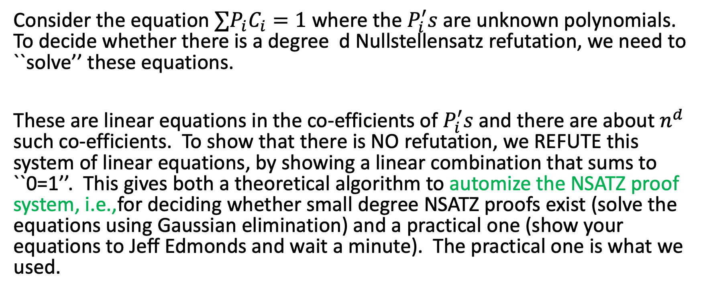
How do we carry out step A? Proof judo
Consider the equation $∑P_{i}C_{i}=1$ where the $P_{i}^{′}s$are unknown polynomials. To decide whether there is a degree d Nullstellensatz refutation, we need to ``solve’’ these equations.
These are linear equations in the co-efficients of $P_{i}^{′}s$and there are about $n^{d}$ such co-efficients. To show that there is NO refutation, we REFUTE this system of linear equations, by showing a linear combination that sums to ``0=1’’. This gives both a theoretical algorithm to automize the NSATZ proof system, i.e.,for deciding whether small degree NSATZ proofs exist (solve the equations using Gaussian elimination) and a practical one (show your equations to Jeff Edmonds and wait a minute). The practical one is what we used.

Slide 16
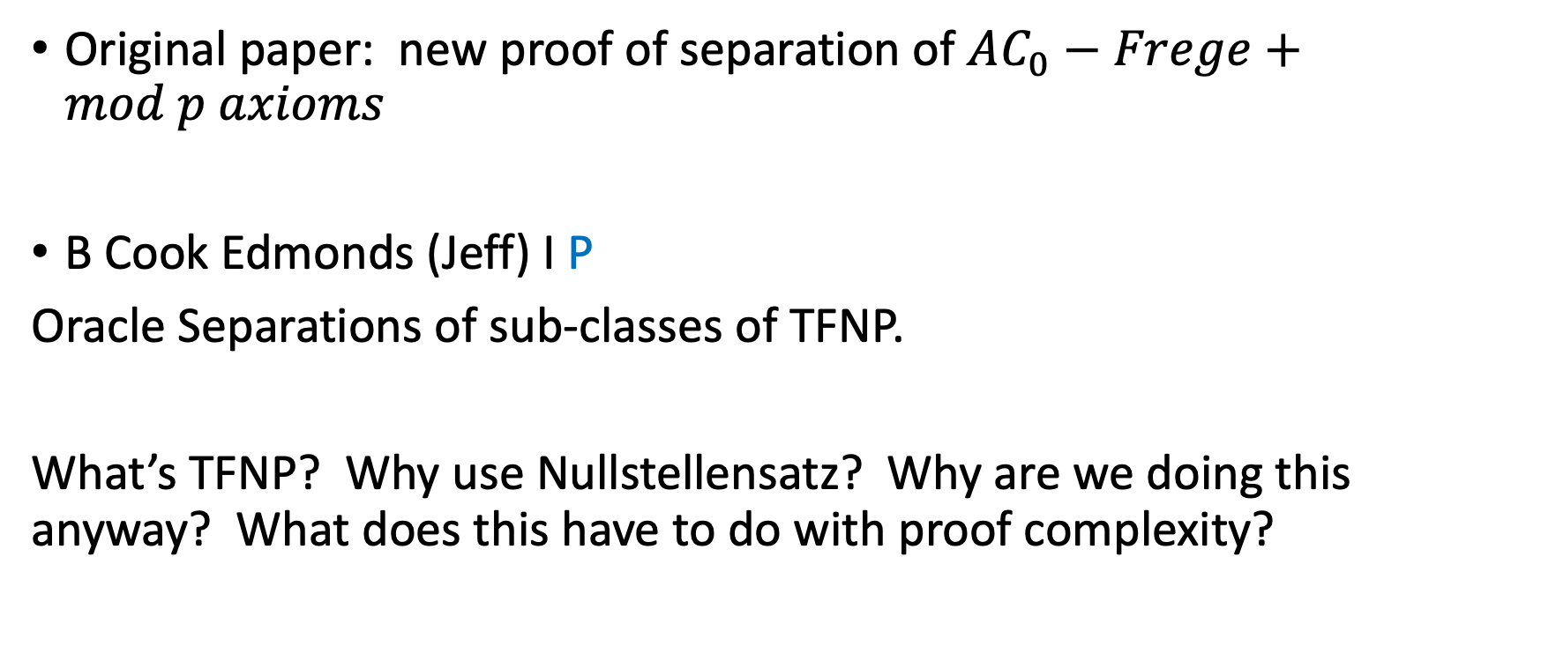
Where’s the profit?
Original paper: new proof of separation of $AC_{0}−Frege+mod p axioms$
B Cook Edmonds (Jeff) I P
Oracle Separations of sub-classes of TFNP.
What’s TFNP? Why use Nullstellensatz? Why are we doing this anyway? What does this have to do with proof complexity?

Slide 17
TFNP
Many problems are most naturally phrased as search-problems: ``Find a factorization of N, find a 3-coloring of G, find the decryption of M.’’
But our complexity classes are phrased as decision problems. Usually, this is OK, because there is an equivalent decision problem to the search problem.Other problems, not so much, especially when the natural decision version is always ``True’’.
E.g., does N have a prime factorization? Yes , it does.

Slide 18
TFNP: class of search problems with trivial decision versions
(I, Naor 88; Cameron, Edmonds (Jack) 90), Megiddio, Papadimitriou (89, 91) )
A search problem for R(x,y) is in TFNP if solutions y to instance x are polynomially describable and verifiable, and for all x, there is a y so that R(x,y). The problem is: Given x, find any y so that R(x,y)
No complete problem (probably) for TFNP , but many subclasses have complete problems.

Slide 19
Subclasses of TFNP= Theorems and their algorithmic implications
Examples: PPP: Given a map f from N to N-1, it is not 1-1.
If f is given explicitly, brute force search finds a collision.
If f is given implicitly, as hard as breaking collision-resistant hashing.
PLS: Local optima always exist. Can we always find one quickly?
PPA: Given a graph with one odd degree vertex, there is another odd degree vertex. If the graph is given implicitly, and is small degree, we can verify this, but how to find the other vertex?

Slide 20
Intuition: Separations of proofs of principles relates to separations of these classes
But why did we decide to use Nullstellensatz lower bounds to give these separations?
The true answer is simple.
Christos was paying Toni’s UCSD postdoc. So she wanted to eventually work on something he cared about.
We also wanted to find SOMETHING that Nullstellensatz lower bounds would be useful for!
Luckily, it worked ! (Unfortunately , Christos got busy with other things and dropped off the project.)

Slide 21
In hindsight, it wasn’t just ``luck’’
Toni went on to show that TFNP is a central link tying proof complexity to circuit complexity:
False
clause
TFNP problem (query)
Lifting
TFNP problem (communication compl.)
Karchmer
Wigderson
games
Circuit class
Proof system
Another way to profit from proving Nullstellensatz bounds: P, Robere, 2018: Lifting Nullstellensatz degree to
Monotone spanning programs lower bounds (via PPA) . Note:many other papers and co-authors making
Similar connections. I’m just giving the one that fits the theme ``Prove Nsatz bounds and profit’’.

Slide 22
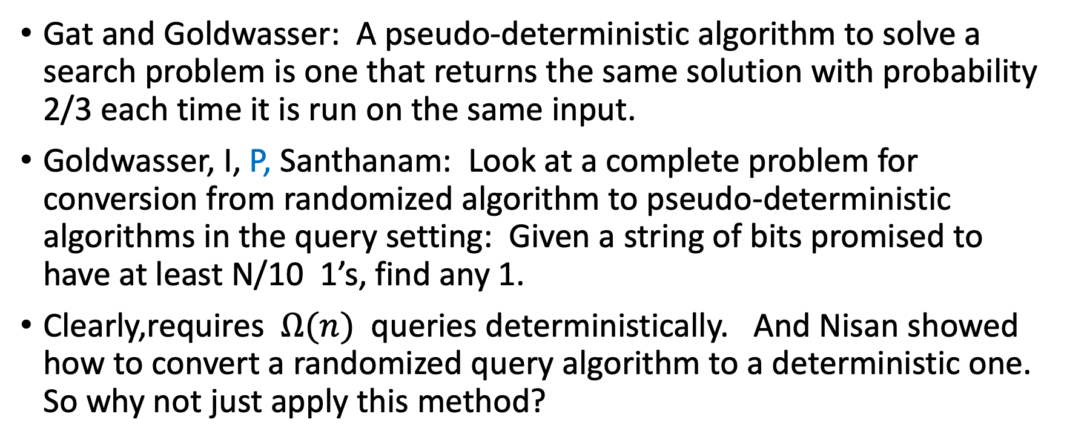
Another way to profit, seemingly unrelated
Gat and Goldwasser: A pseudo-deterministic algorithm to solve a search problem is one that returns the same solution with probability 2/3 each time it is run on the same input.
Goldwasser, I, P, Santhanam: Look at a complete problem for conversion from randomized algorithm to pseudo-deterministic algorithms in the query setting: Given a string of bits promised to have at least N/10 1’s, find any 1.
Clearly,requires $Ω(n)$ queries deterministically. And Nisan showed how to convert a randomized query algorithm to a deterministic one. So why not just apply this method?

Slide 23
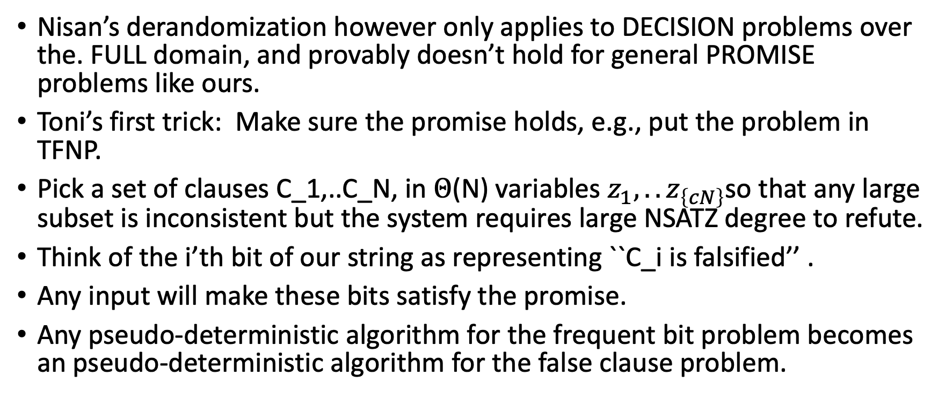
Limits of Nisan’s derandomization
Nisan’s derandomization however only applies to DECISION problems over the. FULL domain, and provably doesn’t hold for general PROMISE problems like ours.
Toni’s first trick: Make sure the promise holds, e.g., put the problem in TFNP.
Pick a set of clauses C_1,..C_N, in $Θ$(N) variables $z_{1},..z_{\left\{cN\right\}}$so that any large subset is inconsistent but the system requires large NSATZ degree to refute.
Think of the i’th bit of our string as representing ``C_i is falsified’’ .
Any input will make these bits satisfy the promise.
Any pseudo-deterministic algorithm for the frequent bit problem becomes an pseudo-deterministic algorithm for the false clause problem.

Slide 24
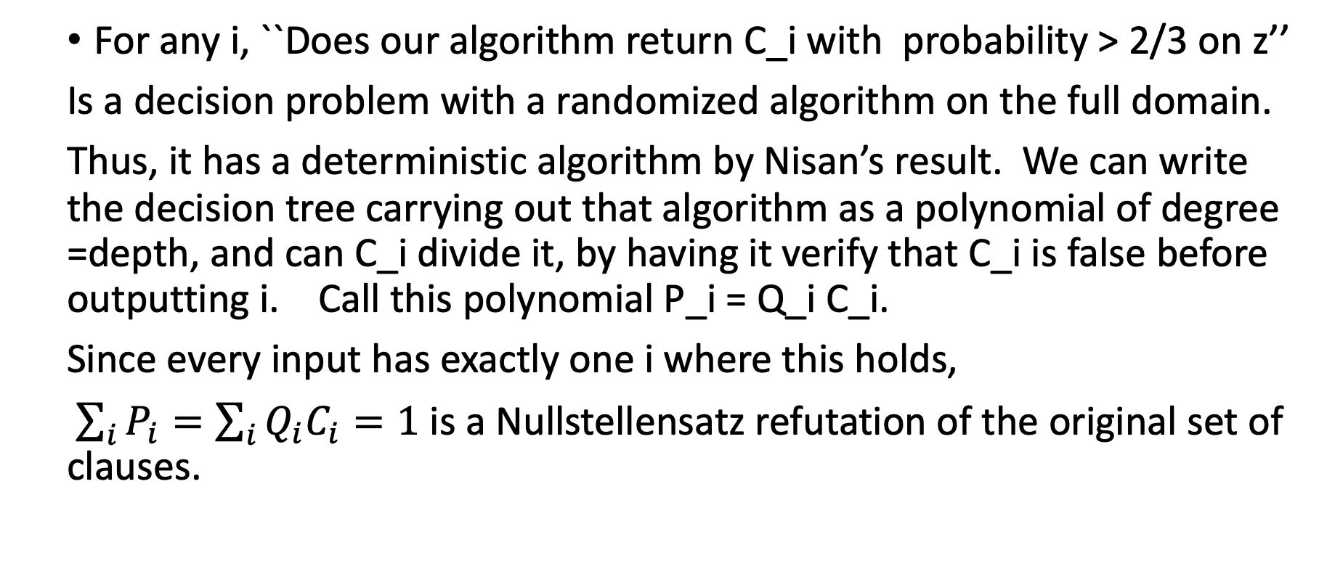
How to get a contradiction:
For any i, ``Does our algorithm return C_i with probability > 2/3 on z’’
Is a decision problem with a randomized algorithm on the full domain.
Thus, it has a deterministic algorithm by Nisan’s result. We can write the decision tree carrying out that algorithm as a polynomial of degree =depth, and can C_i divide it, by having it verify that C_i is false before outputting i. Call this polynomial P_i = Q_i C_i.
Since every input has exactly one i where this holds,
$\sum_{i}{P_{i}=\sum_{i}{Q_{i}C_{i}=1}}$ is a Nullstellensatz refutation of the original set of clauses.

Slide 25
Stronger algebraic proof systems
Polynomial calculus: Clegg, E, I, 96.
Christos motivated this system too. By leaving UCSD. His student Goran Gogic needed a thesis advisor, to read his thesis on automated adaptive reasoning, incorporating new information into a model.
I thought: What if we used the derivable formulas as a model, and added new information as discovered? Then we could make more deductions, and both expand and simplify the ``knowns’’.
Matt Clegg convinced me that Groebner bases is what I meant by a canonical model.

Slide 26
Implicit Nullstellensatz proofs,Ideal Proofs
Even stronger is to look at Nullstellensatz proofs where the linear combination is allowed to be implicitly defined as an arithmetic formula. Toni observed that such proof systems might have to be verified probabilistically using polynomial identity testing.
Ideal proof system (Growchow, P):
G(z_1,..z_m) : G an algebraic formula so that
G(P_1..P_m)= 1, G(0,…0) =0
Lower bounds for IPS imply circuit lower bounds.

Slide 27














Open problem: Refute this equation

