Slide 1


Incompressibility
&
Next-Block Pseudoentropy
Iftach Haitner
Joint work with
Noam Mazor and Jad Silbak
Coinbase

Slide 2

Randomness
A valuable resource in CS
  Algorithms
    Polynomial Identity Testing (PIT)
    Primality Testing
    ….
  Cryptography
    Encryptions
    MPC
    …

Slide 3
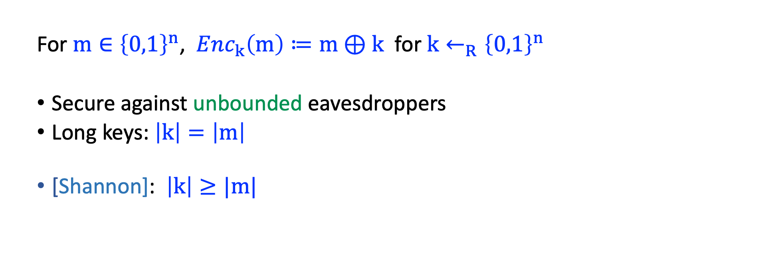
Example: One-Time Pad
  For $m∈{\left\{0,1\right\}}^{n}\text{, }Enc_{k}\left(m\right)≔m⊕k$ for $k←_{R}{\left\{0,1\right\}}^{n}$
  Secure against unbounded eavesdroppers
  Long keys: $\left|k\right|=\left|m\right|$
  [Shannon]: $\left|k\right|≥|m|$

Slide 4


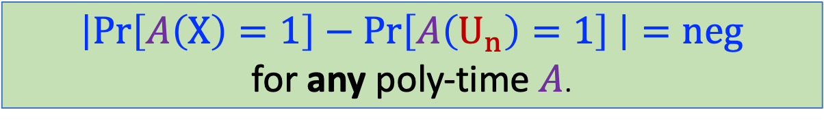
Pseudorandomness
Computational analog of randomness (i.e., of uniformity).
[Goldwasser Micali]: $X \text{over} {\left\{0,1\right\}}^{n}$ is pseudorandom if $X≈_{c}U_{n}$
$$\left|\operatorname{Pr}\left[A\left(X\right)=1\right]−\operatorname{Pr}\left[A\left(U_{n}\right)=1\right] \right|=neg$$
for any poly-time $A$.

Slide 5
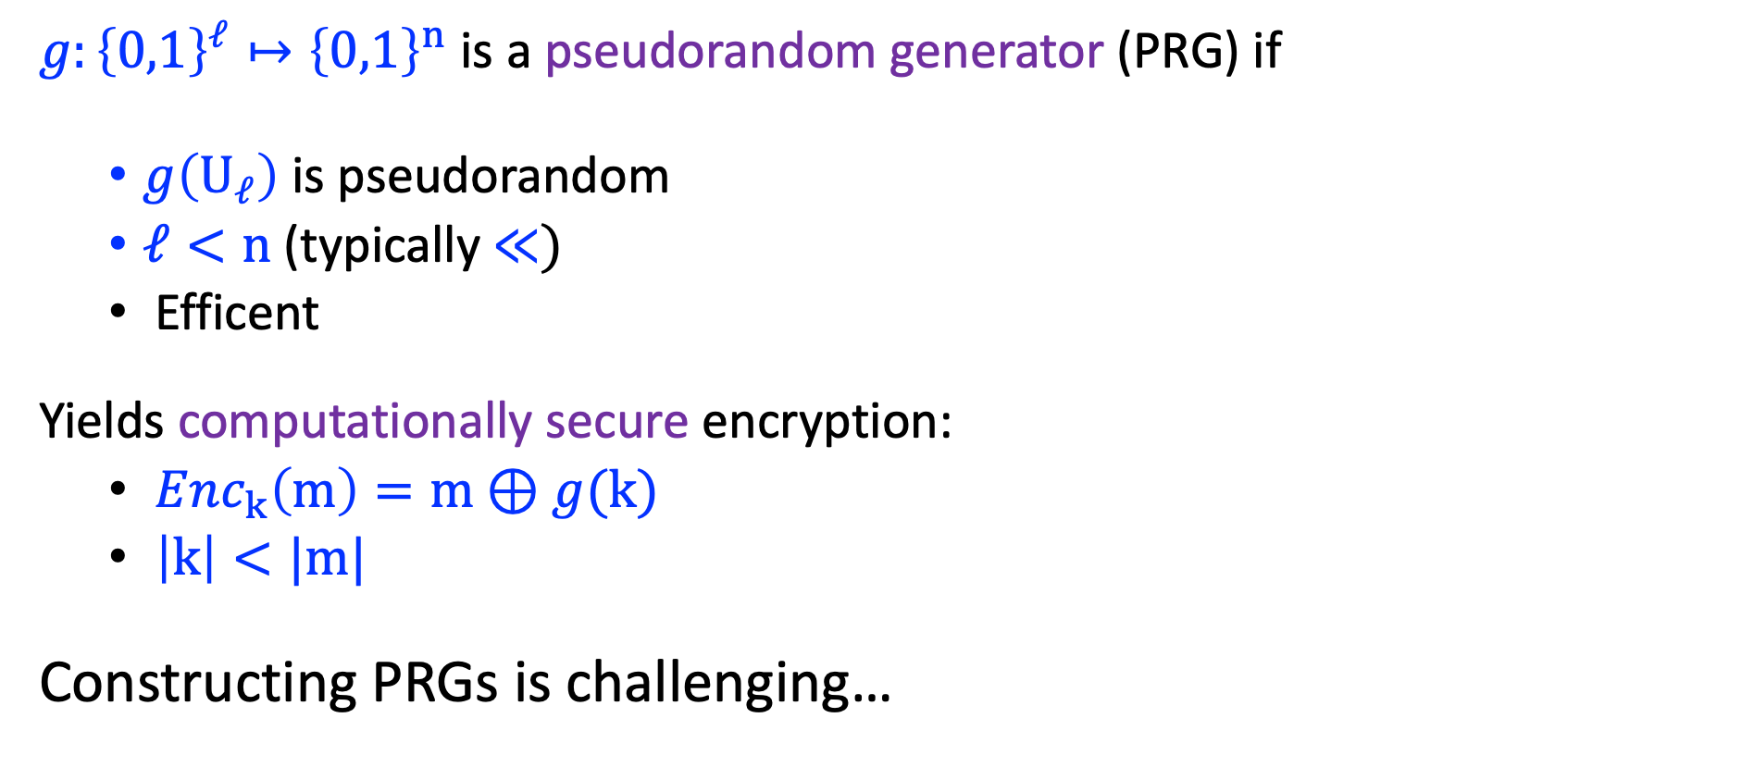
Pseudorandom generator
$g:{\left\{0,1\right\}}^{ℓ}↦{\left\{0,1\right\}}^{n}$ is a pseudorandom generator (PRG) if
  $g\left(U_{ℓ}\right)$ is pseudorandom
  $ℓ<n$ (typically $≪)$
  Efficent
Yields computationally secure encryption:
  $Enc_{k}\left(m\right)=m⊕g(k)$
  $\left|k\right|<|m|$
Constructing PRGs is challenging…

Slide 6
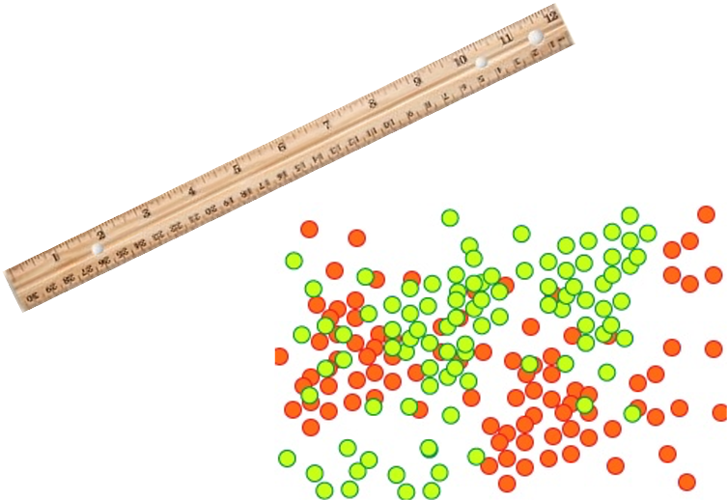

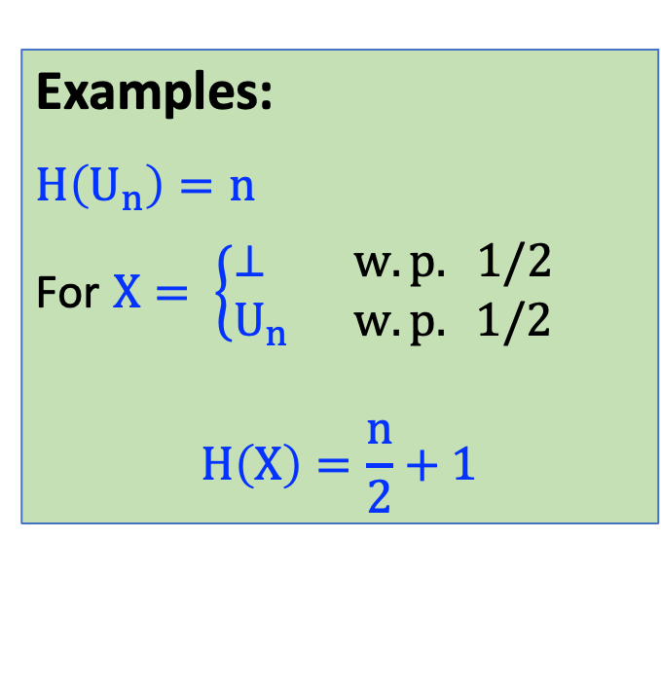
Entropy
Examples:
$$H\left(U_{n}\right)=n$$
For $X= \left\{\begin{aligned}⊥ w.p. 1/2 \\ U_{n} w.p. 1/2\end{aligned} \right.$
$$H\left(X\right)=\frac{n}{2}+1$$
Measure of randomness
  $$H\left(X\right)=E_{x←X}\left[\log{\frac{1}{\operatorname{Pr}\left[X=x\right]}}\right]$$
  Minimal description length of $X$
  # of random bits required to sample $X$
    # of random bits that can be extracted from $X$.
Min-entropy: $\min_{x∈}\left[\log{\frac{1}{\operatorname{Pr}\left[X=x\right]}}\right]$

Slide 7
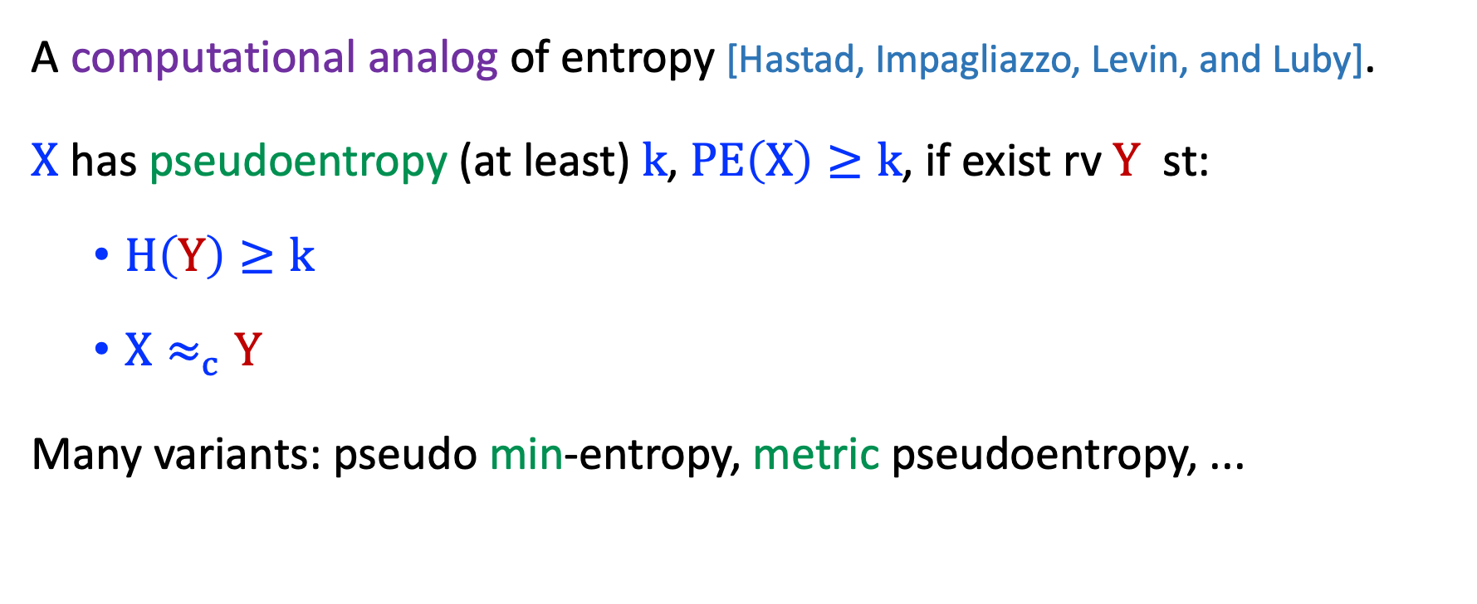
Pseudoentropy
A computational analog of entropy [Hastad, Impagliazzo, Levin, and Luby].
$X$ has pseudoentropy (at least) $k$, $PE\left(X\right)≥k$, if exist rv $Y$ st:
  $H\left(Y\right)≥k$
  $X≈_{c}Y$
Many variants: pseudo min-entropy, metric pseudoentropy, ...

Slide 8
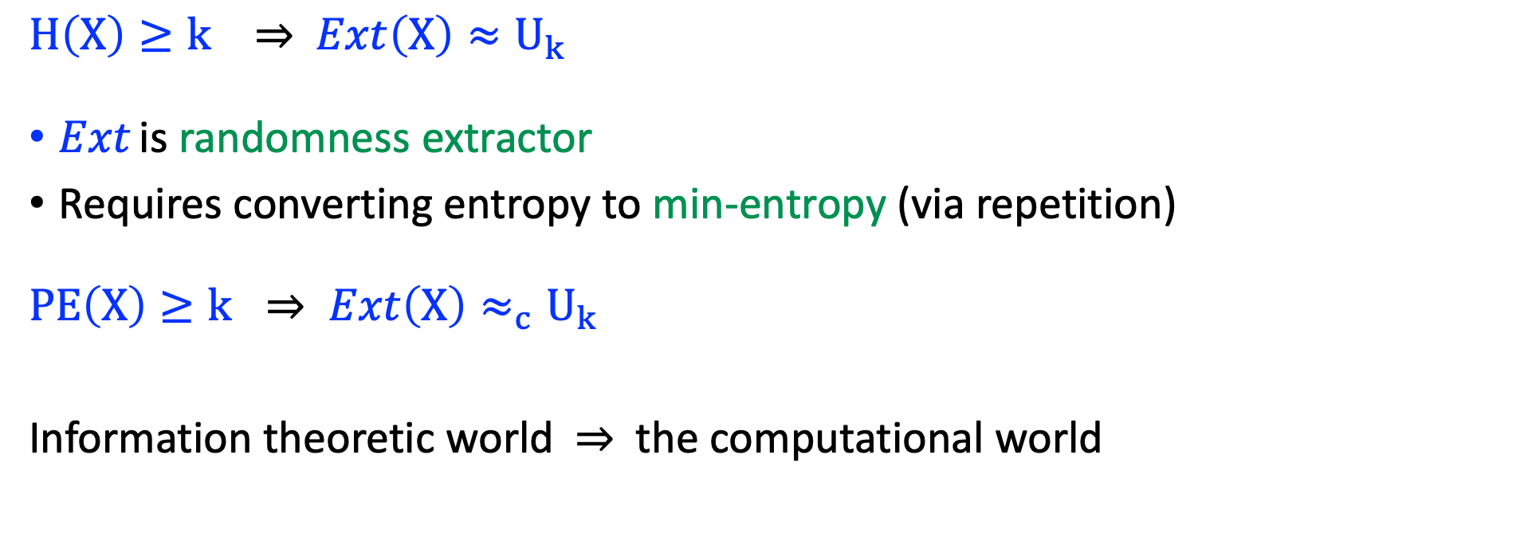
Pseudoentropy to Psedurandomness
$H\left(X\right)≥k ⇒$ $Ext\left(X\right)≈U_{k}$
$Ext$ is randomness extractor
Requires converting entropy to min-entropy (via repetition)
$$PE\left(X\right)≥k ⇒ Ext\left(X\right)≈_{c}U_{k}$$
Information theoretic world $⇒$ the computational world

Slide 9
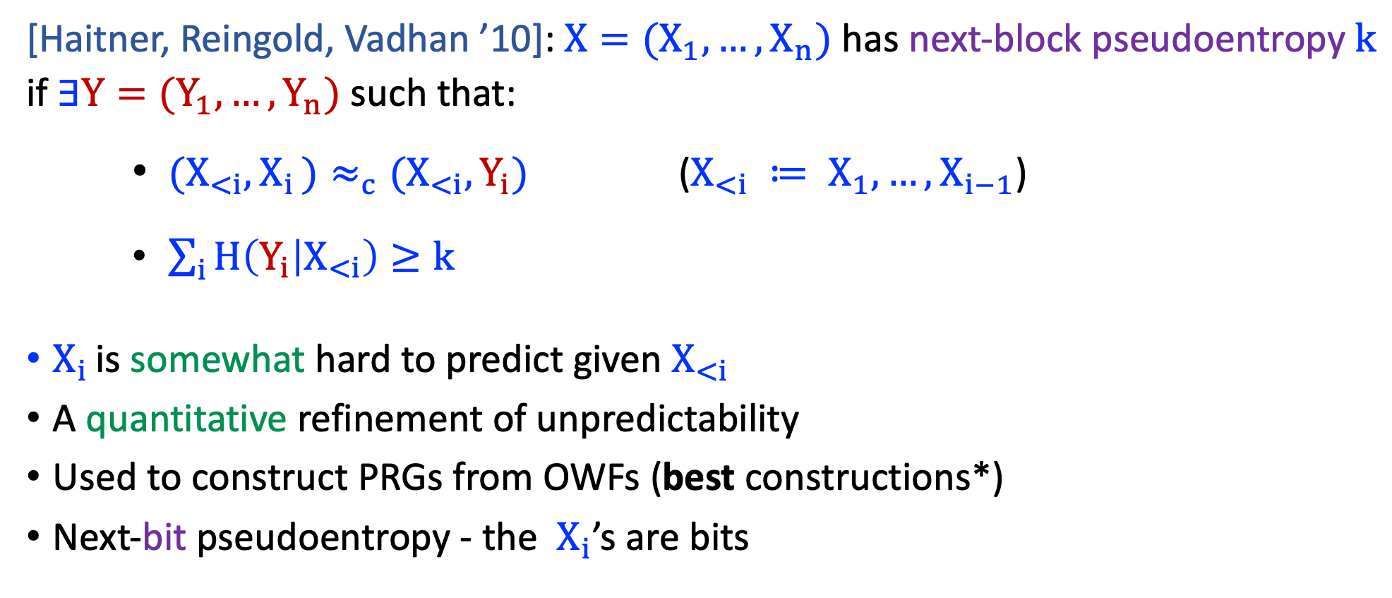
Next-Block Pseudoentropy
[Haitner, Reingold, Vadhan ’10]:$X=(X_{1},…,X_{n})$ has next-block pseudoentropy $k$ if $∃Y=(Y_{1},…,Y_{n})$ such that:
    ${(X}_{<i},X_{i })≈_{c}{(X}_{<i},Y_{i})$ (${X_{<i} ≔ X}_{1},…,X_{i−1}$)
    $\sum_{i}{H\left(Y_{i} | X_{<i}\right)≥k}$
$X_{i }$is somewhat hard to predict given ${X_{<i} }_{ }$
A quantitative refinement of unpredictability
Used to construct PRGs from OWFs (best constructions*)
Next-bit pseudoentropy - the ${ X}_{i}$’s are bits

Slide 10
Computational Analogs of Entropy
Identify a “useful” property that distributions with high entropy have.
Define a computational analog of this property.
Examples: pseudorandomness, pseudoentropy, unpredictability, next-block pseudoentropy
Above notions capture the indistinguishability of distributions
Inaccessible entropy [Haitner, Reingold, Vadhan, Wee ’09]
(cryptographic hash, commitments)
Why do we need many analogs?

Slide 11

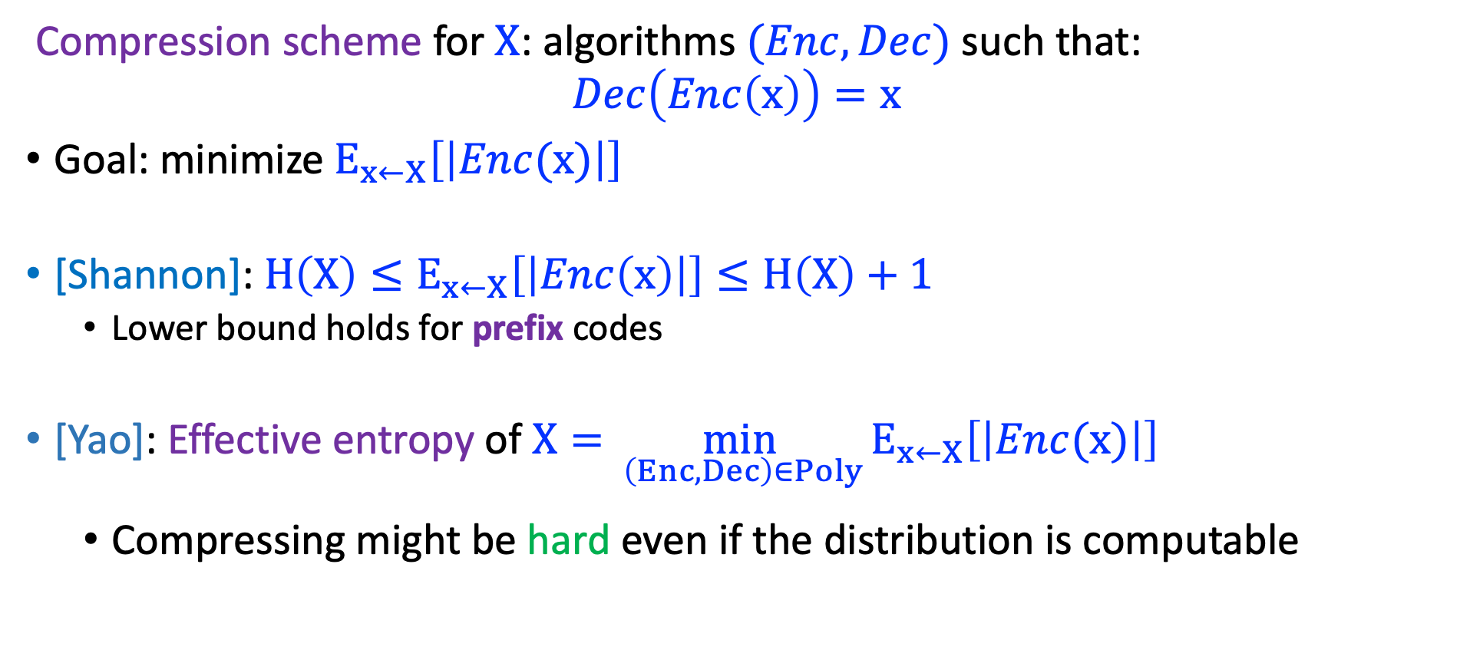
Compression
Compression scheme for $X$: algorithms $(Enc,Dec)$ such that:
$$Dec\left(Enc\left(x\right)\right)=x$$
Goal: minimize $E_{x←X}\left[\left|Enc(x)\right|\right]$
[Shannon]: $H\left(X\right)≤E_{x←X}\left[\left|Enc\left(x\right)\right|\right]≤H\left(X\right)+1$
  Lower bound holds for prefix codes
[Yao]: Effective entropy of $X=\min_{ \left(Enc,Dec\right)∈Poly}{E_{x←X}\left[\left|Enc(x)\right|\right]}$
  Compressing might be hard even if the distribution is computable

Slide 12
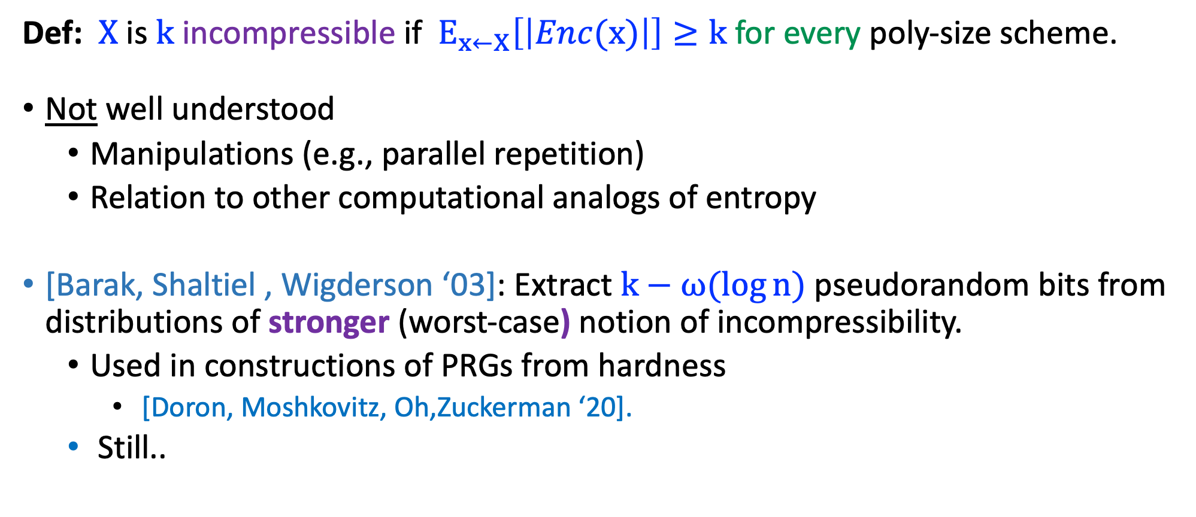
Incompressibility
Def: $X$ is $k$ incompressible if $E_{x←X}\left[\left|Enc(x)\right|\right]≥k$ for every poly-size scheme.
Not well understood
  Manipulations (e.g., parallel repetition)
  Relation to other computational analogs of entropy
[Barak, Shaltiel , Wigderson ‘03]: Extract $k−ω(\log{n})$ pseudorandom bits from distributions of stronger (worst-case) notion of incompressibility.
  Used in constructions of PRGs from hardness
    [Doron, Moshkovitz, Oh,Zuckerman ‘20].
  Still..

Slide 13
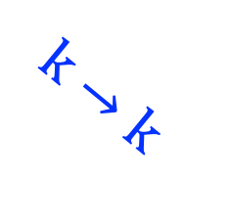
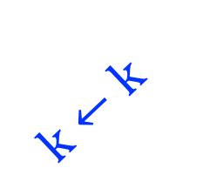

Implies*
Has
Not have
OWF
Pseudoentropy
$$k←k$$
$$k→k$$
Oracle Separation
$$?$$
Incompressibility
Next-block
pseudoentropy

Slide 14
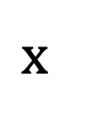
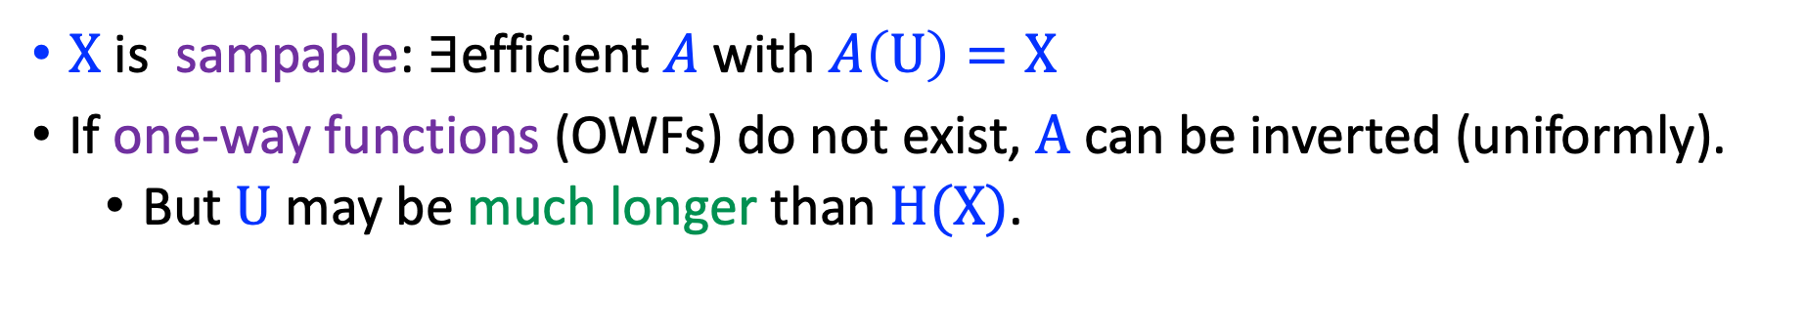
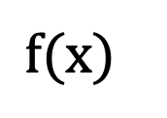
Incompressibility & One-Way Functions
$X$ is sampable: $∃$efficient $A$ with $A\left(U\right)=X$
If one-way functions (OWFs) do not exist, $A$ can be inverted (uniformly).
  But $U$ may be much longer than $H(X)$.
easy
$$x$$
$$f(x)$$
HARD

Slide 15
What is the relation between incompressibility to other computational analogs of entropy?
Does (non-trivial) incompressibility imply cryptography?

Slide 16
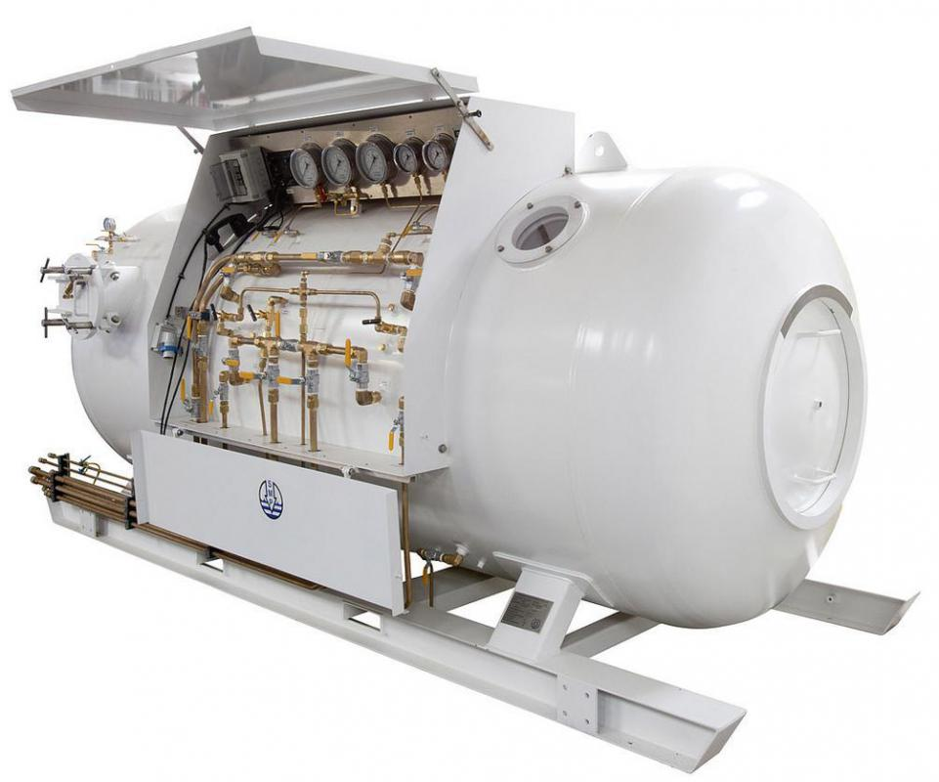
Our results
Our Result

Slide 17
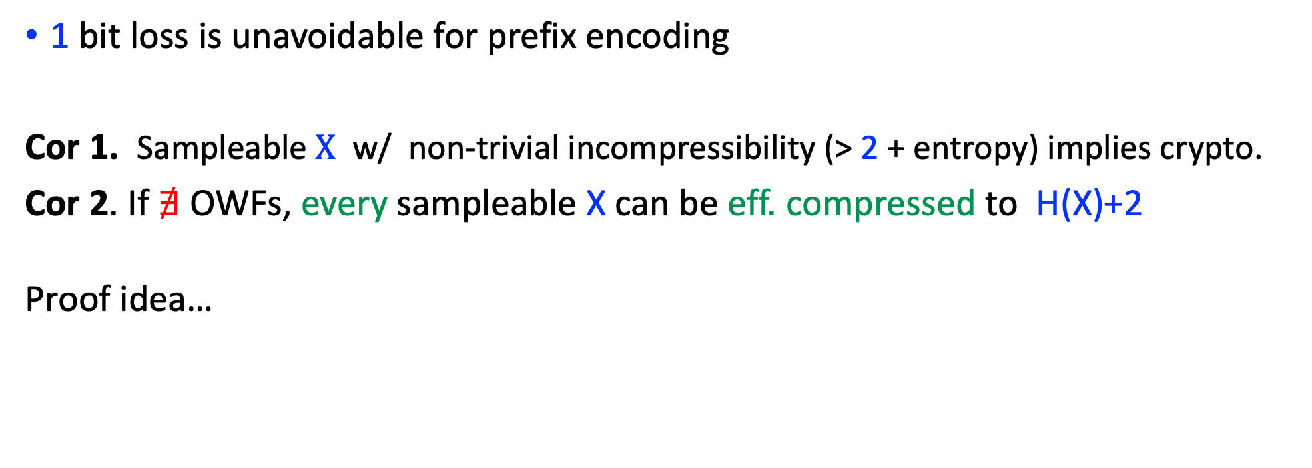

Incompressibility $⇒$Next-Bit Pseudoentropy
Thm. (inf) $X$ is $k$-incompressible $⇒X$ has next-bit pseudoentropy $k−2$.
1 bit loss is unavoidable for prefix encoding
Cor 1. Sampleable $X$ w/ non-trivial incompressibility (> 2 + entropy) implies crypto.
Cor 2. If $∄$ OWFs, every sampleable X can be eff. compressed to H(X)+2
Proof idea…

Slide 18
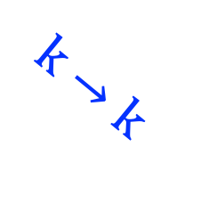
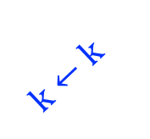
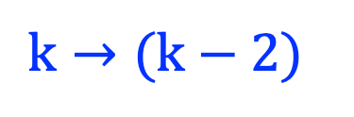

Implies*
Has
Not have
OWF
Pseudoentropy
$$k→k$$
$$k←k$$
Oracle Separation
$$?$$
$$k→(k−2)$$
Next-block
pseudoentropy
Incompressibility

Slide 19
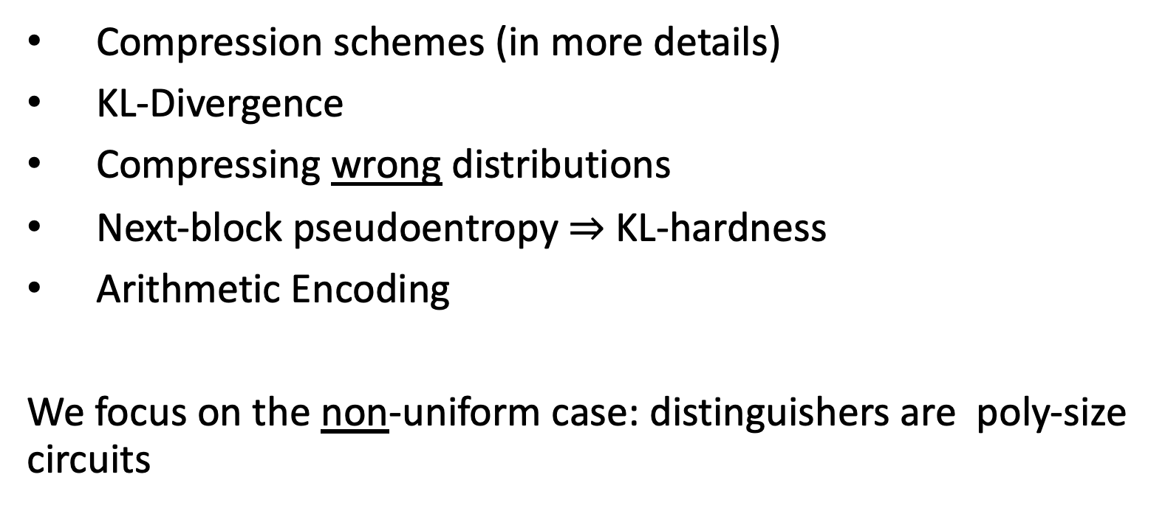
Some Preliminaries (and the proof)
Compression schemes (in more details)
KL-Divergence
Compressing wrong distributions
Next-block pseudoentropy $⇒$ KL-hardness
Arithmetic Encoding
We focus on the non-uniform case: distinguishers are poly-size circuits

Slide 20
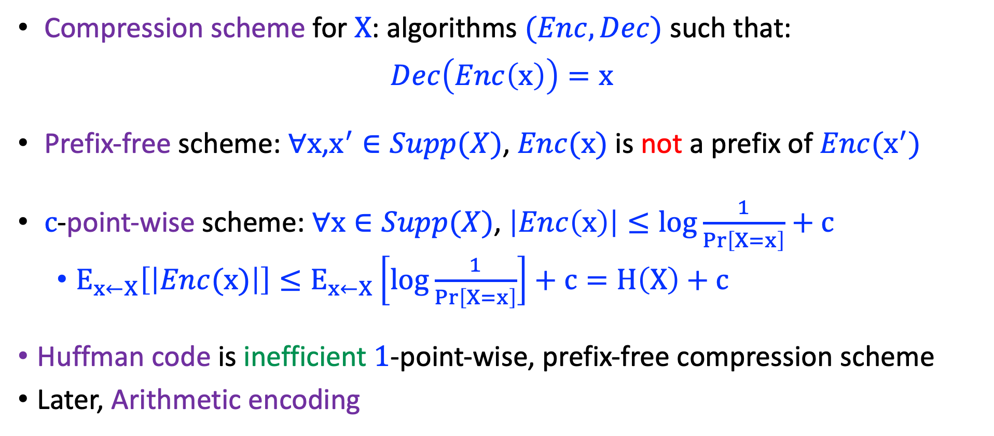
Compression Schemes
Compression scheme for $X$: algorithms $(Enc,Dec)$ such that:
$$Dec\left(Enc\left(x\right)\right)=x$$
Prefix-free scheme: $∀x$,$x^{′}∈Supp(X)$, $Enc(x)$ is not a prefix of $Enc(x^{′})$
$c$-point-wise scheme: $∀x∈Supp(X)$, $\left|Enc\left(x\right)\right|≤\log{\frac{1}{\operatorname{Pr}\left[X=x\right]}}+c$
  $E_{x←X}\left[\left|Enc(x)\right|\right]≤E_{x←X}\left[\log{\frac{1}{\operatorname{Pr}\left[X=x\right]}}\right]+c=H\left(X\right)+c$
Huffman code is inefficient $1$-point-wise, prefix-free compression scheme
Later, Arithmetic encoding

Slide 21
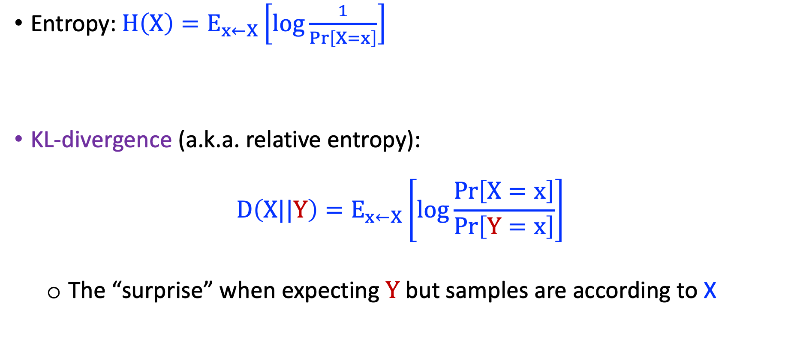
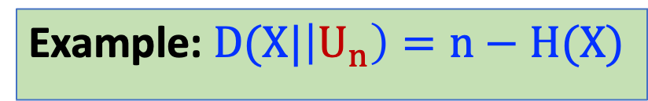
KL Divergence
Entropy:$H\left(X\right)=E_{x←X}\left[\log{\frac{1}{\operatorname{Pr}\left[X=x\right]}}\right]$
KL-divergence (a.k.a. relative entropy):
$D\left(X||Y\right)=E_{x←X}\left[\log{\frac{\operatorname{Pr}\left[X=x\right]}{\operatorname{Pr}\left[Y=x\right]}}\right]$
  The “surprise” when expecting $Y$ but samples are according to X
Example: $D(X|\left|U_{n}\right)=n−H(X)$

Slide 22





Compressing Wrong Distributions
$D(X|\left|Y\right)$ is the “penalty” for using encoding for wrong ditribution
Fact: Let $(Enc,Dec)$ be a $c$-point-wise compression scheme for $Y$, then $E_{x←X}\left[|Enc(x)|\right]=H\left(X\right)+c+D(X|\left|Y\right)$
$$Y$$
$$X$$
$$X$$

Slide 23
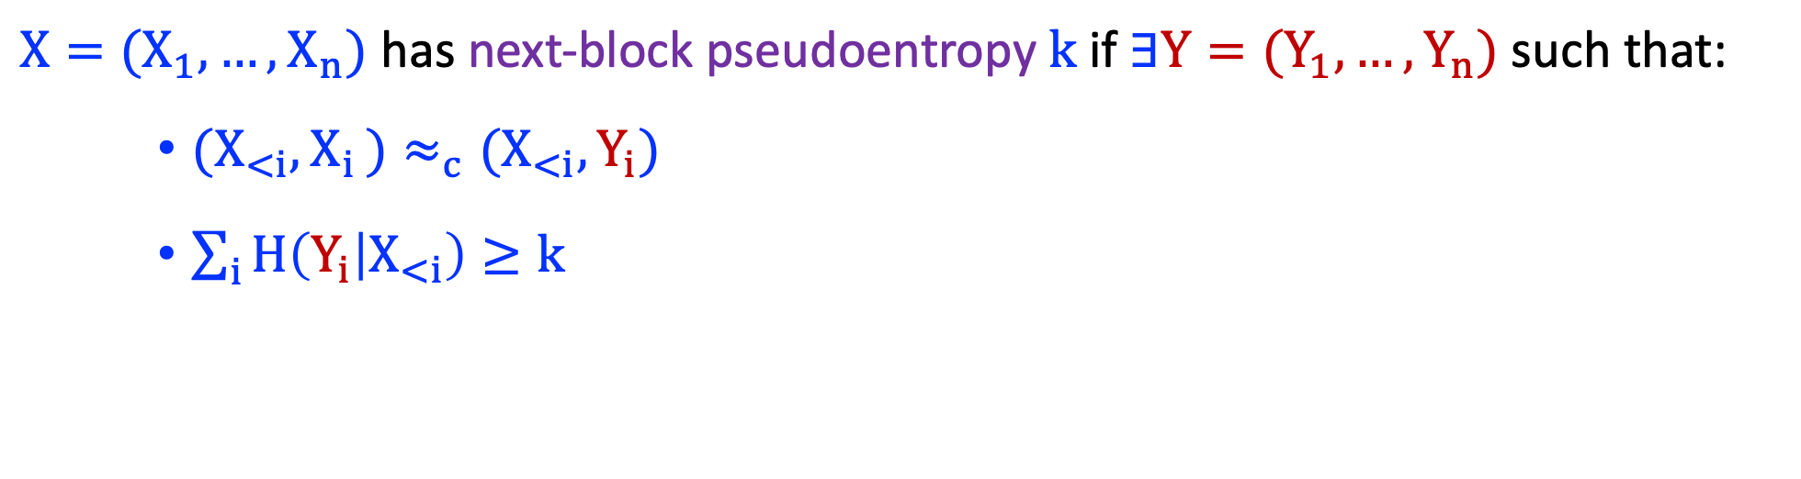
Next-Block Pseudoentropy (reminder)
$X=(X_{1},…,X_{n})$ has next-block pseudoentropy $k$ if $∃Y=(Y_{1},…,Y_{n})$ such that:
    ${(X}_{<i},X_{i })≈_{c}{(X}_{<i},Y_{i})$
    $\sum_{i}{H\left(Y_{i} | X_{<i}\right)≥k}$

Slide 24
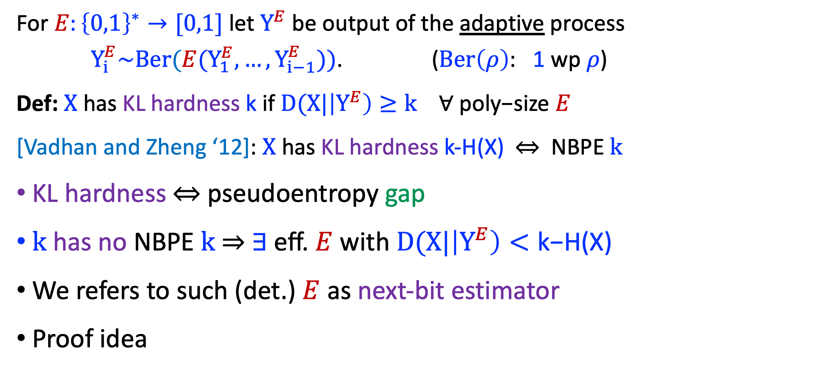

Next-bit pseudoentropy$⇔$ KL-hardness
For $E:{\left\{0,1\right\}}^{∗}→[0,1]$ let $Y^{E}$be output of the adaptive process $Y_{i}^{E}\sim Ber(E(Y_{1}^{E},…,Y_{i−1}^{E}))$. ($Ber\left(ρ\right)$: 1 wp $ρ$)
Def: $X$ has KL hardness k if $D(X|\left|Y^{E}\right)≥k$ $∀ \text{poly}\text{−}\text{size} E$
[Vadhan and Zheng ‘12]: $X$ has KL hardness k-H(X)$⇔$ NBPE $k$
KL hardness$⇔$ pseudoentropy gap
$k$ has no NBPE $k$ $⇒$ $∃ \text{eff}\text{.} E$ with $D(X|\left|Y^{E}\right)<\text{k}\text{−}\text{H}\text{(}\text{X}\text{)}$
We refers to such (det.) $E$ as next-bit estimator
Proof idea

Slide 25
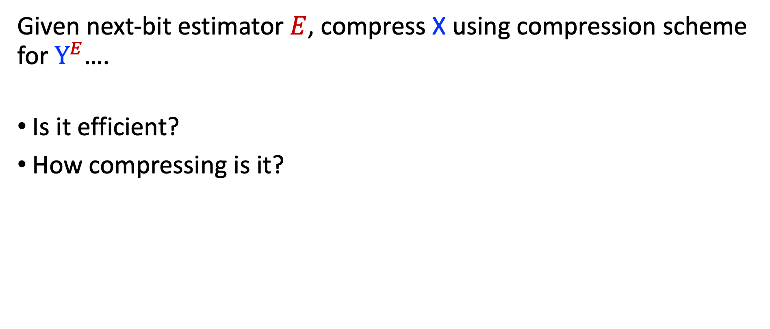

Next-bit Estimation$⇒$ Compression
Given next-bit estimator $E$, compress X using compression scheme for $Y^{E}$….
Is it efficient?
How compressing is it?

Slide 26
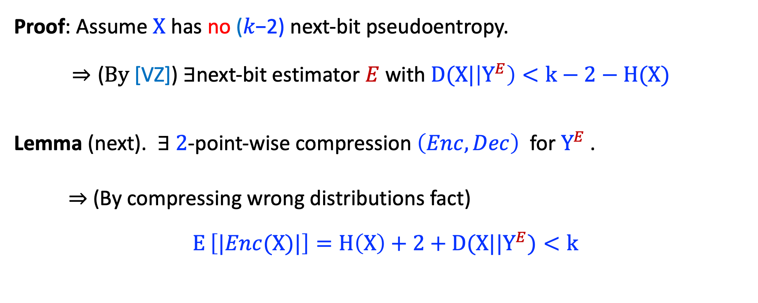
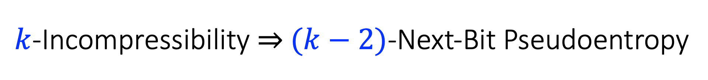
$k$-Incompressibility ⇒ $(k−2)$-Next-Bit Pseudoentropy
Proof: Assume $X$ has no (𝑘−2) next-bit pseudoentropy.
$⇒\text{(}By \text{[}\text{V}\text{Z}\text{])} ∃$next-bit estimator $E$ with $D(X|\left|Y^{E}\right)<k−2−H(X)$
Lemma (next). $∃$ $2$-point-wise compression $\left(Enc,Dec\right)$ for ${Y^{E}}^{ }$.
  $⇒$(By compressing wrong distributions fact)
  $E_{ }\left[|Enc(X)|\right]=H\left(X\right)+2+D(X||Y^{E})<k$

Slide 27
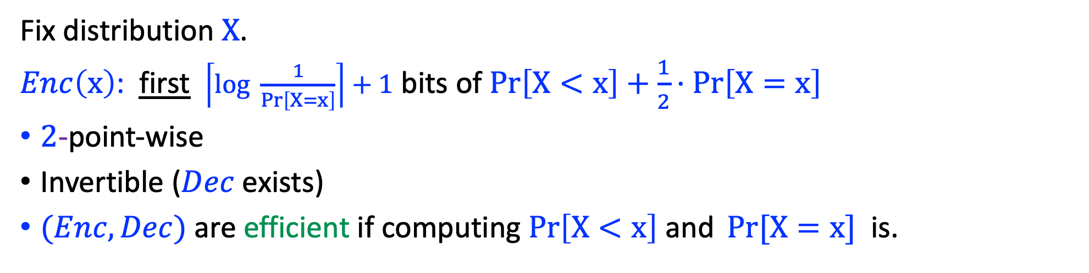
Arithmetic Encoding
Lexicographic order
Fix distribution $X$.
$Enc\left(x\right)$: first $\left\lceil \log{\frac{1}{\operatorname{Pr}\left[X=x\right]}}\right\rceil +1$ bits of $\operatorname{Pr}\left[X<x\right]+\frac{1}{2}⋅Pr\left[X=x\right]$
$2$-point-wise
Invertible ($Dec$ exists)
$(Enc,Dec)$ are efficient if computing $\operatorname{Pr}\left[X<x\right] \text{and} \operatorname{Pr}{[X=x]}$ is.

Slide 28
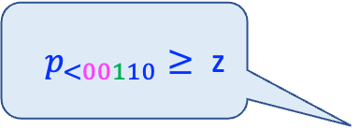

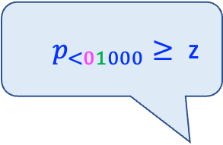
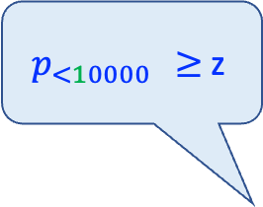
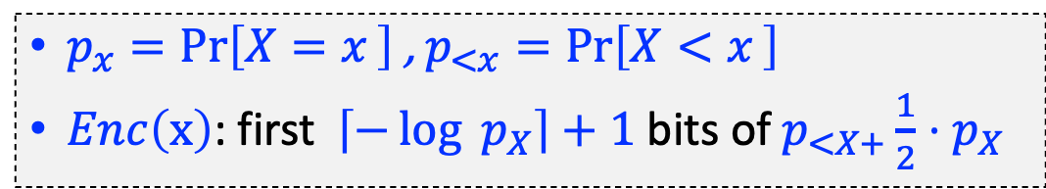
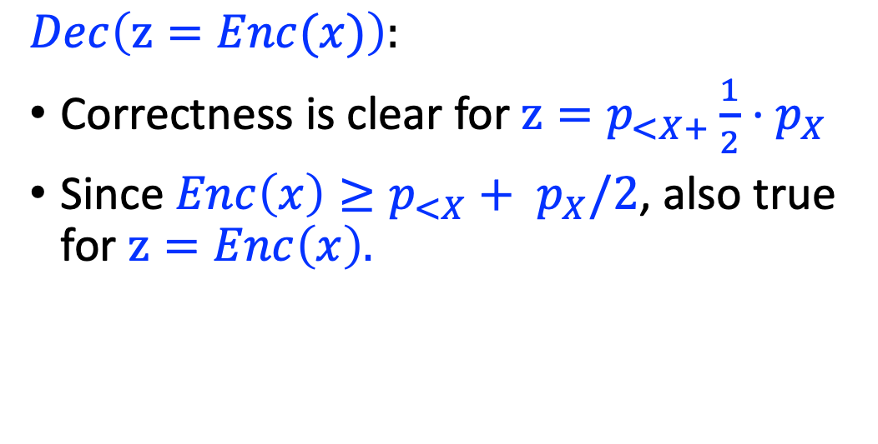

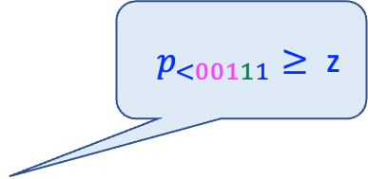
c Decoding
$p_{x}=\operatorname{Pr}\left[X=x_{ }\right]$ , $p_{<x}=\operatorname{Pr}\left[X<x_{ }\right]$
$Enc\left(x\right)$: first $\left\lceil −\log{p_{X}}\right\rceil +1$ bits of $p_{<X+}{\frac{1}{2}⋅p}_{X}$
ג $≥$ zג $p_{<10000}$
?
?
גג $p_{<01000}≥ \text{z}$
0
1
ג $p_{<00110}≥ \text{z}$
?
1
0
ג$p_{<00111}≥ \text{z}$
$$Dec\left(z=Enc(x)\right):$$
Correctness is clear for $z=p_{<X+}{\frac{1}{2}⋅p}_{X}$
Since $Enc\left(x\right)≥p_{<X}+ p_{X}/2$, also true for $z=Enc\left(x\right).$
?
0
1
0
1
$$z_{ }$$
0
$${{(p}_{<x}+p_{X}/2)}_{1…,\left\lceil −\log{p_{X}}\right\rceil +1}$$
1

Slide 29
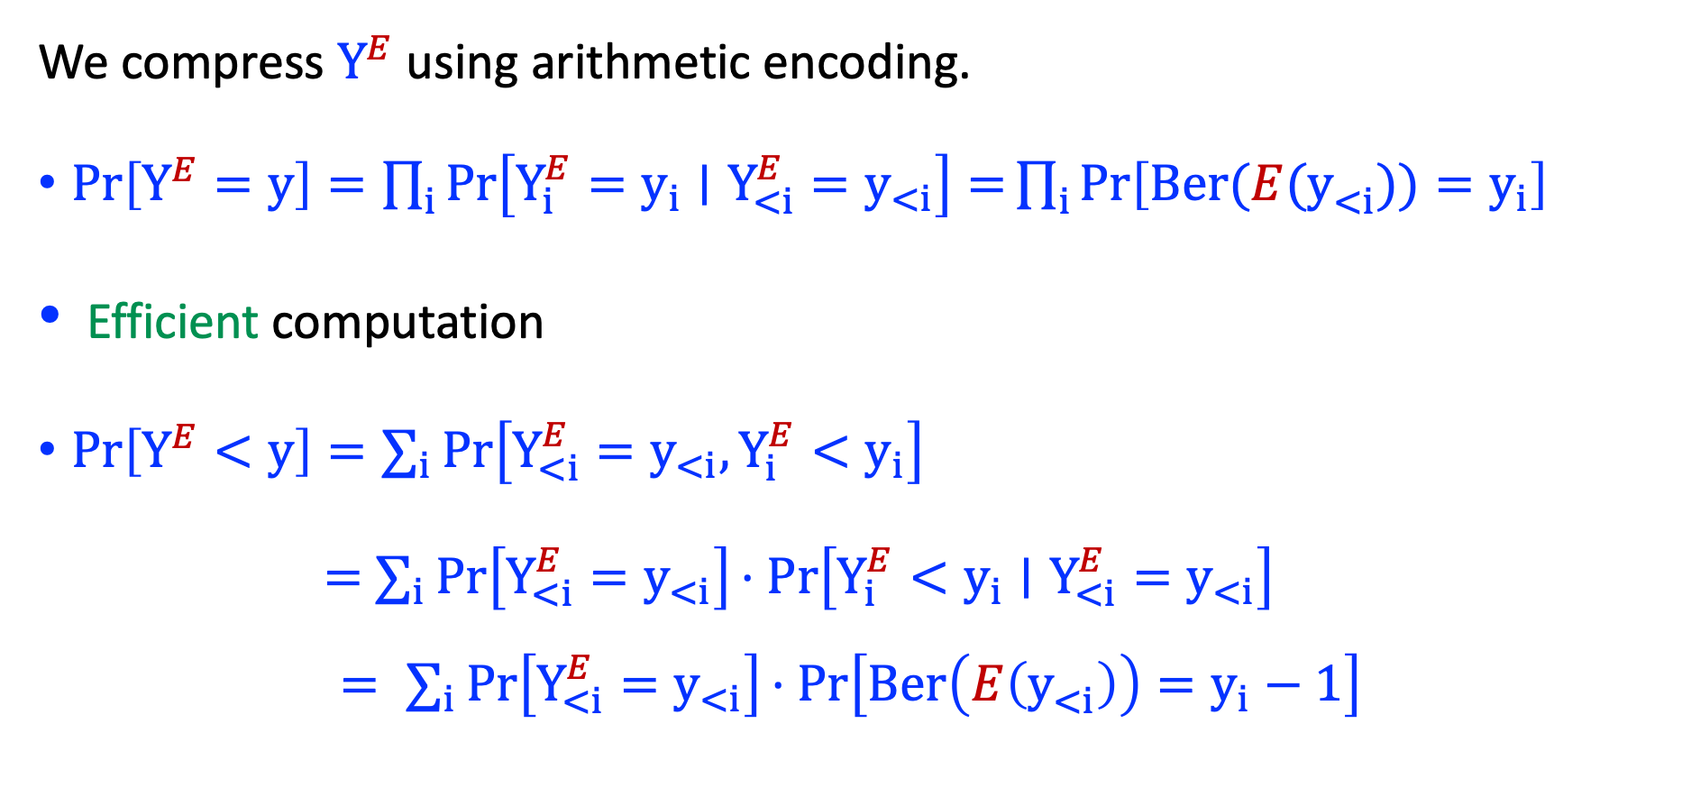

Compressing $Y^{E}$
We compress $Y^{E}$using arithmetic encoding.
$\operatorname{Pr}\left[Y^{E}=y\right]=\prod_{i}{\operatorname{Pr}\left[Y_{i}^{E}=y_{i}∣Y_{<i}^{E}=y_{<i}\right]=\prod_{i}{\operatorname{Pr}\left[Ber(E(y_{<i}^{ }))=y_{i}\right]}}$
Efficient computation
$\operatorname{Pr}\left[Y^{E}<y\right]=∑_{i}\operatorname{Pr}\left[Y_{<i}^{E}=y_{<i},Y_{i}^{E}<y_{i}\right]$
$=$ $∑_{i}\operatorname{Pr}\left[Y_{<i}^{E}=y_{<i}\right]⋅Pr\left[Y_{i}^{E}<y_{i}∣Y_{<i}^{E}=y_{<i}\right]$
$$= ∑_{i}\operatorname{Pr}\left[Y_{<i}^{E}=y_{<i}\right]⋅Pr\left[Ber\left(E\left(y_{<i}^{ }\right)\right)=y_{i}−1\right]$$

Slide 30
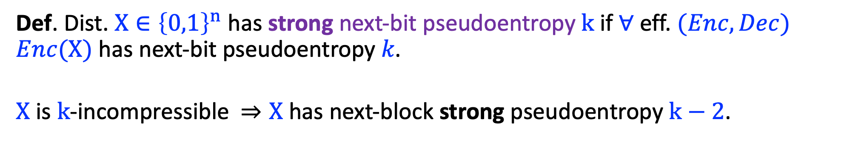

Strong Next-Bit Pseudoentropy $⇒$ Incompressibility
Def. Dist. $X∈{\left\{0,1\right\}}^{n}$ has strong next-bit pseudoentropy $k$ if $∀$eff. $(Enc,Dec)$ $Enc(X)$ has next-bit pseudoentropy 𝑘.
$X$ is $k$-incompressible $⇒X$ has next-block strong pseudoentropy $k−2$.
Thm (inf). $k$strong-next-bit pseudoentropy $⇒$ $k$-incompressibility.

Slide 31
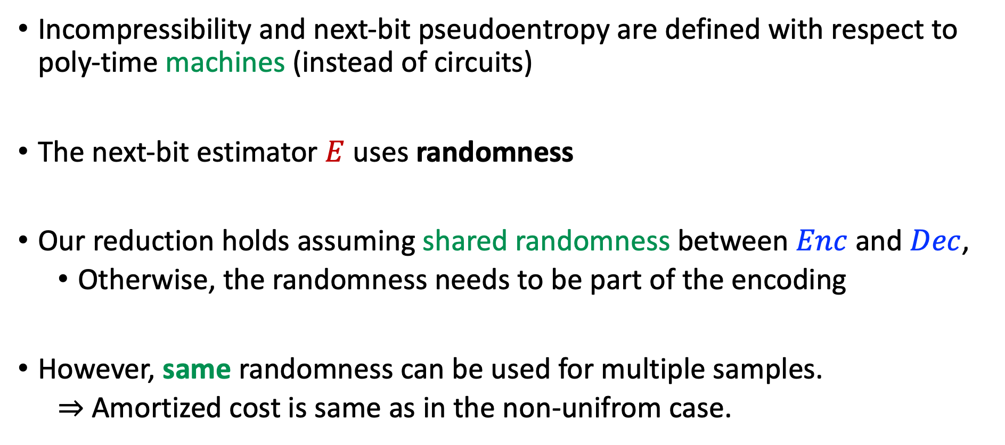
Uniform Incompressibility
Incompressibility and next-bit pseudoentropy are defined with respect to poly-time machines (instead of circuits)
The next-bit estimator $E$ uses randomness
Our reduction holds assuming shared randomness between $Enc$ and $Dec$,
  Otherwise, the randomness needs to be part of the encoding
However, same randomness can be used for multiple samples.
  $⇒$Amortized cost is same as in the non-unifrom case.

Slide 32
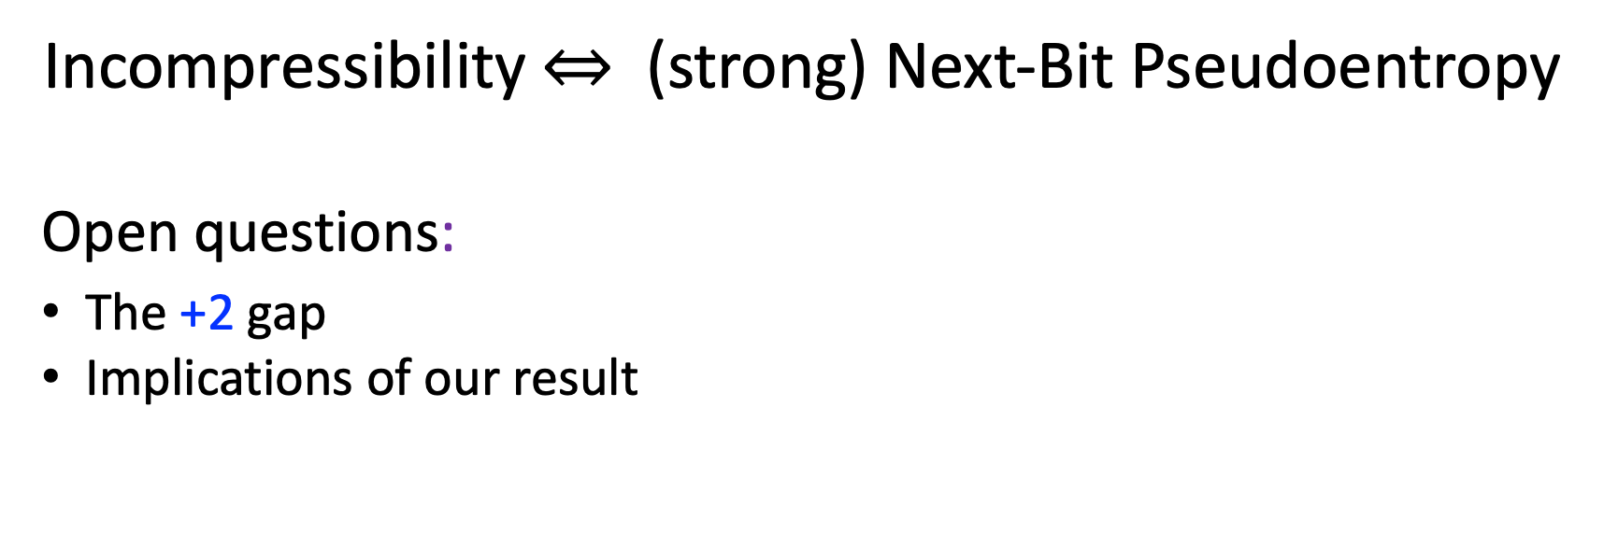
Conclusions & Open Problems
Incompressibility $⇔$ (strong) Next-Bit Pseudoentropy
Open questions:
The +2 gap
Implications of our result
Thanks!

