Slide 1

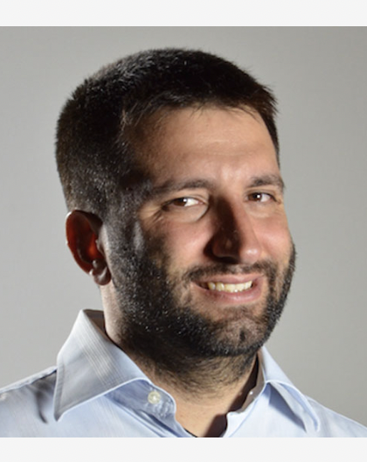



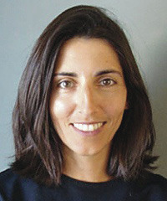

Cryptographic hardness of correlated sampling : a small piece of
Mark Bun, Marco Gaboardi, Max Hopkins, Russell Impagliazzo, Rex Lei, Toniann Pitassi, Satchit Sivakumar, Jessica Sorrell
BU
BU
UCSD
UCSD
UCSD
Columbia
U Penn
BU Algorithms and Theory Seminar

Slide 2
Replicability in Learning
Mark Bun, Marco Gaboardi, Max Hopkins, Russell Impagliazzo, Rex Lei, Toniann Pitassi, Satchit Sivakumar, Jessica Sorrell
BU
BU
UCSD
UCSD
UCSD
Columbia
U Penn
BU Algorithms and Theory Seminar

Slide 3

Replicability
Replication Crisis in Empirical Science
Notes:
In the midst of a replication crisis in empirical science. Many prominent empirical studies have been shown to be bogus- when the same experiment was carried out with different data, the same results were not obtained. Often authors who were well-meaning but had gaps in statistical methodology (for e.g. chose their experiment based on the data/adaptively selected new experiments based on preliminary results and only reported the best ones), that resulted in overfitting to the dataset being analyzed.
Shai Ben David et al.- Stability for clustering. Call out their work perhaps.

Slide 4
Stability
Stability is the principle that the same study when carried out on new data should produce similar results.
What does similar results mean?
  Intuitively, means `close’.
  However, outcomes don’t always have a clear measure of closeness.
Replication Crisis in Empirical Science
Notes:
However, this is not always the case.

Slide 5
Replicability
Replicability is the principle that the same study when carried out on new data should produce the same results.
What does ``the same’’ mean? It means literally
the same. Every bit of output is identical.
Isn’t this too strong to expect?
Replication Crisis in Empirical Science
Notes:
These studies violated a fundamental principle of experimental science- replicability. Replicability is the principle that the same study when carried out on new data should produce the same results. The primary purpose of ensuring replicability is to avoid overfitting to the analyzed data- obtaining the same consequences on new data guarantees that this is unlikely.

Slide 6
Replicability
[Impagliazzo Lei Pitassi Sorrell] Replicability as a stability property of algorithms
Take same results literally.
Notes:
One recent work formalizes this. Explain definition. Conclusions can’t depend on specific data sample, and so need to apply more broadly. But more importantly, verifiable-you publish study with the random coins you used and I can run the same study with same random coins but different data and check if I get the same output. Strong definition.

Slide 7
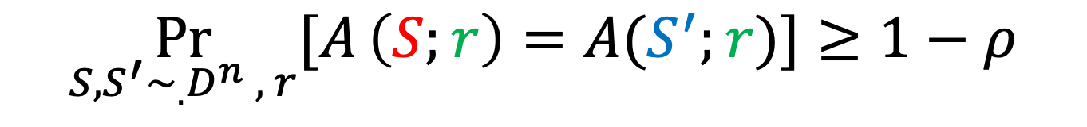
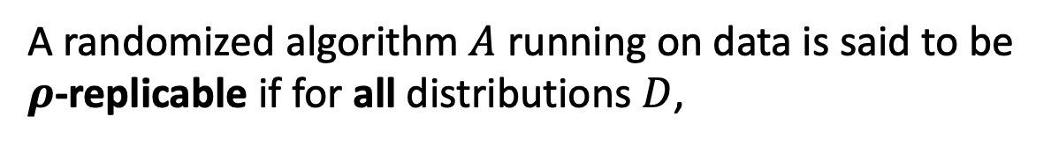
Replicability
[Impagliazzo Lei Pitassi Sorrell] Replicability as a stability property of algorithms
Take same results literally.
A randomized algorithm $A$ running on data is said to be $ρ$-replicable if for all distributions $D$,
Close to 0!
$$\underset{S,S^{′}∼_{.}D^{n} , r}{Pr}{[A}\left(S;r\right)=A(S^{′};r)]≥1−ρ$$
Notes:
the parameter 1-rho indicates the probability with which the outomes are the same- and we want this to be close to 1, hence we think of rho as ideally being close to 0 (a small constant like 0.01).
So one comment I often hear is that this definition looks impossible to achieve. So in the next part of this talk, we’ll investigate this more.

Slide 8
Replicability
[Impagliazzo Lei Pitassi Sorrell] Replicability as a stability property of algorithms
Take same results literally.
A randomized algorithm $A$ running on data is said to be $ρ$-replicable if for all distributions $D$,
Close to 0!
$$\underset{S,S^{′}∼_{.}D^{n} , r}{Pr}{[A}\left(S;r\right)=A(S^{′};r)]≥1−ρ$$
Inspired by work on pseudodeterministic algorithms
[Gat-Goldwasser’11, Grossman-Liu’19, Goldreich’19]
Independent work of [Ghazi-Kumar-Manurangsi’21]
Generalization of Global Stability [Bun-Livni-Moran’20]
Notes:
Inspired by….
Mark: Depending on audience, connecting to pseudodeterminism is a good idea. Want same outcome whp over the choice of algorithm’s randomness (here, over random samples from distribution). Interchanging roles of input and randomness.

Slide 9
Is replicability achievable?

Slide 10




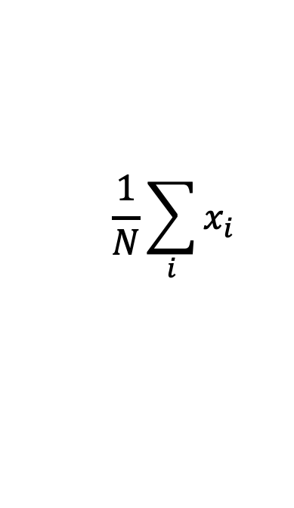




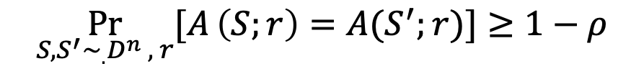


Is replicability achievable?
Attempt 1: Average outcomes
Estimate bias of coin
$$\frac{1}{N}\sum_{i}{x_{i}}$$
1
1
0
0
0
1
1
1
1
1
1
0
1
1
$$x_{1}$$
$${x′}_{1}$$
$$x_{2}$$
$${x′}_{2}$$
Replicability?
.
.
.
.
.
.
$$x_{i}∼Ber(p)$$
$$\underset{S,S^{′}∼_{.}D^{n} , r}{Pr}{[A}\left(S;r\right)=A(S^{′};r)]≥1−ρ$$
$$x_{N}$$
$${x′}_{N}$$
Stable but not replicable
Goal: guess $\hat{p}$ close to $p$.
Notes:
While the averages on two datasets are not exactly the same, they certainly are close as long as the number of samples is large. This motivates the next strategy.

Slide 11









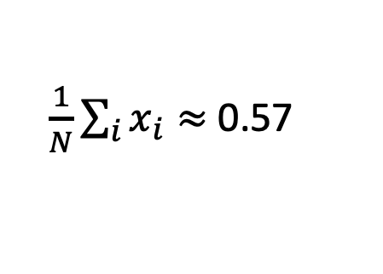



Is replicability achievable?
Replicability definition:
$$\underset{S,S^{′}∼_{.}D^{n} , r}{Pr}{[A}\left(S;r\right)=A(S^{′};r)]≥1−ρ$$
Attempt 2: Average + round
Guessing bias of coin
1
1
0
0
0
1
1
Round down
$\frac{1}{N}\sum_{i}{x_{i}}≈$ 0.57
$$x_{1}$$
$$x_{2}$$
$$p=0.5$$
.
.
.
$$0$$
$$1$$
$$0.1$$
$$0.2$$
$$0.3$$
$$0.4$$
$$0.5$$
$$0.6$$
$$0.7$$
$$0.8$$
$$0.9$$
$$x_{i}∼Ber(p)$$
Replicability?
$$x_{N}$$
Goal: guess $\hat{p}$ close to $p$.
Notes:
Consider the case where the unknown bias p = 0.5. Then, the average of a dataset drawn i.i.d. from such a Bernoulli will be above and below 0.5 with the same probability. Averages above 0.5 are rounded to 0.5 or higher and averages below 0.5 are rounded to 0.4 or lower.

Slide 12

Is replicability achievable?
Replicability definition:
$$\underset{S,S^{′}∼_{.}D^{n} , r}{Pr}{[A}\left(S;r\right)=A(S^{′};r)]≥1−ρ$$
Attempt 2: Average + round
Guessing bias of coin
1
1
0
0
0
1
1
Round down
$\frac{1}{N}\sum_{i}{x_{i}}≈$ 0.57
$$x_{1}$$
$$x_{2}$$
$$p=0.5$$
.
.
.
$$0$$
$$1$$
$$0.1$$
$$0.2$$
$$0.3$$
$$0.4$$
$$0.5$$
$$0.6$$
$$0.7$$
$$0.8$$
$$0.9$$
$$x_{i}∼Ber(p)$$
Replicability?
$$x_{N}$$
$$\underset{S,S^{′}∼_{.}D^{n} , }{Pr}{[A}\left(S\right)=A(S^{′})]≤0.5$$
Goal: guess $\hat{p}$ close to $p$.
Neither stable nor replicable , when on border
Notes:
Hence, when we run the same algorithm on two independently drawn datasets, one average could be rounded to a value above 0.5 and the other to a value below 0.5 with probability a half. Hence, the algorithm is at most 0.5-replicable, and since we want the replicability parameter to be close to 0, this is not good enough.

Slide 13





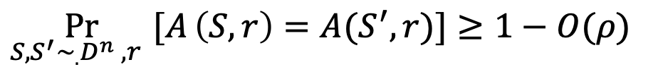
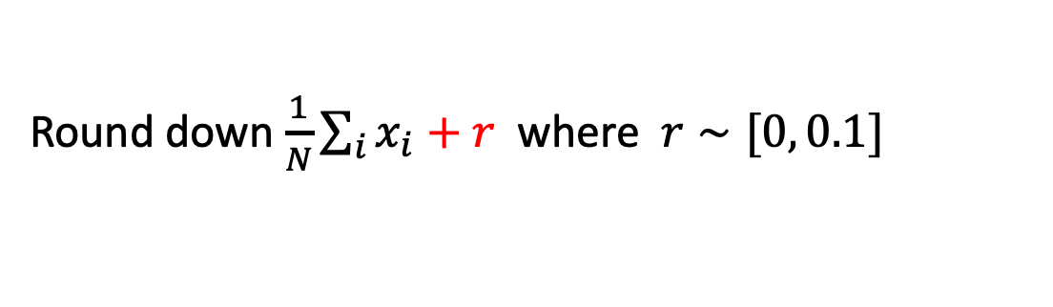

Is replicability achievable?
Replicability definition:
$$\underset{S,S^{′}∼_{.}D^{n} , r}{Pr}{[A}\left(S;r\right)=A(S^{′};r)]≥1−ρ$$
Attempt 3: Average + randomized round
Guessing bias of coin
Round down $\frac{1}{N}\sum_{i}{x_{i}+r}$ where$r∼[0, 0.1]$
$$0.4$$
$$p+r$$
$$0.6$$
$$p=0.5$$
$$\underset{S,S^{′}∼_{.}D^{n} ,r }{Pr}{[A}\left(S,r\right)=A(S^{′},r)]≥1−O(ρ)$$
as long as $N=O\left(1/ρ^{2}\right)$
Notes:
Overall, we get that the algorithm is O(rho) replicable when given roughly 1/rho^2 samples.
Mark: Get rid of big O.

Slide 14
Randomized Rounding for Replicability
  [Impagliazzo Lei Pitasso Sorrell ‘22]: Use randomized rounding to get replicable algorithms for:
    Heavy hitters
    Approximate median
    PAC learning halfspaces
Notes:
This technique of randomized rounding can be used in more and more complicated ways to get algorithms for more complicated statistical tasks, [ILPS22] did these for some of which are listed on the slide.

Slide 15
Randomized Rounding for Replicability
  [Impagliazzo Lei Pitasso Sorrell ‘22]: Use randomized rounding to get replicable algorithms for:
    Heavy hitters
    Approximate median
    PAC learning halfspaces
  [One part of this work] Use generalized randomized rounding, correlated sampling, as generic way to convert stability to replicability.
  [Also this work]. Use this as final link to prove privacy, stability and replicability are all equivalent in terms of sample complexity (up to unavoidable polynomial factors in the parameters)
  [This talk] What are the barriers to making this equivalence also hold computationally, in terms of the computational complexity of algorithms?
Notes:
We extended this technique to get replicable PAC learning algorithms wherever possible.
Now, replicable algorithms looked somewhat similar to algorithms satisfying other stability notions like differential privacy. So we were interested in systematically investigating these connections. To describe what we found, I’ll start by defining the other stability notions we looked at.

Slide 16



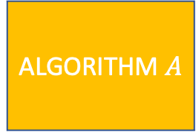
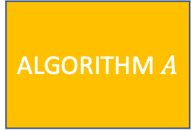
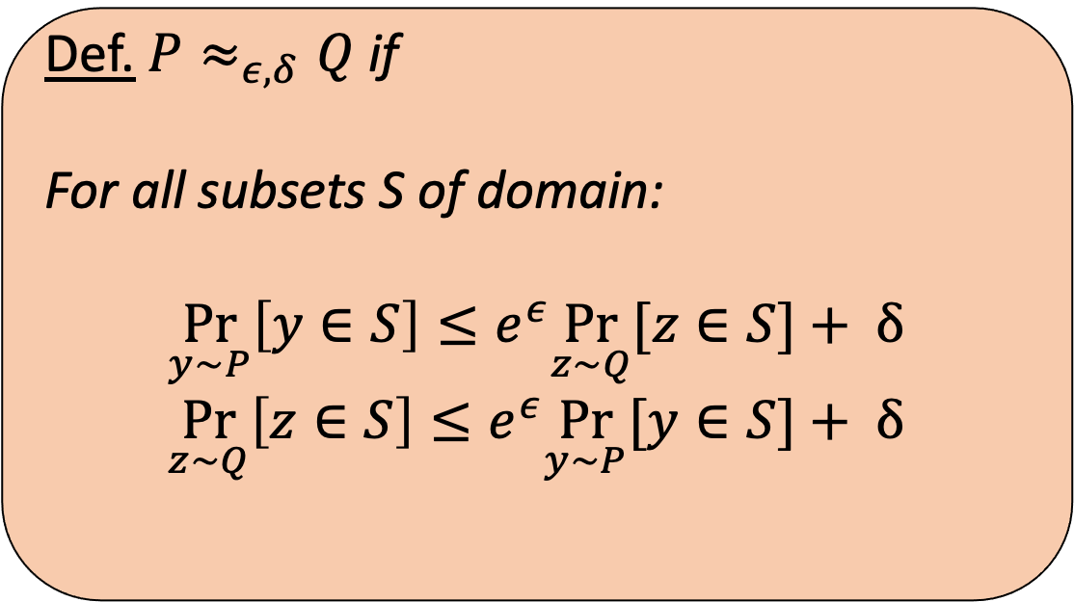


Approx. Differential Privacy [Dwork McSherry Nissim Smith, 2006]
Formal definition of what it means for an
algorithm on datasets to not reveal information
about individuals.
$$X$$
$$X′$$
1
0
0
0
0
0
Def. $P≈_{ε, δ}Q$ if
For all subsets S of domain:
$$\underset{y∼P}{Pr}\left[y∈S\right]≤e^{ε}\underset{z∼Q}{Pr}[z∈S]+ δ$$
$$\underset{z∼Q}{Pr}\left[z∈S\right]≤e^{ε}\underset{y∼P}{Pr}[y∈S]+ δ$$
ALGORITHM $A$
ALGORITHM $A$
$$A(X)$$
$$≈_{ε,δ}$$
$$A(X′)$$
For all neighboring datasets!
Notes:
And closeness is defined in terms of (eps,delta) closeness as shown in the box; all of you have seen it before.
Mark: foreshadow pure and approximate DP. 1 parameter- eps parameter.

Slide 17
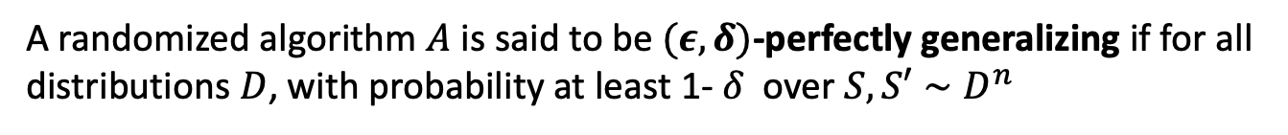
Perfect Generalization [Cummings Ligett Nissim Roth Wu]
A randomized algorithm $A$ is said to be $(ε,δ)$-perfectly generalizing if for all distributions $D$, with probability at least 1- $δ$ over $S,S′∼D^{n}$
$$A\left(S\right)≈_{ε,δ}A(S^{′})$$
Notes:
Explain definition.

Slide 18

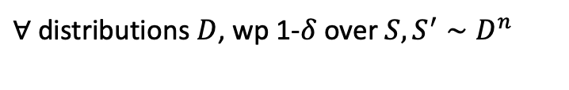
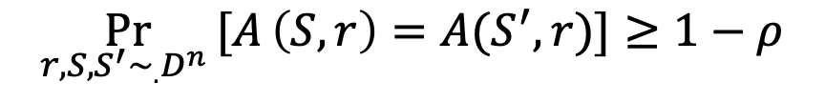


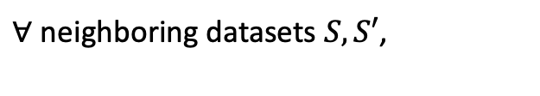

High level comparisons between stability notions
$(ε,δ)$-perfectly generalizing:
$(ε,δ)$-differentially private:
$∀$ distributions $D$, wp 1-$δ$ over $S,S^{′}∼D^{n}$
$∀$ neighboring datasets $S,S′$,
$${A(S)≈}_{ε,δ}A(S^{′})$$
$$A(S)≈_{ε,δ}A(S^{′})$$
$ρ$-Replicability:
$∀$ distributions $D$,
$$\underset{r,S,S^{′}∼_{.}D^{n} }{Pr}{[A}\left(S,r\right)=A(S^{′},r)]≥1−ρ$$
Notes:
Now, let’s compare these definitions to understand their similarities and differences. First, all of they all aim to quantify the idea that an algorithm ‘not be too dependent’ on its samples, which was a motivation for us to connect them. However, they do this very differently, to fit their specific desiderata. Next, we’ll compare them more closely.

Slide 19
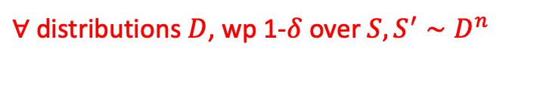
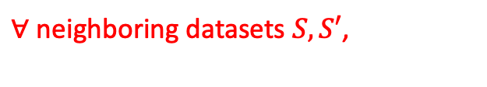
High level comparisons between stability notions
$(ε,δ)$-perfectly generalizing:
$(ε,δ)$-differentially private:
$∀$ distributions $D$, wp 1-$δ$ over $S,S^{′}∼D^{n}$
$∀$ neighboring datasets $S,S′$,
$${A(S)≈}_{ε,δ}A(S^{′})$$
$$A(S)≈_{ε,δ}A(S^{′})$$
$ρ$-Replicability:
$∀$ distributions $D$,
$$\underset{r,S,S^{′}∼_{.}D^{n} }{Pr}{[A}\left(S,r\right)=A(S^{′},r)]≥1−ρ$$
Notes:
One important distinction is that differential privacy is a worst case guarantee applies for *all neighboring datasets*, with no reference to a distribution. On the other hand, perfect generalization applies to all distributions, but the guarantee holds with high probability wrt two datasets drawn from the distribution (so not worst case), which could differ in a lot more than just one entry.

Slide 20


High level comparisons between stability notions
$(ε,δ)$-perfectly generalizing:
$(ε,δ)$-differentially private:
$∀$ distributions $D$, wp 1-$δ$ over $S,S^{′}∼D^{n}$
$∀$ neighboring datasets $S,S′$,
$${A(S)≈}_{ε,δ}A(S^{′})$$
$$A(S)≈_{ε,δ}A(S^{′})$$
$ρ$-Replicability:
$∀$ distributions $D$,
$$\underset{r,S,S^{′}∼_{.}D^{n} }{Pr}{[A}\left(S,r\right)=A(S^{′},r)]≥1−ρ$$
Notes:
On the other hand, the notion of closeness that the notions demand is the same- output distributions on the two datasets are (epsilon, delta) close.

Slide 21
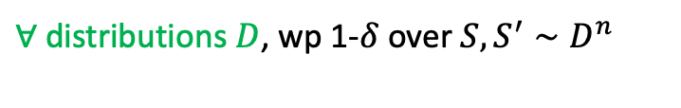

High level comparisons between stability notions
$(ε,δ)$-perfectly generalizing:
$(ε,δ)$-differentially private:
$∀$ distributions $D$, wp 1-$δ$ over $S,S^{′}∼D^{n}$
$∀$ neighboring datasets $S,S′$,
$${A(S)≈}_{ε,δ}A(S^{′})$$
$$A(S)≈_{ε,δ}A(S^{′})$$
$ρ$-Replicability:
$∀$ distributions $D$,
$$\underset{r,S,S^{′}∼_{.}D^{n} }{Pr}{[A}\left(S,r\right)=A(S^{′},r)]≥1−ρ$$
Notes:
Both of these notions are distributional- i.e. they apply for all distributions over the data domain.

Slide 22
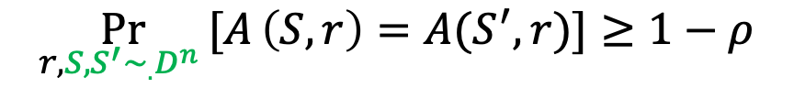
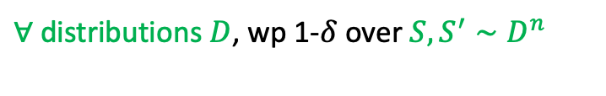
High level comparisons between stability notions
$(ε,δ)$-perfectly generalizing:
$(ε,δ)$-differentially private:
$∀$ distributions $D$, wp 1-$δ$ over $S,S^{′}∼D^{n}$
$∀$ neighboring datasets $S,S′$,
$${A(S)≈}_{ε,δ}A(S^{′})$$
$$A(S)≈_{ε,δ}A(S^{′})$$
$ρ$-Replicability:
$∀$ distributions $D$,
$$\underset{r,S,S^{′}∼_{.}D^{n} }{Pr}{[A}\left(S,r\right)=A(S^{′},r)]≥1−ρ$$
Notes:
They also both reference independently sampled datasets from the domain.

Slide 23
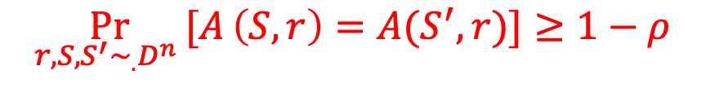
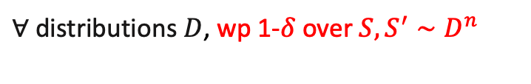


High level comparisons between stability notions
$(ε,δ)$-perfectly generalizing:
$(ε,δ)$-differentially private:
$∀$ distributions $D$, wp 1-$δ$ over $S,S^{′}∼D^{n}$
$∀$ neighboring datasets $S,S′$,
$${A(S)≈}_{ε,δ}A(S^{′})$$
$$A(S)≈_{ε,δ}A(S^{′})$$
$ρ$-Replicability:
$∀$ distributions $D$,
$$\underset{r,S,S^{′}∼_{.}D^{n} }{Pr}{[A}\left(S,r\right)=A(S^{′},r)]≥1−ρ$$
Notes:
However, the types of closeness of the algorithm’s output distribution on two independently drawn datasets is entirely different. Perfect generalization asks that the entire distribution of the algorithm on the two datasets be close in an epsilon, delta sense, whereas replicability asks that if they were run with the same randomness, that the output is the exact same. These notions seemed (atleast to us) technically incomparable, initially.

Slide 24
High level comparisons between stability notions
$(ε,δ)$-perfectly generalizing:
$(ε,δ)$-differentially private:
$∀$ distributions $D$, wp 1-$δ$ over $S,S^{′}∼D^{n}$
$∀$ neighboring datasets $S,S′$,
$${A(S)≈}_{ε,δ}A(S^{′})$$
$$A(S)≈_{ε,δ}A(S^{′})$$
$ρ$-Replicability:
$∀$ distributions $D$,
$$\underset{r,S,S^{′}∼_{.}D^{n} }{Pr}{[A}\left(S,r\right)=A(S^{′},r)]≥1−ρ$$
Notes:
And finally, to compare replicability and differential privacy, both their quantifiers over datasets (distributional vs worst case), and their notion of closeness is entirely different.

Slide 25
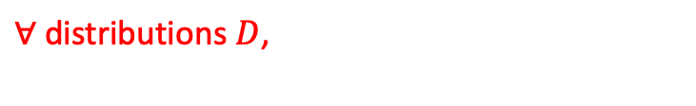

High level comparisons between stability notions
$(ε,δ)$-perfectly generalizing:
$(ε,δ)$-differentially private:
$∀$ distributions $D$, wp 1-$δ$ over $S,S^{′}∼D^{n}$
$∀$ neighboring datasets $S,S′$,
$${A(S)≈}_{ε,δ}A(S^{′})$$
$$A(S)≈_{ε,δ}A(S^{′})$$
$ρ$-Replicability:
$∀$ distributions $D$,
$$\underset{r,S,S^{′}∼_{.}D^{n} }{Pr}{[A}\left(S,r\right)=A(S^{′},r)]≥1−ρ$$
Notes:
And finally, to compare replicability and differential privacy, both their quantifiers over datasets (distributional vs worst case), and their notion of closeness is different.
Mark: Replicability seems stronger in terms of quantifying closeness of outputs.

Slide 26
Equivalence anyway of stability notions
$(ε,δ)$-perfectly generalizing:
$(ε,δ)$-differentially private:
$∀$ distributions $D$, wp 1-$δ$ over $S,S^{′}∼D^{n}$
$∀$ neighboring datasets $S,S′$,
$${A(S)≈}_{ε,δ}A(S^{′})$$
$$A(S)≈_{ε,δ}A(S^{′})$$
Correlated sampling, only non efficient step
$ρ$-Replicability:
$∀$ distributions $D$,
$$\underset{r,S,S^{′}∼_{.}D^{n} }{Pr}{[A}\left(S,r\right)=A(S^{′},r)]≥1−ρ$$
Notes:
Others we don’t mention

Slide 27
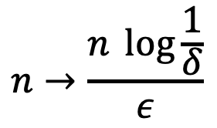

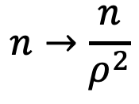
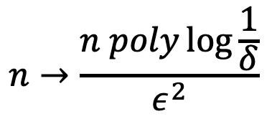
Connections between stability notions
[Our work]
Efficient Transformation
-
$(ε,δ)$-perfectly generalizing:
$(ε,δ)$-differentially private:
$∀$ distributions $D$, wp 1-$δ$ over $S,S^{′}∼D^{n}$
$∀$ neighboring datasets $S,S′$,
$${A(S)≈}_{ε,δ}A(S^{′})$$
$$A(S)≈_{ε,δ}A(S^{′})$$
$$n→n^{2}$$
$$n→\frac{n}{ρ^{2}}$$
$$n→\frac{n \log{\frac{1}{δ}}}{ε}$$
$$n→\frac{n poly\log{\frac{1}{δ}}}{ε^{2}}$$
$ρ$-Replicability:
$∀$ distributions $D$,
$$\underset{r,S,S^{′}∼_{.}D^{n} }{Pr}{[A}\left(S,r\right)=A(S^{′},r)]≥1−ρ$$
Notes:
Explain. Now, the connections we draw show that you can convert from any notion of stability to another by following the arrows. It turns out that this can be used for a number of applications concerning these notions.
Mark: What are on arrows? Spending a sentence or two explaining what that means.

Slide 28
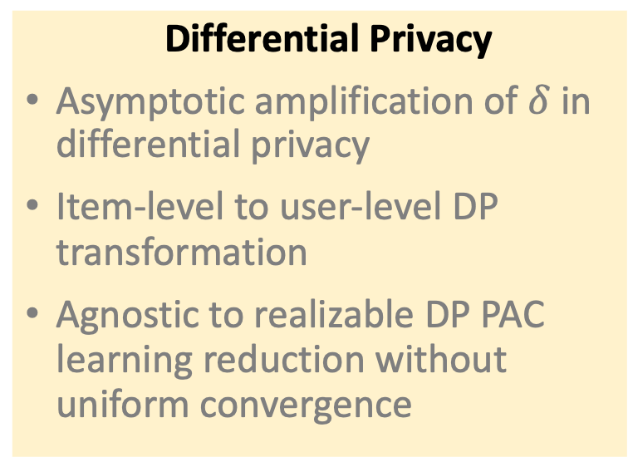
Applications
[Our work]
Perfect Generalization
New perfectly generalizing algorithms
Amplification of perfect generalization parameters
Conversion of one-way perfect generalization to perfect generalization
Differential Privacy
Asymptotic amplification of $δ$ in differential privacy
Item-level to user-level DP transformation
Agnostic to realizable DP PAC learning reduction without uniform convergence
Replicability
New replicable algorithms
Amplification of replicability
Non-adaptive composition of replicability
Notes:
Finally, I want to mention that there are a bunch of other applications in the paper that I don’t have time to talk about, so happy to discuss it offline.

Slide 29
Computational complexity
[Our work]
Does equivalence still hold in terms of computational complexity?
  Assuming Rabin public key encryption secure, computational separation between replicability and differential privacy/perfect generalization
  Assuming no one-way functions, average-case equivalence in the computational setting
  Assuming no non-uniform one-way functions, equivalence holds in the computational setting

Slide 30
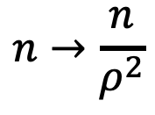
Perfect Generalization => Replicability
[Our work, Ghazi Kumar Manurangsi]
$(ε,δ)$-perfectly generalizing:
$ρ$-Replicability:
$∀$ distributions $D$, wp 1-$δ$ over $S,S^{′}∼D^{n}$
$∀$ distributions $D$,
$${A(S)≈}_{ε,δ}A(S^{′})$$
$$\underset{r,S,S^{′}∼_{.}D^{n} }{Pr}{[A}\left(S,r\right)=A(S^{′},r)]≥1−ρ$$
$$n→\frac{n}{ρ^{2}}$$
Notes:
We show that every perfectly generalizing algorithm can be compiled into a replicable algorithm at a 1/rho^2 cost in sample complexity.

Slide 31
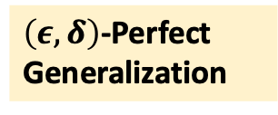
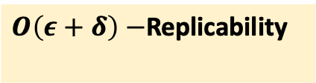
Perfect Generalization => Replicability
No loss in accuracy!
$\left(ε, δ\right)$-Perfect Generalization
$O\left(ε+δ\right)−$Replicability
No sample complexity overhead
Uses a cool algorithmic primitive called correlated sampling!
First used by [Ghazi Kumar Manurangsi] in the context of replicable algorithm design.
Notes:
Correlated sampling was first used in the context of replicable algorithm design by [Ghazi Kumar Manurangsi].

Slide 32

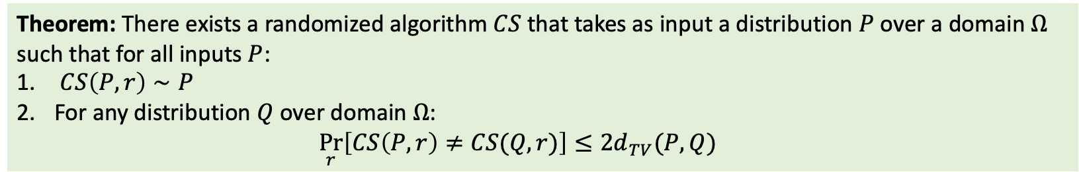








Correlated Sampling
[Broder, Kleinberg and Tardos, Holenstein]
Theorem: There exists a randomized algorithm $CS$ that takes as input a distribution $P$ over a domain $Ω$ such that for all inputs $P$:
$CS\left(P,r\right)∼P$
For any distribution $Q$ over domain $Ω$:
  $$\underset{r}{Pr}\left[CS\left(P,r\right)≠CS(Q,r)\right]≤2d_{TV}(P,Q)$$
$$r∼R$$
$$r$$
$$Distribution P$$
CS
$$i∼P$$
$$Domain Ω$$
$$=$$
$$r$$
$$Distribution Q$$
CS
$$i′∼Q$$
$$Domain Ω$$
Notes:
And if I consider running the algorithm on two distributions over the same domain, with shared randomness, the collision probability is as high as possible i.e., the probability that the outputs are not the same is less than approximately the TV distance between the distributions.

Slide 33
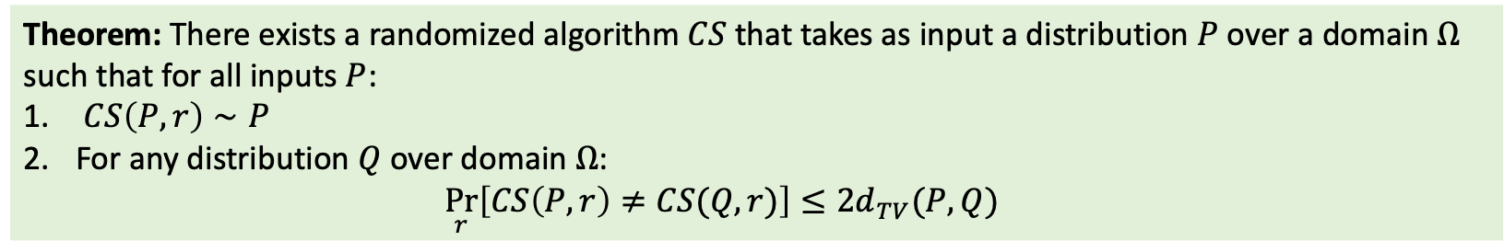
Correlated Sampling
Theorem: There exists a randomized algorithm $CS$ that takes as input a distribution $P$ over a domain $Ω$ such that for all inputs $P$:
$CS\left(P,r\right)∼P$
For any distribution $Q$ over domain $Ω$:
  $$\underset{r}{Pr}\left[CS\left(P,r\right)≠CS(Q,r)\right]≤2d_{TV}(P,Q)$$
Applications: communications complexity, analysis of Boolean functions, hardness of approximation,
Pseudorandomness, ….

Slide 34
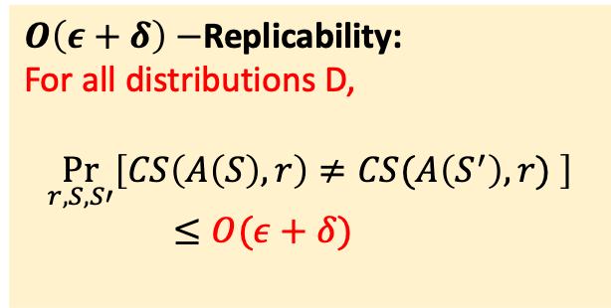
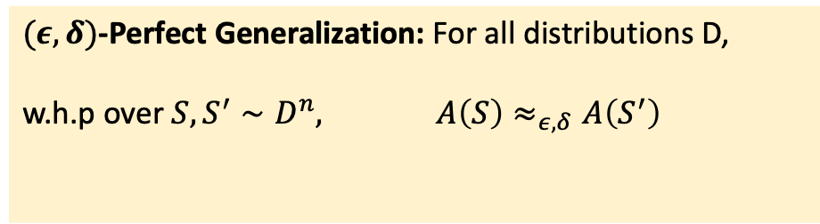

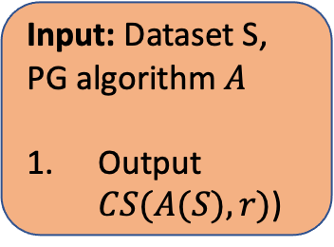

Perfect Generalization => Replicability
Theorem: There exists a randomized algorithm $CS$ that takes as input a distribution $P$ over a domain $Ω$ such that for all inputs $P$:
$CS\left(P,r\right)∼P$
For any distribution $Q$ over domain $Ω$:
  $$\underset{r}{Pr}\left[CS\left(P,r\right)≠CS(Q,r)\right]≤2d_{TV}(P,Q)$$
$O\left(ε+δ\right)−$Replicability:
For all distributions D,
$$\underset{r,S,S′}{Pr}\left[CS\left(A\left(S\right),r\right)≠CS(A\left(S^{′}\right),r) \right]$$
$≤O(ε+δ)$
$(ε, δ)$-Perfect Generalization: For all distributions D,
w.h.p over $S,S^{′}∼D^{n}, A\left(S\right)≈_{ε, δ}A\left(S^{′}\right)$
$$d_{TV}\left(A\left(S\right),A\left(S^{′}\right)\right)≤O(ε+δ)$$
$$A_{PG→Rep}$$
Input: Dataset S, PG algorithm $A$
Output $CS(A(S),r)$)
Notes:
And this is exactly the definition of replicability!

Slide 35
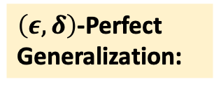
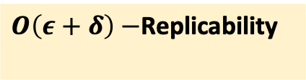
Perfect Generalization => Replicability
Theorem: There exists a randomized algorithm $CS$ that takes as input a distribution $P$ over a domain $Ω$ such that for all inputs $P$:
$CS\left(P,r\right)∼P$
For any distribution $Q$ over domain $Ω$:
  $$\underset{r}{Pr}\left[CS\left(P,r\right)≠CS(Q,r)\right]≤2d_{TV}(P,Q)$$
$\left(ε, δ\right)$-Perfect Generalization:
$O\left(ε+δ\right)−$Replicability
$$A_{PG→Rep}$$
Input: Dataset S, PG algorithm $A$
Output $CS(A(S),r)$)
Notes:
Hence, we conclude that eps,delta-PG can be transformed into O(eps + delta) –replicability.

Slide 36
``White box’’ correlated sampling
Traditionally, the two distributions given explicitly, as vectors of probabilities of all elements of the support
Here, the distribution is the output of the algorithm with perfect generalization (fixing the data, varying the internal randomness)
We need to be efficient in terms of the size of the algorithm description and the time the algorithm takes.
We need to ensure that outputs from two similar distributions are the same, but we don’t know the other distribution, and we cannot really control the way it is being sampled.

Slide 37
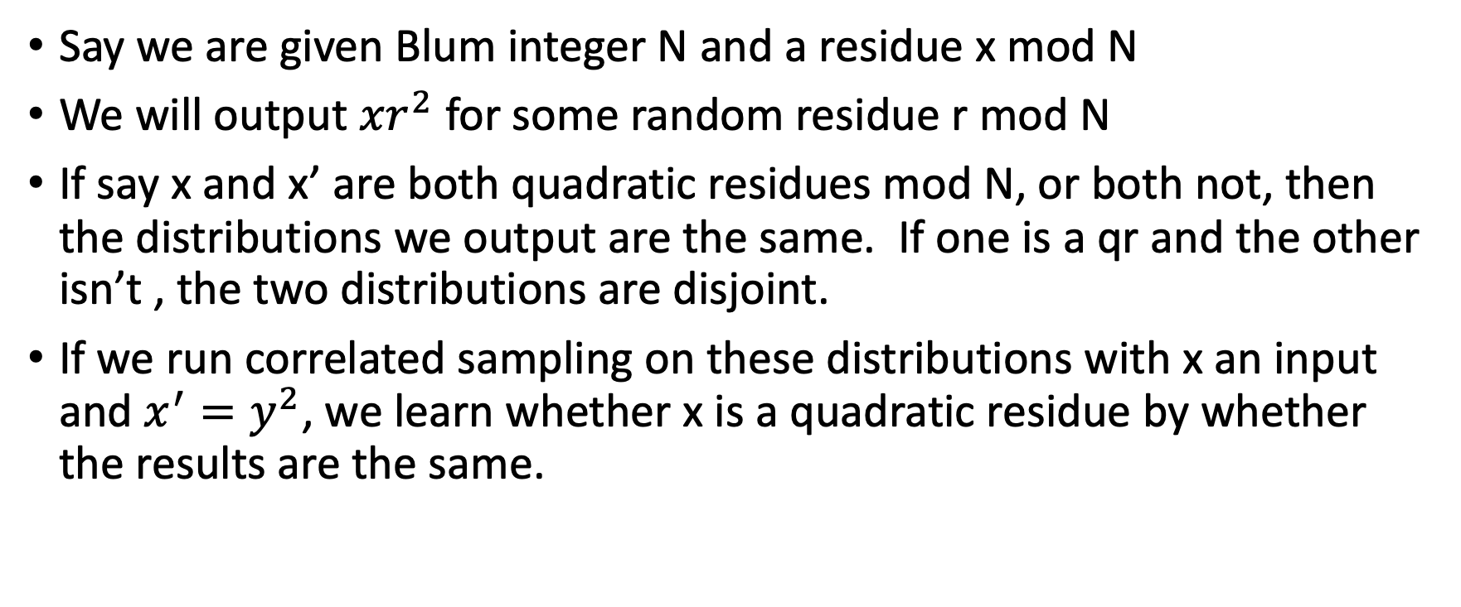
Example
Say we are given Blum integer N and a residue x mod N
We will output $xr^{2}$ for some random residue r mod N
If say x and x’ are both quadratic residues mod N, or both not, then the distributions we output are the same. If one is a qr and the other isn’t , the two distributions are disjoint.
If we run correlated sampling on these distributions with x an input and $x^{′}=y^{2}$, we learn whether x is a quadratic residue by whether the results are the same.

Slide 38
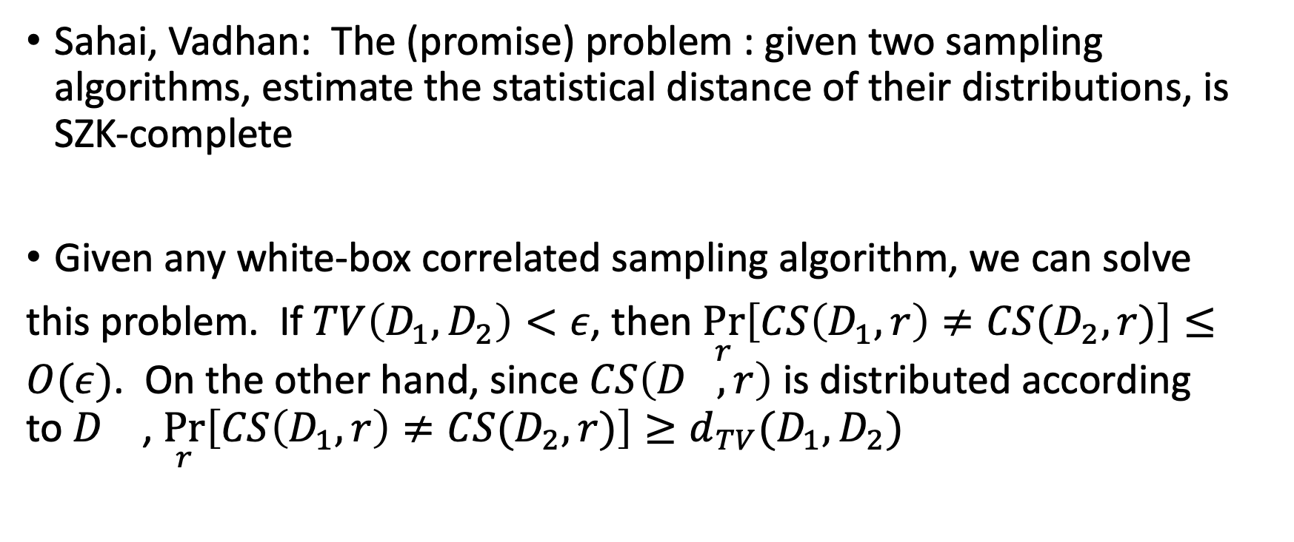
Statistical zero knowledge
Sahai, Vadhan: The (promise) problem : given two sampling algorithms, estimate the statistical distance of their distributions, is SZK-complete
Given any white-box correlated sampling algorithm, we can solve
this problem. If $TV\left(D_{1},D_{2}\right)<ε$, then $\underset{r}{Pr}\left[CS\left(D_{1},r\right)≠CS(D_{2},r)\right]≤O(ε)$. On the other hand, since $CS\left(D_{},r\right)$ is distributed according to$D_{}$, $\underset{r}{Pr}\left[CS\left(D_{1},r\right)≠CS(D_{2},r)\right]≥d_{TV}(D_{1},D_{2})$

Slide 39
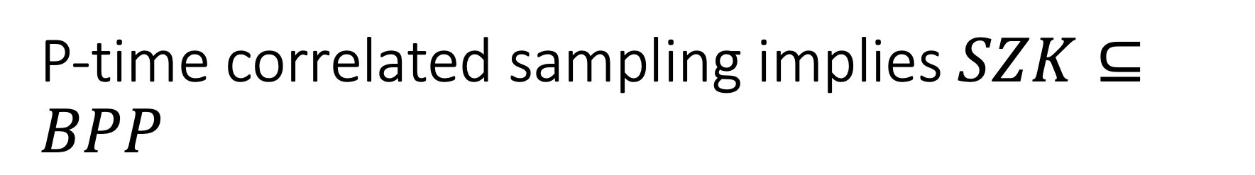
P-time correlated sampling implies $SZK⊆BPP$
A similar result applies for average-case correlated sampling and HeurBPP.

Slide 40
Conditional separations
Theorem: If QR mod Blum integers is difficult, then there is no polynomial time way to convert approximately DP algorithms to replicable algorithms, even in the average case. If certain constructions of homomorphic encryption based on LWE are secure (even for easy special cases, such as computing the encryption of the majority function), then there are problems that are efficiently solvable with ADP but not replicably.

Slide 41
Necessity of cryptographic assumptions
Theorem: If there are no non-uniform OWF’s secure against uniform adversaries, then there is an efficient white-box correlated sampling algorithm. If there are no OWF’s, then there is an efficient average-case correlated sampling algorithm on any distribution of pairs of distributions.

Slide 42

No one way functions implies
Impagliazzo-Luby: If there are no one-way functions, we can almost
Always estimate the probability of an element x under a sampleable distribution D, $p_{D}\left(x\right)$. We can also choose preimages of functions approximately uniformly at random.

Slide 43
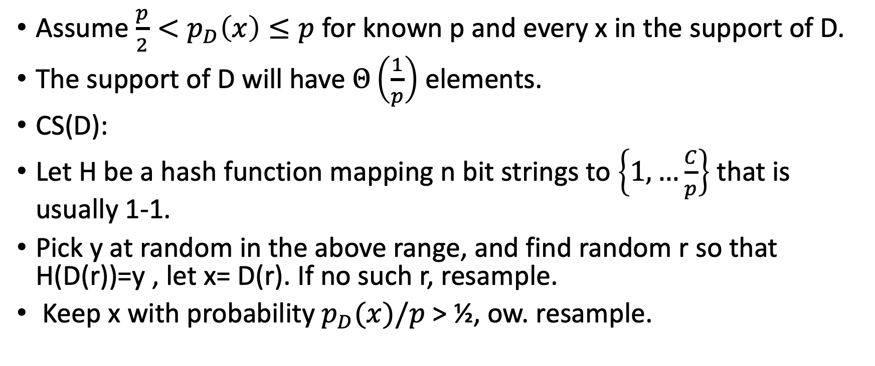
Warm-up
Assume $\frac{p}{2}<p_{D}\left(x\right)≤p$ for known p and every x in the support of D.
The support of D will have $Θ\left(\frac{1}{p}\right)$ elements.
CS(D):
Let H be a hash function mapping n bit strings to $\left\{1,…\frac{C}{p}\right\}$ that is usually 1-1.
Pick y at random in the above range, and find random r so that H(D(r))=y , let x= D(r). If no such r, resample.
Keep x with probability $p_{D}(x)/p$ > ½, ow. resample.

Slide 44
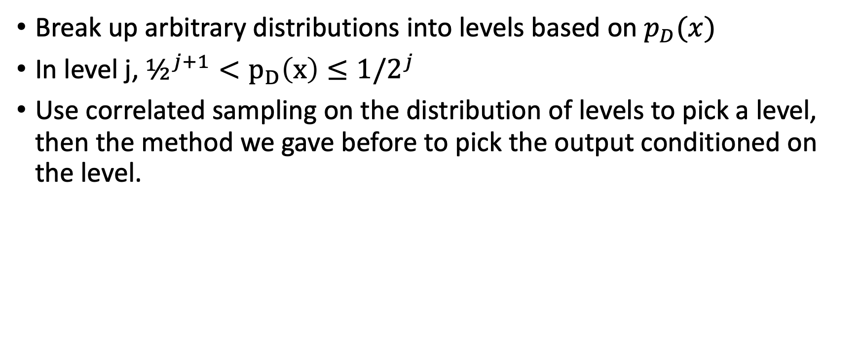
General case, attempt 1:
Break up arbitrary distributions into levels based on $p_{D}(x)$
In level j, $½^{j+1}<p_{D}\left(x\right)≤1/2^{j}$
Use correlated sampling on the distribution of levels to pick a level, then the method we gave before to pick the output conditioned on the level.

Slide 45
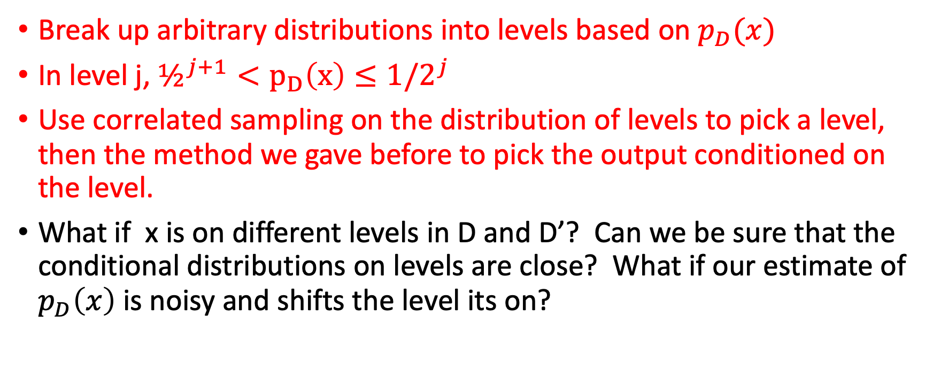
General case, attempt 1: problems
Break up arbitrary distributions into levels based on $p_{D}(x)$
In level j, $½^{j+1}<p_{D}\left(x\right)≤1/2^{j}$
Use correlated sampling on the distribution of levels to pick a level, then the method we gave before to pick the output conditioned on the level.
What if x is on different levels in D and D’? Can we be sure that the conditional distributions on levels are close? What if our estimate of $p_{D}\left(x\right)$ is noisy and shifts the level its on?

Slide 46
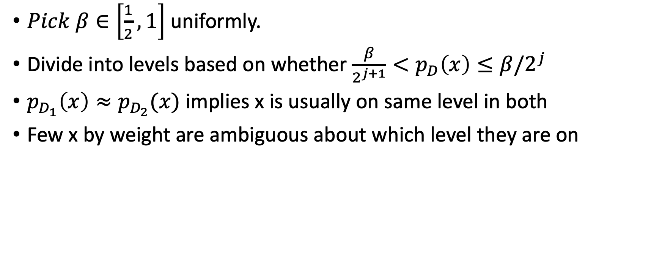
Solution: same as in estimating coin bias
$Pick β∈\left[\frac{1}{2}, 1\right]$ uniformly.
Divide into levels based on whether $\frac{β}{2^{j+1}}<p_{D}\left(x\right)≤β/2^{j}$
$p_{D_{1}}\left(x\right)≈p_{D_{2}}(x)$ implies x is usually on same level in both
Few x by weight are ambiguous about which level they are on

Slide 47
Open problems
General barriers to converting ADP to replicability rather than specific assumptions
Close the gap for correlated sampling
Other ``algorithmic implications’’ of cryptographic assumptions

Slide 48

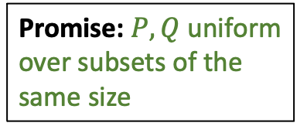
Correlated Sampling under promise
$CS\left(P,r\right)∼P$
For any distribution $Q$ over domain $Ω$:
  $$\underset{r}{Pr}\left[CS\left(P,r\right)≠CS(Q,r)\right]≤2d_{TV}(P,Q)$$
Promise: $P,Q$ uniform over subsets of the same size
1 | 2 | 3 | 4 | . | . | . | . | . | $$|F|$$
Subset $S$
Notes:
Visual depiction.

Slide 49
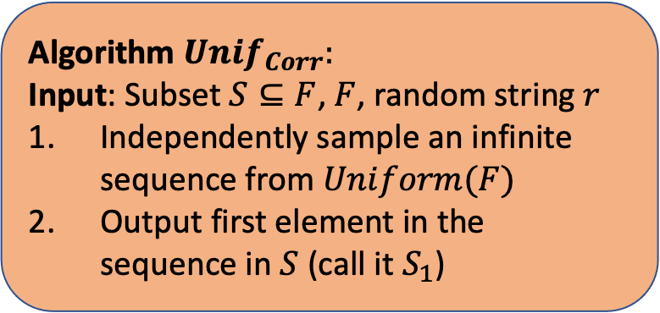
Correlated Sampling under promise
$CS\left(P,r\right)∼P$
For any distribution $Q$ over domain $Ω$:
  $$\underset{r}{Pr}\left[CS\left(P,r\right)≠CS(Q,r)\right]≤2d_{TV}(P,Q)$$
Promise: $P,Q$ uniform over subsets of the same size
1 | 2 | 3 | 4 | . | . | . | . | . | $$|F|$$
Subset $S$
Algorithm ${Unif}_{Corr}:$
Input: Subset $S⊆F$, $F$, random string $r$
Independently sample an infinite sequence from $Uniform(F)$
Output first element in the sequence in $S$ (call it $S_{1}$)
Notes:
First, let’s reason about condition 1.

Slide 50
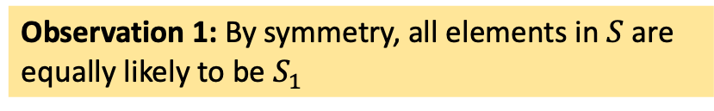
Correlated Sampling under promise
$CS\left(P,r\right)∼P$
For any distribution $Q$ over domain $Ω$:
  $$\underset{r}{Pr}\left[CS\left(P,r\right)≠CS(Q,r)\right]≤2d_{TV}(P,Q)$$
Promise: $P,Q$ uniform over subsets of the same size
1 | 2 | 3 | 4 | . | . | . | . | . | $$|F|$$
Subset $S$
Observation 1: By symmetry, all elements in $S$ are equally likely to be $S_{1}$
Algorithm ${Unif}_{Corr}:$
Input: Subset $S⊆F$, $F$, random string $r$
Independently sample an infinite sequence from $Uniform(F)$
Output first element in the sequence in $S$ (call it $S_{1}$)
Notes:
Read out.

Slide 51

Correlated Sampling under promise
$CS\left(P,r\right)∼P$
For any distribution $Q$ over domain $Ω$:
  $$\underset{r}{Pr}\left[CS\left(P,r\right)≠CS(Q,r)\right]≤2d_{TV}(P,Q)$$
Promise: $P,Q$ uniform over subsets of the same size
1 | 2 | 3 | 4 | . | . | . | . | . | $$|F|$$
Subset $S$
Observation 1: By symmetry, all elements in $S$ are equally likely to be $S_{1}$
Algorithm ${Unif}_{Corr}:$
Input: Subset $S⊆F$, $F$, random string $r$
Independently sample an infinite sequence from $Uniform(F)$
Output first element in the sequence in $S$ (call it $S_{1}$)
Consequence: $Unif_{corr}$returns a sample from $Uniform(S)$=> Condition 1 satisfied.
Notes:
And this implies that the algorithm outputs a sample from the uniform distribution over S.

Slide 52

Correlated Sampling under promise
$CS\left(P,r\right)∼P$
For any distribution $Q$ over domain $Ω$:
  $$\underset{r}{Pr}\left[CS\left(P,r\right)≠CS(Q,r)\right]≤2d_{TV}(P,Q)$$
Promise: $P,Q$ uniform over subsets of the same size
1 | 2 | 3 | 4 | . | . | . | . | . | $$|F|$$
Subset $S$
Observation 1: By symmetry, all elements in $S$ are equally likely to be $S_{1}$
Algorithm ${Unif}_{Corr}:$
Input: Subset $S⊆F$, $F$, random string $r$
Independently sample an infinite sequence from $Uniform(F)$
Output first element in the sequence in $S$ (call it $S_{1}$)
Consequence: $Unif_{corr}$returns a sample from $Uniform(S)$=> Condition 1 satisfied.
Notes:
Which means condition 1 is satisfied- the algorithm produces a sample from its input distribution.

Slide 53
Correlated Sampling under promise
$CS\left(P,r\right)∼P$
For any distribution $Q$ over domain $Ω$:
  $$\underset{r}{Pr}\left[CS\left(P,r\right)≠CS(Q,r)\right]≤2d_{TV}(P,Q)$$
Promise: $P,Q$ uniform over subsets of the same size
1 | 2 | 3 | 4 | . | . | . | . | . | $$|F|$$
Subset $S$
Algorithm ${Unif}_{Corr}:$
Input: Subset $S⊆F$, $F$, random string $r$
Independently sample an infinite sequence from $Uniform(F)$
Output first element in the sequence in $S$ (call it $S_{1}$)
Notes:
Now, we reason about condition 2.

Slide 54

Correlated Sampling under promise
$CS\left(P,r\right)∼P$
For any distribution $Q$ over domain $Ω$:
  $$\underset{r}{Pr}\left[CS\left(P,r\right)≠CS(Q,r)\right]≤2d_{TV}(P,Q)$$
Promise: $P,Q$ uniform over subsets of the same size
Subset $T$
1 | 2 | 3 | 4 | . | . | . | . | . | $$|F|$$
Subset $S$
Algorithm ${Unif}_{Corr}:$
Input: Subset $S⊆F$, $F$, random string $r$
Independently sample an infinite sequence from $Uniform(F)$
Output first element in the sequence in $S$ (call it $S_{1}$)
Notes:
Consider two distributions P and Q over the domain, uniform over subsets S and T.

Slide 55

Correlated Sampling under promise
$CS\left(P,r\right)∼P$
For any distribution $Q$ over domain $Ω$:
  $$\underset{r}{Pr}\left[CS\left(P,r\right)≠CS(Q,r)\right]≤2d_{TV}(P,Q)$$
Promise: $P,Q$ uniform over subsets of the same size
Subset $T$
1 | 2 | 3 | 4 | . | . | . | . | . | $$|F|$$
Subset $S$
Let first element of sequence in $S∪T$ be $i$.
Algorithm ${Unif}_{Corr}:$
Input: Subset $S⊆F$, $F$, random string $r$
Independently sample an infinite sequence from $Uniform(F)$
Output first element in the sequence in $S$ (call it $S_{1}$)
Notes:
Read out.

Slide 56
Correlated Sampling under promise
$CS\left(P,r\right)∼P$
For any distribution $Q$ over domain $Ω$:
  $$\underset{r}{Pr}\left[CS\left(P,r\right)≠CS(Q,r)\right]≤2d_{TV}(P,Q)$$
Promise: $P,Q$ uniform over subsets of the same size
Subset $T$
1 | 2 | 3 | 4 | . | . | . | . | . | $$|F|$$
Subset $S$
Let first element of sequence in $S∪T$ be $i$.
Algorithm ${Unif}_{Corr}:$
Input: Subset $S⊆F$, $F$, random string $r$
Independently sample an infinite sequence from $Uniform(F)$
Output first element in the sequence in $S$ (call it $S_{1}$)
Observation 2: Iff $i∈S∩T$, then ${Unif}_{Corr}(S,r) = {Unif}_{Corr}(T,r).$
Notes:
Note that if I belongs to S intersection T, then the algorithm when run on subsets S and T will encounter i first (i.e. S1 and T1 will both be i), and so the output of the algorithm in both cases will be i. If i does not belong to S intersection T, it belongs to one or the other- let’s say S without loss of generality. Then, the algorithm when run on S will output i, but the algorithm when run on T will never output i because it doesn’t belong to T.

Slide 57
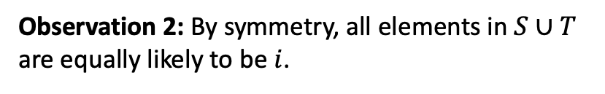
Correlated Sampling under promise
$CS\left(P,r\right)∼P$
For any distribution $Q$ over domain $Ω$:
  $$\underset{r}{Pr}\left[CS\left(P,r\right)≠CS(Q,r)\right]≤2d_{TV}(P,Q)$$
Promise: $P,Q$ uniform over subsets of the same size
Subset $T$
1 | 2 | 3 | 4 | . | . | . | . | . | $$|F|$$
Subset $S$
Let first element of sequence in $S∪T$ be $i$.
Algorithm ${Unif}_{Corr}:$
Input: Subset $S⊆F$, $F$, random string $r$
Independently sample an infinite sequence from $Uniform(F)$
Output first element in the sequence in $S$ (call it $S_{1}$)
Observation 2: Iff $i∈S∩T$, then ${Unif}_{Corr}(S,r) = {Unif}_{Corr}(T,r).$
Observation 2: By symmetry, all elements in $S∪T$ are equally likely to be $i$.
Notes:
Read out.

Slide 58

Correlated Sampling under promise
$CS\left(P,r\right)∼P$
For any distribution $Q$ over domain $Ω$:
  $$\underset{r}{Pr}\left[CS\left(P,r\right)≠CS(Q,r)\right]≤2d_{TV}(P,Q)$$
Promise: $P,Q$ uniform over subsets of the same size
Subset $T$
1 | 2 | 3 | 4 | . | . | . | . | . | $$|F|$$
Subset $S$
Let first element of sequence in $S∪T$ be $i$.
Algorithm ${Unif}_{Corr}:$
Input: Subset $S⊆F$, $F$, random string $r$
Independently sample an infinite sequence from $Uniform(F)$
Output first element in the sequence in $S$ (call it $S_{1}$)
Observation 2: Iff $i∈S∩T$, then ${Unif}_{Corr}(S,r) = {Unif}_{Corr}(T,r).$
Observation 2: By symmetry, all elements in $S∪T$ are equally likely to be $i$.
$$\underset{r}{Pr}\left[i∈S∩T\right]=\frac{\left|S∩T\right|}{\left|S∪T\right|}$$
Notes:
Hence, the probability that i belongs to s intersection T is exactly,

Slide 59

Correlated Sampling under promise
$CS\left(P,r\right)∼P$
For any distribution $Q$ over domain $Ω$:
  $$\underset{r}{Pr}\left[CS\left(P,r\right)≠CS(Q,r)\right]≤2d_{TV}(P,Q)$$
Promise: $P,Q$ uniform over subsets of the same size
Subset $T$
1 | 2 | 3 | 4 | . | . | . | . | . | $$|F|$$
Subset $S$
Let first element of sequence in $S∪T$ be $i$.
Algorithm ${Unif}_{Corr}:$
Input: Subset $S⊆F$, $F$, random string $r$
Independently sample an infinite sequence from $Uniform(F)$
Output first element in the sequence in $S$ (call it $S_{1}$)
Observation 2: Iff $i∈S∩T$, then ${Unif}_{Corr}(S,r) = {Unif}_{Corr}(T,r).$
Observation 2: By symmetry, all elements in $S∪T$ are equally likely to be $i$.
$$\underset{r}{Pr}\left[i ∉S∩T\right]=1−\frac{\left|S∩T\right|}{\left|S∪T\right|}$$
Notes:
Inverting, the probability that I does not belong to S intersection T is….

Slide 60

Correlated Sampling under promise
$CS\left(P,r\right)∼P$
For any distribution $Q$ over domain $Ω$:
  $$\underset{r}{Pr}\left[CS\left(P,r\right)≠CS(Q,r)\right]≤2d_{TV}(P,Q)$$
Promise: $P,Q$ uniform over subsets of the same size
Subset $T$
1 | 2 | 3 | 4 | . | . | . | . | . | $$|F|$$
Subset $S$
Let first element of sequence in $S∪T$ be $i$.
Algorithm ${Unif}_{Corr}:$
Input: Subset $S⊆F$, $F$, random string $r$
Independently sample an infinite sequence from $Uniform(F)$
Output first element in the sequence in $S$ (call it $S_{1}$)
Observation 2: Iff $i∈S∩T$, then ${Unif}_{Corr}(S,r) = {Unif}_{Corr}(T,r).$
Observation 2: By symmetry, all elements in $S∪T$ are equally likely to be $i$.
$$\underset{r}{Pr}\left[i ∉S∩T\right]=\frac{\left|S∪T\right|−\left|S∩T\right|}{\left|S∪T\right|}$$
Notes:
Doing some algebra….this numerator is the number of items in S union T but not their intersection.

Slide 61

Correlated Sampling under promise
$CS\left(P,r\right)∼P$
For any distribution $Q$ over domain $Ω$:
  $$\underset{r}{Pr}\left[CS\left(P,r\right)≠CS(Q,r)\right]≤2d_{TV}(P,Q)$$
Promise: $P,Q$ uniform over subsets of the same size
Subset $T$
1 | 2 | 3 | 4 | . | . | . | . | . | $$|F|$$
Subset $S$
Let first element of sequence in $S∪T$ be $i$.
Algorithm ${Unif}_{Corr}:$
Input: Subset $S⊆F$, $F$, random string $r$
Independently sample an infinite sequence from $Uniform(F)$
Output first element in the sequence in $S$ (call it $S_{1}$)
Observation 2: Iff $i∈S∩T$, then ${Unif}_{Corr}(S,r) = {Unif}_{Corr}(T,r).$
Observation 2: By symmetry, all elements in $S∪T$ are equally likely to be $i$.
$$\underset{r}{Pr}\left[i ∉S∩T\right]=\frac{\left|S Δ T\right|}{\left|S∪T\right|}$$
Notes:
That is exactly equal to the size of the symmetric difference between S and T

Slide 62

Correlated Sampling under promise
$CS\left(P,r\right)∼P$
For any distribution $Q$ over domain $Ω$:
  $$\underset{r}{Pr}\left[CS\left(P,r\right)≠CS(Q,r)\right]≤2d_{TV}(P,Q)$$
Promise: $P,Q$ uniform over subsets of the same size
Subset $T$
1 | 2 | 3 | 4 | . | . | . | . | . | $$|F|$$
Subset $S$
Let first element of sequence in $S∪T$ be $i$.
Algorithm ${Unif}_{Corr}:$
Input: Subset $S⊆F$, $F$, random string $r$
Independently sample an infinite sequence from $Uniform(F)$
Output first element in the sequence in $S$ (call it $S_{1}$)
Observation 2: Iff $i∈S∩T$, then ${Unif}_{Corr}(S,r) = {Unif}_{Corr}(T,r).$
Observation 2: By symmetry, all elements in $S∪T$ are equally likely to be $i$.
$$\underset{r}{Pr}\left[i ∉S∩T\right]=\frac{\left|S Δ T\right|}{\left|S∪T\right|}$$
$$≤2d_{TV}(U\left(S\right),U\left(T\right))$$
Notes:
It turns out that this quantity is less than or equal to twice th TV distance bw uniform distributions on S and T. Combning this with observation 2 gives the result.

Slide 63
Correlated Sampling under promise
$CS\left(P,r\right)∼P$
For any distribution $Q$ over domain $Ω$:
  $$\underset{r}{Pr}\left[CS\left(P,r\right)≠CS(Q,r)\right]≤2d_{TV}(P,Q)$$
Promise: $P,Q$ uniform over subsets of the same size
Subset $T$
1 | 2 | 3 | 4 | . | . | . | . | . | $$|F|$$
Subset $S$
Let first element of sequence in $S∪T$ be $i$.
Algorithm ${Unif}_{Corr}:$
Input: Subset $S⊆F$, $F$, random string $r$
Independently sample an infinite sequence from $Uniform(F)$
Output first element in the sequence in $S$ (call it $S_{1}$)
Observation 2: Iff $i∈S∩T$, then ${Unif}_{Corr}(S,r) = {Unif}_{Corr}(T,r).$
Observation 2: By symmetry, all elements in $S∪T$ are equally likely to be $i$.
$$\underset{r}{Pr}\left[i ∉S∩T\right]=\frac{\left|S Δ T\right|}{\left|S∪T\right|}$$
$$≤2d_{TV}(U\left(S\right),U\left(T\right))$$

Slide 64
Correlated Sampling under promise
$CS\left(P,r\right)∼P$
For any distribution $Q$ over domain $Ω$:
  $$\underset{r}{Pr}\left[CS\left(P,r\right)≠CS(Q,r)\right]≤2d_{TV}(P,Q)$$
Promise: $P,Q$ uniform over subsets of the same size
Subset $T$
1 | 2 | 3 | 4 | . | . | . | . | . | $$|F|$$
Subset $S$
Let first element of sequence in $S∪T$ be $i$.
Algorithm ${Unif}_{Corr}:$
Input: Subset $S⊆F$, $F$, random string $r$
Independently sample an infinite sequence from $Uniform(F)$
Output first element in the sequence in $S$ (call it $S_{1}$)
Observation 2: Iff $i∈S∩T$, then ${Unif}_{Corr}(S,r) = {Unif}_{Corr}(T,r).$
Observation 2: By symmetry, all elements in $S∪T$ are equally likely to be $i$.
$$\underset{r}{Pr}\left[i ∉S∩T\right]=\frac{\left|S Δ T\right|}{\left|S∪T\right|}$$
$$≤2d_{TV}(U\left(S\right),U\left(T\right))$$
Notes:
So, we have argued that Unifcorr is a correlated sampling procedure under the promise.

Slide 65
Correlated Sampling under promise
$CS\left(P,r\right)∼P$
For any distribution $Q$ over domain $Ω$:
  $$\underset{r}{Pr}\left[CS\left(P,r\right)≠CS(Q,r)\right]≤2d_{TV}(P,Q)$$
Promise: $P,Q$ uniform over subsets of the same size
Subset $T$
1 | 2 | 3 | 4 | . | . | . | . | . | $$|F|$$
Subset $S$
Let first element of sequence in $S∪T$ be $i$.
Algorithm ${Unif}_{Corr}:$
Input: Subset $S⊆F$, $F$, random string $r$
Independently sample an infinite sequence from $Uniform(F)$
Output first element in the sequence in $S$ (call it $S_{1}$)
Observation 2: Iff $i∈S∩T$, then ${Unif}_{Corr}(S,r) = {Unif}_{Corr}(T,r).$
Observation 2: By symmetry, all elements in $S∪T$ are equally likely to be $i$.
$$\underset{r}{Pr}\left[i ∉S∩T\right]=\frac{\left|S Δ T\right|}{\left|S∪T\right|}$$
$$≤2d_{TV}(U\left(S\right),U\left(T\right))$$

Slide 66
Correlated Sampling under promise
$CS\left(P,r\right)∼P$
For any distribution $Q$ over domain $Ω$:
  $$\underset{r}{Pr}\left[CS\left(P,r\right)≠CS(Q,r)\right]≤2d_{TV}(P,Q)$$
Promise: $P,Q$ uniform over subsets of the same size
Algorithm ${Unif}_{Corr}:$
Input: Subset $S⊆F$, $F$, random string $r$
Independently sample an infinite sequence from $Uniform(F)$
Output first element in the sequence in $S$ (call it $S_{1}$)
Notes:
Now, when I consider the general case without promise.

Slide 67
Correlated Sampling
$CS\left(P,r\right)∼P$
For any distribution $Q$ over domain $Ω$:
  $$\underset{r}{Pr}\left[CS\left(P,r\right)≠CS(Q,r)\right]≤2d_{TV}(P,Q)$$
Algorithm ${Unif}_{Corr}:$
Input: Subset $S⊆F$, $F$, random string $r$
Independently sample an infinite sequence from $Uniform(F)$
Output first element in the sequence in $S$ (call it $S_{1}$)

Slide 68
Correlated Sampling
$CS\left(P,r\right)∼P$
For any distribution $Q$ over domain $Ω$:
  $$\underset{r}{Pr}\left[CS\left(P,r\right)≠CS(Q,r)\right]≤2d_{TV}(P,Q)$$
Reduction to the uniform case!
Algorithm ${Unif}_{Corr}:$
Input: Subset $S⊆F$, $F$, random string $r$
Independently sample an infinite sequence from $Uniform(F)$
Output first element in the sequence in $S$ (call it $S_{1}$)
Notes:
We’ll design an algorithm by reducing to the uniform case.

Slide 69

Correlated Sampling
$CS\left(P,r\right)∼P$
For any distribution $Q$ over domain $Ω$:
  $$\underset{r}{Pr}\left[CS\left(P,r\right)≠CS(Q,r)\right]≤2d_{TV}(P,Q)$$
Reduction to the uniform case!
Algorithm $CS:$
Input: Distribution $P$, $Ω$, random string $r$
Create set
$S = \{ \left(w,p\right) | p≤P\left(w\right), w∈Ω\}$.
Apply the $Unif_{corr}$ algorithm on set $S$ and domain $Ω×[0,1]$.
Obtaining ($w^{∗},p^{∗})$, output $p^{∗}$
Algorithm ${Unif}_{Corr}:$
Input: Subset $S⊆F$, $F$, random string $r$
Independently sample an infinite sequence from $Uniform(F)$
Output first element in the sequence in $S$ (call it $S_{1}$)
Notes:
Explain inputs.

Slide 70
Correlated Sampling
$CS\left(P,r\right)∼P$
For any distribution $Q$ over domain $Ω$:
  $$\underset{r}{Pr}\left[CS\left(P,r\right)≠CS(Q,r)\right]≤2d_{TV}(P,Q)$$
Reduction to the uniform case!
Algorithm $CS:$
Input: Distribution $P$, $Ω$, random string $r$
Create set
$S = \{ \left(w,p\right) | p≤P\left(w\right), w∈Ω\}$.
Apply the $Unif_{corr}$ algorithm on set $S$ and domain $Ω×[0,1]$.
Obtaining ($w^{∗},p^{∗})$, output $p^{∗}$
Algorithm ${Unif}_{Corr}:$
Input: Subset $S⊆F$, $F$, random string $r$
Independently sample an infinite sequence from $Uniform(F)$
Output first element in the sequence in $S$ (call it $S_{1}$)
Notes:
Read out and explain.

Slide 71
Correlated Sampling
$CS\left(P,r\right)∼P$
For any distribution $Q$ over domain $Ω$:
  $$\underset{r}{Pr}\left[CS\left(P,r\right)≠CS(Q,r)\right]≤2d_{TV}(P,Q)$$
Reduction to the uniform case!
Algorithm $CS:$
Input: Distribution $P$, $Ω$, random string $r$
Create set
$S = \{ \left(w,p\right) | p≤P\left(w\right), w∈Ω\}$.
Apply the $Unif_{corr}$ algorithm on set $S$ and domain $Ω×[0,1]$.
Obtaining ($w^{∗},p^{∗})$, output $p^{∗}$
Algorithm ${Unif}_{Corr}:$
Input: Subset $S⊆F$, $F$, random string $r$
Independently sample an infinite sequence from $Uniform(F)$
Output first element in the sequence in $S$ (call it $S_{1}$)
Notes:
Read out

Slide 72

Correlated Sampling
$CS\left(P,r\right)∼P$
For any distribution $Q$ over domain $Ω$:
  $$\underset{r}{Pr}\left[CS\left(P,r\right)≠CS(Q,r)\right]≤2d_{TV}(P,Q)$$
Reduction to the uniform case!
Algorithm $CS:$
Input: Distribution $P$, $Ω$, random string $r$
Create set
$S = \{ \left(w,p\right) | p≤P\left(w\right), w∈Ω\}$.
Apply the $Unif_{corr}$ algorithm on set $S$ and domain $Ω×[0,1]$.
Obtaining ($w^{∗},p^{∗})$, output $w^{∗}$
Algorithm ${Unif}_{Corr}:$
Input: Subset $S⊆F$, $F$, random string $r$
Independently sample an infinite sequence from $Uniform(F)$
Output first element in the sequence in $S$ (call it $S_{1}$)
Notes:
Read out.

Slide 73

Correlated Sampling
$CS\left(P,r\right)∼P$
For any distribution $Q$ over domain $Ω$:
  $$\underset{r}{Pr}\left[CS\left(P,r\right)≠CS(Q,r)\right]≤2d_{TV}(P,Q)$$
Reduction to the uniform case!
Algorithm $CS:$
Input: Distribution $P$, $Ω$, random string $r$
Create set
$S = \{ \left(w,p\right) | p≤P\left(w\right), w∈Ω\}$.
Apply the $Unif_{corr}$ algorithm on set $S$ and domain $Ω×[0,1]$.
Obtaining ($w^{∗},p^{∗})$, output $p^{∗}$
Algorithm ${Unif}_{Corr}:$
Input: Subset $S⊆F$, $F$, random string $r$
Independently sample an infinite sequence from $Uniform(F)$
Output first element in the sequence in $S$ (call it $S_{1}$)
Key insight: $Unif\left(S\right){\left.​\right|}_{w^{∗}}≡P$
Notes:
The key insight is that the uniform distribution over S restricted to its first coordinate is distributed exactly as the input distribution P. Now, using the guarantees of the uniform correlated sampling procedure (note, as stated, it only applied for finite domains, but the analysis is easy to generalize for this domain) give the result.

Slide 74
Correlated Sampling
$CS\left(P,r\right)∼P$
For any distribution $Q$ over domain $Ω$:
  $$\underset{r}{Pr}\left[CS\left(P,r\right)≠CS(Q,r)\right]≤2d_{TV}(P,Q)$$
Reduction to the uniform case!
Algorithm $CS:$
Input: Distribution $P$, $Ω$, random string $r$
Create set
$S = \{ \left(w,p\right) | p≤P\left(w\right), w∈Ω\}$.
Apply the $Unif_{corr}$ algorithm on set $S$ and domain $Ω×[0,1]$.
Obtaining ($w^{∗},p^{∗})$, output $p^{∗}$
Algorithm ${Unif}_{Corr}:$
Input: Subset $S⊆F$, $F$, random string $r$
Independently sample an infinite sequence from $Uniform(F)$
Output first element in the sequence in $S$ (call it $S_{1}$)
Key insight: $Unif\left(S\right){\left.​\right|}_{w^{∗}}≡P$
Notes:
And that’s it!

Slide 75
Connections between stability notions
[Our work]
Efficient Transformation
-
$(ε,δ)$-perfectly generalizing:
$(ε,δ)$-differentially private:
$∀$ distributions $D$, wp 1-$δ$ over $S,S^{′}∼D^{n}$
$∀$ neighboring datasets $S,S′$,
$${A(S)≈}_{ε,δ}A(S^{′})$$
$$A(S)≈_{ε,δ}A(S^{′})$$
$$n→n^{2}$$
$$n→\frac{n}{ρ^{2}}$$
$$n→\frac{n \log{\frac{1}{δ}}}{ε}$$
$$n→\frac{n poly\log{\frac{1}{δ}}}{ε^{2}}$$
$ρ$-Replicability:
$∀$ distributions $D$,
$$\underset{r,S,S^{′}∼_{.}D^{n} }{Pr}{[A}\left(S,r\right)=A(S^{′},r)]≥1−ρ$$
Notes:
Explain. Now, the connections we draw show that you can convert from any notion of stability to another by following the arrows. It turns out that this can be used for a number of applications concerning these notions.

